Slide 1
Multi-purpose for the SCEP detector array
Reporter: Beige Liu
Director: Qing Lin

Slide 2
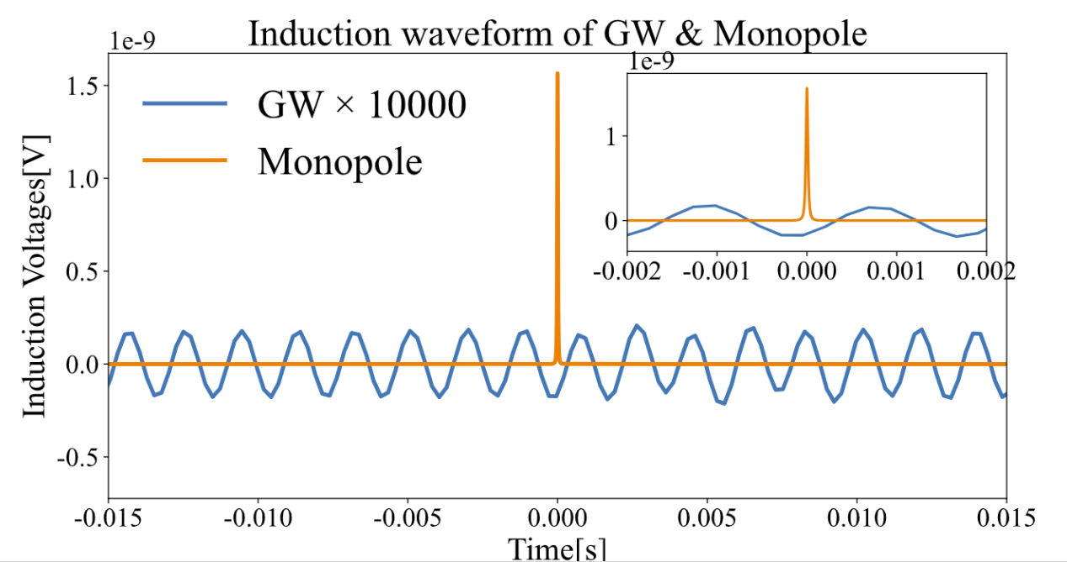






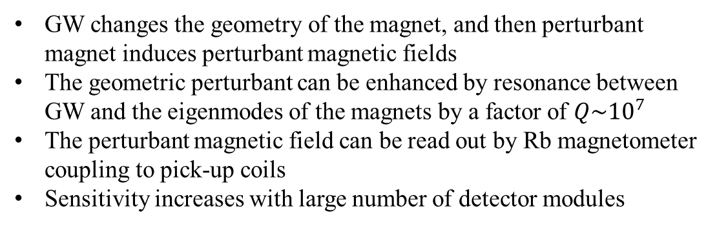
1. The effects when GW coupling to magnets
Magnet
GW changes the geometry of the magnet, and then perturbant magnet induces perturbant magnetic fields
The geometric perturbant can be enhanced by resonance between GW and the eigenmodes of the magnets by a factor of $Q\sim {10}^{7}$
The perturbant magnetic field can be read out by Rb magnetometer coupling to pick-up coils
Sensitivity increases with large number of detector modules
$$I_{0}$$
$$δ\vec{r}\sim Qh$$
$$B_{0}\sim 1T$$
GW strain h~$10^{−21}$
$${δB}_{gw}\sim QhB_{0}$$
Monopole events: triggered by 2 or 3 the coils
GW events: triggered by all the coils in the array
$$I_{gw}$$
Rb atoms
GW
Monopoles & GWs multi-purpose detection array:
GW
monopole
Coil layer 1
~10cm
magnet layer
~100cm
Coil layer 2
~10cm
Problem to solve:
extra noises introduced by the magnets?
GW signals
Monopole signals

Slide 3

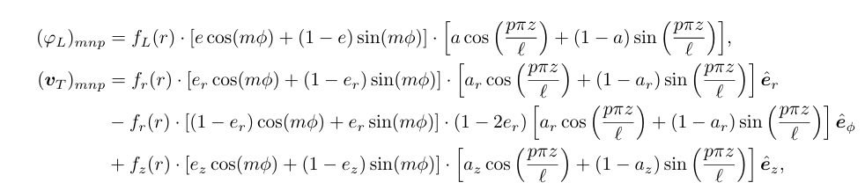

2. Theoretical framework
Eigenmodes solution
GW Coupling
Magnetic field calculation
Detector simulation
1. Equations of vibration eigenmodes:
$λ,μ$ are the Lame coefficients, $ρ$ is the density of the materials
2. Helmholtz decomposition to solve in coaxial cylinder geometry:
$$u= ∇φ_{L}+∇×v_{T}$$
Here m,n,p represent to angular, radial and longitudinal index of the mode

Slide 4

2. Theoretical framework
Eigenmodes solution
GW Coupling
Magnetic field calculation
Detector simulation
The coupling of the eigenmodes with the GWs can be calculated using perturbant theory:
Here $η_{mnp}^{A}=\frac{1}{2Vl_{η}}∫{{e_{ij}^{A}r^{i}[u}_{mnp}^{∗}]}^{j} dV$ is the coupling efficiency

Slide 5
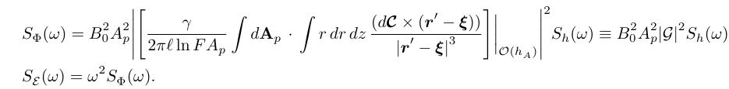





2. Theoretical framework
Eigenmodes solution
GW Coupling
Magnetic field calculation
Detector simulation
The total flux in the pick-up coils can be calculated as:
$$δr′\sim h$$
$$Δr_{0}= r−r′$$
Biot-Savart’s Law
General gain factor $G$
$$ξ=Δr_{0}+δr−δr′$$
$$δr\sim Qh$$

Slide 6
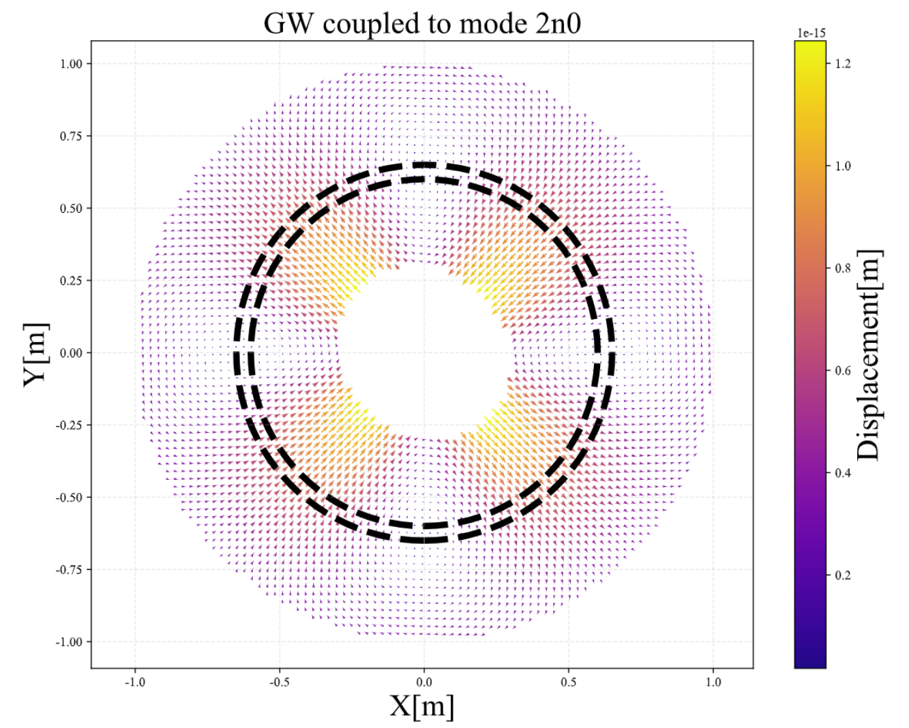
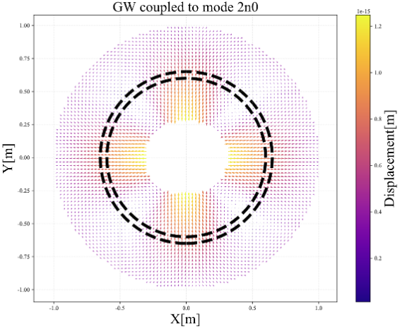
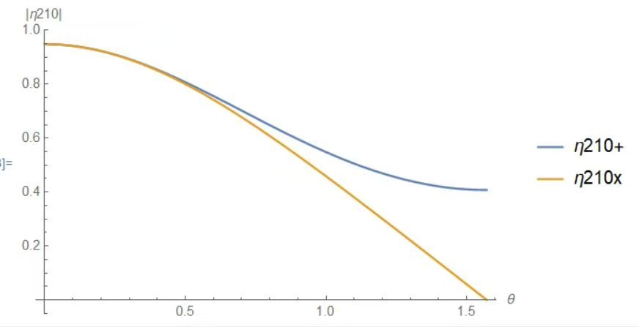
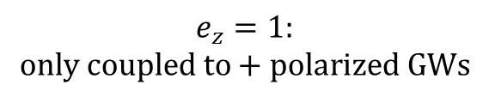
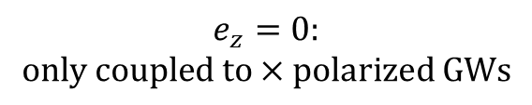
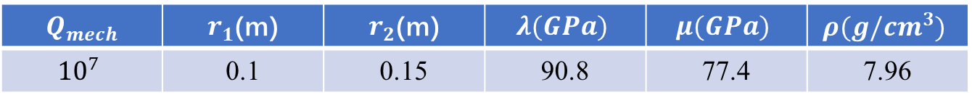
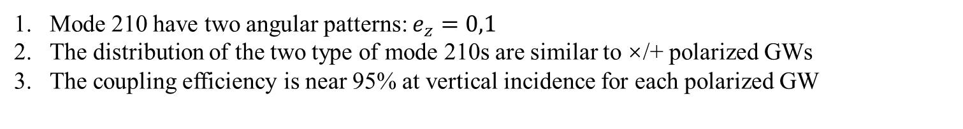
3. Show Case of mode 210
Benchmark settings: stainless steel
$$Q_{mech}$$ | $r_{1}$(m) | $r_{2}$(m) | $$λ(GPa)$$ | $$μ(GPa)$$ | $$ρ(g/cm^{3})$$
$${10}^{7}$$ | 0.1 | 0.15 | 90.8 | 77.4 | 7.96
The eigen frequency of mode 210
in this set up is 42.3kHz
$$e_{z}=0:$$
$$only coupled to×polarized GWs$$
$$e_{z}=1:$$
$$only coupled to+polarized GWs$$
Mode 210 have two angular patterns: $e_{z}=0,1$
The distribution of the two type of mode 210s are similar to ×/+ polarized GWs
The coupling efficiency is near 95% at vertical incidence for each polarized GW

Slide 7
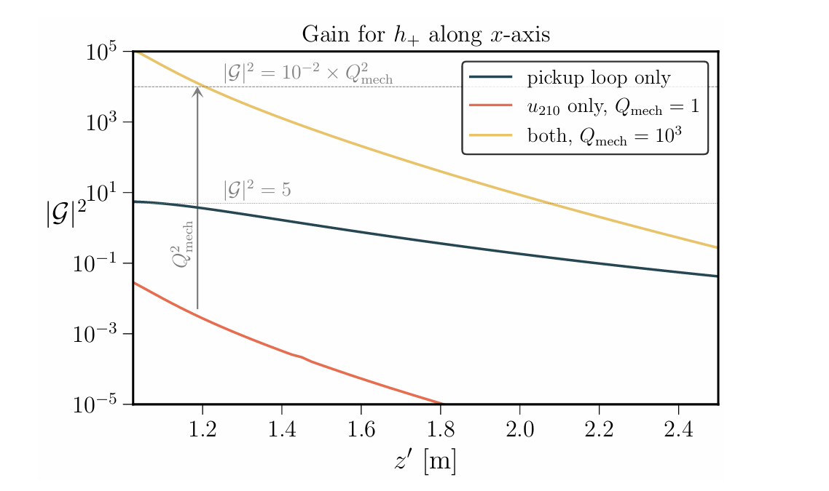
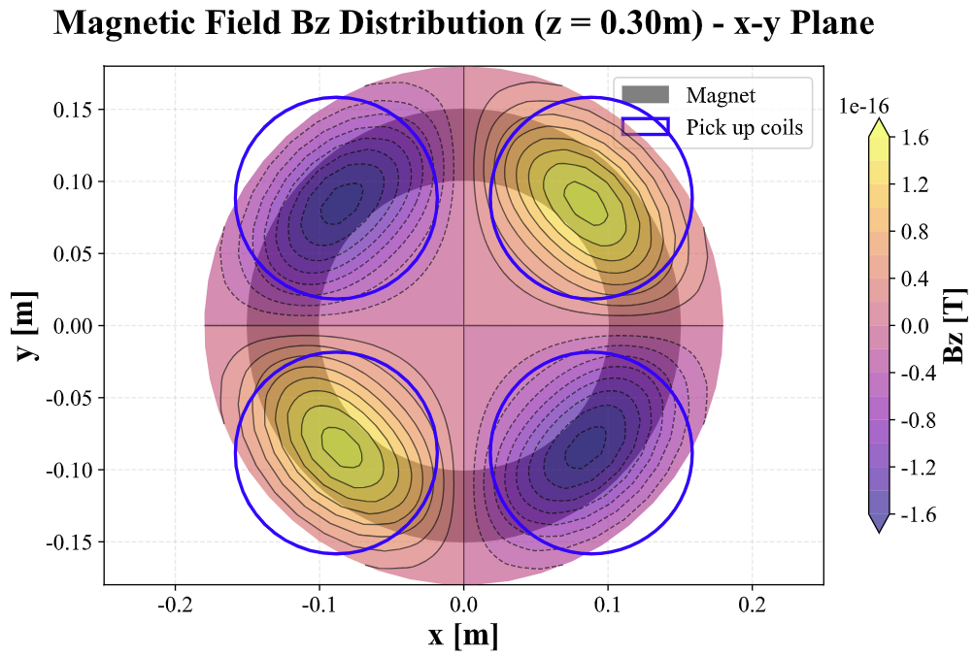
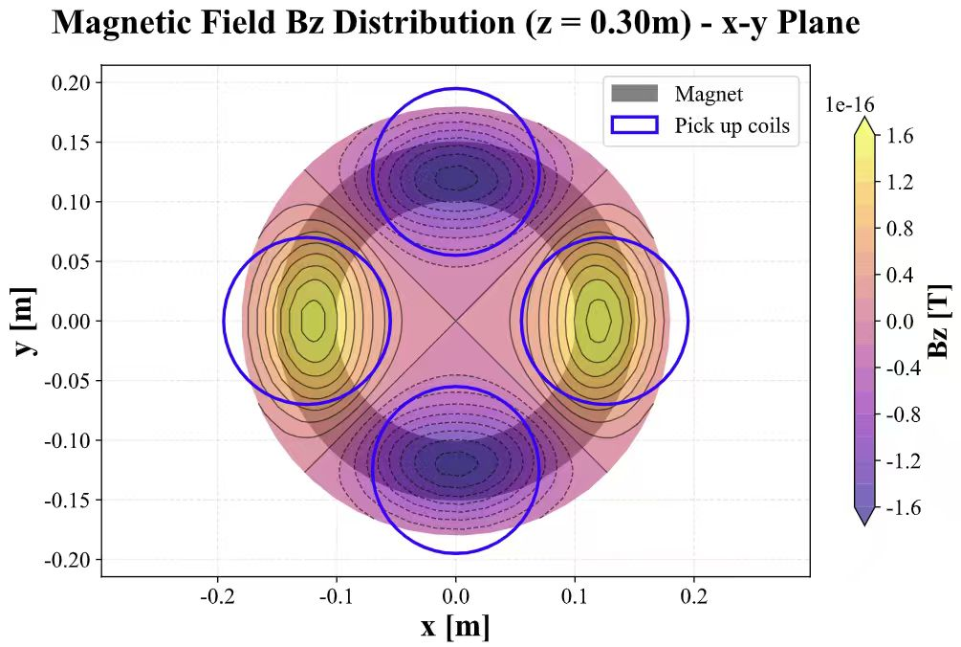




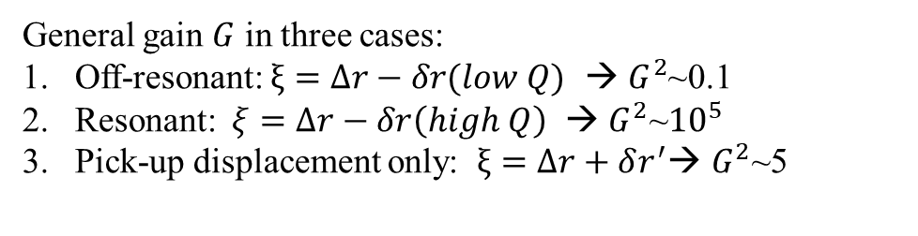
3. Show Case of mode 210
× polarized
+ polarized
$$δr′\sim h$$
$$Δr= r−r′$$
Different polarized GWs excite different distributed MFs
General gain $G$ in three cases:
Off-resonant:$ξ=Δr−δr(low Q)$ → $G^{2}$~0.1
Resonant:$ξ=Δr−δr\left(high Q\right) \text{→ }G^{2}\text{\sim }{10}^{5}$
Pick-up displacement only: $ξ=Δr+δr^{′}\text{→ }G^{2}\text{\sim }\text{5}$
$$ξ=Δr+δr−δr′$$
$$δr\sim Qh$$

Slide 8
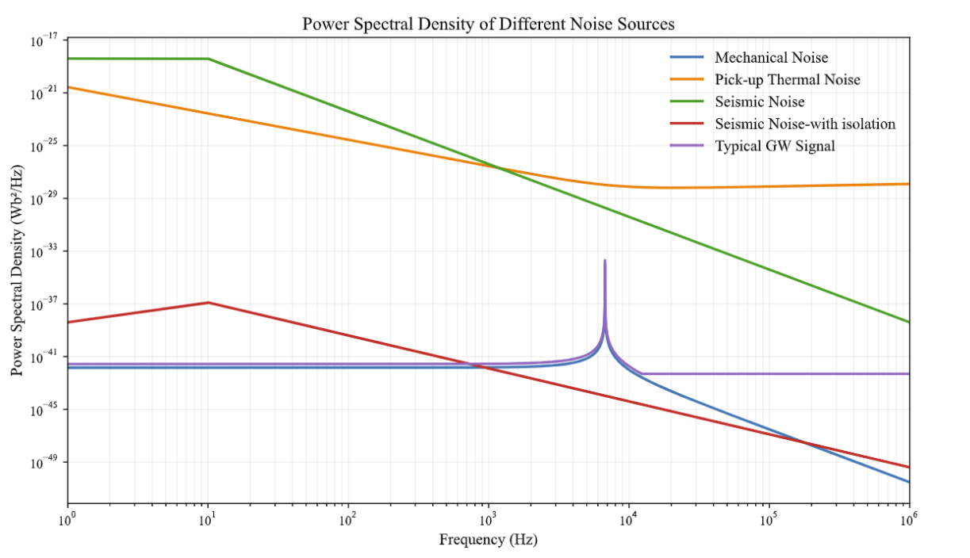
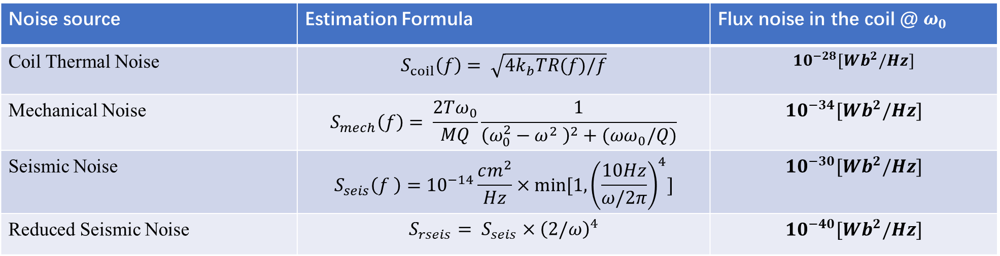
4. Noise & Sensitivity
Coil thermal noise
Mechanical Noise
Environmental EM noise
ground
Seismic Noise
Noise source | Estimation Formula | Flux noise in the coil @ $ω_{0}$
Coil Thermal Noise | $$S_{coil}\left(f\right)= \sqrt{4k_{b}TR(f)/f}$$ | $${10}^{−28}[Wb^{2}/Hz]$$
Mechanical Noise | $$S_{mech}\left(f\right)= \frac{2Tω_{0}}{MQ}\frac{1}{{\left(ω_{0}^{2}−ω^{2} \right)}^{2}+(ωω_{0}/Q)}$$ | $${10}^{−34}[Wb^{2}/Hz]$$
Seismic Noise | $${S_{seis}\left(f \right)=10}^{−14}\frac{cm^{2}}{Hz}×min⁡[1,{\left(\frac{10Hz}{ω/2π}\right)}^{4}]$$ | $${10}^{−30}[Wb^{2}/Hz]$$
Reduced Seismic Noise | $${S_{rseis}= S}_{seis}×{\left(2/ω\right)}^{4}$$ | $${10}^{−40}[Wb^{2}/Hz]$$

Slide 9
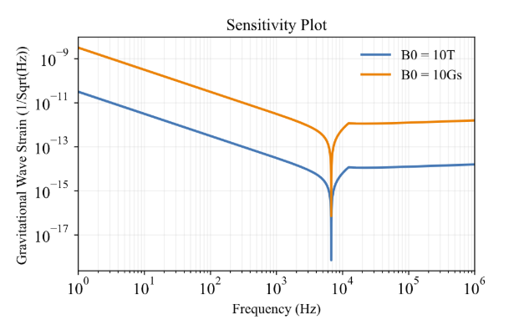
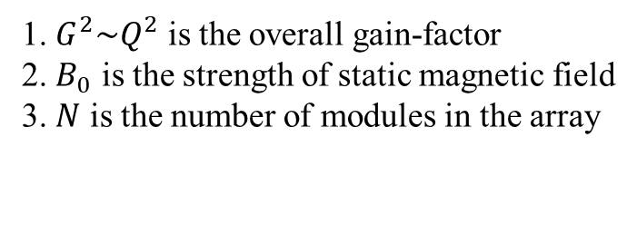
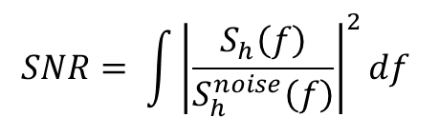
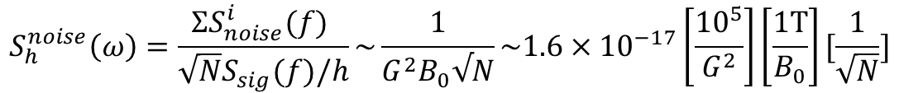

4. Noise & Sensitivity
Preliminary sensitivity for mode 210 at resonant frequency:
1. $G^{2}\sim Q^{2}$ is the overall gain-factor
2. $B_{0}$ is the strength of static magnetic field
3. $N$ is the number of modules in the array
$$S_{h}^{noise}\left(ω\right)=\frac{ΣS_{noise}^{i}(f) }{\sqrt{N}S_{sig}(f)/h}\sim \frac{1}{G^{2}B_{0}√N}\sim 1.6×{10}^{−17}\left[\frac{{10}^{5}}{G^{2}}\right]\left[\frac{1T}{B_{0}}\right][\frac{1}{\sqrt{N}}]$$
Preliminary sensitivity for different frequency GWs
when we only consider mode 210
In off-resonant region, we set ${\left|G\right|}^{2}\sim 5$
For a certain type of GW, the SNR is:
$$SNR= {\int{\left|\frac{S_{h}\left(f\right)}{S_{h}^{noise}\left(f\right)}\right|}}^{2}df$$
To optimize:
Consider more eigenmodes
Gain factor optimization
Better reconstruction method
Coil optimization etc..

Slide 10
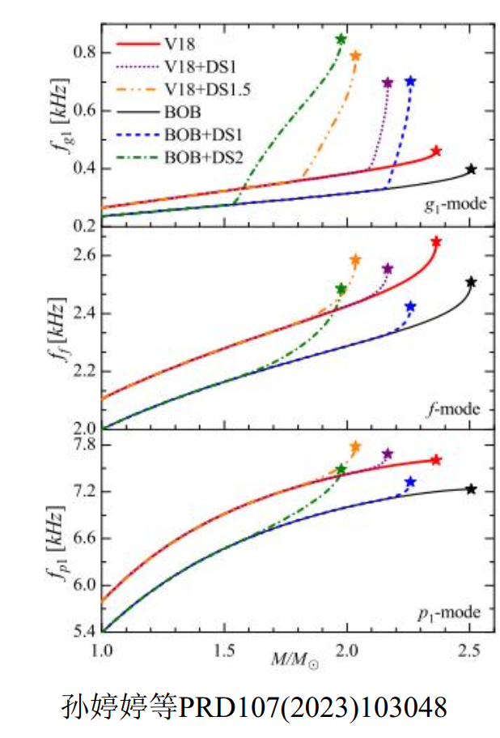
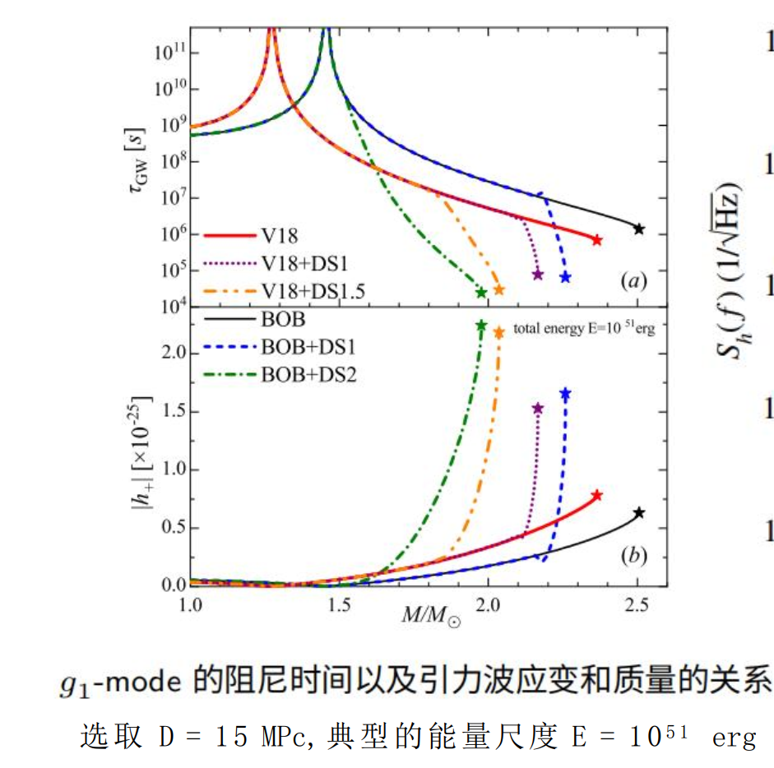
5. Extend: physics of ultra-high frequency GWs
1. Non-Radial vibration GW radiation of the neutron star
For D~10kPc(Within the galactic),${h\sim 10}^{−21} ,f\sim kHz$

