Slide 1

Survey of Moon-Based Research: FCP & Axion
Qing Lin
University of Science and Technology of China
2021-08-23

Slide 2
Outline
Fractional charged particles (FCP) – millicharged
Axion
Others

Slide 3
General methods
Accelerator based search
Bulk material search
  Levitometer
  Liquid drop
Particle search for millicharged particle from outside of Earth
  Underground Low-background Detector
  Ultra-low threshold detector
Production in magnetic field

Slide 4
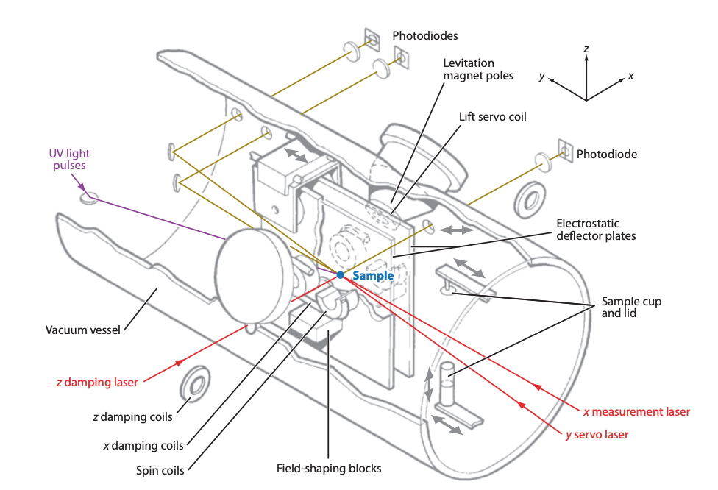
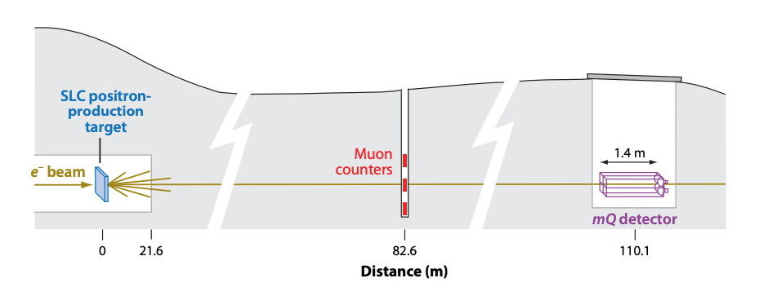
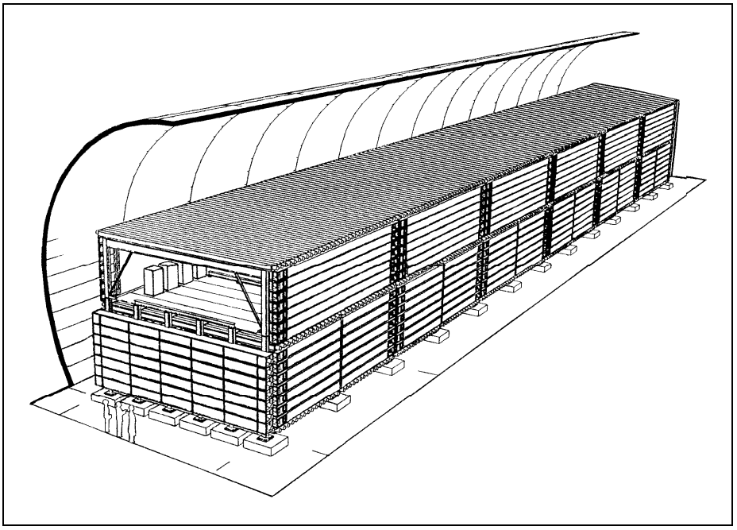
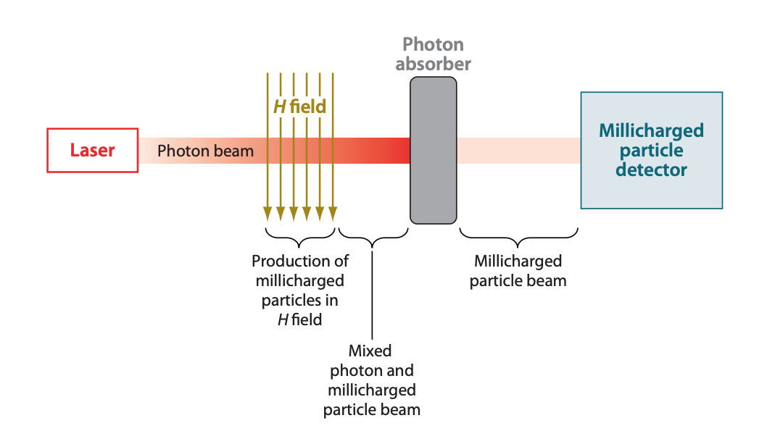
Most use large equipment
Levitometer
Accelerator-based search (beam-dump)
Large low-background detector
Light-shining-through-wall

Slide 5
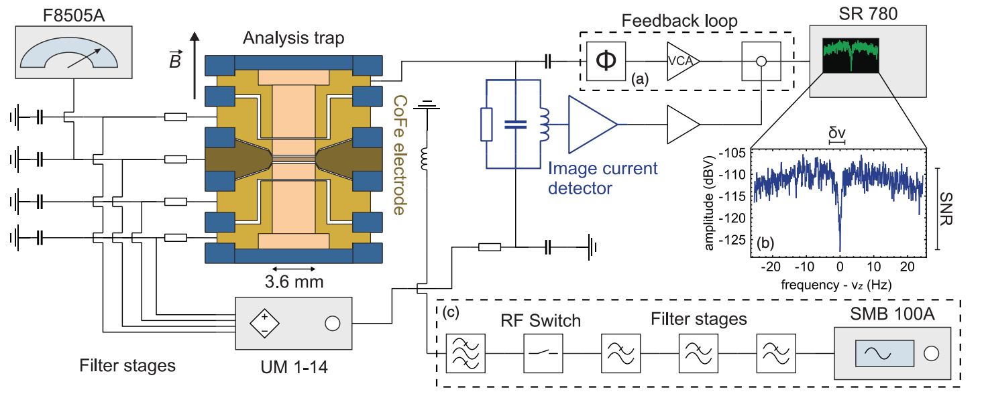
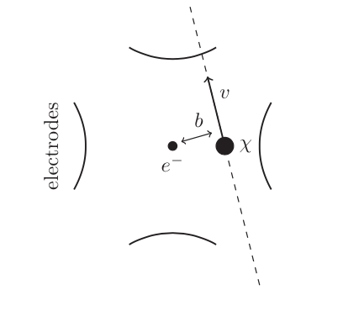
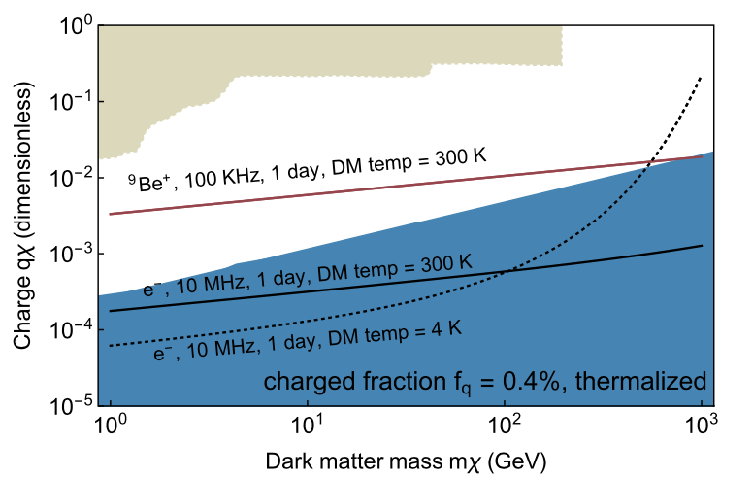
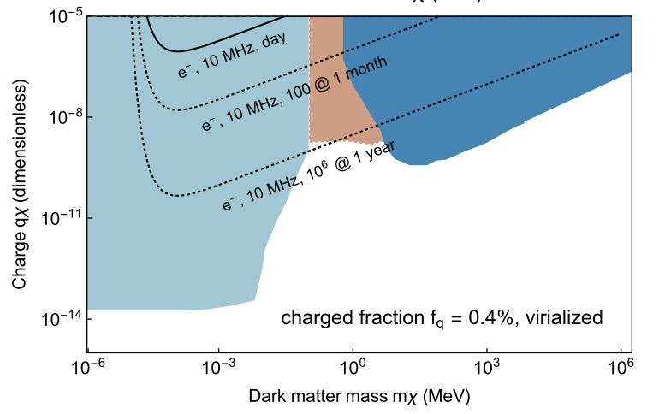
Electron/Ion trap for mili-charged particle
σ ~ 1/ν²

Slide 6
Search on Moon?
Most searches need large equipments, which is not suitable for moon-based searches (early phase);
More importantly, there does not to be more advantageous to search fractionally charged particle on moon than on Earth
The only exception may be for light mili-charged particle which has adequate charge fraction, which may be shielded by atmosphere and rock overburden for low-background experiments.

Slide 7
Outline
Fractional charged particles (FCP) – millicharged
Axion
Others

Slide 8
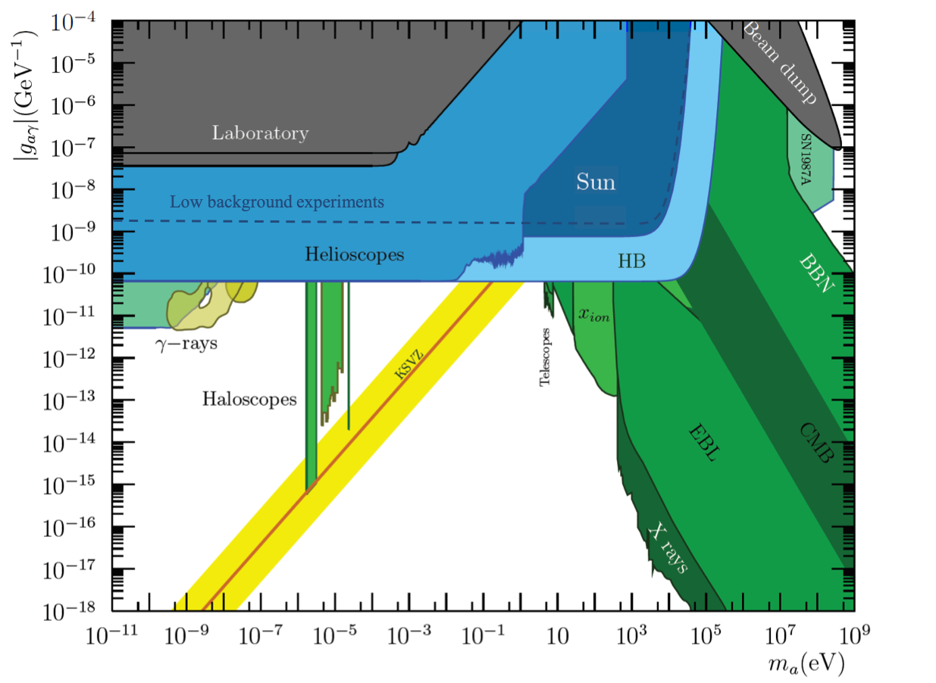
Overview
Experimental methods:
Haloscopes
  Cavity
  Dielectric
  LC circuit
  NMR
  Plasma
Helioscopes
  Dipole Magnet pointed to Sun
  Low-background experiments
Laboratory production.
  Light-Shining-through-Wall
Notes:
Cavity limited by size

Slide 9
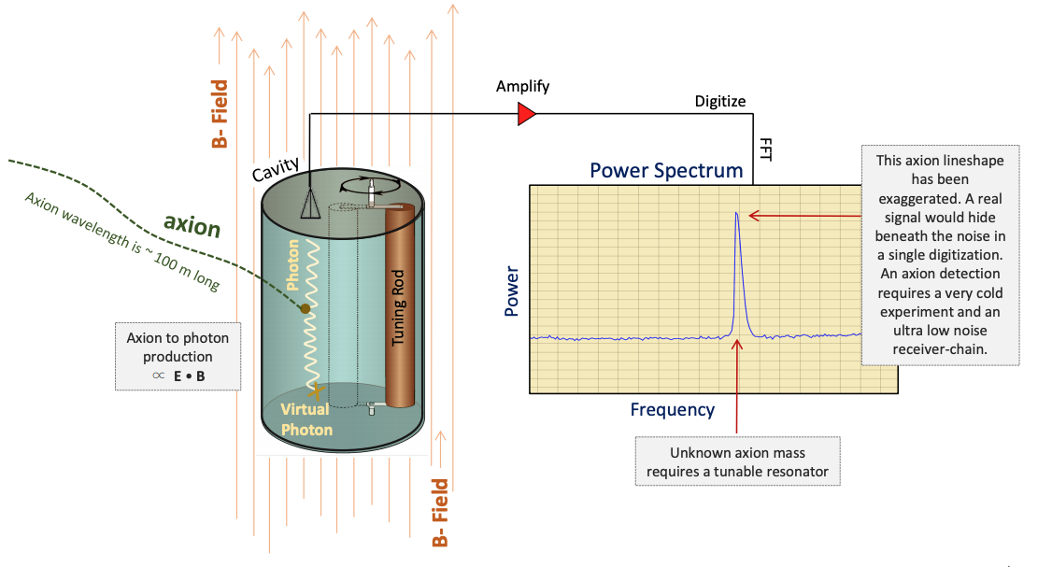
Cavity
B field ✓
Cryogenic ✓
Vacuum ✓
Moon Supremacy ✗
Shielding ❍

Slide 10
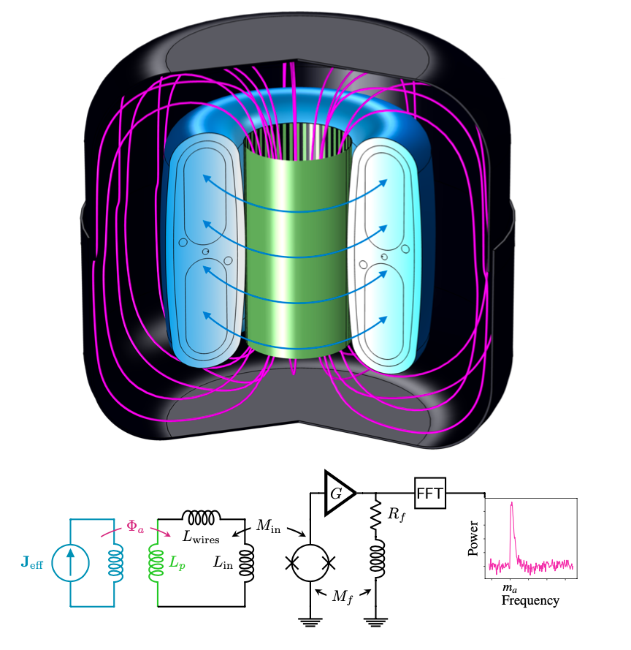
LC circuit
B field (superconductor)✓
Cryogenic ✓
Vacuum ✓
Moon Supremacy ✗
Shielding ✗

Slide 11
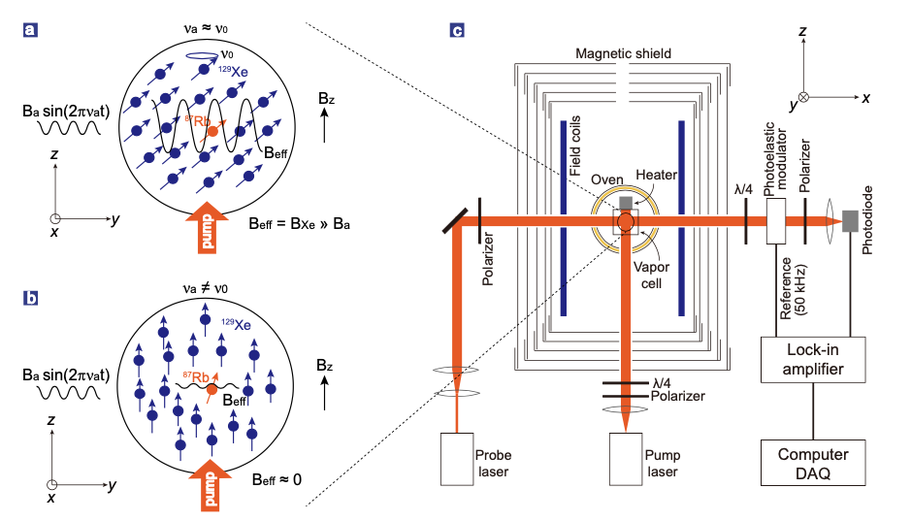
NMR
B field (small bias) ✓
Cryogenic✗
Vacuum ✗
Moon Supremacy ✗
Shielding (magnetic) ✓

Slide 12
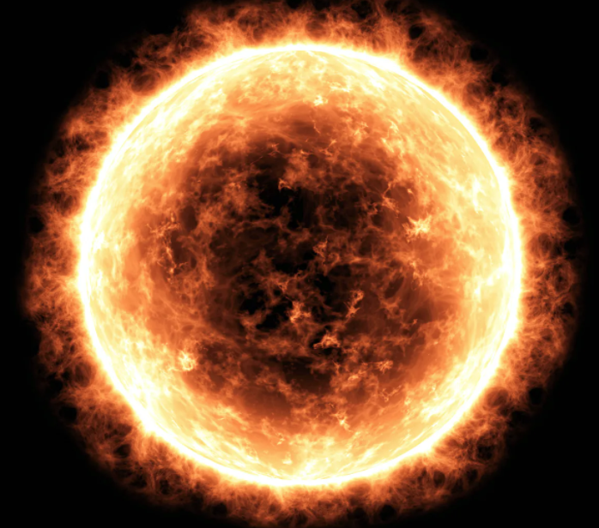
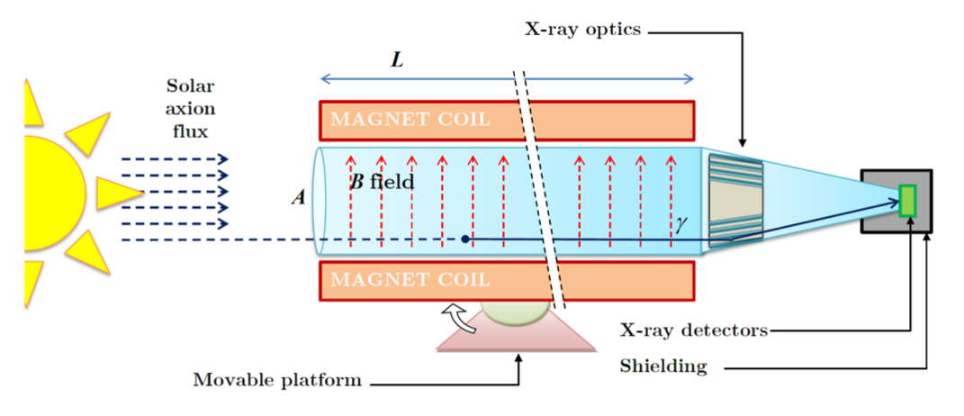
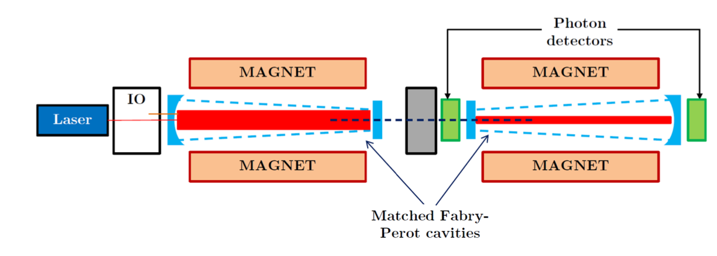
Helioscopes and LSW
Low-background
Solar helioscope
axion
LSW
(not low-bkg)
B field ✓
Cryogenic✗
Vacuum ✗
Moon Supremacy ✗
Shielding❍

Slide 13
Search on Moon?
Most axion searches require strong magnetic field to enhance the axion-photon coupling, which is not so preferable for a moon-based experiment.
Also it does not have advantage to search on moon for axion field is most likely uniform in space;
However if we assume the axion field is not uniform, such as DM steaming etc, then putting a simple detector on moon and networking with terrestrial detectors can be beneficial.

Slide 14
Outline
Fractional charged particles (FCP) – millicharged
Axion
Others
Monopole detection using quantum sensor

Slide 15
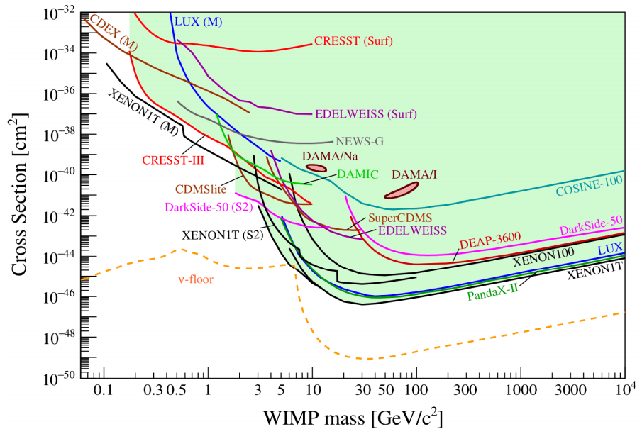
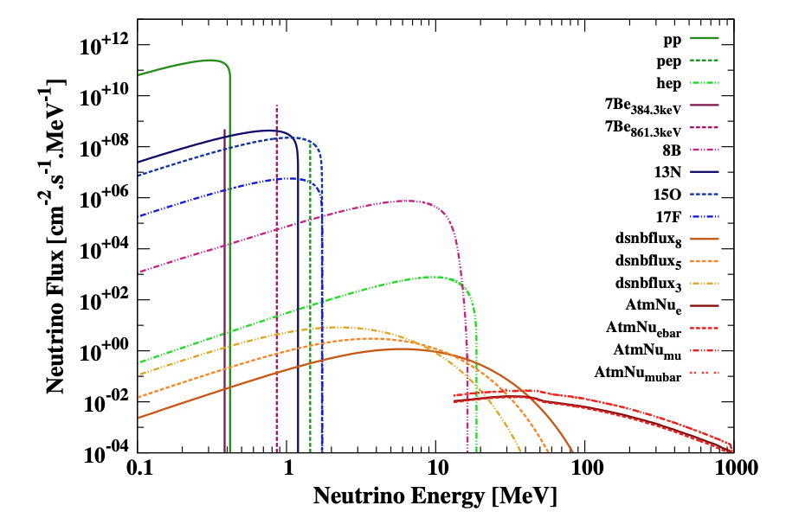
For future phases: DM detection
High-mass WIMP detection has intrinsic limit on Earth, mainly due to atmospheric neutrinos.

Slide 16
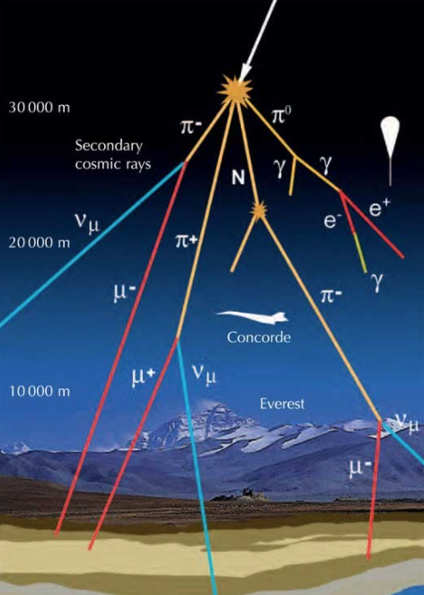
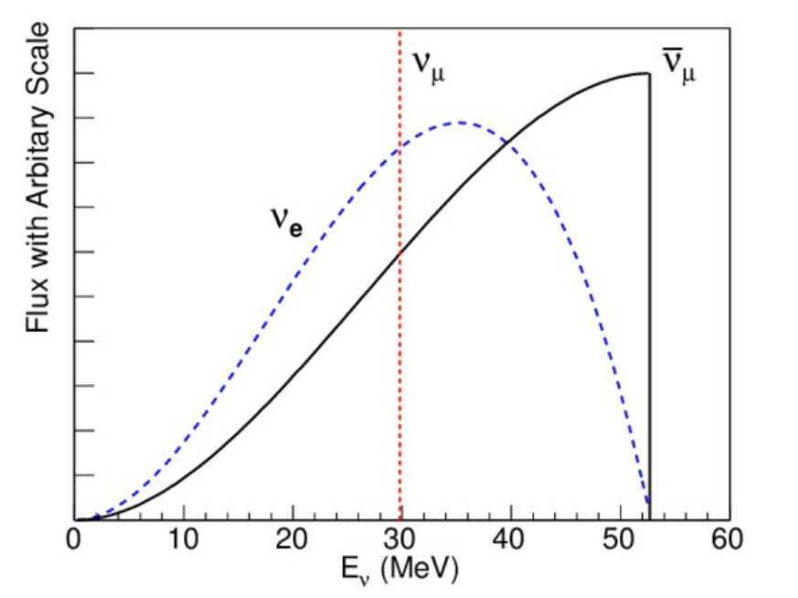
Atmospheric neutrino on Moon?
No atmosphere on Moon makes high-mass WIMP detection on Moon can have no intrinsic background;
There still will be some muon and neutrino created when cosmic rays hit Moon surface, but their energies are much lower than atmospheric neutrion;
Muon flux is also lower, which means the rock overburden does not need to be as thick as the terrestrial underground lab.

Slide 17
Template

