Slide 1
无损数据压缩在物理实验中的应用
沈仲弢 王淑文
2019年4月23日 合肥
核探测与核电子学国家重点实验室
中国科学技术大学

Slide 2
Outline
Data Compression & Physical experiments
MPGD Readout System
Situation1
Situation2
Summary

Slide 3
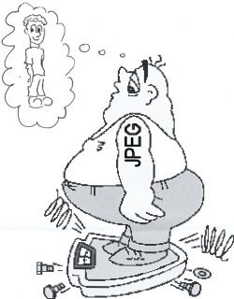
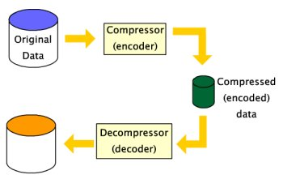
Data Compression
Data Compression is about storing and sending a smaller number of bits
See a lot of usage in the fields of audio, video etc

Slide 4
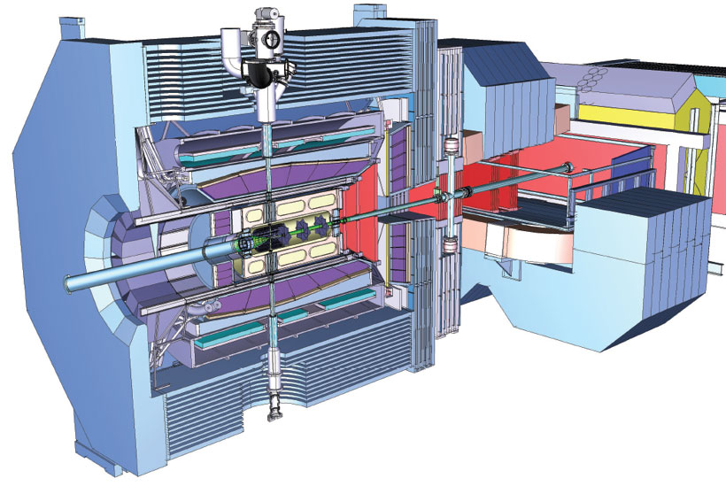
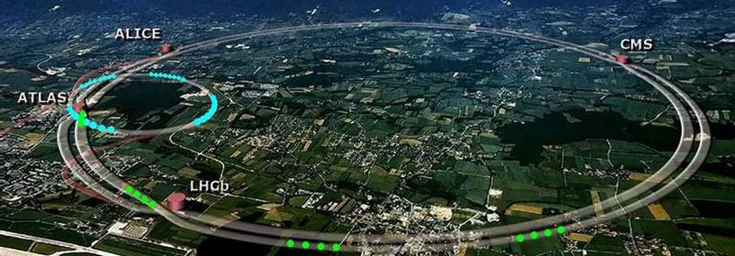
Modern Physical Experiments
More and more detector channels, higher and higher measure precision, higher and higher sample rate
  Give high pressure on data transmission and storage
Low entropy system
  The physical process, the detectors and readout electronics feature the signals
LHC:
10~100Mchannels
~100Gbyte/s
PANDA:
~10GHz
40~200Gbyte/s

Slide 5
Compression Strategy
Loss Compression VS Lossless Compression
Two Step
  Preprocessing
    According to the characteristics of the data.
  Compression
    Huffman coding
    LZ coding
    Run-length coding
Preprocessing example
1, 2, 3, 5, 5, 6, 8, 7, 8, …
Y = X
0, 0, 0, 1, 0, 0, 2, 0, 0, …

Slide 6
Data Compression in physics
Raw Data
Preprocessing
Compression
Compressed Data
Trig Strategy/
Zero Compression

Slide 7
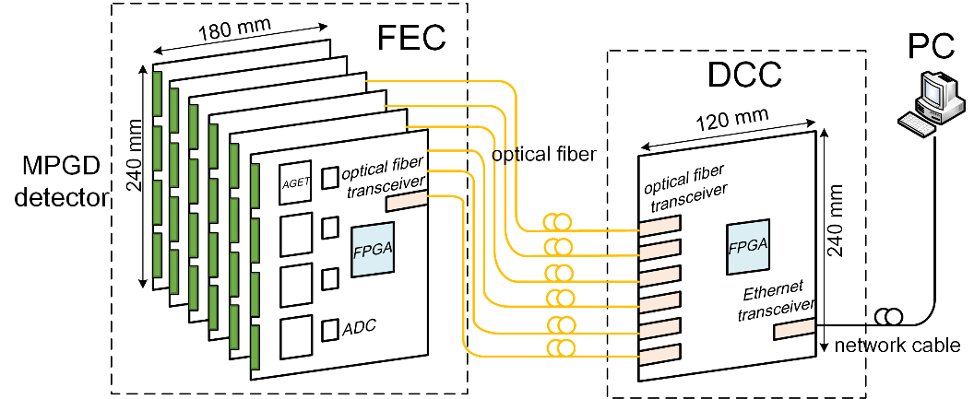
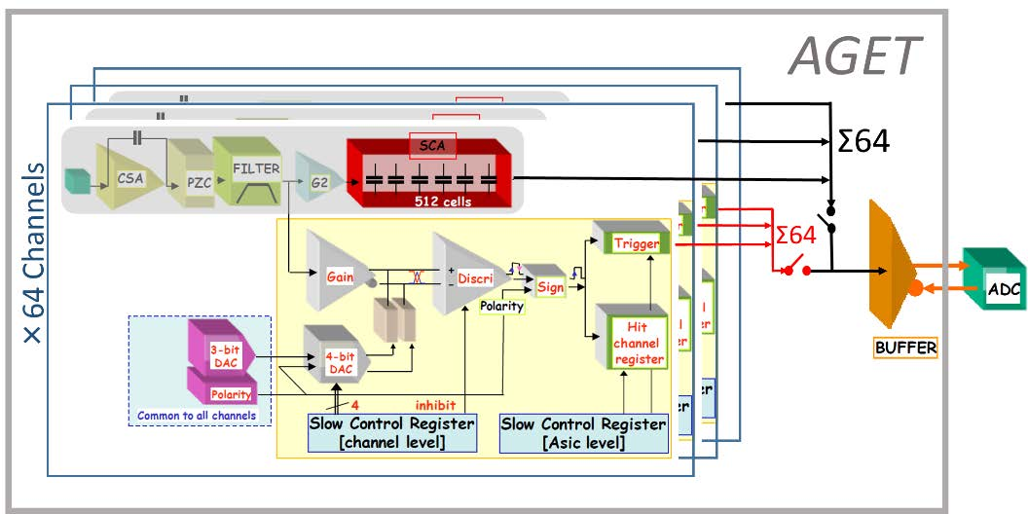
MPGD Readout System
Micro-pattern Gas Detectors (MPGD) Readout System
  FEC & DCC
  Scalable
AGET Chip
  Designed by GET collaboration for MPGD readout
  64 channels
  CSA, Shaping, SCA (512 sample deep)
Structure of MPGD system
Analog part of AGET

Slide 8
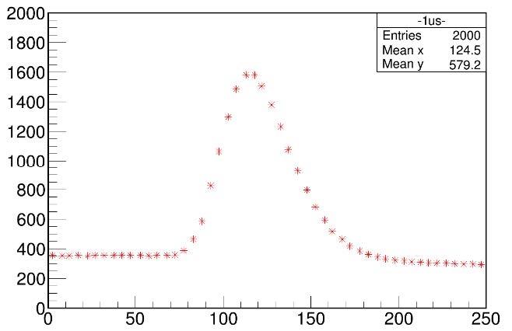
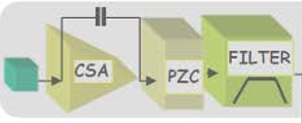
Situaton1
Output wave of AGET
  Gaussian waveform
  Determined by the shaping circuit

Slide 9
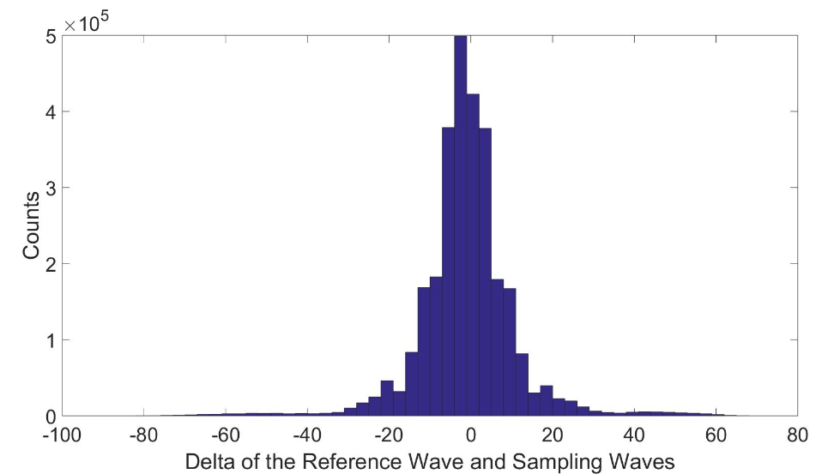
Compression Method
Preprocessing
  Compared with the reference wave
Compression
  Huffman coding

Slide 10
Huffman Coding
Coding according to the frequency
  Higher frequency, shorter code
Dynamic table VS Static table
Parallel Huffman core in FPGA to improve the speed
E = 01
I = 00
C = 10
A = 111
H = 110
Before | After
75bits | 55bits
ACAIEEIEAHIIECICIEEICCEEH

Slide 11

FPGA Implementation
Xlinx Zynq-7000 (xc7z045ffg676-2)
Runs well under the clock of 100MHz
Compression Delay: 150~450 clock cycles (1.5us ~ 4.5us)
Slice LUTS (218600) | Slice Registers (437200) | Block RAM Tile (545) | DSP
438 | 372 | 5 | 0
0.20% | 0.09% | 0.92% | 0

Slide 12
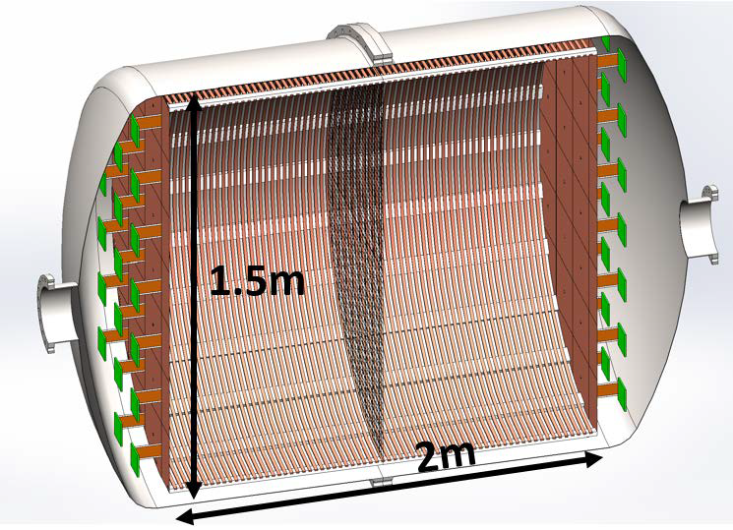
Situation2
PandaX-III
  Searching for neutrinoless double β decay
  ¹³⁶Xe TPC, Micromegas
Signal
  May be as long as 100us
  Get the signal information by integrating the waveform

Slide 13
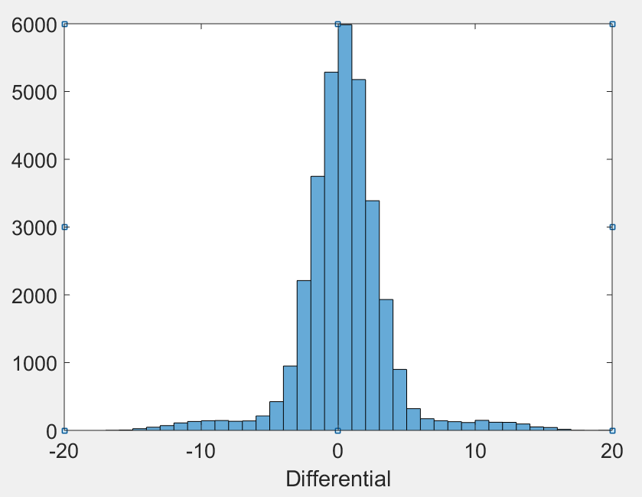
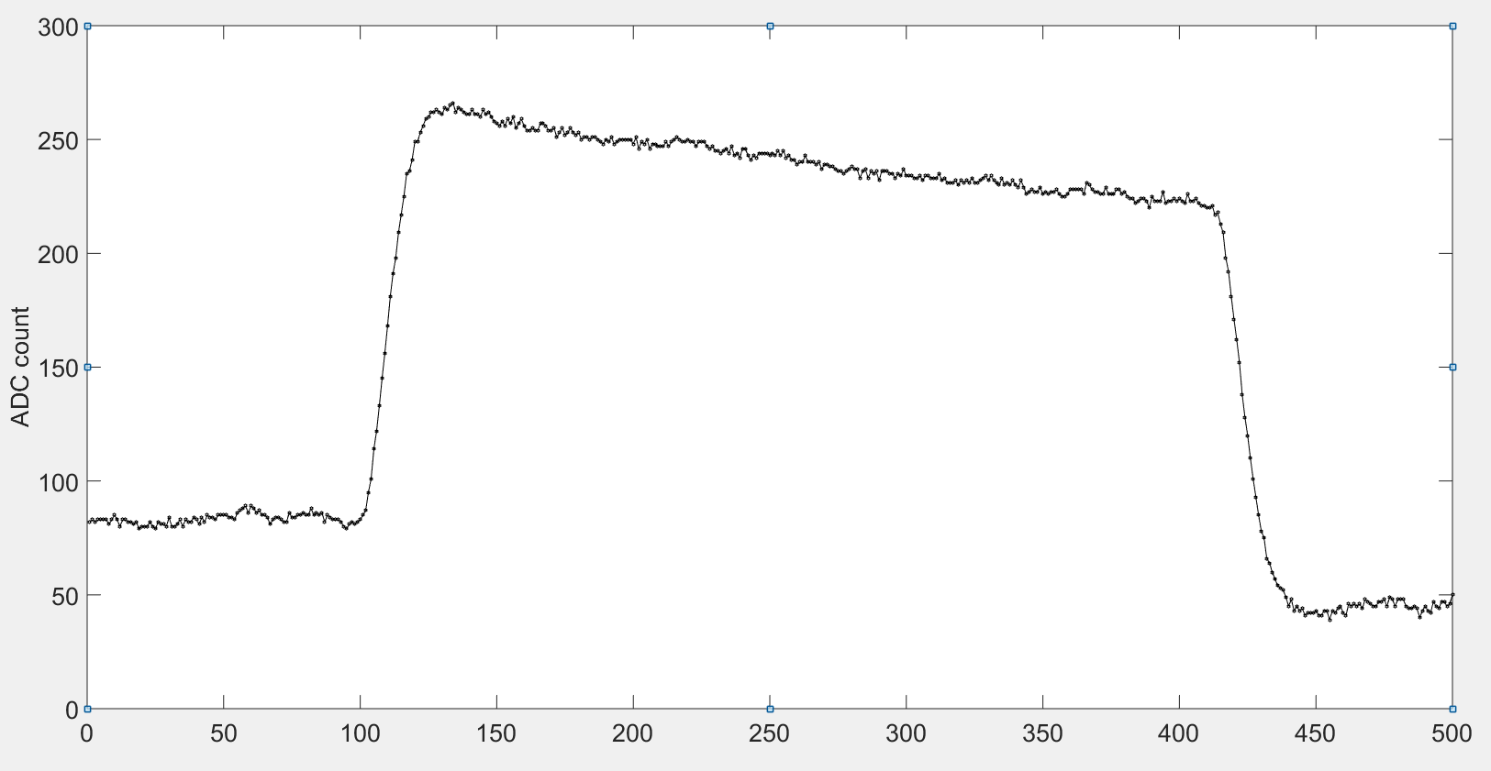
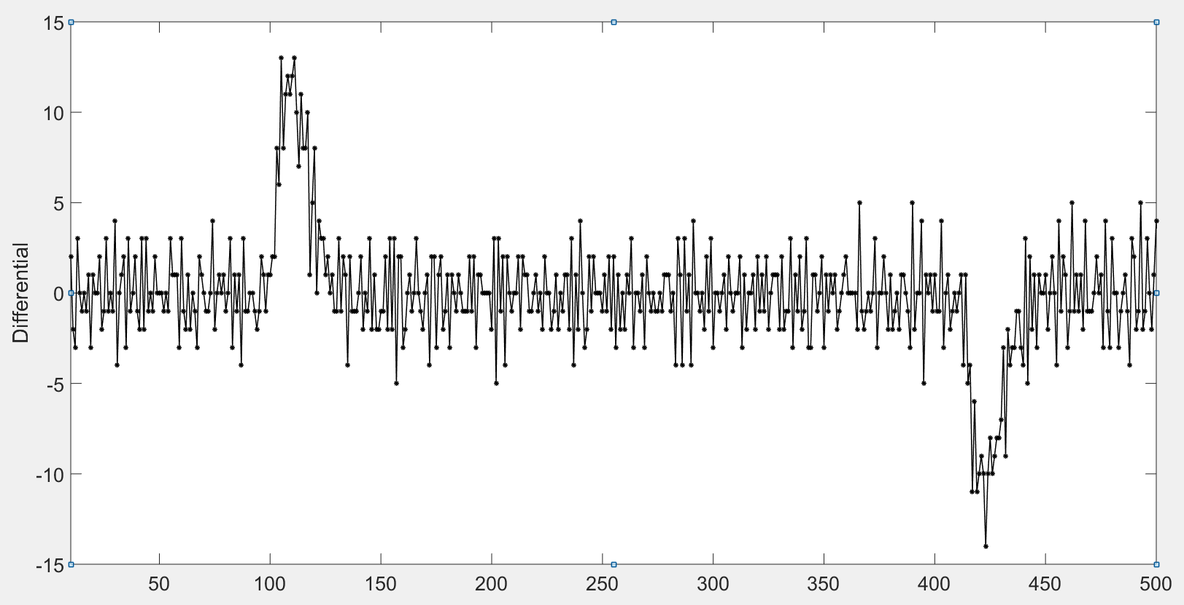
Compression
Preprocessing
  Calculation the differential of the wave
  Results are centred around zero
Compression
  Huffman coding

Slide 14
FPGA Implementation
Xlinx Zynq-7000 (xc7z045ffg676-2)
Runs well under the clock of 100MHz
Compression Delay: <10 clock cycles (100ns)
Slice LUTS (218600) | Slice Registers (437200) | Block RAM Tile (545) | DSP
394 | 293 | 1 | 0
0.18% | 0.07% | 0.18% | 0

Slide 15
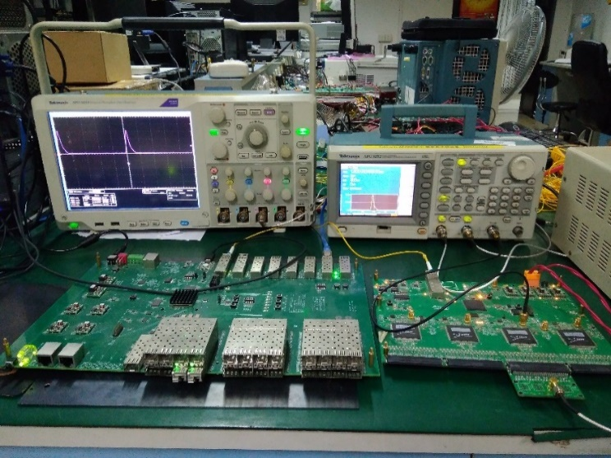
Test
Test with signal generator
  A step signal is generated
  A charge signal is generated after C1
  Width of charge signal is decided by the
  rising edge of the step signal
Compression rate
  Situation1: 43%
  Situation2: 30%

Slide 16
学术交流&论文发表
21st IEEE Real Time Conference，大会报告
“Study on the Real-time Lossless Data Compression Method Used in the Readout System for Micro-pattern Gas Detector”, IEEE Transactions on Nuclear Science, under review.

Slide 17
Summary
Considering using data compression in physical experiments
Based on a MPGD readout system, for two different situations, implementation two different real-time compression algorithms
More than MPGD

