Slide 1
Study of transparency of graphene to low energy electrons
ZHU Chengguang
Shandong University

Slide 2
Motivation
Use graphene to prevent ions from contaminating TPC volume, which looks impressive in preliminary test.
The transparency of graphene to low energy electrons is critical to be understood.
  Due to the scattering of electron with gas molecules, the energy of electron in gas can’t increase much(<10eV).
  Energy of electrons can be improved but limited.
Transparency of high energy(>1keV) electron has been reported in literature but not for very low energy electrons
The cost, stability, manufacture of a working detector is not covered by now.

Slide 3
Schematic setup
Electron gun
graphene
Electron collector
Electron emitter/gun produce electrons
Electrons are pushed to graphene by electric field and energy is determined.
Part of electrons pass through graphene and collected by receiver/pico-amiter.
Vacuum

Slide 4
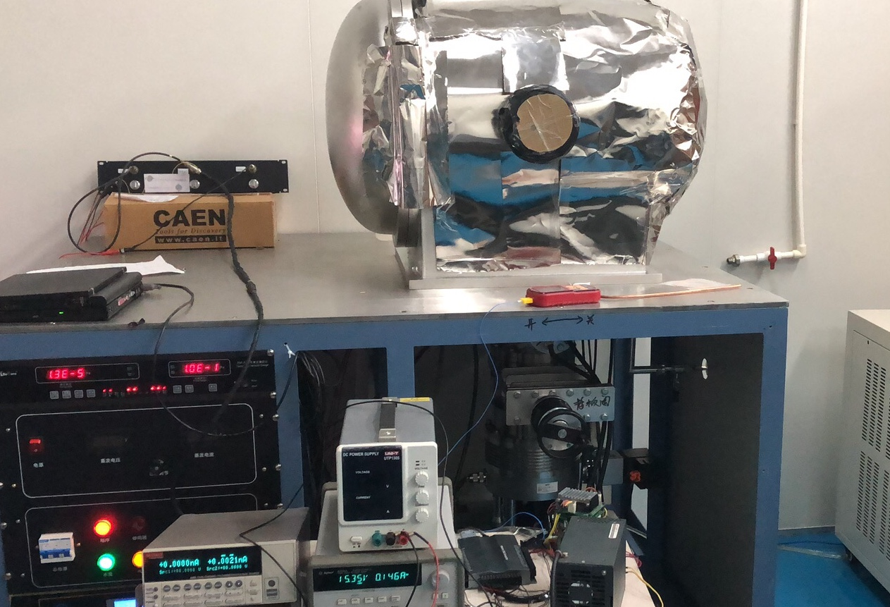
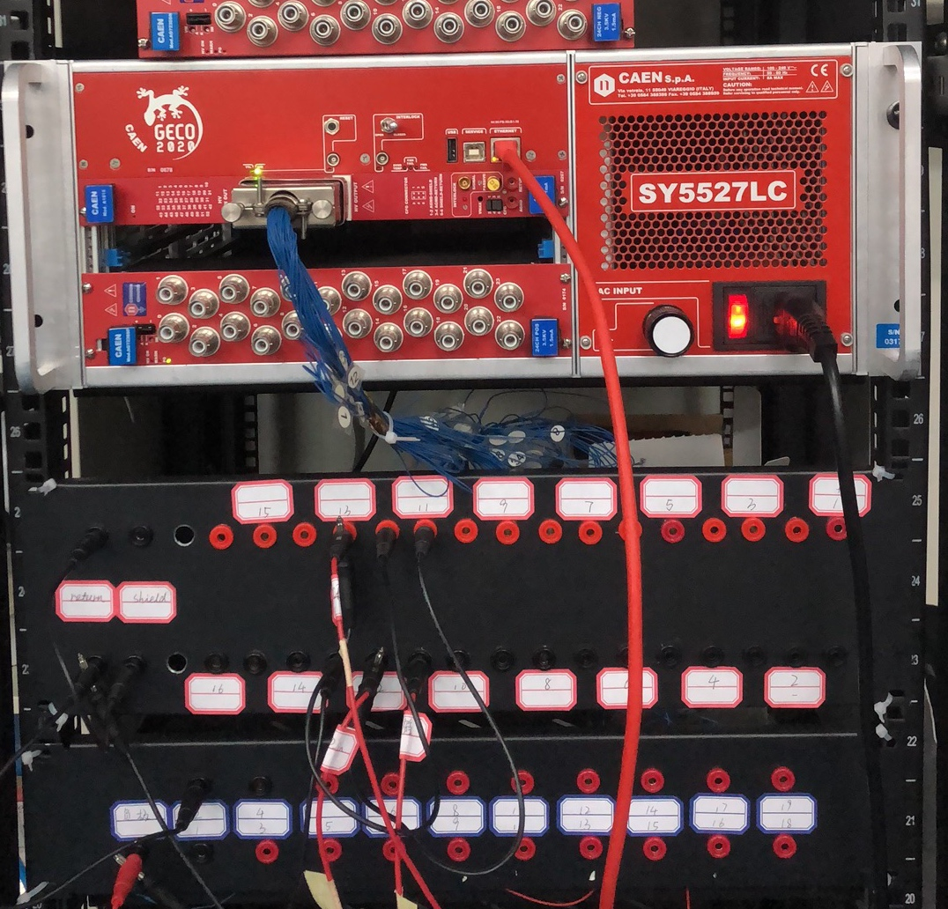
Setup in Lab

Slide 5
Electron producer
Photon-electron effect to produce the initial electrons
MCP to magnify the electrons
The main problem is the big energy spreading

Slide 6
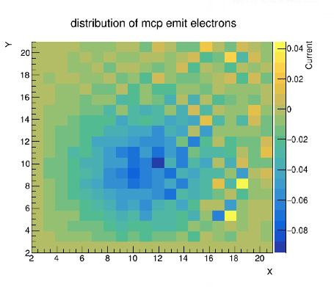
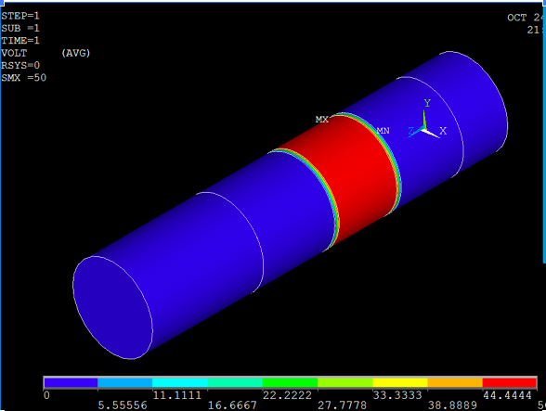
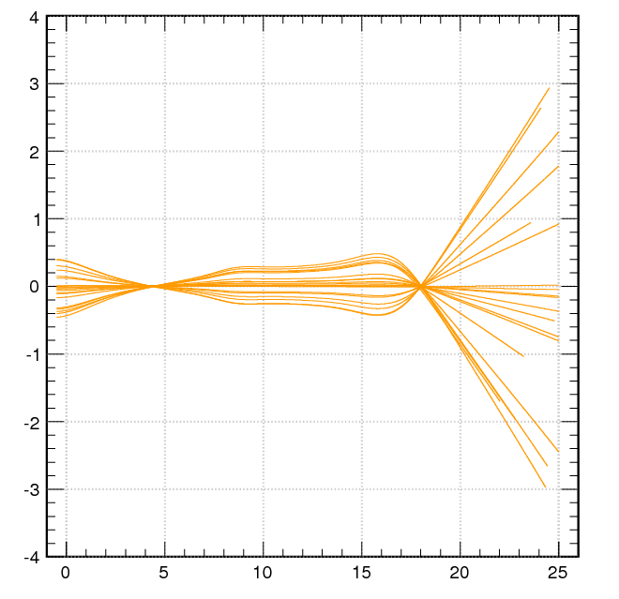
Beam focusing without focusing, the beam profile is quite large
Based on Garfield++, compose focusing simulation software
Ansys for the electric field generation
Not tested in reality

Slide 7
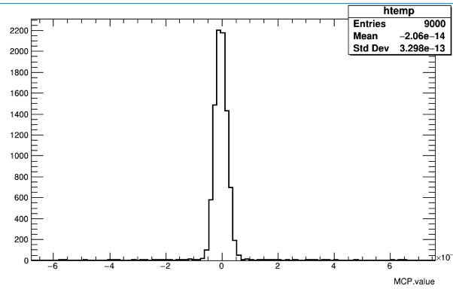
Current measurement
The current measured by pico-ameter with a precision we can reach at 10pA.
The main problem is the secondary electron emitting from surface of instrument.
  The electron re-emit is very complicated and depends heavily on the conditions of the surface.
  Simulating the re-emit to understand the effects
  Search for low re-emit material and surface treatment.
Well controlled precision
Several sources to affect its precision

Slide 8
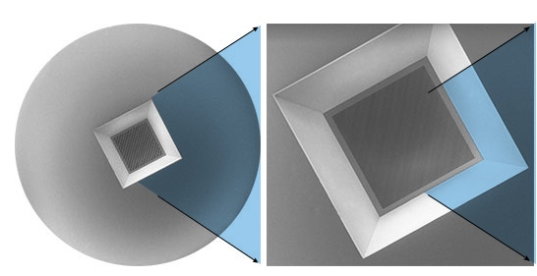
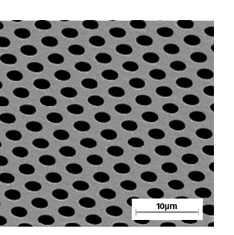
Silicon Nitride supported graphene
Film thickness 0.2 micros
with graphene covered
holes diameter 2.5micro
Get cooperated from material institute.

Slide 9
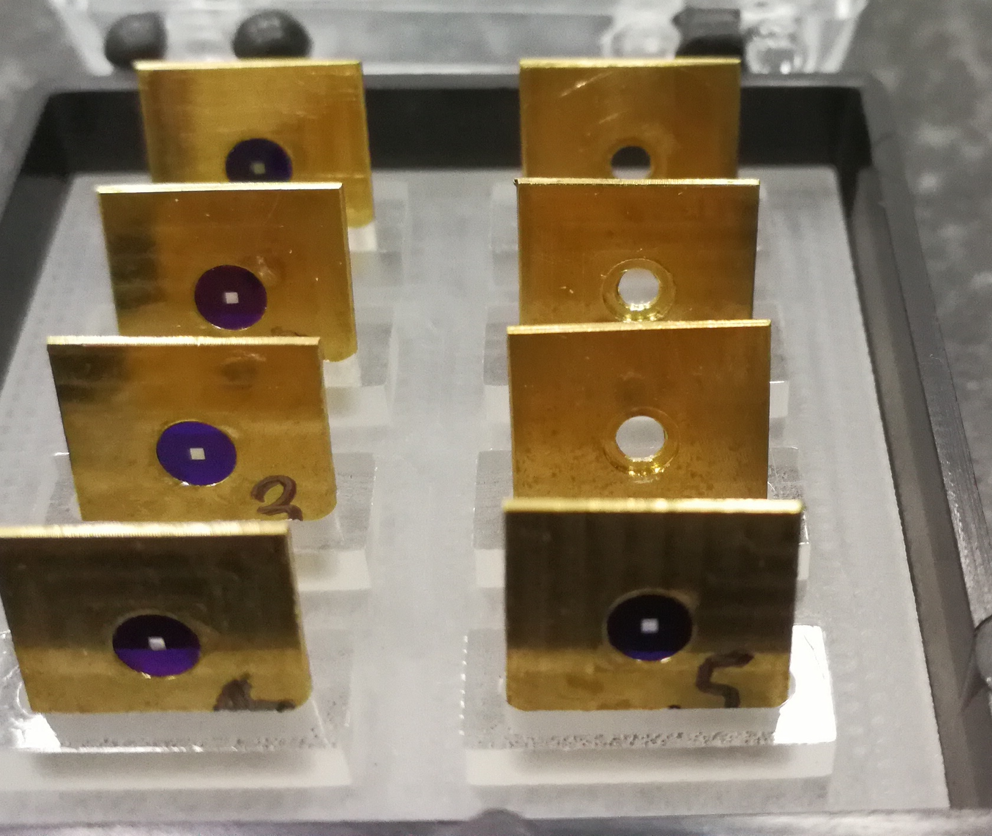
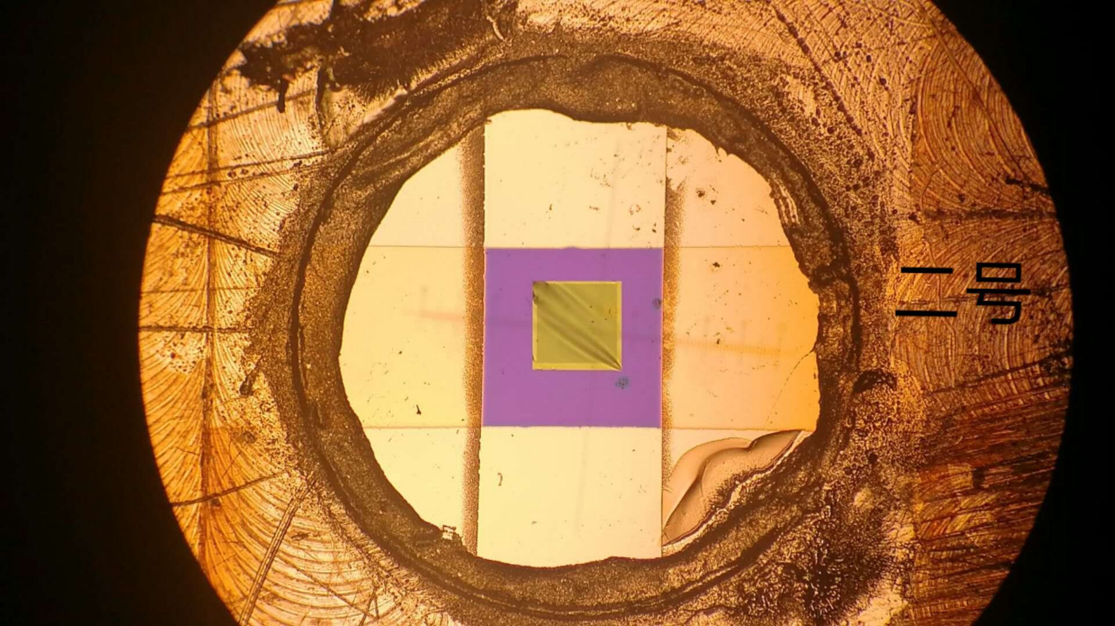
Graphene samples
Graphene on the 0.5*0.5mm square
The area around graphene coated by gold layer for electric connection.

Slide 10
Summary
The main instruments are installed
Hard to control low energy electrons, problems from the re-emit
Plan to move to a new way to produce electrons.
With the problem solved, the test is quite straitforward.

