Slide 1
SiPM应用新进展
JUNO-TAO&GECAM
孙希磊
中科院高能所
核探测与核电子学&核物理重点实验室年会
合肥2019.4.23

Slide 2
报告内容
SiPM介绍
JUNO-TAO应用
GECAM应用
总结和展望

Slide 3
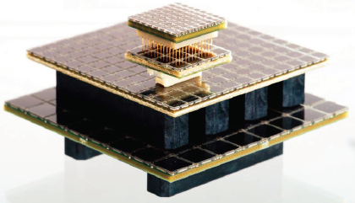
SiPMs Performance
High PDE and High dynamic range two directions
SiPM technology has made great progress in the past 10 years
Fill factor>70%, PDE>50%, DCR<100 kHz/mm², CT<10%
O (m²) SiPMs has been or is planned to be used in high-energy physics experiments
MEGII(0.9 m²), nEXO(4 m²), Darkside-20k(14 m²), DUNE(10 m²), JUNO-TAO (10.2 m²)
 | SensL | Hamamatsu | FBK
Type | MicroFJ-60035 | S14160 | NUV-HD
Cell size (um) | 35 | 50 | 35
Cell Fill factor (%) | 76 | 74 | 81
PDE (%) | 51 (Vbr+5V) | 50 (Vbr+2.7V) | 56 (Vbr+5V)
Peak wavelength (nm) | 420 (250-900) | 450 (270-900) | 410 (280-700)
Dark count rate (kHz/mm²) | 70 (Vbr+5V) | 166 (Vbr+2.7V) | 150 (Vbr+5V)
Gain | 6.0X10⁶ (Vbr+5V) | 2.5X10⁶ (Vbr+2.7V) | 3.5X10⁶ (Vbr+4.5V)
Crosstalk probability (%) | 20 (Vbr+5V) | 7 (Vbr+2.7V) | 10 (Vbr+5V)
Break-down voltage (V) | 24.5 | 37 | 26
ΔTVop(mV/℃) | 21.5 | 34 | 20

Slide 4
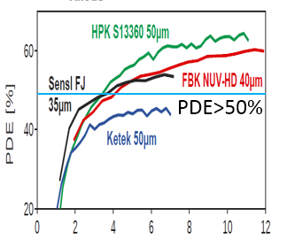
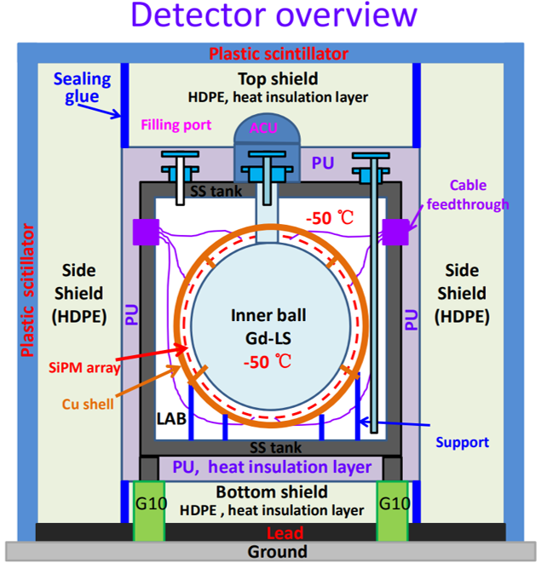
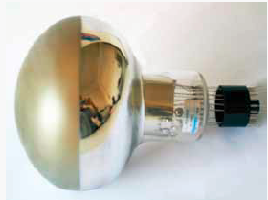
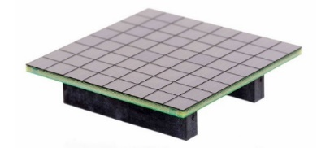
JUNO-TAO Introduction
SiPM instead of PMT is the determinants of energy resolution
PMT 2.5% SiPM 1.7%
5000p.e., 1.7% @1MeV
Compare w/ JUNO
Cov. 75%→~100% | X 1.33
PDE 27% → 50% | X 1.85
~4000 x 25 cm² SiPM arrays to cover area of ~10 m²
1 p.e. capability
1 p.e. resolution ~20%
SNR of 1 p.e.>5
Dynamic range ~100 p.e. (FV)
Power consumption <0.25 W
PDE >50%
DCR ~100 Hz/mm² @-50ºC
CT ~10%
FE and readout design
SiPM type selection
为了压低SiPM热噪声，必须-50度运行

Slide 5
Read out options
Two basic different readout schemes:
SiPM—PreAmps—Anolog—FADC—Trigger&DAQ
SiPM—ASIC—Digital—Trigger&DAQ
Cryostat LAB
Trigger &
DAQ
PreAmps scheme
Advantages
Traditional scheme, technology is mature
Simple structure in LTLS, PreAmps and cable
DAQ is outside, easy to maintain for long-term operational stability
Compatible with lower temperature usage LXe/LAr
LS
(2m)
(5m)
FADC
PreAmps
Analog
Disadvantage
Analog signal transmission requires coaxial cables
SiPM
Cryostat LAB
ASIC scheme
Advantages
System on chip, High integration
Front-end digitization, Digital signal transmission
Less cables
LS
(2m)
(5m)
Trigger &
DAQ
Disadvantage
Complex circuit structure in LTLS
Inconvenient maintenance in LTLS
ASIC is difficult to be compatible with LXe/LAr experiments
SiPM
Digital
ASIC
Tow different read out Schemes

Slide 6
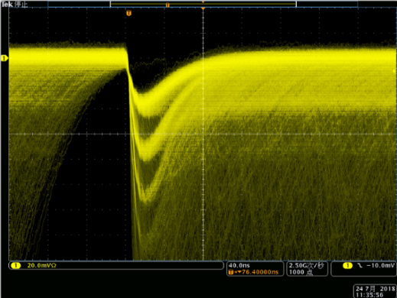
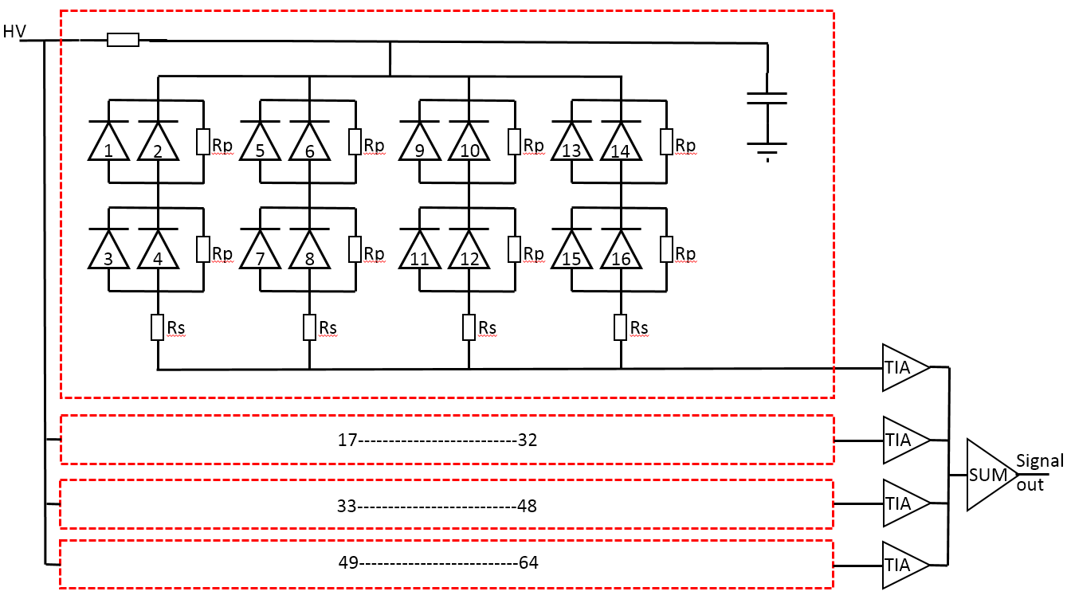
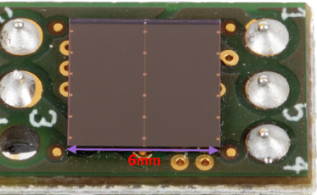
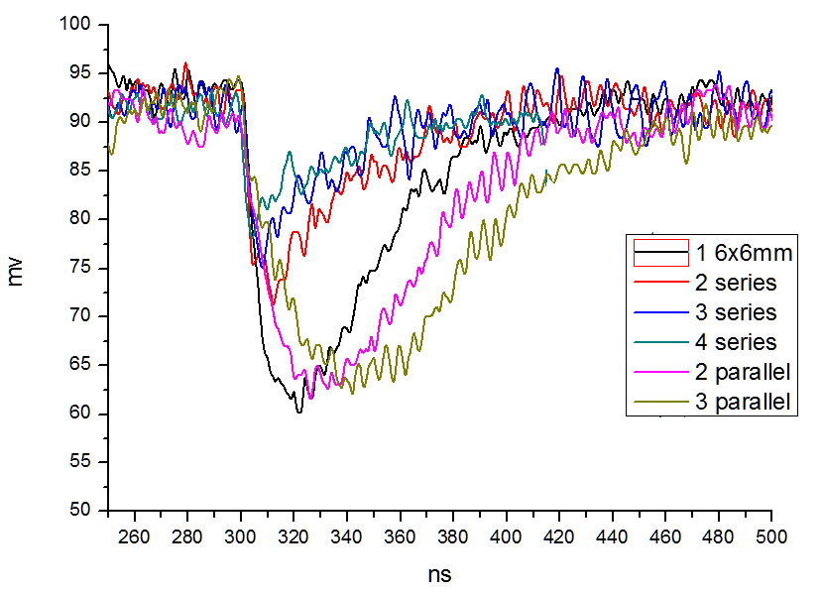

PreAmps design
Basic design considerations
Series for timing but larger charge attenuation
Parallel for charge but poor time performance
6 mm
1 p.e.
2 p.e.
3 p.e.
4 p.e.
50 mm
Design challenges(1 chip — 64 chips)
One SiPM chip size 6*6 mm
1 p.e. signal is very clear
SiPM array size 50*50 mm, 64 chips
Simple parallel can't do 1 p.e. readout
Solutions
Hybrid Series parallel 4p(2p2s), 1—16 chips
4 active ganging，to improve SNR, 16—64 chips
-50 ⁰C, to reduce signal stacking 100k-100Hz/mm²

Slide 7
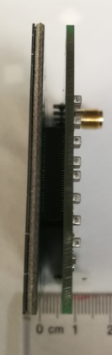
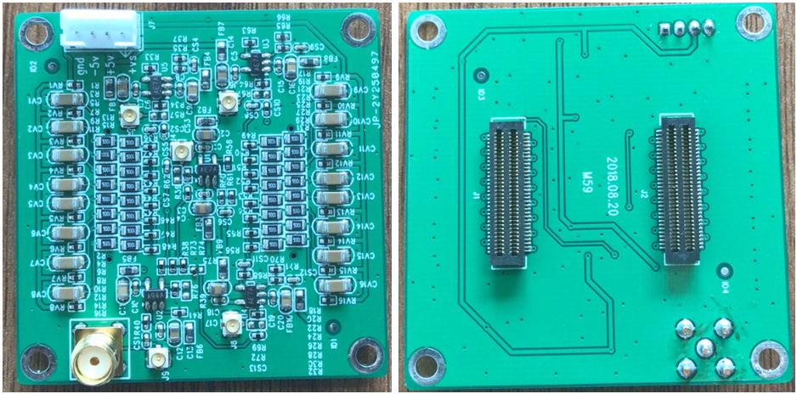
PreAmps boards
Basic consideration
convenience of installation and assembly
Compatibility with LAB, mechanical connection
SiPM and PreAmp are located on both sides of the copper shell, SiPM temperature uniformity
Position can be fine-tuned, array gap< 0.2 mm
The connector is also the SiPM array support rod
Screw
Connector
Connector
SiPM array
Cu shell
PreAmp
Support SiPM with connectors

Slide 8
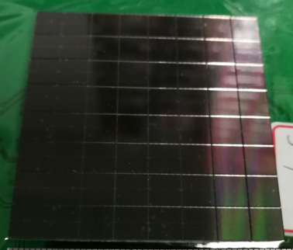
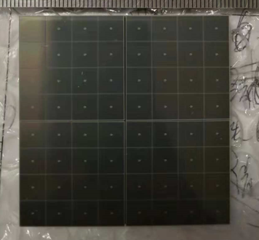
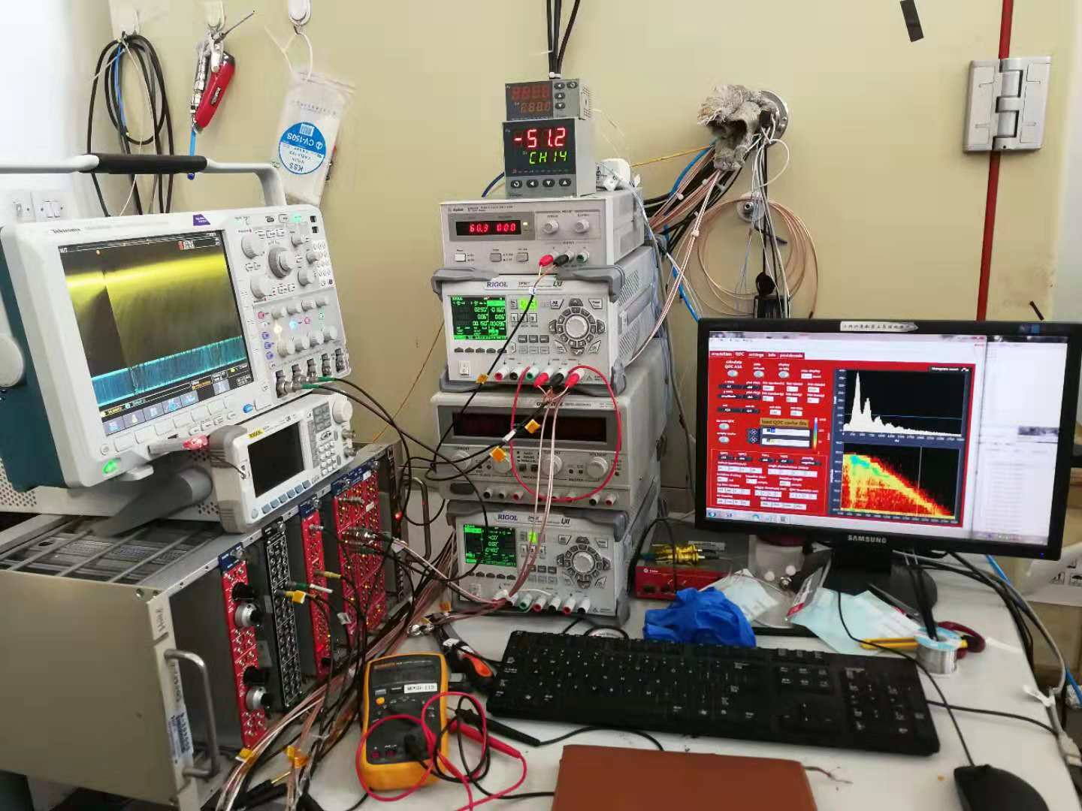
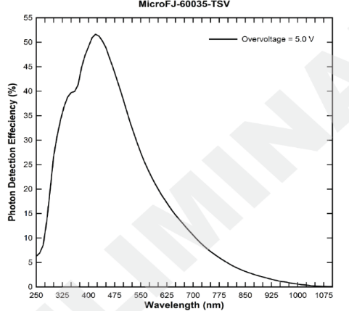
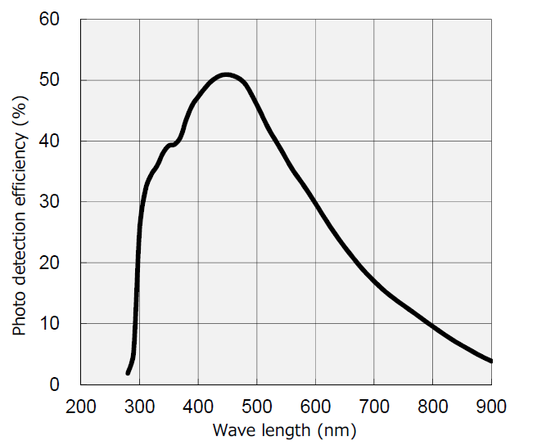
SiPM arrays and test setup
SiPM/MPPC Arrays from SensL and Hamamatsu were built out
Test setup
Cryogenic device -80—+80 ºC
FADC: DT5751 1GS/s 10bit
Cables: 2m
Temperature Sensor: pt100
power supply
NIM General Plugin
SensL
MicroFJ-60035-TSV
Hamamatsu
S14161-6050HS-04
5 cm
5 cm

Slide 9
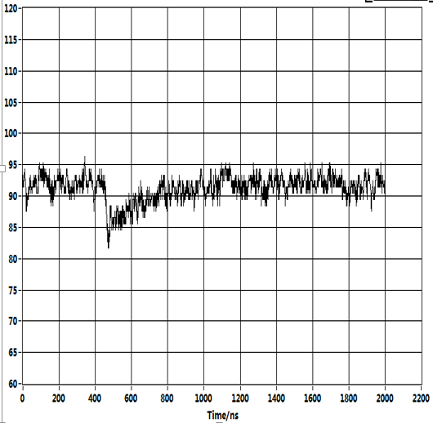
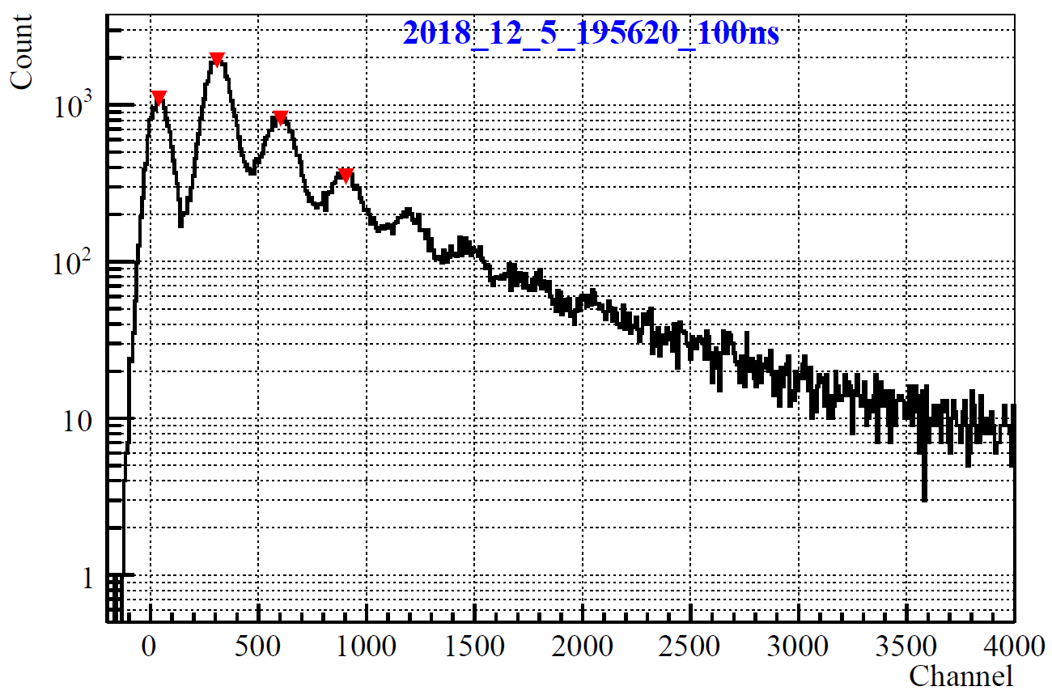
Trigger and Data processing method
1 p.e.
0 p.e.
2 p.e.
3 p.e.
4 p.e.
5 p.e.
Trigger Threshold
Integration window
Preliminary
-50 ºC SensL @5V overvoltage
1 p.e resolution: ~18%
SNR: peak (1 p.e.)/sigma(0 p.e.) ~7
PreAmp Power consumption: ~0.2 W
DCR: 130 Hz/mm²
Baseline calculation: sum(0-400)/400
Waveform integration: sum(A-baseline)
Threshold: 0.5 p.e. for DCR, 1.5 p.e. for CT

Slide 10
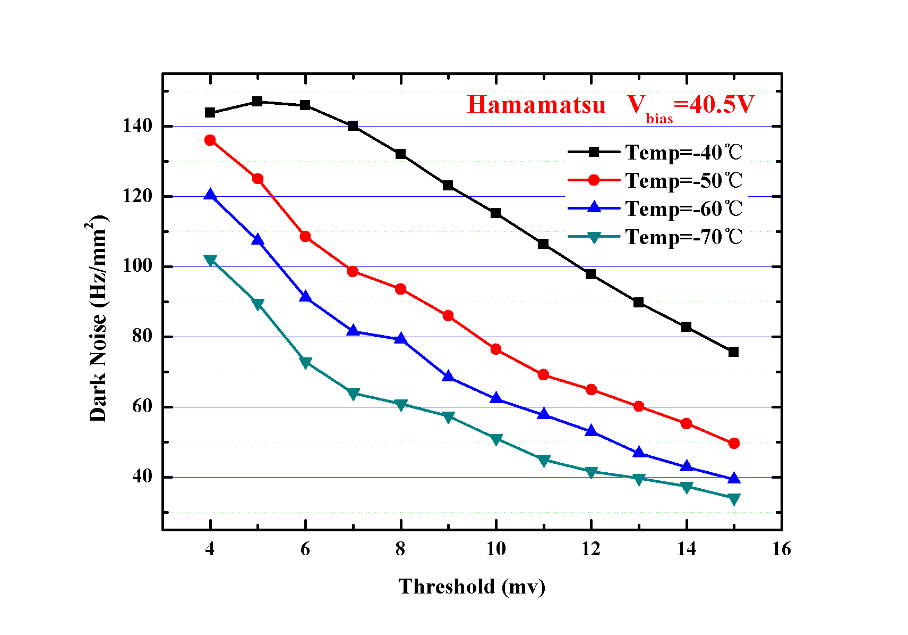
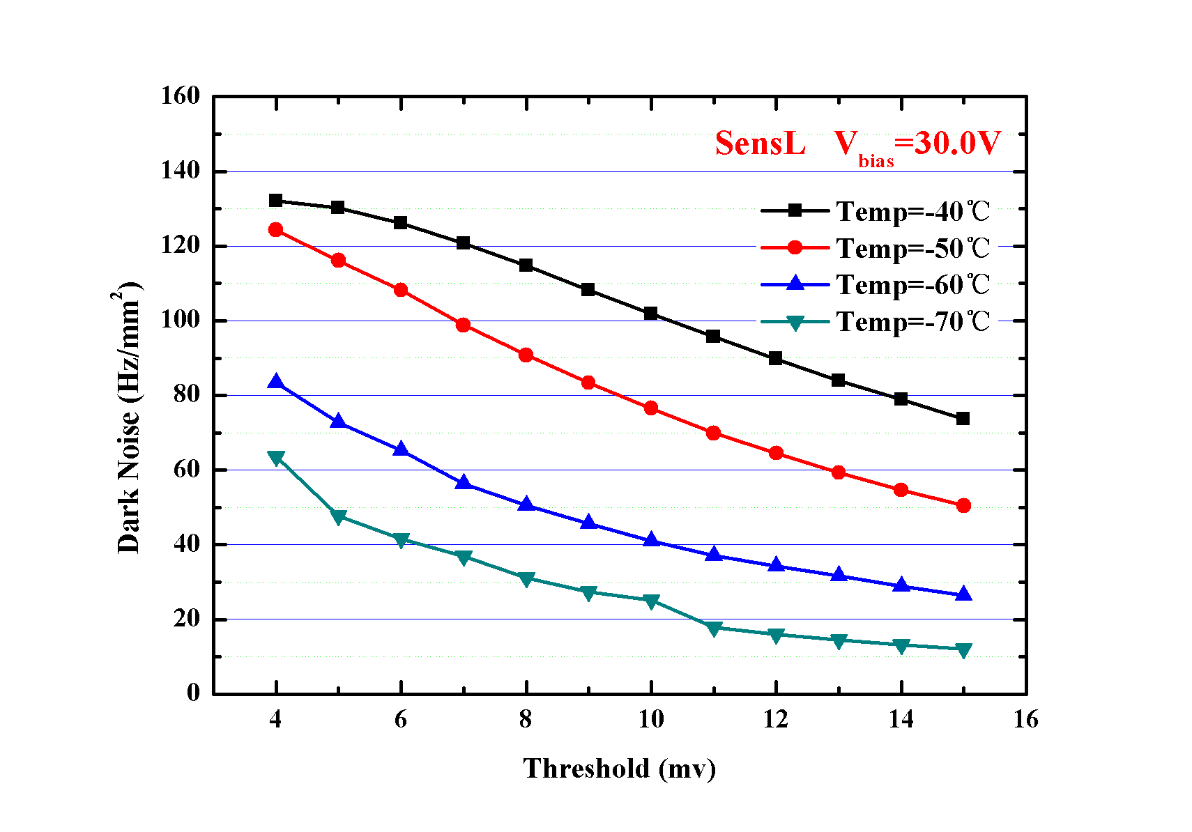
Dark noise
Preliminary
Preliminary

Slide 11
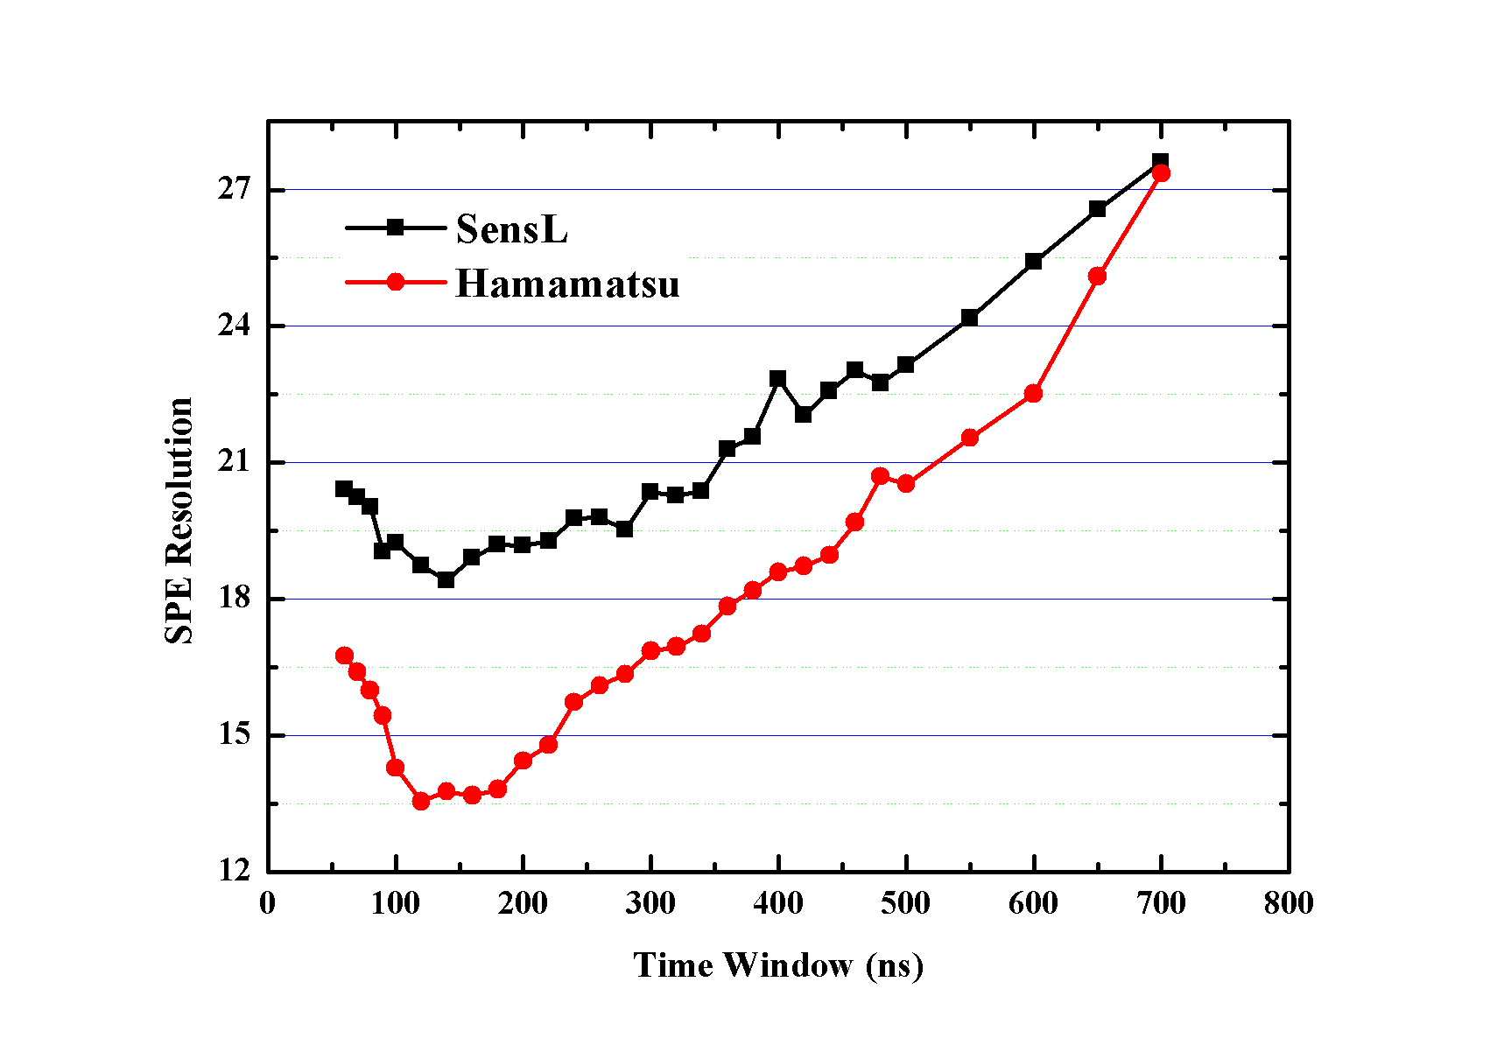
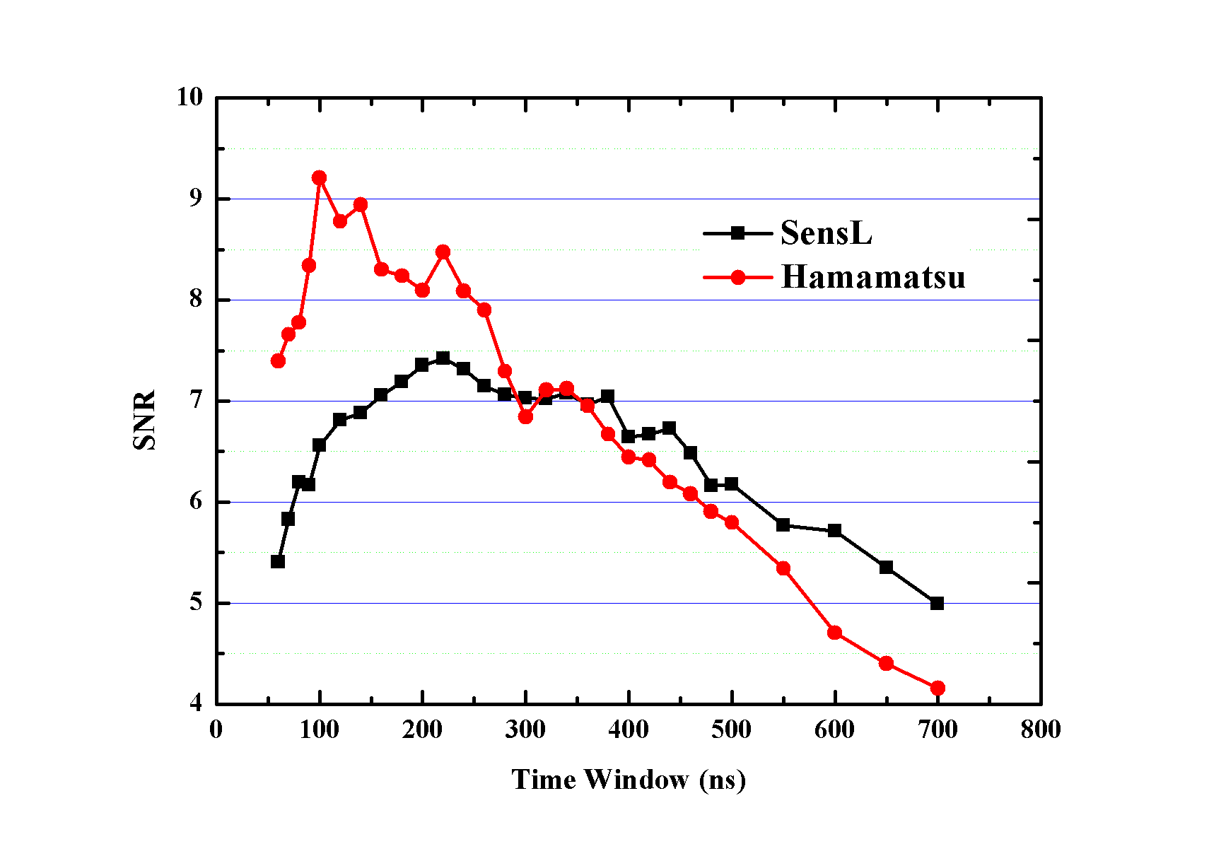
1 p.e. resolution and SNR
Preliminary
Preliminary

Slide 12
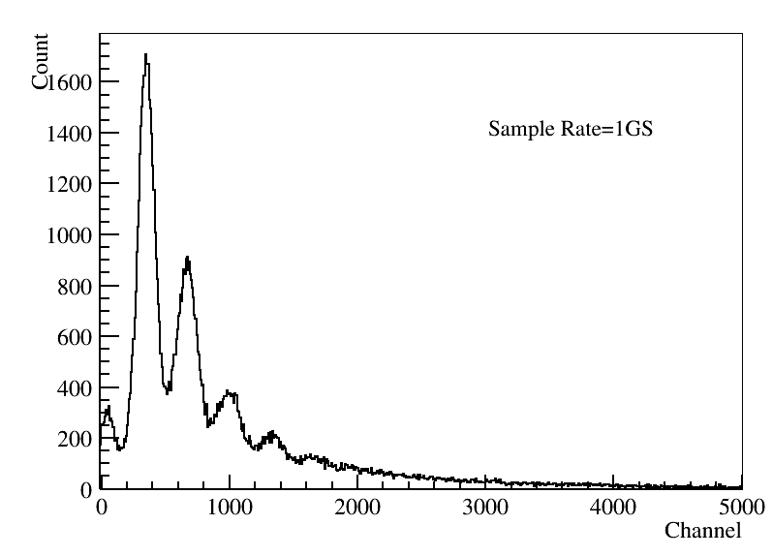
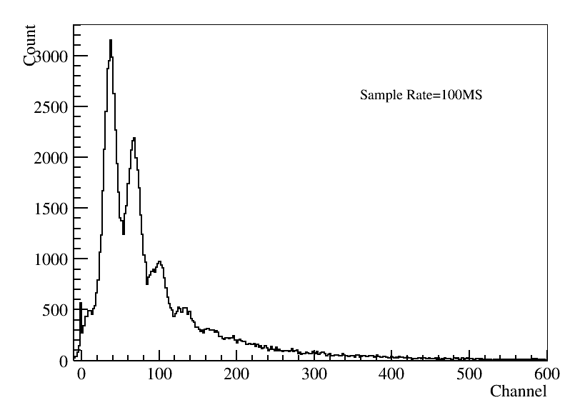
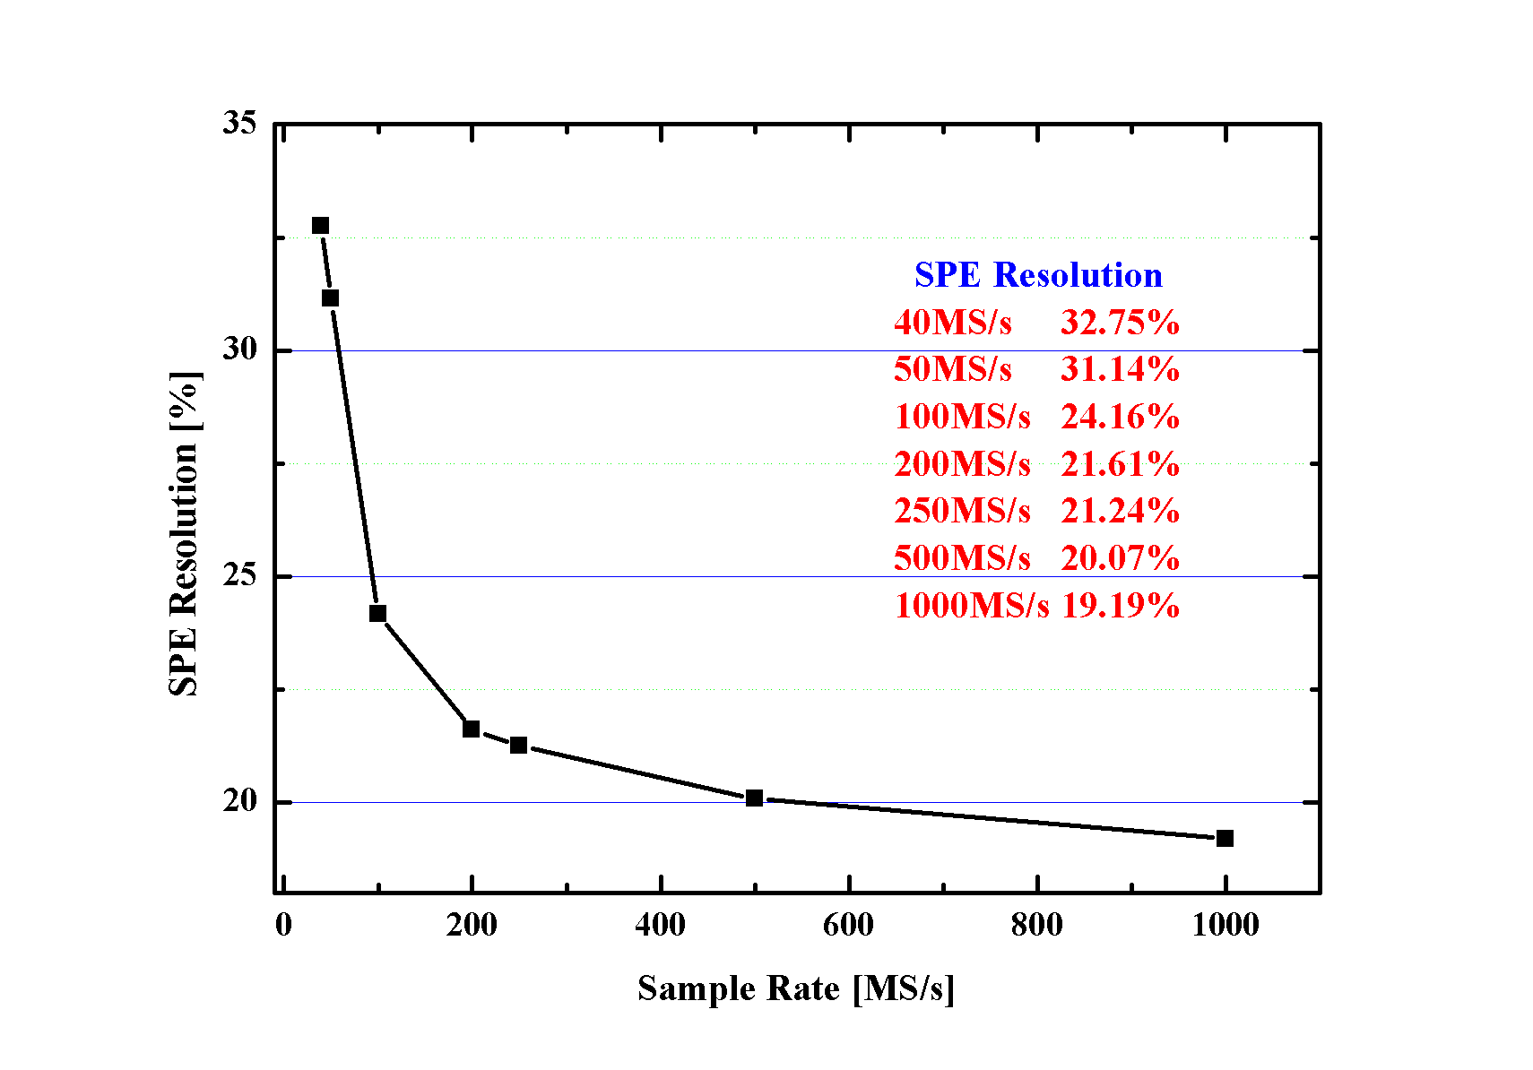
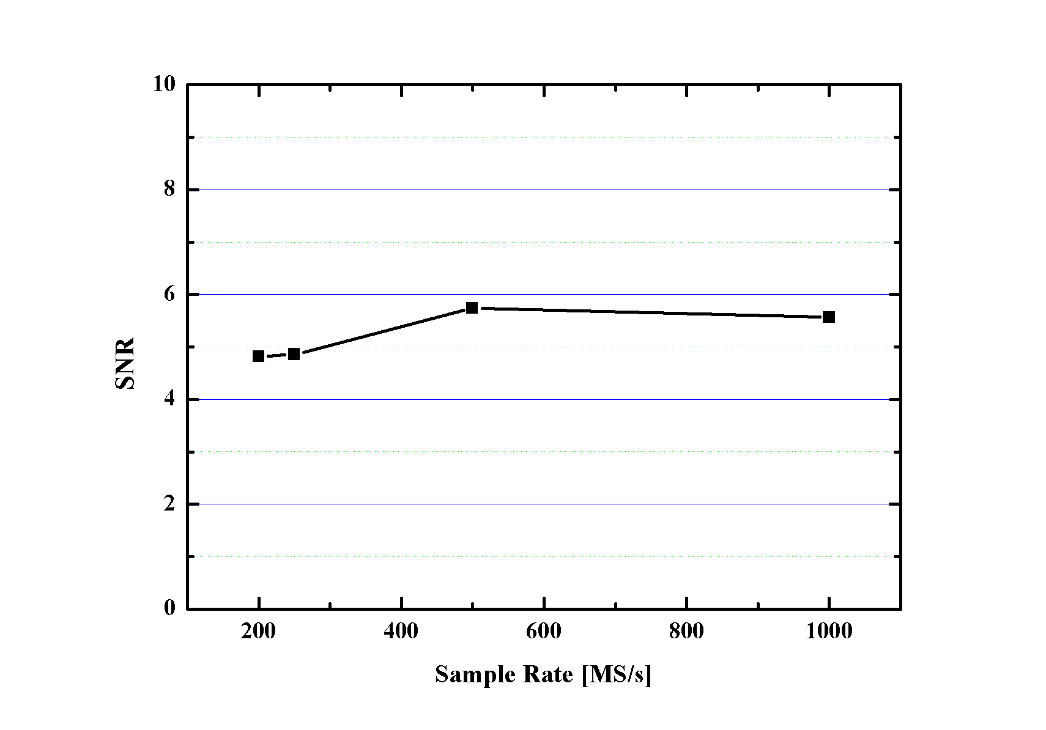
Sampling Rate VS Energy resolution
Use 1GS/s SensL data to get
low sample rate results
Contribution to energy resolution
1 GS/s, 19%/sqrt(4000)=0.3%，
100 MS/s, 24%/sqrt(4000)=0.38%
40MS/s, 32%/sqrt(4000)=0.51%
MPPC should have better performance
1 GS/s
100 MS/s
Preliminary
Preliminary

Slide 13
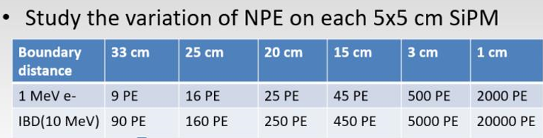
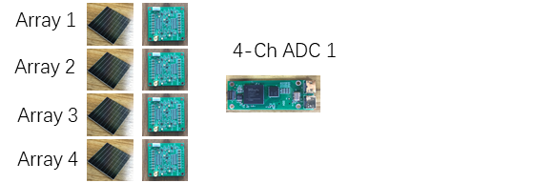
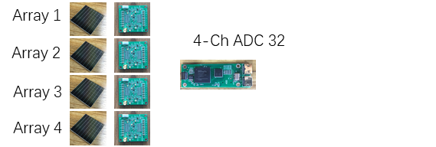
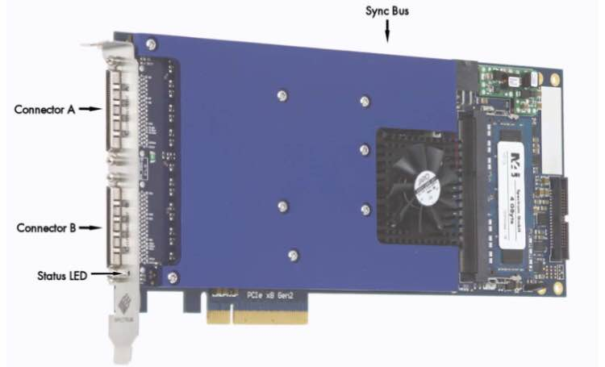
Data Acquisition scheme
High G
1-150 p.e
SiPM
ADC 100MS/s 12bit
FPGA 100Mbps
Charge&T
Low G
100-20000 p.e
PC Motherboard
Low-Level
Buffer Card 1
High-Level Buffer Card
GPU Card
……
PCIe slot
Local trigger
……
Low-Level
Buffer Card 32
Global trigger
Global clock
Power supply
32-Ch High speed LVDS
PCIe slot
22Gbps
SiPM array + PreAmp: 4000
4-Ch ADC boards: 1024
low-level data buffer boards: 32
high-level data buffer boards: 1
32-Ch LVDS capture card: 1
high performance graphics cards: 1
Dell workstation computers: 1
4096 ch
1 million
RMB

Slide 14
JUNO-TAO Summary
JUNO-TAO, using SiPM instead of PMT, goal 1.7%
The SiPM array + PreAmps has been designed and works well
Size 5x5 cm
Single photon sensitive
SensL/Hamamatsu arrays meet the requirements
1 p.e. resolution< 19
1 p.e SNR>7
DCR <140 Hz/mm²
Low temperature stability
Power 0.2 w
Data Acquisition scheme is preliminarily selected
High gain, low gain
100 MS/s FADC
Two level buffer and trigger scheme
LVDS DAQ card
General compatibility considerations
Consider the possibility of compatible LXe/LAr experiment

Slide 15
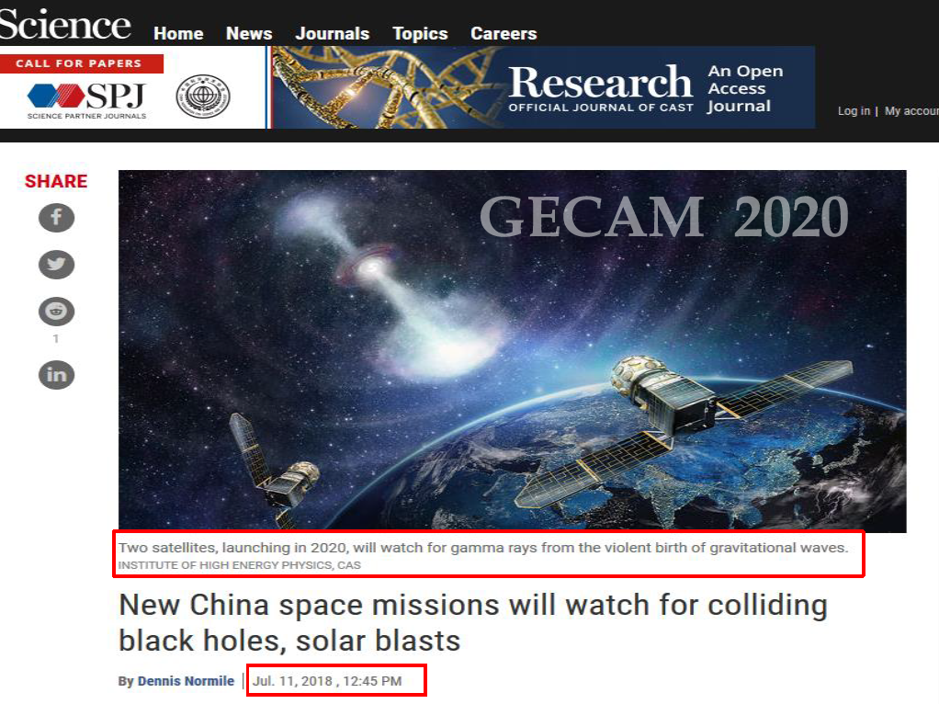

Slide 16
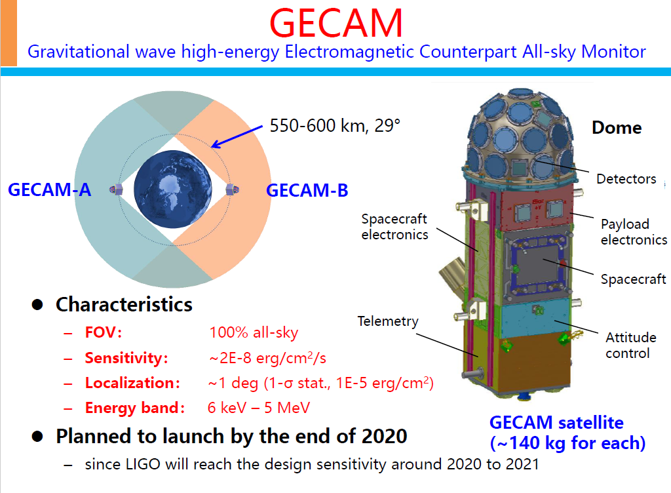

Slide 17

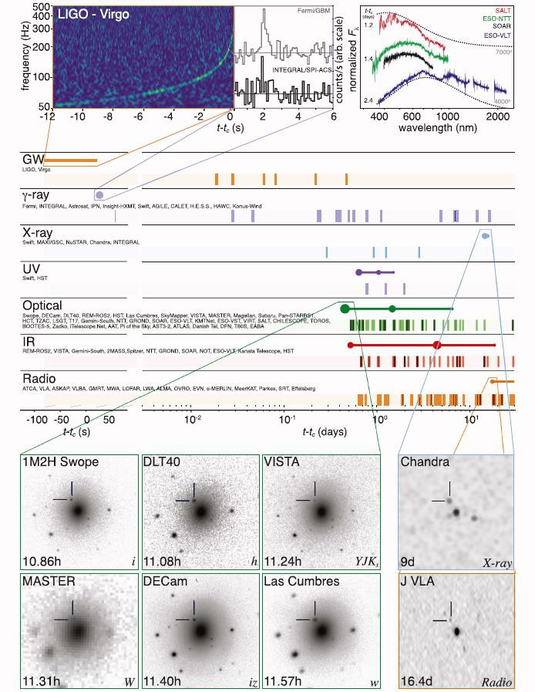

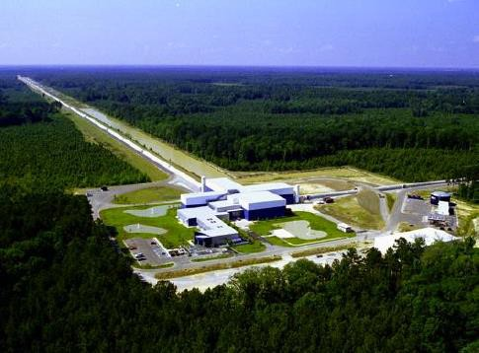

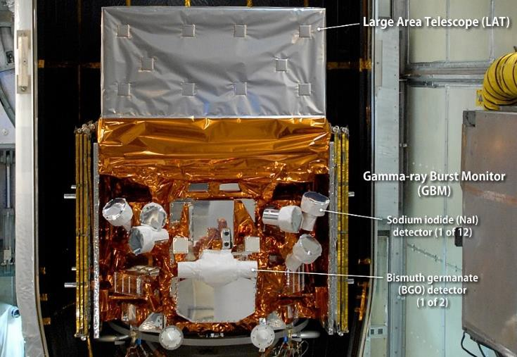

The new era of gravitational wave multi-messenger astronomy
4π
ears
is ready
LIGO
Need a new
4π eyes
GECAM
GW170817A
Fermi/GBM

Slide 18
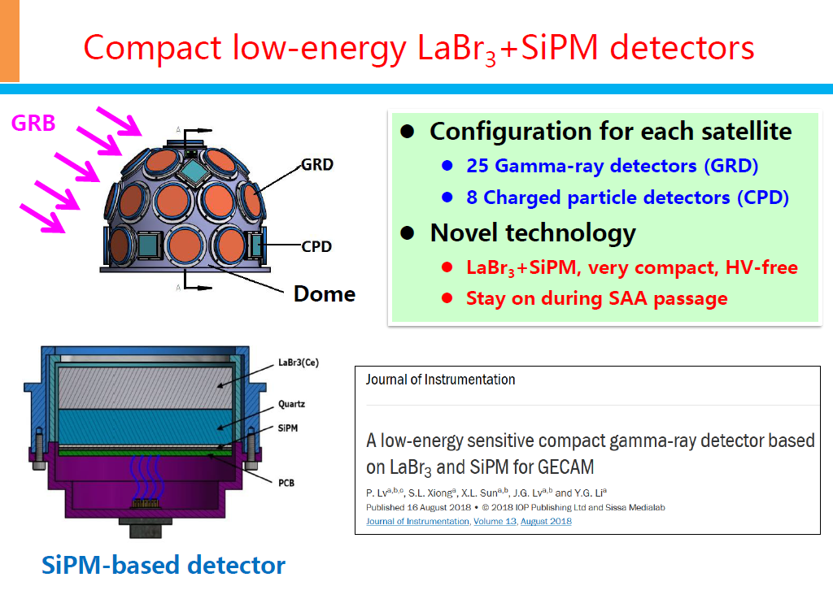

Slide 19
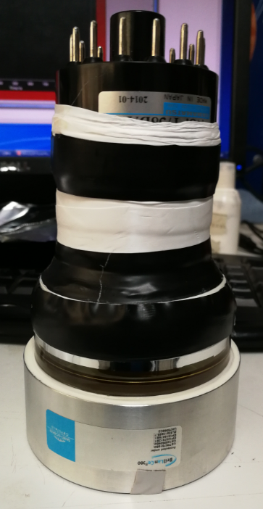

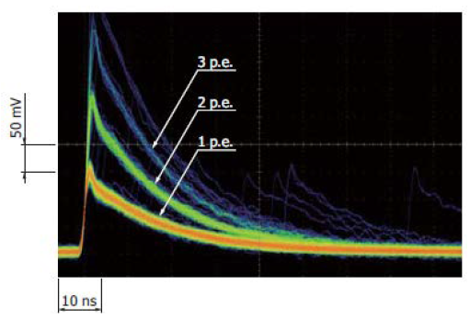
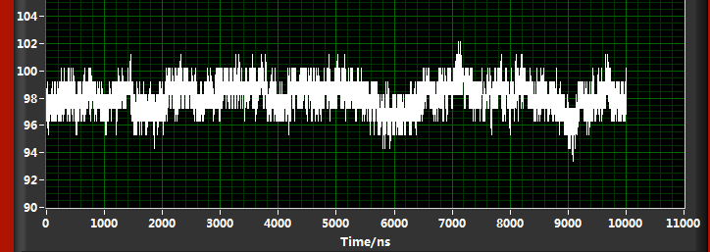
The detectors solution
PMT, has a large volume and a high operating voltage, which make it inappropriate for microsatellites.
SiPM, the performance has been greatly improved over the past decade
Compact size
Large dynamic range
Single-photon sensitivity
High photon detection efficiency
Insusceptibility to magnetic fields
low power supply and consumption
However, the high thermal-noise of SiPMs ~100 kHz/mm² is an obstacle to detect low-energy X-rays especially below 10 keV.
So the high light yield and fast decay time of the scintillator are the key factors to suppress the SiPM’s noise for low energy X-rays detection.
LaBr3
>60,000 photons/MeV, fast decay time (16 ns)
SiPM + LaBr₃ is the solution

Slide 20
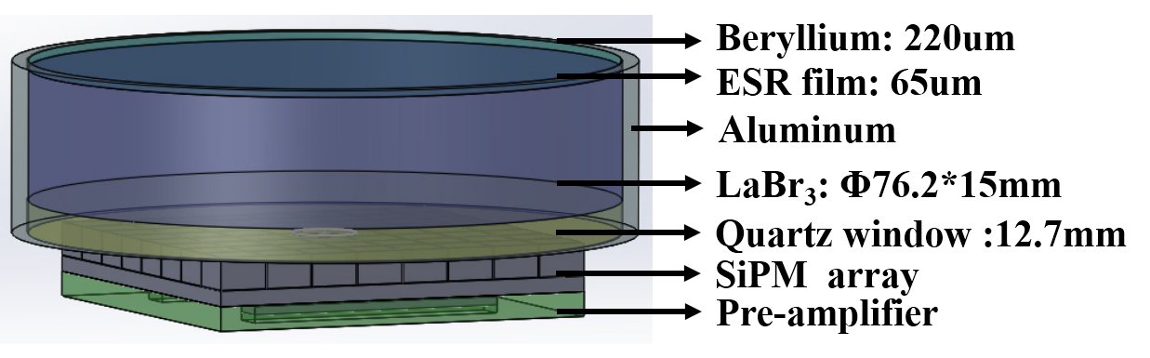
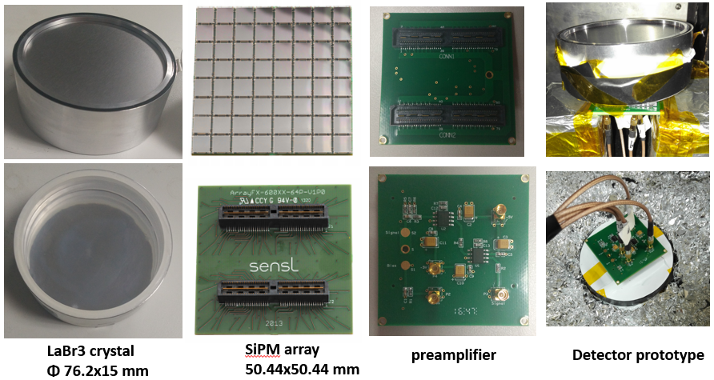
The detector structure
transmission ~80% for 5 keV X-rays
absorption efficiency >35% for 1MeV gamma

Slide 21
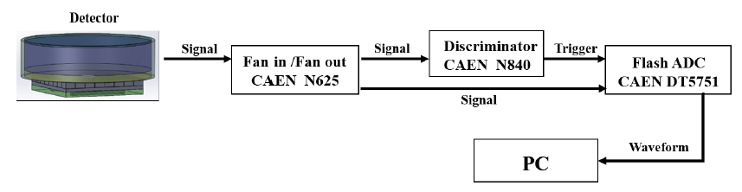
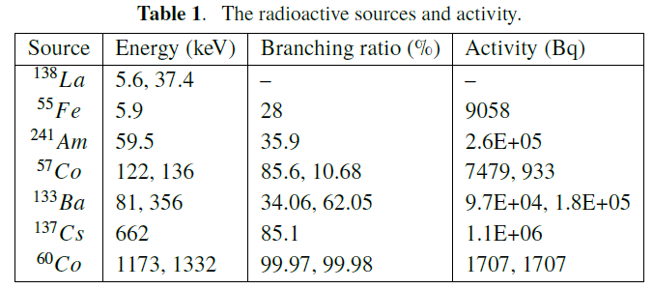
The test system

Slide 22
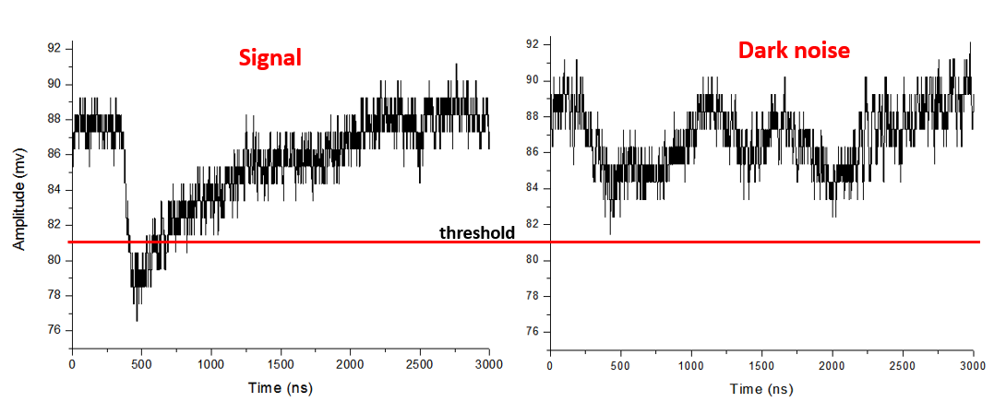
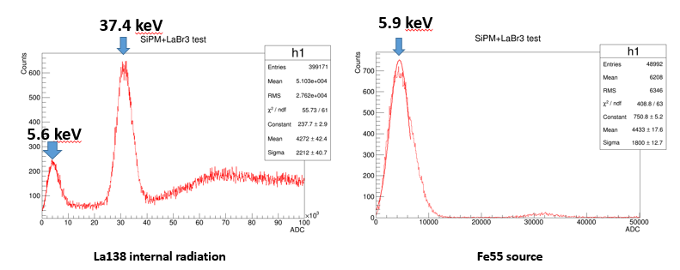
The low energy performance
The typical waveform of of 5.9 keV X-rays and the dark noise of SiPM at room temperature.
The spectra of Fe55 and inner radioactive sources.

Slide 23
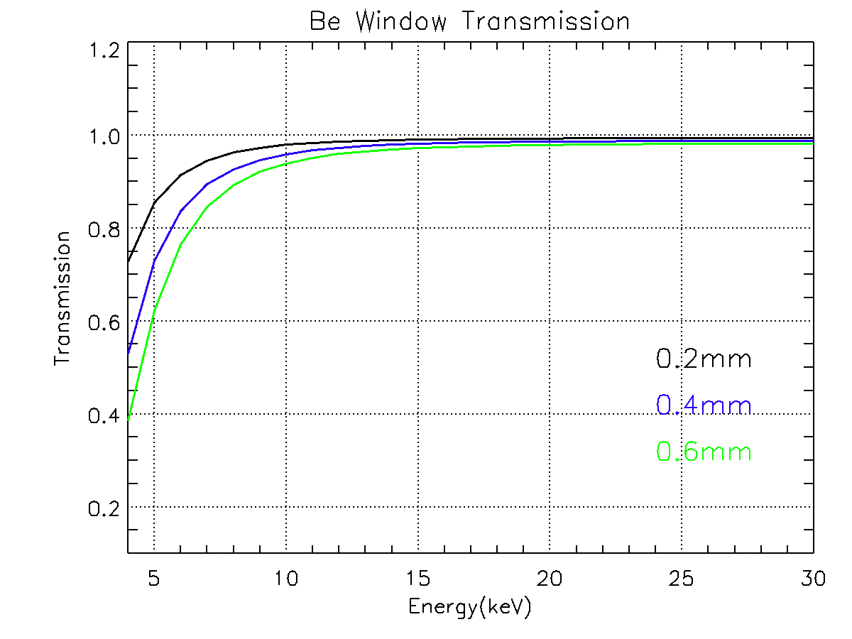
Detection Efficiency of 5.9 keV
Fe55 5.9 keV
4π 2536 Bq in 2017
Face to the Be window ~2π is 1268 Bq
Fe55 +background 1170 Hz，
Background 280 Hz，
Fe55 count rate is 1170-280=890 Hz
890/1268
Detection Efficiency >70%.
Consistent with the simulation

Slide 24
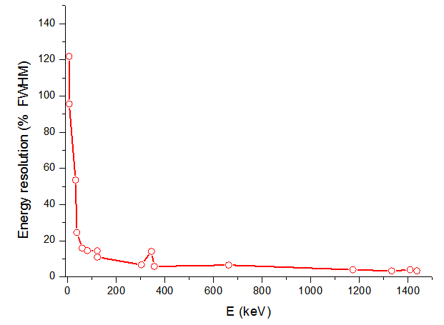
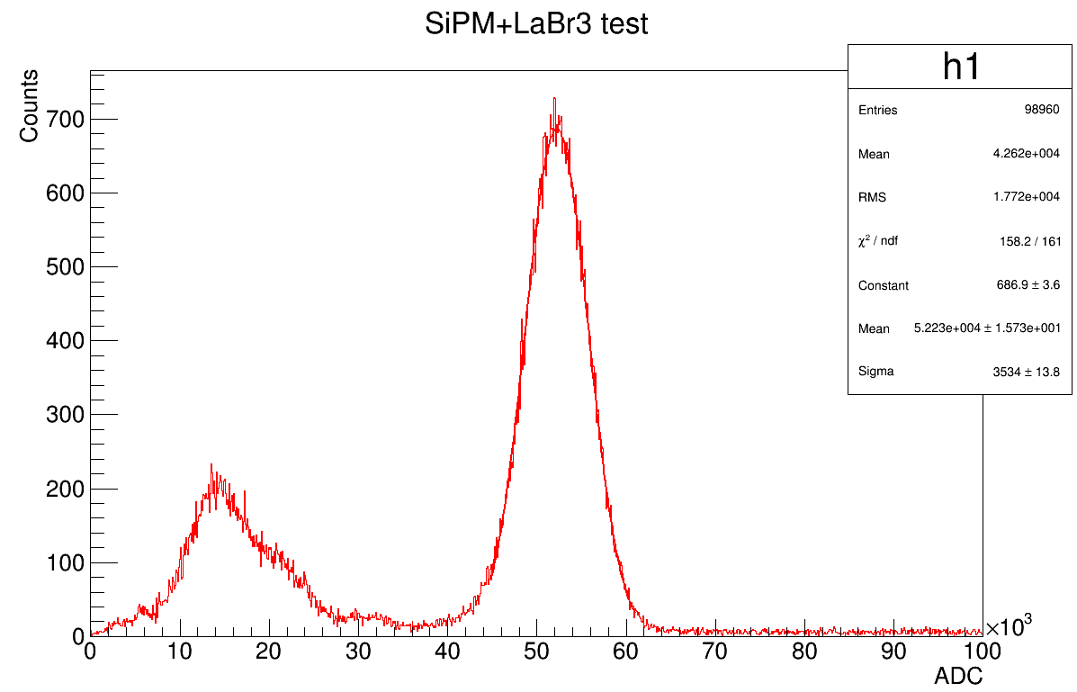
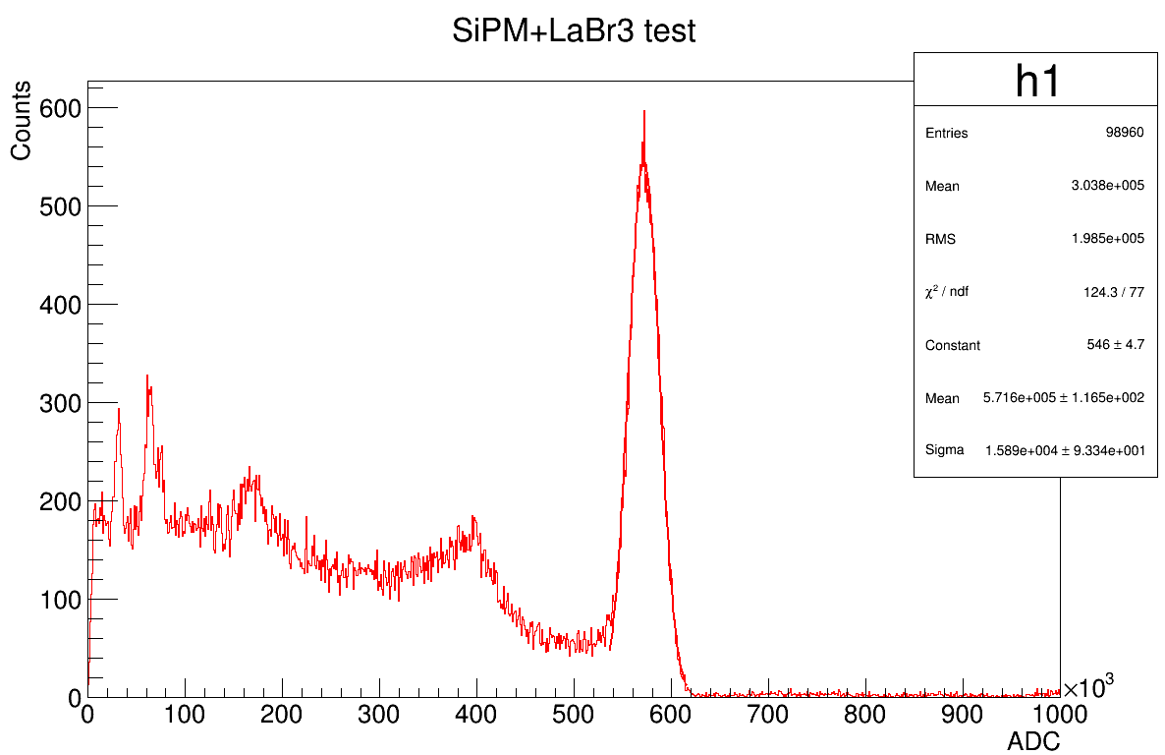
The energy resolution
95.6% @ 5.9 keV
FWHM 15.9% @ 59.5 keV
FWHM 6.5% @ 662 keV
Slightly worse energy resolution mainly affected by two factors compared to traditional PMT:
One is the dark noise of the SiPM, both cross talk and after pulse
Another is the uniformity of the light collection, the edge position lost more photons than the center position because the square SiPM cannot cover the round crystal window completely.

Slide 25
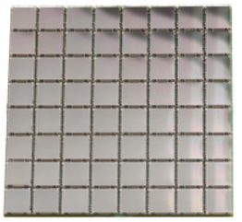


The Uniformity
50mm
light collection efficiency declines 5%-7% as the location moves from the center to the edge

Slide 26



The Linearity
5.6 - 662 keV
The maximum signal amplitudes that can be collected by DT5751 is only 1 V, next work is to design dual-gain circuit, high gain for low-energy rays and a low gain for high-energy rays.

Slide 27



The new round SiPM array
76mm
Excellent uniformity <1% from 7%
Energy resolution 4.1% from 6.5%

Slide 28








Internal radiation
the internal
La138, Ac227
~1 cps/cc
5.6 keV,
37.4 keV
1.4 MeV
peaks can be used to do the detector calibration in space

Slide 29
GECAM Summary
GECAM is proposed for the All-sky searches for the GRB from gravitational wave events.
launched in 2020, two microsatellites, 2-10 events/year
A low-energy sensitive compact gamma-ray detector has been developed for GECAM and works well
Based on LaBr3 and SiPM
Low energy x-ray to ~6 keV
Energy resolution 4%@662keV
Efficiency of 5.9 keV >70%
Uniformity <1%
Internal radiation for calibration

Slide 30
总结和展望
SiPM技术进步迅速，在越来越多的方向正在采用。
热噪声问题是限制SiPM大面积应用的主要因素，决定因素是信噪比
SiPM本质上是数字器件，但目前SiPM大多还是模拟读出，前端数字化是SiPM技术发展方向
希望重点实验室支持SiPM的大面积应用研究

