Slide 1
Progress of GEM R&D in Lanzhou Univerity
Yi Zhang

Slide 2
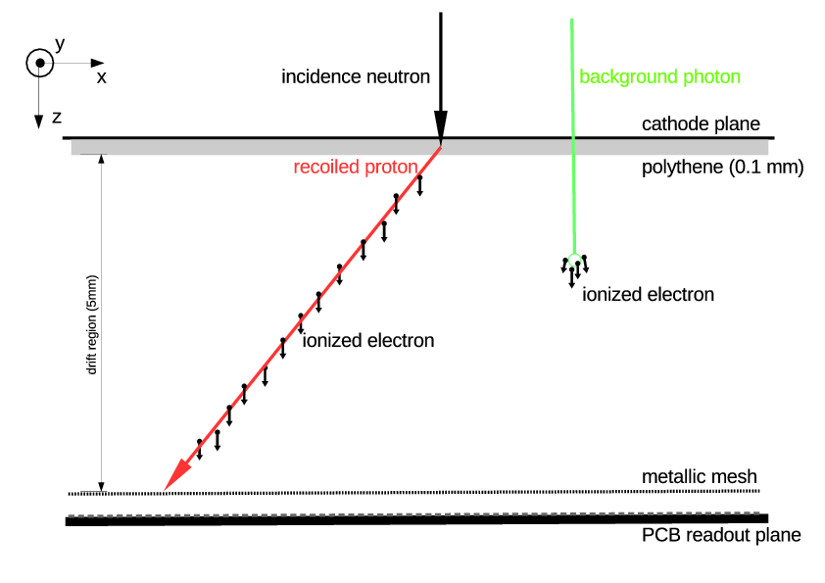
Application I: fast neutron imagining

Slide 3
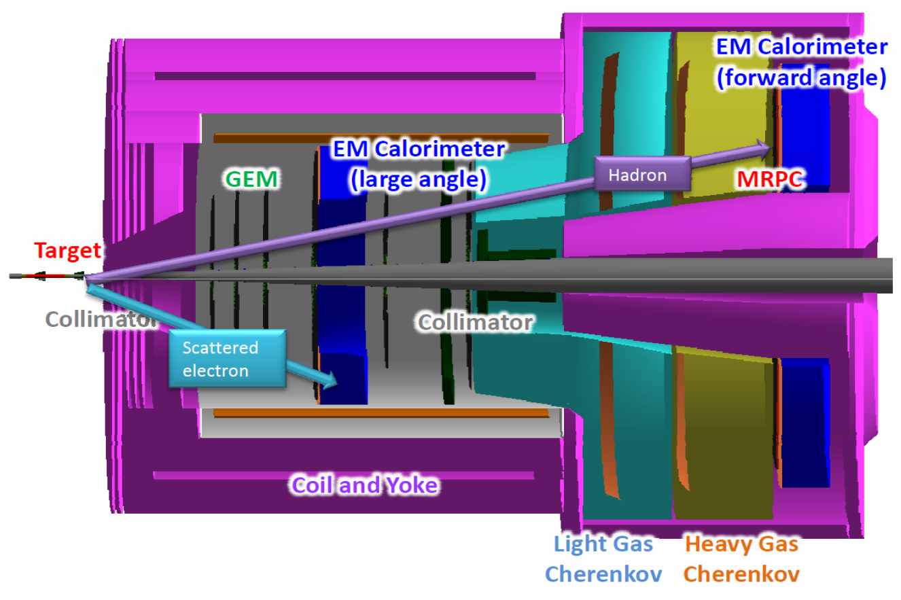
Application II：SoLID @ JLab

Slide 4
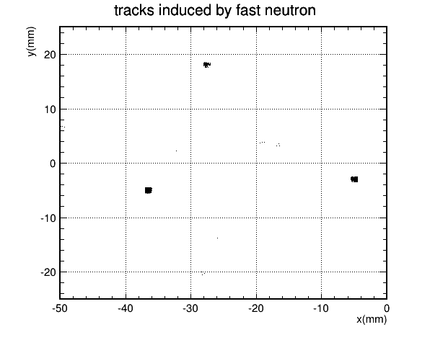
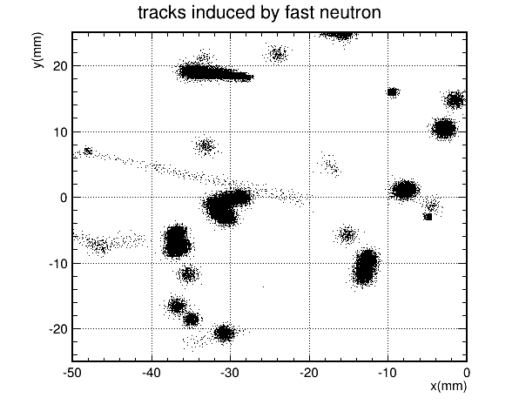
Avalanche electrons collected on by detector (simulation)

Slide 5
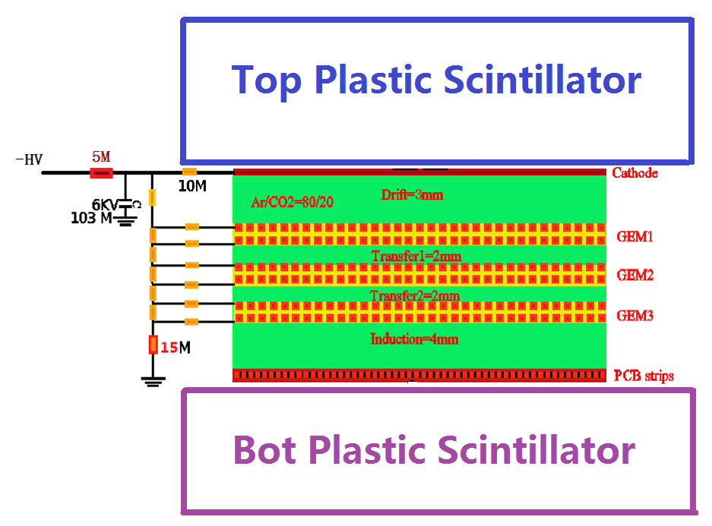
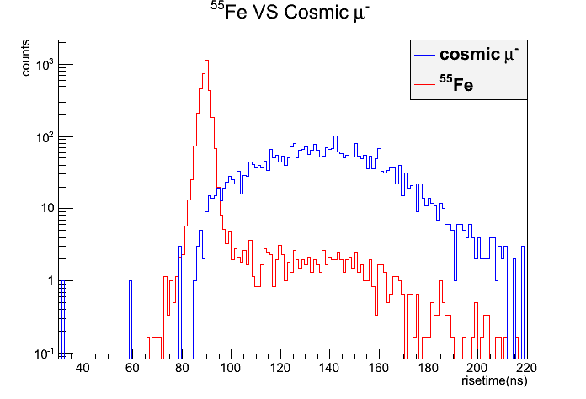
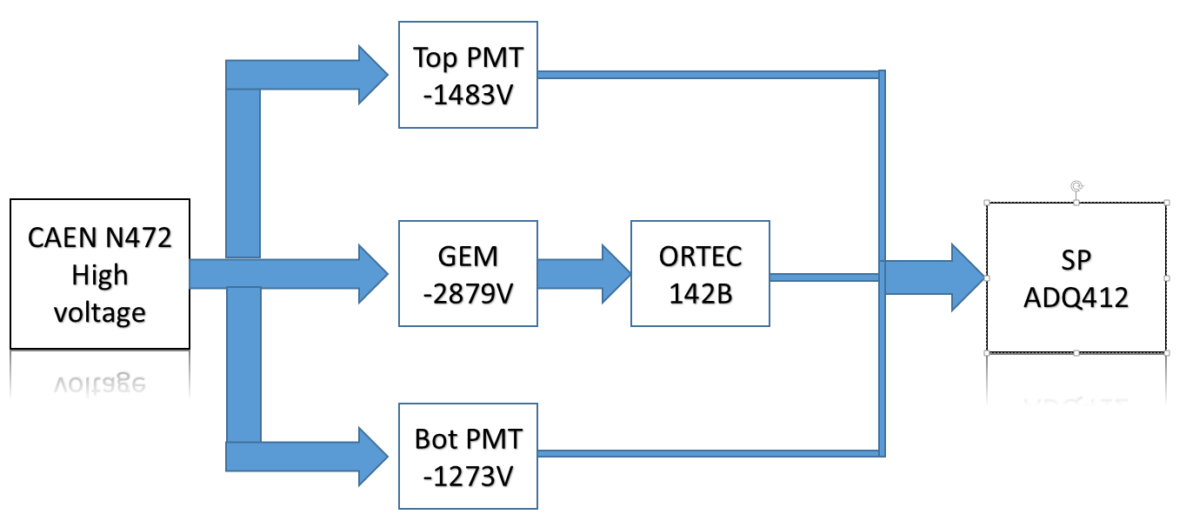
Background: Track identification by signal timing
Mean=89.4ns
σ= 1.744
Mean=135.7ns
σ= 22.8
SP-ADQ412: 1.8GHz

Slide 6
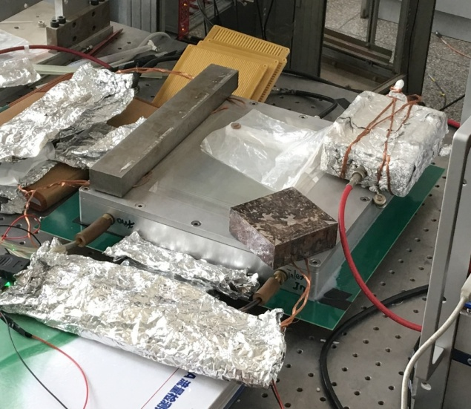
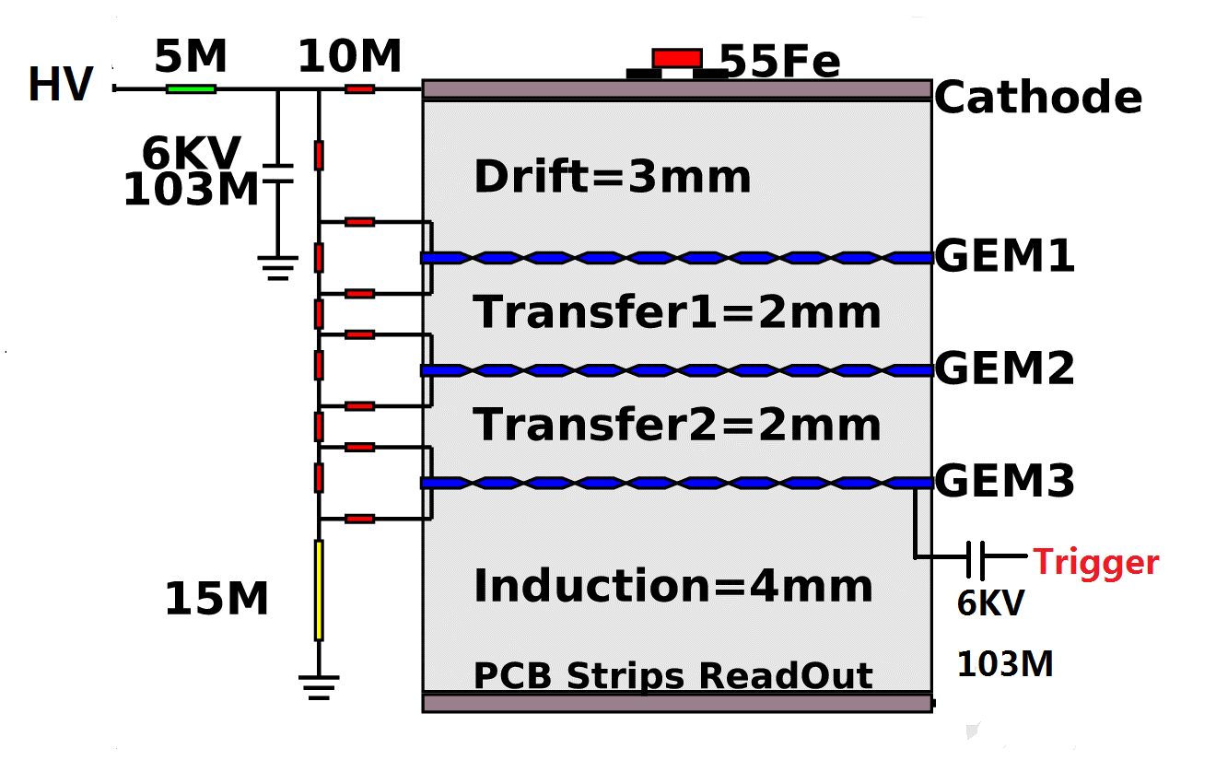
Triple-layer GEM detector

Slide 7
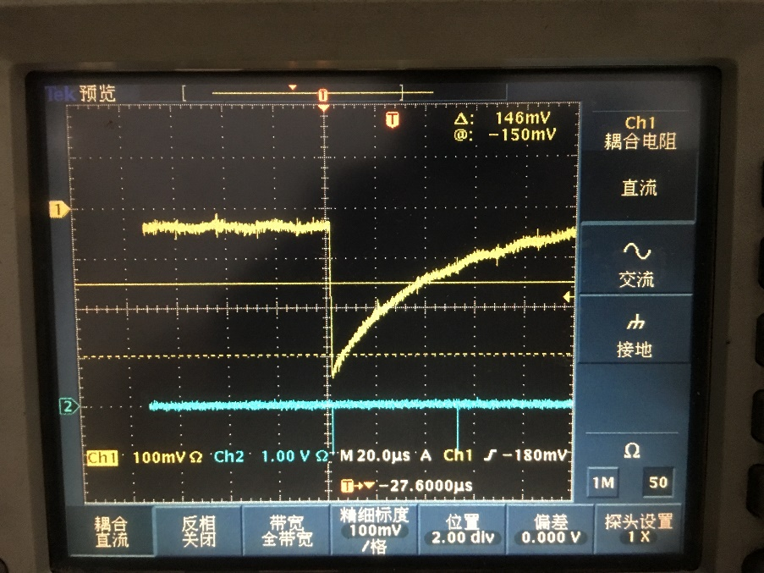
High voltage and trigger
HV
drift electrode
MPD+V1218
5M
10M
6KV
103M
10M
CF8000 discriminator
}GEM I
}GEM II
}GEM III
6KV
103M
15M
Trigger

Slide 8
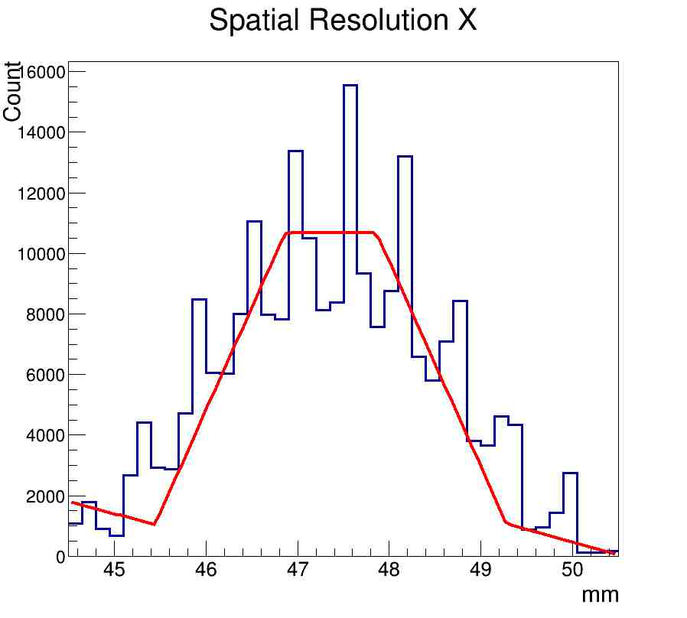
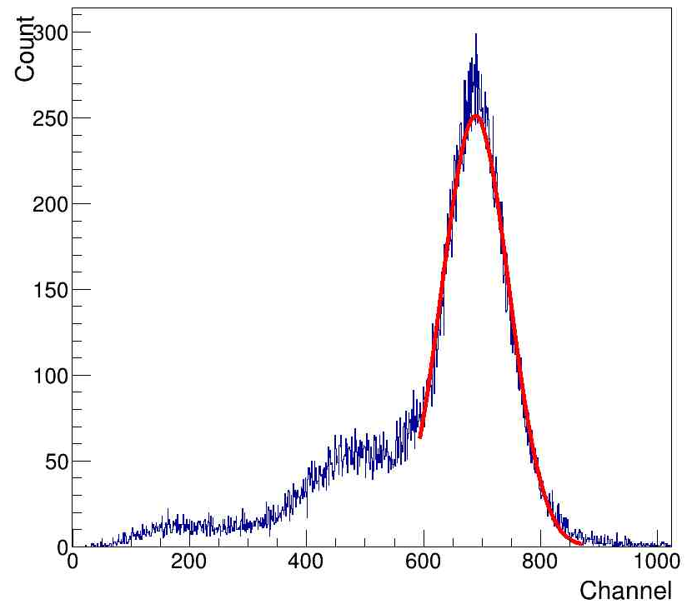
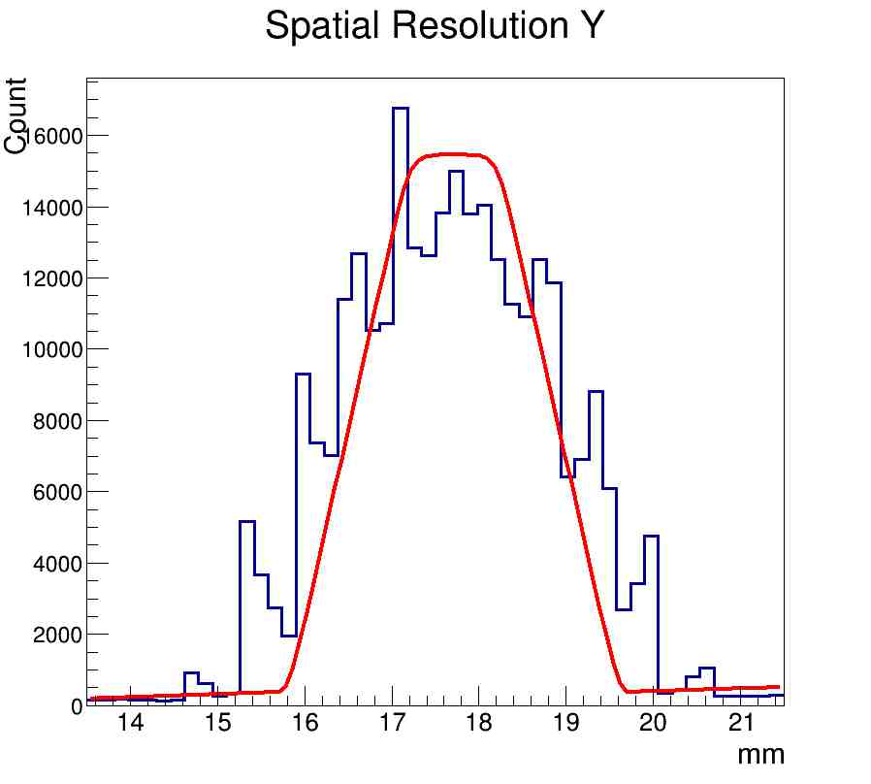
Test result of new detector (⁵⁵Fe)
σ~127um
σ_{E}~19.5%
σ~127um

Slide 9
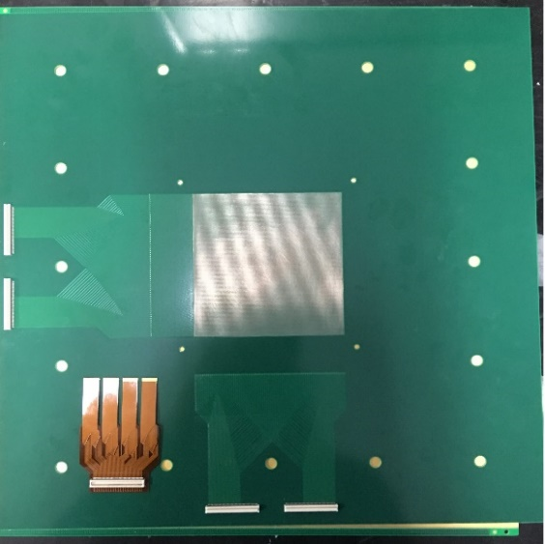
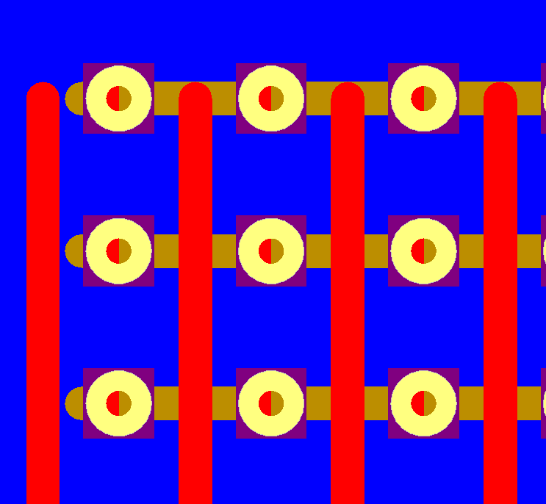
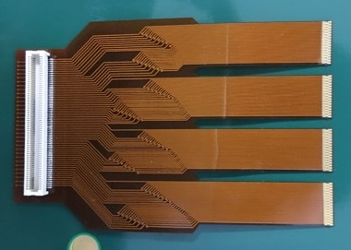
Design of 2D readout panel
top pad width：130um
bottom pad width：280um
pitch：600um
To APV25
10cm×10cm area
both X- and Y-axis have 167 electrodes
Panasonic130P
total readout area on two dimensions are identical, to get same amount of charge

Slide 10
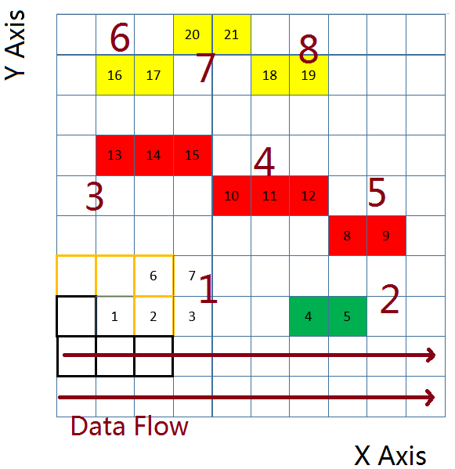
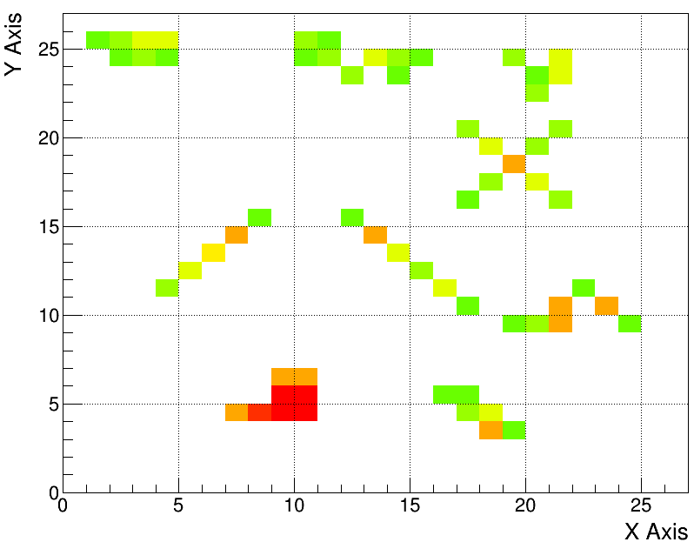
Forming hit clusters in 1 time slice
fake data test (27×27 chns)

Slide 11
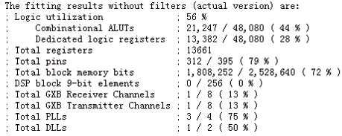
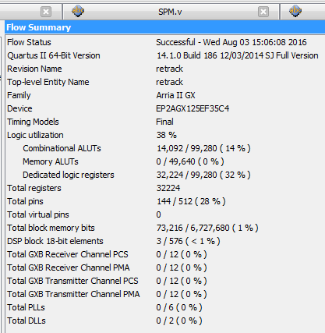
Resources consumption budget (2048 chs)
reports of our code:
from INFN :
Iterms of resources | Total | Usage of current daq | Usage of out code
Combinational ALUTs | 48,080 | 21,247 (44%) | 14,092 (29%)
Dedicated registers | 48,080 | 13,382 (28%) | 32,224 (67%)
DSP | 256 | 0 | 3(1%)
Block Memory Bits | 2,528,640 | 1,808,252 (72%) | 73,216 (3%)

Slide 12
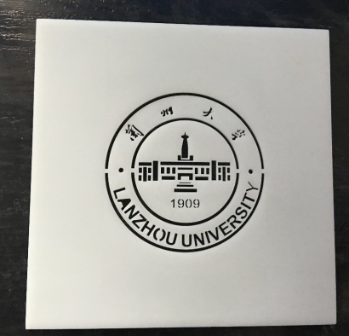
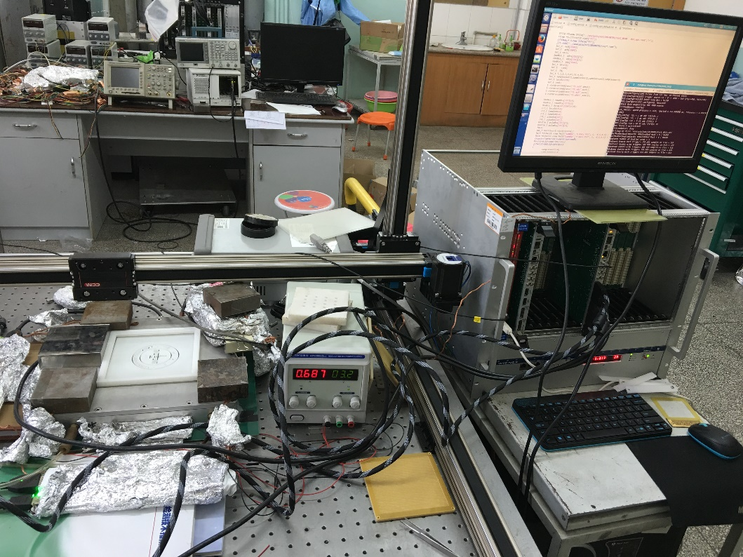
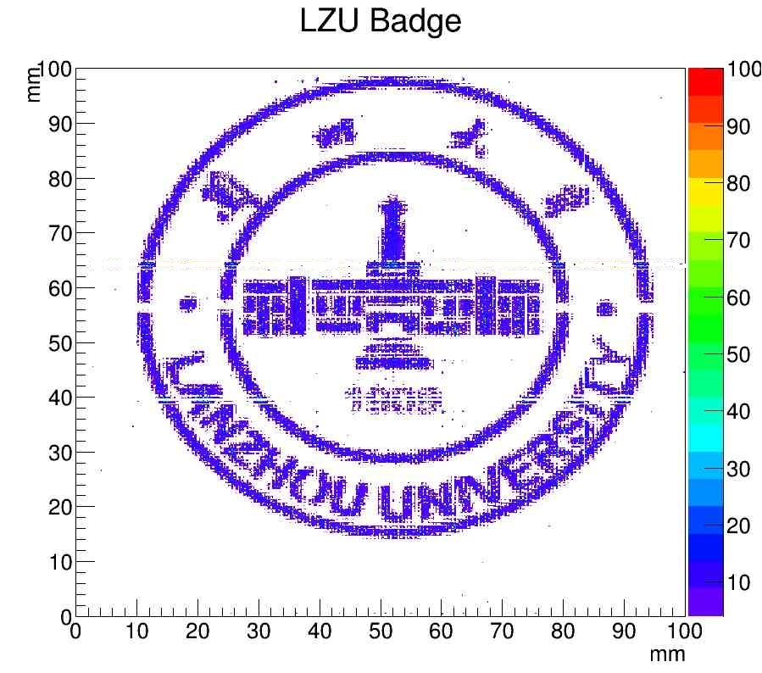
x-ray imaging by new detector and Daq
10 cm
detector & daq system

Slide 13
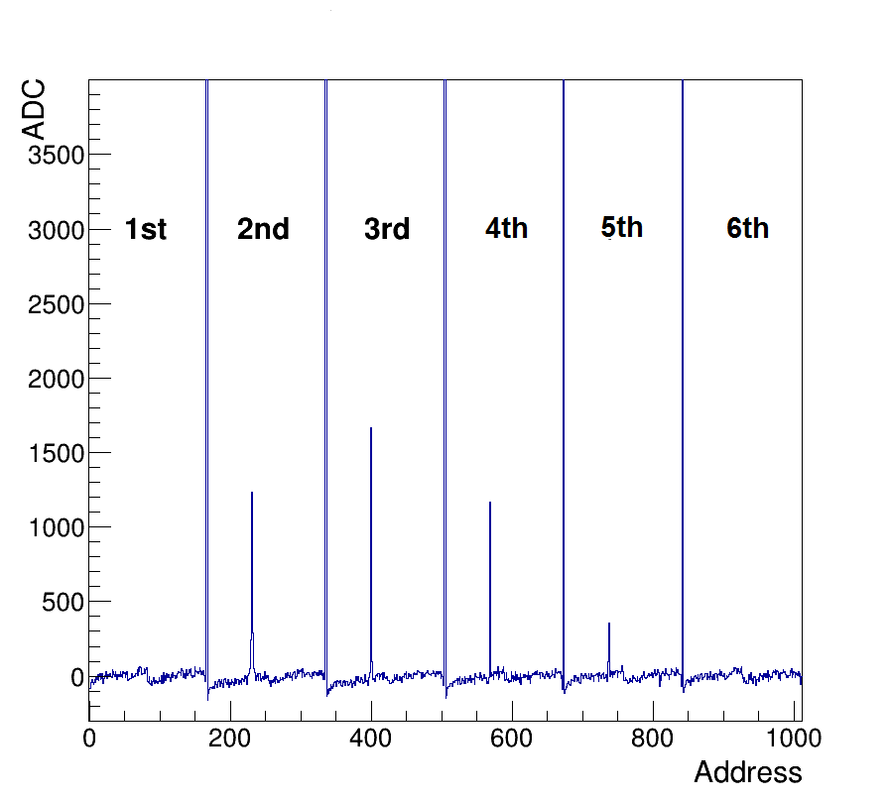
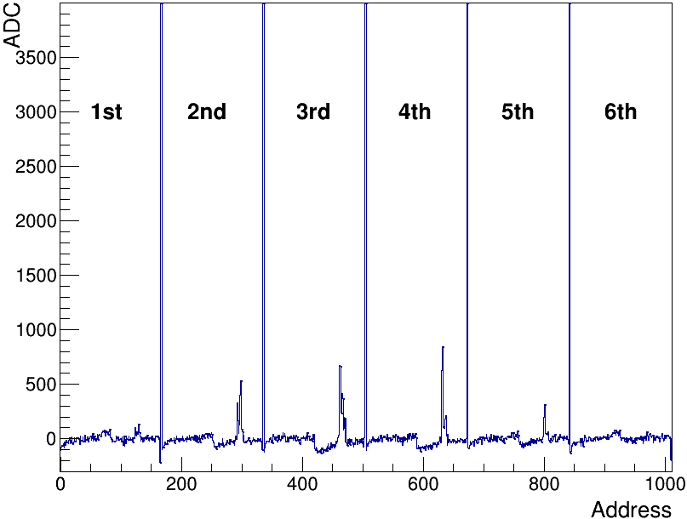
Real signals recorded in Daq
⁵⁵Fe
cosmic μ⁻

Slide 14
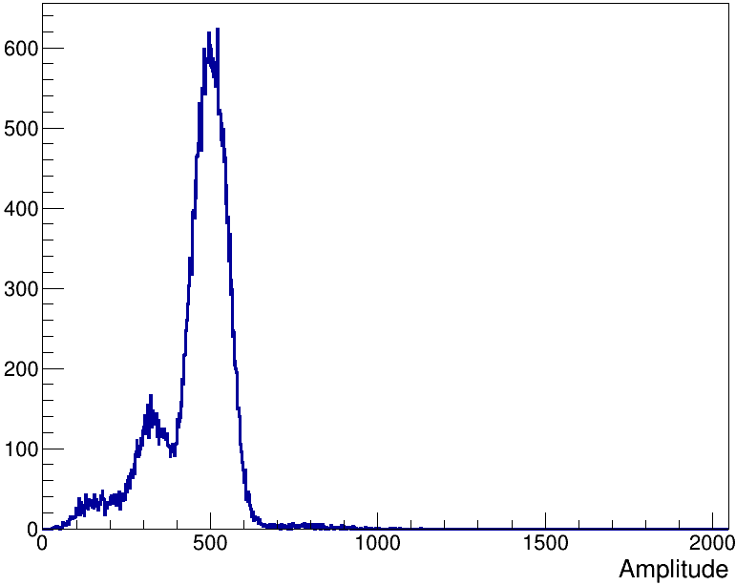
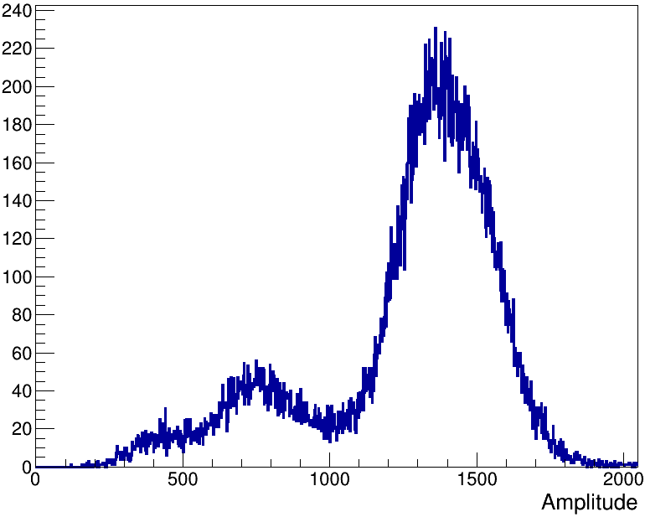
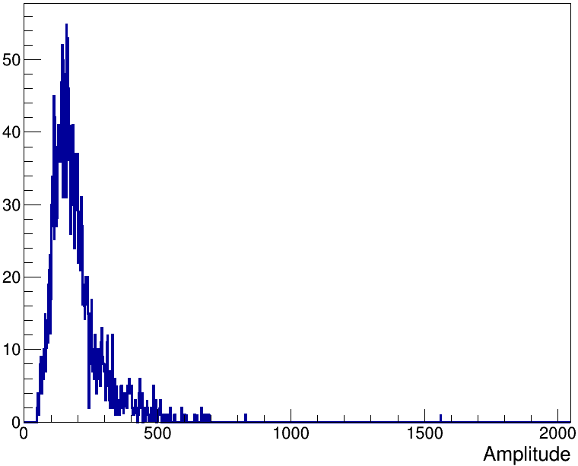
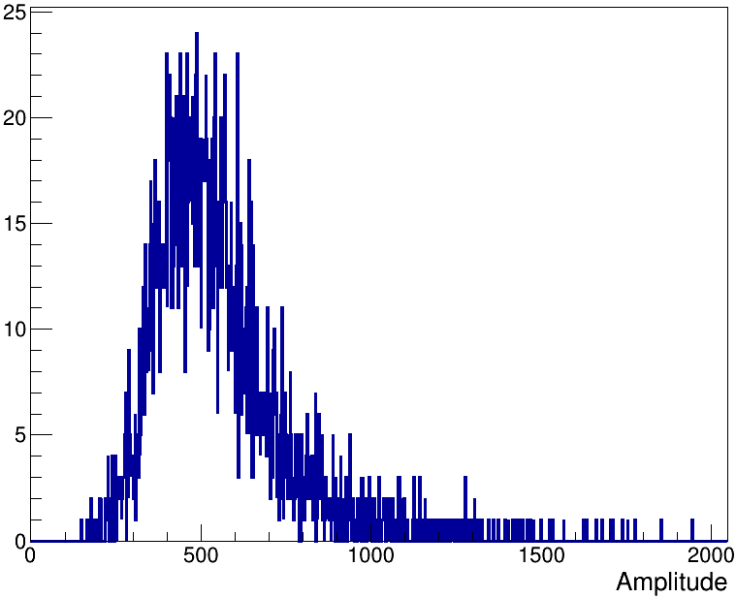
comparing signal amplitudes of different particle
x-ray in
mutil period
x-ray in 1 period
muon in
mutil period
muon in 1 period

Slide 15
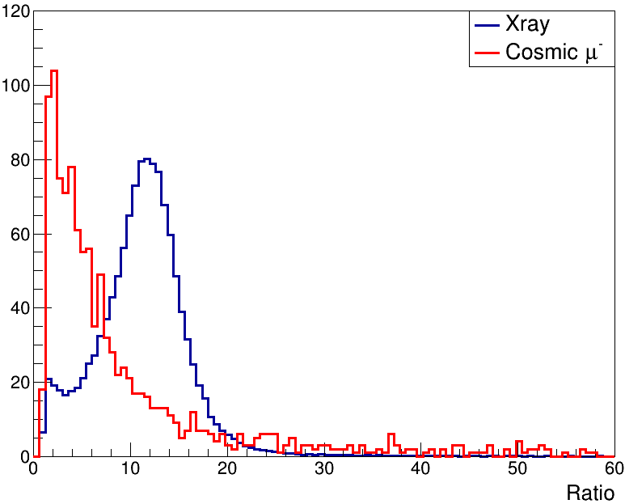
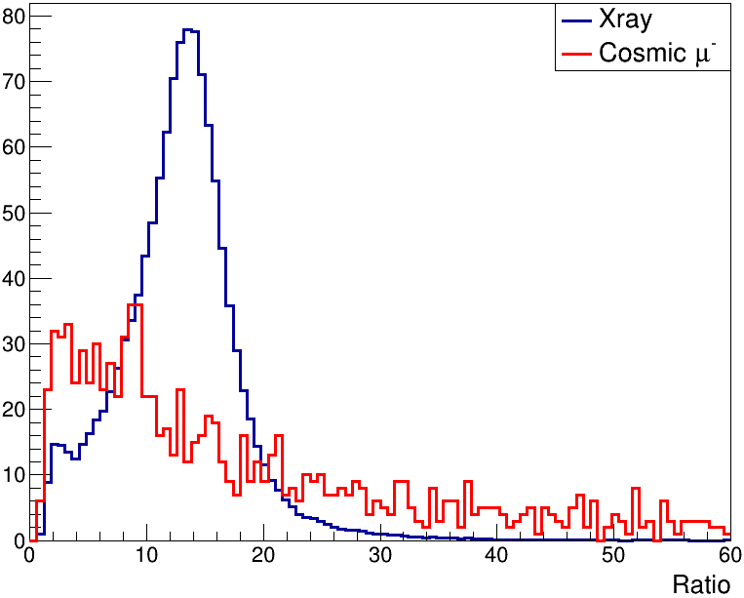
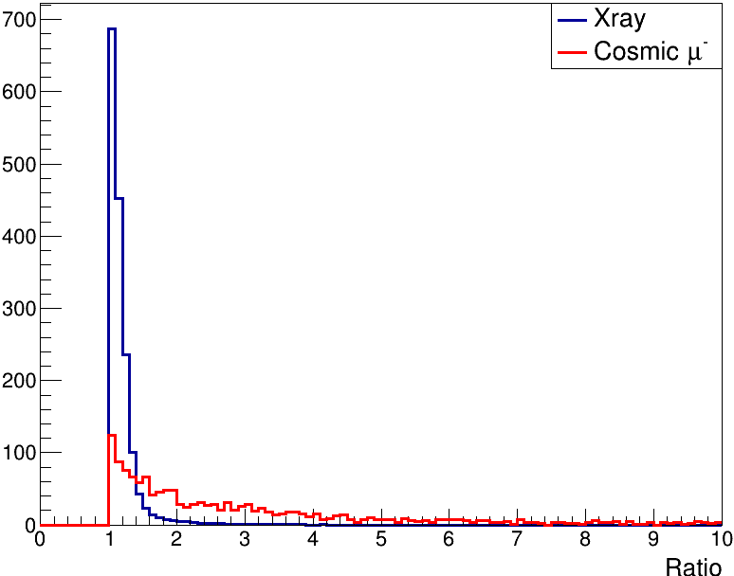
Try to identify signals of different particle (data)
period2/period1
period3/period1
period3/period2

Slide 16
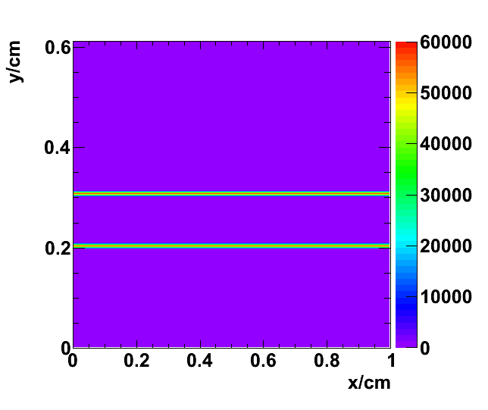
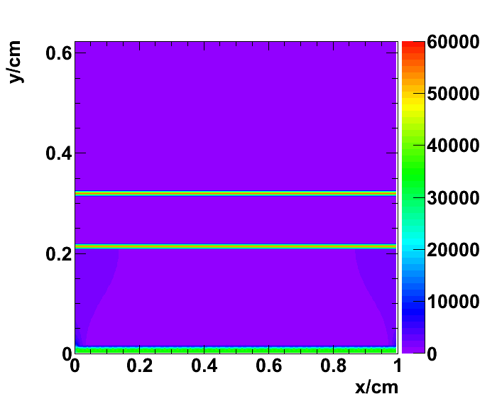
Garfield++ simulation of the double GEM + Mesh
Garfield++ simulation of the double GEM (reference)
E_{drift}=1kV/cm
E_{Gem}=58.33kV/cm
gain=9032
E_{drift}=1kV/cm
E_{Gem}=58.33kV/cm
E_{amp}=40kV/cm
gain=68930

Slide 17
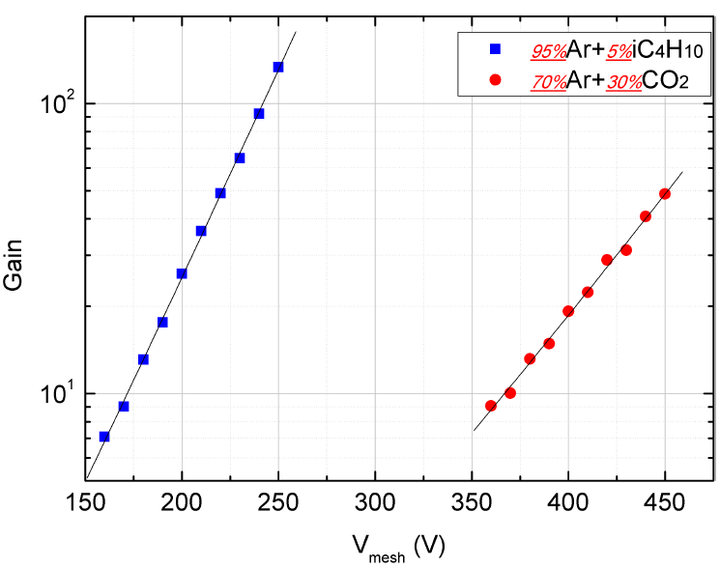
Gain VS voltage of micro mesh (simulation)

Slide 18
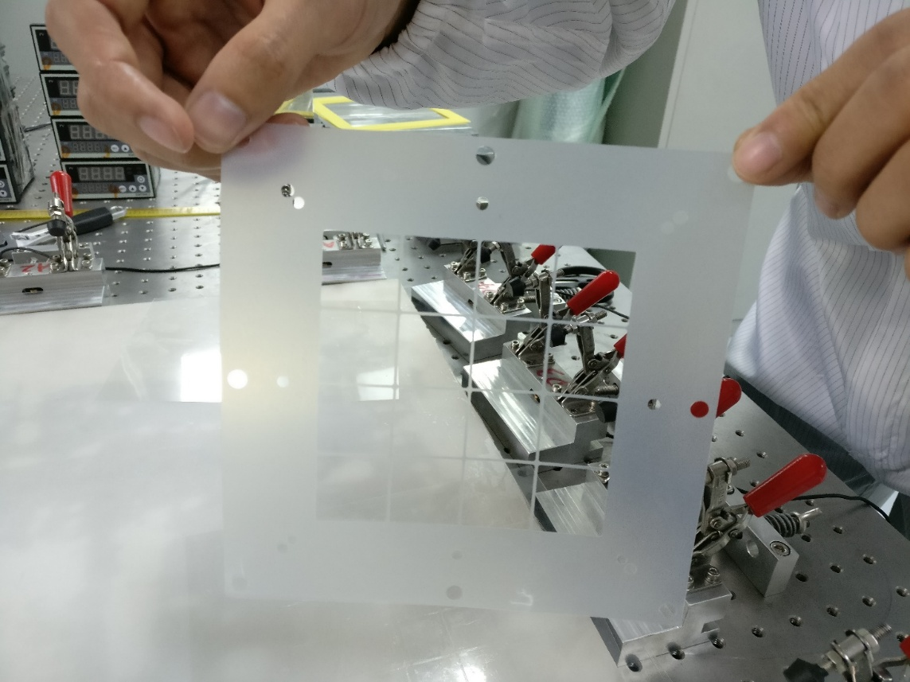
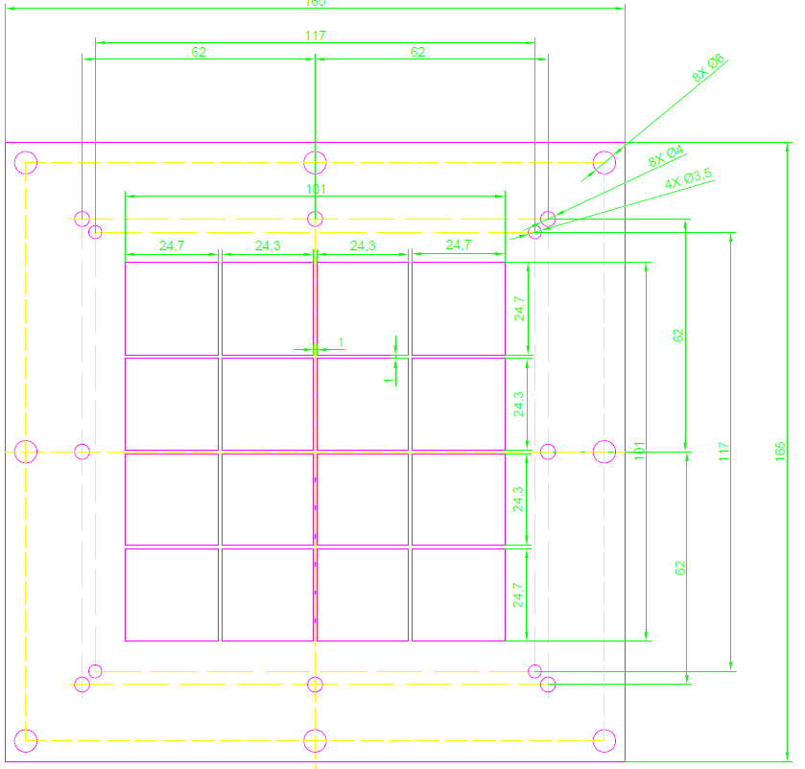
Spacer : FR4 foil (laser erosion)
dead area: 8.91%

Slide 19
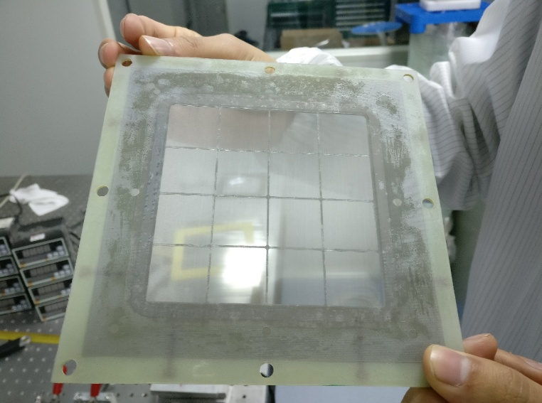
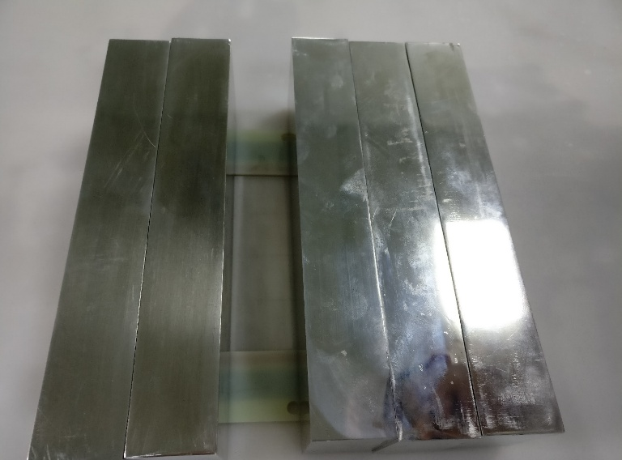
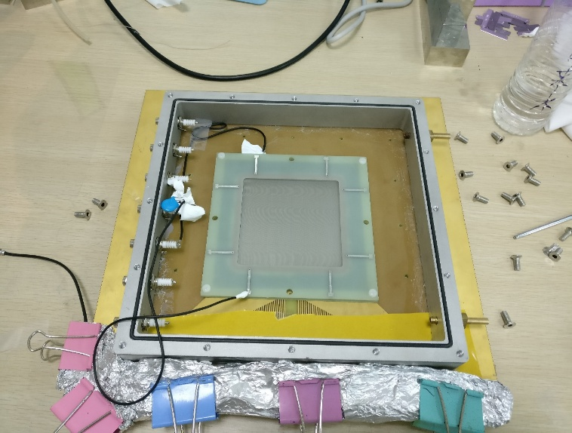
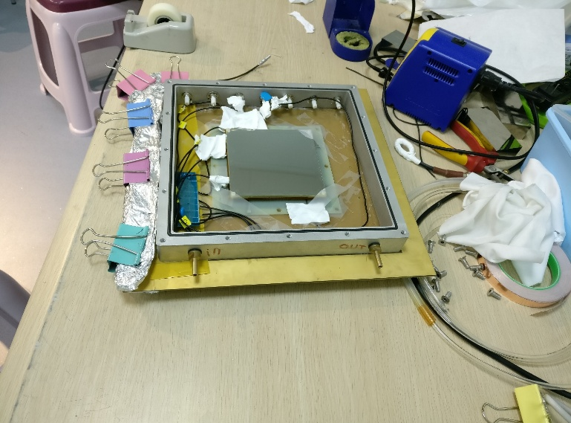

Detector installation
MicroMesh:
400 Holes/inch
tension：7KG
thickness：100um

Slide 20
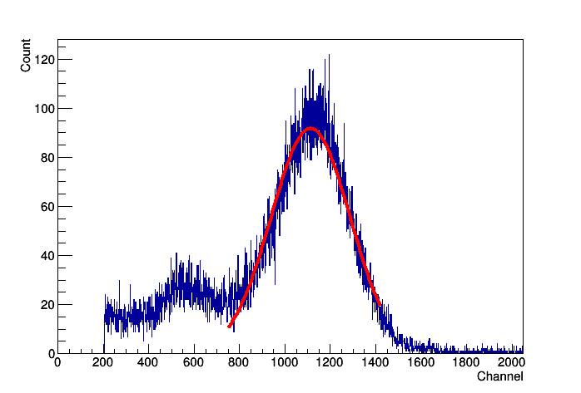
Energy spectrom of hybrid detector
resolution: 35%

Slide 21
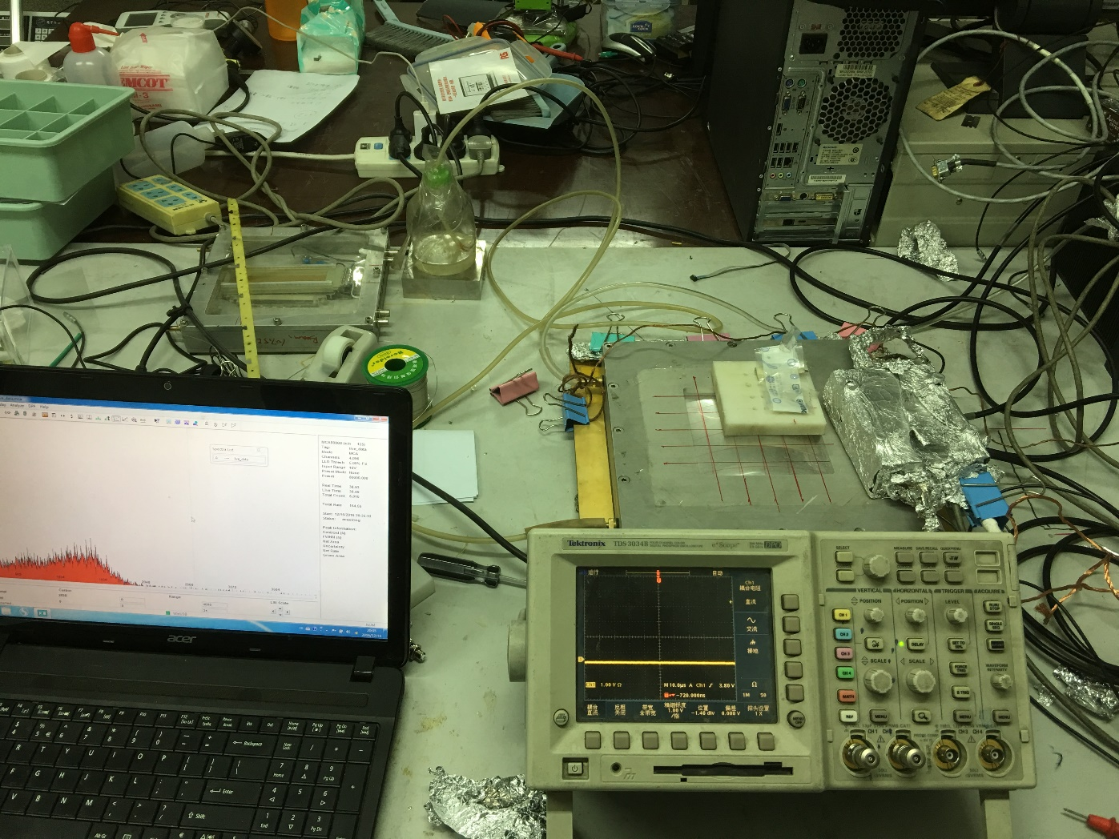
Tested with a α source

Slide 22
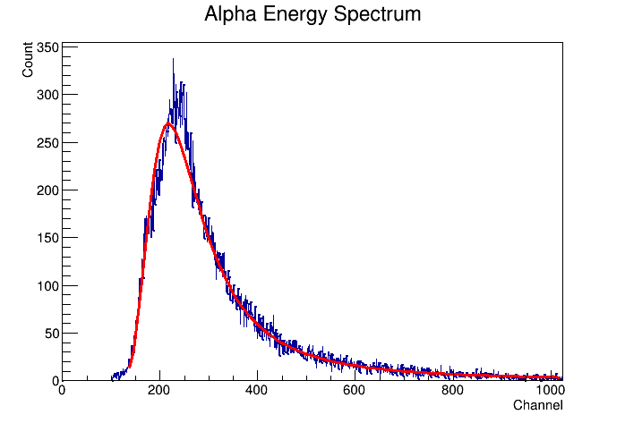
Energy spectrum of α on thick GEM

Slide 23
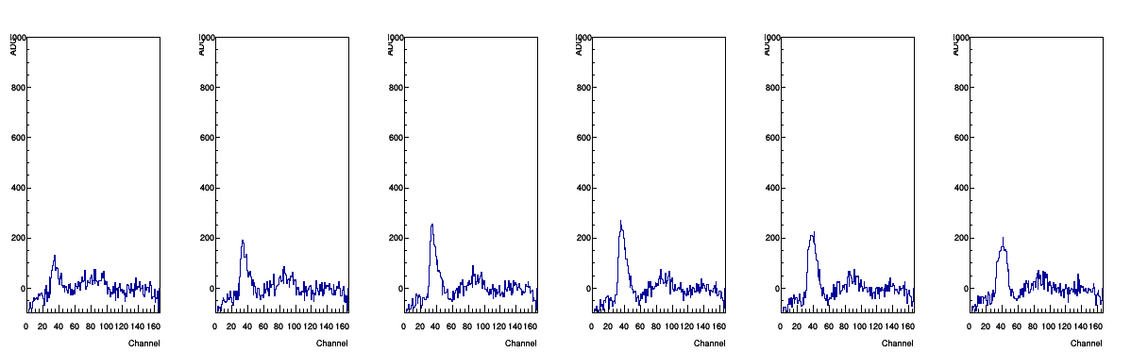
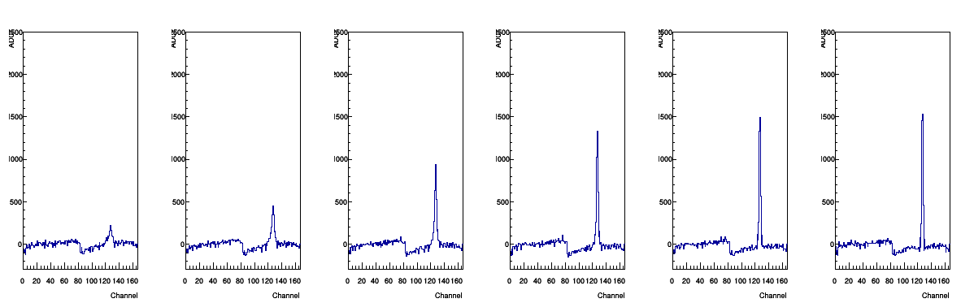
signals of α-track in different FEE periods

Slide 24
感谢核探测与核电子学国家重点实验室的大力资助，以上研究工作得以顺利开展。

