Slide 1

CEPC ECAL KEK ANALYSIS
李想，刁洪滨
2025.9.8

Slide 2
motivation：
Select MIP events from the electron beam data
strategy:
Apply Hough transform to identify tracks with minimal shower activity

Slide 3
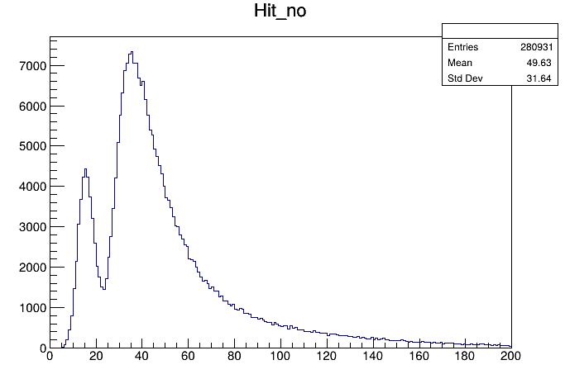
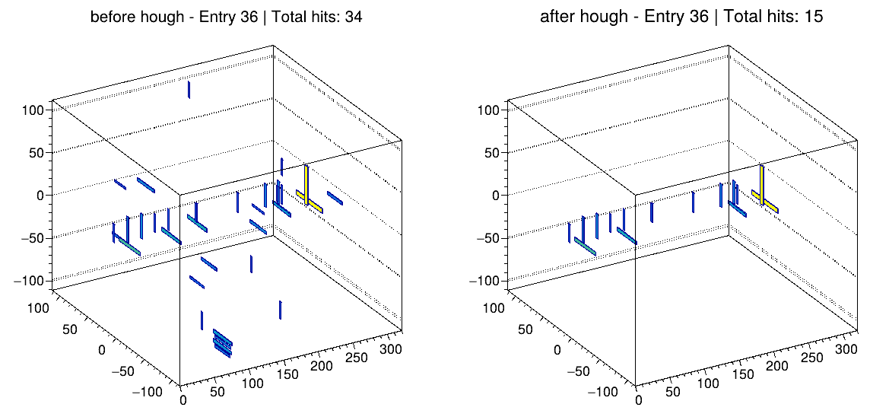
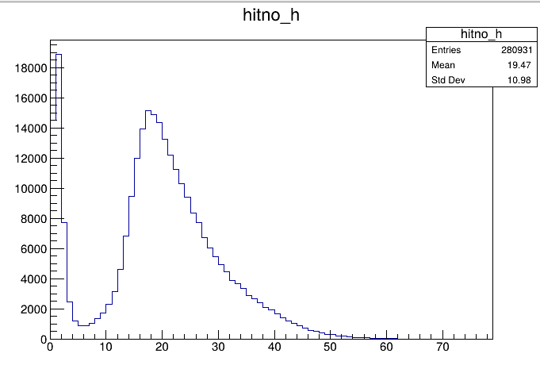
Raw data
Run 171 , Without Absorber
Beam Center:(525，910)
layer_except_10_11_14_15_20_21_26_27
Before hough
After hough
Notes:
Here is the result of the same event after applying the Hough transform and removing the noise.The two plots on the right show the statistics of the number of hits after the Hough transform from last night.Below, I will give a detailed description of the Hough transform method.

Slide 4
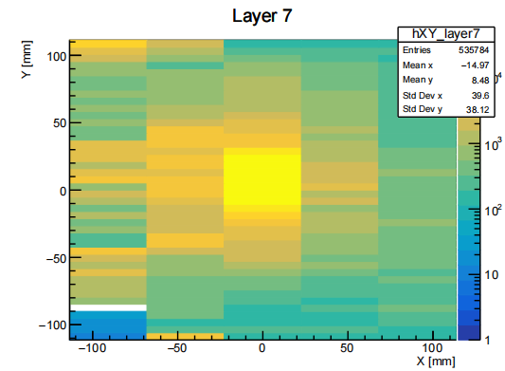
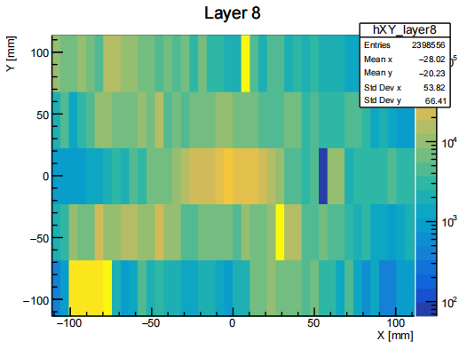
Preparation for Hough Transformation – Good Layer Selection
Run 171 , Without Absorber
Analyze each run individually
Identify good layers where hits are spatially concentrated
For each layer, compute the RMS of hit positions in X and
Y directions
Layers with small RMS values are selected as good layers
These layers are used as inputs for track reconstruction
Layer 7: RMS X = 39.601, RMS Y = 38.1213
Layer 8: RMS X = 53.8245, RMS Y = 66.4107
Notes:
To prepare for Hough transformation, we first identify the "good layers" for each run. A layer is considered good if the hit positions are spatially clustered. This is quantified by calculating the RMS of the hit positions in both X and Y directions for each layer — layers with smaller RMS values are regarded as good candidates.
These layers are used as inputs for track reconstruction

Slide 5
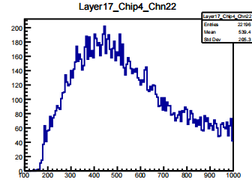
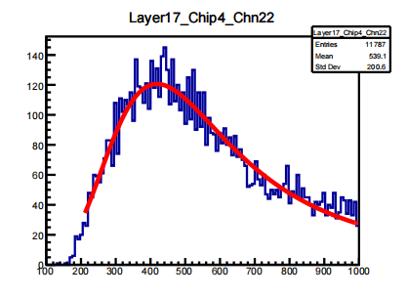
Hough Transform
Before
Method
Apply two-stage Hough transform for track reconstruction.
Use only the good layers in both stages to suppress noise from deeper layers.
Select events with more than 2 hits in the good layers.
Data Processing
Remove noise hits far from the reconstructed track.
Select events with total hit counts (hit_no>10&&hit_no<30).
Select (hits<3) for each layer.
Fitting
Landau-Gaussian convolution function to extract the MPV.
After
Notes:
We apply a two-stage Hough transform to reconstruct tracks. Due to significant noise in the deeper layers, both transforms use only the first four layers. Events with more than two hits in the good layers are selected.
For data processing, we remove noise hits that deviate significantly from the identified track. Events with a total number of hits between 10 and 30 are selected for further analysis.
Fit the energy distribution with a Landau-Gaussian convolution function to extract the most probable value (MPV).
Subtract pedestal

Slide 6
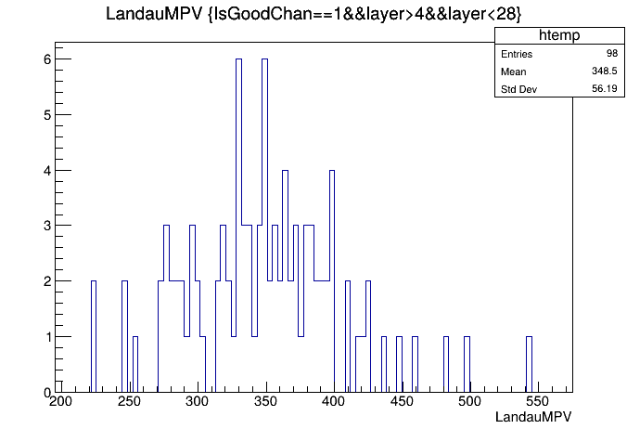
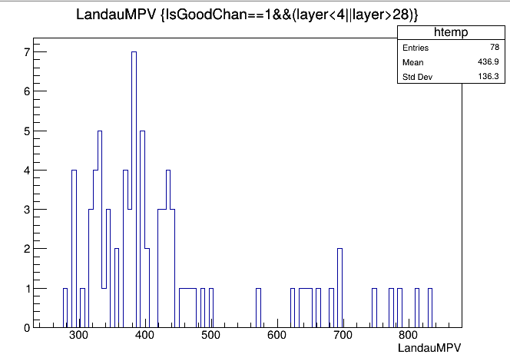
Raw data
layer_except_10_11_14_15_20_21_26_27
Totel channels:4608
Channels (statistics exceed 2200): 3216
Good channels(15mm):65
Good channels(10mm):98
Notes:
For each run, we picked out the good channels — the ones with a clear rising edge. The table shows how many good channels we found in each run, and in total it’s about 200.

Slide 7
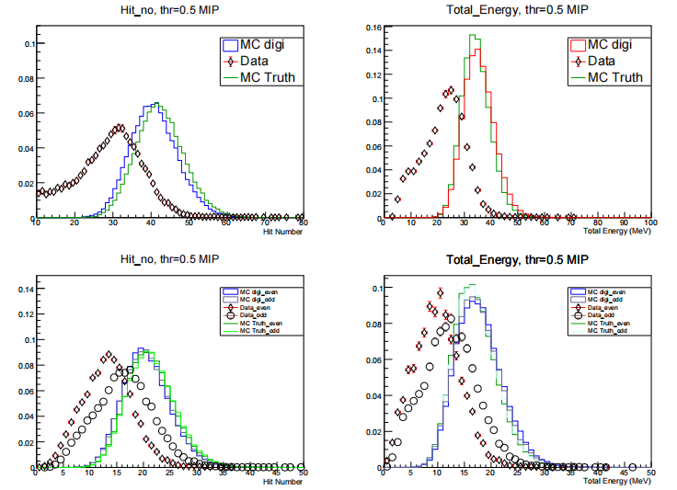
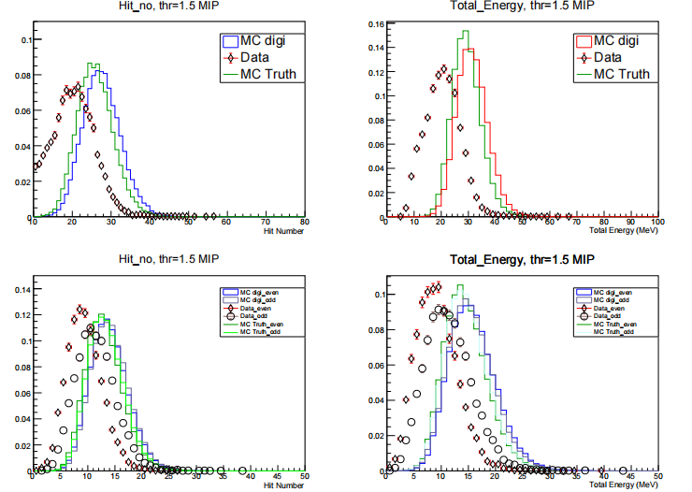
Digital or Semi-digital
Data source：PS
1GeV，threshold：0.5 MIP
1GeV，threshold：1.5 MIP
Notes:
For each run, we picked out the good channels — the ones with a clear rising edge. The table shows how many good channels we found in each run, and in total it’s about 200.

Slide 8
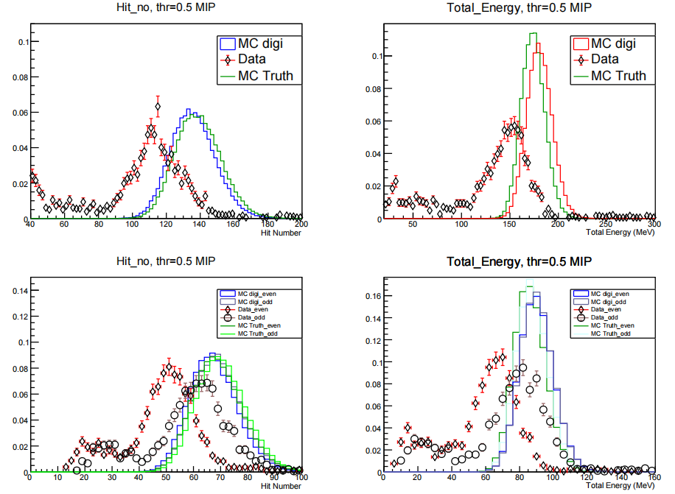
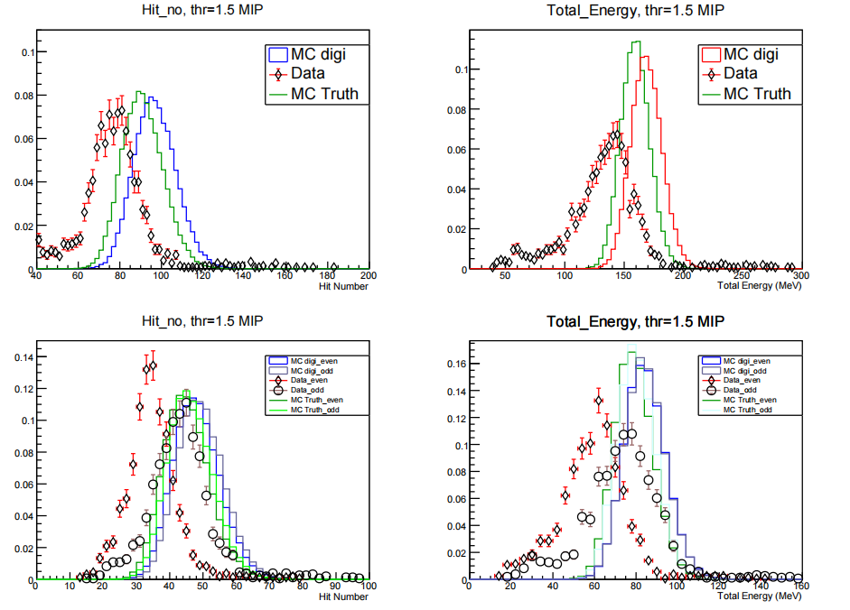
Digital or Semi-digital
Data source：PS
5GeV，threshold：0.5 MIP
5GeV，threshold：1.5 MIP
Notes:
For each run, we picked out the good channels — the ones with a clear rising edge. The table shows how many good channels we found in each run, and in total it’s about 200.

Slide 9
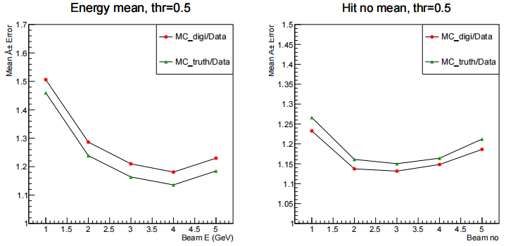
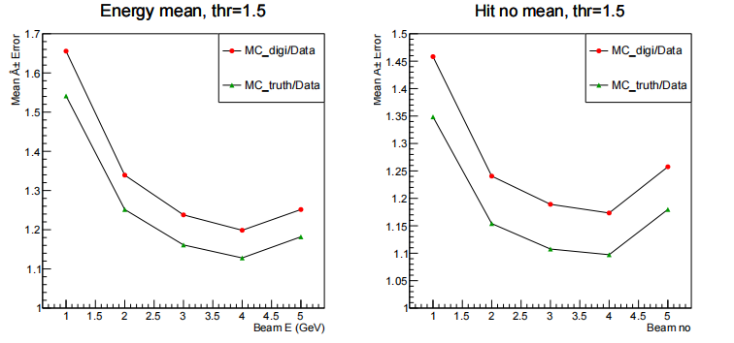
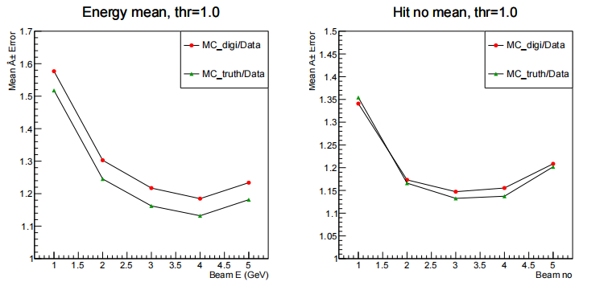
Digital or Semi-digital
Data source：PS
Notes:
For each run, we picked out the good channels — the ones with a clear rising edge. The table shows how many good channels we found in each run, and in total it’s about 200.

Slide 10
Summary
Due to the low signal-to-noise ratio at CEPC, the MPV calibration results are not very good.
Would it be possible to use a digital or semi-digital approach, taking the number of hits as the measure of resolution?

Slide 11
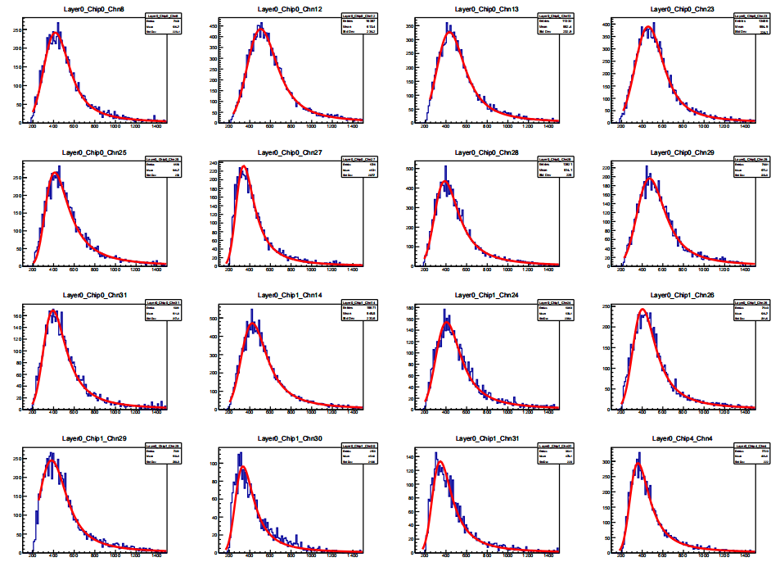
KEK Data MPV_Calibration
Notes:
To obtain the MPV map, we merged the ROOT files from all layers except 10, 11, 14, 15, 20, 21, 26, and 27.
After merging, we observed significant variations in the MPV values across different layers and chips.
To include some shower events in the rear layers, we also kept events with fewer than 2 hits per layer, and loosened the total hit count requirement.

Slide 12
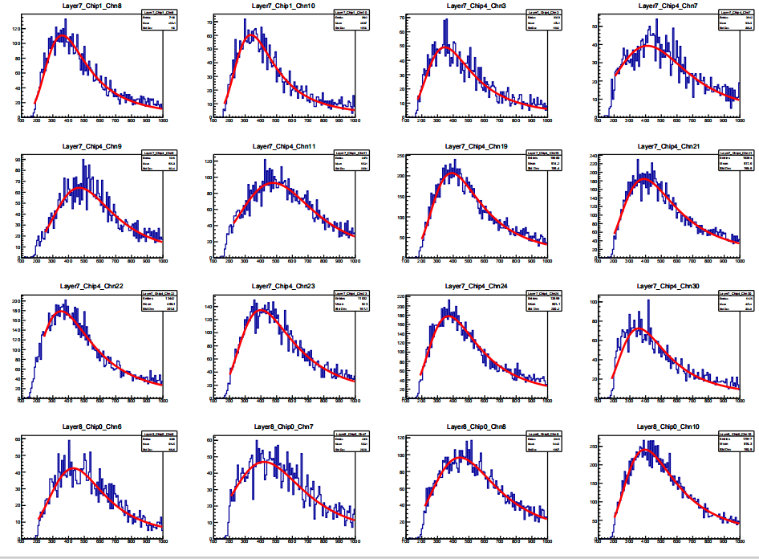
KEK Data MPV_Calibration
Notes:
To obtain the MPV map, we merged the ROOT files from all layers except 10, 11, 14, 15, 20, 21, 26, and 27.
After merging, we observed significant variations in the MPV values across different layers and chips.
To include some shower events in the rear layers, we also kept events with fewer than 2 hits per layer, and loosened the total hit count requirement.

Slide 13
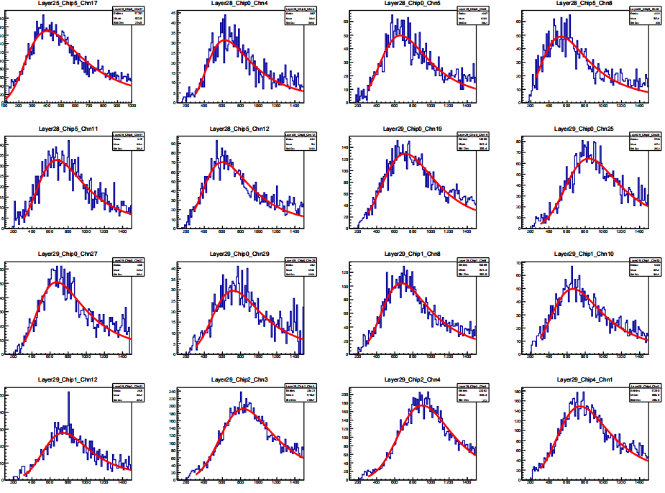
KEK Data MPV_Calibration
Notes:
To obtain the MPV map, we merged the ROOT files from all layers except 10, 11, 14, 15, 20, 21, 26, and 27.
After merging, we observed significant variations in the MPV values across different layers and chips.
To include some shower events in the rear layers, we also kept events with fewer than 2 hits per layer, and loosened the total hit count requirement.

Slide 14
Digital or Semi-digital
Data source：PS
1GeV，threshold：0.5 MIP
1GeV，threshold：1.5 MIP
Notes:
For each run, we picked out the good channels — the ones with a clear rising edge. The table shows how many good channels we found in each run, and in total it’s about 200.

Slide 15
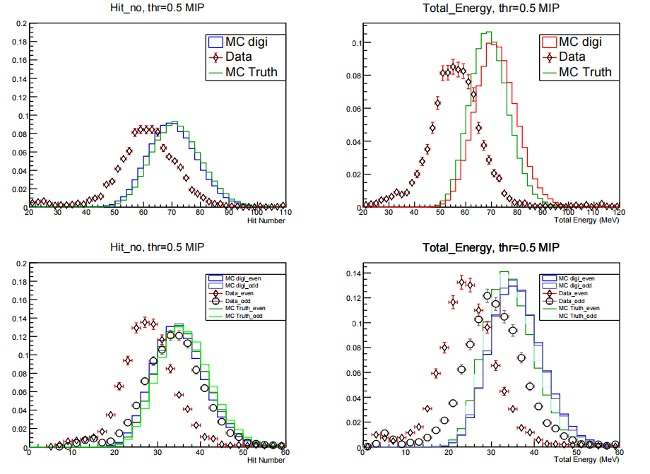
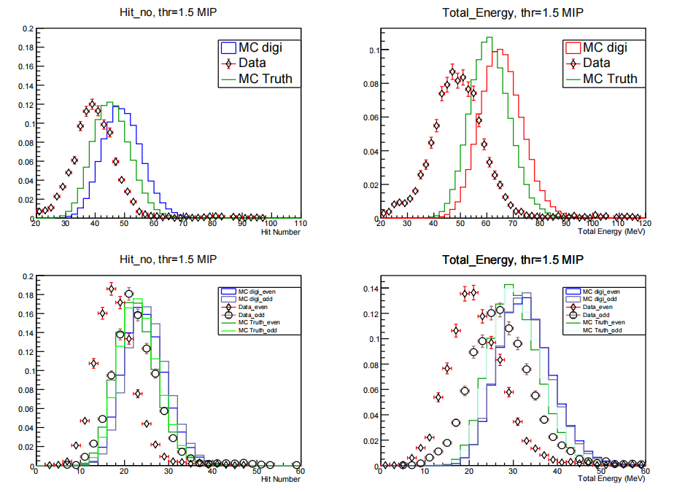
Digital or Semi-digital
Data source：PS
2GeV，threshold：0.5 MIP
2GeV，threshold：1.5 MIP
Notes:
For each run, we picked out the good channels — the ones with a clear rising edge. The table shows how many good channels we found in each run, and in total it’s about 200.

Slide 16
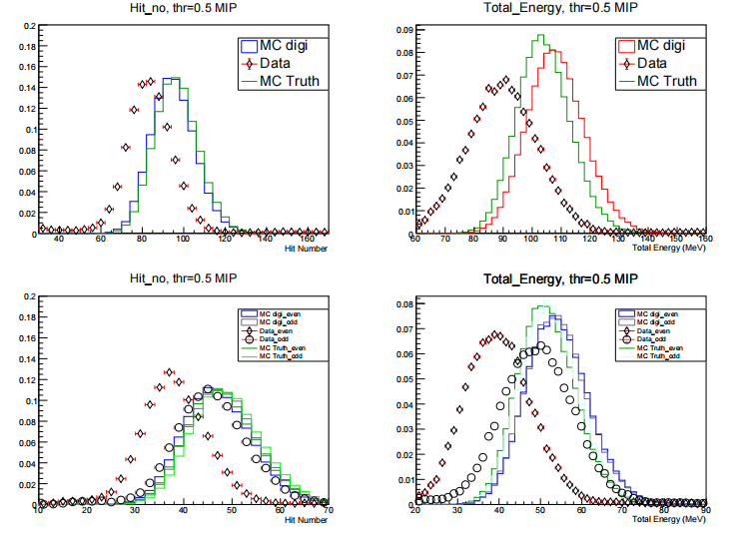
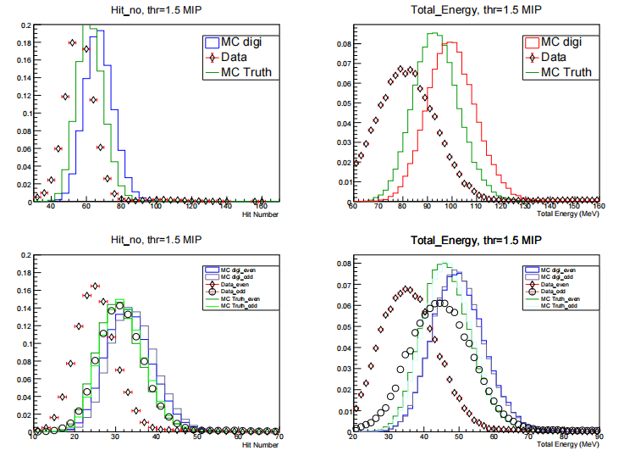
Digital or Semi-digital
Data source：PS
3GeV，threshold：0.5 MIP
3DGeV，threshold：1.5 MIP
Notes:
For each run, we picked out the good channels — the ones with a clear rising edge. The table shows how many good channels we found in each run, and in total it’s about 200.

Slide 17
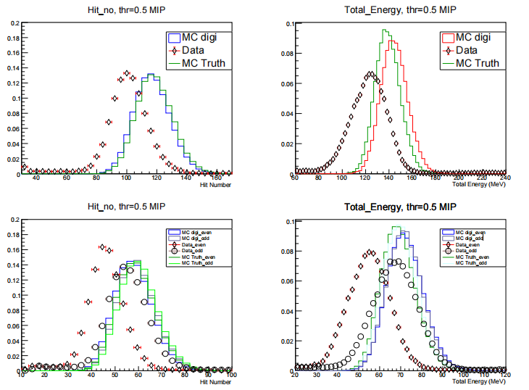
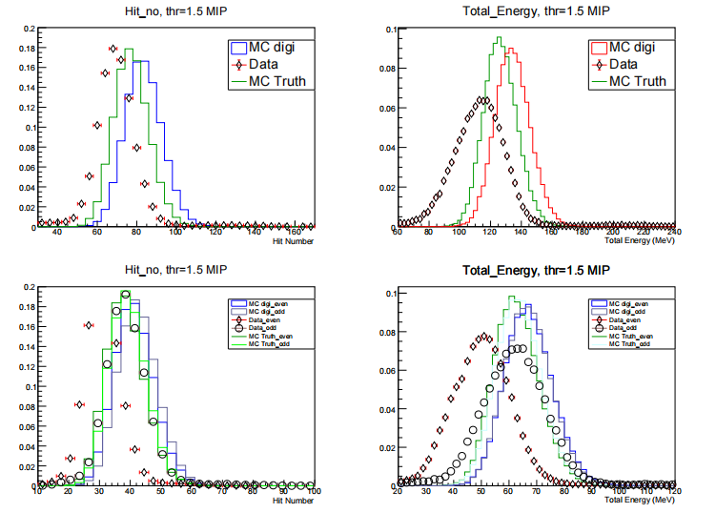
Digital or Semi-digital
Data source：PS
4GeV，threshold：0.5Mip
4GeV，threshold：1.5Mip
Notes:
For each run, we picked out the good channels — the ones with a clear rising edge. The table shows how many good channels we found in each run, and in total it’s about 200.

