Slide 1

CEPC ECAL KEK ANALYSIS
李想，刁洪滨
2025.8.19

Slide 2
motivation：
Select MIP events from the electron beam data
strategy:
Apply Hough transform to identify tracks with minimal shower activity

Slide 3
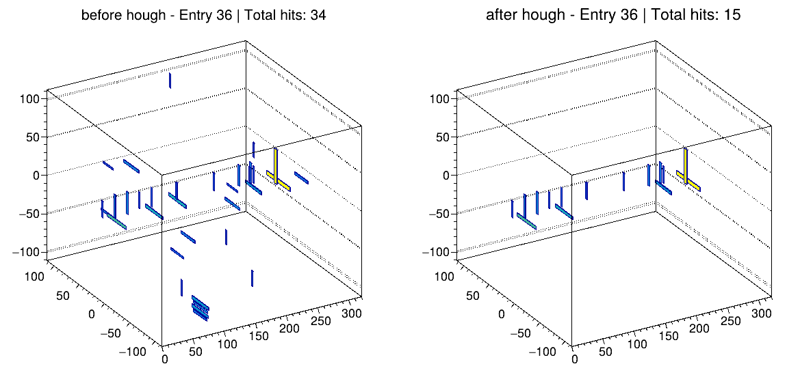
Raw data
Run 171 , Without Absorber
Beam Center:(525，910)
layer_except_10_11_14_15_20_21_26_27
Notes:
Next, we apply the Hough transform to real detector data in order to reconstruct tracks and analyze event topology in a more realistic setting.This is the behavior observed in a single run.

Slide 4
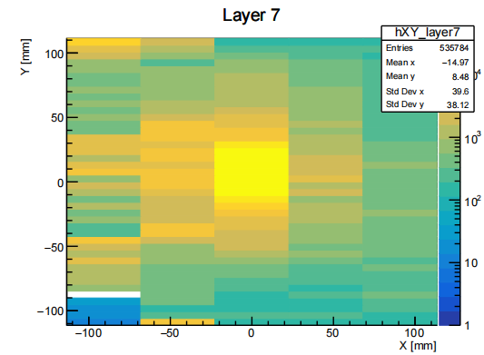
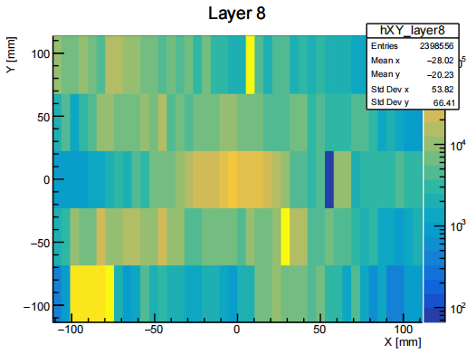
Preparation for Hough Transformation – Good Layer Selection
Run 171 , Without Absorber
Analyze each run individually
Identify good layers where hits are spatially concentrated
For each layer, compute the RMS of hit positions in X and
Y directions
Layers with small RMS values are selected as good layers
These layers are used as inputs for track reconstruction
Layer 7: RMS X = 39.601, RMS Y = 38.1213
Layer 8: RMS X = 53.8245, RMS Y = 66.4107
Notes:
To prepare for Hough transformation, we first identify the "good layers" for each run. A layer is considered good if the hit positions are spatially clustered. This is quantified by calculating the RMS of the hit positions in both X and Y directions for each layer — layers with smaller RMS values are regarded as good candidates.

Slide 5
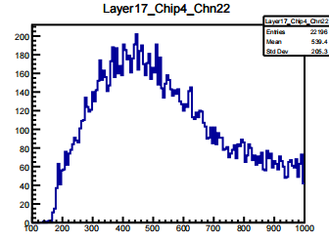
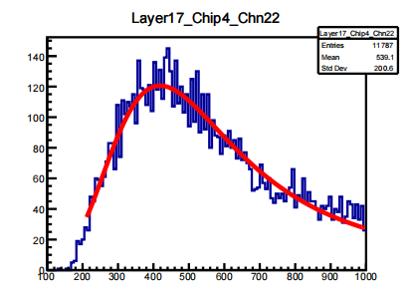
Hough Transform
Before
Method
Apply two-stage Hough transform for track reconstruction.
Use only the good layers in both stages to suppress noise from deeper layers.
Select events with more than 2 hits in the good layers.
Data Processing
Remove noise hits far from the reconstructed track.
Select events with total hit counts (hit_no>10&&hit_no<30).
Select (hits<3) for each layer.
Fitting
Landau-Gaussian convolution function to extract the MPV.
Aftr
Notes:
We apply a two-stage Hough transform to reconstruct tracks. The first Hough transform scans a wide range of angles to identify rough track candidates. The second transform refines the track parameters with higher resolution. Due to significant noise in the deeper layers, both transforms use only the first four layers. Events with more than two hits in the first four layers are selected.
For data processing, we remove noise hits that deviate significantly from the identified track. Events with a total number of hits between 20 and 25 are selected for further analysis.
Fit the energy distribution with a Landau-Gaussian convolution function to extract the most probable value (MPV).
For runs 142 to 169, a cabling issue caused reversed channel positions in some super-layers — e.g., channels 4 and 5 were connected as 5 and 4. This will be manually corrected in the data later.
Subtract pedestal

Slide 6
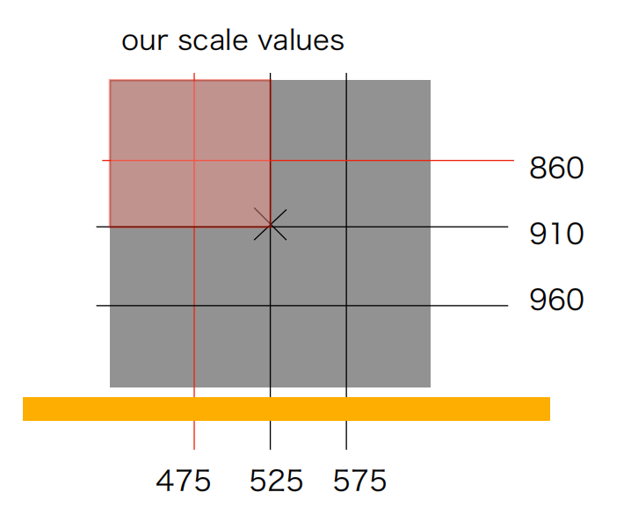
Raw data
layer_except_10_11_14_15_20_21_26_27
Run | Beamcenter | Good channel
ECAL_Run171_20250605_162329.dat | 525, 910 | 14
ECAL_Run172_20250605_183026.dat | 525, 910 | 16
ECAL_Run173_20250605_192245.dat | 445, 980 | 0
ECAL_Run174_20250605_200917.dat | 495, 980 | 10
ECAL_Run175_20250605_205644.dat | 555, 980 | 29
ECAL_Run176_20250605_214258.dat | 595, 980 | 18
ECAL_Run177_20250605_224729.dat | 595, 940 | 19
ECAL_Run178_20250605_233727.dat | 555, 940 | 19
Run | Beamcenter | Good channel
ECAL_Run180_20250606_010924.dat | 445, 940 | 11
ECAL_Run181_20250606_020630.dat | 445, 880 | 0
ECAL_Run182_20250606_025727.dat | 495, 880 | 0
ECAL_Run185_20250606_052613.dat | 555, 880 | 7
ECAL_Run186_20250606_061235.dat | 595, 880 | 16
ECAL_Run187_20250606_070111.dat | 595, 840 | 9
ECAL_Run188_20250606_074502.dat | 555, 840 | 5
ECAL_Run189_20250606_083033.dat | 495, 840 | 12
Notes:
To obtain the MPV map, we merged the ROOT files from all layers except 10, 11, 14, 15, 20, 21, 26, and 27.
After merging, we observed significant variations in the MPV values across different layers and chips.
To include some shower events in the rear layers, we also kept events with fewer than 2 hits per layer, and loosened the total hit count requirement.

Slide 7
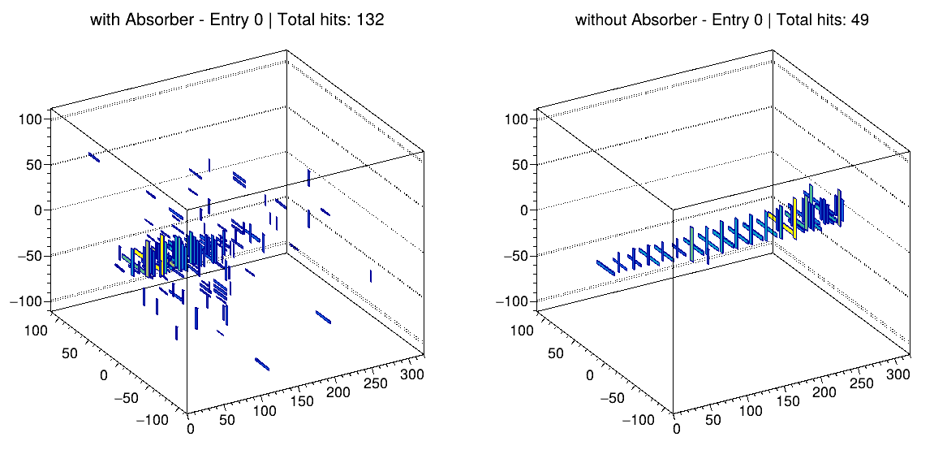
MC
P=5GeV e- Energy>0.3MIP
Notes:
To obtain the MPV map, we merged the ROOT files from all layers except 10, 11, 14, 15, 20, 21, 26, and 27.
After merging, we observed significant variations in the MPV values across different layers and chips.
To include some shower events in the rear layers, we also kept events with fewer than 2 hits per layer, and loosened the total hit count requirement.

Slide 8
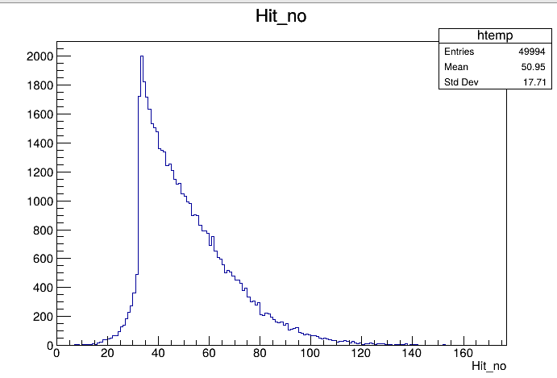
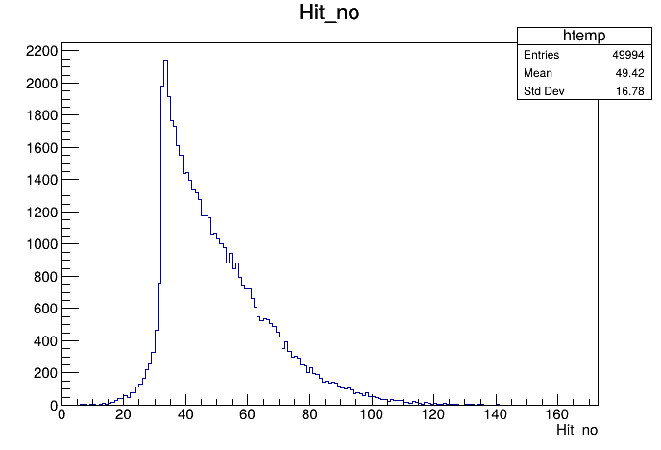
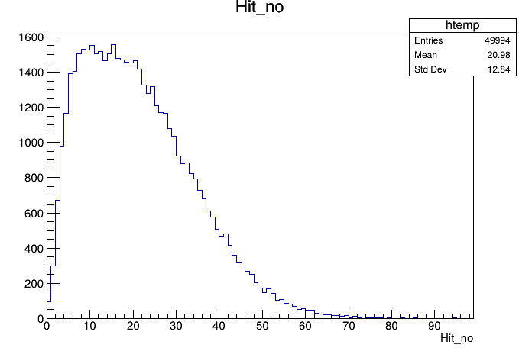
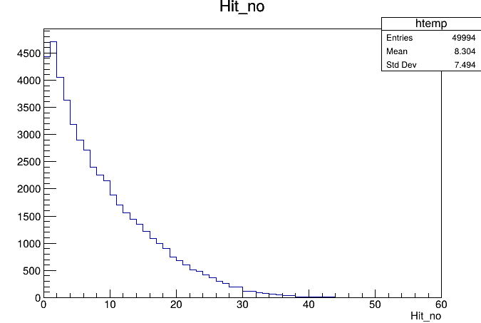
MC
P=5GeV e- Without Absorber
Energy>0.3MIP
Energy>0.5MIP
Energy>MIP
Energy>2MIP
Notes:
To obtain the MPV map, we merged the ROOT files from all layers except 10, 11, 14, 15, 20, 21, 26, and 27.
After merging, we observed significant variations in the MPV values across different layers and chips.
To include some shower events in the rear layers, we also kept events with fewer than 2 hits per layer, and loosened the total hit count requirement.

Slide 9
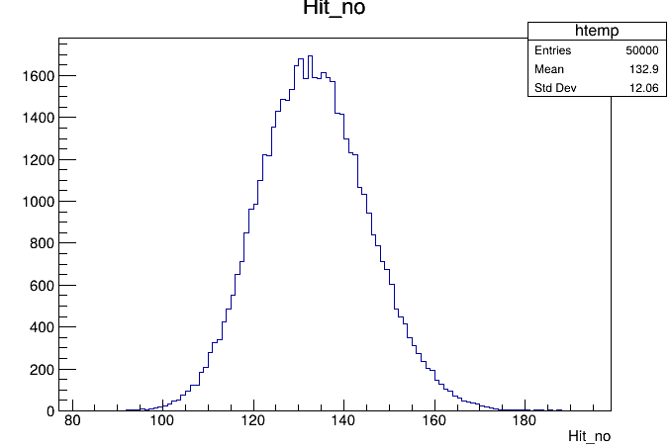
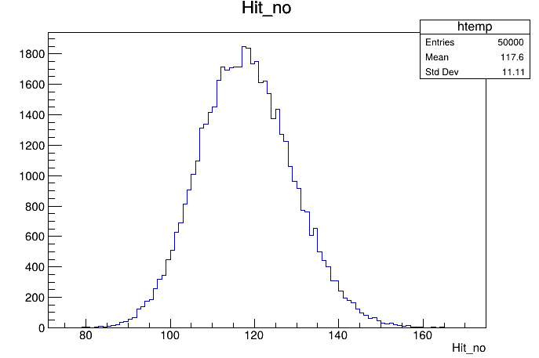
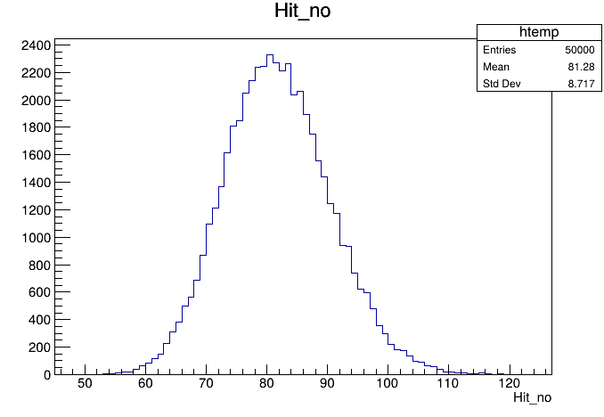
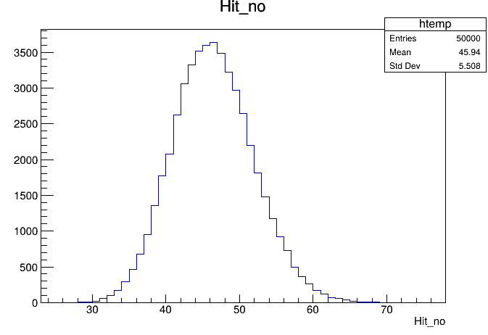
MC
P=5GeV e- With Absorber
Energy>0.3MIP
Energy>0.5MIP
Energy>MIP
Energy>2MIP
Notes:
To obtain the MPV map, we merged the ROOT files from all layers except 10, 11, 14, 15, 20, 21, 26, and 27.
After merging, we observed significant variations in the MPV values across different layers and chips.
To include some shower events in the rear layers, we also kept events with fewer than 2 hits per layer, and loosened the total hit count requirement.

Slide 10
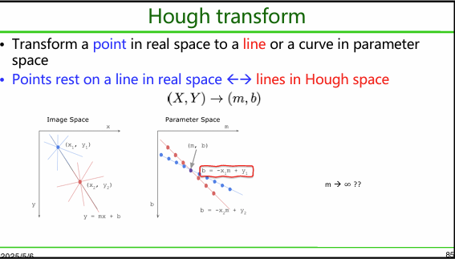
back up

Slide 11
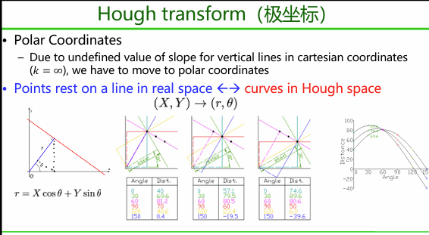
back up

