Slide 1
AHCAL
Hongbin Diao
State key laboratory of particle detection and electronics
University of Science and Technology of China

Slide 2
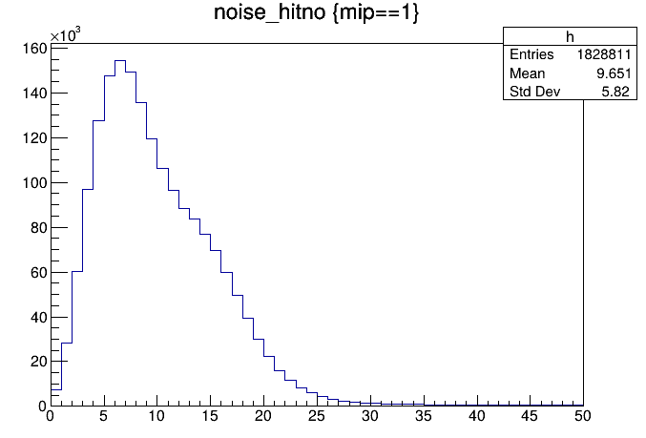
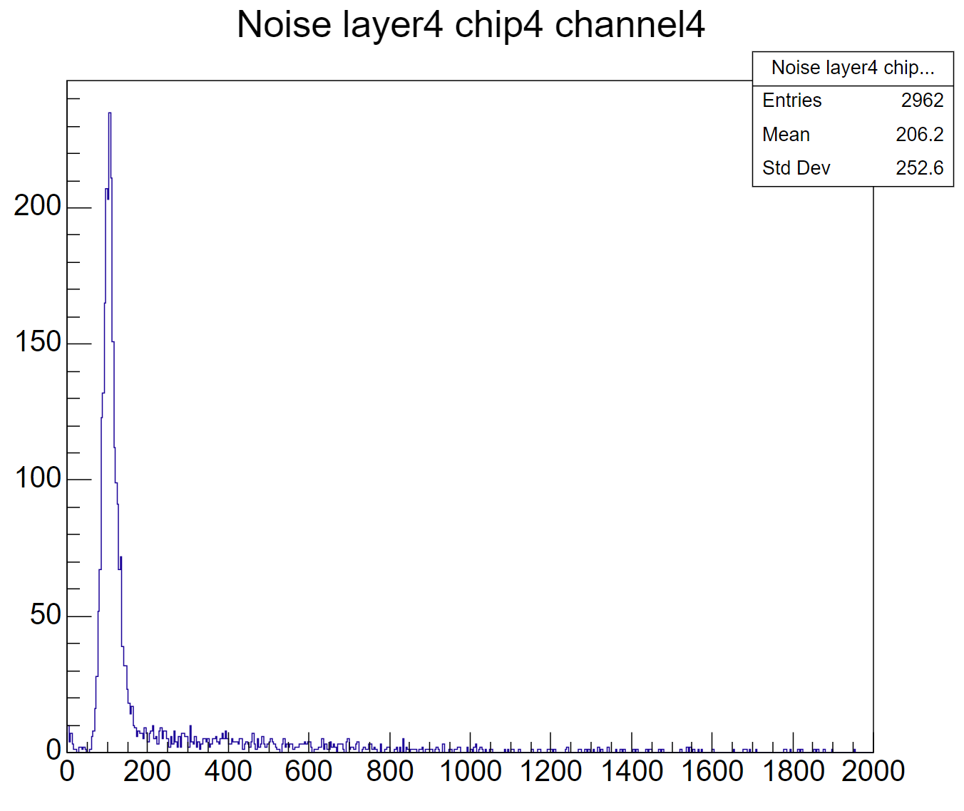
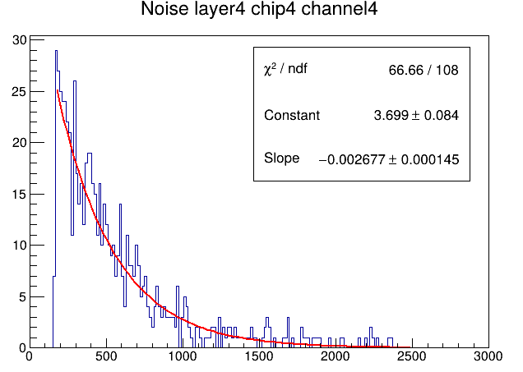
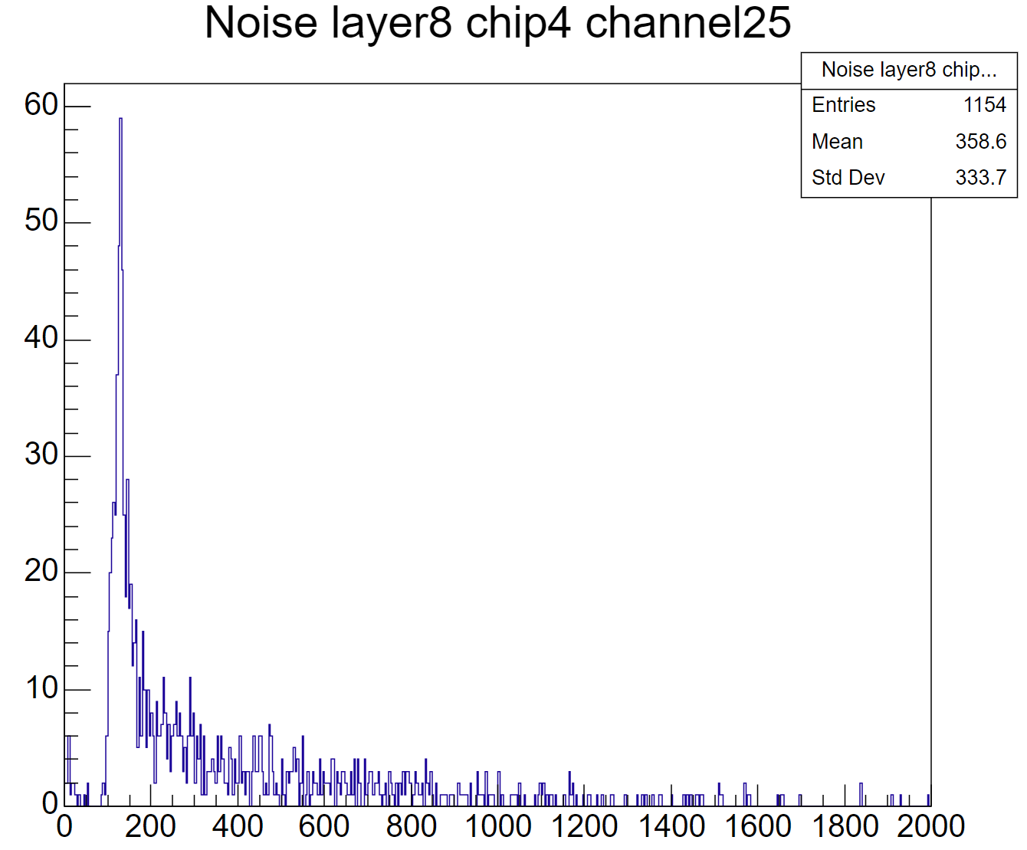
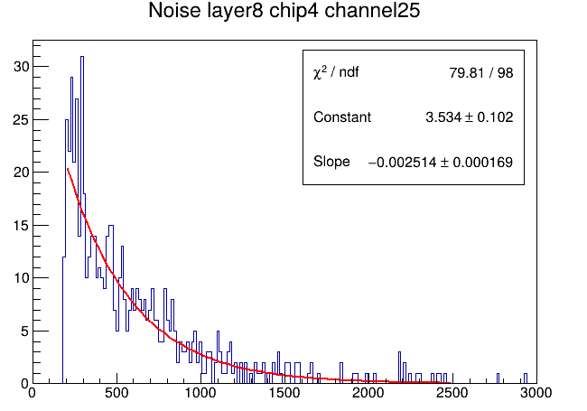
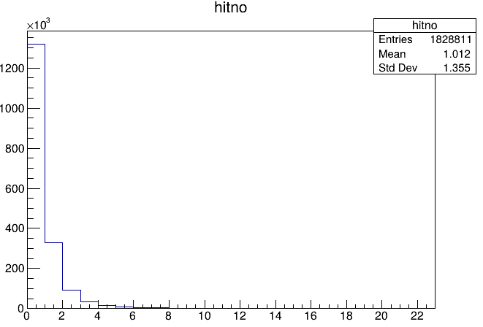
noise in muon
select the hit that not near the muon track
noise hitno
in all chips
noise hitno > 0.5 MIP
in chip4
tau=-1/slope
highgian noise
highgian noise > 0.5MIP

Slide 3
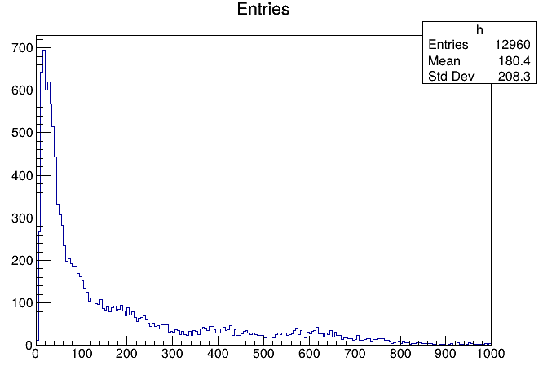
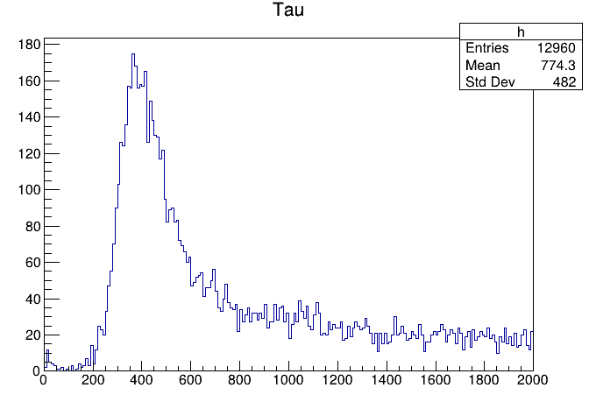
add noise in digitization
add this noise at the channel level
for single channel, it has probability of #Entries / 1.8M
entries is corrected by tau
magnitude is given by an exponential distribution

Slide 4
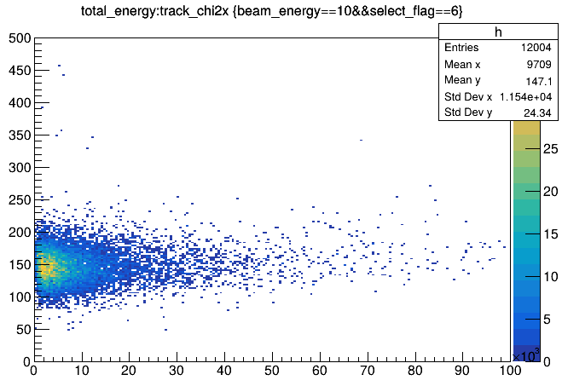
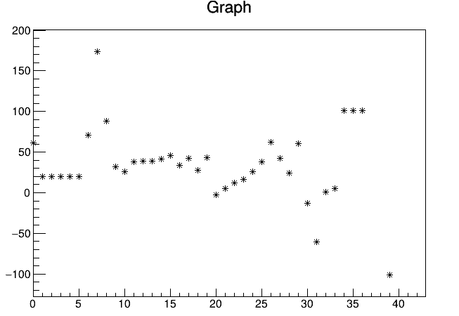
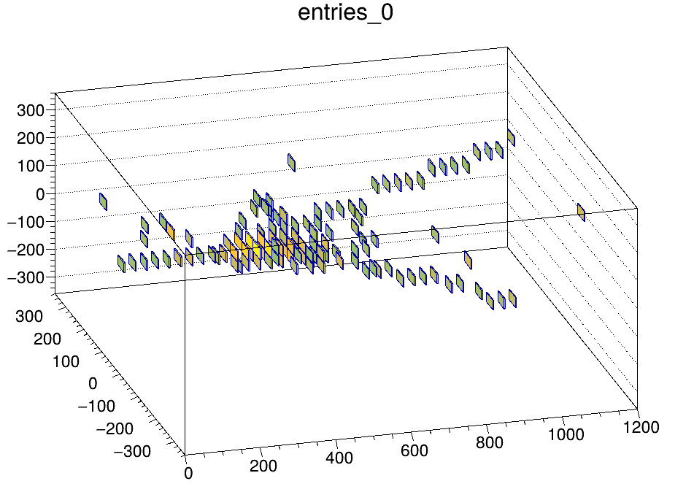
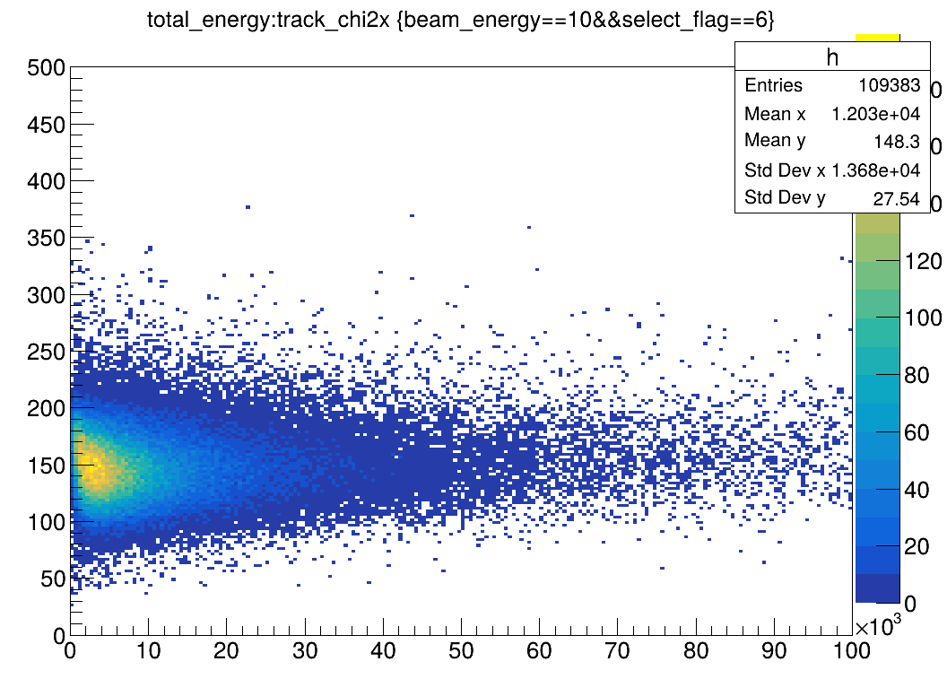
track fit
find the energy center of each layer
then fit layer 2-15 with linear line
MC
center X
data
layer

Slide 5
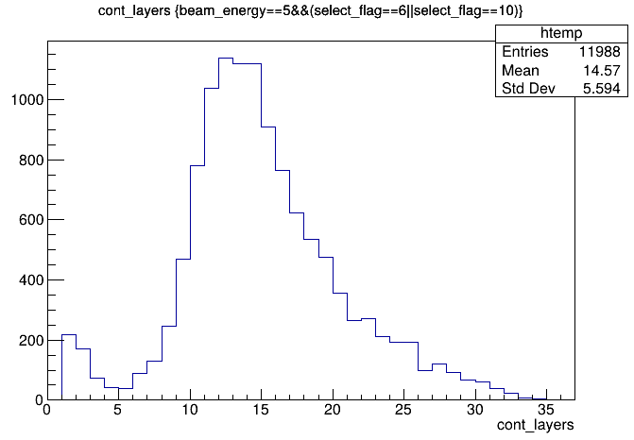
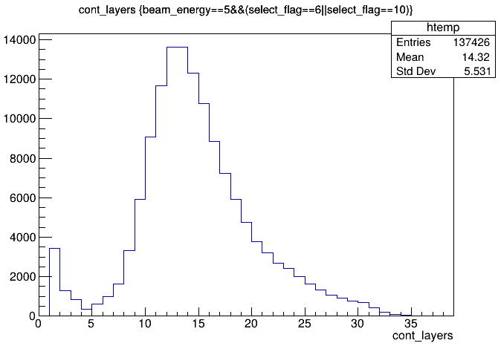
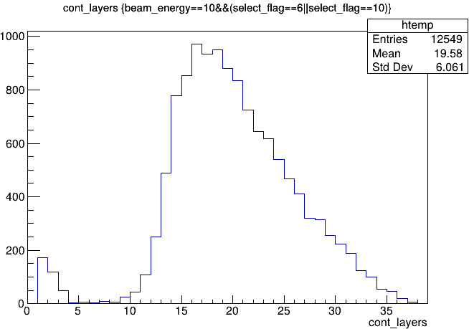
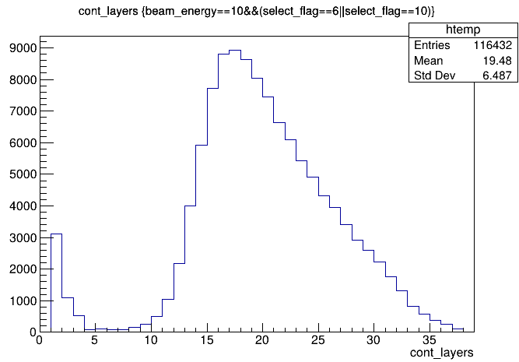
continuous layers
MC
5GeV
pion
Data
5GeV
pion
MC
10GeV
pion
Data
10GeV
pion

Slide 6
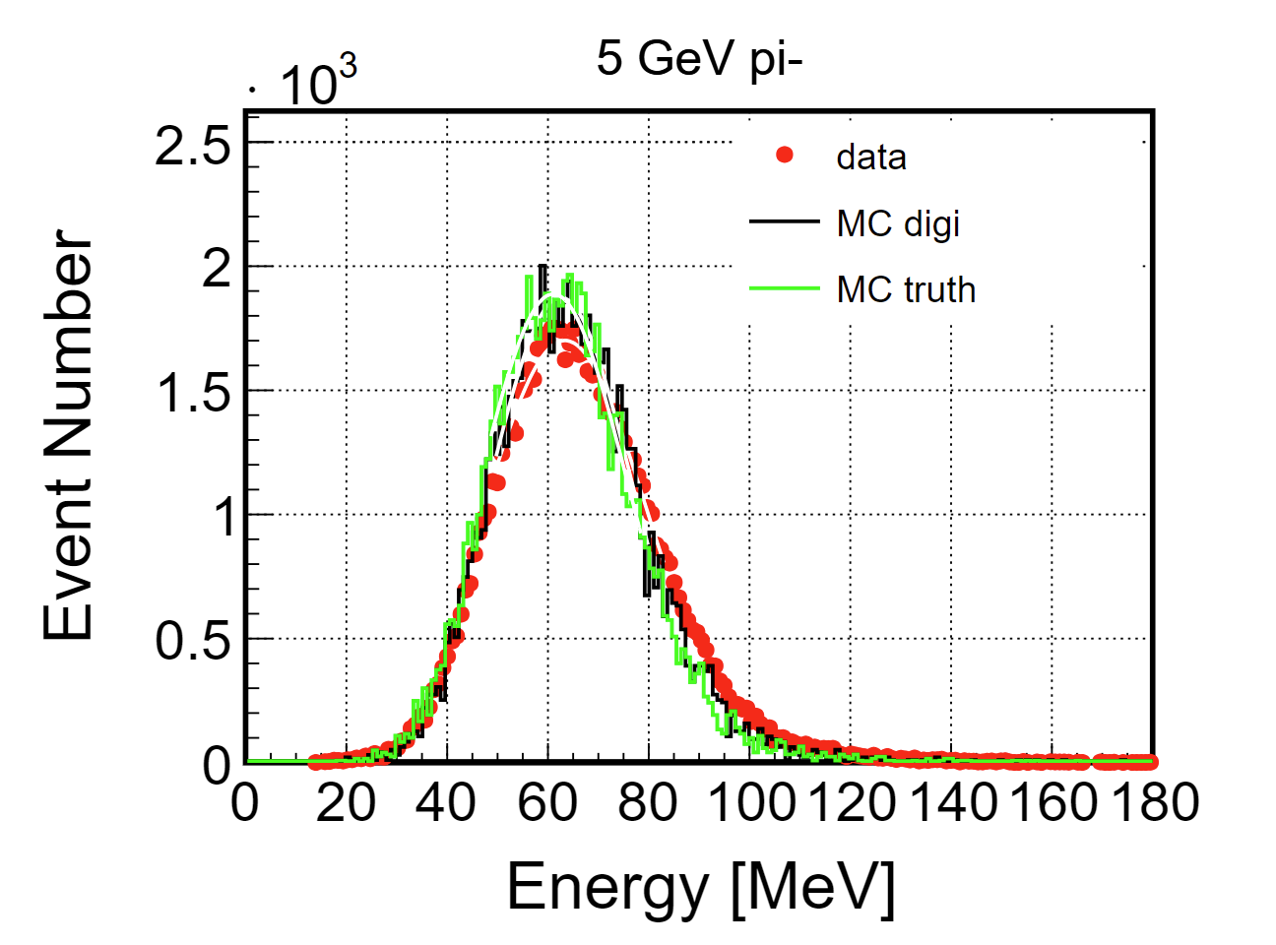
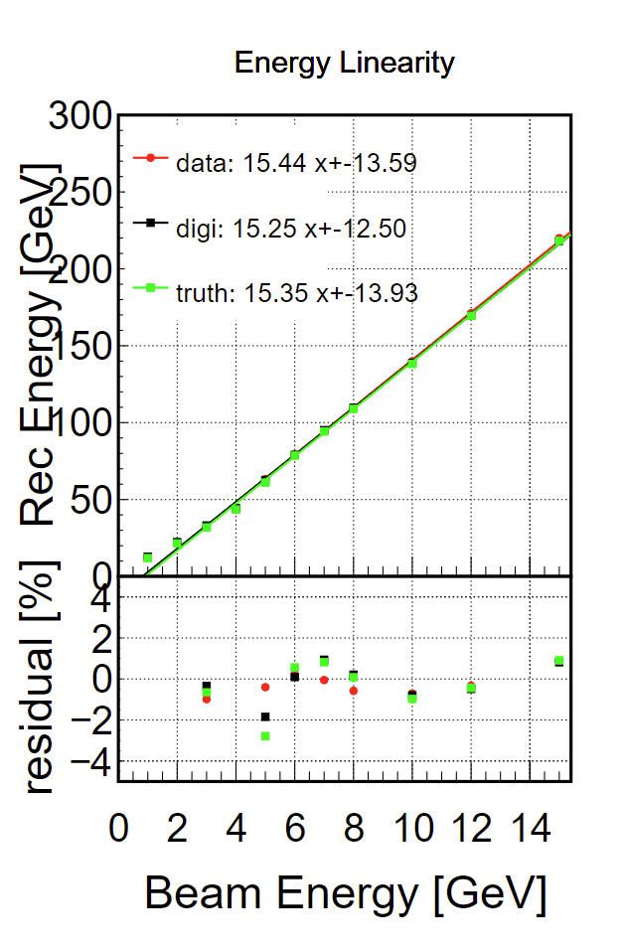
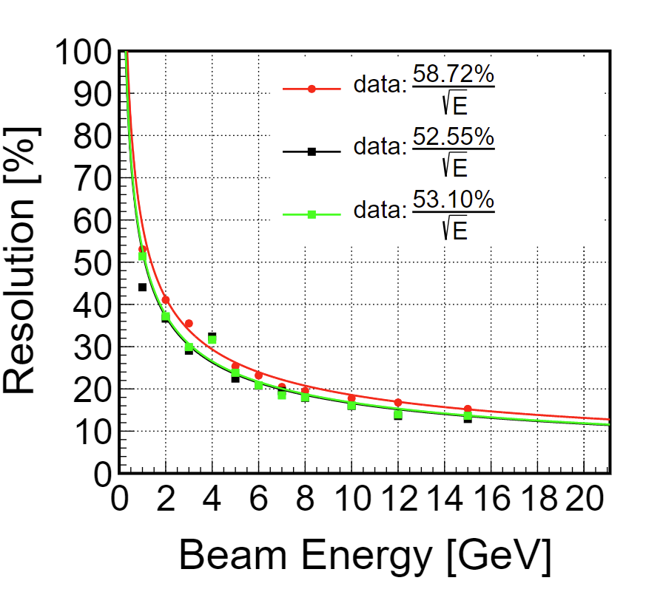
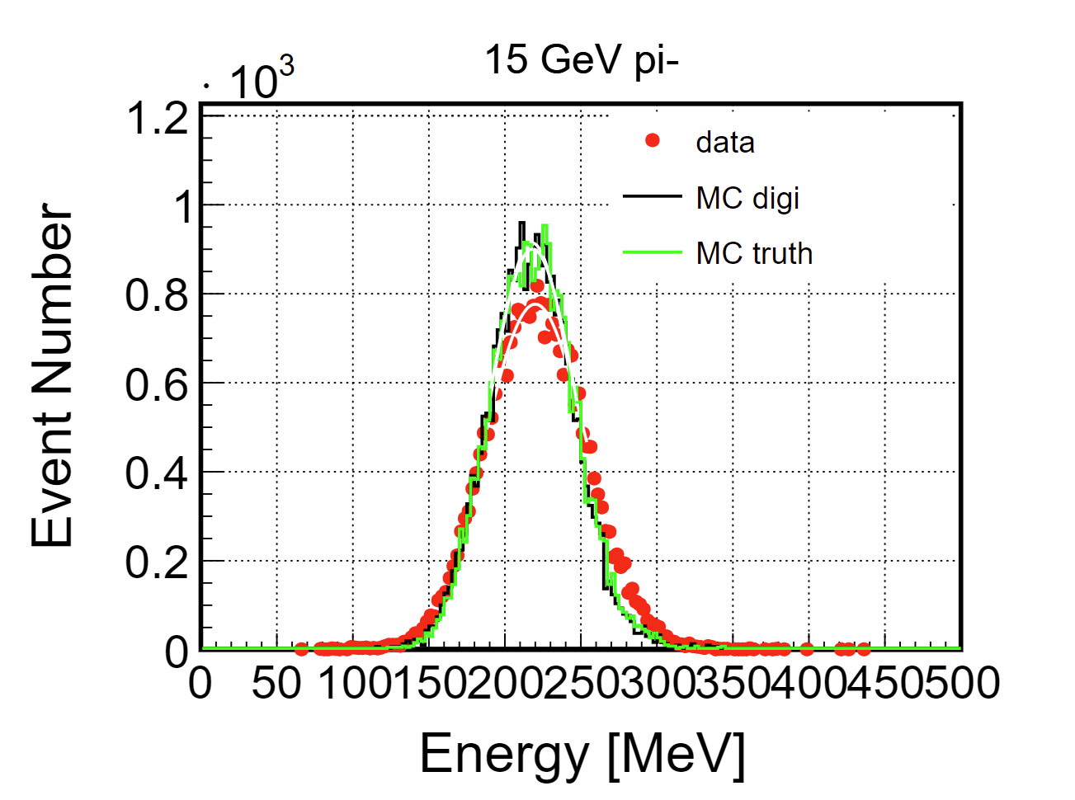

Slide 7
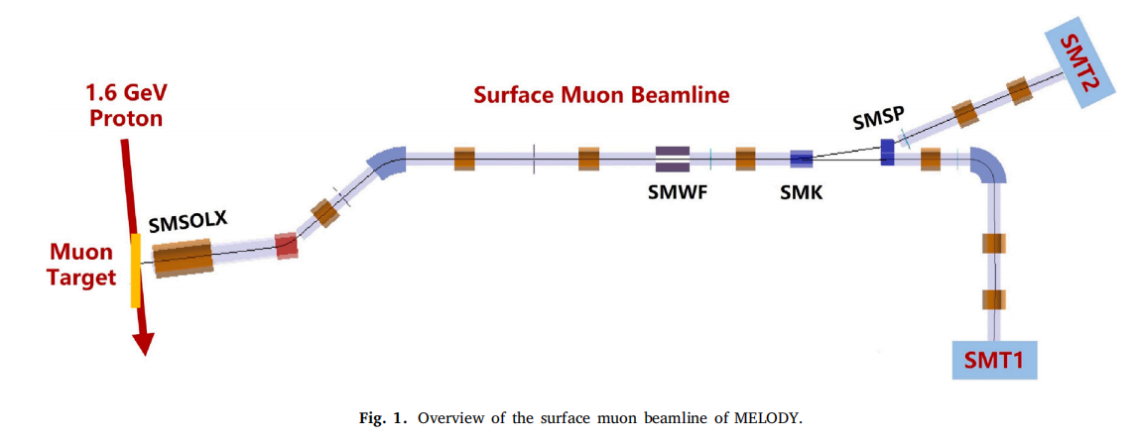
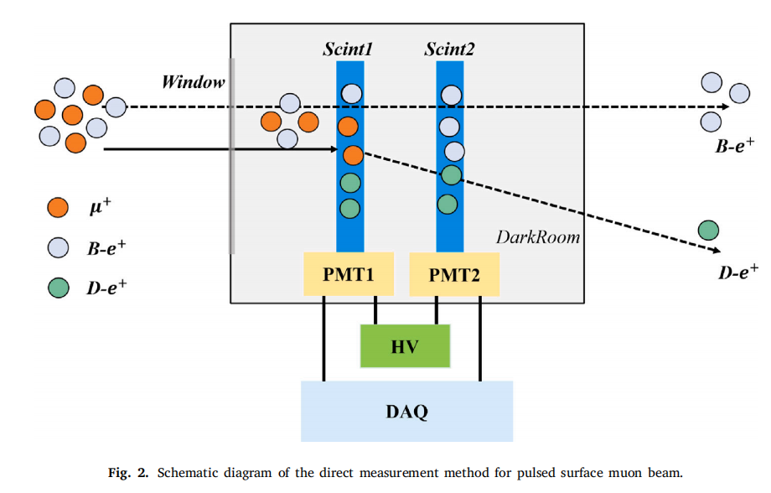
CSNS -- MELODY
https://doi.org/10.1016/j.nima.2025.170871
to measure the muon beam intensity and purity
plastic scintillator detector and current shape discrimination (CSD) method are used
in its test, birks constant has been considered

Slide 8
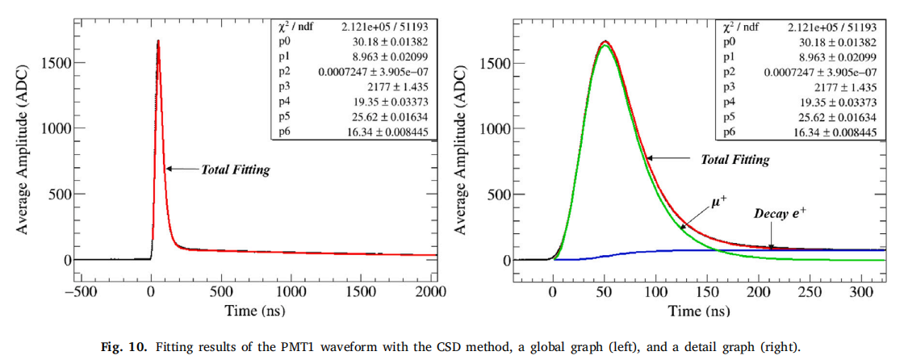
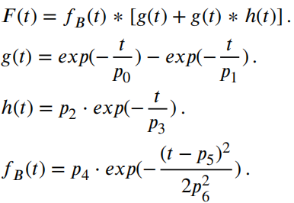

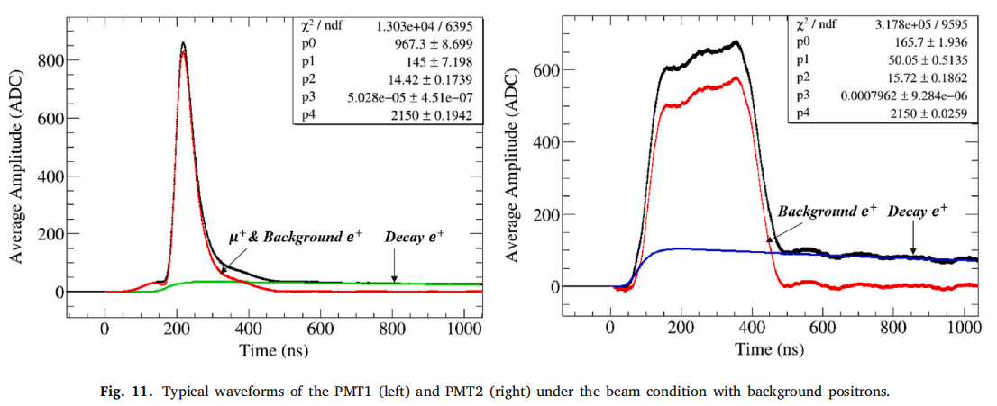
Current shape discrimination
: muon components
: decay positron components

Slide 9
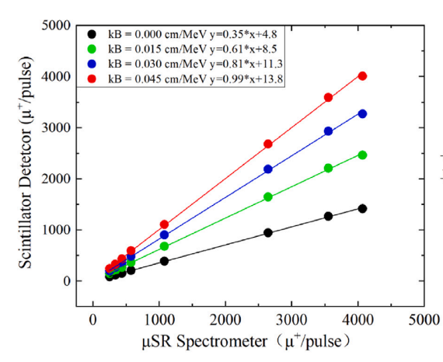
Birks constant
horizontal axis represents the absolute muon count per pulse obtained from μSR spectrometer measurements
vertical axis displays the corresponding intensity values reconstructed using the scintillator detector system with a Birks constant of 0, 0.015, 0.03, and 0.045
optimal agreement between both measurement systems was achieved when applying a Birks constant of 0.045

