Slide 1
触发系统物理性能评价与分析
 | 黄钰贺

Slide 2
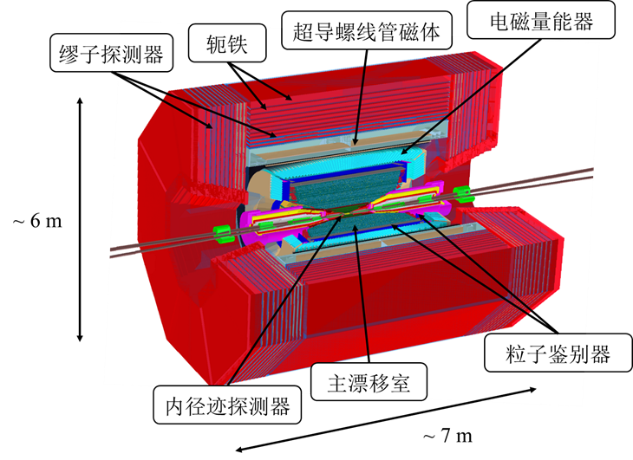
STCF主要特点及触发需求
STCF 主要特点
峰值对撞亮度 > 0.5×10³⁵ cm⁻²·s⁻¹
峰值物理事例率 400 kHz
STCF 触发需求
极高物理触发率 (~99%)
低本底触发率 (< 50 kHz)
高数据量吞吐，低延迟 (< 5 μs)
相邻事例区分能力 (△T < 100 ns)
STCF 1bkg下数据量统计

Slide 3
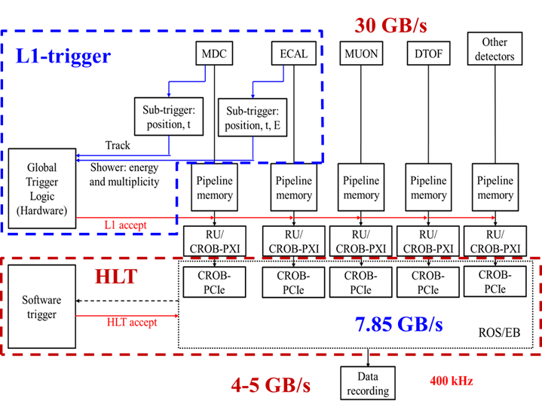
L1触发框架设计
触发框架设计
L1触发与DAQ\CLDT系统的关系

Slide 4
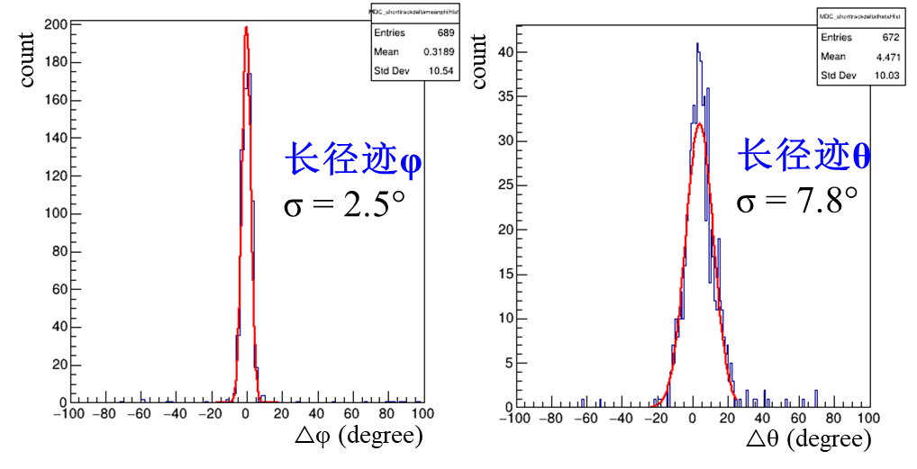
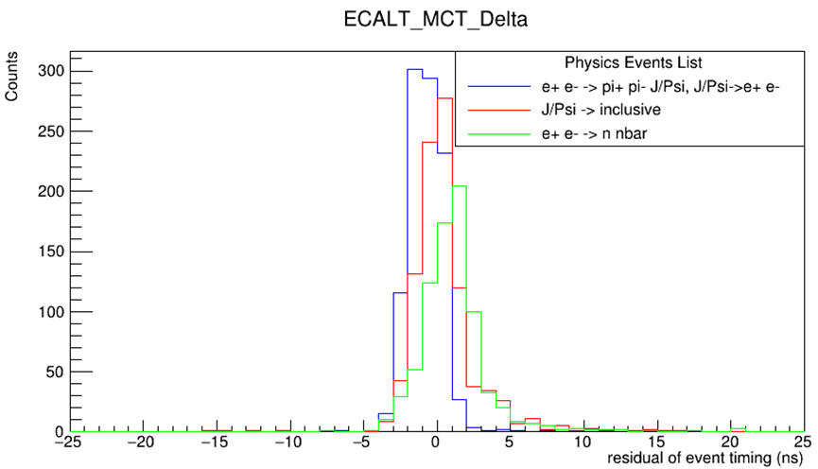
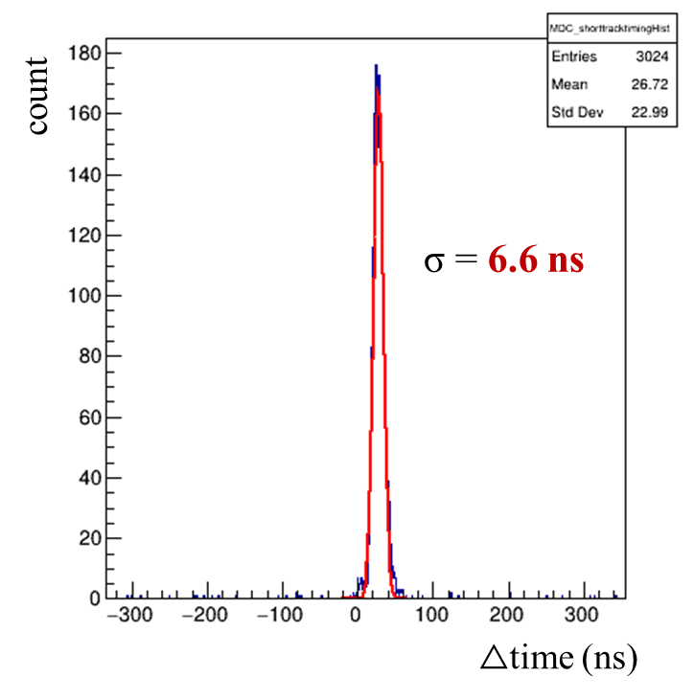
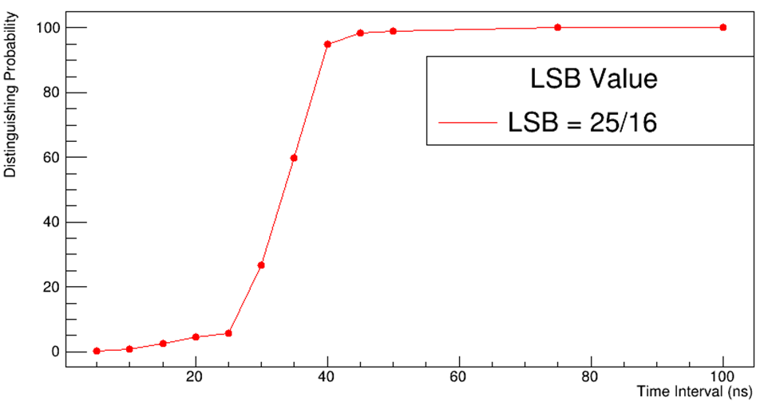
子触发基本性能
MDC子触发性能
ECAL子触发性能
对不同物理过程定时误差均在5ns以内
能够完全区分间隔50ns以上的事例

Slide 5
全局触发触发表设计
触发条件主要为径迹/簇团数量，匹配情况，能量沉积情况和是否背靠背
根据末态径迹数量把带电道分布少、中、多三个并且单独为具有背靠背特征的过程设置背靠背带电道，并选取了末态具备以上特点的物理过程进行性能验证
根据nnbar等末态纯中性过程的特点设置了中性道
根据RBB的背靠背和能量沉积高的特征设置了亮度监测道

Slide 6
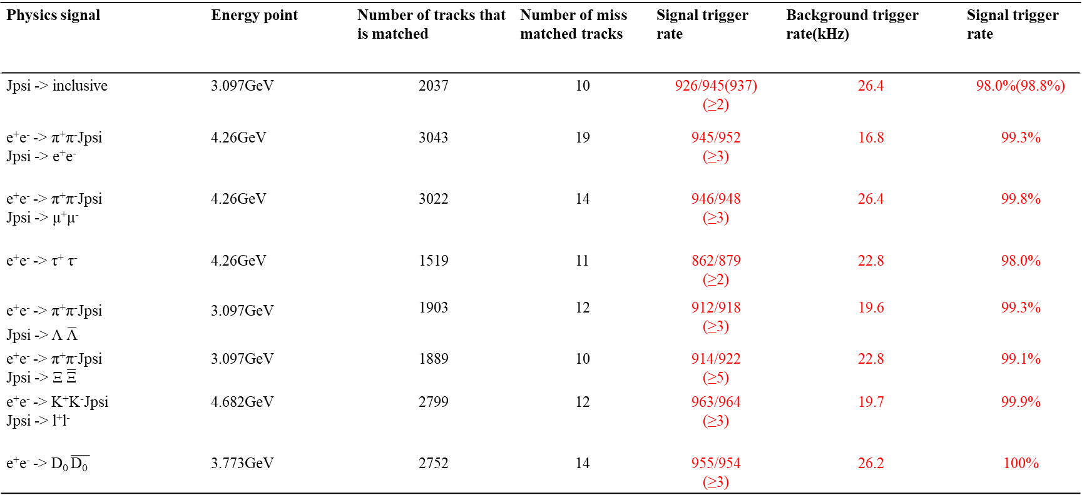
触发性能展示
Physics signal | Energy point | Number of tracks that is matched | Number of miss matched tracks | Signal trigger rate | Background trigger rate(kHz) | Signal trigger rate
Jpsi -> inclusive | 3.097GeV | 2037 | 10 | 926/945(937) (≥2) | 26.4 | 98.0%(98.8%)
e⁺e⁻ -> π⁺π⁻Jpsi Jpsi -> e⁺e⁻ | 4.26GeV | 3043 | 19 | 945/952 (≥3) | 16.8 | 99.3%
e⁺e⁻ -> π⁺π⁻Jpsi Jpsi -> μ⁺μ⁻ | 4.26GeV | 3022 | 14 | 946/948 (≥3) | 26.4 | 99.8%
e⁺e⁻ -> τ⁺ τ⁻ | 4.26GeV | 1519 | 11 | 862/879 (≥2) | 22.8 | 98.0%
e⁺e⁻ -> π⁺π⁻Jpsi Jpsi -> Λ $\overline{\text{Λ}}$ | 3.097GeV | 1903 | 12 | 912/918 (≥3) | 19.6 | 99.3%
e⁺e⁻ -> π⁺π⁻Jpsi Jpsi -> Ξ $\overline{\text{Ξ}}$ | 3.097GeV | 1889 | 10 | 914/922 (≥5) | 22.8 | 99.1%
e⁺e⁻ -> K⁺K⁻Jpsi Jpsi -> l⁺l⁻ | 4.682GeV | 2799 | 12 | 963/964 (≥3) | 19.7 | 99.9%
e⁺e⁻ -> D₀ $\overline{\text{D}\text{0 }}$ | 3.773GeV | 2752 | 14 | 955/954 (≥3) | 26.2 | 100%

Slide 7
触发性能展示
Physics signal | Energy point | Number of tracks that is matched | Number of false matched tracks | Signal trigger efficiency | Background trigger rate(kHz) | Signal trigger efficiency
e⁺e⁻ -> D⁺ D⁻ | 3.773GeV | 2834 | 15 | 983/983 (≥3) | 22.4 | 100%
e⁺e⁻ -> D_{s}⁺ D_{s}⁻ | 4.04GeV | 3491 | 17 | 937/936 (≥5) | 23.5 | 100%
J/psi-> gam invisable | 3.097GeV | - | - | 520/524 (≥1&&gam_momentum>=1) | 24.8 | 99.2%
e⁺e⁻ -> n nbar | 3.097GeV | - | - | 534/548 (≥2&&Nbar≥1&&SigEDep_in_EMC ≥0.6) | 23.7 | 97.4%
e⁺e⁻ -> gam n nbar | 3.097GeV | - | - | 717/730 (≥2&&Nbar≥1&&SigEDep_in_EMC ≥1) | 28.8 | 98.2%
e⁺e⁻ -> gam n nbar(ISR) | 3.713GeV | - | - | 358/366 (≥2&&Nbar≥1&&SigEDep_in_EMC ≥0.75) | 32.8 | 97.8%
Radiative Bhabha | 4.26GeV | 636 | - | 391/400 (≥2&&In[21.4,158.6]) | 0.63% | 97.8%

Slide 8
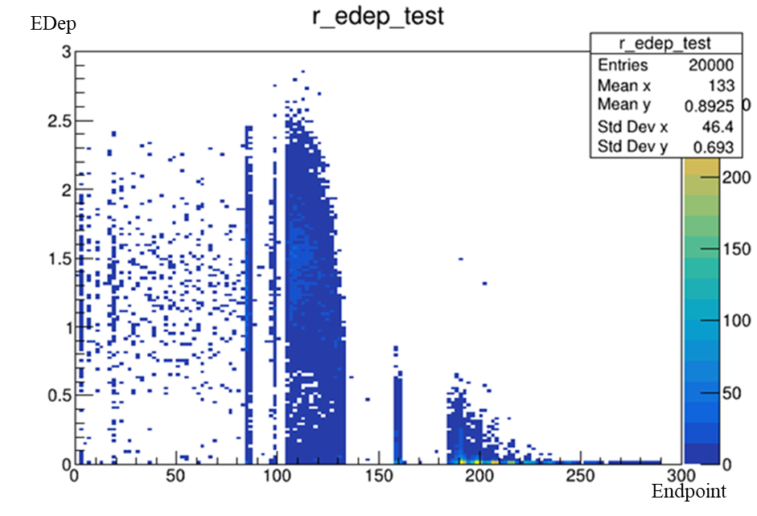
Q1：中性道的筛选条件
中性道筛选条件的选取
 | EDep<0.5GeV | EDep>=0.5GeV | Total
End_beforeECAL | 314 | 1727 | 2041
End_inECAL | 976 | 3965 | 4941
End_outofECAL | 3014 | 4 | 3018
Total | 4304 | 5696 | 10000
由于n在探测器中沉积的能量远小于nbar，在nnbar类的过程中，nbar通常为主要的能量沉积粒子

Slide 9
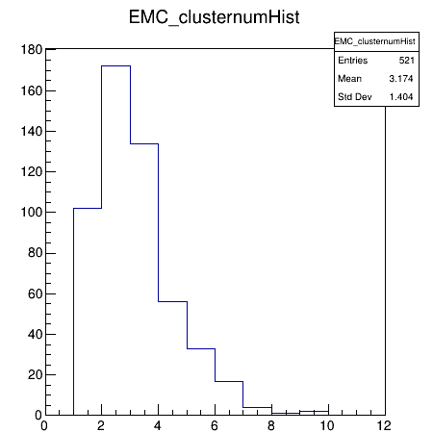
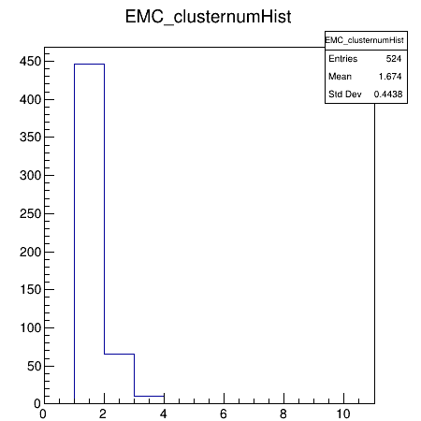
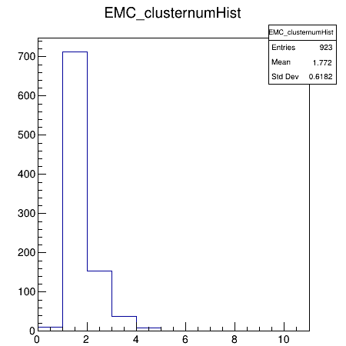
Q2：中性道触发条件设置
含nbar过程簇团数量分布
Gammainv簇团数量分布
本底簇团数量分布
典型中性过程和本底事例的簇团数量分布如上图所示，将中性道按照末态数量分为了三部分并分区设置阈值

Slide 10
Q2：中性道触发条件设置
Physics signal | Energy point | Signal trigger efficiency | Background trigger rate(kHz) | Signal trigger efficiency
J/psi-> gam invisable | 3.097GeV | 526/546 (≥1&&gam_momentum>=1) | 23.8 | 96.3%
e⁺e⁻ -> n nbar | 3.097GeV | 534/548 (≥2&&Nbar≥1&&SigEDep_in_EMC ≥0.6) | 23.7 | 97.4%
e⁺e⁻ -> gam n nbar | 3.097GeV | 717/730 (≥2&&Nbar≥1&&SigEDep_in_EMC ≥1) | 28.8 | 98.2%
e⁺e⁻ -> gam n nbar(ISR) | 3.713GeV | 386/405 (≥2&&Nbar≥1&&SigEDep_in_EMC ≥0.75) | 34.6 | 95.3%
Physics signal | Energy point | Signal trigger efficiency | Background trigger rate(kHz) | Signal trigger efficiency
J/psi-> gam invisable | 3.097GeV | 537/546 (≥1&&gam_momentum>=1) | 27.5 | 98.4%
e⁺e⁻ -> n nbar | 3.097GeV | 537/548 (≥2&&Nbar≥1&&SigEDep_in_EMC ≥0.6) | 31.0 | 98.0%
e⁺e⁻ -> gam n nbar | 3.097GeV | 718/730 (≥2&&Nbar≥1&&SigEDep_in_EMC ≥1) | 37.0 | 98.4%
e⁺e⁻ -> gam n nbar(ISR) | 3.713GeV | 390/405 (≥2&&Nbar≥1&&SigEDep_in_EMC ≥0.75) | 37.0 | 96.3%
内端盖能量阈值无限大
内端盖能量阈值[0.8,1.5]GeV
内端盖定义为靠近束流管的三圈晶体，θ覆盖范围约为[20°,25°]和[155°,160°]

Slide 11
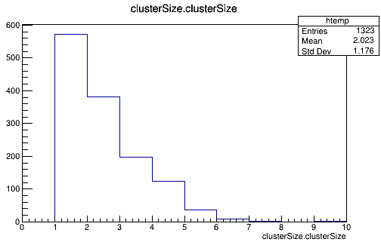
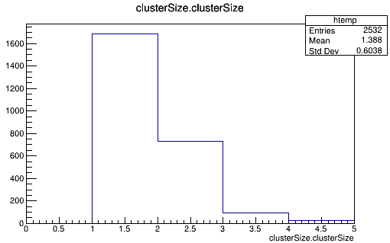
Q2：中性道触发条件设置
Physics signal | Energy point | Signal trigger efficiency(filter在原本基础上要求nbar和gamma范围) | Background trigger rate(kHz) | Signal trigger efficiency
J/psi-> gam invisable | 3.097GeV | 520/524 (≥1&&gam_momentum>=1) | 24.8 | 99.2%
e⁺e⁻ -> n nbar | 3.097GeV | 512/523 (≥2&&Nbar≥1&&SigEDep_in_EMC ≥0.6) | 24.8 | 97.9%
e⁺e⁻ -> gam n nbar | 3.097GeV | 695/706 (≥2&&Nbar≥1&&SigEDep_in_EMC ≥1) | 25.5 | 98.4%
e⁺e⁻ -> gam n nbar(ISR) | 3.713GeV | 358/366 (≥2&&Nbar≥1&&SigEDep_in_EMC ≥0.75) | 32.8 | 97.8%
nbar
受影响不同的原因
ECAL自身定位精度
Nbar和gamma产生簇团的大小不同
含nbar的过程与以gamma为主要能量沉积粒子过程在簇团总数上的区别
gamma
改为在filter中去除了击中内端盖的nbar或gamma
减少了几何效率但是能有效提升信号触发率并且对本底触发率的影响很小

Slide 12
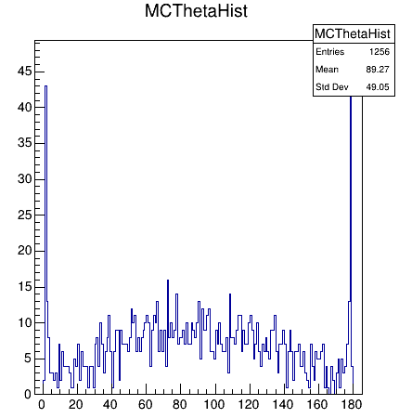
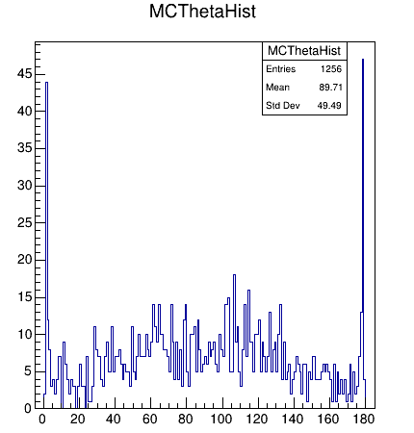
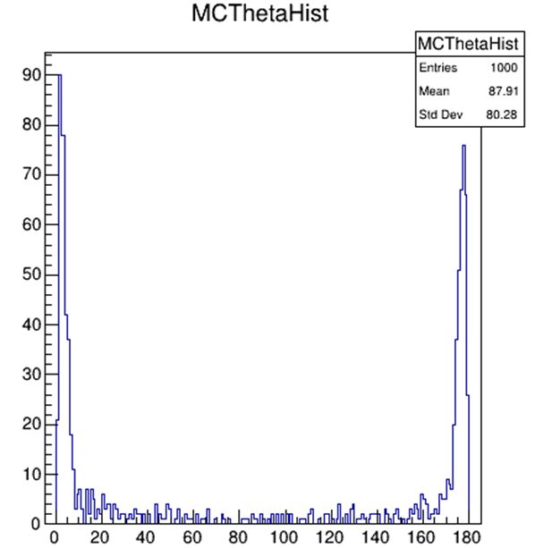
Q2：中性道触发条件设置
Gamnnbar过程中gamma粒子的Iptheta分布
Gaminv过程中gamma粒子的Iptheta分布
GamnnbarISR过程中gamma粒子的Iptheta分布
三个带有gamma的中性过程中，gamnnbar_ISR过程的gamma几乎没有进入接收度

Slide 13
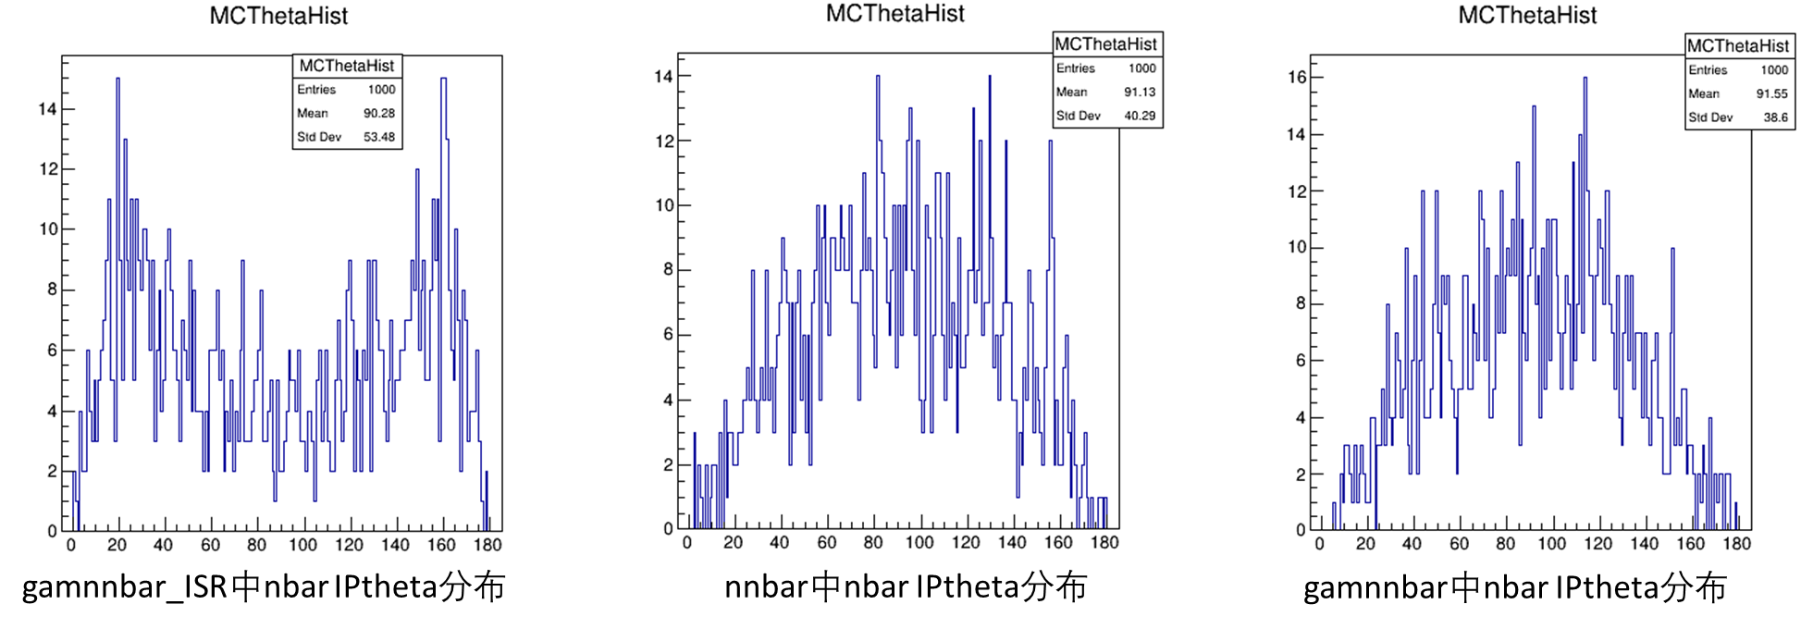
Q2：中性道触发条件设置
同为含有nnbar的过程，gamnnbar_ISR过程的nbar极角分布也与另外两个过程不同
更容易击中内端盖导致能量丢失的概率更高

Slide 14
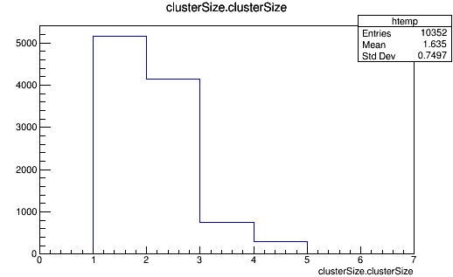
Q3：RBB的选择条件
RBB选择条件设置
RBB过程有概率只有1个末态粒子进入谱仪接收度，在event filter中没有将此类事例作为”好事例”
e有大概率产生2个TC大小的簇团，在接收度边缘位置击中时可能出现能量丢失，使该事例被误判或无法触发，因此在event filter中将内端盖最内圈晶体去除
内端盖最内圈晶体中心对应的θ角是20.5557°，在θ方向覆盖的角度范围是1.60477°，因此去除该圈晶体后，实际接收度范围约为[21.4°,158.6°]
1GeV e-产生的簇团size大小

Slide 15
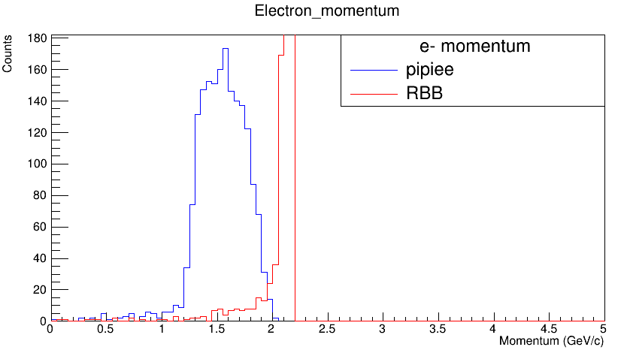
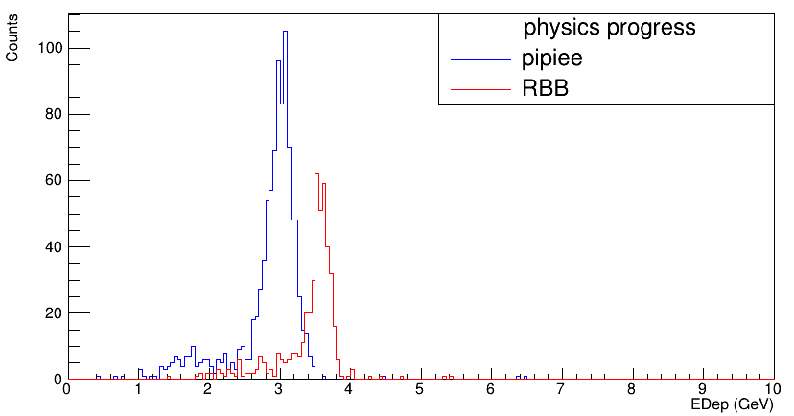
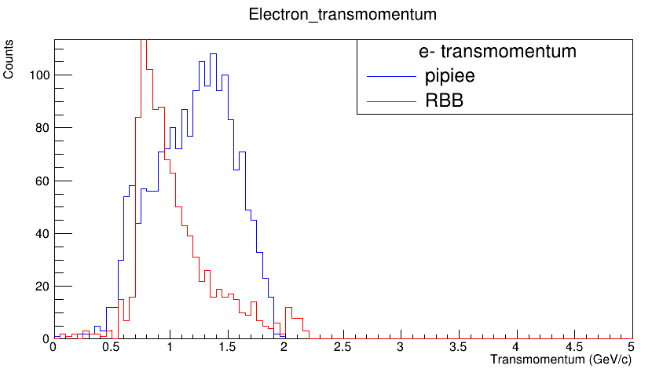
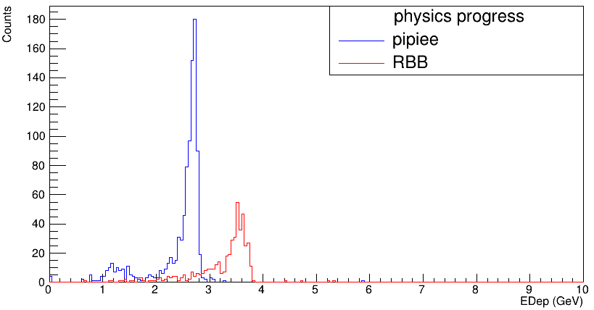
Q4：RBB触发条件设置
RBB触发条件设置
RBB过程和pipiee过程的动量(左上)和横动量(左下)分布图，RBB中e±的横动量基本保持在0.5GeV/c以上
RBB过程和pipiee过程的总能量沉积分布不能完全分离(右上图)
统计能量沉积超过0.6GeV以上簇团的总能量沉积 (右下图)

Slide 16
Q5：去除2圈晶体后的影响
选择条件 (要求为满足对应条件的粒子≥2) | 未去除晶体时的触发率 | 去除2圈晶体后的触发率 (在选择条件的基础上再删除2圈晶体)
[21.4°,158.6°] | 391/400(97.8%) | 348/372(93.5%)
[21.4°,158.6°]&&pt≥0.5GeV/c | 385/392(98.2%) | 342/364(94.0%)
[20°,160°]&&pt≥0.5GeV/c | 445/457(97.4%) | 402/429(93.7%)
[20°,160°] | 453/467(97.0%) | 410/439(93.4%)
去除的是端盖第10圈晶体，对应晶体中心的θ角度是33.7°和146.3°，晶体覆盖的角度范围是1.42°，因此在filter中去除的范围为[32.99°,34.41°]和[145.59°,147.01°]
去除2圈晶体后，RBB触发率下降明显，对比去除晶体前后的事例特点得出的结论为当末态粒子击中的位置在上述晶体范围之外的场合，也有概率丢失部分能量，导致无法触发
去除2圈晶体实际带来的影响至少为6圈左右晶体的能量沉积可能丢失

Slide 17
Q6：多倍本底的情况
e⁺e⁻ -> π⁺π⁻Jpsi Jpsi -> e⁺e⁻ | Number of tracks that should( is ) matched | Number of false matched tracks | Signal trigger rate | Background trigger rate(kHz) | Trigger channel 05 background trigger rate(kHz) | Trigger channel 02 background trigger rate(kHz)
1bkg | 3043 | 19 | 99.3% | 16.8 | 7.35 | 9.45
2bkg | 2936 | 32 | 99.1% | 68.3 | 36.8 | 28.4
3bkg | 2902 | 38 | 98.6% | 101.9 | 56.7 | 41.0
5bkg | 2753 | 108 | 98.6% | 321.4 | 201.7 | 107.1
本底触发率集中在少径迹道和中性道
少径迹道本底触发率较稳定
中性道本底触发率波动较大
Jpsi -> inclusive | Number of tracks that should( is ) matched | Number of false matched tracks | Signal trigger rate | Background trigger rate(kHz) | Trigger channel 05 background trigger rate(kHz) | Trigger channel 02 background trigger rate(kHz)
1bkg | 2037 | 10 | 98.0% | 26.4 | 16.9 | 7.41
2bkg | 2001 | 20 | 97.6% | 61.4 | 46.6 | 14.8
3bkg | 1950 | 80 | 97.5% | 139.7 | 87.8 | 47.6
5bkg | 1870 | 125 | 96.7% | 319.6 | 171.4 | 121.7

Slide 18
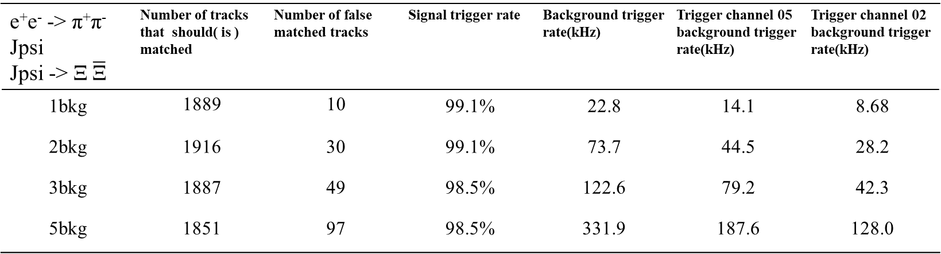
Q6：多倍本底的情况
e⁺e⁻ -> τ⁺ τ⁻ | Number of tracks that should( is ) matched | Number of false matched tracks | Signal trigger rate | Background trigger rate(kHz) | Trigger channel 05 background trigger rate(kHz) | Trigger channel 02 background trigger rate(kHz)
1bkg | 1519 | 11 | 98.0% | 22.8 | 17.1 | 4.55
2bkg | 1459 | 34 | 95.9% | 46.6 | 26.2 | 20.5
3bkg | 1445 | 60 | 96.5% | 118.3 | 75.1 | 42.1
5bkg | 1326 | 109 | 95.1% | 292.4 | 169.5 | 105.8
末态数量较少的过程在高本底下触发率下降较快
末态数量较多的过程在高本底下触发率仍较高
e⁺e⁻ -> π⁺π⁻Jpsi Jpsi -> Ξ $\overline{\text{Ξ}}$ | Number of tracks that should( is ) matched | Number of false matched tracks | Signal trigger rate | Background trigger rate(kHz) | Trigger channel 05 background trigger rate(kHz) | Trigger channel 02 background trigger rate(kHz)
1bkg | 1889 | 10 | 99.1% | 22.8 | 14.1 | 8.68
2bkg | 1916 | 30 | 99.1% | 73.7 | 44.5 | 28.2
3bkg | 1887 | 49 | 98.5% | 122.6 | 79.2 | 42.3
5bkg | 1851 | 97 | 98.5% | 331.9 | 187.6 | 128.0

Slide 19
Q6：多倍本底的情况
e⁺e⁻ -> n nbar | Signal trigger rate | Background trigger rate(kHz) | Trigger channel 05 background trigger rate(kHz)
1bkg | 512/523(97.9%) | 24.8 | 21.0
2bkg | 532/550(96.7%) | 60.0 | 49.1
3bkg | 526/567(92.8%) | 112.9 | 82.9
5bkg | 500/587(85.2%) | 281.1 | 190.1
e⁺e⁻ -> n nbar | Signal trigger rate | Background trigger rate(kHz) | Trigger channel 05 background trigger rate(kHz)
1bkg | 476/489(97.3%) | 18.4 | 14.3
2bkg | 476/489(97.3%) | 45.0 | 34.8
3bkg | 471/501(94.0%) | 83.8 | 51.9
5bkg | 444/515(86.2%) | 231.1 | 137.9
表1
表2
e⁺e⁻ -> π⁺π⁻Jpsi Jpsi -> e⁺e⁻ | Signal trigger rate | Background trigger rate(kHz) | Trigger channel 05 background trigger rate(kHz)
1bkg | 99.2% | 13.7 | 4.2
2bkg | 98.9% | 58.8 | 26.3
3bkg | 98.6% | 83.0 | 35.7
5bkg | 98.2% | 247.9 | 127.1
表1为常规的选择和触发条件设置下nnbar过程的触发性能
表2和表3为在选择和触发条件中去除端盖后的触发性能
高本底水平下把端盖部分信息舍弃对压低本底触发率有一定帮助
表3

Slide 20
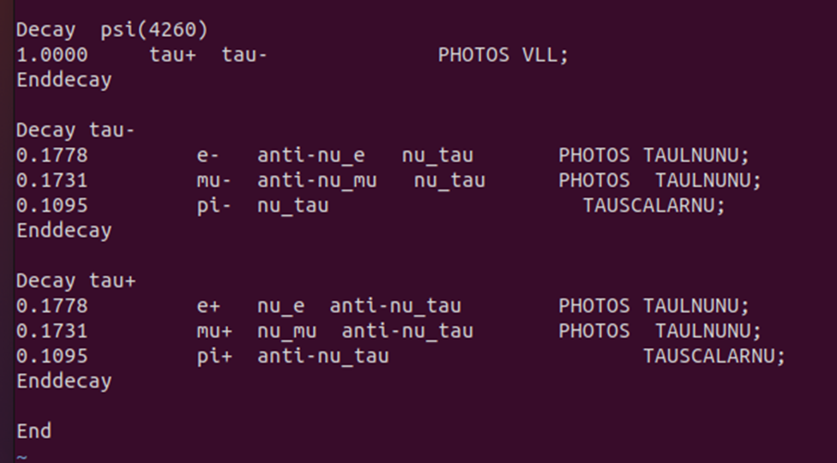
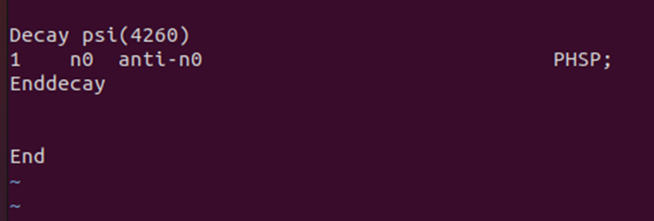
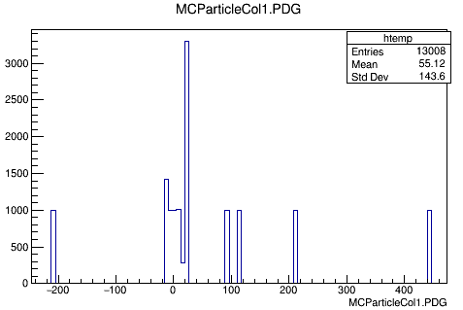
其他
nnbar的decay文件设置
taupair的decay文件设置
1月份改为使用KKMC直接生成的tau pair后无末态
物理方面有没有其他比较感兴趣的过程？
目前Jpsi -> inclusive和e⁺e⁻ -> τ⁺ τ⁻两个过程的触发率仍在99%以下
2.6版本的oscar下有部分物理过程的产生子似乎有问题(taupair过程没有末态，nnbar过程普遍有2条末态径迹)

Slide 21
总结
STCF 触发需求与触发系统设计性能对比
极高物理触发率 （~99%）
典型带电道触发率99%以上
中性道平均触发率98%以上
低本底触发率 （< 50 kHz）
平均本底触发率30kHz以下
高数据量吞吐，低延迟(< 5 μs)
ECAL硬件算法延迟150ns
MDC硬件算法延迟350+200ns
GTL硬件算法延迟预计在1~2μs
相邻事例区分能力（△T < 100 ns）
能完全区分间隔50ns以上的事例

Slide 22
谢谢

Slide 23
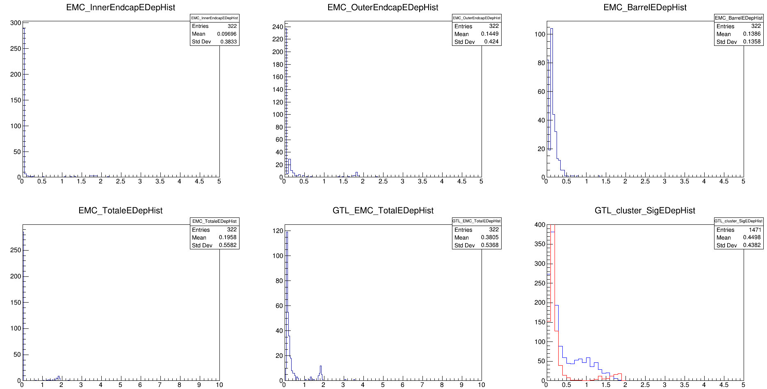
Backup
不去除内端盖时本底能量沉积特点

Slide 24
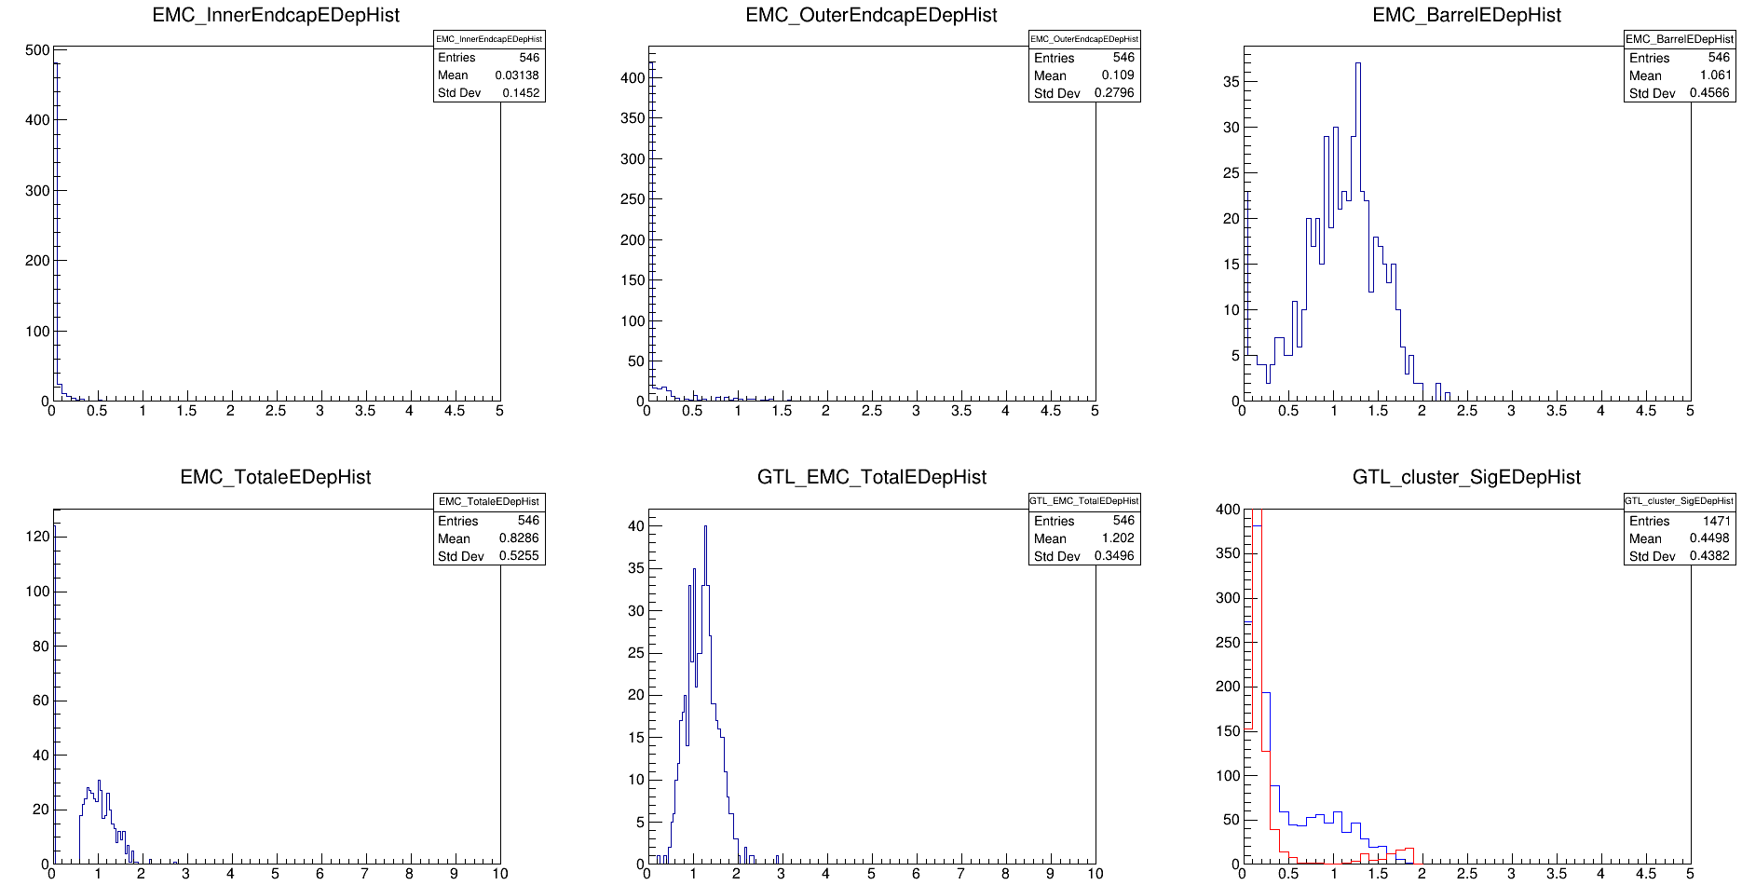
Backup
不去除内端盖时nnbar能量沉积特点

Slide 25
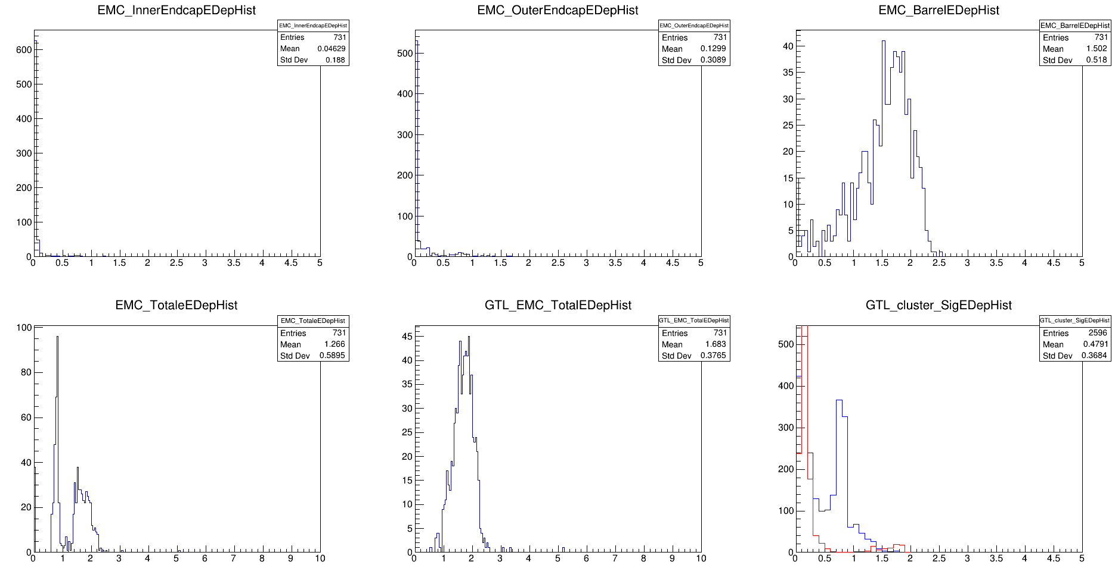
Backup
不去除内端盖时gamnnbar能量沉积特点

Slide 26
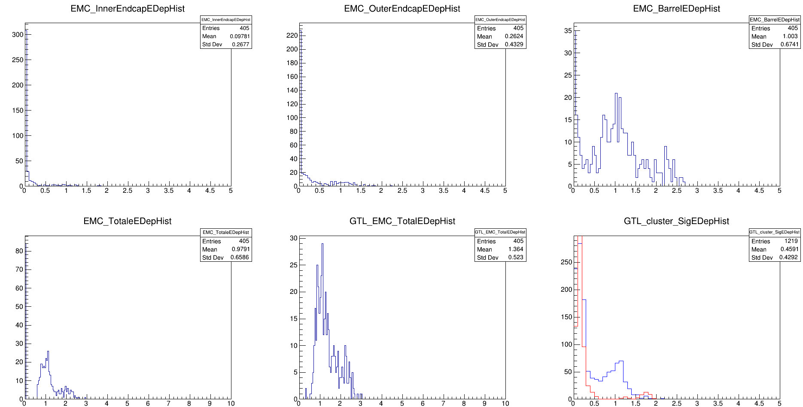
Backup
不去除内端盖时gamnnbarISR能量沉积特点

Slide 27
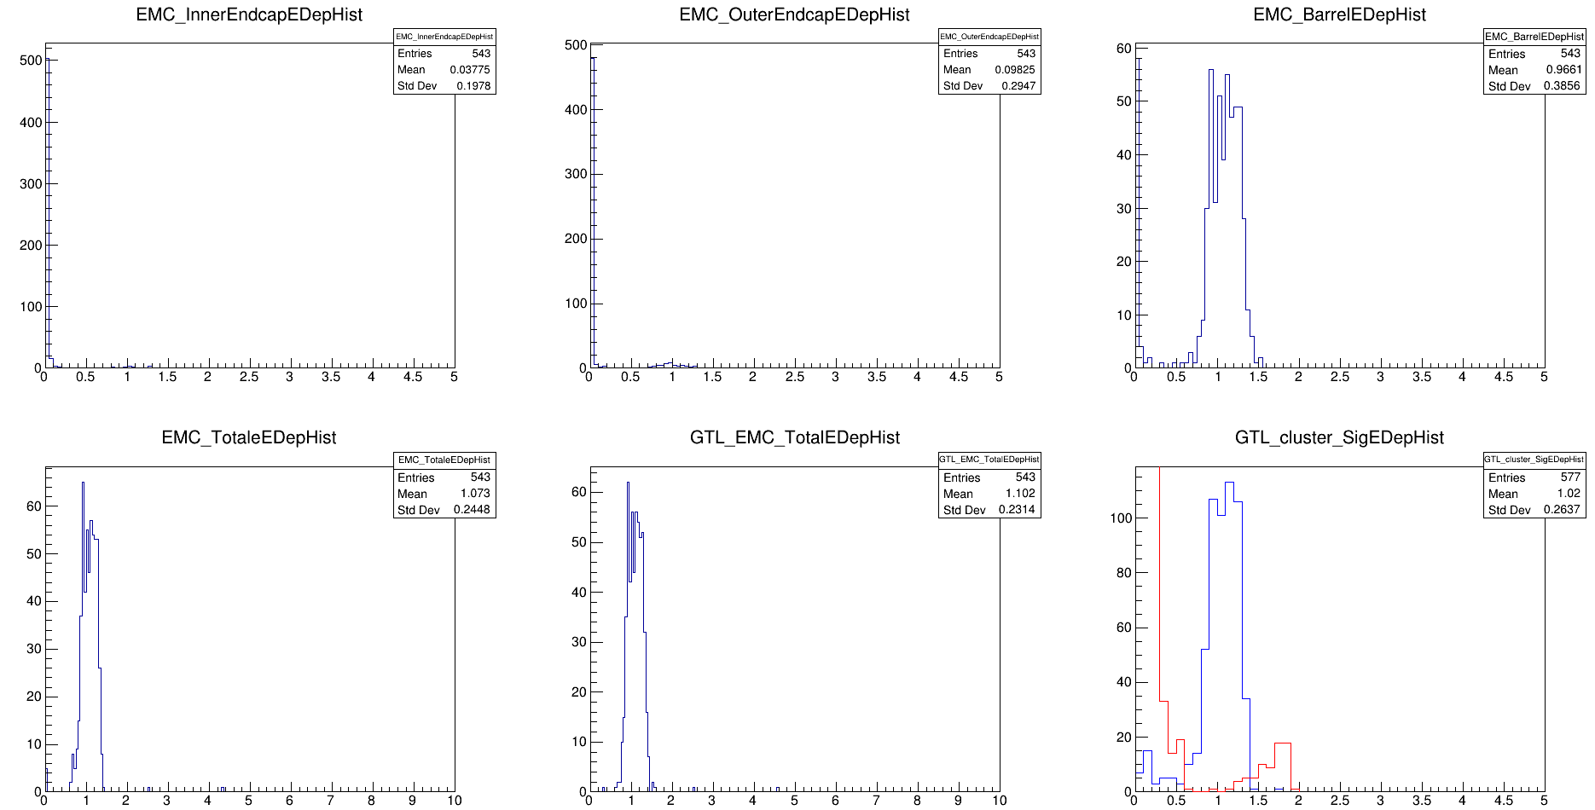
Backup
不去除内端盖时gaminv能量沉积特点

Slide 28
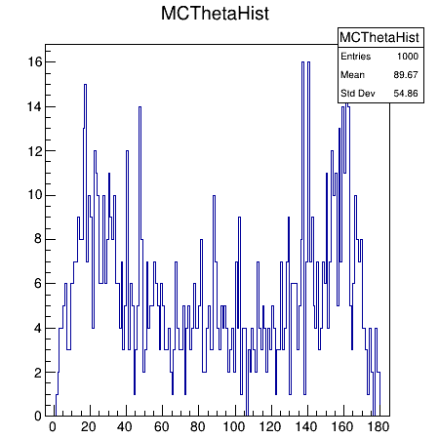
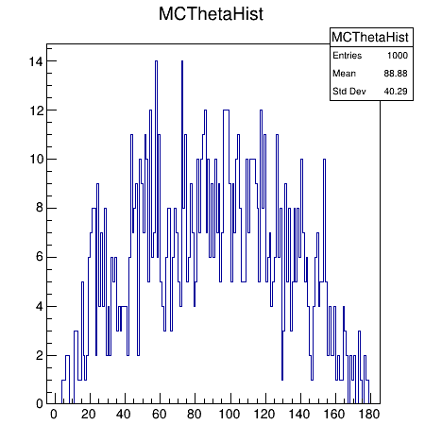
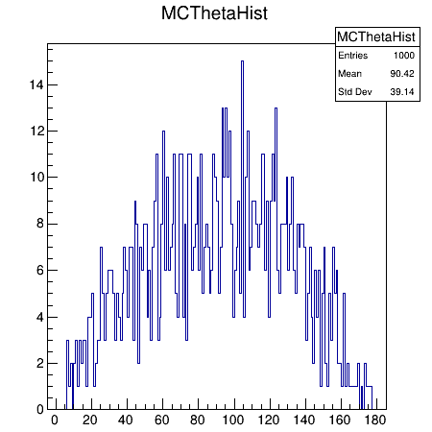
Backup
gamnnbarISR过程中n的Iptheta分布
nnbar过程中n的Iptheta分布
Gamnnbar过程中n的Iptheta分布

Slide 29
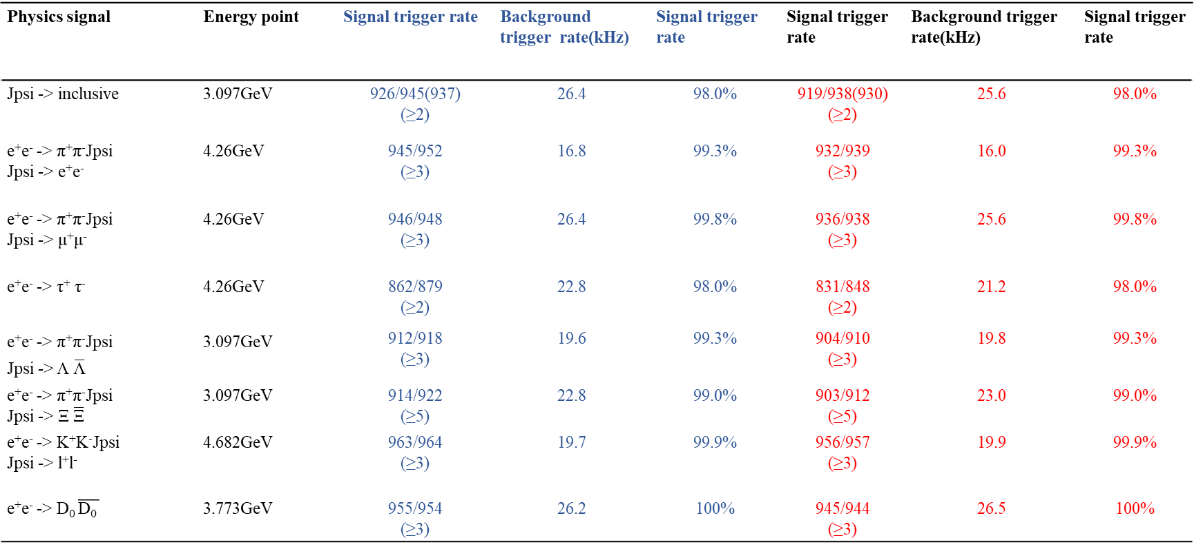
Backup
去除2圈晶体后的触发效果(蓝色是未去除前的效果)
Physics signal | Energy point | Signal trigger rate | Background trigger rate(kHz) | Signal trigger rate | Signal trigger rate | Background trigger rate(kHz) | Signal trigger rate
Jpsi -> inclusive | 3.097GeV | 926/945(937) (≥2) | 26.4 | 98.0% | 919/938(930) (≥2) | 25.6 | 98.0%
e⁺e⁻ -> π⁺π⁻Jpsi Jpsi -> e⁺e⁻ | 4.26GeV | 945/952 (≥3) | 16.8 | 99.3% | 932/939 (≥3) | 16.0 | 99.3%
e⁺e⁻ -> π⁺π⁻Jpsi Jpsi -> μ⁺μ⁻ | 4.26GeV | 946/948 (≥3) | 26.4 | 99.8% | 936/938 (≥3) | 25.6 | 99.8%
e⁺e⁻ -> τ⁺ τ⁻ | 4.26GeV | 862/879 (≥2) | 22.8 | 98.0% | 831/848 (≥2) | 21.2 | 98.0%
e⁺e⁻ -> π⁺π⁻Jpsi Jpsi -> Λ $\overline{\text{Λ}}$ | 3.097GeV | 912/918 (≥3) | 19.6 | 99.3% | 904/910 (≥3) | 19.8 | 99.3%
e⁺e⁻ -> π⁺π⁻Jpsi Jpsi -> Ξ $\overline{\text{Ξ}}$ | 3.097GeV | 914/922 (≥5) | 22.8 | 99.0% | 903/912 (≥5) | 23.0 | 99.0%
e⁺e⁻ -> K⁺K⁻Jpsi Jpsi -> l⁺l⁻ | 4.682GeV | 963/964 (≥3) | 19.7 | 99.9% | 956/957 (≥3) | 19.9 | 99.9%
e⁺e⁻ -> D₀ $\overline{\text{D}\text{0 }}$ | 3.773GeV | 955/954 (≥3) | 26.2 | 100% | 945/944 (≥3) | 26.5 | 100%

Slide 30
Backup
去除2圈晶体后的触发效果
Physics signal | Energy point | Signal trigger rate | Background trigger rate(kHz) | Signal trigger rate | Signal trigger efficiency | Background trigger rate(kHz) | Signal trigger efficiency
e⁺e⁻ -> D⁺ D⁻ | 3.773GeV | 983/983 (≥3) | 22.4 | 100% | 976/976 (≥3) | 22.5 | 100%
e⁺e⁻ -> D_{s}⁺ D_{s}⁻ | 4.04GeV | 937/936 (≥5) | 23.5 | 100% | 913/911 (≥5) | 22.0 | 100%
J/psi-> gam invisable | 3.097GeV | 520/524 (≥1&&gam_momentum>=1) | 24.8 | 99.2% | 511/515 (≥1&&gam_momentum>=1) | 25.2 | 99.2%
e⁺e⁻ -> n nbar | 3.097GeV | 534/548 (≥2&&Nbar≥1&&SigEDep_in_EMC ≥0.6) | 23.7 | 97.4% | 522/535 (≥2&&Nbar≥1&&SigEDep_in_EMC ≥0.6) | 22.4 | 97.6%
e⁺e⁻ -> gam n nbar | 3.097GeV | 717/730 (≥2&&Nbar≥1&&SigEDep_in_EMC ≥1) | 28.8 | 98.2% | 713/726 (≥2&&Nbar≥1&&SigEDep_in_EMC ≥1) | 28.9 | 98.2%
e⁺e⁻ -> gam n nbar(ISR) | 3.713GeV | 358/366 (≥2&&Nbar≥1&&SigEDep_in_EMC ≥0.75) | 32.8 | 97.8% | 350/358 (≥2&&Nbar≥1&&SigEDep_in_EMC ≥0.75) | 30.7 | 97.8%
RBB | 4.26GeV | 391/400 (≥2&&pt≥0.5GeV/c) | 0.63% | 97.8% | 348/372 (≥2&&pt≥0.5GeV/c) | 0.64% | 93.5%

Slide 31
Backup
Physics signal | Energy point | Signal trigger efficiency | Background trigger rate(kHz) | Signal trigger efficiency
e⁺e⁻ -> n nbar | 3.097GeV | 548/688(628) (≥2&&Nbar≥1&&EndinECAL) | 21.8 | 79.7%
e⁺e⁻ -> gam n nbar | 3.097GeV | 738/757 (≥2&&Nbar≥1&&EndinECAL) | 30.4 | 97.5%
e⁺e⁻ -> gam n nbar(ISR) | 3.713GeV | 396/511(462) (≥2&&Nbar≥1&&EndinECAL) | 33.3 | 77.5%
Physics signal | Energy point | Signal trigger efficiency | Background trigger rate(kHz) | Signal trigger efficiency
e⁺e⁻ -> n nbar | 3.097GeV | 534/548 (≥2&&Nbar≥1&&SigEDep_in_EMC ≥0.6) | 23.7 | 97.4%
e⁺e⁻ -> gam n nbar | 3.097GeV | 717/730 (≥2&&Nbar≥1&&SigEDep_in_EMC ≥1) | 28.8 | 98.2%
e⁺e⁻ -> gam n nbar(ISR) | 3.713GeV | 386/405 (≥2&&Nbar≥1&&SigEDep_in_EMC ≥0.75) | 34.6 | 95.3%
死亡位置在ECAL以内
能量沉积在0.5GeV以上
采用能量沉积在0.5GeV以上可以获得更高的触发率，但是事例利用率低于使用死亡位置在ECAL以内的情况
Gamnnbar过程的主要末态为gamma，因此对筛选条件的变化不敏感

Slide 32
Backup
 | No | 触发道类型 | 触发道设置
Charged trigger channel | 01 | Charged final state with back-to-back characteristic | IfRBB == 0 && (tempEMCpair[x]>=1 || tempMDCpair>=1) && (((EMC_totalclusternumber[x]>=2 && MDC_TWtracknum[x]>=2) && (Barrelmatch_num[x]>=1 || Barrelmightmatch_num[x]>=1 || (Endcapmatch_num[x]>=1 && Endcapmatch_num[x]<=2 && Inner_Endcap_match_num[x]<2)))) && GTL_EMC_TotalEDep[x]>=EMC_totalEDepmidthreshold&&GTL_total_highcluster_EDep[x]<3
3 | 02 | Charged final state with few final states (signal track number≤2) | IfRBB == 0 && EMC_totalclusternumber[x]>=1 && EMC_totalclusternumber[x]<=4 && MDC_TWtracknum[x]>=1 && MDC_TWRetracknum[x]<=4 && (((Barrelmatch_num[x]+Endcapmatch_num[x]>=1||Barrelmightmatch_num[x]+Endcapmightmatch_num[x]>=2) && Inner_Endcap_match_num[x]<=1 && GTL_EMC_TotalEDep[x]>=0.15)) &&GTL_EMC_TotalEDep[x]<EMC_totalEDephighthreshold&&EMC_overhighEDepthreshold[x]<=1
4 | 03 | Charged final state with middle final states (3≤signal track number≤6) | IfRBB == 0 && (EMC_totalclusternumber[x]>=3 && EMC_totalclusternumber[x]<=7) && ((MDC_TWtracknum[x]>=3 && MDC_TWRetracknum[x]<=7 && (Barrelmatch_num[x]>=1 || Barrelmightmatch_num[x]>=1 || (Endcapmatch_num[x]>=1&&Endcapmatch_num[x]<=2 && Inner_Endcap_match_num[x]<=1)) && GTL_EMC_TotalEDep[x]>=EMC_totalEDeplowthreshold) || (MDC_TWtracknum[x]>=1&&(Barrelmatch_num[x]+Endcapmatch_num[x]+Barrelmightmatch_num[x]) >=1 && (GTL_EMC_TotalEDep[x]>=EMC_totalEDepmidthreshold) && MDC_TWRetracknum[x]<=3) || (Barrelmatch_num[x]+Endcapmatch_num[x]==0 && MDC_TWtracknum[x]>=2 && GTL_EMC_TotalEDep[x]>=0.6))
5 | 04 | Charged final state with massive final states (signal track number≥7) | IfRBB == 0 && (EMC_totalclusternumber[x]>=7 || MDC_TWRetracknum[x]>=7) && (Barrelmatch_num[x]>=1 || Barrelmightmatch_num[x]>=1 || (Endcapmatch_num[x]>=1 && Endcapmatch_num[x]<=2 && Inner_Endcap_match_num[x]<1)) && GTL_EMC_TotalEDep[x]>=EMC_totalEDeplowthreshold
Neutral trigger channel | 05 | Neutral final states | IfRBB == 0 && ((EMC_totalclusternumber[x]>2 && MDC_TWtracknum[x]<=1 && (EMC_BarrelEDep[x]>=0.4 || GTL_EMC_TotalEDep[x]>=0.6)) || (EMC_totalclusternumber[x]==2 && MDC_TWtracknum[x]<1 && (EMC_BarrelEDep[x]>=0.4 || (EMC_OuterEndcapEDep[x]>=0.5 && EMC_OuterEndcapEDep[x]<=1.4))) || (EMC_totalclusternumber[x]==1 && (EMC_BarrelEDep[x]>=0.5 || (EMC_OuterEndcapEDep[x]>=0.5 && EMC_OuterEndcapEDep[x]<=1.4))&&MDC_TWtracknum[x]<=1))&&GTL_total_highcluster_EDep[x]<3
Luminosity monitoring trigger channel | 06 | Radiative Bhabha | ((tempEMCRBBpair[x]>=1 || MDC_RBBcount==1) && MDC_TWtracknum[x]>=0 && MDC_TWRetracknum[x]<4 && (GTL_total_highcluster_EDep[x]>=3 || ((EMC_InnerEndcapEDep[x]>=1.5 || (EMC_InnerEndcapEDep[x]+EMC_OuterEndcapEDep[x])>=2.8) && EMC_BarrelEDep[x]<=0.2)) && (Barrelmatch_num[x]+Endcapmatch_num[x])<=3)
Random trigger channel

Slide 33
Backup
Trigger criteria | Definition
ECAL
ECAL_totalclusternumber | ECAL中的簇团数量
ECAL_overEDepthreshold_clusternum | ECAL 中单个簇团能量沉积超过一定阈值的簇团数量
ECAL_TotalClusterEDep | ECAL 中的总能量沉积
ECAL_RegionEDep | ECAL桶部，外端盖，内端盖各自的总能量沉积
ECAL_Endcapbtb | ECAL端盖是否有背靠背簇团
ECAL_Barrelbtb | ECAL桶部是否有背靠背簇团
ECAL_Total_high_EDep | ECAL中高能簇团(>0.6GeV)沉积的能量之和
MDC
MDC_totaltracknumber | MDC中的识别径迹总数
MDC_totalretracknumber | MDC中的能够到达ECAL的径迹总数
MDC_btb | MDC中是否有背靠背径迹
Global
Barrelmatch_num | 桶部的匹配数量
OuterEndcapmatch_num | 外端盖的匹配数量
InnerEndcapmatch_num | 内端盖的匹配数量
Match_num | 总的匹配数量
Non-match_num (Might_matchnum) | 在空间维度(方位角，极角)没能完成匹配，但是在时间维度上能够与ECAL时间片段匹配的径迹数量
IfRBB | 是否满足RBB道的触发条件

Slide 34
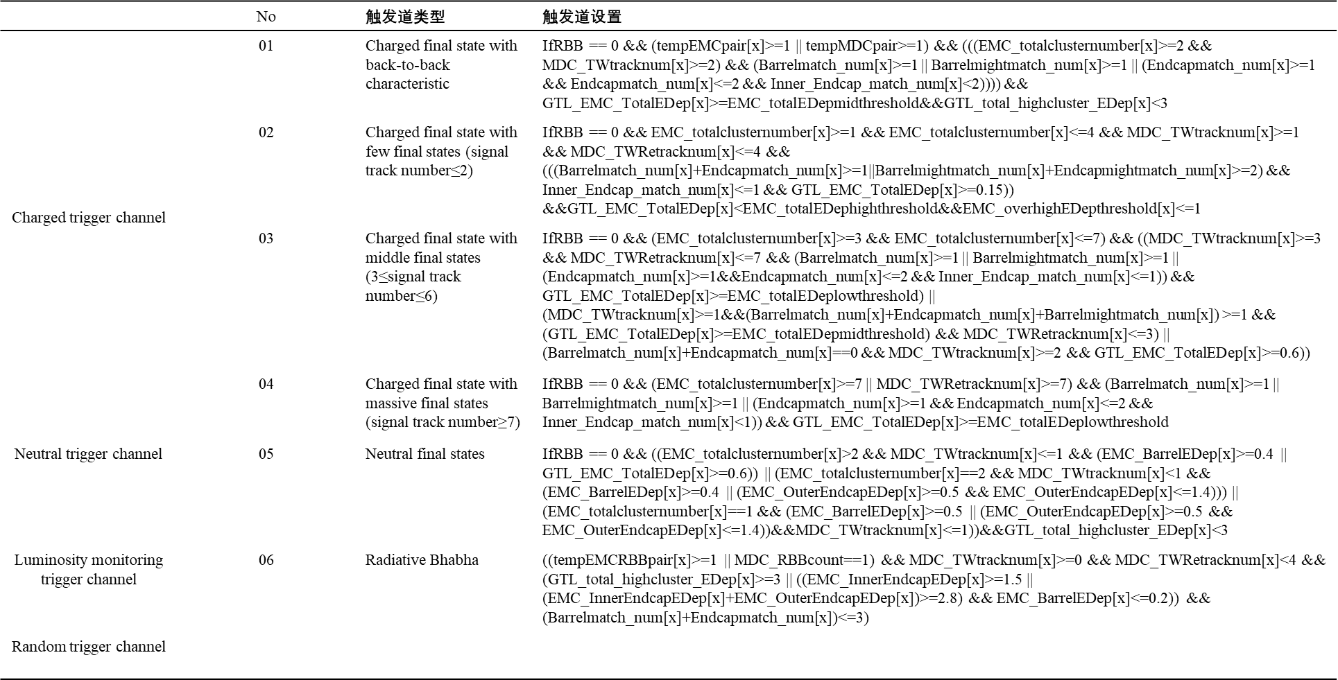
Backup

