Slide 1
Physics of Energy Correlators: an Overview
朱华星
北京大学
碎裂函数和能量关联研讨会
兰州近代物理研究所
2025年8月9日

Slide 2
Outline
Energy correlators as a systematic approach to organize collider measurements
Why now?
50 years of energy correlators: experiment and theory
Highlight of new experimental results
New opportunities at new energy scale

Slide 3
Outline
Energy correlators as a systematic approach to organize collider measurements
Why now?
50 years of energy correlators: experiment and theory
Highlight of new experimental results
New opportunities at new energy scale
From R-ratio to N-point correlator; EECs v.s. event shape observable; Generalization to multiple colliders
From scaling phenomenology to CFT; Analyticity in spin; Conformal collider physics; scaling at the LHC
EEC illustration; Pluto, SLD; highlight in theory;
numeric NNLO; analytic NLO, NNLO
alpha_s, confinement transition, medium modification, charge dynamics,
LEP re-analysis
The missing energy window; An analogy: PDFs at low energy;
a-theorem and one-point energy flux;

Slide 4

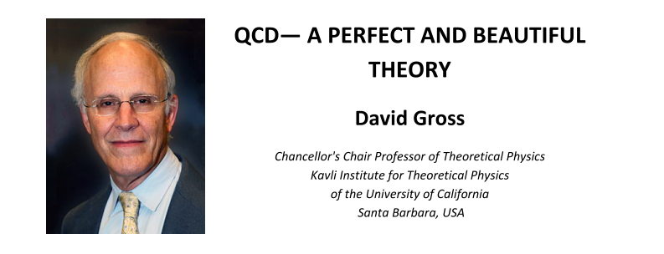
Seminar at JINR in Dubna
天地有大美而不言
                —《庄子：知北游》

Slide 5
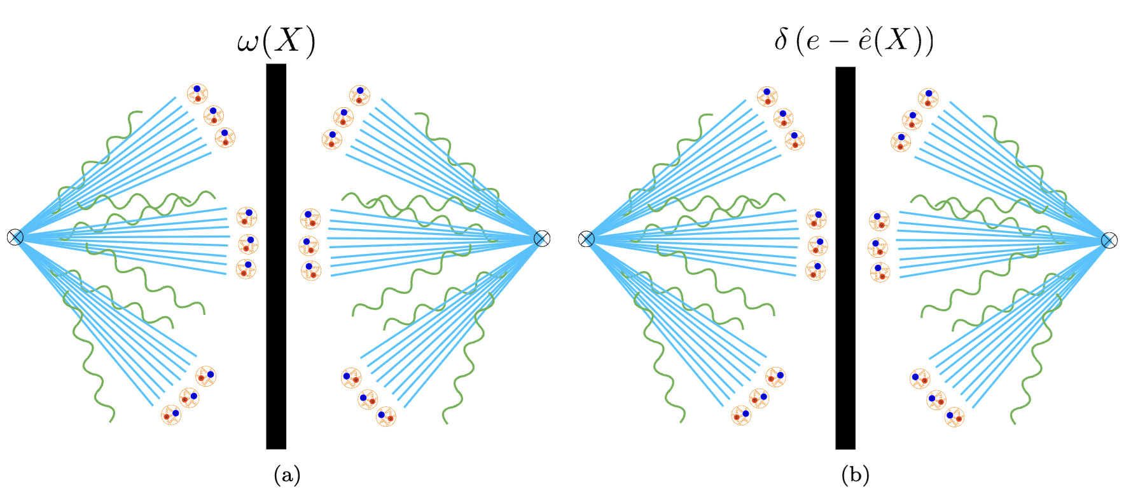
Chapter I:
Energy correlators as a systematic approach to organize collider measurements

Slide 6
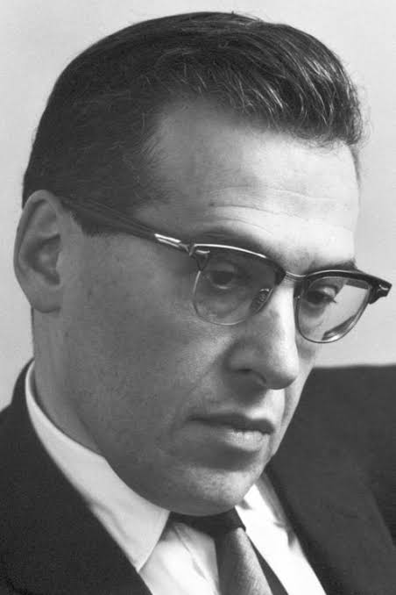
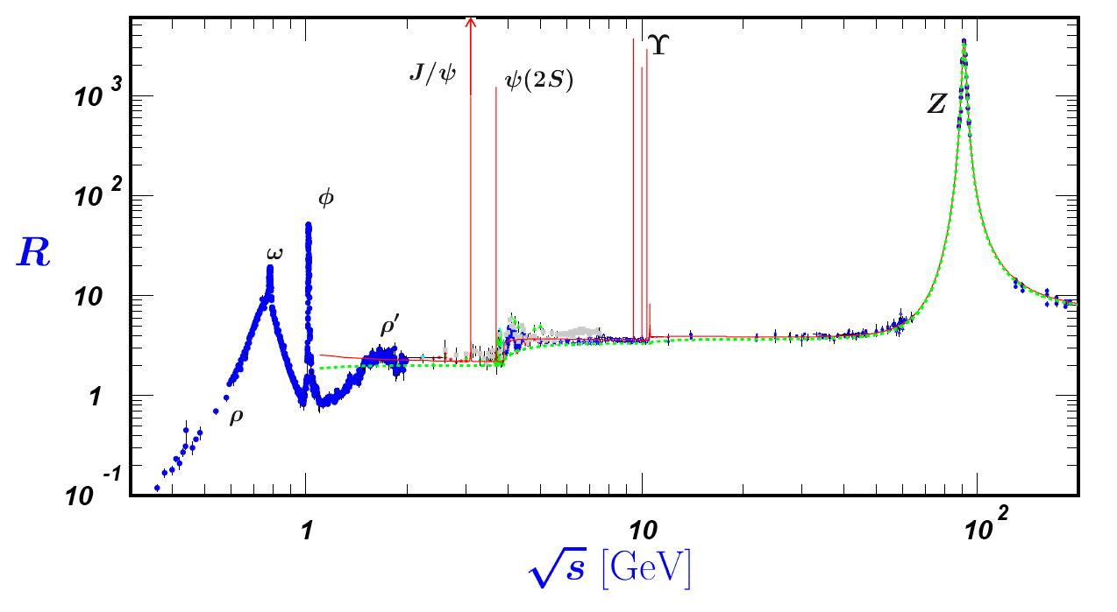
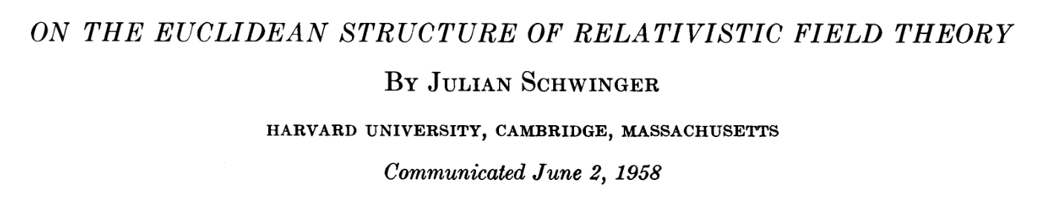
Observable in Quantum Field Theory
$$R(s)=\frac{σ(e^{+}e^{-}→\text{hadrons})}{σ(e^{+}e^{-}→μ^{+}μ^{-})}$$
传递这种对应关系的工具是量子场论中的格林函数(n点关联函数)，它包含了所有可能的物理信息。

Slide 7
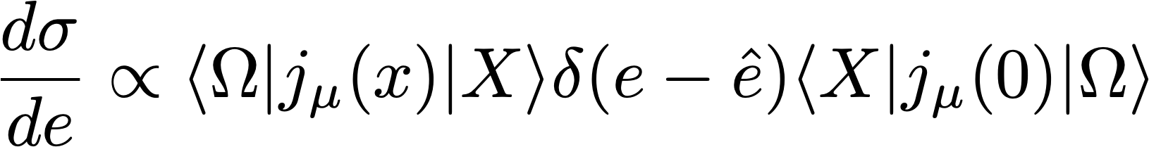
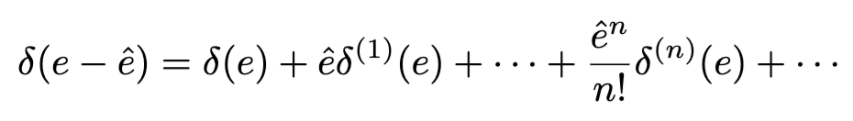
Event shape v.s. Correlation function
event shape
correlation function
thrust
C parameter
spherocity
broadening
…
energy correlation
charge correlation
flavor correlation
particle correlation
…
Intuitive,
but theoretical challenging
Less intuitive,
but theoretical clean
They are connected through moment expansion!
Korchemsky, Sterman, 1999
H. Chen, I. Moult, X.Y. Zhang, HXZ, 2020

Slide 8
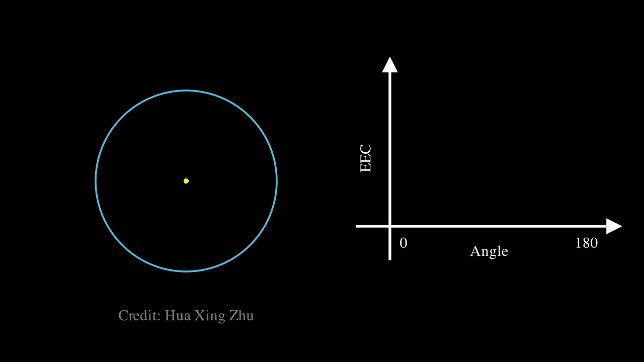
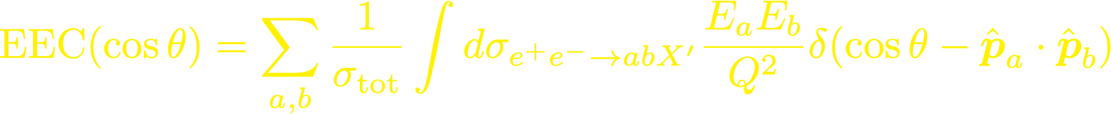
What is Energy-Energy Correlator? Basham, Brown, Ellis, Love, 1978

Slide 9

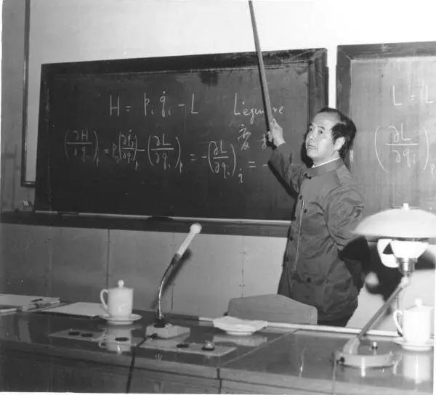
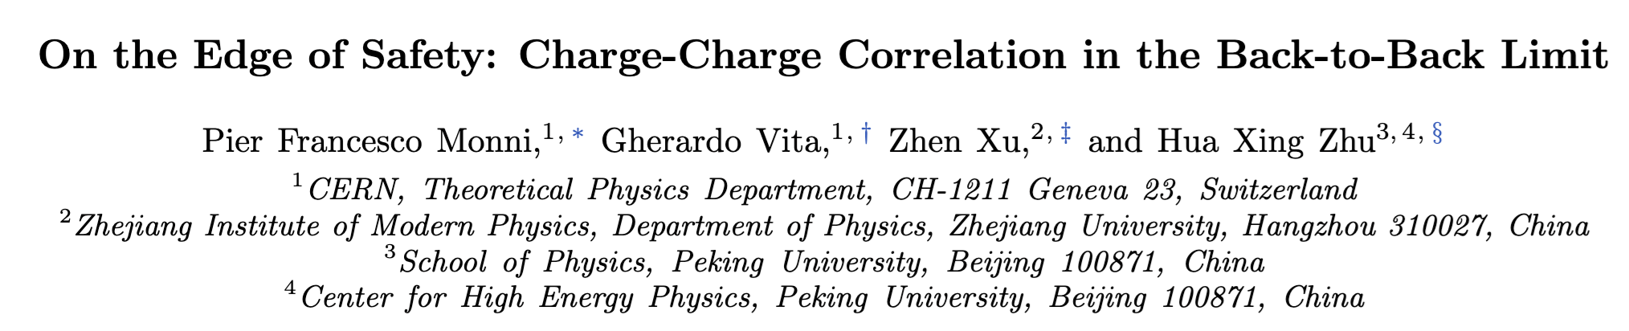
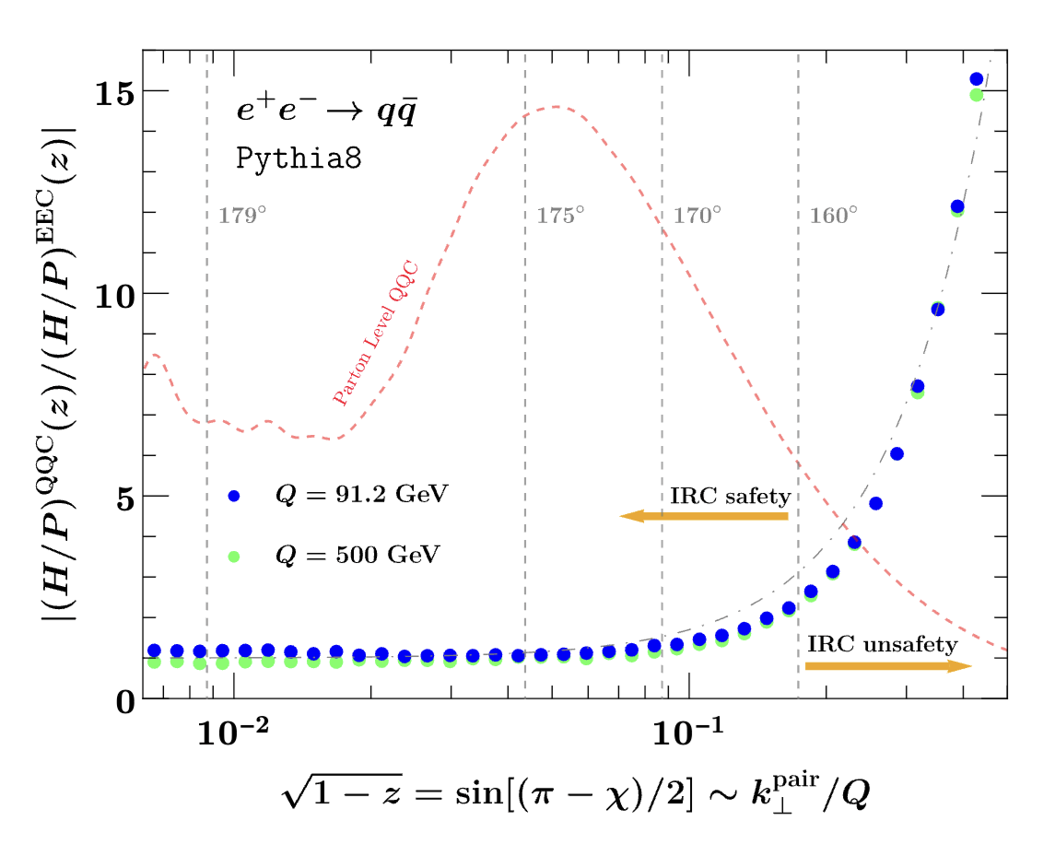
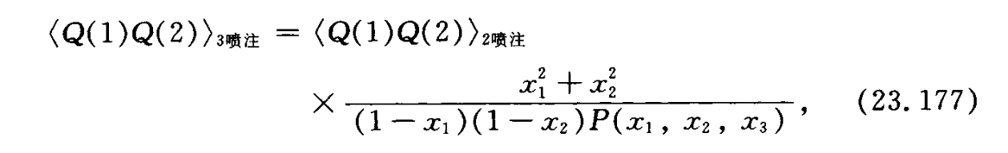
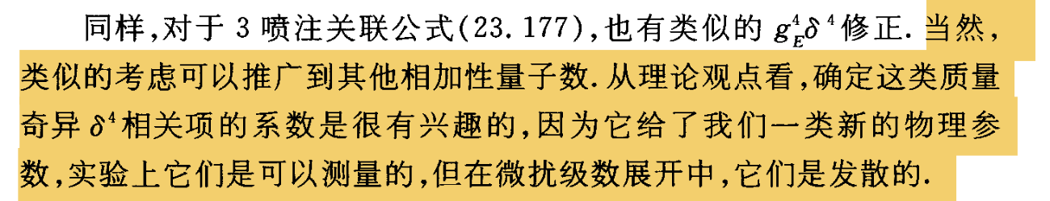
Charge-Charge Correlation (QQC)

Slide 10
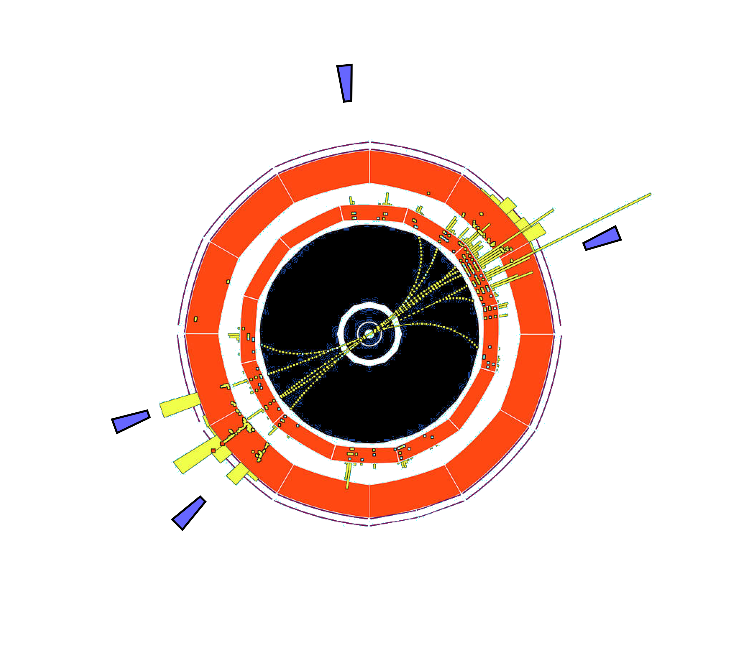
Energy correlators as an open quantum system
detector
Event shape attempt to contains the shape of full event
Energy correlators, or general detector correlators, encode only partial information of the full quantum system
“Open quantum system”
Interesting connection to condense matter, AMO, quantum optics, …

Slide 11
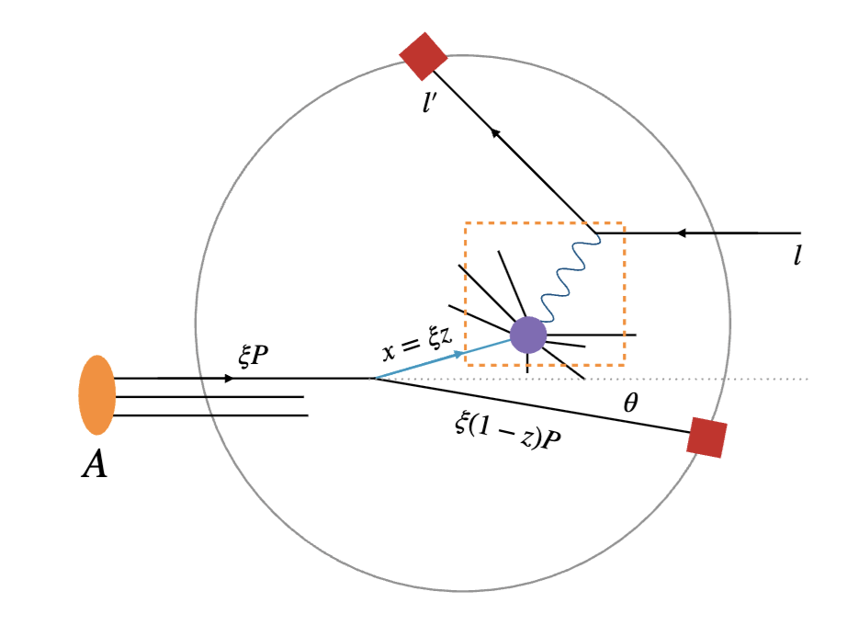
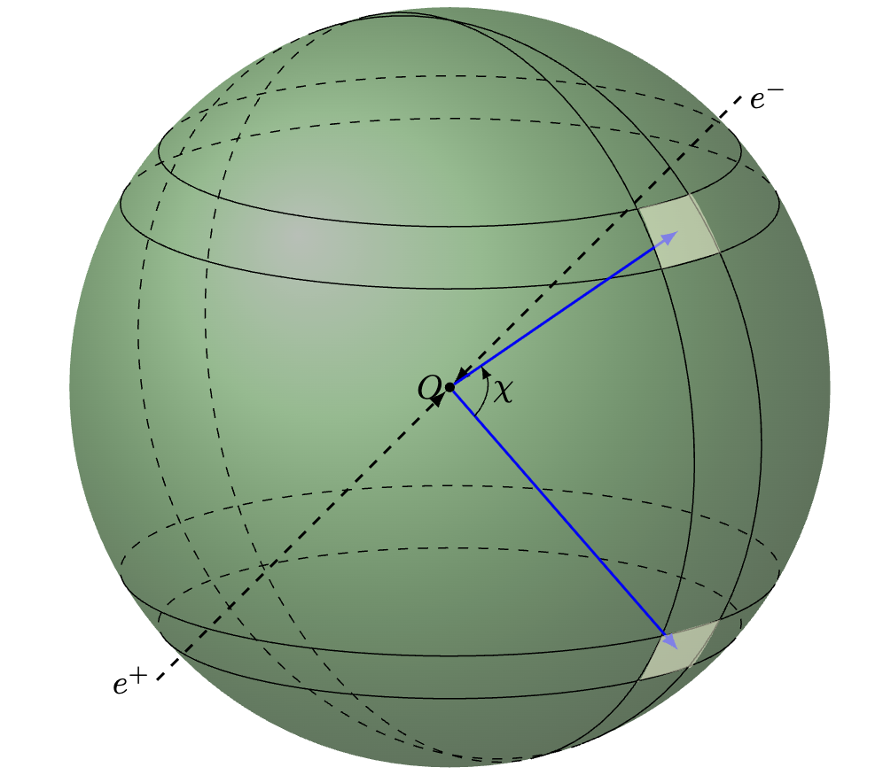
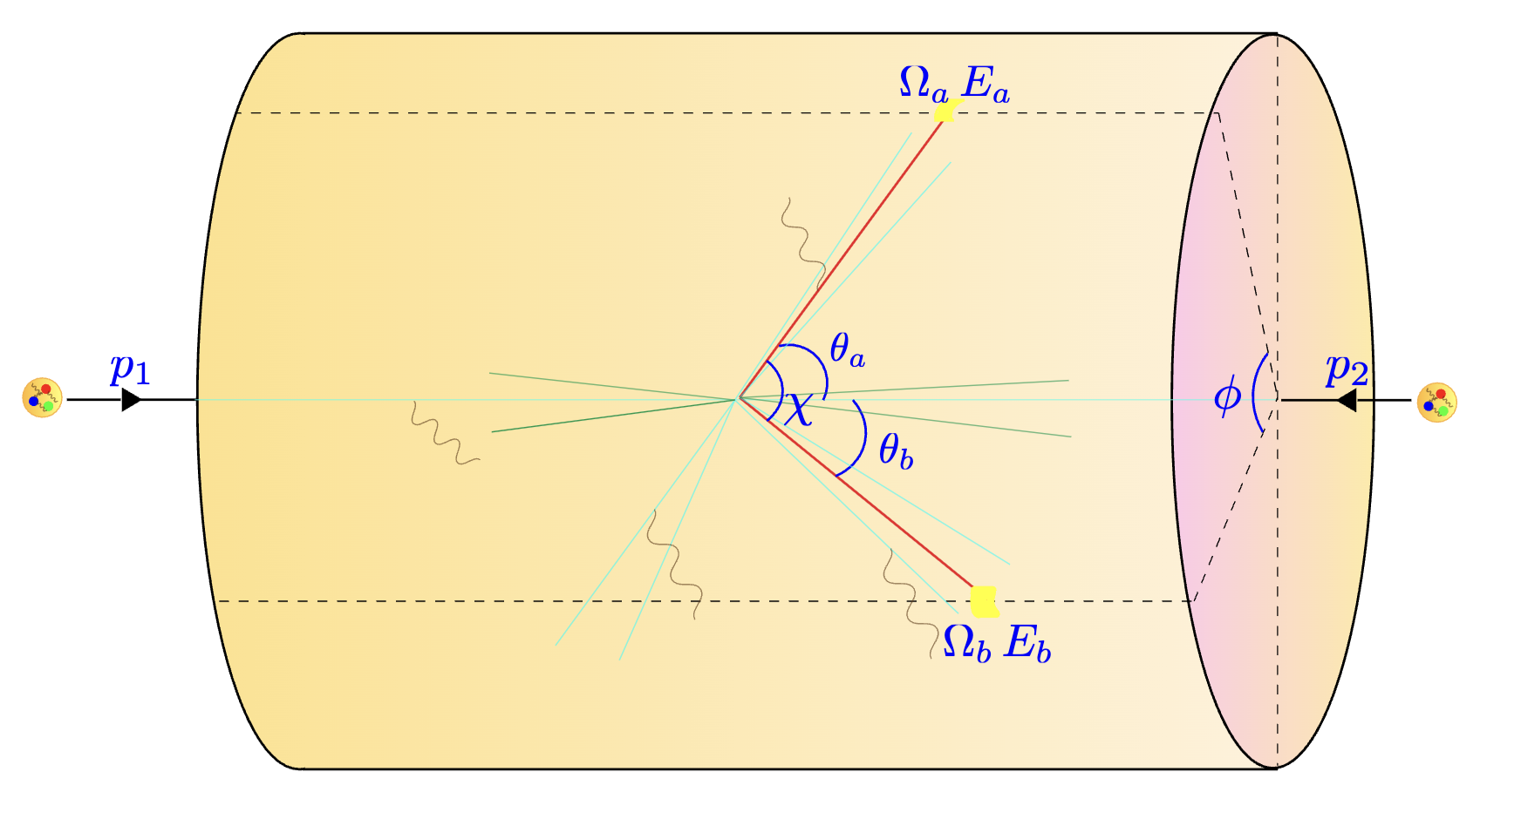
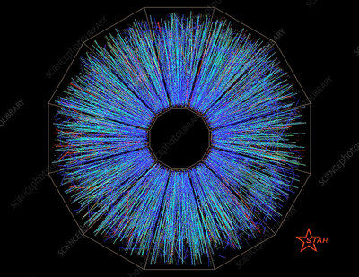
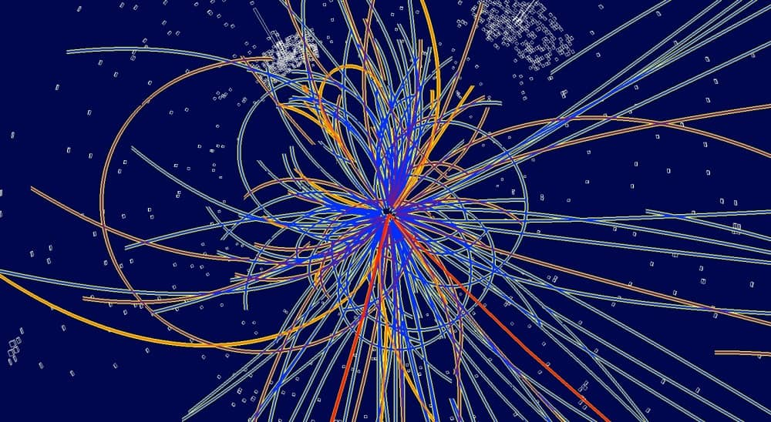
Generalizable to multiple colliders
ee
DIS
pp
AA
track-based observable

Slide 12
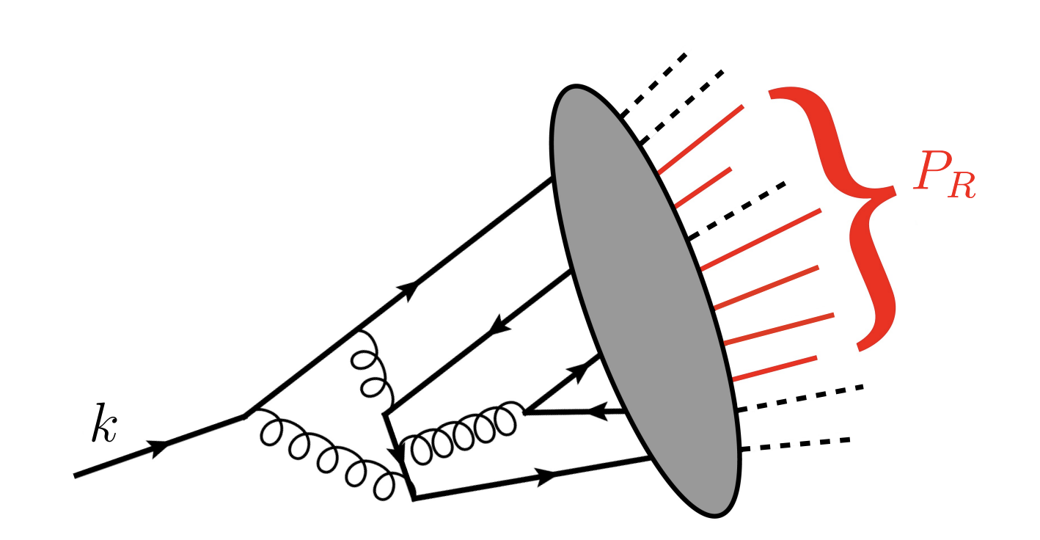
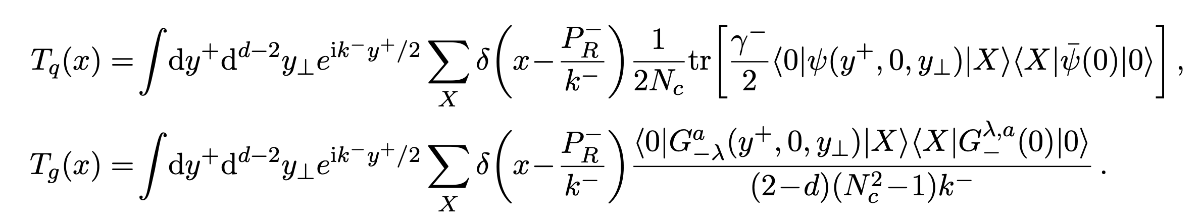
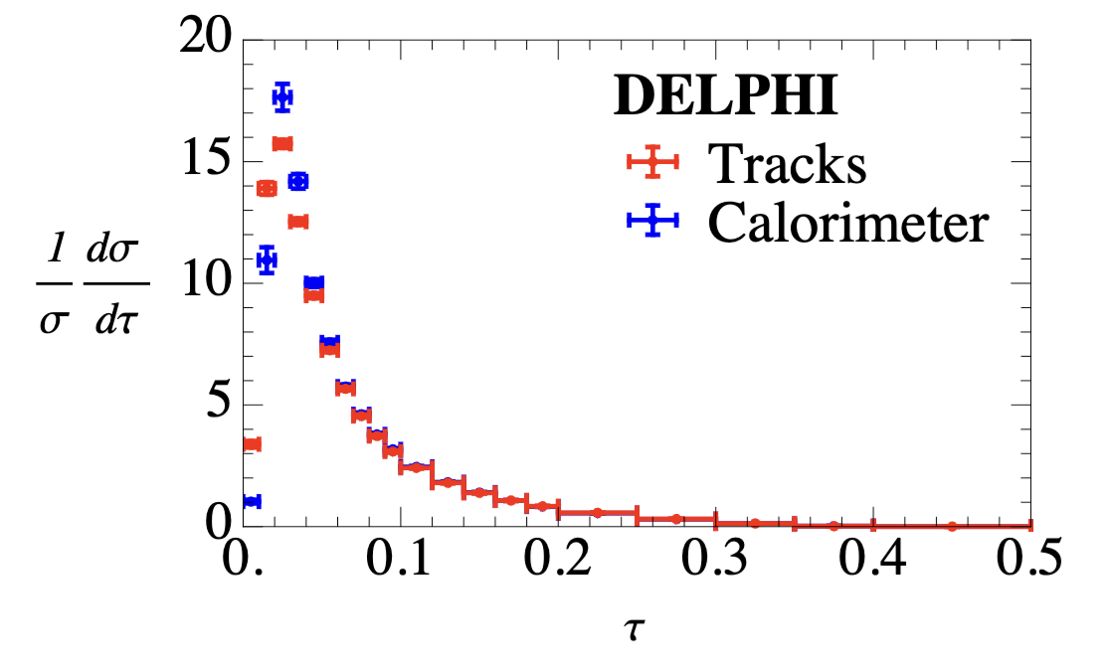
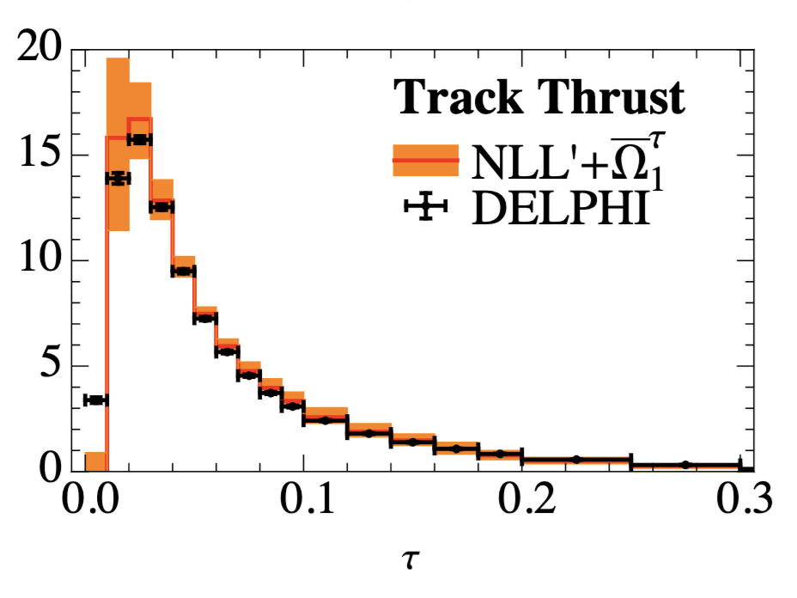
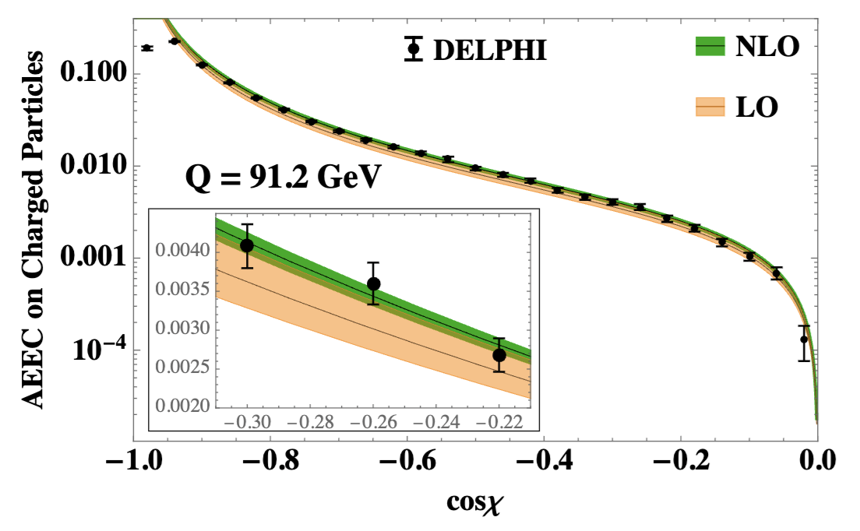
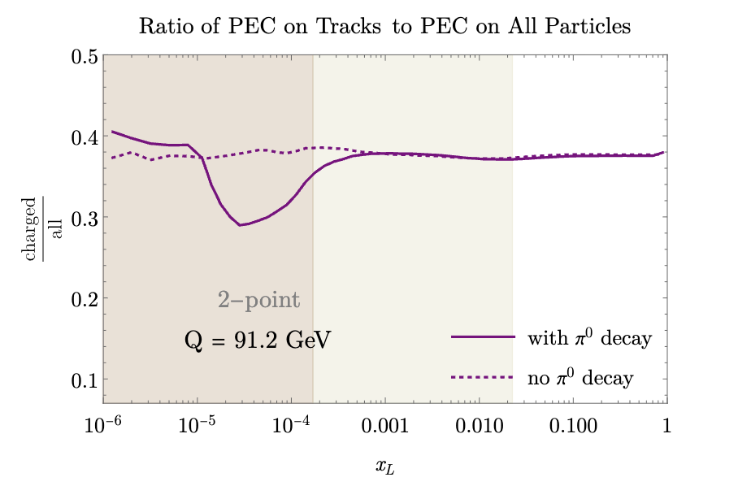
Track-based observable
H.-M. Chang, M. Procura, J. Thaler, W. Waalewijn, 2013
LO + NLL
H.-M. Chang, M. Procura, J. Thaler, W. Waalewijn, 2013
Y. Li, et al., 2021
Jaarsma, et al., 2021

Slide 13
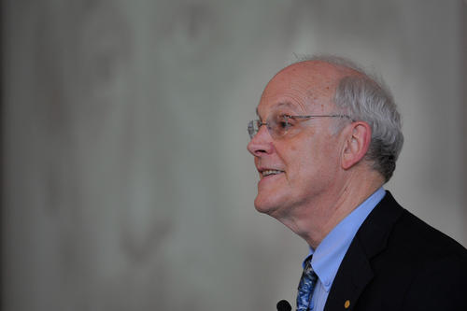
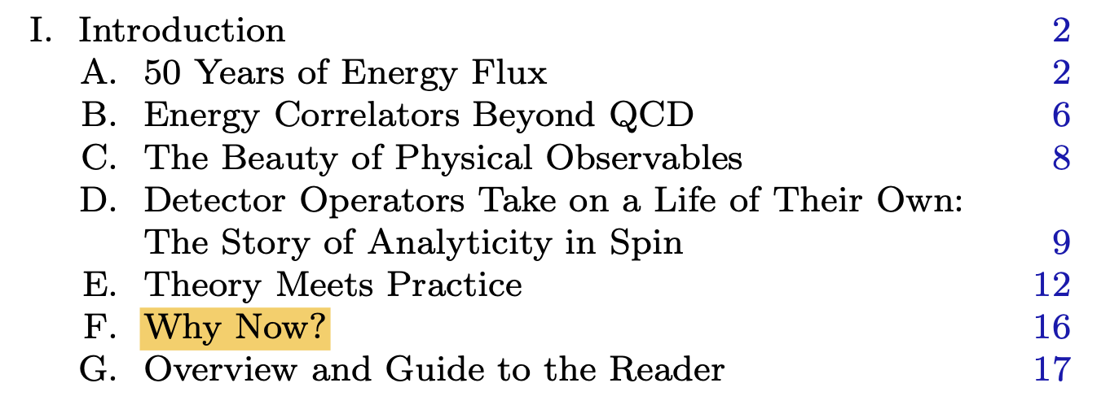
Chapter II:
Why now?

Slide 14
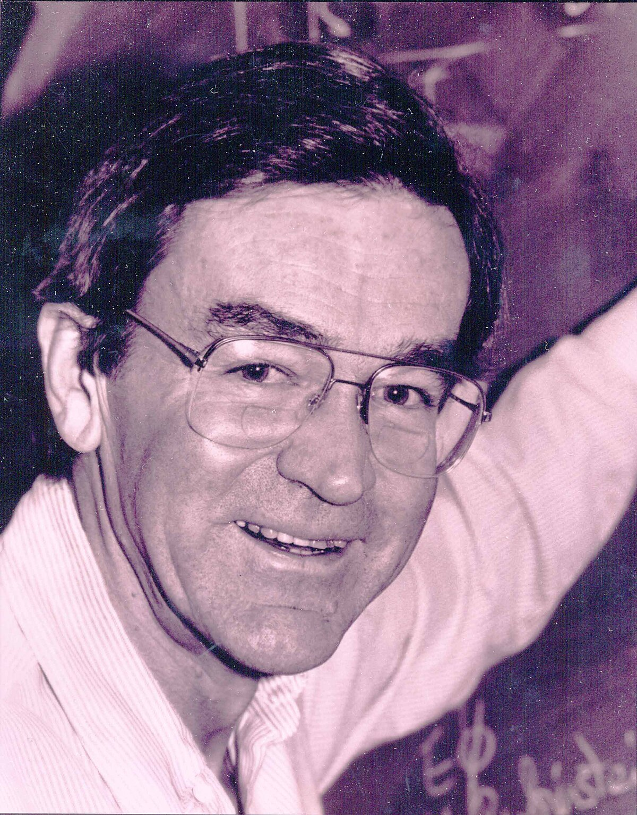
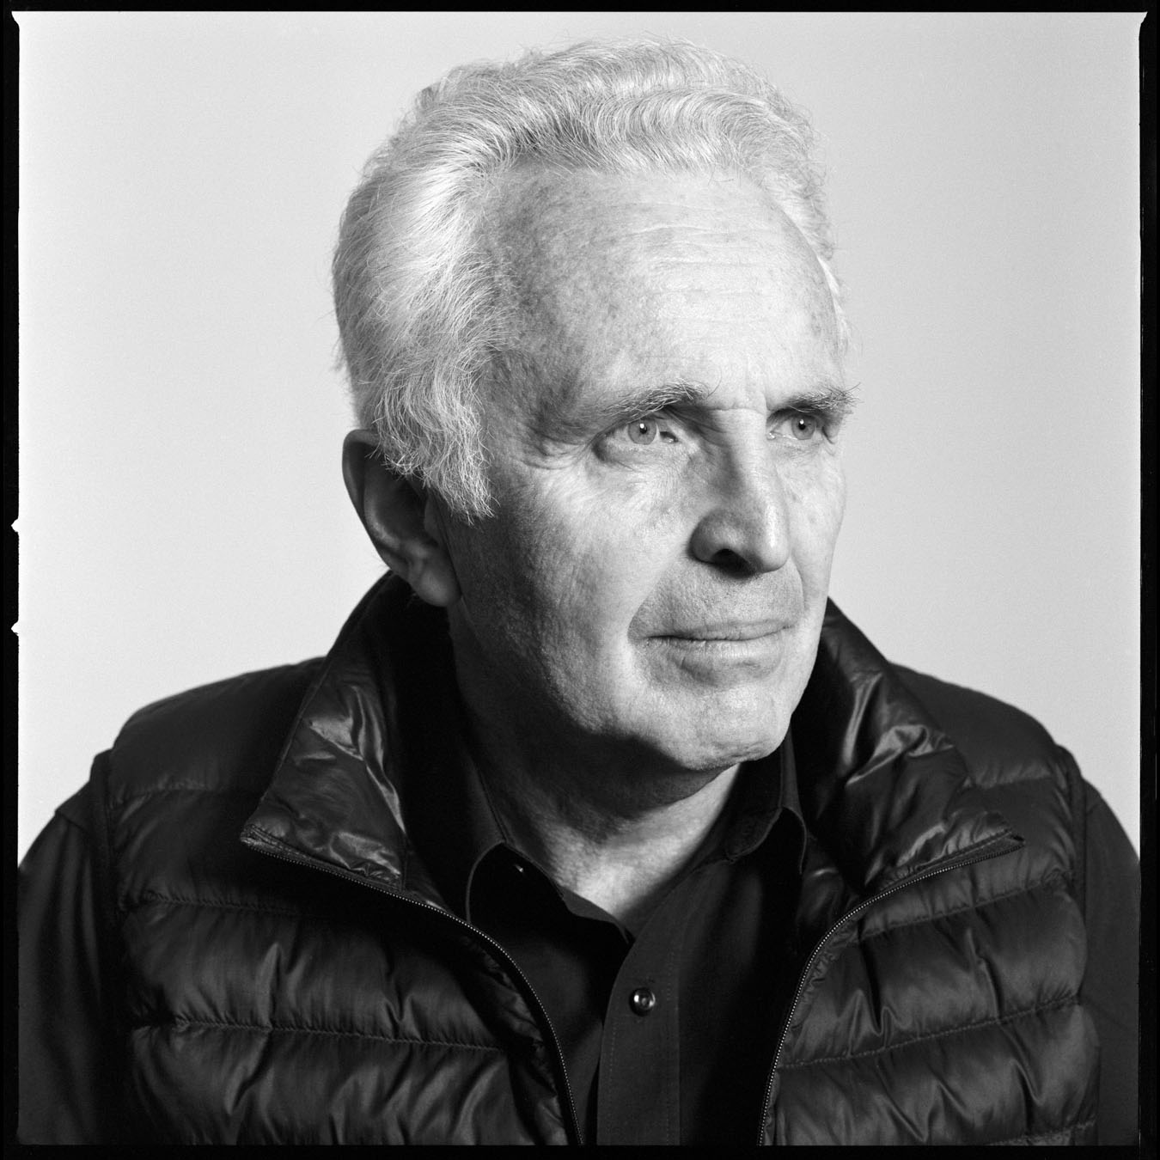
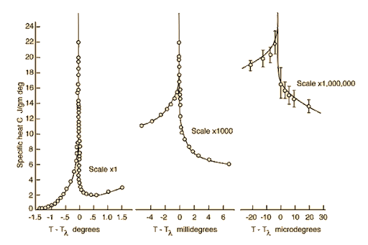
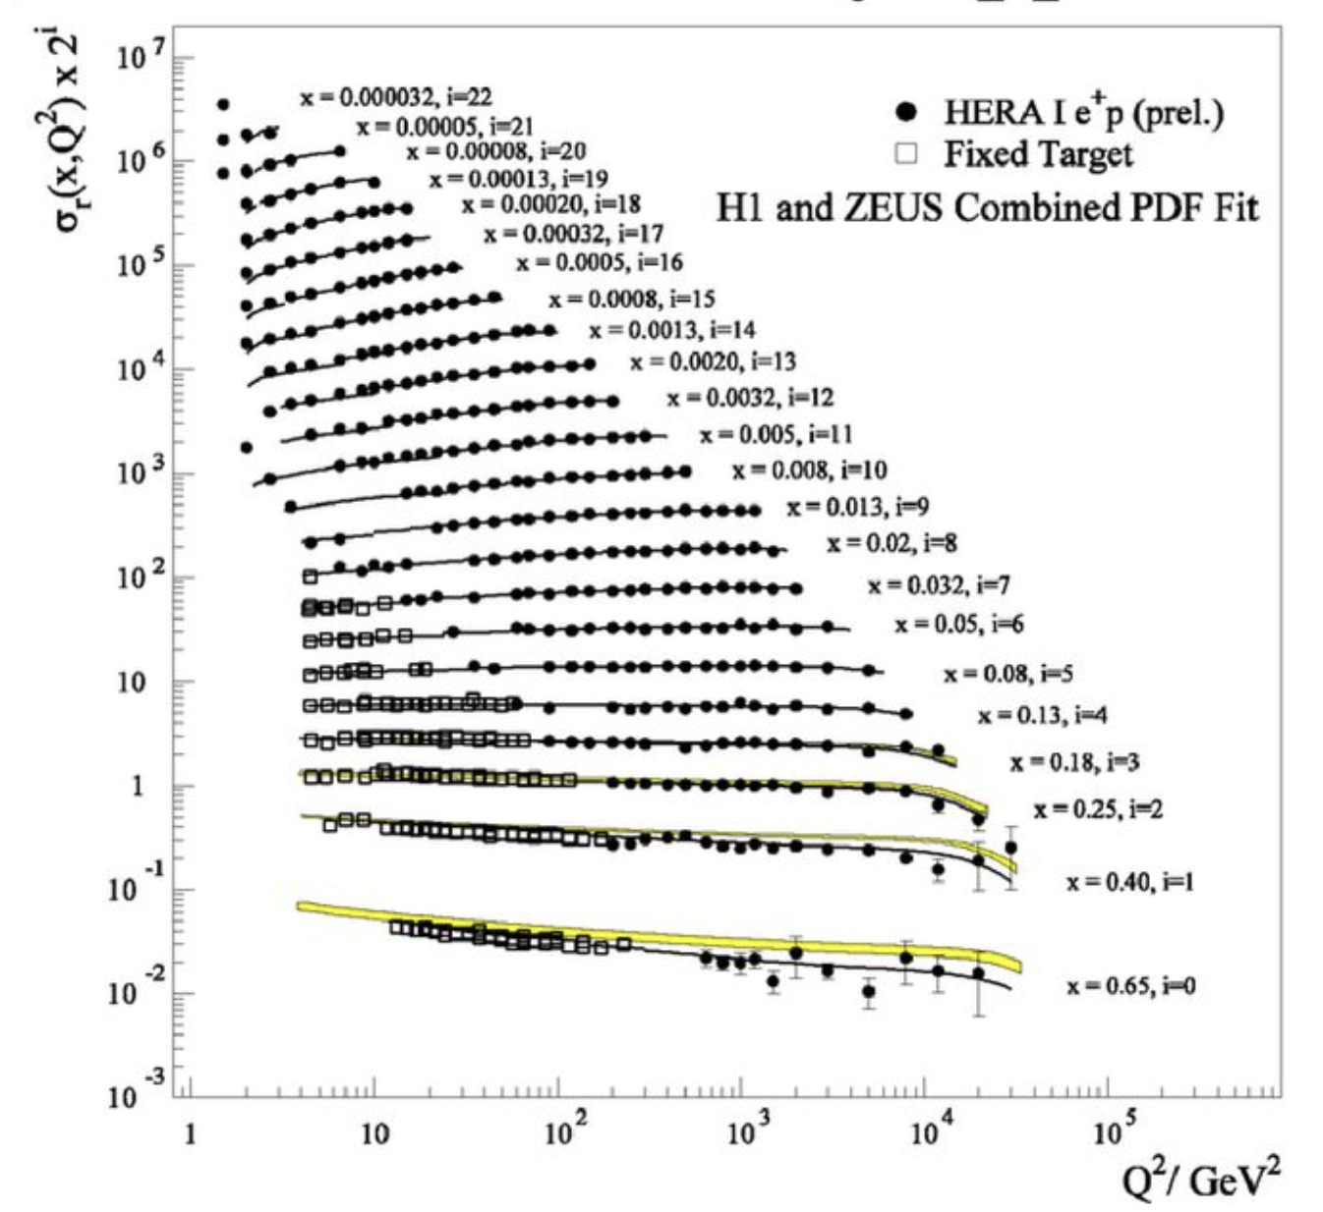
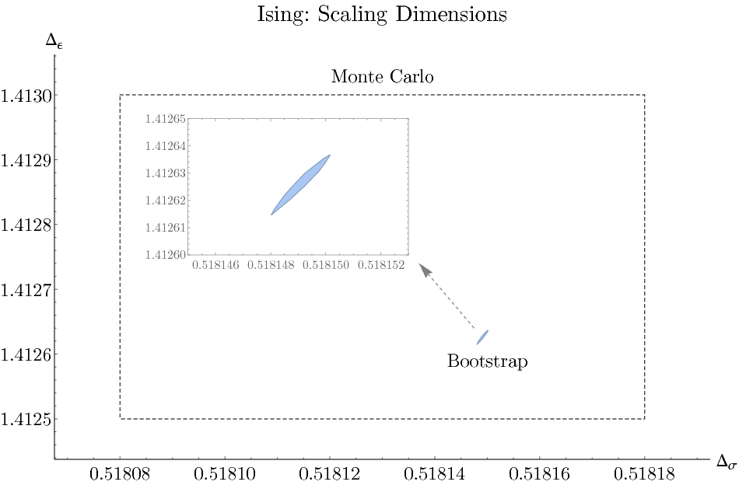
Scaling phenomena in nature
Conformal bootstrap revolution
I’m trying to understand elementary particles by looking at a boiling kettle.

Slide 15
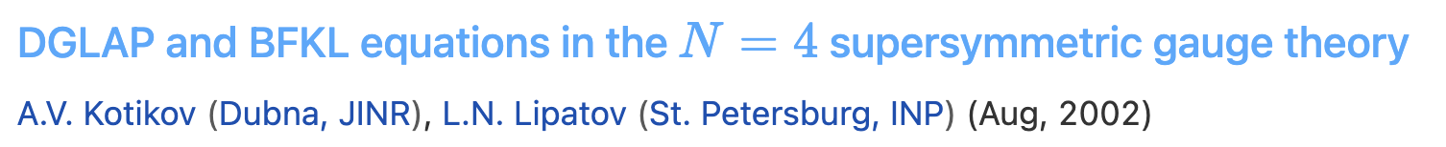
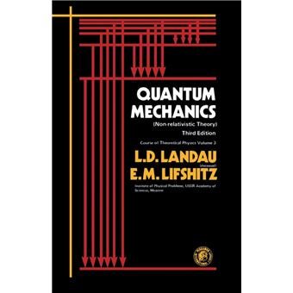
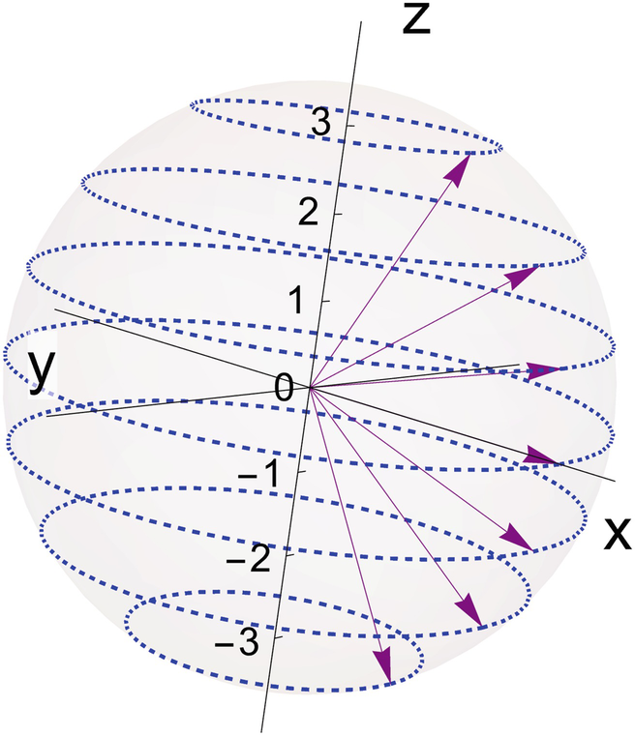
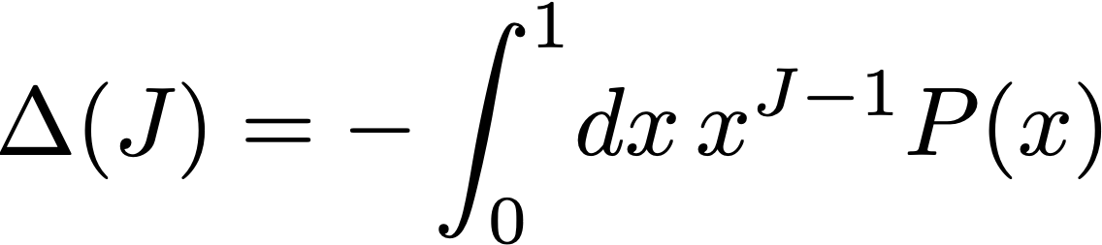
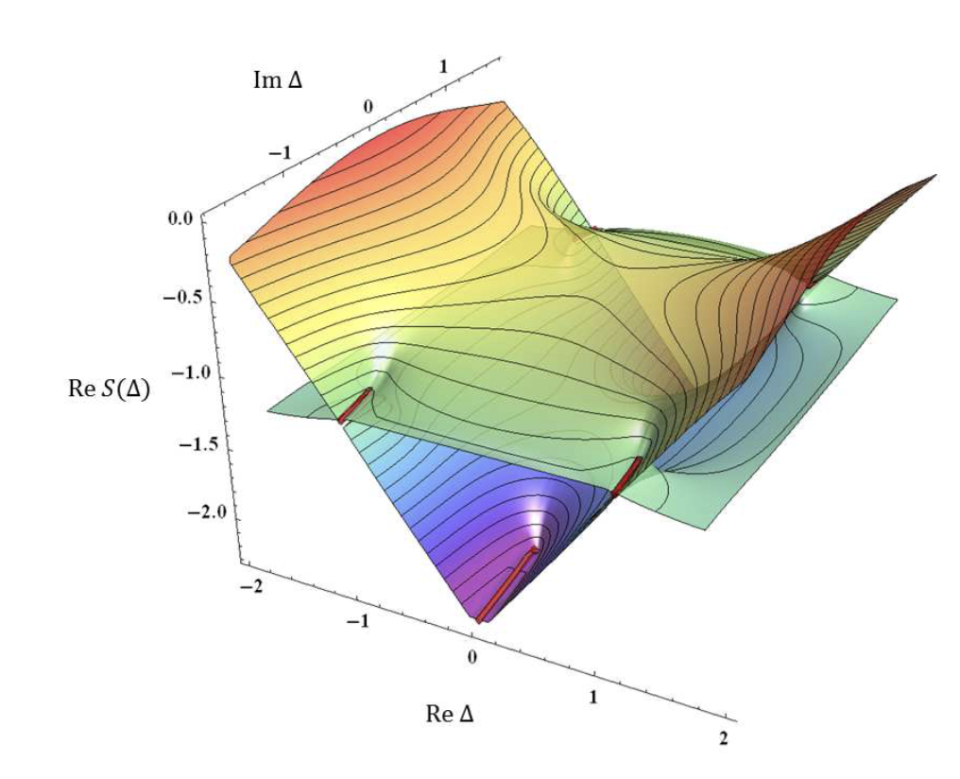
Analyticity in spin
anomalous dimension of twist-2 operator
Splitting function
$Δ$ is an analytic function of J,
and vice versa!
Spin takes only integer or half integer values
Gromov, Levkovich-Maslyuk, Sizov, 2016

Slide 16
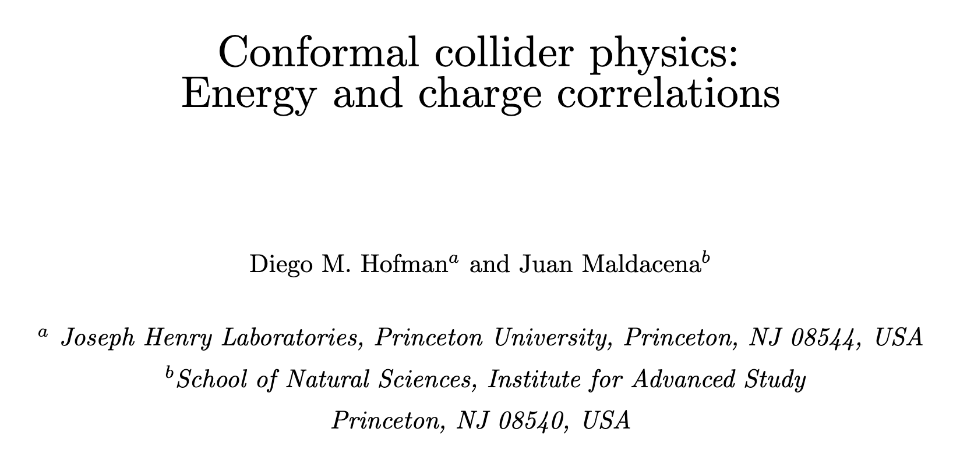
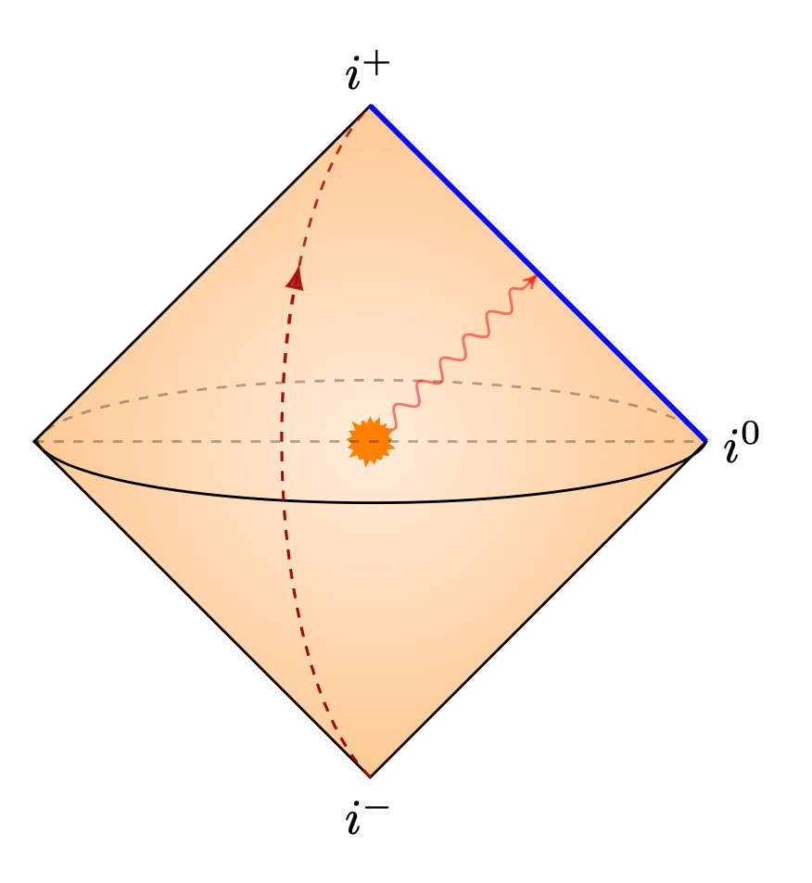
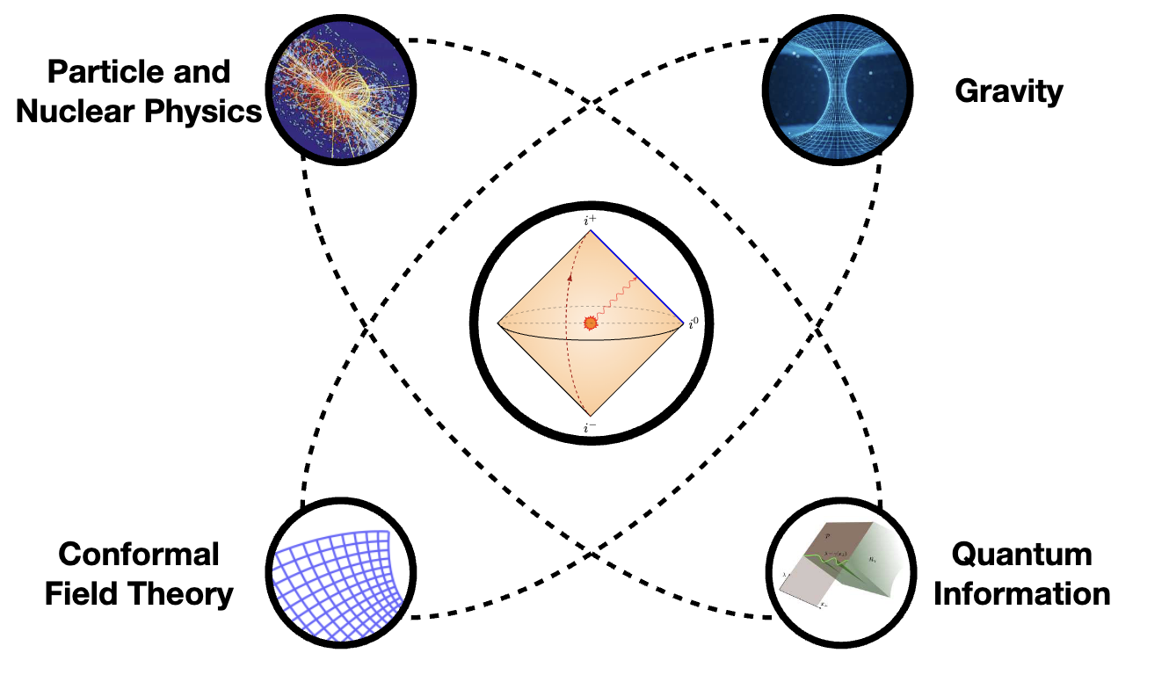
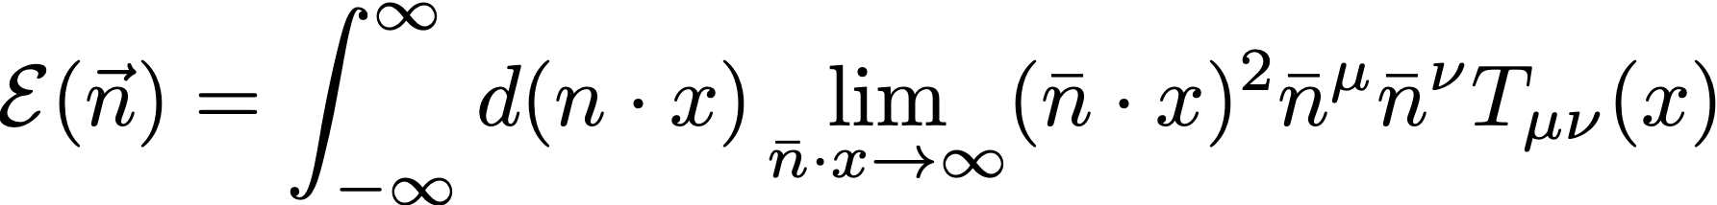
Conformal collider physics
A unified language for analyticity in spin and scaling phenomena
Kologlu, Kravachuk, Simmons-Duffin, Zhiboedov, 2019

Slide 17
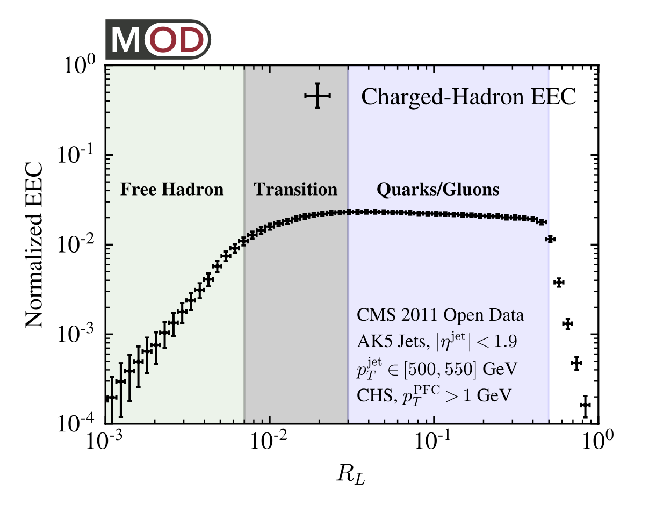
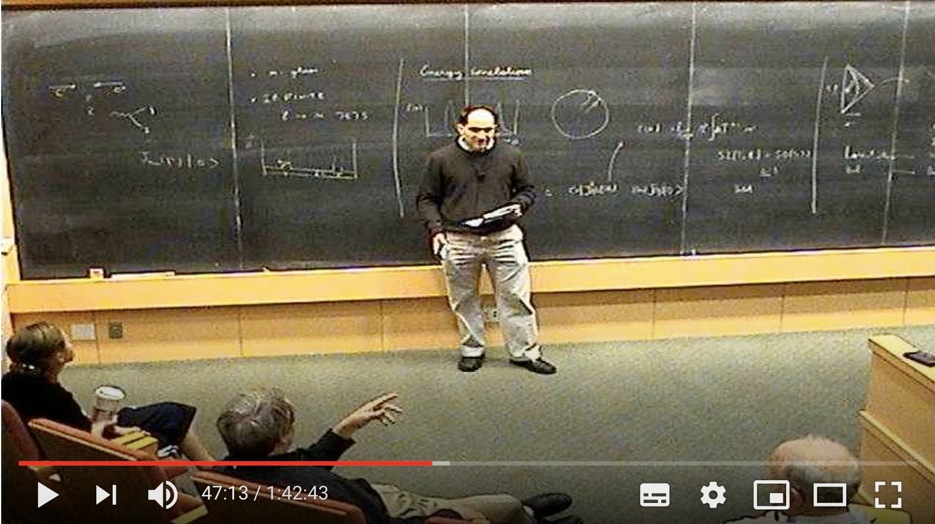
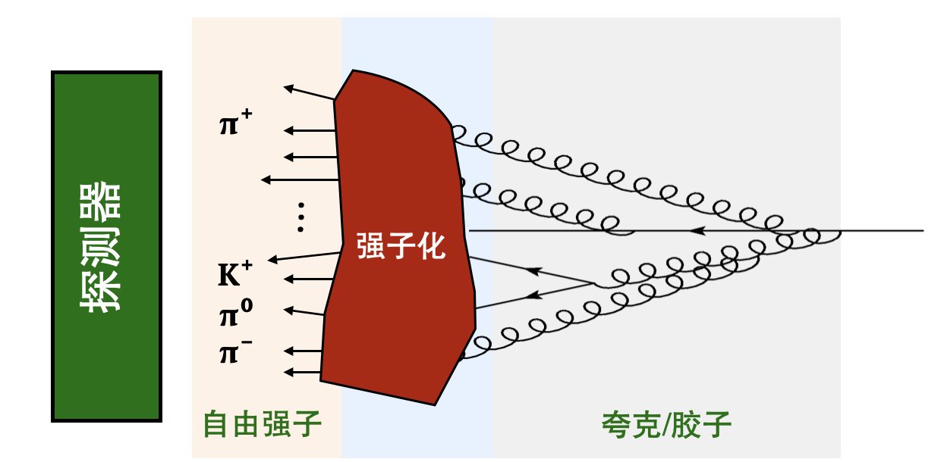
Scaling at the LHC
Komiske, Moult, Thaler, HXZ, 2022
post-
confinement
pre-confinement
Polchinski: 有大量的QCD数据，你能在其中看到这种（标度行为）吗？
Maldacena: 但他们没有研究小角度的情况。我问他，他们不研究小角度是否有充分的理由，他们说，嗯，我们不知道重求和公式……
Dixon, Moult, HXZ, 2019

Slide 18
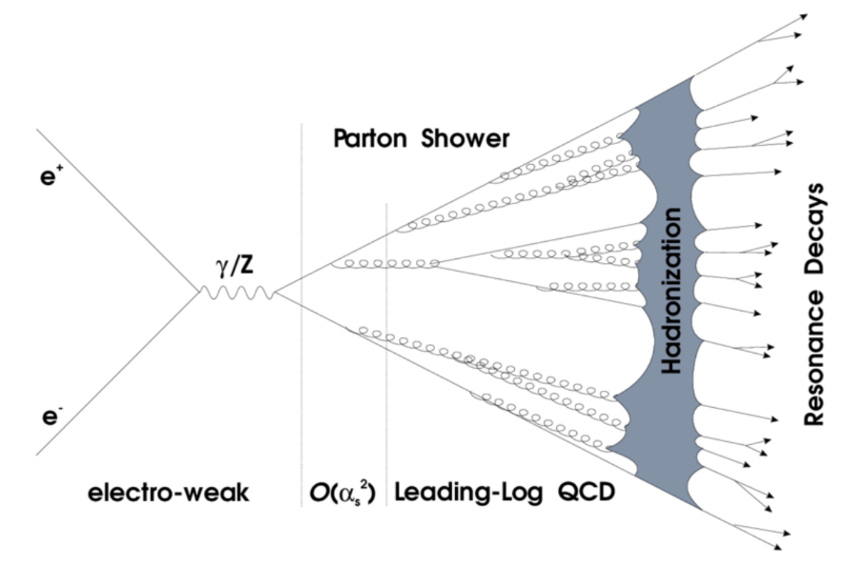
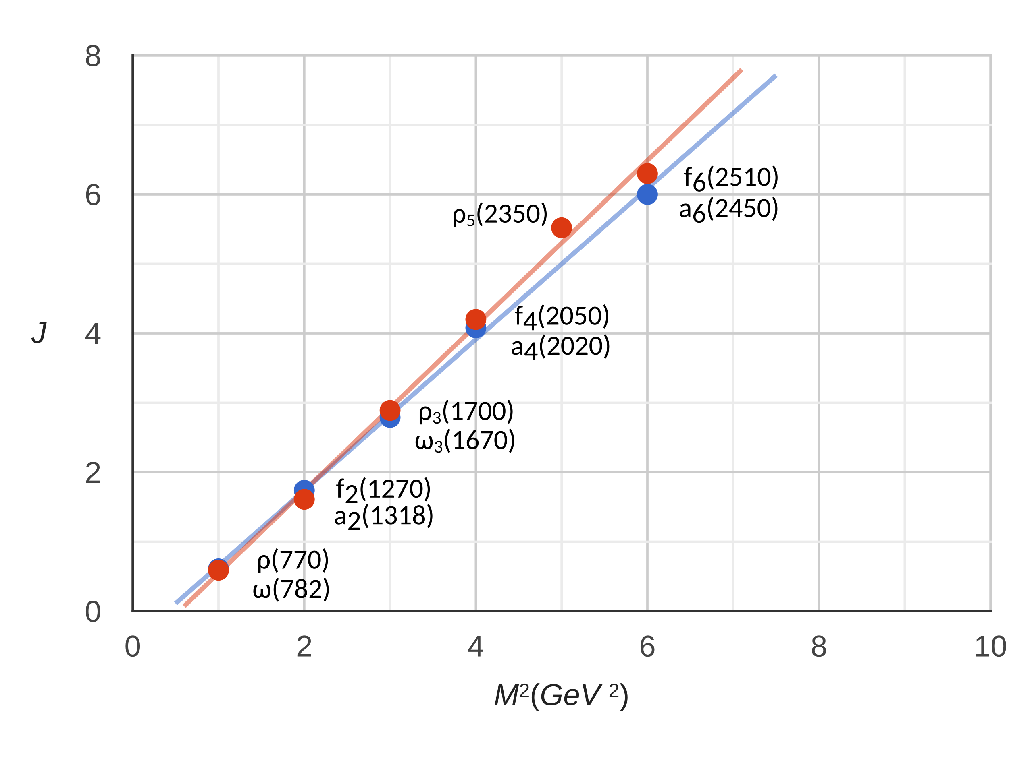
Unified language for asymptotic freedom and confinement?
???
pQCD
hadron spectroscopy
???
hadron Regge trajectory
detector Regge trajectory

Slide 19
Chapter III:
50 years of energy correlators: experiment and theory

Slide 20
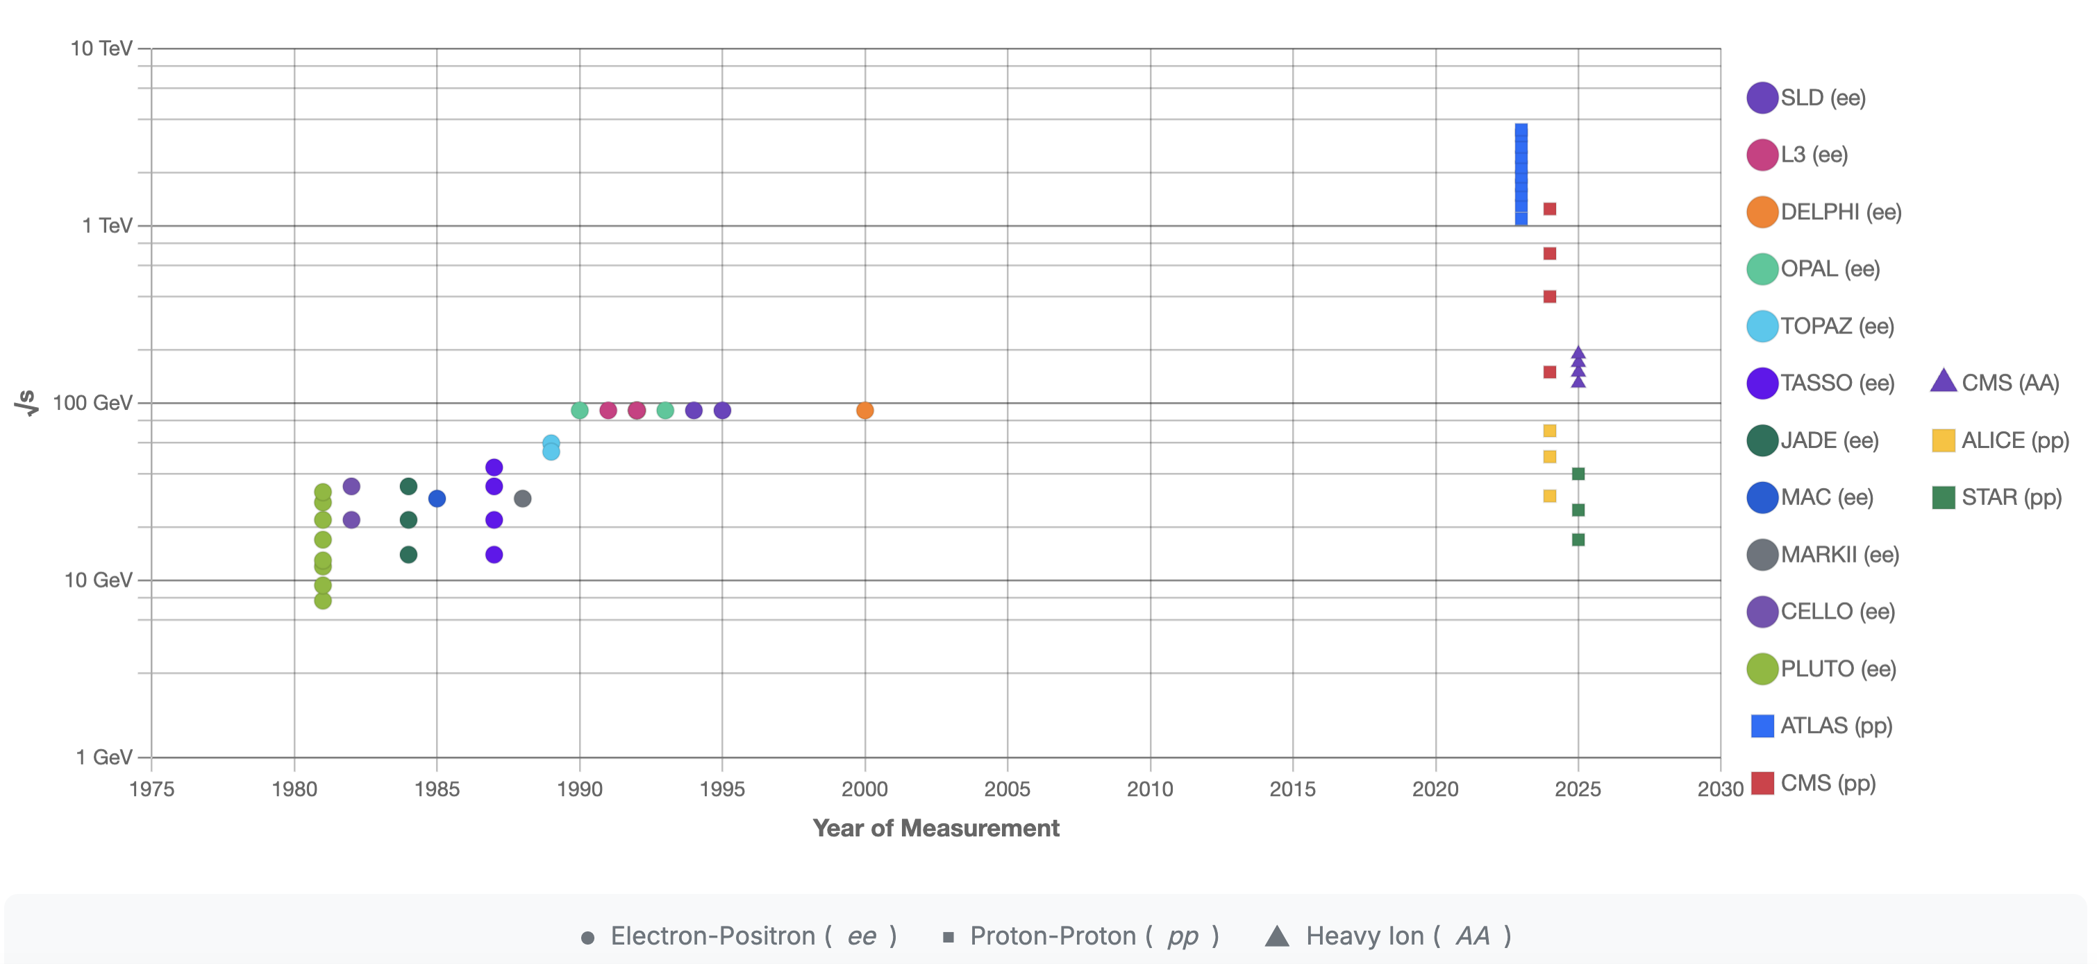
50 years of EEC experiment

Slide 21
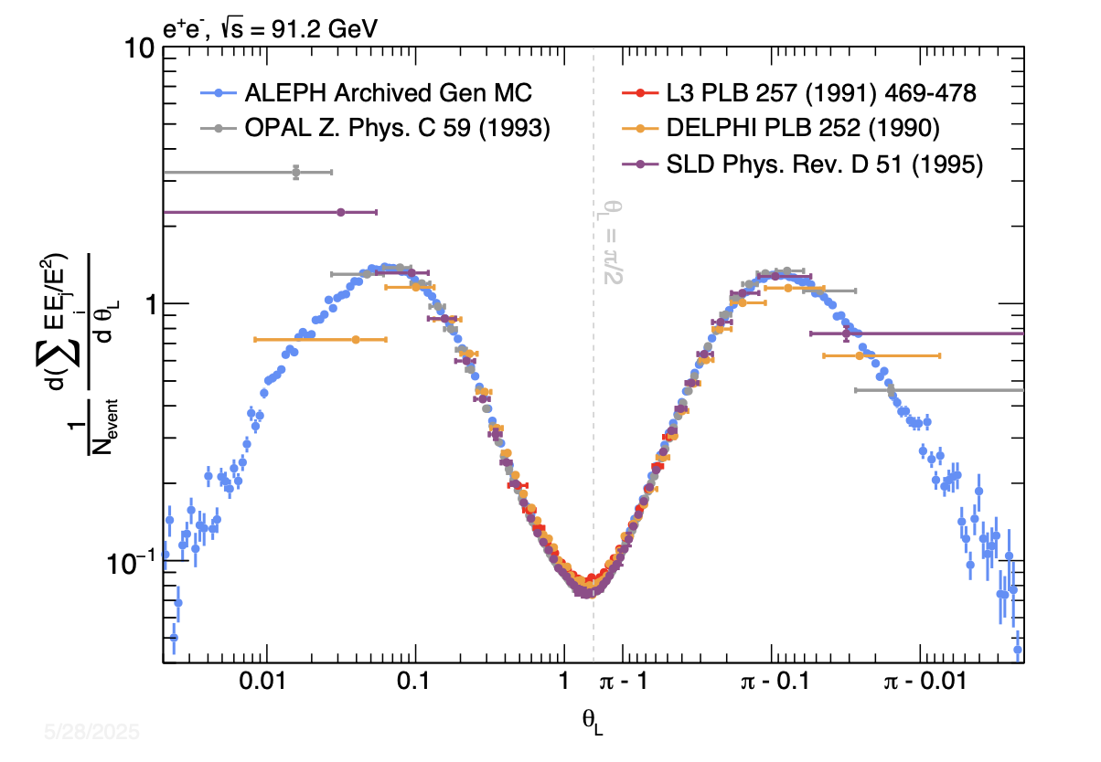
Improvement on experiment

Slide 22
50 years of EEC theory
Analytical
Loops
Numerical
Del Duca, Duhr, Kardos, Somogyi, Trocsanyi, 2016
Collinear limit
Alvarez, Cantero, Czakon, Llorente, Mitov, Poncelet, 2023
3
QCD
N=4 SYM
Henn, Sokatchev, Yan, Zhiboedov, 2019
Catani, Seymour, 1996
2
QCD @ pp
Chen, Moult, Luo, Yang, Zhang, Zhu, 2019
Chicherin, Moult, Sokatchev, Yan, Zhu, 2024
Belitsky, Hohenegger, Korchemsky, Sokatchev, Zhiboedov, 2013
1
Dixon, Luo, Shtabovenko, Yang, Zhu, 2018
Yan, Zhang, 2022
Basham, Brown, Ellis, Love, 1978
Yang, Zhang, 2022
He, Jiang, Yang, Zhang, 2024 [integrand only]
Points
2
3
4
11

Slide 23
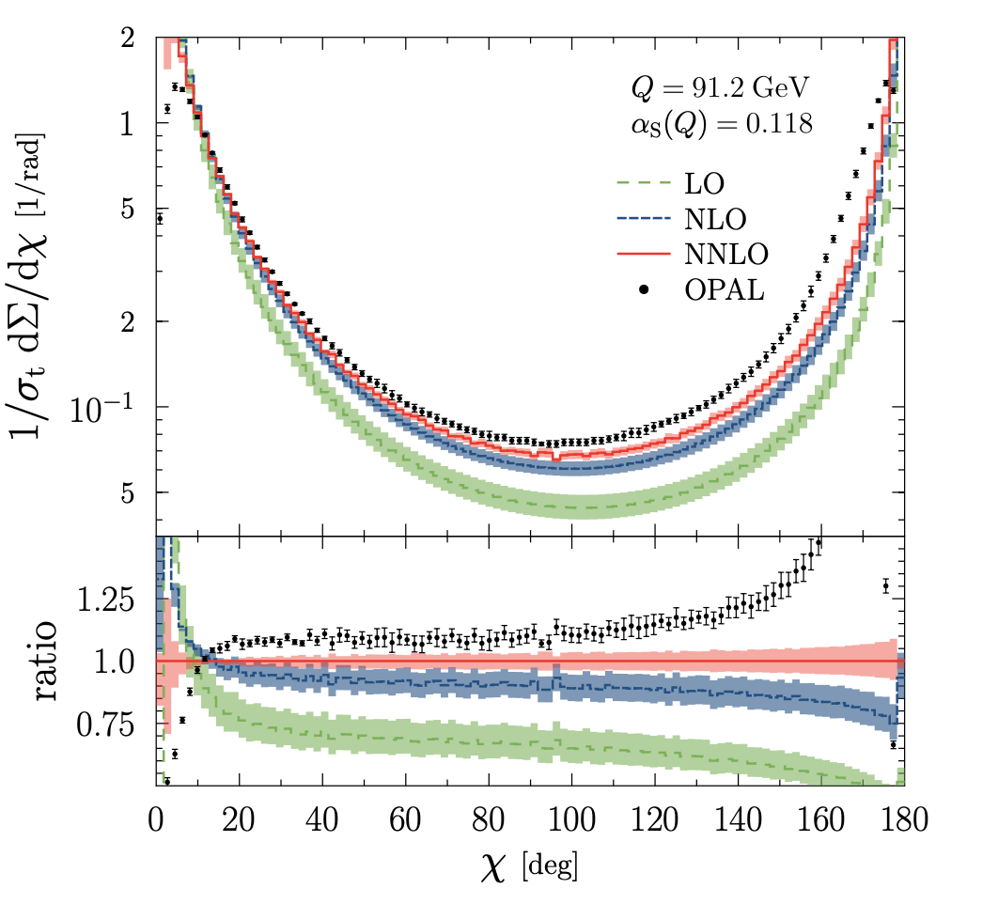



Progress on theory v.s. experiment
Tulipant, Kardos, Somogyi, 2017
Chen, Gao, Li, Xu, Zhang, HXZ, 2023
Duhr, Mistlberger, Vita, 2022

Slide 24
Chapter IV:
Highlight of new experimental results

Slide 25

Strong coupling measurement I
Is it possible to precisely measure strong coupling constant in jet substructure?
Hannesdottir, Pathak, Schwartz, Stewart, 2210.04901

Slide 26



Strong coupling measurement II
$$θ^{2}$$
$$θ^{2}$$
$$θ^{2}$$
$$θ^{2}$$
Slope $≈$
Detector Regge Trajectory at J=3

Slide 27


Strong coupling measurement III
$$∼θ^{γ_{3}(α_{s})-γ_{4}(α_{s})}$$
Chen, Moult, Zhang, HXZ, 2020
4%. Most precise alphas from jet substructure!
$$θ^{2}$$

Slide 28



Observation of confinement transition
See Xiaohui’s talk

Slide 29


Observation of nuclear modification

Slide 30
Chapter V:
New opportunities at new energy scale

Slide 31
$$2\text{GeV}≤\sqrt{s}≤7\text{GeV}$$
Nothing is known here!

Slide 32



Multiple observables
Energy flux
Energy-Energy Correlation
Xiaohui’s talk
Dingyu’s talk

Slide 33






Energy flux distribution
Zamolodchikov
Cardy
2024 fundamental physics breakthrough prize
The angular distribution is sensitive to fundamental parameter in quantum field theory

Slide 34



Theoretical understanding of $a_{2}$
free fermion $a_{2}=-\frac{3}{2}$
free boson $a_{2}=3$
Conformal collider bound
$$-\frac{3}{2}≤a_{2}≤3$$
Hofman, Maldacena, 2008

Slide 35


Can we observe the crossing
3
Crossing at 0 suggest the transition from fermion D.O.F. to Bosonic D.O.F
0
Fermion
Boson
No experiment has observed this phenomena before!
$a_{2}≡0$ in a supersymmetric conformal field theory

Slide 36



Summary
2506.09119

