Slide 1
Quark Spin
in Baryon determined by LQCD
Peng Sun
Collaborators: Zhi-cheng Hu, Ji-Hao Wang, Liuming Liu，and Yi-Bo Yang

Slide 2
Outline
1) Background
2) Blending method
3) Quark spin in baryon
4) Summary

Slide 3
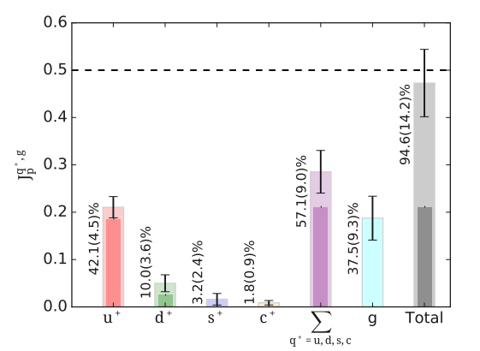
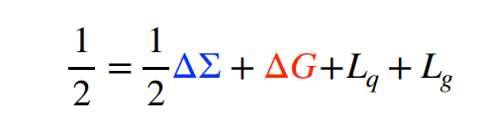
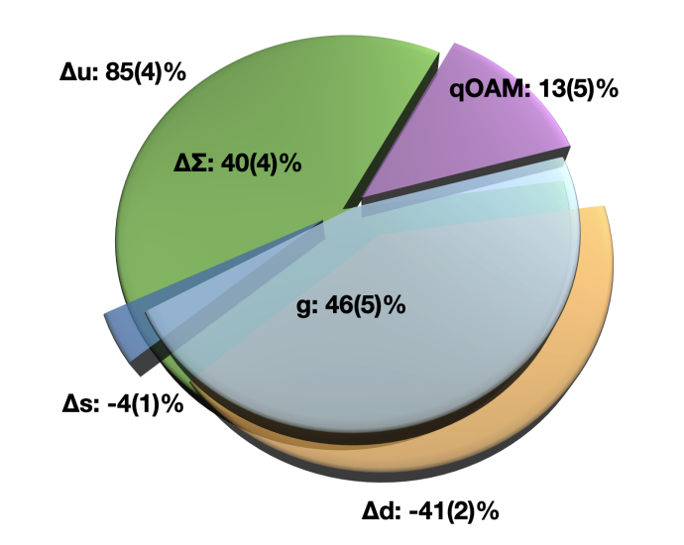
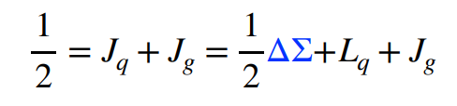
Proton spin sum rule
Proton is a composite particle with spin 1/2
Jaffe-Manohar sum rule Jaffe and Manohar, NPB 90’
ETMC Collaboration 2020
• Complete decomposition into quark and gluon spin & orbital AM
• Gauge-dependent, but with clear partonic interpretation
Ji sum rule Ji, PRL 97’
• Frame- and gauge-independent
• Quark and gluon contributions related to the moments of GPDs
ChiQCD Collaboration 2022

Slide 4
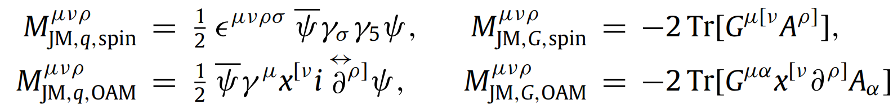
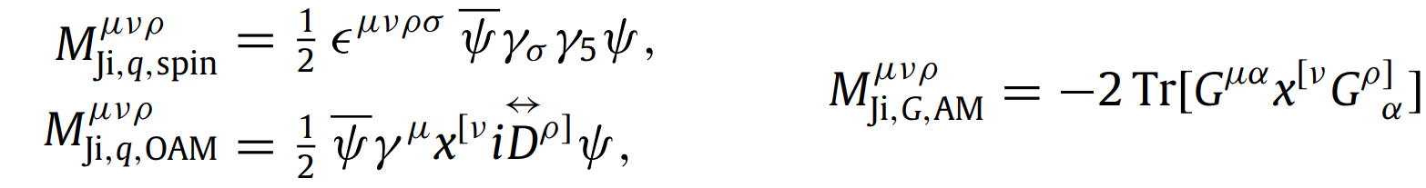
The Jaffe–Manohar decomposition：
The Ji decomposition：
The Belinfante decomposition…
The gauge-invariant kinetic decomposition…
The gauge-invariant canonical decomposition…

Slide 5




Ji sum rule Ji, PRL 97’
Quark helicity PDF 0th moment
Quark GPD 1th moment
Gluon GPD 1th moment
Jaffe-Manohar sum rule Jaffe and Manohar, NPB 90’
Gluon helicity PDF 0th moment

Slide 6
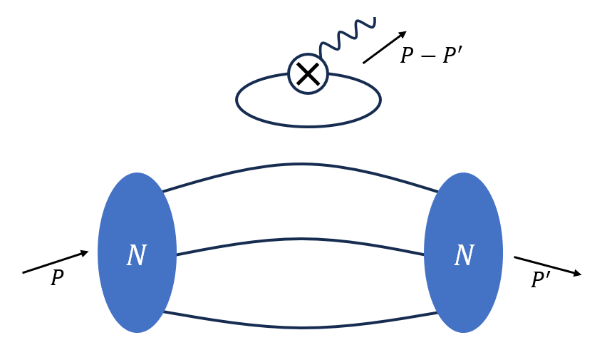
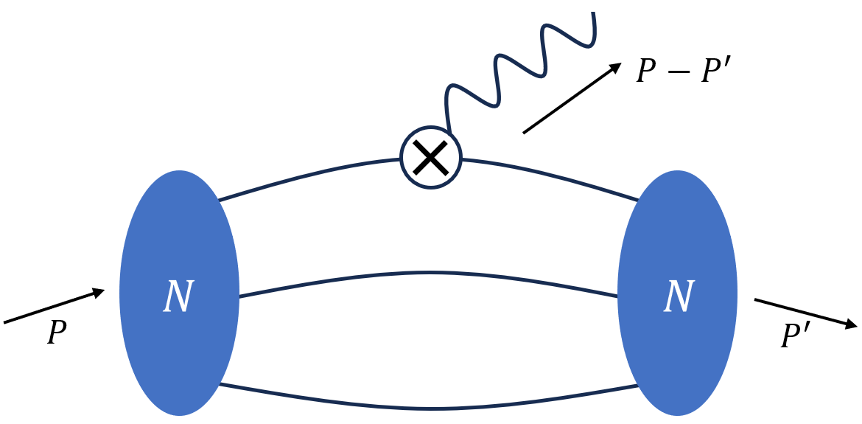

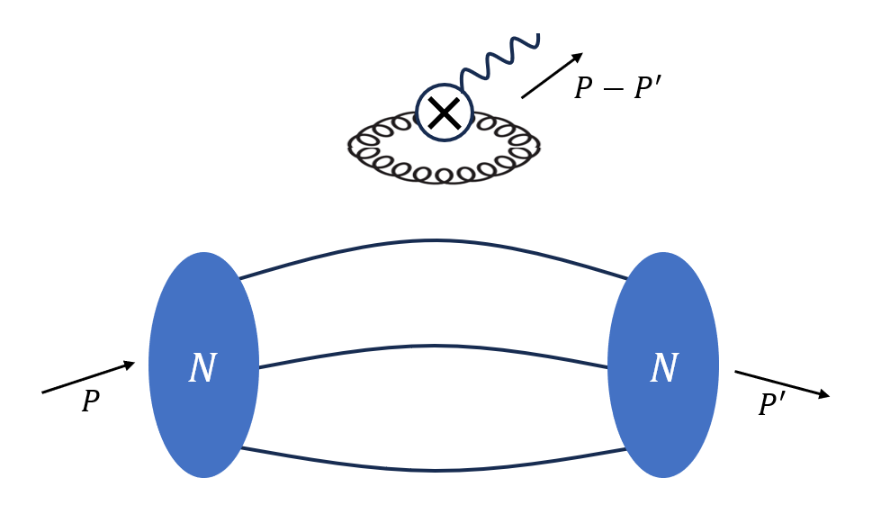

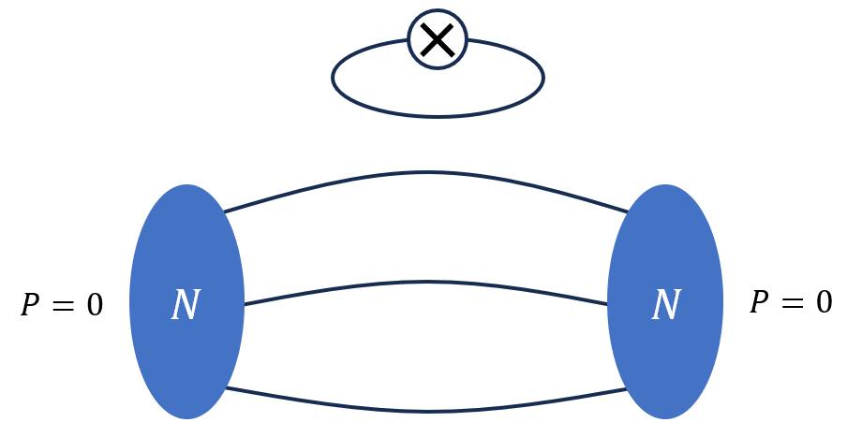
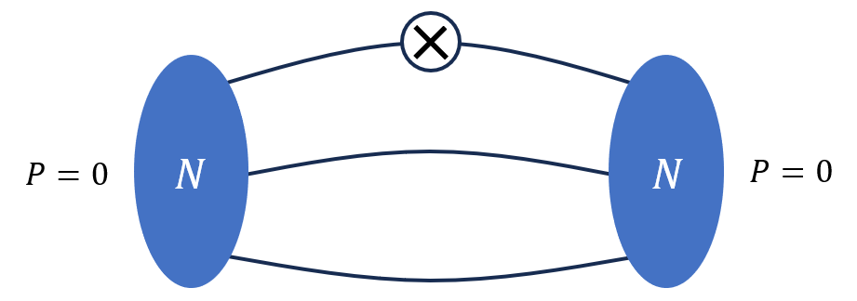

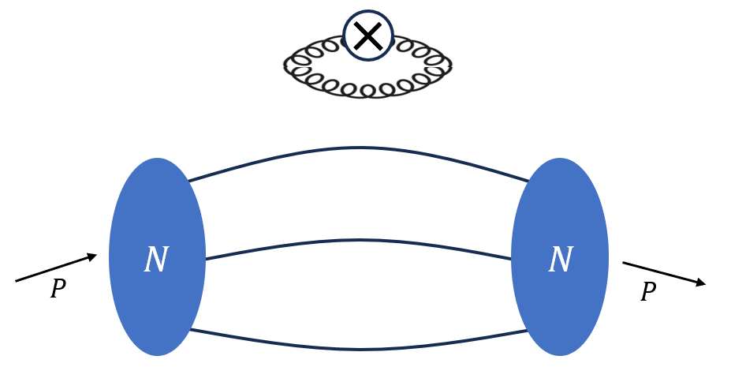

Lattice calculation

Slide 7


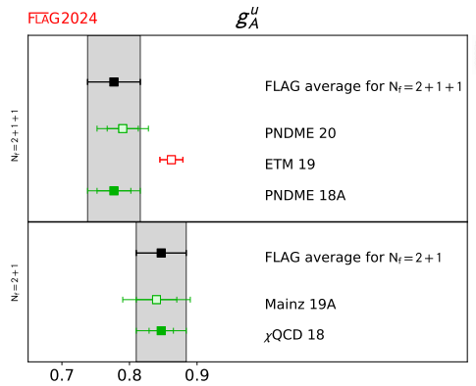
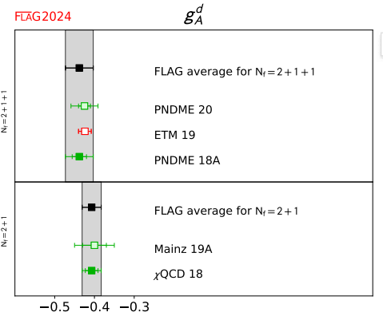
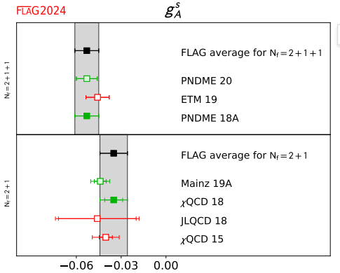
Lattice calculation
（ ）
in proton

Slide 8

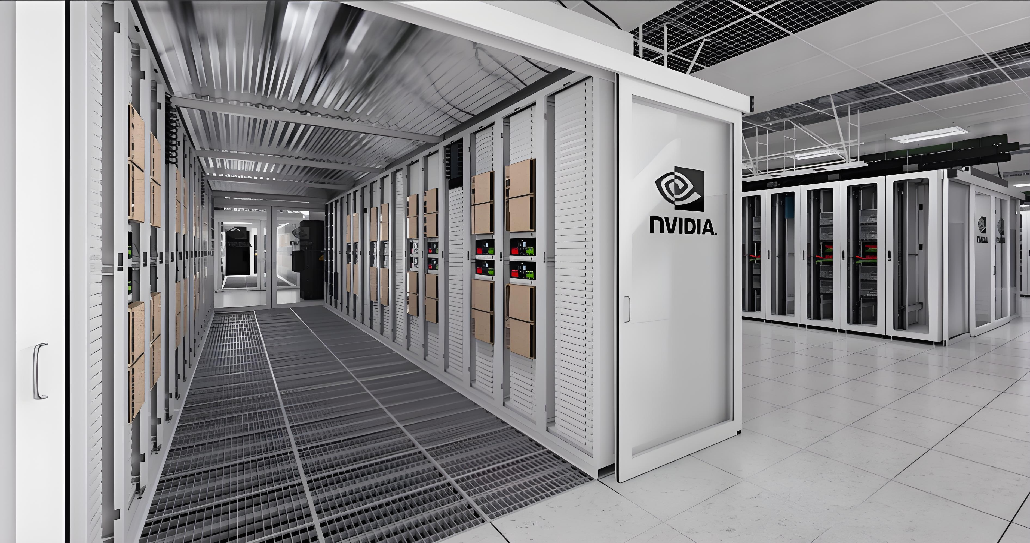
LQCD is expensive, but we can reduce the cost.
Good compute resource
Good strategy or idea

Slide 9
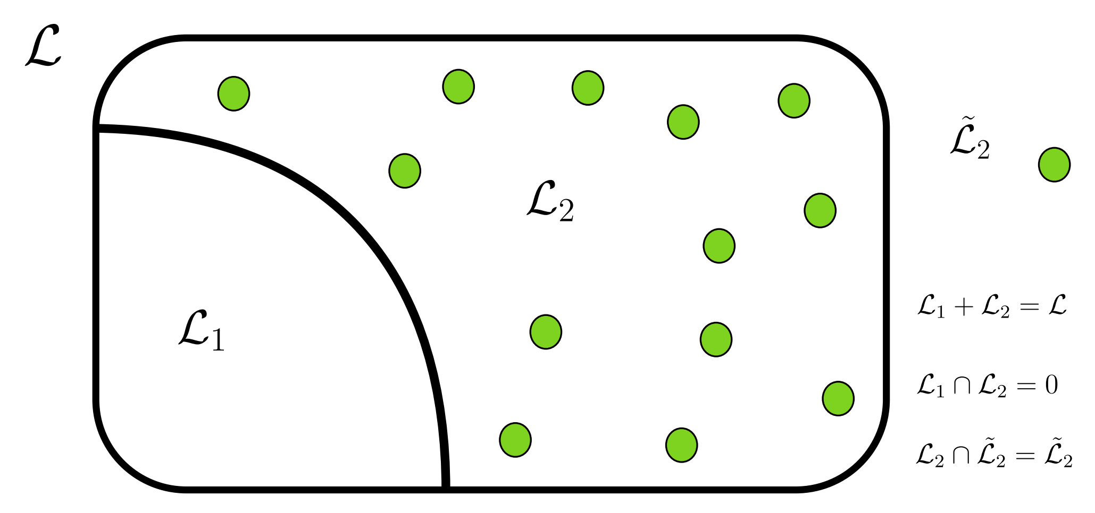
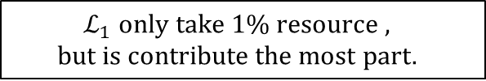
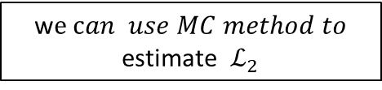
A Method to reduce the cost
Distillation method has been broadly used in lattice calculation of two-point functions
P.R.D. 80, 054506 (2009)
w$e can use MC method to$
estimate $ℒ_{2}$
~1%
$$ℒ_{1} only take 1\% resource ,$$
$$but is contribute the most part.$$

Slide 10






The blending Method to reduce the cost
ArXiv:2505.01719
All-to-All propagator will be
Unacceptable!
All-to-all propagator size: ${ \left(4N_{c}N_{T}N_{V}^{ }\right)}^{2}$
1. Vectors
2.Perambulator
+
$$\frac{N_{e}+N_{st}}{[ℒ]}≈1\%$$
$${\left(N_{c}N_{T}N_{V}^{ }\right)(N_{e}+N_{st})}^{ }$$
$${\left[4N_{T}\left(N_{e}+N_{st}\right)\right]}^{2}$$
Acceptable!

Slide 11
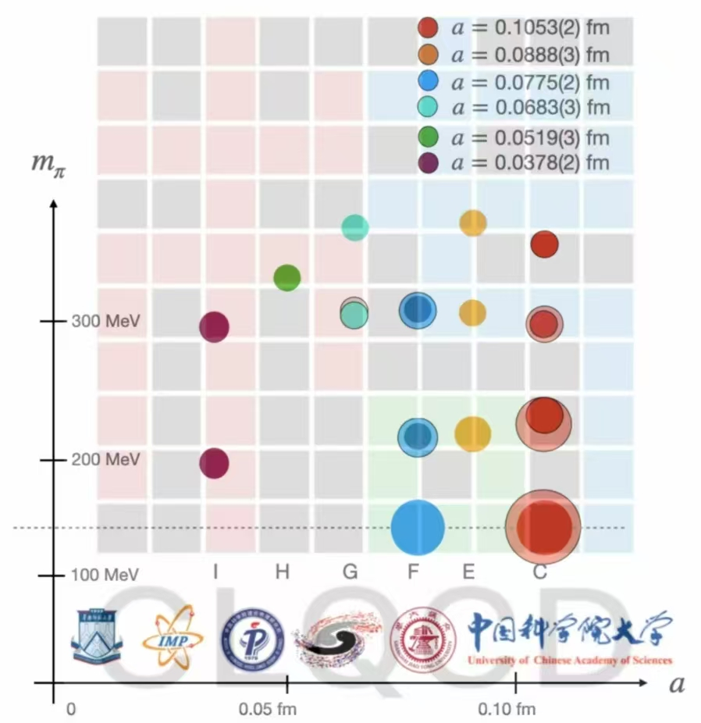

CLQCD ensembles
We have 6 lattice spacings from 0.105fm to 0.038fm.
Each case has several pion masses from 300MeV to 140MeV.
We have two ensembles with around physical points (pion mass is about 140MeV) at lattice spacing 0.105fm and 0.077fm.
With such ensembles, we can control the systematic uncertainty.

Slide 12

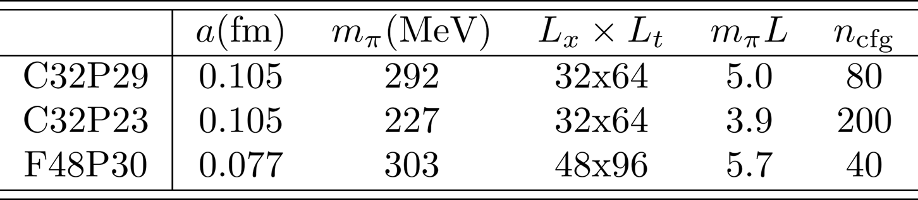
2+1 flavor tadpole-improved Clover Fermion with Symanzik gauge action

Slide 13
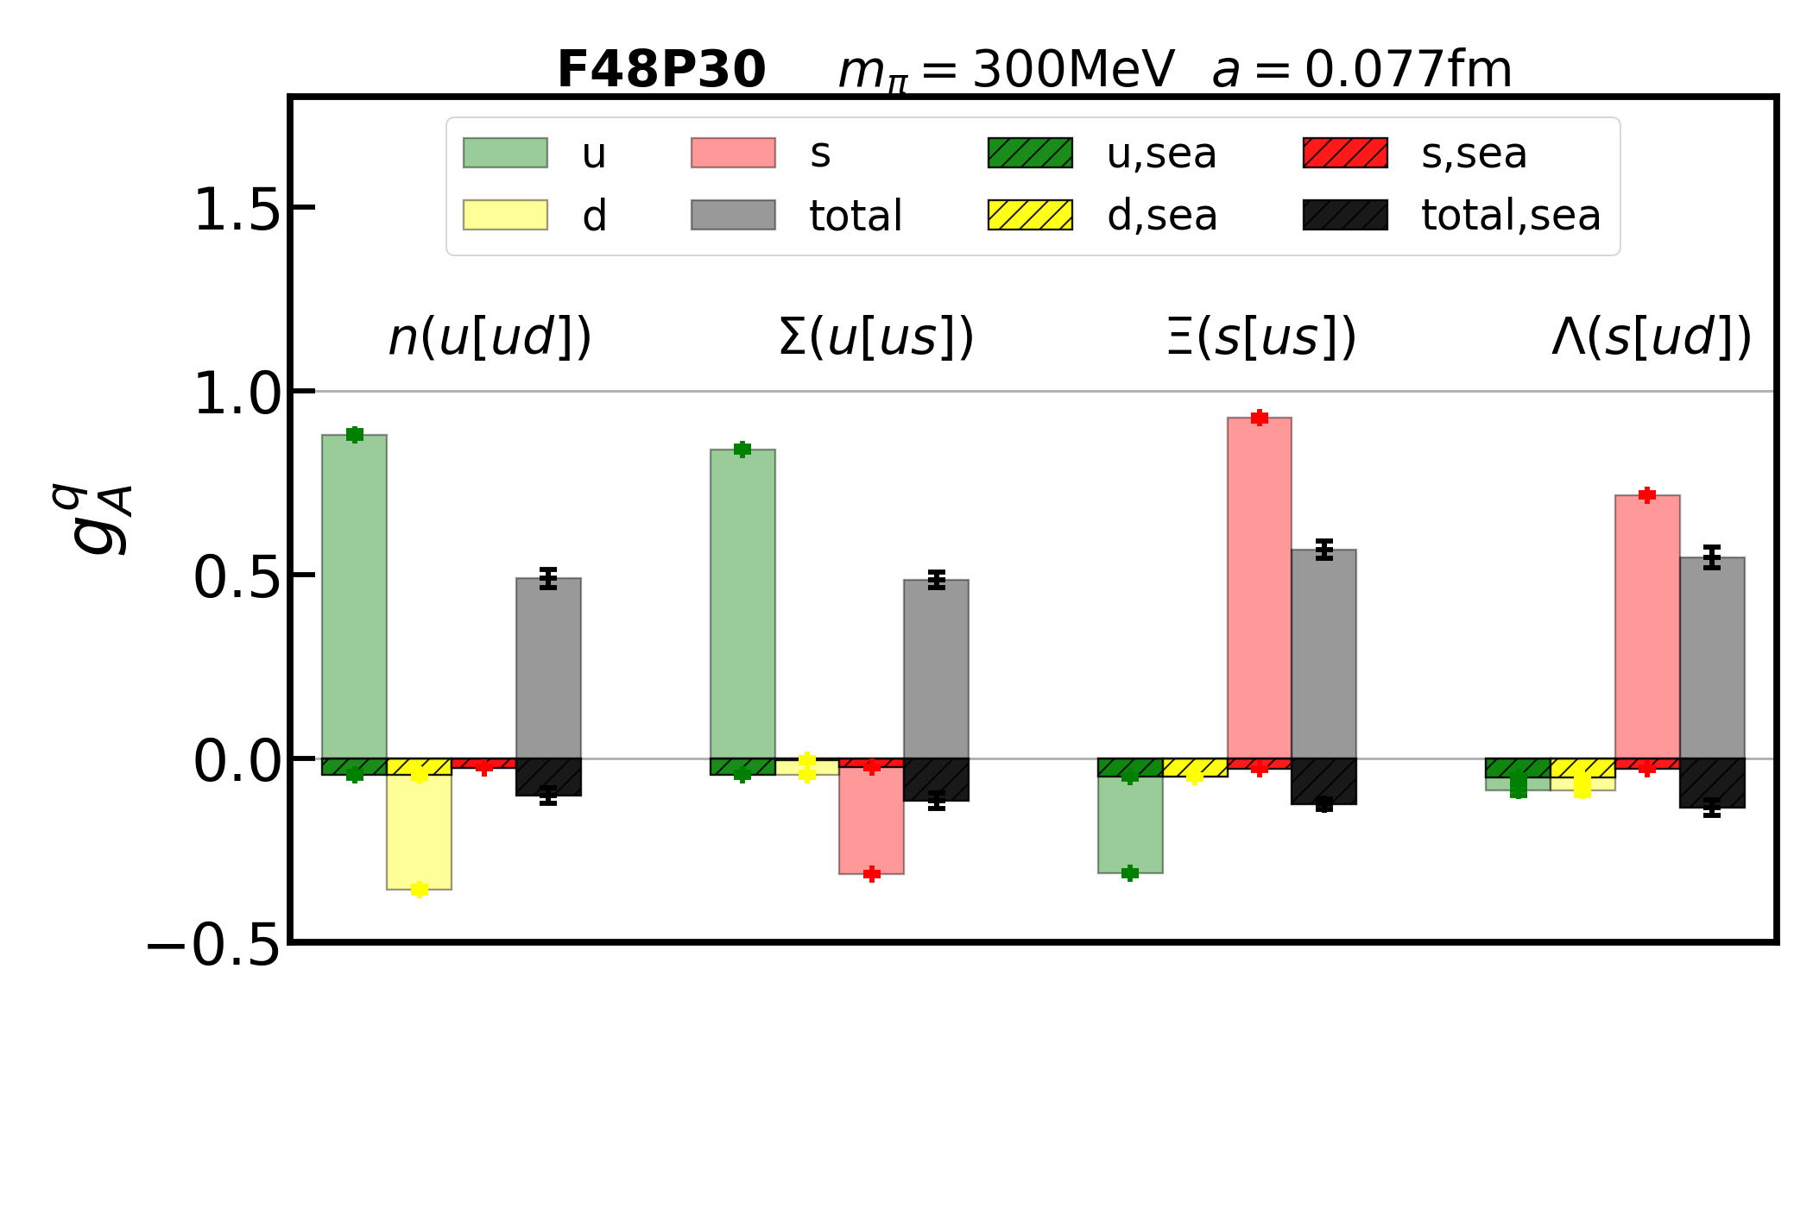
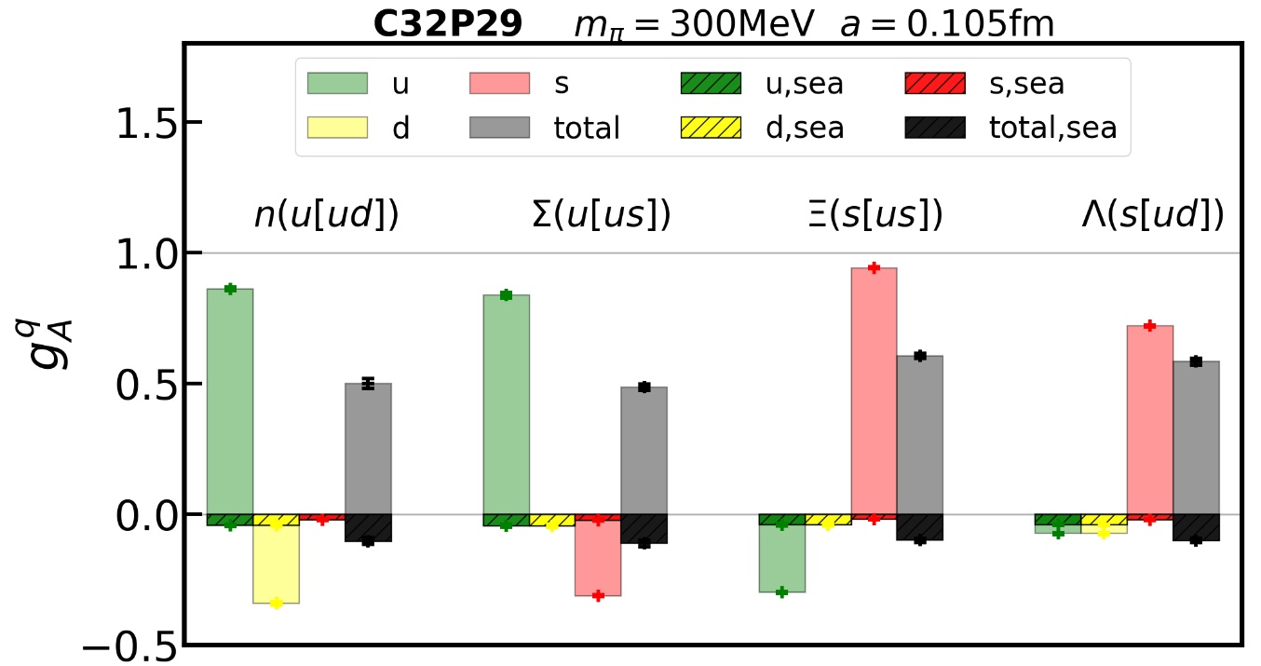
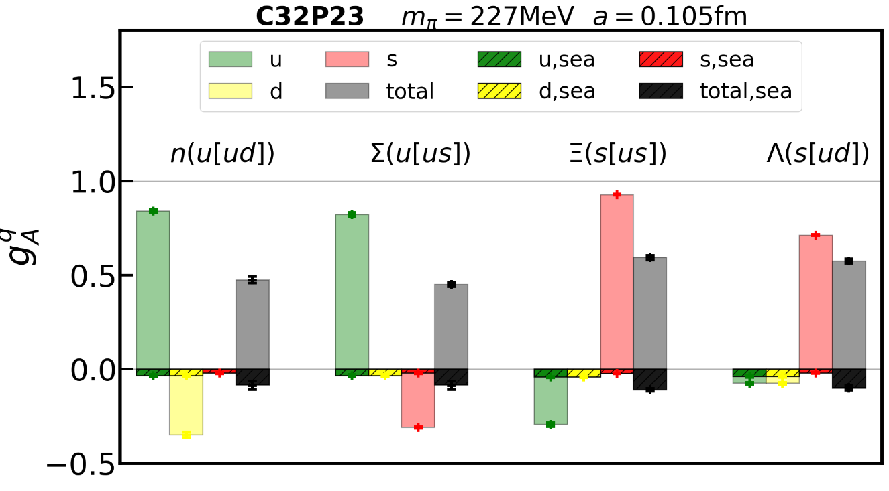
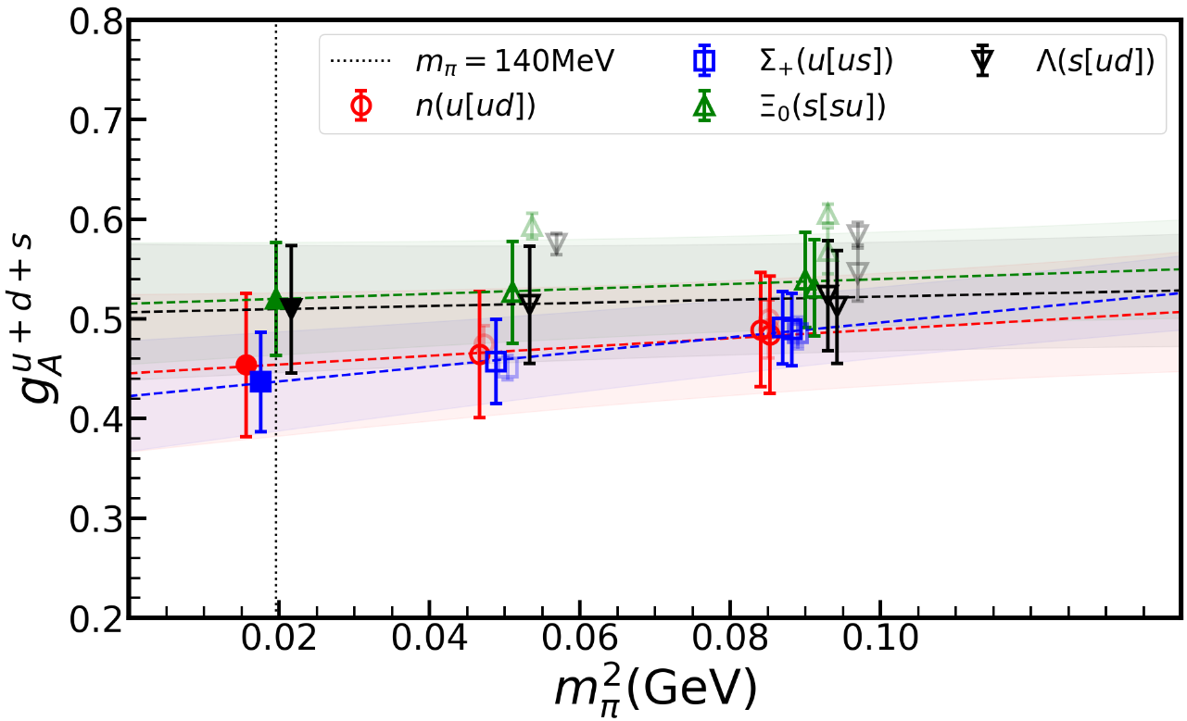
Our result

Slide 14
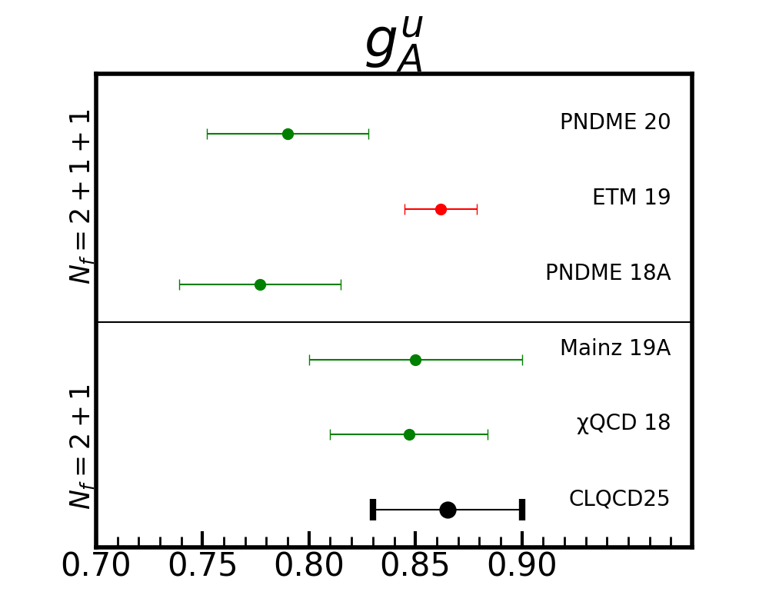
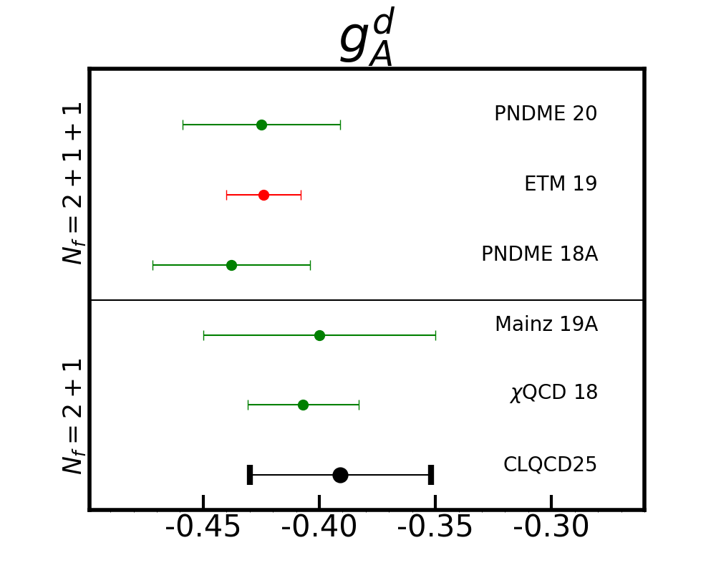
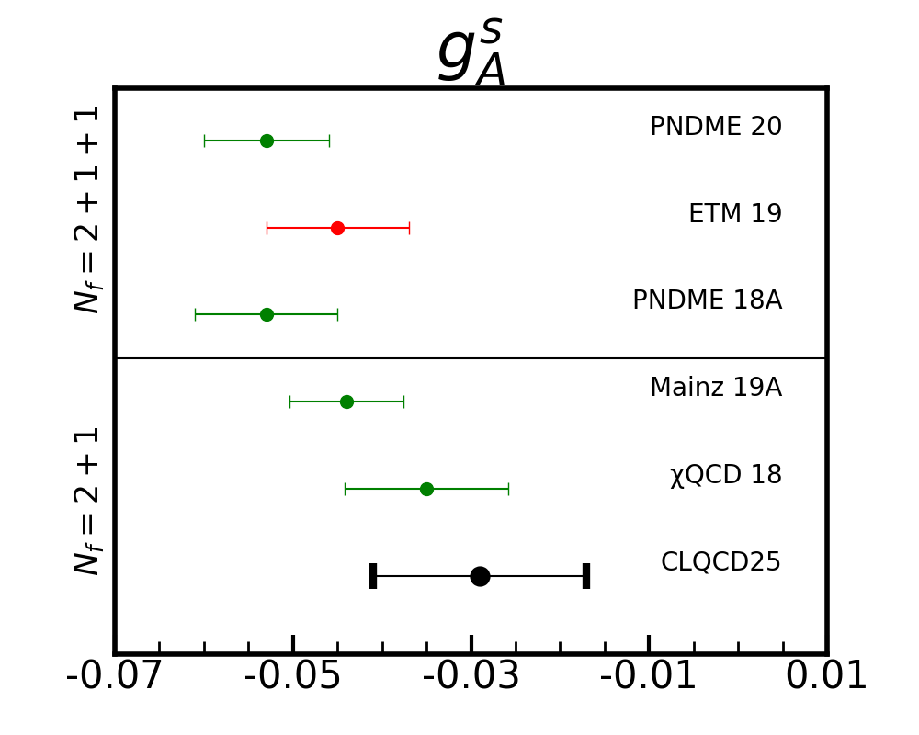
Quark spin in proton comparing to other groups

Slide 15

summary
Proton spin budget have been done by LQCD, however more researches are still needed.
To finish the lambda spin budget, we have a long journey to go.
In terms of our current calculation , the strange quark contributes a lot for the spin of lambda particle.

Slide 16
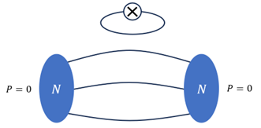
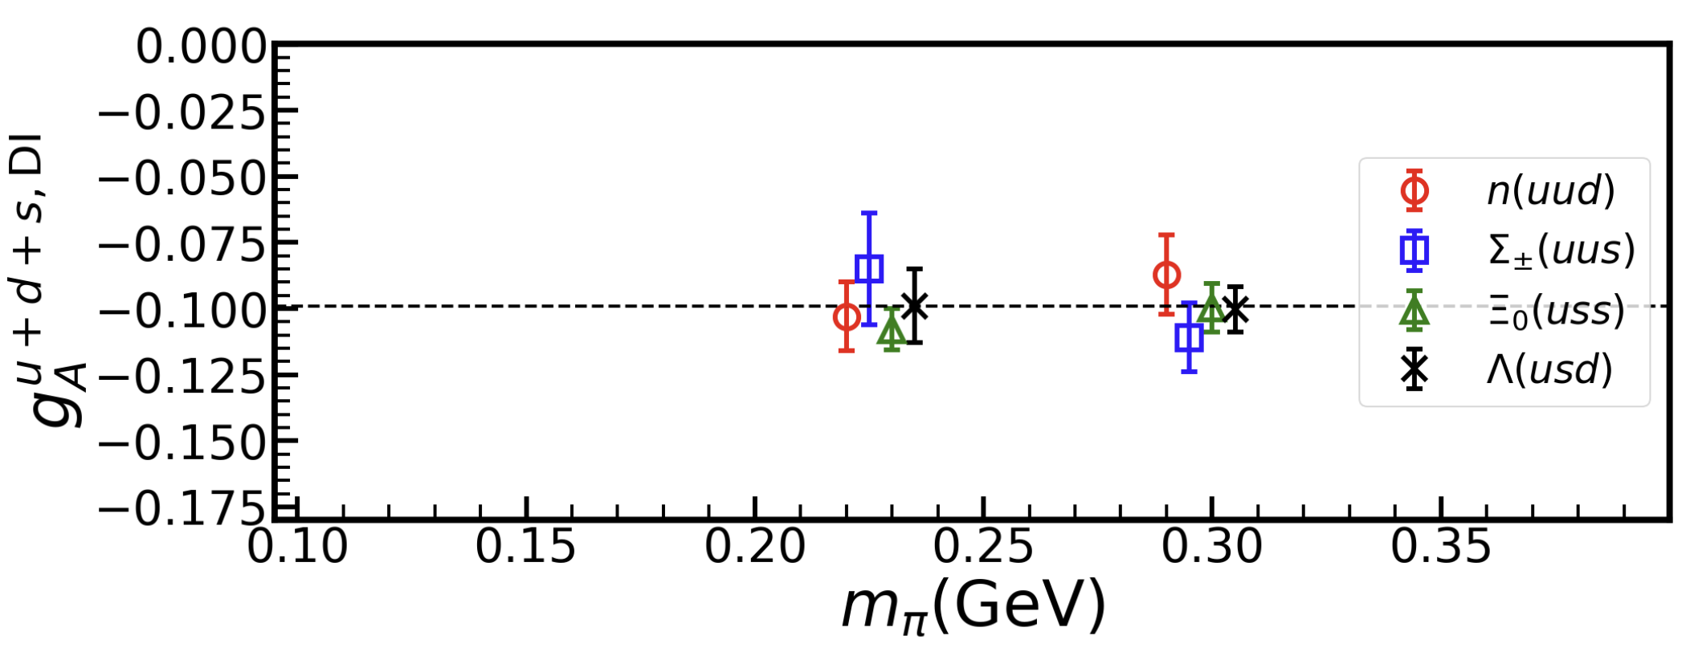
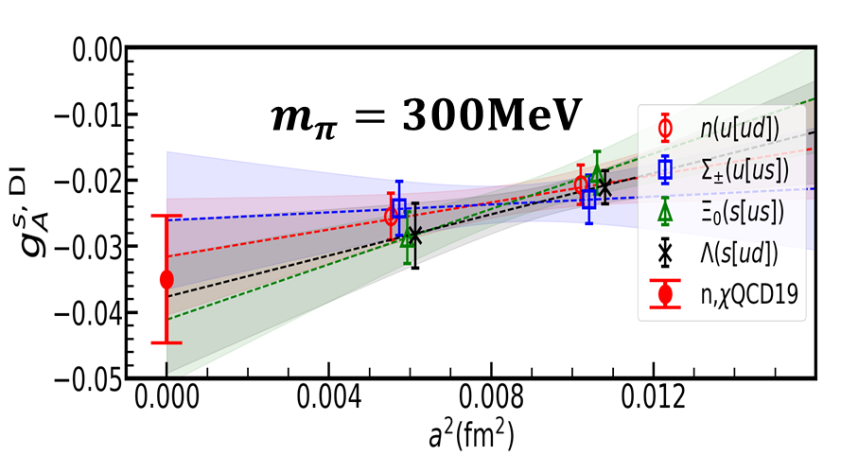
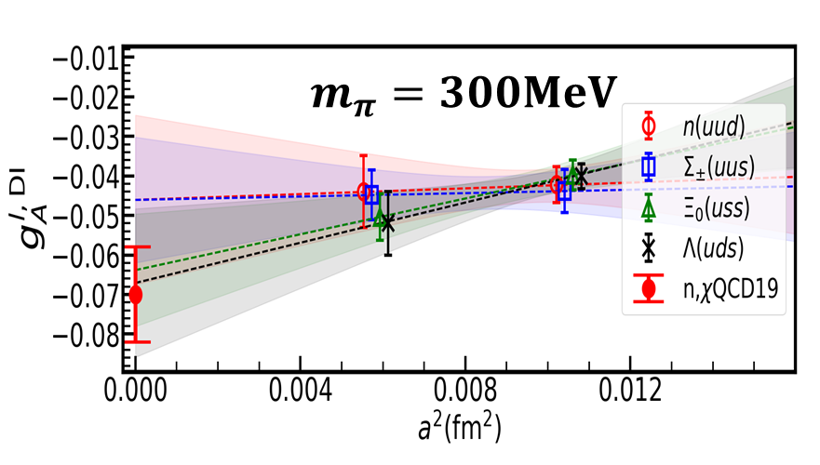


The sea quark contribution
$$u+d+s$$
$$a=0.105fm$$

Slide 17
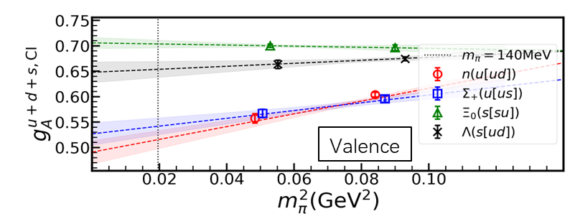
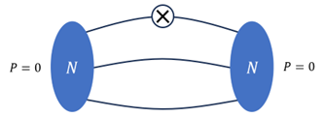
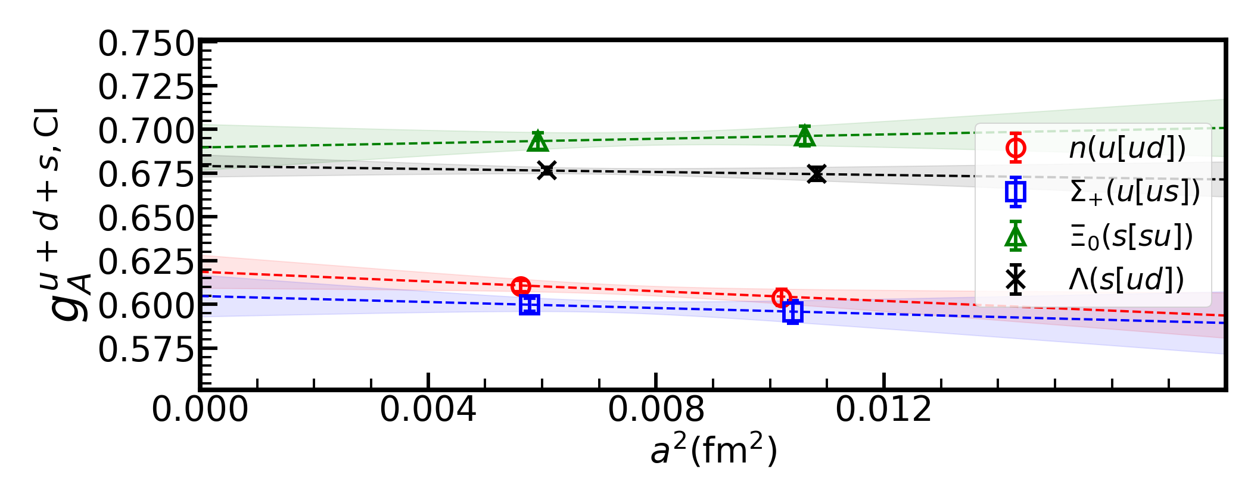

The valence quark contribution
$$a=0.105fm$$

