Slide 1

Closing Remarks
Haiping Peng
University of Science and Technology, China

Slide 2
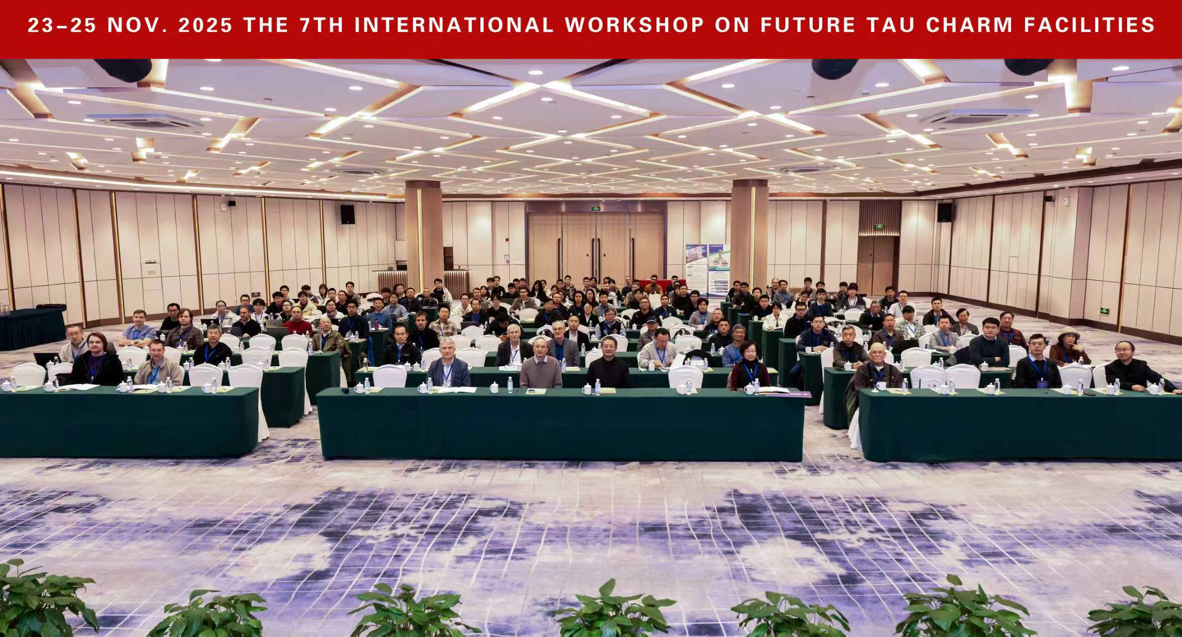
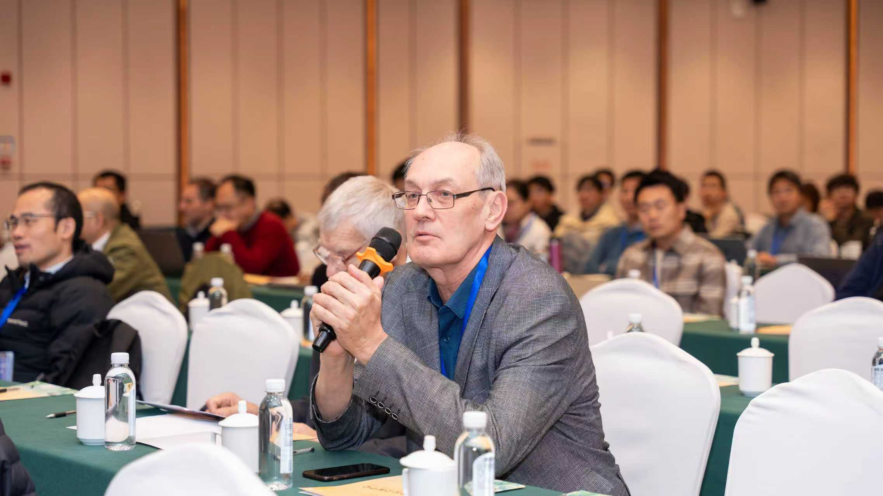
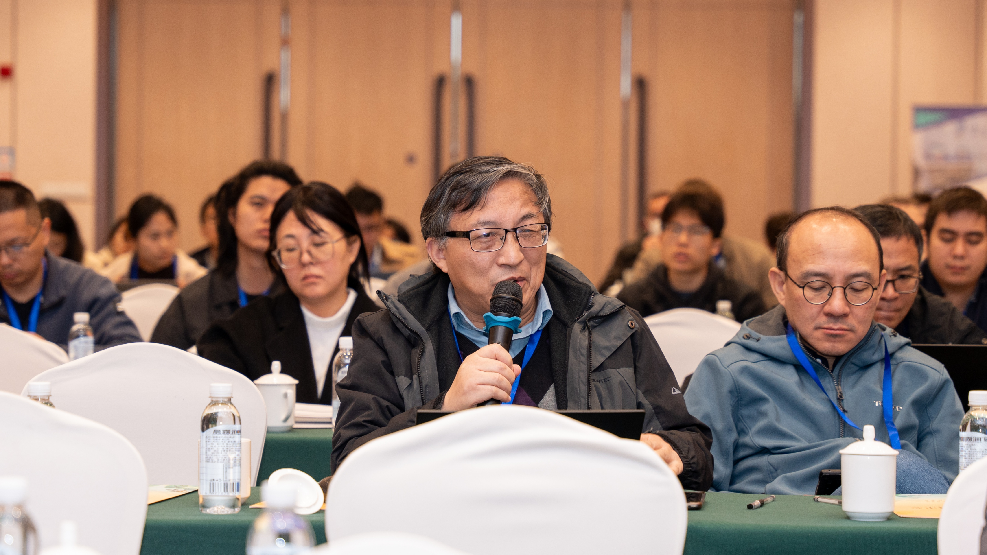
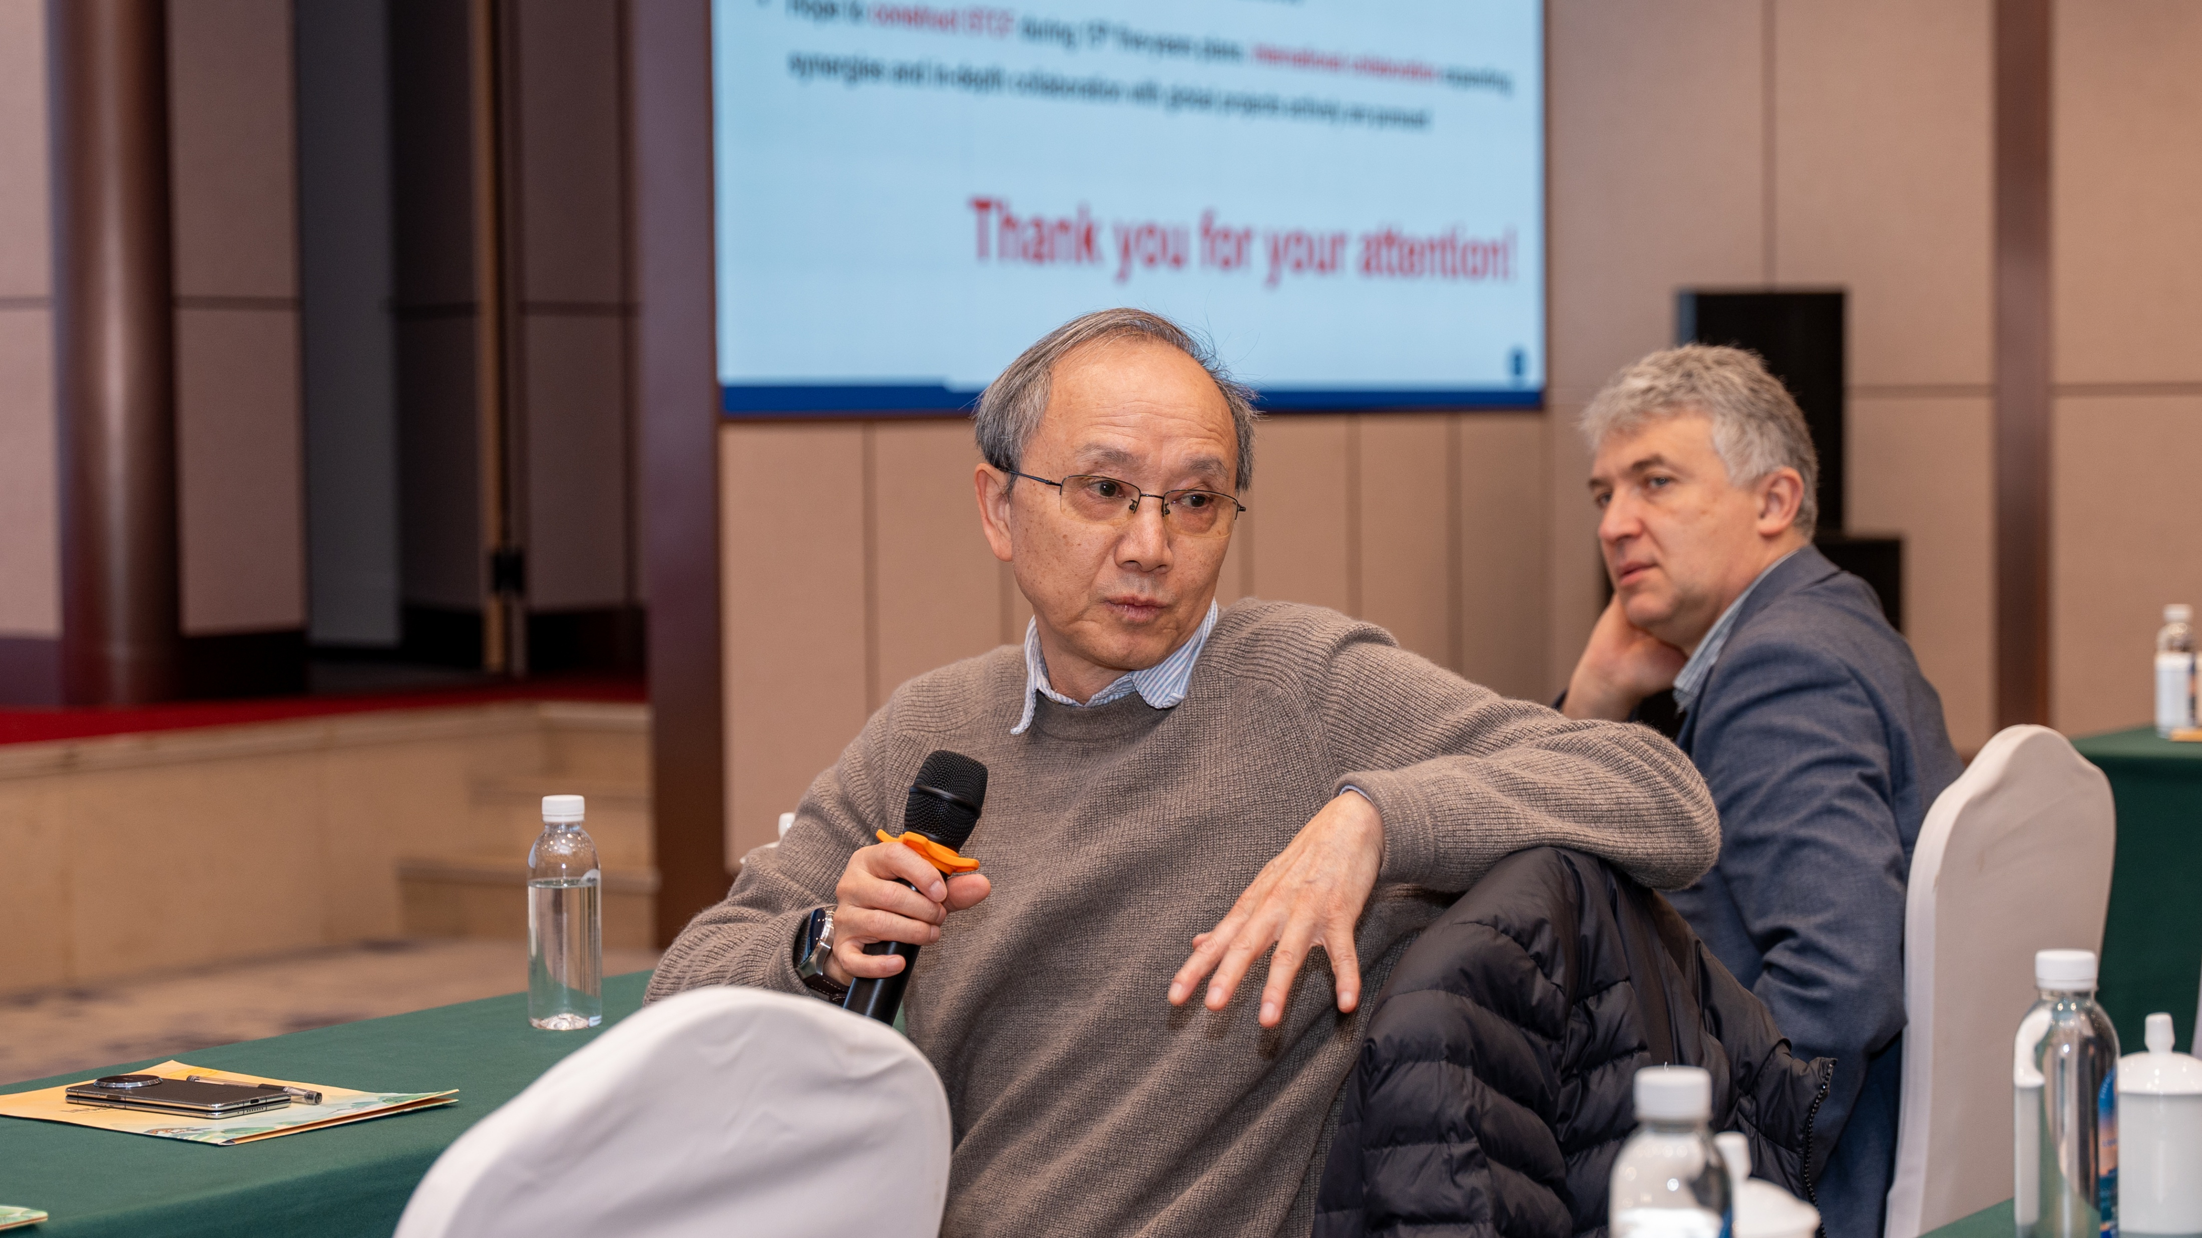
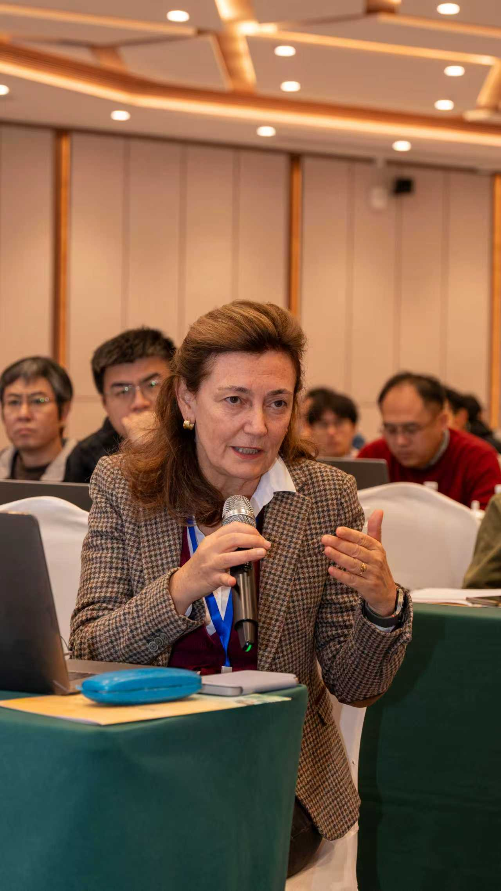
Some Numbers
More than 200 participants
125 talks in total
19 plenary talks :
STCF/SCTF overview (5), physics/theory (5)，
accelerator (3), detector (3), software/computing (3)
parallel talks (106):
accelerator (22), detector (33), physics/experiment (26),
software/computing (25).
Several experiments :
Intensively, fruitfully and Impressively

Slide 3
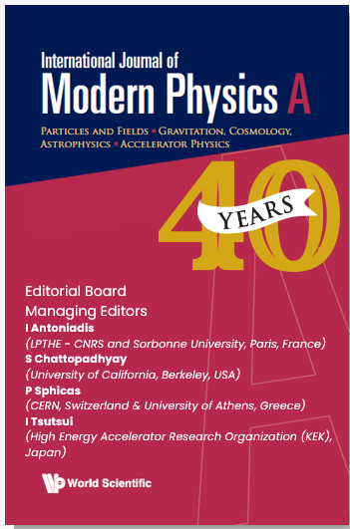
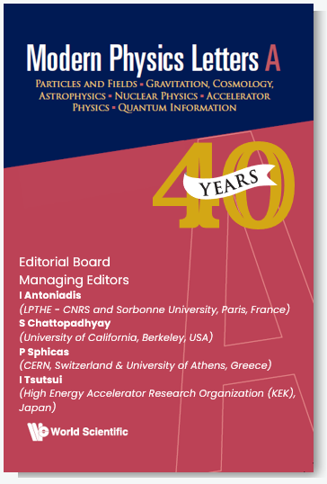
Publication of the proceeding
Two options for Special Issue paper publication of the presentations given in FTCF2025 are offered:
1) IJMPA –For physics and detector (https://www.worldscientific.com/worldscinet/ijmpa)
2)MPLA – For accelerator and software & computing (https://www.worldscientific.com/worldscinet/mpla)
Both journals are founded together in 1986 and have been managed by a common Editorial Board. They have been indexed in various key indexing databases, including SCI, Scopus, InspireHEP, NASA/ADS, etc.
https://indico.pnp.ustc.edu.cn/event/4580/page/90-publication-of-the-proceeding

Slide 4
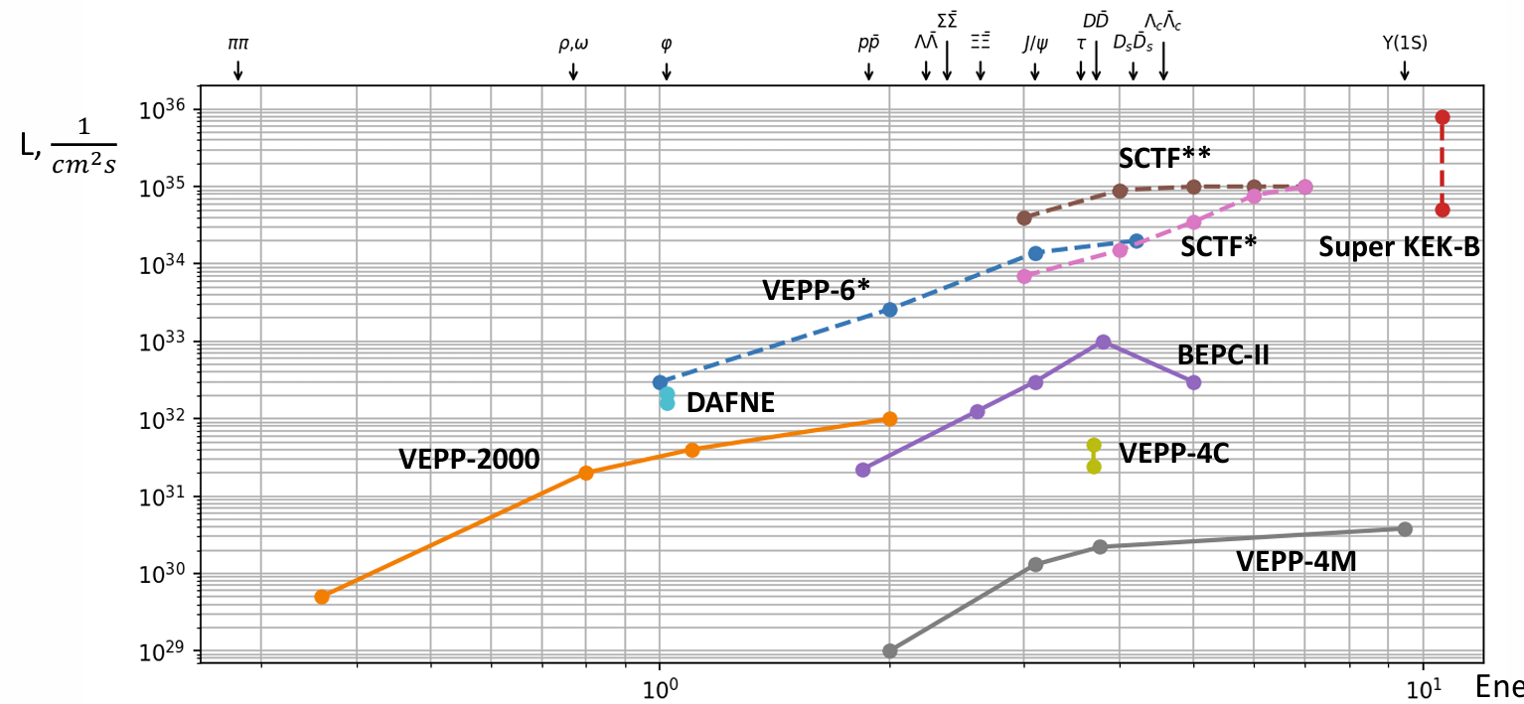
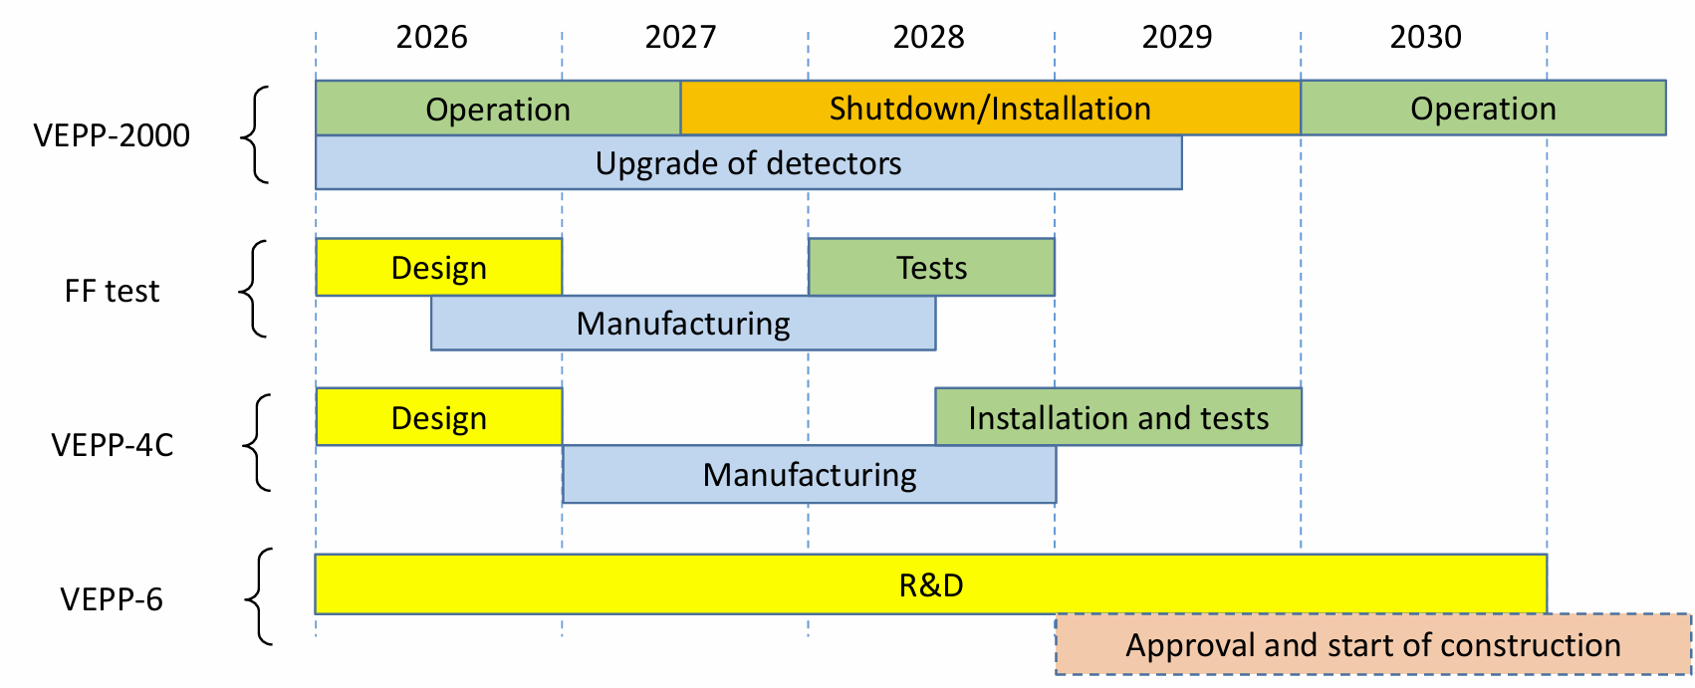
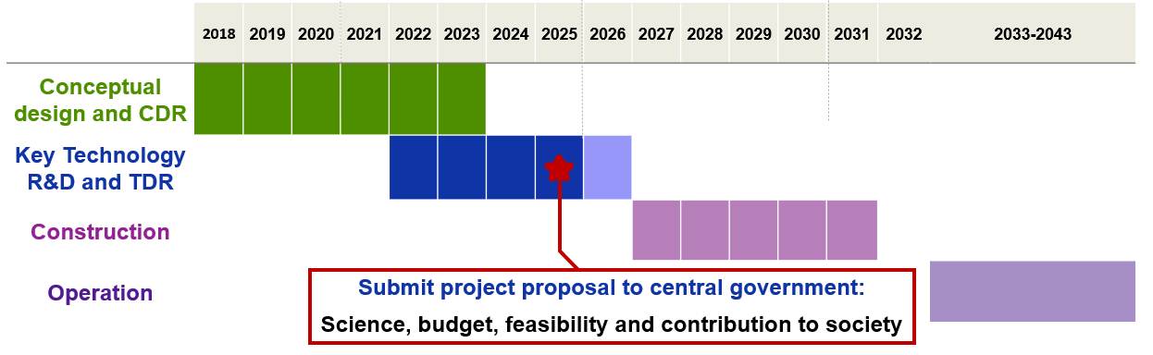
Remarks on STCF/VEPP
Physics :
Unique features with a broad and impressive physics reach,
Allow for results of world-leading precision and significant discovery potential.
Ideally complement both and the other facilities, great interest to community
Challenges :
both accelerator and detector, also project organization
Progress :
good
A lot of works :
refining physics gold,
optimizing design,
concentrating efforts on the key technology
Good organization of projects
Intensively international collaboration and synergies with other experiments are crucial and necessary!

Slide 5
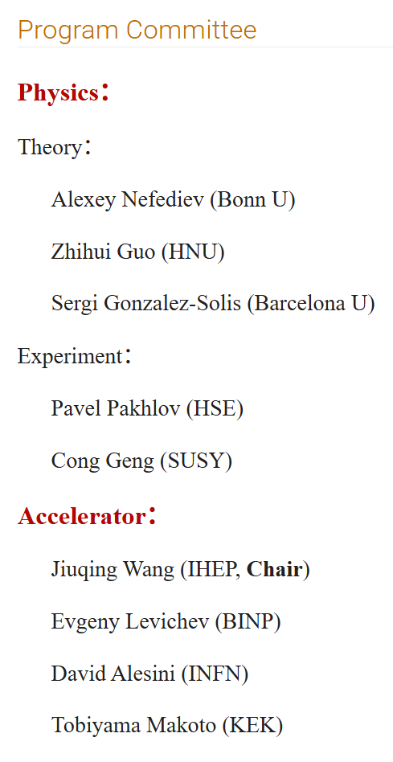
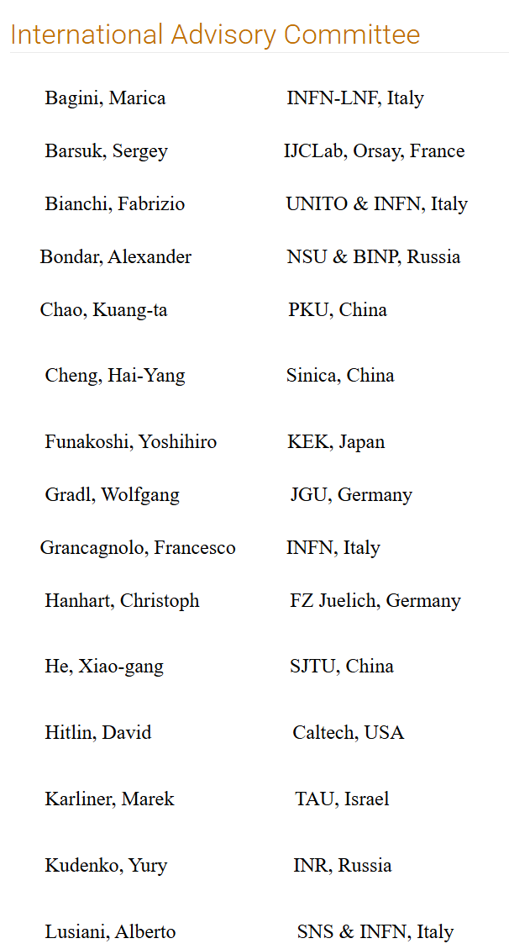
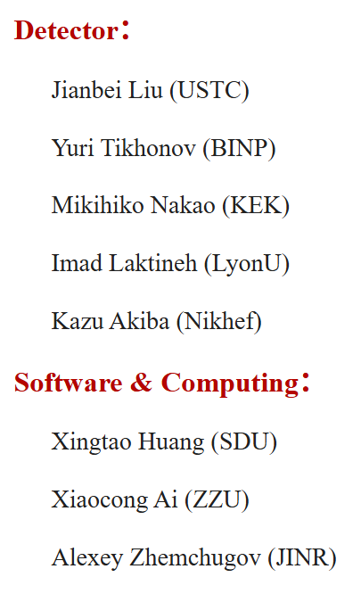
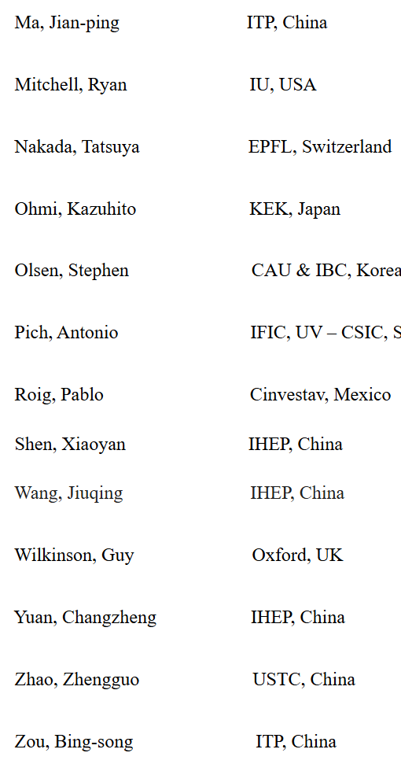
Thanks !

Slide 6
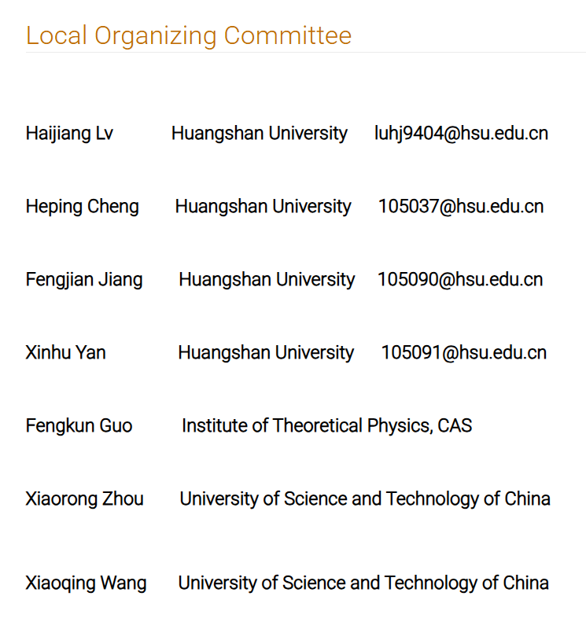
Thanks !
A lots of faculties from Huangshan College
闫新虎，黄志永，程瑶，刘旭安，杨丹萍；王磊，耿卉，沈婕，杜雪梅，张坤，田吉 程和平，蒋峰建，项芳莉，方淼晖，吴琬菁，周佳佳，朱黎明，胡晓丹

Slide 7
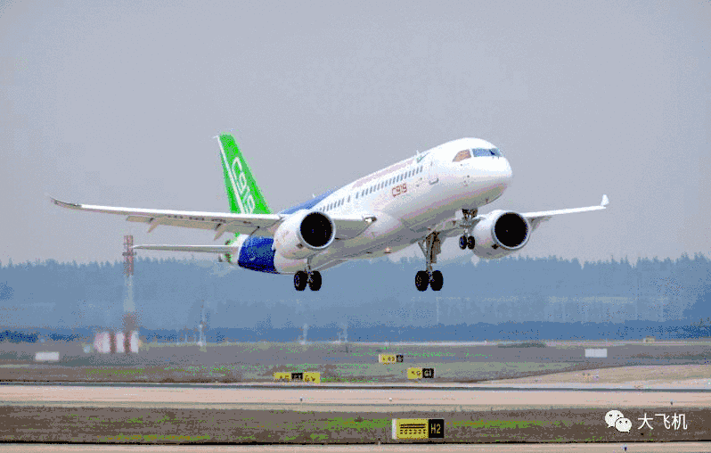
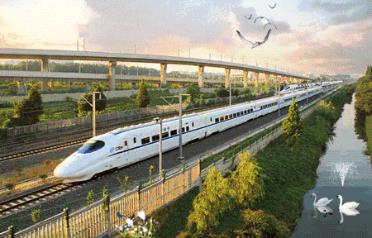
Have a safe and pleasant return journey back home

