Slide 1

Barrel-DTOF (BTOF) Software for Super Tau-Charm Facility
Teng Ma
University of Science and Technology of China
State Key Laboratory of Particle Detection and Electronics
(On behalf of the STCF BTOF working group)
FTCF2025
Nov 26, 2025, Huangshan

Slide 2
OutLine
Introduction
Simulation
Digitization
Reconstruction
Optimization
Summary

Slide 3
_{Introduction}

Slide 4
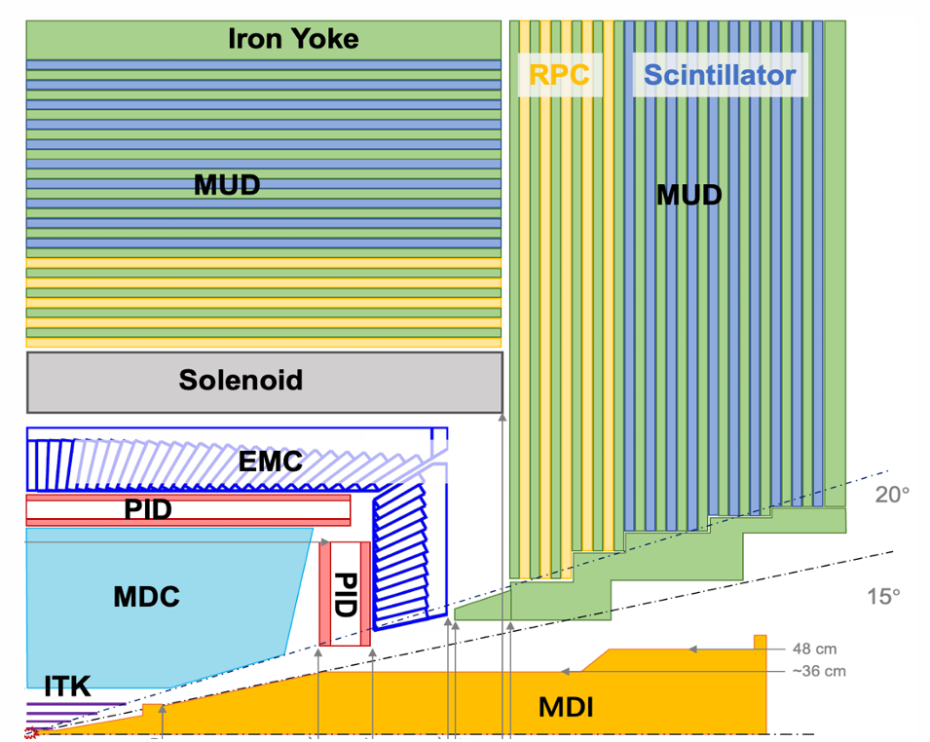
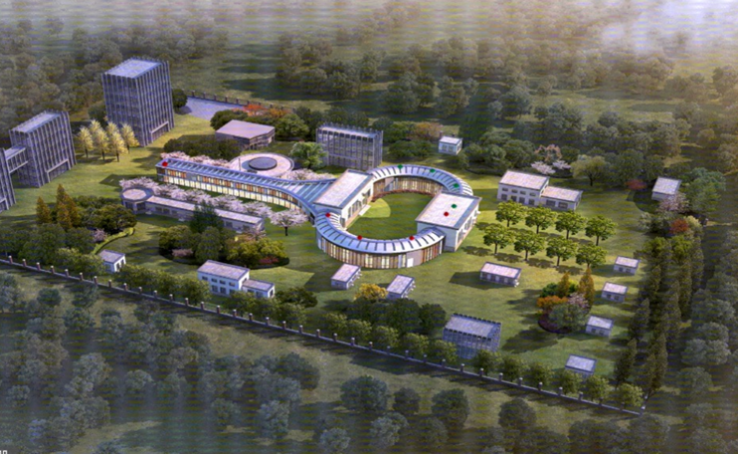
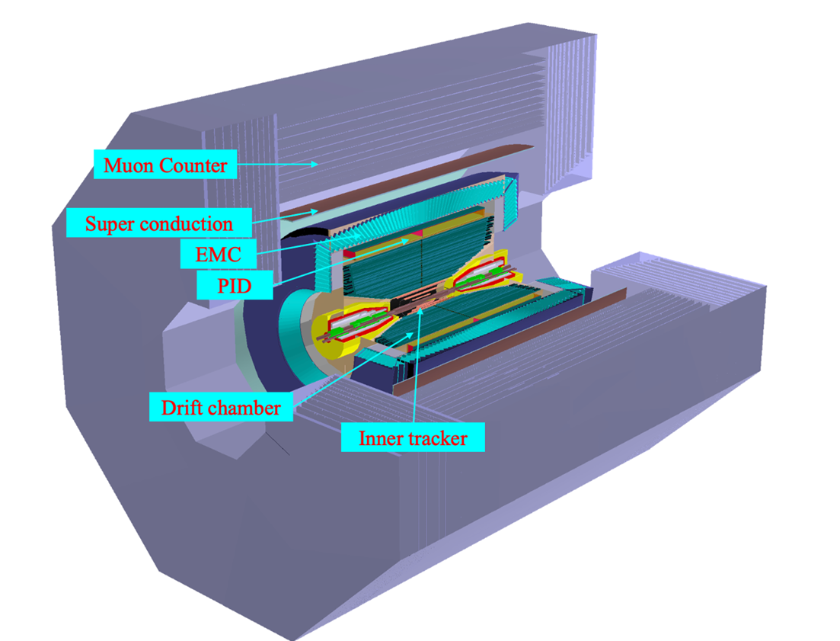
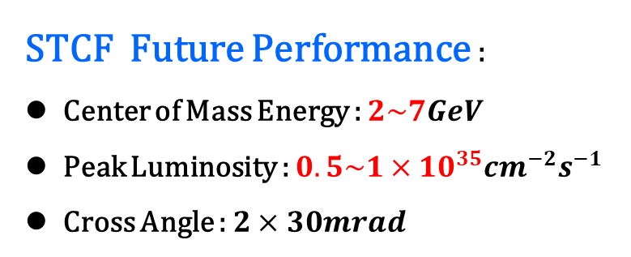
STCF Introduction
STCF Future Performance :
Center of Mass Energy : $2\sim 7GeV$
Peak Luminosity : $0.5\sim 1×{10}^{35}{cm}^{−2}s^{−1}$
Cross Angle : $2×30mrad$

Slide 5
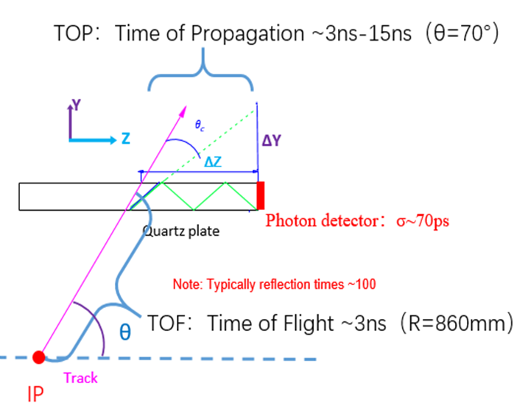
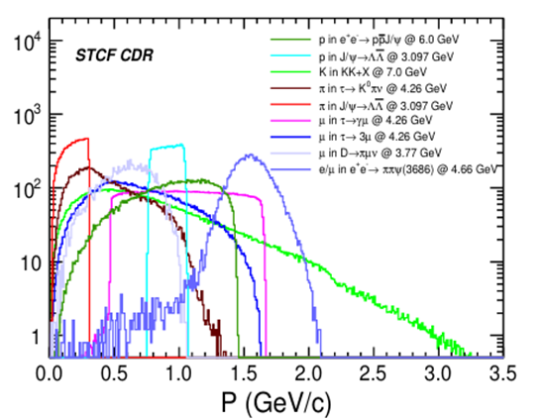
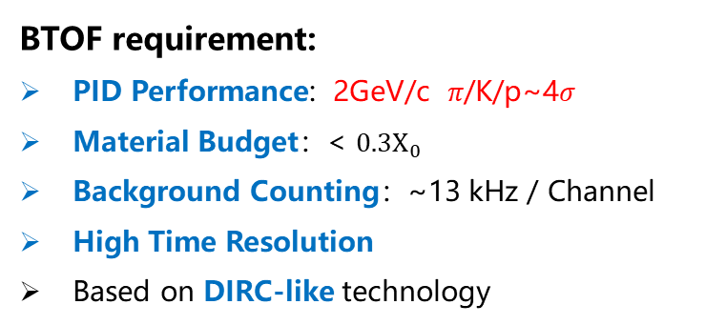
BTOF Introduction
BTOF requirement:
PID Performance: 2GeV/c 𝜋/Κ/p~4𝜎
Material Budget：< $0.3X_{0}$
Background Counting：~13 kHz / Channel
High Time Resolution
Based on DIRC-like technology

Slide 6
_{Simulation}

Slide 7
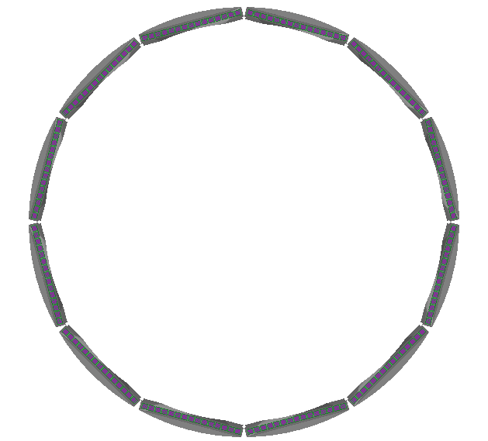
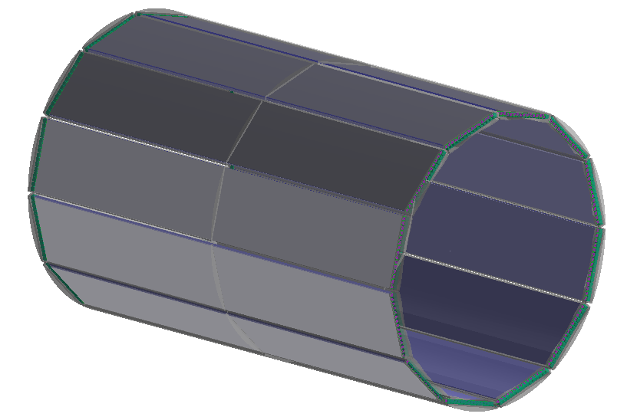
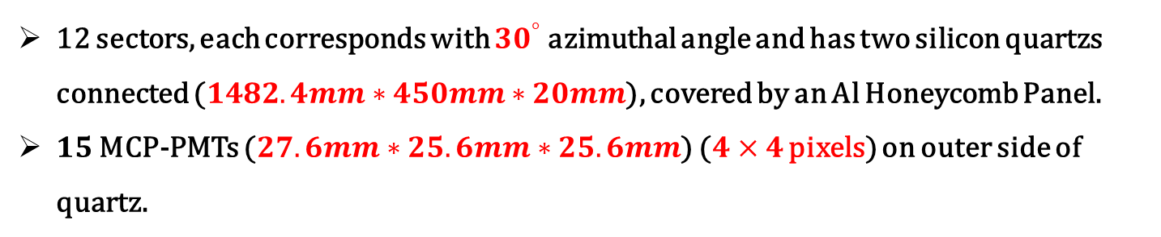
BTOF Geometry
12 sectors, each corresponds with ${30}^{°}$ azimuthal angle and has two silicon quartzs connected ($1482.4mm∗450mm∗20mm$), covered by an Al Honeycomb Panel.
$15$ MCP-PMTs ($27.6mm∗25.6mm∗25.6mm$) ($4×4$ pixels) on outer side of quartz.

Slide 8
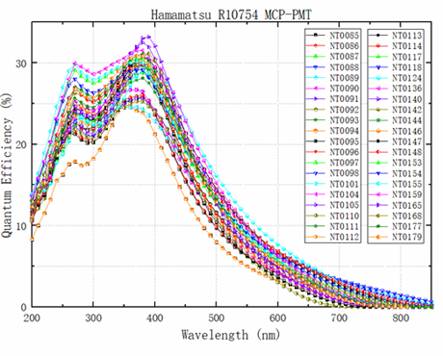
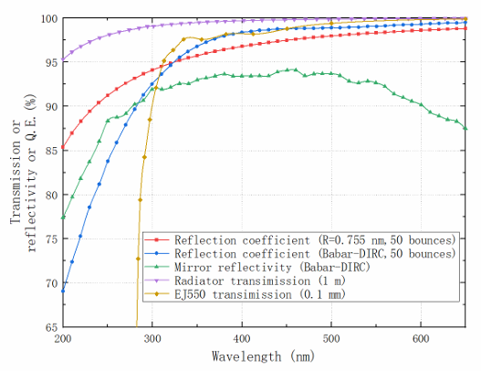
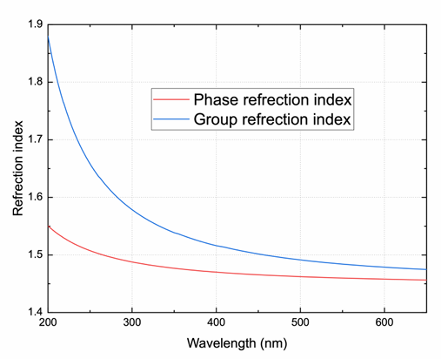
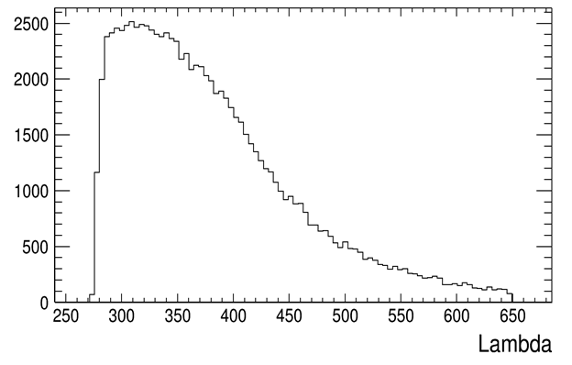
Simulation Parameter
The cutting point of grease transmission (The yellow one) has been changed to about 375nm to reduce the dispersion and improve the time resolution.

Slide 9
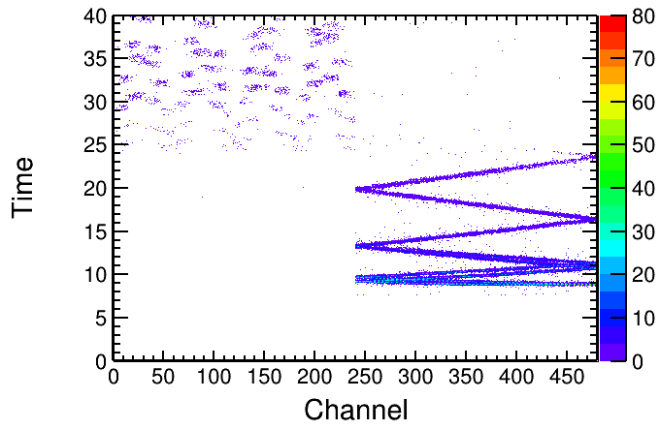
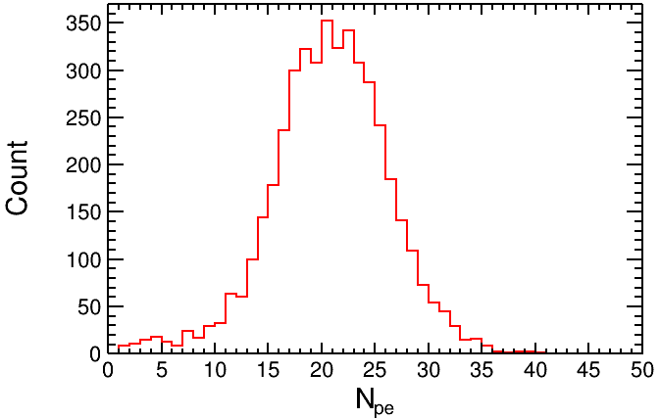
Simulation Result
$P=2GeV θ={65}^{°} φ={90}^{°}$

Slide 10
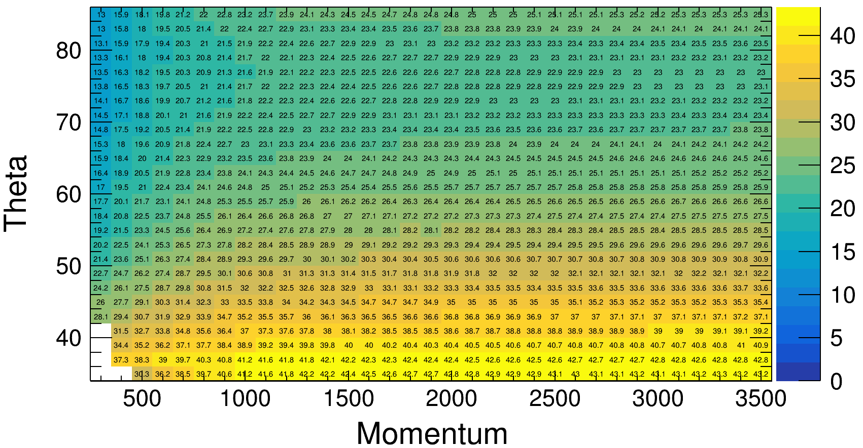
Number of Photon Electron
$N_{pe}$ of $π$

Slide 11
_{Digitization}

Slide 12
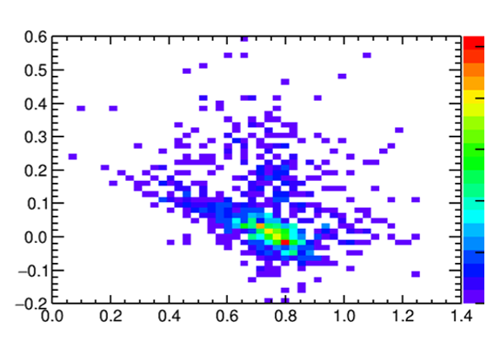
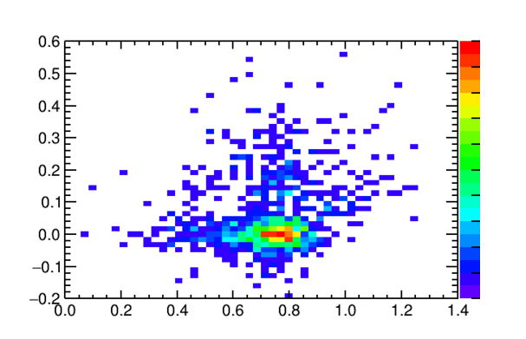
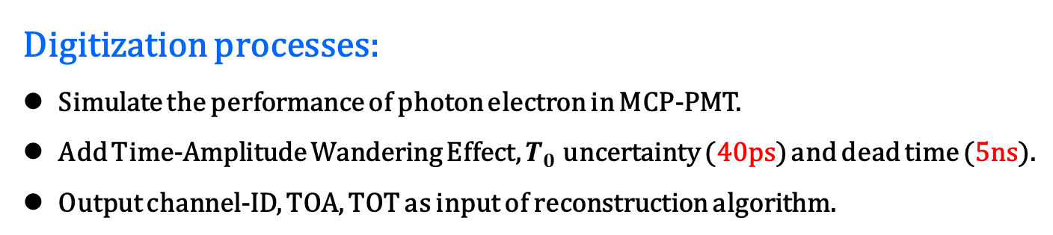
BTOF Digitilization
Digitization processes:
Simulate the performance of photon electron in MCP-PMT.
Add Time-Amplitude Wandering Effect, $T_{0}$ uncertainty (40ps) and dead time (5ns).
Output channel-ID, TOA, TOT as input of reconstruction algorithm.
TOA : TOT
TOA : TOT
(after correction)

Slide 13
_{Reconstruction}

Slide 14
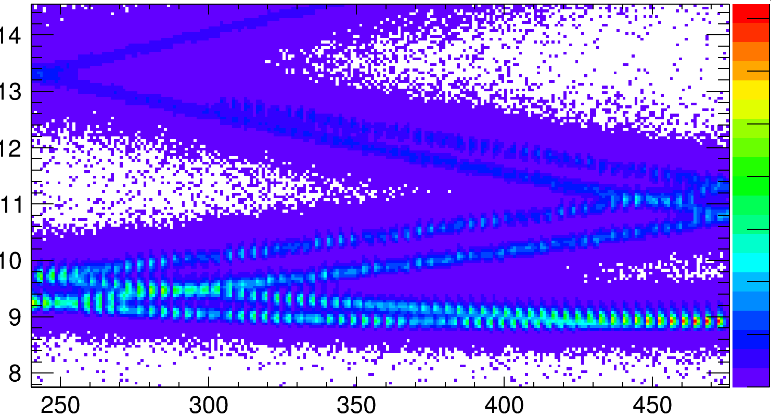
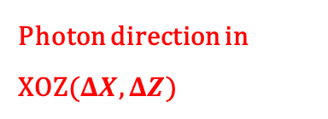
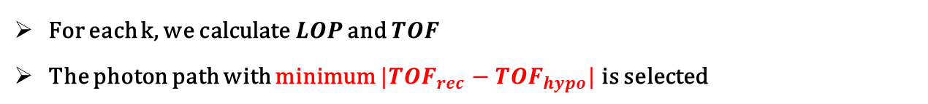



Timing Method
Photon direction in XOZ($ΔX$, $ΔZ$)
$$k_{1}$$
$$k_{0}$$
Time
$$k_{−1}$$
XOZ Plane
Channel-ID
For each k, we calculate$LOP$ and $TOF$
The photon path with minimum $|{TOF}_{rec}−{TOF}_{hypo}|$ is selected

Slide 15
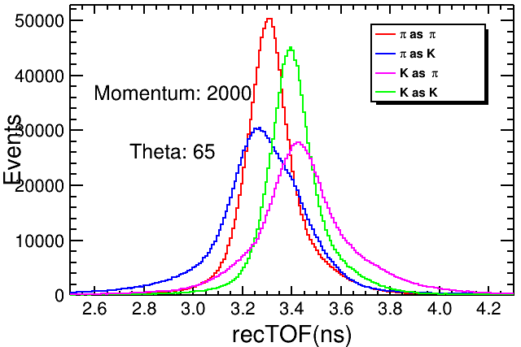
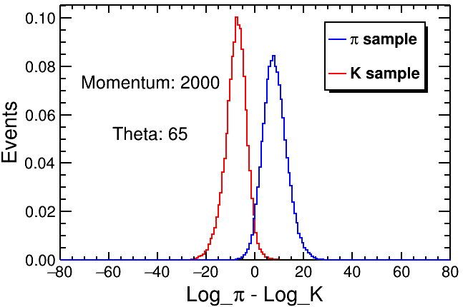
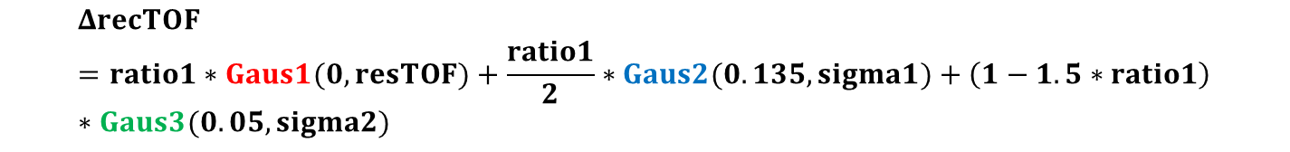
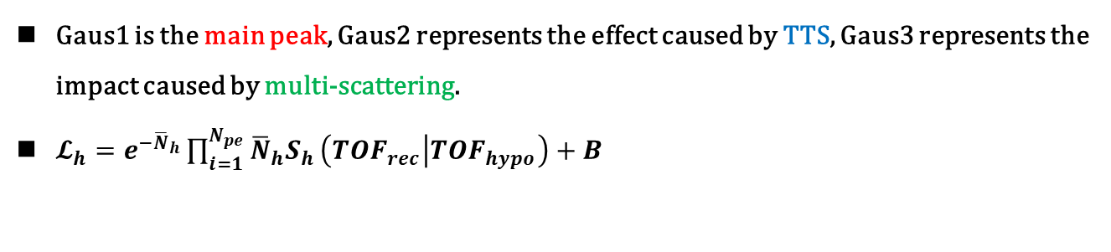
Timing Method
$Δ$recTOF (${TOF}_{rec}−{TOF}_{hypo}$) distribution can be described with 3 Gauss model :
$$ΔrecTOF=ratio1∗Gaus1(0,resTOF)+\frac{ratio1}{2}∗Gaus2(0.135,sigma1)+\left(1−1.5∗ratio1\right)∗Gaus3(0.05,sigma2)$$
Gaus1 is the main peak, Gaus2 represents the effect caused by TTS, Gaus3 represents the impact caused by multi-scattering.
$𝓛_{h}=e^{−{\overline{N}}_{h}}\prod_{i=1}^{N_{pe}}{{\overline{N}}_{h}S_{h}}\left({TOF}_{rec} | {TOF}_{hypo}\right)+B$

Slide 16
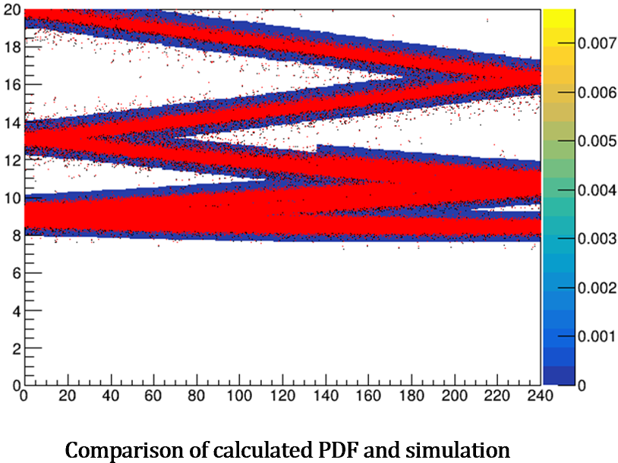
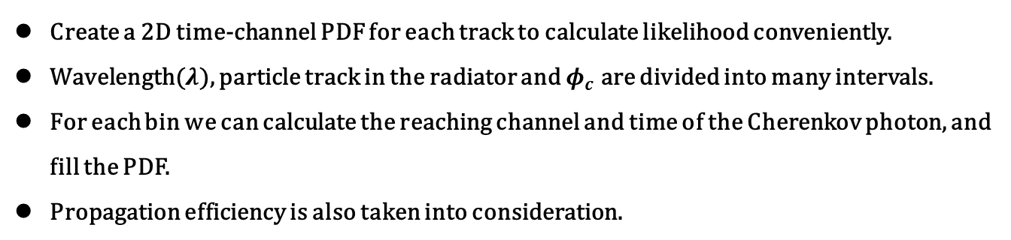
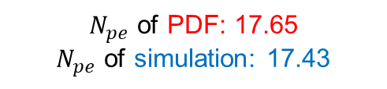
Imaging Method
Create a 2D time-channel PDF for each track to calculate likelihood conveniently.
Wavelength($λ$), particle track in the radiator and $φ_{c}$ are divided into many intervals.
For each bin we can calculate the reaching channel and time of the Cherenkov photon, and fill the PDF.
Propagation efficiency is also taken into consideration.
The red dots and COLZ PDF represent simulation data and calculated PDF
Good agreement between calculated pattern and simulation
$N_{pe}$ of PDF: 17.65
$N_{pe}$ of simulation: 17.43

Slide 17
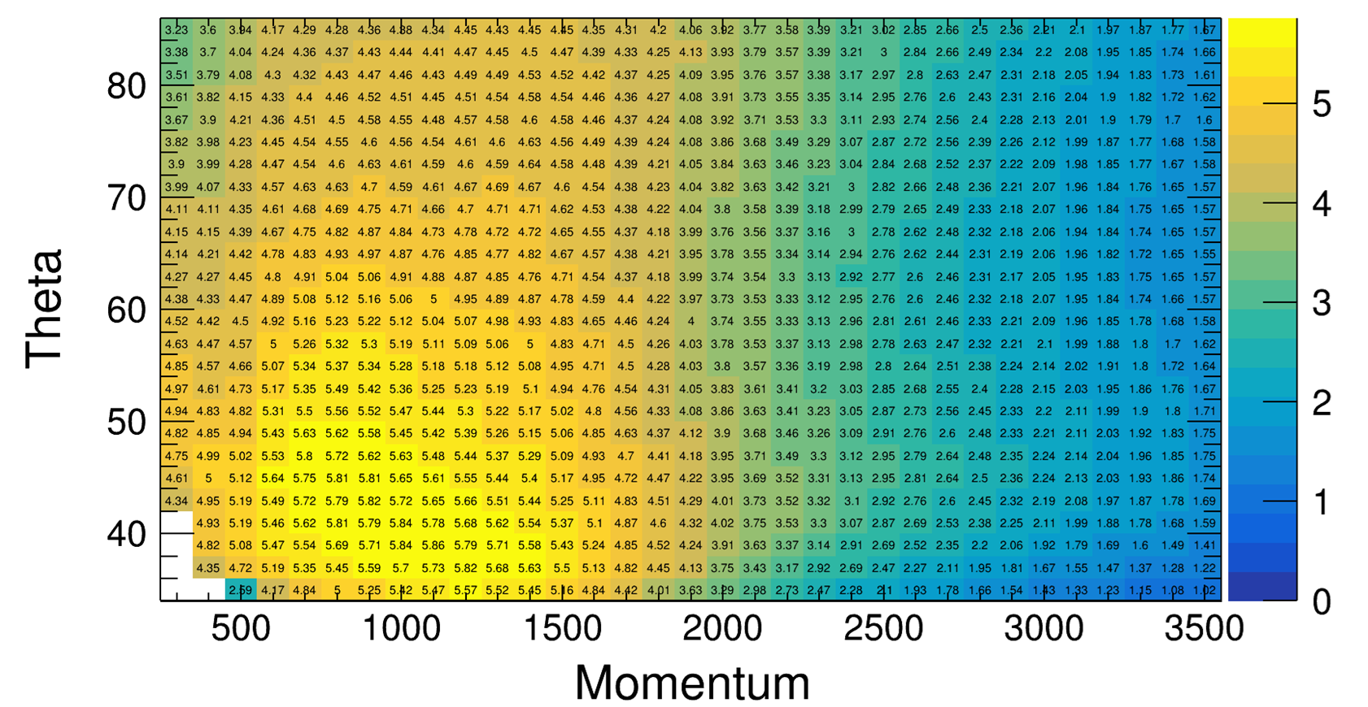
Timing Method
Separation between $π/K$

Slide 18
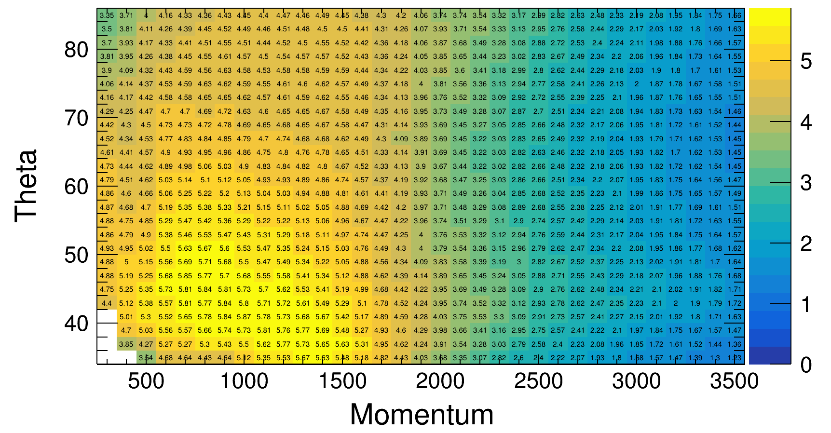
Imaging Method
Separation between $π/K$ (missid = 2%)

Slide 19
_{Future Plan}

Slide 20

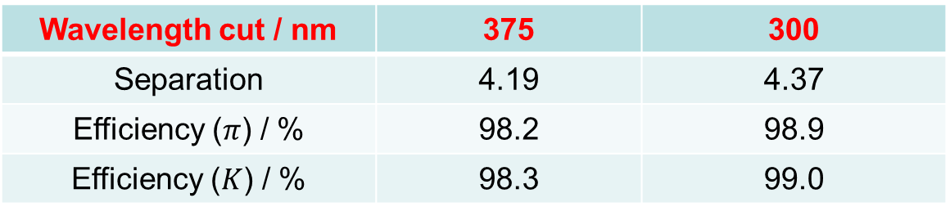
Future Plan
Add a large light guide to improve the spatial discrimination
The current wavelength cut (375nm) can be extended to lower level (~300nm) , larger number of photon electron will lead to better separation
Effect on PMT lifetime and dispersion need to be evaluated carefully.
Standalone result ($P=2GeV θ={65}^{°} φ={90}^{°}$)
Wavelength cut / nm | 375 | 300
Separation | 4.19 | 4.37
Efficiency ($π$) / % | 98.2 | 98.9
Efficiency ($K$) / % | 98.3 | 99.0
Notes:
背景

Slide 21
Summary
Finished
BTOF full chain process has been completed.
Two reconstruction algorithm have almost reached the PID requirement.
Performance analysis has been done.
Next to do
BTOF Geometry optimization.
Further study on wavelength cut optimization.

Slide 22
_{Backup}

Slide 23
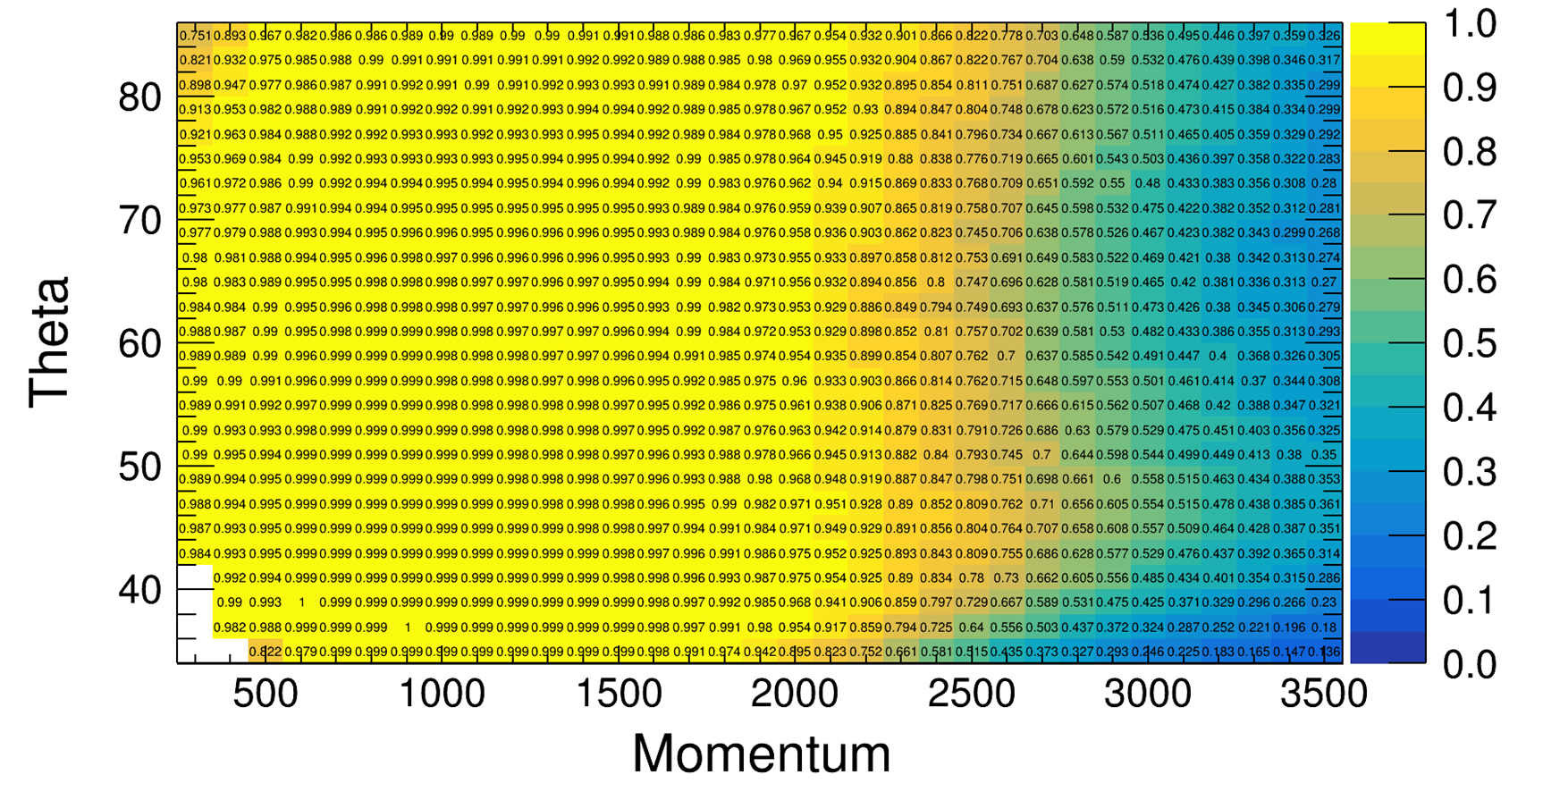
Timing Method
Efficiency of $π$ (missid = 2%)

Slide 24
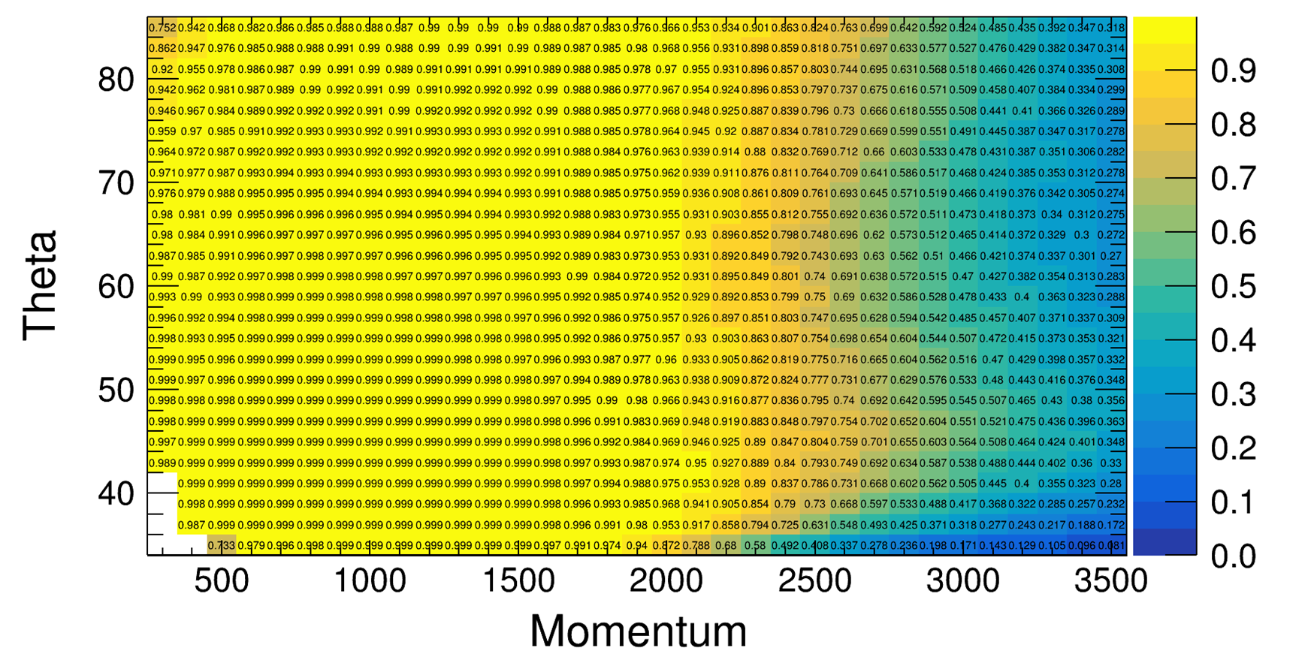
Timing Method
Efficiency of $K$ (missid = 2%)

Slide 25
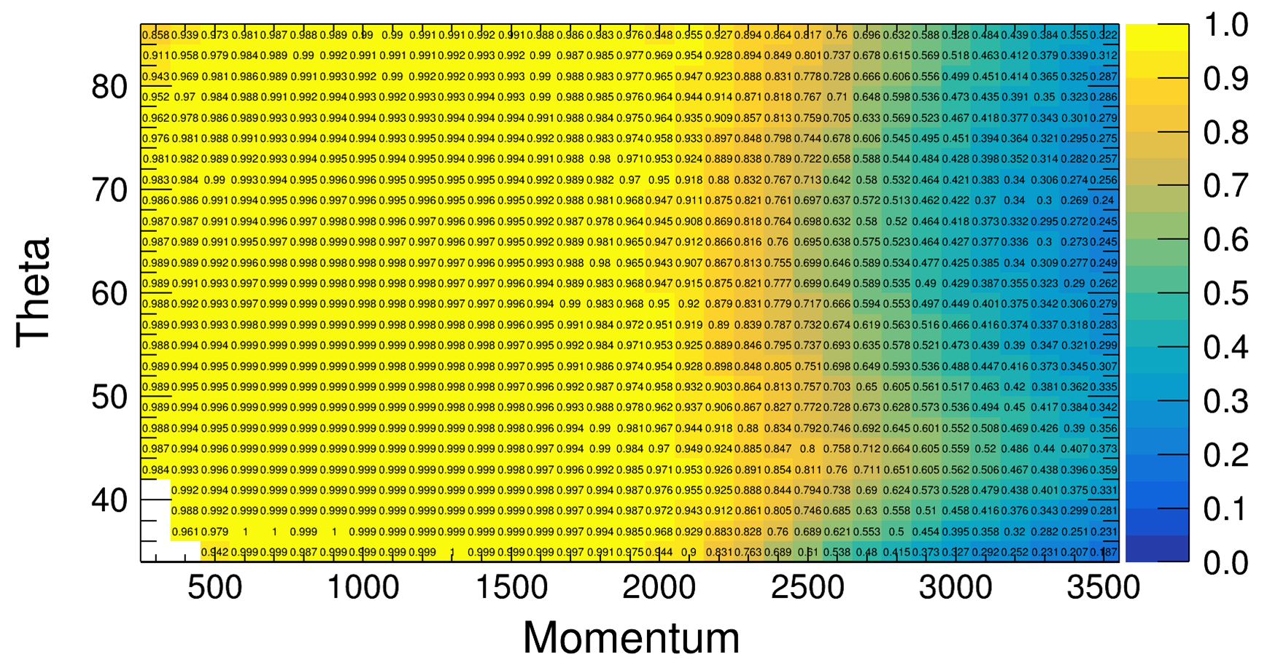
Imaging Method
Efficiency of $π$ (missid = 2%)

Slide 26
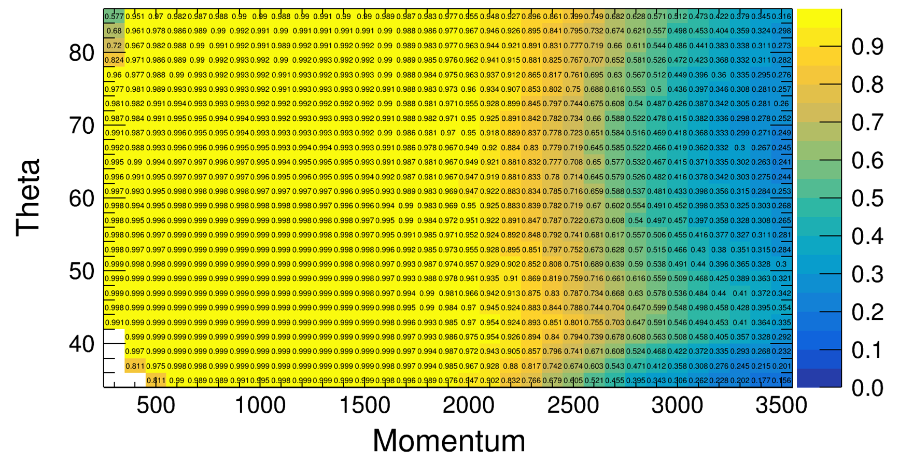
Imaging Method
Efficiency of $K$ (missid = 2%)

