Slide 1


Superconducting Quadrupoles for BEPCII energy upgrade
Yingshun Zhu
On behalf of IR SC magnet system for BEPCII upgrade
Nov. 23-27, FTCF2025, Huangshan, China

Slide 2
Content
Introduction
R&D of IR quadrupole magnet technology at IHEP
Superconducting quadrupoles development for BEPCII upgrade
Summary

Slide 3
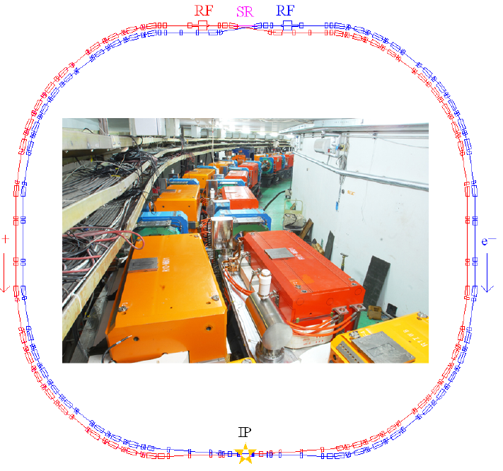
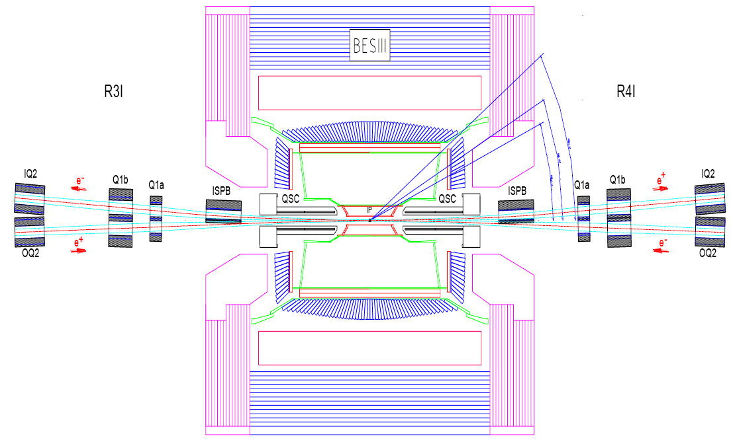
Introduction
BEPCII is a double-ring collider in tau-charm energy region running since 2007
Two final focus SC quadrupoles (SCQ,) on both sides of IP are key devices for BEPCII to attain the target collision luminosity (nominal 18.7 T/m)
Developed in 2006 in collaboration with BNL
BEPCII upgrade project: started in 2021, increase the luminosity at higher beam energy
Maximum beam energy: 2.8 GeV; nominal field gradient of new SCQ: 25 T/m

Slide 4
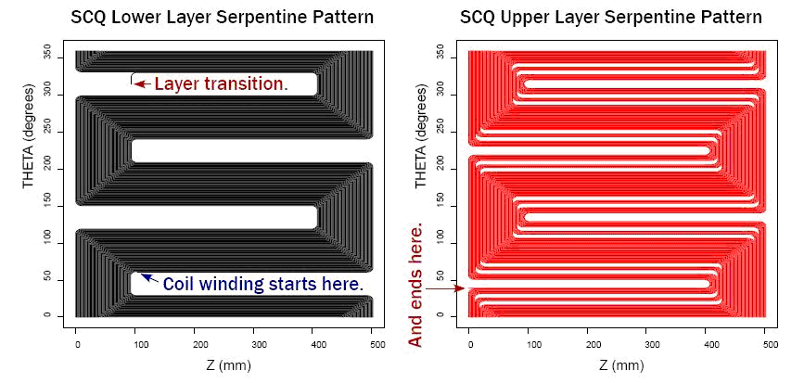
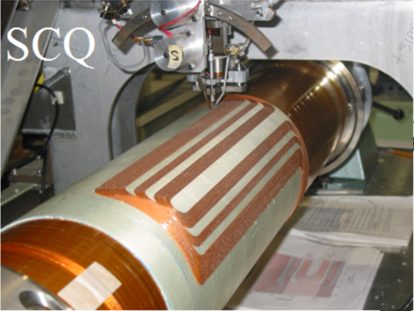
Introduction
Serpentine quadrupole coil
An innovation developed for BEPCII SCQ by BNL
Small wire around 1mm, wind coil layer by layer using direct winding technology
Winding machine with multi-axis motion and ultrasonic bounding
Accurate wire position and high magnetic field precision
No gap between adjacent layers or coils
Compact structure for SC magnets with multiple coils
Pre-stress applied by wrapping fiberglass on coil layers

Slide 5
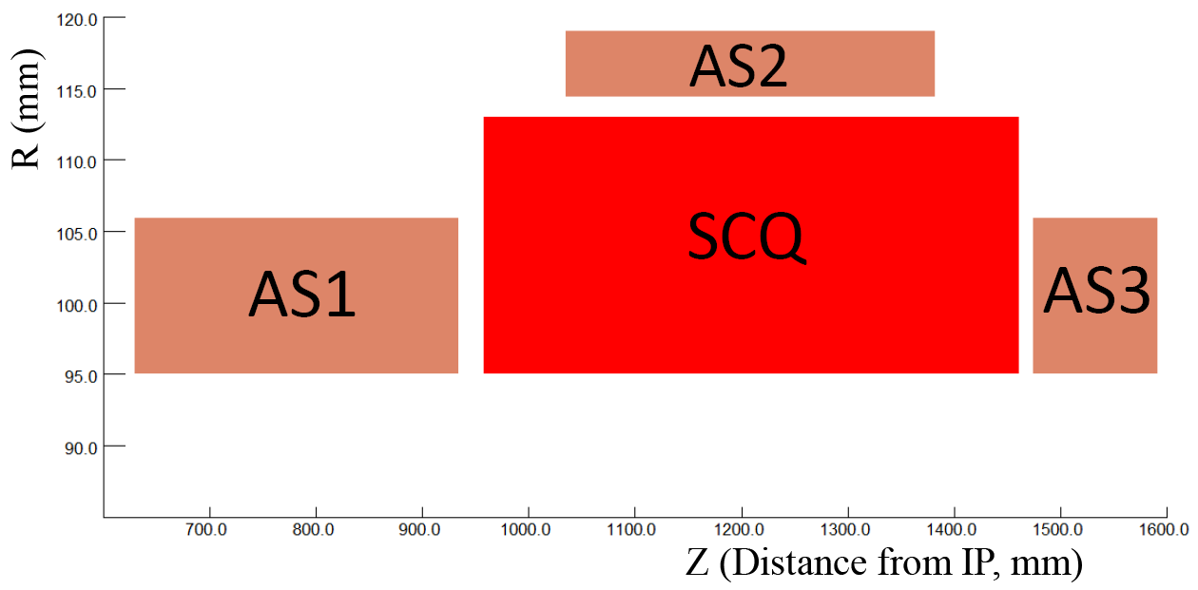
Introduction
BEPCII SCQ: maximum gradient 22T/m @ 2.47 GeV
Two new final focus SCQ magnets need to be developed for BEPCII upgrade project
Nominal field gradient: 25 T/m
Magnetic length: 400mm
Field harmonics: ≤ 3×10⁻⁴ @50mm
Coil inner radius: 95mm
Anti-solenoid: cancel solenoid field of BESIII detector

Slide 6
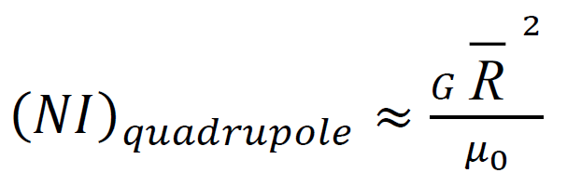

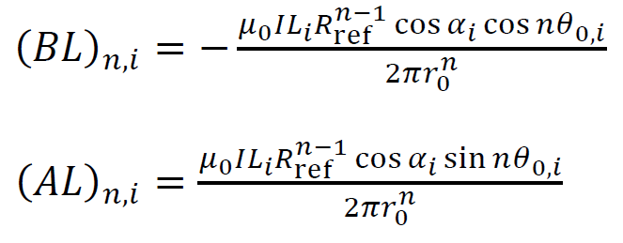
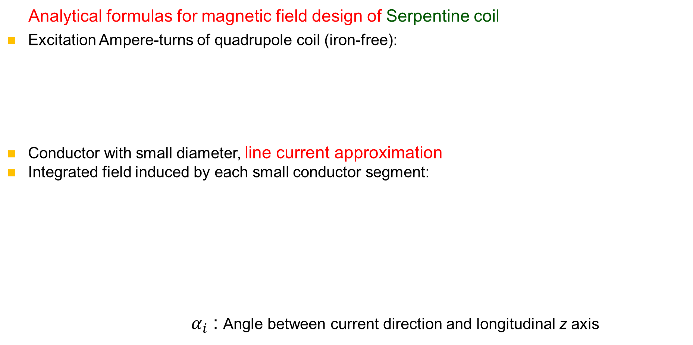
R&D of IR Magnet technology at IHEP
Analytical formulas for magnetic field design of Serpentine coil
Excitation Ampere-turns of quadrupole coil (iron-free):
Conductor with small diameter, line current approximation
Integrated field induced by each small conductor segment:
${ α}_{i}$ : Angle between current direction and longitudinal z axis
: average coil radius

Slide 7
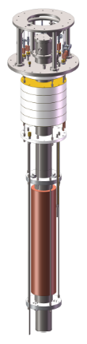
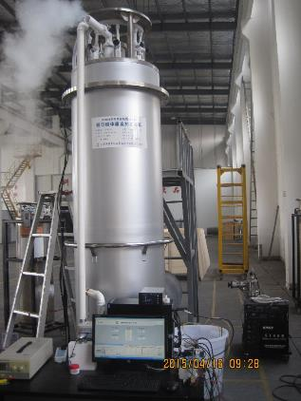
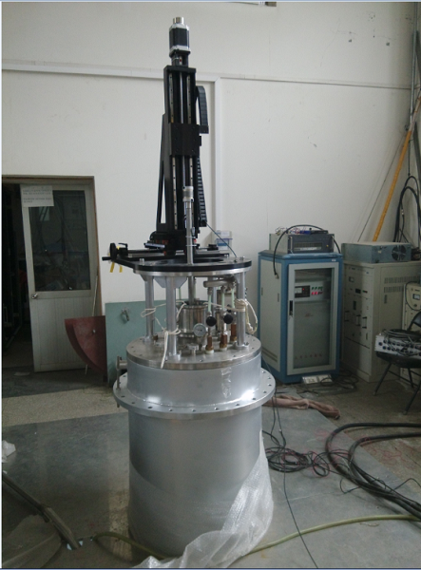
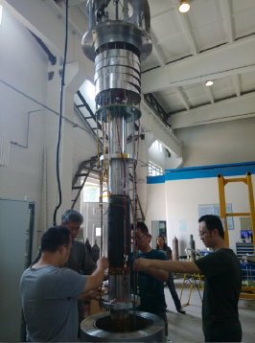
R&D of IR Magnet technology at IHEP
Development of Cryogenic vertical test facility (2016)
Cryogenic dewar
Rotating coil magnetic field measurement system
Power supply
Quench detection and protection system

Slide 8
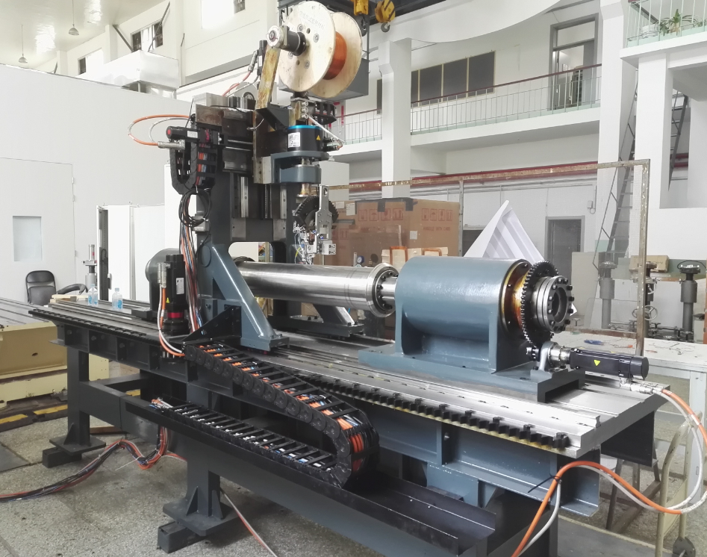
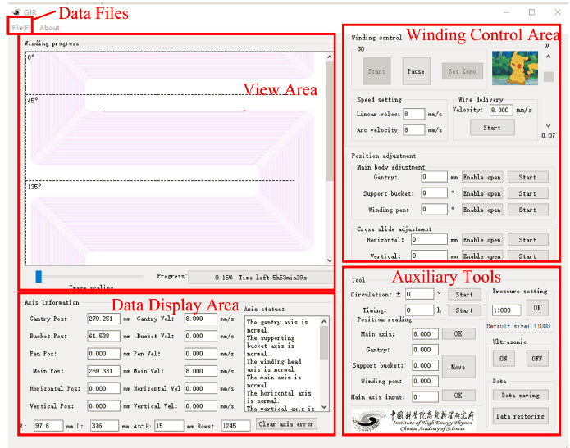
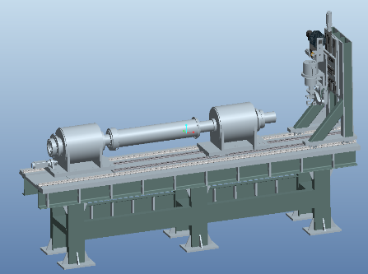
R&D of IR Magnet technology at IHEP
Winding machine developed for Serpentine coil with direct winding technology
Coil length: up to 1.5m
Wind a full coil layer according to theoretical trajectory of each turn conductor
Position accuracy of coil winding: < 0.02mm
Mechanical system, control system, etc.

Slide 9
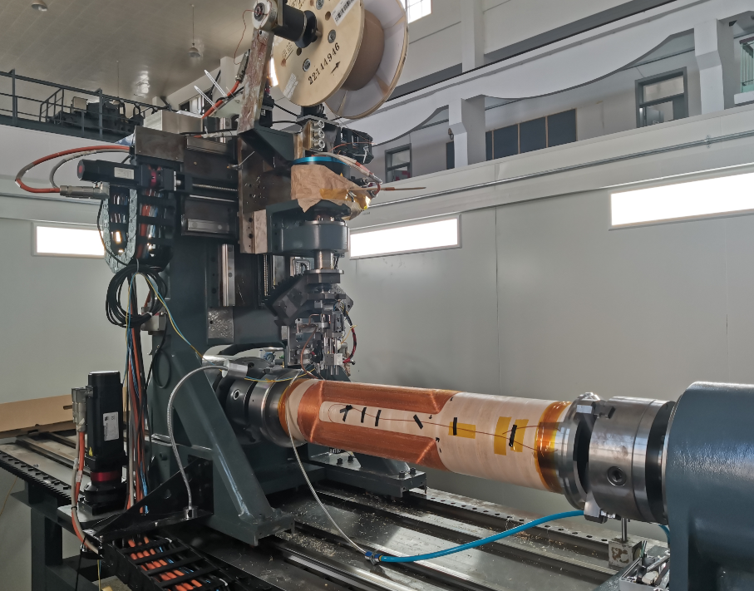
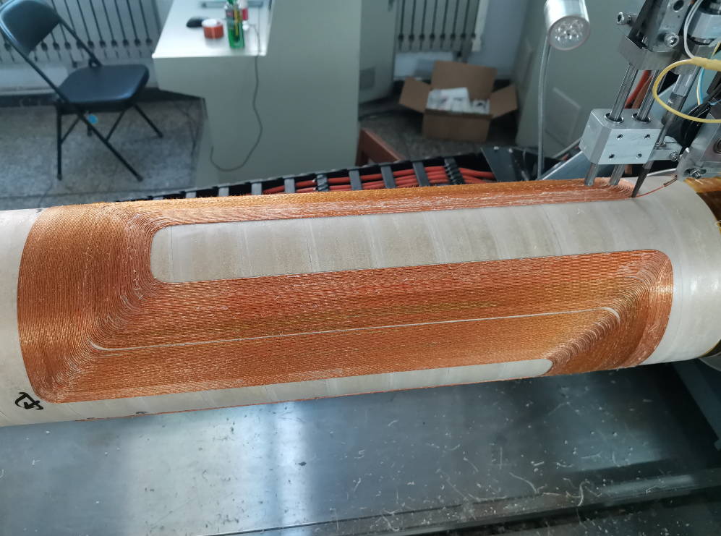
R&D of IR Magnet technology at IHEP
Direct winding technology for Serpentine quadrupole coil was mastered (2021)
Many technical difficulties solved:
Fabrication of “Six around one” superconductor and epoxy coating
Real time winding and ultrasonic heating bonding of wire
Accurate synchronization of conductor laying out speed and winding speed
Accurate alignment of winding machine and coil support tube

Slide 10
SCQ development for BEPCII upgrade
BEPCII upgrade project started in 2021
Two new SCQ magnets are symmetric to the IP and share an identical basic design
Overall design considerations of new SCQ
NbTi conductor with 1 mm diameter, Cu/SC ratio 1.3
SCQ consists of 10 layer serpentine coils
Calculated field harmonics < 1×10⁻⁴
Coil surface machining for every two layers
Room temperature field measurement, field harmonics < 3×10⁻⁴
Cryogenic vertical test of 8 layer coil at 4.2 K :validate magnet fabrication process
Cryogenic horizontal test at 4.5 K: SCQ should operate stably at 110% the nominal current to provide an operational margin in BEPCII collider

Slide 11

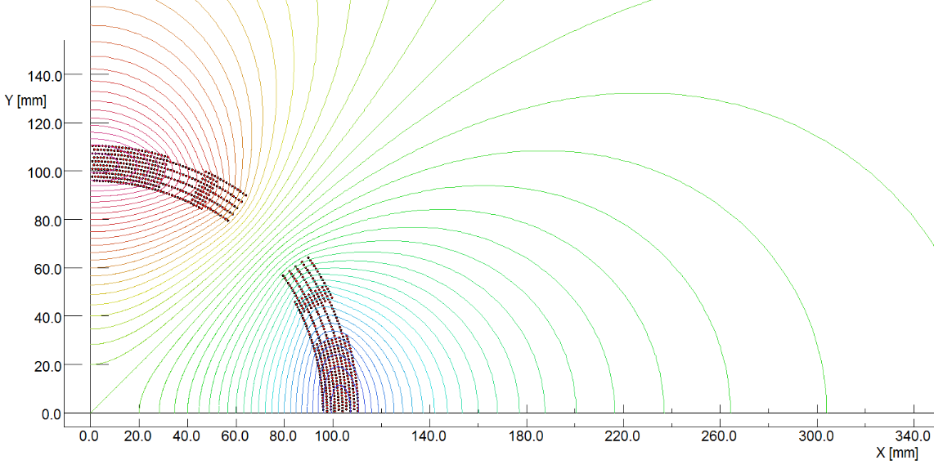
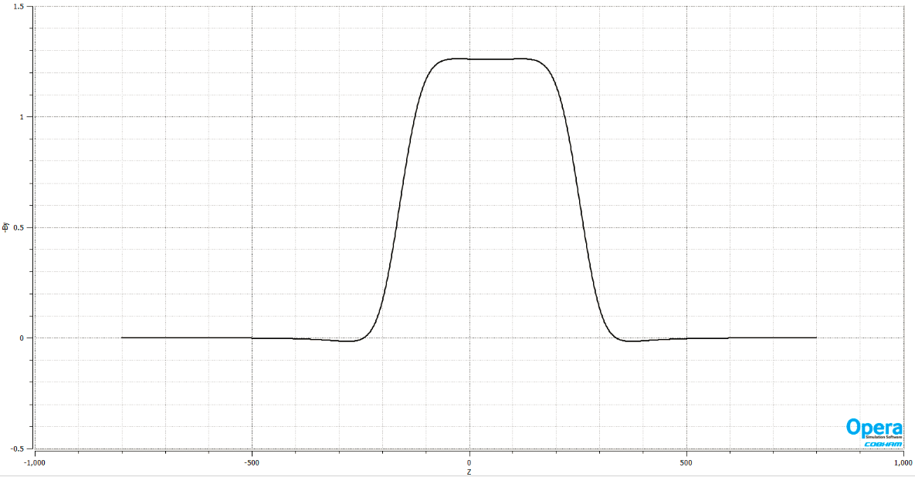

SCQ development for BEPCII upgrade
2D and 3D magnetic modelling using OPERA
SCQ: 10 layers Serpentine coil, 25T/m @ 530A

Slide 12
SCQ development for BEPCII upgrade
Main design parameters of SCQ
Parameter | Unit | Value
Nominal field gradient | T/m | 25
Nominal operation current | A | 530 @ 2.8GeV
NbTi conductor | mm | ∅1.0, Cu/SC=1.3
Coil layers |  | 10
Storage energy | KJ | 31.0
Inductance | H | 0.221
Maximum field in coil | T | 3.6
Load line @ 4.2K |  | 71.2%
Effective length | mm | 400
Coil length | mm | 502

Slide 13
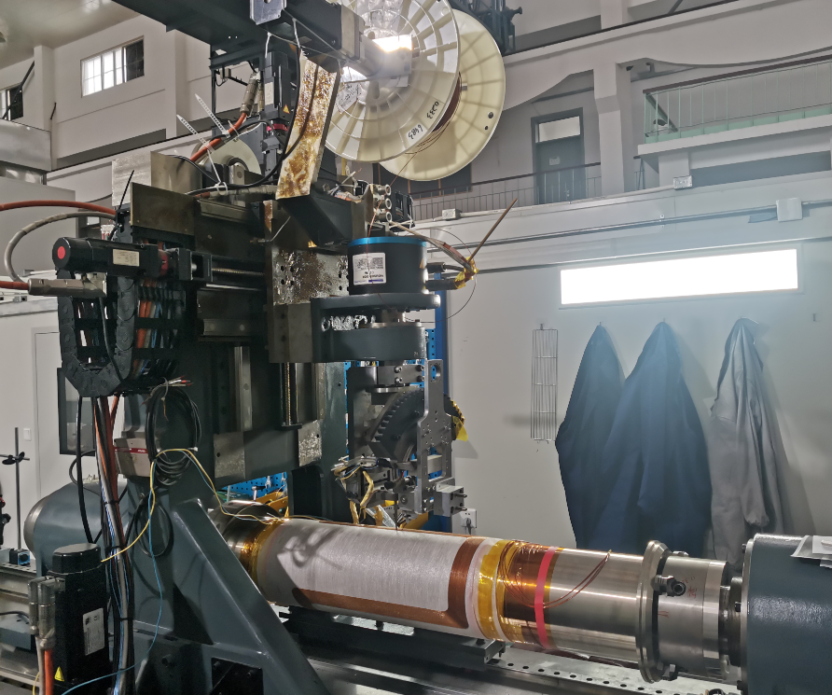
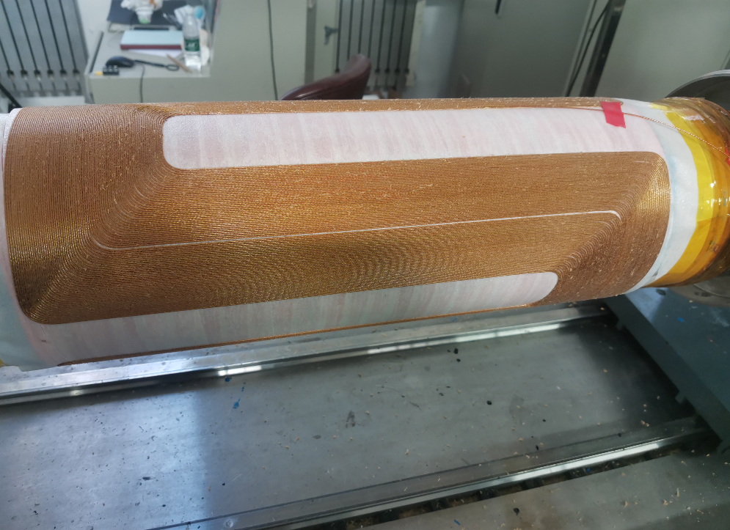
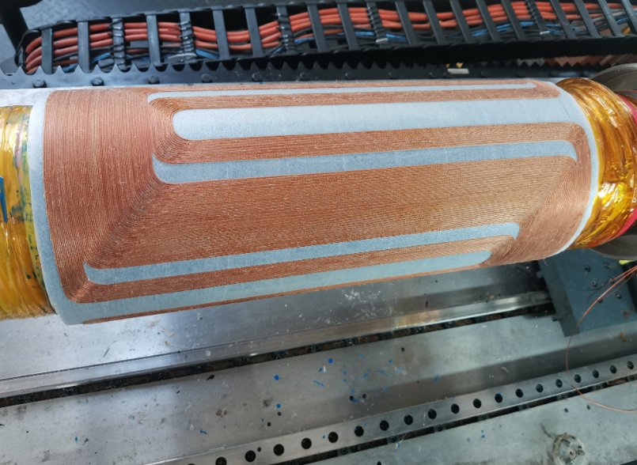
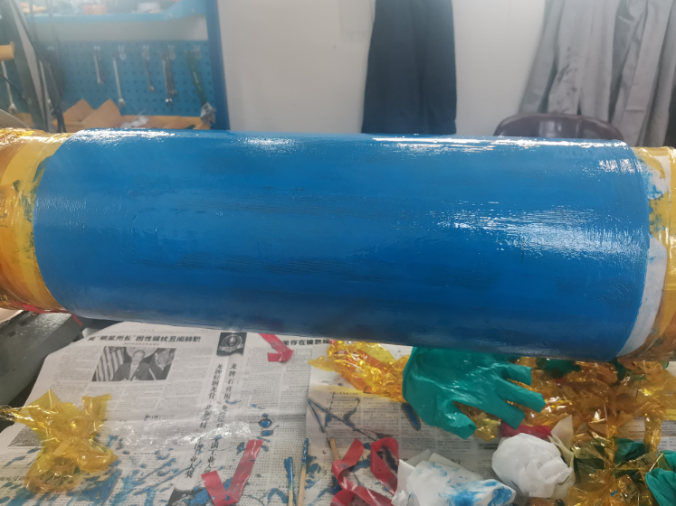
SCQ development for BEPCII upgrade
Winding and fabrication of SCQ coil

Slide 14
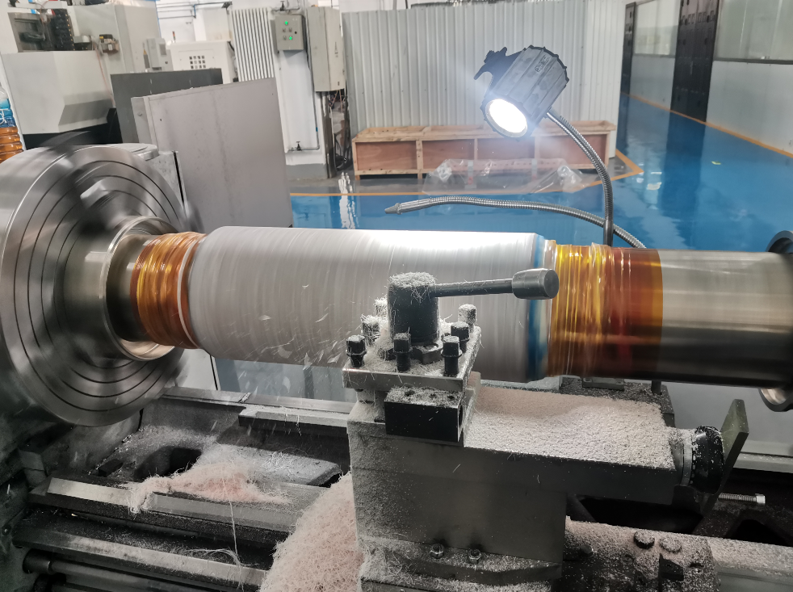
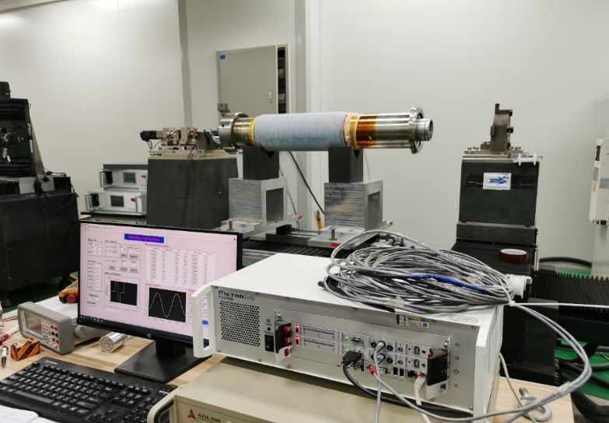
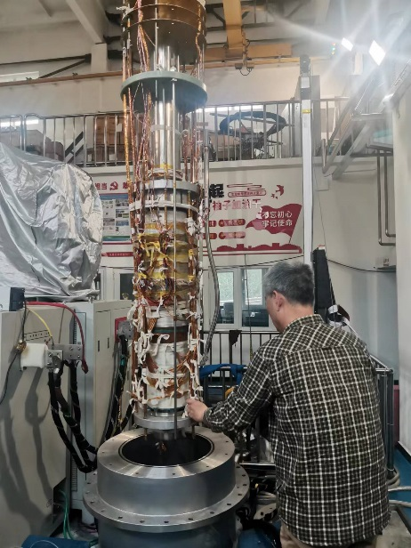
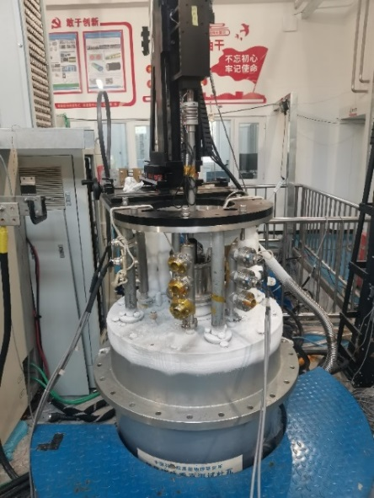
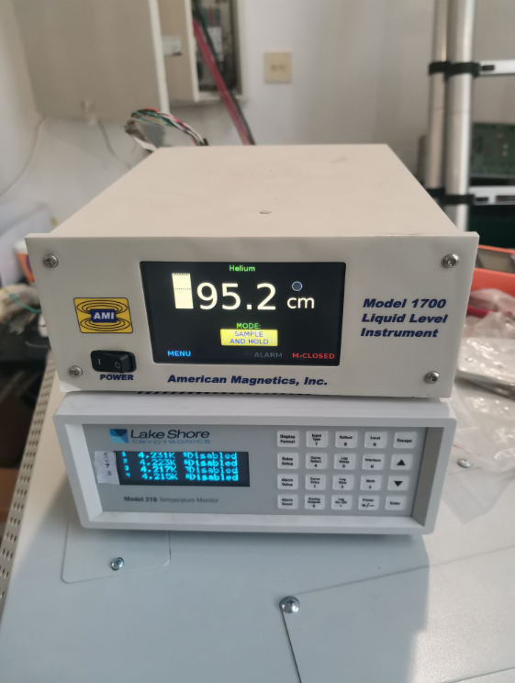
SCQ development for BEPCII upgrade
Coil surface machining, room temperature field measurement, cryogenic vertical test
Measured field harmonics < 2×10⁻⁴

Slide 15
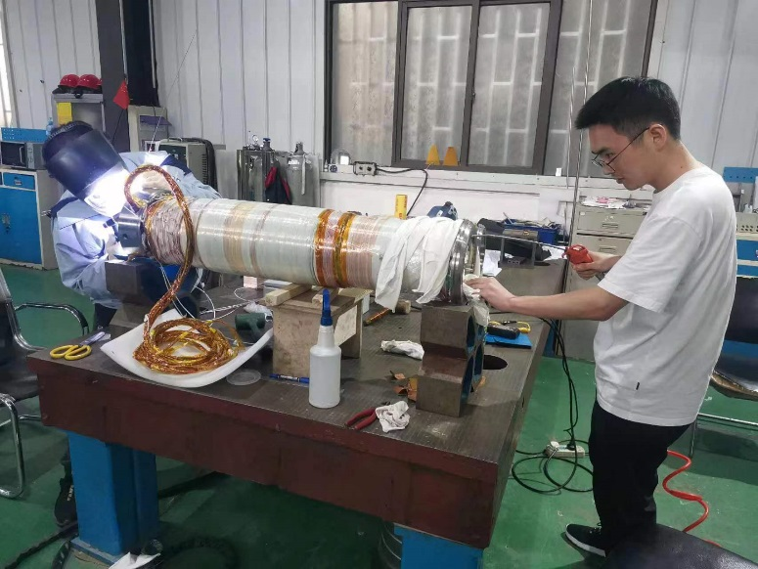
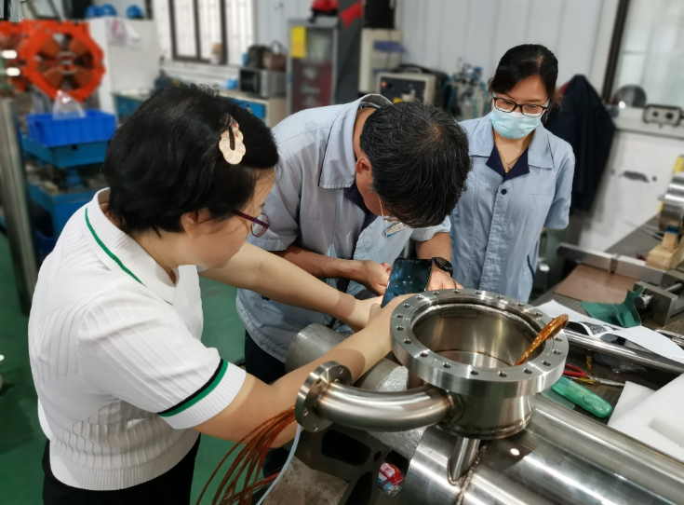
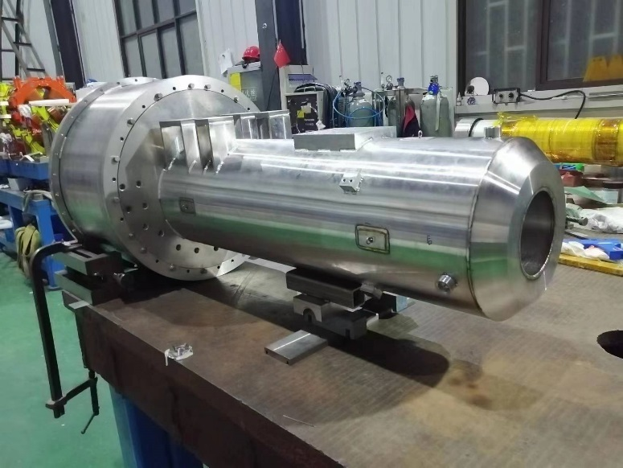
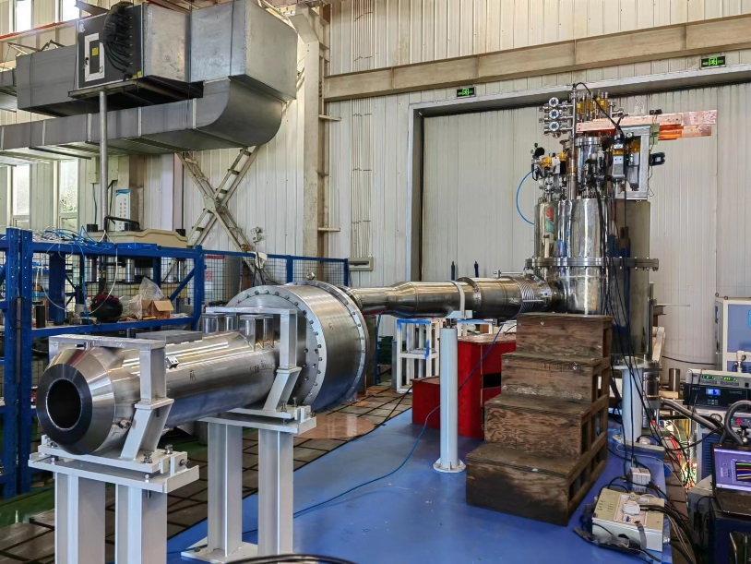
SCQ development for BEPCII upgrade
Assembly of superconducting coil and cryostat

Slide 16
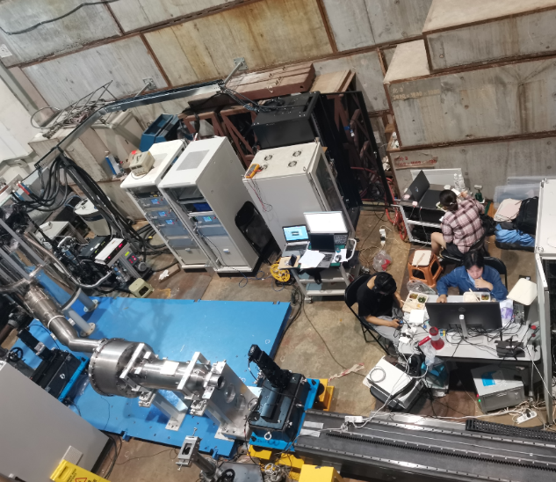
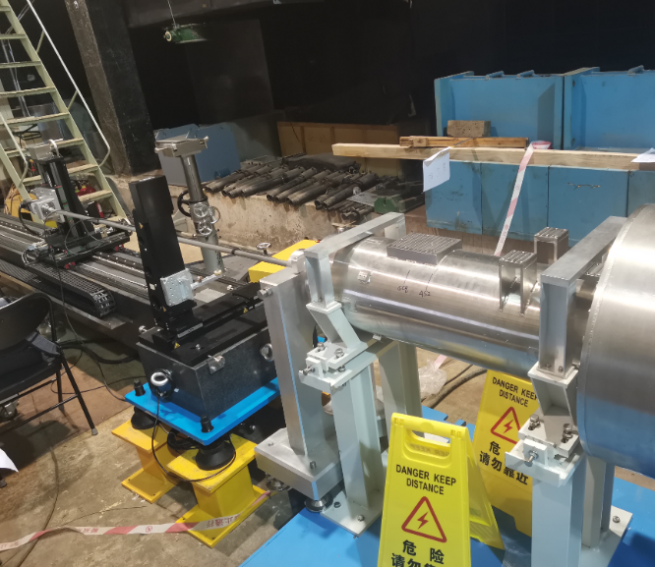
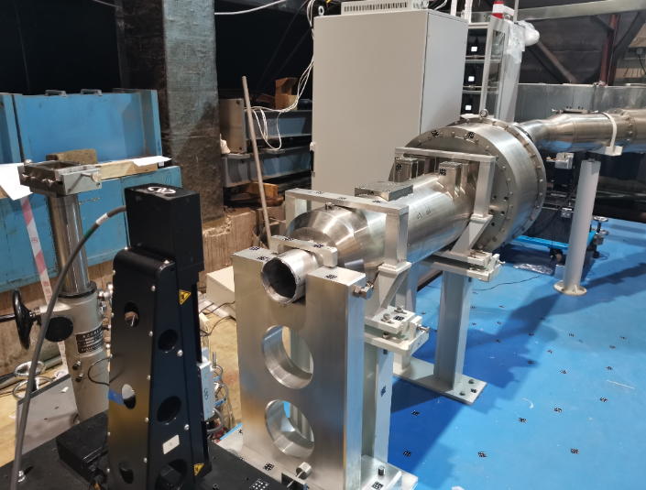
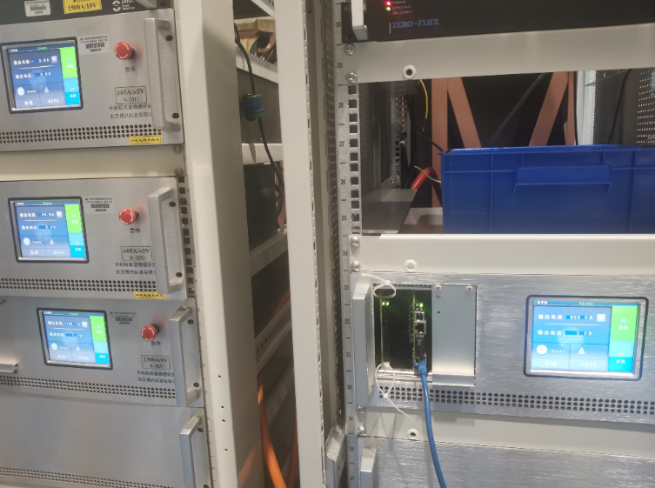
SCQ development for BEPCII upgrade
Cryogenic horizontal test of SCQ magnets at IHEP
Field measured using two measurement systems
1) Hall probe
2) Rotating coil

Slide 17
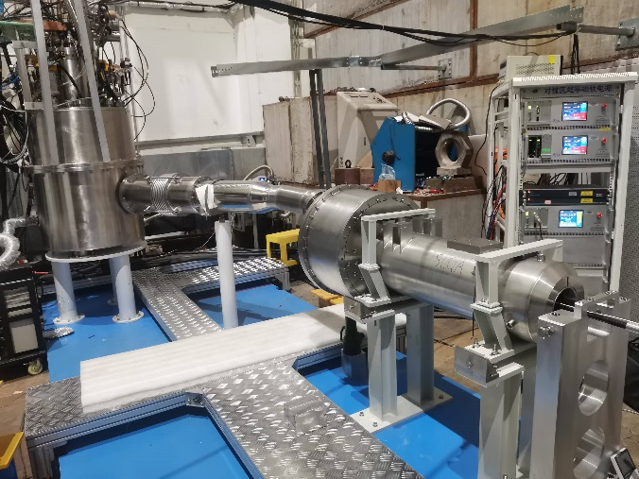
SCQ development for BEPCII upgrade
Cryogenic horizontal test at 4.5K
Maximum stable current of SCQ magnets: 620A
Sufficient operational margin
Field gradient 25.2 T/m, Integrated field gradient 10.1T @ 530A
First SCQ: thermally cycled to room temperature and cooled down to 4.5 K twice
Excited to the nominal current without a quench

Slide 18
SCQ development for BEPCII upgrade
Cryogenic horizontal test at 4.5K
SCQ field harmonics @ 530A in units of 1 ×10⁻⁴
B_{n}/B₂ < 2×10⁻⁴
At working current, stable operation of SCQ + Anti-Solenoid
Field performance meets the requirements
 | B_{n}/B₂
n | SCQ on east side of IP | SCQ on west side of IP
3 | 1.15 | 1.38
4 | 1.12 | 0.54
5 | 0.34 | 0.47
6 | 1.15 | 0.75
7 | 0.26 | 0.29
8 | 0.23 | 0.30

Slide 19
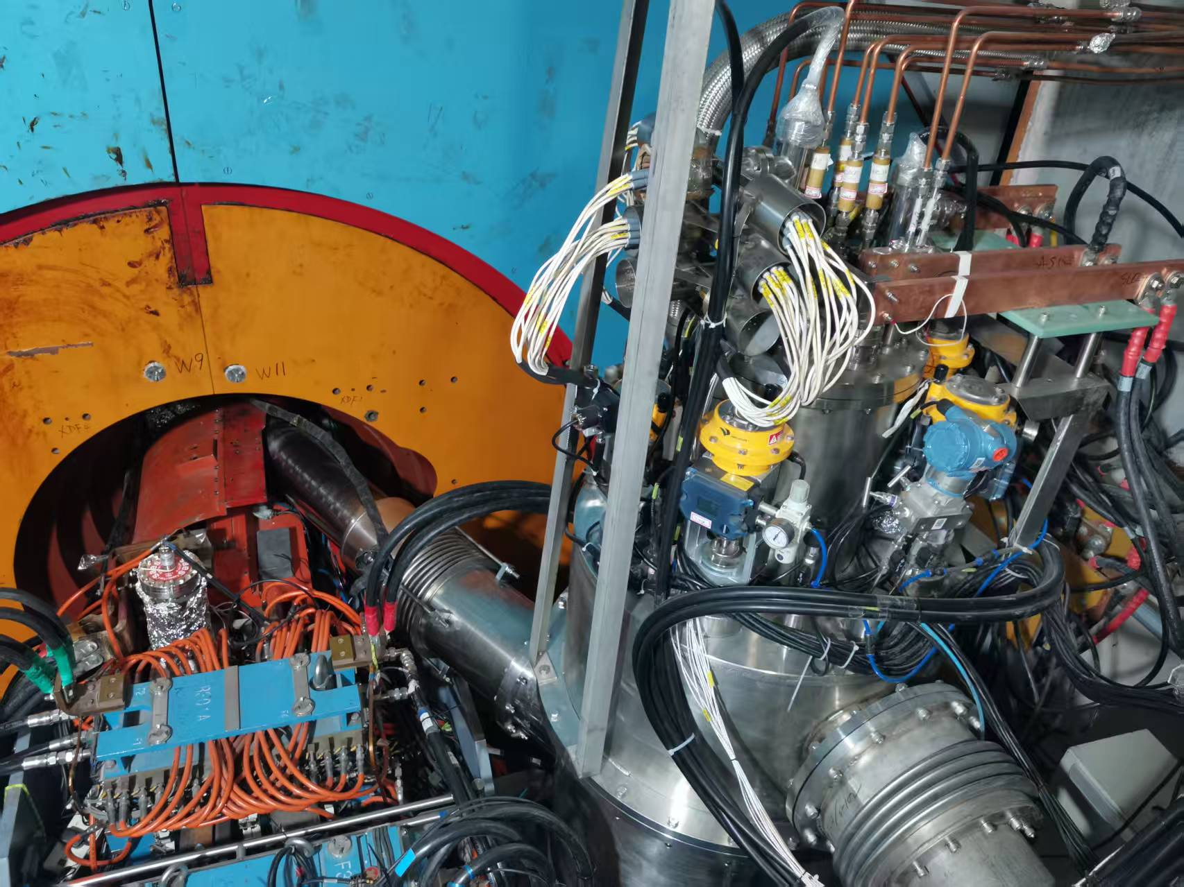
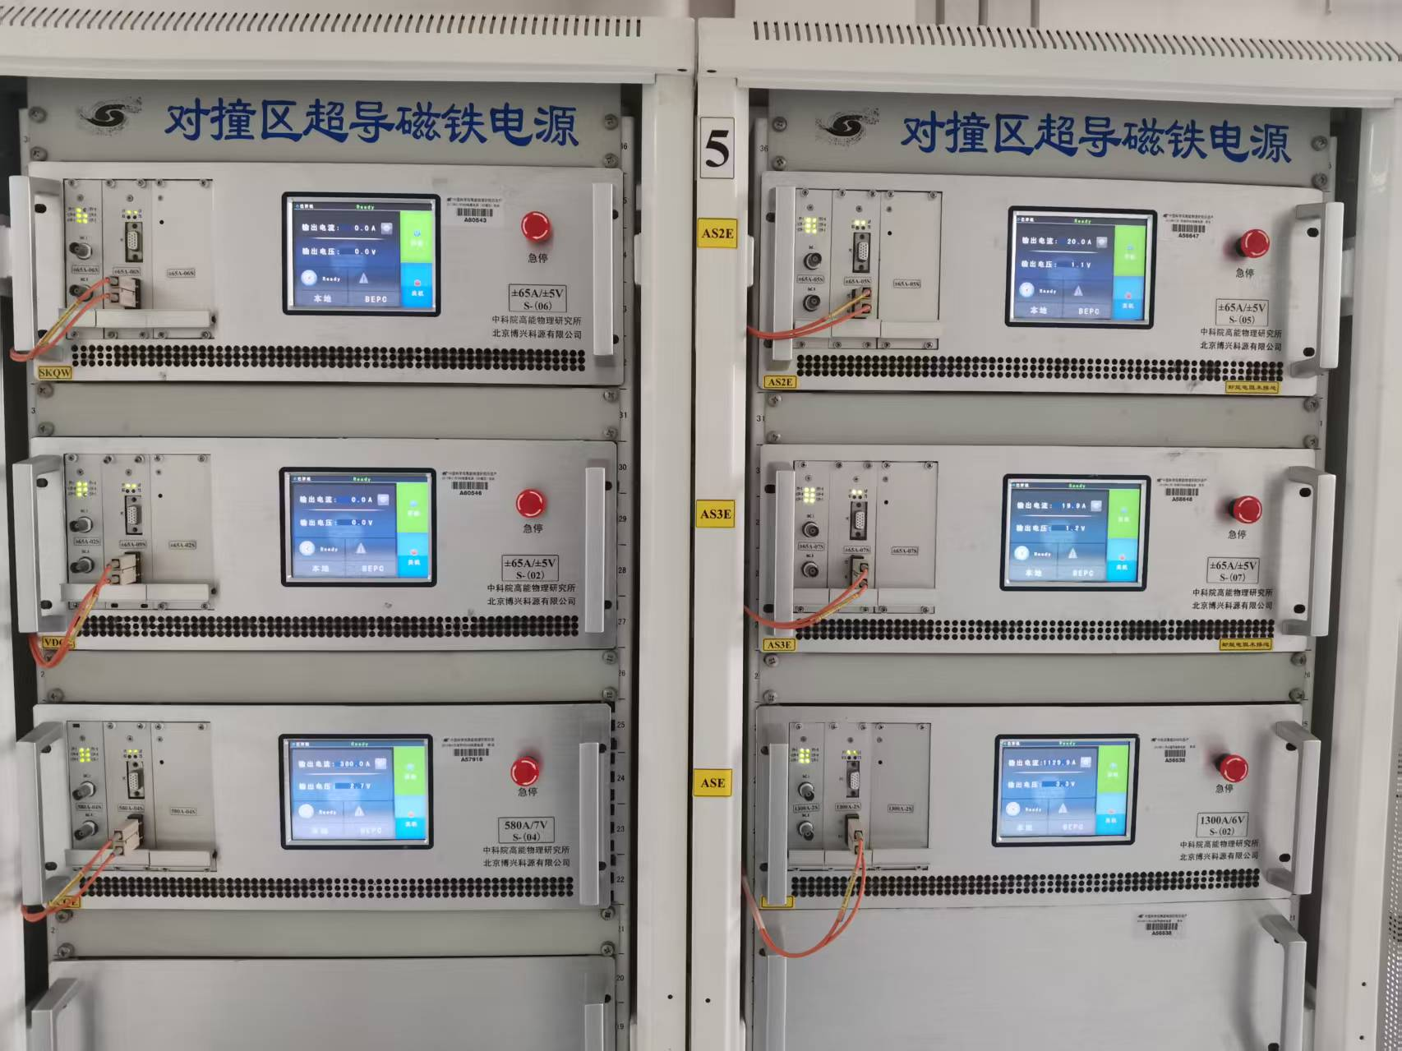
SCQ development for BEPCII upgrade
Two new SCQ magnets were installed in upgraded BEPCII interaction region at the end of 2024
They have maintained stable operation under the Detector solenoid field without any quench since May 2025

Slide 20
Summary
After R&D, IHEP Magnet Group has mastered the key technologies for development of superconducting IR quadrupole magnets with serpentine coil
In line with the schedule of BEPCII upgrade project, two new final focus SCQ magnets have been successfully developed at IHEP
Measured field harmonics of SCQ magnets are below 2×10⁻⁴, corresponding to the increased field gradient of 25 T/m
Since May 2025, the two SCQ magnets have been operating stably under the Detector solenoid field with no quench

Slide 21
Thanks for your attention!

