Slide 1


Error effect analysis and correction for STCF collider rings
Penghui Yang, USTC
On behalf of the STCF team
FTCF2025, Huangshan, Nov. 23-27, 2025
Notes:
Good morning, everyone. It’s my honor to have the opportunity to present the recent work on the error effect analysis and correction for the STCF collider rings.

Slide 2


1. Error effect analysis
2. Error correction
3. Effect of the multipole fields
4. Summary and outlook
Notes:
My presentation will be structured as follows. Including ……
Finally, the summary and outlook are given.

Slide 3

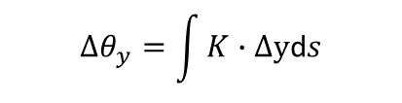
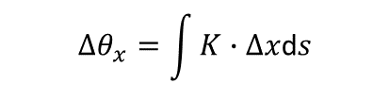
The effect on closed orbit
Quadrupole misalignment is dominant
The most significant error source is the misalignment of FFT quadrupoles
——large βy and gradient
Vertical misalignment is more pronounced than that of horizontal one
Misalignment of FFT doublets should be controlled within 30 μm in RMS.
$$∆θ_{x}=\int{K∙∆x\text{d}s}$$
$$∆θ_{y}=\int{K∙∆\text{y}\text{d}s}$$
Add random misalignment to all quadrupoles
Add random misalignment to only FFT quadrupoles
Notes:
The effect on closed orbit is first studied. For the closed orbit, the effect of quadrupole misalignment is dominant. The feed-down effect of quadrupole misalignment will bring a kick for the particle, which is proportional to the quadrupole gradient and the offset value. The orbit distortion is proportional to the kick and the square root of beta function
The left figures show that with 50 micrometers misalignment for all quadrupoles, the orbit survival possibility is only 15% left. And the rms orbit distortion has reached to 2 mm.
Among these quadrupoles, the most significant error source is the transverse misalignment of FFT doublets near the IP, because these quadrupoles have large gradients and the beta functions are very large too
Add 50 micrometers misalignment into FFT qaudrupoles, the orbit survival ratio reduced to 50%, and result in orbit distortion larger than 1 mm, as shown in the right figures.
In addition, we find that the impact of vertical misalignment is more pronounced than that of the horizontal one.
To suppress the orbit distortion, The misalignment of FFT doublets should be controlled within 30 micrometers in RMS.

Slide 4




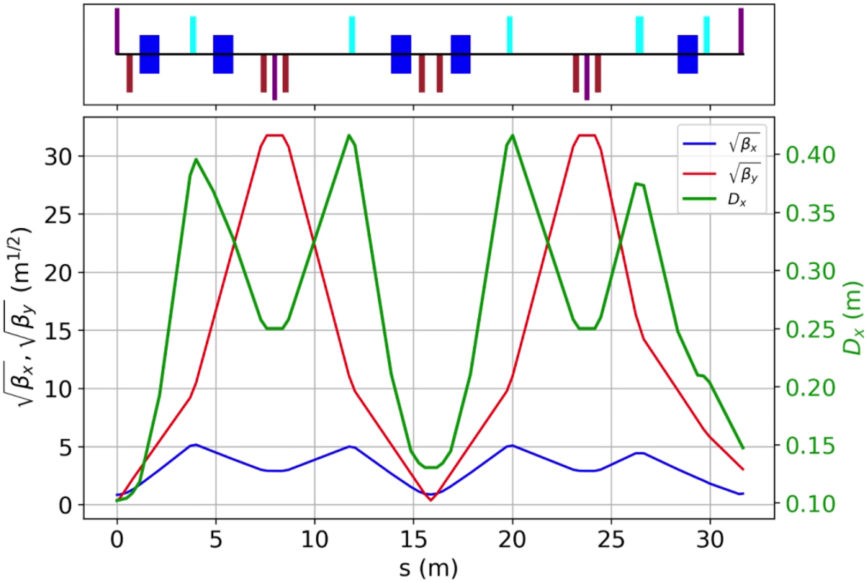
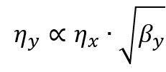
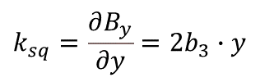

The effect of sextupole misalignment
The sextupole offset has obvious effects on β, η and coupling
Horizontal offset——> Quad. Field
$$k=\frac{∂B_{y}}{∂x}=2b_{3}∙x$$
β-beat, Δη_{x} and tune shifts
Vertical offset——> Skew Quad. Field
$$k_{sq}=\frac{∂B_{y}}{∂y}=2b_{3}∙y$$
Δη_{y} and coupling
IR sextupoles are in the areas with high β or dispersion, which makes it sensitive to the sextupole offsets
Notes:
For the sextupole offset, it has obvious effects on linear optics and coupling. The horizontal offset of sextupole will generate quadrupole field, which is proportion to the sextupole strength and offset value.
This will result in β-beat, dispersion distortion and tune shift
While the vertical offset of sextupole will generate skew quadrupole field, which may generate vertical dispersion and coupling.
For the STCF collider rings, the sextupoles in the IR are located in the areas with high β or dispersion, which makes it sensitive to the sextupole misalignments

Slide 5
The effect of sextupole misalignment
The effects of x offset of Crab Sextupole
The β_{y} here is very large (~900 m)
——> large β_{y}-beat and tune shift
30 μm offset for Crab Sextupole cause a β_{y}-beat@IP of 8.4%
The dispersion here is very small
——> has little effect on dispersion
Similarly, a horizontal offset for S1X where β_{x} and η_{x} are both very large will cause large β_{x}-beat and δη_{x}
Notes:
As an example, I studied the effect of horizontal offset for the Crab sextupole. At this place, the vertical beta function is very large, so the horizontal offset will cause large vertical beta-beat and tune shift. An offset of 30um will result in a vertical beta beat of 8.4% @IP, which may reduce the luminosity .
On the other hand, the betaX and dispersion is very small, so the offset has little effect on them.
Similarly, a horizontal offset for S1X where β_{x} and η_{x} are both very large will cause large horizontal β-beat and distortion of horizontal dispersion

Slide 6
The effect of sextupole misalignment
The effects of y offset of S1Y
The β_{y} (1210 m) and η_{x} (0.25 m) here are very large
——> large η_{y,} 30 μm offset ~ 5 mm η_{y}
Large β_{y} also result in large |C| and considerable transverse coupling. 30 μm offset ~ 0.2% coupling.
Has little effect on β function or η_{x}
Misalignment should be limited within 30 μm and 50 μm in RMS for the IR sextupoles and ARC sextupoles, respectively.
Notes:
Another example is the S1Y, where the betaY and dispersion are both large. If S1Y has a vertical offset, it will cause large vertical dispersion and considerable transverse coupling.
For example, when S1CY has a vertical offset of 30 micrometers, the vertical dispersion excited reaches to 5 mm. Besides, it contribute to the coupling by 0.2%.
So to control the effect on optics and coupling, the misalignment should be limited within 30 micrometers and 50 micrometers in RMS for the IR sextupoles and ARC sextupoles, respectively.

Slide 7
Error budget
The error budget for the STCF collider rings
RMS value, Cut-off@2.5σ
Component | Horizontal (μm) | Vertical (μm) | Longitudinal (μm) | Rotation (mrad) | Main Field Error
Dipole | 100 | 100 | 100 | 0.1 | 0.02%
Quadrupole | 50 | 50 | 100 | 0.1 | 0.02%
FFT Doublet | 30 | 30 | 100 | 0.1 | 0.02%
Arc/IR Sextupole | 50 / 30 | 50 / 30 | 100 | 0.1 | 0.02%
Girder misalignments have not been considered
The BPM errors used in the following simulation are as follows:
BPM offset (before BBA) | BPM offset (after BBA) | BPM noise (TBT) | BPM noise (Closed Orbit) | BPM gain | BPM roll
300 μm | 20 μm | 1 μm | 0.1 μm | 5% | 0.1 mrad
Notes:
Considering that the effect on beam dynamics and referring to the error tolerance of other collider rings，the error budget for the STCF collider rings is set as the following table.
The quadrupole and sextupole transverse misalignment are 50 micrometers. But for FFT doublets and IR sextupoles, it should be strict. They are 30 micrometers.
We should point out that the girder misalignments have not been considered, yet.
In addition, we also set the BPM errors in the following correction simulation, including the BPM offset, noise, gain and roll.

Slide 8
1. Error effect analysis
2. Error correction
3. Effect of the multipole fields
4. Summary and outlook
Notes:
Next, I will introduce the error correction procedure and results

Slide 9

Error correction
BPM、corrector and skew quadrupole arrangement
BPM: Place BPM next to almost each quadrupole;
corrector：QF——CORx, QD——CORy, Sextupole——double-plane corrector；
Skew quadrupole： Attached to sextupoles or placed near some quadrupoles;
Each ring has 387 BPM, 274 CORx, 243 CORy and 163 skew quadrupoles.
Correction chain and methods
First turn trajectory correction：SVD + Trajectory Response Matrix
Orbit and dispersion correction: SVD + Dispersion Free Steering (DFS)
Orbit and dispersion @ IP correction: SVD with weight factor
Optics and coupling correction: Linear optics from closed orbits (LOCO)
β_{y}* correction: K-modulation
Iteration may be needed
Notes:
Based on the present lattice, we first arranged the BPMs、correctors and skew quadrupoles. The BPM is placed next to almost each quadupole.
And the horizontal corrector is placed next to focusing quadrupole and vertical corrector is placed next defocusing quadrupole. And double-plane correctors are attached to the sextupoles.
As for the skew quadrupoles, they are attached to sextupoles or placed near some quadrupoles. Finally, each ring has 387 BPMs, 274 horizontal correctors, 243 vertical correctors and 163 skew quadrupoles.
The correction chain and methods are as follows. First, we perform the first turn correction, with SVD method and the trajectory response matrix.
Second, we correct the orbit and dispersion using the dispersion free steering method.
Third, the orbit and dispersion at IP are corrected particularly.
Fourth, the linear optics and coupling are corrected using the LOCO method.
And finally, we correct the vertical beta function @IP particularly.

Slide 10
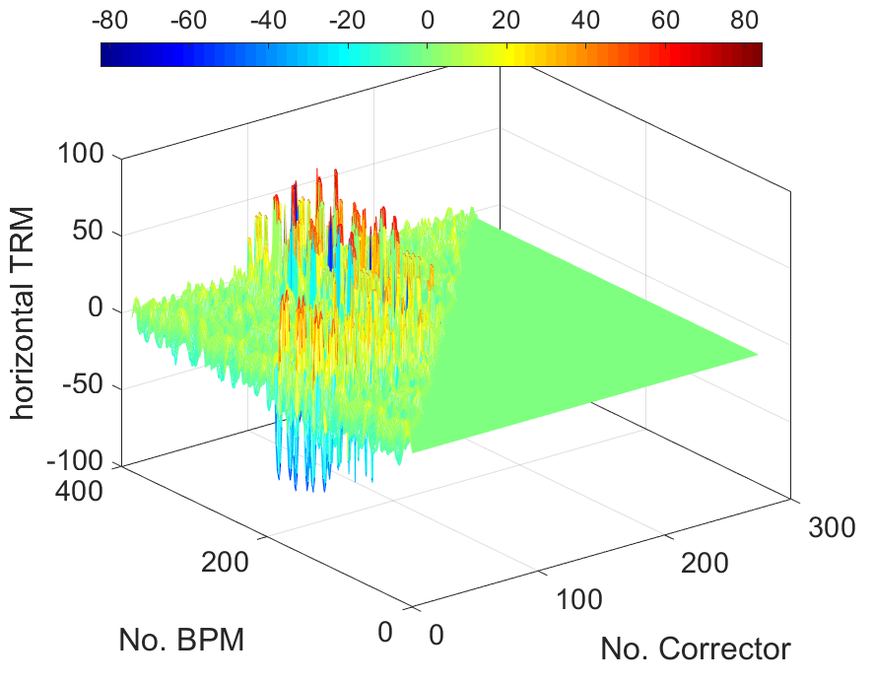

First-turn correction
Sextupole off; knobs: correctors
Trajectory response matrix + SVD
$Θ_{n}=−R^{−1}X_{m}$;
25% of the SV is selected in the trajectory correction
Notes:
We first carry out the first turn threading. In this correction, the sextupoles and octupoles are switched off to reduce nonlinear effects.
Then we use trajectory response matrix and SVD method to adjust corrector strengths.
In the correction, only 25% of the singular values is selected so as to avoid over limit of the corrector and reduce the disturbance of BPM errors

Slide 11
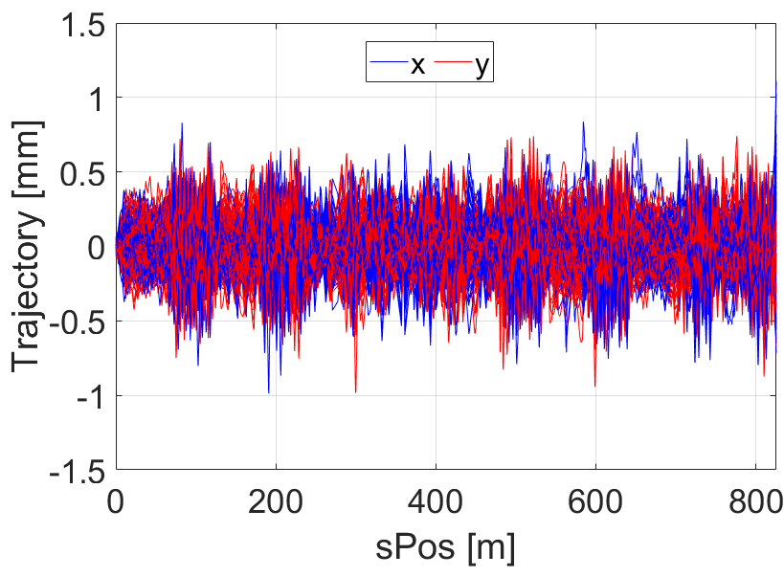
First-turn correction
Consider (1) BPM errors (offset, roll, gain, noise); (2)Corrector errors (roll, gain); (3)Physical aperture
~40% succeeds first turn threading without correction;
FFT quadrupoles are main lost positions;
Need 2~3 correction steps to complete the first turn;
After correction, the first turn trajectory < 2 mm;
Maximum COR strength ~ 0.16 mrad.
Notes:
In the First turn correction, the BPM and Corrector strength errors are considered, and the Physical aperture at present is also included.
We tested 1000 error seeds, about 40% of them can complete the first turn without any correction. And FFT quadrupoles are main positions where particles lost.
The simulation shows that it generally takes about 2~3 correction steps to complete the first turn. For example, the left two figures show the trajectories of 3 times correction of one seed.
In the first turn correction, the maximum COR strength is about 0.16 milli radian. After correction, the first turn trajectory is generally within 2 mm.

Slide 12
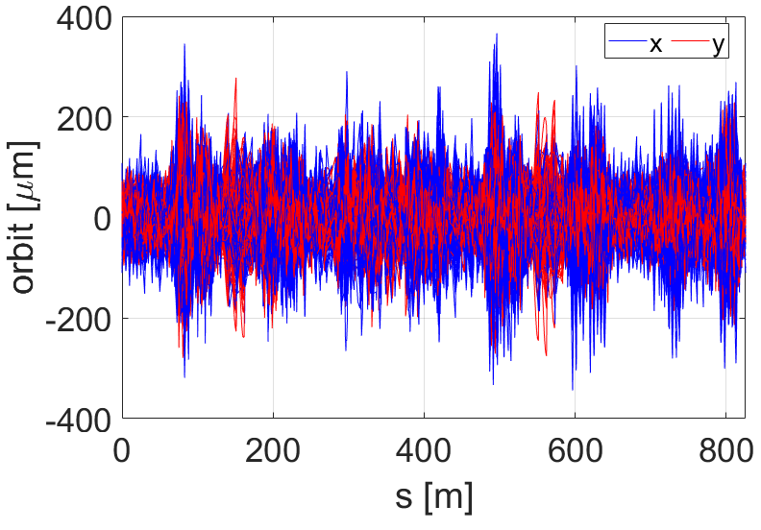
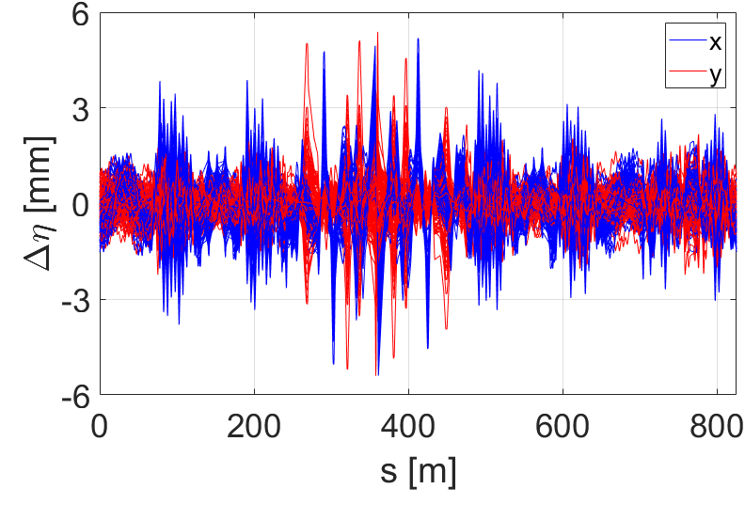
Orbit and Dispersion correction
Sextupole on; knobs: correctors;
SVD + DFS, with α=0.1
COD ~ 50 μm in RMS;
δη <6 mm;
θ < 0.35 mrad;
After corr., about 78% of the seeds have stable linear optics.
Orbit | Before Corr. (mm) | After Corr. (μm)
X, MAX | 1.8 | 366
Y, MAX | 5.0 | 279
X, RMS | 0.25 | 52
Y, RMS | 0.39 | 51
δη | Before Corr. (m) | After Corr. (mm)
X, MAX | 0.38 | 5.4
Y, MAX | 1.84 | 5.3
X, RMS | 0.02 | 0.69
Y, RMS | 0.10 | 0.41
Notes:
After first turn correction, we use the dispersion free steering method to correct both closed orbit and dispersion. The weight factor for the dispersion is selected as 0.1
The table and figures show the orbit and dispersion distortion before and after correction.
After correction, the orbit distortion is about 50 micrometers in RMS, the dispersion distortion is less than 6 mm.
The corrector strength used is less than 0.35 milli radian

Slide 13
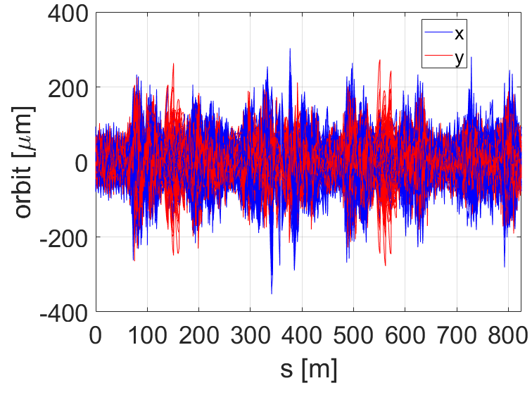
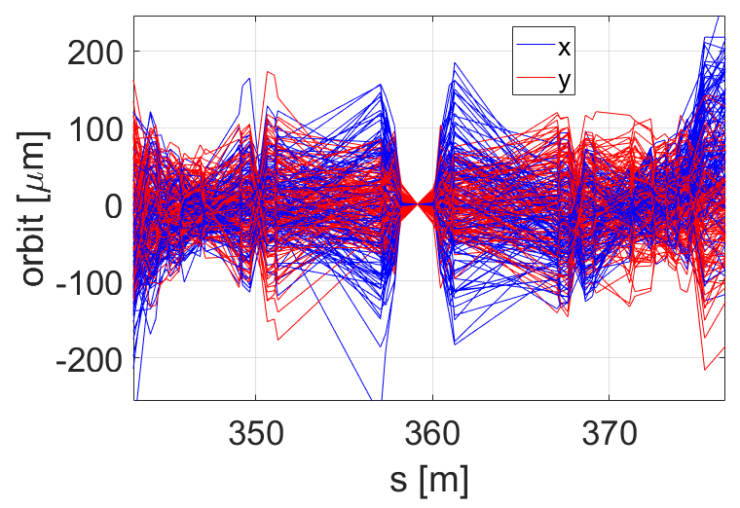

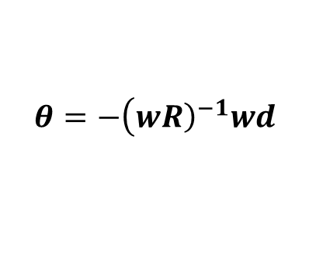
Orbit and Dispersion @IP correction
DFS + SVD with weight factor
$$θ=−\left(w{\left.R\right)}^{−1}wd\right.$$
with $w_{IP}$=1000
COD @IP < 0.1 μm in RMS, about 10% of σ_{y};
η_{y} < 5 μm, little effect on the luminosity;
COD and δη at other places are slightly broken;
The correction effect depends on the resolution of BPM or luminosity monitor.
Orbit@IP | Before Corr. (μm) | After Corr. (nm)
X, MAX | 83 | 223
Y, MAX | 124 | 62
X, RMS | 30 | 77
Y, RMS | 45 | 18
δη@IP | Before Corr. (mm) | After Corr. (μm)
X, MAX | 3.8 | 14.9
Y, MAX | 1.3 | 4.7
X, RMS | 1.7 | 5.5
Y, RMS | 0.6 | 1.2
Notes:
After the global correction, the closed orbit and dispersion at IP are corrected particularly, to reduce the effect on the luminosity.
We use the same DFS and SVD method but impose a large weight factor on the orbit and dispersion of the BPM adjacent to the IP.
The tables and figures show the Orbit and dispersion @IP before and after correction.
After correction, the orbit distortion at IP is less than 0.1 micrometer in RMS, about 10% of vertical beam size. The vertical dispersion is less than 5 micrometers, which has little effect on the luminosity.
But here, we have not considered the BPM noise and resolution for the BPM adjacent to the IP or the resolution of the luminosity monitor, which will affect the correction result.

Slide 14
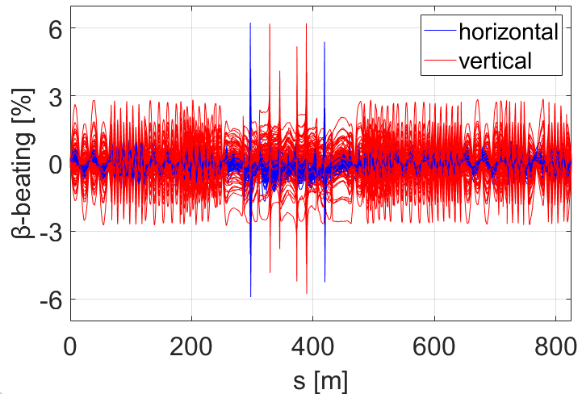
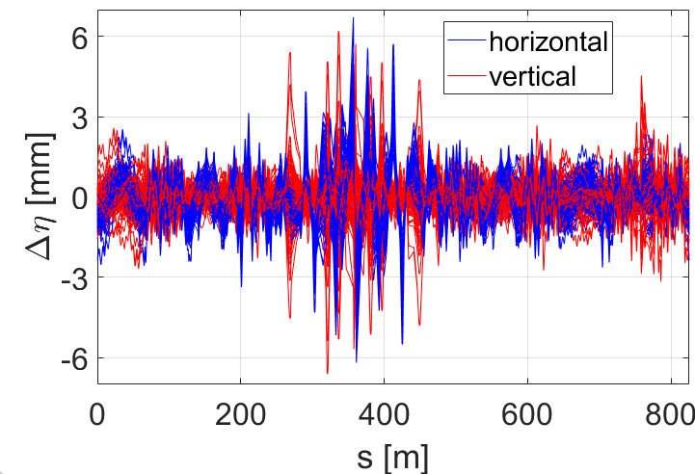
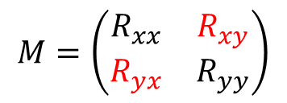
Global β, η and coupling correction
$$M=\left(\begin{matrix}R_{xx} & R_{xy} \\ R_{yx} & R_{yy}\end{matrix}\right)$$
LOCO method knobs: strengths of Quad. and skew Quad.
β-beat < 1% in RMS, except the β_{y}@IP;
Coupling ratio < 0.1%;
k_{sq} < 0.4 T/m.
After Correction | Global | @IP
Hor./Ver. orbit, MAX (μm) | 349/279 | 0.14/0.04
Hor./Ver. orbit, RMS (μm) | 43/50 | 0.46/0.09
Hor./Ver. dispersion deviation, MAX (mm) | 6.7/6.6 | 0.70/0.05
Hor./Ver. dispersion deviation, RMS (mm) | 0.67/0.43 | 0.29/0.02
Hor./Ver. β-beat, MAX (%) | 6.2/6.2 | 0.8/51
Hor./Ver. β-beat, RMS (%) | 0.3/0.5 | 0.3/12
Hor./Ver. tune shift, MAX (×10⁻³） | 0.3/2.5
Coupling ratio, MAX (%) | 0.11
Notes:
After orbit and dispersion correction, we use LOCO method and quadrupole and skew quadrupole knobs to correct the global β，dispersion function and transverse coupling together.
We fit the orbit response matrix of the error seeds and the ideal lattice. By fitting Rxx and Ryy, the beta-beat can be reduced. And By fitting Rxy and Ryx, the transverse coupling can be reduced.
In addition, the dispersion of the error seed is also measured and fitted. After correction, the β-beat can be reduced to less than 1% in RMS, except the β_{y}@IP
The coupling ratio can be controlled within ~0.1%. The maximum gradient of skew quadrupoles used is about 0.4 T/m. Note that the vertical beat function @IP can not be well corrected using LOCO.
So, we will correct betaY@ IP particularly.

Slide 15
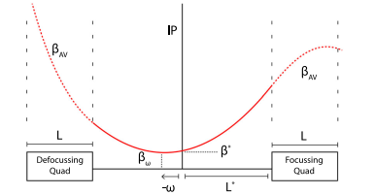
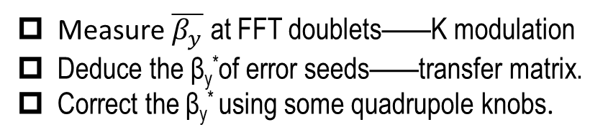
β_{y}@IP (β_{y}*) correction
K-modulation knobs: three pairs of Quad. strengths on both sides of IP
After corr., β_{y} –beat@IP < 3%;
β function outside the knob quadrupole should be measured and constrained to prevent the leakage of β-beat globally;
Measurement accuracy of tunes, PS ripple, etc, will influence the correction effect.
Measure $\overline{β_{y}}$ at FFT doublets——K modulation
Deduce the β_{y}*of error seeds——transfer matrix.
Correct the β_{y}* using some quadrupole knobs.
β-beat@IP | RMS (%) | MAX (%)
Before Corr. x/y | 0.3/12 | 0.8/51
After Corr. x/y | 0.34/0.46 | 0.8/2.2
Carlier F, Tomás R. Accuracy and feasibility of the β* measurement for LHC and high luminosity LHC using k modulation. Physical Review Accelerators and Beams, 2017, 20(1): 011005
Notes:
We correct the betaY star referring to this paper. The method is as follow, first using K-modulation method to measure average beta at FFT Quad on both sides of IP, as the left figure shows.
Then we can deduce the βy* of error seeds using transfer matrix and the measured beta at FFT quadrupoles.
Finally, correct the βy* using certain Quad Knobs. Here, we used three pairs of Quad. on both sides of IP to correct the betaY star.
After correction, the β-beat at IP can be reduced to be less than 3%. The right figure show an example for correcting one error seed. Before correction, there is an obvious waist between the IP and the minimum beta position.
After correction, the waist are almost removed. But we should point out that the correction effect will be limited by the measurement accuracy of tunes, power supply ripple of quadrupoles, etc, which have not been considered at present.

Slide 16
DA and LMA after correction
After correction, the DA is about ~25σ_{x} and 55σ_{y} in RMS.
Case | Touschek lifetime (second)
w/o error | 368
w/ error (average) | 245
Notes:
After correction above, the dynamic aperture is well recovered, which is about 25 times the beam size in the horizontal plane and 55 times the beam size in the vertical plane. The touschek lifetime is recovered to 245 seconds, which is about 67% of the ideal lattice.

Slide 17
Effect of the multipole fields
The effect of GFR
Multipole field at different Quad.
Add multipole fields into FFT doublets. The DAs are quite different with different good field regions (GFR), though the fractional multipole values are the same (≤5e-4)
Compared to other quadrupoles, the multipole fields of FFT doublets have the most serious effect on DA (≤5e-4 with GFR of 30 mm).
Note that this study is based on v4 lattice, different from previous slides (v5 lattice)
Notes:
We also studied the multipole field effect on nonlinear dynamics preliminarily. We should point out that in this study on multipole field, the lattice used is the fourth version, different from the fifth version at present.
First, we find that the good field region value affect a lot.
For example, we added multipole fields into FFT doublets, The DA is quite different with different good field regions (GFR), though the so-called fractional multipole values are the same.
Second, the multipole field on different magnets also have different influences. The right figure shows the DA with the same multipole field value but on different quadrupoles.
The result show that the multipole fields on the FFT doublets have the most severe influence.

Slide 18
Effect of the multipole fields
Limit the multipole fields <2e-4 for FFT doublets
Multipole field | Touschek lifetime | Reduction
0 | 364 | 0
<3e-4 | 339 s | -6.9%
<5e-4 | 331 s | -9.1%
<1e-3 | 301 s | -17.3%
With the multipole fields <2e-4 for FFT Quad and <5e-4 for other magnets, the effect on DA and lifetime is acceptable.
Notes:
Since the FFT doublets are the most important, their multipole field are required to be limited within 2 units at present.
In this case, we checked the DA and Touschek lifetime with different multipole field values for other magnets. Simulation results show that 5 units for other magnets is acceptable.
In this case, the DA will not shrink so much, and the reduction of lifetime is less than 10%

Slide 19
Summary and Outlook
The quadrupole misalignments, especially the FFT quadrupoles have the most obvious effect on closed orbit;
The IR sextupole misalignments have a large effect on β, η and coupling;
Error budget for STCF colliders ring are presented and BPM, corrector and skew quadrupole are arranged;
First-turn, closed orbit, β, η and coupling are corrected, especially the parameters at IP. After correction, the DA is well recovered, and the lifetime is recovered by about 67%;
The multipole fields of FFT quadrupoles have a large effect on nonlinear dynamics. At present, we make a request for the multipole field <2e-4 for FFT quadrupoles and <5e-4 for other magnets.
Next step：
Optimize the layout of BPM, corrector and skew quadrupole；
Take the girder misalignment into consideration；
Study the knobs to adjust parameters @IP;
Try to correct the nonlinear optics and further recover the lifetime.
Thanks for your attention

