Slide 1



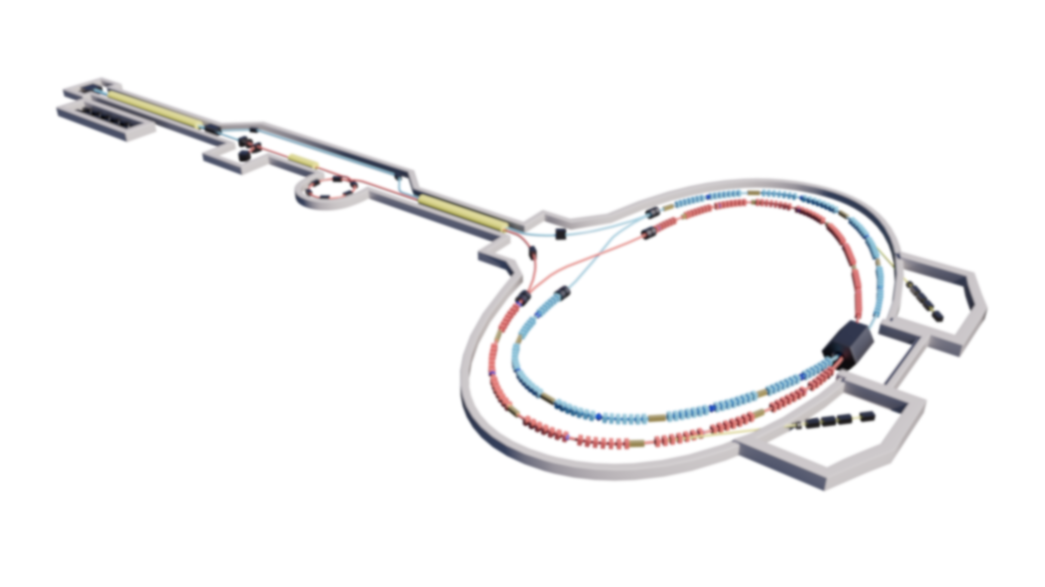
Nonlinear Optimization for the Super Tau-Charm Facility (STCF)
Tao Liu
University of Science and Technology of China (USTC)
Acknowledgement
Thanks to Demin Zhou, Penghui Yang, Linhao Zhang, Ye Zou, Sangya Li and other members of the Collider Rings Physics Group.
The 7th International Workshop on Future Tau-Charm Facilities (FTCF2025)
Huangshan | November 25th, 2025

Slide 2
Outline
Background and motivation
Part I : optimization strategy for STCF
Part II: optimization results for STCF
Summary and outlook

Slide 3
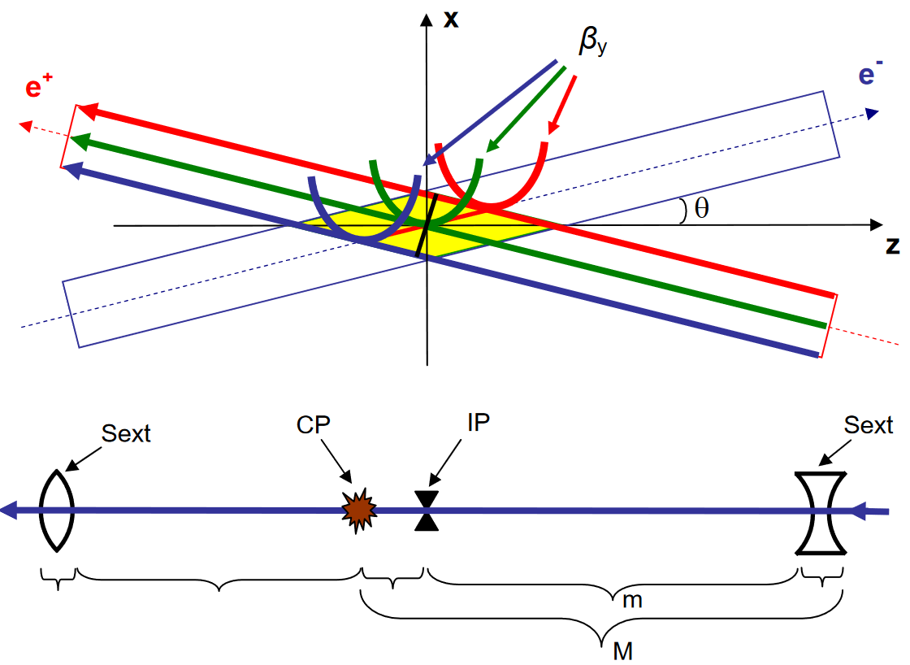
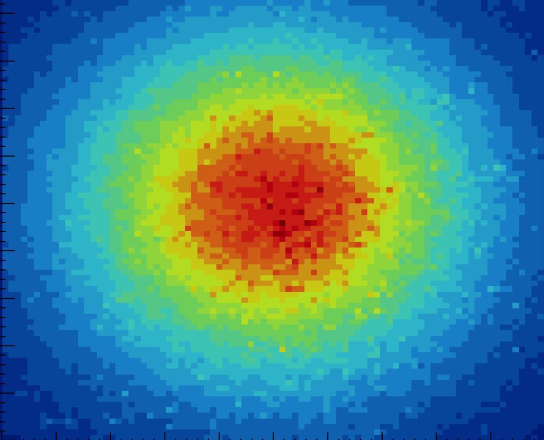
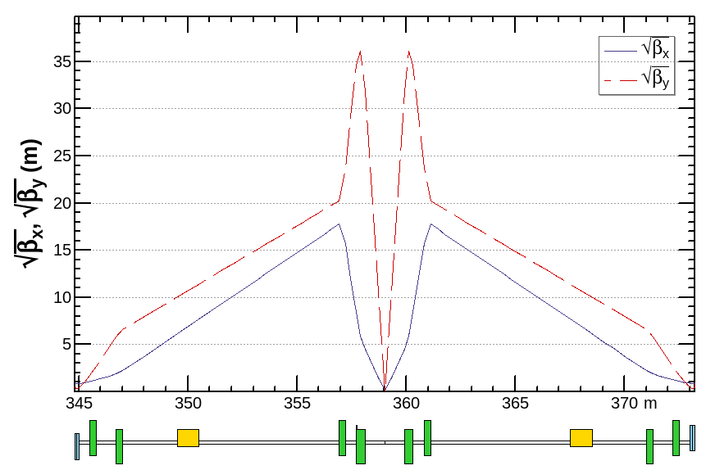
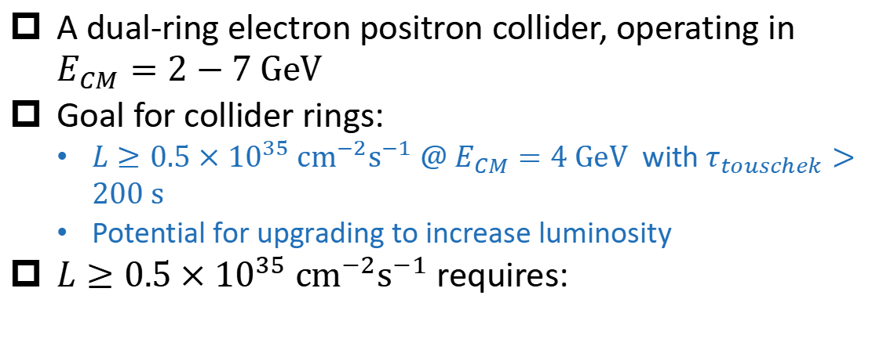

Super Tau Charm Facility
A dual-ring electron positron collider, operating in $E_{CM}=2−7 GeV$
Goal for collider rings:
$L≥0.5×{10}^{35} cm^{−2}s^{−1} @ E_{CM}=4 GeV$ with $τ_{touschek}>200 s$
Potential for upgrading to increase luminosity
$L≥0.5×{10}^{35} cm^{−2}s^{−1}$ requires:
See Ye Zou’s talk for details
Low $β_{y}^{∗}(≤1 mm)$ at IP
Crab waist scheme
Strong beam current

Slide 4
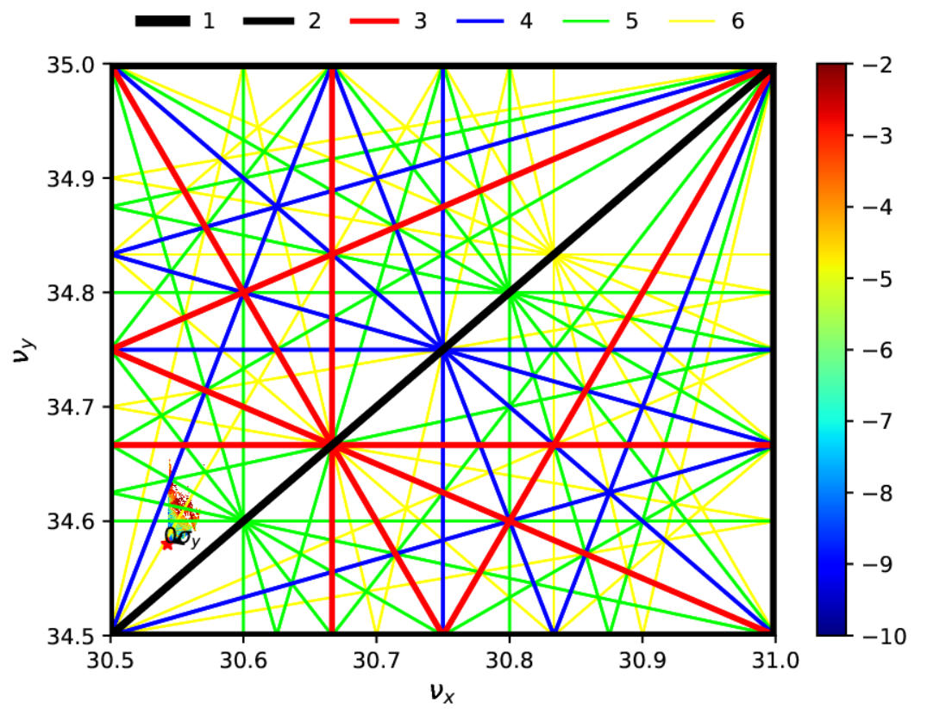


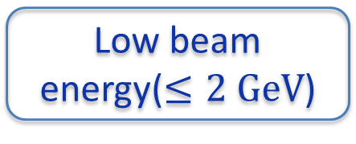
Consequent nonlinear challenges
Low $β_{y}^{∗}(≤1 mm)$ at IP
Crab waist scheme
Tune near resonance
Strong beam current
Strong nonlinearity from chromatic sextupoles, fringe effect
Strong nonlinearity from crab sextupoles
Strict requirement for tune spread
Low beam energy($≤2 GeV$)
$$τ_{Touschek }∝γ^3/{NP}_{bunch}$$
Limit DA and MA
Short Touschek lifetime

Slide 5
Effective strategies
See Linhao Zhang’s talk for IR design
Correcting high order chromaticity order by order[1,2].
Optimizing 2nd order chromaticity with fine tuning of chromaticity correction sextupoles(CCS)
Optimizing 3rd order chromaticity with sextupoles at IP phase position[1]
Optimizing 4th and 5th order chromaticity with octupole and decapole at IP phase position [2]
Controlling amplitude-driving terms(ADTs)
Cancelling the finite-length effect of CCS[3]
Minimizing the interplay of fringe field and crab sextupole[4]
Minimizing the total ADTs between crab sextupoles[2]
The above is necessary but not sufficient. Nonlinear optimization study is still essential to achieve the goal
[1] A. V. Bogomyagkov, E. B. Levichev, and B. S. Ras. (CERN), 4 (2016). [2] P. Raimondi et al. Phys. Rev. Accel. Beams 28, 021002 (2025).
[3] A. Bogomyagkov, E. Levichev, and P. Piminov, 15 (n.d.). [4] A. Bogomyagkov et al. ,. Phys. Rev. Accel. Beams 19, 121005 (2016).

Slide 6
Outline
Background and motivation
Part I : optimization strategy for STCF
Part II: optimization results for STCF
Summary and outlook

Slide 7
Optimization strategies
Common optimization strategies
Controlling magnet strengths.
Controlling Resonance driving terms(RDTs) , amplitude dependent terms(ADTs) or RDTs fluctuation
Controlling Montague function
Minimizing diffusion rate by frequency map analysis(FMA)
Maximizing dynamic aperture(DA)
Maximizing Touschek lifetime
……
Optimization strategy for STCF:
Step I: optimizing fast nonlinear parameters(see next page) with large scale MOGA
Step II: optimizing slow nonlinear parameters(see page after next) with small scale MOGA

Slide 8
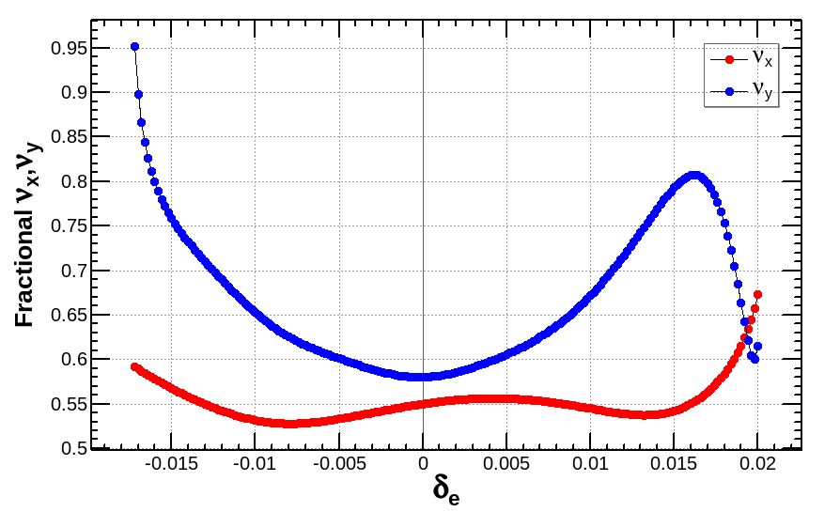
Step I
Optimizing fast nonlinear parameters with large scale MOGA
Goal:​ Rapidly optimize "fast" nonlinear parameters.
Parameters:​
Montague function
On-momentum RDTs/ADTs,
Off-momentum tune shift range and the flattening of tune-shift.
Method:​ A large-scale MOGA (NSGA-II) with ~10,000 individuals, >100 generations.
Variables: Sextupoles, octupoles, phase trombones.

Slide 9
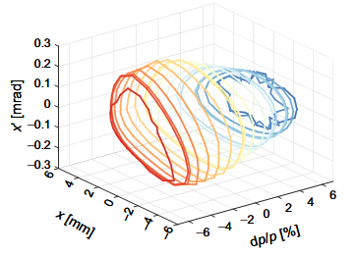
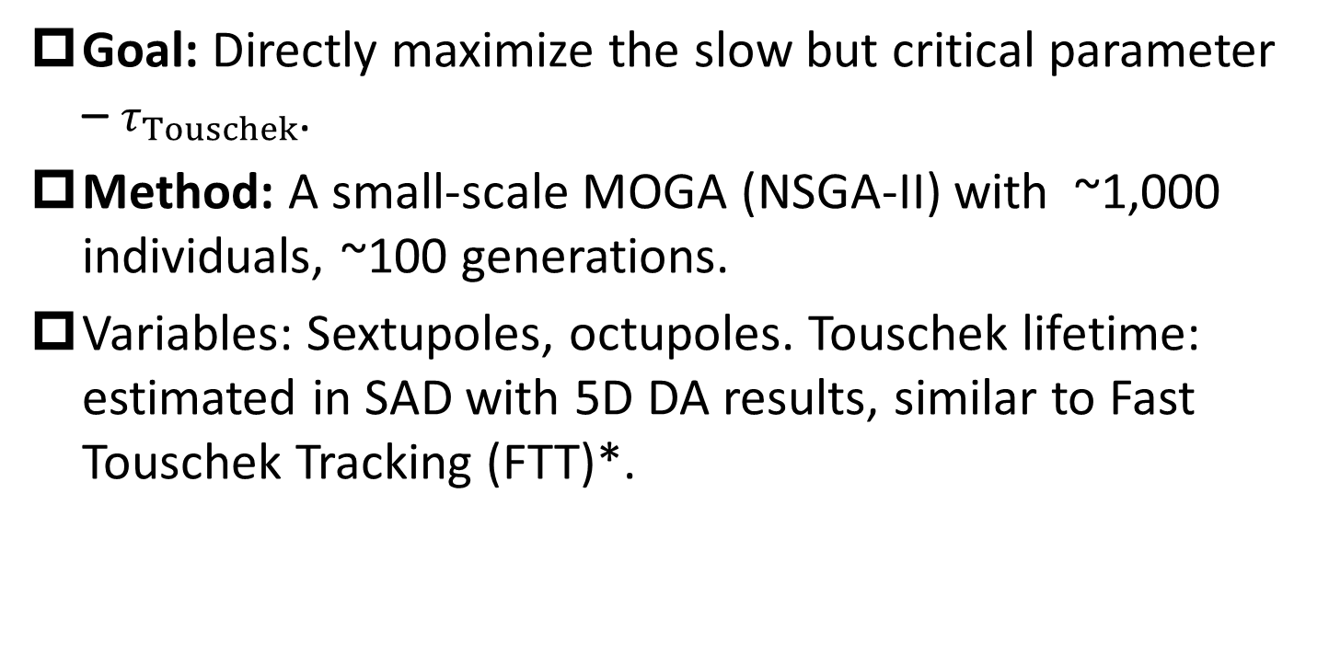
Step II
Optimizing Touschek lifetime with small scale MOGA
Goal:​ Directly maximize the slow but critical parameter – $τ_{Touschek}$.
Method:​ A small-scale MOGA (NSGA-II) with ~1,000 individuals, ~100 generations.
Variables: Sextupoles, octupoles. Touschek lifetime: estimated in SAD with 5D DA results, similar to Fast Touschek Tracking (FTT)*.
*
Fast Touschek Tracking(FFT)
* B. Riemann et al. Phys. Rev. Accel. Beams 27, 94002 (2024).

Slide 10
Outline
Background and motivation
Part I : optimization strategy for STCF
Part II: optimization results for STCF
Summary and outlook

Slide 11
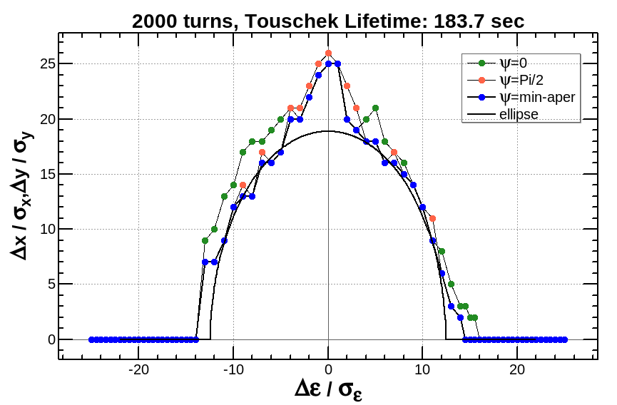
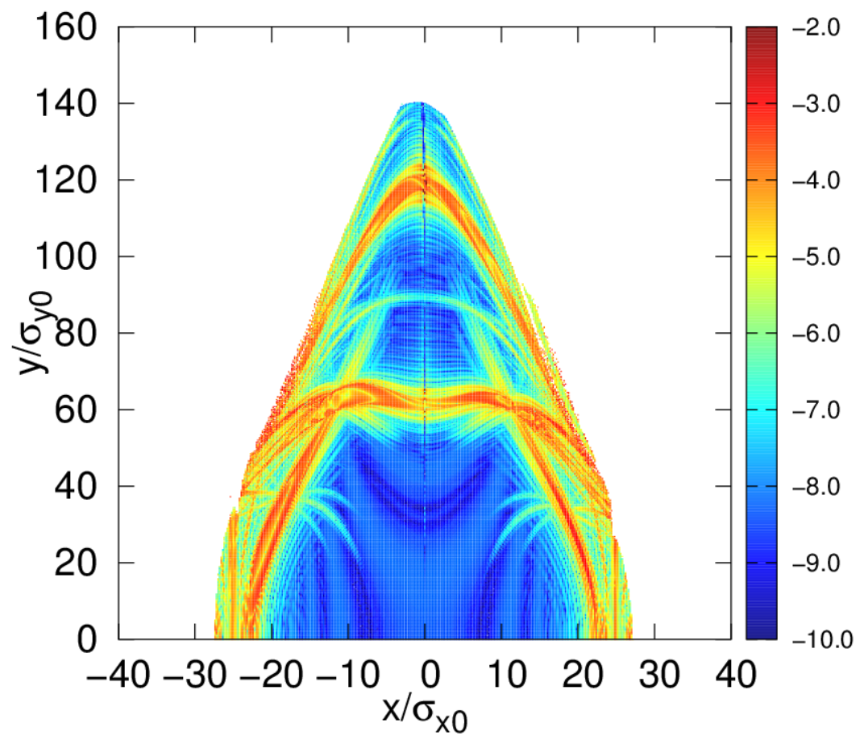
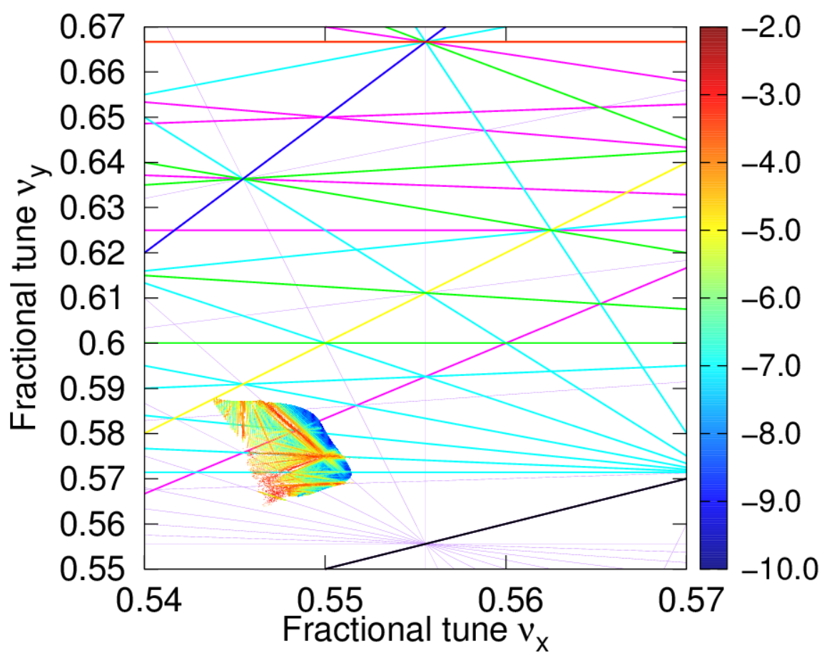

Results after step I (page 8)
Lattice: V5, 2 GeV, w/o fringe
Variables: sextupoles, phase trombone(replaced by changing quadrupoles)
A wide range of stable off-momentum closed orbit
A large DA because the small $α_{yy}$ and $α_{xx}$, the large high order ADTs form the folding tune spread
Valid but insufficient Touschek lifetime(183 seconds)

Slide 12
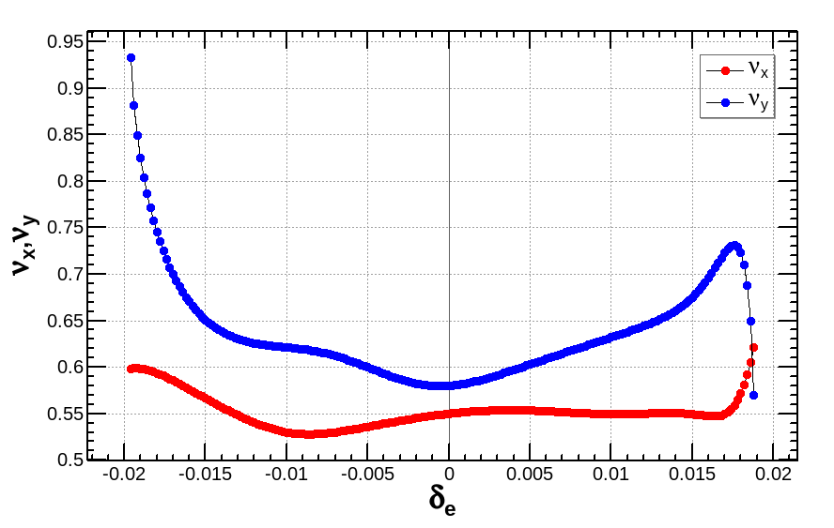
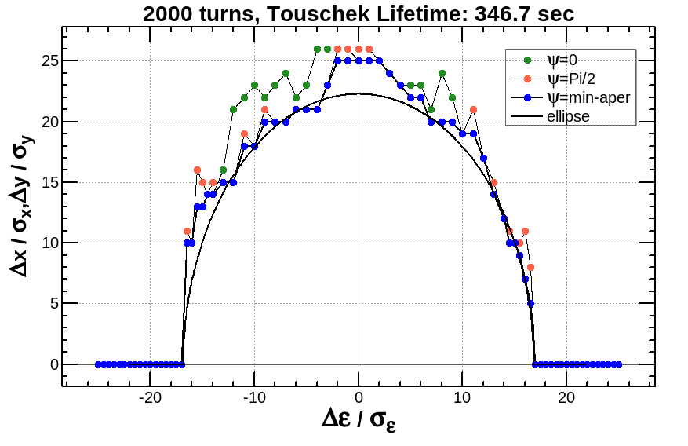
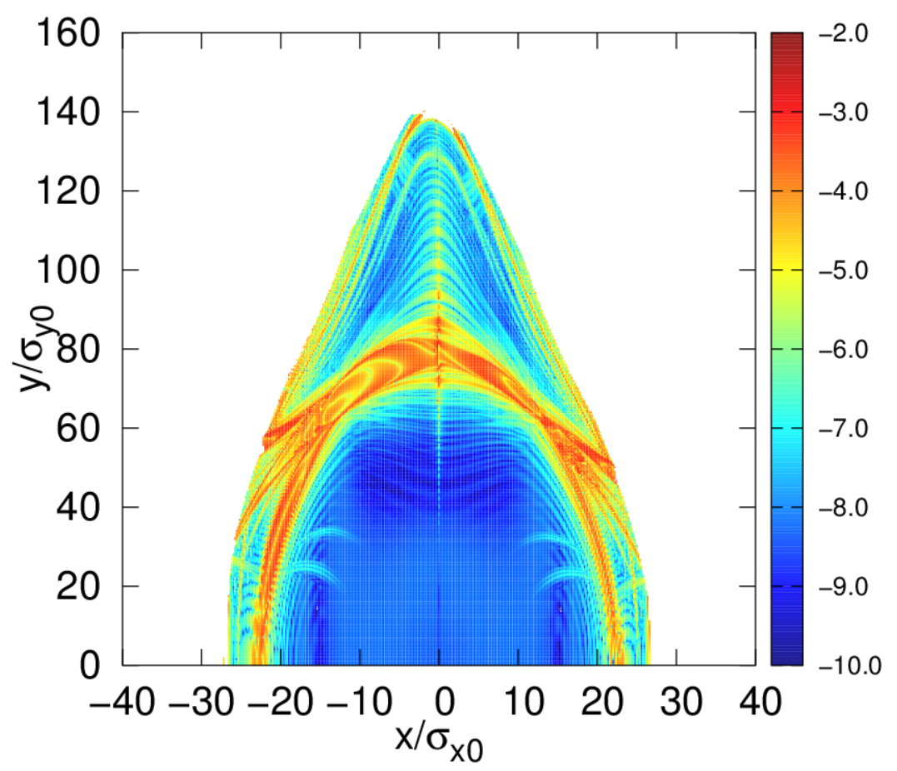
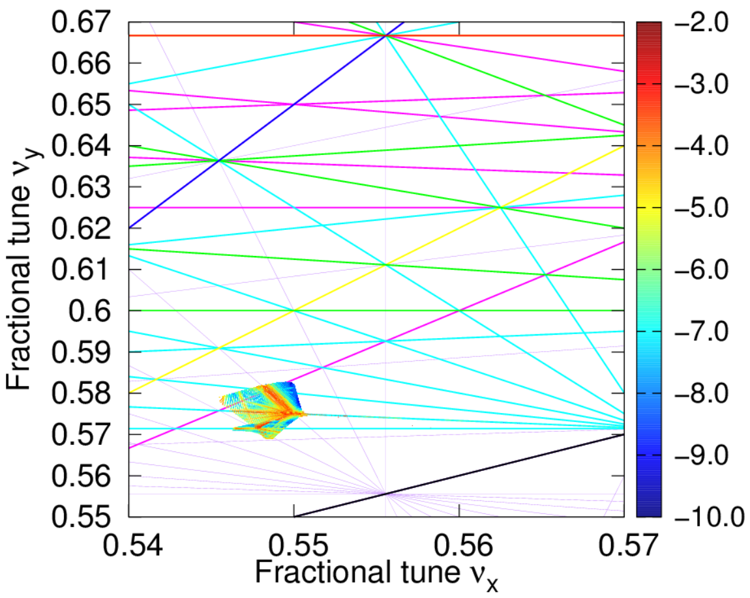
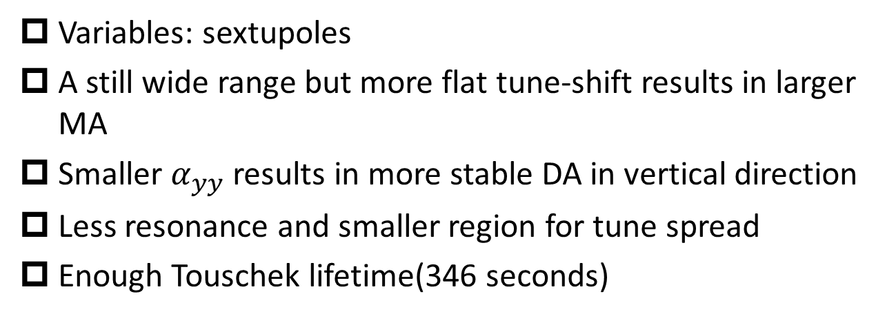
Results after step II (page 9)
Lattice: V5, 2 GeV, w/o fringe
Variables: sextupoles
A still wide range but more flat tune-shift results in larger MA
Smaller $α_{yy}$ results in more stable DA in vertical direction
Less resonance and smaller region for tune spread
Enough Touschek lifetime(346 seconds)

Slide 13

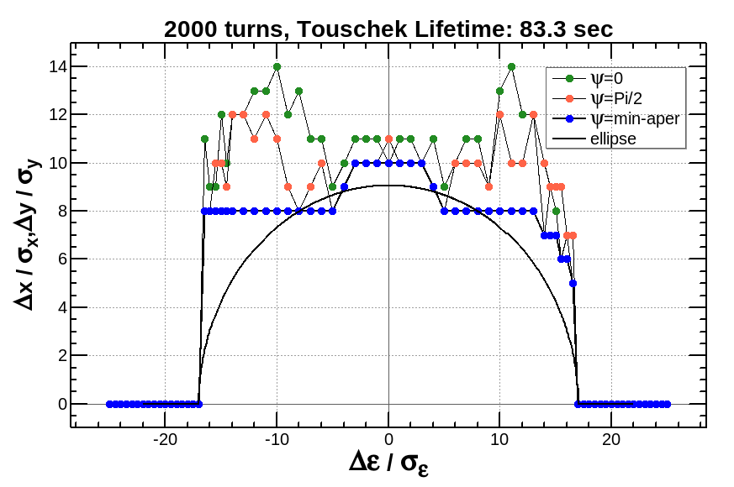
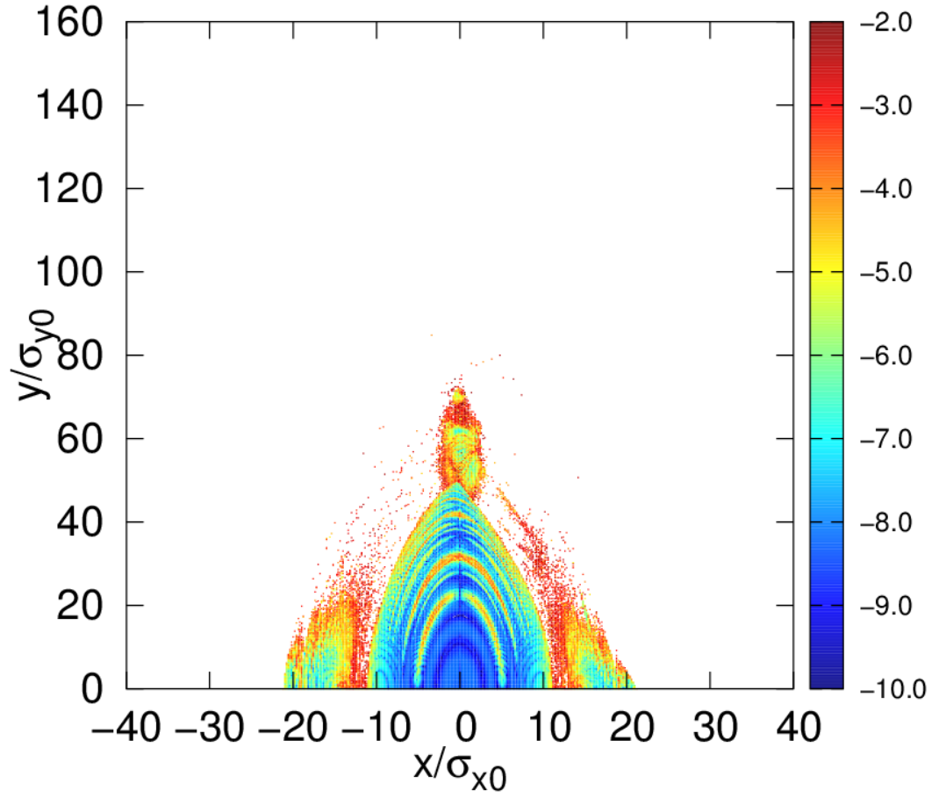
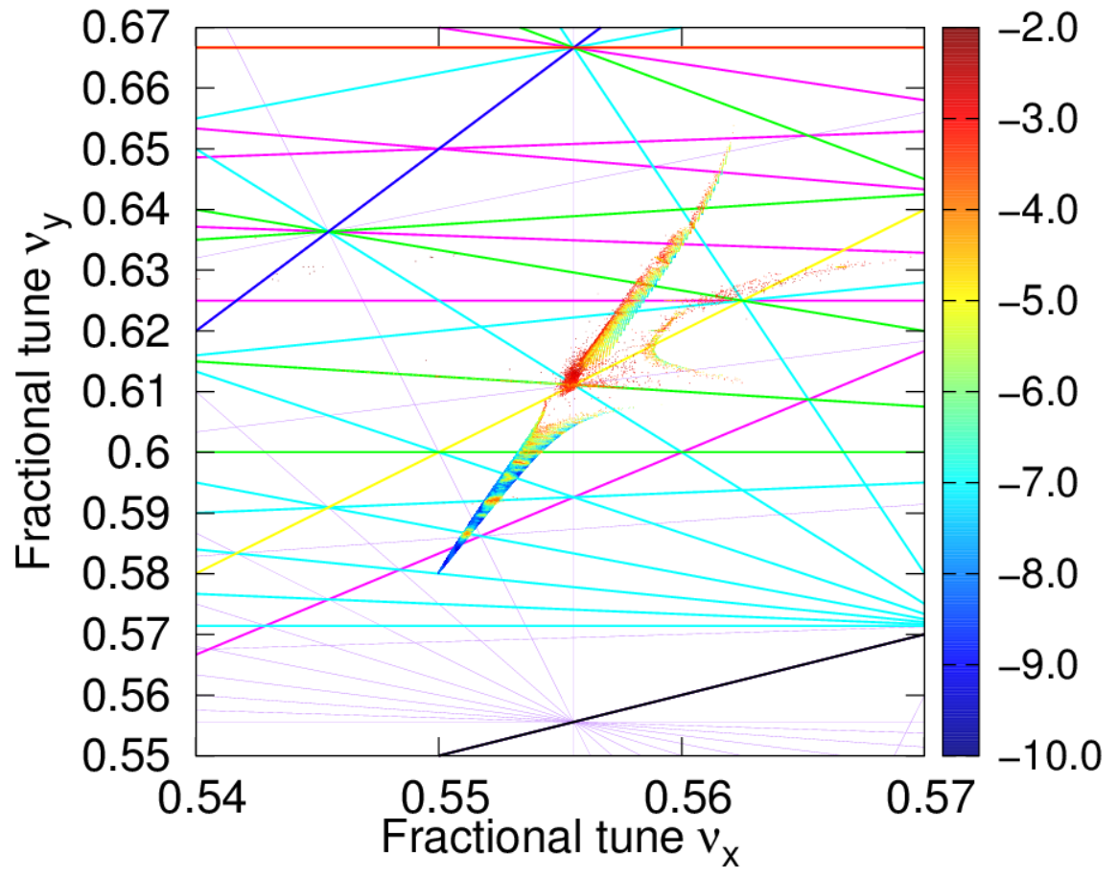
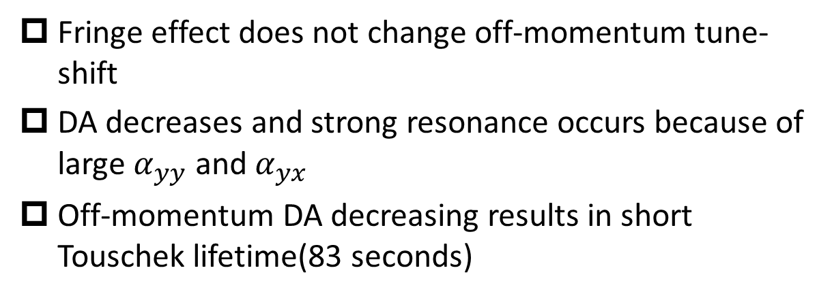
Fringe effect of final doublet
Lattice: V5, 2 GeV, with fringe
Fringe effect does not change off-momentum tune-shift
DA decreases and strong resonance occurs because of large $α_{yy}$ and $α_{yx}$
Off-momentum DA decreasing results in short Touschek lifetime(83 seconds)

Slide 14
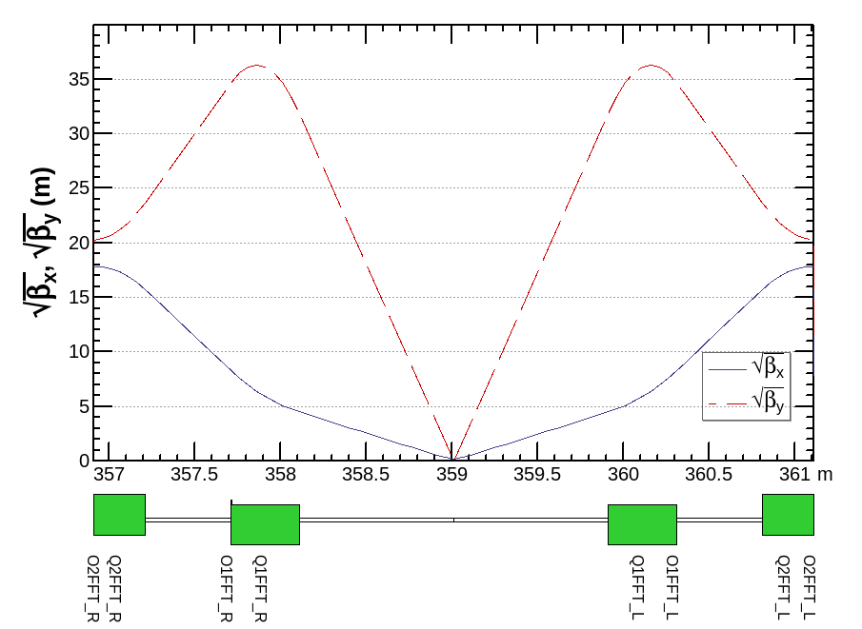
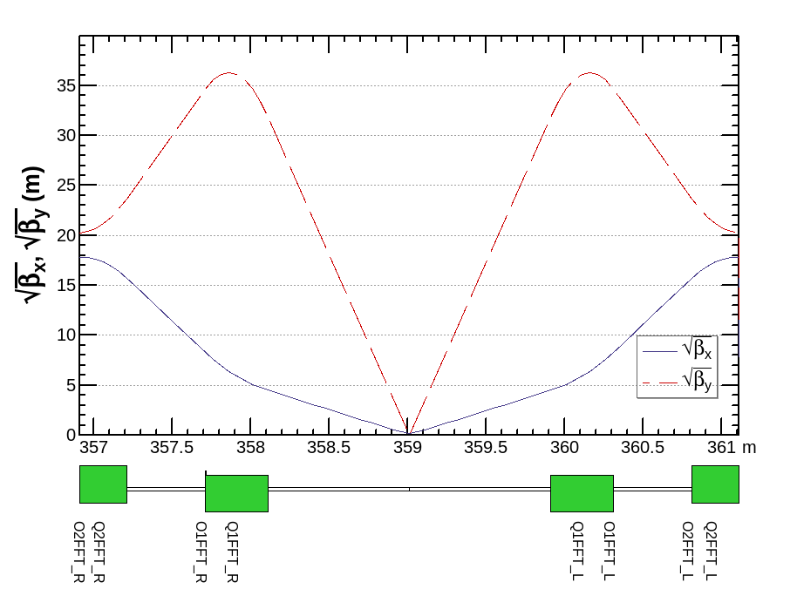
Recover Touschek lifetime with octupole coils
Lattice: V5, 2 GeV, with fringe
Octupole coils added to final doublets
Two scheme for octupole coils
Symmetric layout
Asymmetric layout
Symmetric octupoles
Asymmetric octupoles

Slide 15
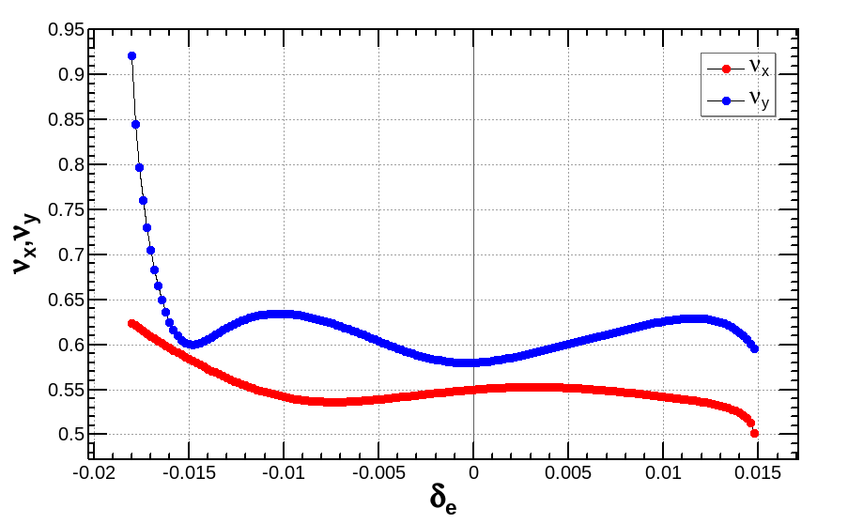
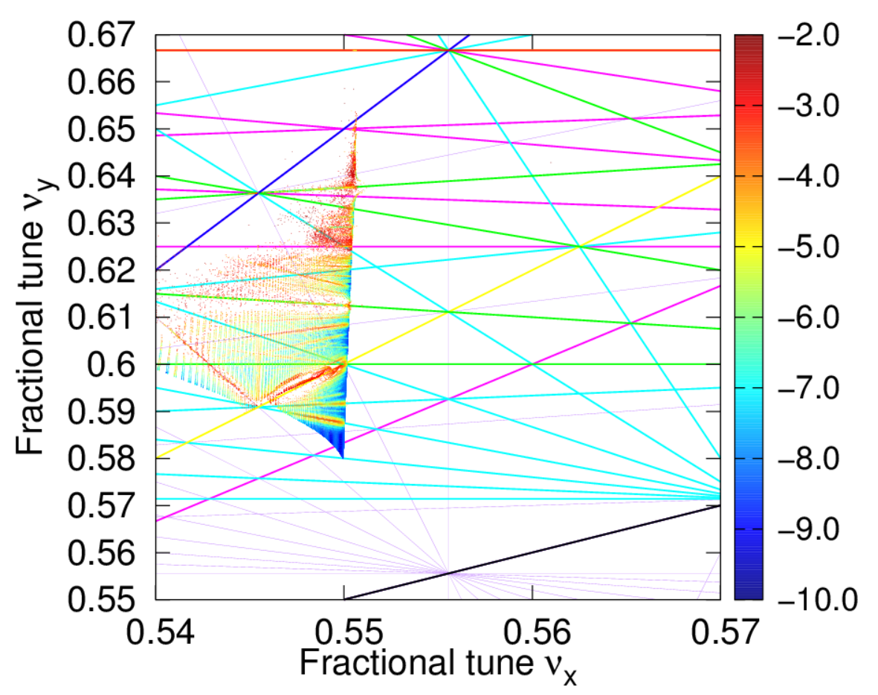
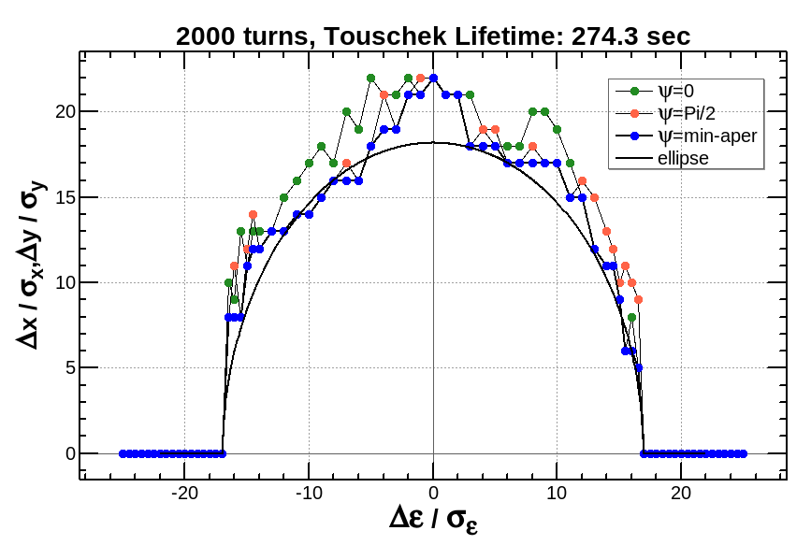
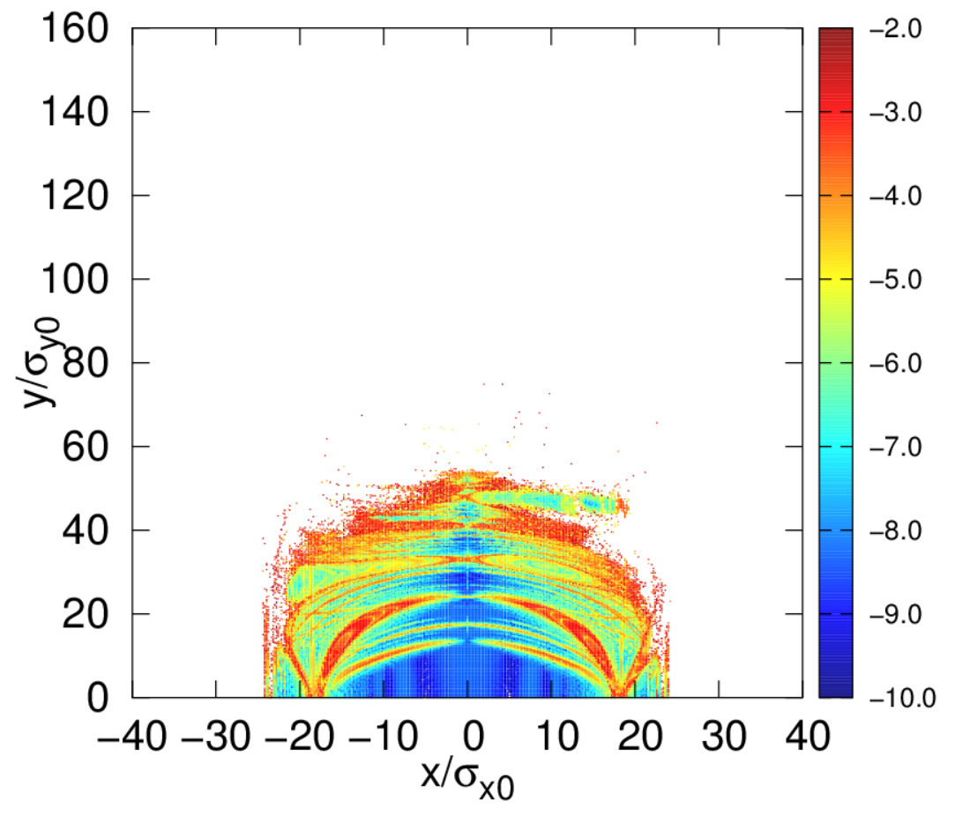
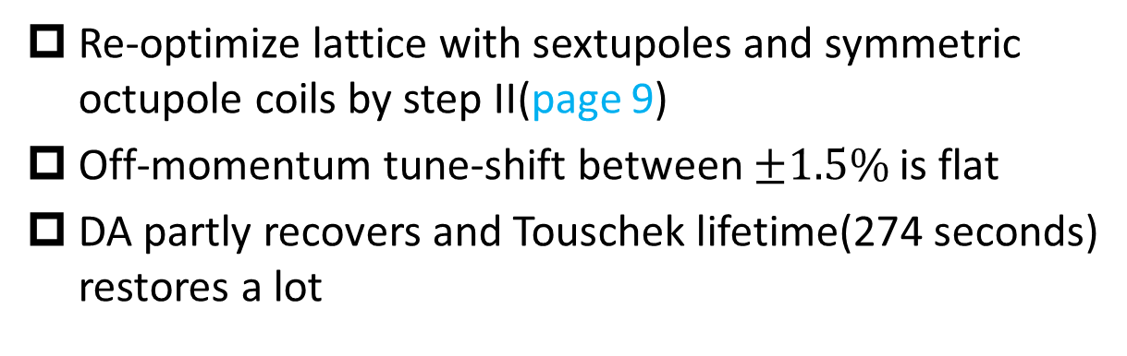
Correction with symmetric octupole coils
Lattice: V5, 2 GeV, with fringe
Re-optimize lattice with sextupoles and symmetric octupole coils by step II(page 9)
Off-momentum tune-shift between $±1.5\%$ is flat
DA partly recovers and Touschek lifetime(274 seconds) restores a lot

Slide 16
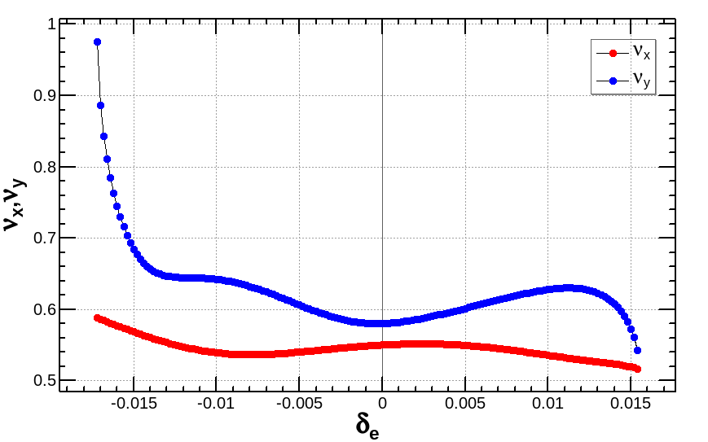
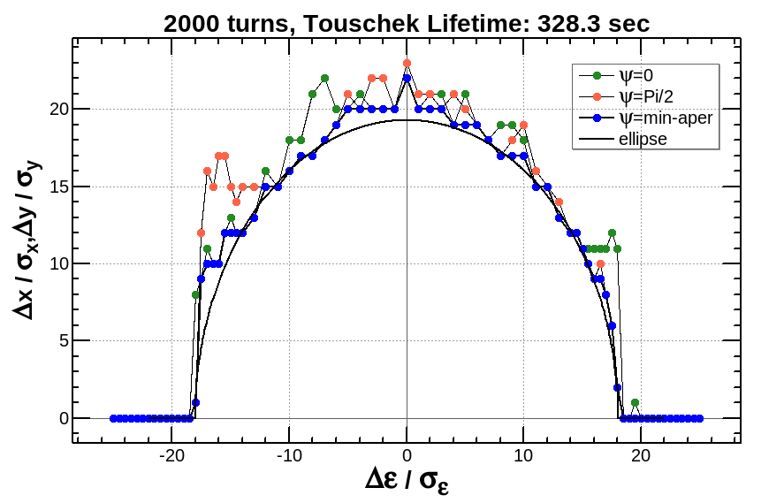
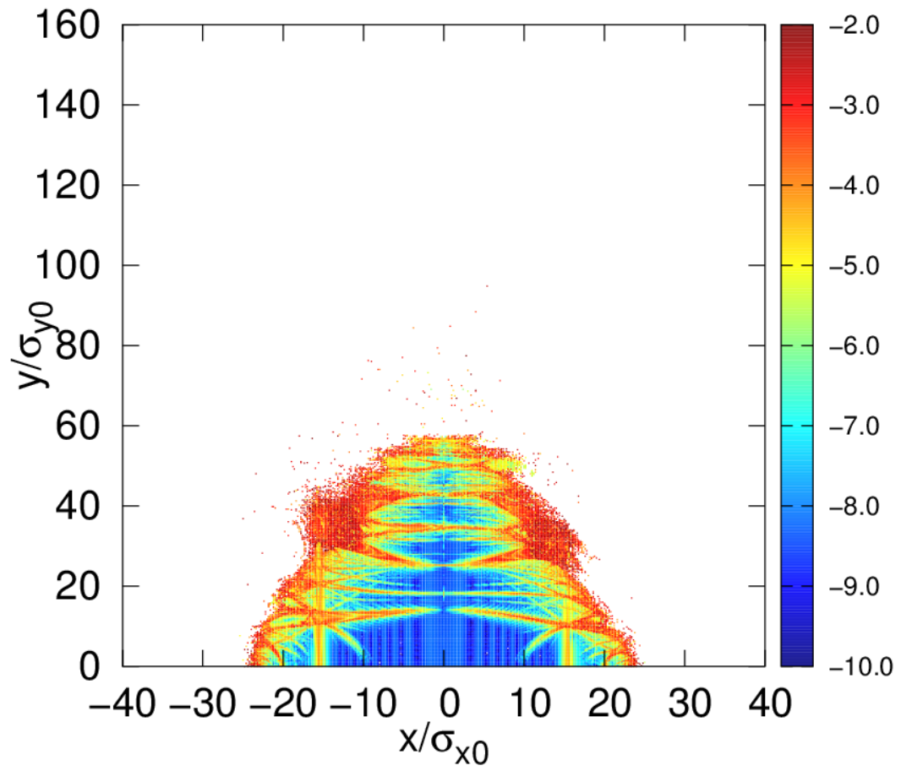
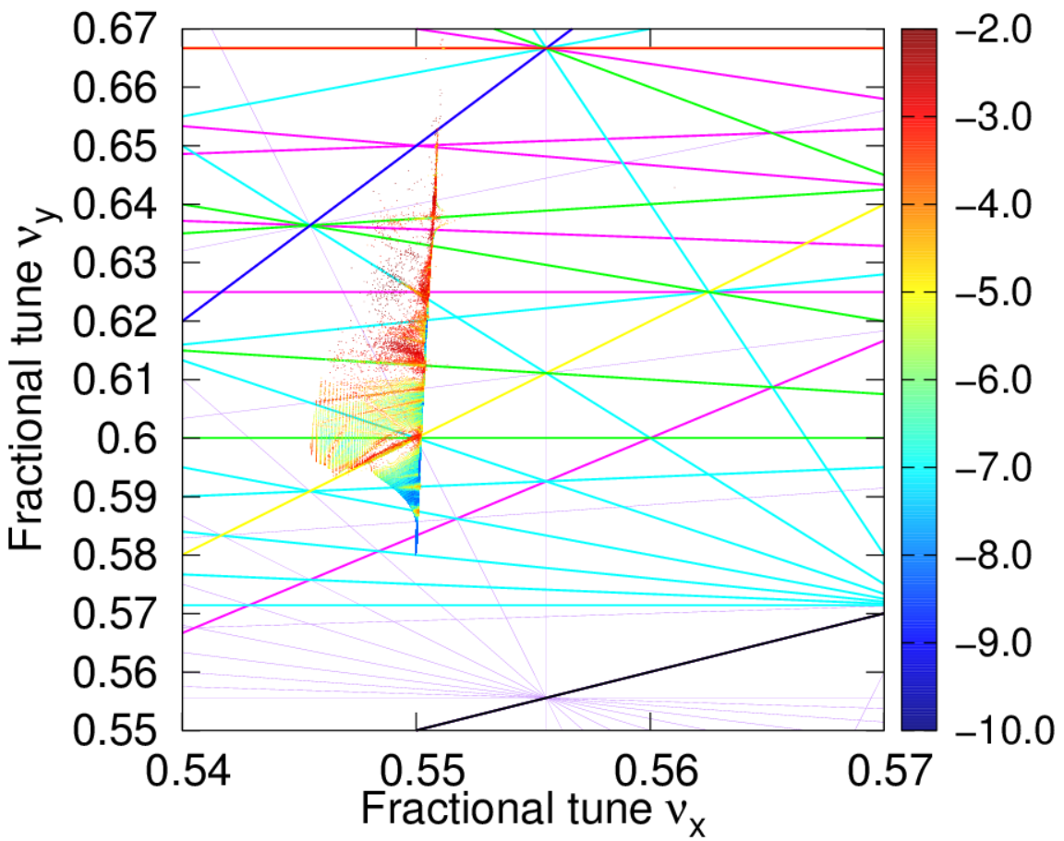
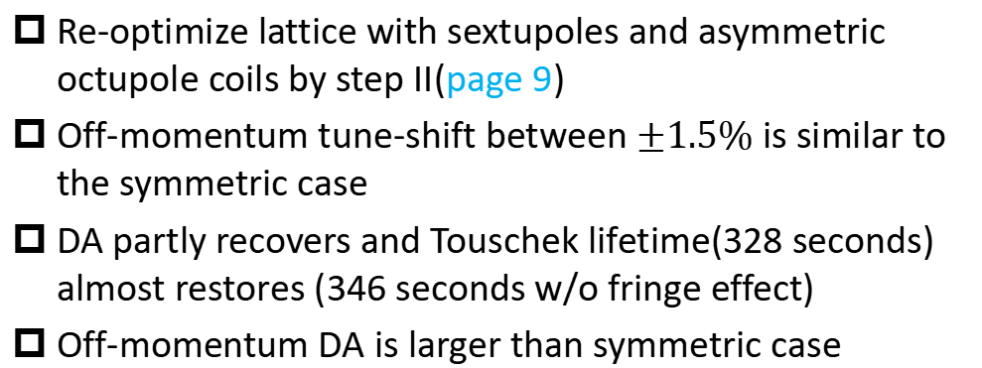
Correction with asymmetric octupoles
Lattice: V5, 2 GeV, with fringe
Re-optimize lattice with sextupoles and asymmetric octupole coils by step II(page 9)
Off-momentum tune-shift between $±1.5\%$ is similar to the symmetric case
DA partly recovers and Touschek lifetime(328 seconds) almost restores (346 seconds w/o fringe effect)
Off-momentum DA is larger than symmetric case

Slide 17
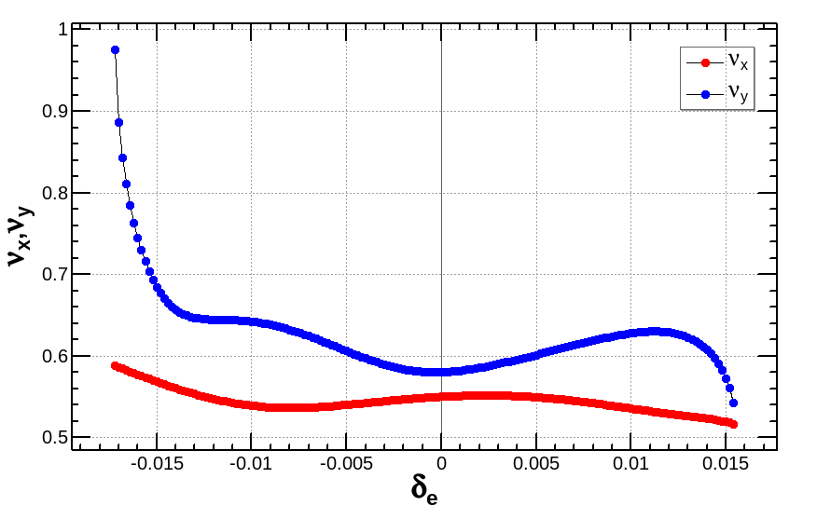
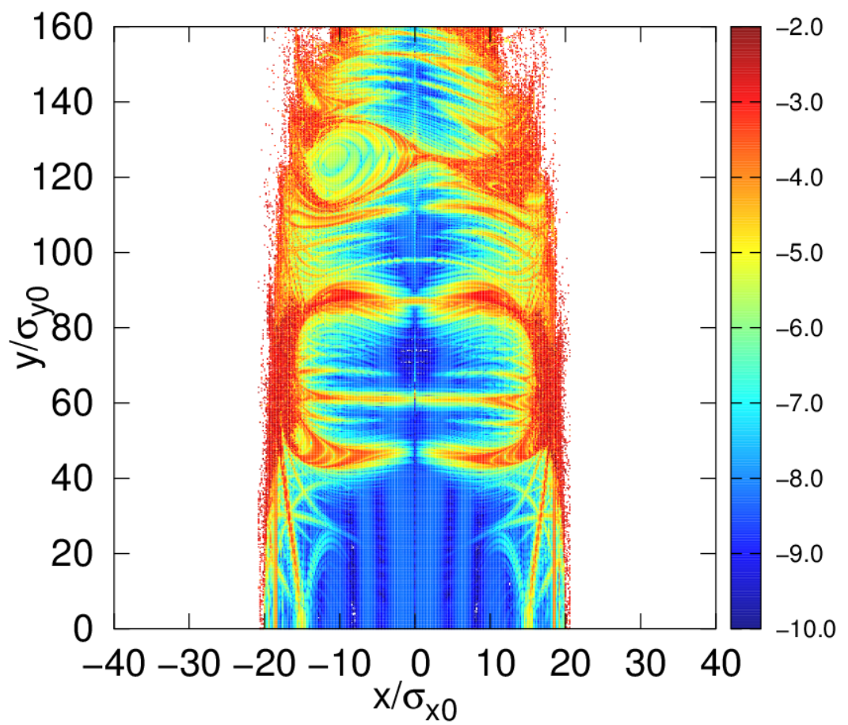
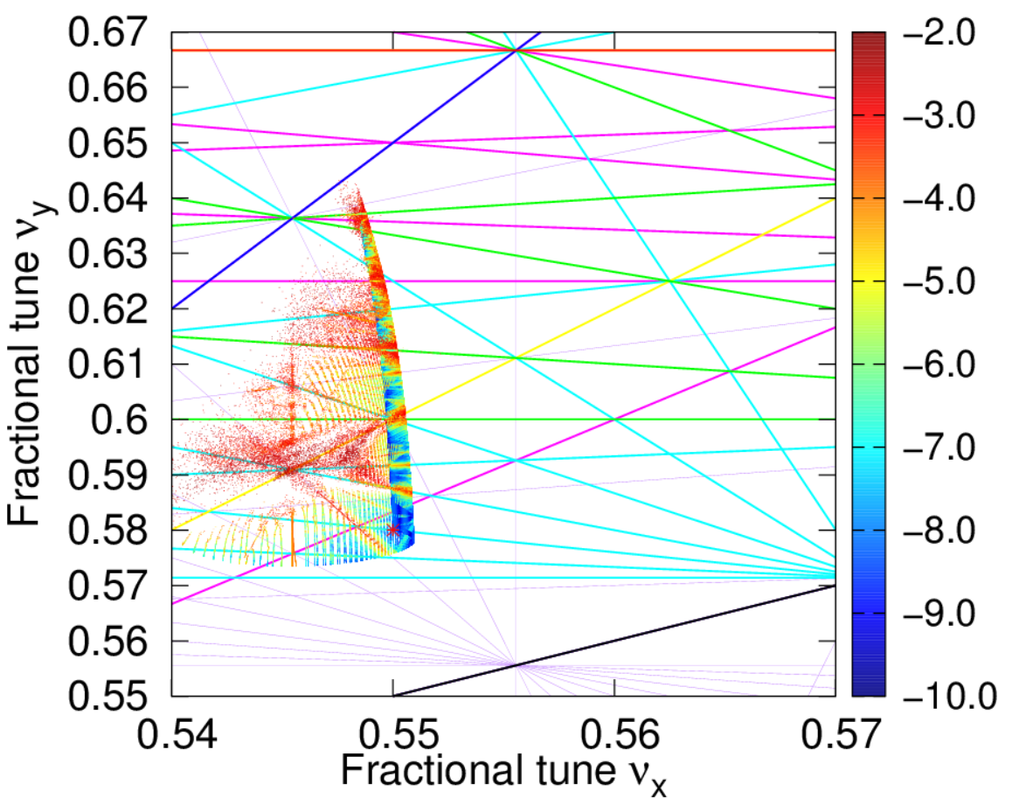
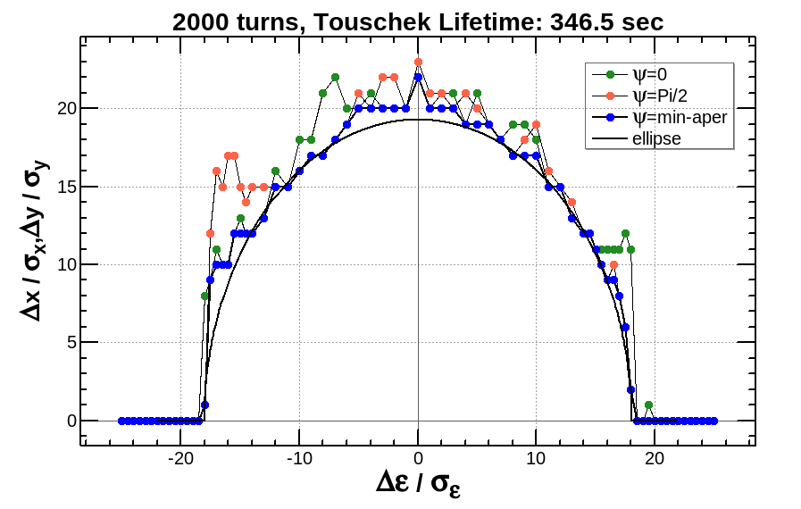
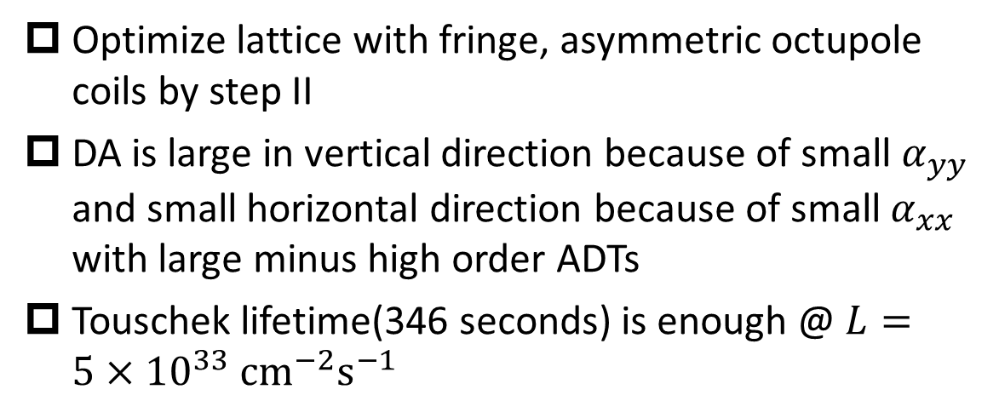
Results for lattice @ 1 GeV
Lattice: V5, 1 GeV, with fringe
Optimize lattice with fringe, asymmetric octupole coils by step II
DA is large in vertical direction because of small $α_{yy}$ and small horizontal direction because of small $α_{xx}$ with large minus high order ADTs
Touschek lifetime(346 seconds) is enough @ $L=5×{10}^{33} cm^{−2}s^{−1}$

Slide 18
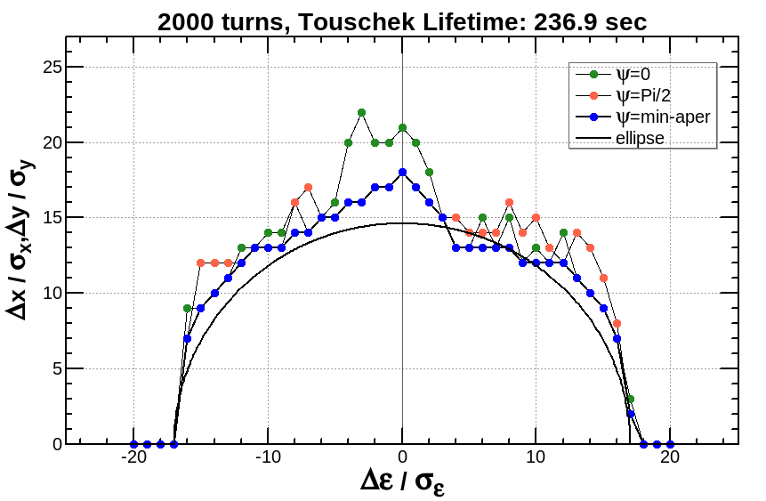
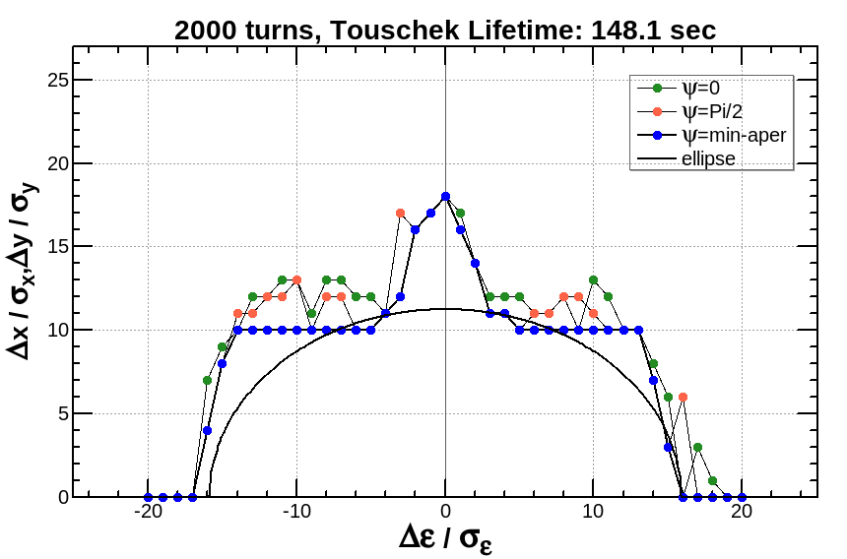
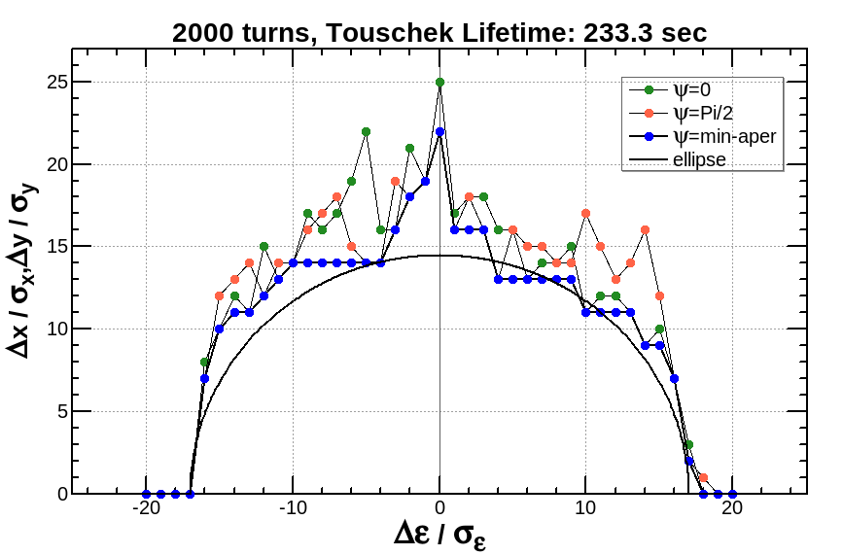
Results before& after optimization with W-S Beam-Beam
Lattice: V 4.3 ,with fringe, with symmetric oct
Simulating the beam-beam effect on lattice dynamics in SAD with the weak-strong model
Beam-beam effect reduces off-momentum DA, resulting in the decrease of Touschek lifetime
Off-momentum DA restores after re-optimization with step II
Optimized with step II
Turn on beam-beam
Re-optimize with step II

Slide 19
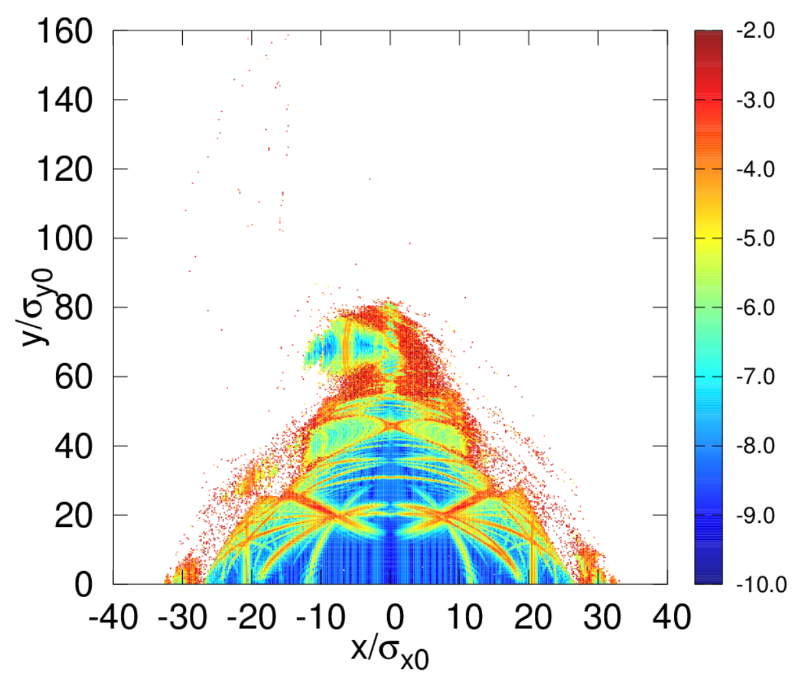
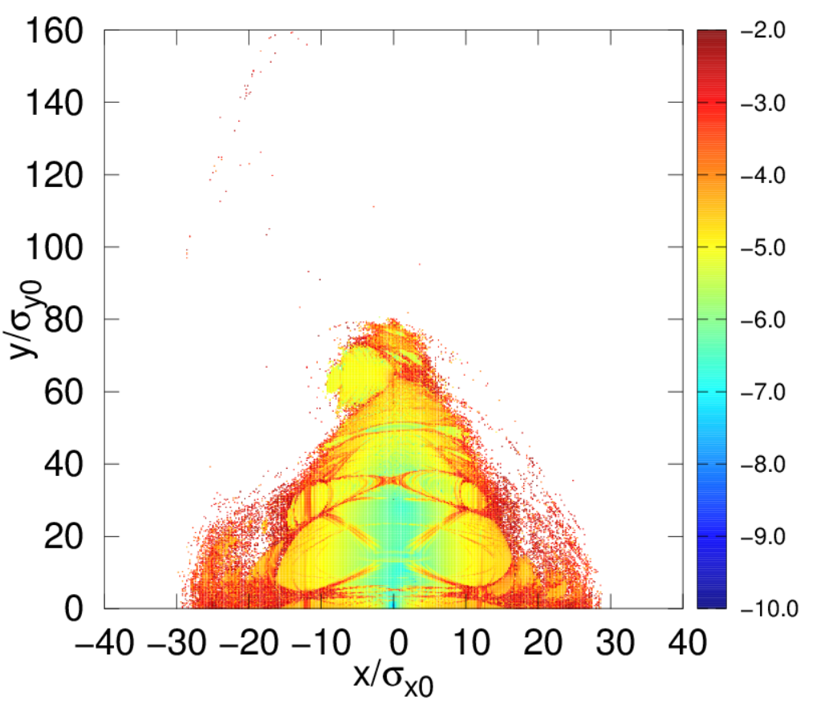
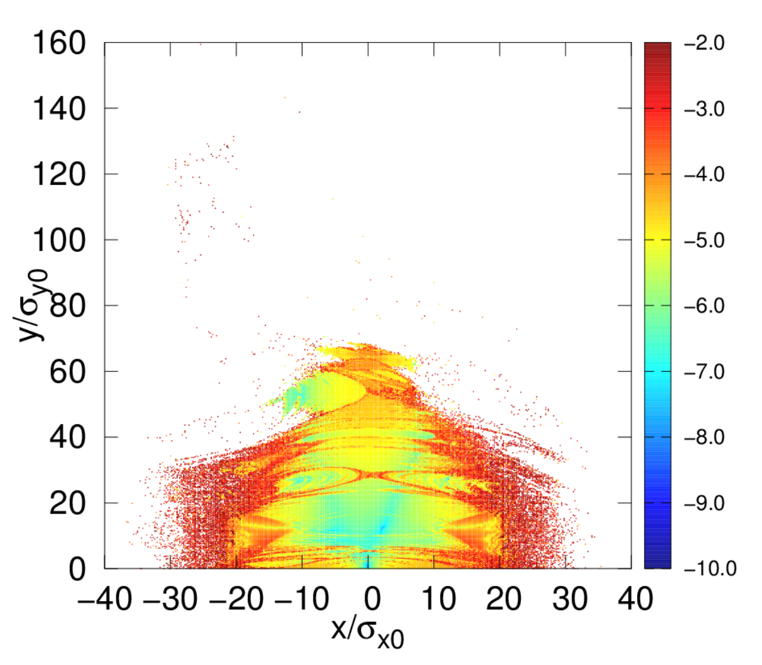
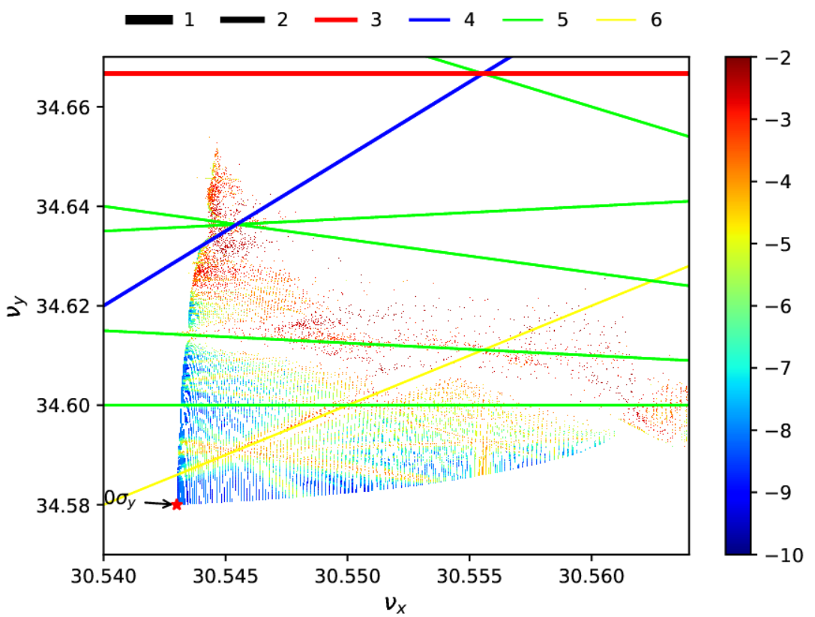
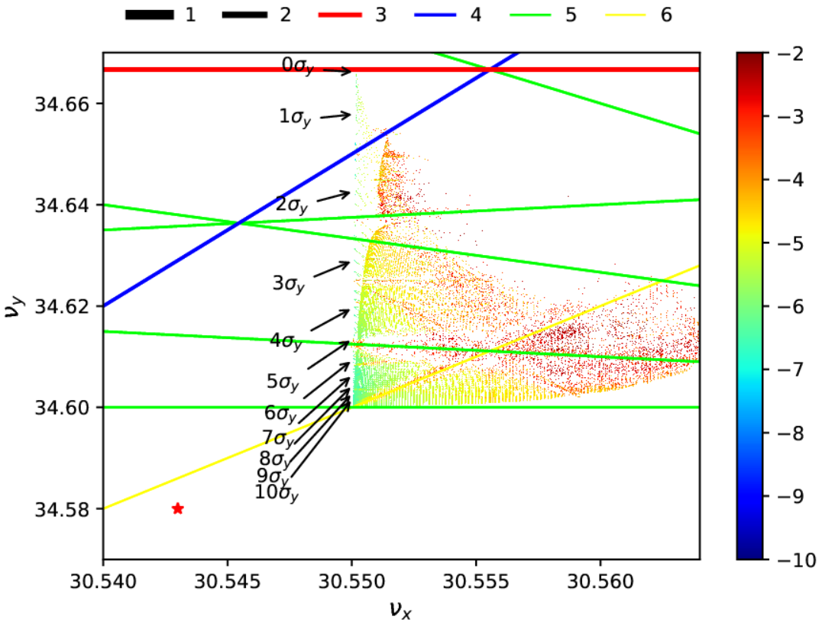
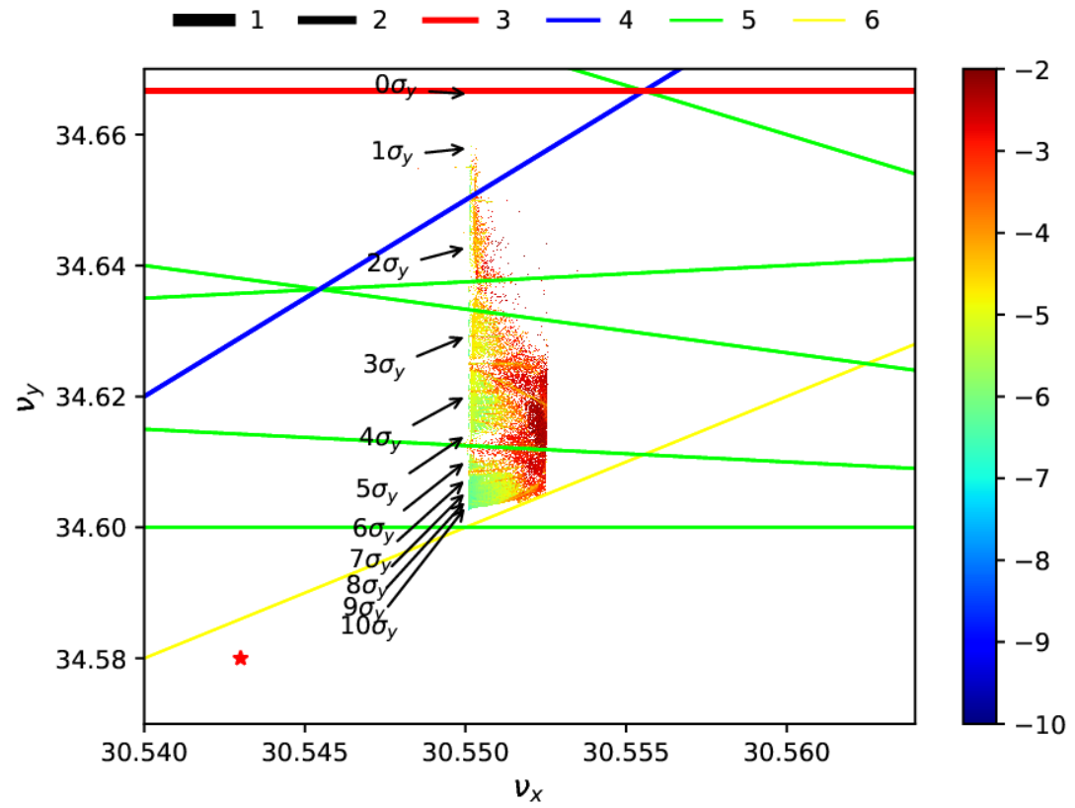
FMA before & after optimization with W-S Beam-Beam
Lattice: V 4.3 ,with fringe, with symmetric oct
Optimized with step II
Turn on beam-beam
Re-optimize with step II
Beam-beam effect increases the diffusion rate
Optimization with beam-beam effect tends to small tune spread area

Slide 20
Outline
Background and motivation
Part I : optimization strategy for STCF
Part II: optimization results for STCF
Summary and outlook

Slide 21
Summary
Our two-step optimization strategy is effective​ for STCF.
Fringe field compensation with symmetric/asymmetric octupoles​ successfully restores DA and Touschek lifetime.
Beam-beam effect​ significantly degrades Touschek lifetime but can be mitigated by re-optimization.
Acceptable Touschek lifetimes are obtained for both 2 GeV and 1 GeV lattices.

Slide 22
Outlook and future work
Further investigation into beam-beam dynamics.
Understand the mechanism​ of fringe/beam-beam compensation.
Develop faster optimization methods to replace "black-box“ tracking.
Incorporate fringe effects directly into Step I.
Explore alternative optimization strategies (e.g., P. Raimondi's method).

Slide 23
Thank you for your attention!

Slide 24
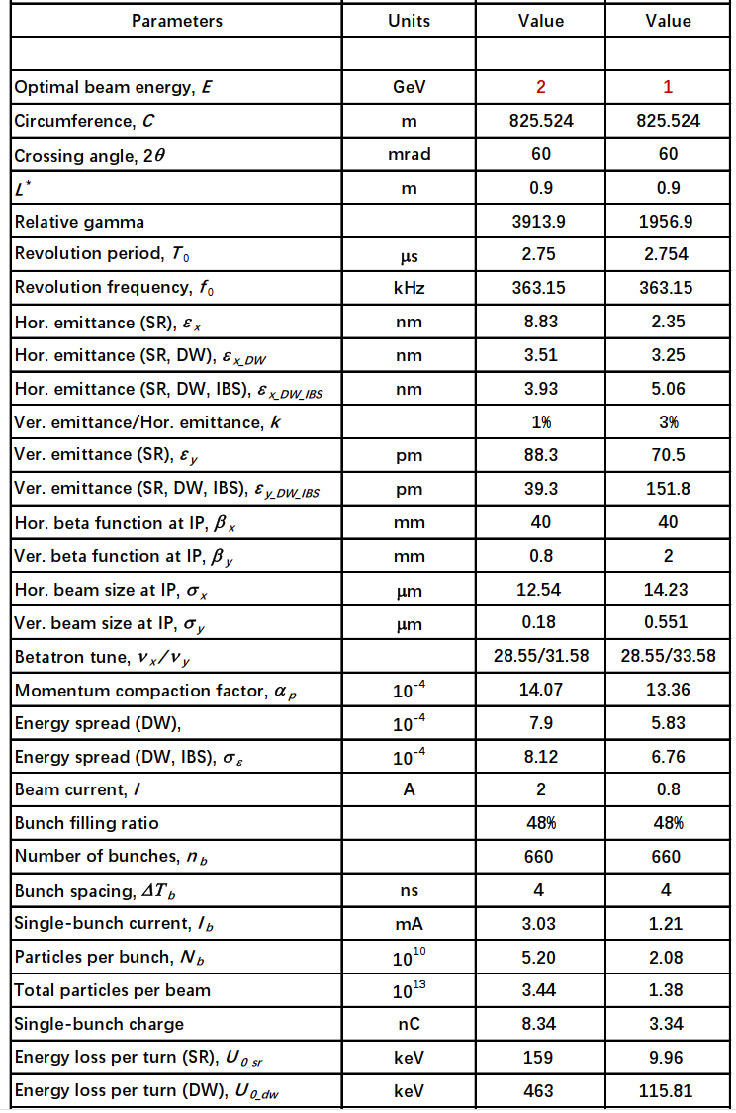

Parameters for the low energy region of STCF
Lattice: V5

Slide 25














FMA before & after optimization with W-S Beam-Beam
Lattice: V 4.3 with fringe, with oct
w/o BB
With BB
$$0σ_{y}$$
Before
$$1σ_{y}$$
$$2σ_{y}$$
$$3σ_{y}$$
$$4σ_{y}$$
$$5σ_{y}$$
$$6σ_{y}$$
$$7σ_{y}$$
$$8σ_{y}$$
$$0σ_{y}$$
After
$$1σ_{y}$$
$$2σ_{y}$$
$$3σ_{y}$$
$$4σ_{y}$$
$$5σ_{y}$$
$$6σ_{y}$$
$$7σ_{y}$$
$$8σ_{y}$$

Slide 26


Slide 27

Results before& after optimization with W-S Beam-Beam
Lattice: V 4.3 Fringe + RAD
w/o BB
with BB
With beam-beam
Before
Optimized after Step II
Impact of beam-beam effect on lattice dynamics
Restored after re-optimization
Re-optimize
After
Conducted in SAD with weak-strong model

