Slide 1

Synergy between LHCb and FTCF programs
Wenbin Qian
University of Chinese Academic of Sciences
2025/11/27
On behalf of LHCb Collaboration
7th International Workshop on Future Tau Charm Facilities, 2025, Huangshan
2025/11/27
UCAS, Wenbin Qian
1

Slide 2
Outline of the talk
Introduction
Complementary in CKM physics
Synergy in rare decay measurements
Common interests in exotic particle studies
Conclusions
2025/11/27
UCAS, Wenbin Qian

Slide 3
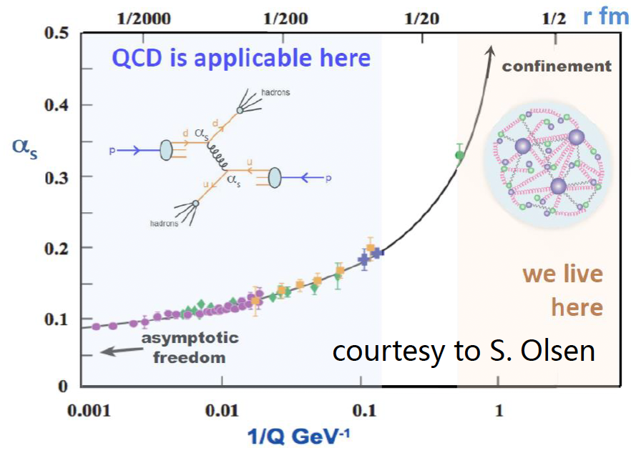
Common physics interests
SM model very successful;
Still an effective theory, many unexplained phenomena;
Most related to flavor and hadron physics: FTCF and LHCb can contribute
Understanding QCD at low energy
New Physics hunting
Properties of QCD confinement
Structures of hadrons
Matter and antimatter asymmetry observed in the Universe
Origin of dark matter? New particles or new forces? Flavor hierarchy
Non-perturbative!
2025/11/27
UCAS, Wenbin Qian
3

Slide 4
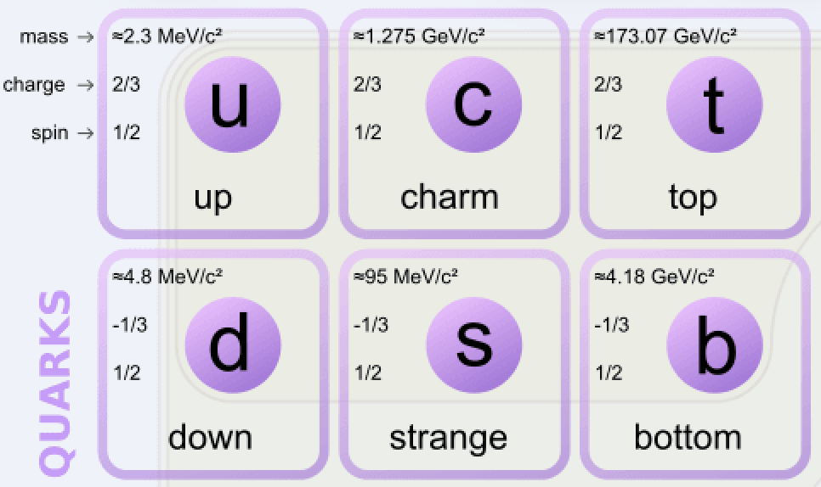
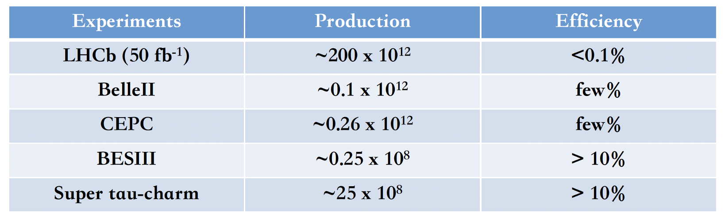
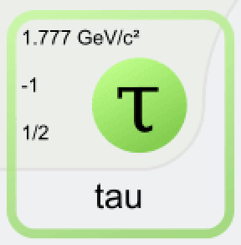

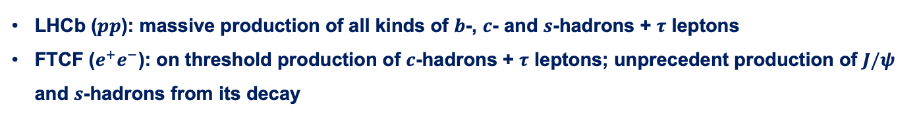
Complementary physics programs
Production environment
LHCb ($pp$): massive production of all kinds of $b$-, $c$- and $s$-hadrons + $τ$ leptons
FTCF ($e^{+}e^{−}$): on threshold production of $c$-hadrons + $τ$ leptons; unprecedent production of $J/ψ$ and $s$-hadrons from its decay
$D$ mesons
Detection abilities
LHCb: specialized in charged final and with high precision vertexing
FTCF: both charged and neutral final states + kinematic constraints for missing particles
2025/11/27
UCAS Wenbin Qian
4

Slide 5
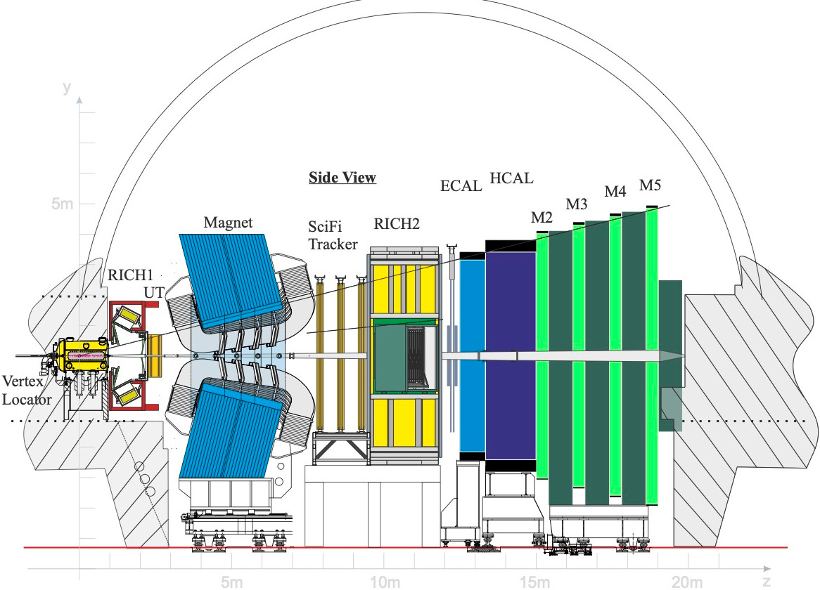
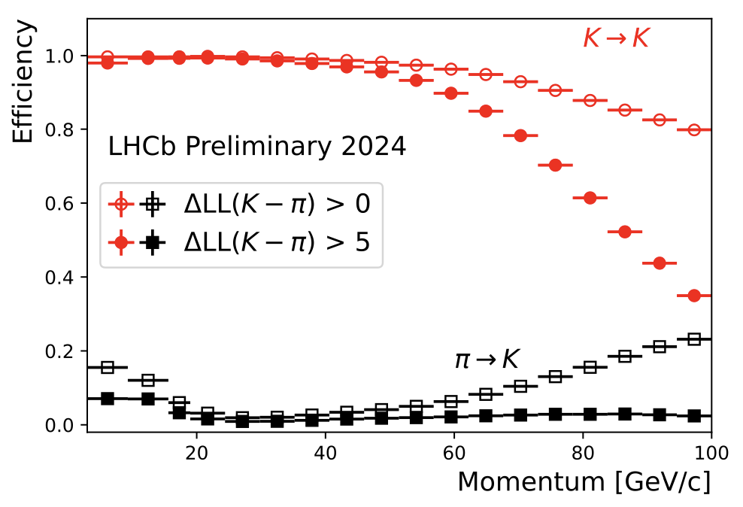
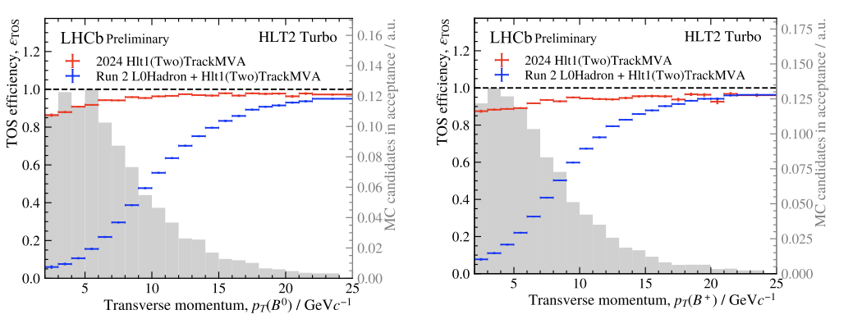
New LHCb detector at Run 3
Similar detector performance than Run1+2 on PID, track reconstruction and vertexing
More importantly, full software trigger ➜ better performance on hadronic final states
New pixel Velo
New UT
New SciFi
Removed M1 and new readout
Similar PID performance
Twice trigger efficiencies (hadronic)
Removed PS/SPD and new readout
New RICH optics and PMs
2025/11/27
UCAS, Wenbin Qian
5

Slide 6
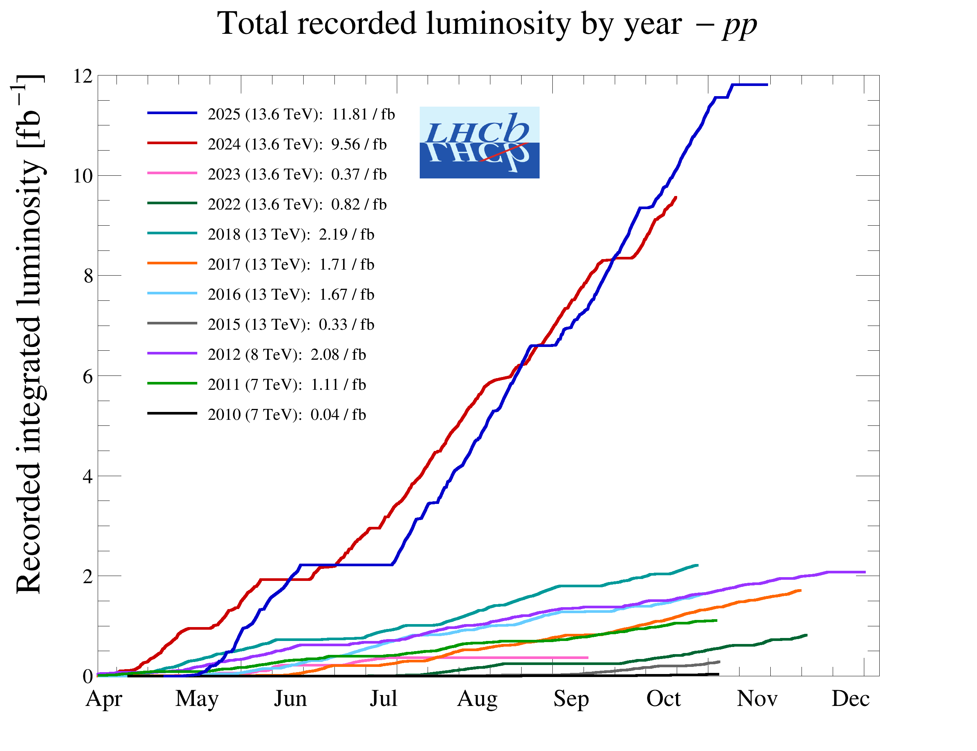
The LHCb status
Run 1:
2011 (7 TeV): 1 fb⁻¹
2012 (8 TeV): 2 fb⁻¹
Run 2:
2015-2018 (13 TeV): 6 fb⁻¹
Run 3:
2024 alone (13.6 TeV): 9.56 fb⁻¹
2025 (13.6 TeV): 11.81 fb⁻¹
Operates at $×5$ higher instantaneous luminosity
1 year @ Run 3 > Run 1+2; + increase in efficiencies
2025/11/27
UCAS, Wenbin Qian
6

Slide 7
Outline of the talk
Introduction
Complementary in CKM physics
Synergy in rare decay measurements
Common interests in exotic particle studies
Conclusions
2025/11/27
UCAS, Wenbin Qian

Slide 8
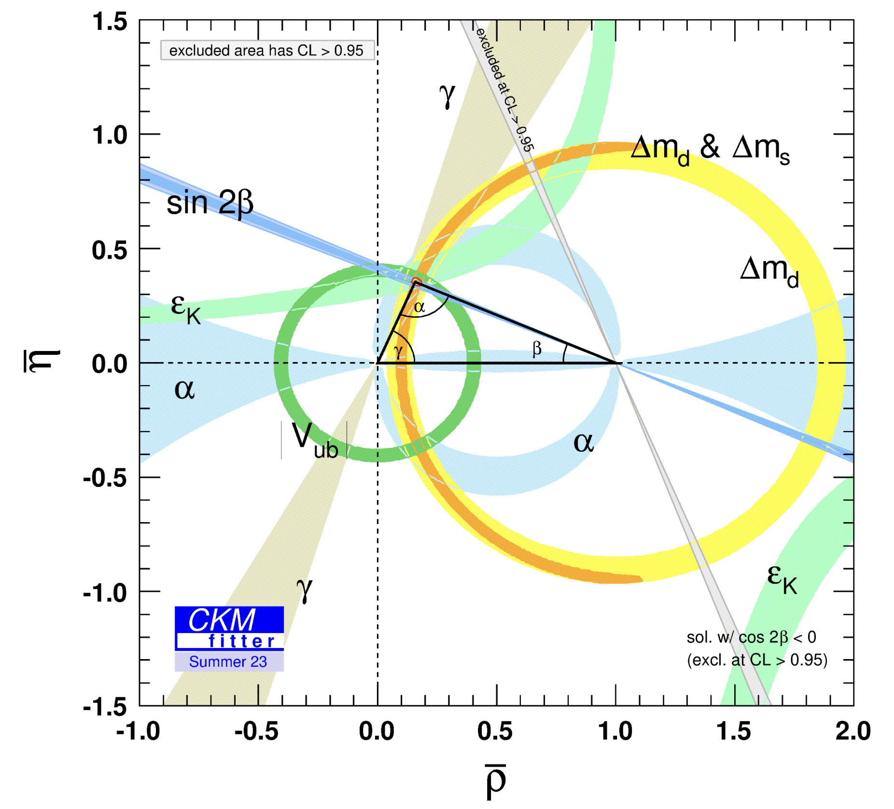
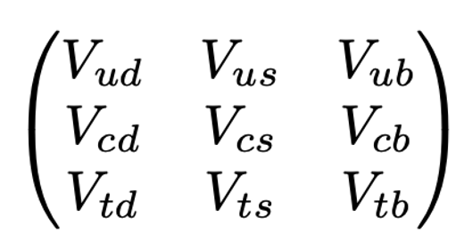
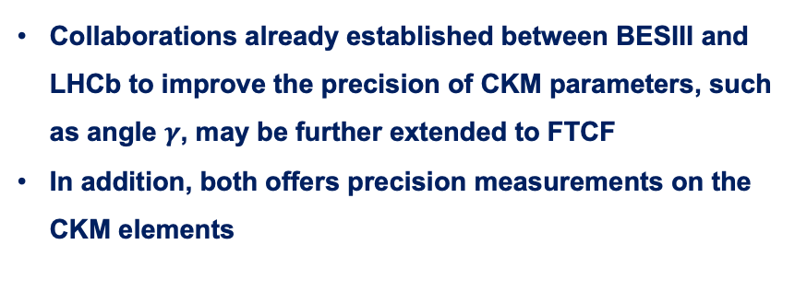
CKM physics
Unitarity test remains one of the main directions to probe NP beyond SM
Precision essential to constrain NP scenarios
Collaborations already established between BESIII and LHCb to improve the precision of CKM parameters, such as angle $γ$, may be further extended to FTCF
In addition, both offers precision measurements on the CKM elements
FTCF
LHCb
2025/11/27
UCAS Wenbin Qian
8

Slide 9
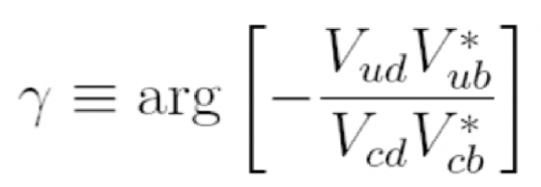
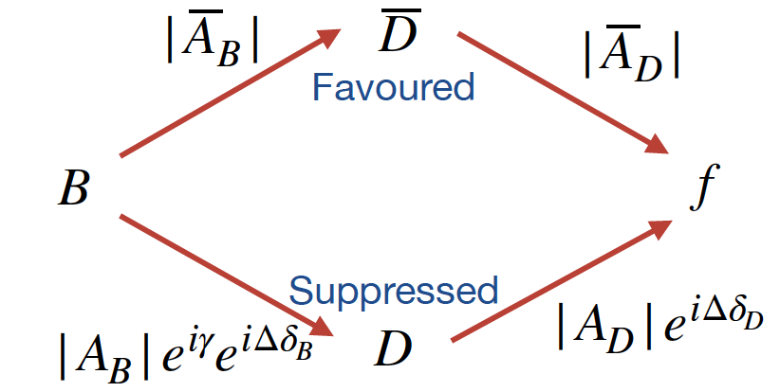
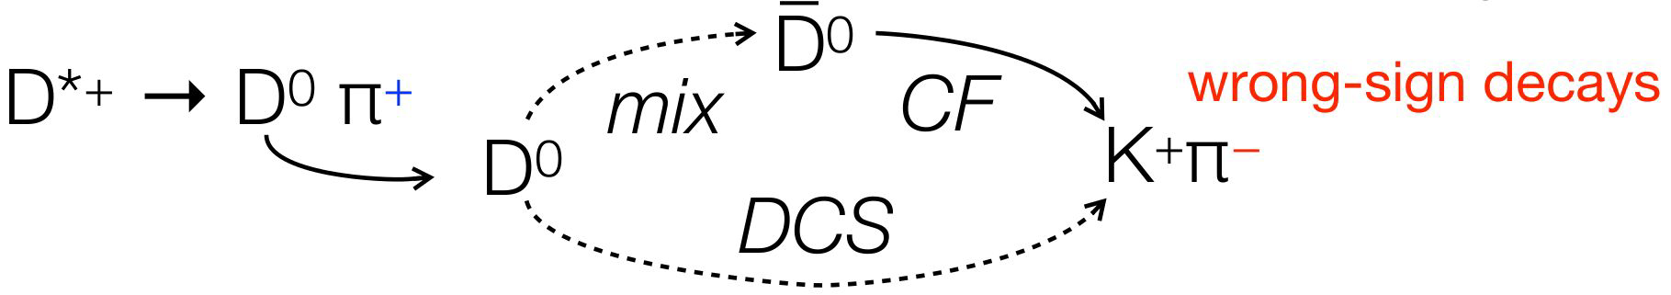


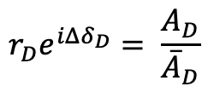







CKM angle $γ$
$b→c:$
$$\overline{A}\left(D\right):{\overline{D}}^{0}→f$$
$$r_{D}e^{iΔδ_{D}}= \frac{A_{D}}{{\overline{A}}_{D}}$$
$$A\left(D\right):D^{0}→f$$
$$D^{0}(\vec{p})$$
$b→u:$
$γ$ measurements
$$ψ\left(3770\right)$$
QC data
Charm mixing
$$\overline{D^{0}}(−\vec{p})$$
2025/11/27
UCAS Wenbin Qian
9

Slide 10
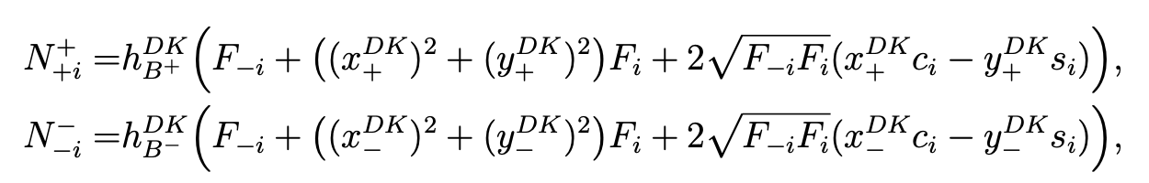

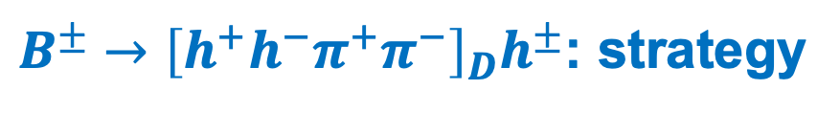

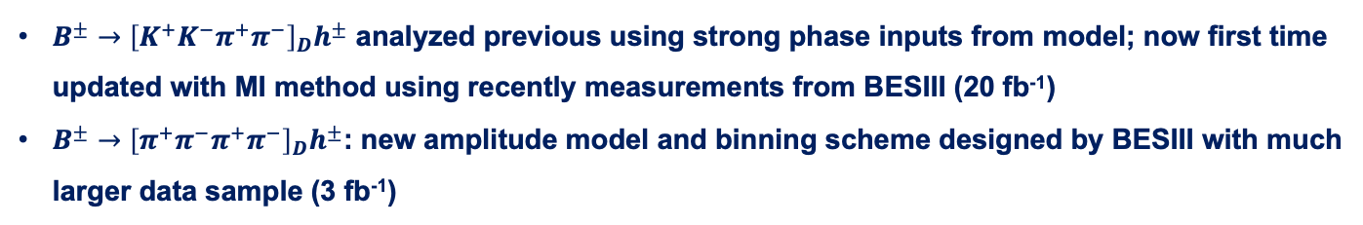
$B^{±}→{\left[h^{+}h^{−}π^{+}π^{−}\right]}_{D}h^{±}$: strategy
arXiv: 2509.15139
Constrained from $B^{±}→Dπ^{±}$
BESIII inputs
LHCb measurements (mass fit)
Fit parameters
where $γ$ enters
$B^{±}→{\left[K^{+}K^{−}π^{+}π^{−}\right]}_{D}h^{±}$ analyzed previous using strong phase inputs from model; now first time updated with MI method using recently measurements from BESIII (20 fb⁻¹)
$B^{±}→{\left[π^{+}π^{−}π^{+}π^{−}\right]}_{D}h^{±}$: new amplitude model and binning scheme designed by BESIII with much larger data sample (3 fb⁻¹)
2025/11/27
UCAS Wenbin Qian
10

Slide 11
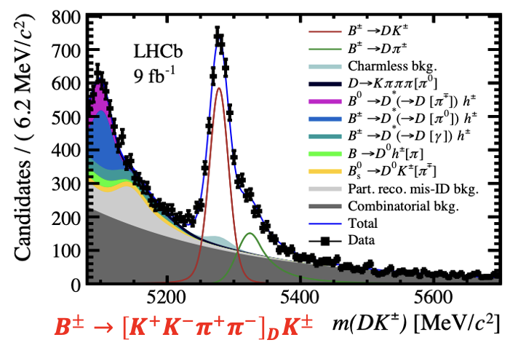
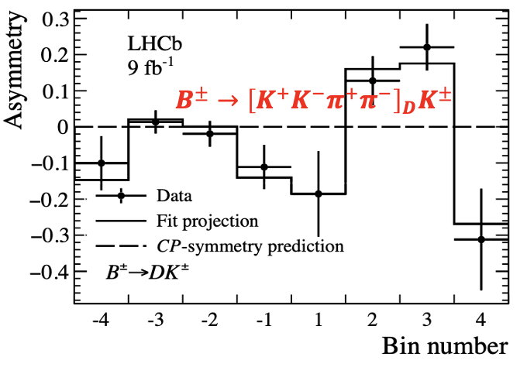
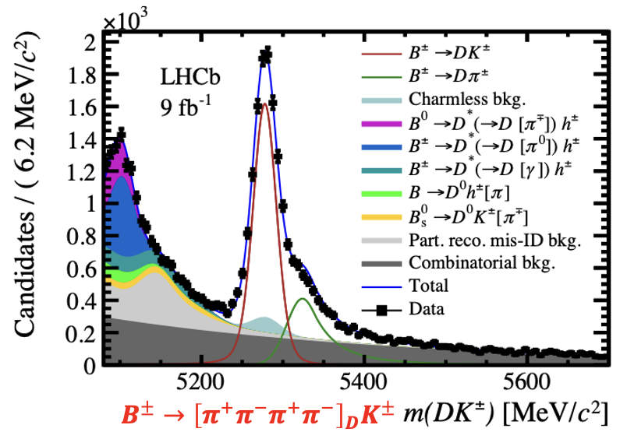
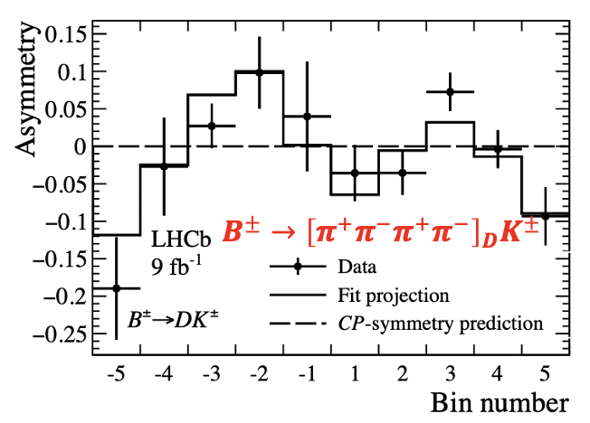
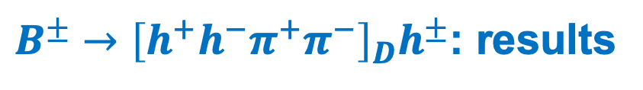
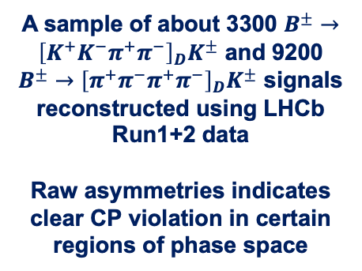
$B^{±}→{\left[h^{+}h^{−}π^{+}π^{−}\right]}_{D}h^{±}$: results
arXiv: 2509.15139
A sample of about 3300 $B^{±}→{\left[K^{+}K^{−}π^{+}π^{−}\right]}_{D}K^{±}$ and 9200 $B^{±}→{\left[π^{+}π^{−}π^{+}π^{−}\right]}_{D}K^{±}$ signals reconstructed using LHCb Run1+2 data
Raw asymmetries indicates clear CP violation in certain regions of phase space
Raw asymmetries
2025/11/27
UCAS Wenbin Qian
11

Slide 12
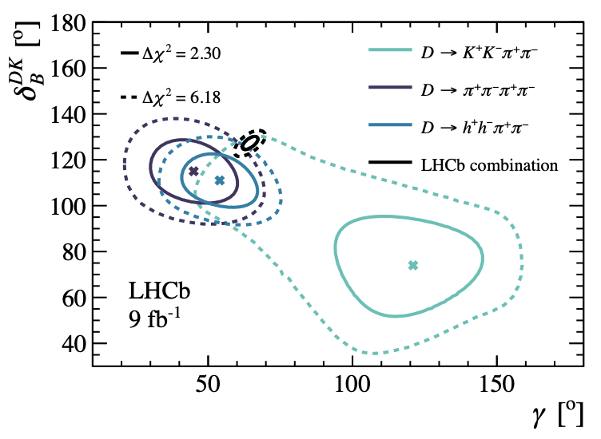
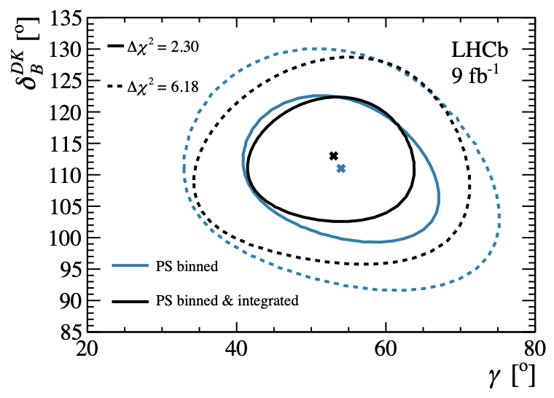
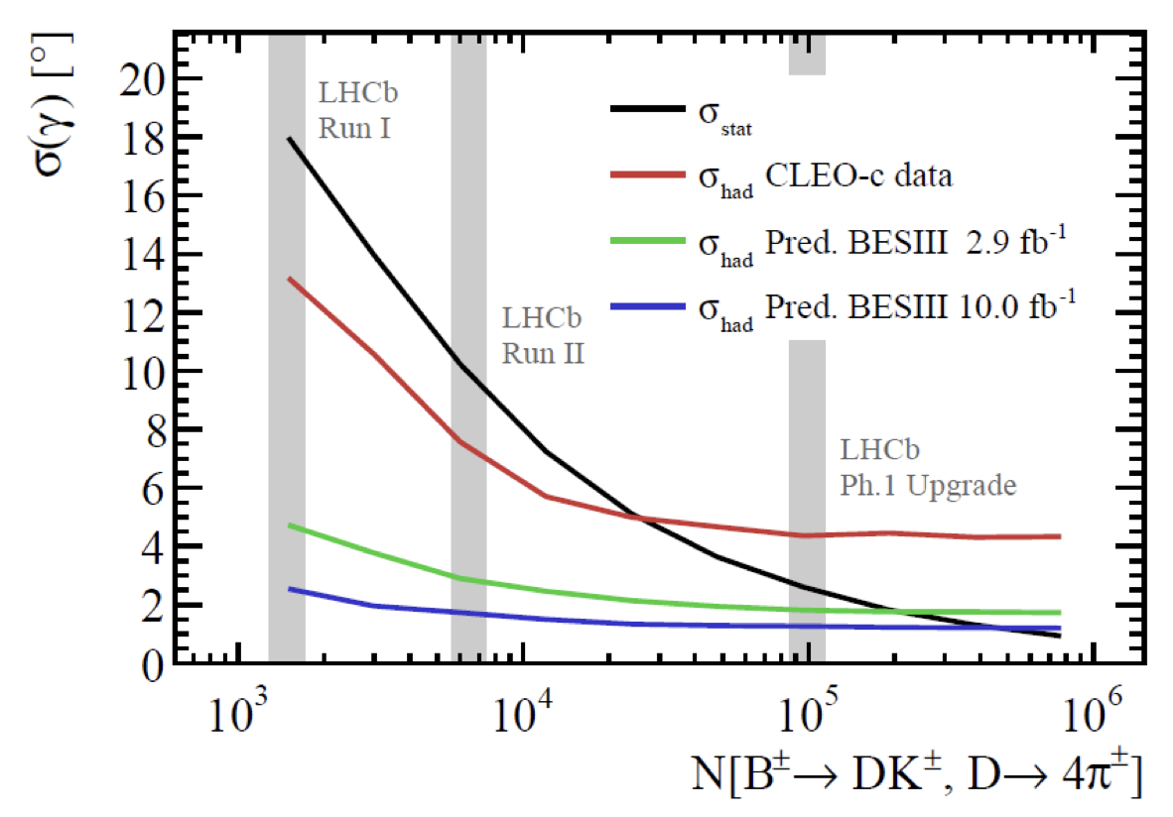
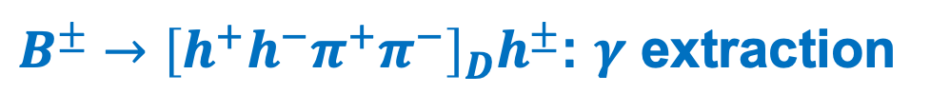
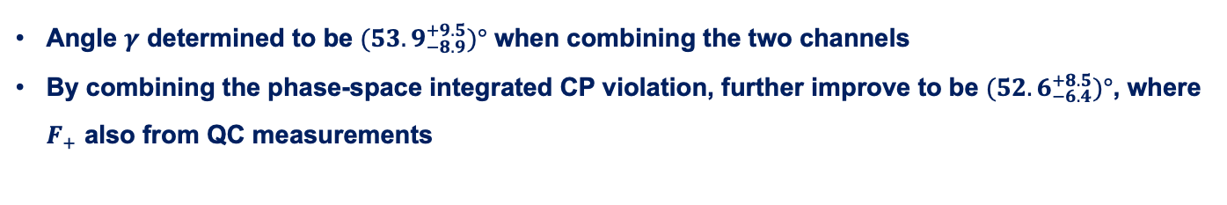
$B^{±}→{\left[h^{+}h^{−}π^{+}π^{−}\right]}_{D}h^{±}$: $γ$ extraction
arXiv: 2509.15139
Angle $γ$ determined to be $(53.9_{−8.9}^{+9.5})°$ when combining the two channels
By combining the phase-space integrated CP violation, further improve to be $(52.6_{−6.4}^{+8.5})°$, where $F_{+}$ also from QC measurements
From G. Wilkinson
Uncertainties from strong phase inputs as one of the dominant sources, further improvements from FTCF and $D$ mixing data from LHCb essential
2025/11/27
UCAS Wenbin Qian
12

Slide 13
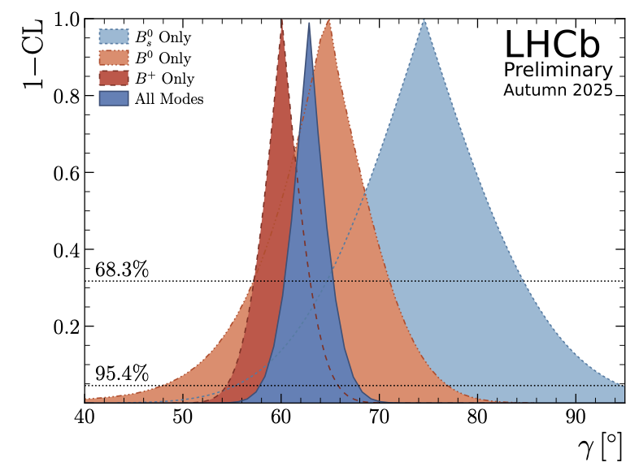
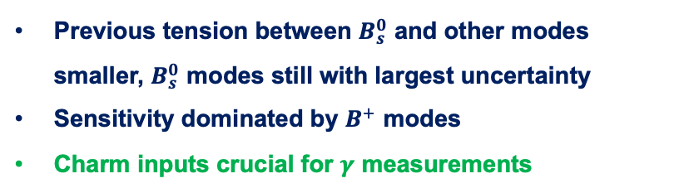


Global combination from LHCb
LHCb-CONF-2025-003
20 LHCb $B$ decay measurements + 12 $D$ decay measurements + 14 inputs from LHCb, HFLAV, BESIII and CLEO-c = 29 physics parameters of interest + additional nuisance parameters
$$γ={\left(62.8±2.6\right)}^{∘}$$
surpass LHCb design: $4^{∘}$
Previous tension between $B_{s}^{0}$ and other modes smaller, $B_{s}^{0}$ modes still with largest uncertainty
Sensitivity dominated by $B^{+}$ modes
Charm inputs crucial for $γ$ measurements
Advertisement: a new joint analysis between LHCb and BESIII may come out soon, stay tuned!
2025/11/27
UCAS Wenbin Qian
13

Slide 14
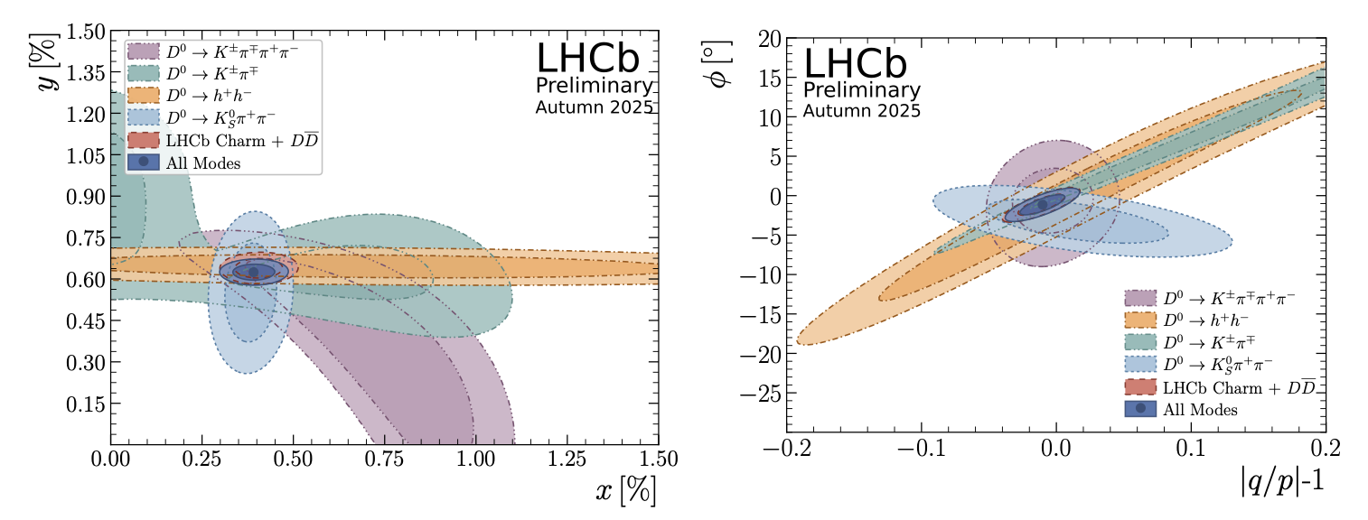
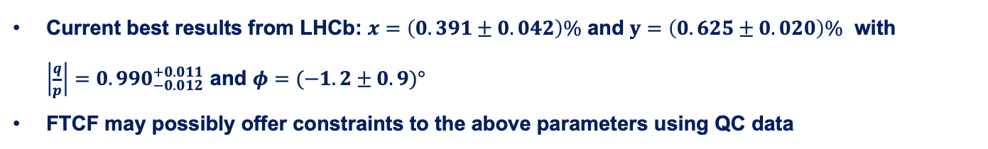
D mixing parameters
LHCb-CONF-2025-003
Strong parameters also essential for determine charm mixing parameters and CP violation quantities
Current best results from LHCb: $x=\left(0.391±0.042\right)\%$ and $y=\left(0.625±0.020\right)\%$ with $\left|\frac{q}{p}\right|=0.990_{−0.012}^{+0.011}$ and $φ=(−1.2±0.9)°$
FTCF may possibly offer constraints to the above parameters using QC data
2025/11/27
UCAS Wenbin Qian
14

Slide 15
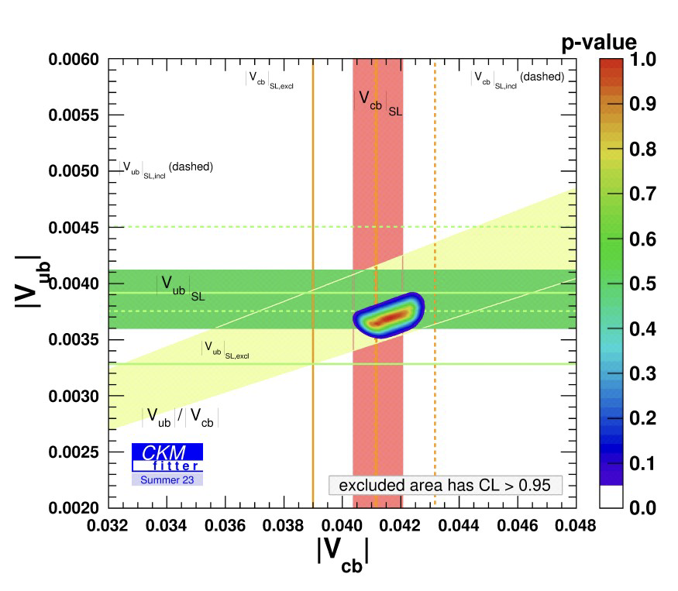
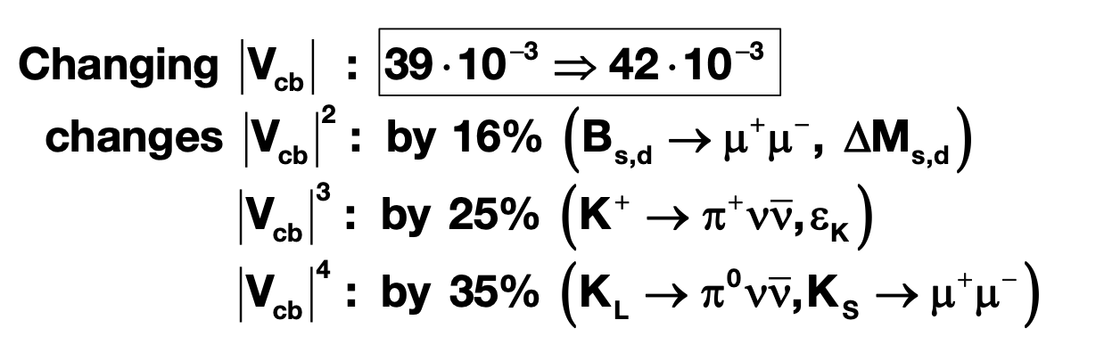

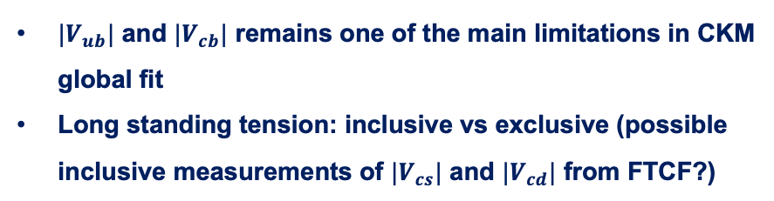
$$\left|V_{ub}\right|, |V_{cb}|$$
$|V_{ub}|$ and $|V_{cb}|$ remains one of the main limitations in CKM global fit
Long standing tension: inclusive vs exclusive (possible inclusive measurements of $|V_{cs}|$ and $|V_{cd}|$ from FTCF?)
inclusive
Disaster for new physics searches if CKM elements not precise
exclusive
CKMfitter group (http://ckmfitter.in2p3.fr)
From A. Buras
LHCb also plays a leading role despite difficulties in reconstructing missing particles and more precise in measuring ratios
PRL 126 (2021) 081804, JHEP 12 (2020) 124, PRD 101 (2020) 072004, NP 11 (2015) 743
2025/11/27
UCAS, Wenbin Qian
15

Slide 16
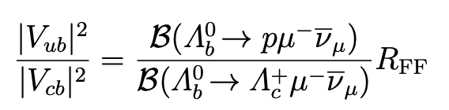
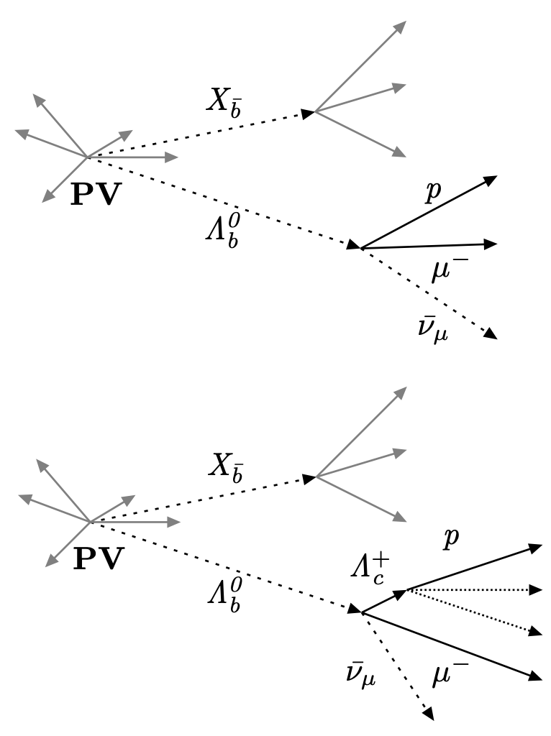
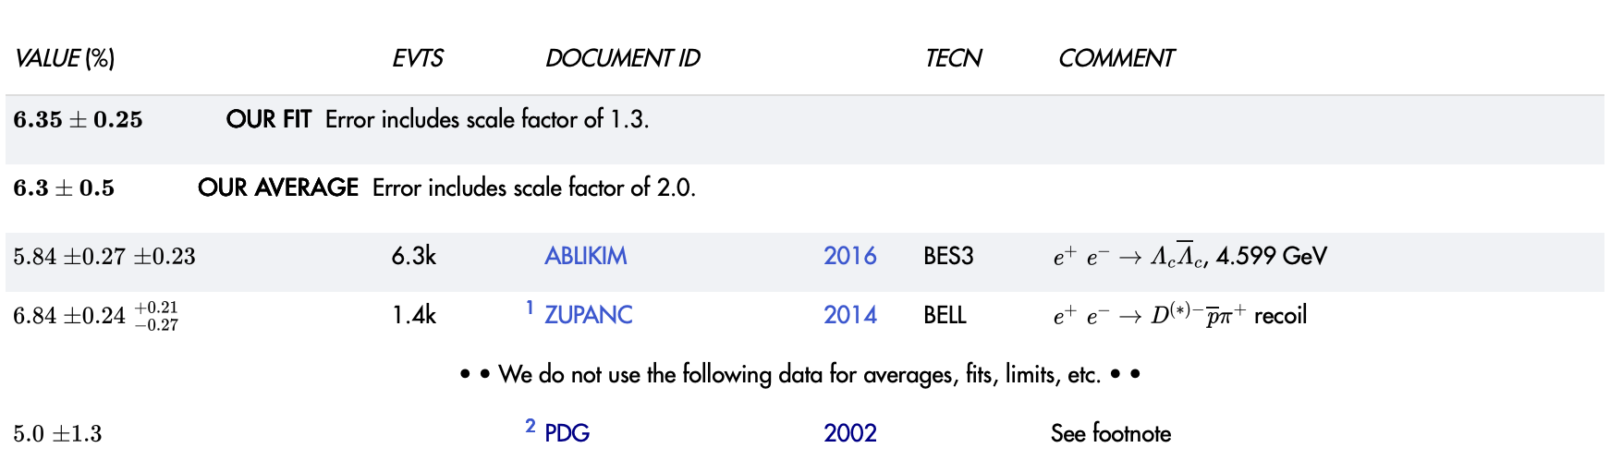
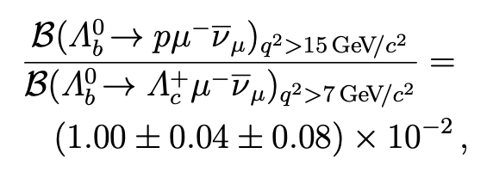


$\left|V_{ub}\right|, |V_{cb}|$: inputs from FTCF
Nature Physics 11 (2015) 743
Ratio between $\left|V_{cb}\right|$ and $|V_{ub}|$ determined using $Λ_{b}^{0}→pμ^{−}{\overline{ν}}_{μ}$ and $Λ_{b}^{0}→Λ_{c}^{+}μ^{−}{\overline{ν}}_{μ}$
Inputs from LQCD
$Λ_{c}^{+}$ reconstructed in $pK^{+}π^{−}$ final states, thus branching fraction essential inputs
$$5.0±1.3$$
Tension seen between BESIII and Belle measurements
Uncertainties still large
Contributing half of systematic uncertainties
2025/11/27
UCAS, Wenbin Qian
16

Slide 17
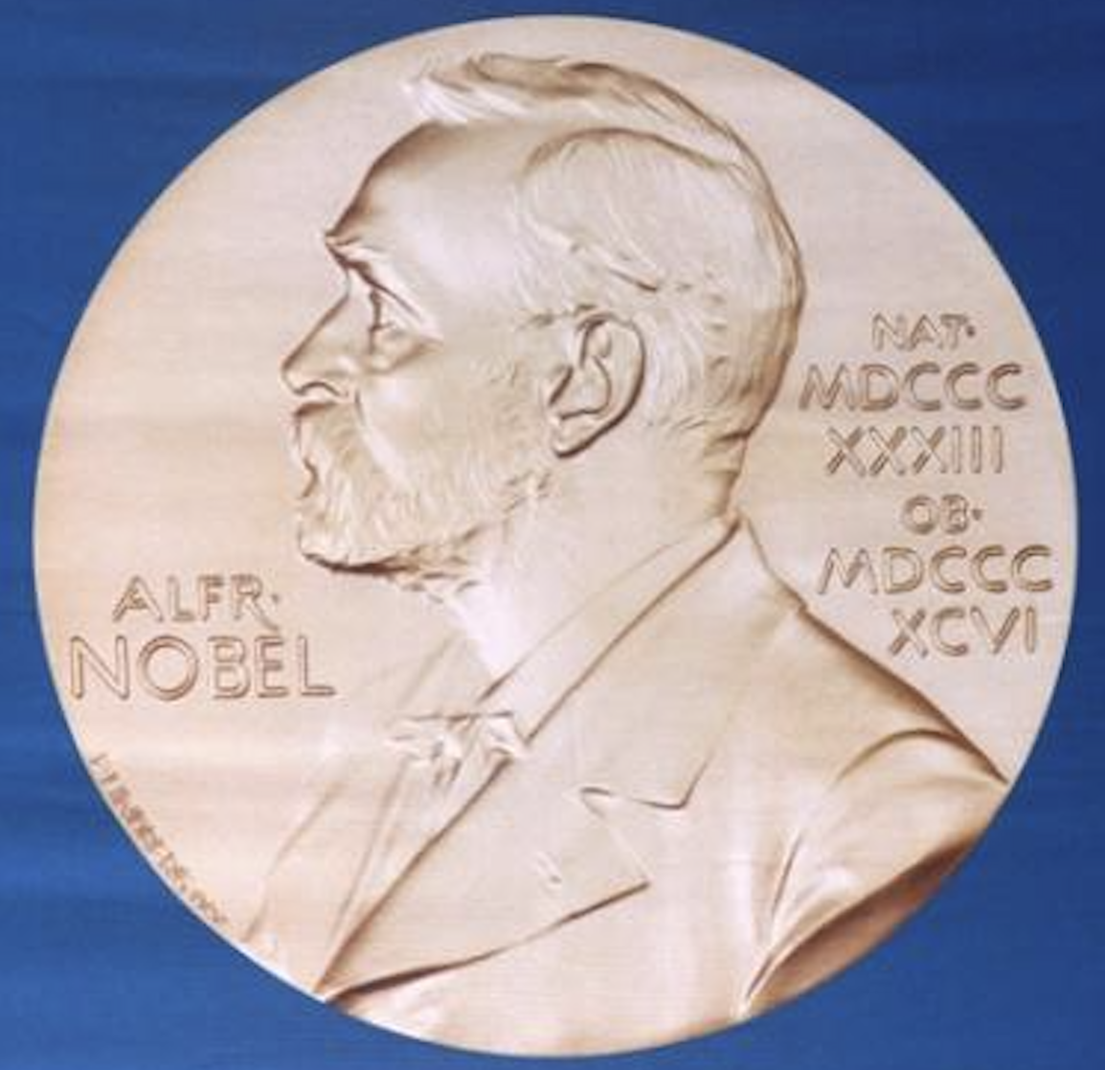
CP violation in baryon decays
CP violation in baryon decays finally established after 61 years of its discovery
1956, Parity violation, Lee, Yang & Wu
1973, CP violation mechanism, Kobayashi & Maskawa
2025, CP violation in baryon decays,
LHCb collaboration
1957
2008
1980
1964, CP violation, Cronin & Fitch
2008
2001, CP violation in B decays, Babar & Belle collaborations
However, CP violation in charmed baryons and hyperons still missing
Both can contribute and complementary to each other
2025/11/27
UCAS, Wenbin Qian
17

Slide 18
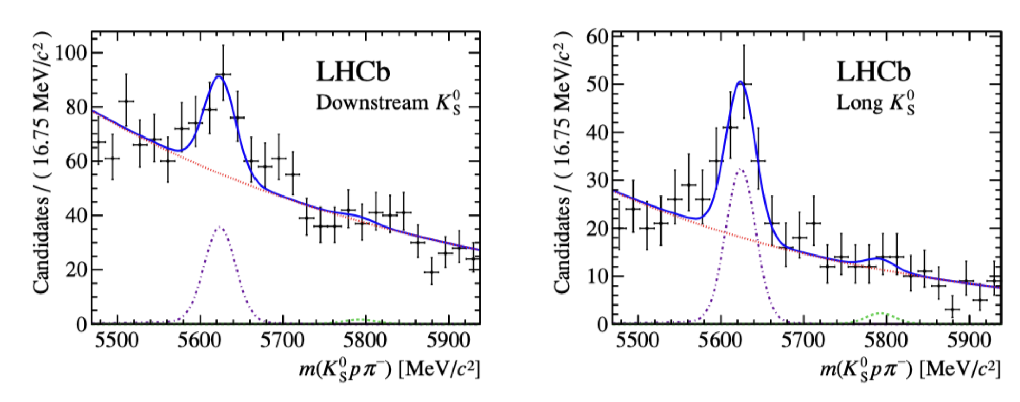
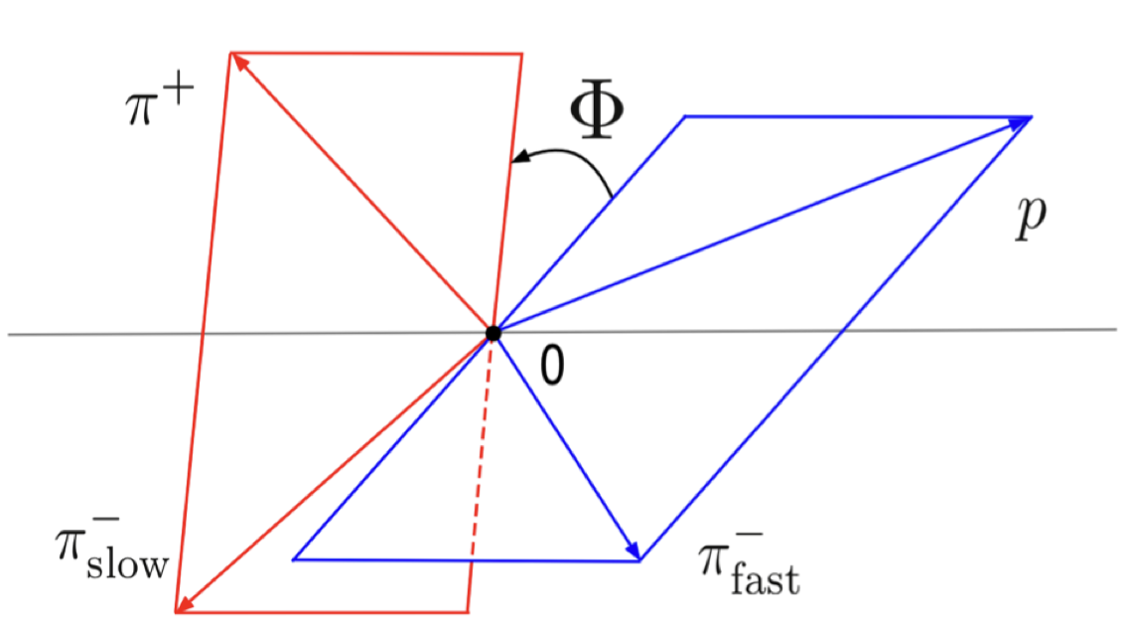
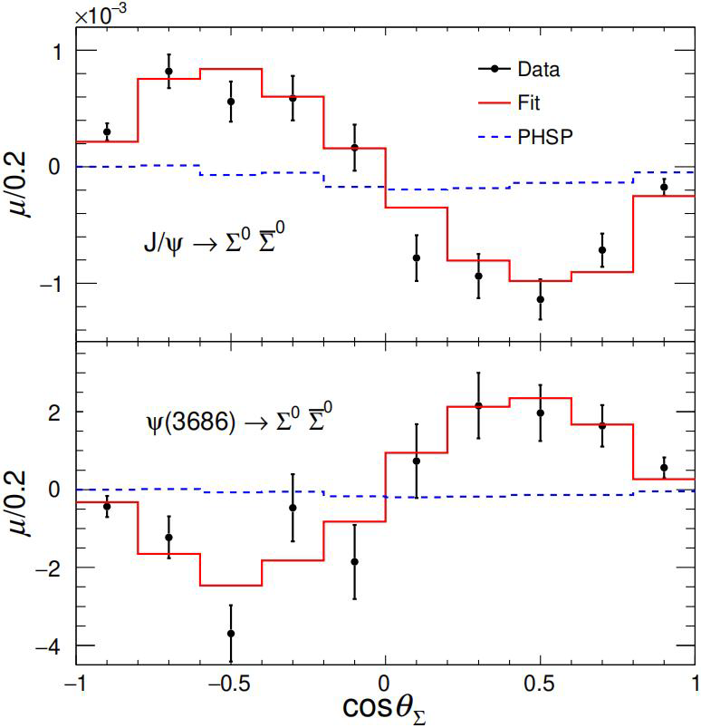
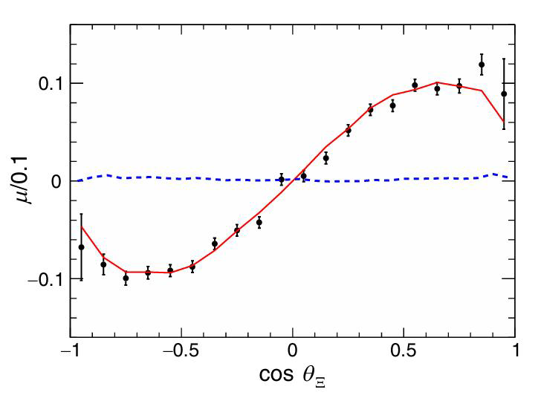




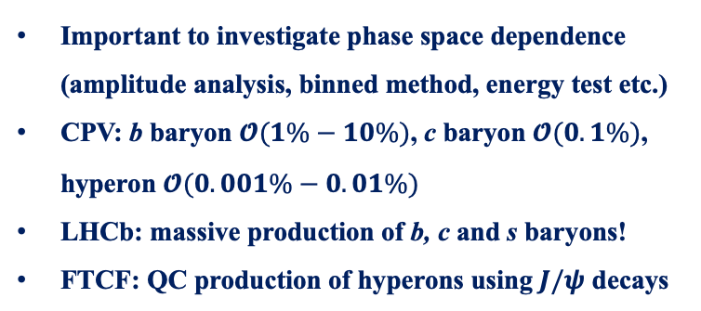
Methods to search for CP violation
JHEP04(2014)087
PRD108(2023)L011101
PRL133 (2024) 101902
Nature Phys.13(2017)391
Many methods have been explored to search for CP violation in baryon decays
Direct CP violation ($∝sin\left(Δδ_{ST}\right)sin(Δφ_{EW})$)
Triple-product asymmetry ($∝cos\left(Δδ_{ST}\right)sin(Δφ_{EW})$)
$$Λ_{b}^{0}→pK_{S}^{0}π^{−}$$
$$Λ_{b}^{0}→pπ^{+}π^{−}π^{+}$$
Decay parameters asymmetry
Important to investigate phase space dependence (amplitude analysis, binned method, energy test etc.)
CPV: b baryon $𝓞(1\%−10\%)$, c baryon $𝓞(0.1\%)$, hyperon $𝓞(0.001\%−0.01\%)$
LHCb: massive production of b, c and s baryons!
FTCF: QC production of hyperons using $J/ψ$ decays
$J/ψ$ $→Ξ^{0}{\overline{Ξ}}^{0}, Ξ^{0}→Λπ^{0}$
2025/11/27
UCAS Wenbin Qian
18

Slide 19
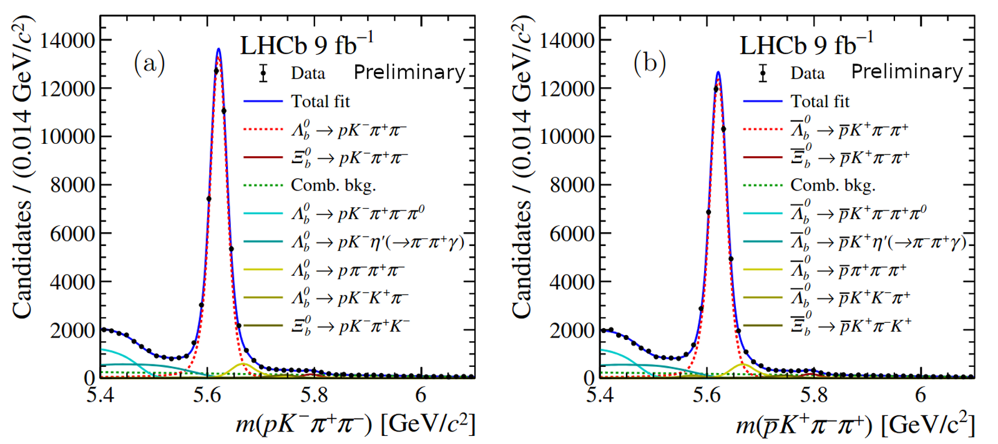


Observation of CP violation in baryon decays
Nature 643 (2025) 1223
CP symmetry violated by more than 5$σ$
2025/11/27
UCAS, Wenbin Qian
19

Slide 20

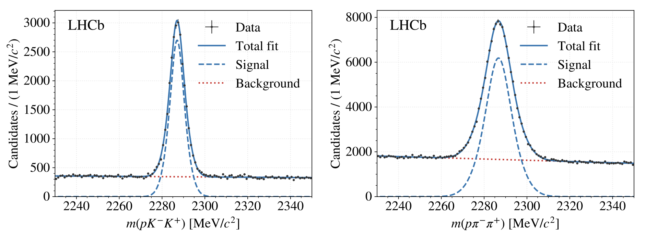

CP violation in charmed baryon decays
JHEP 03 (2018) 182
Published results only with Run1+2 data using samples from $H_{b}→Λ_{c}^{+}μ^{−}X$ (semi-leptonic)
24K
161K
Current efforts on prompt $Λ_{c}^{+}$ decays and secondary $Λ_{c}^{+}$ decays may reduce uncertainty by 1/10
CP violation from other $Λ_{c}^{+}$ decay may also yield interesting results
2025/11/27
UCAS, Wenbin Qian
20

Slide 21
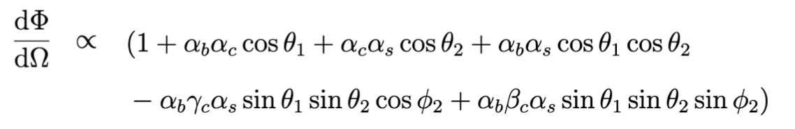









Decay parameter measurements
PRL 133 (2024) 261804
Several decay chains considered:
$$Λ_{b}^{0}→Λ_{c}^{+}{(→Λh^{+})h}^{−}, Λ→pπ^{−}$$
$$Λ_{b}^{0}→Λ_{c}^{+}{(→pK_{S}^{0})h}^{−}$$
$$α_{b}:Λ_{b}^{0}→Λ_{c}^{+}h^{−}$$
$$α_{c}:Λ_{c}^{+}→pK_{S}^{0}$$
$$α_{b}:Λ_{b}^{0}→Λ_{c}^{+}h^{−}$$
$$α_{c},β_{c},γ_{c}:Λ_{c}^{+}→Λh^{+}$$
$$α_{s}:Λ→pπ^{−}$$
2025/11/27
UCAS Wenbin Qian
21

Slide 22














Results of decay parameters
PRL 133 (2024) 261804
$$Λ_{b}^{0}→Λ_{c}^{+}(→pK_{S}^{0})h^{−}$$
$$Λ_{b}^{0}→Λ_{c}^{+}{\left(→Λh^{+}\right)π}^{−}$$
First determination of $α$ in $Λ_{b}^{0}→Λ_{c}^{+}h^{−}$ decays (precision $\sim 0.9\%$ for $Λ_{c}^{+}π^{−}$)
Most precise determinations of $α,(β,γ)$ in $Λ_{c}^{+}→pK_{S}^{0}$ (precision $\sim 1.4\%$) and $Λ_{c}^{+}→Λh^{+}$ decays
Confirmation of $α(Λ→pπ^{−})$ from BESIII (significantly higher than previous measurements)
Results consistent with no CP violation in both $A_{α}$ and $R_{β_{1}} (\text{precision} \sim 2\% \text{for} Λ_{c}^{+}π^{−})$
Pave the way for other decay parameter measurements (more sensitive)
Complementary programs in hyperon studies
$$Λ_{b}^{0}→Λ_{c}^{+}π^{−}$$
$$Λ_{c}^{+}→Λπ^{+}$$
$$Λ_{b}^{0}→Λ_{c}^{+}K^{−}$$
$$Λ_{c}^{+}→ΛK^{+}$$
$$Λ_{c}^{+}→Λπ^{+}$$
$$Λ_{c}^{+}→Λπ^{+}$$
$$Λ_{c}^{+}→ΛK^{+}$$
$$Λ_{c}^{+}→ΛK^{+}$$
$$Λ_{b}^{0}→Λ_{c}^{+}{\left(→Λh^{+}\right)π}^{−}$$
$$Λ_{b}^{0}→Λ_{c}^{+}{\left(→Λh^{+}\right)π}^{−}$$
2025/11/27
UCAS Wenbin Qian
22

Slide 23
Outline of the talk
Introduction
Complementary in CKM physics
Synergy in rare decay measurements
Common interests in exotic particle studies
Conclusions
2025/11/27
UCAS, Wenbin Qian

Slide 24






$R(D^{(∗)})$ measurements
PRL 134 (2025) 061801
PRD 108 (2023) 012018
Tension between measurements of $R(D)$ and $R\left(D^{∗}\right)$ between SM around $2.5σ$ and $2.3σ$
2D deviation around $3.8σ$
Two main ways for $τ$ reconstruction at LHCb: $τ^{−}→μ^{−}{\overline{ν}}_{μ}ν_{τ}$ and $τ^{+}→3π\left(X\right)ν_{τ}$
Recent LHCb results using 2 fb⁻¹ data from Run2:
Muonic:
Hadronic:
Future precisions down to around 1%
Main background, double charmed background with $D_{s}^{+}→3πX$
2025/11/27
UCAS, Wenbin Qian
24

Slide 25






Contributions from $D_{s}^{+}$ decays
PRD 108 (2023) 012018
$τ→3πν_{τ}$ mainly through $a_{1}^{+}(→ρ^{0}π^{+})$ while $D_{s}^{+}→3π(X)$ mainly through $η^{(′)}$ with small $a_{1}$ contribution
Anti-$D_{s}^{+}$ BDT, trained using $B^{0}→D^{∗−}τ^{+}ν_{τ}$ and $D_{s}^{+}→3π(X)$ simulation samples, to reject (distinguish) $D_{s}^{+}$ background (Information from $D_{s}^{+}$ decays thus crucial)
Data-driven method (reversed anti-$D_{s}^{+}$ cut)：FTCF inputs very helpful here
Systematic uncertainties due to $D_{s}^{+}$ decays contribute to 1/3 of the total one
fit
Similarly, information from $D$ decays also needed, though smaller than $D_{s}^{+}$
2025/11/27
UCAS, Wenbin Qian
25

Slide 26






Photon polarization
PRL 112 (2014) 161801
Photon from $b→sγ$ predominantly left-handed; significant right-handed component indicates NP
Up-down asymmetry proportional to photon polarization
Fit performed to extract $A_{ud}$ in four different regions
Non-zero photon polarization discovered with a significance of 5.2 $σ$
2025/11/27
UCAS, Wenbin Qian
26

Slide 27





Photon polarization: BESIII inputs
To extract $λ_{γ}$, $f_{h}=Im\left[\vec{n}∙\left(\vec{J}×{\vec{J}}^{∗}\right)\right]/{\left|\vec{J}\right|}^{2}$needed
PRL 125 (2020) 051802
Proposed to use up-down asymmetry in $D→K_{1}\left(1270\right)e^{+}ν_{e}$ to extract $f_{h}$ in region 1: ${A′}_{ud}=4f_{h}/3$
${A′}_{ud}=0.01±0.11$
Consistent with SM prediction ($0.092±0.022$), however, still statistically limited, FTCF data needed
PRL 135 (2025) 091801
2025/11/27
UCAS, Wenbin Qian
27

Slide 28
Outline of the talk
Introduction
Complementary in CKM physics
Synergy in rare decay measurements
Common interests in exotic particle studies
Conclusions
2025/11/27
UCAS, Wenbin Qian

Slide 29



Particle zoo 2.0
Many new hadrons discovered since the discovery of $χ_{c1}(3872)$ in 2003: renaissance and revolution?
30 new hadrons
LHC (mainly LHCb)
BESIII
+ 17 new hadrons from Belle (>35 from its start)
> 20 new hadrons since 2022 (only selected ones are shown)
Complementary between $e^{+}e^{−}$ and $b$-decay + $pp$ environments (small overlaps)
More than 140 new hadrons
2025/11/27
UCAS, Wenbin Qian
29

Slide 30









A history of understanding
$c\overline{c}(X)$ + $c\overline{s}(X)$
More states
Better understanding
Unified model for all hadrons?
$$c\overline{c}g$$
$$c\overline{c}$$
+
$$c\overline{c}qq$$
+
+
$$c\overline{c}$$
$$qq$$
+ …
Particle X =
$$cq$$
$$\overline{c}q$$
2025/11/27
UCAS, Wenbin Qian
30

Slide 31





Structure of $χ_{c1}(3872)$：global efforts
Properties extensively studied, usually leading to different conclusions
Mass: very close to $D^{0}{\overline{D}}^{∗0}$, $m_{D^{0}}+m_{{\overline{D}}^{∗0}}−m_{χ_{c1}\left(3872\right)}=0.01±0.14$ MeV
Width: narrow width (0.1~1 MeV)
$J^{PC}$: $1^{++}$
Decay: $D^{0}{\overline{D}}^{∗0}$ (~35%), $J/ψω$ (~4%), $J/ψρ$ (~3%)
Production: $pp, p\overline{p}, B$ decays, $pP$b, PbPb
Molecular like
Charmonium like
$$c\overline{c}$$
+
$$c\overline{c}qq$$
+
$$cq$$
$$\overline{c}q$$
+
$$c\overline{c}$$
$$qq$$
$χ_{c1}(3872)$ =
Can we determine contributions of different components?
2025/11/27
UCAS, Wenbin Qian
31

Slide 32
















Structure of $χ_{c1}(3872)$
JHEP 11 (2024) 121
PRL 124 (2020) 242001
$$J/ψ$$
$$ψ(2S)$$
Photon to probe its structure
$${ψ→μ}^{+}μ^{−}$$
$${ψ→e}^{+}e^{−}$$
$<0.59 @$ 90 C.L.
$$c\overline{c}$$
$$D{\overline{D}}^{∗}$$
$$1.67±0.25$$
2025/11/27
UCAS, Wenbin Qian
32

Slide 33





Observation of $T_{c\overline{c}\overline{s}1}$
PRL 127 (2021) 082001
PRL 126 (2021) 102001
BESIII observed a narrow state: $T_{c\overline{c}\overline{s}1}{\left(3985\right)}^{+}$ decaying into $D_{s}^{+}{\overline{D}}^{∗}+\overline{D}D_{s}^{∗+}$ with quark content $c\overline{c}s\overline{u}$
Similarly, LHCb observed two broad states: $T_{c\overline{c}\overline{s}1}{\left(4000\right)}^{+}$ and $T_{c\overline{c}\overline{s}1}{\left(4220\right)}^{+}$ with same quark content
$m\left(Z_{cs}{\left(4000\right)}^{+}\right)=\left(4003±6_{−14}^{+ 4}\right)$ MeV
$Γ\left(Z_{cs}{\left(4000\right)}^{+}\right)=(131±15±26)$ MeV
Whether the two same states or not still under debate
If the same, future data to test its underlying mechanics?
2025/11/27
UCAS, Wenbin Qian
33

Slide 34





Amplitude analysis tools
Amplitude analyses: key to flavor physics
AI? QC?
Larger and larger data size: BESIII now collects 10B $J/ψ$ sample; 10$×$ more data from LHCb (~2030); Belle II, 50$×$ Belle (~2030); FTCF 100 $×$ more than BESIII
More and more complicated amplitude analyses;
Common languages between different measurements and theorists
？
TF-PWA + COMPWA + LAURA+…
2025/11/27
UCAS, Wenbin Qian
34

Slide 35
Prospects on flavor physics programs
Belle II
0.4 ab⁻¹
1 ab⁻¹
10 ab⁻¹
50 ab⁻¹
250 ab⁻¹
2019-2022
2024-2032
Run 1
LS1
Run 2
LS2
Run 3
upgrade
2015-2018
2019-2022
2022-2026
2027-2029
2030-2033
2034-2035
2036-future
Run2
LS2
Run3
LS3
Run4
LS4
Run5-6
Phase I
Upgrade
Phase Ib
Upgrade
Phase II
Upgrade
LHCb
20+ fb⁻¹
50 fb⁻¹
300 fb⁻¹
HL-LHC
CMS/ATLAS
200 fb⁻¹
3000 fb⁻¹
BESIII/super $τ$-charm/CEPC
BEPCII upgrade + running of super $τ$-charm/CEPC
2025/11/27
UCAS, Wenbin Qian

Slide 36
Conclusion
Physics programs of LHCb and BESIII, FTCF complementary to each other
Communications and cooperations important for understanding of fundamental questions
Thank you for your attention!
2025/11/27
UCAS, Wenbin Qian

