Slide 1
AHCAL Test Update
Heng Yang¹,
Hongbin Diao², Zhen Hu¹, Jianbei Liu², Hao Liu², Yasuhiro Maruya³, Hidetoshi Otono⁴, Zhongtao Shen², Zhen Wang², Jiaxuan Wang², Chengjun Zhang², Shunliang Zhang¹, Yunlong Zhang²
¹ Department of Physics, Tsinghua University, China
² State Key Laboratory of Particle Detection and Electronics, University of Science and Technology of China
³Tokyo Institute of Technology, Japan
⁴Kyushu University, Japan
July 22, 2025
Notes:
7/22/25
1

Slide 2
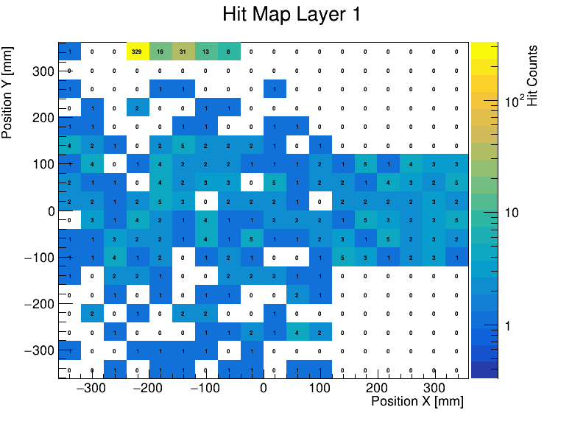
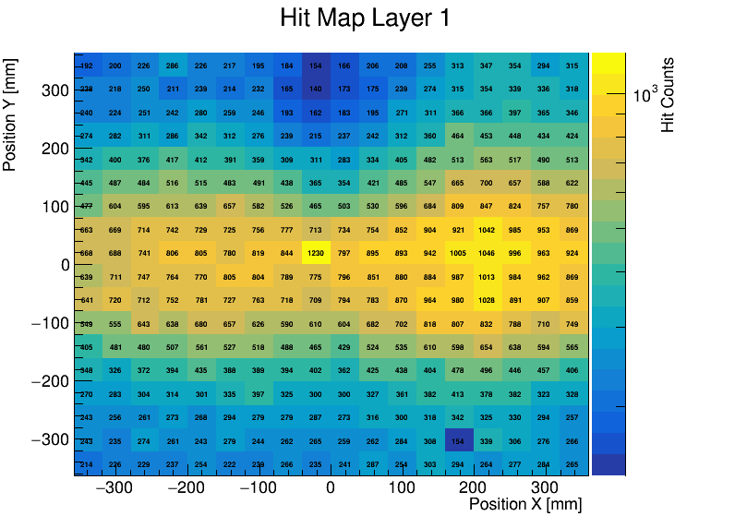
Non-Responsive Chips in Layer 1 – Issue Resolved
Previously, after connecting a LEMO connector to Layer 1, Chip 0 and Chip 6 did not record any data.
After reconnecting the DIF board to the sensitive layer, the issue was resolved, and both chips now function correctly.
Run234 (several minutes)
Run400 (12.5 hours)
Notes:
7/22/25
2

Slide 3
Hardware Issue-Layer 38 and Layer 6
Layer 38: Based on Hao Liu’s inspection, the issue seems to be with the HBU rather than the DIF board. We will reconnect it and re-check the HV settings to confirm.
Layer 6: In runs where the “No hit after 1 second” issue occurred, hits were sometimes recorded only in Layer 6.
→ After disconnecting Cable 38 and skipping Layer 38, the issue disappeared, and Layer 6 no longer exhibited abnormal behavior.
Notes:
7/22/25
3

Slide 4
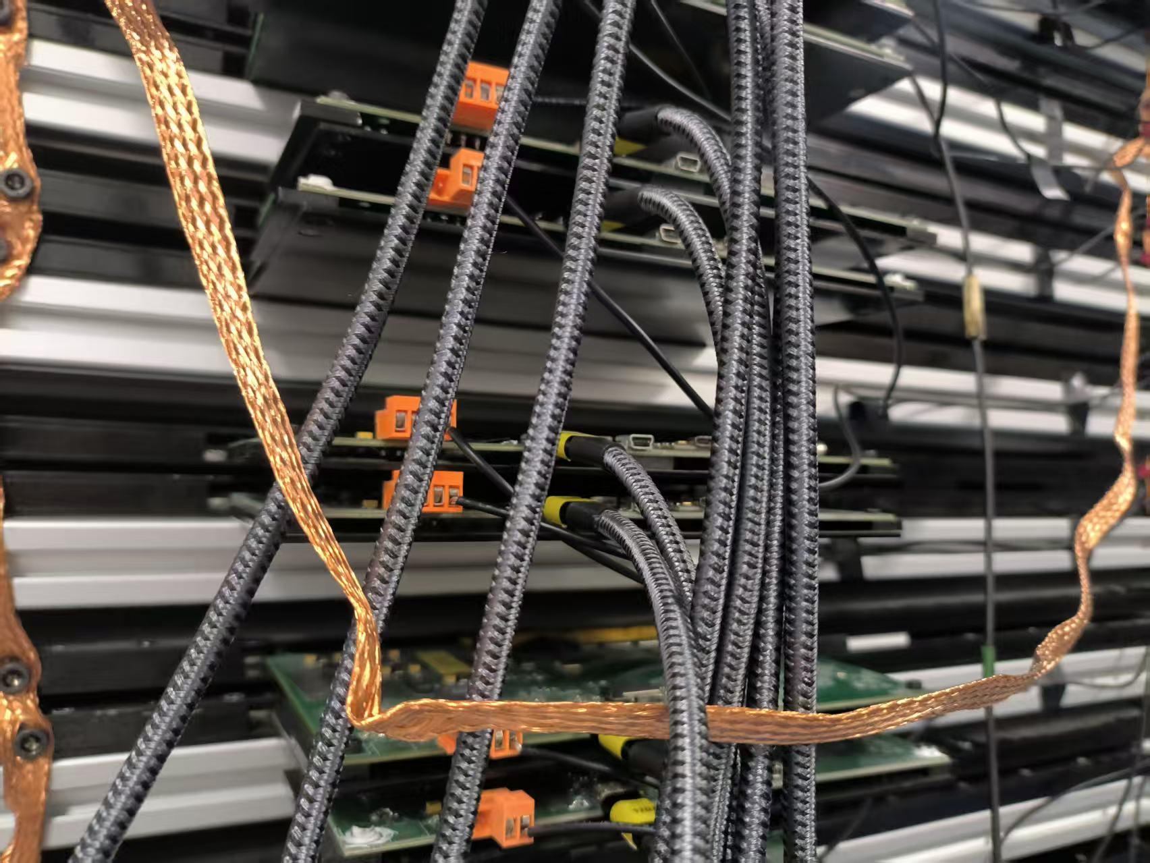
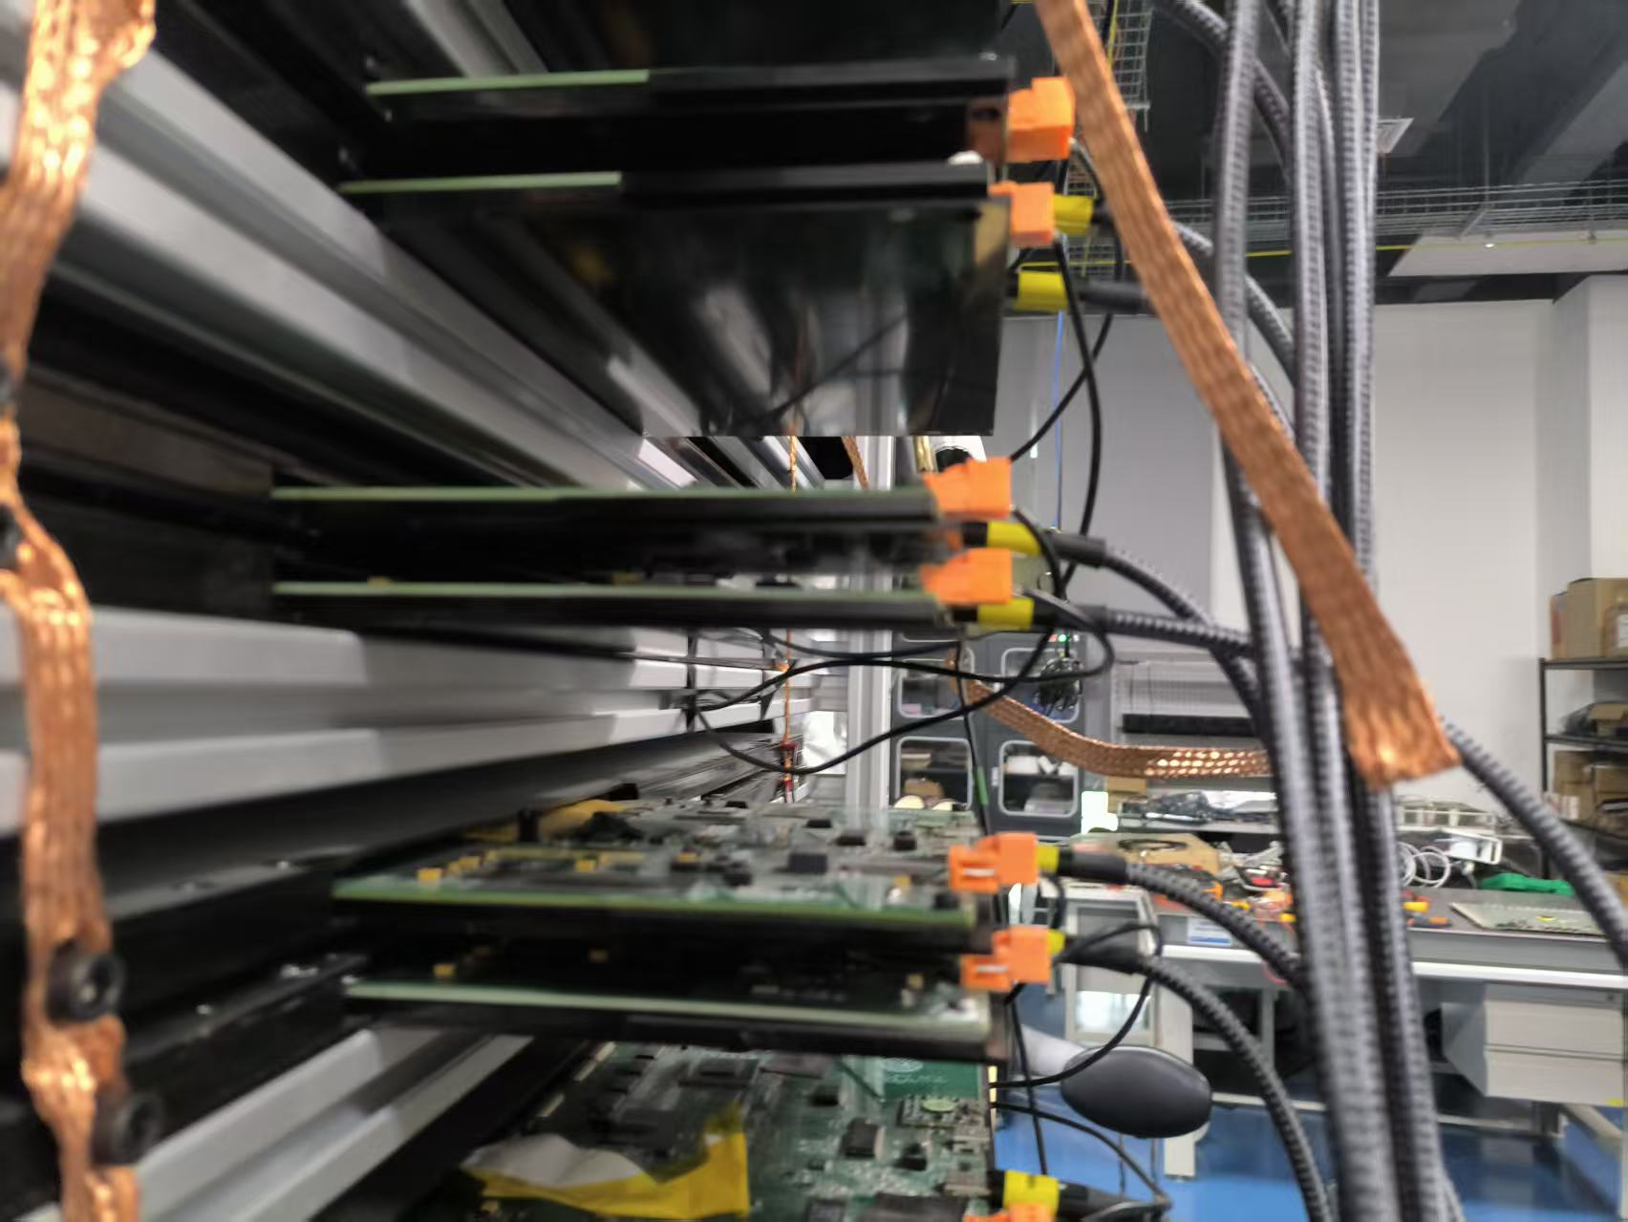
Layer 9 Footer Loss Resolved
Layer 9 footer loss appears to be caused by poor cable contact.
After supporting the USB-C cable at a specific angle, the issue disappeared.
  → Should we consider replacing the USB-C port on Layer 9?
Notes:
7/22/25
4

Slide 5
Layer 35 Footer Loss Issue
Layer 35 presents a more complex issue:
  Replugging the cable temporarily improved the performance.
  However, after rebooting, the problem returned and caused a noticeable drop in trigger rate.
  Interestingly, stopping and restarting the run allowed the layer to recover—but its behavior remains unstable.
During a ~9-hour run last night (starting when Layer 35 appeared stable), the system performed quite well overall.
Event Statistics: Total events: 6,298,476; Events with incomplete structure: 41
Layer Footer Loss Breakdown
  1 case each: Layers 15, 17, 18, 20, 23, 24, 31, 32, 33
  2 cases: Layer 36
  4 cases: Layer 39
  22 cases: Layer 35
No issues were observed in Layer 9.
Layer 35 still showed the most footer losses (22 cases), although its stability has significantly improved compared to earlier runs.
Notes:
7/22/25
5

Slide 6
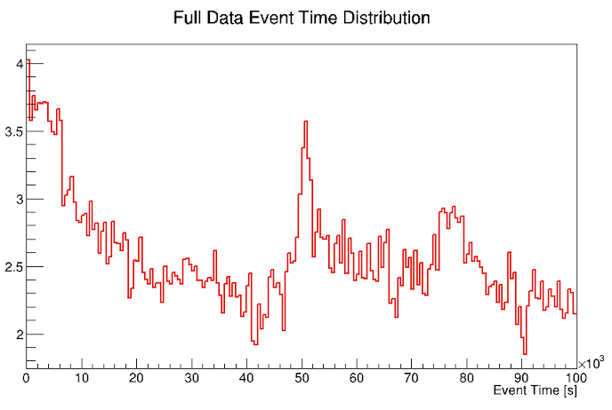
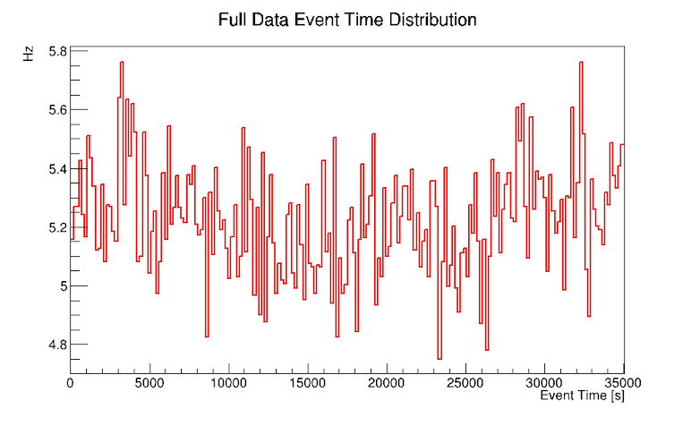
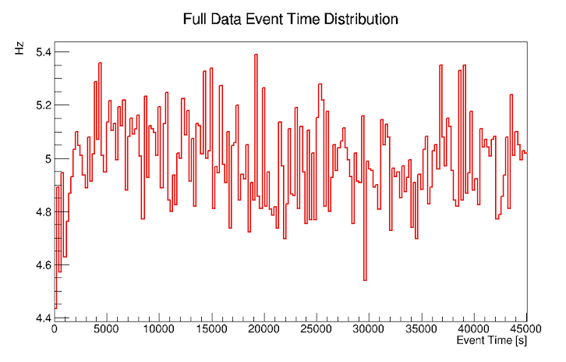
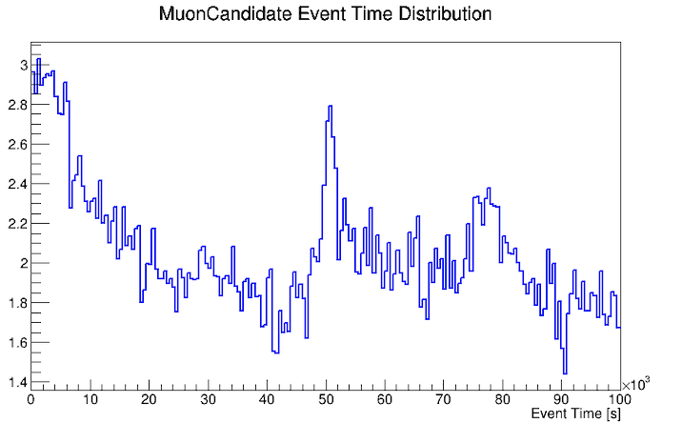
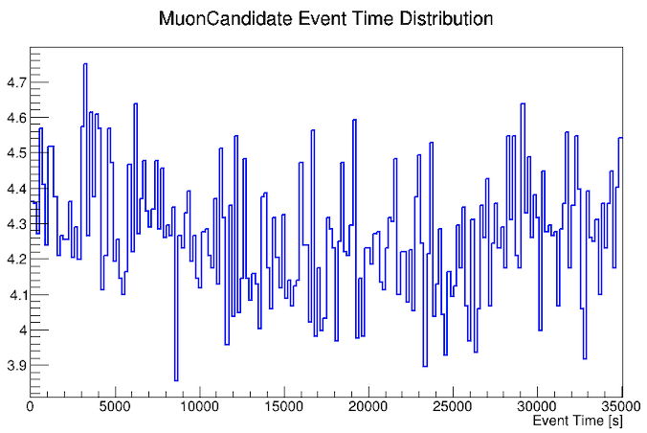
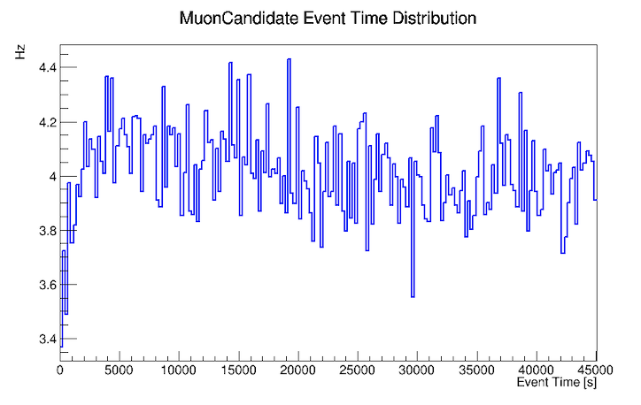
Trigger Rate Stability
Trigger Rate Observations
  Run 236 (~72h): A periodic increase followed by a gradual decrease in trigger rate was observed.
  Run 354 (~9h) and Run 400 (~12.5h): Trigger rate remained stable throughout.
The main difference is that Cable 38 was disconnected in the latter two runs.
Run 236
Run 354
Run 400
Notes:
7/22/25
6

Slide 7
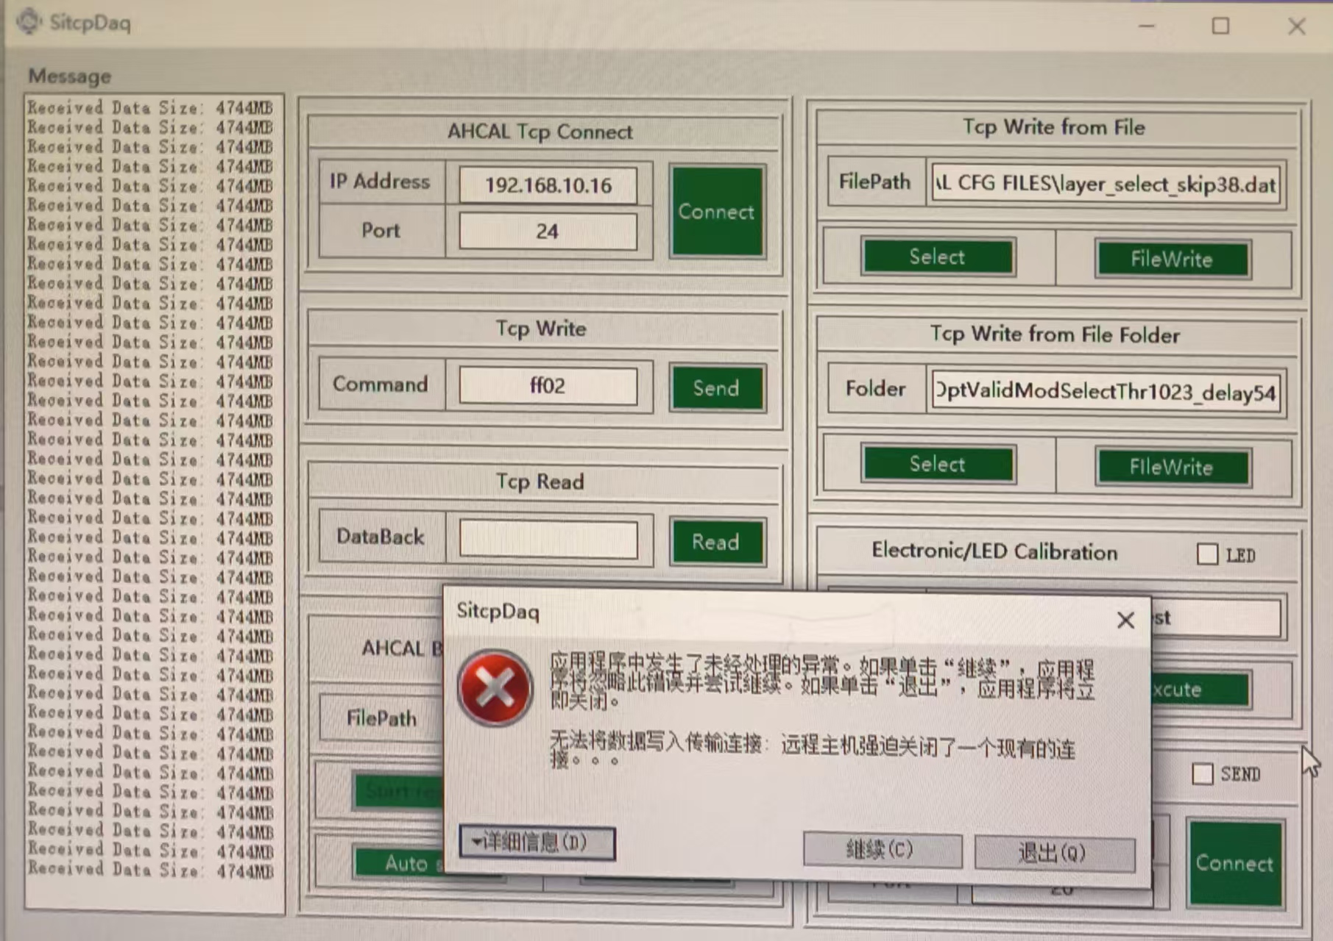
New DAQ Software Issue
      DAQ Software Interruption
        In Run 400 (started 21:31 on July 21), the DAQ software was interrupted at 06:24 the next morning.
        This issue did not occur in previous long runs.
        The only new condition was starting the temperature monitoring, though it was done on a different laptop.
      We may need to investigate whether temperature monitoring interferes with DAQ operations.
Notes:
7/22/25
7

Slide 8
Thank You
Notes:
7/22/25
8

