Slide 1

CEPC ECAL KEK ANALYSIS
李想，刁洪滨
2025.7.22

Slide 2
motivation：
Select MIP events from the electron beam data
strategy:
Apply Hough transform to identify tracks with minimal shower activity

Slide 3
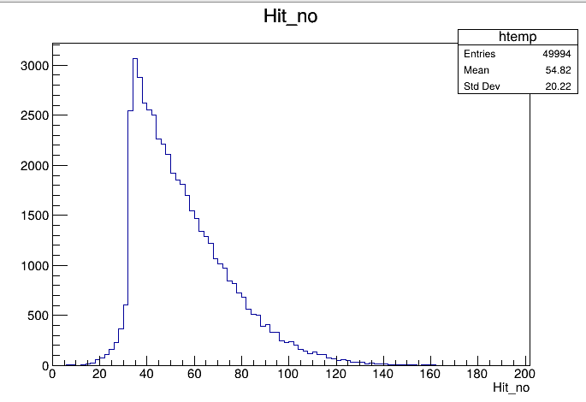
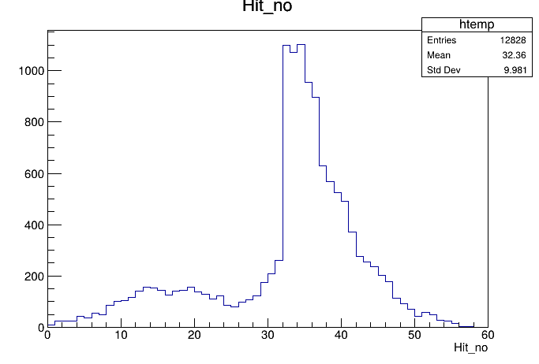
MC_Truth
Selection method
Total number of hits per event in the detector(25<Hit_no<37) ratio=0.16
single layer hit_no<3 :layer0-12 ratio>0.9; layer28-31:ratio<0.6
Hough Transform :sum_dist<750mm ratio=0.256
MC_Truth with all layers
Notes:
This is a rough summary of Run142.

Slide 4
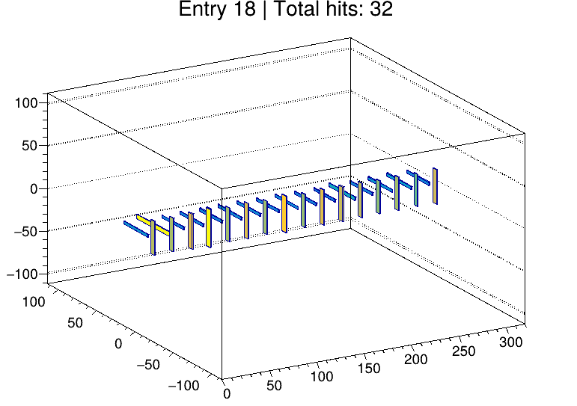
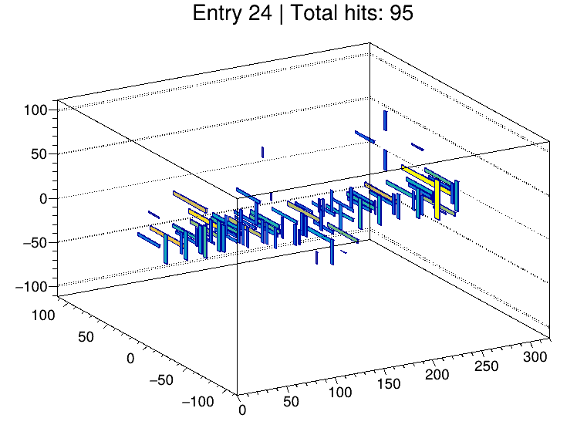
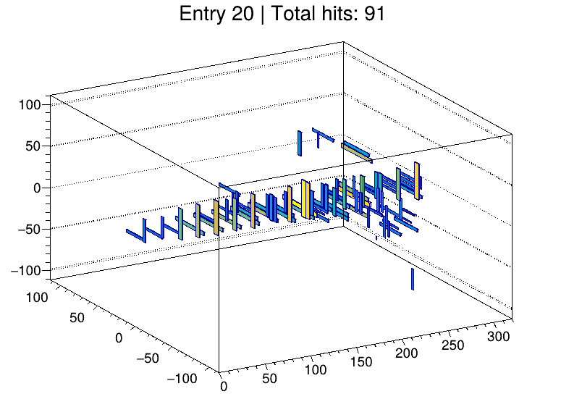
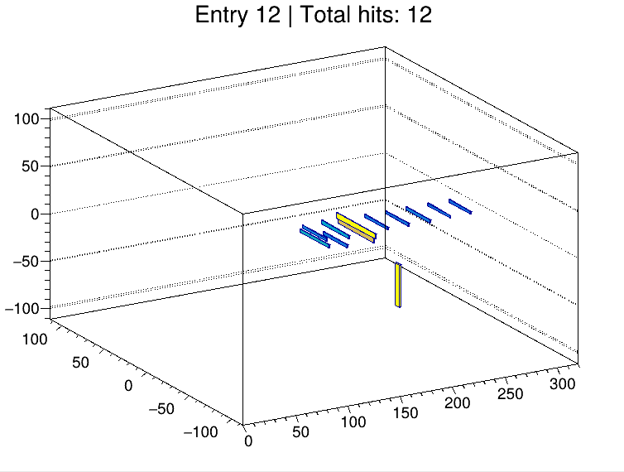
MC_Truth——Typical hit pattern
Typical MIP event
Hits are observed around the reconstructed track
A shower develops in the downstream layers.
Events with a small number of hits
Notes:
This is a rough summary of Run142.

Slide 5
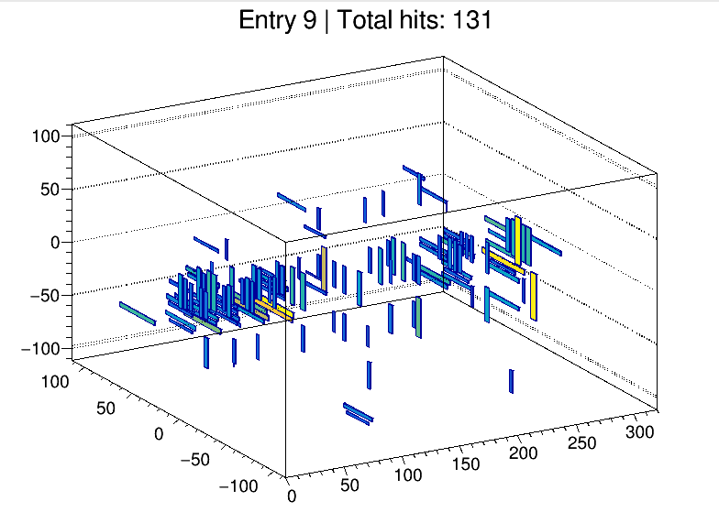
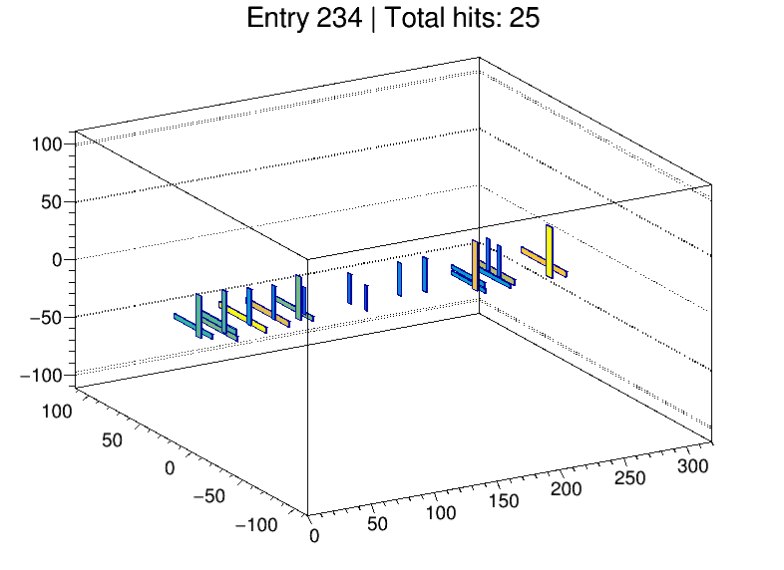
Raw data
Run 171 , Without Absorber
Beam Center:(525，910)
layer_except_10_11_14_15_20_21_26_27
Hough Transform
Notes:
This is a rough summary of Run142.

Slide 6
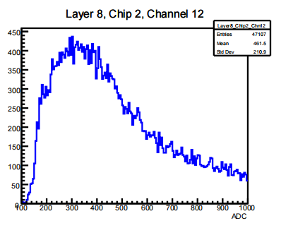
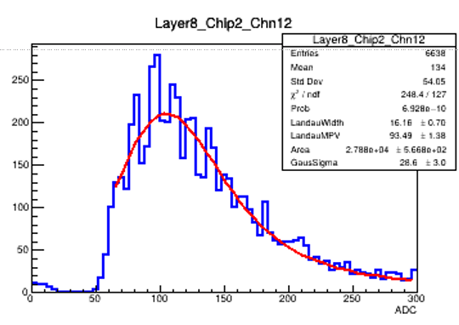
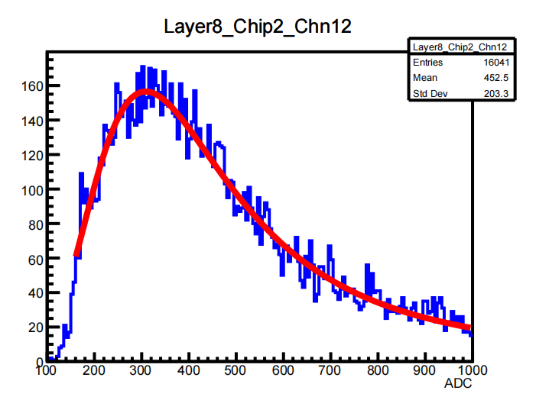
Hough Transform
Before
Method
Apply two-stage Hough transform for track reconstruction.
Use only the first 4 layers in both stages to suppress noise from deeper layers.
Select events with more than 2 hits in the first 4 layers.
Data Processing
Remove noise hits far from the reconstructed track.
Select events with total hit counts (hit_no>20).
Add distances between each hit and the reconstructed track(sum_dist<750)
Fitting
Landau-Gaussian convolution function to extract the MPV.
After
Notes:
We apply a two-stage Hough transform to reconstruct tracks. The first Hough transform scans a wide range of angles to identify rough track candidates. The second transform refines the track parameters with higher resolution. Due to significant noise in the deeper layers, both transforms use only the first four layers. Events with more than two hits in the first four layers are selected.
For data processing, we remove noise hits that deviate significantly from the identified track. Events with a total number of hits between 20 and 25 are selected for further analysis.
Fit the energy distribution with a Landau-Gaussian convolution function to extract the most probable value (MPV).
For runs 142 to 169, a cabling issue caused reversed channel positions in some super-layers — e.g., channels 4 and 5 were connected as 5 and 4. This will be manually corrected in the data later.
Subtract pedestal

Slide 7
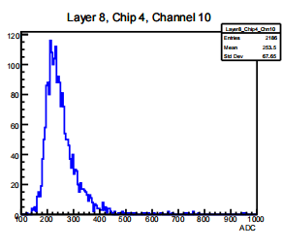
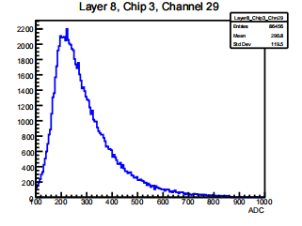
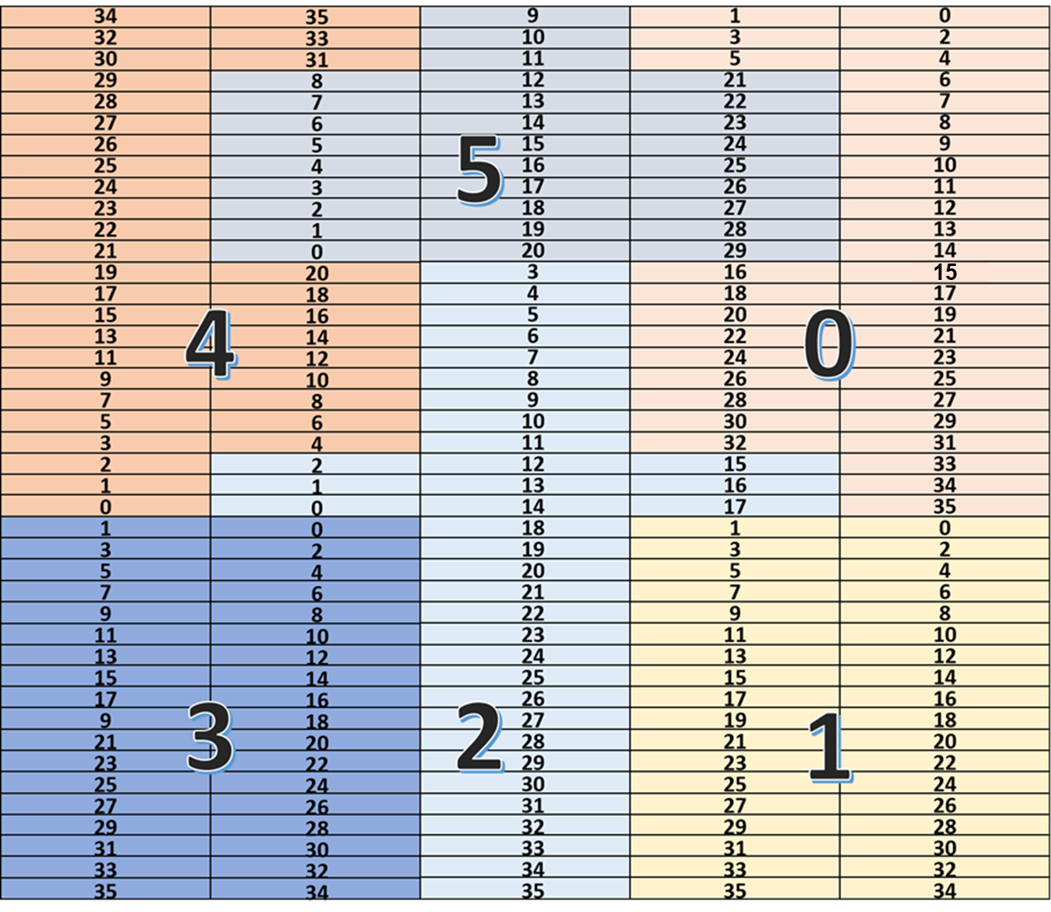
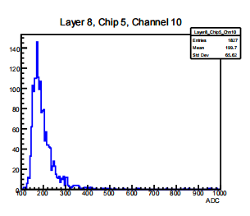
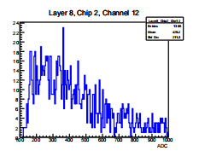
Noise
Notes:
We apply a two-stage Hough transform to reconstruct tracks. The first Hough transform scans a wide range of angles to identify rough track candidates. The second transform refines the track parameters with higher resolution. Due to significant noise in the deeper layers, both transforms use only the first four layers. Events with more than two hits in the first four layers are selected.
For data processing, we remove noise hits that deviate significantly from the identified track. Events with a total number of hits between 20 and 25 are selected for further analysis.
Fit the energy distribution with a Landau-Gaussian convolution function to extract the most probable value (MPV).
For runs 142 to 169, a cabling issue caused reversed channel positions in some super-layers — e.g., channels 4 and 5 were connected as 5 and 4. This will be manually corrected in the data later.
Subtract pedestal

Slide 8
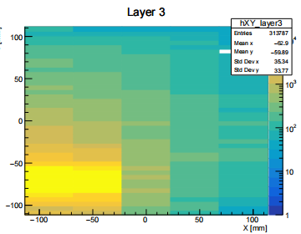
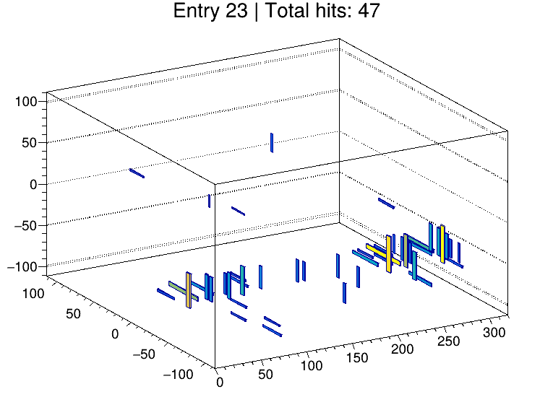
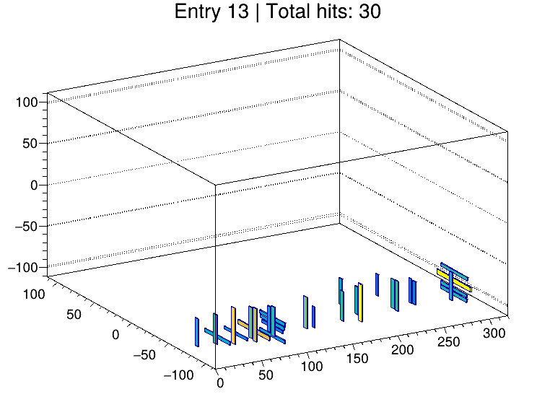
Raw data
Run 173 , Without Absorber
Beam Center:(445, 980)
layer_except_10_11_14_15_20_21_26_27
Hough Transform
Notes:
This is a rough summary of Run142.

Slide 9
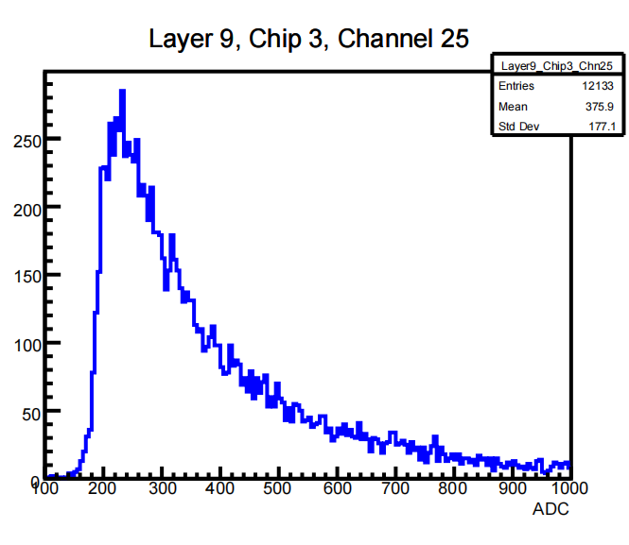
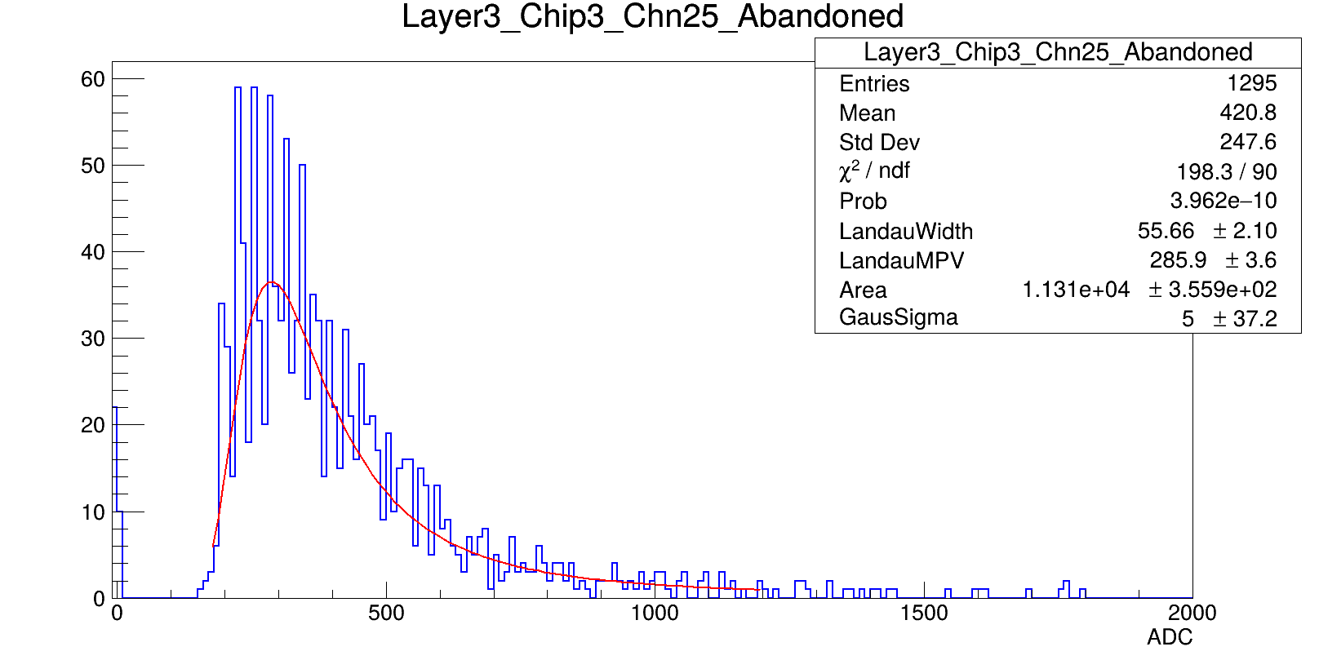
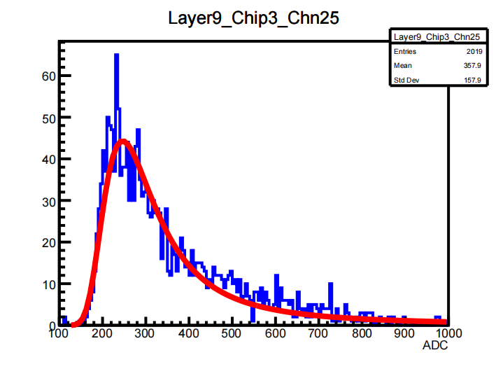
Hough Transform
Before
Method
Apply two-stage Hough transform for track reconstruction.
Use only the first 4 layers in both stages to suppress noise from deeper layers.
Select events with more than 2 hits in the first 4 layers.
Data Processing
Remove noise hits far from the reconstructed track.
Select events with total hit counts (hit_no>20).
Add distances between each hit and the reconstructed track(sum_dist<750)
Fitting
Landau-Gaussian convolution function to extract the MPV.
After
Notes:
We apply a two-stage Hough transform to reconstruct tracks. The first Hough transform scans a wide range of angles to identify rough track candidates. The second transform refines the track parameters with higher resolution. Due to significant noise in the deeper layers, both transforms use only the first four layers. Events with more than two hits in the first four layers are selected.
For data processing, we remove noise hits that deviate significantly from the identified track. Events with a total number of hits between 20 and 25 are selected for further analysis.
Fit the energy distribution with a Landau-Gaussian convolution function to extract the most probable value (MPV).
For runs 142 to 169, a cabling issue caused reversed channel positions in some super-layers — e.g., channels 4 and 5 were connected as 5 and 4. This will be manually corrected in the data later.
Subtract pedestal

Slide 10
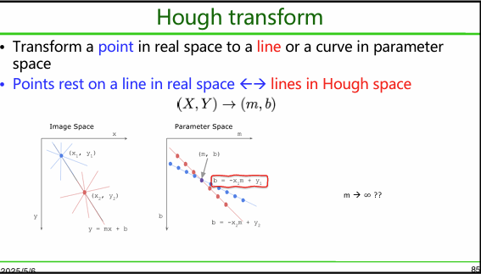
back up

Slide 11
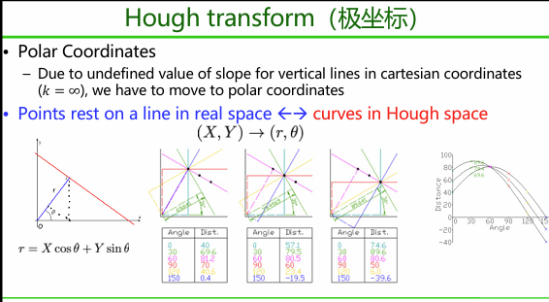
back up

