Slide 1






Response of AHCAL to
Pion and Electron
Hongbin Diao
State Key Laboratory of Particle Detection and Electronics
University of Science and Technology of China

Slide 2
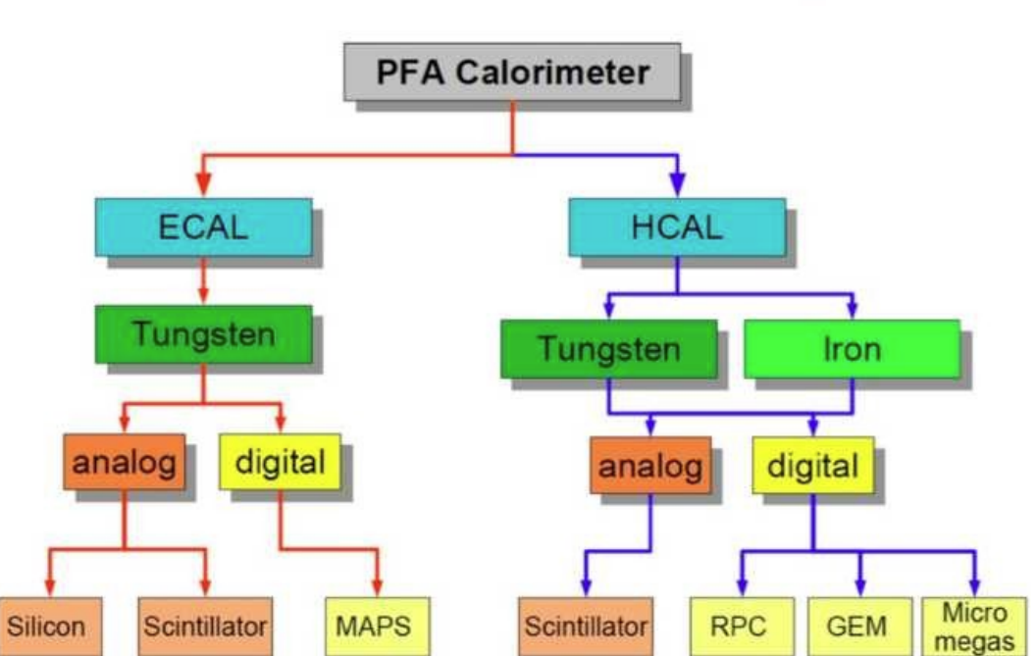
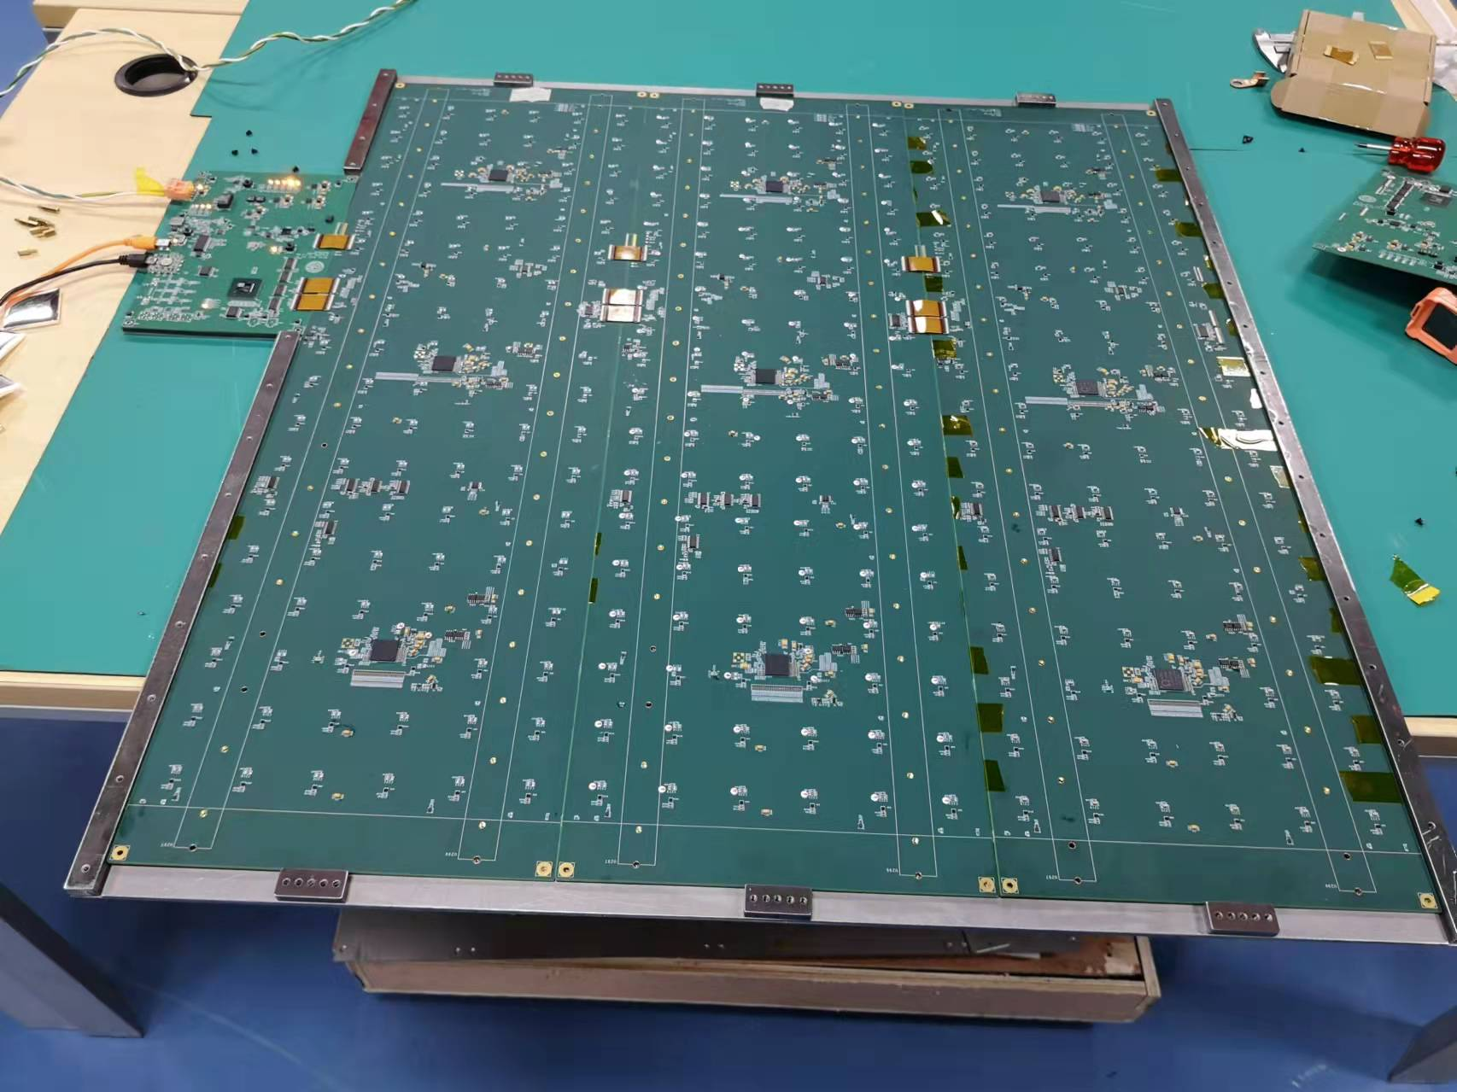
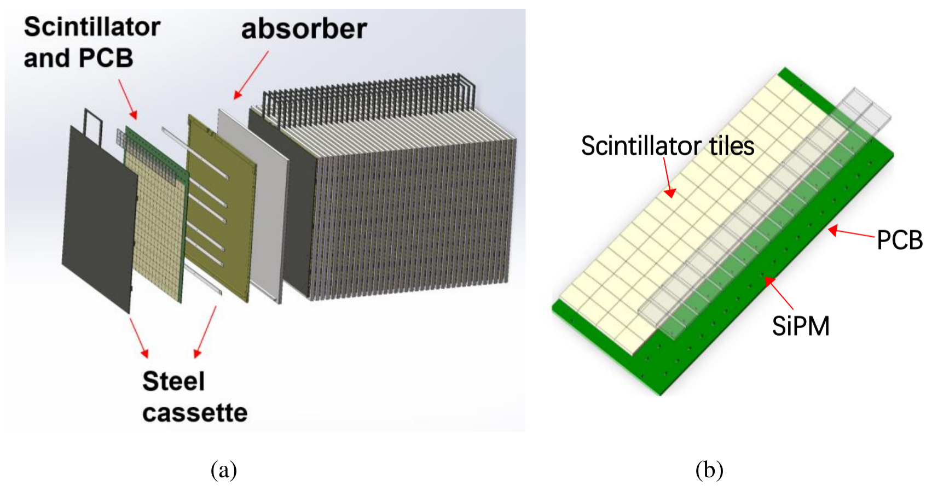
AHCAL Prototype
an Analogue readout Hadronic Calorimeter prototype has been developed
Total layers | 40
Sensitive area | 72cm*72cm
Granularity | 4cm*4cm*0.3cm
Total channels | 12960
NIL | 4.6
Energy Resolution | <60%@ 1 GeV
Weight | 5.0T
Plastic
Glass
AHCAL

Slide 3
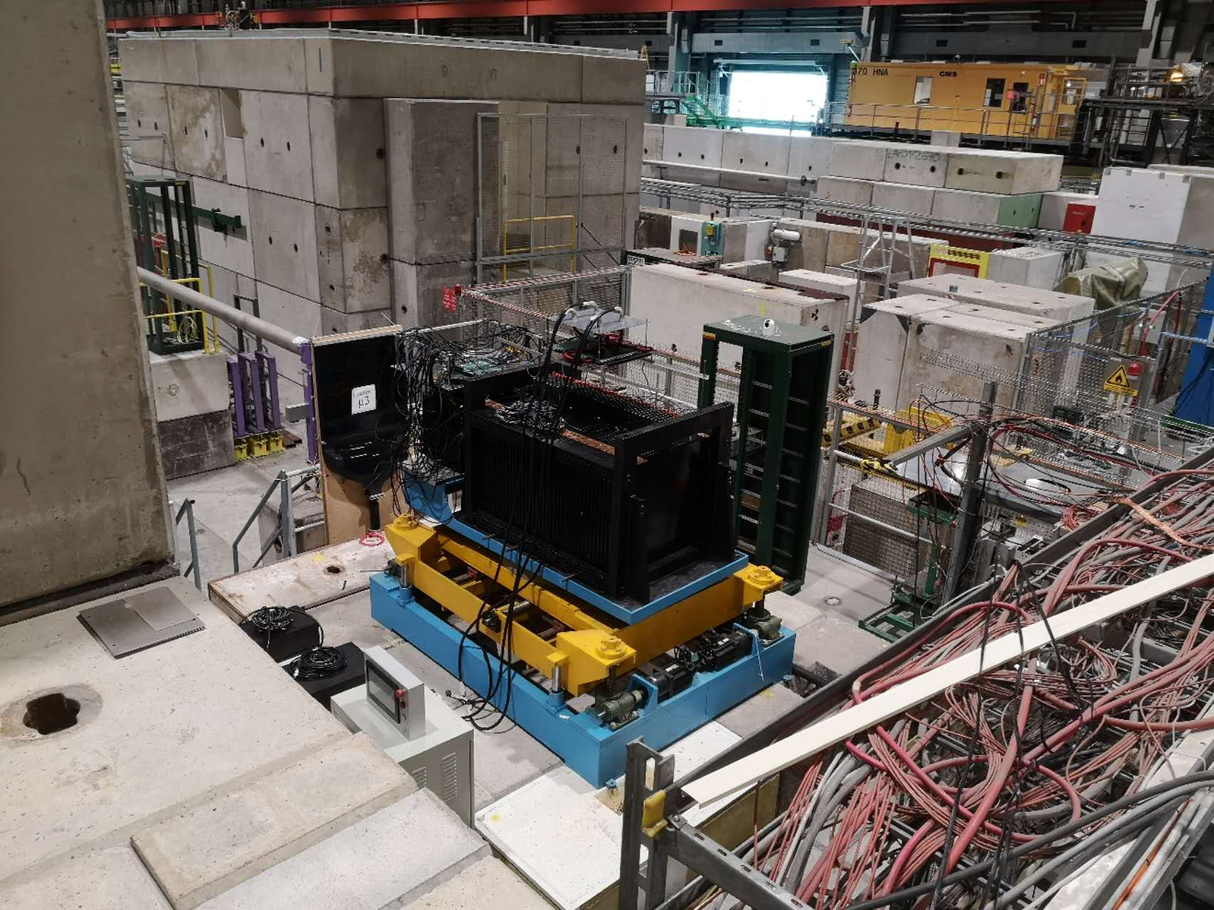
Beam Tests
3 beam tests have been done at CERN
  muon position scan(100GeV/c)
  pion (1-120GeV/c)
  electron (1-120GeV/c)
2022 SPS H8
2023 PS T9
2023 SPS H2

Slide 4
selection steps
0.5 MIP threshold
shower start < 10
shower end < 25(35) for electron(pion)
hitno
hitlayer
remove mip events (energy fraction of layer 30-37 < 0.05)
layer 0 has only 1 hit
cherenkov
energy of layer 2345

Slide 5
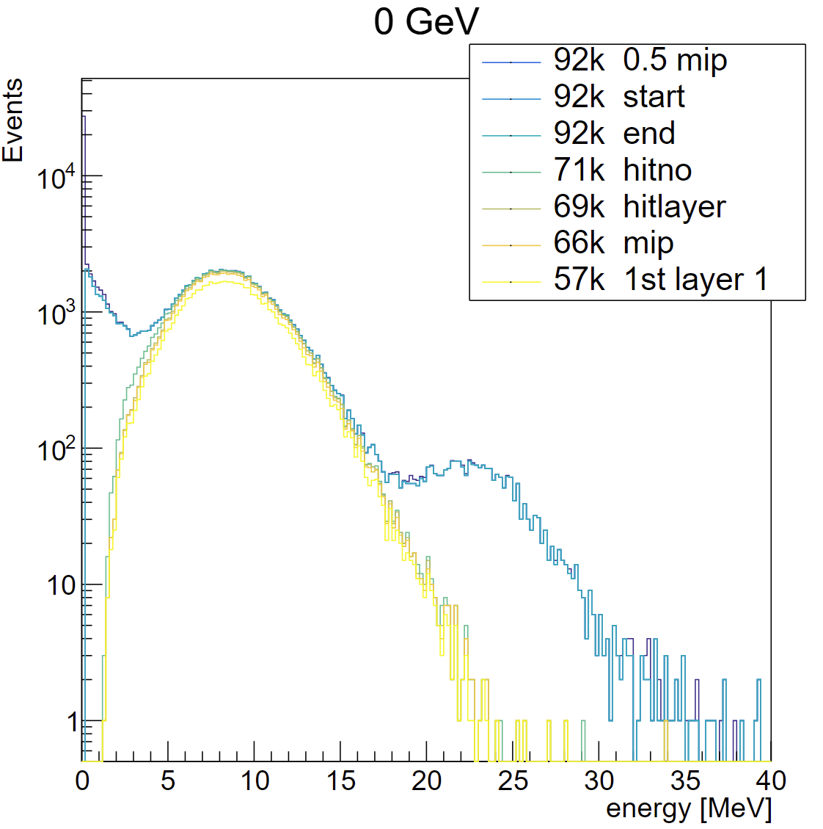
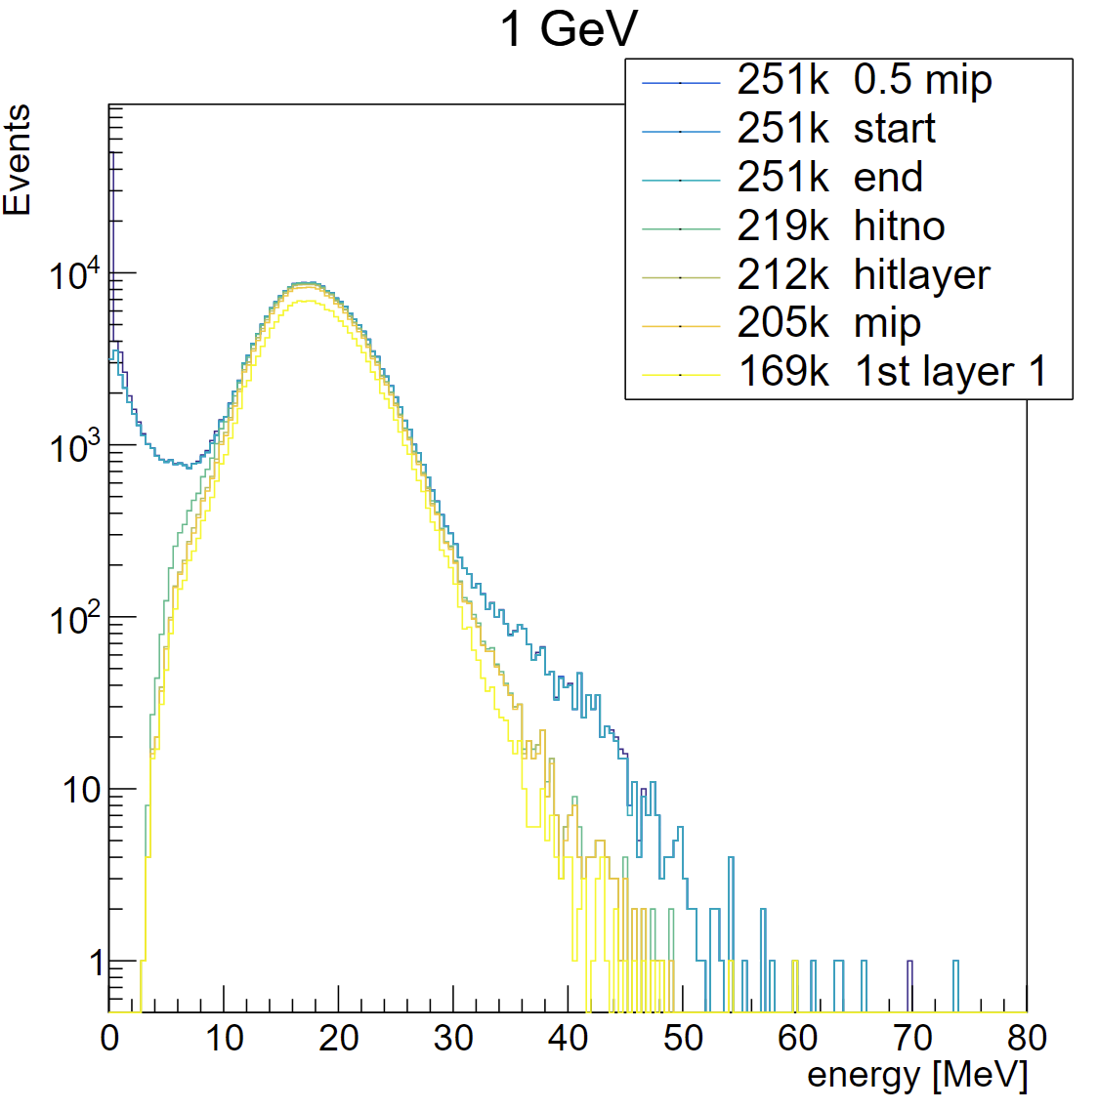
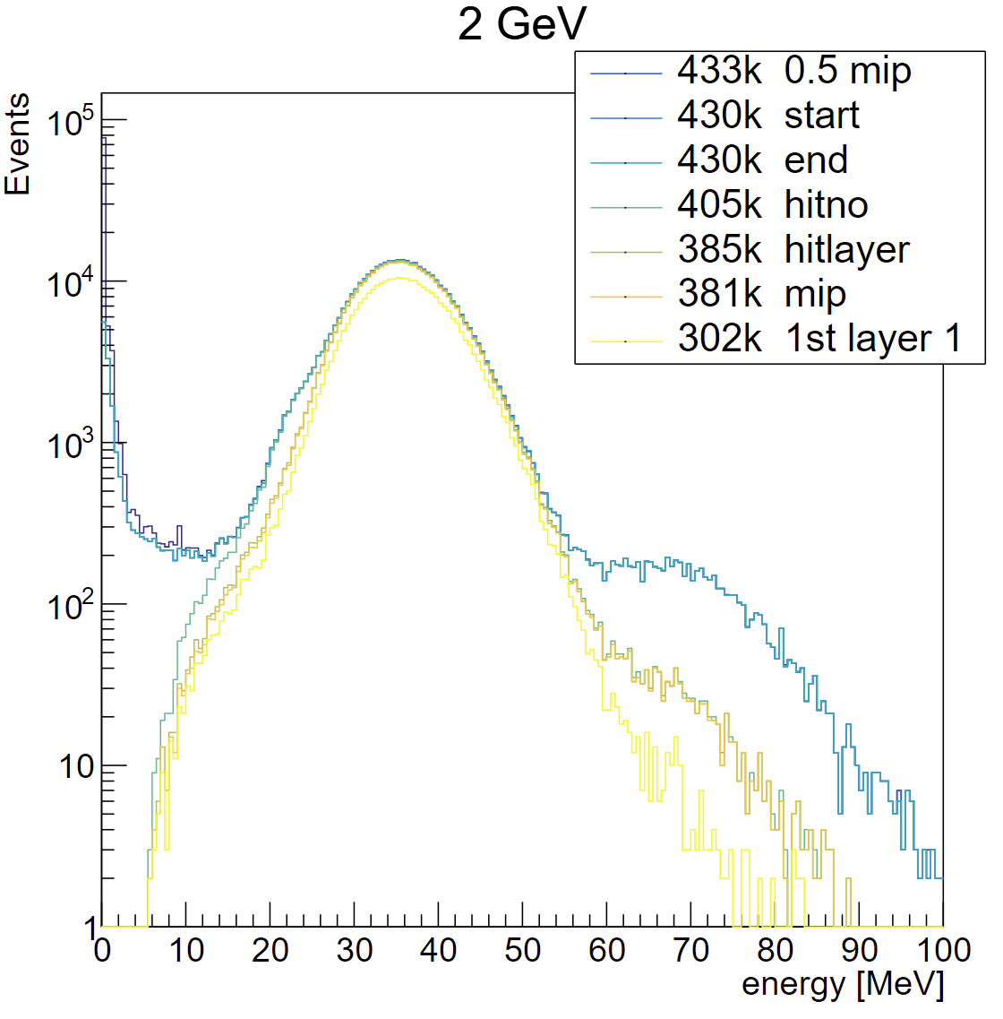
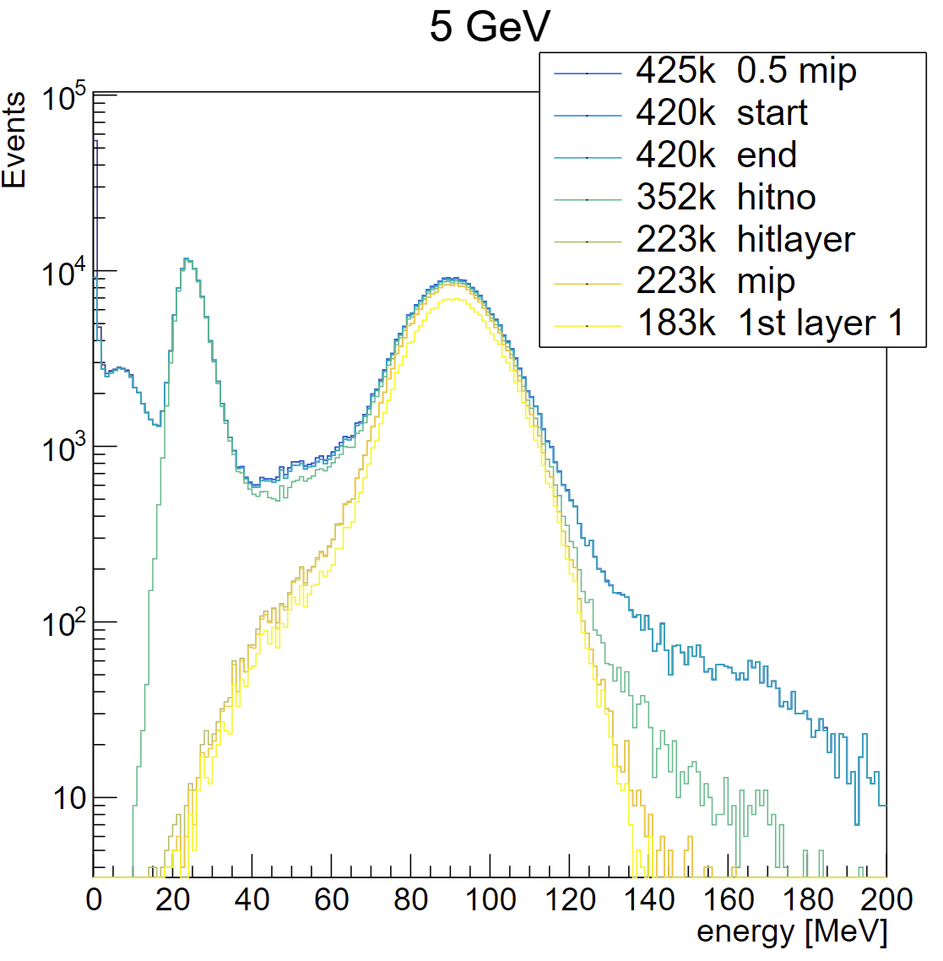
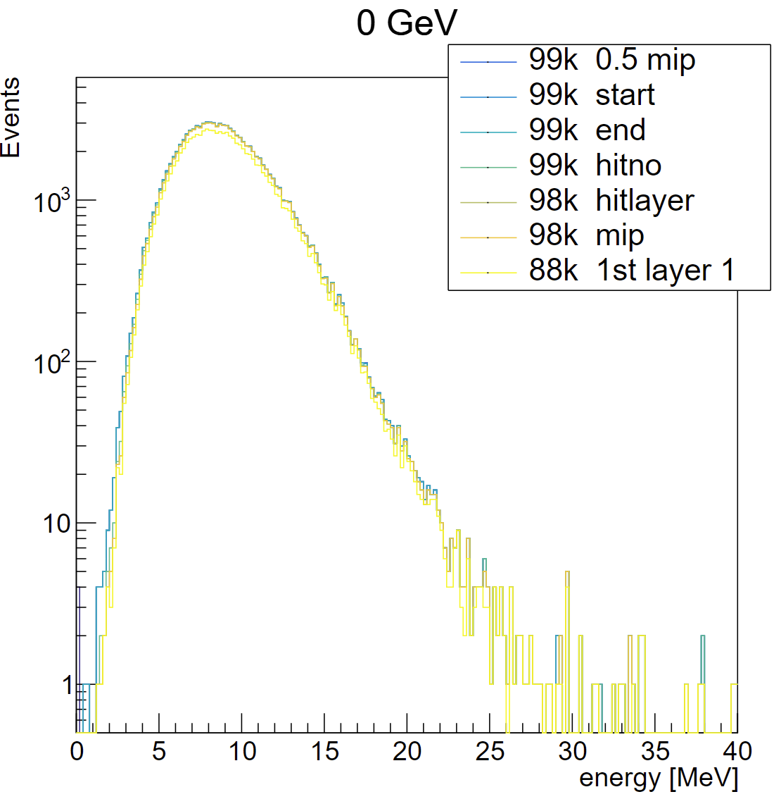
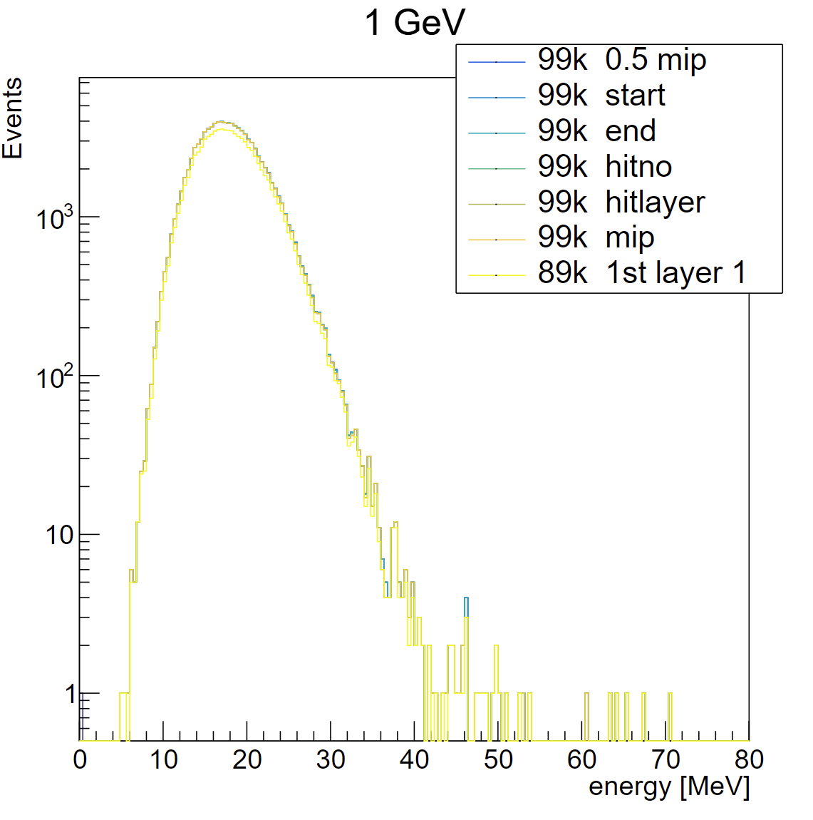
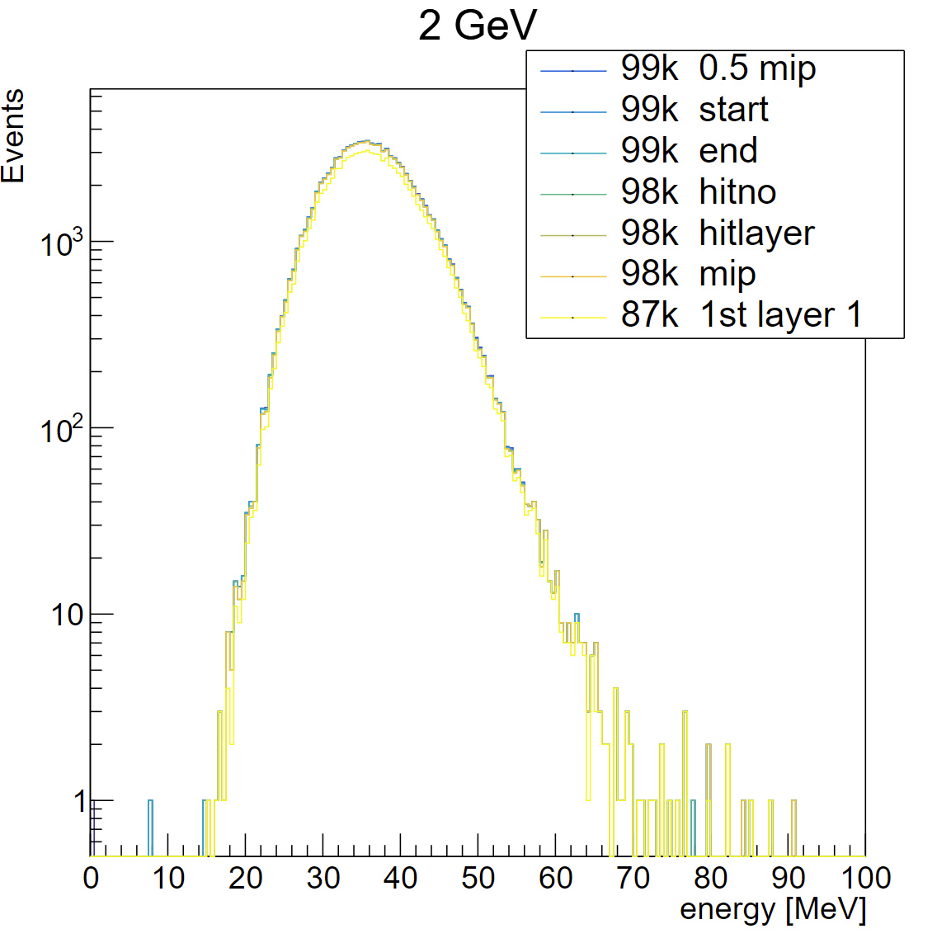
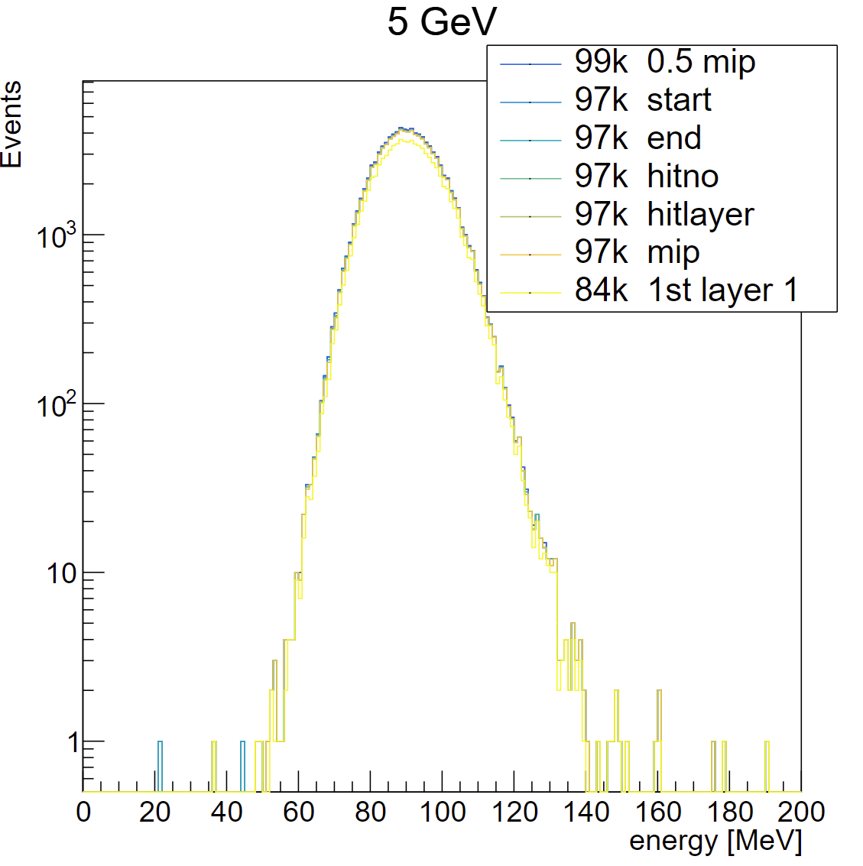
electron select flow
data
MC

Slide 6
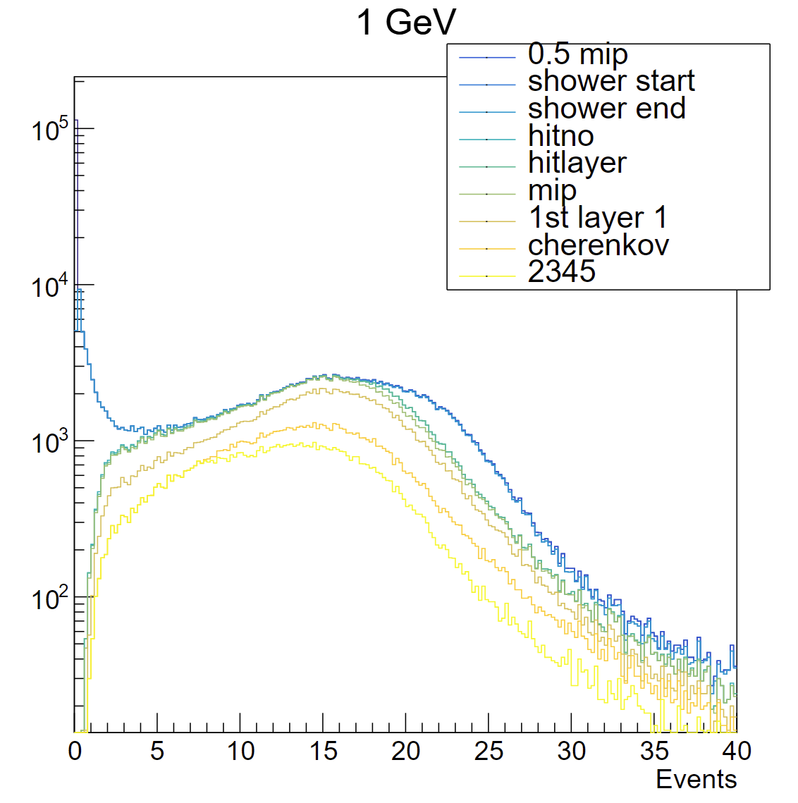
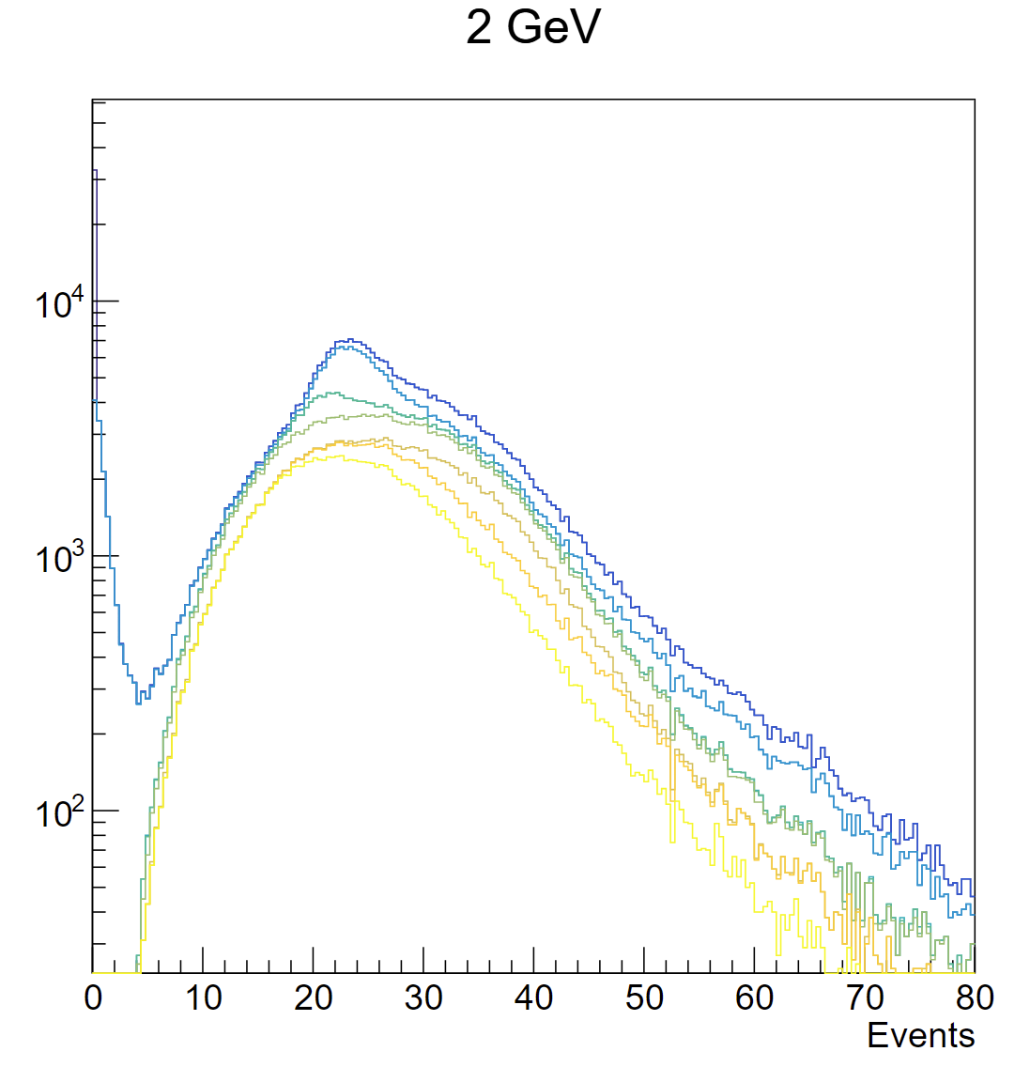
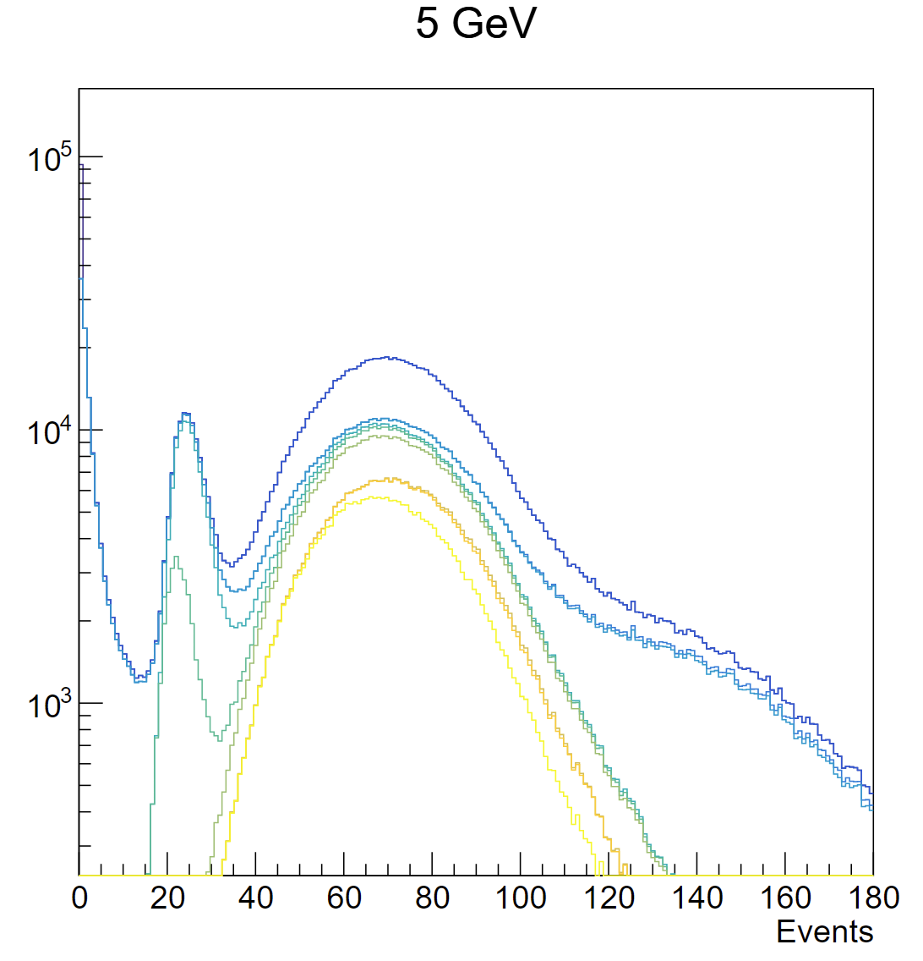
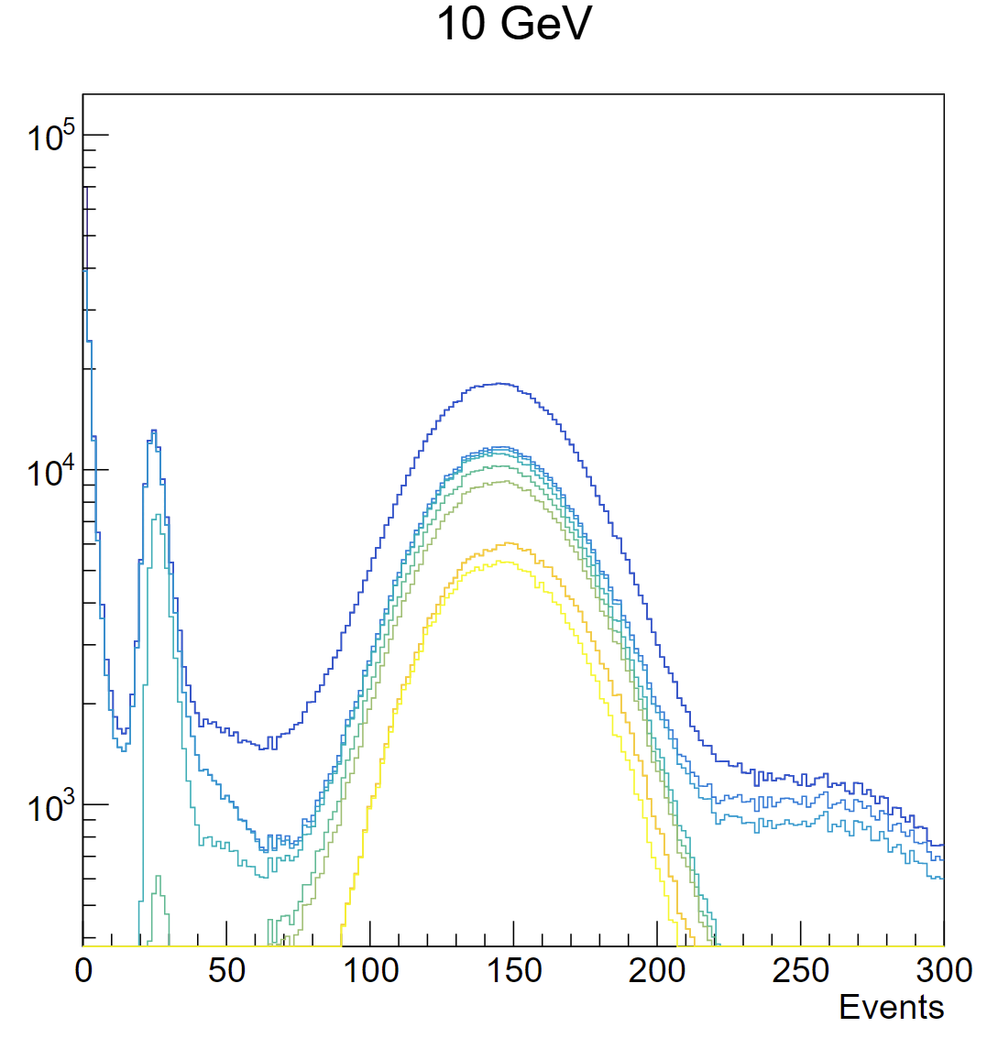
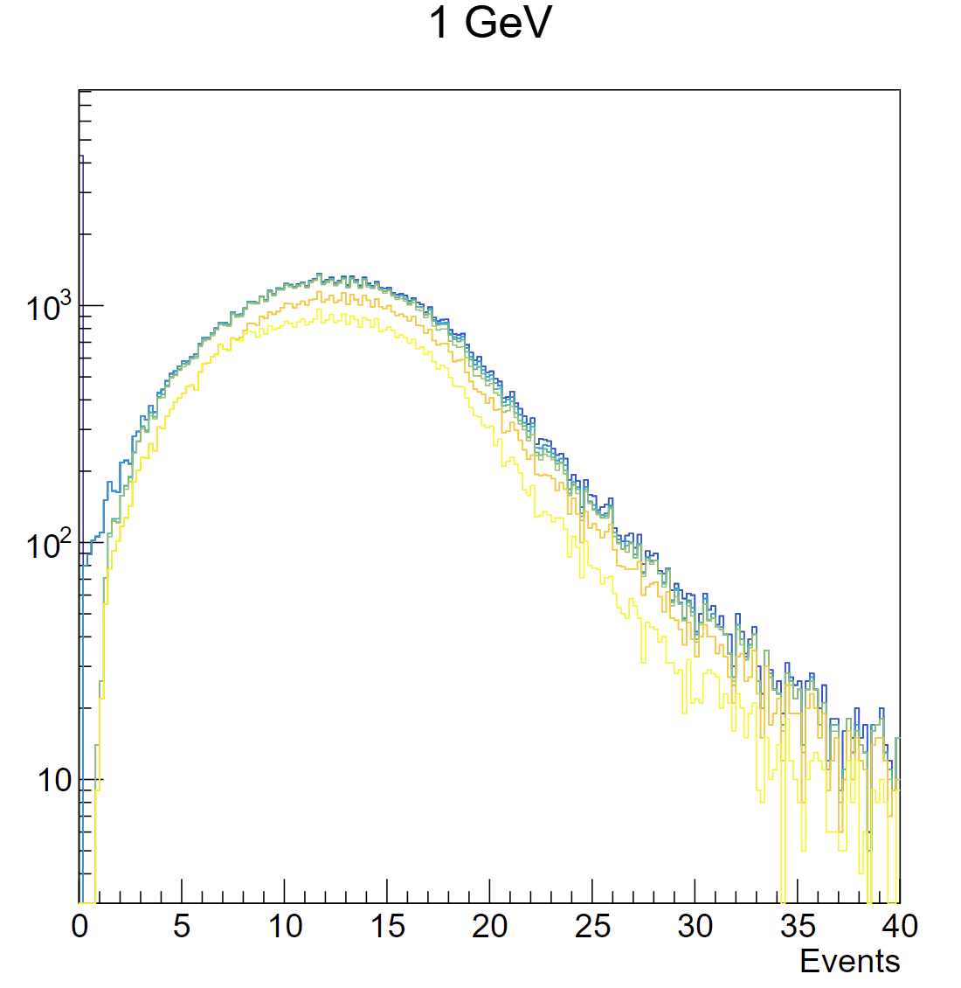
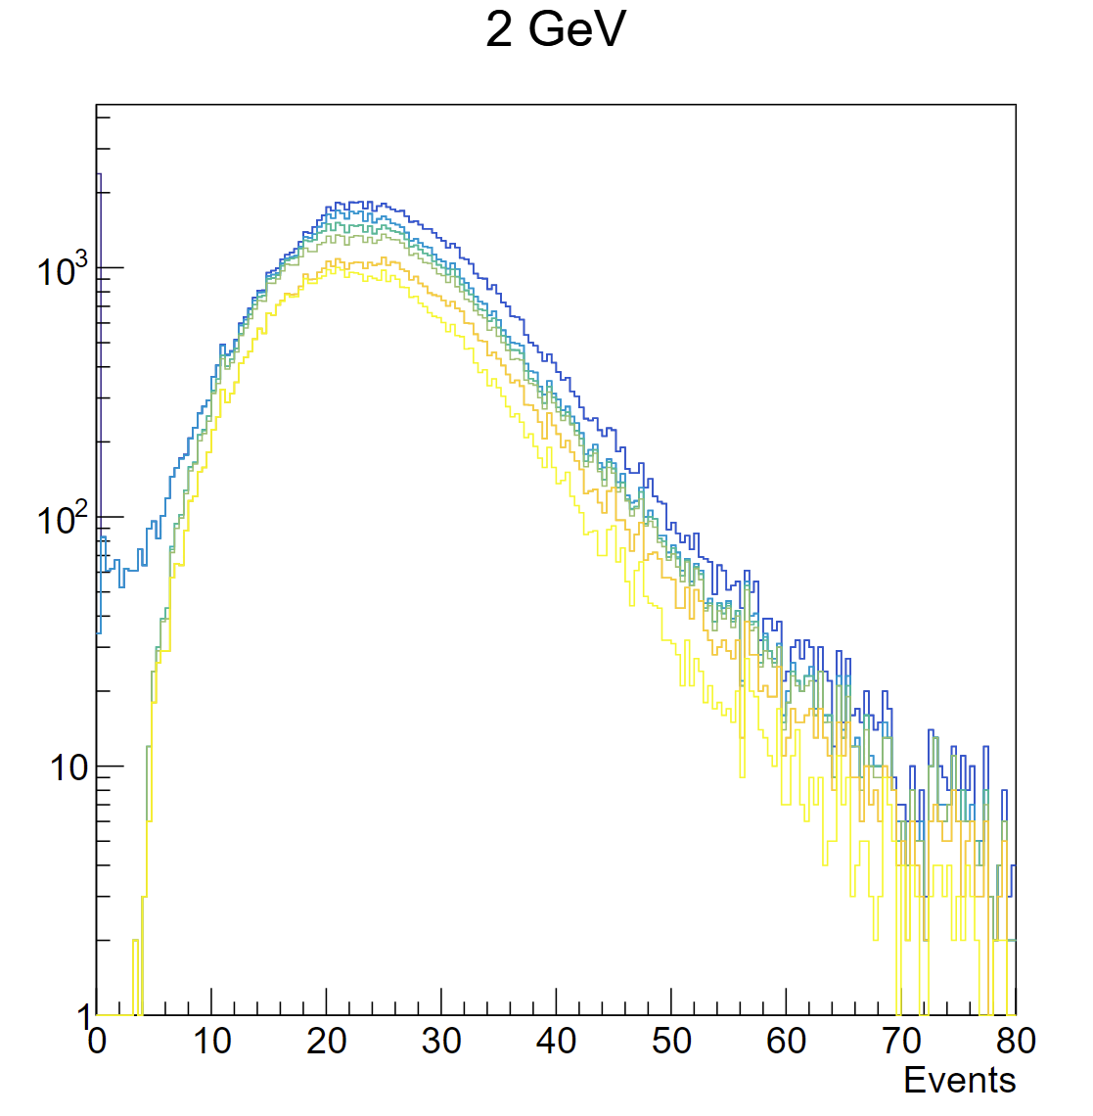
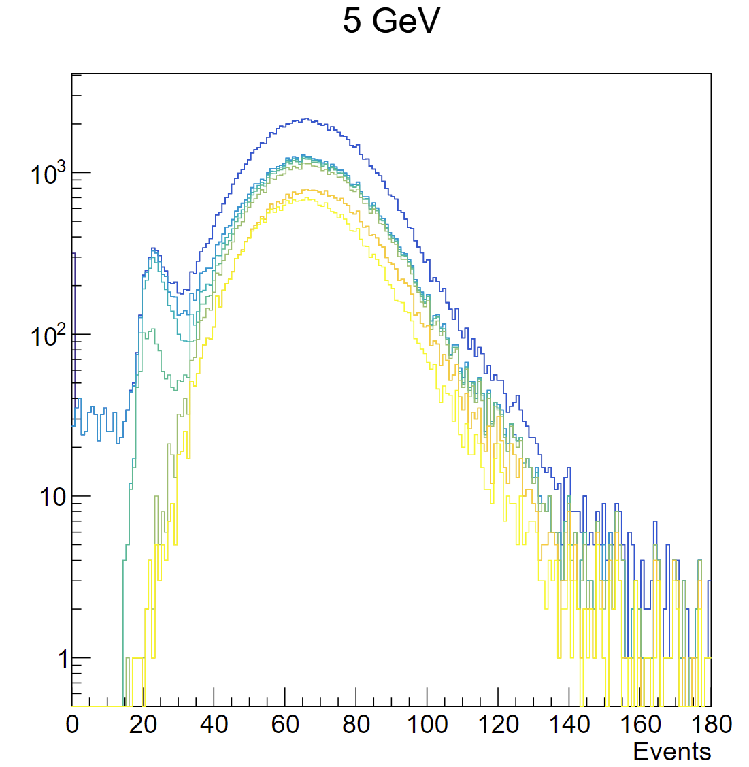
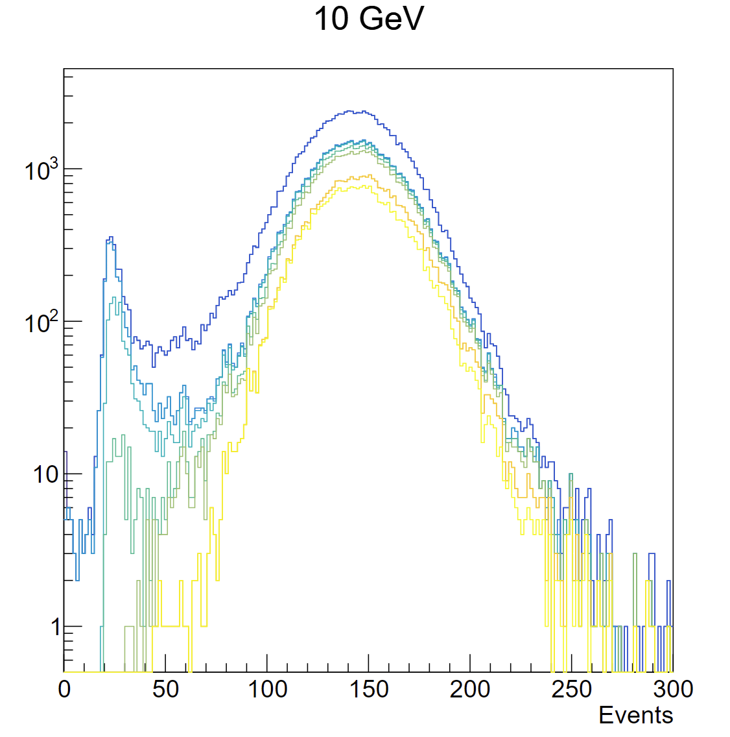
pion select flow
data
MC

Slide 7
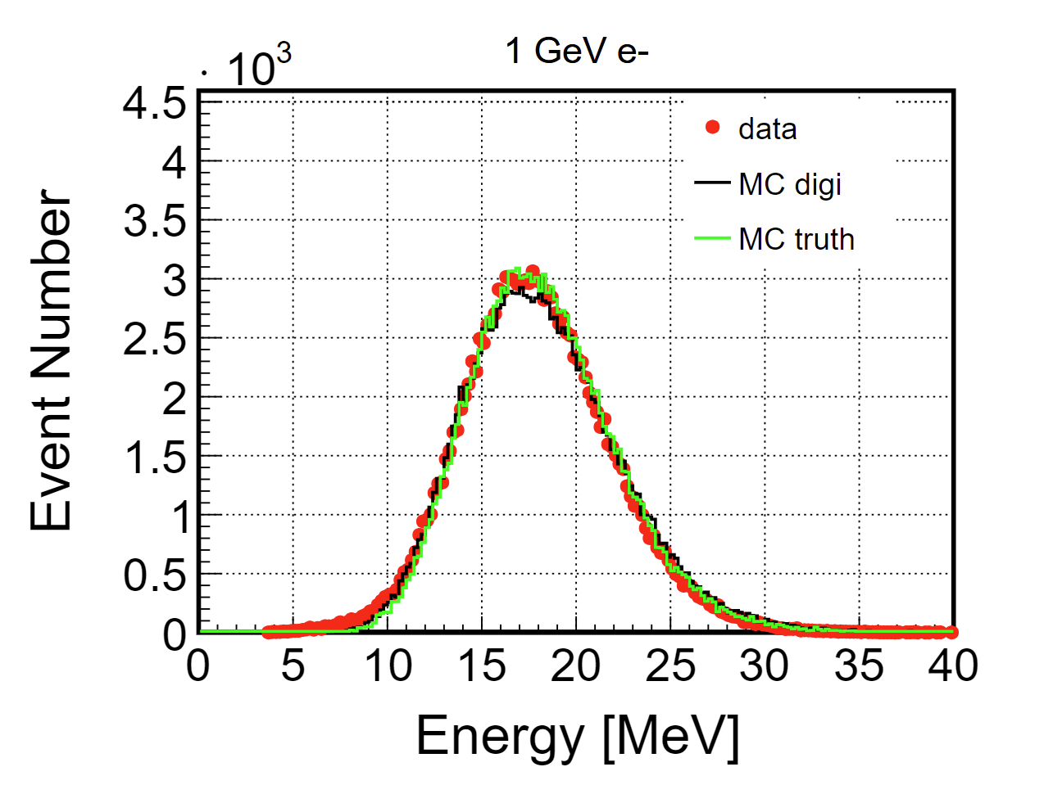
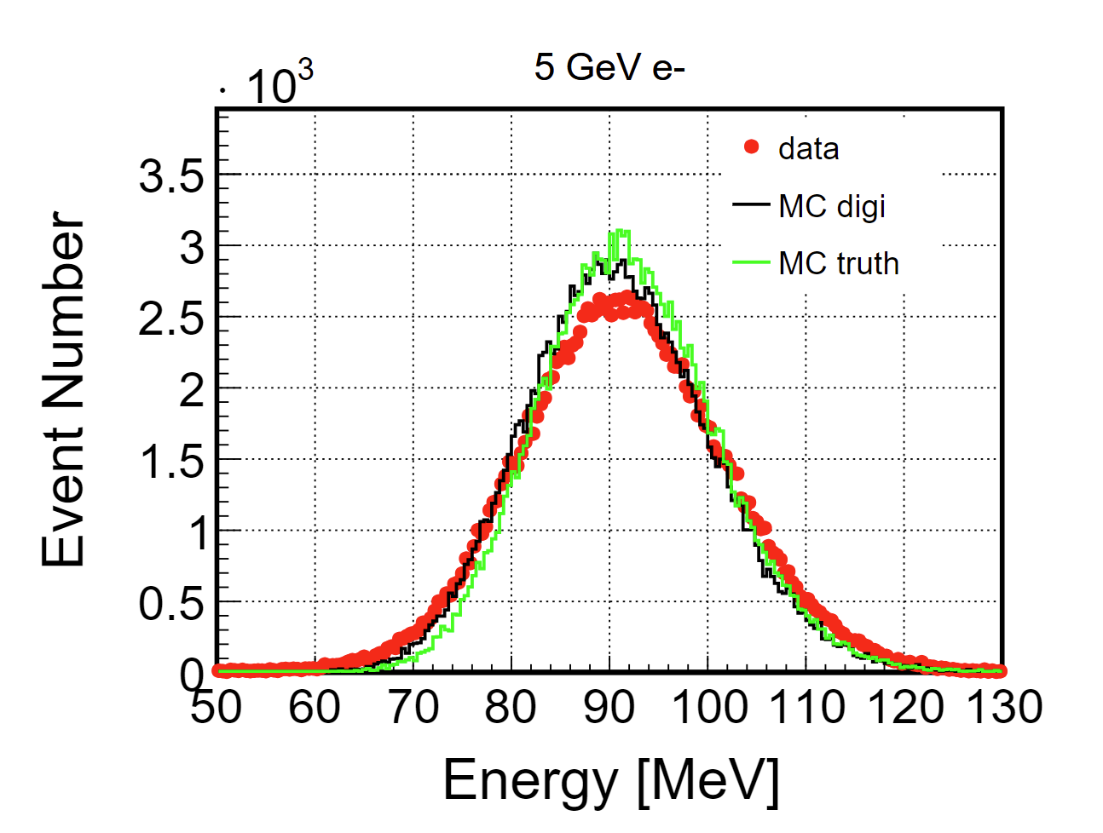
Electron

Slide 8
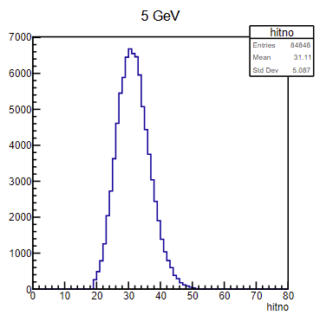
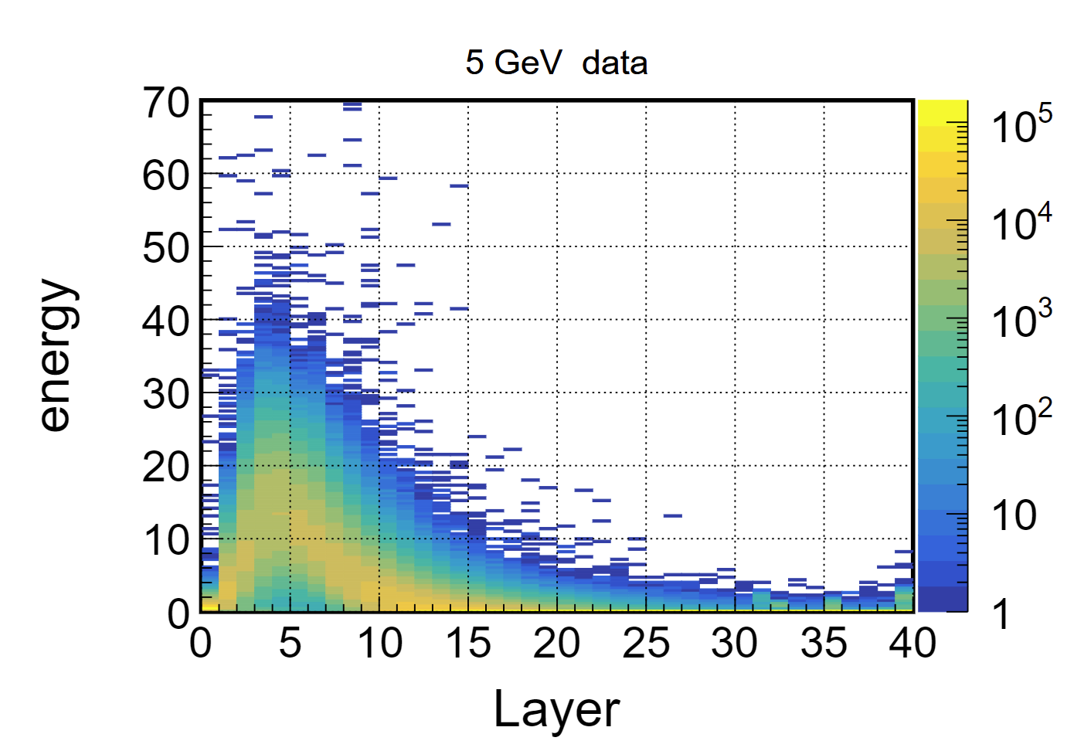
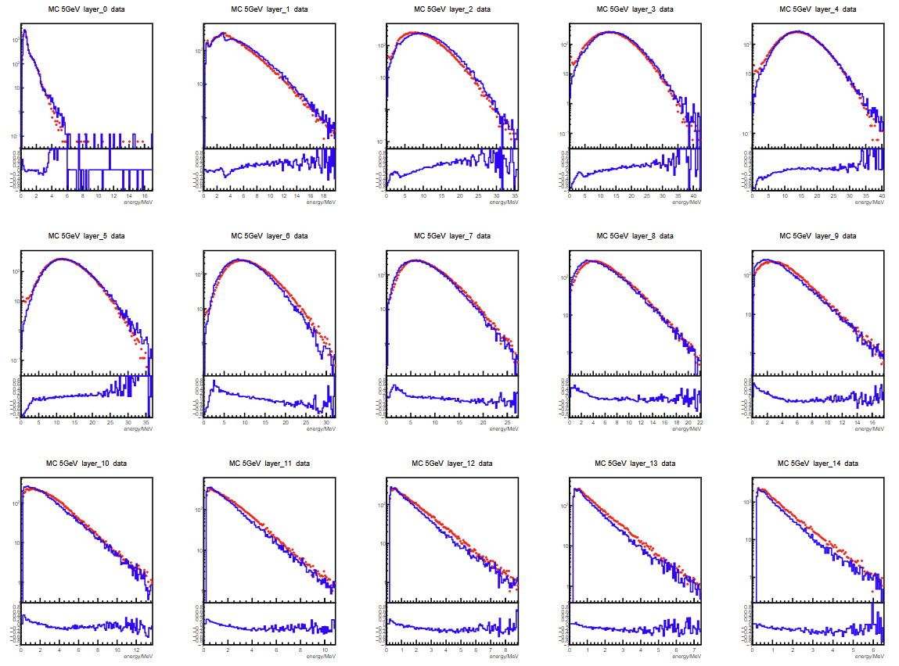
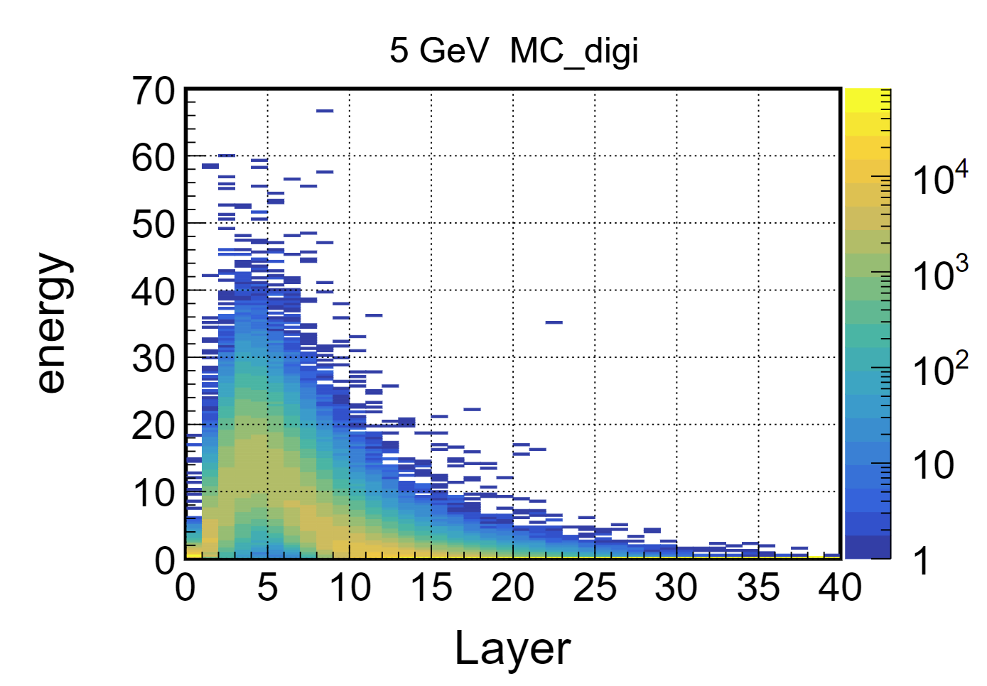
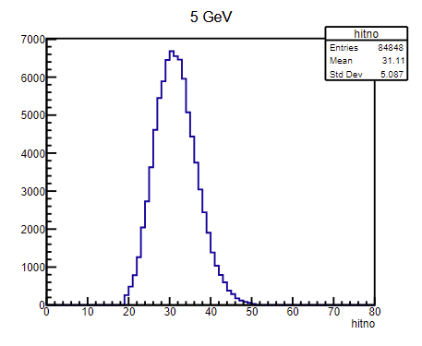
Electron 5GeV
hitno
data
MC digi

Slide 9
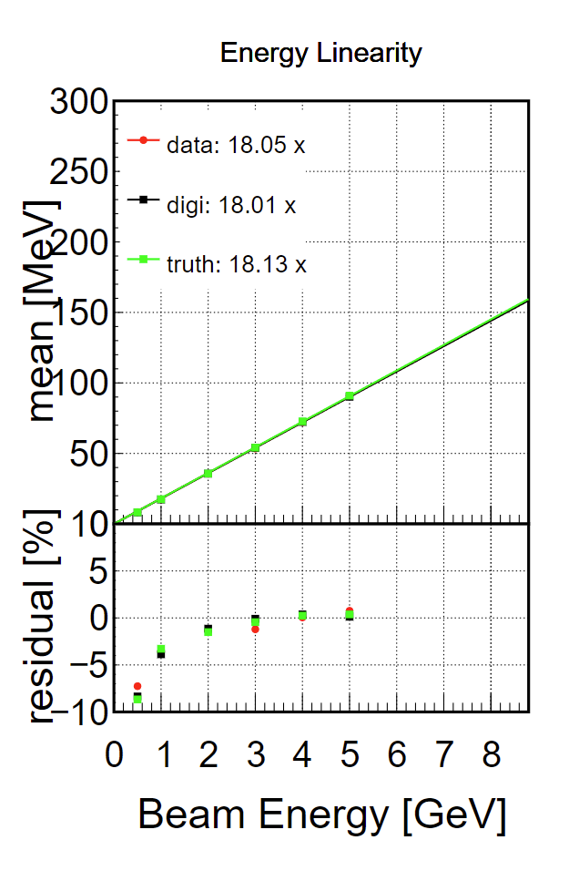
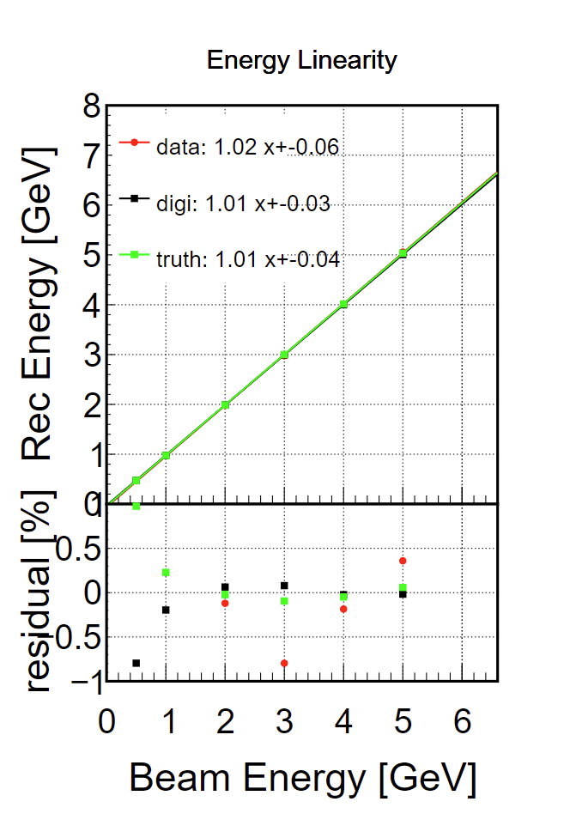
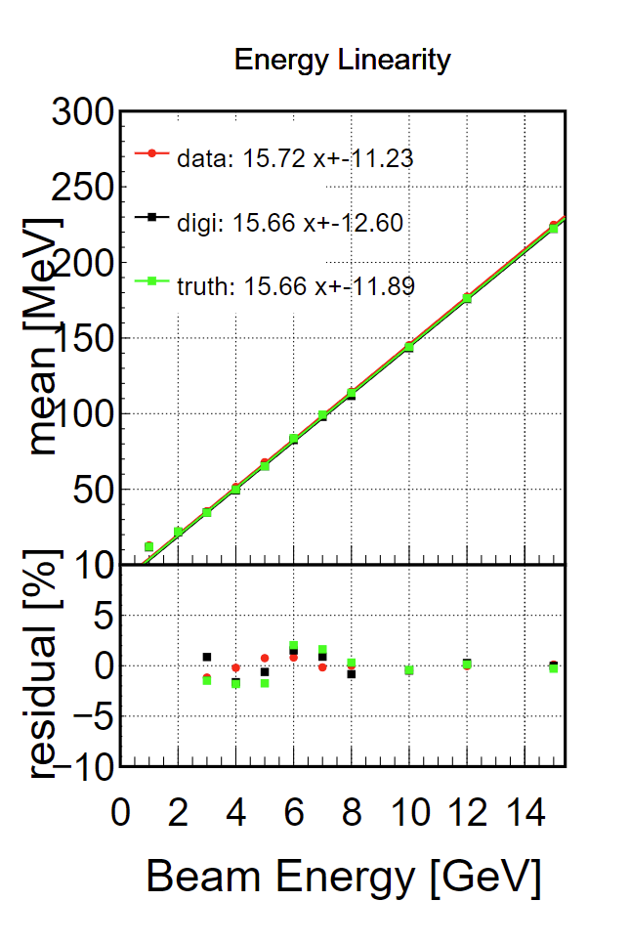
energy reconstruction
e-
e-
pi-
10% events
total events
10% events

Slide 10
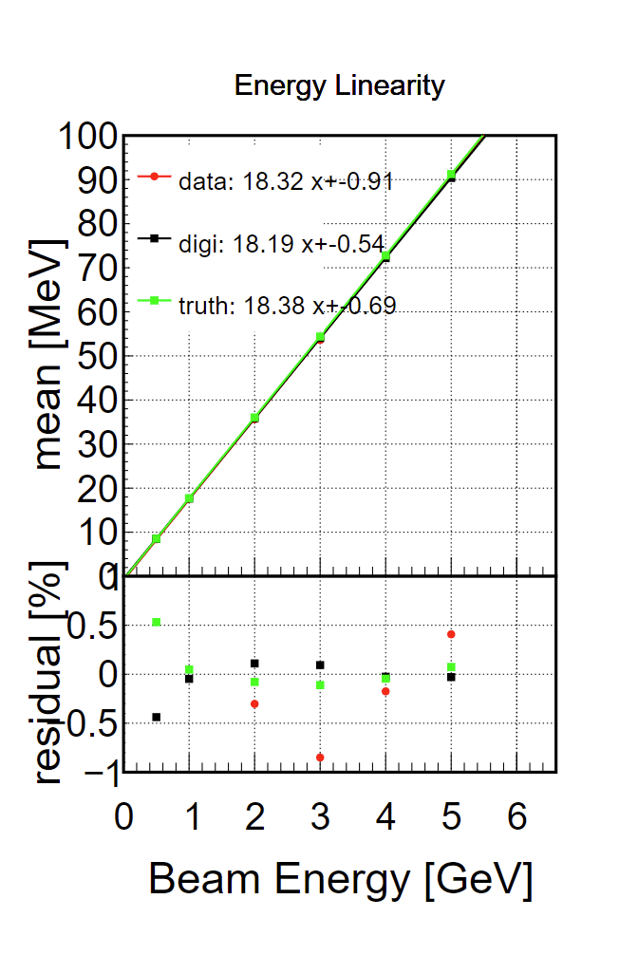
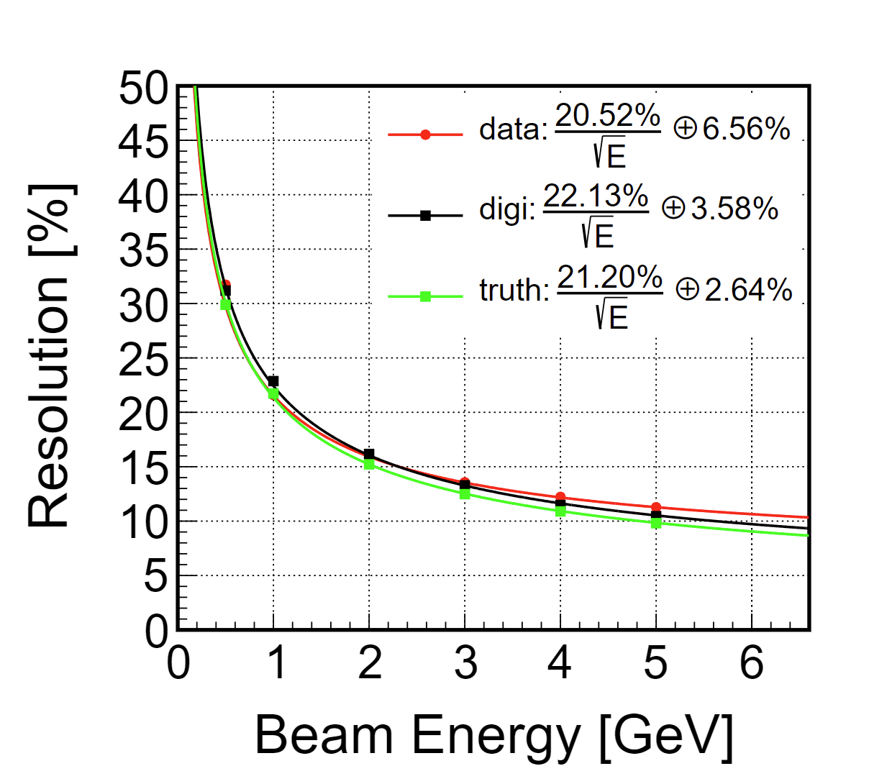
Electron

Slide 11
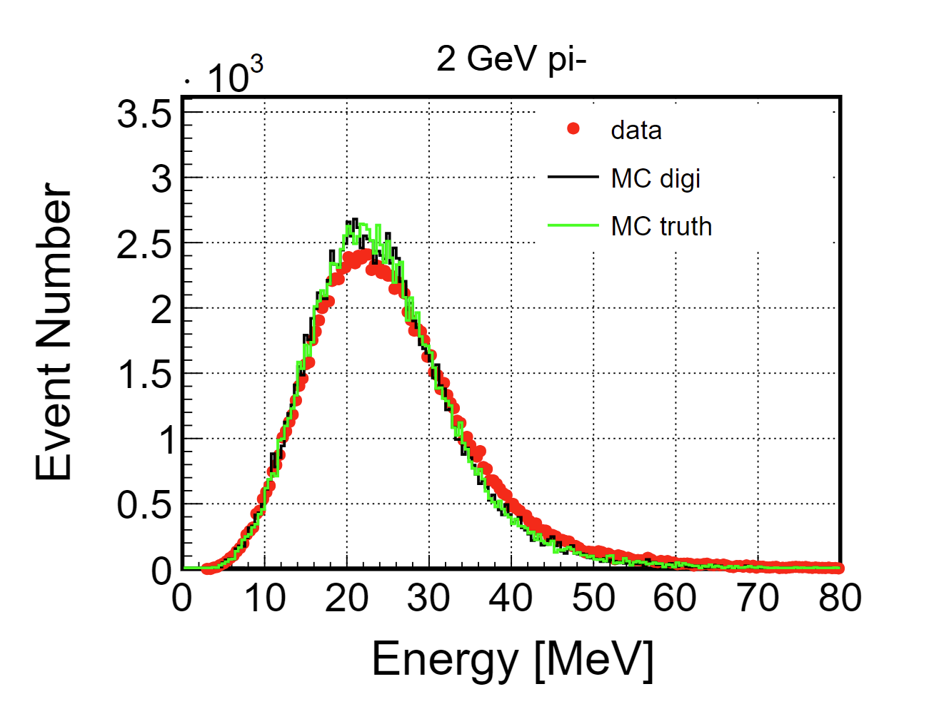
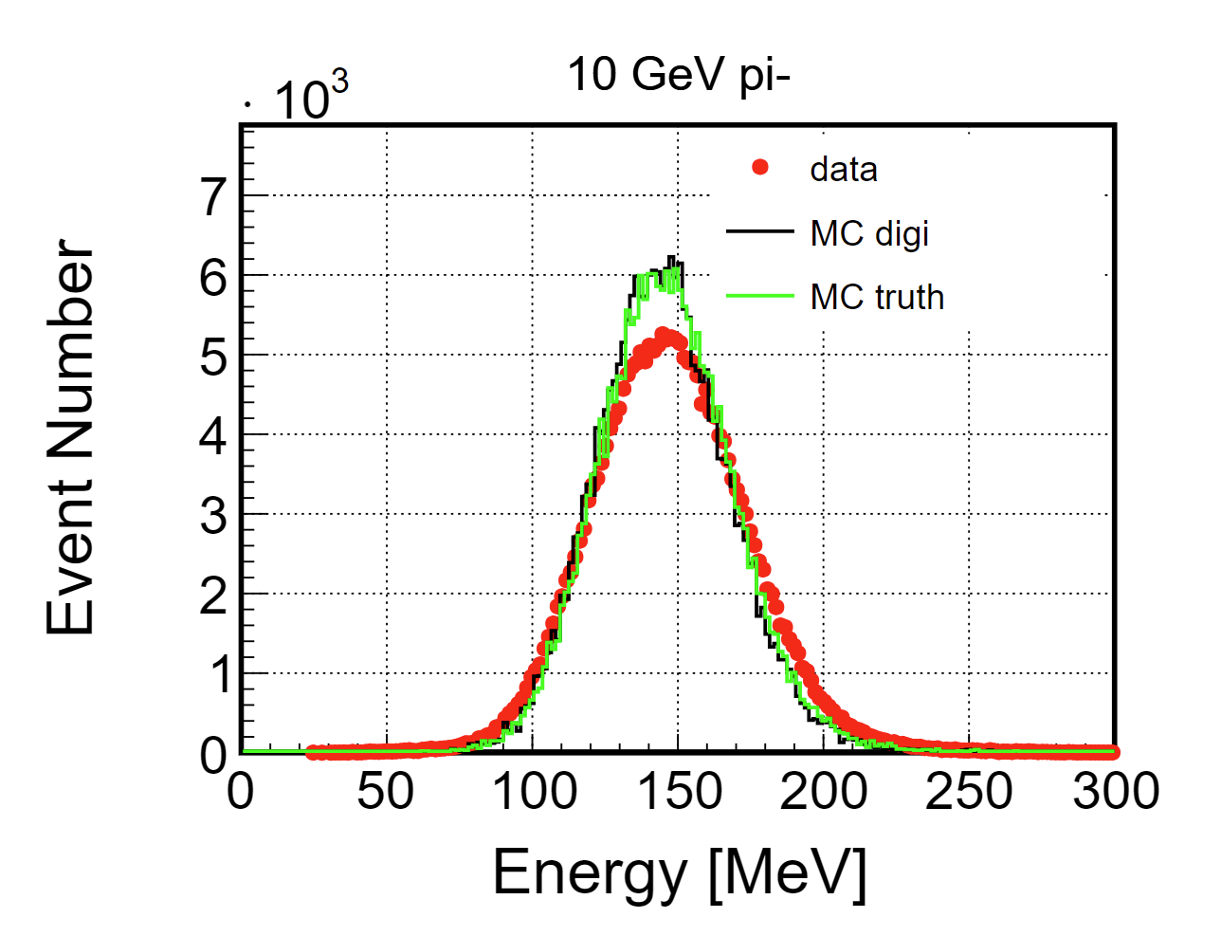
Pion

Slide 12
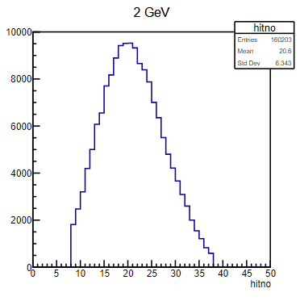
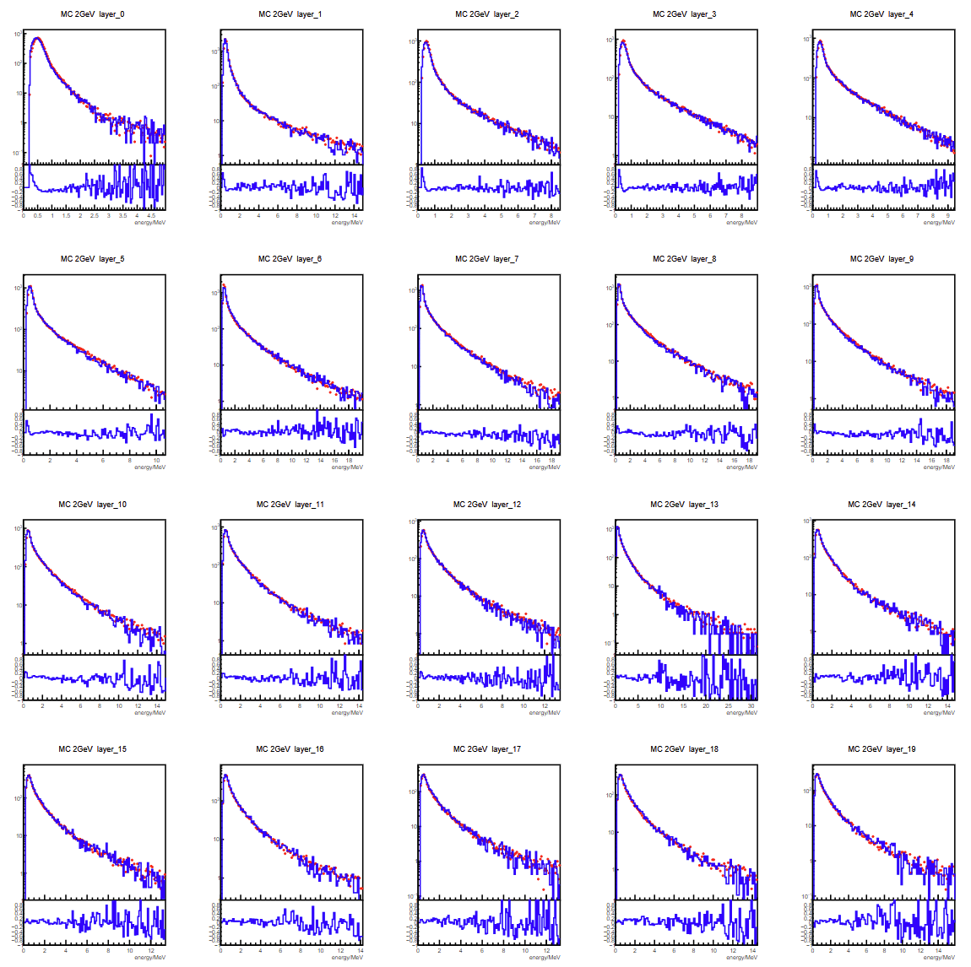
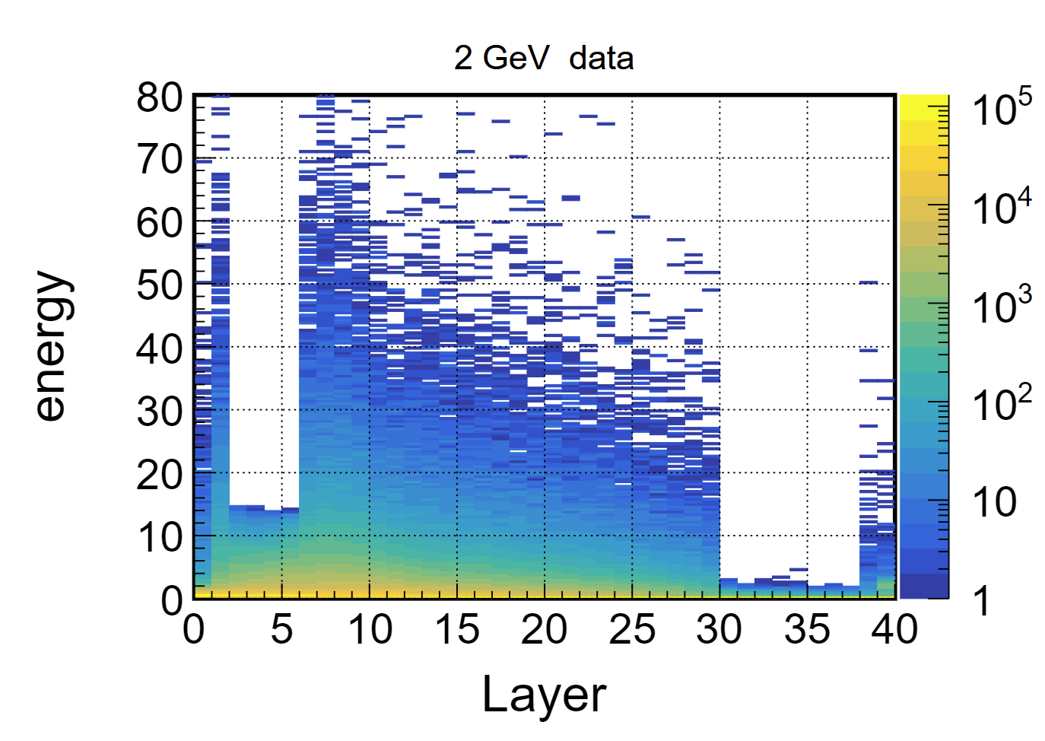
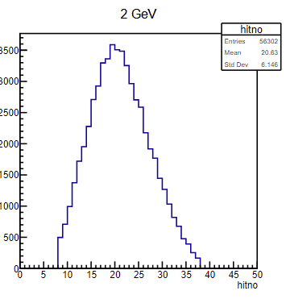
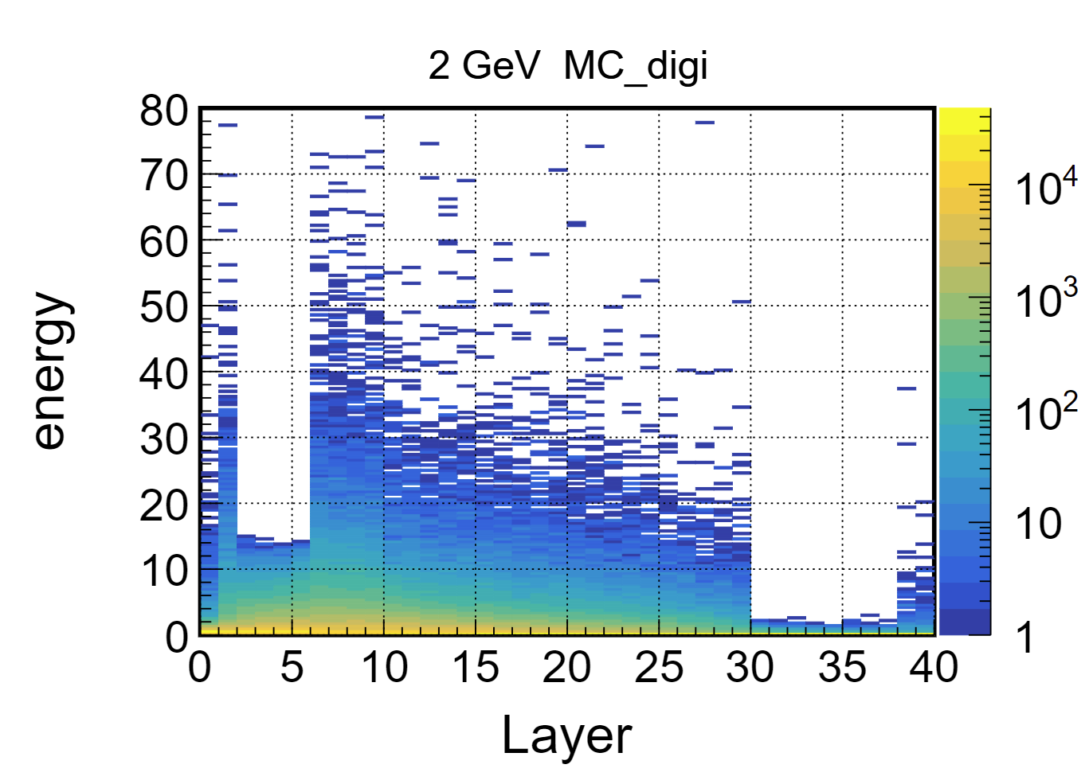
Pion 2GeV
hitno
data
MC digi

Slide 13
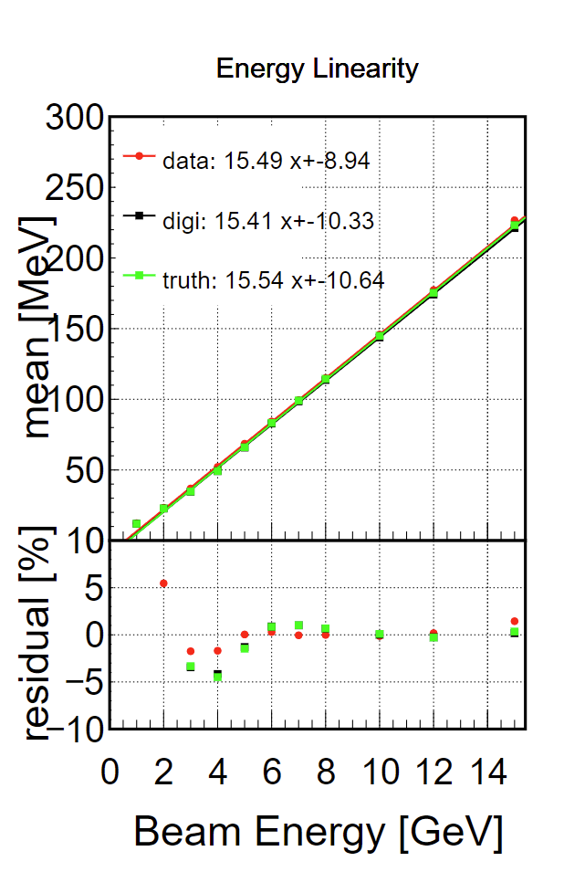
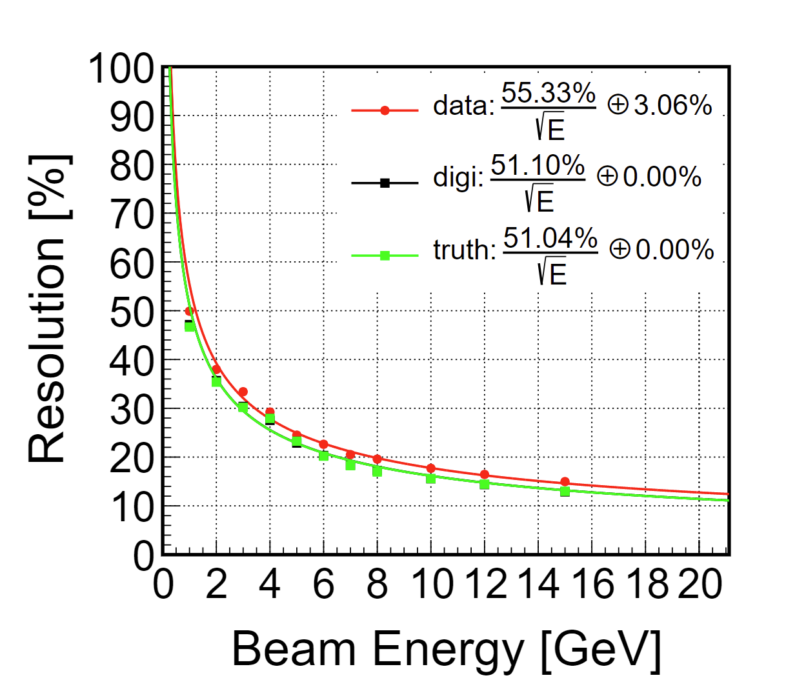
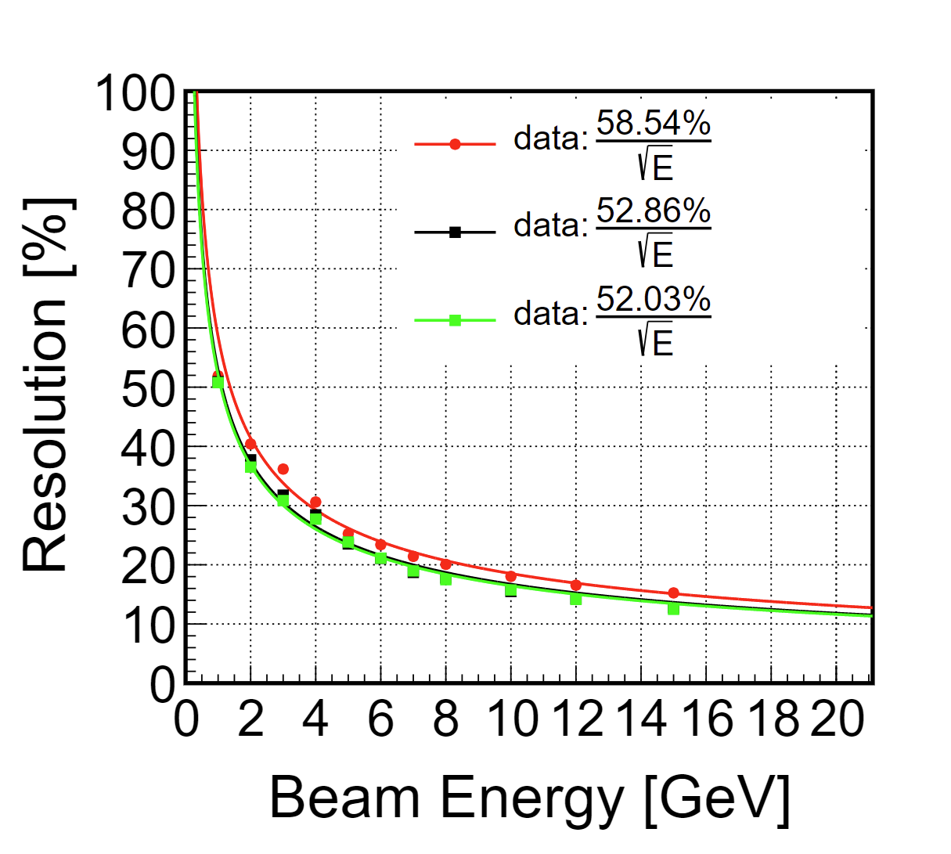
Pion

Slide 14
Backup

Slide 15
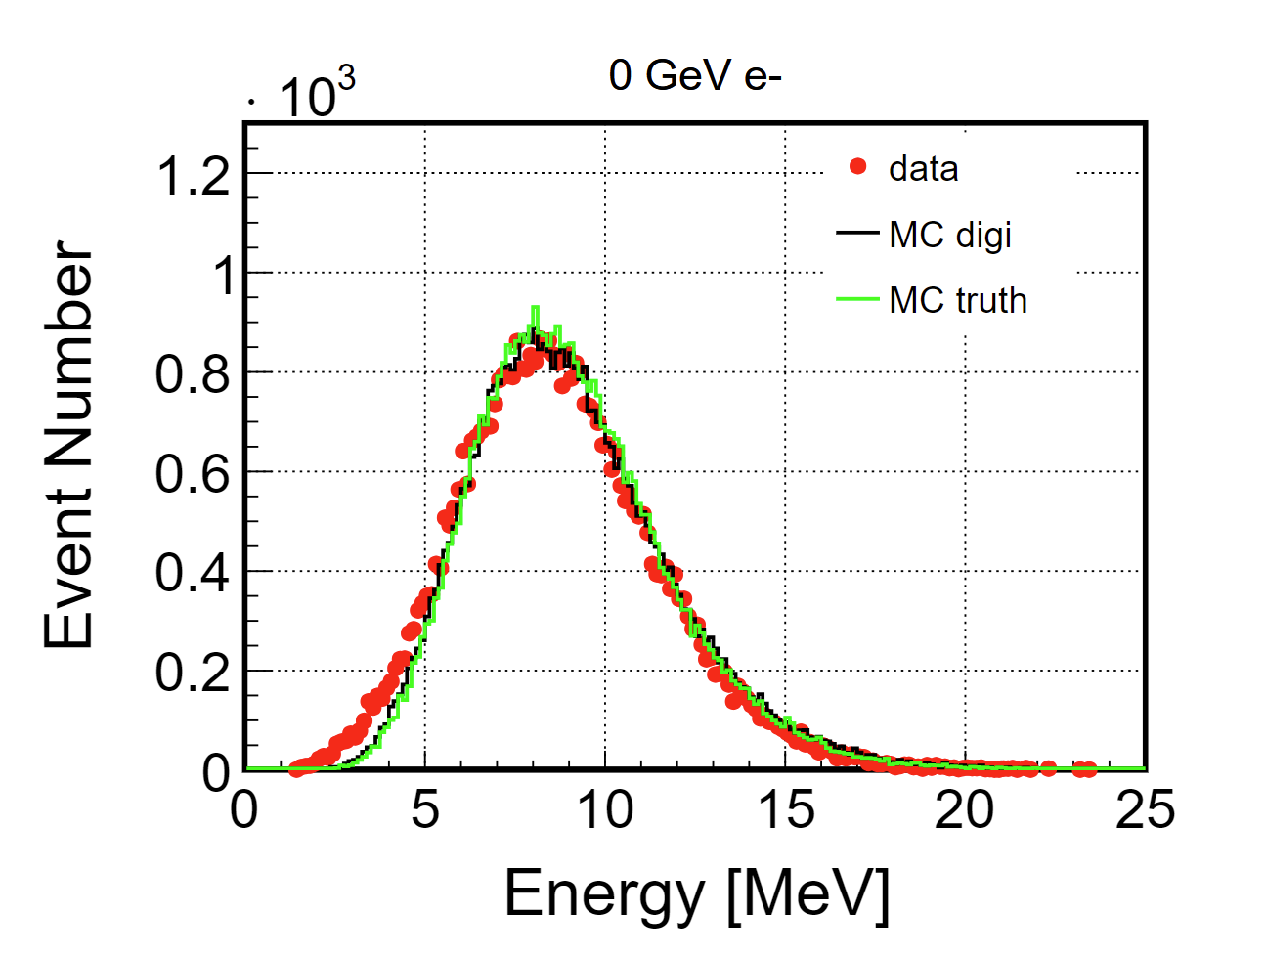
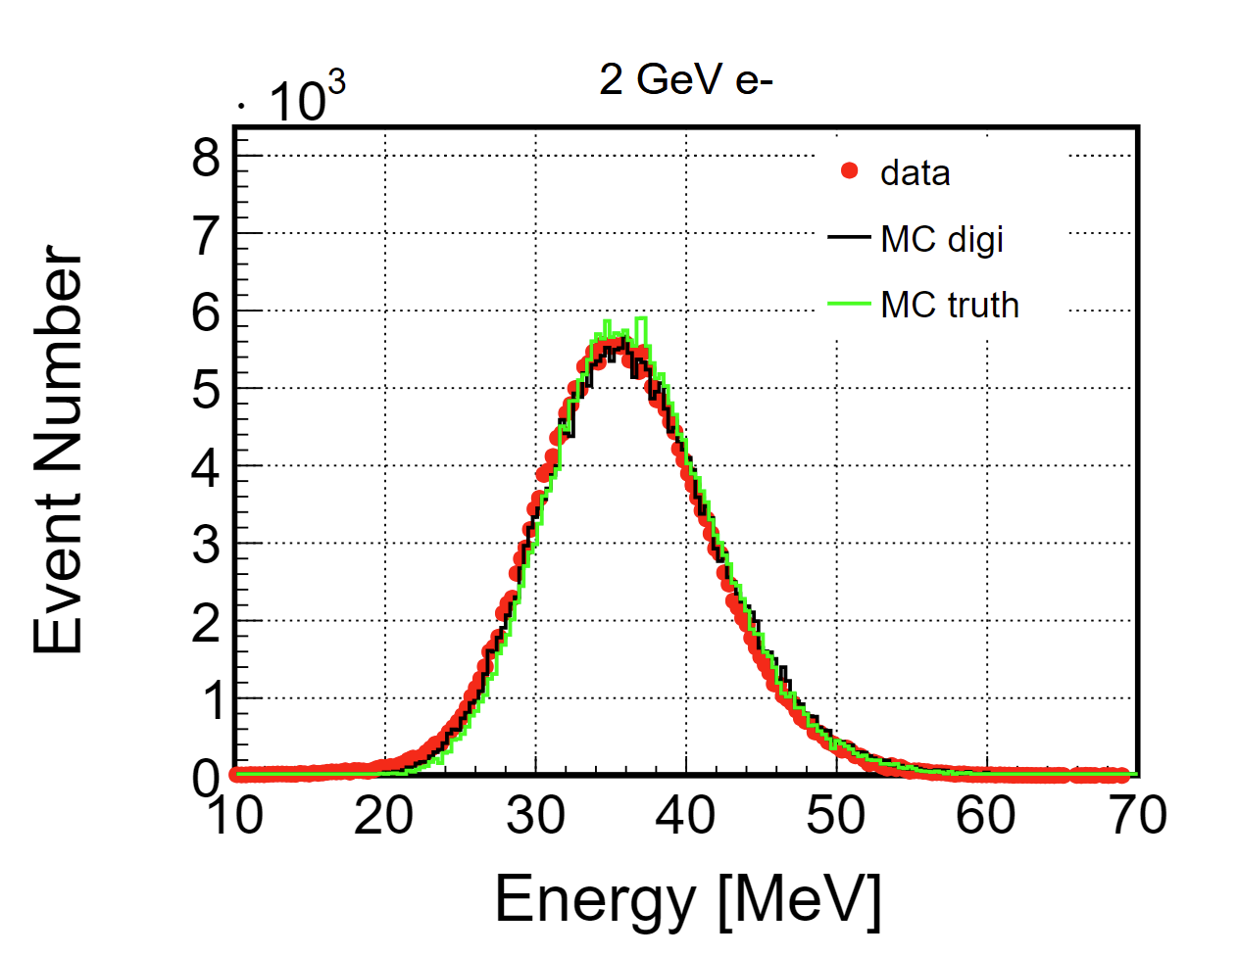
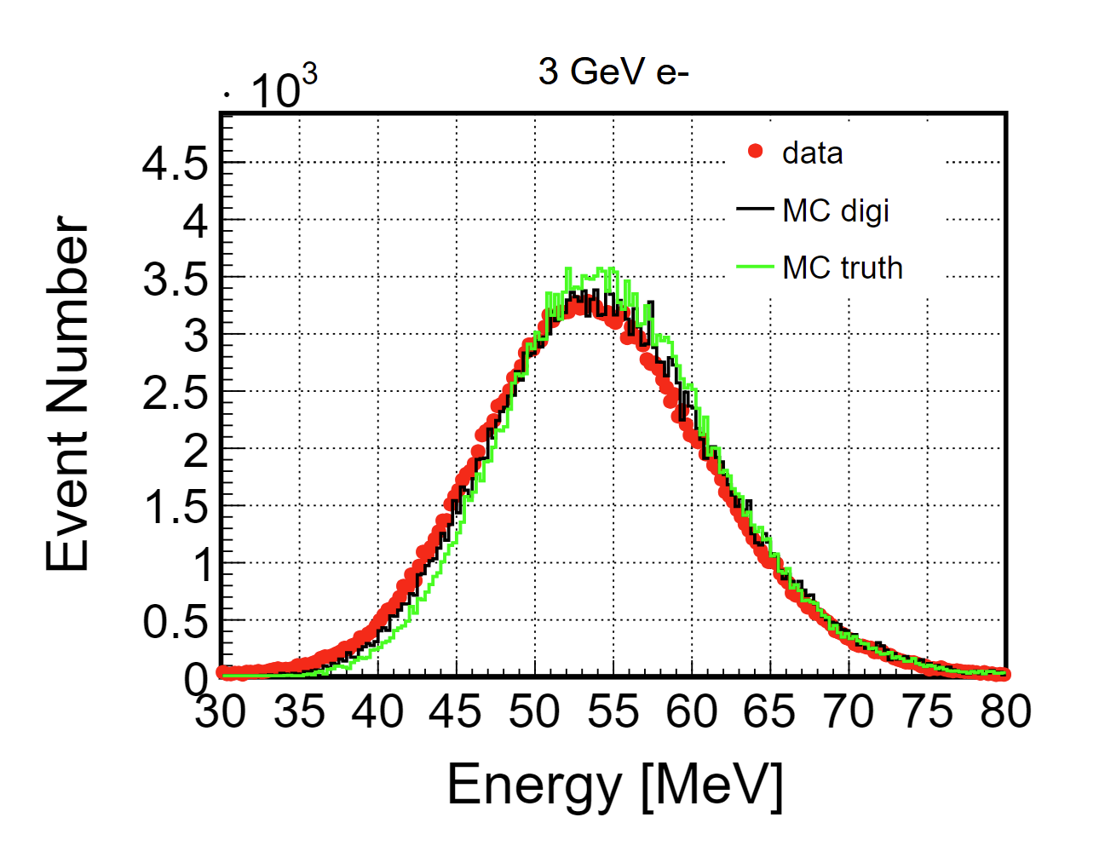
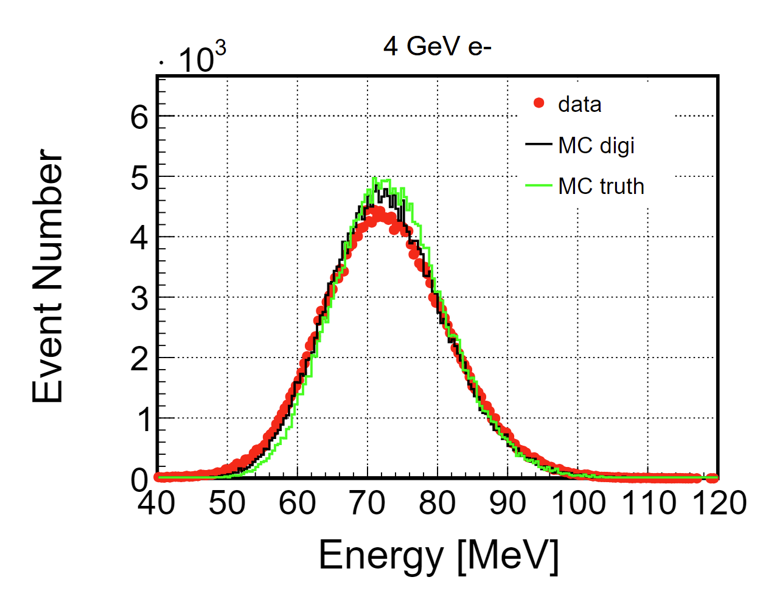
Electron

Slide 16
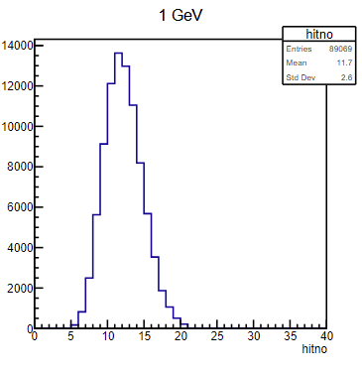
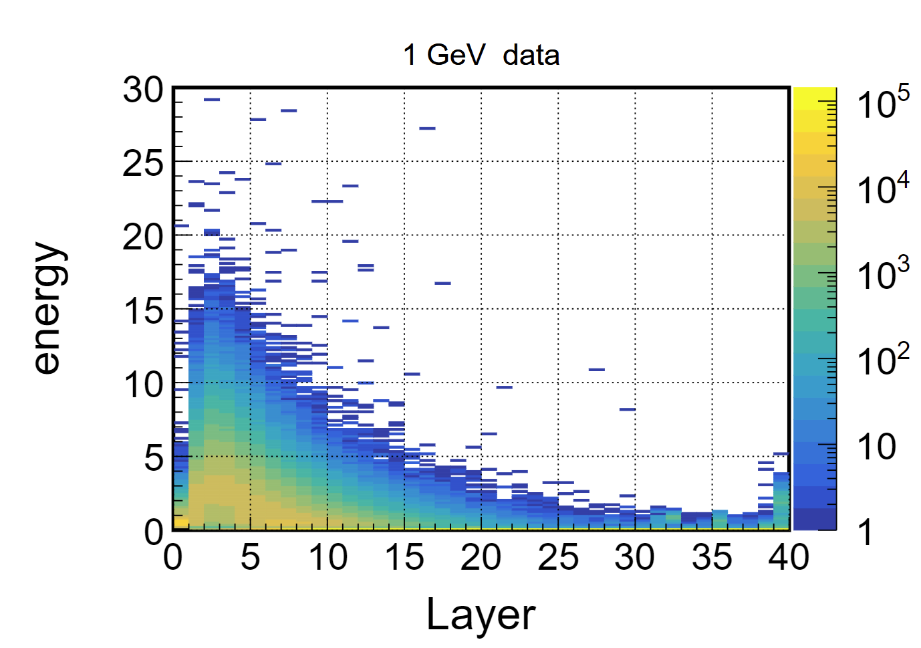
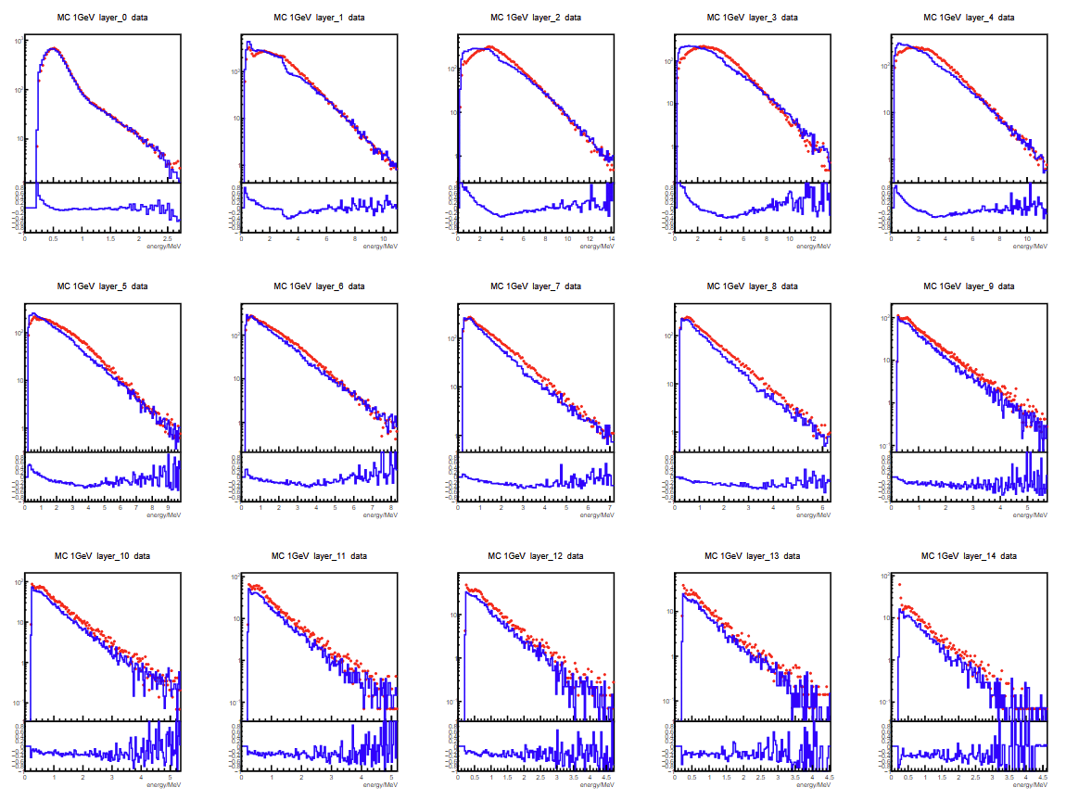
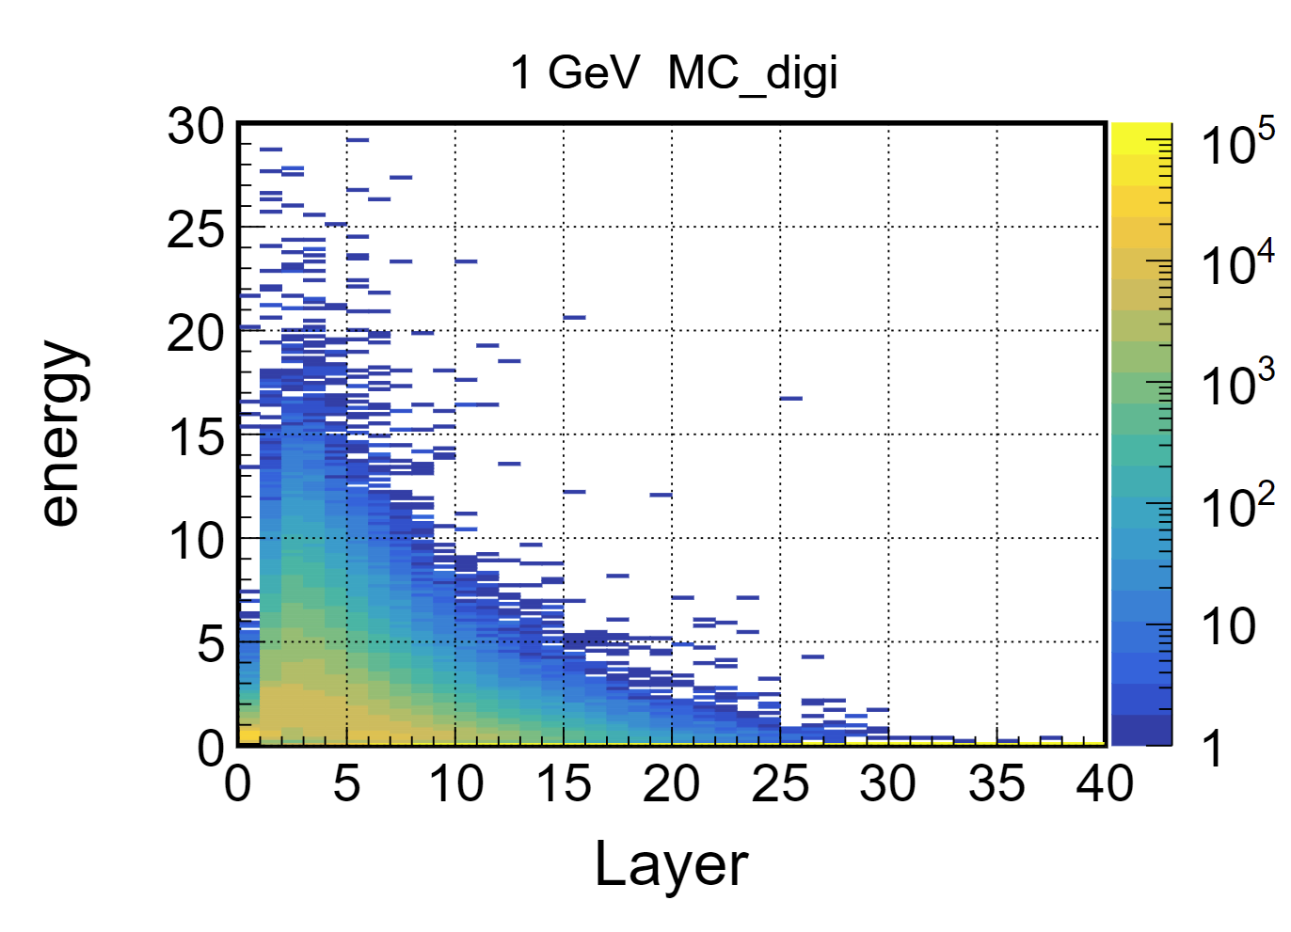

Electron 1GeV
hitno
data
MC digi

Slide 17





Electron 2GeV
hitno
data
MC digi

Slide 18





Electron 3GeV
hitno
data
MC digi

Slide 19





Electron 4GeV
hitno
data
MC digi

Slide 20








Pion

Slide 21





Pion 1GeV
hitno
data
MC digi

Slide 22





Pion 3GeV
hitno
data
MC digi

Slide 23





Pion 4GeV
hitno
data
MC digi

Slide 24





Pion 5GeV
hitno
data
MC digi

Slide 25





Pion 6GeV
hitno
data
MC digi

Slide 26





Pion 7GeV
hitno
data
MC digi

Slide 27





Pion 8GeV
hitno
data
MC digi

Slide 28





Pion 12GeV
hitno
data
MC digi

Slide 29





Pion 15GeV
hitno
data
MC digi

