Slide 1
LightFCP
Rong Yi
2025/6/27

Slide 2
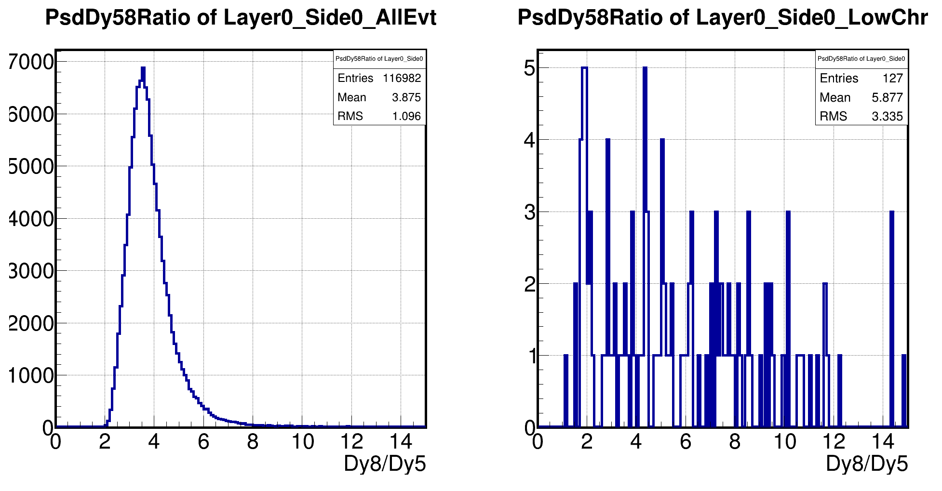
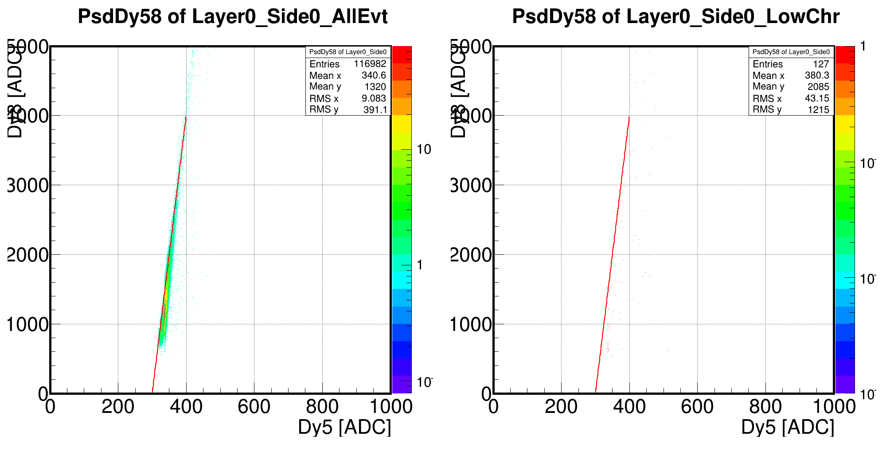
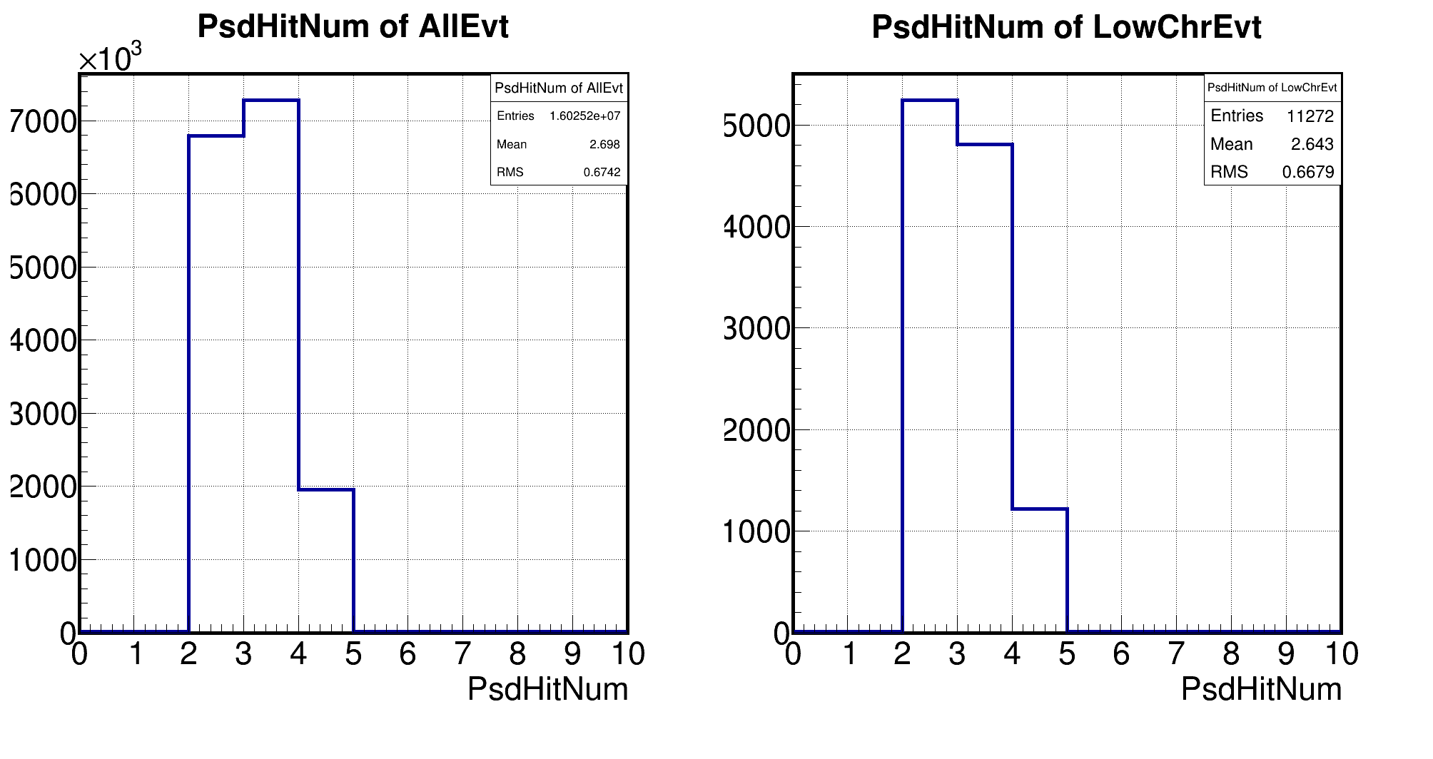
Review: PSD Dy58 and PsdHitNum

Slide 3
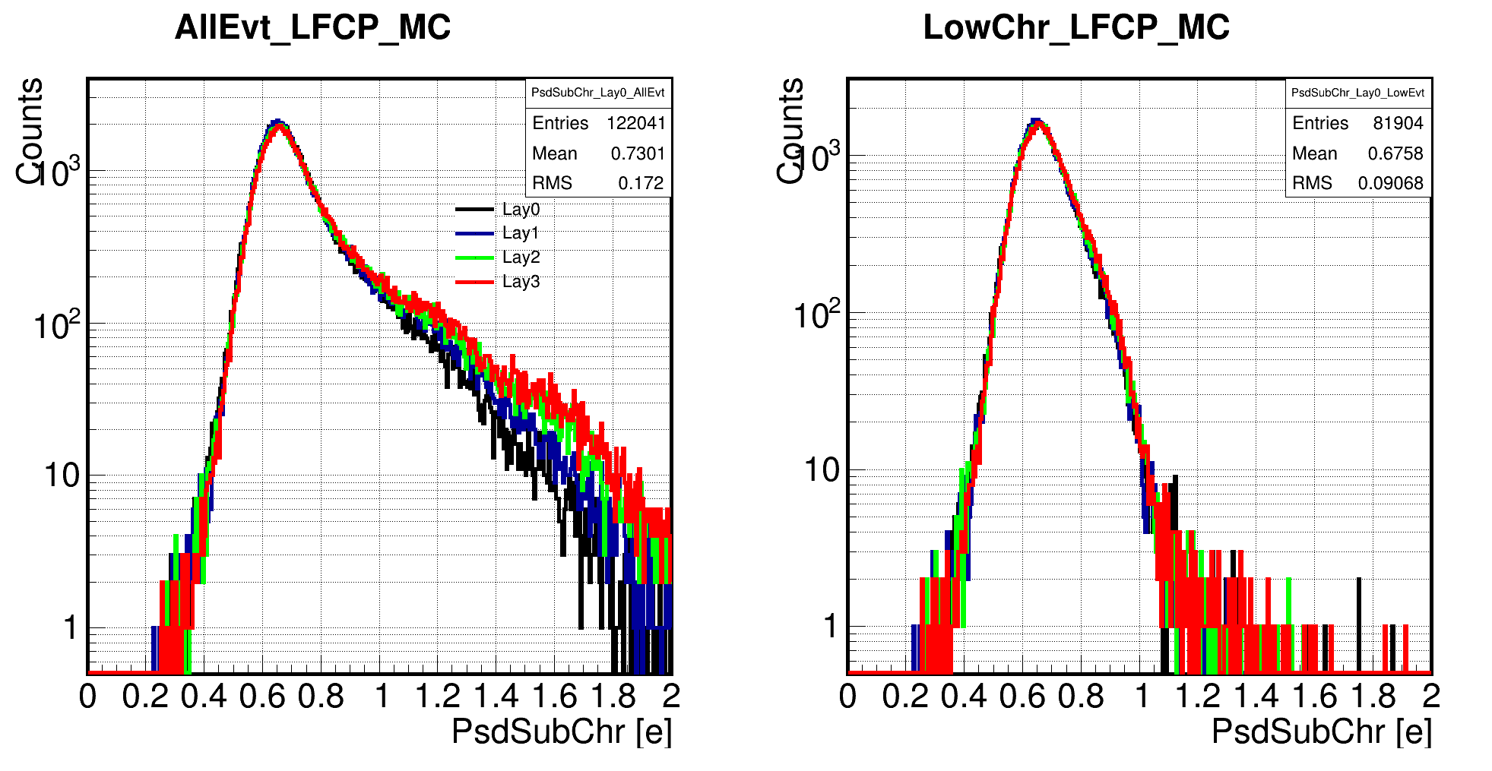
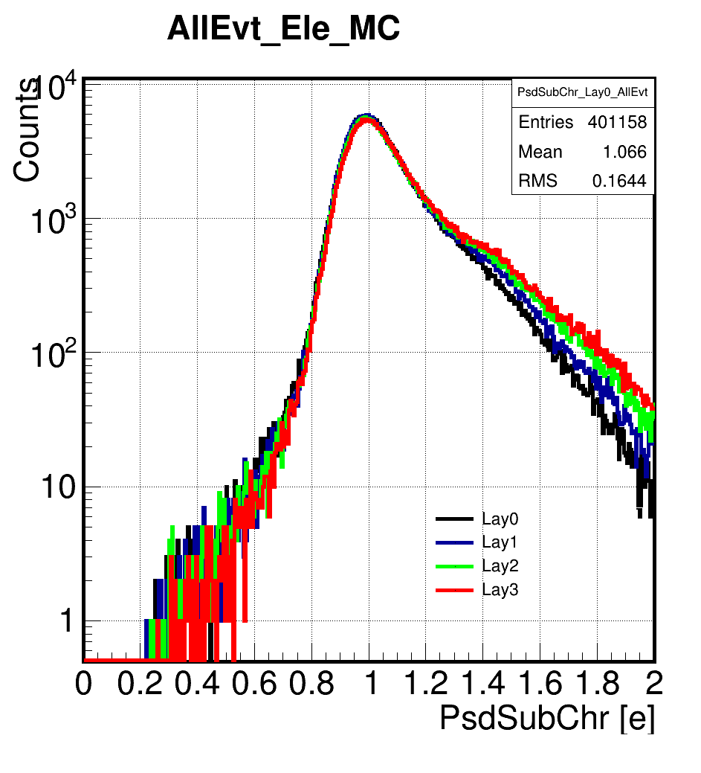
PsdSubFourChr

Slide 4
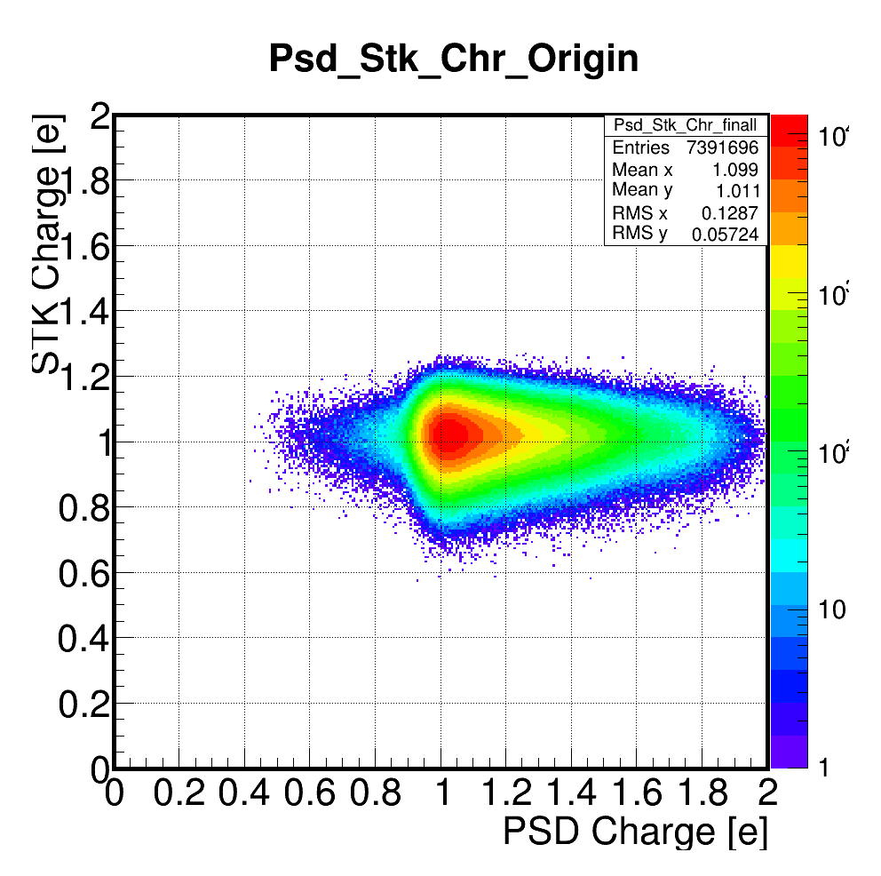
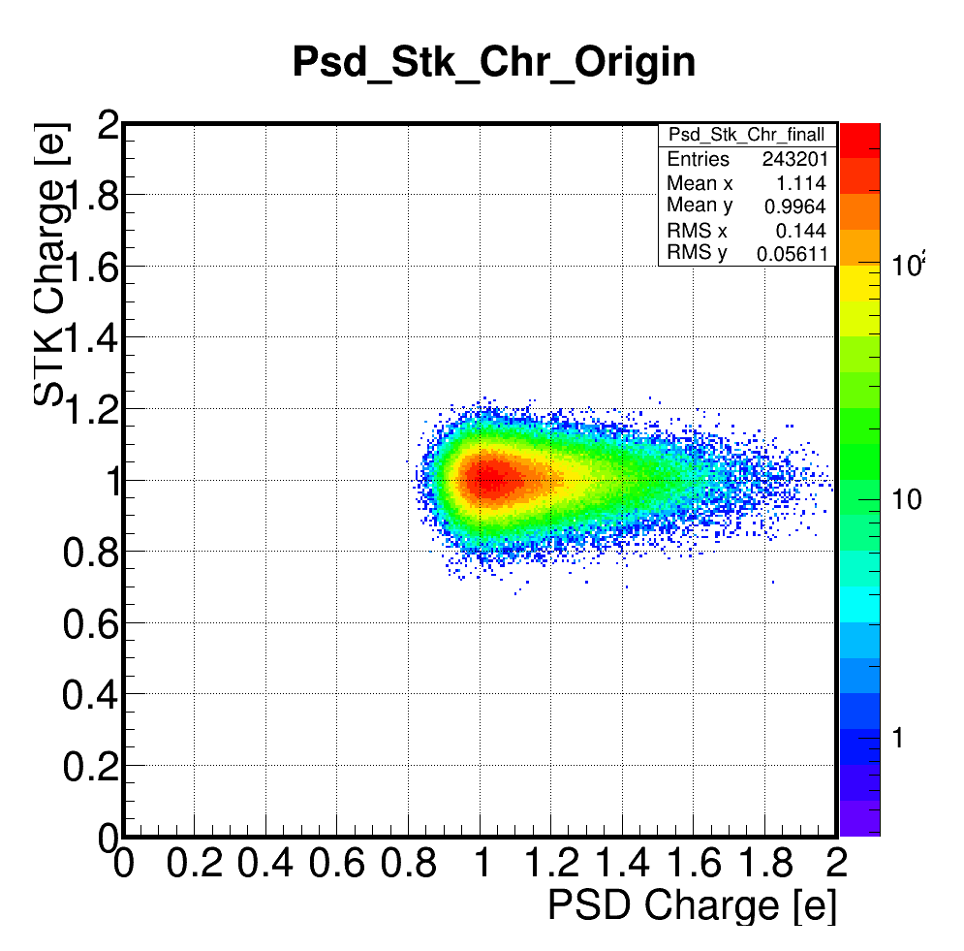
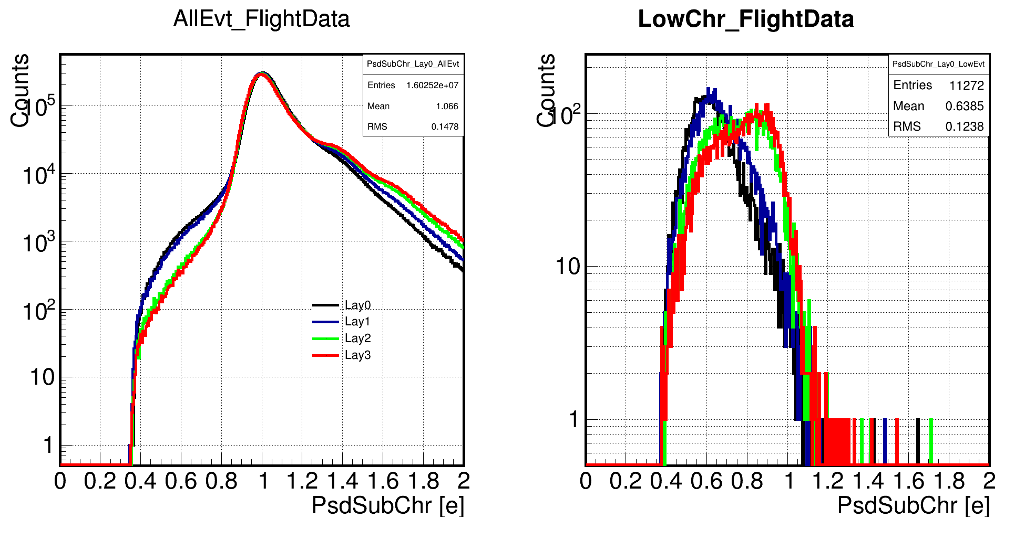
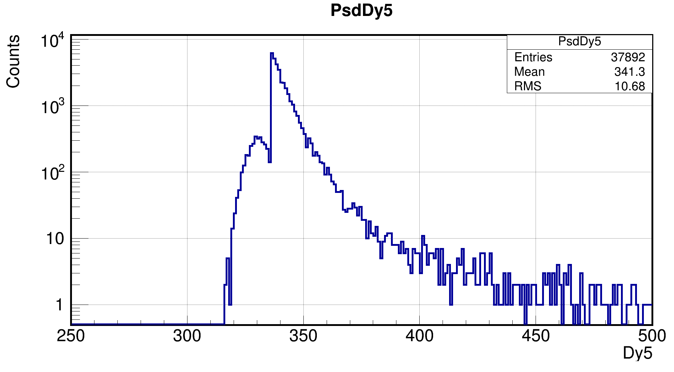
PsdSubFourChr
Data
MC

Slide 5
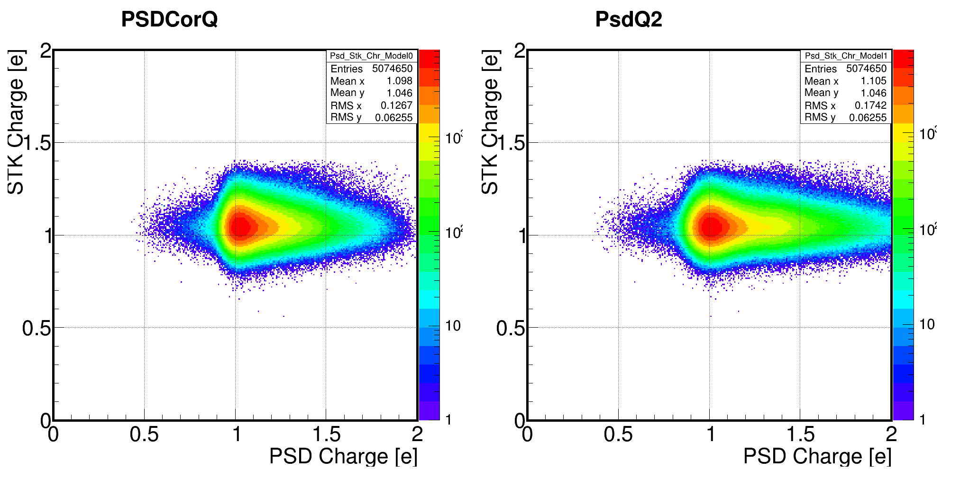
CorQ -> Q2

Slide 6
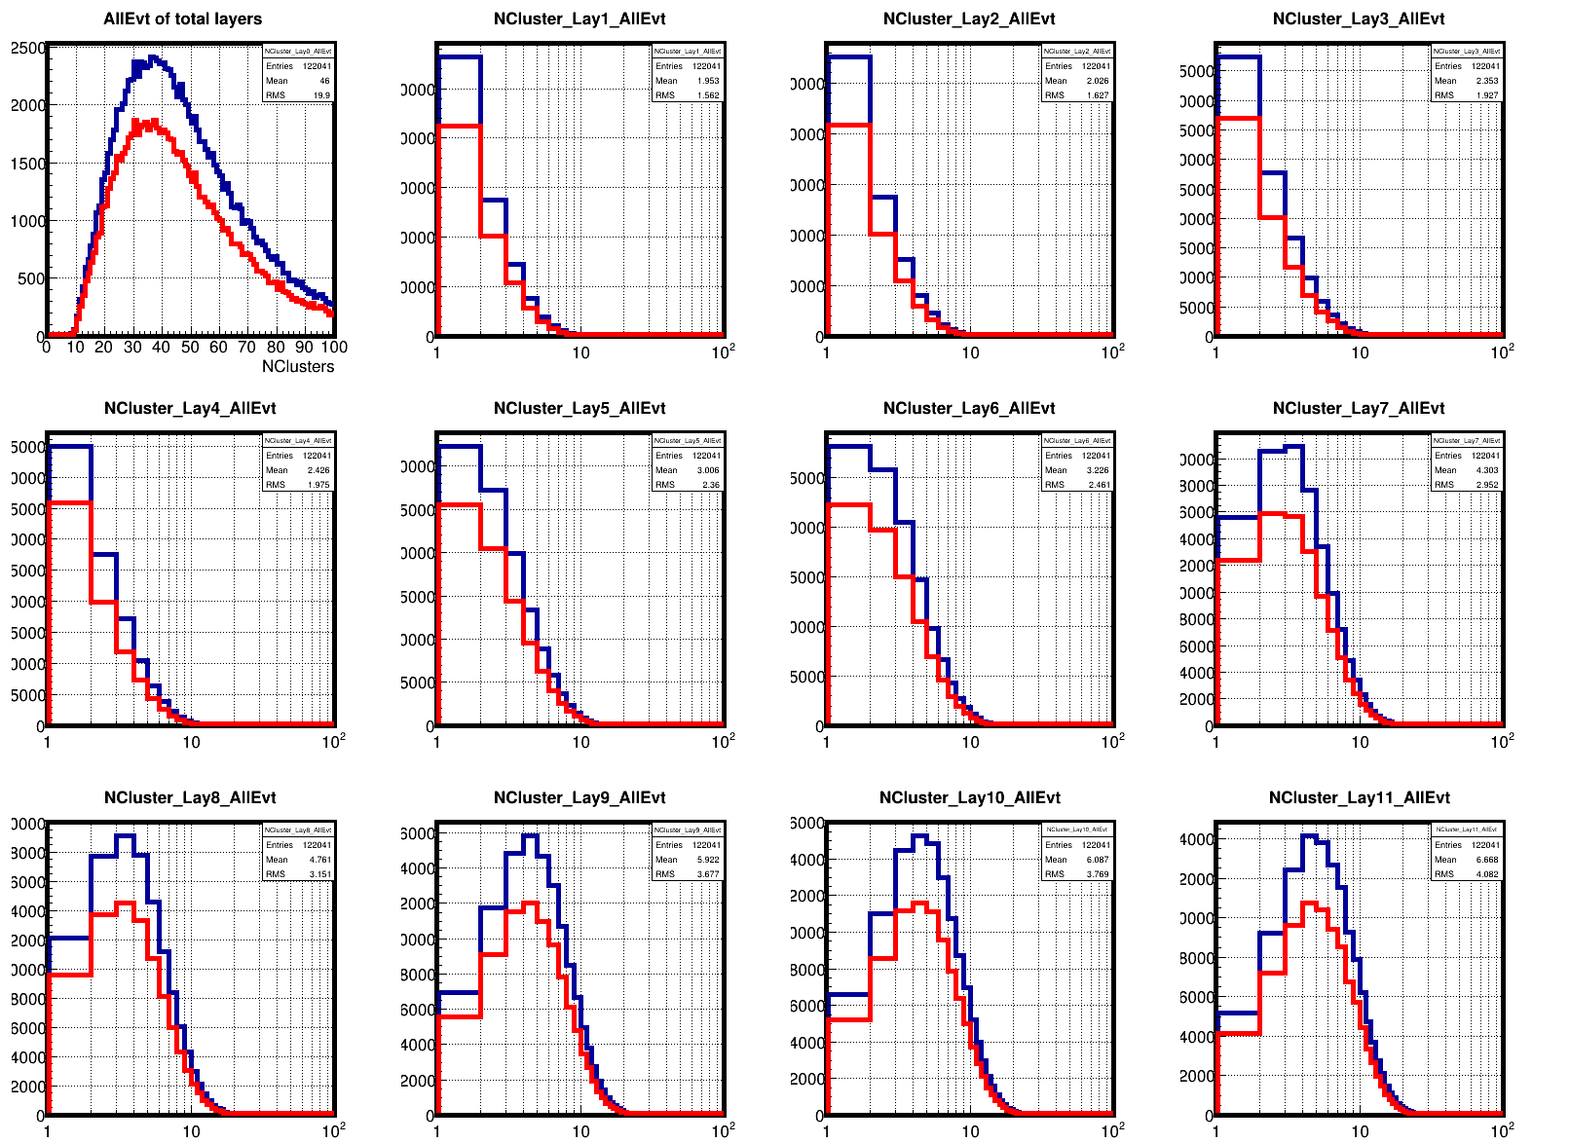
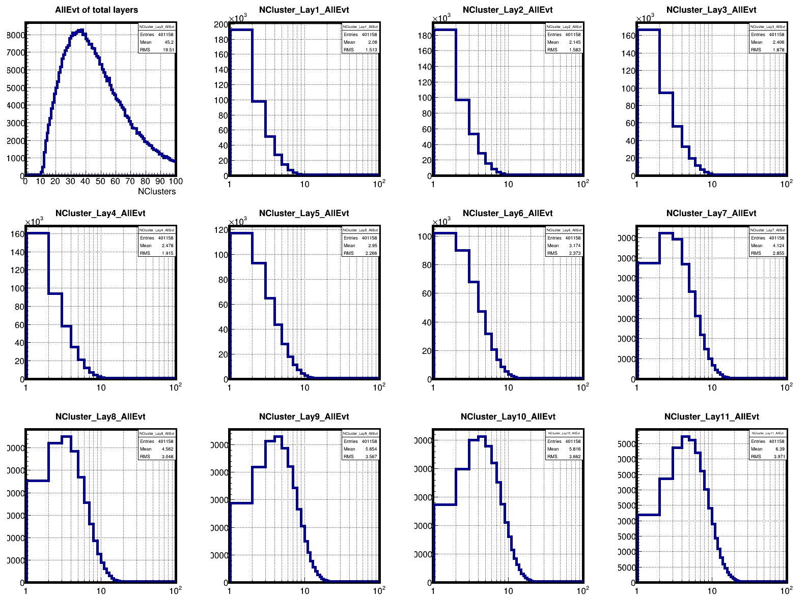
Number of clusters
LFCP_MC:
Blue line is total events;
Red line is low PSD charge events.
Ele_MC:
There are no low charge events.

Slide 7
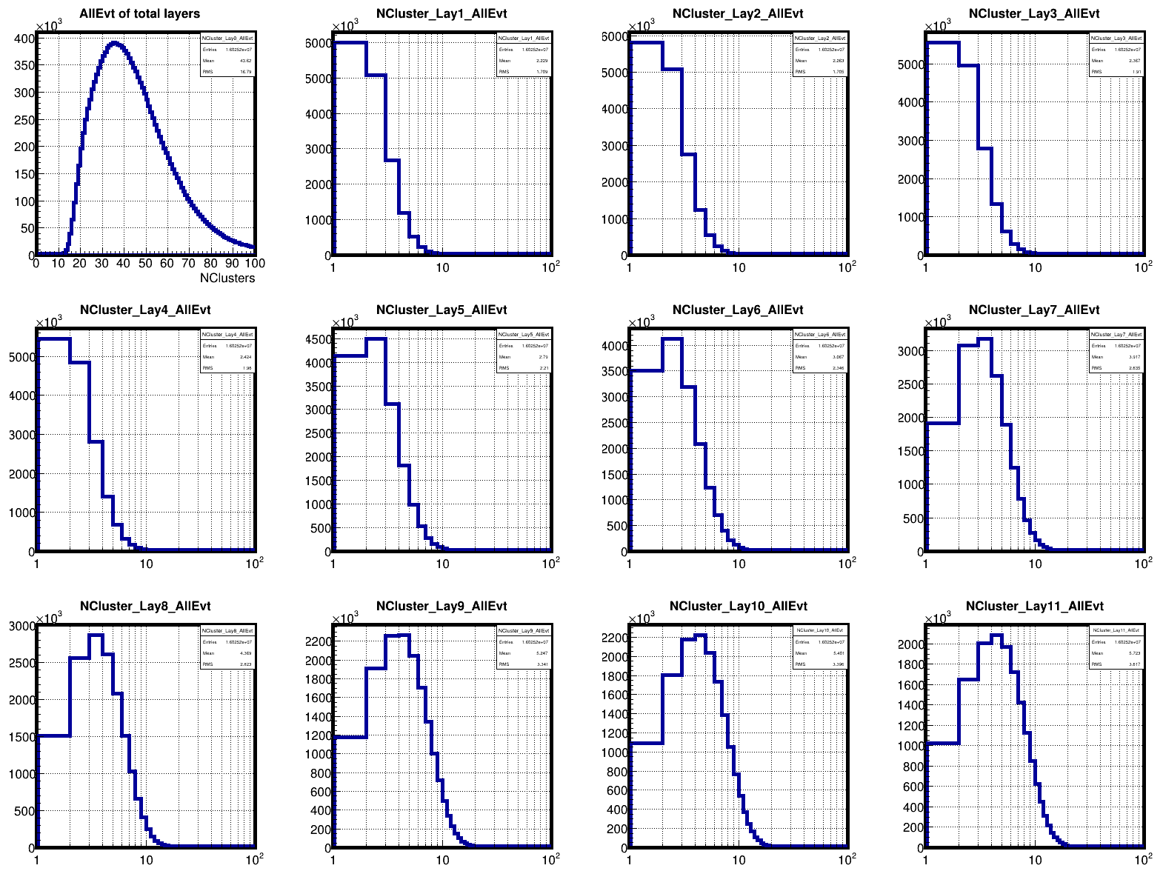
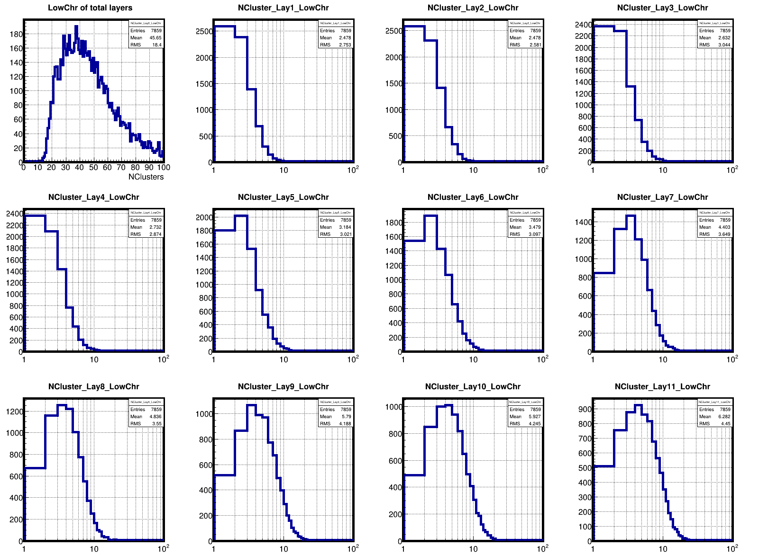
Number of clusters
Flight Data:
Left is total events;
Right is low PSD charge events.

Slide 8
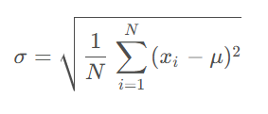
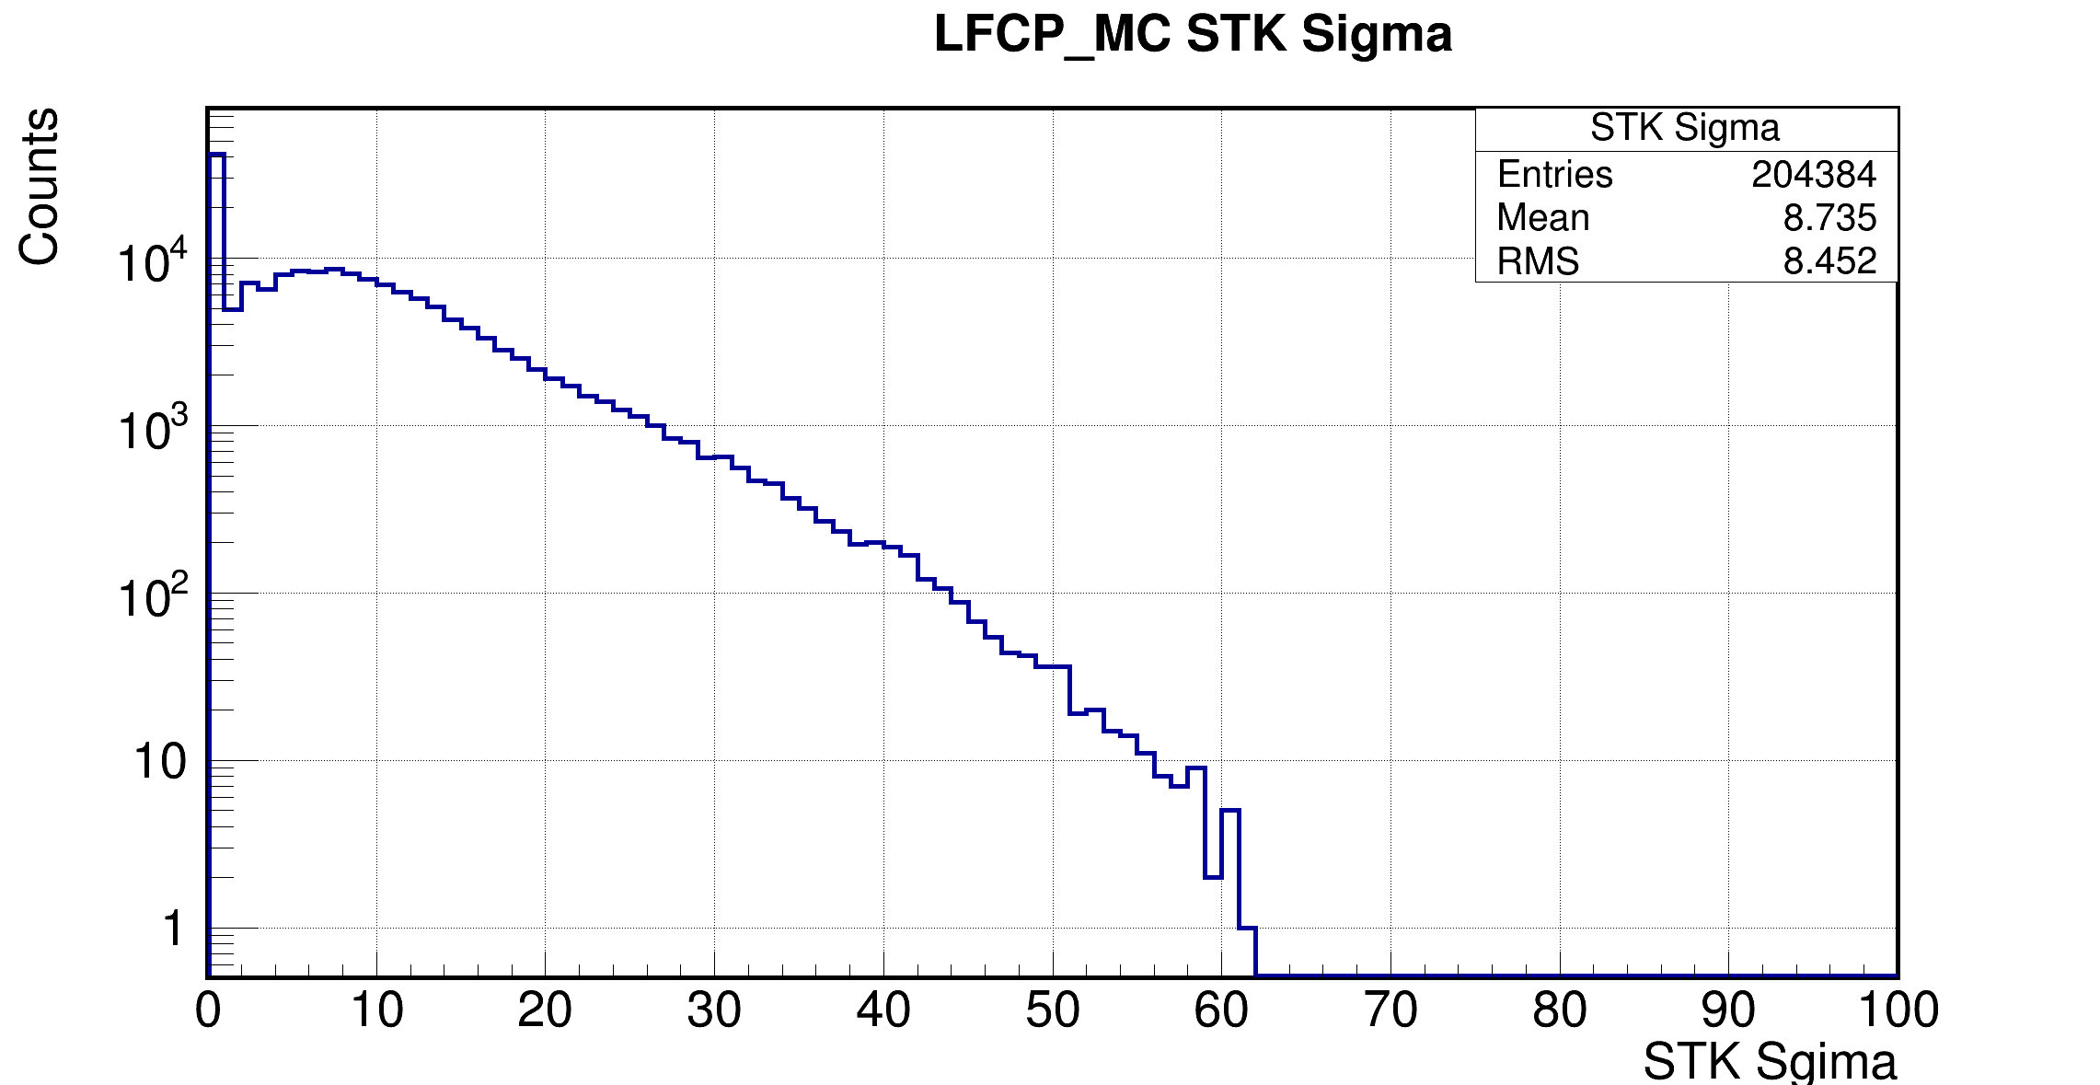
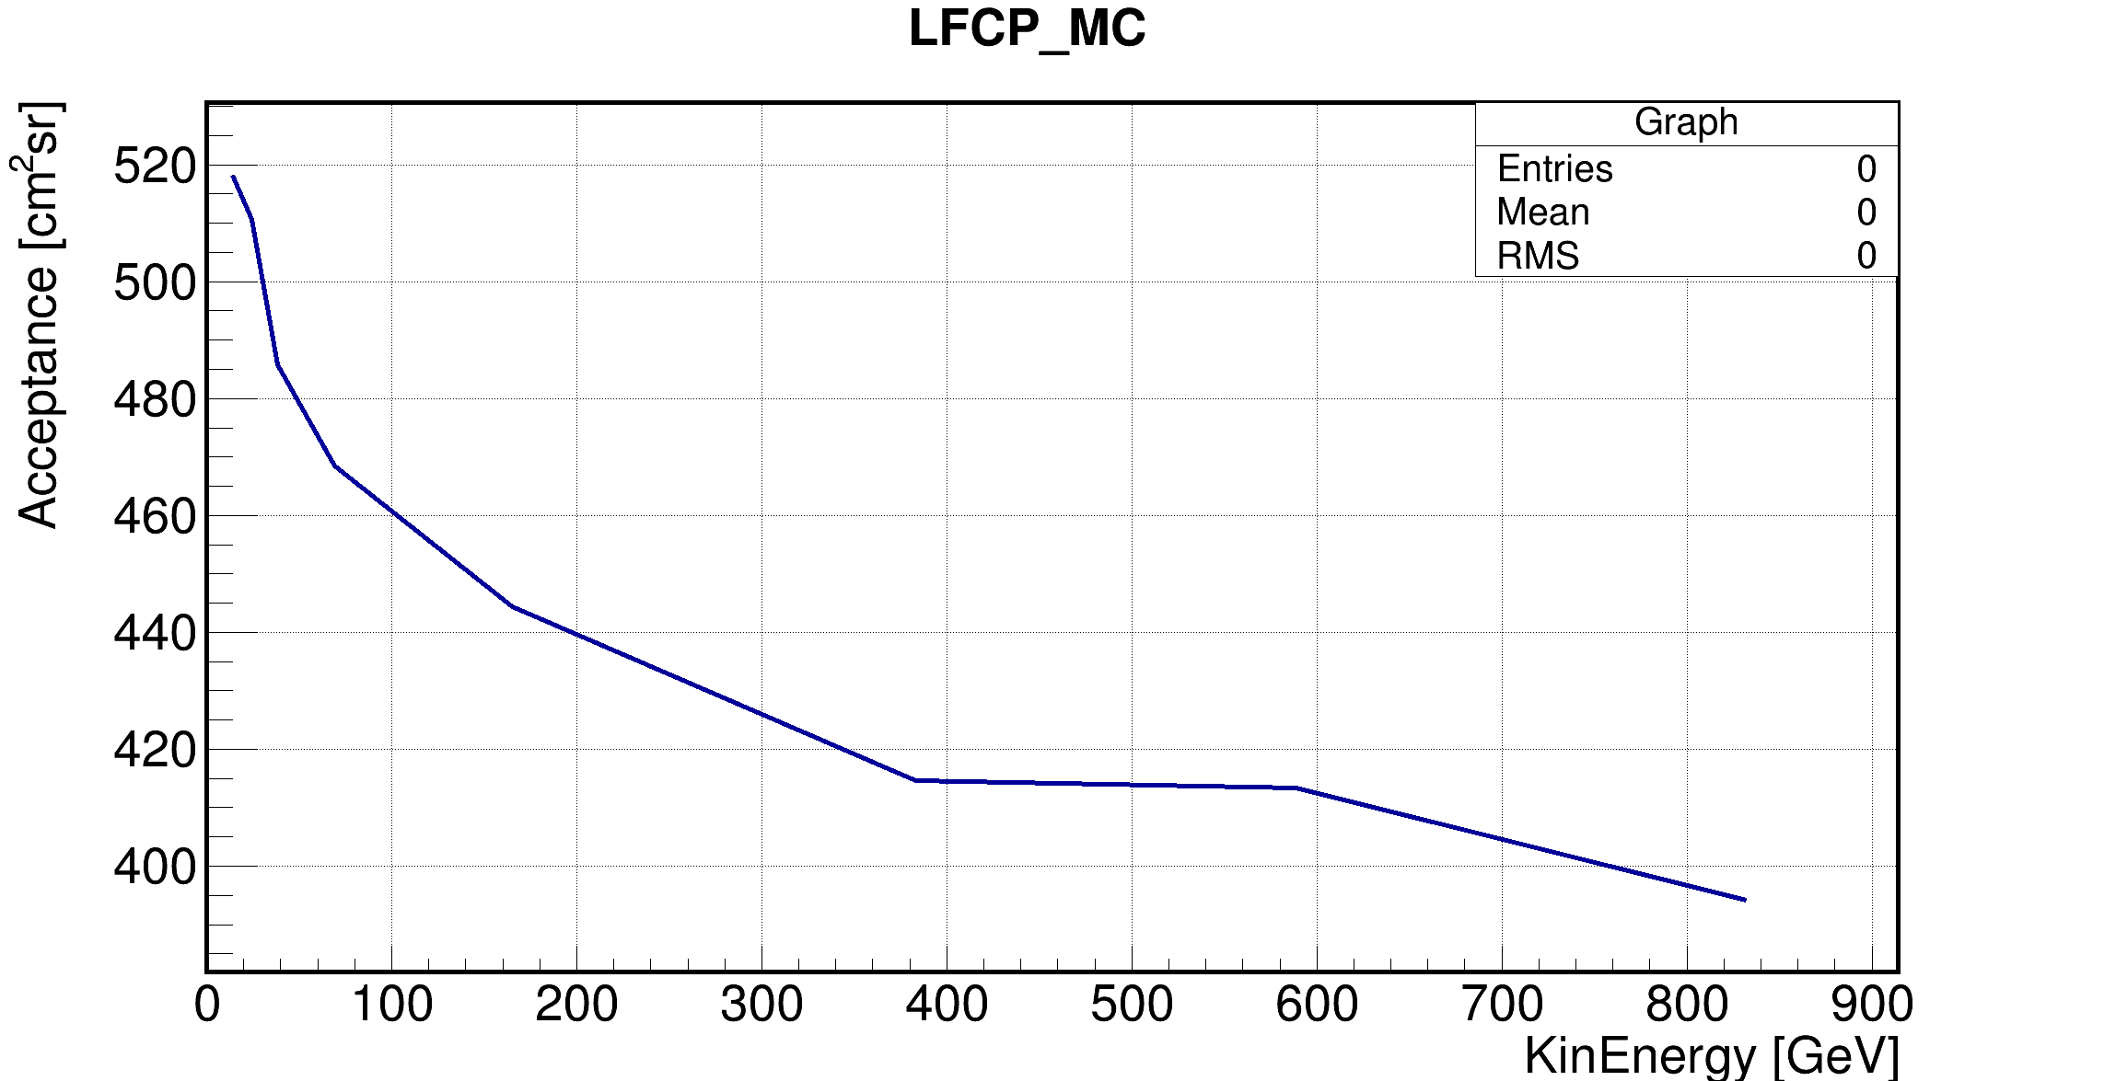
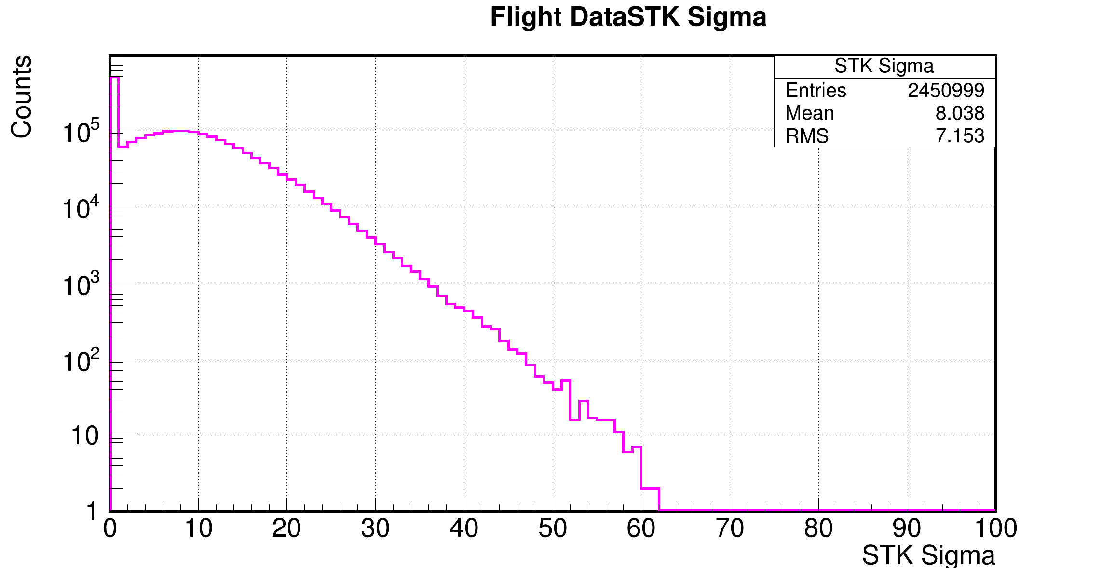
STK Standard Deviation of Efficiency Signals
Sigma <= 15

Slide 9
Backup

Slide 10
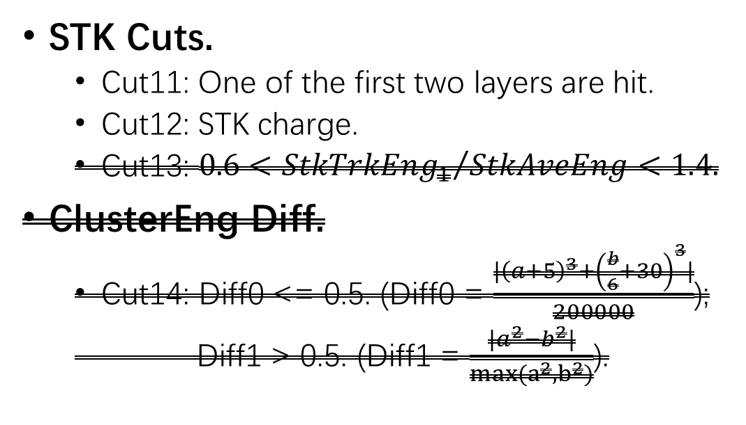
Selections (MC data sample: Light FCP 10 GeV~1TeV)
Pre-Selections.
  Cut1: G0, G3.
  Cut2: Good track.
  Cut3: Fiducial cut.
Remove oblique events.
  Cut4: LayerMaxEng/TotEng<0.45
Remove proton.
  Cut5: Zeta value.
  Cut6: nBarLayer13.
PSD Cuts.
  Cut8: PSD charge.
  Cut9: PSD path length.
  Cut10: PSD two end ratio.
STK Cuts.
  Cut11: One of the first two layers are hit.
  Cut12: STK charge.
  $\text{Cut}\text{13: }0.6<{StkTrkEng_{1}}/{StkAveEng}<1.4.$
ClusterEng Diff.
  $\text{Cut}\text{14}$: Diff0 <= 0.5. (Diff0 = $\frac{|{\left(a+5\right)}^{3}+{\left(\frac{b}{6}+30\right)}^{3}|}{200000}$);
  Diff1 > 0.5. (Diff1 = $\frac{|a^{2}−b^{2}|}{max(a^{2},b^{2})}$).

