Slide 1
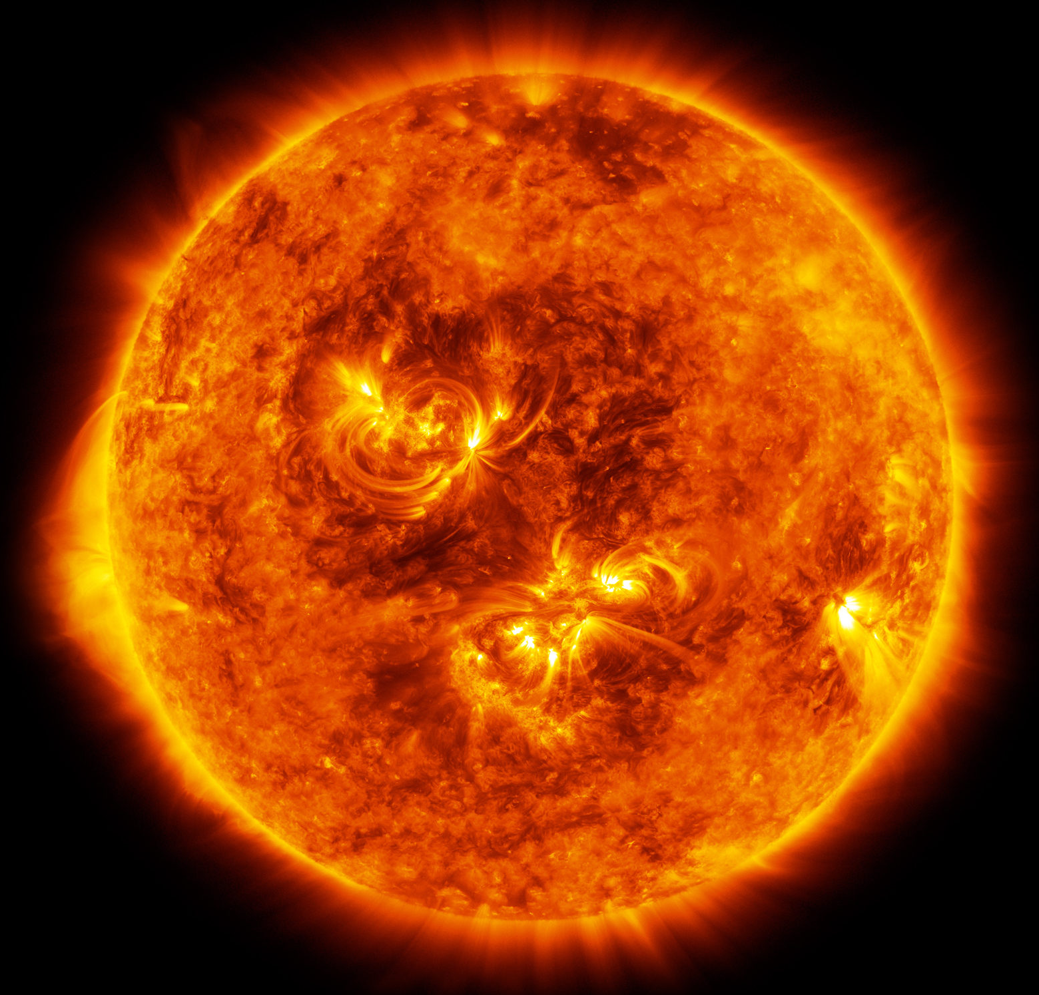
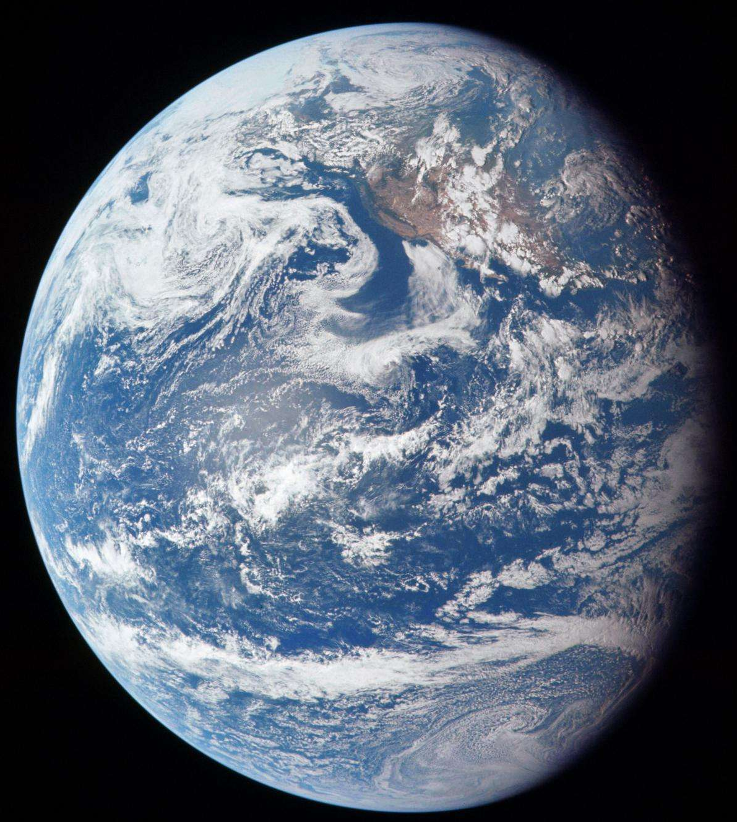
On the rigidity-dependent delay time of the GCR modulation versus open solar magnetic flux
Yubao Wang¹, Jingnan Guo^{1,2,3}, Claudio Corti⁴, Yuming Wang^{1,2}, Weihao Liu⁵,
¹Deep Space Exploration Laboratory/School of Earth and Space Sciences, University of Science and Technology of China
²CAS Center for Excellence in Comparative Planetology, University of Science and Technology of China
³Collaborative Innovation Center of Astronautical Science and Technology
⁴University of Hawaii at Manoa, Honolulu, USA
⁵University of Michigan, Ann Arbor, USA
乌鲁木齐 2025.7.31

Slide 2
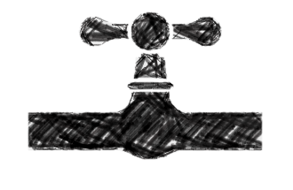
Terminal shock
Heliopause
LIS
OF
IMF
Solar activity
GCR modulation
OF
GCR flux
F10.7
SSN

Slide 3

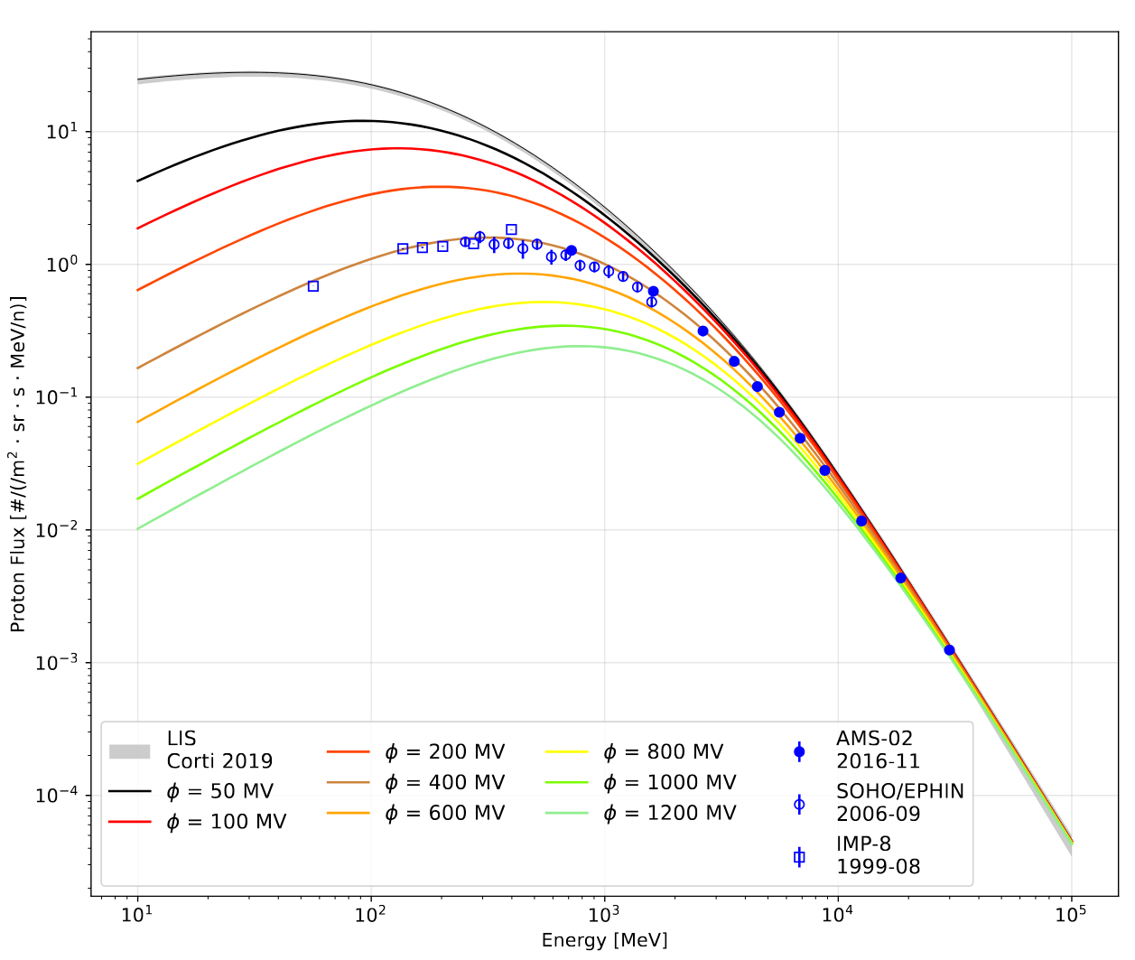

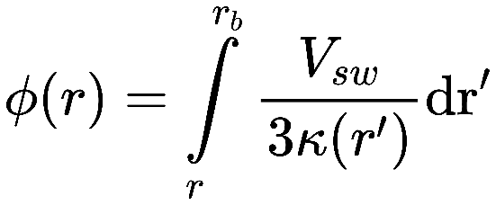

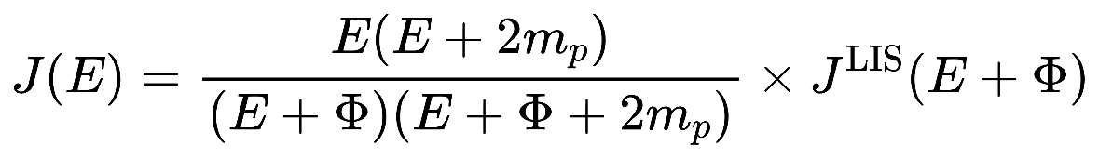
Introduction Solar Modulation of GCR: Force-field model
Force Field model Glesson&Urch 1973
The observed GCR energy spectrum in the inner heliosphere can be related to the GCR Local Interstellar Spectrum(LIS) by a single parameter depending on the heliocentric distance r:
With
The observed GCR energy spectrum can be expressed by
Notes:
The charged extrasolar cosmic ray particles are strongly influenced by magnetic field as they penetrate from the outside into the heliosphere.
Cosmic rays with rigidity R (= total moment um per unit charge) > 10 GV have Larmor radii smaller than the characteristic dimension of the sector structure anywhere in the interplanetary medium, and move along the largescale interplanetary magnetic field.
During their movement they are scattered by the small-scale magnetic field irregularities. Since the irregularities, along with the large-scale n lagnetic field, are moving essentially outward with the
solar wind, this scattering process tends to sweep cosmic rays out of the solar system. Then the density of extrasolar cosmic rays that we observe at Earth is lower than the density present in the local interstellar medium, and the observed spectra are altered from their interstellar forms.
The spectra are modulated as these particles pass through the interplanetary medium.

Slide 4
Data selection
4
Solar activity index
Parameter | Source | Time period | Temporal resolution
SSN | WDC-SILSO, Royal Observatory of Belgium, Brussels | 1818-01 to 2023-03 | 1 Month
F10.7 | Canadian Solar Radio Monitoring Program | 1947-02 to 2024-10
Solar open flux | Wang et.al 2022 by CSSS model based on WSO observations | 1976-06 to 2021-01
GCR flux
Particle | Instrument | Rigidity Range | Time period | Solar Cycle | Temporal resolution
Proton | IMP-8 | 0.33–1.07 GV, 6 rigidity bins | 1974-03 to 2001-09 | 21, A-, 22, A+, 23 | 1 Month
 | SOHO EPHIN | 0.71-2.47 GV, 14 rigidity bins | 1995-12 to 2016-12 | 23, A-, 24
 | AMS02 | 1-11 GV, 8 rigidity bins | 2011-05 to 2022-05 | 24, A+, 25
Electron | AMS02 | 1-11 GV, 8 rigidity bins | 2011-05 to 2022-05 | 24, A+, 25

Slide 5
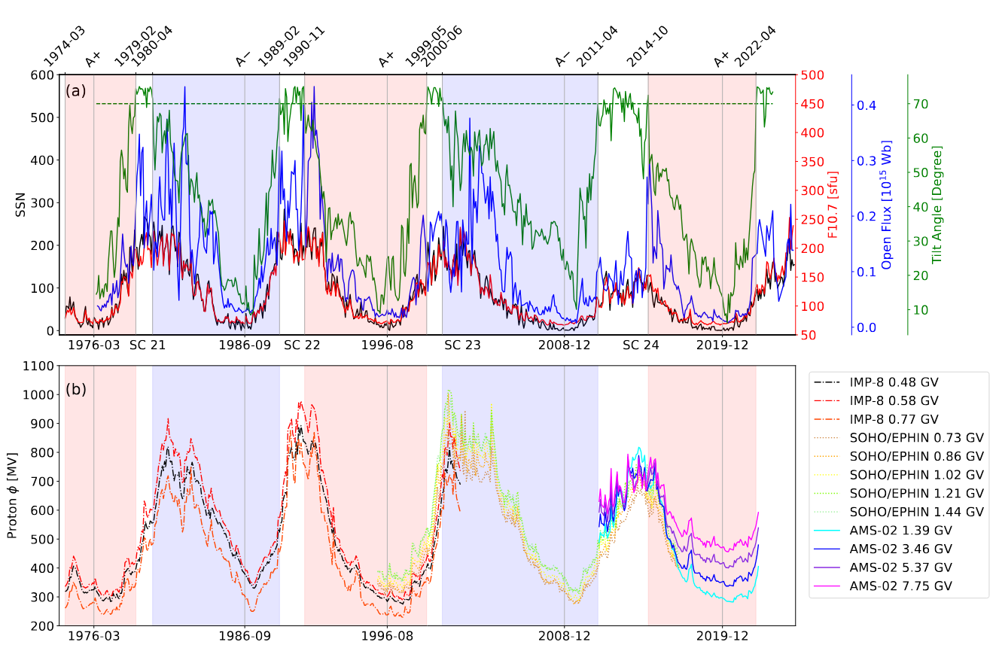
Data selection
5
Solar activity index
GCR modulation

Slide 6
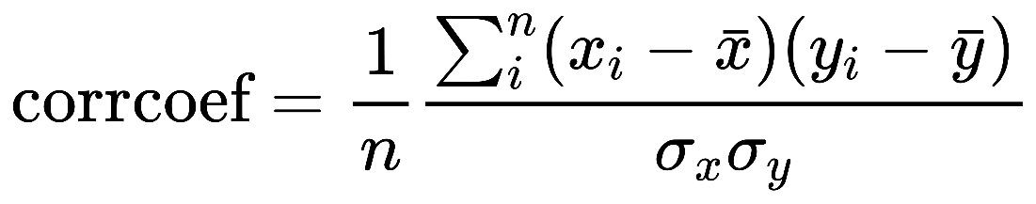
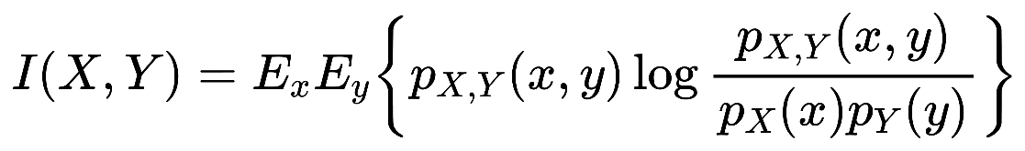

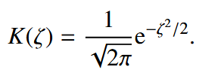
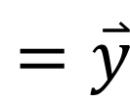
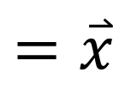
Methods
6
Two methods to find the delay time:
The maximum cross coefficient
The maximum mutual information
Kernel Density Estimation (KDE)
GCR
Phi / flux
$$=\overset{⃑}{x}$$
SSN/ F10.7\OF
$$=\overset{⃑}{y}$$
Time
Monte Carlo uncertainty
We generate 500 new sets of GCR flux–time data by Gaussian sampling, using the measured GCR fluxes and their uncertainties as means and standard deviations, respectively. For each realization, we repeat the methods to calculate the delay time.

Slide 7
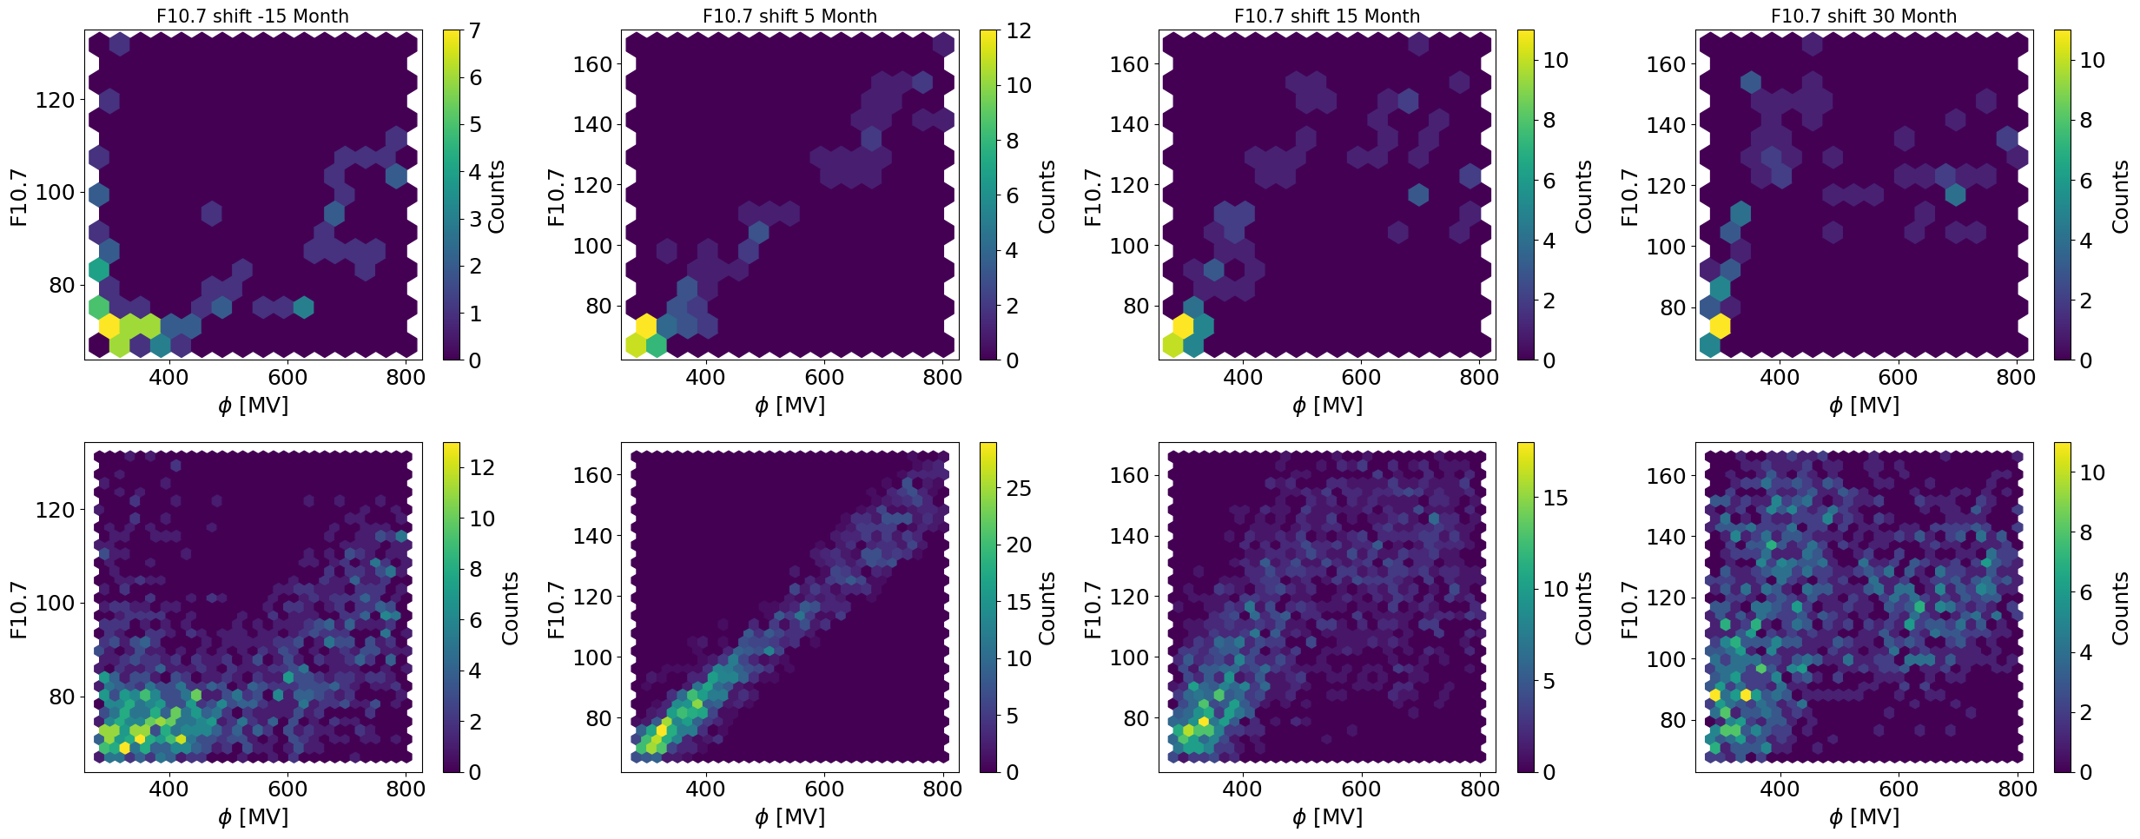
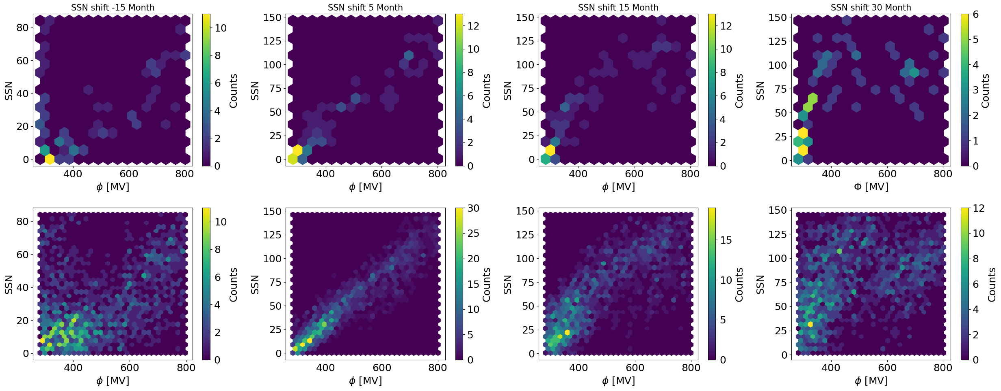
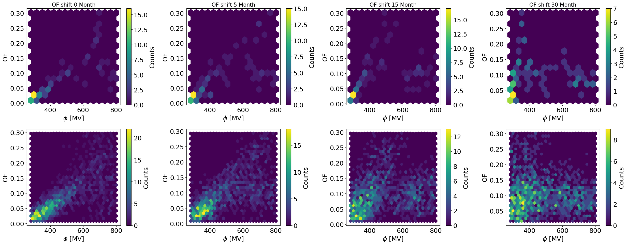
Methods: joint distribution
7
Two ways to estimate the joint distribution
1) upper panels: data bins; 2) bottom panels: kernel density estimation(KDE).

Slide 8
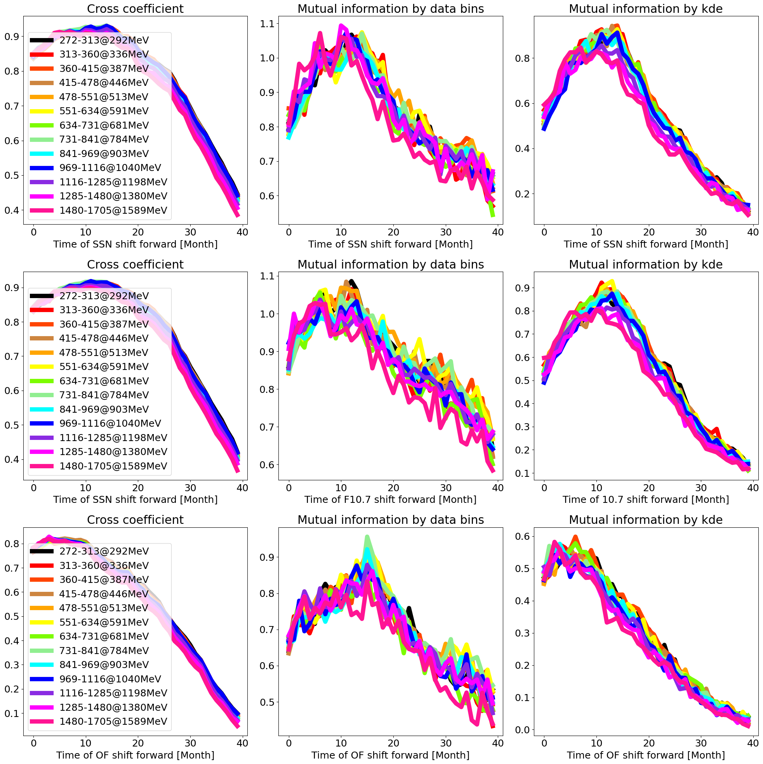
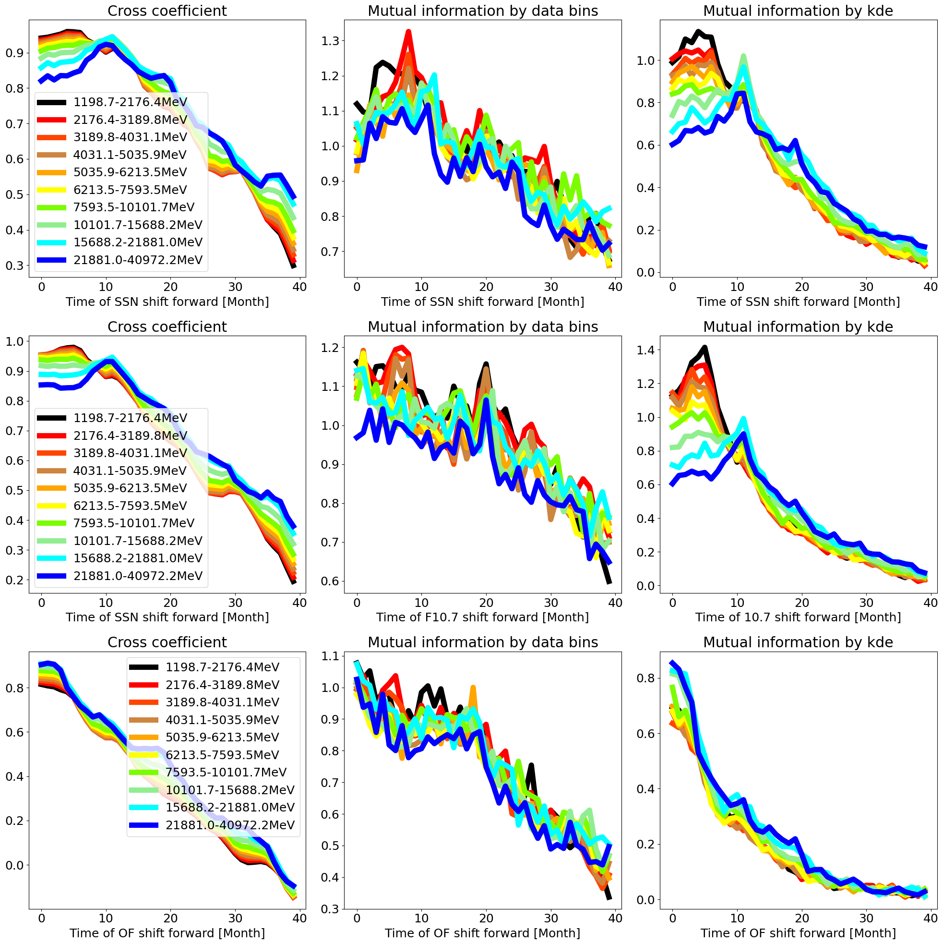
Methods
8
SOHO A-
AMS02 A+

Slide 9
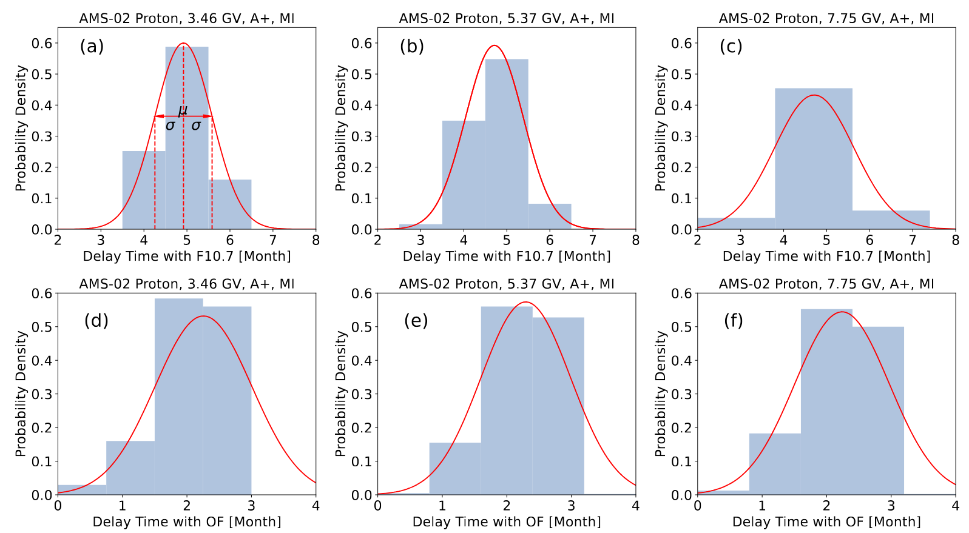
Methods: Monte Carlo uncertainty
9

Slide 10
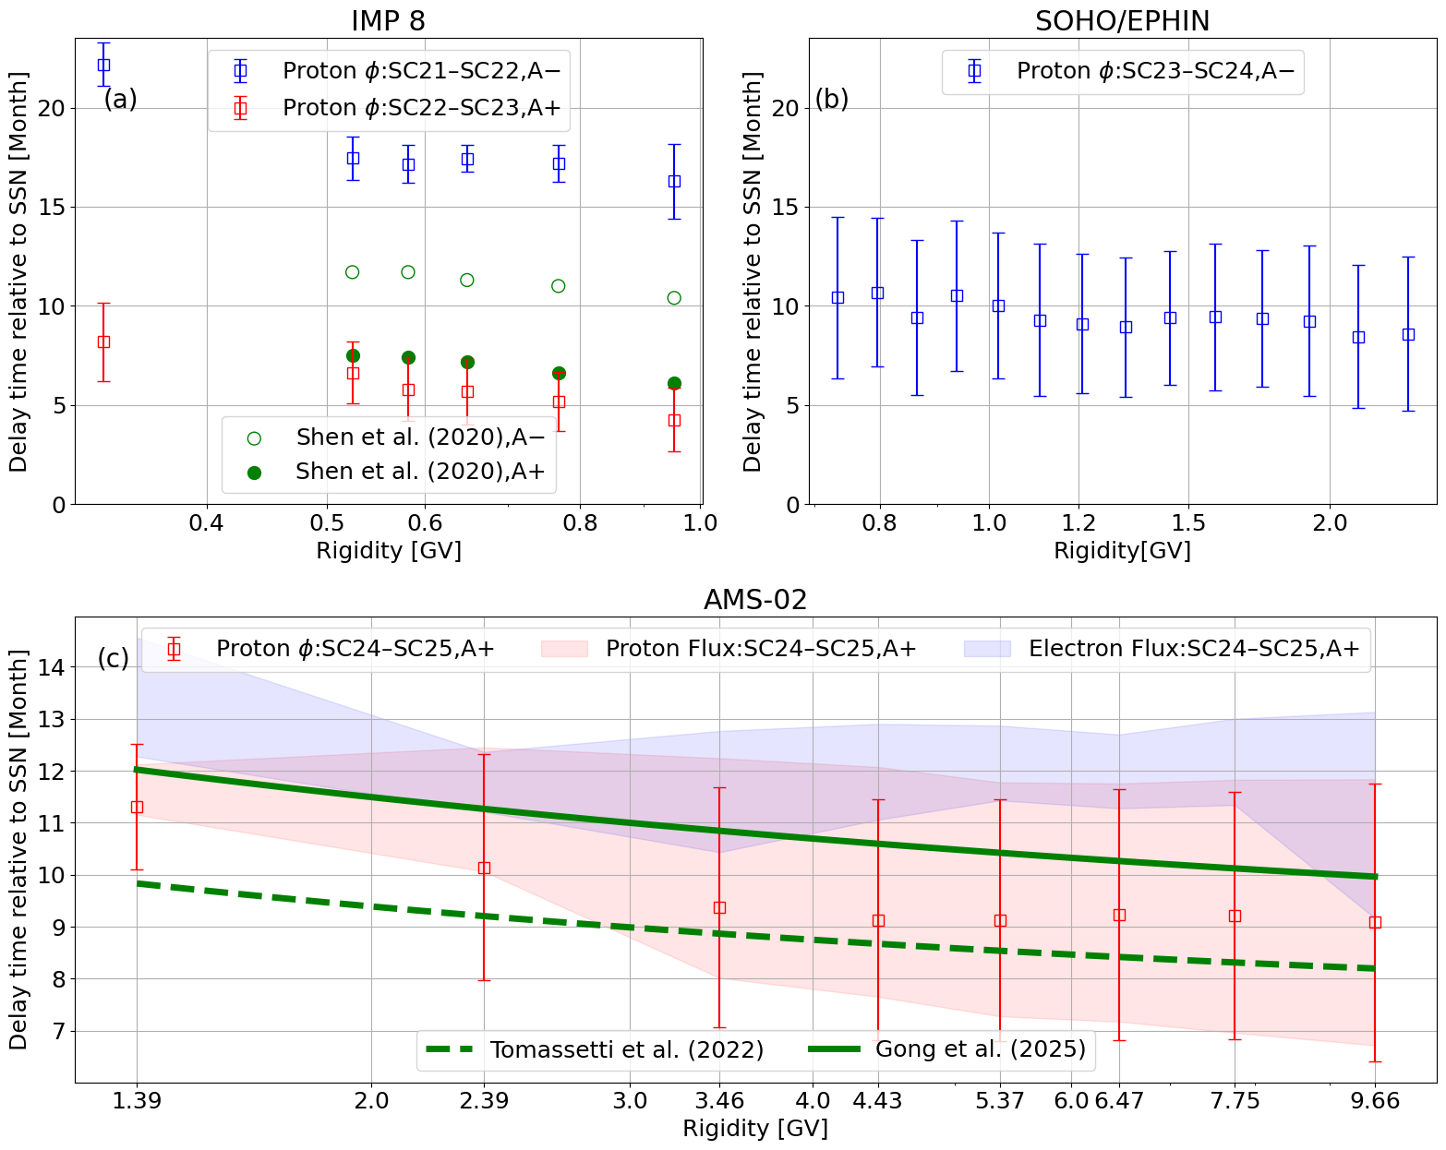
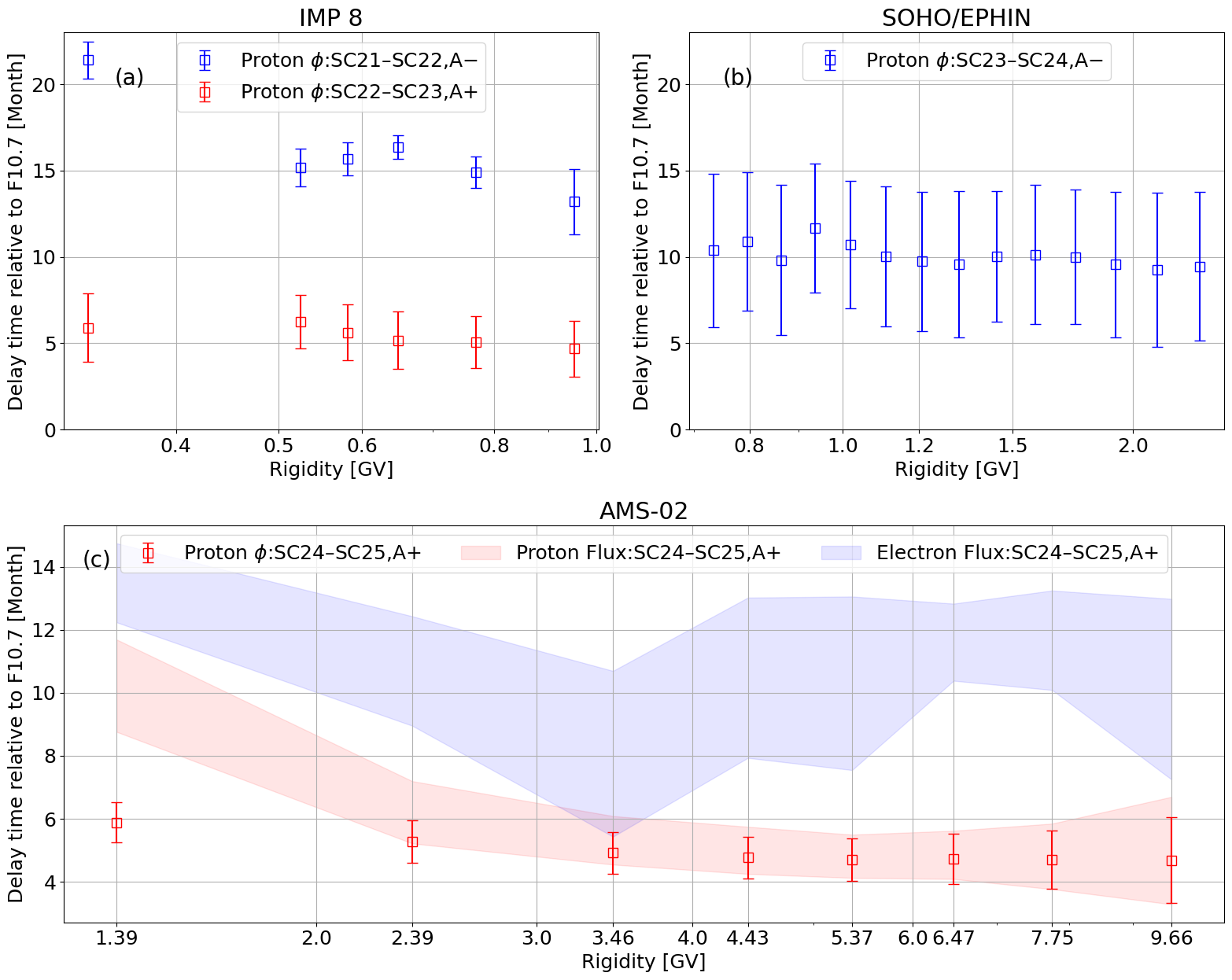
Results: SSN and F10.7
10

Slide 11
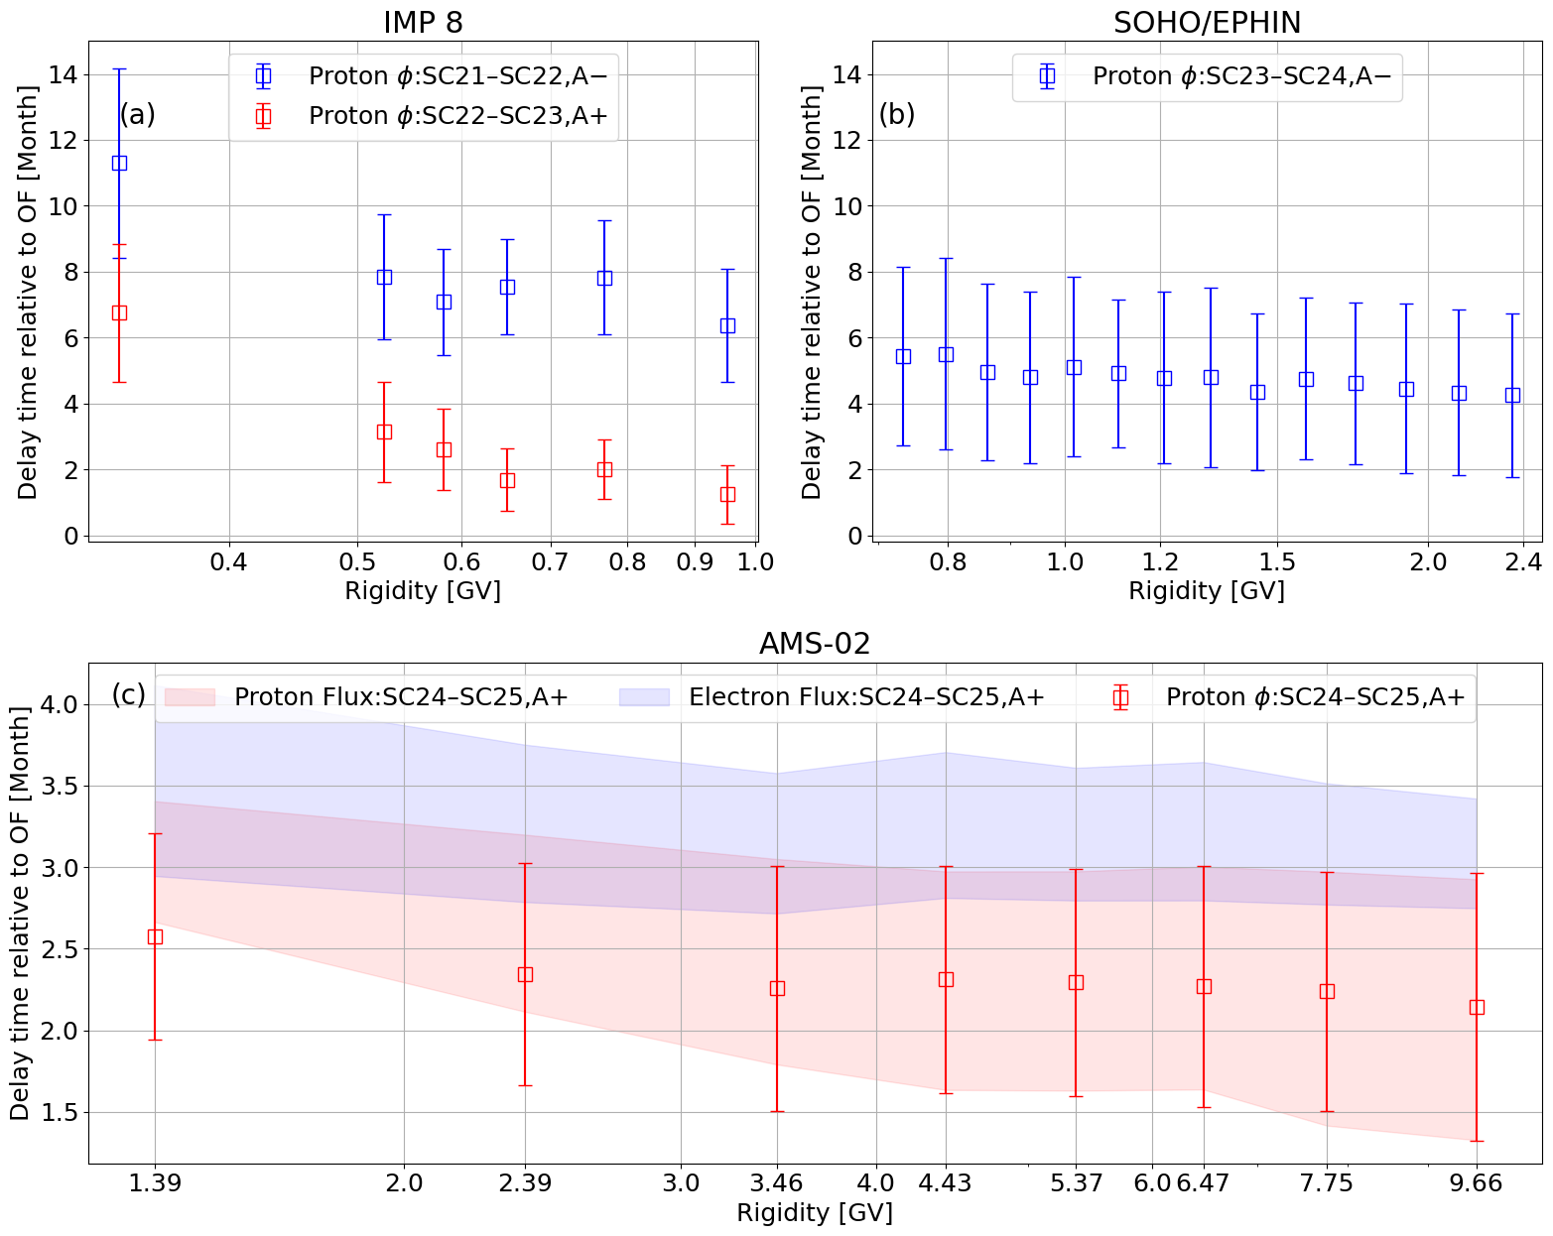
Results: Solar open magnetic flux
11

Slide 12
Summary
12
The delay time relate to OF decreases with the increase of particle rigidity;
The delay time relate to SSN and F10.7 is longer than OF;
The delay time is longer during qA<0 than qA>0, maybe caused by drift effect.
The quantitative explanation of delay time is still insufficient;
Mutual information method can effectively determine the delay time of time series data.

Slide 13
Rigidity-dependent delay time
Transport time of influenced GCR particles
Transport time of solar activity
Delay time between GCR modulation and Solar activity
Dominate among High rigidity particles
Dominate among Low rigidity particles

Slide 14
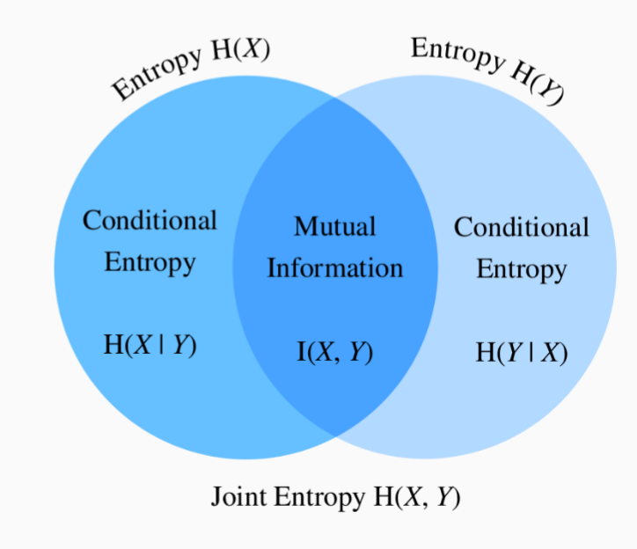
Methods
How much information is shared between two variables X and Y?
Define the mutual information I(X,Y) of a pair random variables (X,Y)
I(X,Y) = H(X,Y) - H(Y|X) - H(X|Y)
Also,
I(X,Y) = H(X) + H(Y) - H(X,Y)
I(X,Y) = H(X) - H(X|Y)
I(X,Y) = H(Y) - H(Y|X)
Properties of mutual information:
1) I(X,Y) = I(Y,X)
2) I(X,Y) ≥ 0
3) If and only if X and Y are independent, I(X,Y)=0
If X is an invertible function of Y, then X and Y share all information
I(X,Y) = H(X) = H(Y)

Slide 15
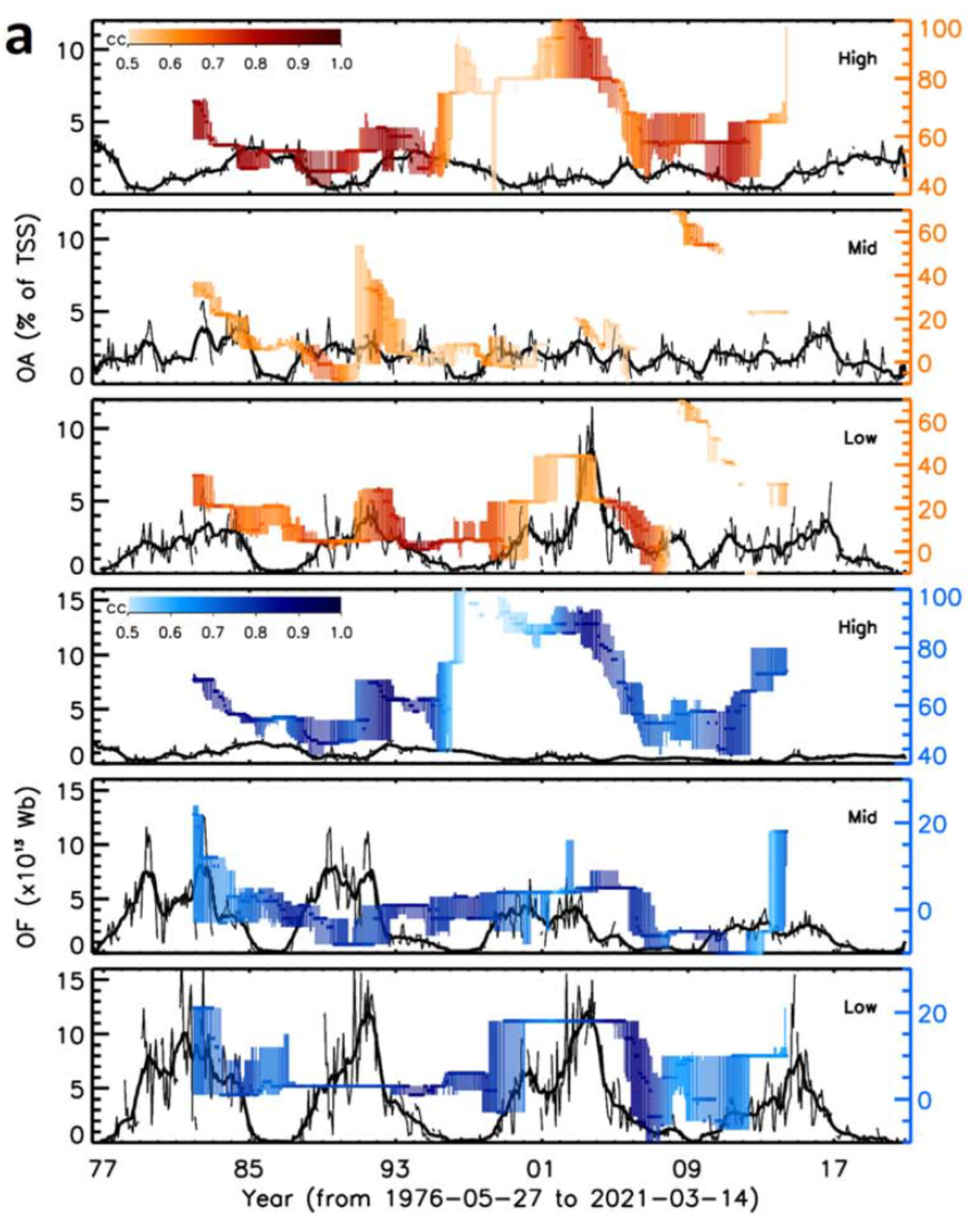
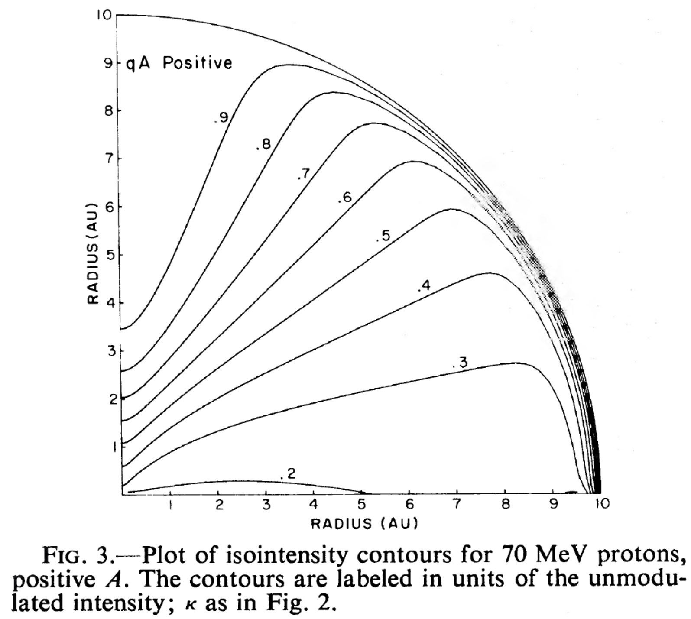
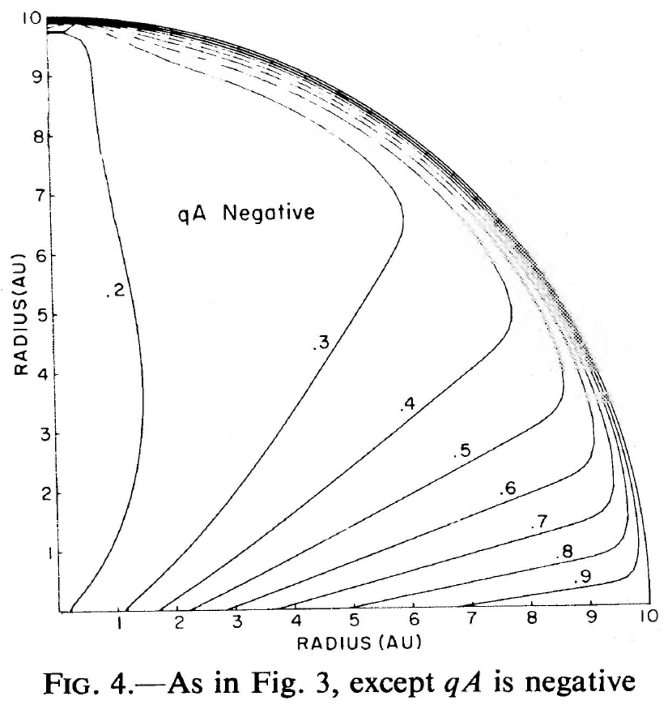
Delay time for two drift patterns
15
Low latitude OF Wang et.al 2022
Particle drift Jokippi et.al 1979
positively charged particles
negatively charged particles
The open flux of the sun is dominated by the low latitude (near the equator), which leads to the continuous influence of the change of the open flux on the transport of cosmic rays (proton) to the inner heliosphere during the A- period, with a longer delay time. The A+ period shows zero delay time.

