Slide 1
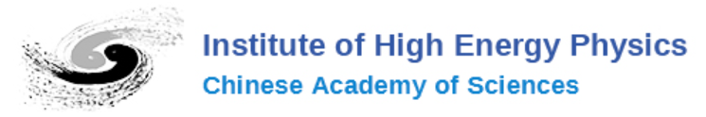

A Measurement Scheme of Anisotropy from quasi-2D to true-2D with EAS array
Reporter: Dan Liª
Wei Liuª, Dongxu Sun^{b}, Hongbo Huª
ªInstitute of High Energy Physics
^{b}Purple Mountain Observatory
31-07-2025

Slide 2
OUTLINE
Introduction: Current observations of the two-dimensional anisotropy of cosmic rays with high energy
Proposed Scheme: Rotating EAS Array
Study of Toy-mc and Preliminary results
Discussion and Summary

Slide 3
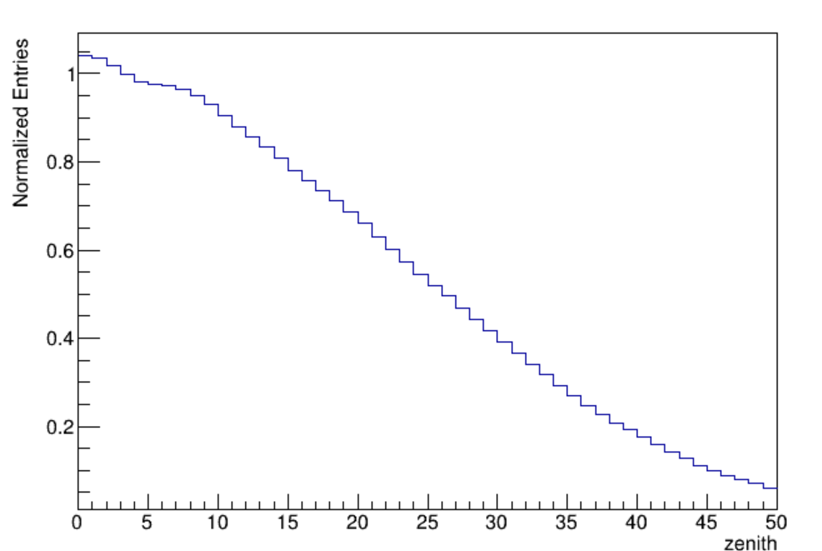
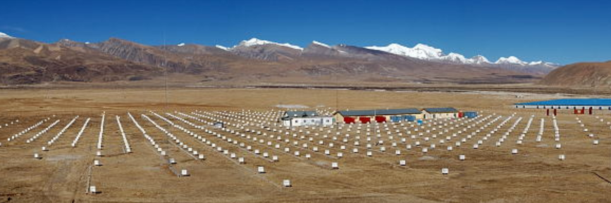
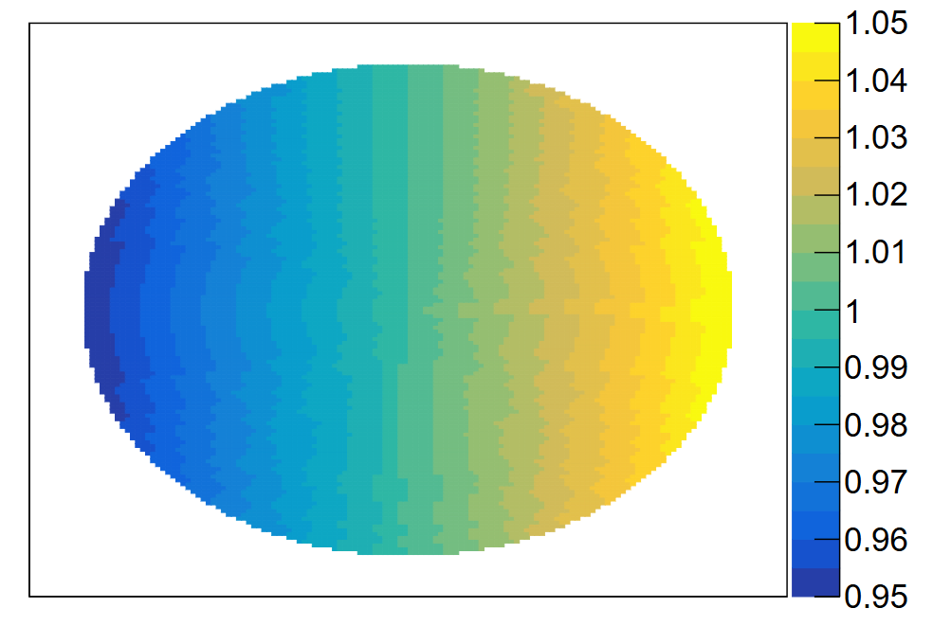



Introduction: Current Observations
Anisotropy is measured by numerous observations:
For ground-based experiments,
Detector efficiency $ε_{det}$($θ,φ$)
zenith
($θ^{′},φ^{′}$)
($θ,φ$)
Zenith efficiency
Relatively unstable
AMS-02
Asγ
Azimuth efficiency
N
zenith
E
Relatively stable
Notes:
The detection efficiency varies for cosmic rays incident from different directions. Affected by the atmosphere, the detector efficiency changes significantly in the zenith angle direction and is relatively unstable. In contrast, the azimuthal efficiency is relatively stable. This figure shows the azimuthal efficiency, with the center representing the zenith, the upward pointing north, and the rightward pointing east. Such arrays also include Argo-YBJ, Hawc, IceCube, LHAASO, as well as space experiments like Fermi-LAT, AMS, DAMPE, and so on.

Slide 4
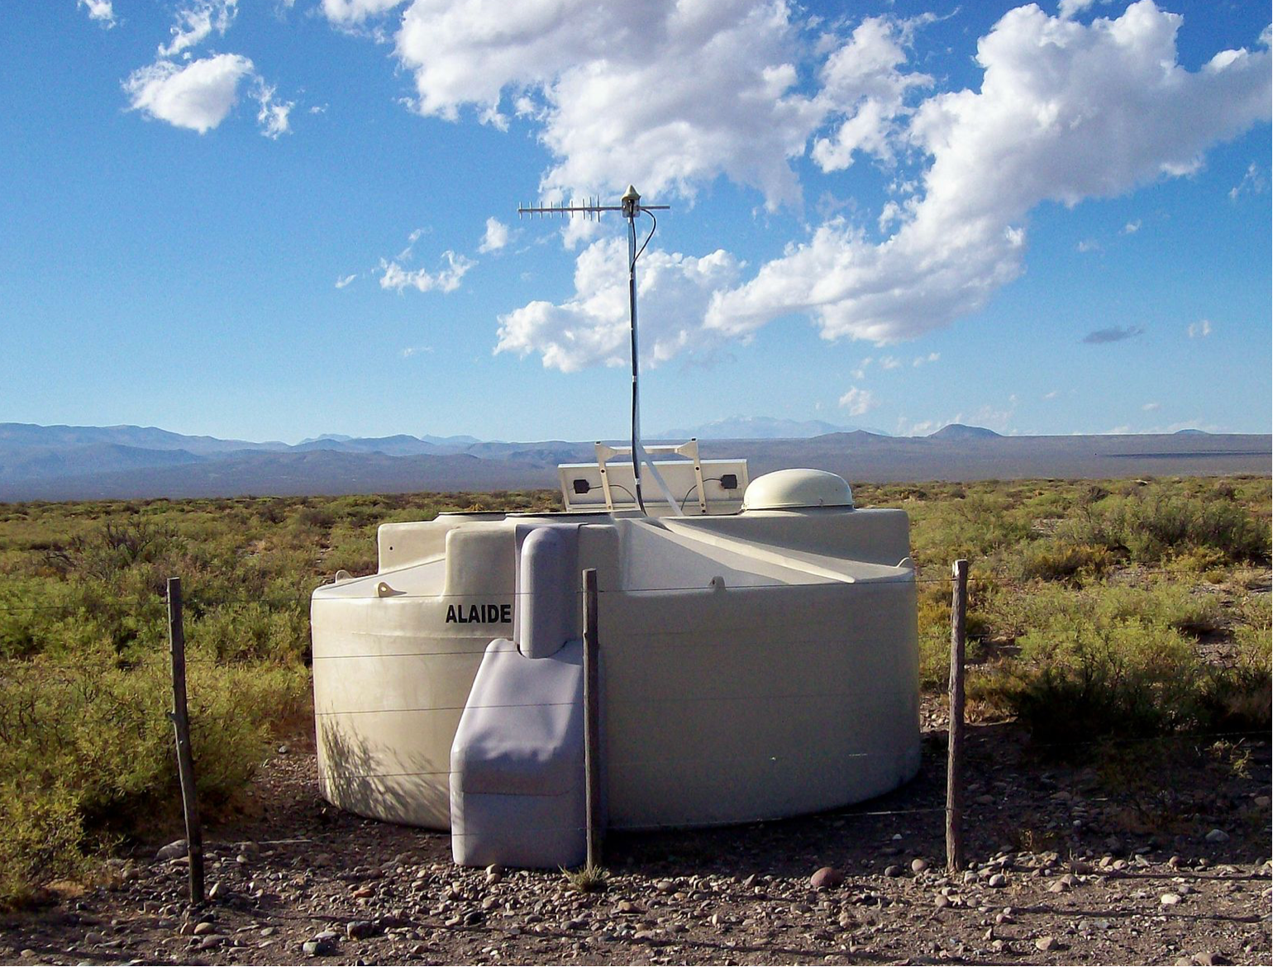
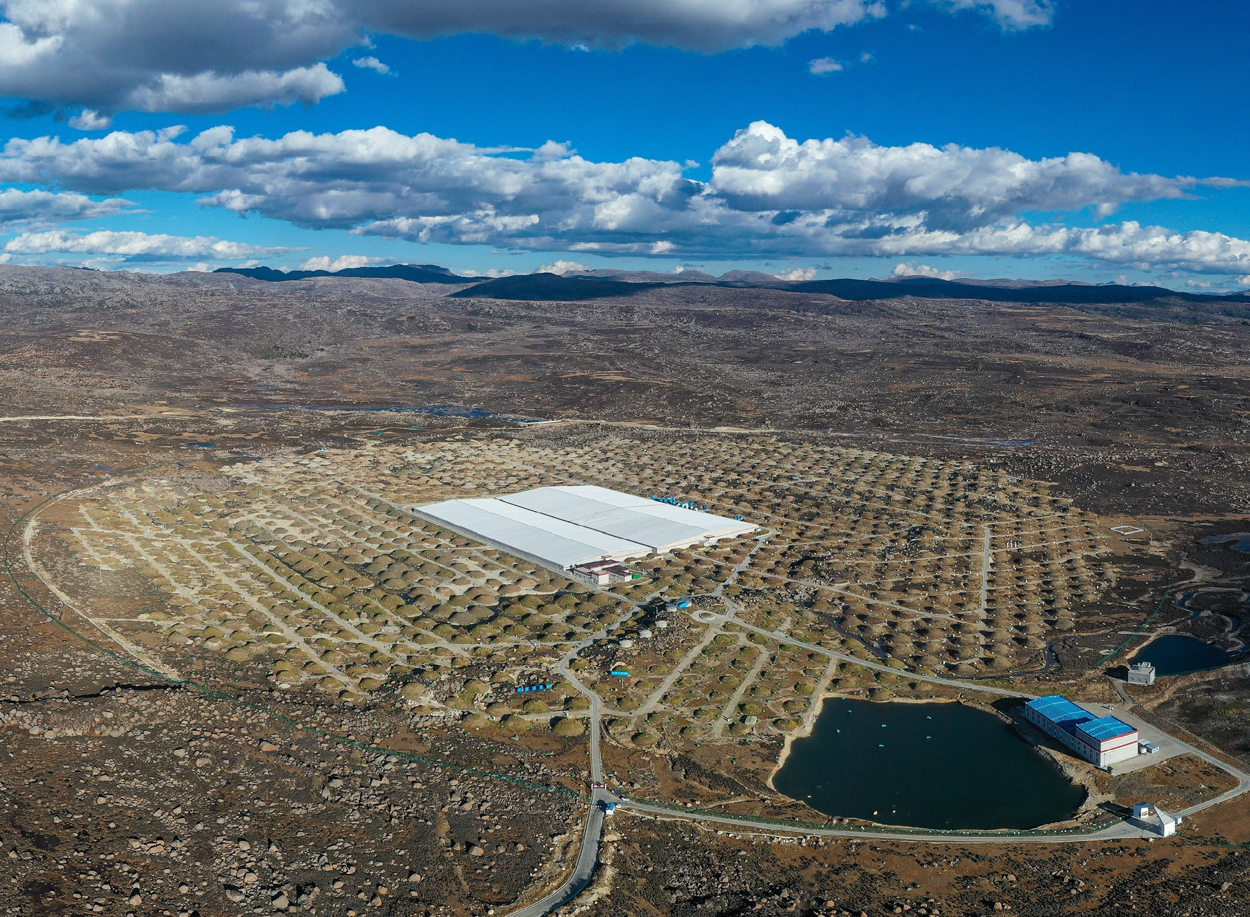
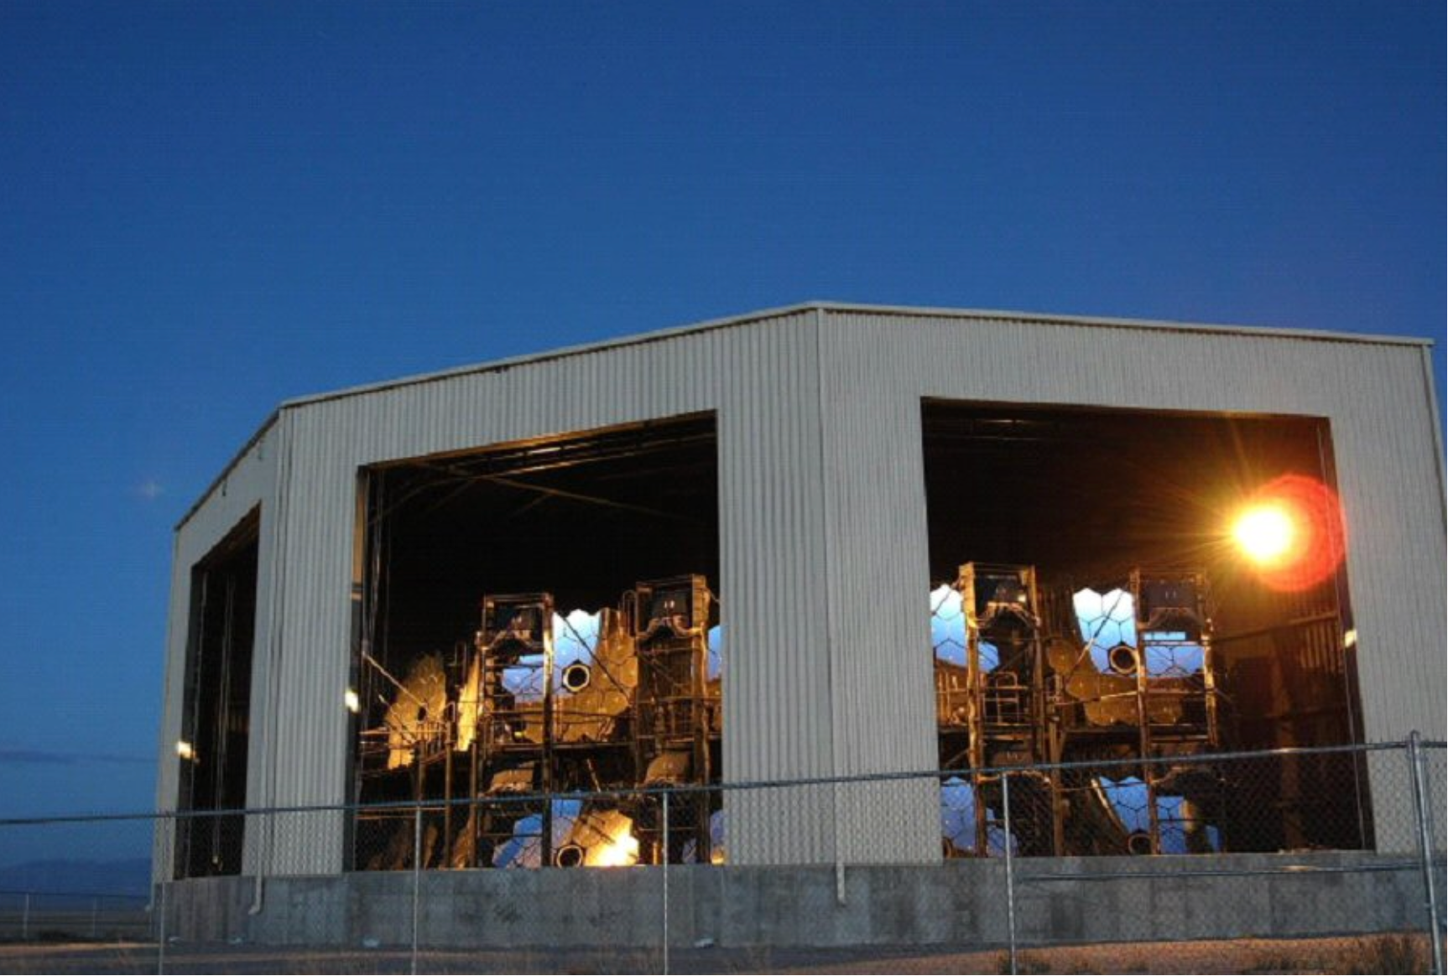
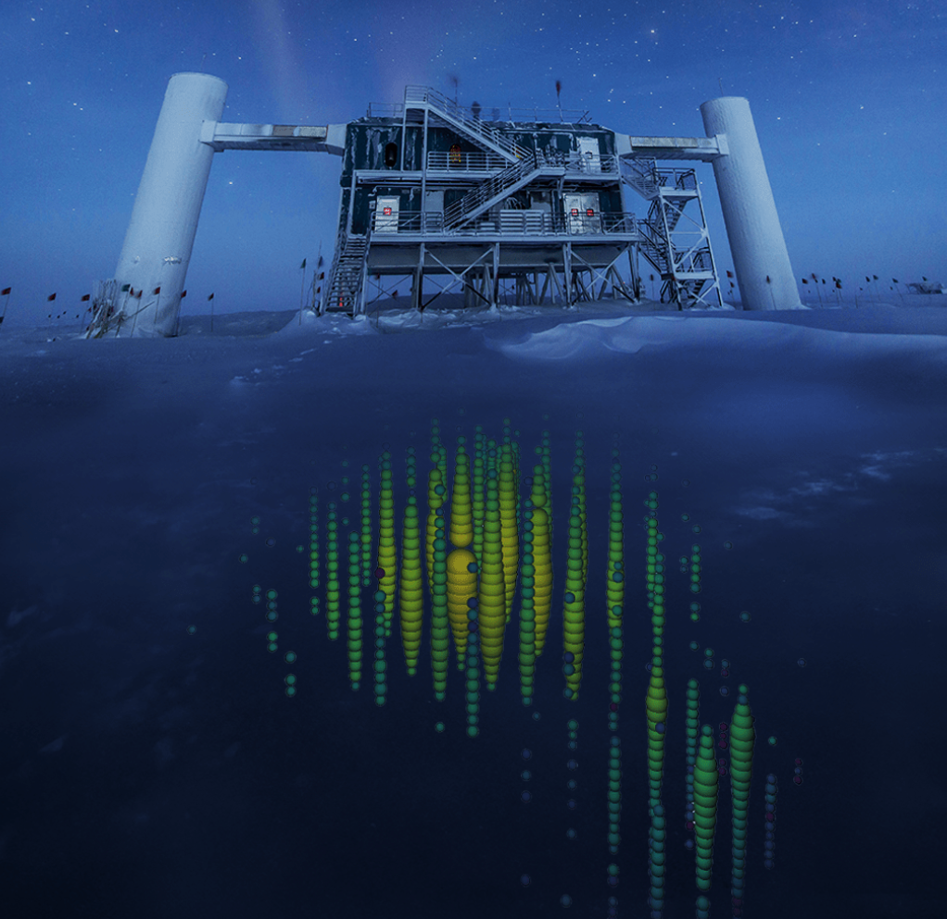
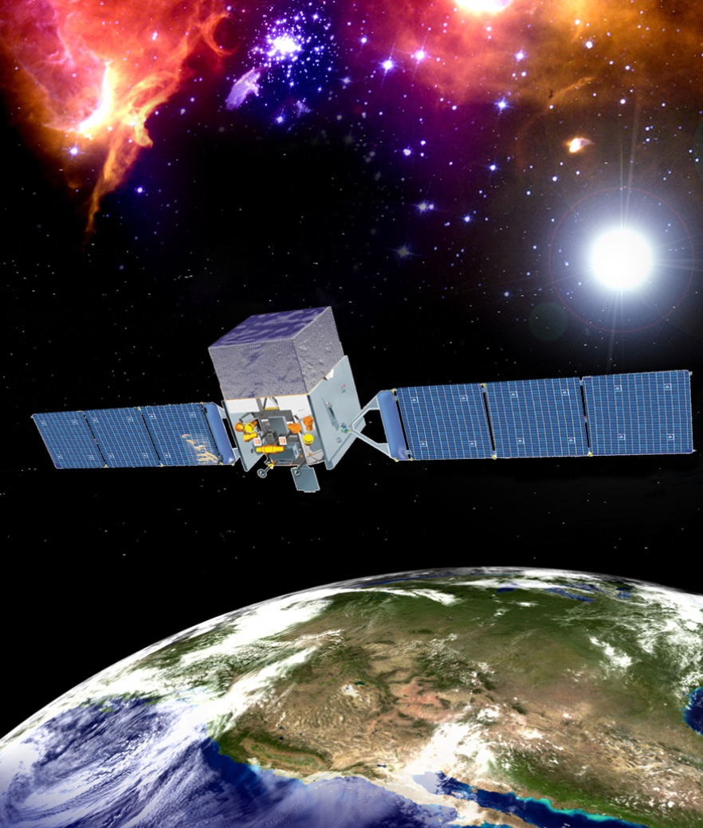
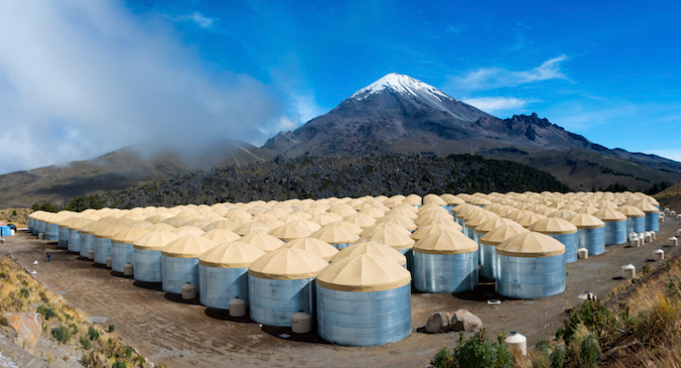
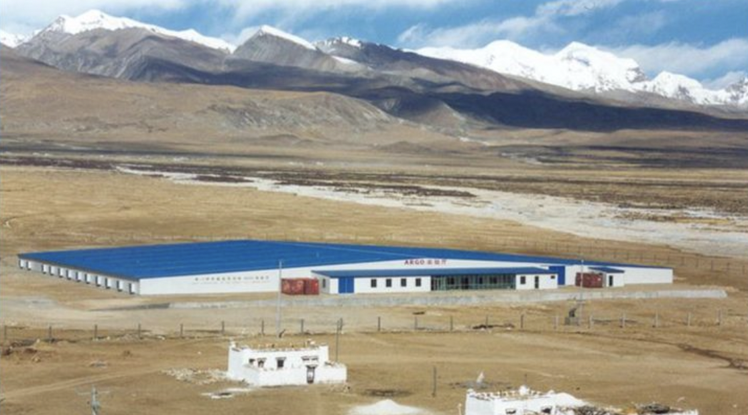
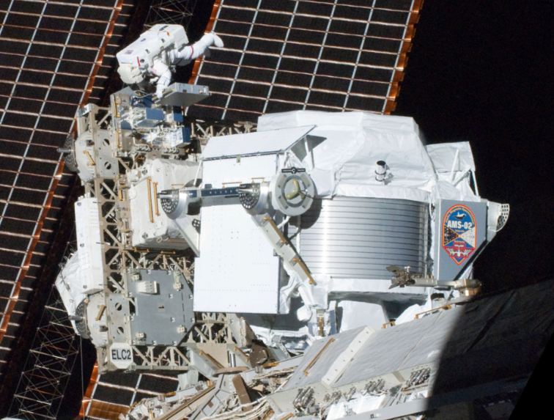
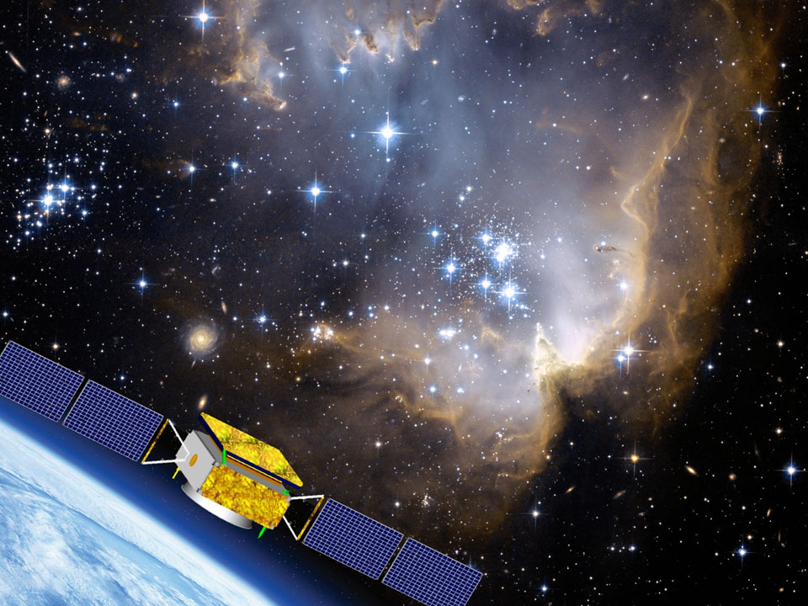
Introduction: Current Observations
Anisotropy is measured by numerous observations:
For ground-based experiments,
Detector efficiency $ε_{det}$($θ,φ$)
zenith
($θ^{′},φ^{′}$)
($θ,φ$)
Space-based experiments
LHAASO
AUGER
Zenith efficiency
ICECUBE
TA
Relatively unstable
ARGO-YBJ
HAWC
Fermi-Lat
AMS-02
AMS-02
AMS-02
Asγ
Azimuth efficiency
DAMPE
N
Relatively stable
…
zenith
E

Slide 5
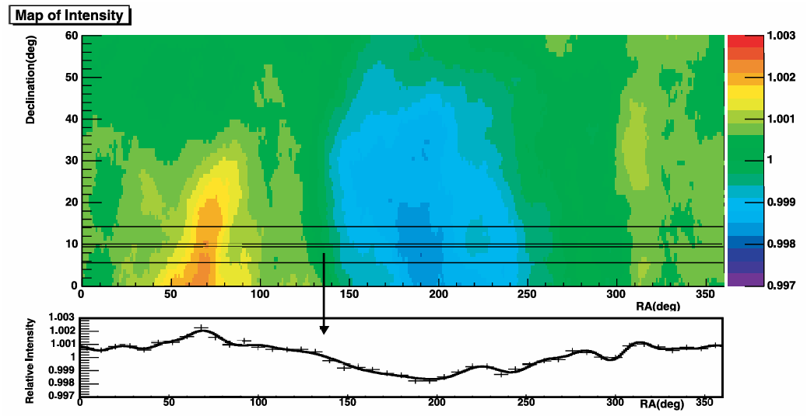
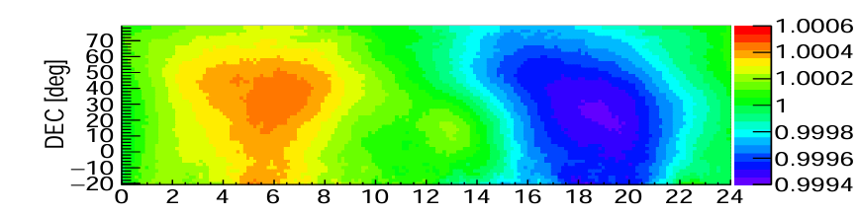
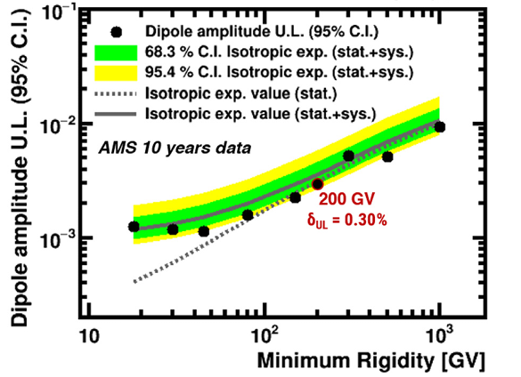
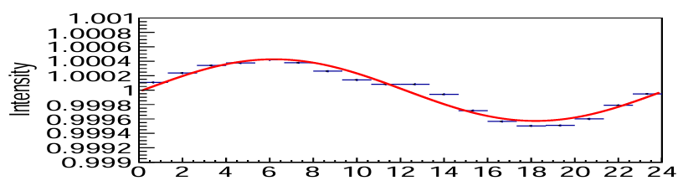

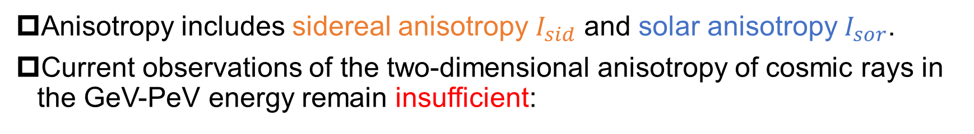


Introduction: Observations results
Anisotropy includes sidereal anisotropy $I_{sid}$ and solar anisotropy $I_{sor}$.
Current observations of the two-dimensional anisotropy of cosmic rays in the GeV-PeV energy remain insufficient:
① In TeV-PeV
② In GeV-TeV, only upper limits !
$I_{sid}$(ra,dec)
$I_{sor}$(local solar time,dec)
Quasi-2D
Quasi-2D
Quasi-2D
Normalize Declination to 1
1.1TeV
EAS array
EAS array
Satellites
EAS array
Local solar time [hr]
As$γ$, 2005
LHAASO-WCDA, 2023 ICRC
AMS-02, 2019
Notes:
Anisotropy includes sidereal anisotropy and solar anisotropy. The sidereal anisotropy is defined in the Equatorial coordinate system. And the solar anisotropy is defined in the local solar time-dec coordinate system. Current observations of the two-dimensional anisotropy of cosmic rays in the GeV-PeV energy remain insufficient. In TeV to PeV, due to the detector efficiency, it have to normalize declination to 1 for EAS array. It means that the skymap of anisotropy is quasi-2D, because different dec band can not be compared. Therefore, it is common to project 2D skymap onto the ra direction to make it easier to compare with theoretical model. In GeV to TeV, space-based experiments provide only upper limits.

Slide 6
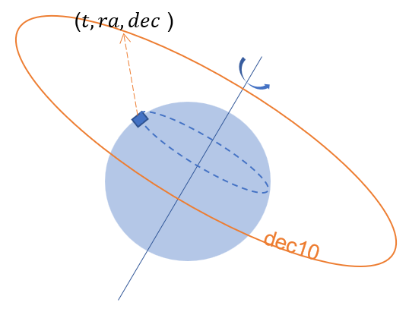
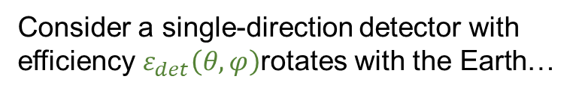
Introduction: Problem of Observations
Consider a single-direction detector with efficiency $ε_{det}\left(θ,φ\right)$rotates with the Earth…
Right Ascension directions:
Efficiency of Detector remains uniform.
Intensity in different Ra. can be compared precisely.
Declination direction:
no scanning across Dec.
Intensity in different Dec. can not be compared precisely!
Quasi-2D anisotropy
Notes:
Now consider a single-direction detector with efficiency rotates with the earth, when it completes a full rotation, the efficiency will remain uniform on the dec band. So intensity in different ra can be compared precisely. However, there are no scanning across dec direction, so the intensity in different dec band can not be compared precidely. That is why the ground-based experiment only measure quasi-2d anisotropy.

Slide 7



Proposed scheme
Zenith
If detector achieve scanning in two dimension, the Ra.-Dec. direction can be compared precisely.
($t^{′}, {ra}^{′}, dec^{′}$)
($t^{′}, {ra}^{′}, dec^{′}$)
($t,ra,dec$)
dec20
dec20
dec10
By expanding the single-direction detector into a large-scale array, we will measure true-2D anisotropy!
Notes:
if we enable the detector to rotate around the zenith direction on the ground, it will scan in ra-dec direction. for example, at the t time, detector points to ra-dec, as detector rotates it will point to ra prime, dec prime at the t prime time. So the intensity of these two directions can be compared with each other. By expanding the single-direction detector into a large-scale array, we will measure true-2D anisotropy.

Slide 8
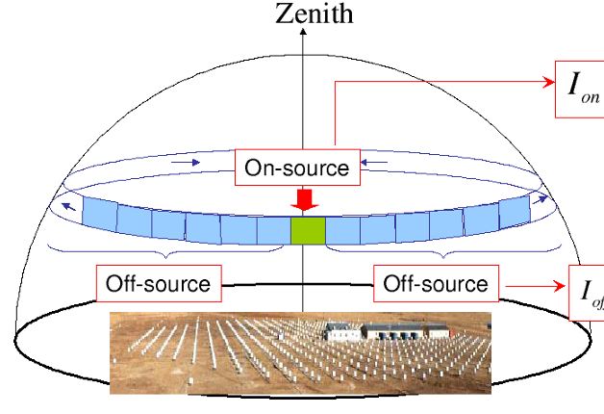





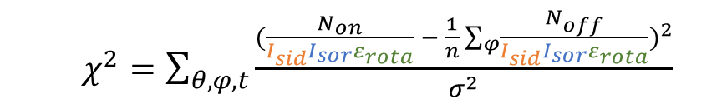
Analysis method
Data includes : $I_{sid}\left(ra,dec\right),I_{sor}\text{(}\text{local} \text{solar} \text{time}\text{,}\text{dec}\text{), }ε_{det}\left(θ,φ\right)$
Estimates background: equal-zenith method
Iterative solution of $I_{sid}, { I}_{sor}, ε_{det}$
$$\frac{Non}{I_{sid}I_{sor}ε_{det}}$$
$I_{sid}\left(ra,dec\right),I_{sor}\text{(}\text{lst}\text{,}\text{dec}\text{)}\text{, }ε_{det}\left(θ,φ\right), Non$
$I_{sid}\left(ra′,dec′\right),I_{sor}\text{(}\text{lst}’\text{,}\text{dec}’\text{)}\text{,}ε_{det}\left(θ′,φ′\right), Noff$
$$\frac{Noff}{I_{sid}I_{sor}ε_{det}}$$
  $χ^{2}=\sum_{θ,φ,t}{\frac{{(\frac{N_{on}}{I_{sid}I_{sor}ε_{rota}} − \frac{1}{n}\sum_{φ}{\frac{N_{off}}{I_{sid}I_{sor}ε_{rota}}})}^{2}}{σ^{2}}}$
Notes:
Next, let's introduce the analysis method. measurement data includes sidereal anisotropy, solar anisotropy and detector efficiency. We adopt equal-zenith background estimation . The on window has Non events which includes intensity of sidereal,solar anisotropy and efficiency of a certain direction. The off window has Noff events which includes that of another direction. The ratio of on-window events to the signals equals to the ratio of off-window events to the signals . Based on the equation, we can get the chi2 function and iterate the intensity of sidereal and solar anisotropy and detector efficiency.

Slide 9
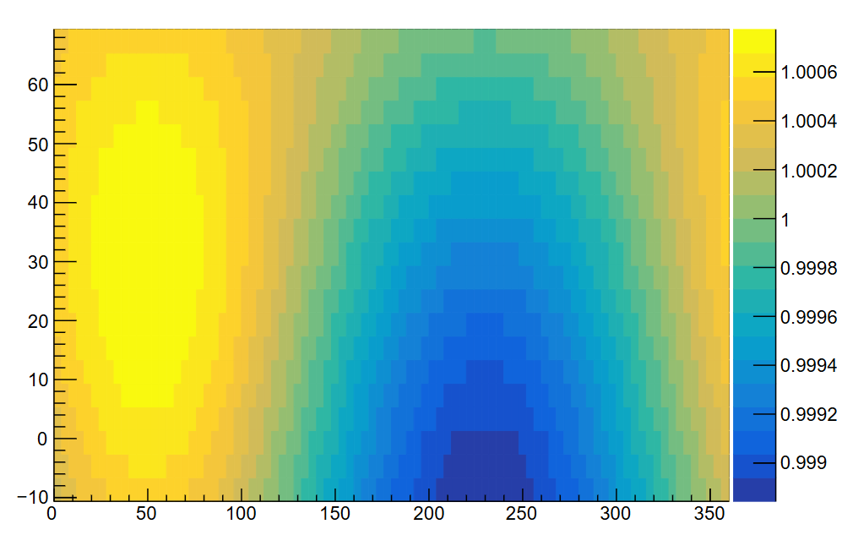



Toy-mc
Sidereal anisotropy and Detector efficiency
stable efficiency with${ ω}_{rota}=\frac{2π}{80min}$(​arbitrary)
Parameters：
Time:365 days, events: ~10⁹/day, zenith angle<40°
$$I_{sid}(ra,dec)$$
$$ε_{det}(θ,φ)$$
N
input
Dec
input
efficiency
Intensity
zenith
E
Ra
Notes:
“We tested this with a toy Monte Carlo. Simply, we take sidereal anisotropy and detector efficiency as input signals. We use stable efficiency with detector rotation period of 80 minutes, but the value of angular velocity is arbitrary. And we simulate 365 days of data, about 10 to the power of nine events per day, zenith is less than 40 degree.

Slide 10
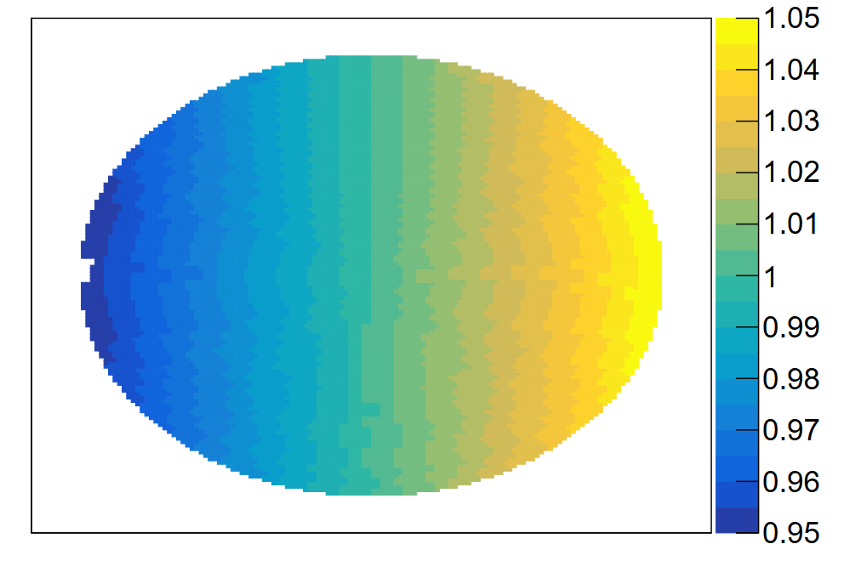
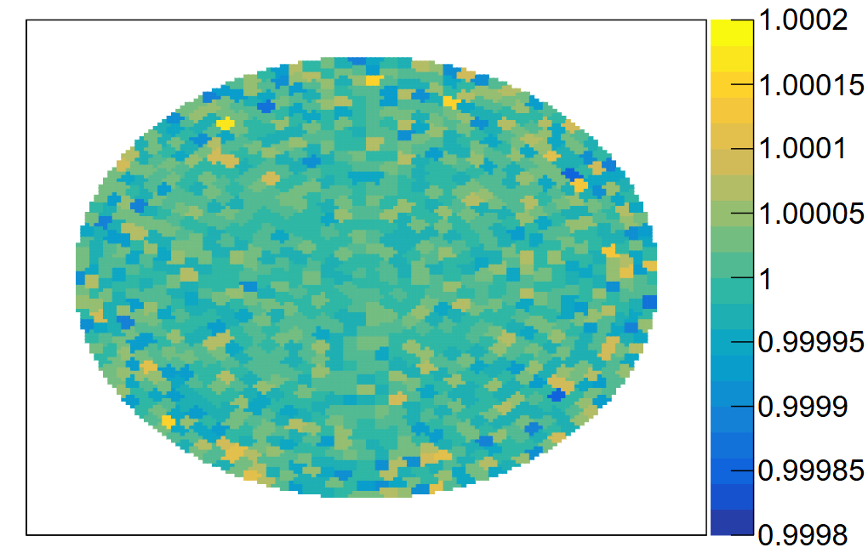


Preliminary results
$$ε_{det}(θ,φ)$$
$$ε_{det}(θ,φ)$$
Input / output
N
input
N
output
N
efficiency
zenith
efficiency
zenith
efficiency
E
E
zenith
E
Ratio is in statistical error.
Notes:
Here comes the simulation results, the left figure shows the input detector efficiency, the middle figure shows our output result, it presents the input and output results remain consistent. The right figure shows the ratio of input to output. And the ratio is in statistical error.

Slide 11
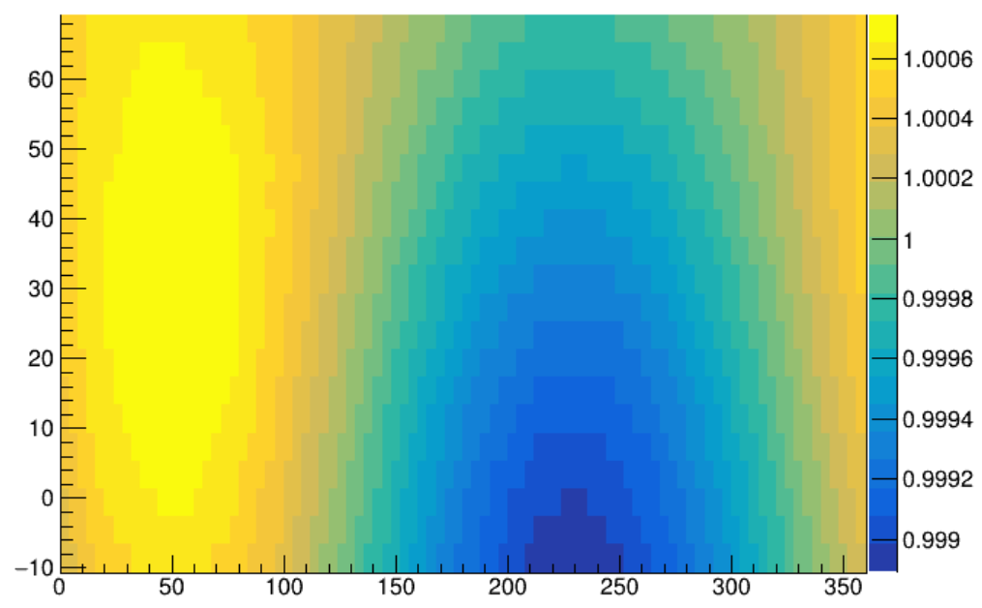
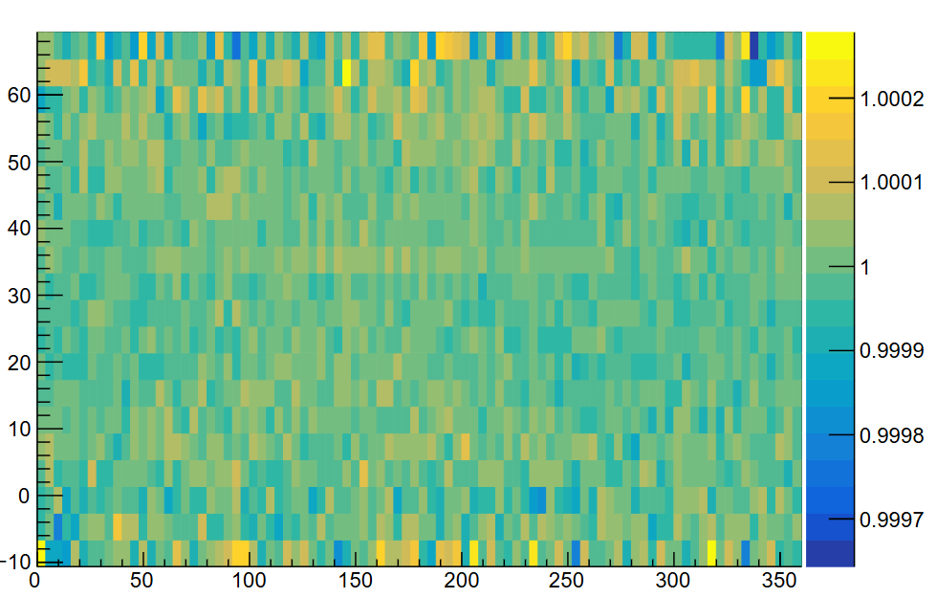


Preliminary results
$$I_{sid}(ra,dec)$$
$$I_{sid}(ra,dec)$$
Input / output
input
output
Dec
True-2D
Dec
Dec
Intensity
Intensity
Intensity
Ra
Ra
Ra
Don’t need to normalize Declination band
Ratio is in statistical error.
Notes:
The results of sidereal anisotropy have the same conclusion. It is worth noting that we don’t need to normalize the dec band to 1 when we solve the sidereal anisotropy.

Slide 12
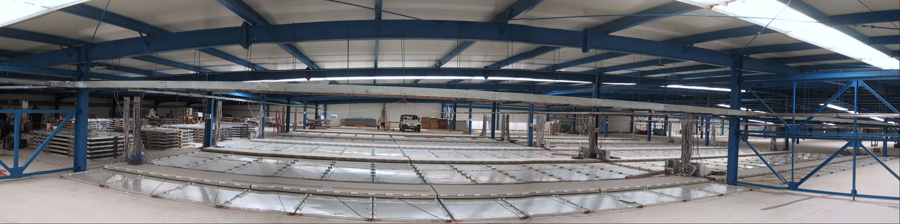
Discussion
Different angular frequency
  Different angular frequency have consistent results
Unstable detector efficiency
  Factors:
  Temperature, atmospheric pressure, Maintenance(periodic),etc
  Parameter Model：
    Time parameters or periodic solution
Feasibility study
  i.e., it’s easy for ARGO-YBJ to lay the tracks
  on the ground and install scintillation detectors.
4. Apply to space experiments
  Space experiment rotates in 2 dimension.
ARGO-YBJ
Notes:
Finally, let's have some discussions.
Firstly, ‌different angular frequencies‌ have been tested, and they yield ‌consistent results‌ in our studies.
Secondly, detector efficiency does not remain stable over time‌, which can be influenced by various factors such as ‌temperature, atmospheric pressure, and periodic maintenance‌. To address this, we propose a ‌parameter model‌ focusing on time or periodic solutions.
Lastly, our feasibility study confirms that the ‌ARGO-YBJ hall is available site. It‘s easy to lay tracks and install detectors. Notably, the study can apply to space experiments as well

Slide 13
Summary
This study proposes a rotational ground-based EAS array scheme to achieve precise measurement of true-2D anisotropy and efficiency.
The analysis methods could be applicable to space experiments as well.

Slide 14
THANKS！

Slide 15
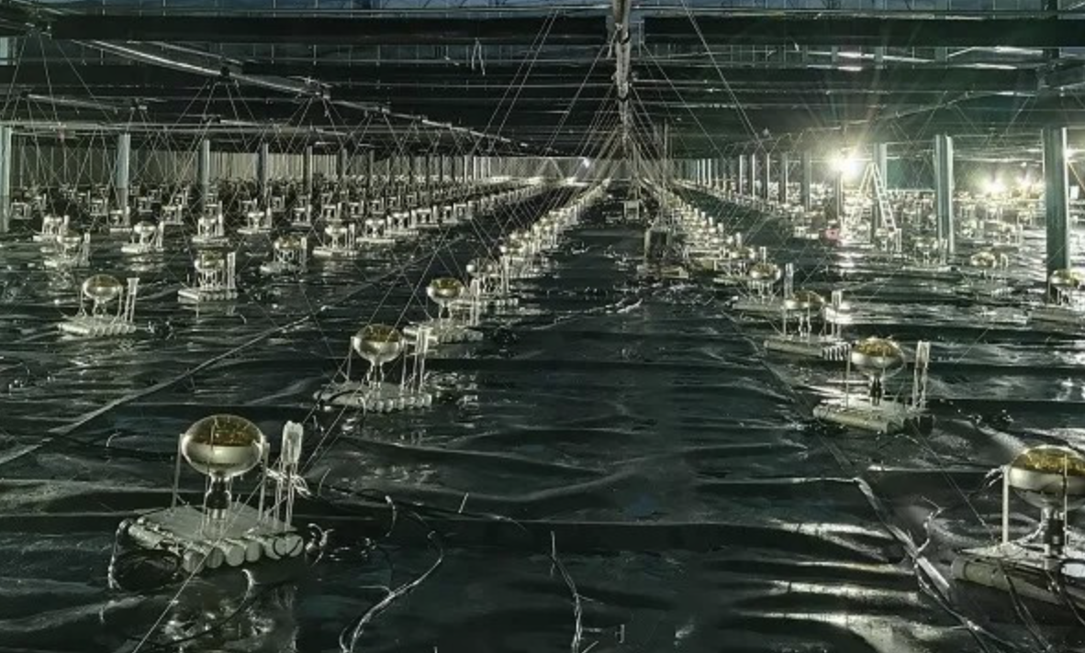
Feasibility study
Available scheme 1 (on the ground):
~100m*100m
Lay circular tracks on the ground.
Install scintillation detectors on the “carrier”.
let the ”carrier” run.
ARGO-YBJ
LHAASO-WCDA
Available scheme 2 (in the water):
~300m*300m
Lay circular tracks in the water.
Install Cherenkov detectors on the “carrier”.
let the ”carrier” run.

Slide 16
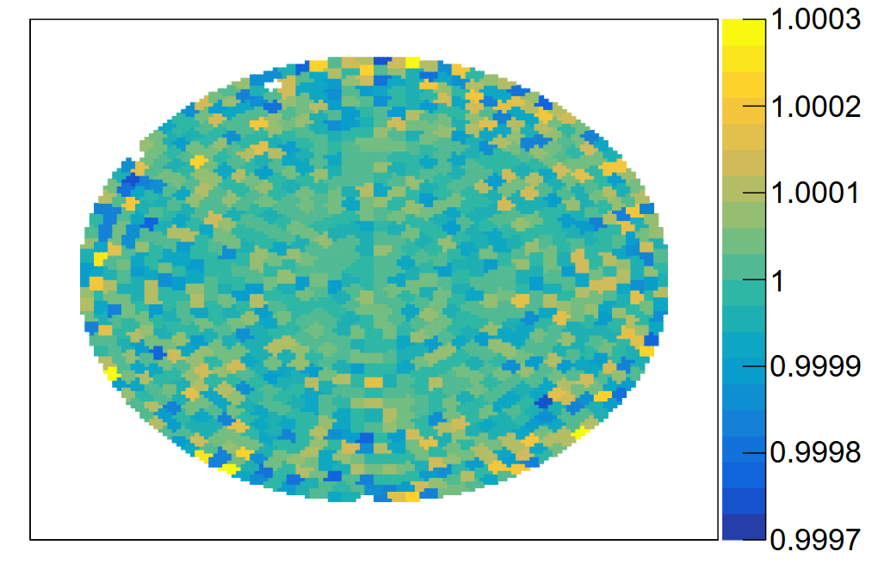
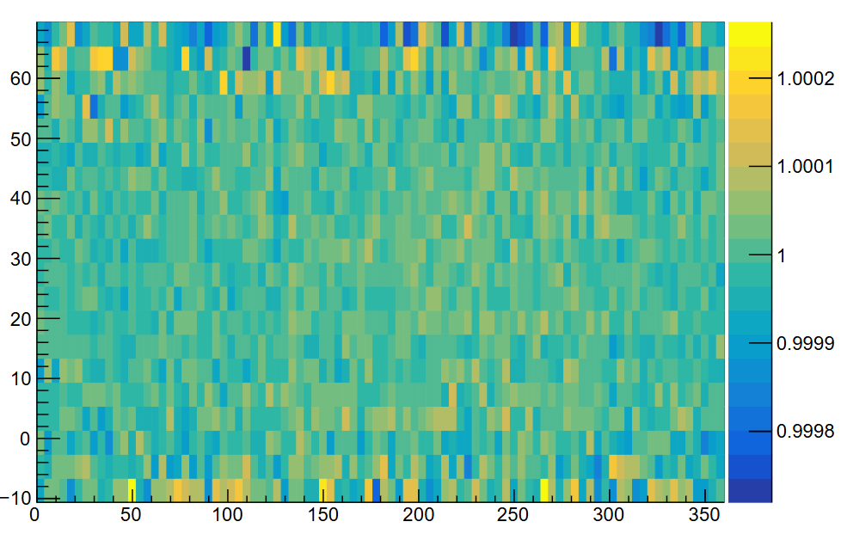
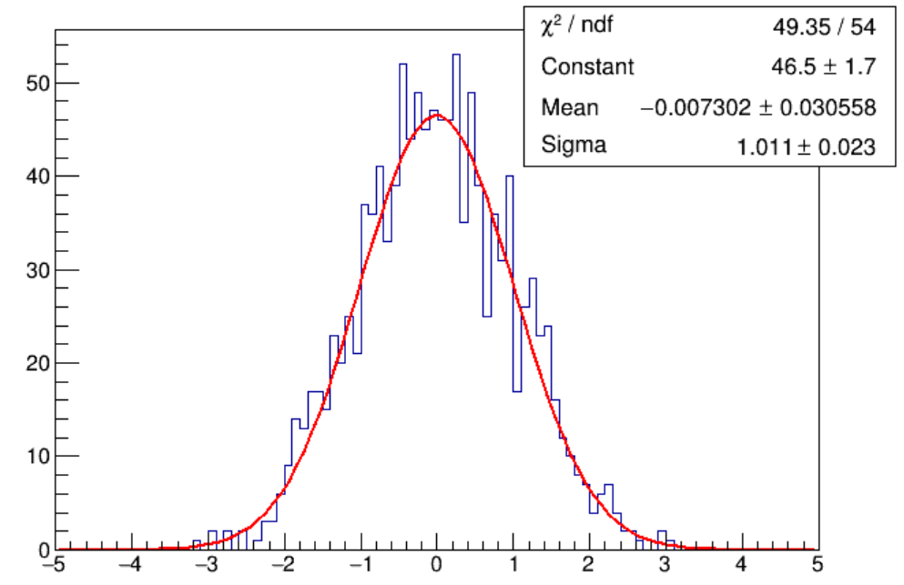
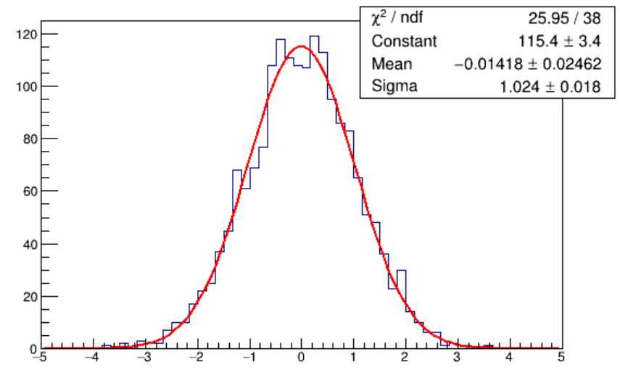

Back up
$${ ω}_{rota}=2π/80min$$
Output/Input(Detector efficiency)
Output/Input(sidereal anisotropy)
In 1 sigma
In 1 sigma

Slide 17
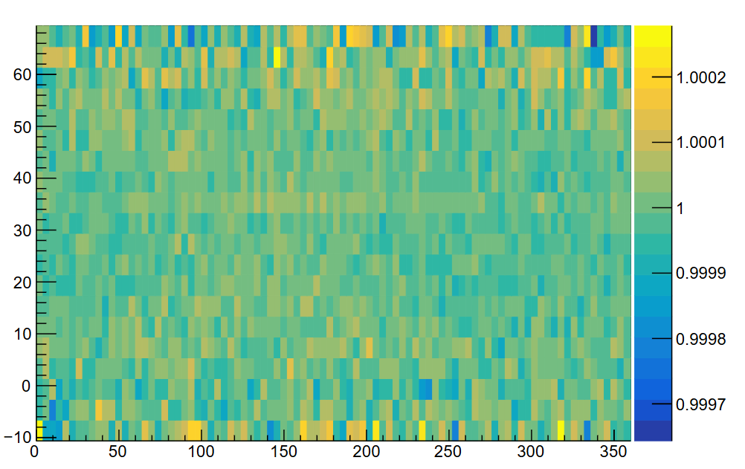
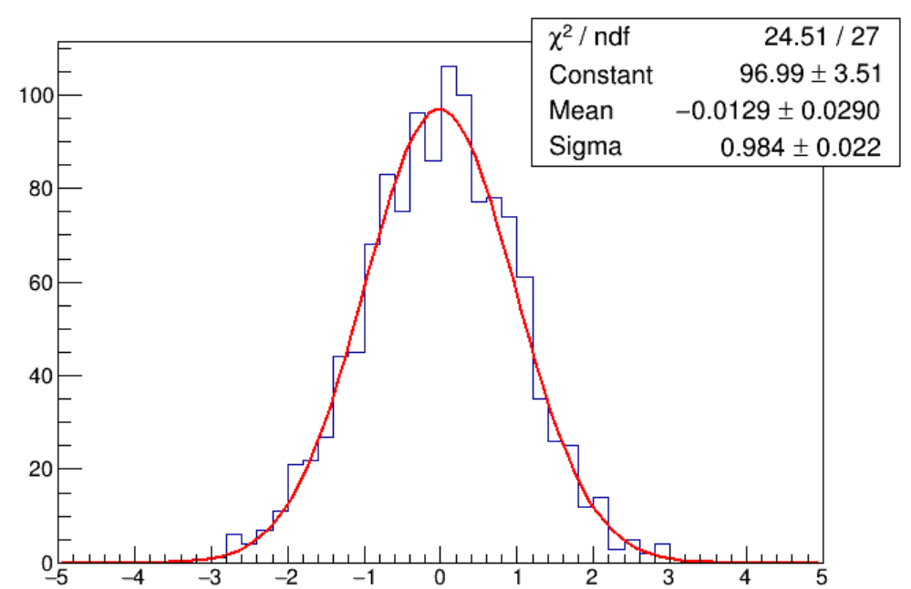
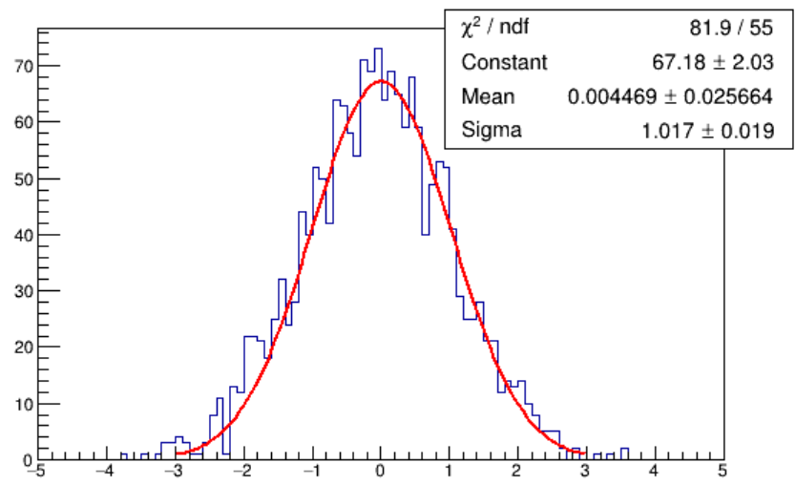

Back up
$${ ω}_{rota}=2π/24h$$
Output/Input(Detector efficiency)
Output/Input(sidereal anisotropy)
In 1 sigma
In 1 sigma

Slide 18
zen34
zen32
dec
zen30
ra

Slide 19
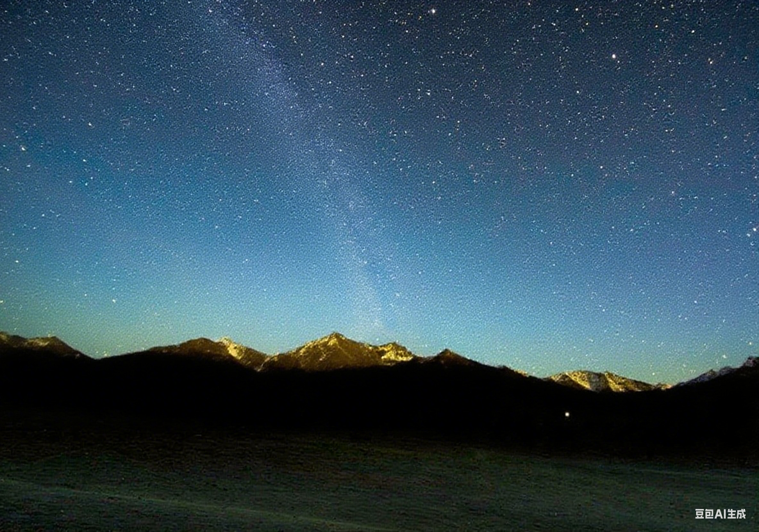


($t^{′}$,$θ^{′},φ^{′}$)
($t$,θ,φ)
dec30°
dec20°

