Slide 1
Introduction of 2HDM Higgs
Boyang Gao

Slide 2
Outline
Introduction of SM Higgs
Problem in SM
Introduction of 2HDM
Exprement of BSM
$H^{±}→τ^{±}ν$
H/$A→τ^{+}τ^{−}$
Summary plots
References

Slide 3
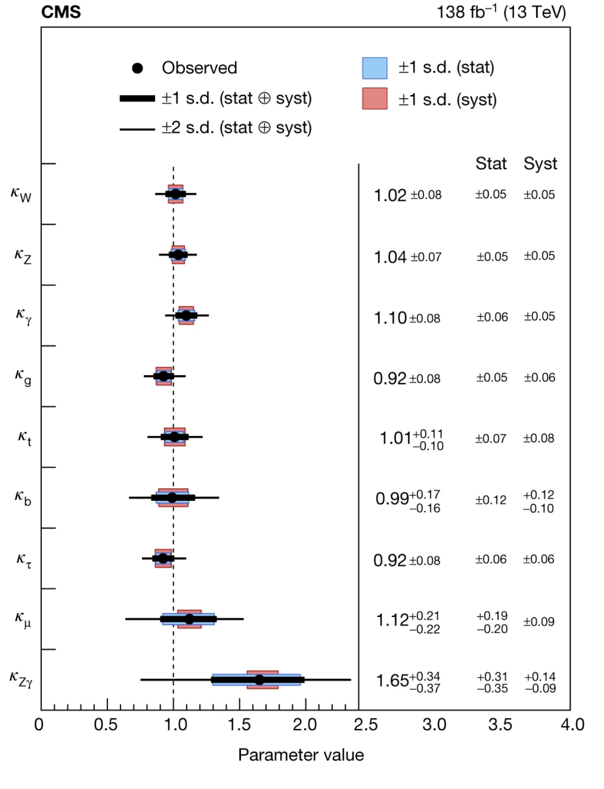
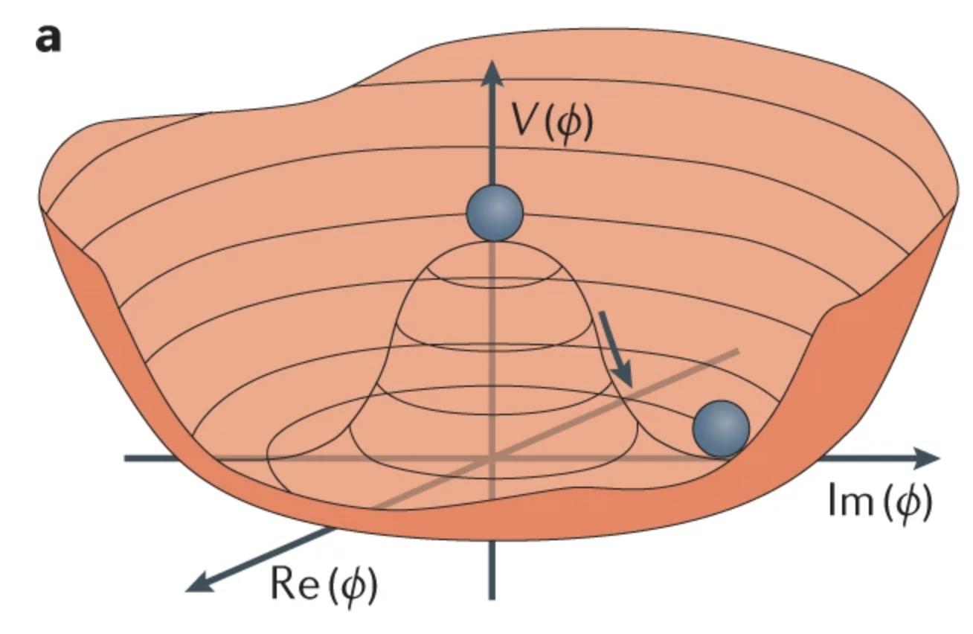
Higgs Boson in SM
Higgs Boson:mass=125Gev, spin=0
For solved vector boson have mass and without Higgs violates unitarity at high enegy.
Higgs potential:V=$−\frac{1}{2}μ^{2}(φ^{∗}φ)+\frac{1}{4}λ^{2}(φ^{∗}φ)^{2}$

Slide 4
Areas where the standard model cannot be applied
The matter-antimatter asymmetry problem
Dark mater and dark energy
Hierarchy/Fine tuning problem
Origin of the large difference in fermion mass
We need Beyond SM Model Higgs!

Slide 5
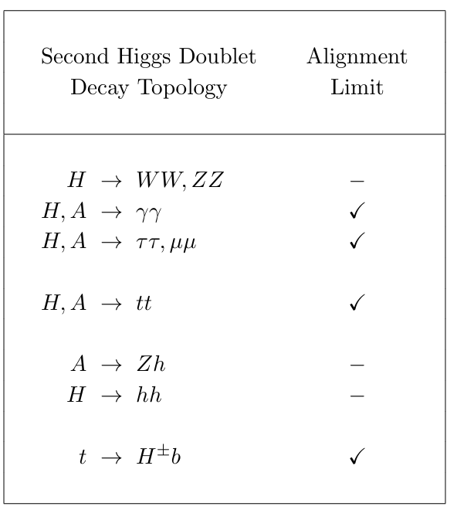
Introduction of Two Higgs Doublet Model (2HDM)
Motivation of 2HDM:
Supersymmetry:A signal Higgs cant give mass to both quarks with charge 2/3 and charge 1/3
Axion models:Lagrangian contains an U(1) symmertry that need 2 Higgs Doublet Model
SM is unable to generate a baryon asymmetry of the Universe of sufficient size
Extend Particles in 2HDM:
2 CP-even particles:h ,H h is 125Gev Higgs , H is Heavy Higgs
1 CP-odd particle:A
2 Charge particles: $H^{±}$

Slide 6
Higgs potential of 2HDM
Potential:
$V=m_{11}^{2}Φ_{1}^{+}Φ_{1}{+m}_{22}^{2}Φ_{2}^{+}Φ_{2}+m_{12}^{2}(Φ_{2}^{+}Φ_{1}+Φ_{1}^{+}Φ_{2})+\frac{λ_{1}}{2}(Φ_{1}^{+}Φ_{1})^{2}+\frac{λ_{2}}{2}(Φ_{2}^{+}Φ_{2})^{2}+λ_{3}Φ_{1}^{+}Φ_{1}Φ_{2}^{+}Φ_{2}+λ_{4}Φ_{2}^{+}Φ_{1}Φ_{1}^{+}Φ_{2}+\frac{λ_{5}}{2}(({Φ_{2}^{+}Φ_{1})}^{2}+({Φ_{1}^{+}Φ_{2})}^{2})$
Two complex scalar SU(2) doublets there are eight field
$Φ^{a}=\left(\begin{aligned}Φ^{+} \\ \frac{V_{a}+ρ_{a}+iη_{a}}{2}\end{aligned}\right)$
Minimization of this potential:
$〈Φ^{1}〉=\left(\begin{aligned}0 \\ \frac{V_{1}}{2}\end{aligned}\right)$ , $〈Φ^{2}〉=\left(\begin{aligned}0 \\ \frac{V_{2}}{2}\end{aligned}\right)$
3 feilds are eaten by boson (Z,$W^{±}$) ,5 feilds beacome higgs:h,H,A, $H^{±}$

Slide 7
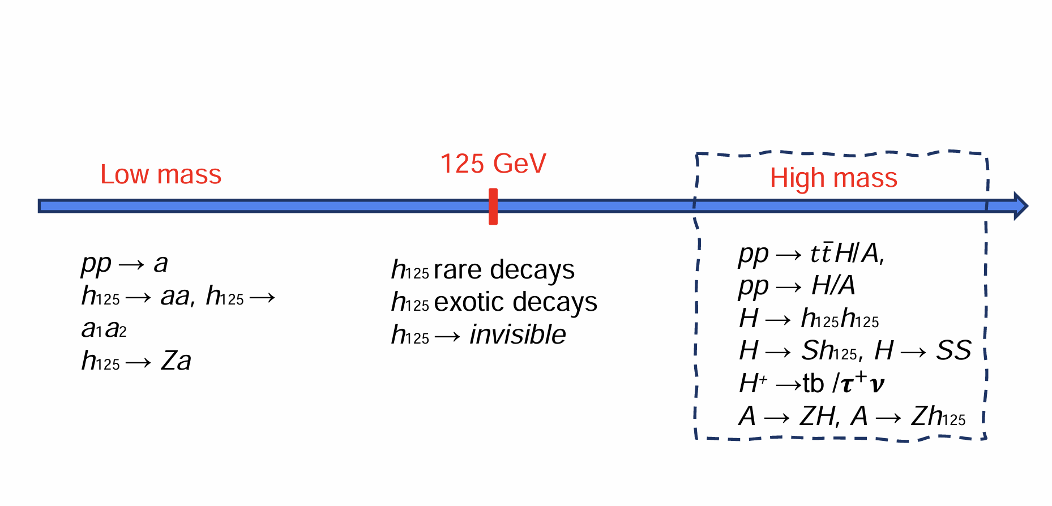
BSM Higgs boson searches
We pay attention to the search for high mass range

Slide 8
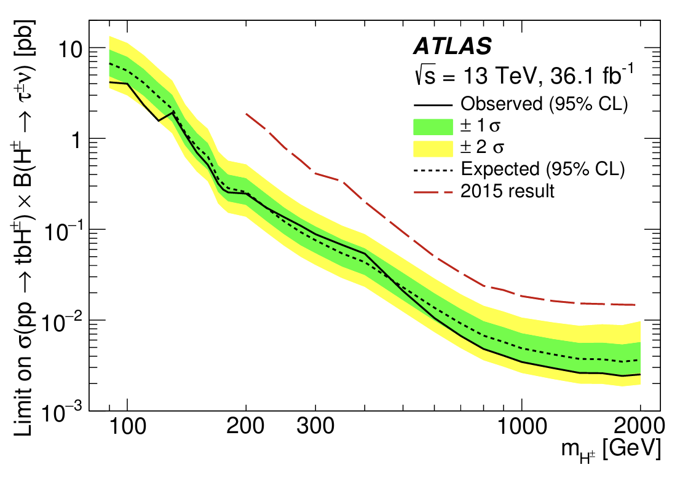
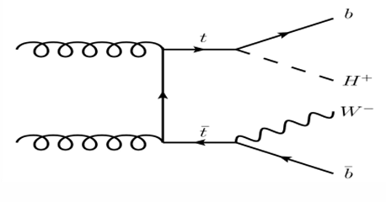
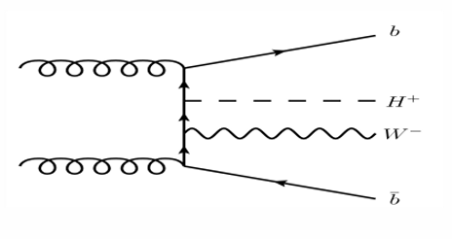
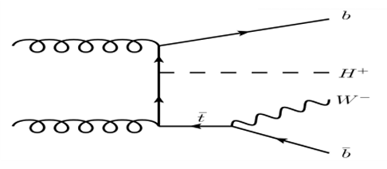
E$xprement of H^{±}→τ^{±}ν$
Set limits for $H^{±}→τ^{±}ν$
Double-resonant top-quark production
Non-resonant top-quark production
single-resonant top-quark production
Conducted over a wide mass range of 80–2000 GeV The results agree with the background expectation of the Standard Mode

Slide 9
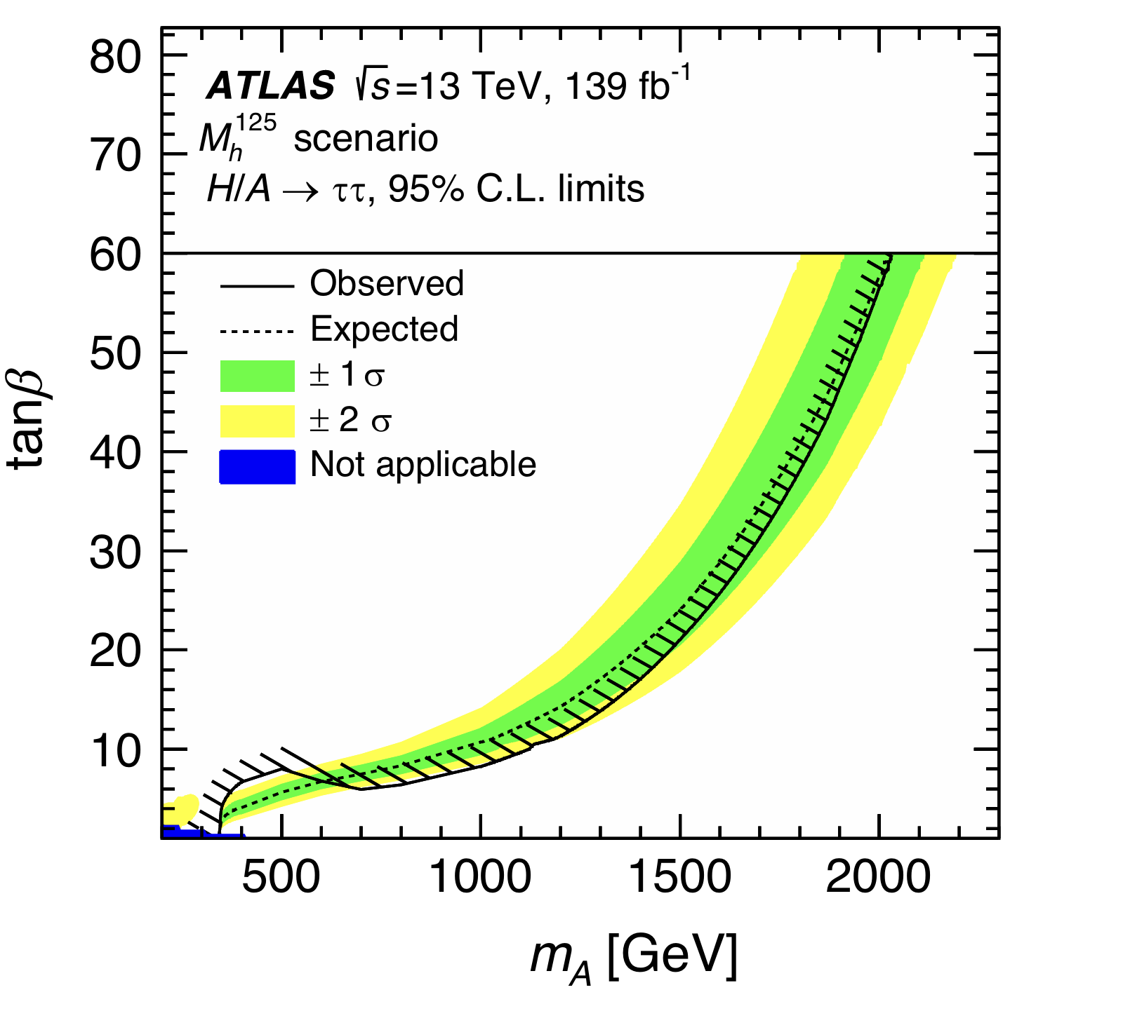
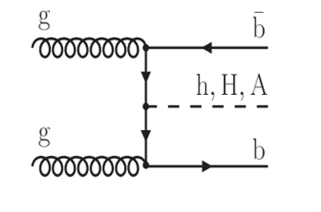
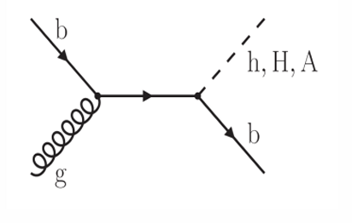
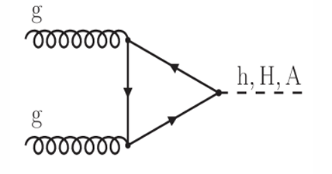
$$Exprement of A→τ^{+}τ^{−}$$
local significance = 2.2𝜎 (ggF), 2.7𝜎 (b-associated production)
global significance = 1.9

Slide 10
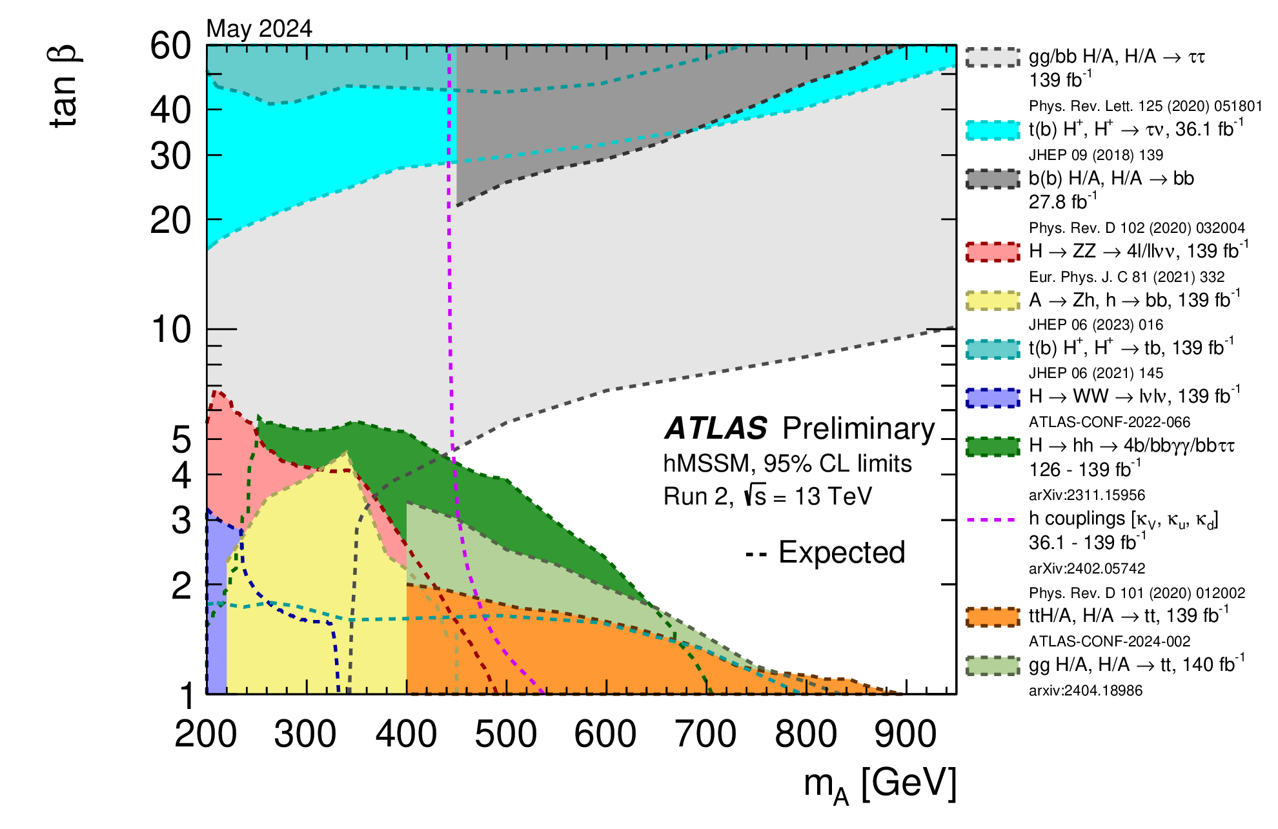
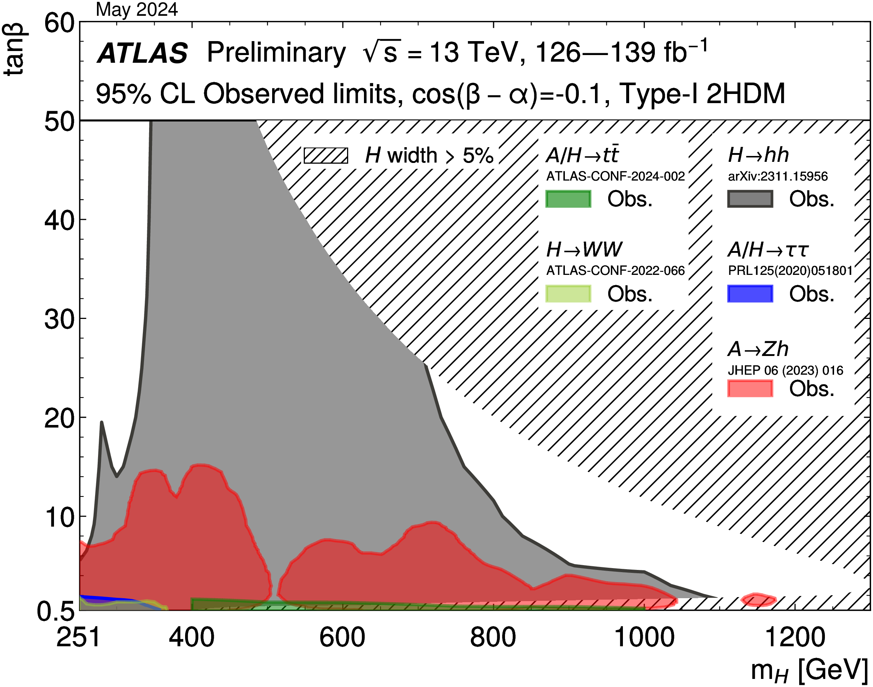
Summary plots for beyond Standard Model Higgs boson

Slide 11
References
[1]G. C. Branco, P. M. Ferreira, L. Lavoura,M. N. Rebelo, Marc Sher, and Joao P. Silva Theory and phenomenology of two-Higgs-doublet models.https://arxiv.org/abs/1106.0034
[2]Search for Heavy Higgs Bosons Decaying into Two Tau Leptons with the ATLAS Detector Using 𝑝𝑝Collisions at √𝑠=13 TeV.Phys. Rev. Lett. 125, 051801 – Published 27 July, 2020.DOI: https://doi.org/10.1103/PhysRevLett.125.051801
[3]The CMS Collaboration. A portrait of the Higgs boson by the CMS experiment ten years after the discovery. Nature 607, 60–68 (2022). https://doi.org/10.1038/s41586-022-04892-x
[4]BSM Higgs searches (incl. exotic Higgs decays)ATL-PHYS-SLIDE-2024-493https://cds.cern.ch/record/2915340
[5]Summary plots for beyond Standard Model Higgs boson benchmarks for direct and indirect searches.https://cds.cern.ch/record/2898861
[6]The ATLAS collaboration., Aaboud, M., Aad, G. et al. Search for charged Higgs bosons decaying via H± → τ±ντ in the τ+jets and τ+lepton final states with 36 fb−1 of pp collision data recorded at \sqrt{s}=13 TeV with the ATLAS experiment. J. High Energ. Phys. 2018, 139 (2018). https://doi.org/10.1007/JHEP09(2018)139

