Slide 1
LightFCP
Rong Yi
2025/4/25

Slide 2
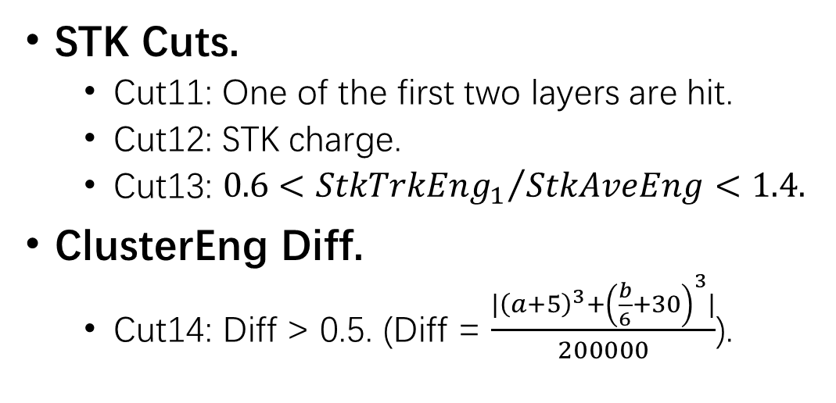
Selections (MC data sample: Light FCP 10 GeV~1TeV)
Pre-Selections.
  Cut1: G0, G3.
  Cut2: Good track.
  Cut3: Fiducial cut.
Remove oblique events.
  Cut4: LayerMaxEng/TotEng<0.45
Remove proton.
  Cut5: Zeta value.
  Cut6: nBarLayer13.
PSD Cuts.
  Cut8: PSD charge.
  Cut9: PSD path length.
  Cut10: PSD two end ratio.
STK Cuts.
  Cut11: One of the first two layers are hit.
  Cut12: STK charge.
  $\text{Cut}\text{13: }0.6<{StkTrkEng_{1}}/{StkAveEng}<1.4.$
ClusterEng Diff.
  $\text{Cut}\text{14}$: Diff > 0.5. (Diff = $\frac{|{\left(a+5\right)}^{3}+{\left(\frac{b}{6}+30\right)}^{3}|}{200000}$).

Slide 3
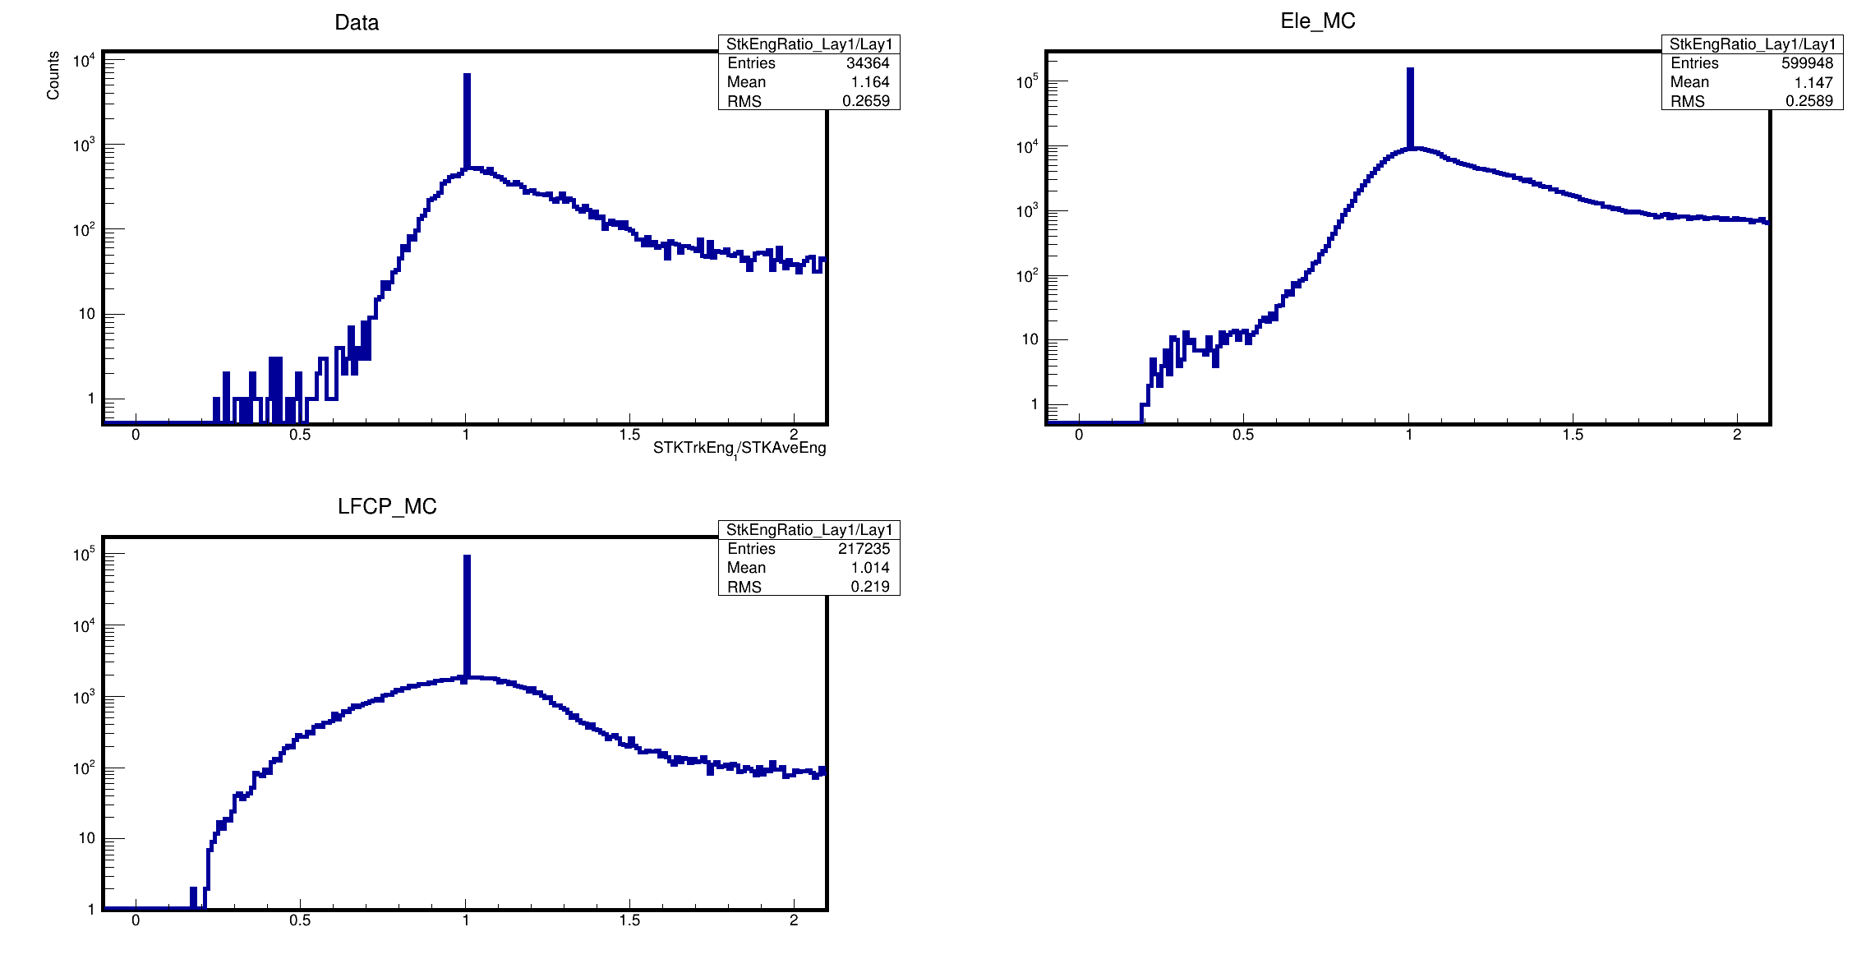
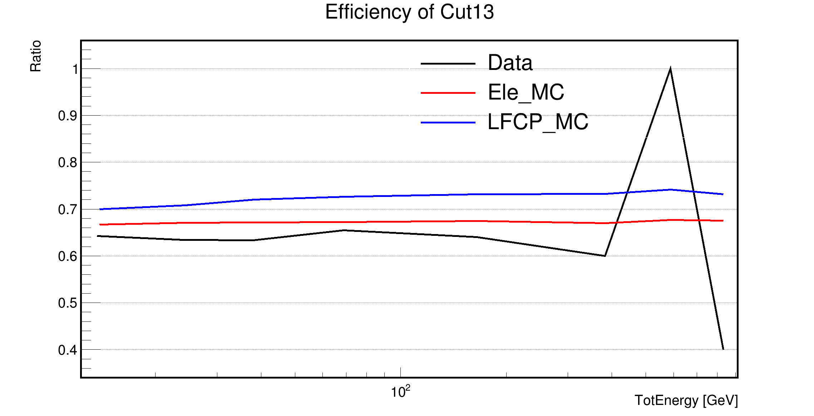
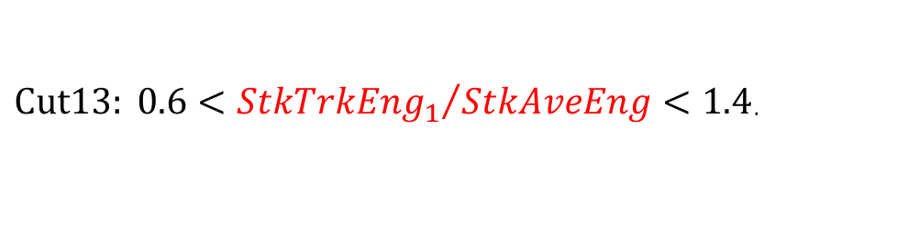
New Cuts
$Cut13: 0.6<{StkTrkEng_{1}}/{StkAveEng}<1.4$.
Fluctuations caused by a low flight data sample size.

Slide 4
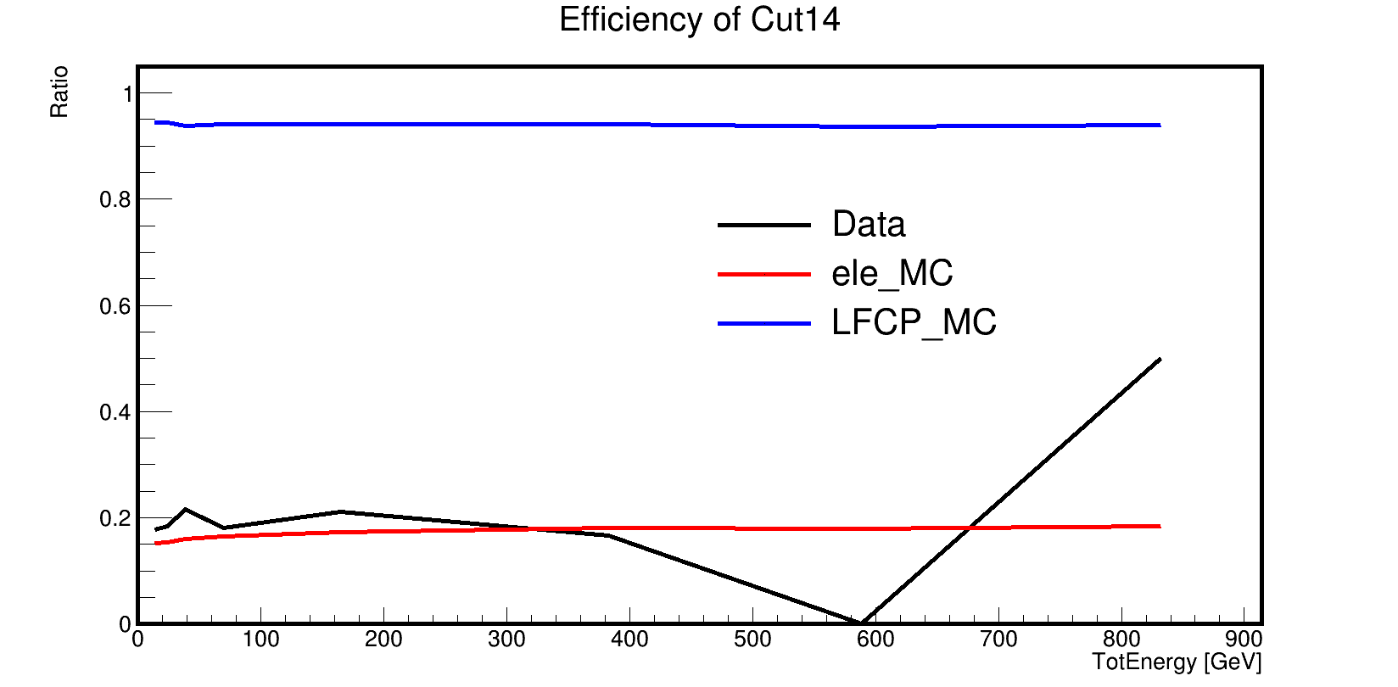
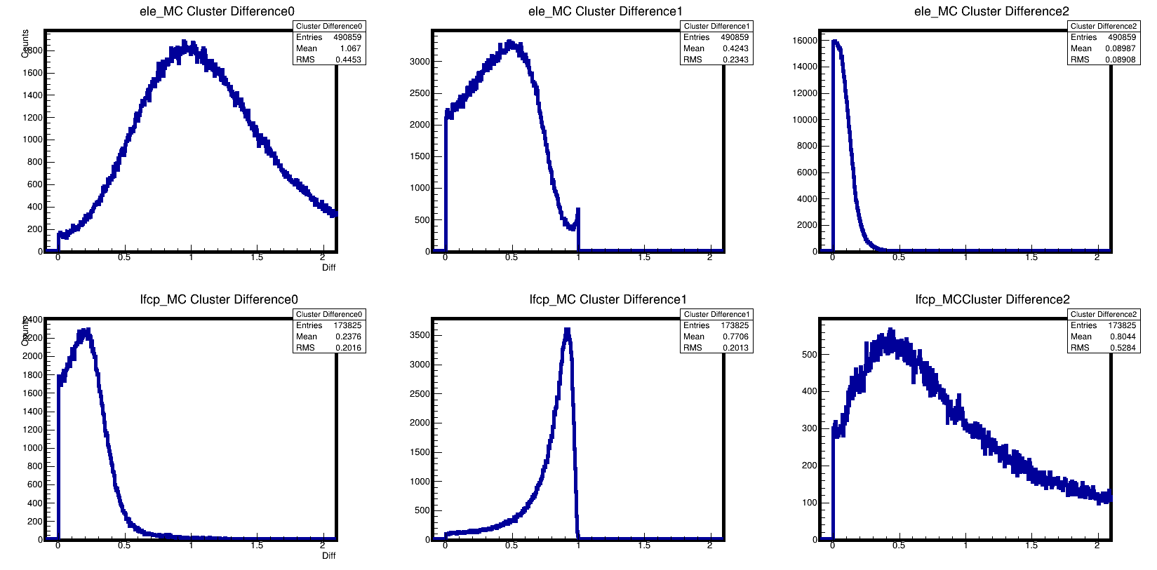
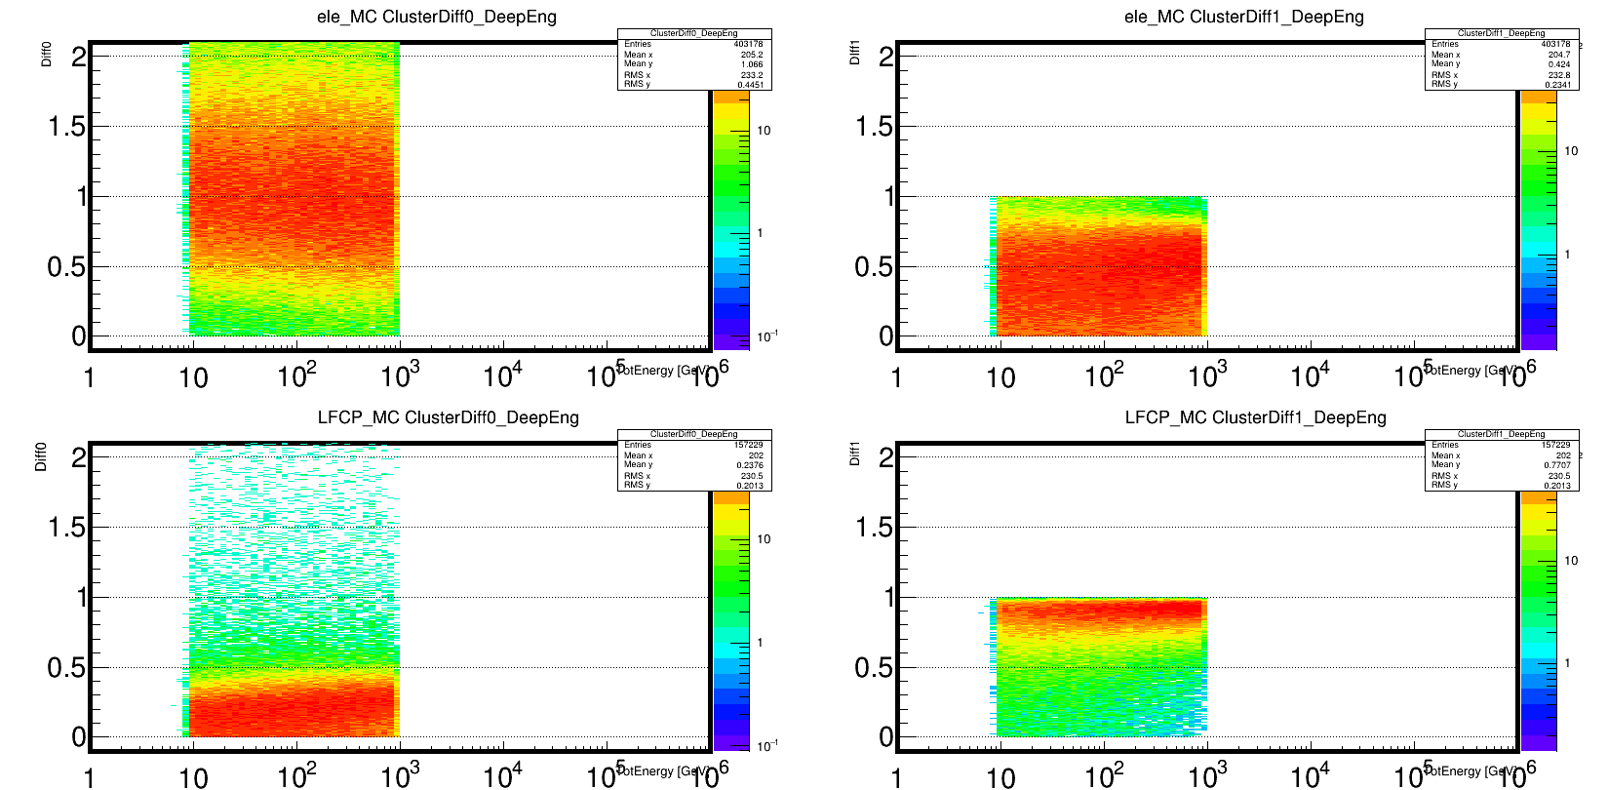
New Cuts
Cut14: ClusterDiff0 = $\frac{|{\left(a+5\right)}^{3}−{\left(\frac{b}{6}+30\right)}^{3}|}{200000}$ > 0.5; ClusterDiff1 = $\frac{|a^{2}−b^{2}|}{max⁡(a^{2},b^{2})}$.
a: STK Energy of Primary particle; b: STK Energy of Secondary particle.
Fluctuations caused by a low flight data sample size.

Slide 5
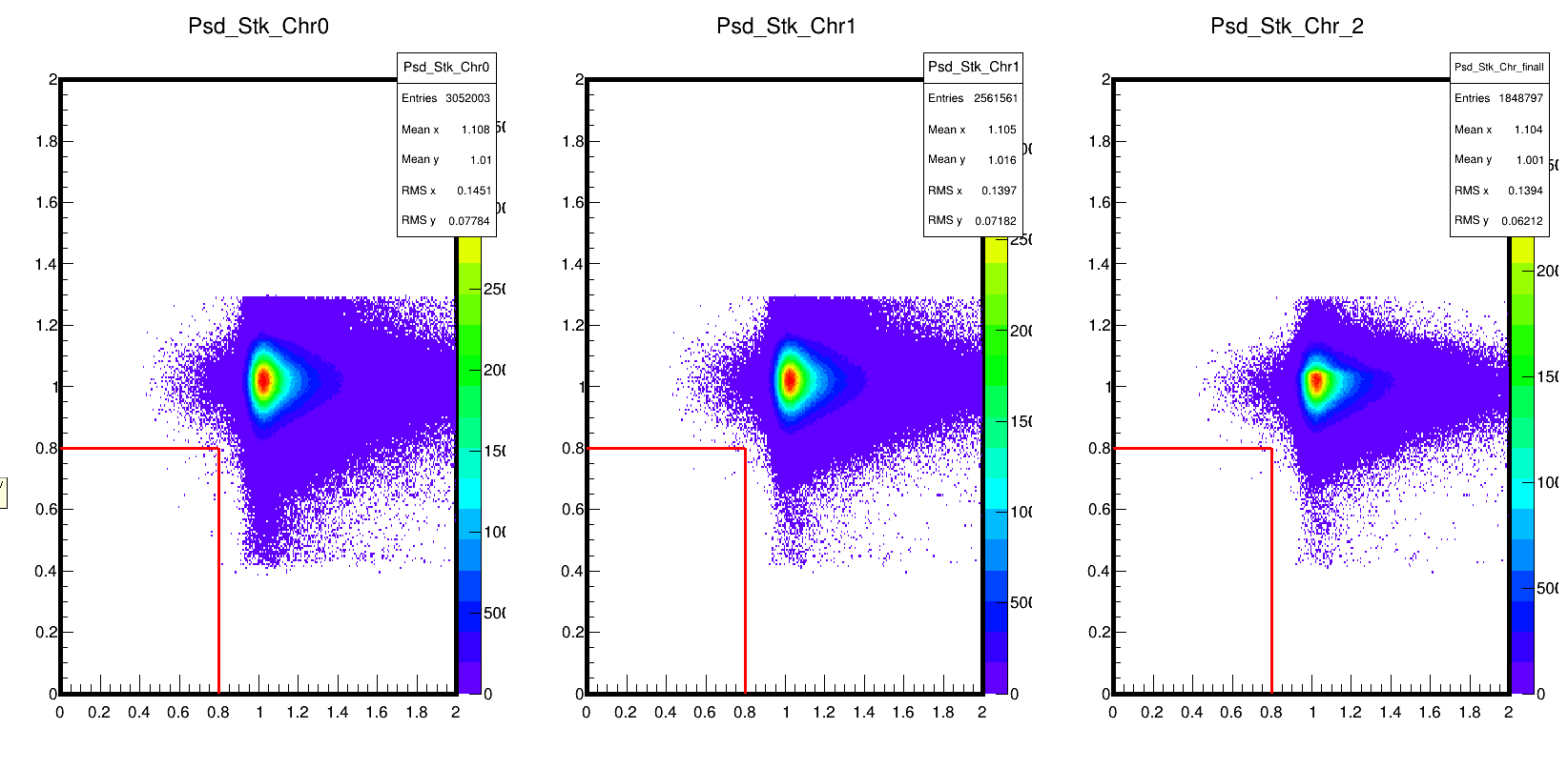
Signal Scale (PSDChr<0.8e and STKChr<0.8e)
Cut12
Cut13
Cut14

Slide 6
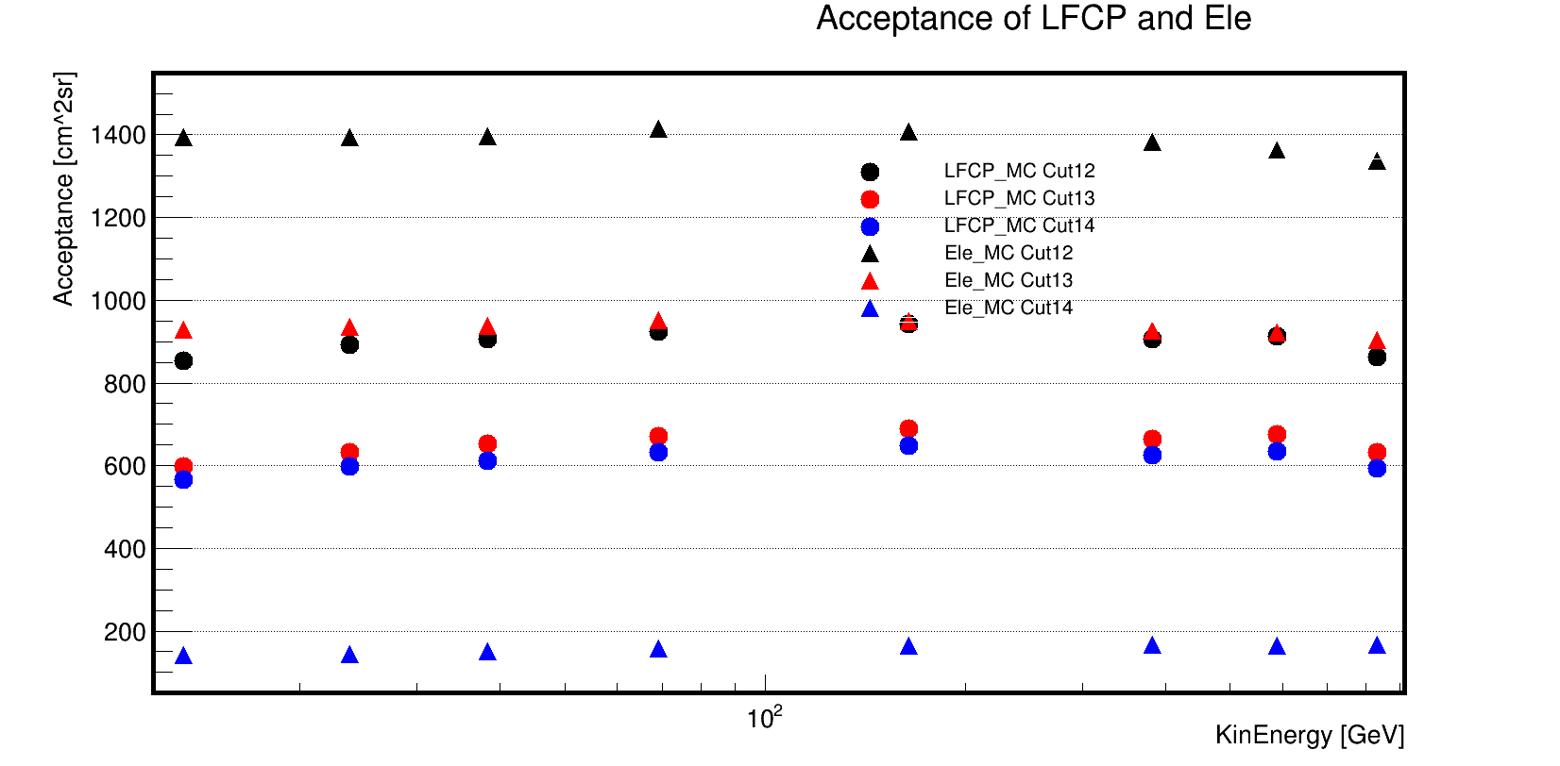
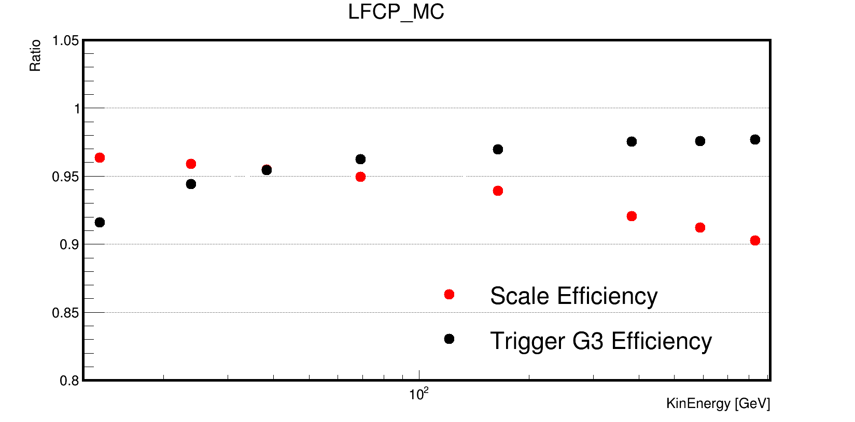
Acceptance and Efficiency

Slide 7
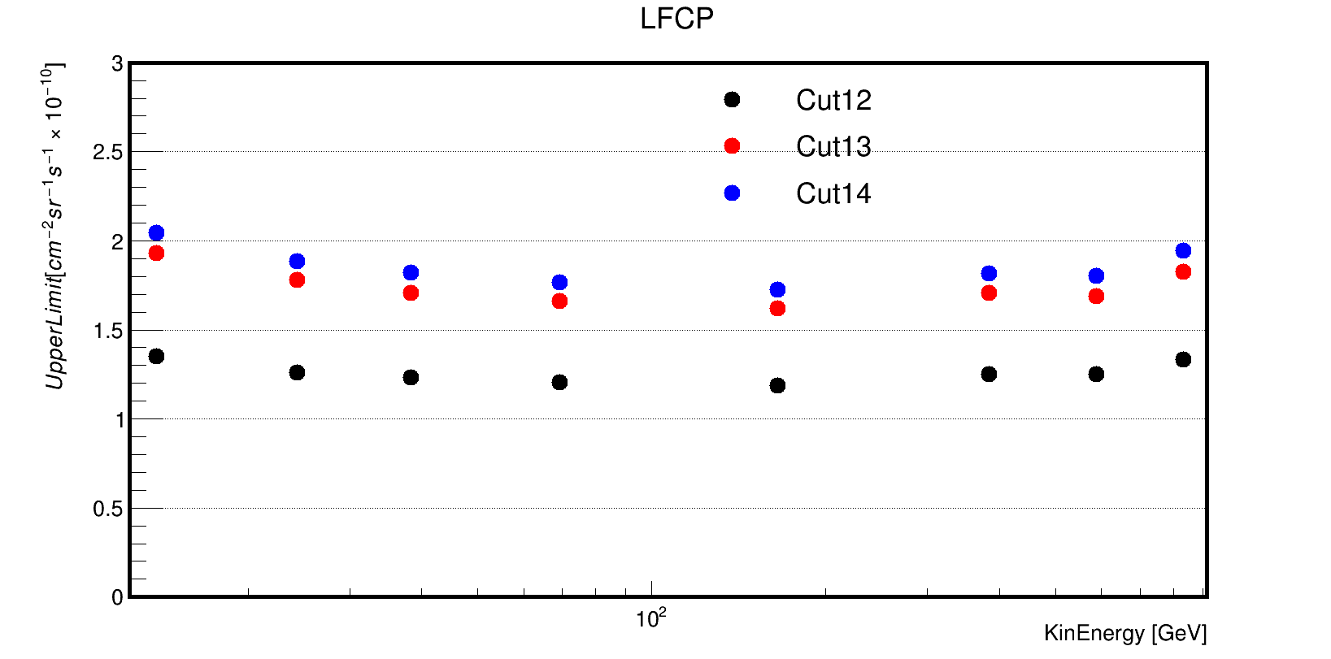
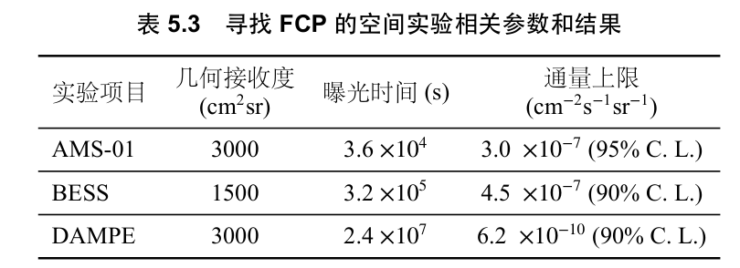
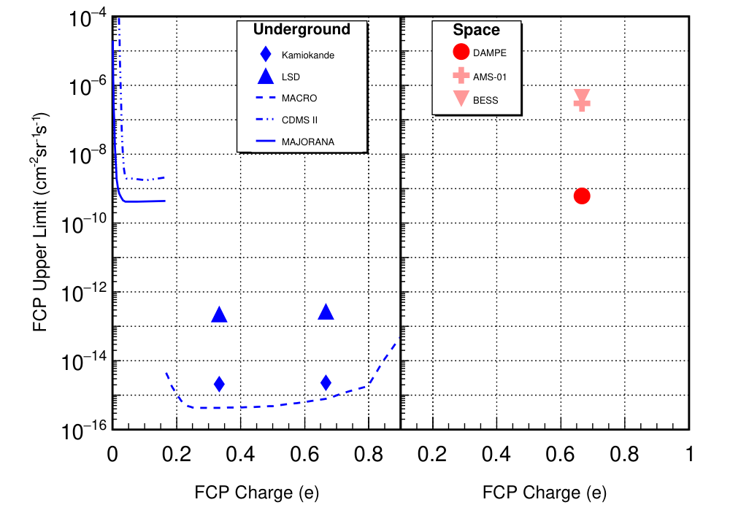
Upper Limit (for one year)

Slide 8
Backup

Slide 9
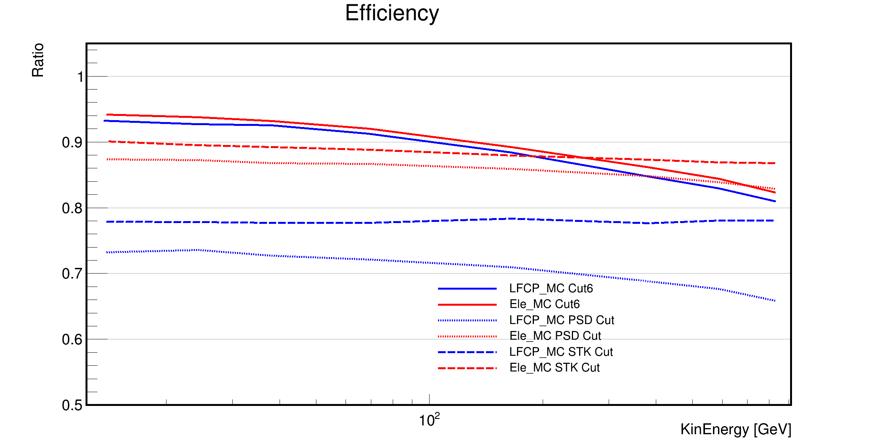
Efficiency

Slide 10
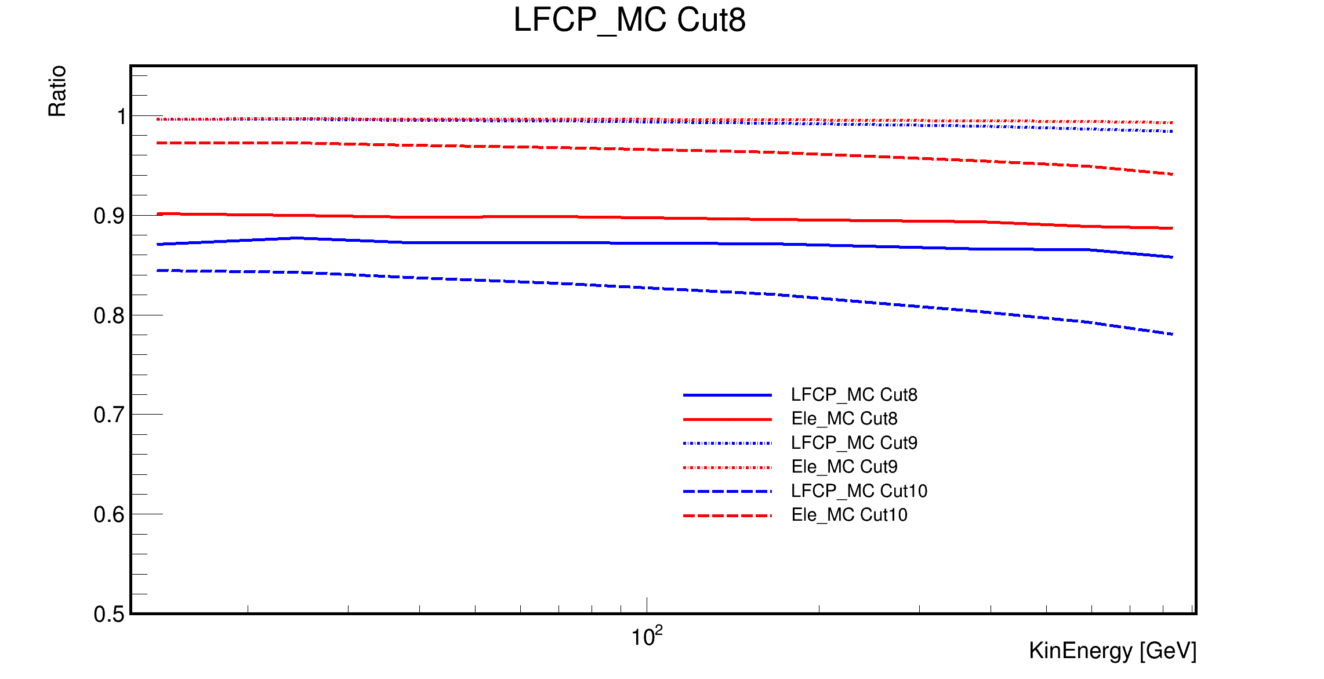
Efficiency
Efficiency of PSD Cuts

Slide 11
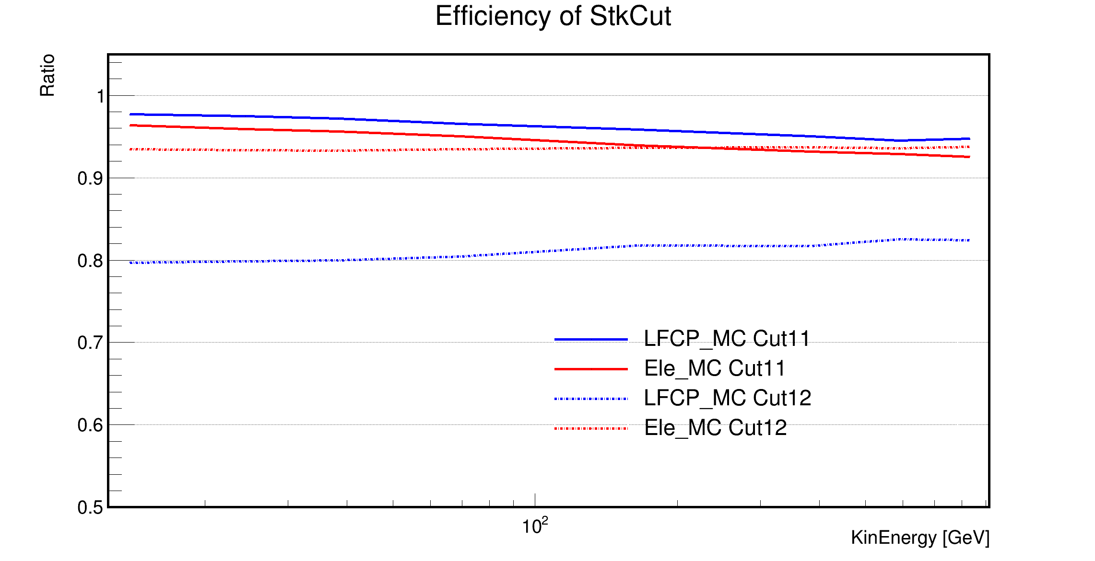
Efficiency

Slide 12
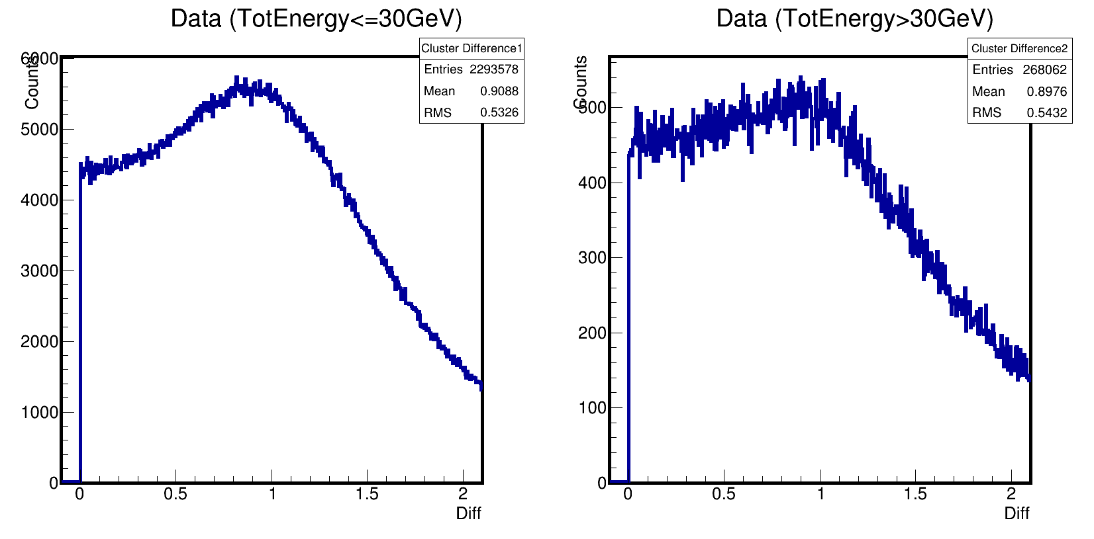
ClusterDiff0: b=StkTrkEng_last

Slide 13
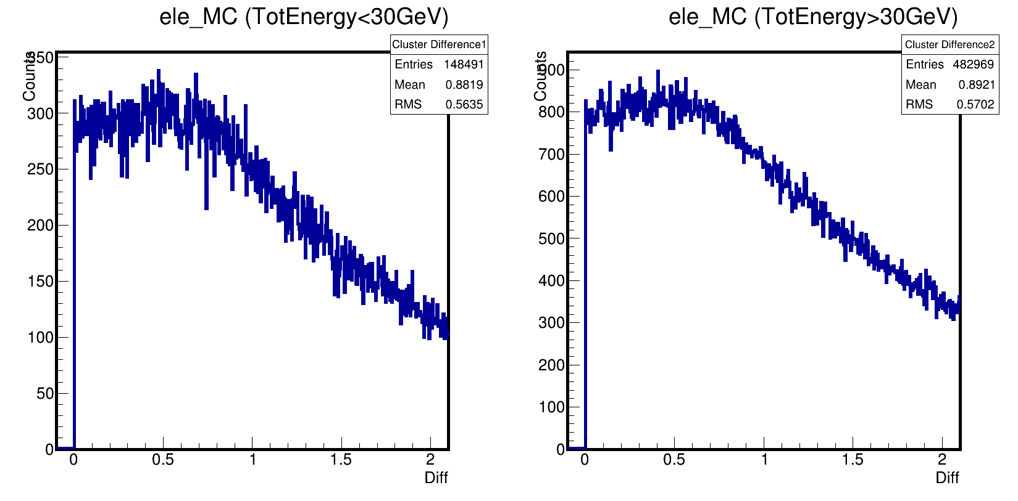
ClusterDiff0: b=StkTrkEng_last

Slide 14
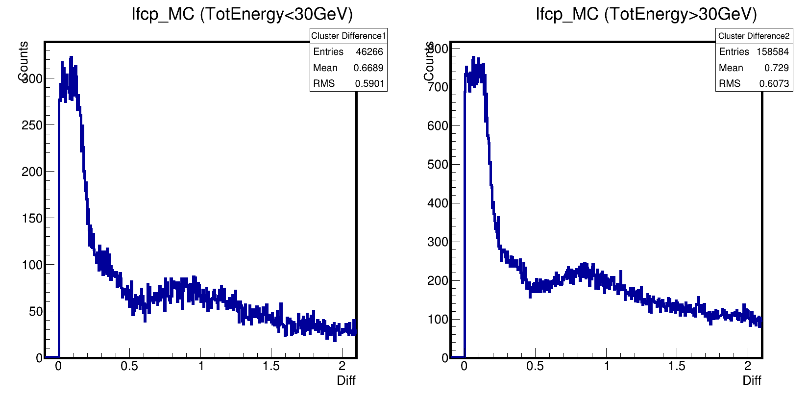
ClusterDiff0: b=StkTrkEng_last

Slide 15
ClusterDiff: b=StkAveClusterEng_last

