Slide 1
IPChamber阻抗分析
何天龙
20250327

Slide 2
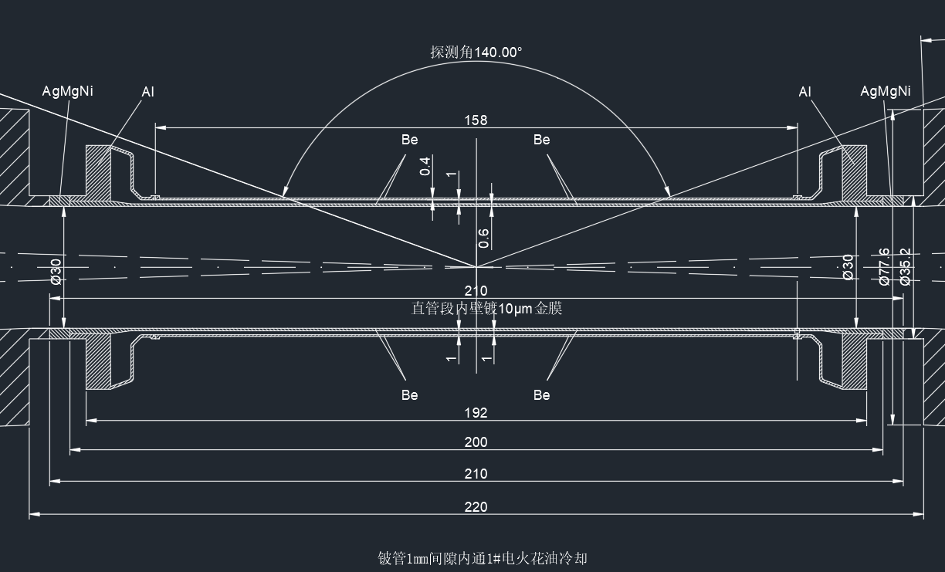
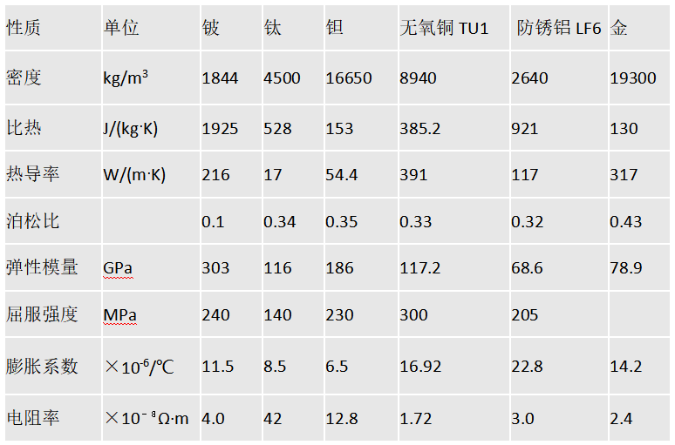
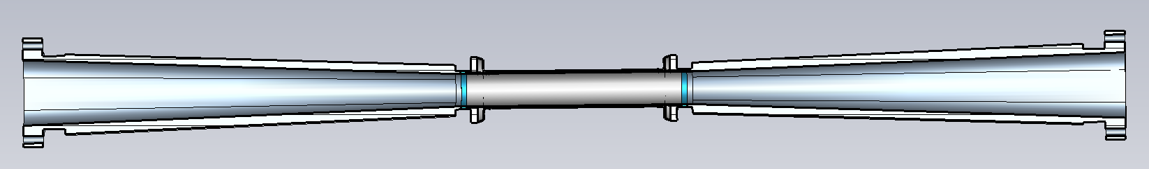
IP-Chamber model
电导率 | MS/m | 25 | 2.38 | 7.81 | 58 | 33.3 | 41.7
镀Cu 10 um
镀Au 10 um

Slide 3
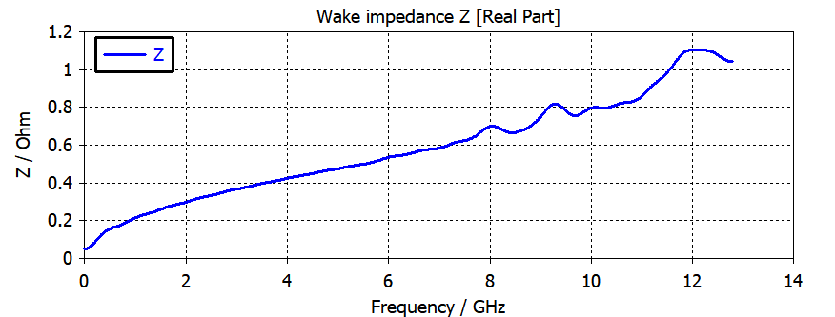
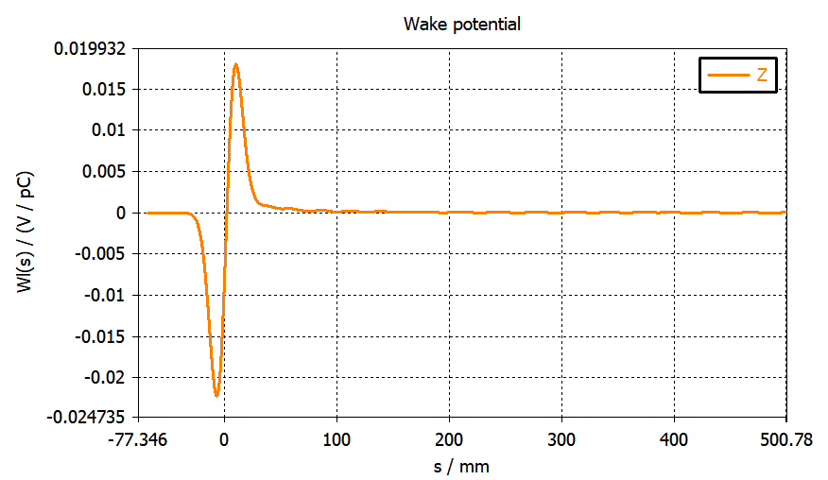
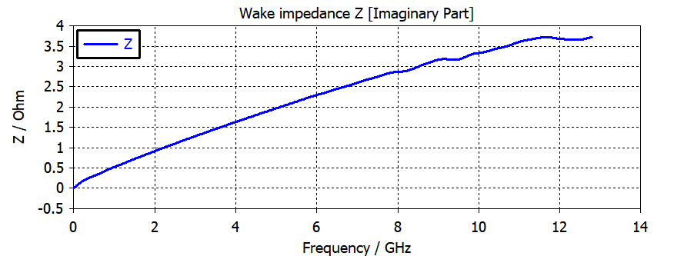

尾势与阻抗 @ rms 8 mm Gaussian bunch

Slide 4
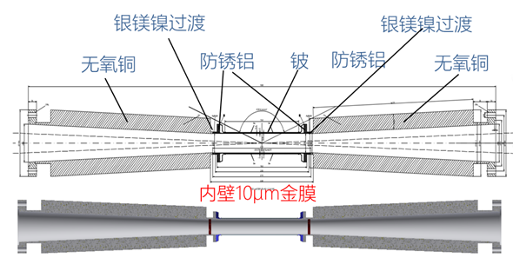
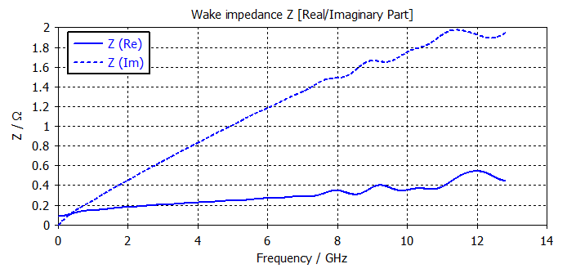
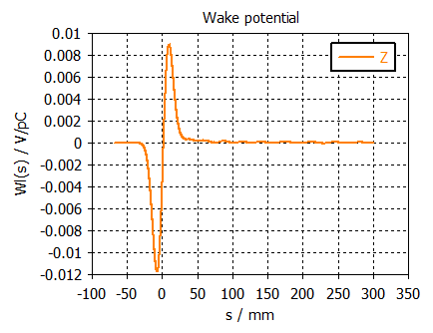
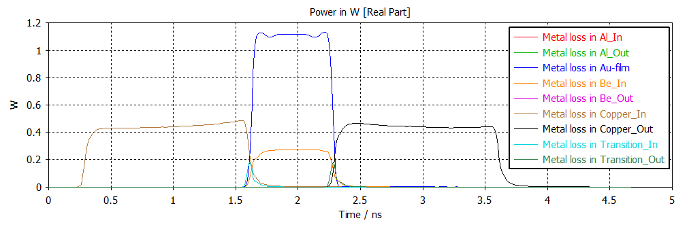
2025/04/08
2.172676e-03 V/pC
Copper in
Copper Out
15 um 金膜

Slide 5
Beam power disspation evaluation
Loss factor: 2.172676e-03 V/pC
→ 8.5 *2.172676 * 2 = 36.5 W
P_{diss}~ 1.8 W
Au-film
Be-In

Slide 6
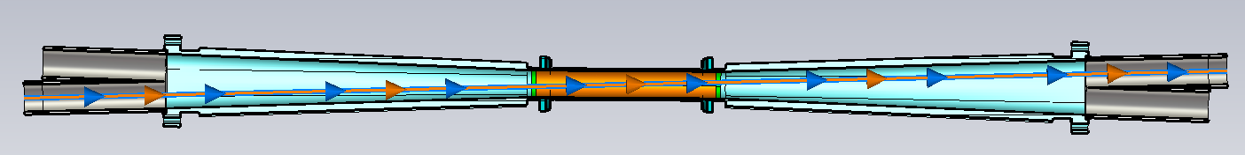
2025/04/15 (+叉管)
Loss factor: 45.8676e-03 V/pC
→ 8.5 *45.8676 * 2 ~ 780 W

Slide 7
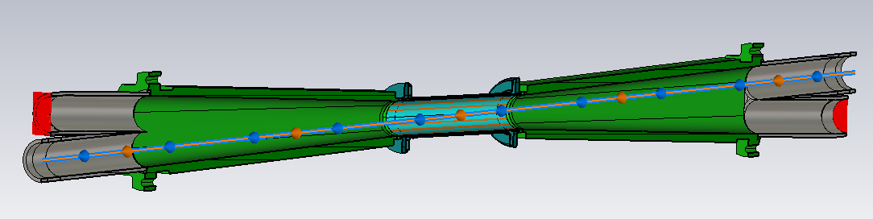
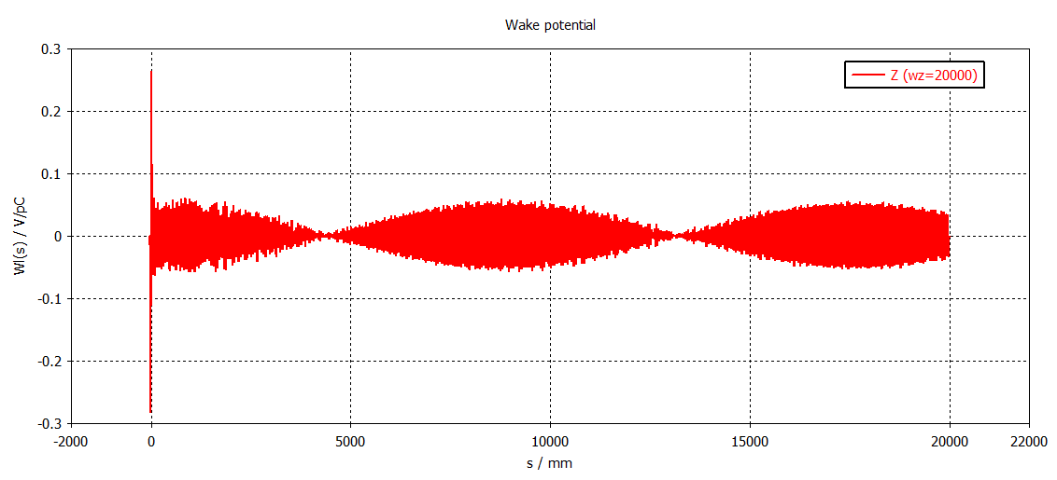
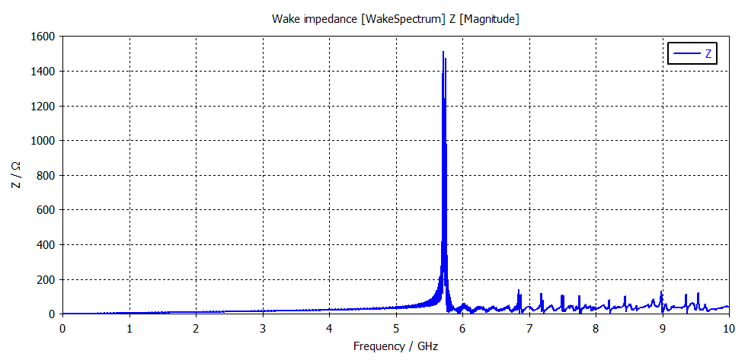
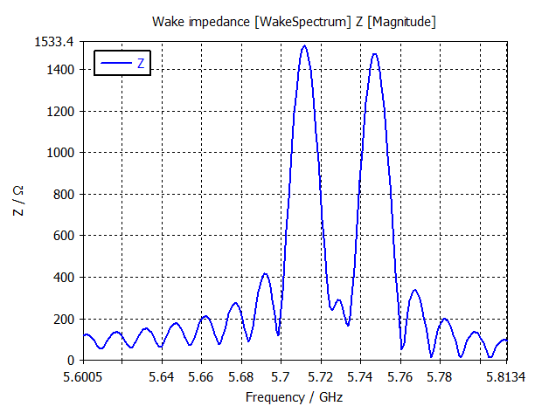
20240418
Loss factor: 46.3e-03 V/pC
→ 8.5 *46.3 * 2 ~ 787 W

