Slide 1
CEPC AHCAL PID
李想，刁洪滨
2025.5.13

Slide 2
motivation：
Beam test:A small fraction of electrons is mixed into the π⁻ beam.
strategy:
MC:Find a specific character

Slide 3
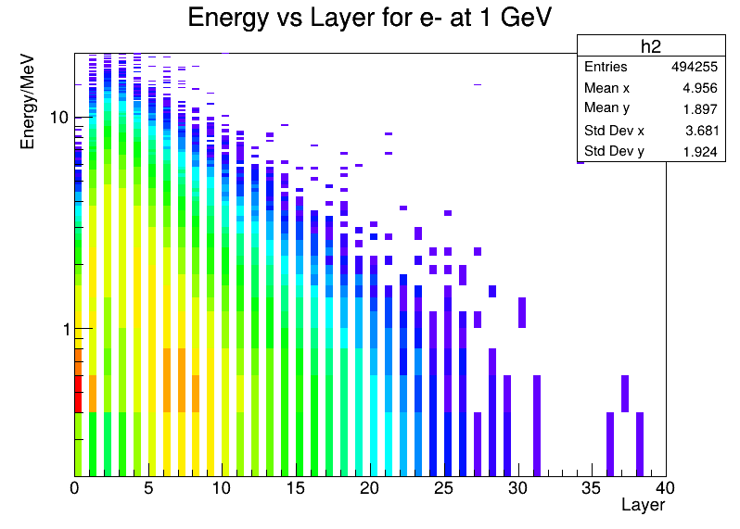
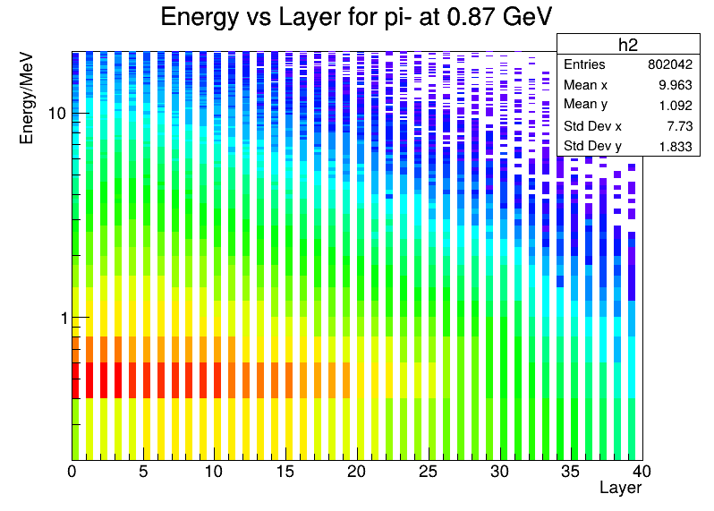
MC:P=1GeV e- VS Pi-
Energy deposition distribution per layer
50000 event
The shower of the π⁻ penetrates deeper, but the energy deposition per layer is smaller.
In particular, there are significant differences in energy deposition between layers 2, 3, 4, and 5

Slide 4
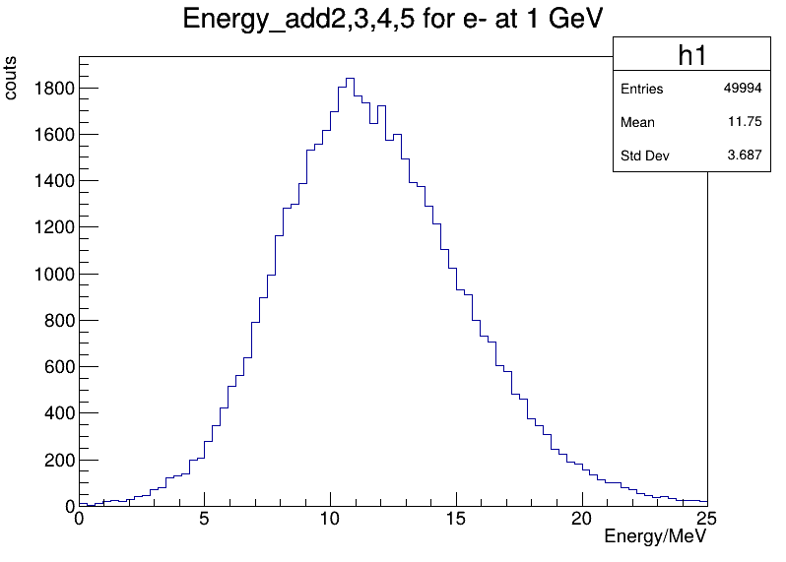
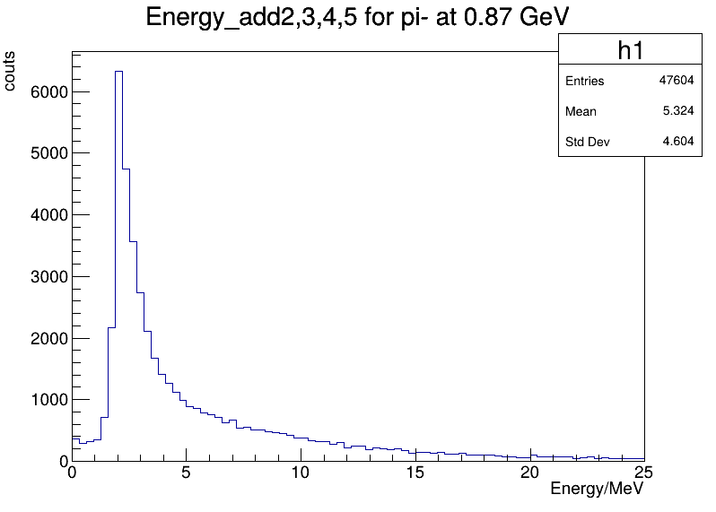
MC : Local energy deposition
add layer 2,3,4,5 energy deposition

Slide 5
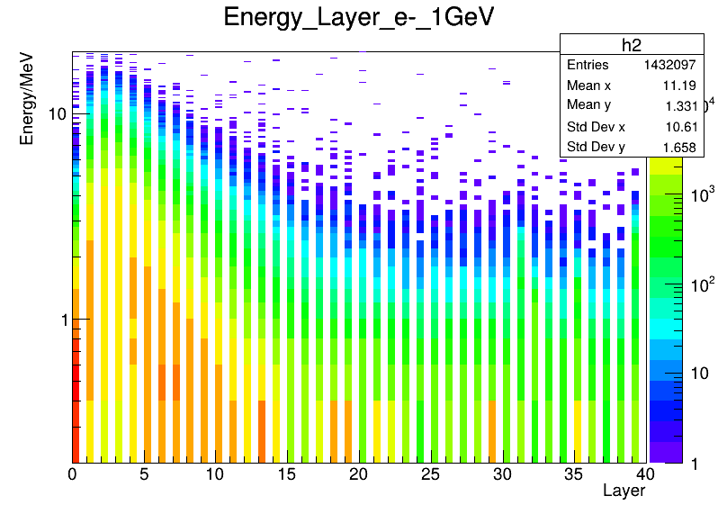
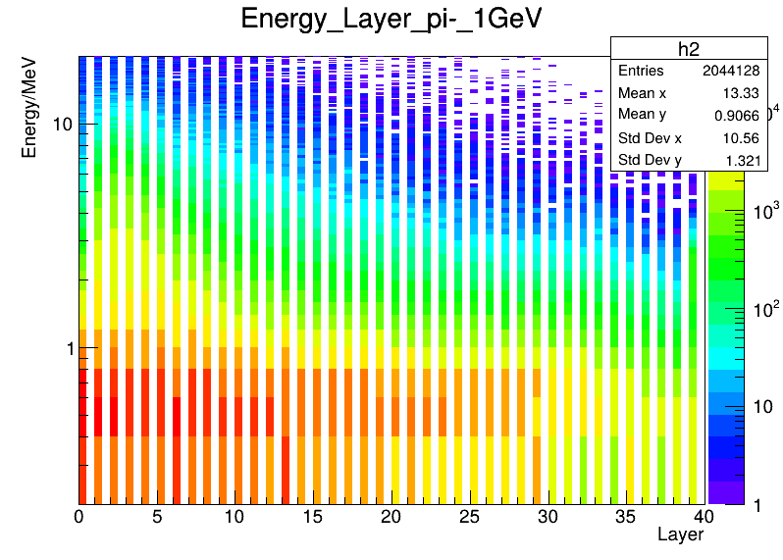
Beam test: Local energy deposition
e- : AHCAL_Run142_20230529_182837
pi- : AHCAL_Run125_20230528_000221

Slide 6
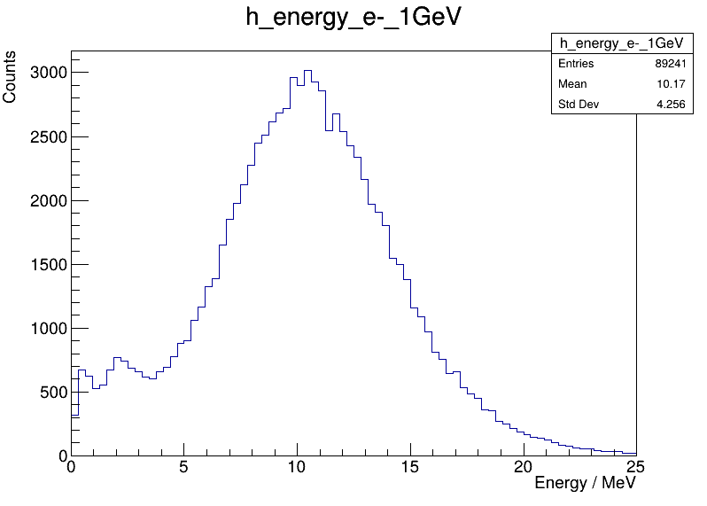
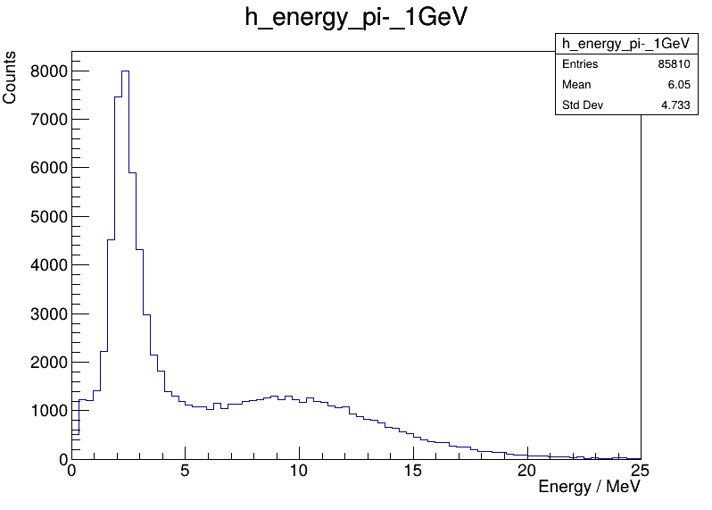
Beam test: Local energy deposition
add layer 2,3,4,5 energy deposition

Slide 7
Summery:
π⁻ and e⁻ with a momentum of 1 GeV show significant differences in energy deposition per layer in the AHCAL.
There is a significant difference in the total energy deposited in layers 2 to 5 between π⁻ and e⁻.
To do:
Try to use distinct energy deposition in layers 2 to 5 to do particle identification between π⁻ and e⁻
Find other character

Slide 8
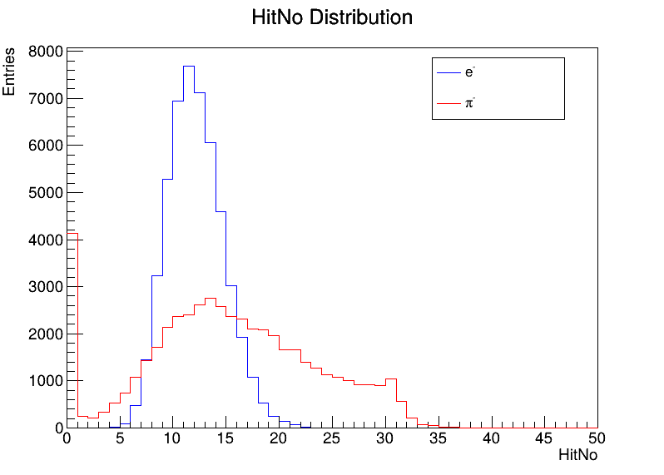
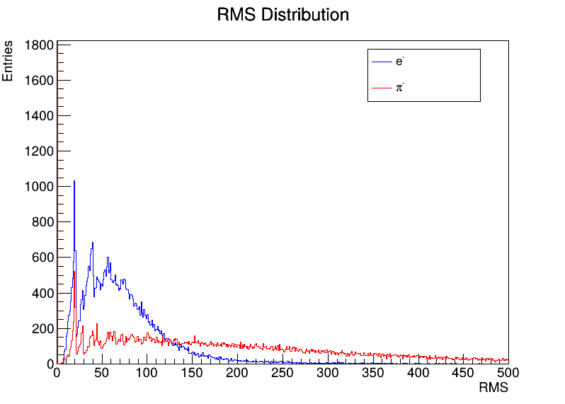
back up
MC:

Slide 9
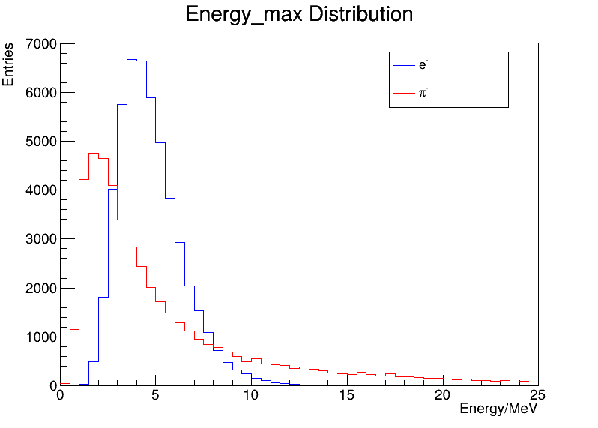
back up
MC:

