Slide 1

Doctoral Proposal Defense
-- Development and Performance Study of
VLAST-P Crystal Electromagnetic Calorimeter
2025/04/29
Supervisor: Prof. Yunlong Zhang(张云龙教授)
Speaker : Jiaxuan Wang(王家轩, BA22004050)

Slide 2



Motivation
VLAST-P ECAL
Summary & Prospect

Slide 3
Motivation
  Physics Cases
  Vlast-P Project
VLAST-P ECAL
Summary & Prospect

Slide 4
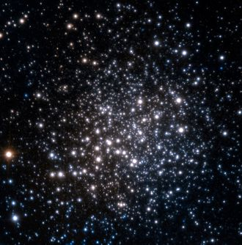
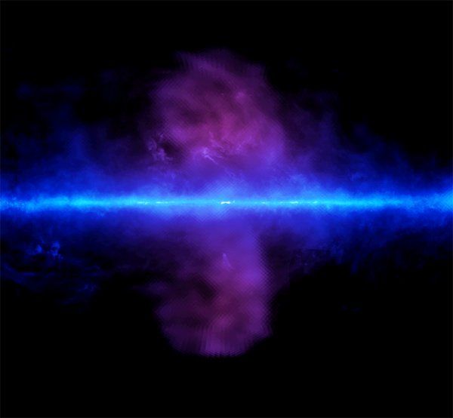
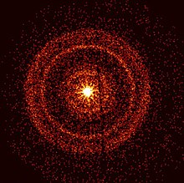
Gamma-ray physics
Broadband gamma-ray radiation exists in space
  Electron: bremsstrahlung radiation, inverse Compton effect
  Hadron: hadronic interaction
  Possible dark matter particle annihilation
Gamma-ray physics cases
  High-energy time-domain astronomy
  Dark matter indirect detection
  Cosmology physics
Search for gamma-ray spectral line
Millisecond pulsar
Fermi bubbles
Gamma-ray burst
High-precision gamma-ray detection will open a new observational window!

Slide 5
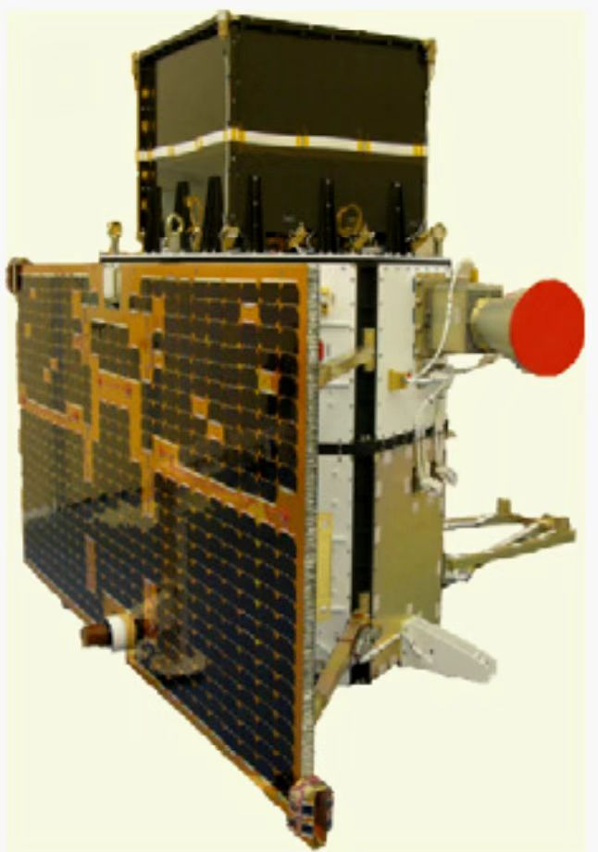
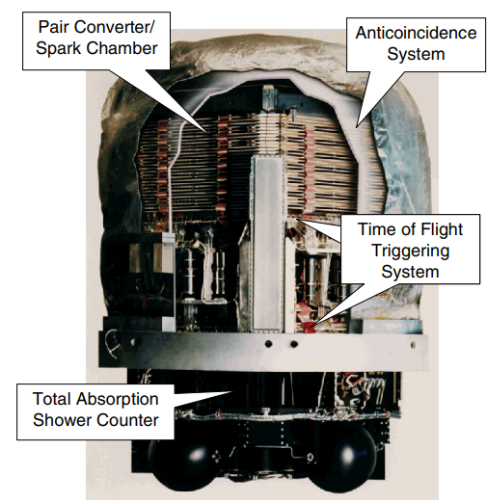
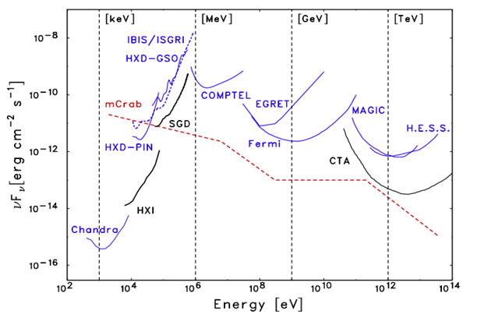
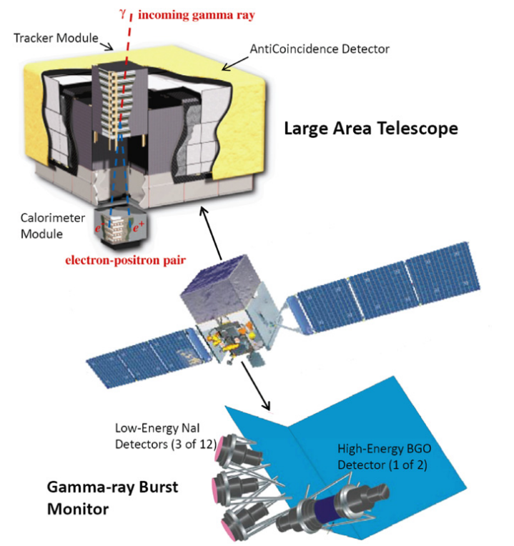
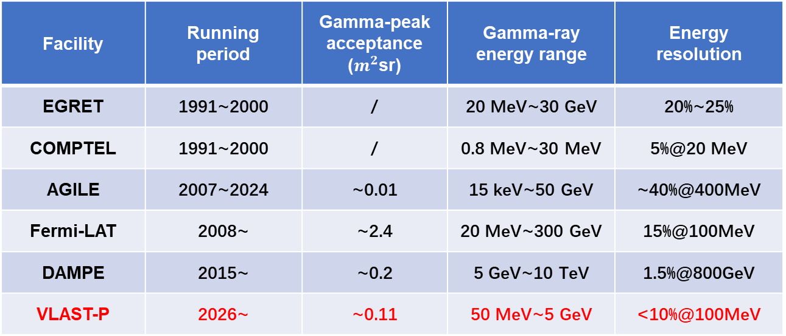
Gamma-ray space instruments
AGILE
EGRET
Fermi Gamma-ray Space Telescope
The research on gamma-ray detection instruments is thriving!

Slide 6
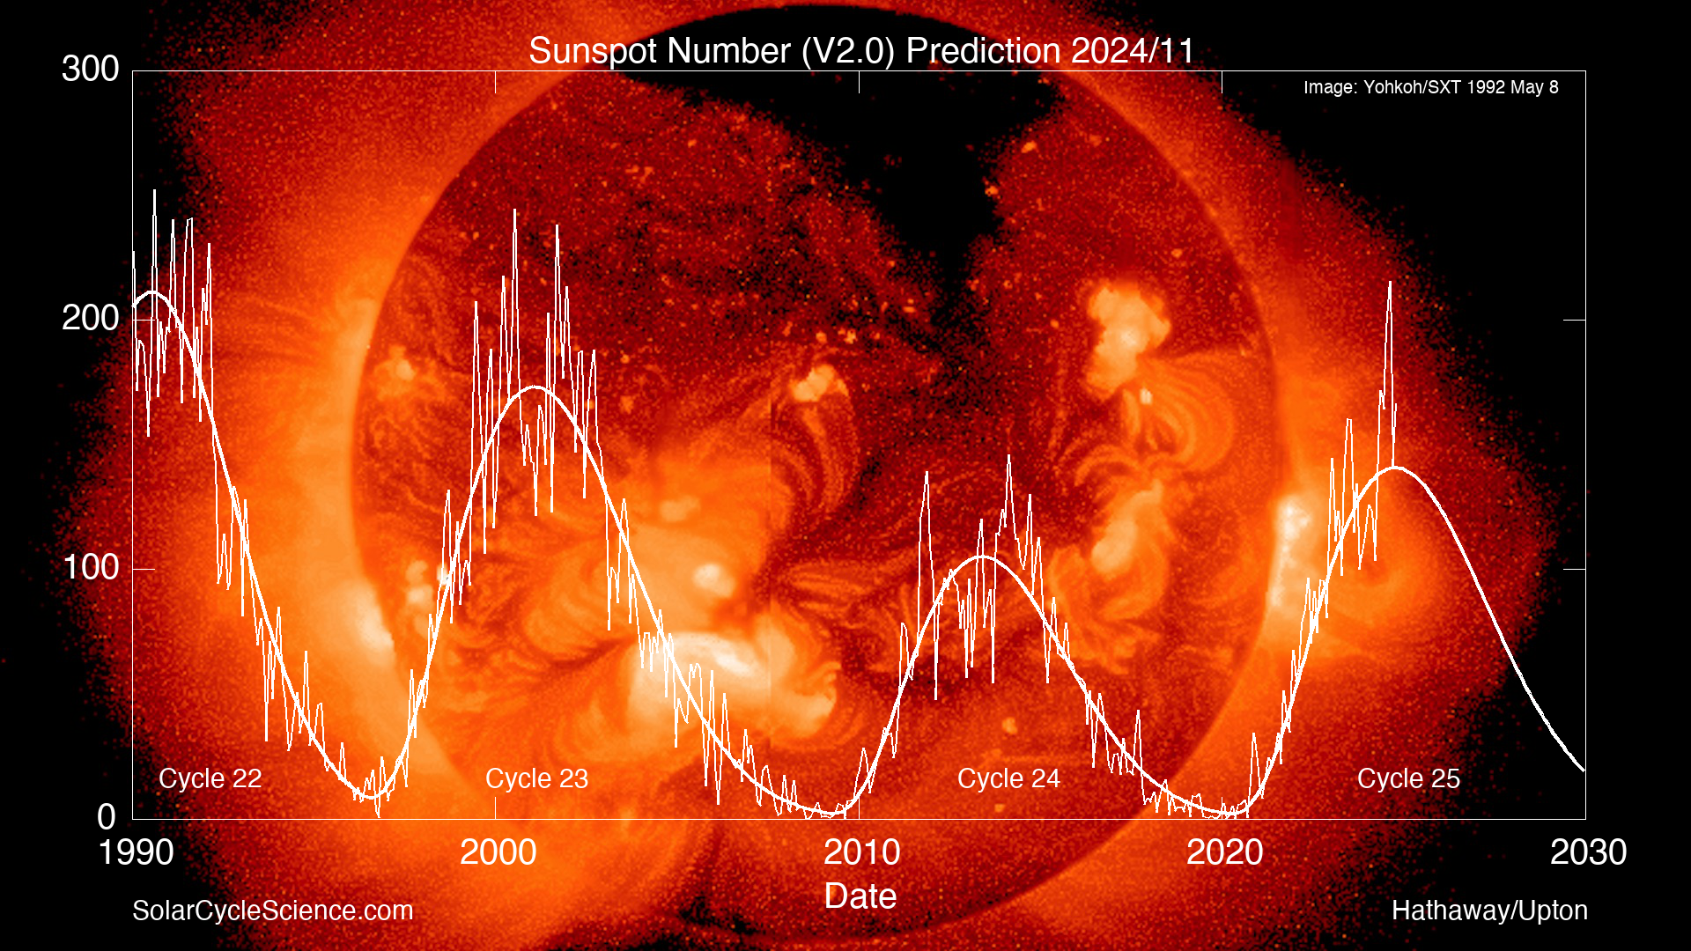
VLAST-Pathfinder(VLAST-P)
China’s first mission to observe gamma radiation from the sun in the sub-GeV energy range on orbit
VLAST-P physics goal
  Verify key technologies for flagship telescopes VLAST
  High precision observation of sub-GeV gamma rays of the sun
Solar cycle
Large-area silicon microstrip detector technology
Plastic scintillator embedded optical fibers for ACD

Slide 7
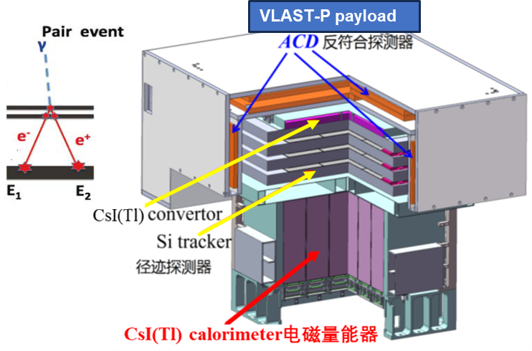
Detectors on VLAST-P
VLAST-P payload: 2026 launch mission(expect)
  Anticoincidence detector(ACD): > 99.9% uniform detection efficiency
  Si Tracker(ST): 50 um position resolution
  Electromagnetic calorimeter(ECAL): 10%@100MeV
ACD top part
Converter
ACD side part
Si-strip part
ACD side part
Tracker
ECAL
VLAST-P detectors structure diagram
VLAST–P ECAL development is my doctoral research project!

Slide 8
Motivation
VLAST-P ECAL
  ECAL scheme design
  Geant4 simulation
    Standalone ECAL
    ECAL + Converter
  Sensitive unit test
  On-orbit calibration
Summary & Prospect

Slide 9
VLAST-P calorimeter challenge
To meet the requirements of calorimeter on VLAST-P, the ECAL faces numerous challenges:
  Engineering ECAL development
  On-orbit calibration and energy reconstruction
  Low noise robust readout electronics
Performance simulation
and optimization
Sensitive unit
development
ECAL prototype
development
Readout electronics
development
This project focuses on scheme design and prototype development of a CsI(Tl) crystal calorimeter for VLAST-P.

Slide 10
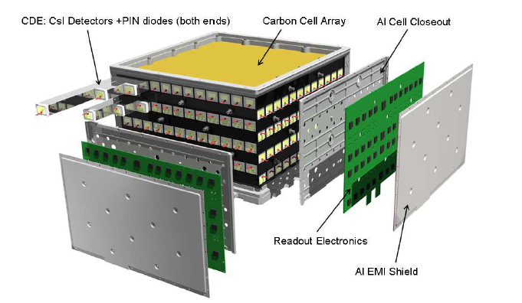
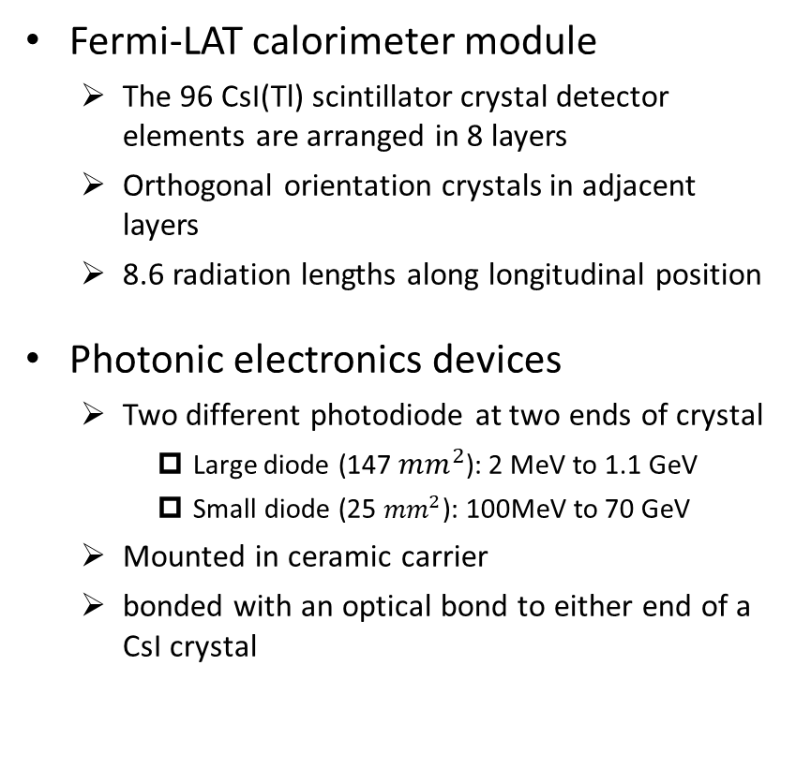
International developments
Fermi-LAT calorimeter module
  The 96 CsI(Tl) scintillator crystal detector elements are arranged in 8 layers
  Orthogonal orientation crystals in adjacent layers
  8.6 radiation lengths along longitudinal position
Photonic electronics devices
  Two different photodiode at two ends of crystal
    Large diode (147 ${mm}^{2}$): 2 MeV to 1.1 GeV
    Small diode (25 ${mm}^{2}$): 100MeV to 70 GeV
  Mounted in ceramic carrier
  bonded with an optical bond to either end of a CsI crystal

Slide 11
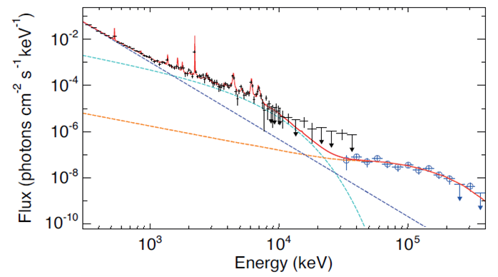
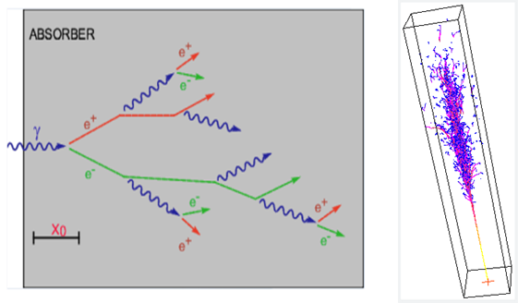
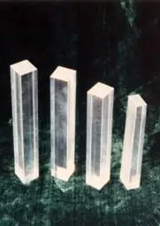
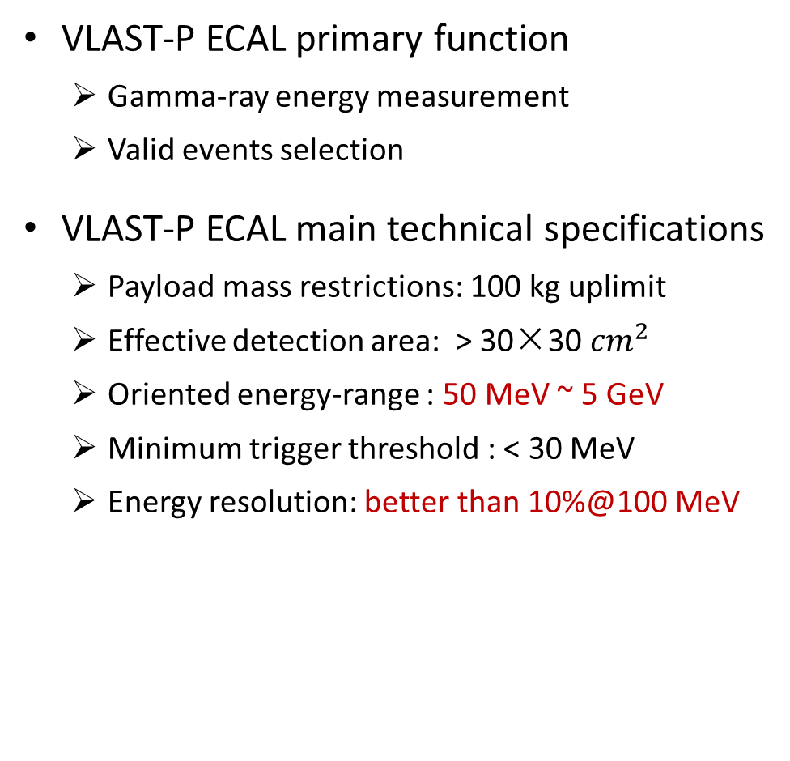
VLAST-P ECAL physics requirement
VLAST-P ECAL primary function
  Gamma-ray energy measurement
  Valid events selection
VLAST-P ECAL main technical specifications
  Payload mass restrictions: 100 kg uplimit
  Effective detection area: > 30×30 ${cm}^{2}$
  Oriented energy-range : 50 MeV ~ 5 GeV
  Minimum trigger threshold : < 30 MeV
  Energy resolution: better than 10%@100 MeV
Fermi LAT results
Gamma-ray energy measurement

Slide 12
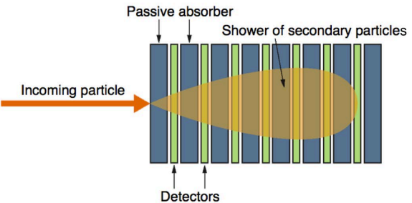
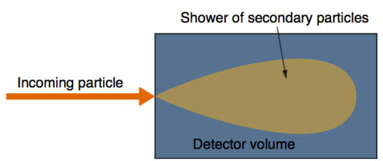
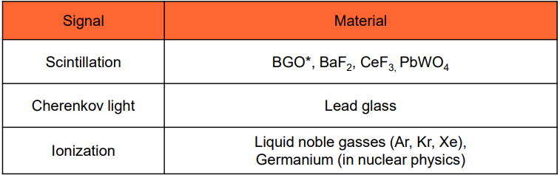
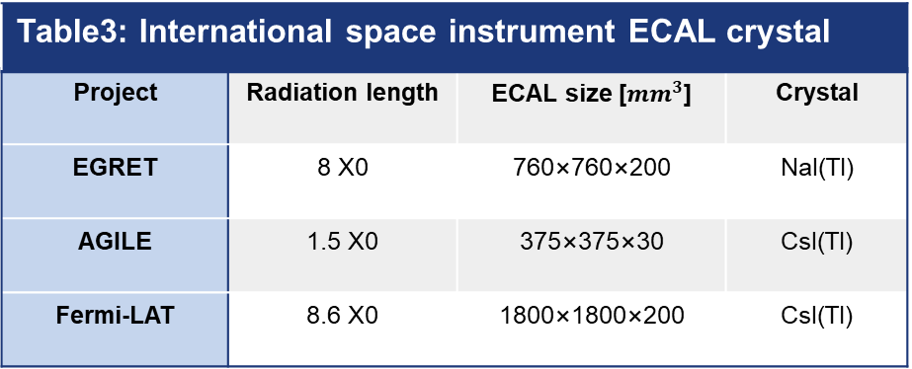
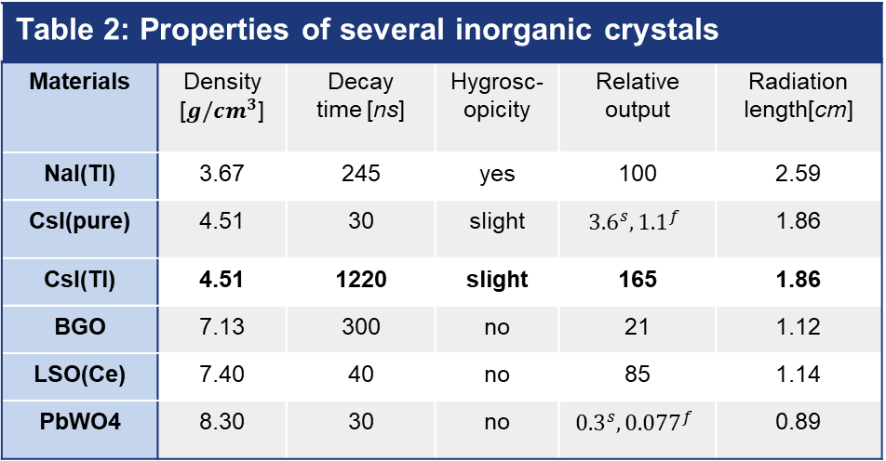
VLAST-P ECAL design scheme(1)
Calorimeter type selection
  Sampling calorimeter
    Cost-effective
    Limited energy resolution
  Homogeneous calorimeter
    Unified material
    Better energy resolution
Material selection
  Space environment → crystal
  Light yield → NOT pCsI, BGO, PWO
  Practicality → CsI(Tl)
Table 2: Properties of several inorganic crystals
Materials | Density [${g/cm}^{3}$] | Decay time [ns] | Hygrosc-opicity | Relative output | Radiation length[cm]
NaI(Tl) | 3.67 | 245 | yes | 100 | 2.59
CsI(pure) | 4.51 | 30 | slight | $${3.6}^{s}, {1.1}^{f}$$ | 1.86
CsI(Tl) | 4.51 | 1220 | slight | 165 | 1.86
BGO | 7.13 | 300 | no | 21 | 1.12
LSO(Ce) | 7.40 | 40 | no | 85 | 1.14
PbWO4 | 8.30 | 30 | no | $${0.3}^{s}, {0.077}^{f}$$ | 0.89
Table3: International space instrument ECAL crystal
Project | Radiation length | ECAL size [${mm}^{3}$] | Crystal
EGRET | 8 X0 | 760×760×200 | NaI(Tl)
AGILE | 1.5 X0 | 375×375×30 | CsI(Tl)
Fermi-LAT | 8.6 X0 | 1800×1800×200 | CsI(Tl)
Considering the main factors, Homogenous CsI(Tl) crystal calorimeter is the better choice.

Slide 13
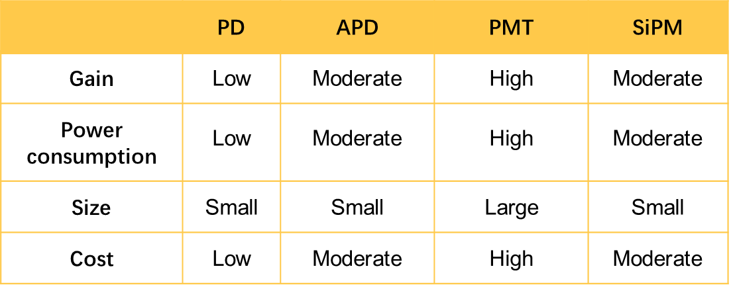
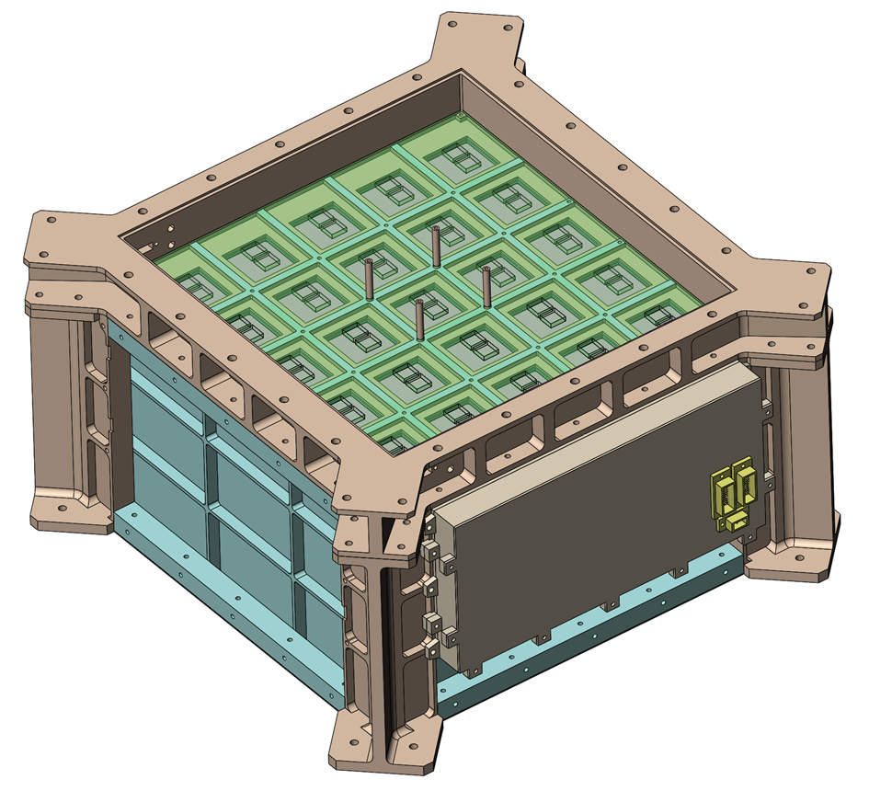
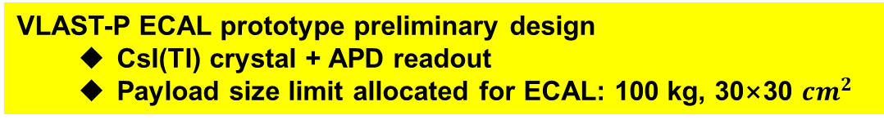
VLAST-P ECAL design scheme(2)
Photonic electronics devices
  Physics requirements: gain, noise
  Engineering Development
    Power consumption
    Photonic device size
    Engineering cost
Considering physics requirements and working environments, APD is chosen as photonic device
VLAST-P ECAL prototype preliminary design
  CsI(Tl) crystal + APD readout
  Payload size limit allocated for ECAL: 100 kg, 30×30 ${cm}^{2}$

Slide 14
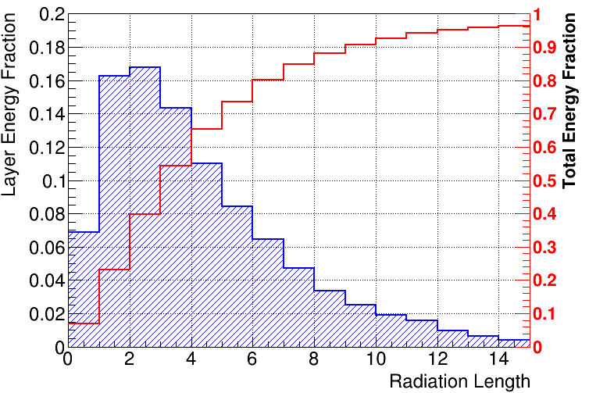
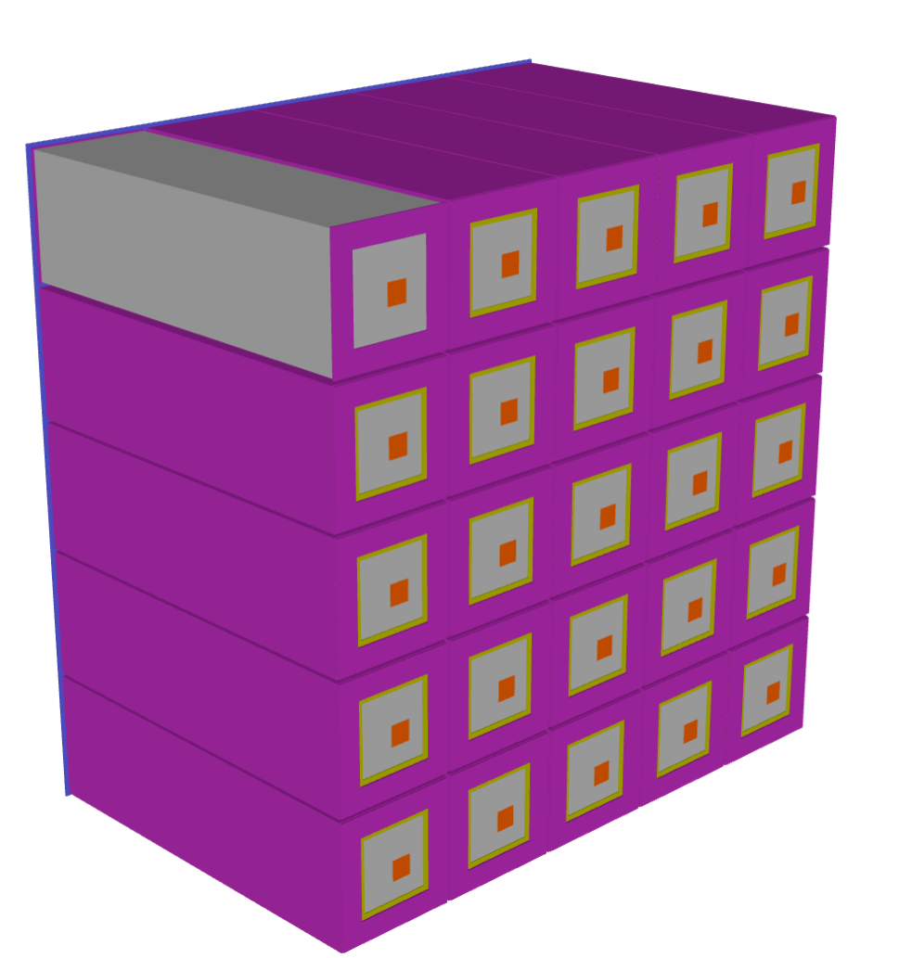
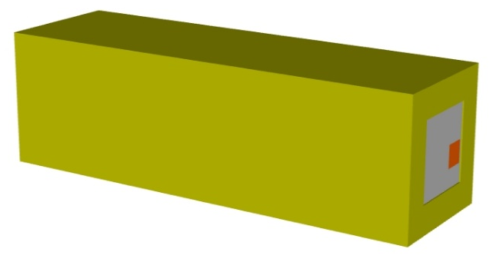
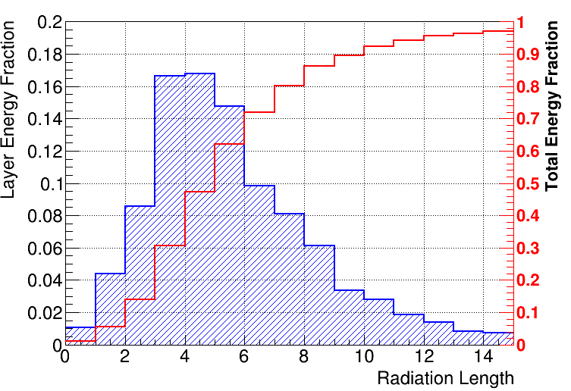


ECAL prototype size
Longitudinal size optimization
  > 10 $X_{0}$makes sure 90% particle primary energy deposited
  Considering the payload mass limits: 100 kg
ECAL prototype size design: 5×5 CsI(Tl) crystal
100 MeV gamma energy profile
1 GeV gamma energy profile
60×60×200 ${mm}^{3}$ CsI(Tl) Crystal
5×5 CsI(Tl) Crystal placement

Slide 15
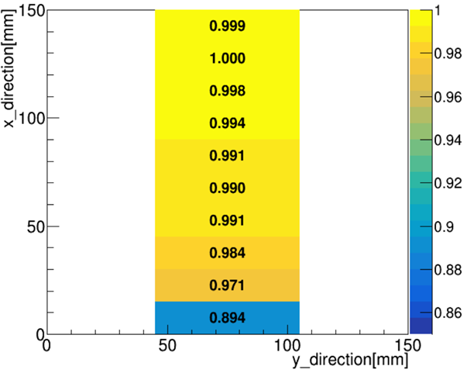
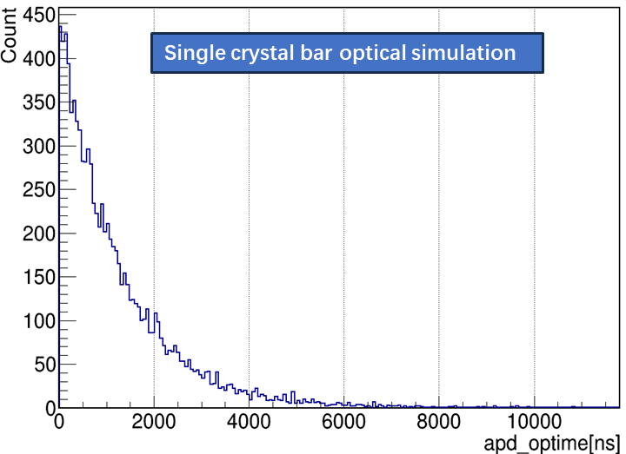
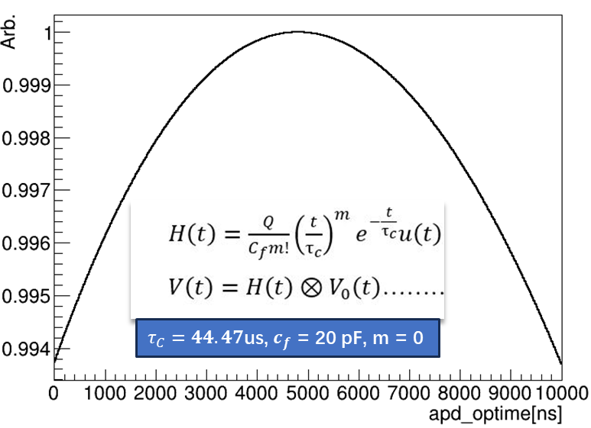
Physics process considered
ECAL all materials added
  Reflector: 0.6 mm TiO₂
  Cushioning layer: Silicone rubber
  Shield: carbon fiber frame
Light yield non-uniformity
Electronic noise: 475 electrons
APD ionization: 10um sensitive region(Silicon ~3.6 eV)
  Secondary particle hit APD directly
  Fluctuate according to energy collected at each APD
Photons arriving-to-APD time distribution -> real signal response

Slide 16
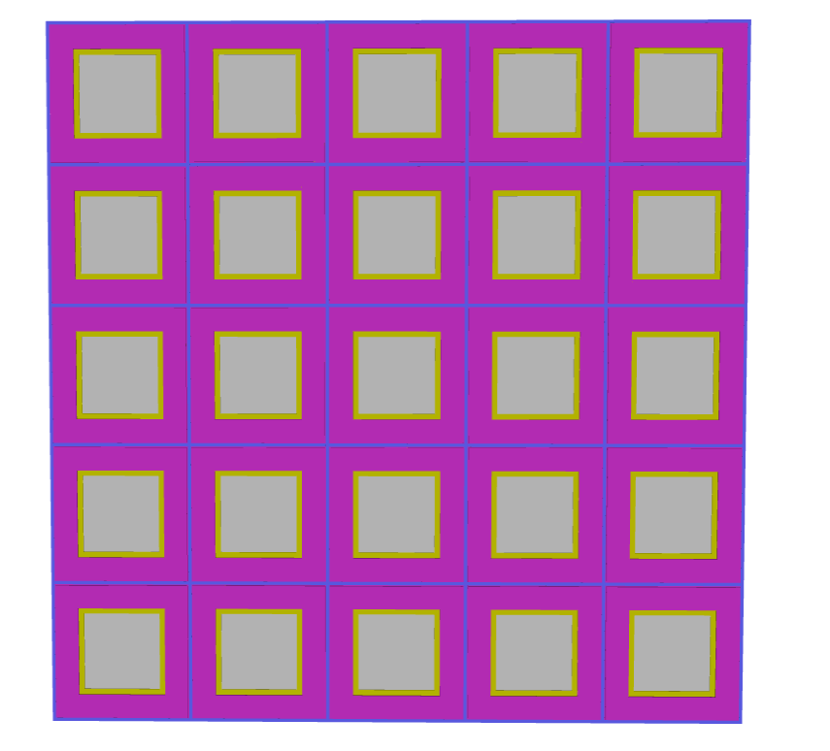
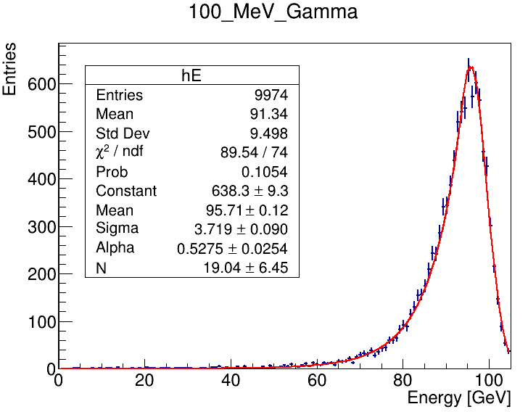
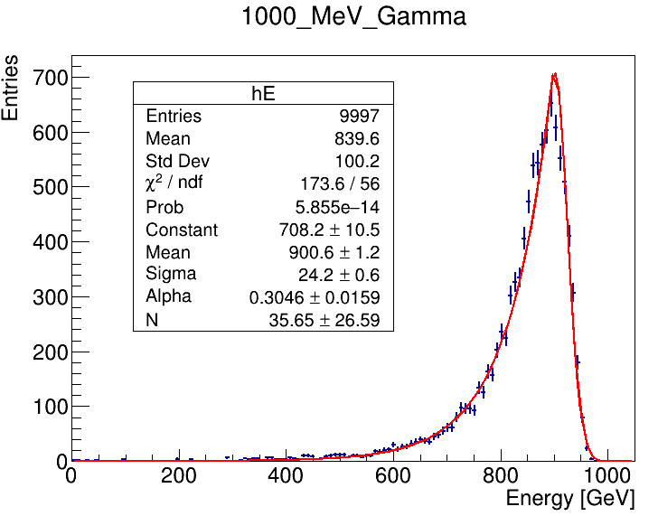

ECAL energy reconstruction
Isotropic point source as gamma source
Event selection
  Reconstruct clusters: within the inner ECAL cells
  Reconstruct energy: sum of nine crystals around highest-energy crystal.

Slide 17
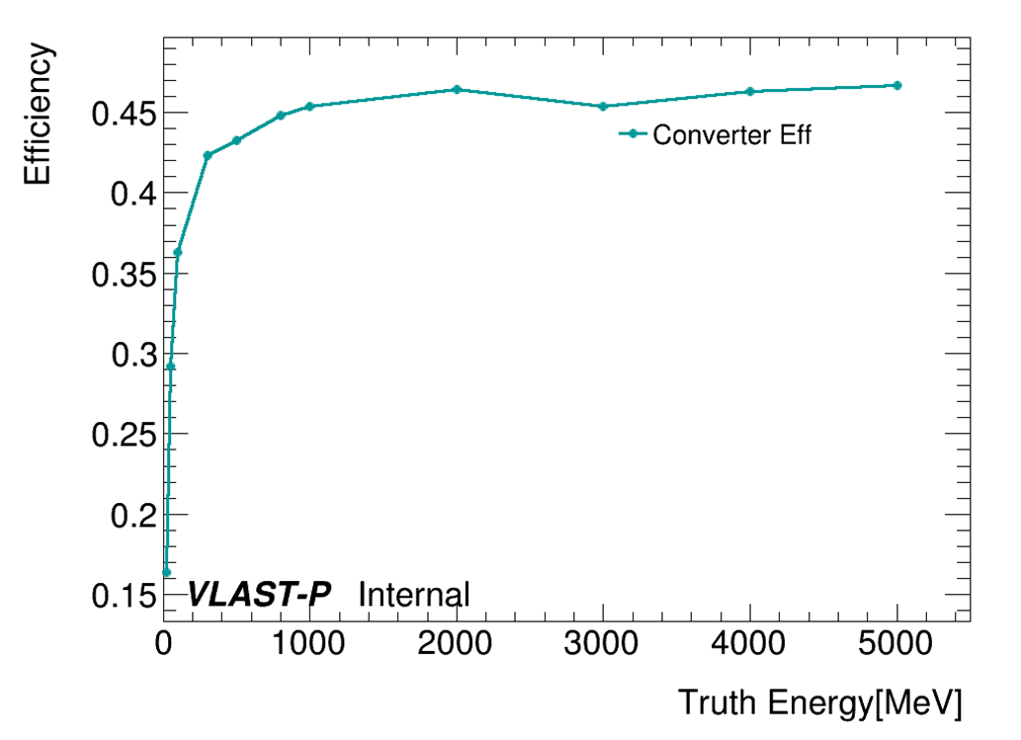
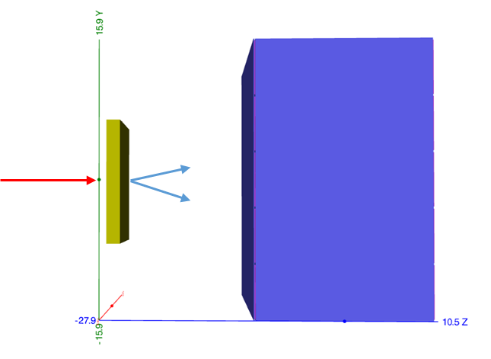
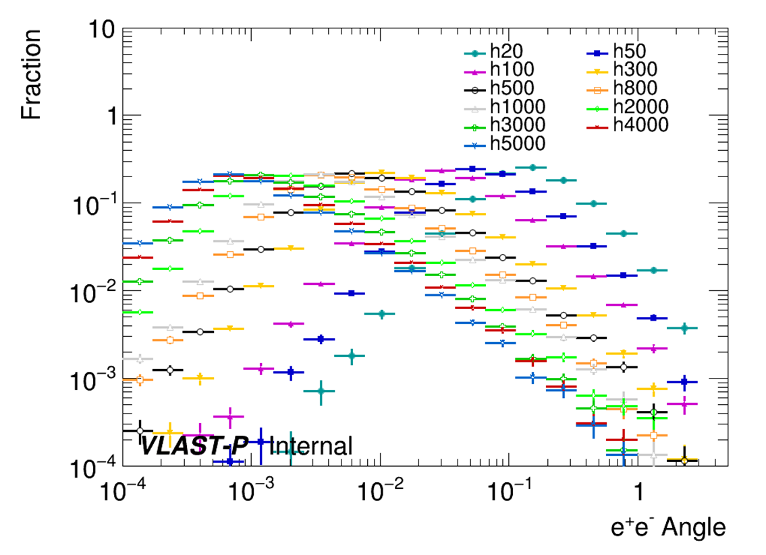
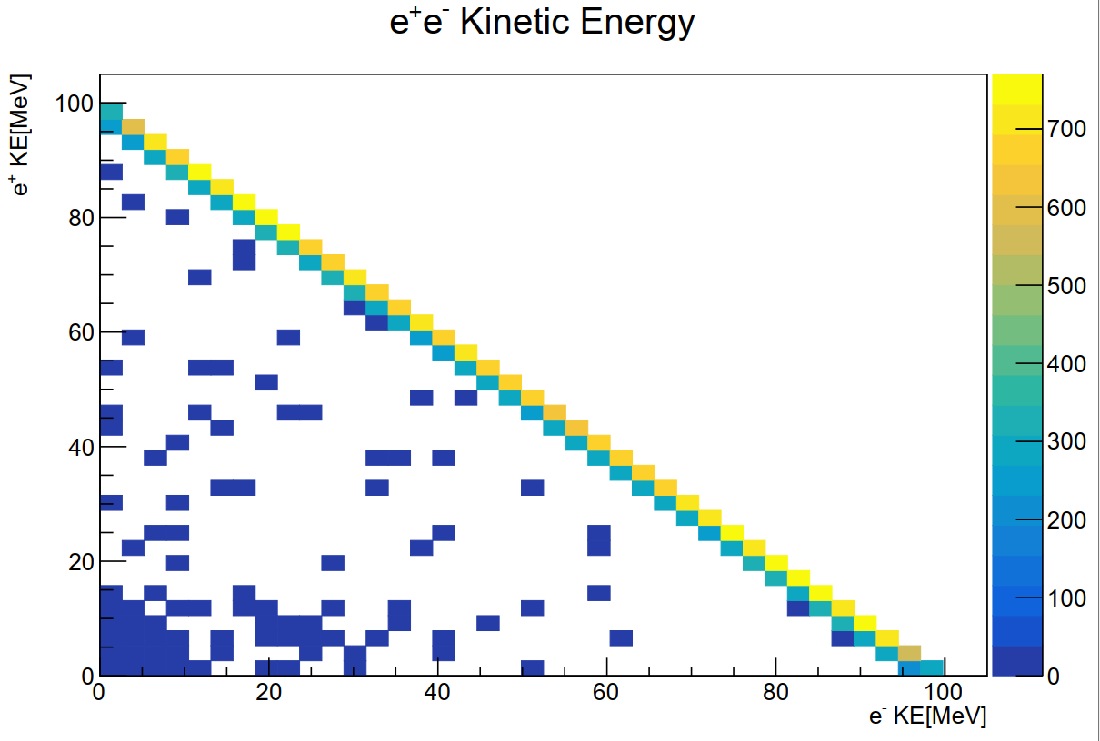

GEANT4 simulation: ECAL + converter
Geant4 MC settings
  Interval between ECAL and converter: 160 mm
  Particle direction: (0,0,1)
  Particle position: 5 mm in front of converter
Converter data analysis
  Converter efficiency
  Angle fraction
  Electron and positron
$$E_{γ}=100MeV$$

Slide 18
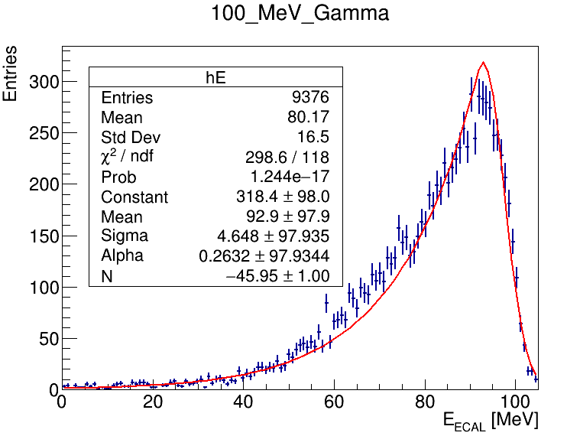
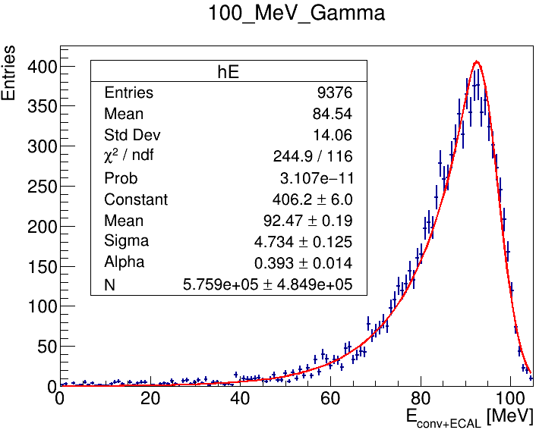
ECAL + converter energy reconstruction
Energy spectrum under (ECAL + Converter) MC setting
FWHM/2.35 : 10.8%
FWHM/2.35 : 9.5%

Slide 19
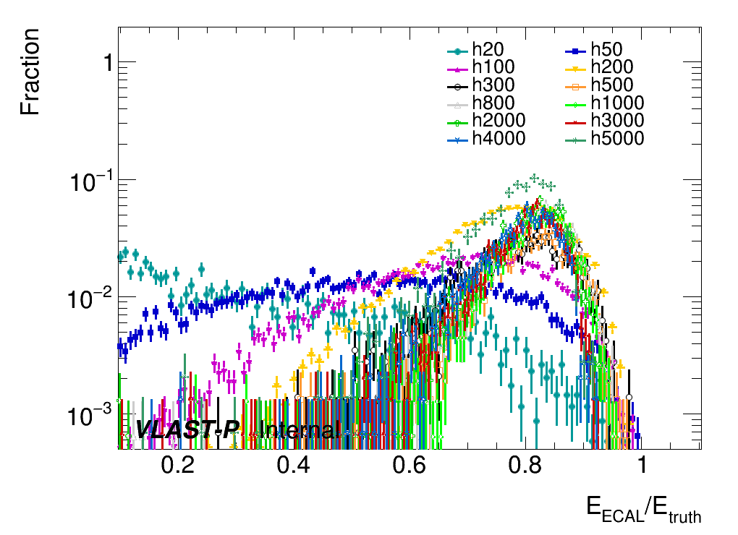
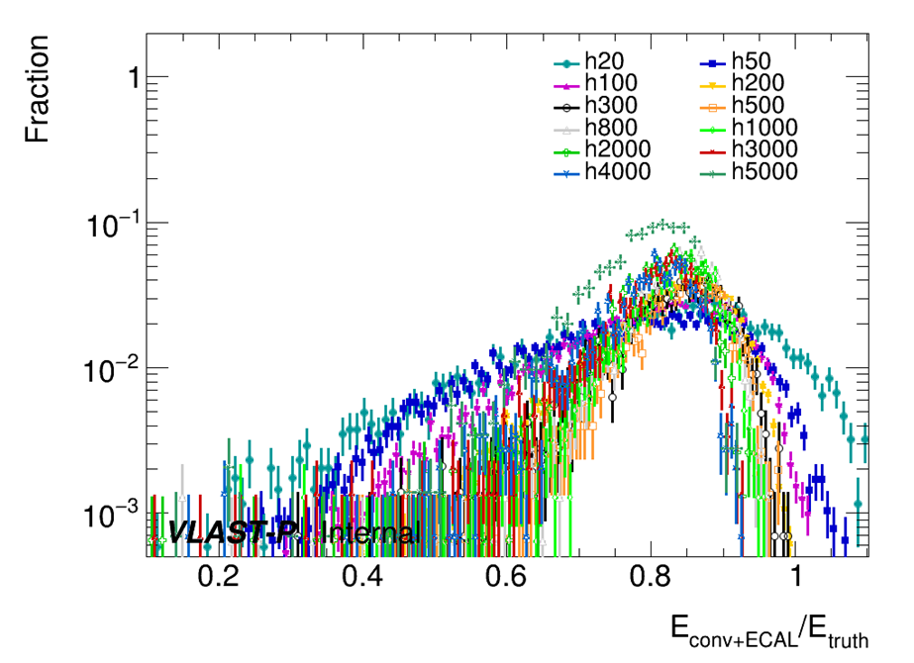
ECAL + converter energy reconstruction
Total reconstructed energy comparison
It shows significant improvement on energy reconstruction for
low-energy electron when energy deposited in converter get counted

Slide 20
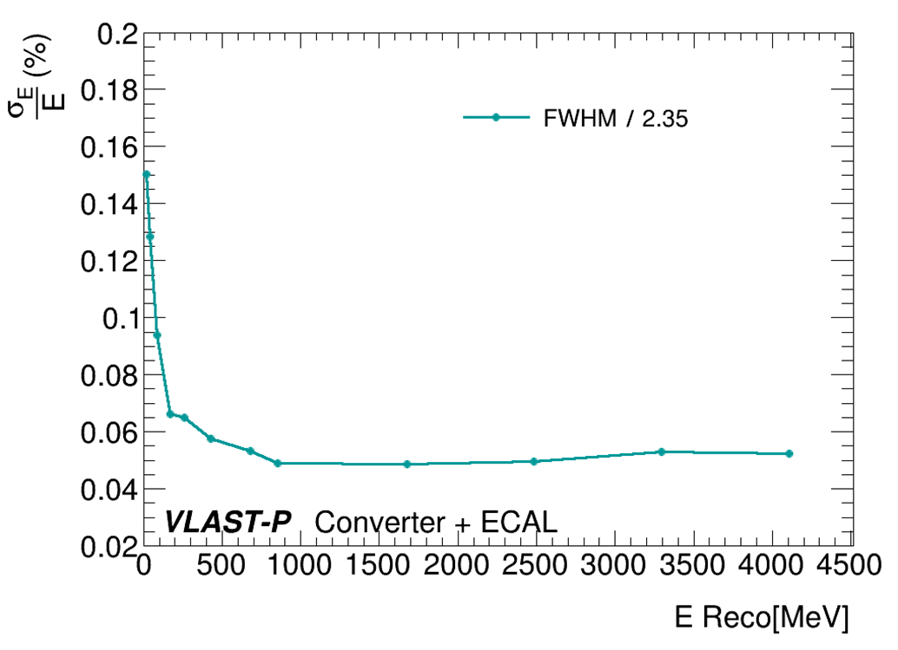
Energy resolution
Energy resolution based on MC
VLAST-P ECAL prototype MC simulation status
  All ECAL prototype materials added
  Front detector tracker: converter part added
  Main physics process considered
Energy resolution in Simulation
  9.5% @ 100 MeV
  4.9% @ 1 GeV
Potential improvement on energy resolution
  low electronics noise
  event selection algorithm
  on-orbit calibration accuracy

Slide 21
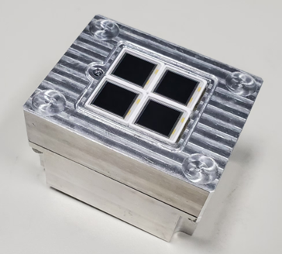
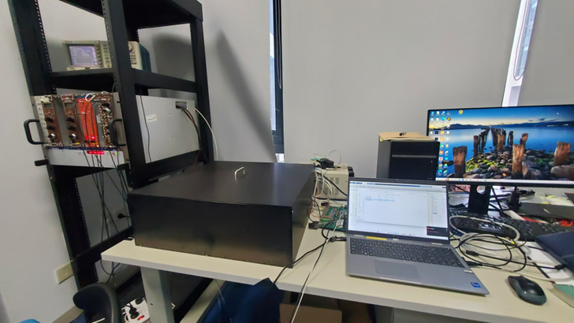
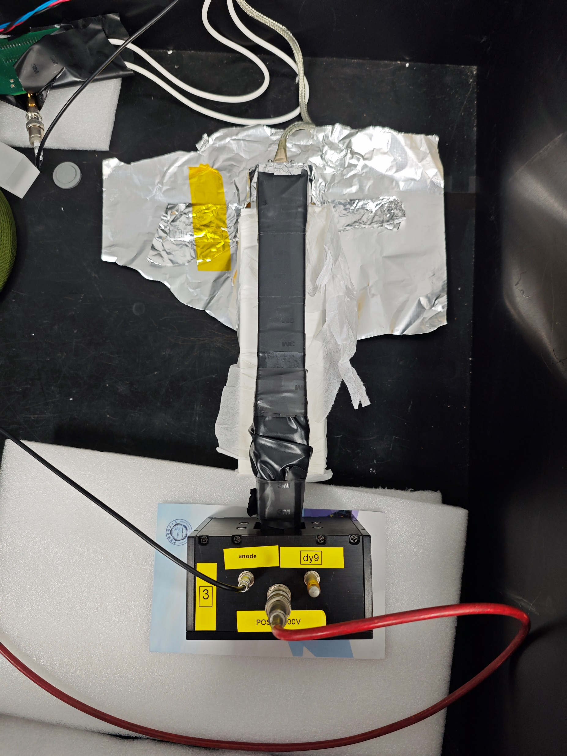
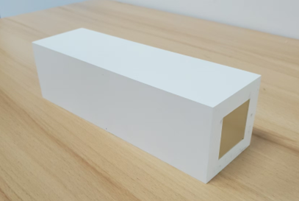

Light yield test: bar CsI(Tl)
Hamamatsu Bar CsI(Tl)
  Crystal size: 60×60 ×200 ${mm}^{3}$
  Optical window: 35×35 ${mm}^{2}$
  TiO2 coating: 0.6 mm
Hamamatsu APD S8664-1010
  4*APD readout + Al frame + FEE
  APD gain: ~50
  4 APDs integrated in Al frame
Trigger part
Test unit
  Bar CsI(Tl) crystal with optical window
  External trigger
Cosmic ray

Slide 22
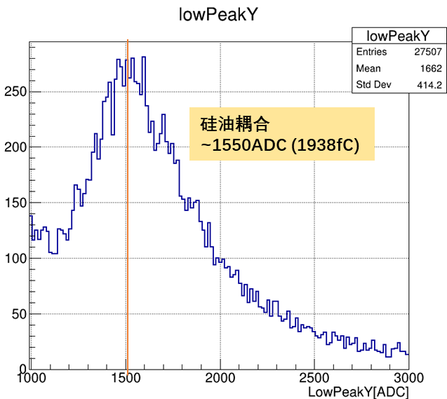

Optical coupling optimization(1)
Coupling mediums optimization: Air coupling, silicon oil coupling
Light yield: ~ 6700 p.e. / MeV
Light yield: ~ 3500 p.e. / MeV
Under both coupling mediums situation, the light yield meet the requirements
Considering the space circumstance, air might be the first choice

Slide 23




Optical coupling optimization(2)
Coupling medium thickness: 2 mm, 3 mm and 5 mm air gap
Less than 2% difference
By adjusting the air gap thickness, it shows little impact on crystal light yield.
3 mm air is a proper value for gap

Slide 24

Light yield non-uniformity test: bar CsI(Tl)
Signal response at different positions in crystal → Hit position information needed
Track information provided by Micromegas platform → Combined test
Cosmic ray
Micromegas
detector
Test unit

Slide 25






Light yield non-uniformity test: bar CsI(Tl)
Event selection
  4 layers get hit in total 6 Micromegas layers → 8k events/day
Non-uniformity analysis
  Crystal is divided into 10 sub-sections along longitudinal direction
  Normalization based on the maximum signal
  Crystal placement in Micromegas test platform
The light yield non-uniformity of bar CsI(Tl) crystal has tiny affect on response, less than 1%

Slide 26





Light yield test: plate CsI(Tl)
Plate CsI(Tl) crystals are used to improve energy reconstruction
Hamamatsu plate CsI(Tl)
  Crystal size: 150×150×16 ${mm}^{3}$
  Optical window: 15×15 ${mm}^{2}$
  TiO2 coating: 0.6 mm
Light yield test settings
  Other optical windows get blocked
  Only one APD used
More optical windows could be used at same time.
Light yield: ~ 986 p.e. /MeV

Slide 27






Light yield non-uniformity test: plate CsI(Tl)
Light yield non-uniformity test
  Lab: ~ 11.1%
  MC: ~ 7%
Non-uniformity of light yield of plate CsI(Tl) is more significant.

Slide 28




On-orbit calibration: east-west effect
Geomagnetic cutoff -> Anisotropic proton spectrum on-orbit
The VLAST-P satellite is Sun-pointed during observation
IGRF13 geomagnetic field -> Backtracing Json library
Ease-west effect has quite significant influence on MIP calibration.

Slide 29



On-orbit calibration: proton calibration
Each solid angle bin is associated with a specific geomagnetic cutoff rigidity.
Sample generation process
  Inside point: placed at the prototype detector
  Initiation direction: solid angle get randomly sampled
  Additional logical requirements: ACD get hits

Slide 30

On-orbit calibration: proton calibration
Proton calibration step:
  Logic trigger selection: ACD + converter + ECAL over threshold
  ECAL hit No cut: hits <= 5 in total 25 crystals
  Track finding and fitting: 3 <= hits <=5 and angle
  Pass length correction
 | After cut | All | Eff | Total eff
Trigger | 3819981 | 10000000 | 38.2% | 38.2%
ECAL HitNo | 868582 | 3819981 | 22.7% | 8.7%
Track | 207671 | 868582 | 24.0% | 2.1%

Slide 31






Electronics design update
Ongoing activities
  Verification system FEE and PAM design, PCB layout, soldering, and debugging.
  Ground check board design and production.
Future plan
  Functionality and performance testing of the verification system.
  Electrical components FEE and PAM design.
  Procurement of electrical components.
  Radiation testing system design.
FEE
DAQ
APD
PAM
The VLAST-P electronics work part is mainly finished by Qian Chen.

Slide 32
Motivation
VLAST-P ECAL
Summary & Prospect

Slide 33
Summary & prospect
VLAST-P will make significant sense in gamma-ray research.
  Unique sub-GeV energy range observation of gamma-ray radiation from the sun
  Excellent energy resolution theoretically, better than 10%@100MeV
Geant4 MC and Cosmic ray test
  Light yield ~3500 p.e./MeV for ECAL bar CsI(Tl), ~1000 p.e./MeV for converter
  Non-uniformity of CsI(Tl) crystal is verified by the light yield test together with Micromegas
Highlights
  Engineering ECAL development
  On-orbit calibration and event energy reconstruction

Slide 34
Project timeline
Completed work
  VLAST-P ECAL conceptual design
  VLAST-P ECAL standalone Geant4 simulation
  Light yield test of single sensitive unit
Ongoing activities
  Batch testing of sensitive units
  Electronics design and mechanics integrated
  Simulation detailed parameter optimized
  Full simulation of all sub-detector systems within VLAST framework
Future plans
  2025.3 ECAL engineering model assembly and comic ray test
  2025.4 Thermal Testing and Mechanical Vibration Testing
  2025.8 ECAL flight model handover
  2026 H1 Space mission and on-orbit calibration
Thanks for your attention!

Slide 35
Backup

Slide 36






Previous related work: CEPC-ScECAL
Fundamental parameter calibration
  Pedestal calibration
  Asic gain calibration
  MIP spectrum calibration
  SiPM gain calibration
MC simulation and digitization
  Non-uniformity implemented
  SiPM model study

Slide 37









Scintillator-tungsten ECAL prototype(ScW-ECAL)
ScW-ECAL technological prototype
ScW-ECAL “Superlayer” design
ScW-ECAL basic unit design
16%/$\sqrt{E(GeV)}$⊕1%
ScW-ECAL layer arrangement
Plastic scintillator strips with ESR film on PCB board
ScW-ECAL technological prototype
  Sensitive area : 22x22 $cm^{2}$, 32 layers in longitude dimension(~22.4$X_{0}$)
  Orthogonal placement of two adjacent layers for almost 5x5 ${mm}^{2}$ granularity
  Plastic scintillator strips(45×5×2 ${mm}^{3}$) + WCu(85:15) absorber + Hamamatsu S12571-010, S12571-015 SiPMs
  6920 channels, 192 SPIROC2E electronics chips, ~350kg, fans cooling system
SiPM coupled with scintillator

Slide 38




CERN beamtests in 2022-2023
Beamtest @SPS H2
Hoist
Assemble
Beamtest @SPS H8
Three beamtest campaigns at CERN SPS-H8(2022), SPS-H2(2023) and PS-T9(2023)
  Data acquisition: combined mode, AHCAL standalone mode
  Supporting table for alignment of ECAL and AHCAL transverse sensitive area and adjustment of beam position
Beamtest @PS T9

Slide 39


Simulation and digitization
Geant4 simulation: standalone ScW-ECAL and AHCAL prototypes’ geometry
Digitization: Improvement on consistency of MC/data
  Energy deposition in Geant4 → ADC counts in electronics
    Scintillation process: Energy deposition → photon number (SiPM gain, MIP MPV)
    SiPM response: Photon number → fired pixel number (sampling model to do SiPM saturation correction)
    Electronics: fired pixel number → ADC counts (Pedestal , ASIC chip gain)
SiPM response MC sampling model diagram

Slide 40

Detailed VP structure

Slide 41

GEANT4 simulation: converter
VLAST-P requires precise gamma measurements for low-energy gamma rays.
Use scintillation materials as gamma-ray converter, combine the energy of ECAL with converter
Optical simulation setup:
  Surface type: dielectric_dielectric
  Surface model: unified
  Surface finish: ground
  Surface reflectivity: 0.98
Light yield non-uniformity

Slide 42

Converter energy deposition

Slide 43


Tracker
Supporting aluminum is replaced with equivalent-mass cubes

Slide 44

Energy Resolution with Tracker
Critical impact on low-energy events
Conversion process is required to happen in event selection step
Fewer events in low-E region due to low conversion efficiency

Slide 45


Energy Resolution with Tracker
Conversion not required
20 MeV

Slide 46


Length correction

Slide 47


Track finding

Slide 48


Light yield test: bar CsI(Tl)
Cosmic ray test
  Sampling rate: 100 MHz
  Wave shape readout : 1023 points/hit
Pedestal calibration
  High gain pedestal mean ~ 2312，low gain pedestal mean ~ 2343
  High gain pedestal sigma ~71.2, low gain pedestal sigma ~5.4

Slide 49

DAC calibration
FEB 6-1（4通道求和）
FEB 5-1（4通道求和）
FEB 5-1（单通道 #3）

Slide 50




Micromegas
18.5 mm
10.0 mm
晶体底层到#2 Micromegas顶层60.8 mm
晶体总厚17.2 mm
因此按69.4 mm计算
2.2 mm
29.1 mm

Slide 51

Light yield test: plate CsI(Tl)
Plate CsI(Tl) crystals are used to improve energy reconstruction
Hamamatsu plate CsI(Tl)
  Crystal size: 150×150×16 ${mm}^{3}$
  Optical window: 15×15 ${mm}^{2}$
  TiO2 coating: 0.6 mm
Light yield: ~ 986 p.e. /MeV
Light yield: ~ 638 p.e. /MeV

Slide 52
Gamma-ray physics
Time-domain astronomy
Gamma-ray burst
Millisecond pulsar
Fermi bubbles
Dark matter spectral line search

Slide 53


VLAST
VLAST优势
  更大的峰值接受度：10 $m^{2}Sr$
  更广的能谱覆盖范围：1 MeV ~ 10TeV
  高能量分辨：~1.5%@10GeV
VLAST的物理挑战
  TeV量级下伽马流量远小于质子，电子 -> 卓越的粒子鉴别性能
  高能伽马在探测器材料产生的正负电子容易发生方向偏折 -> 高精度的径迹探测器
VLAST的关键技术
  塑闪预埋光纤的反符合探测器技术
    >99.9%均匀探测效率
    10kHz/$m^{2}高$计数率
  高分辨的超大面积硅微条
    >50um的位置分辨

Slide 54

VLAST-P
前期预研
VLAST-P载荷配置技术参数设计指标

Slide 55

DAMPE, HERD, MeGaT and other detector
Facility | Running period | Gamma-peak acceptance ($m^{2}$sr) | Gamma-ray energy range | Energy resolution
EGRET | 1991~2000 | / | 20 MeV~30 GeV | 20%~25%
COMPTEL | 1991~2000 | / | 0.8 MeV~30 MeV | 5%@20 MeV
AGILE | 2007~2024 | ~0.01 | 15 keV~50 GeV | ~40%@400MeV
Fermi-LAT | 2008~ | ~2.4 | 20 MeV~300 GeV | 15%@100MeV
DAMPE | 2015~ | ~0.2 | 5 GeV~10 TeV | 1.5%@800GeV
VLAST-P | 2026~ | ~0.11 | 50 MeV~5 GeV | <10%@100MeV

Slide 56

前期预研
前期预研

Slide 57
高能时域天文
超新星遗迹
  超新星遗迹（英语：Supernova remnant，缩写SNR）是超新星爆发时抛出的物质在向外膨胀的过程中与星际介质相互作用而形成的延展天体，形状有云状、壳状等，差异很大。截至2006年，已经在银河系中发现了200余个超新星遗迹。
活动星系核
  活动星系核（英语：Active galactic nucleus，缩写：AGN）是星系中心的一个紧密区域，在至少一部分--可能全部的电磁波谱上远比普通光度高，它的特征表明过高的光度不是由恒星产生的。如此高的非恒星辐射在无线电、微波、红外线、可见光、紫外、X光、γ射线波段观测到。一个有着活动星系核的星系被称作“活动星系”。从活动星系核发出的辐射被认为是因为宿主星系中央的超大质量黑洞物质吸积产生的。
  活动星系核是宇宙中电磁辐射最明亮、最持久的来源，如此之明亮以至于可以用作发现遥远天体的方法；他们伴随宇宙的时间演化，但也将它们的约束置于宇宙模型之上。
伽马射线暴
  伽马射线暴（英语：Gamma-ray burst，缩写GRB），又称伽马暴，是来自遥远星系、能量极高的爆炸的光芒。伽马射线暴是宇宙中自大爆炸以来能量和光度都最高的电磁脉冲事件。^{[1]}爆发可持续十毫秒至数小时。最初的伽马射线闪光过后，还会留下时间更长、波长更长的“余辉”（X光、紫外光、可见光、红外光、微波乃至无线电波）

Slide 58
高能时域天文以及其他
毫秒脉冲星
  是自转周期在1-10毫秒范围内的脉冲星，它目前仅能在微波、X射线和γ射线的电磁波频谱的波段上被观察到。
  毫秒级脉冲星可以高精度定时，艾伦方差优于1997年最佳的原子钟^{[2]}。这也使它们成为对环境非常敏感的探测器。
费米气泡
  2010 年，费米望远镜的伽马射线观测发现了银河系中以前不为人知的特征，它们横跨半个天空。这些神秘的结构，现在被称为 "费米气泡"（Fermi Bubbles），出现在银河系中心的上方和下方，总长度约为 5 万光年。银河系的平面（上图中蓝色部分）在伽马射线的照射下发出耀眼的光芒，这是被称为宇宙射线的高能粒子与气体和尘埃相互作用的结果。费米气泡发出的伽马射线比银河系其他盘面发出的伽马射线能量更高。
  这些气泡可能与银河系中心的超大质量黑洞释放出的巨大能量有关。我们知道，在其他星系中，摄入大量物质的超大质量黑洞可以产生高能喷流。银河系的中心黑洞在过去可能也经历过这样的阶段，产生的喷流造成了我们今天看到的费米气泡。

Slide 59
暗物质理论
弱相互作用大质量粒子, WIMP(Weakly Interacting Massive Particles)
  弱相互作用: WIMPs与普通物质之间的相互作用仅通过弱核力，因而非常微弱，这使得它们极难被直接探测到。
  大质量: 其质量通常被假设在 10 GeV - 10 TeV 范围内，远大于中微子。
  长寿命: 或稳定性为了解释宇宙学观测，WIMPs需要在宇宙大尺度结构形成过程中保持稳定（即不会快速衰变）。
  冷暗物质模型的支持: WIMPs的低速和高质量特性符合冷暗物质（CDM）的理论框架，有助于解释宇宙大尺度结构的形成。
轴子与暗物质的联系
  质量极轻：轴子的质量通常被预测为 ·10^{-6} eV 到 10^{-3} eV，远低于标准模型粒子的质量范围。
  极弱的相互作用：轴子与普通物质的相互作用非常微弱，通过耦合到光子、电子或核子实现，极难探测。
  冷暗物质特性：在宇宙早期，轴子通过非热机制（非热平衡的相变或弦网络辐射）生成，属于冷暗物质的范畴，能够很好地解释宇宙的大尺度结构。
  宇宙中的高丰度：由于其长寿命（甚至是稳定的）和生成机制，轴子可以占据宇宙暗物质的主要成分。

Slide 60
 | PD | APD | PMT | SiPM
Gain | Low | Moderate | High | Moderate
Power consumption | Low | Moderate | High | Moderate
Size | Small | Small | Large | Small
Cost | Low | Moderate | High | Moderate

