Slide 1
ECAL Test
Hongbin Diao
State key laboratory of particle detection and electronics
University of Science and Technology of China

Slide 2
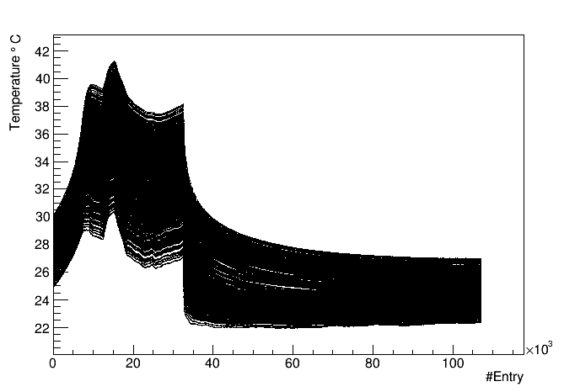
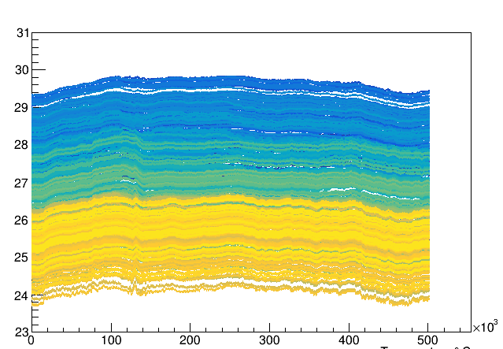
temperature
add fan

Slide 3
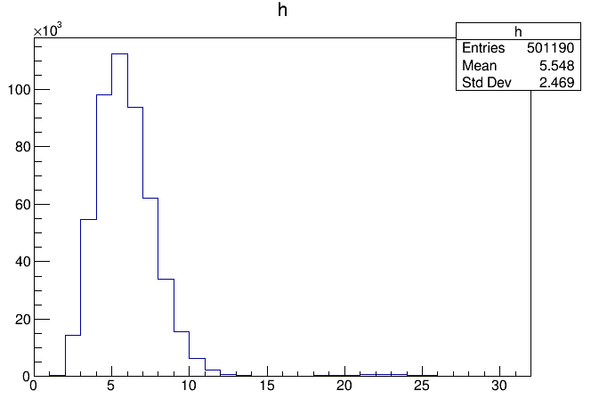
trigger
trigger: layer 1 & layer 31
average hitlayer is only 5.5
layer
hitlayer

Slide 4
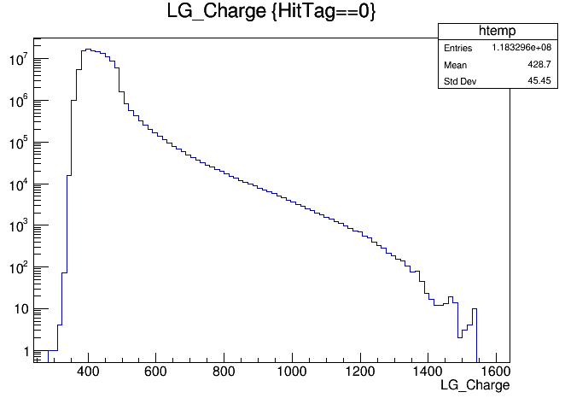
HitTag=0

Slide 5
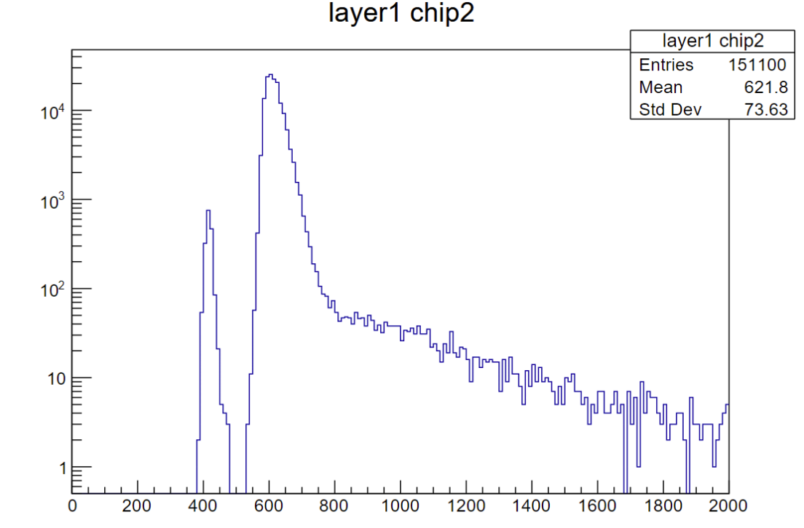
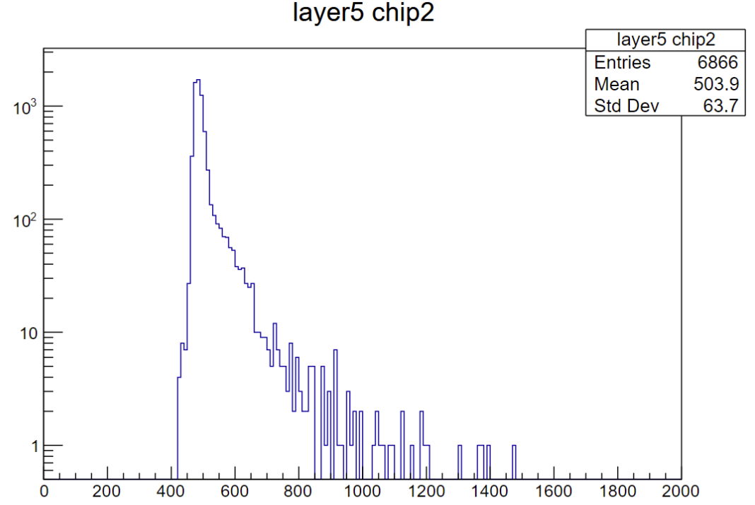
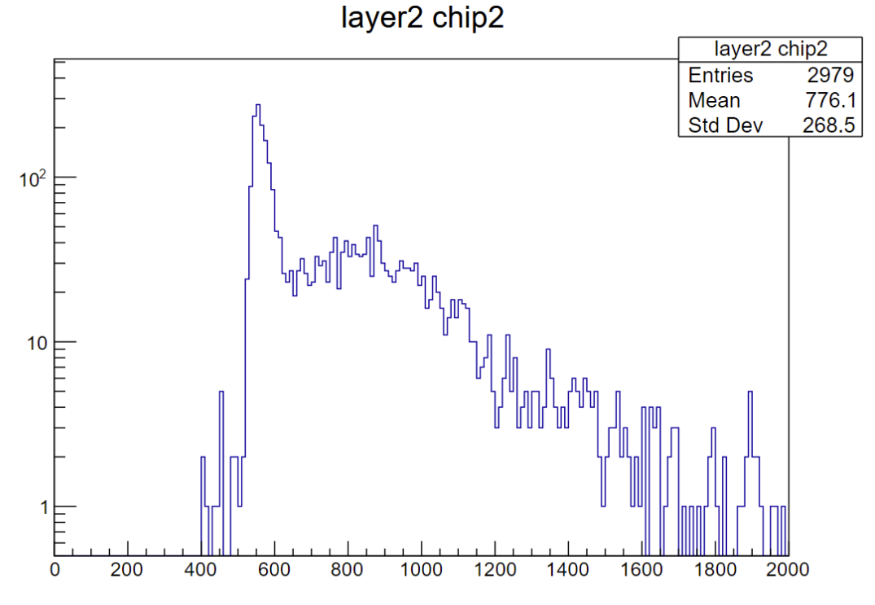
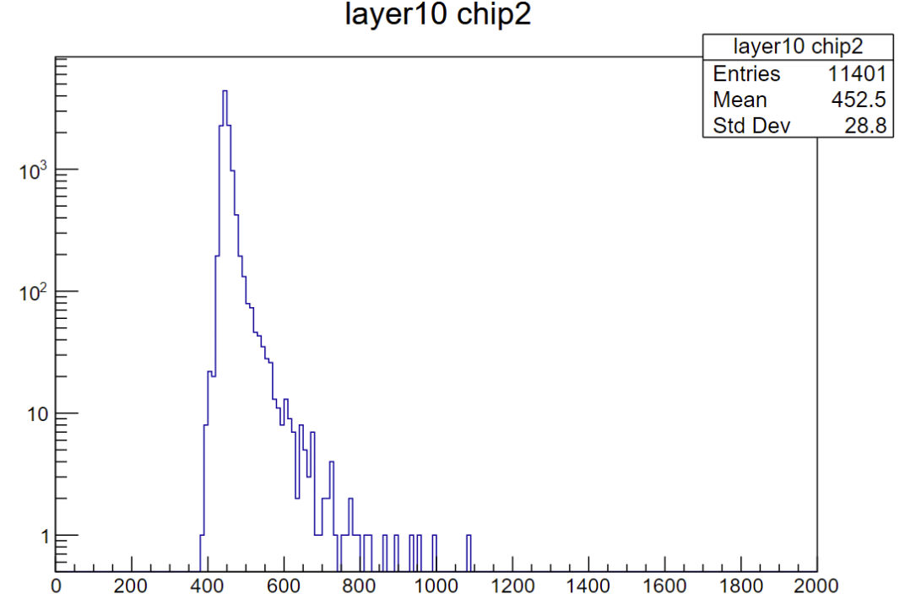
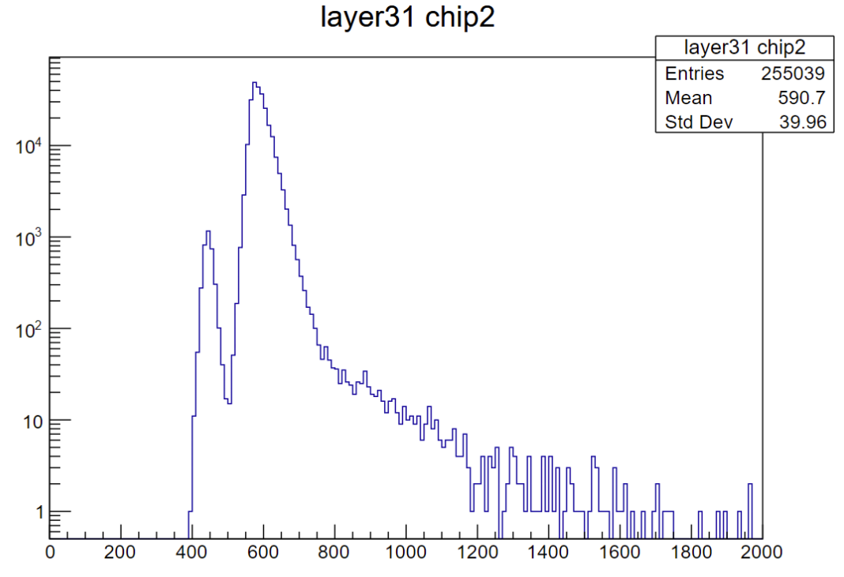
hittag=1

