Slide 1
VLAST-P ECAL on-orbit MIP calibration
2025/03/18
Speaker : Jiaxuan Wang

Slide 2
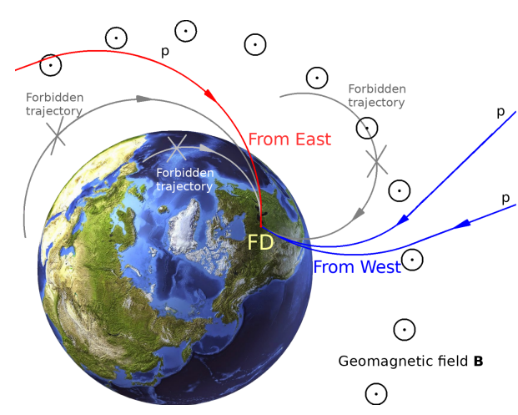
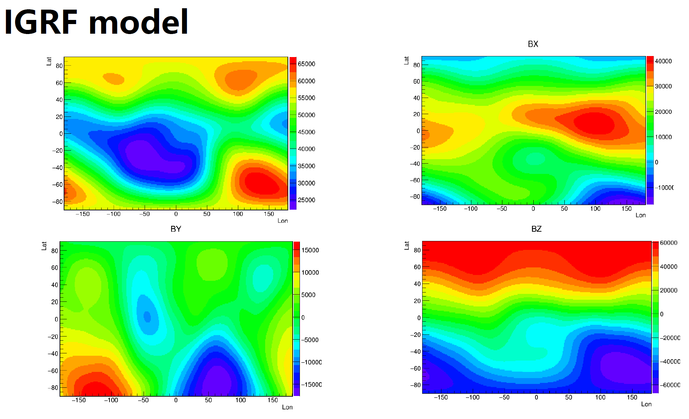
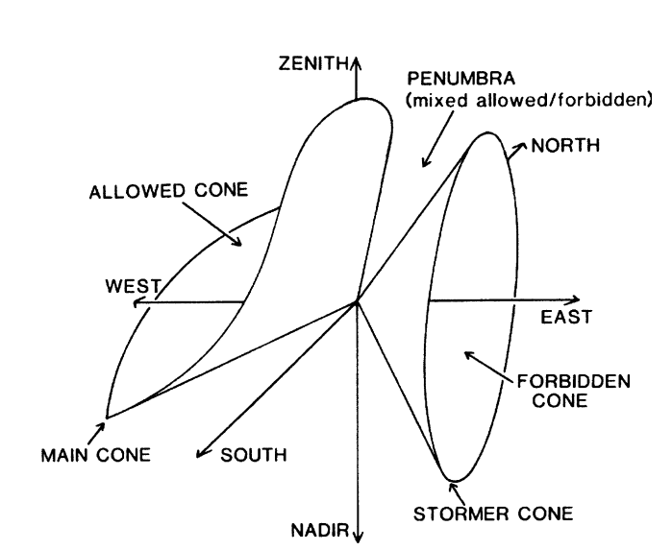
Motivation
Geomagnetic cutoff -> On-orbit calibration with different proton spectrum
IGRF13 geomagnetic field update -> Backtracing Json library

Slide 3
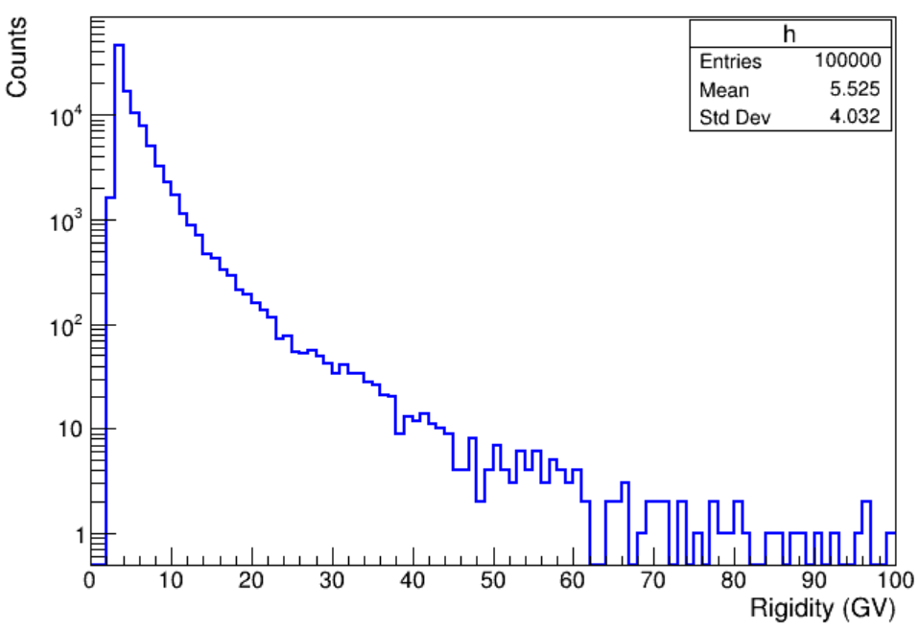
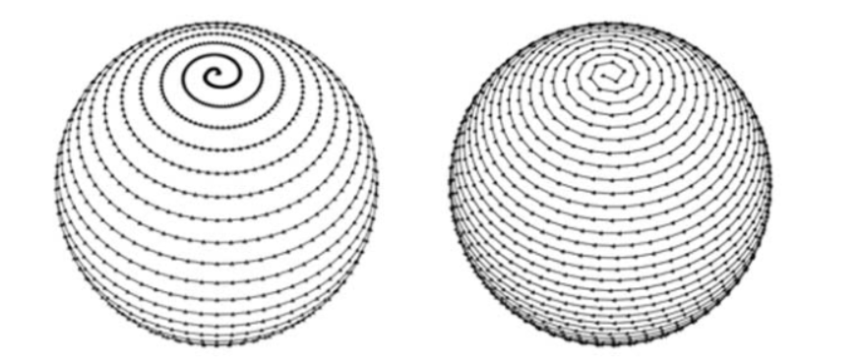
Geomagnetic cutoff MC analysis
Proton properties
Rigidity: sampled from AMS-02 proton flux
Direction: sampled from 4$π$
Time-reversal approach
Difficult to evolve forward
Backtracing Json library
Spiral grid method: theta, arc
Json library indicate whether allowed directly

Slide 4
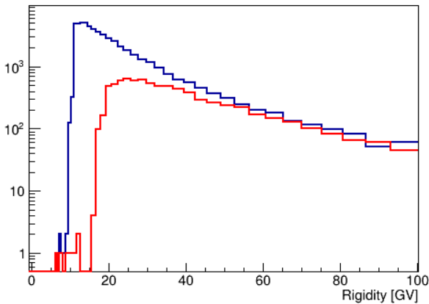
Proton spectrum
Proton spectrum from east and west
Particle selection: along Y axis with 60 degrees cone angle
Block selection: Particle Earth block and geomagnetic cutoff
Red: from east
Blue: from west

Slide 5
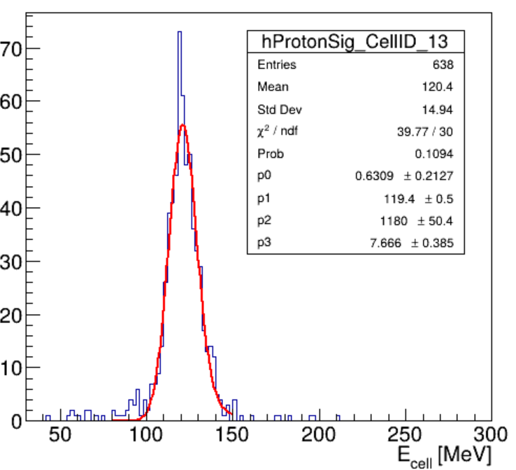
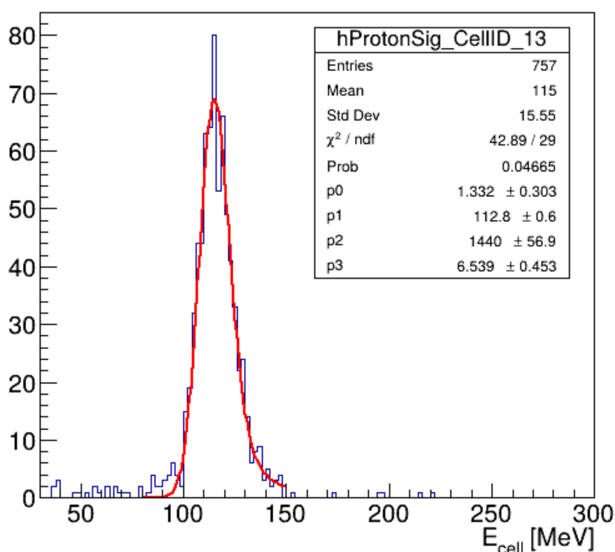
ECAL geometry
Apply proton spectrum to VLAST-P ECAL standalone geometry
Particle incident direction
EAST
WEST

Slide 6
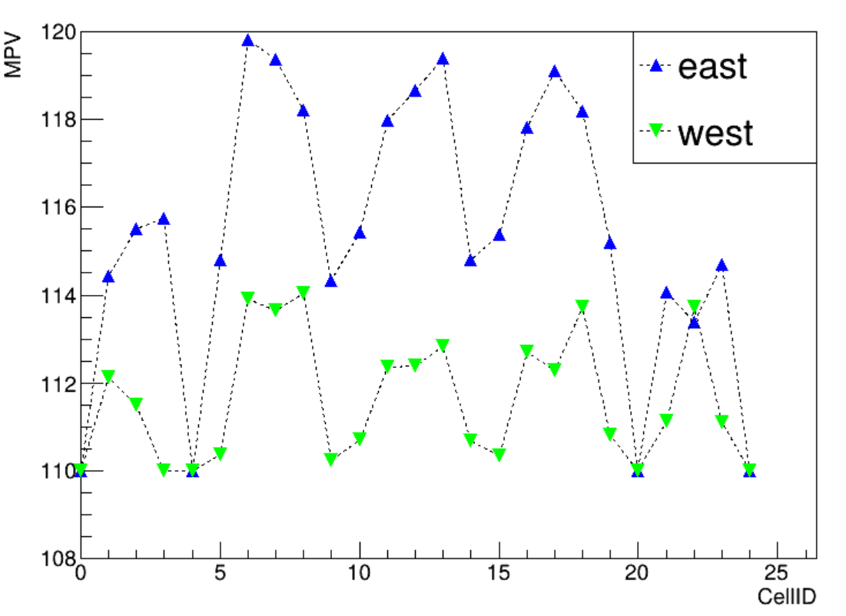
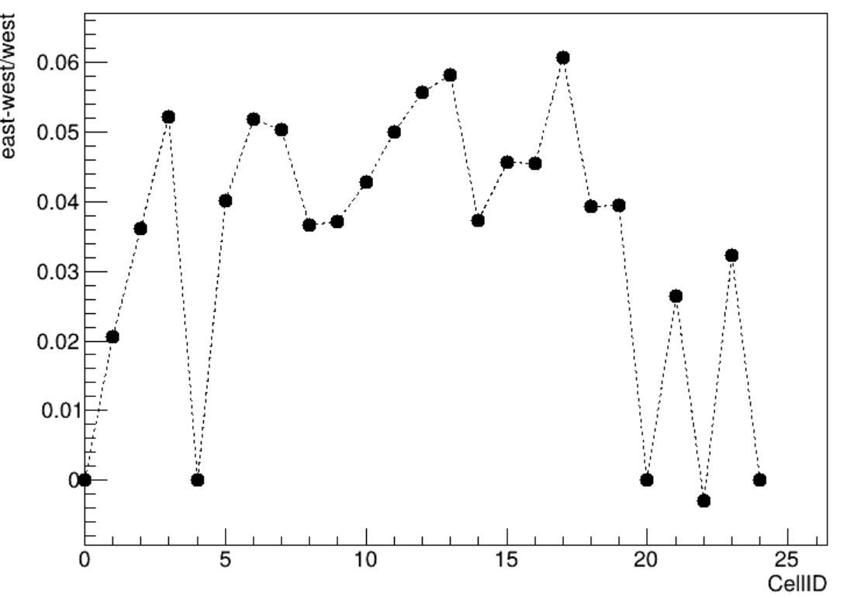
MIP result
MIP comparison from east and west

Slide 7
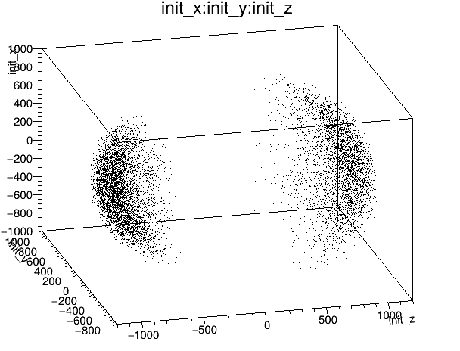
Proton Calibration
A geomagnetic cutoff rigidity is associated with each solid angle bin
Sample generate
sphere center: in the prototype
sphere radius: 1m
Bias sample: acd hit

Slide 8
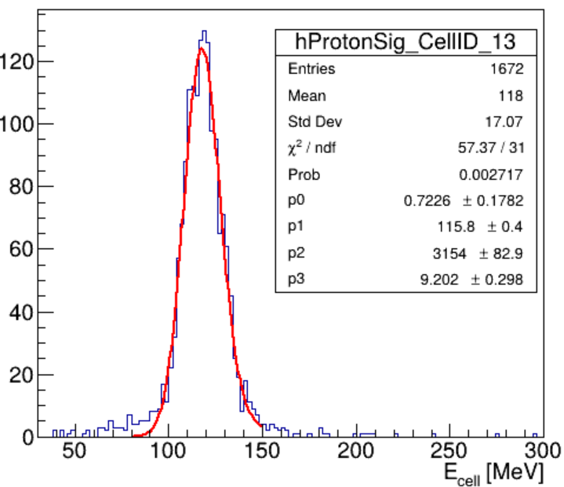
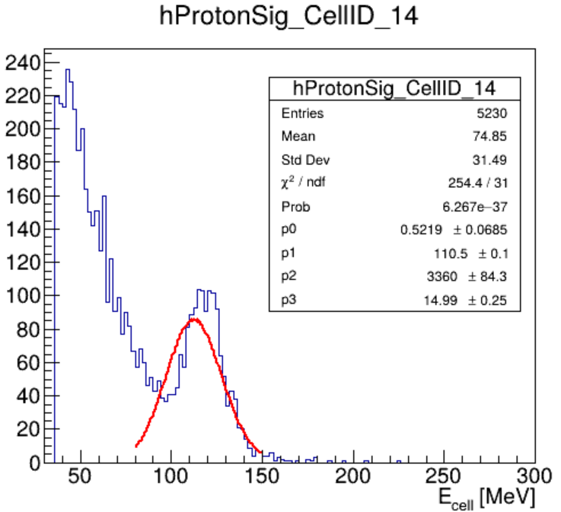
MIP selection
Restriction added to extract MIP-like proton
Logic trigger
Hit ECAL unit No

Slide 9
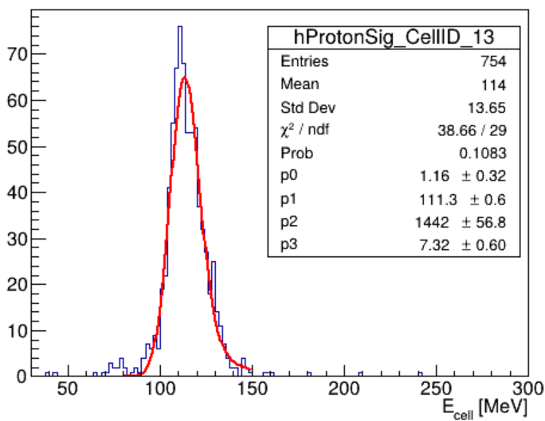
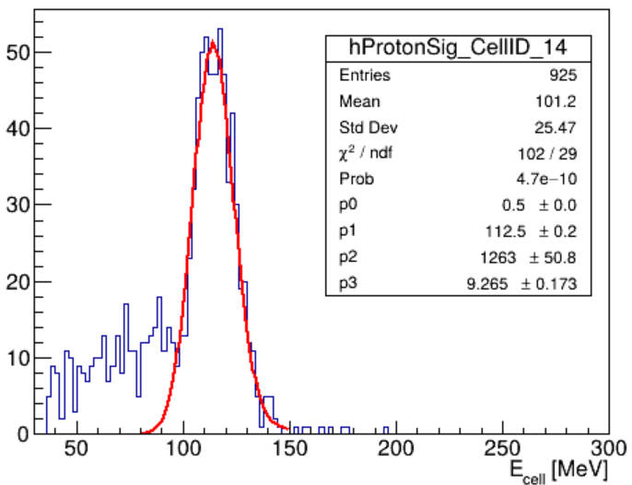
MIP selection
Restriction added to extract MIP-like proton
Logic trigger
Hit ECAL unit No
Proton direction(Truth level)
 | After cut | All | Eff | Total eff
Trigger | 3819981 | 10000000 | 38.2% | 38.20%
HitNo | 91638 | 381991 | 2.4% | 0.92%
Angle(T) | 21711 | 91638 | 23.69% | 0.22%

Slide 10
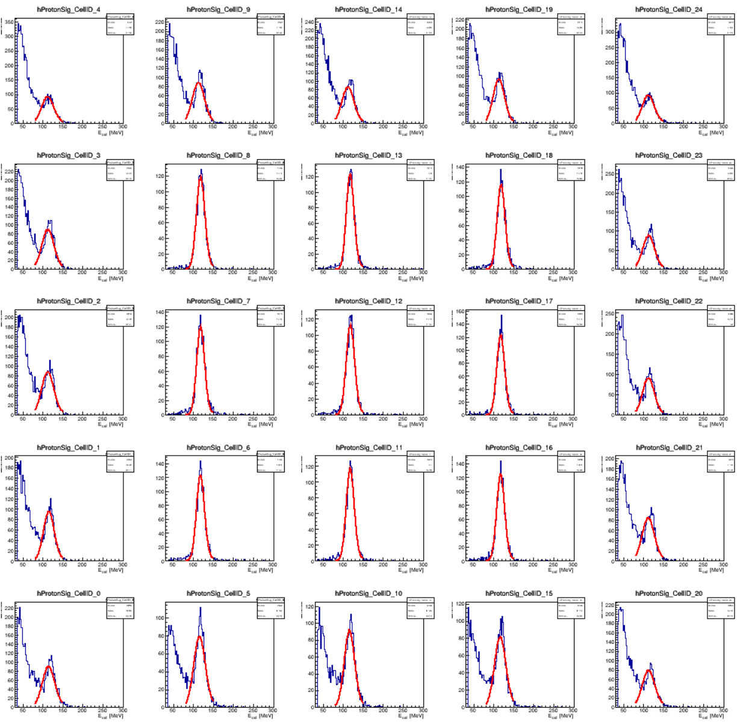
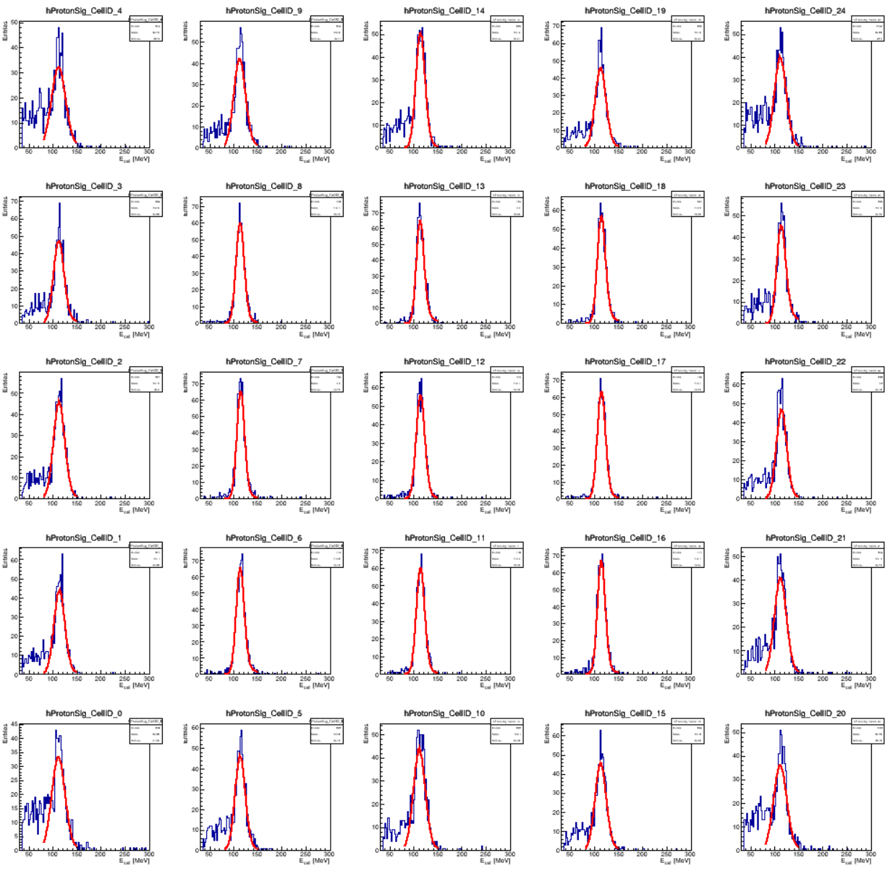
MIP selection
The surrounding ECAL cell with more noise as particle could only penetrate one single ECAL crystal with a quite large incident angle

Slide 11
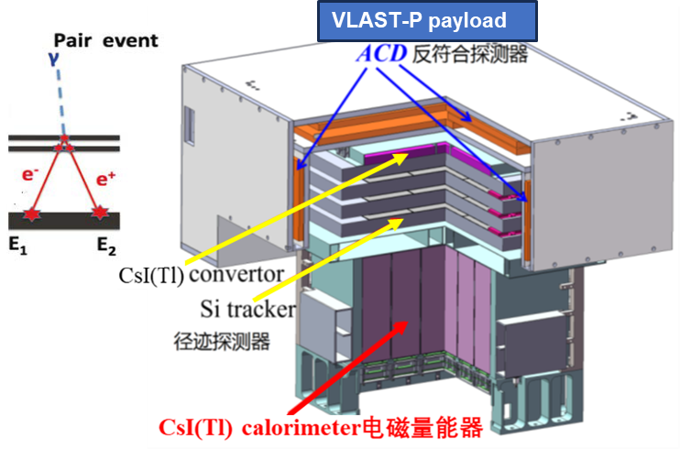
Tracker message
VLAST-P tracker
Six layers: Si strips with orthogonal in two adjacent layers
~ 3 sets of coordinates
Track finding and track fitting
GenFit Toolkit
An experiment-independent framework for track reconstruction
Basic step:
Initialize GENFIT environment: magnetic field and material effect
Create the track and Add hits as measurements
Fit the track with Kalman Fitter

Slide 12
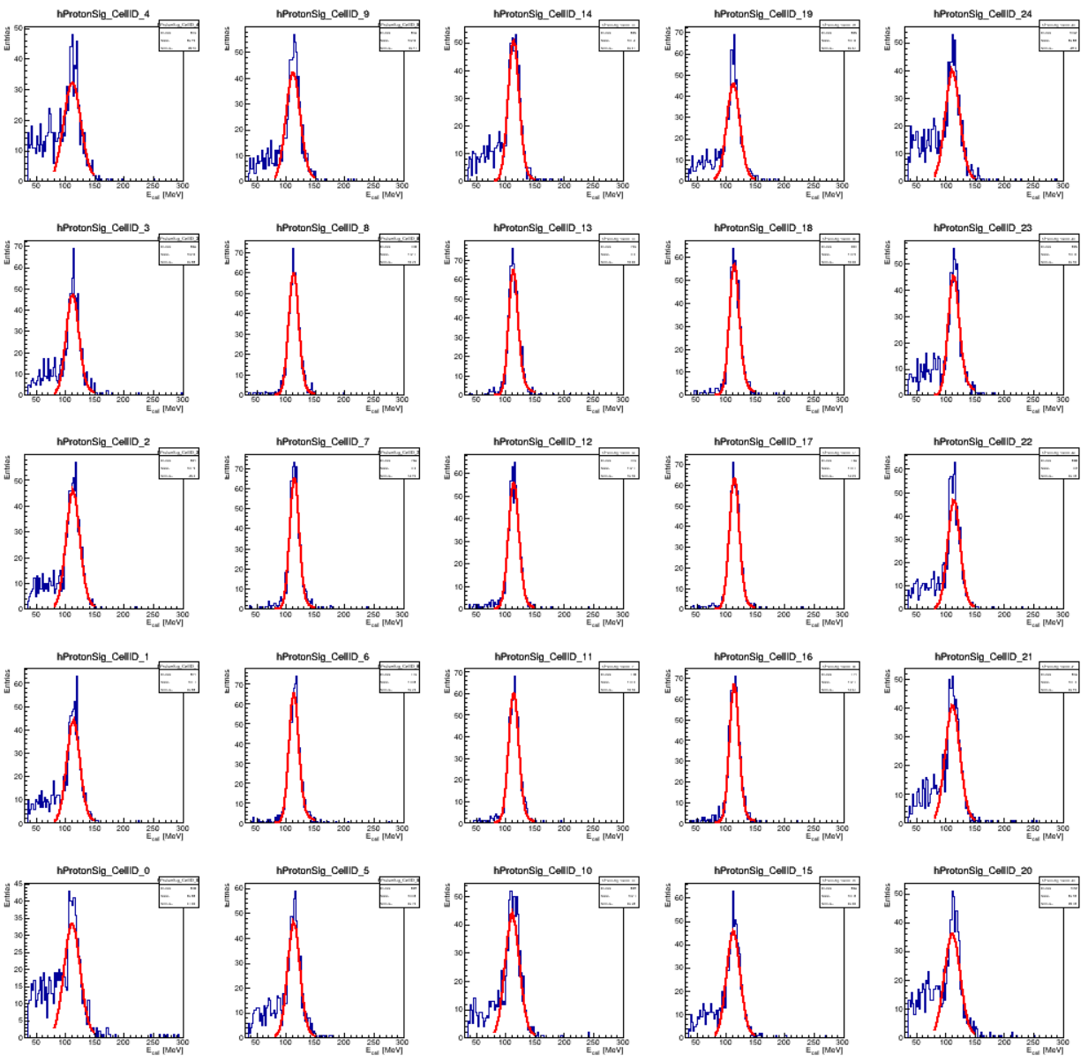
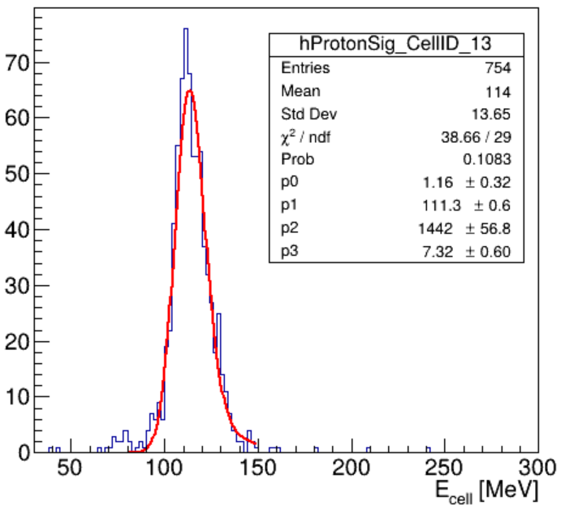
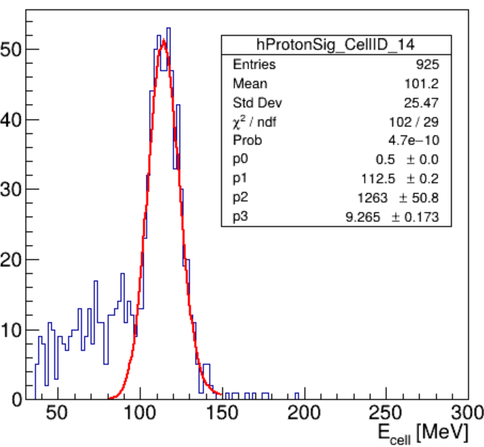
MIP selection
Restriction added to extract MIP-like proton
Logic trigger
Hit ECAL unit No
GenFit fitted state momentum
 | After cut | All | Eff | Total eff
Trigger | 3819981 | 10000000 | 38.2% | 38.20%
HitNo | 91638 | 381991 | 2.4% | 0.92%
Angle(T) | 20930 | 91638 | 22.8% | 0.21%

Slide 13
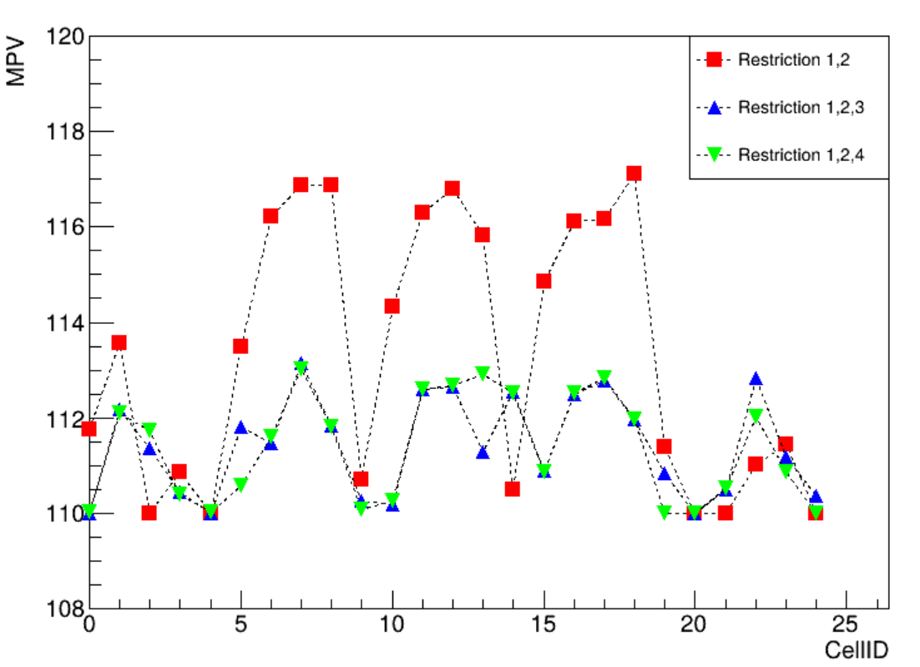
MIP MPV comparison
Comparison

Slide 14
Summary and next step
East-west effect influence the proton MIP MPV
MIP proton selection
Truth level info(incident direction) could help with the noise issue
By exploiting GenFit toolkit, the noise issue could also be depressed
GenFit optimization or other alternative method

Slide 15
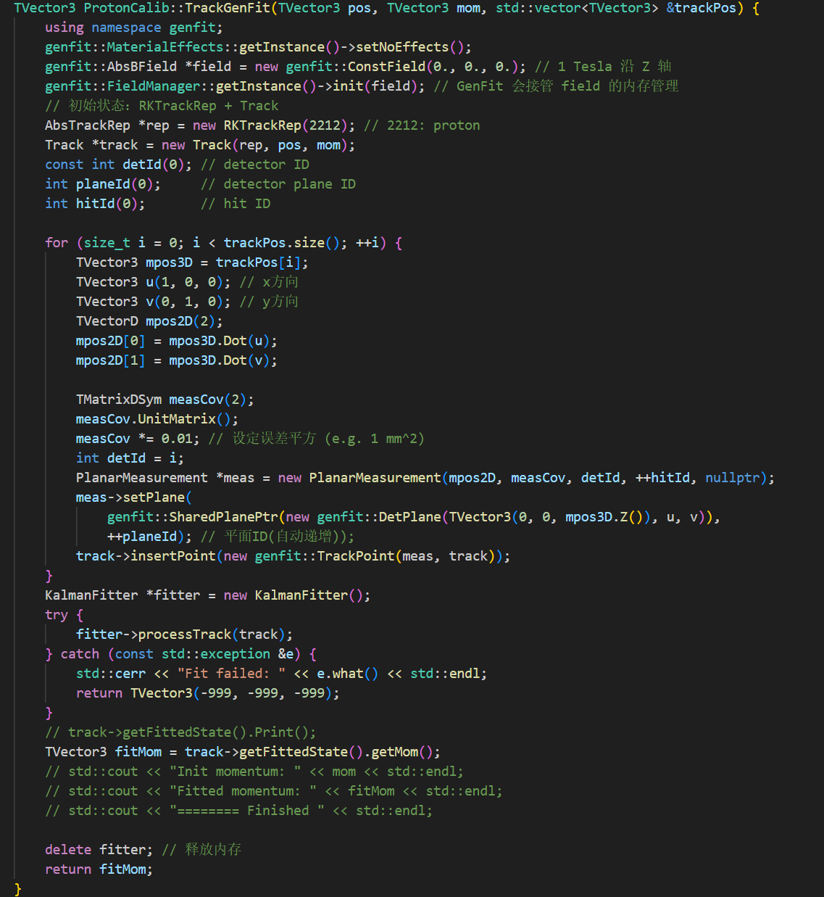
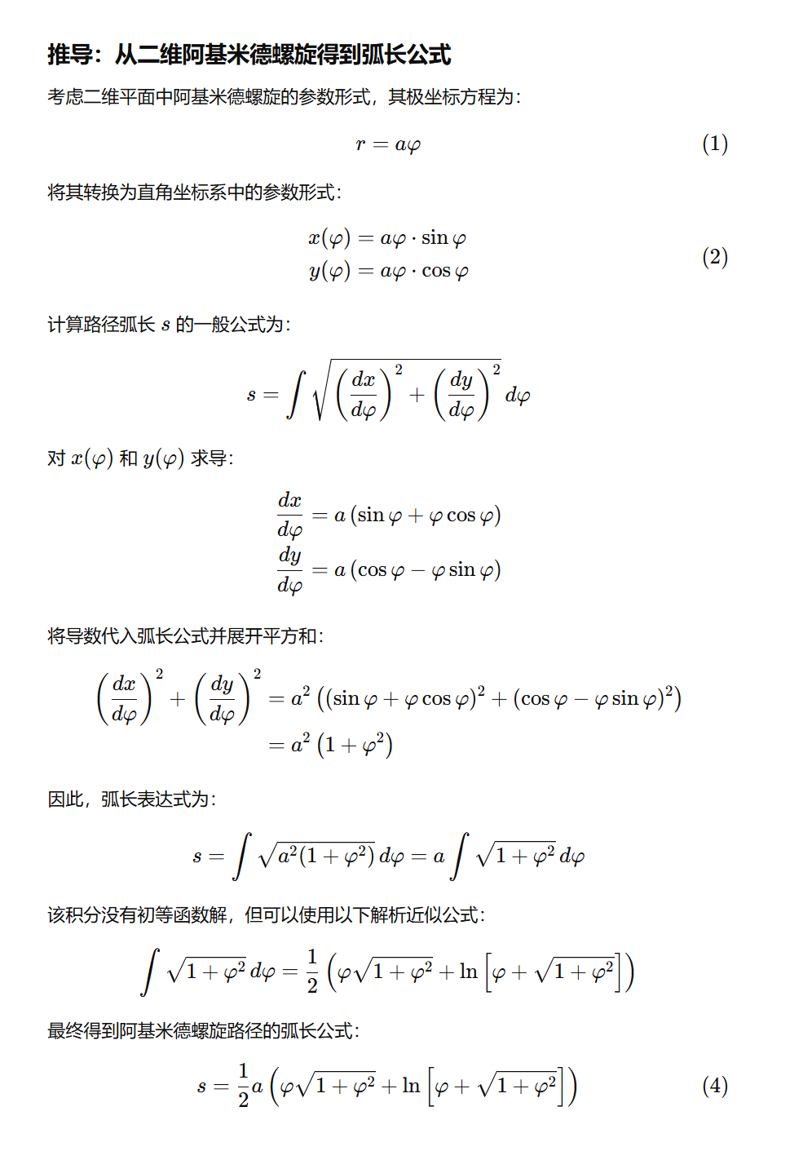
Backup
File path: /home/wangzhen/mnt2/VLASTP/vcalo/run/OOC/result/ooc.root

Slide 16
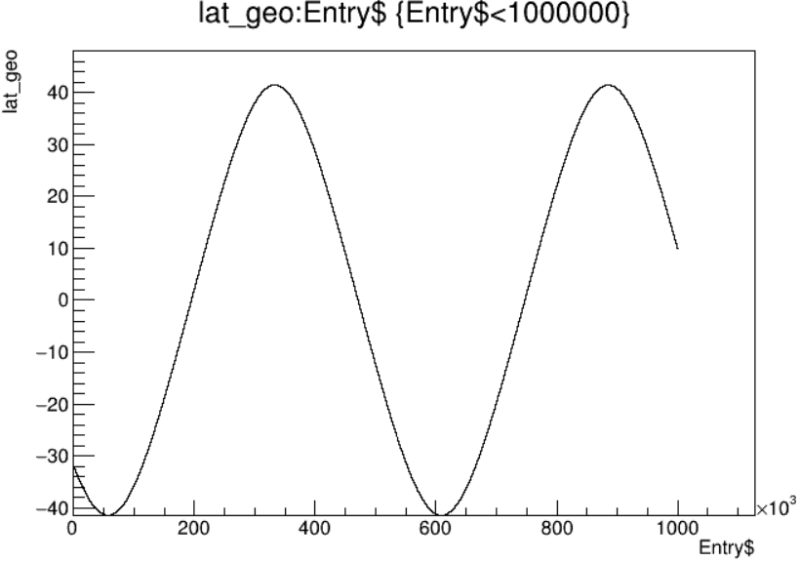
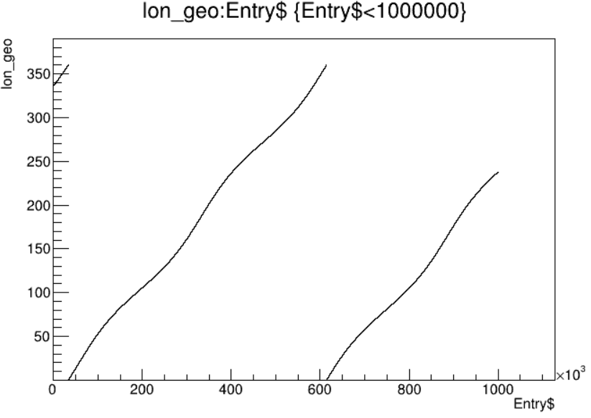
Lat and lon

Slide 17
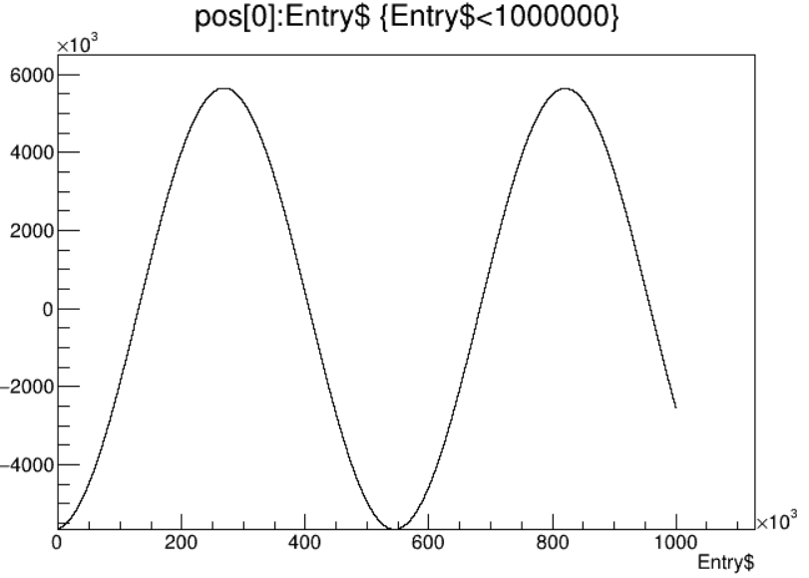
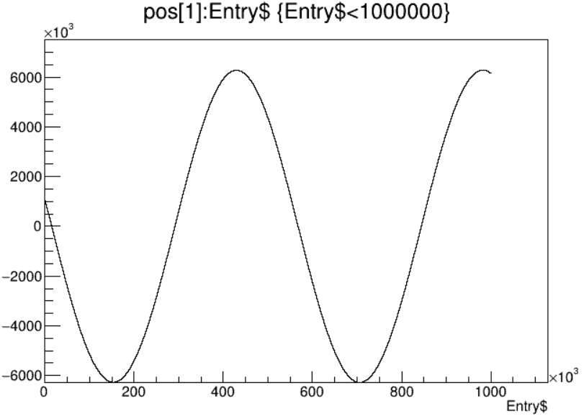
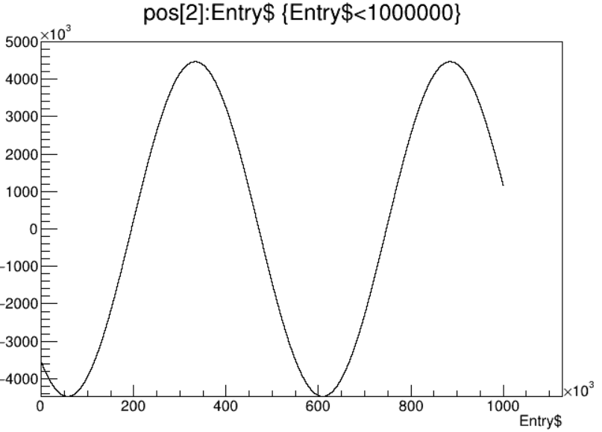
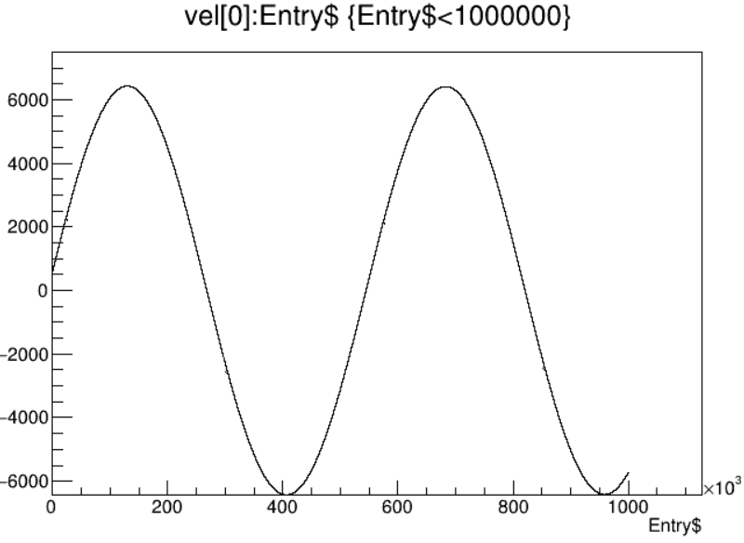
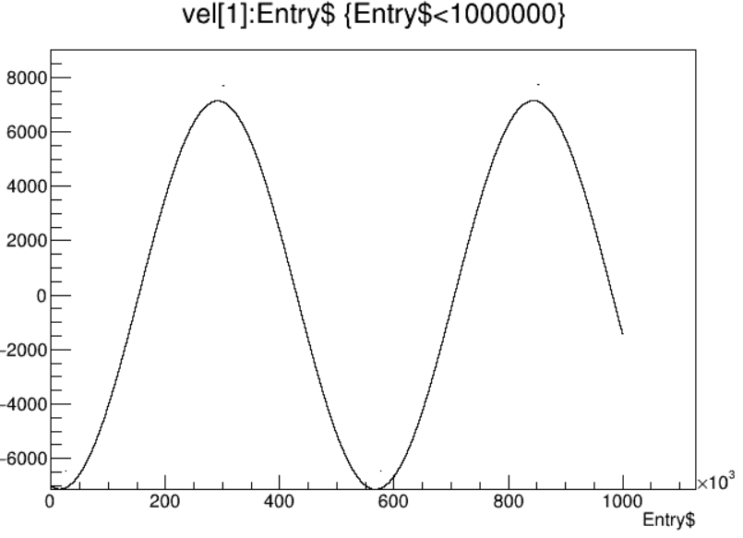
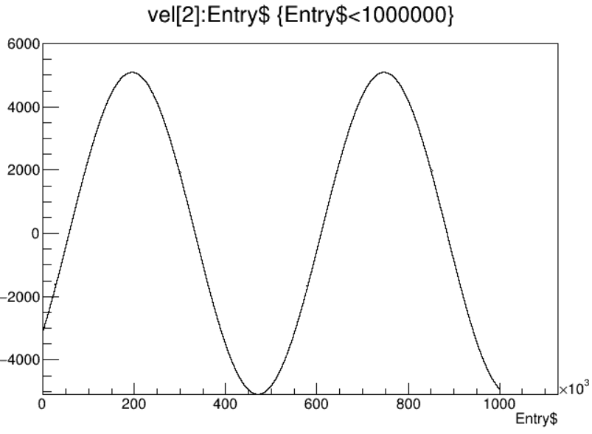
Pos and vel

Slide 18
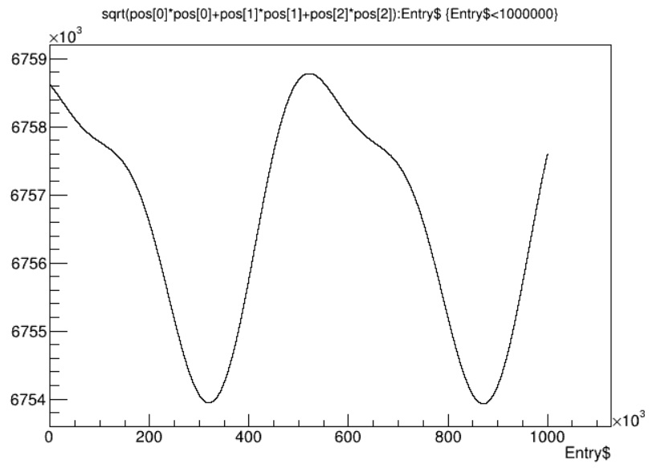
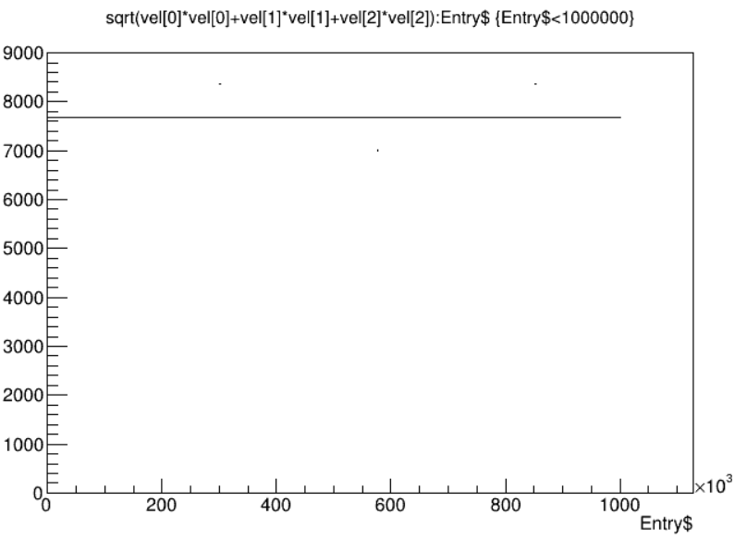
Pos and vel

