Slide 1

利用高精度光电RPC寻找环保RPC工作气体
赵一锭 胡东栋 邵明
State Key Laboratory of Particle Detection and Electronics
Department of Modern Physics, USTC

Slide 2

目 录
研究背景
环境友好气体
皮秒级时间分辨RPC
低GWP工作气体工作状态
总结

Slide 3
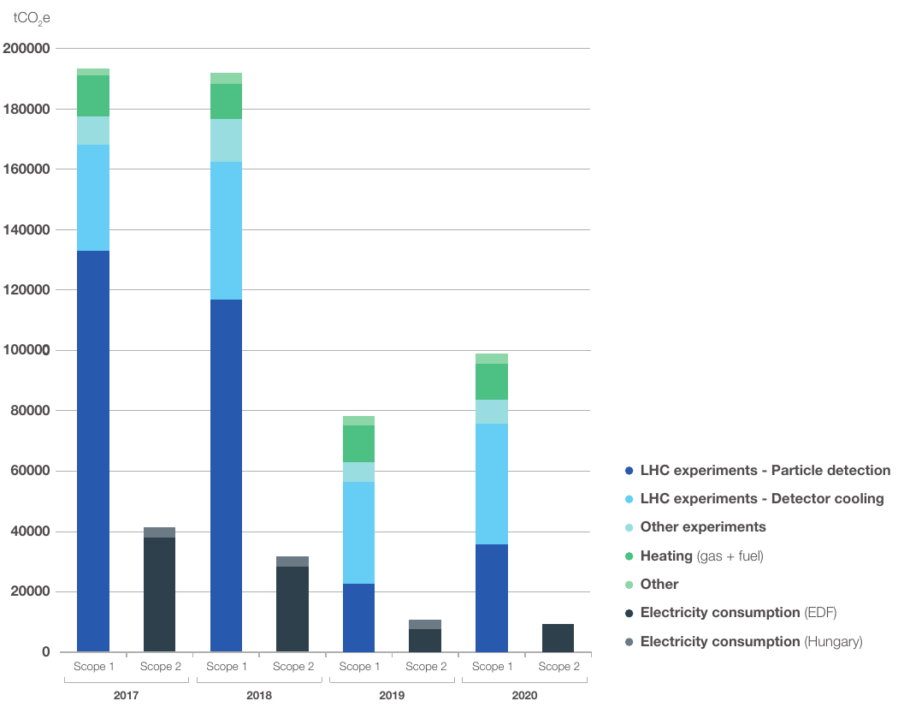
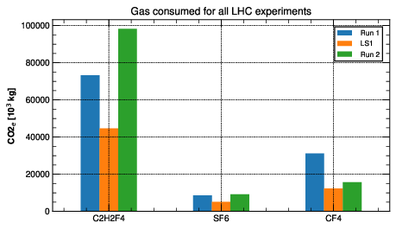

温室气体使用量
Total CERN emissions during 1 year of Run 2 ~ 200 000 tCO2e ~ 50% from particle detectors
→ mostly due to leaks and operation
C₂H₂F₄/R-134a biggest contributor → leaks from RPC detector
CF₄ → due to operation of CSC and RICH systems
SF₆ → Related to RPCs as R-134a
Emissions from
particle detection
tCO_{2e}
2017
2018
2019
2020
Run2
LS2

Slide 4
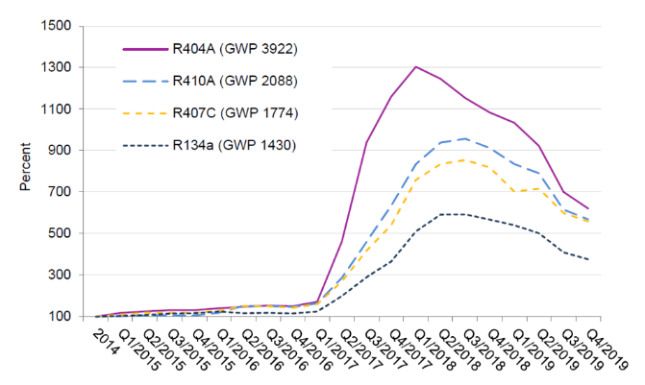
环境友好气体的研究背景
环保气体研究
紧迫性：全球范围内制定了减少温室气体排放的规划，气体探测器中大量使用温室气体，急需找到可以替代现有的工作气体
Price fluctuations:
decrease due to industrial conversion to new low GWP gases
用于大型强子对撞机实验中的粒子检测
~135千吨二氧化碳当量（2017）
~119千万吨二氧化碳当量（2018年）
~101 ktCO2当量（2022（CERN Env.）报告)
increase due to EU HFC phase-down/reduced availability
Today
CERN Environment Report 2019-2020
2021: CERN’s Year of Environmental Awareness.
CERN Environment workshop: 12 and 13 October 2022
CERN Environment Report 2021-2022

Slide 5
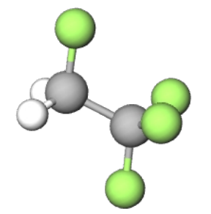
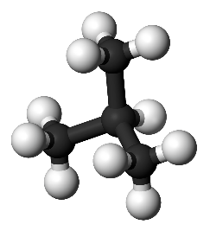
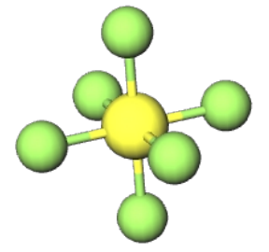
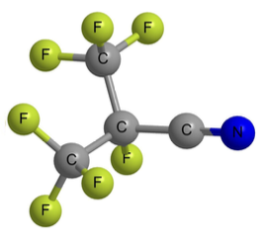
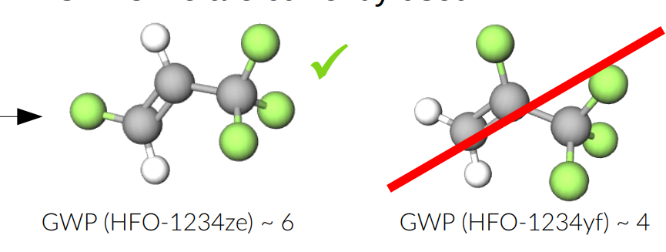
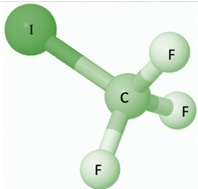






Search of an eco friendly gas mixture
The standard gas mixture has a high Global Warming Potential (GWP)
90-95% ̴ 5% 2-7%
Novec 4710
+
+
Total GWP 1350 ~1450
GWP ($C_{2}H_{2}F_{4}$) ~1430
GWP (i$C_{4}H_{10}$) ~5
GWP (${SF}_{6}$) ~22800
GWP 2240
GWP(C$O_{2})$~1
新型混合气体的GWP~10
GWP ($HFO−1234ze$) ~6
GWP ($HFO−1234yf$) ~4
GWP (CF3I) ~5
Performance comparable to those of the standard gas (efficiency,current, rate capability, time resolution…)
Low GWP
Longevity of the detector for collider experiments
Search for an alternative gas mixture

Slide 6
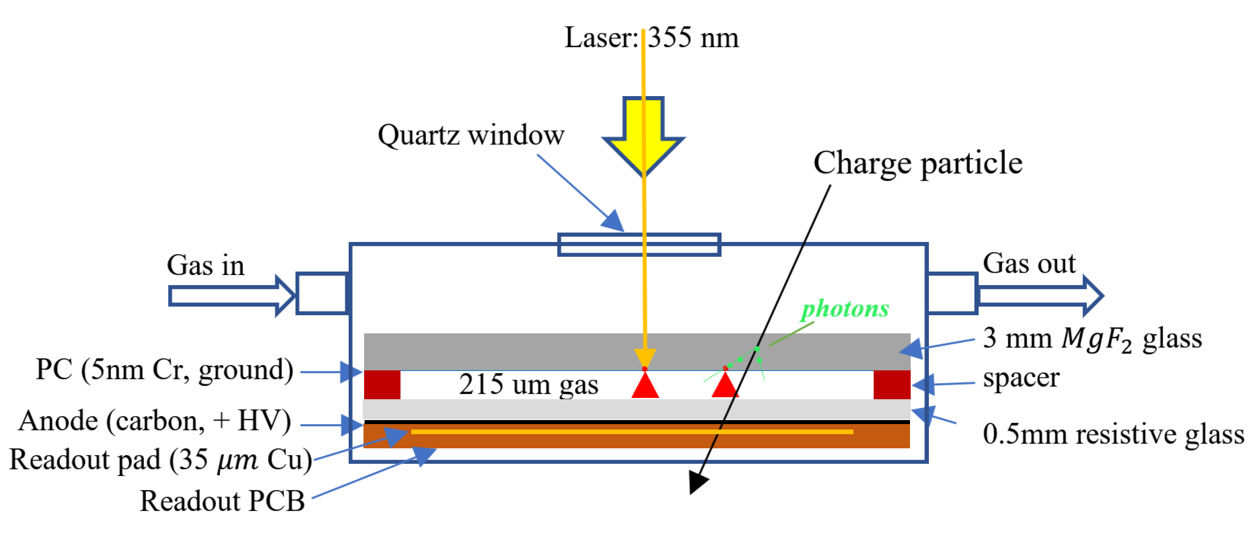
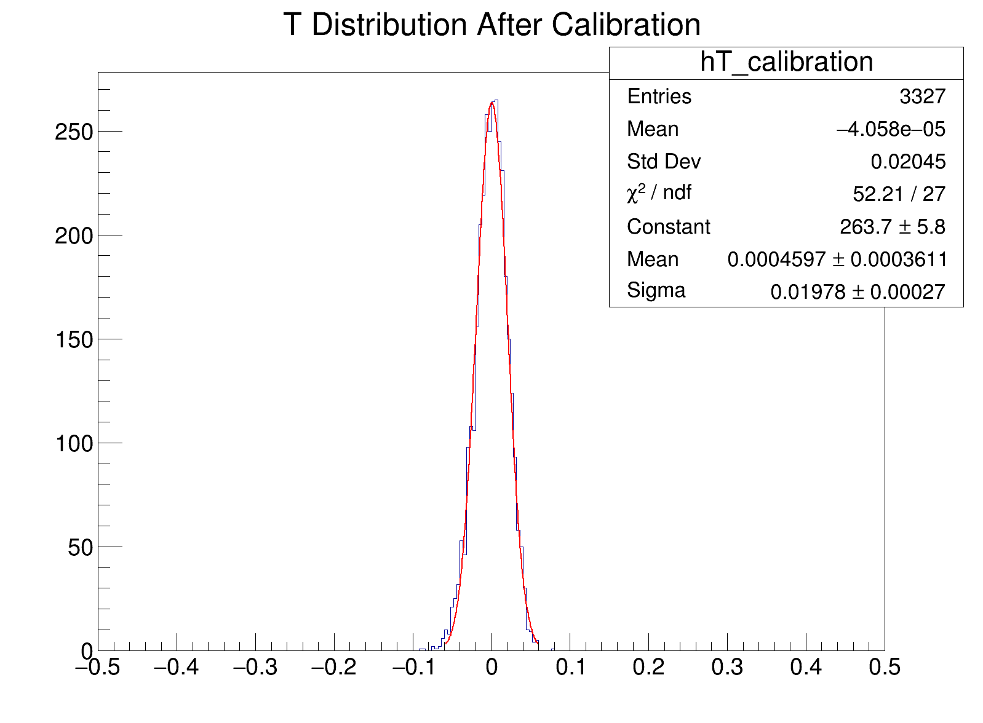
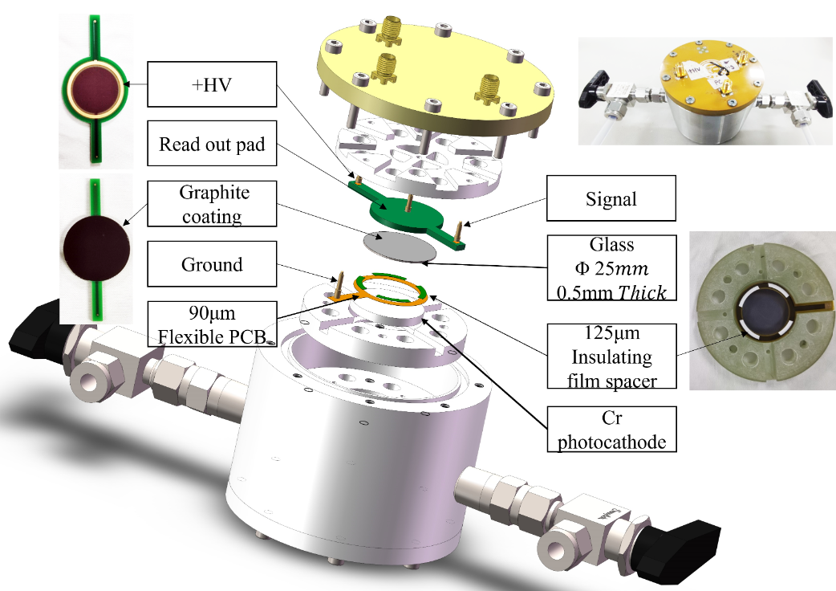
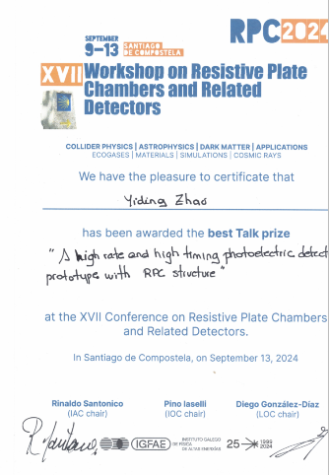
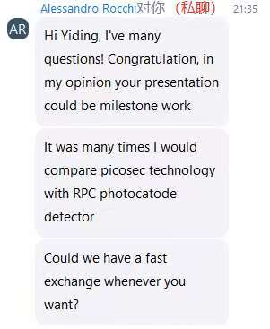
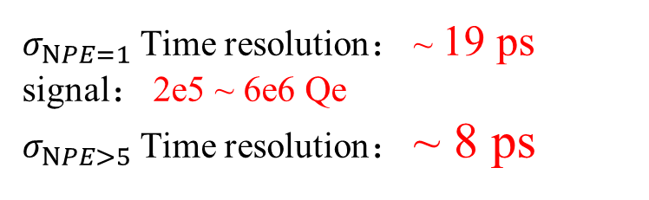
Photo RPC detector system
见赵一锭报告
Best talk prize 2024RPC
Invited Talk DRD1-WG1
$σ_{NPE=1}$ Time resolution： ~ 19 ps
signal： 2e5 ~ 6e6 Qe
$σ_{NPE>5}$ Time resolution： ~ 8 ps
Resistive glass: 0.5 mm
Gas gap: 215 um
Photocathode: 5nm Cr, in lab laser test, use ordinary quartz glass replace MgF2.
Zhao Y, Hu D, Shao M, et al.. Nuclear Instruments and Methods in Physics Research Section A, 2025, 1078: 170593.

Slide 7
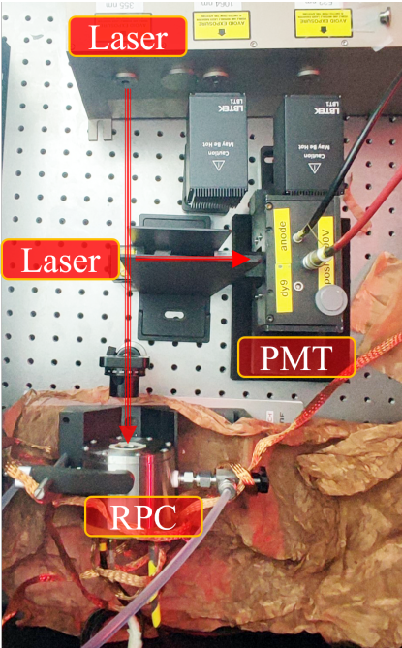
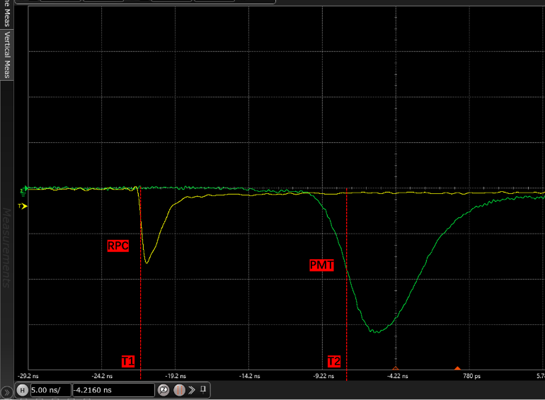
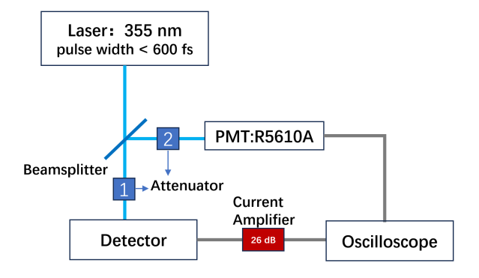
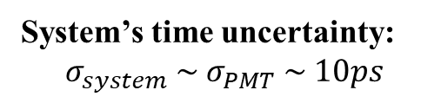
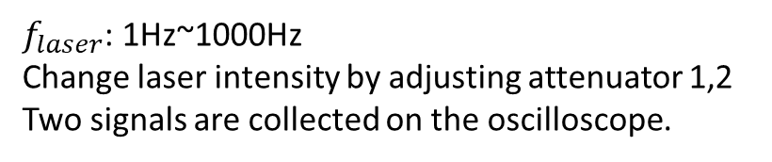
Test system
Setup in darkroom
System’s time uncertainty:
$$σ_{system} \sim σ_{PMT} \sim 10ps$$
$f_{laser}$: 1Hz~1000Hz
Change laser intensity by adjusting attenuator 1,2
Two signals are collected on the oscilloscope.

Slide 8
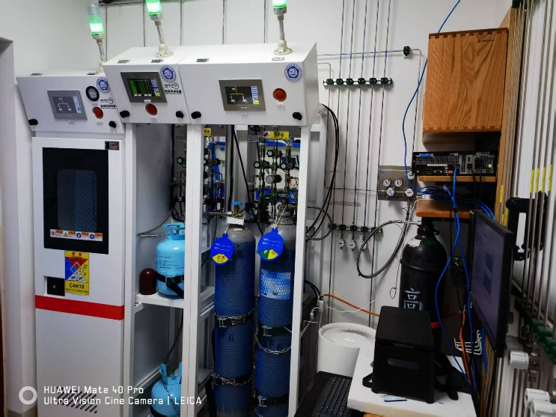
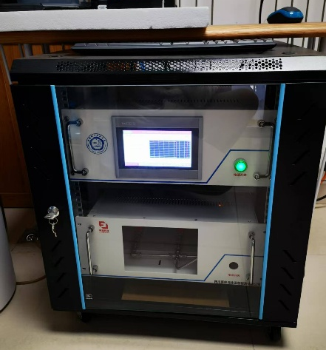
气体集成系统
C₄H₁₀
氟利昂
SF₆
High-Purity,
Uninterrupted Gas Supply
High-Precision Gas Mixing
Computerized Remote Control
见靳惠泽报告

Slide 9
环境友好气体测试
Test the single-PE performance
gain, time resolution, working voltage
Gas | formula | GWP
R134a | CF3-CFH2 | 1430
R1234ze | CF3-CH=CHF | <1
R1233zd | CF3-CH=CHCl | 1
R1234yf | CF3-CF==CH2 | <1
Iso-butane | iC4H10 | 3.3
 | SF6 | 22800
 | CF3I | <5
test schedule
1 | R134a/iso/SF6
2 | SF6->CF3I
3 | R134a->R123ze
4 | R134a->R1233zd
5 | R134a->R1234yf
6 | R134a->R123ze SF6->CF3I
only change the working gas

Slide 10
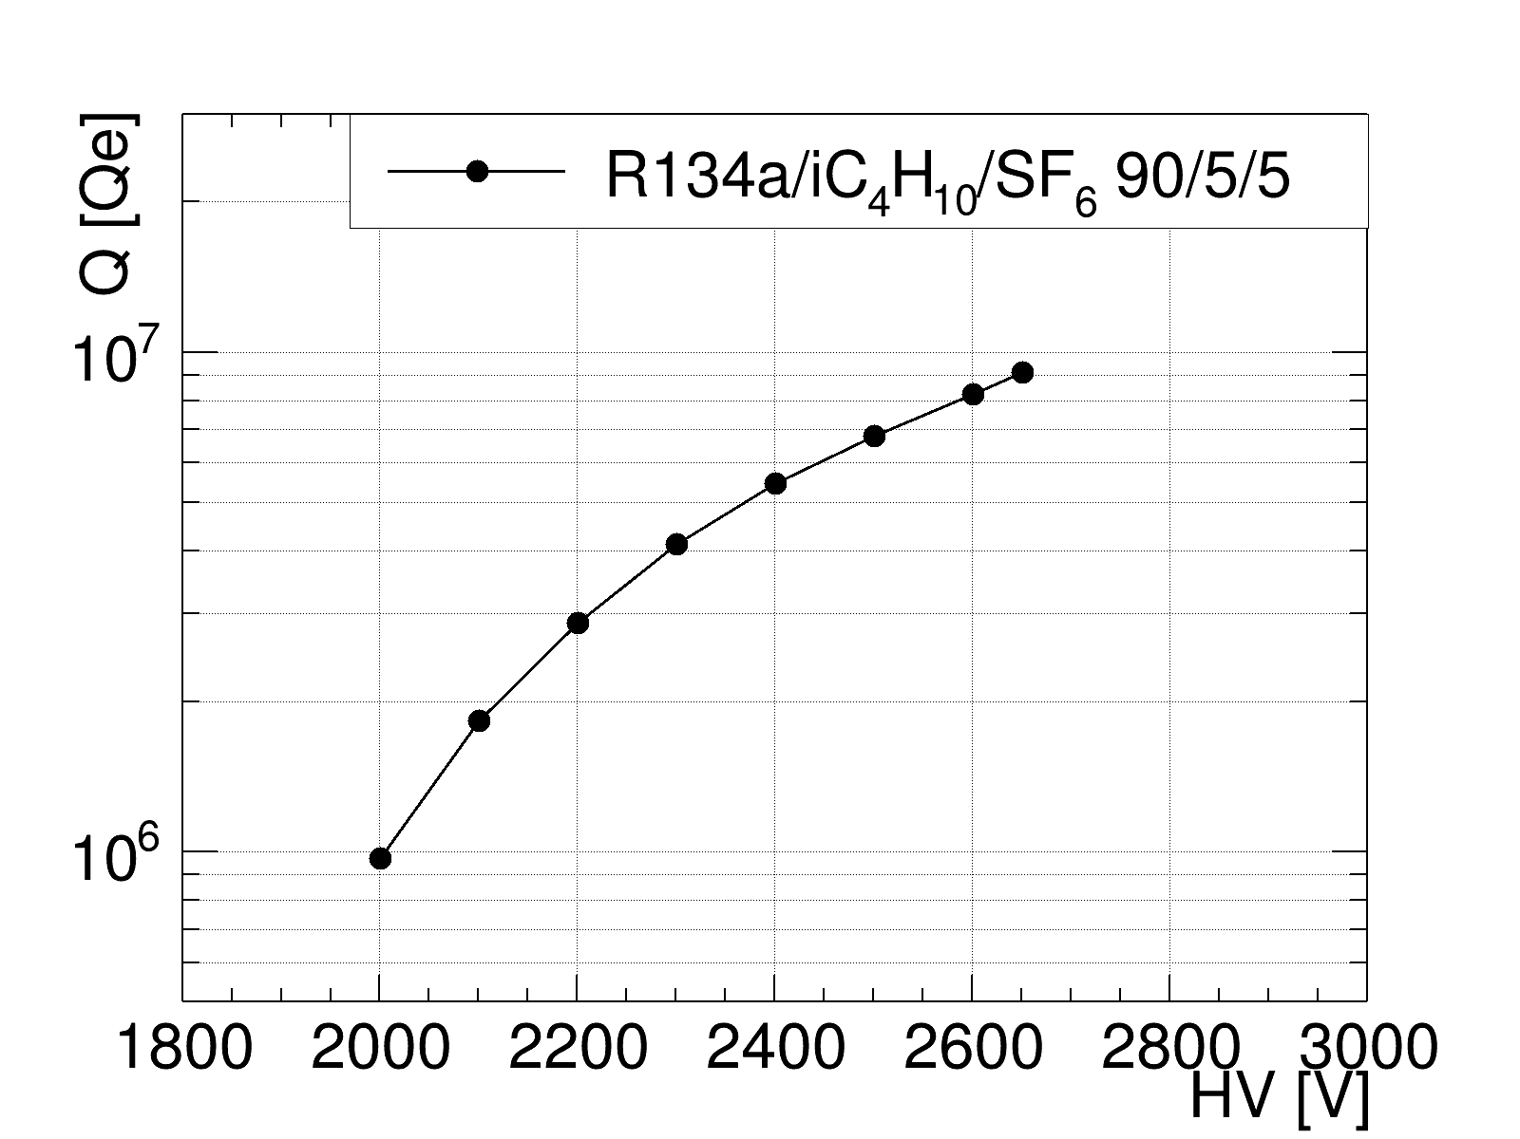
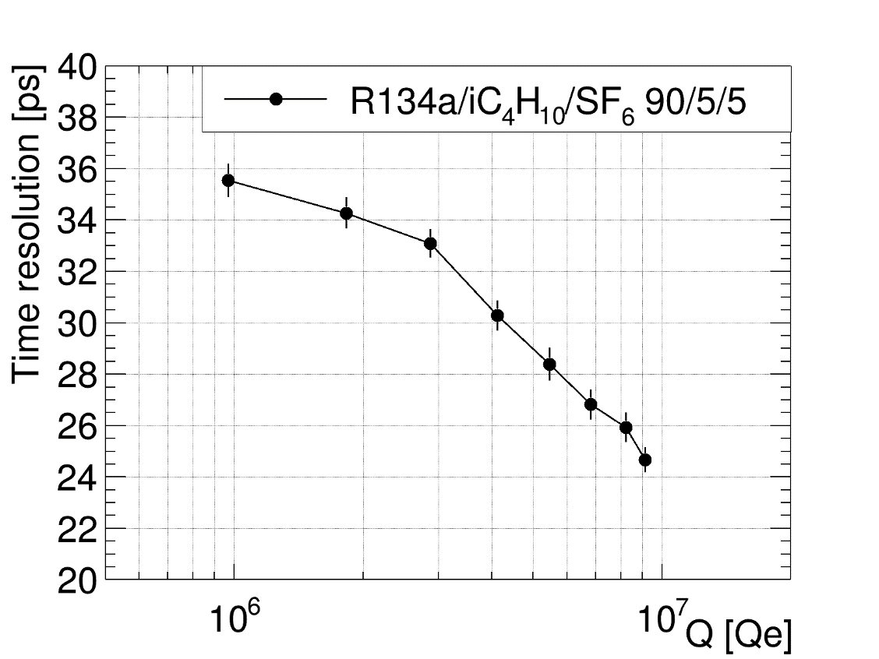
Standard RPC gas mixtures

Slide 11
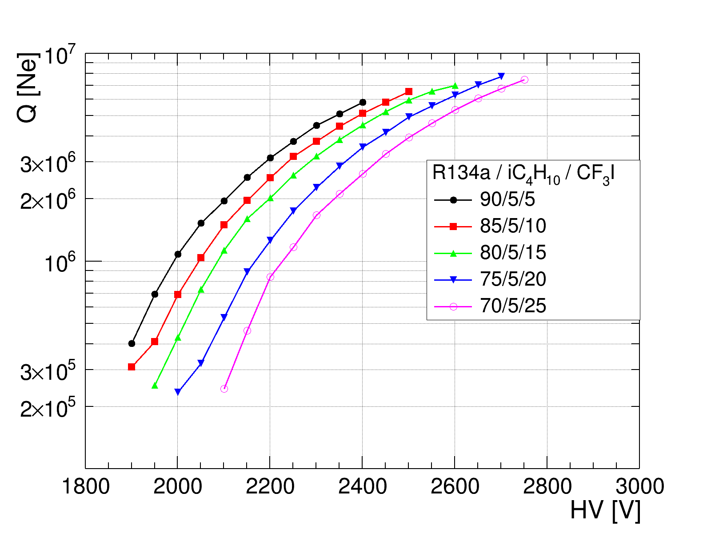
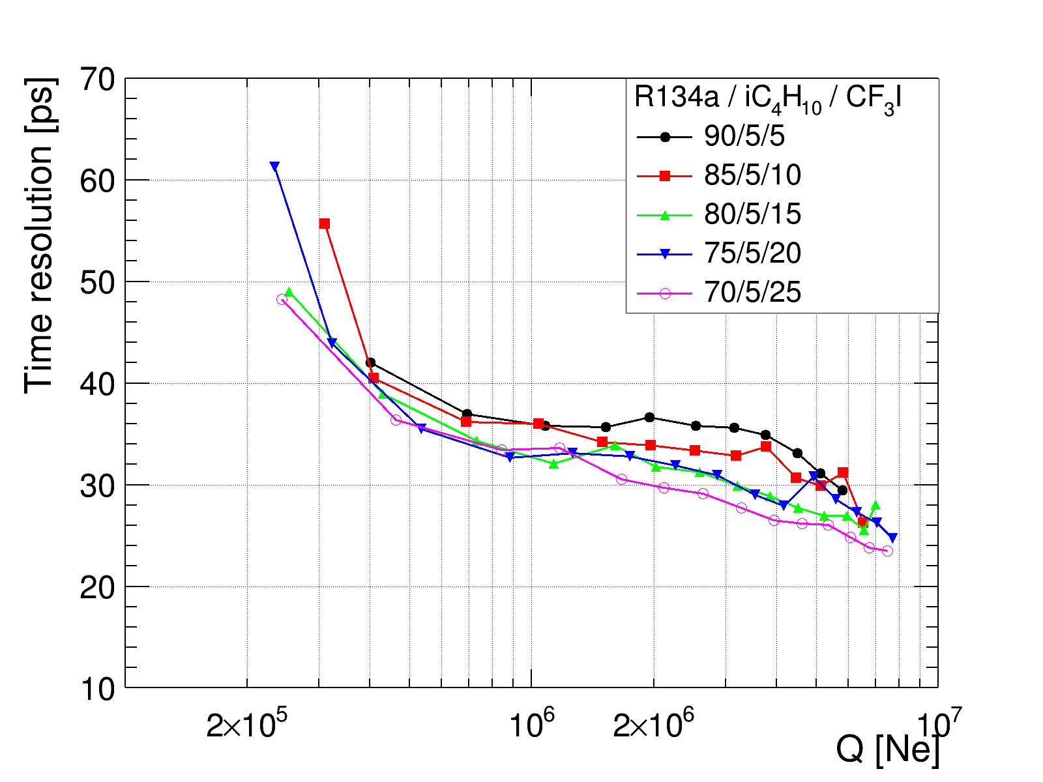
SF6 → CF3I
Fix iC4H10 = 5%, CF3I = (5,10,15,20,25)%
$\text{Increase} \text{CF}\text{3}\text{I}\text{: }\text{Gain} \text{↘, }\text{HV}\text{↗, }\text{TR}\text{↘}$

Slide 12
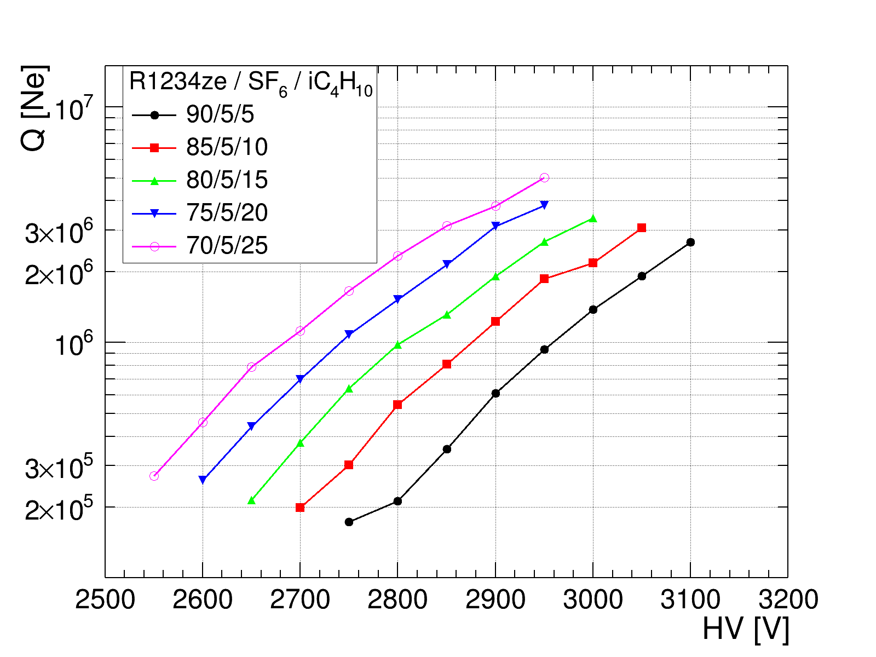
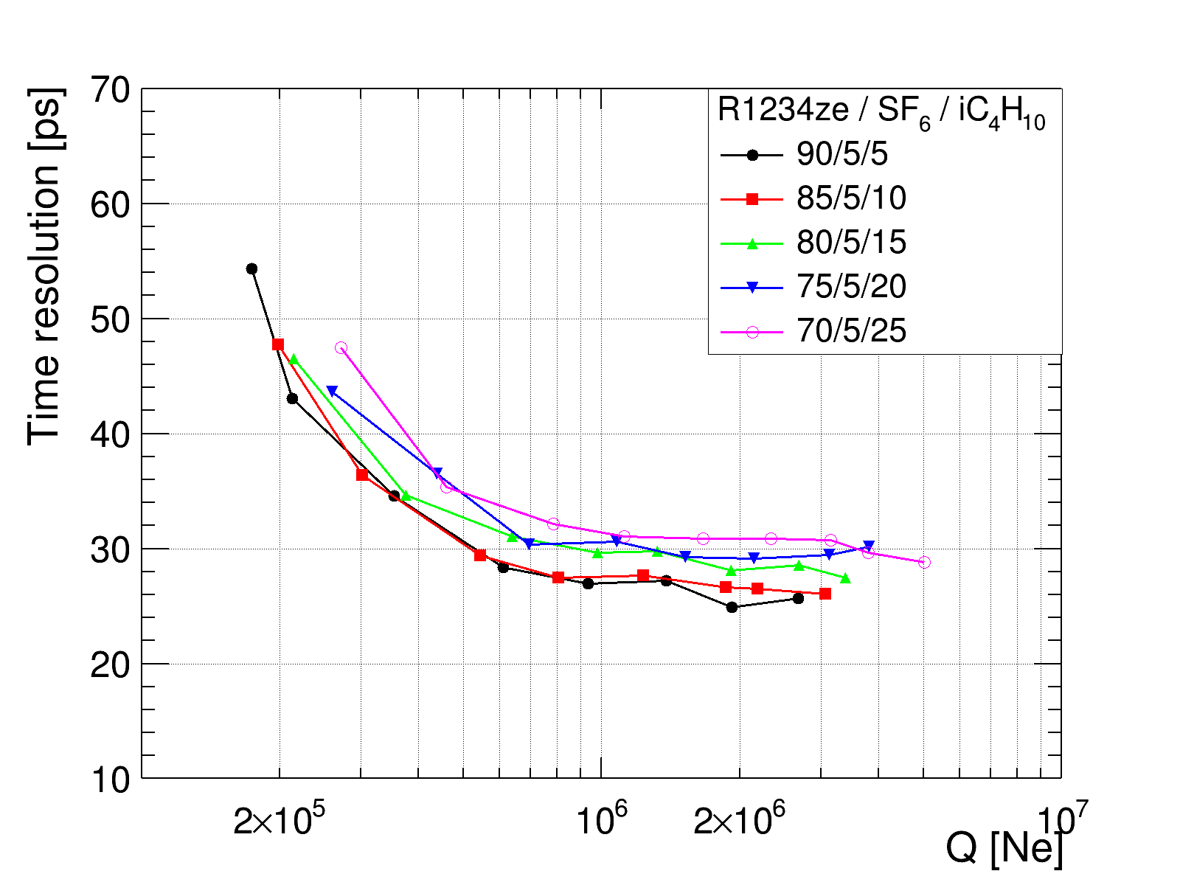
R134a → R1234ze
Fix SF6 = 5%, R1234ze = (90,85,80,75,70)%
$\text{Increase} \text{iC}\text{4}\text{H}\text{10 }\text{: }\text{Gain} \text{↗}\text{, }\text{HV}\text{↘}\text{, }\text{TR}\text{↗}$

Slide 13
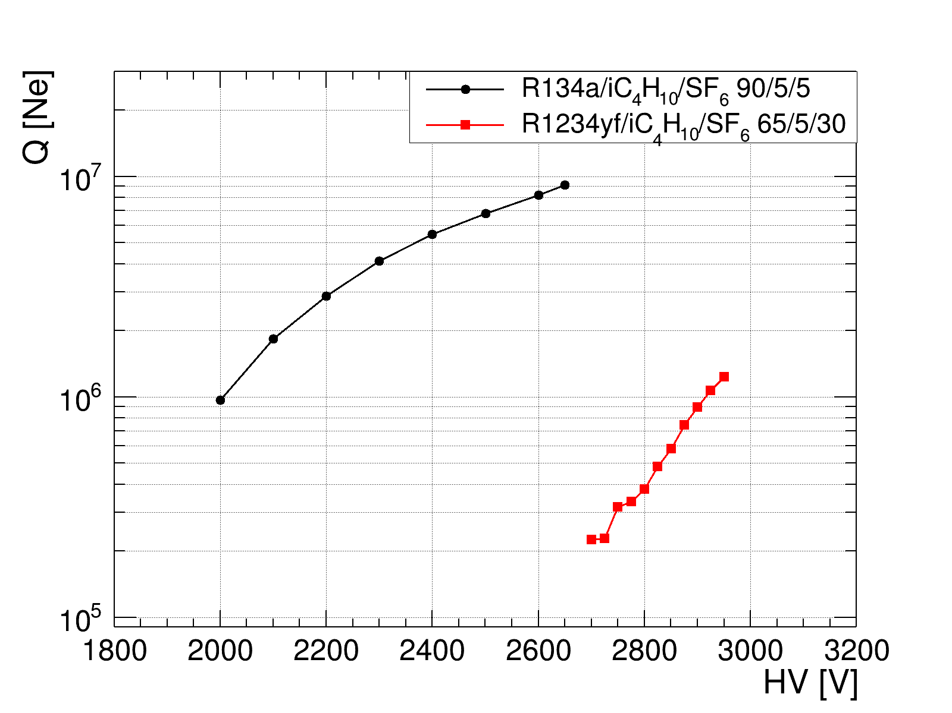
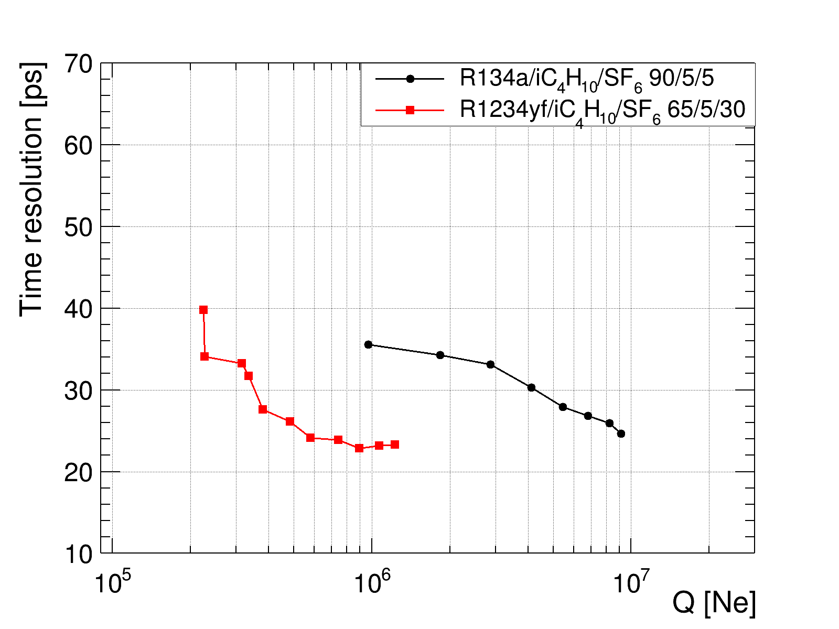
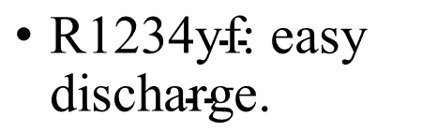
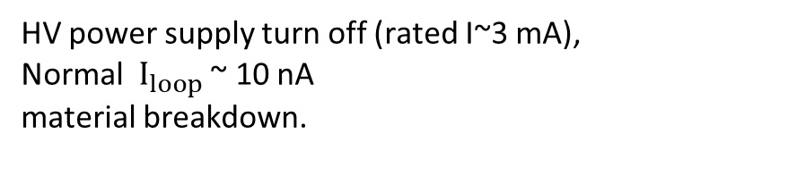
R134a → R1234yf
iC4H10 = 5%, R1234yf = 65%, SF6 = 30%
R1234yf ratio [%] | discharge HV [V]
90 | 2300
80 | 2600
65 | 3000
$\text{R}\text{1234}\text{yf}\text{: }\text{easy} \text{discharge}\text{. }$
HV power supply turn off (rated I~3 mA),
Normal $I_{loop}$ ~ 10 nA
material breakdown.
R134a → R1233zd (<3100V)
No signal at all, can’t work.
(A flat and peaceful curve on oscilloscope until a big discharge at >~3000V)

Slide 14
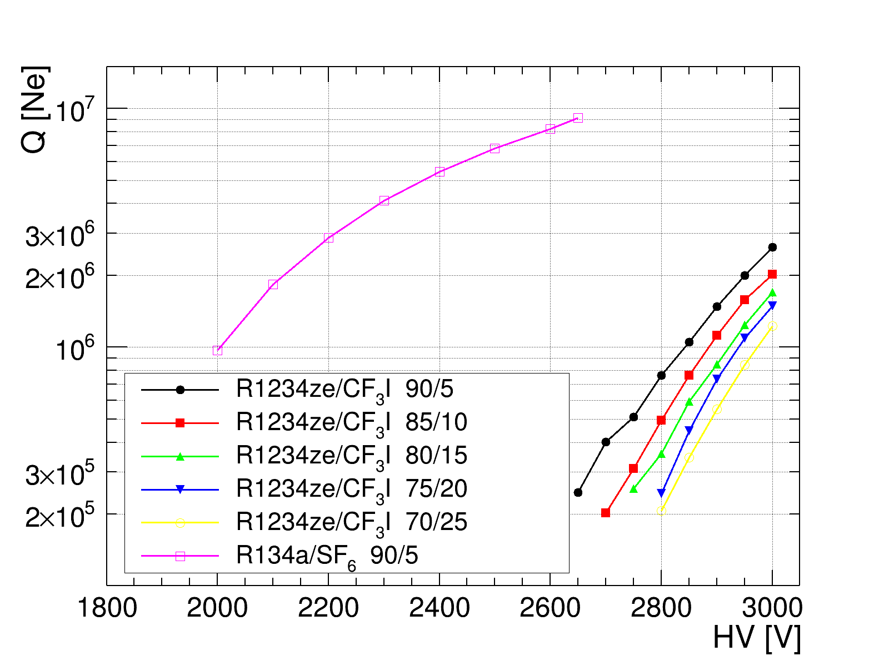
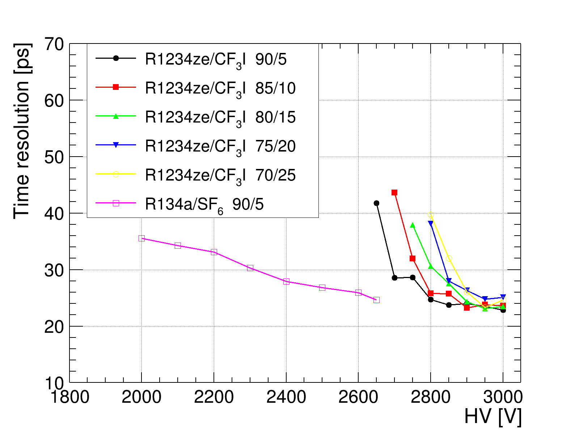
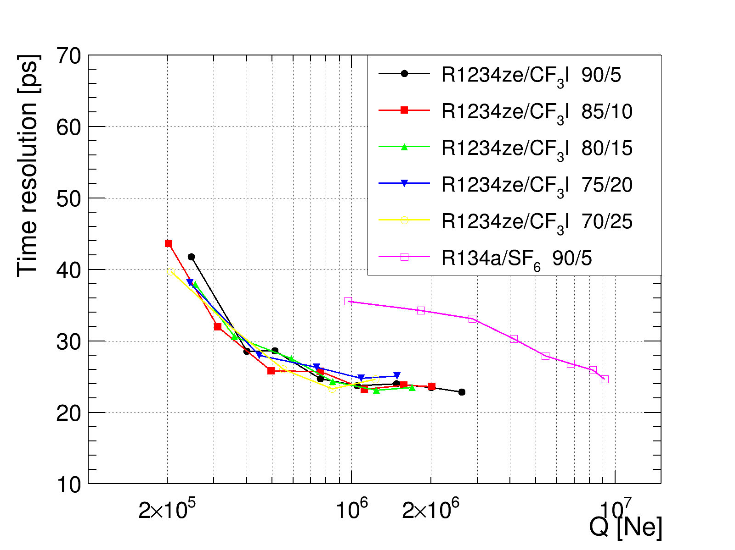
R134a → R1234ze, SF6 → CF3I
Fix SF6 = 5%, R1234ze = (90,85,80,75,70)%
Q(Gain) vs. HV
Time resolution vs. HV
Time resolution vs. Q
$\text{Increase} \text{CF}\text{3}\text{I}\text{ : }\text{Gain} \text{↘, }\text{HV}\text{ ↗, }\text{TR}\text{ \sim }\text{unchanged}$

Slide 15
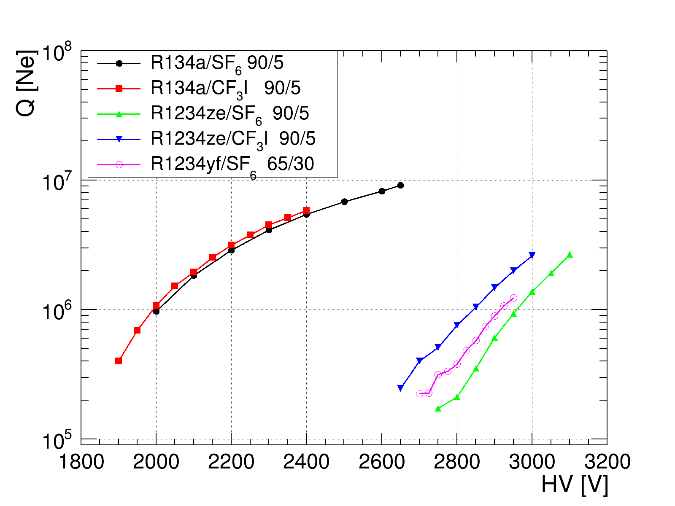
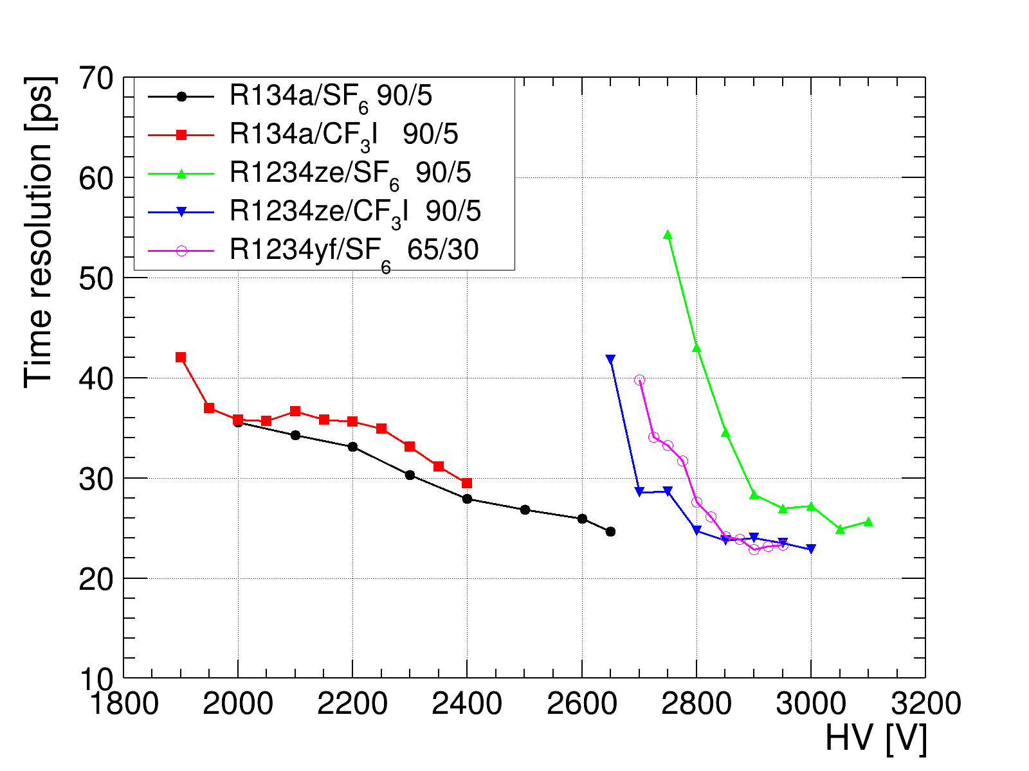
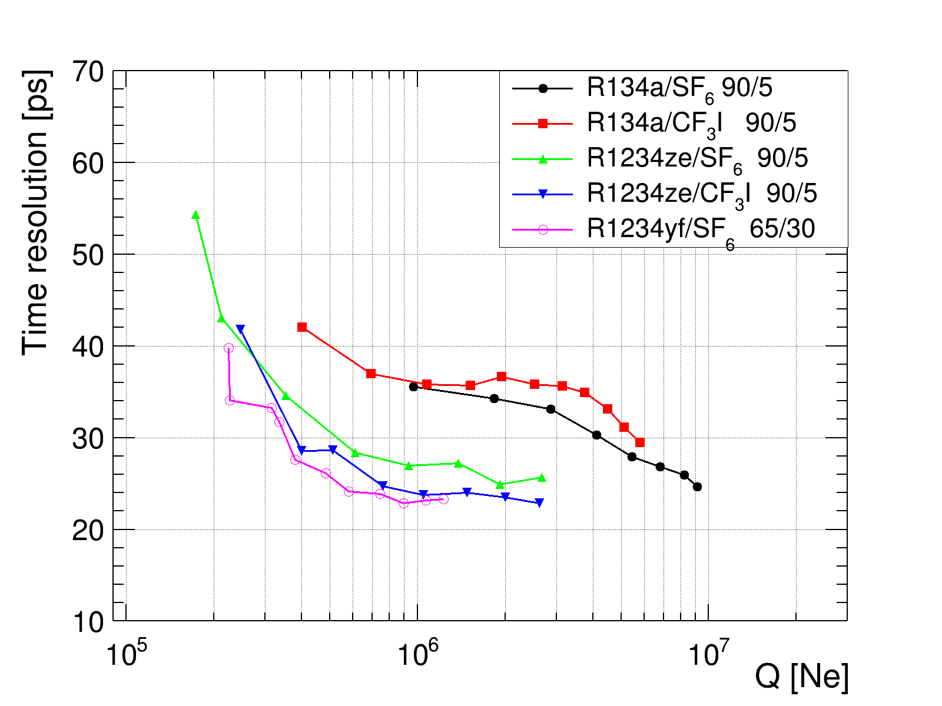
Result of all gas, fix iC4H10 = 5%
Q(Gain) vs. HV
Time resolution vs. HV
Time resolution vs. Q
R1234ze/iC4H10/CF3I(90/5/5) perform best:
low GWP, good TRvsQ, moderate working voltage

Slide 16
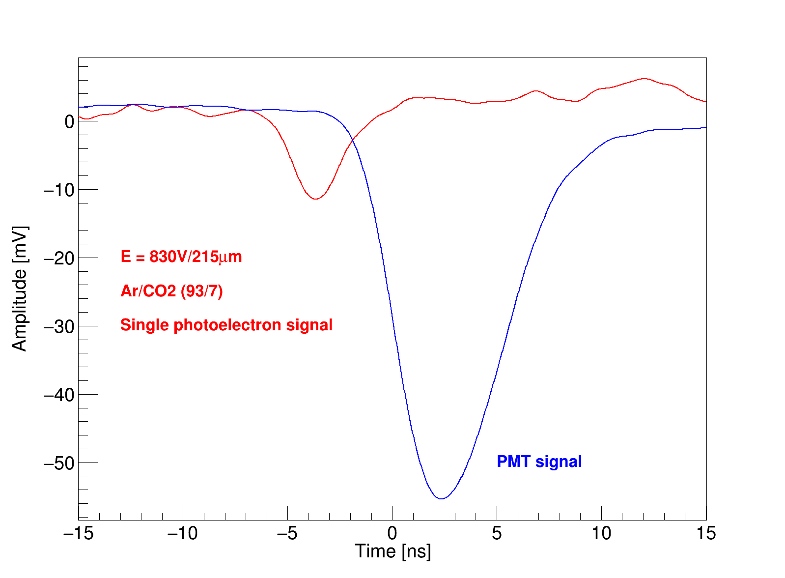
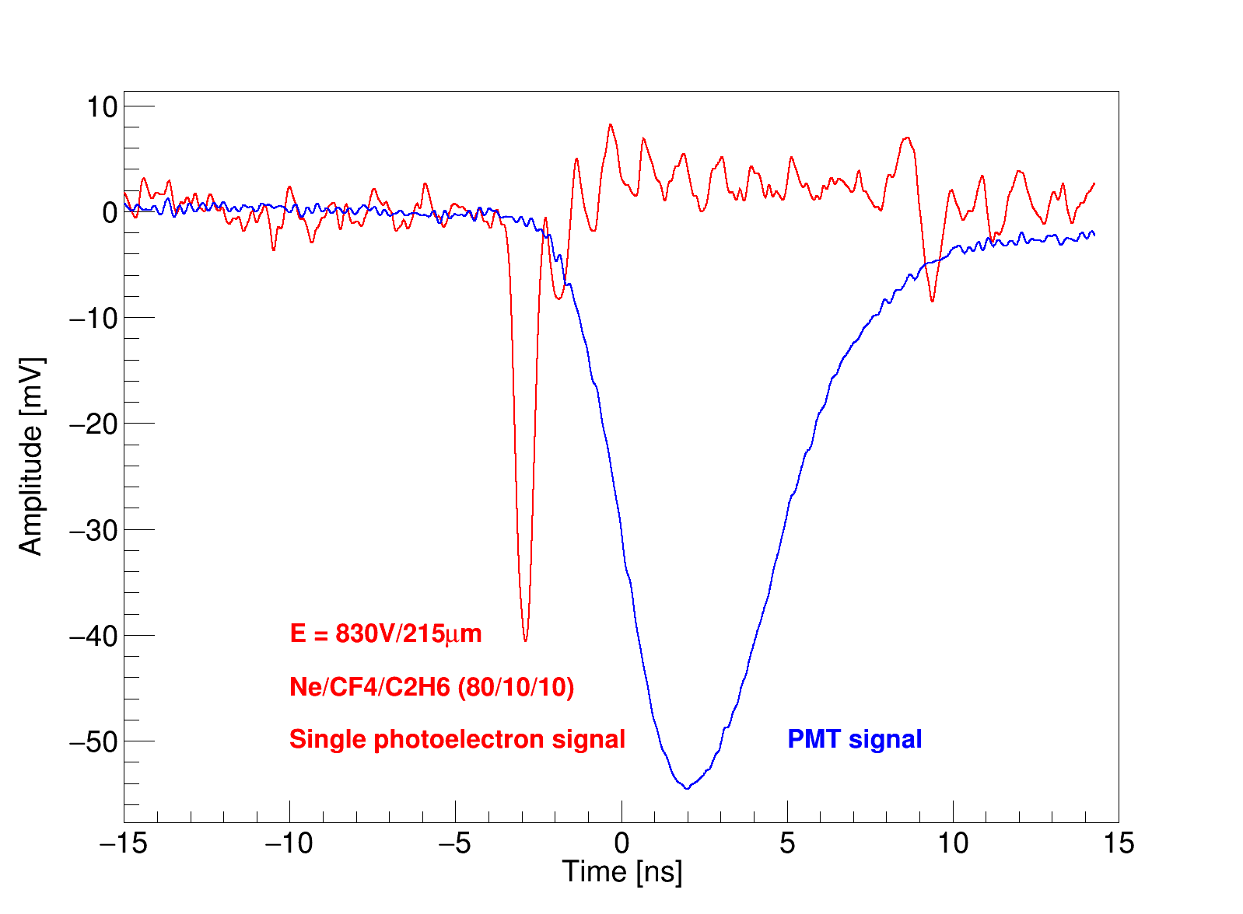
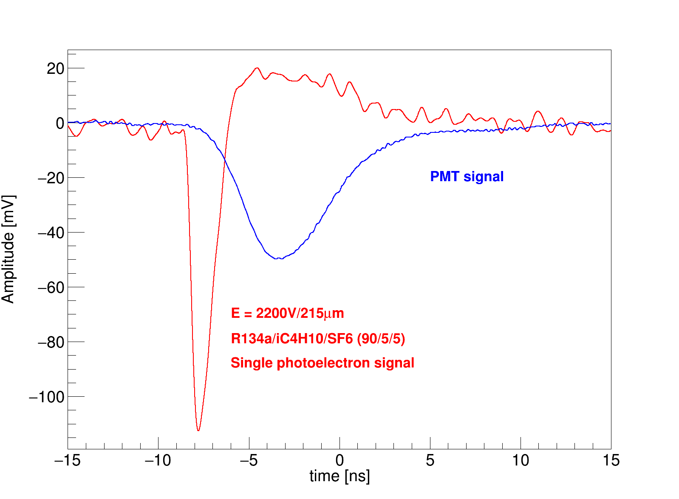
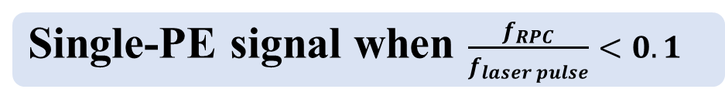
Single-photoelectron test
Single-PE signal when $\frac{f_{RPC}}{f_{laser pulse}}<0.1$
Typical signal of single-photoelectron collected by oscilloscope.
Signal amplitude, width, rise time are obviously different in different gas.
Ar/CO2(93/7)
2 GHz BW due to big S/N
COMPASS gas
Ne/C2H6/CF4(80/10/10)
MRPC gas
R134a/iC4H10/SF6(90/5/5)

Slide 17
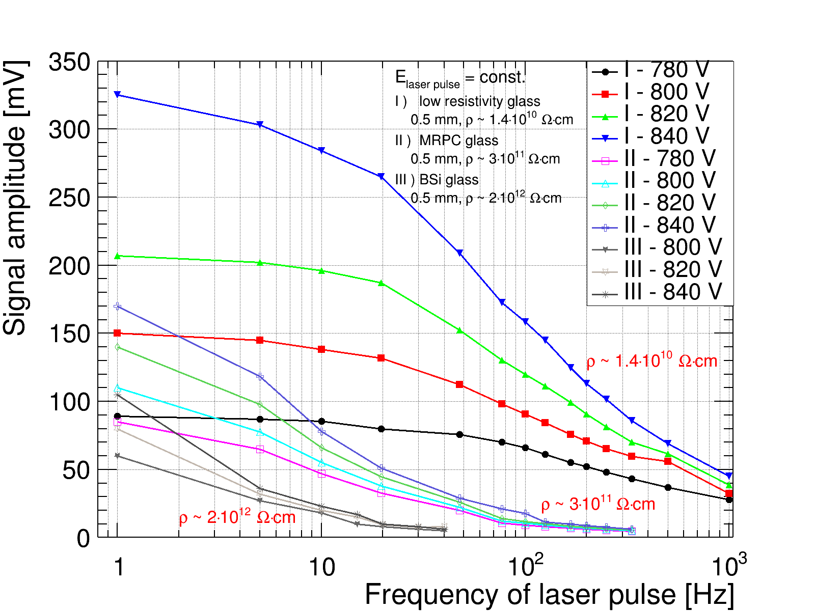
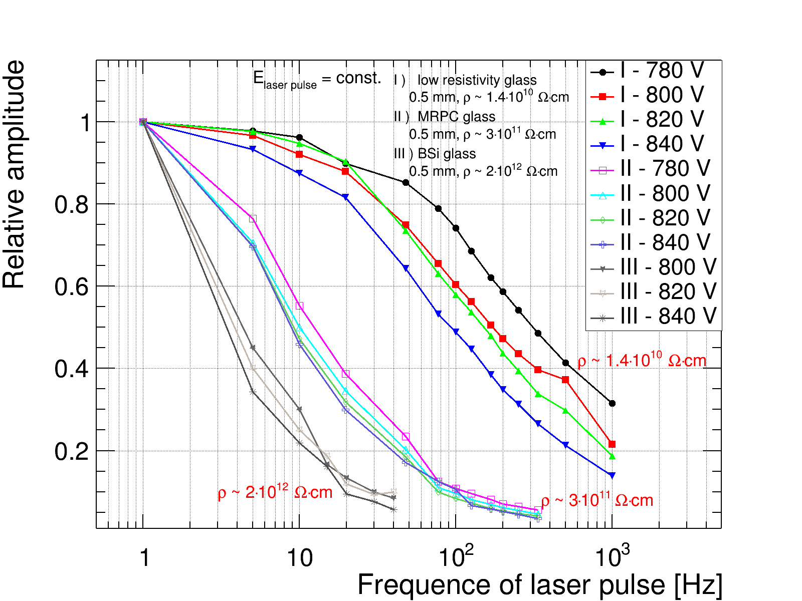
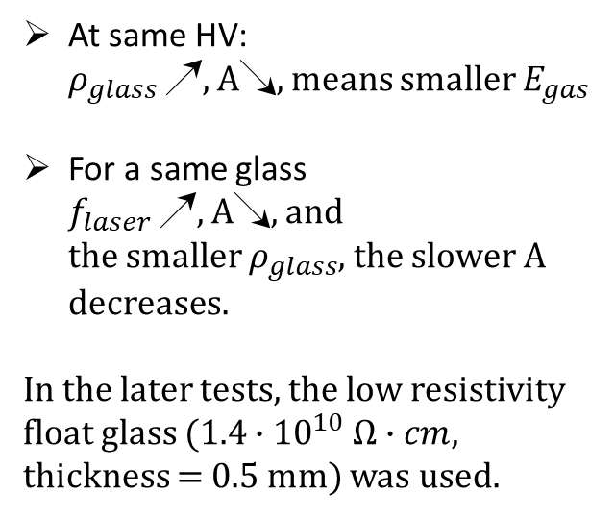

Rate capability of different $ρ_{glass}$
Test amplitude of RPC signal
Fix $E_{laser}$, so the number of primary photoelectrons stays the same.
Test $A_{RPC}$ with different glass in Ar/CO2(93/7) as a function of pulse frequency.
At same HV:
$ρ_{glass}$ ↗, A↘, means smaller $E_{gas}$
For a same glass
$f_{laser}$ ↗, A↘, and
the smaller $ρ_{glass}$, the slower A decreases.
In the later tests, the low resistivity float glass ($1.4∙{10}^{10} Ω∙cm$, thickness = 0.5 mm) was used.
Real amplitude
Max amplitude = 1

Slide 18
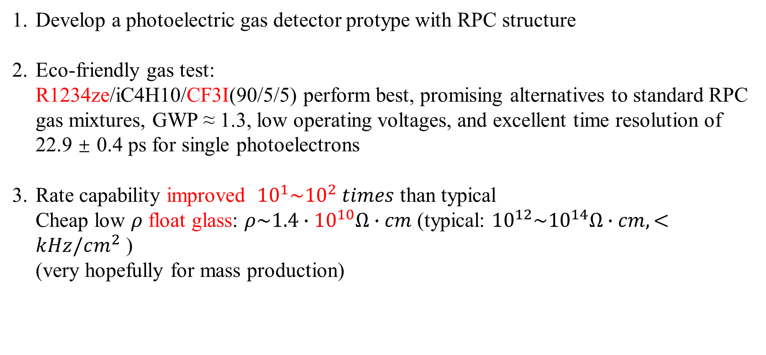
总 结
Develop a photoelectric gas detector protype with RPC structure
Eco-friendly gas test:
R1234ze/iC4H10/CF3I(90/5/5) perform best, promising alternatives to standard RPC gas mixtures, GWP ≈ 1.3, low operating voltages, and excellent time resolution of 22.9 ± 0.4 ps for single photoelectrons
Rate capability improved ${10}^{1}\sim {10}^{2} times$ than typical
Cheap low $ρ$ float glass: $ρ\sim 1.4∙{10}^{10}Ω∙cm$ (typical: ${10}^{12}\sim {10}^{14}Ω∙cm, <kHz/cm^{2}$ )
(very hopefully for mass production)
Thank you

