Slide 1
LightFCP
Rong Yi
2025/3/26

Slide 2
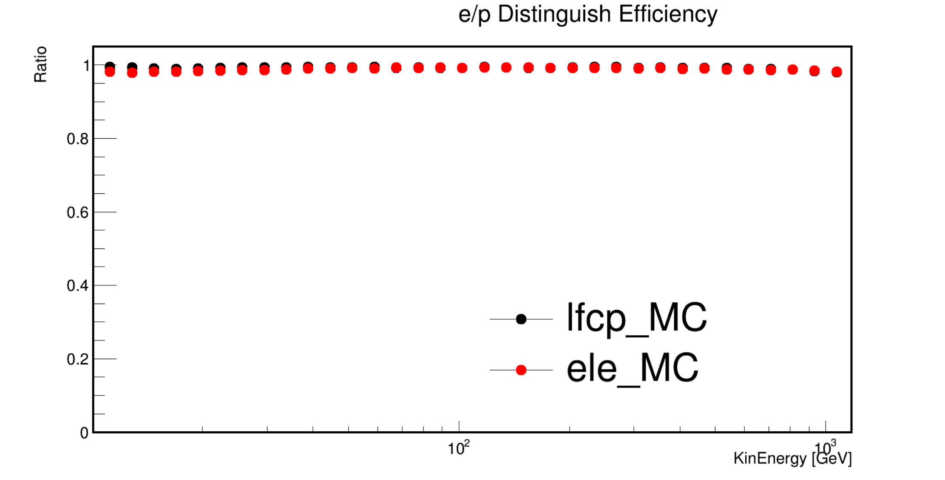
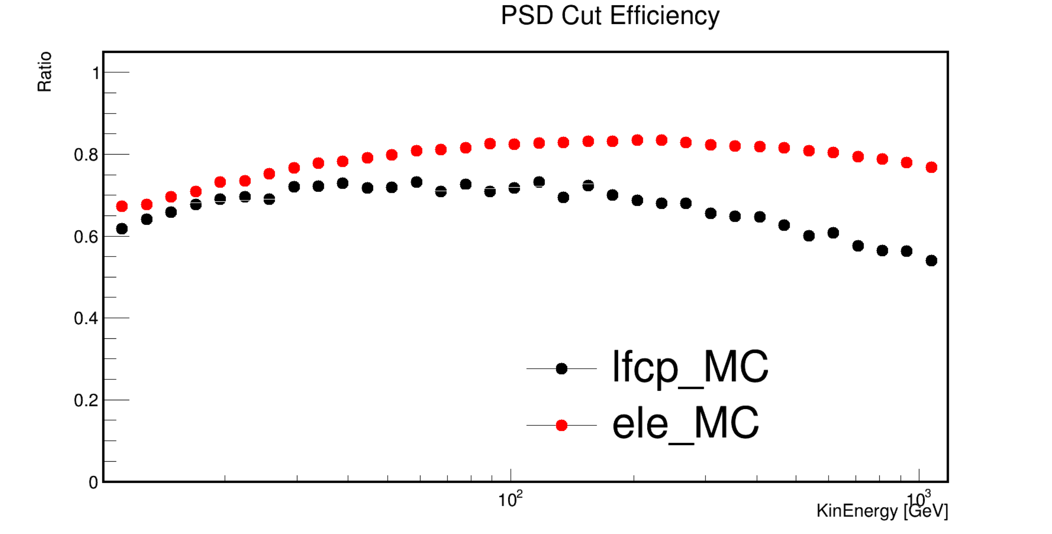
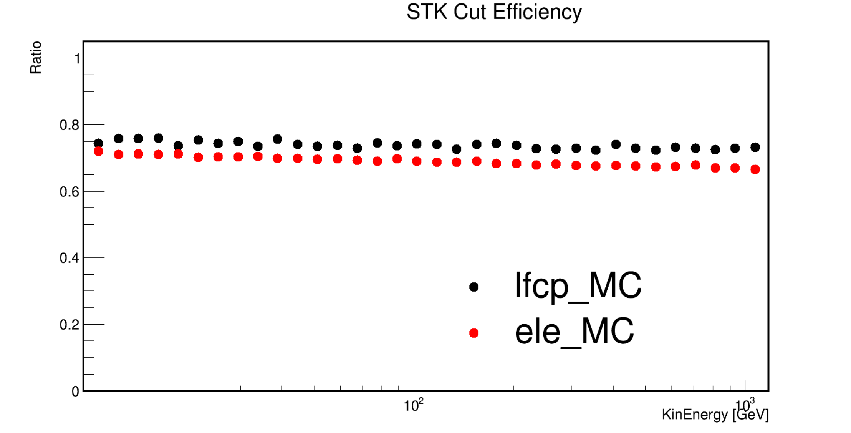
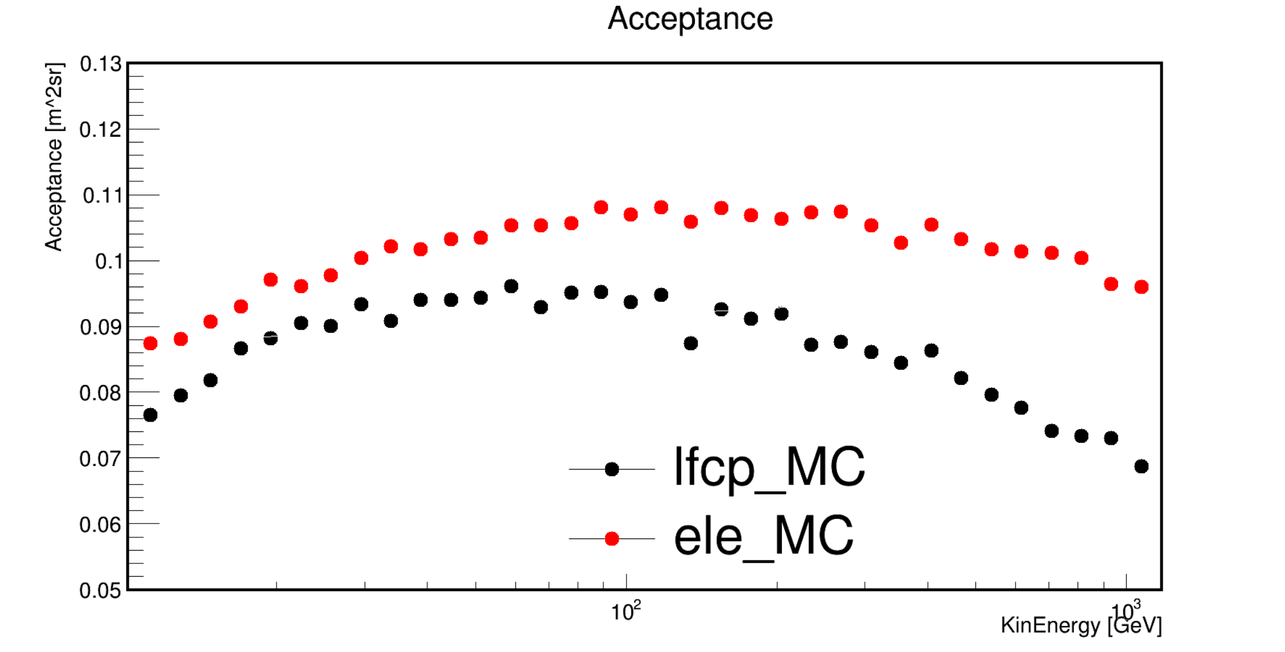
Comparison between lfcp and electron
e/p distinguish efficiency.
PSD cut efficiency.
STK cut efficiency.
Acceptance.

Slide 3
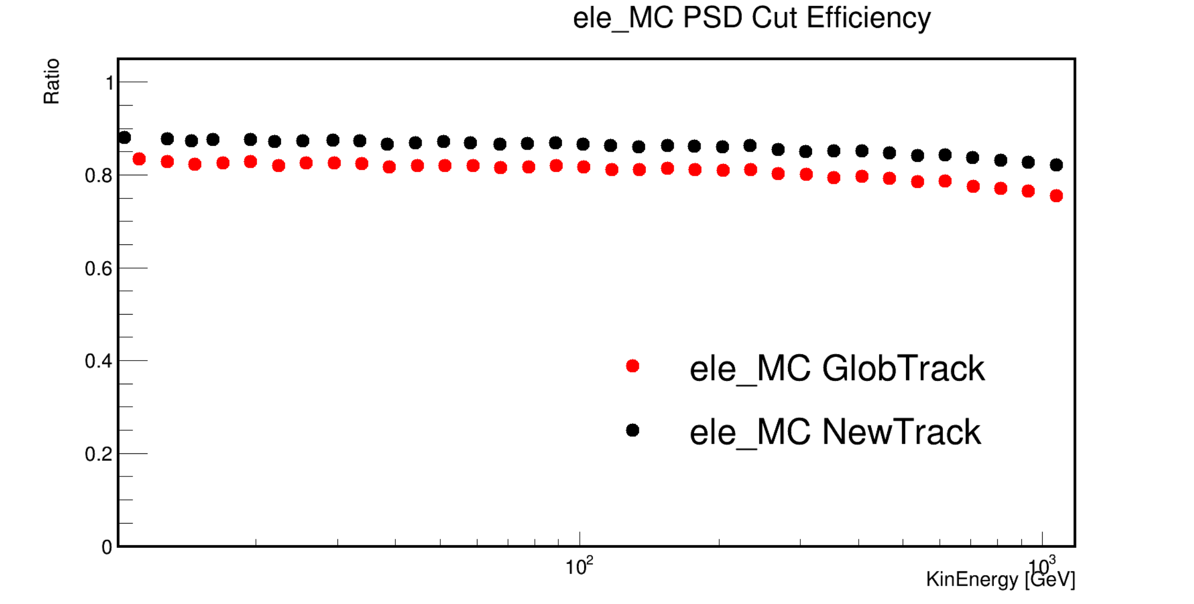
Ele_MC PSD Cut Efficiency

Slide 4
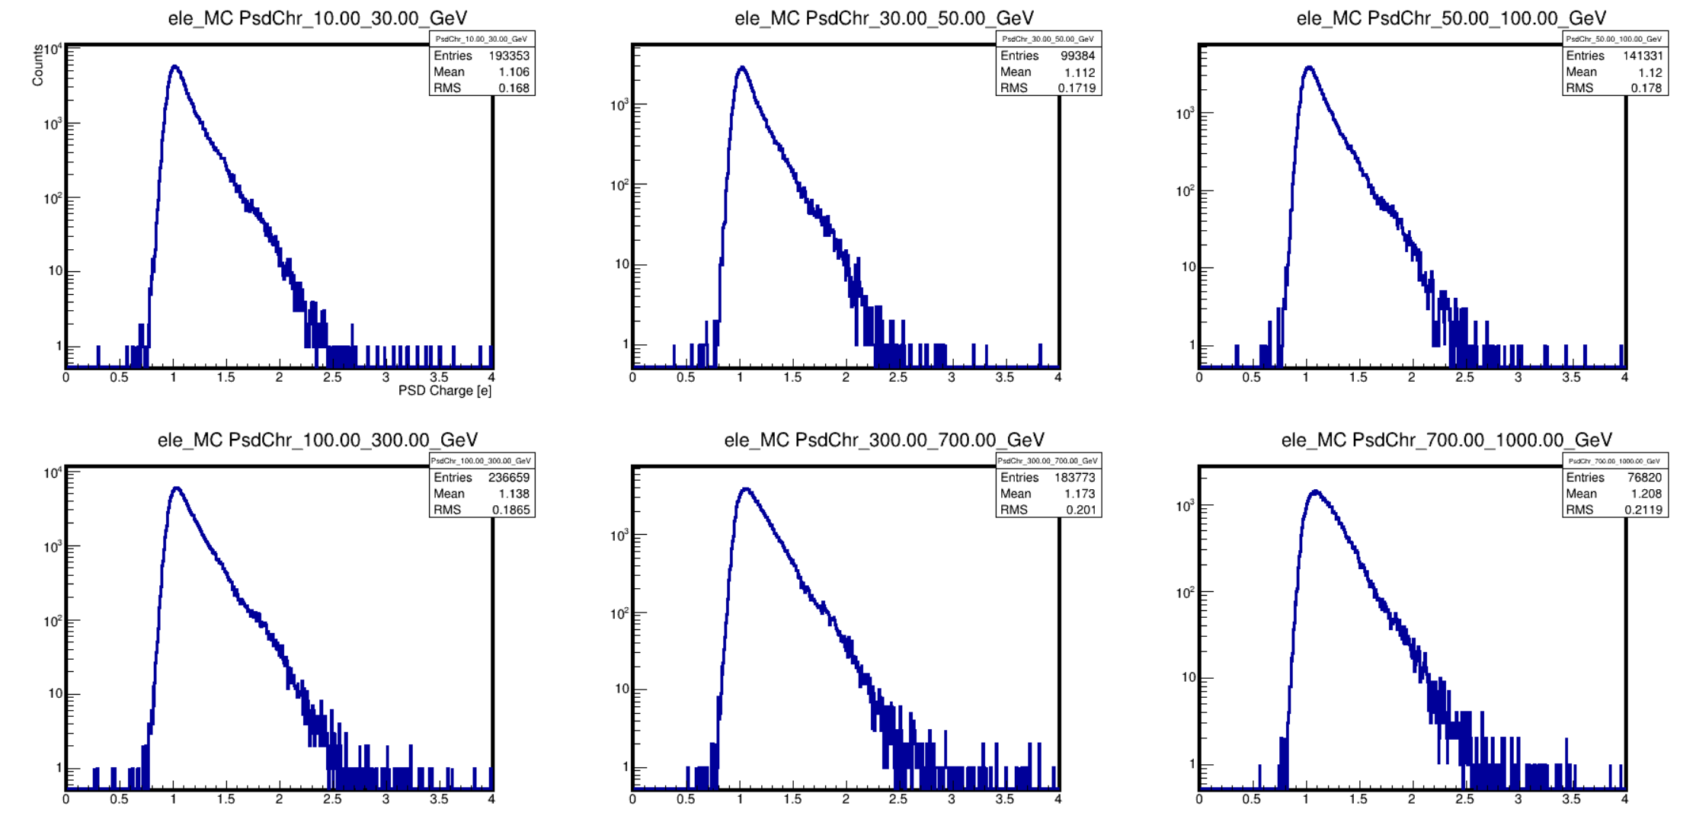
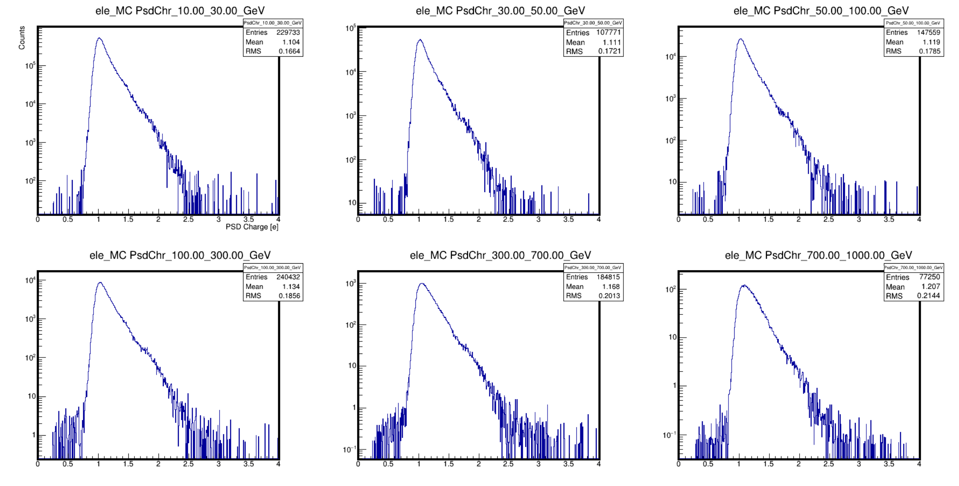
PSD Charge
Ele_MC GlobTrk
Ele_MC NewTrk

Slide 5
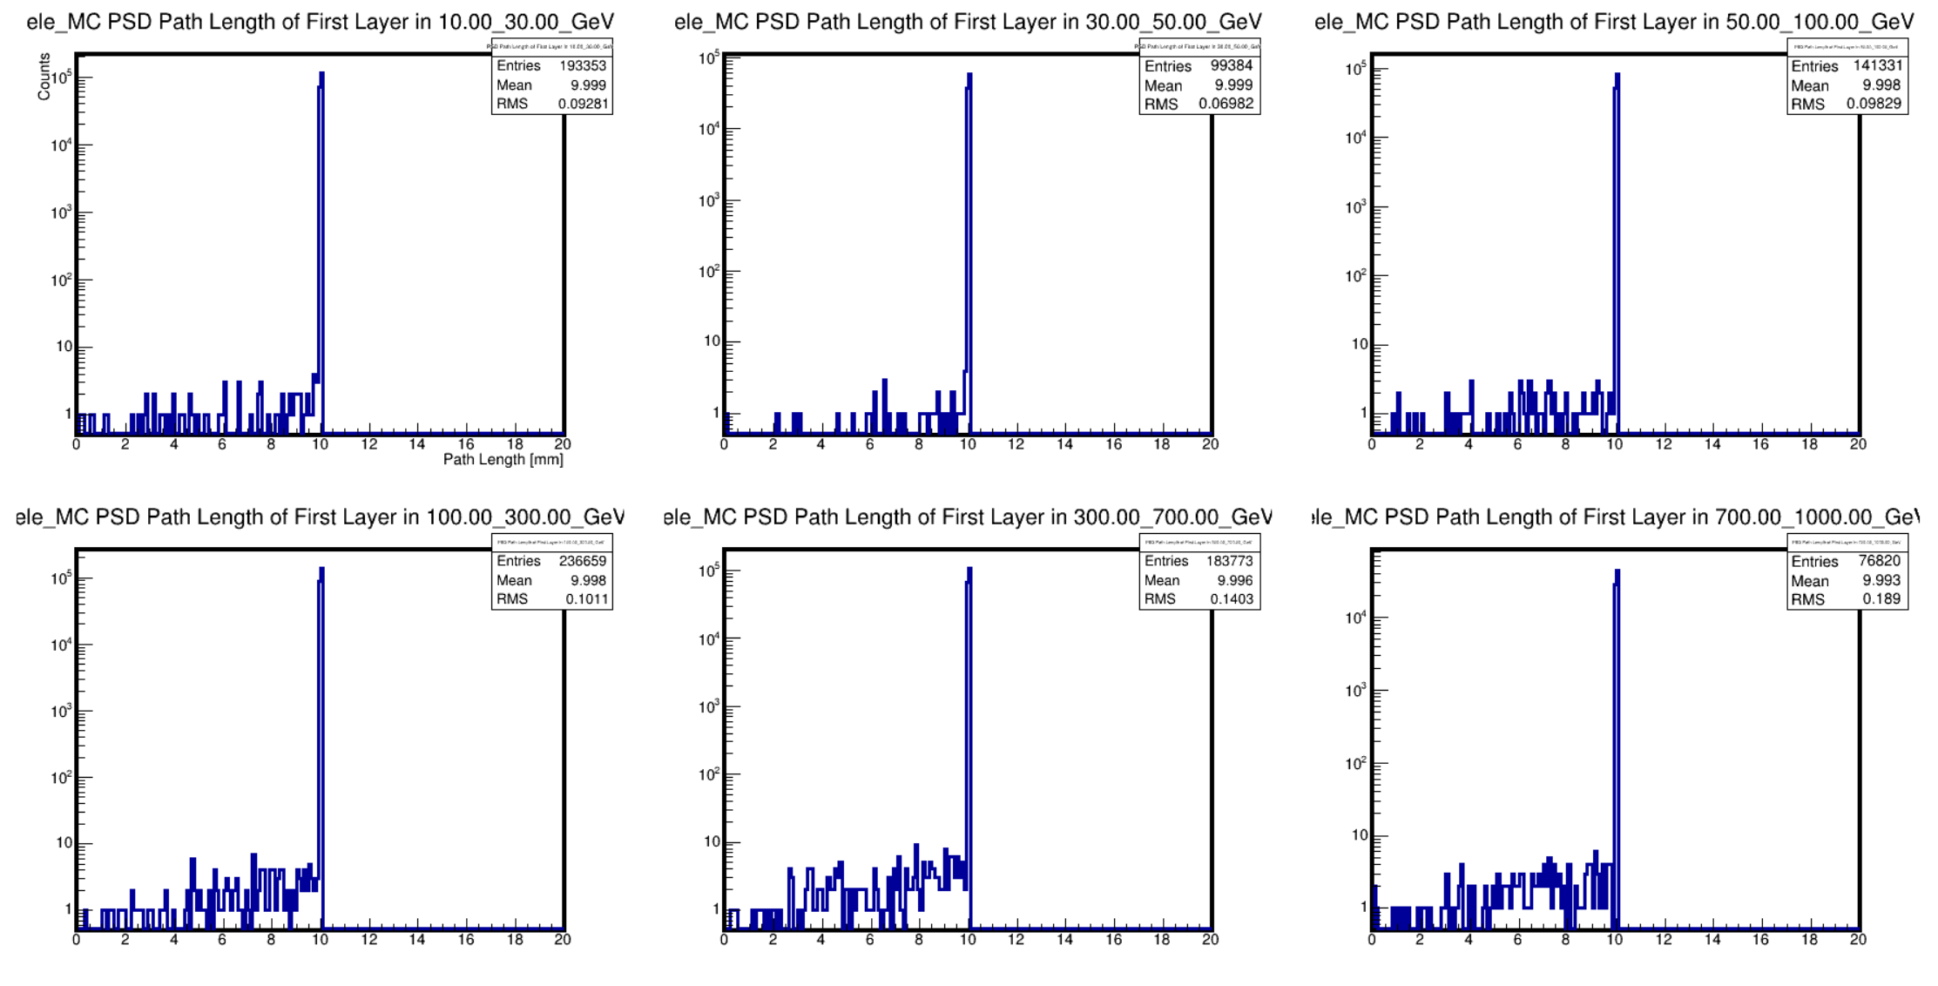
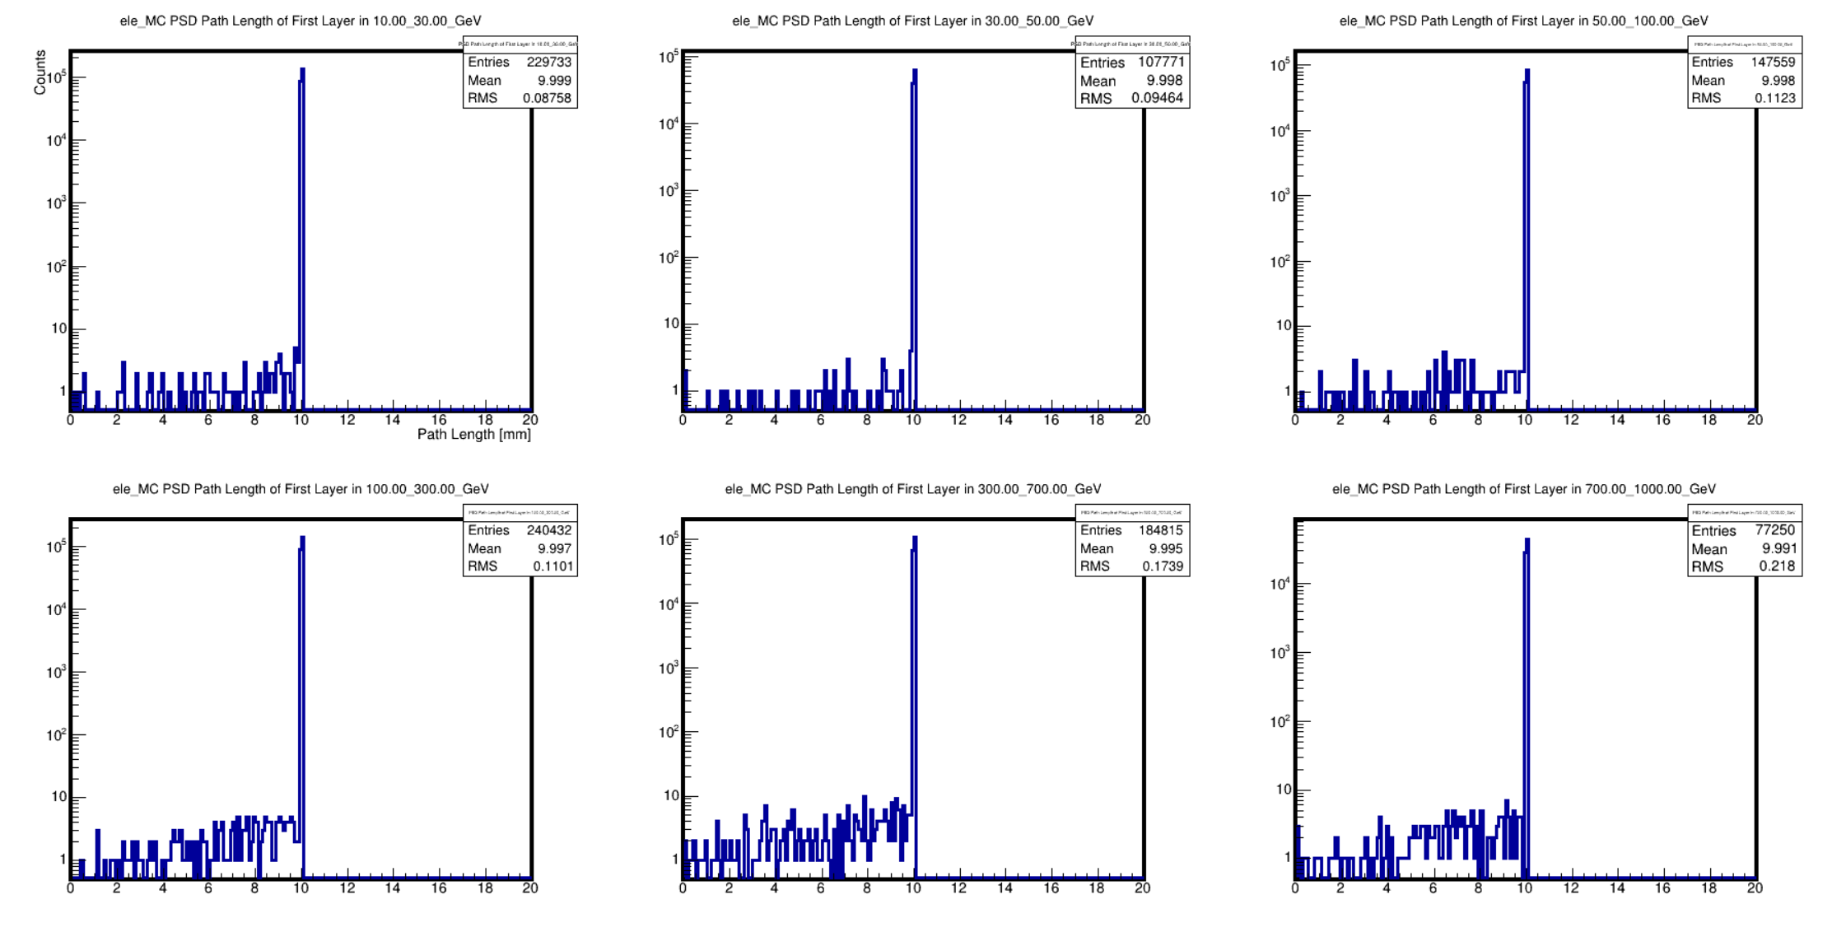
PSD Path Length
Ele_MC GlobTrk
Ele_MC NewTrk

Slide 6
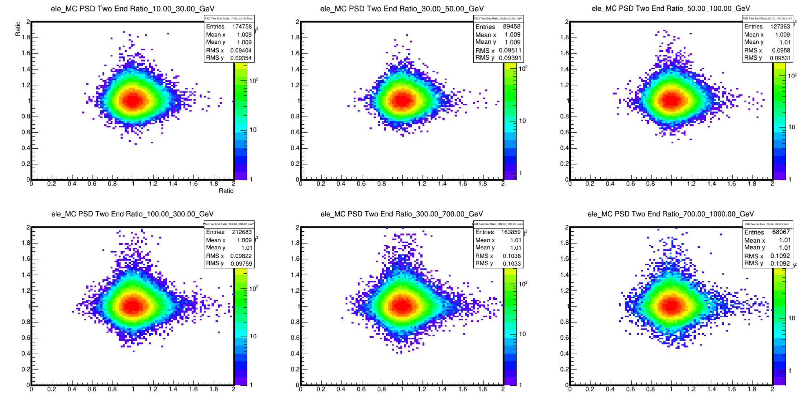
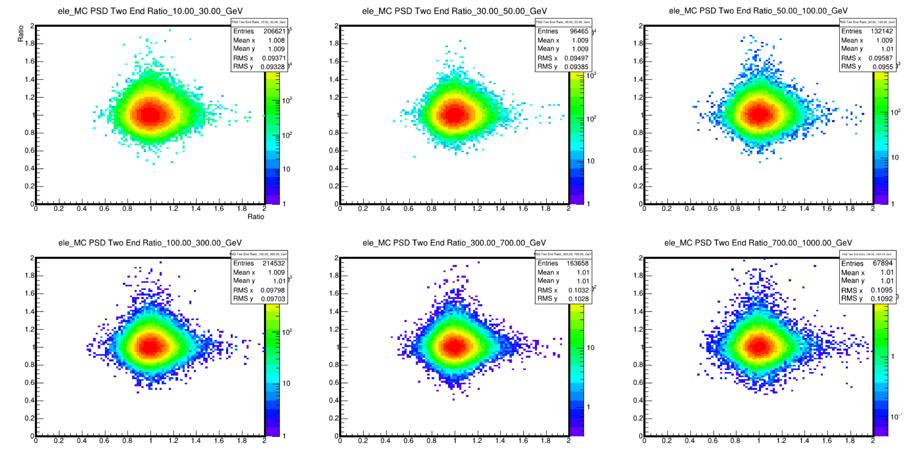
PSD Two End Ratio
Ele_MC GlobTrk
Ele_MC NewTrk

Slide 7
Backup

Slide 8
Selections (MC data sample: Light FCP 10 GeV~1TeV)
Pre-Selections.
  Trigger: G0, G3.
  Good track.
  Fiducial cut.
Remove oblique events.
Remove proton.
  Zeta value.
  nBarLayer13.
PSD Cuts.
  PSD charge.
  PSD path length.
  PSD two end ratio.
STK Cuts.
  First two layers are hit.
  Remove ladder’s edge cluster, and STK charge cut.

Slide 9
