Slide 1
Light-mass FCP selections
Chengming Liu
2025 03 28

Slide 2
STK charge method
Add total edep > 10 GeV
Add Max-Edep strip limitation
Eta correction
Hitting edge ejection
Effective signal selection
Old method: average signals with adc < 120 from first 4 sub-layers (effective number >=2)
4LNs6: average signals from first 4 sub-layers (effective number >=2)
12LNs6: average signals from all of the sub-layers (effective number >=4)
X: The difference between track hitting PSD strip and maximum energy deposition strip
Y: Maximum deposition of PSD energy (without angle correction)
E120Ns6: $\frac{6}{120}StkEng+Strips<6$

Slide 3
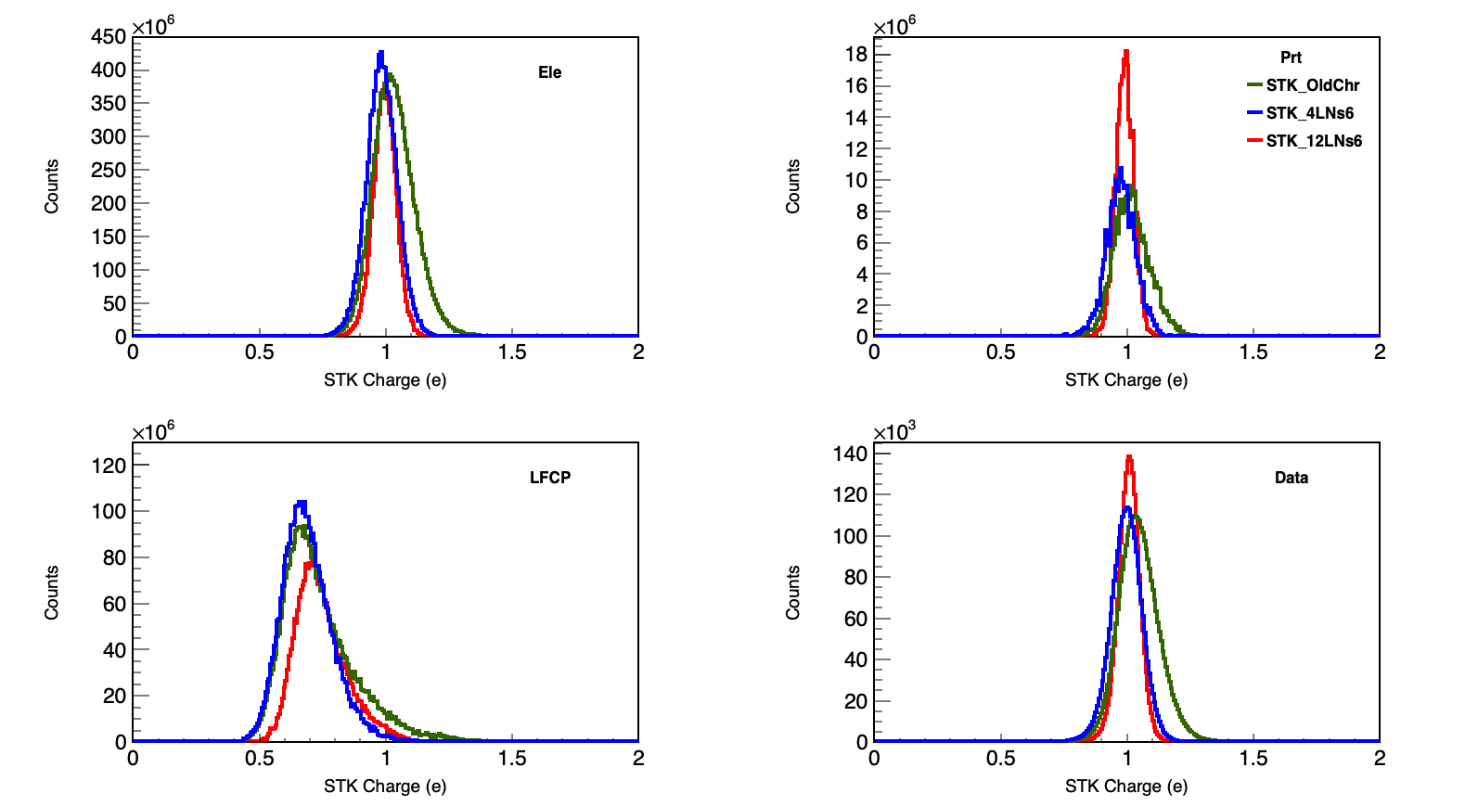
STK charge
Item | Ele | Prt | LFCP | Data
STK_Old | 674050 | 10782 | 212403 | 3.12702e+06
STK_4LNs6 | 531525 | 9857 | 197082 | 2.52233e+06
STK_12LNs6 | 271926 | 10935 | 108700 | 2.11738e+06

Slide 4
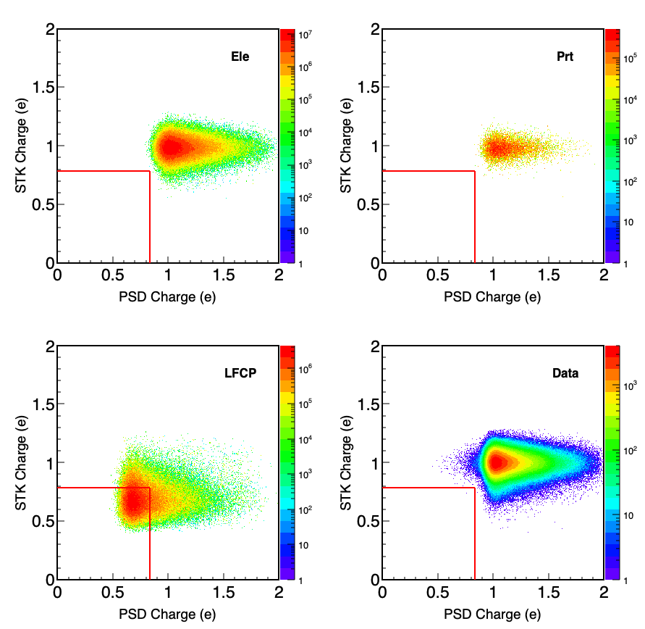
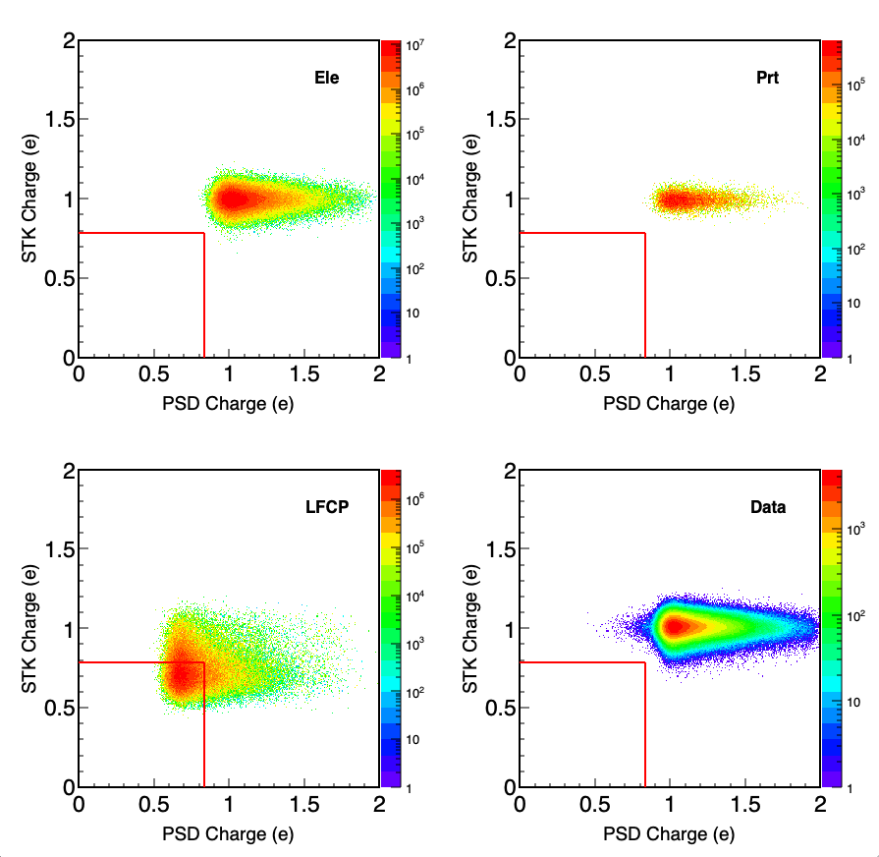
4LNs6
12LNs6

Slide 5
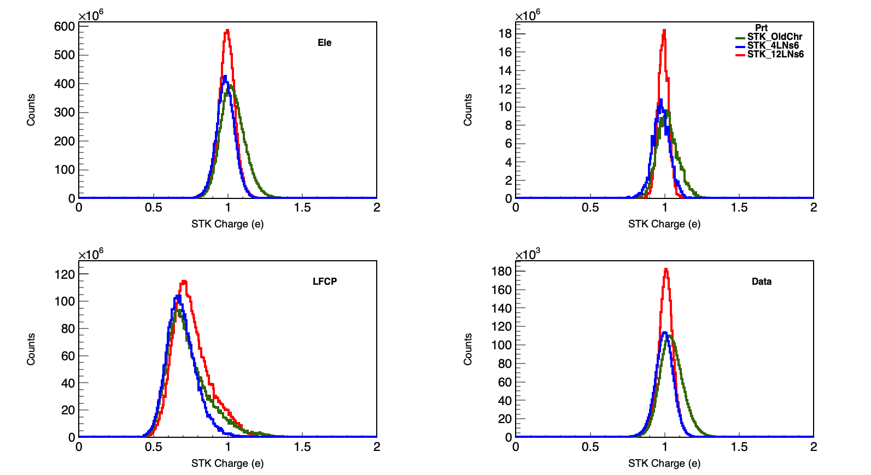
STK charge
Old method:(effective number >=2)
4LNs6: (effective number >=2)
12LNs6: (effective number >=2)
Item | Ele | Prt | LFCP | Data
STK_Old | 674050 | 10782 | 212403 | 3.12702e+06
STK_4LNs6 | 531525 | 9857 | 197082 | 2.52233e+06
STK_12LNs6 | 614991 | 11079 | 236856 | 3.19362e+06

Slide 6
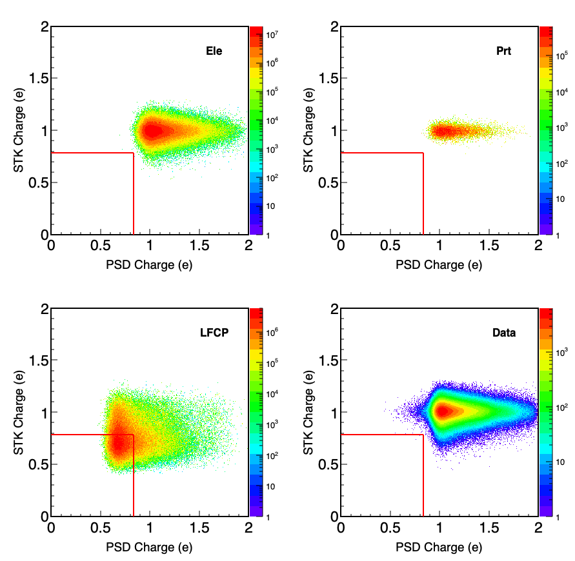
4LNs6
12LNs6

Slide 8
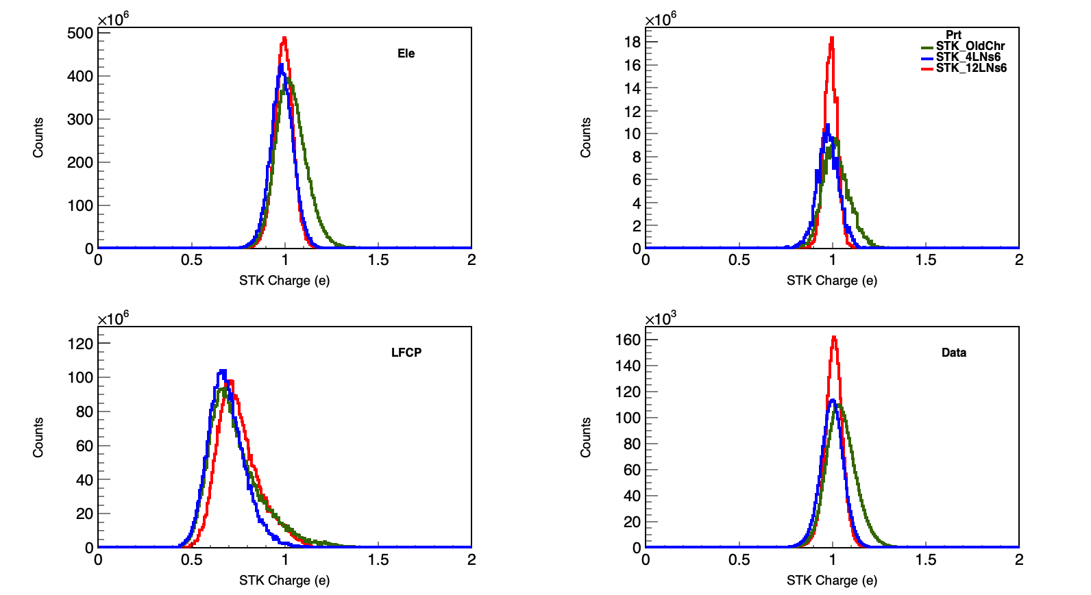
STK charge
Old method:(effective number >=2)
4LNs6: (effective number >=2)
12LNs6: (effective number >=3)
Item | Ele | Prt | LFCP | Data
STK_Old | 674050 | 10782 | 212403 | 3.12702e+06
STK_4LNs6 | 531525 | 9857 | 197082 | 2.52233e+06
STK_12LNs6 | 614991 | 11079 | 236856 | 3.19362e+06

Slide 9
4LNs6
12LNs6

Slide 10
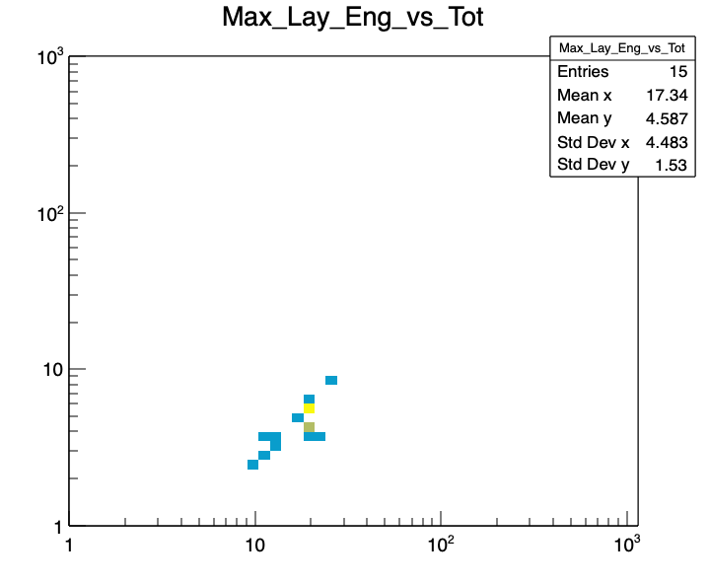
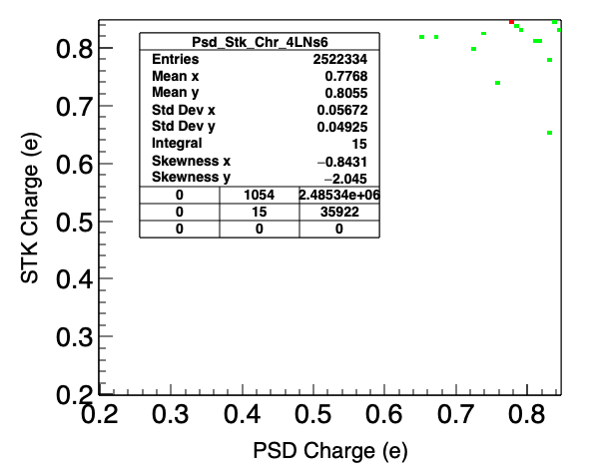
Small charge events
Max Layer Edep (GeV)
Total Edep (GeV)

Slide 11
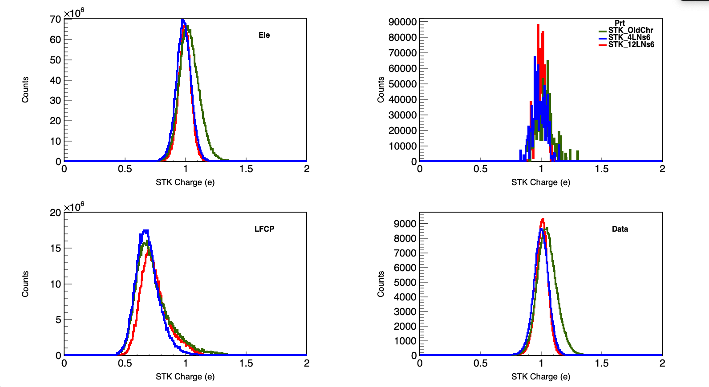
STK charge (TotE>30GeV)
Old method:(effective number >=2)
4LNs6: (effective number >=2)
12LNs6: (effective number >=3)
Item | Ele | Prt | LFCP | Data
STK_Old | 521271 | 285 | 160788 | 252302
STK_4LNs6 | 409139 | 266 | 149405 | 193481
STK_12LNs6 | 297356 | 291 | 116608 | 166665

Slide 12
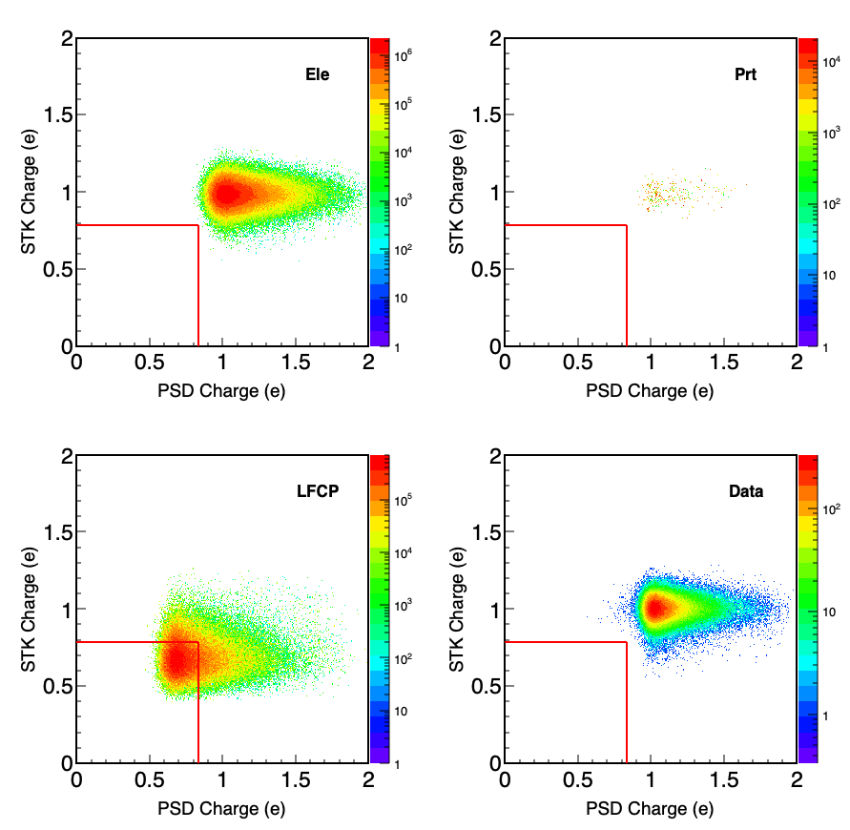
4LNs6
4LNs6 (TotE>30GeV)

