Slide 1

  Workshop on Multi-front Exotic phenomena in Particle and Astrophysics
  Search for exotic spin-dependent interactions with solid-state-spin quantum sensors
Rong, Xing
CAS Key Laboratory of Microscale Magnetic Resonance
University of Science and Technology of China (USTC)
2023@Hefei

Slide 2
OUTLINES
Background
NV center magnetometer
Search for exotic interactions based on single-NV centers
Recent experiment based on Ensemble NV centers
Outlook

Slide 3
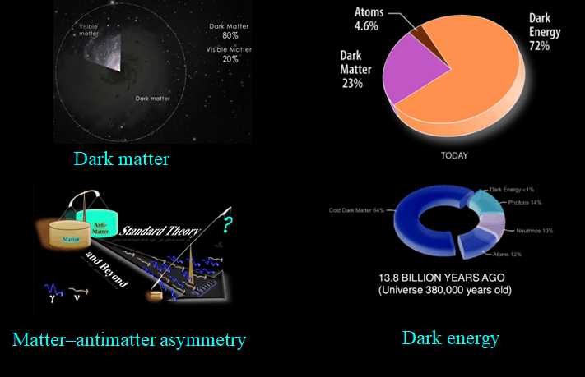

Slide 4
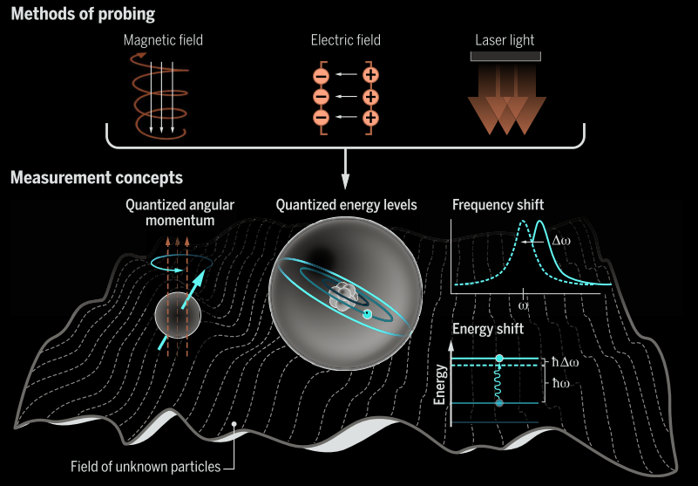
Probing the frontiers of particle physics
with tabletop-scale experiments
Ion trap
Nature 510, 376–380 (2014)
Phys. Rev. Lett. 081801, 1–5 (2015)
Nature 606, 479–483 (2022)
Atom EDM
Phys. Rev. Lett. 116, 1–5 (2016)
Phys. Rev. Lett. 120, 013202 (2018)
Atomic magnetometer
Sci. Adv. 7, 1–9 (2021)
Nat. Phys. 17, 1402 (2021)
Solid-state NV center
Nat. Commun. 9, 739 (2018)
D. DeMille et al., Science 357, 990–994 (2017)
Notes:
Kotler, S., Akerman, N., Navon, N., Glickman, Y. & Ozeri, R. Measurement of the magnetic interaction between two bound electrons of two separate ions. Nature 510, 376–380 (2014).
Kotler, S., Ozeri, R. & Kimball, D. F. J. Constraints on Exotic Dipole-Dipole Couplings between Electrons at the Micrometer Scale. Phys. Rev. Lett. 081801, 1–5 (2015).
Sailer, T. et al. Measurement of the bound-electron g-factor difference in coupled ions. Nature 606, 479–483 (2022).
Graner, B., Chen, Y., Lindahl, E. G. & Heckel, B. R. Reduced Limit on the Permanent Electric Dipole Moment of Hg 199. Phys. Rev. Lett. 116, 1–5 (2016).
Stadnik, Y. V., Dzuba, V. A. & Flambaum, V. V. Improved Limits on Axionlike-Particle-Mediated P，T-Violating Interactions between Electrons and Nucleons from Electric Dipole Moments of Atoms and Molecule. Phys. Rev. Lett. 120, 013202 (2018).
Su, H. et al. Search for exotic spin-dependent interactions with a spin-based amplifier. Sci. Adv. 7, 1–9 (2021).

Slide 5
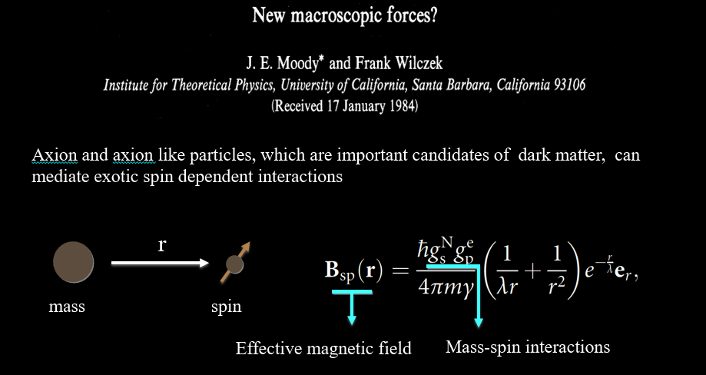



SPIN CAN BE USED TO EXPOLE INTERACTIONS MEDIATED BY AXION/ ALPs
Effective magnetic field
Unknown coupling strength
$$B(r)=\frac{g_{A}g_{A}}{4πℏc}\frac{ℏc }{r}e^{−\frac{r}{λ} }\vec{σ_{1}}∙\vec{σ_{2}}$$

Slide 6
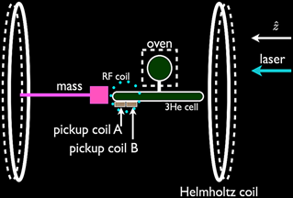
SPIN CAN BE USED TO EXPOLE INTERACTIONS MEDIATED BY AXION/ ALPs
Thickness of vapor cell：200 μm
Experimental investigation of interaction at force range below micrometer scale is elusive due to the size of spin sensors.
G. Raffelt, Physical Review D 86, 015001 (2012).

Slide 7
OUTLINES
Background
NV center magnetometer
Search for exotic interactions based on single-NV centers
Recent experiment based on Ensemble NV centers
Outlook

Slide 8
nitrogen-vacancy (NV) CENTERS
Point defects composed of a substitutional nitrogen fixed adjacent to a vacancy;
Exhibit spin-1 triplet electronic ground state.
[1] J. R. Maze et al., Nature 455, 644 (2008).
[2] F. Dolde et al., Nat. Phys. 7, 459 (2011).
[3] Kucsko, Georg, et al. Nature 500, 54–58 (2013).

Slide 9
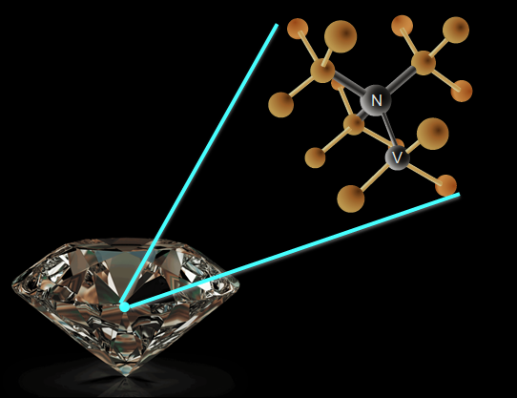
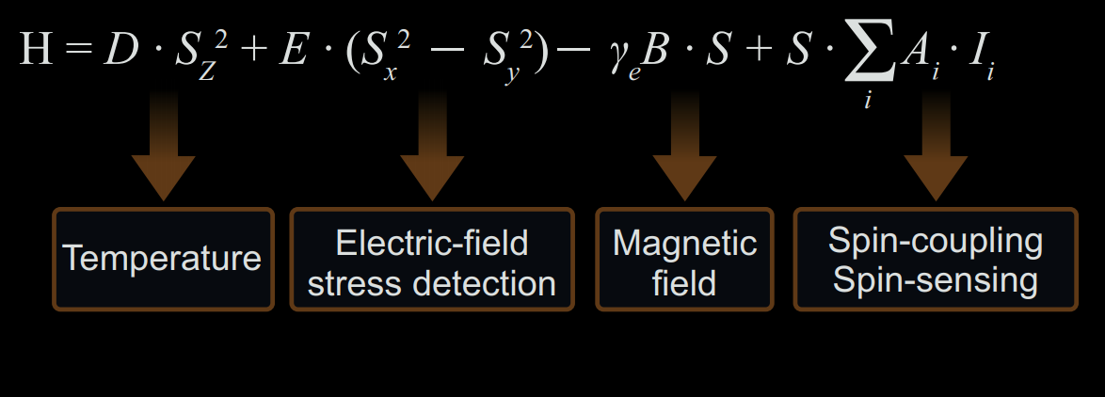
nitrogen-vacancy (NV) CENTERS
Quantum sensor for temperature, electric-field, stress, magnetic field, and nearby spin due to its spin properties.

Slide 10
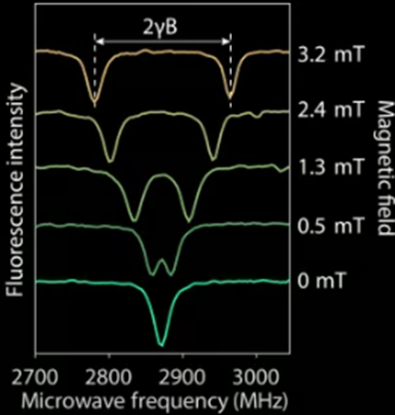



Principle of magnetic field sensing based on NV CENTERS
${|m}_{s}=±1$>
$$2γB$$
${|m}_{s}=0$>

Slide 11
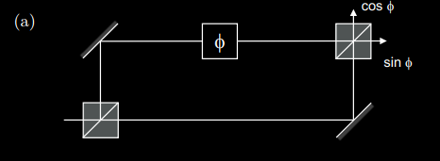
Magnetic field Sensing protocol——Pulse mode
Sequence
Interferometer principle
Laser
MW
Polarization
Evolution
Readout

Slide 12
Magnetic field Sensing protocol——CW mode
Sequence
Frequency modulation to overcome flicker noise
Laser
Modulated MW
Continuously sensing
Y. J. Xie et al. Sci. Bull. 66, 127–132 (2021).

Slide 13
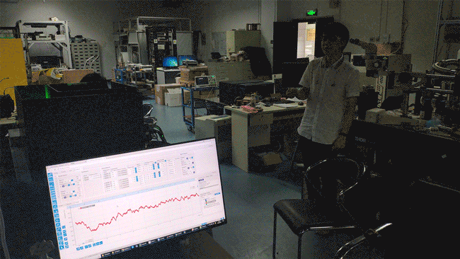
A video

Slide 14
OUTLINES
Background
NV center magnetometer
Search for exotic interactions based on single-NV centers
Recent experiment based on Ensemble NV centers
Outlook

Slide 15
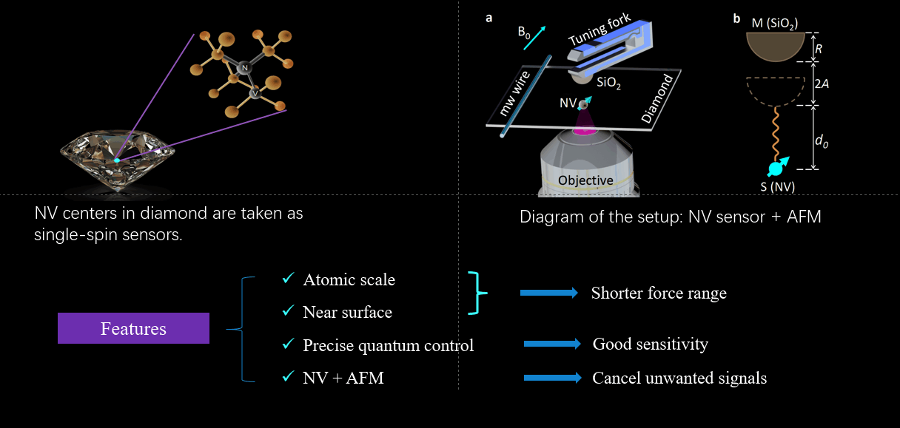
UTILIZING SINGLE-SPIN SENSOR TO SEARCH FOR EXOTIC INTERACTIONS

Slide 16
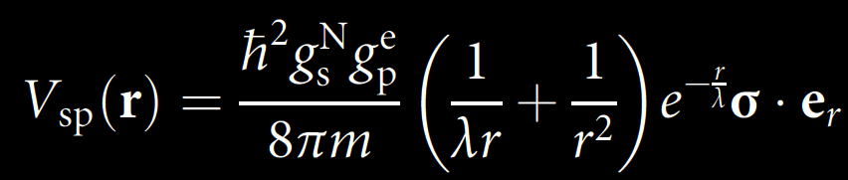
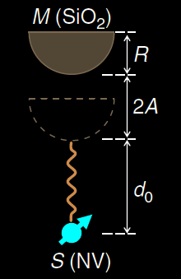
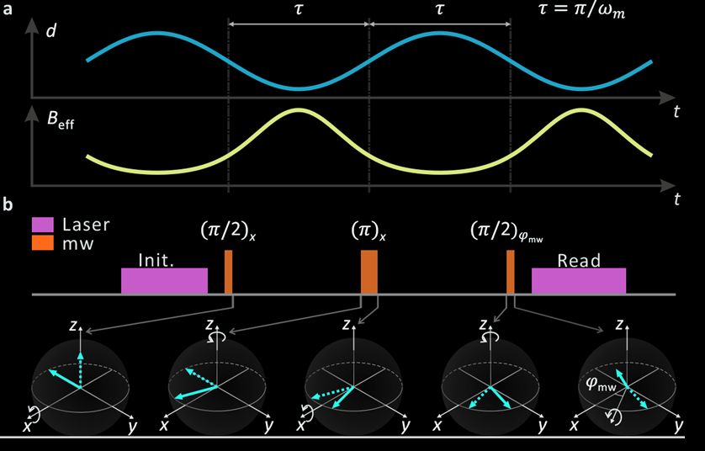
SEARCHING FOR
ELECTRON-NUCLEON MONOPOLE-DIPOLE INTERACTION
The pulse sequence is designed to accumulate the possible distance-dependent effect.
  Nature Communications 9, 739 (2018)

Slide 17
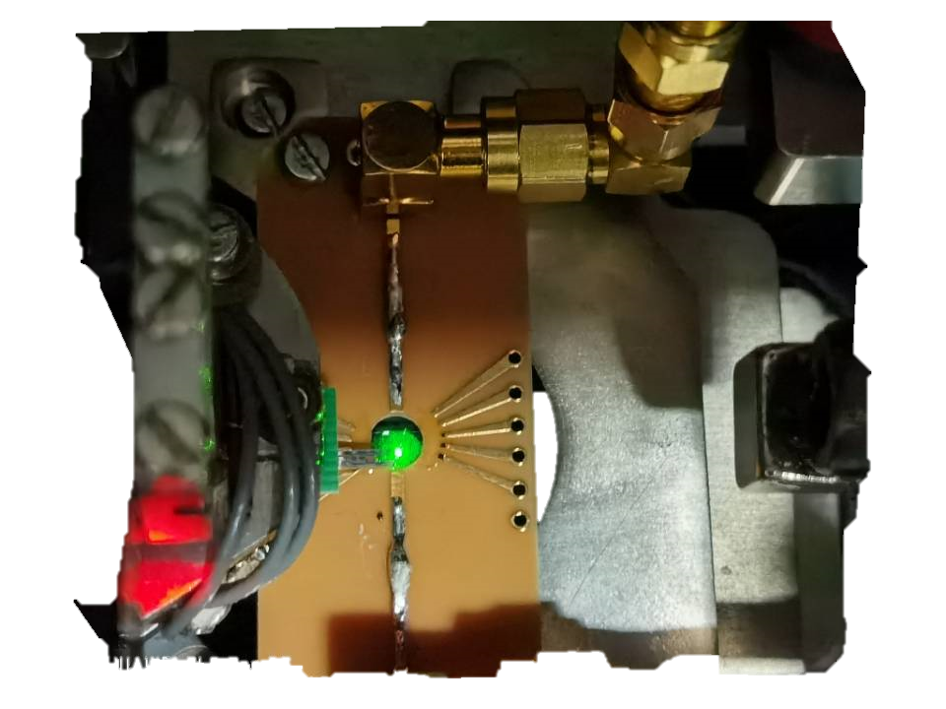
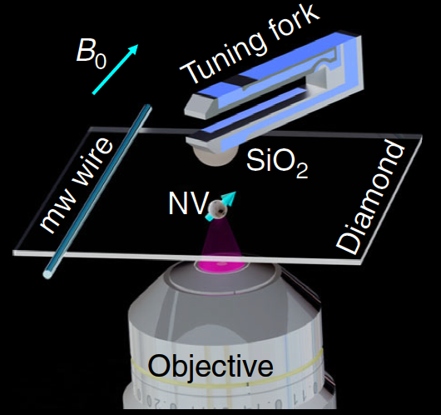
EXPERIMENTAL SETUP

Slide 18
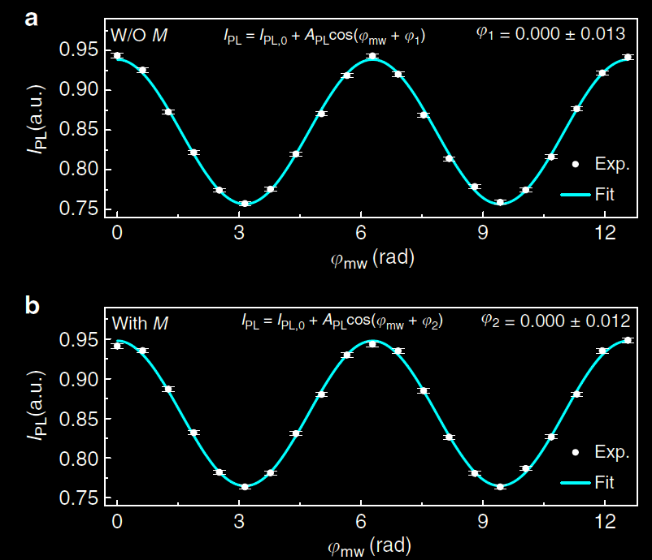
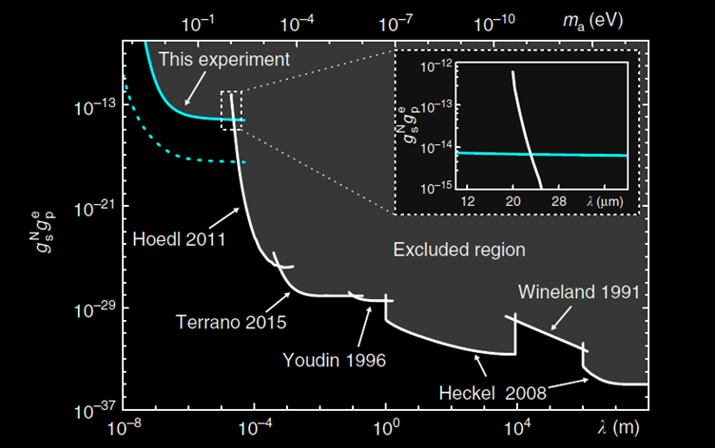
SEARCHING FOR
ELECTRON-NUCLEON MONOPOLE-DIPOLE INTERACTION
No signal
  A serious of work has been done.
  X. Rong et al., Nat. Commun. 9, 739 (2018), X. Rong et al., PRL 121, 080402 (2018),
  M. Jiao et al., PRL 127, 010501 (2021)

Slide 19
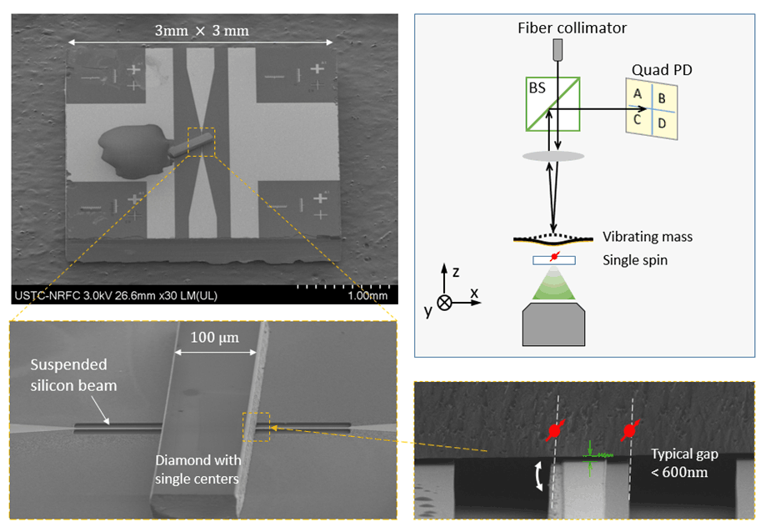
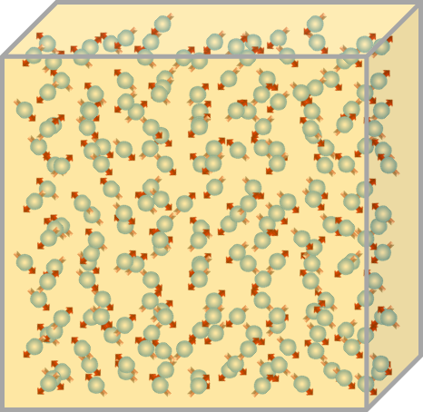



How to further improve searching sensitivity？
Develop array of diamond sensors.
——integrated on-chip sensor
Achieve number enhancement directly using ensemble NV centers in one diamond.
$$η∝\frac{1}{γ\sqrt{NT_{2}^{∗}}}$$
$N$： number of integrated chip
$N$： number of electron spins in diamond
Pu Huang et al. in progress
  H. Liang et al., Natl. Sci. Rev nwac262 (2022)

Slide 20
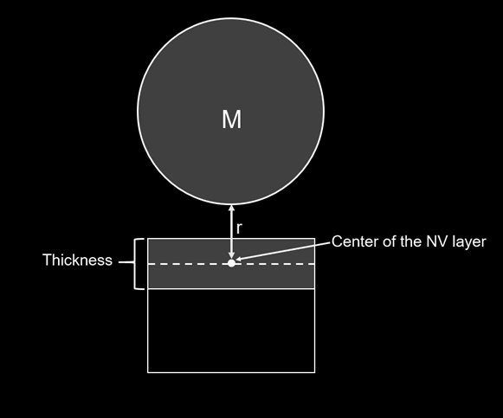

Challenges of using ensemble NV centers
Diamond sensor
  Optimize sample concentration
  Optimize sensing volume
$$η∝\frac{1}{γ\sqrt{NT_{2}^{∗}}}$$
Poor
sensing number
Poor
coherence
concentration
Optimize concentration to achieve higher sensitivity
Optimize thickness to
achieve sub-millimeter search

Slide 21
OUTLINES
Background
NV center magnetometer
Search for exotic interactions based on single-NV centers
Recent experiment based on ensemble NV centers
Outlook

Slide 22
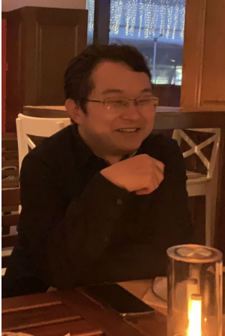
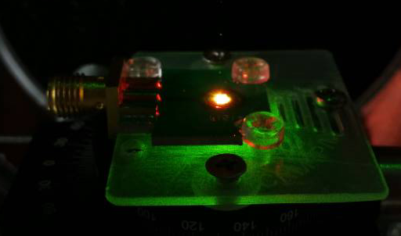
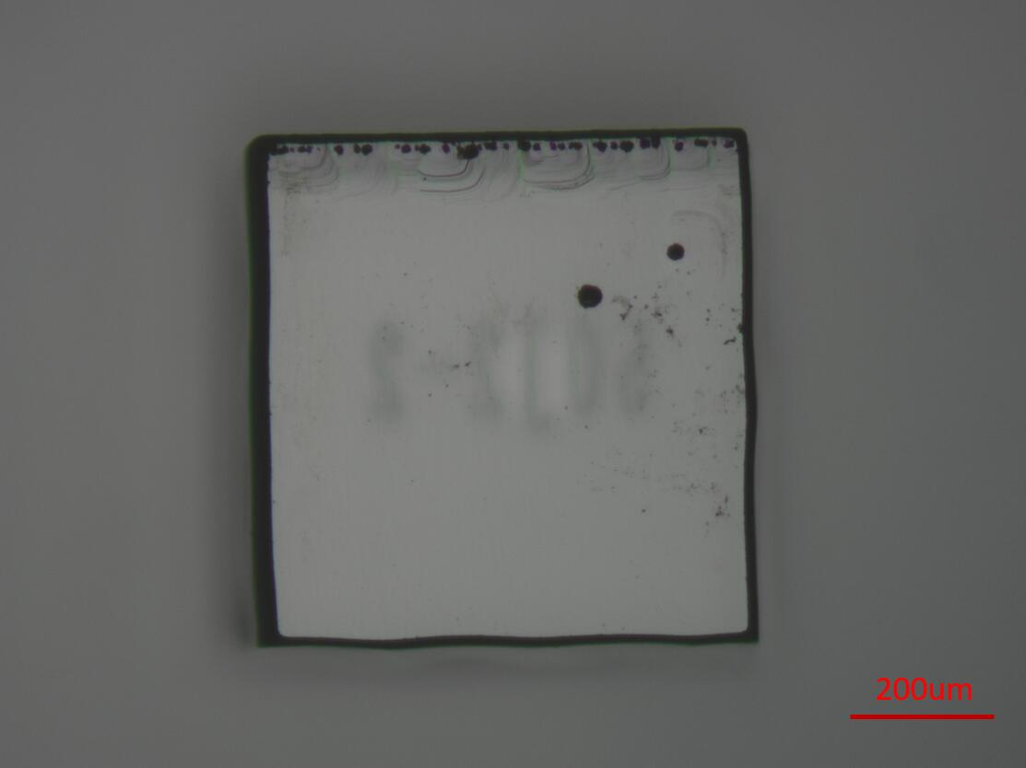
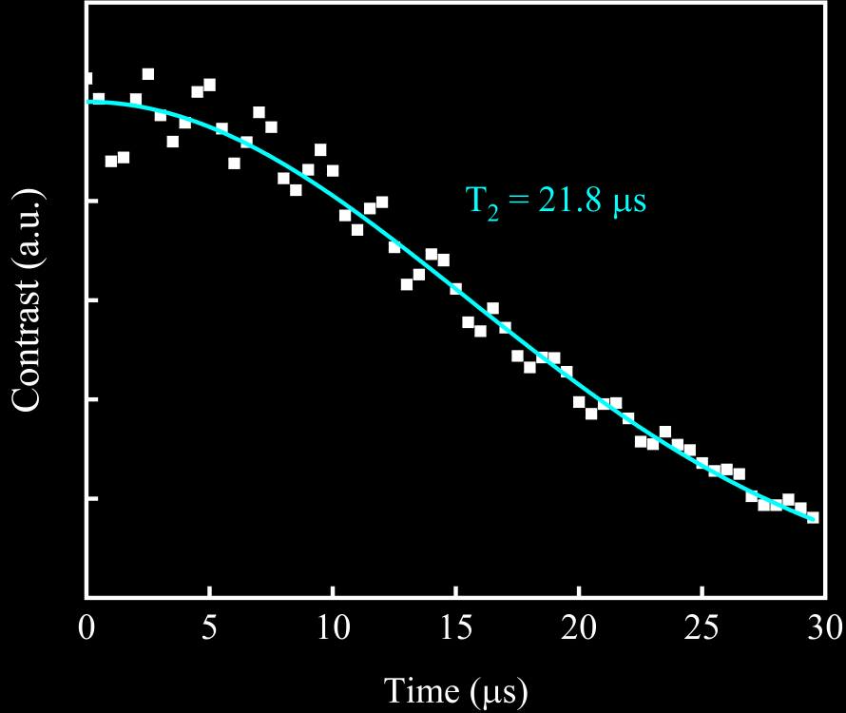
Experiment based on Ensemble NV
Home built diamond sensor
We developed a 23 μm thick ¹²C,¹⁴N-enriched layer on an electronic-grade diamond as our layer sensor.
NV concentration layer sensor：14 ppm
Exhibit excellent coherence properties.
Notes:
23 μm ¹²C ,¹⁴N enriched layer on an electronic-grade diamond

Slide 23
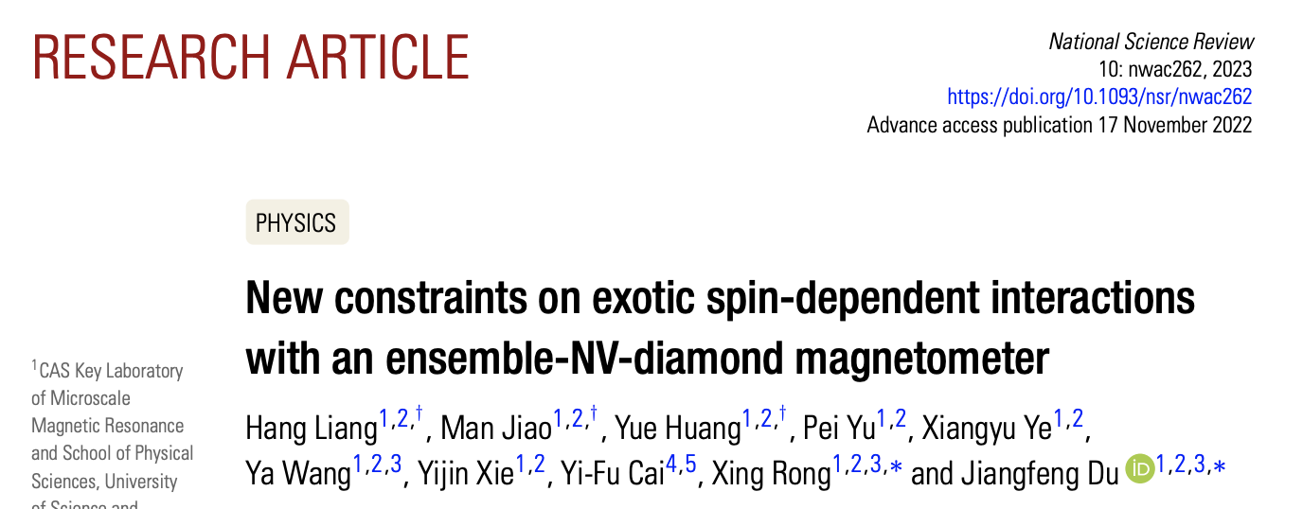
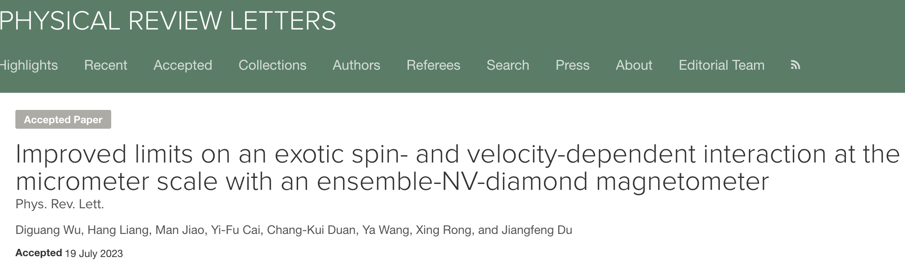
Searching for exotic spin interactions by ensemble-NV-diamond magnetometer
  H, Liang, NSR 2022, D. Wu et al., PRL 131, 071801 (2023)

Slide 24
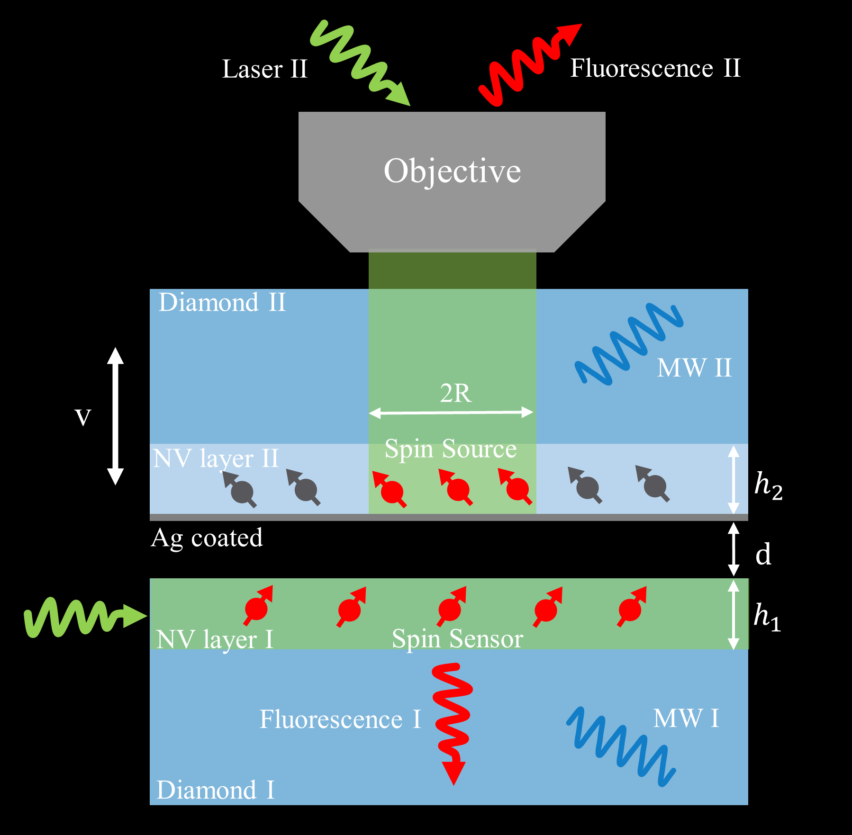
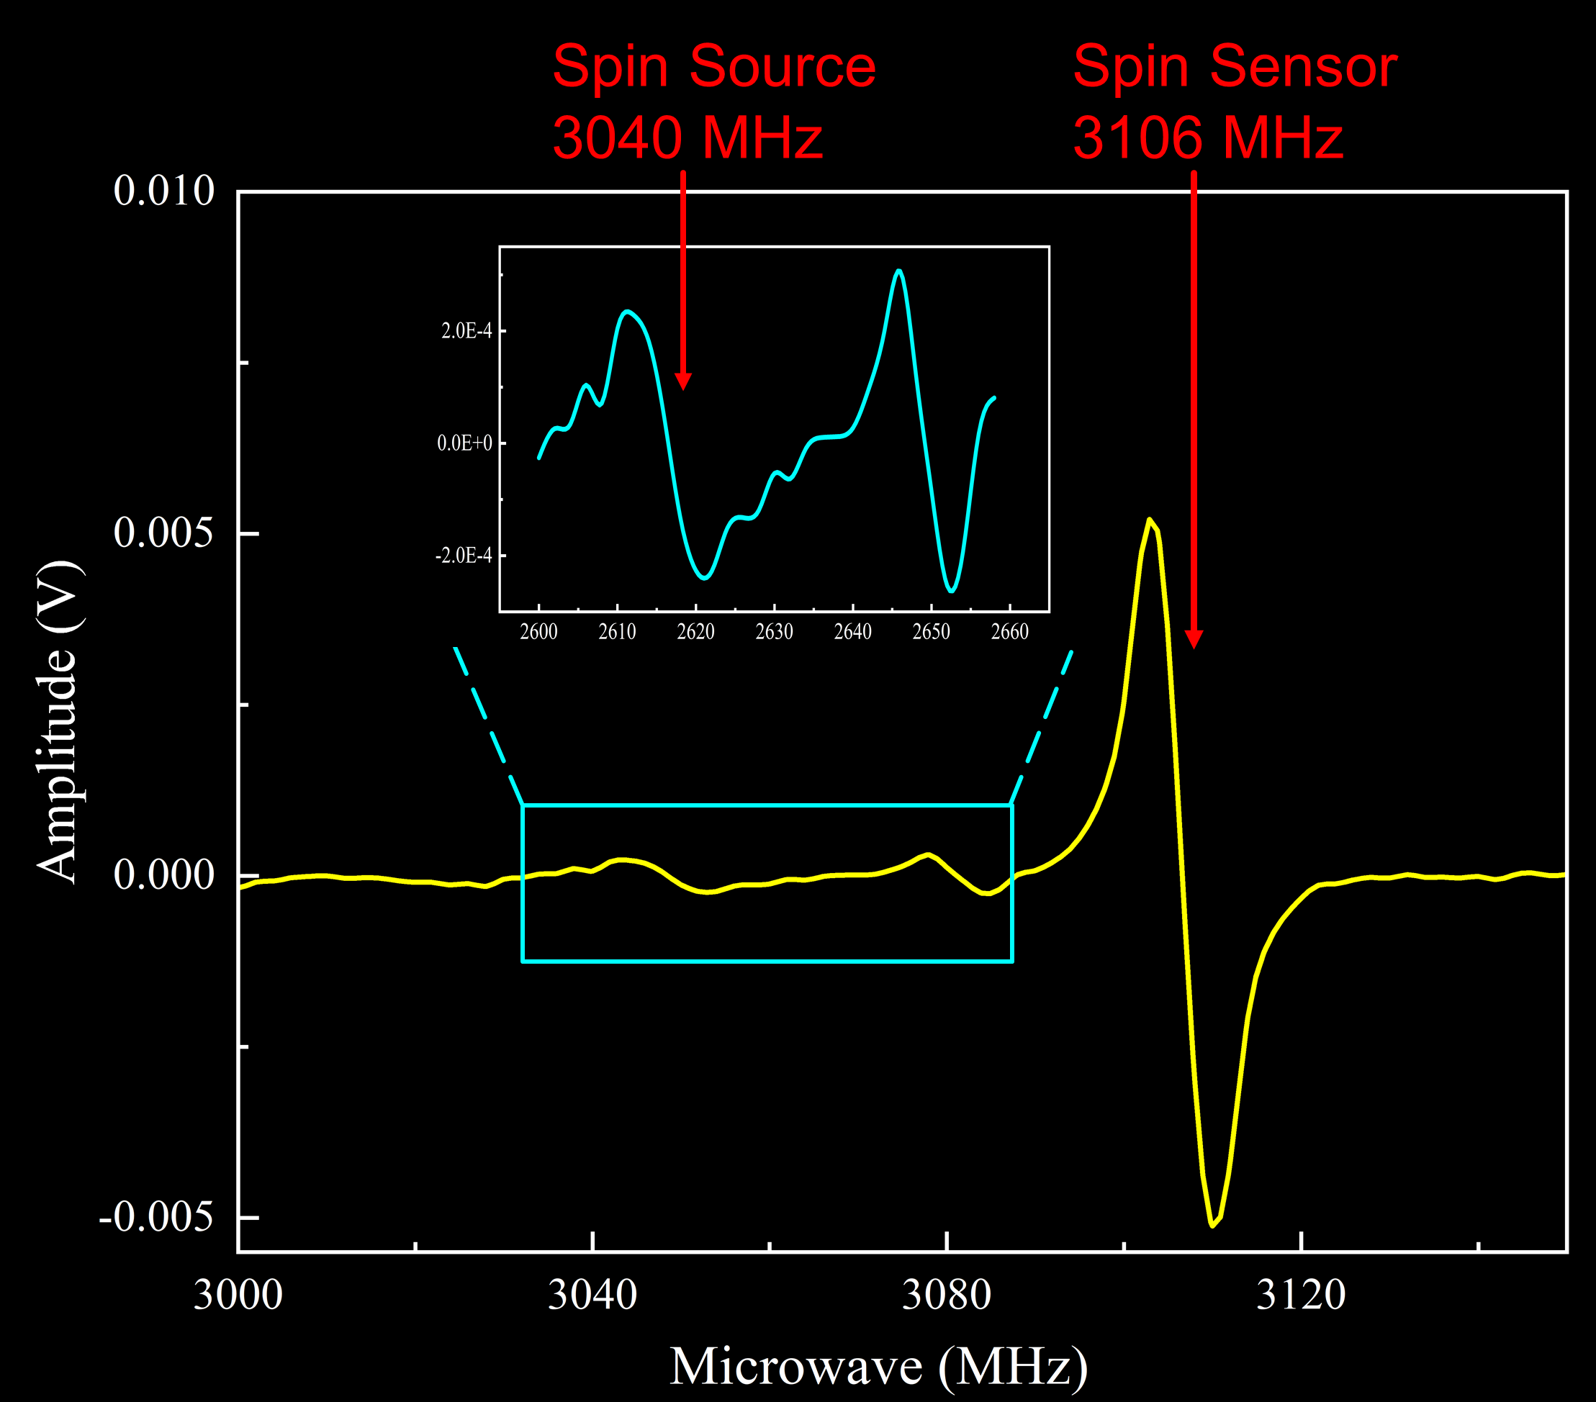
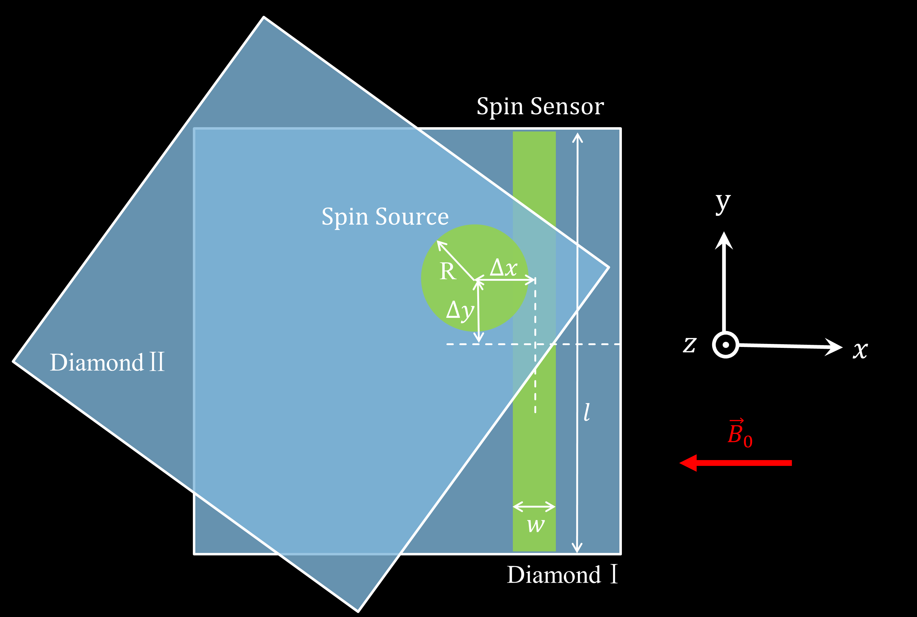
Experiment scheme of searching for
The exotic Velocity-dependent interaction
A 94 G static magnetic field B₀ was applied along the NV symmetry axis of the spin sensor to separate |m_{s} = ±1⟩ spin states
$$V_{6}=−f_{6}\frac{ℏ^{2}}{4πm_{e}c}\left[\left({\hat{σ}}_{1}∙\vec{v}\right)\left({\hat{σ}}_{2}∙\vec{r}\right)+\left({\hat{σ}}_{1}∙\vec{r}\right)\left({\hat{σ}}_{2}∙\vec{v}\right)\right]\left(\frac{1}{λr}+\frac{1}{r^{2}}\right)e^{−r/λ}$$
v
Two thin layers of nitrogen-vacancy (NV) ensembles in two individual diamonds are implemented as the spin sensor and the spin source, and are initialized by 532 nm laser from the side and top, respectively.
We independently manipulate the spin states of the spin sensor and the spin source by applying microwaves of two distinct frequencies.
Notes:
The ensemble resonance line shape is broadened by both the distribution of linecenters (left) and the distribution of linewidths (right) of the constituentspins.

Slide 25
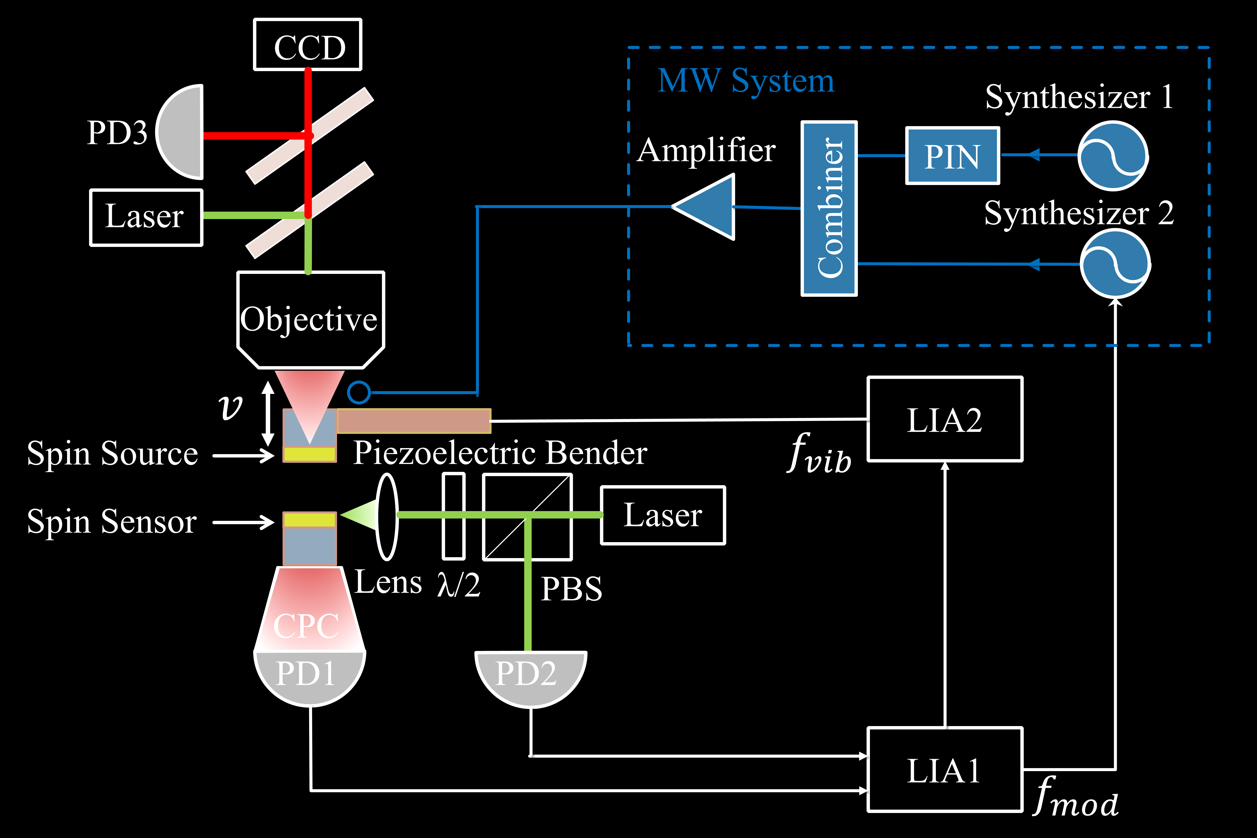
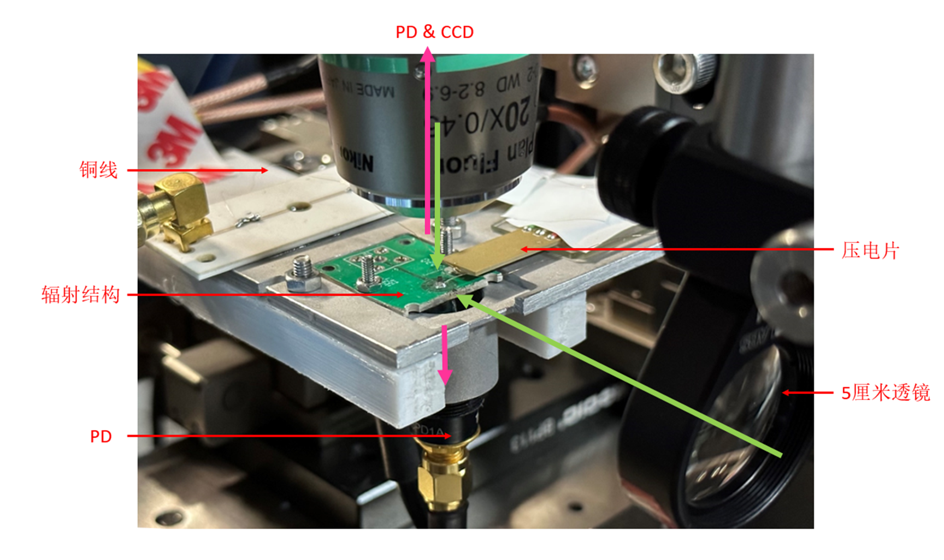

Experiment Setup based on Ensemble-NV-diamonds
Photo of part of the setup
NV Ensemble Magnetometer
Schematic of the experimental configuration
Notes:
23 μm ¹²C ,¹⁴N enriched layer on an electronic-grade diamond

Slide 26
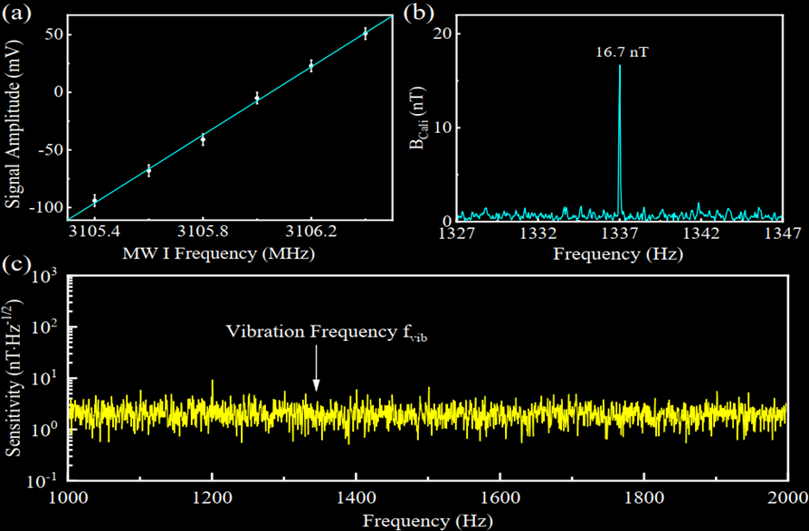
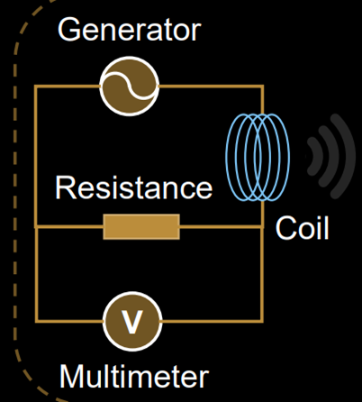
Performance of NV ensemble magnetometer
Coefficient of the magnetic field to the output of the magnetometer was determined by the max slope of the CW spectrum.
The magnetic measurement capacity was demonstrated using a calibration signal generated by a coil.
Sensitivity：2 nT/Hz^{1/2} from 1 to 2 kHz

Slide 27
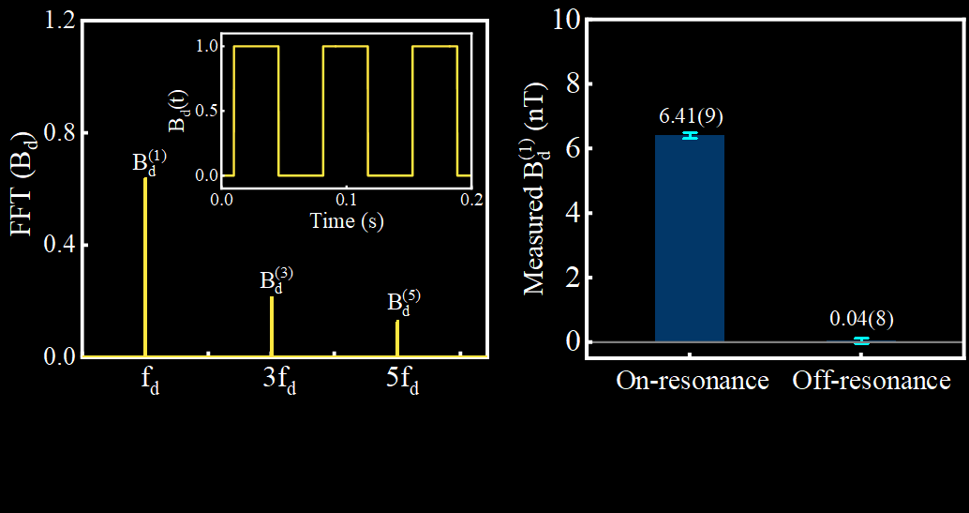
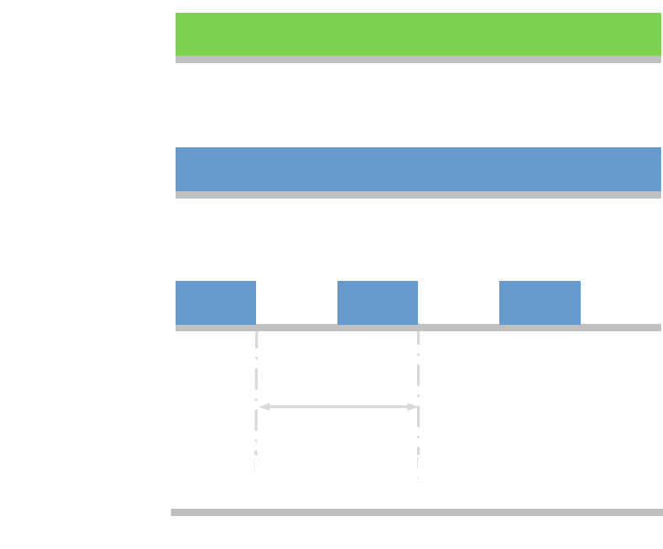

Measurement of the polarized spin density
First, the polarized spin density of spin source is obtained by measuring the magnetic dipole-dipole interaction between the two NV ensembles.
$$B_{d}=−\frac{μ_{0}γℏ}{8π}\frac{1}{V_{I}}ρ_{pol}\int_{V_{I}}{dV}\int_{V_{II}}{ dV^{′}}\frac{3\left({\hat{σ}}_{1}∙\vec{r}\right)\left({\hat{σ}}_{2}∙\vec{r}\right)\text{− }{\hat{σ}}_{1}∙{\hat{σ}}_{2}}{r^{3}}=\sum_{n=odd}^{∞}{B_{d}^{(n)}sin⁡(2πnf_{d})}$$
$$ρ_{pol}=1.14\left(2\right)×{10}^{23} m^{−3}$$
$$ρ_{pol}=0.01\left(2\right)×{10}^{23} m^{−3}$$
The polarization of the spin source was modulated by periodically switching MW II via a microwave switch with $f_{d}=14 Hz$
The polarized spin density $ρ_{pol}=1.14(2)×{10}^{23} m^{−3}$ when MW II was on-resonance.

Slide 28
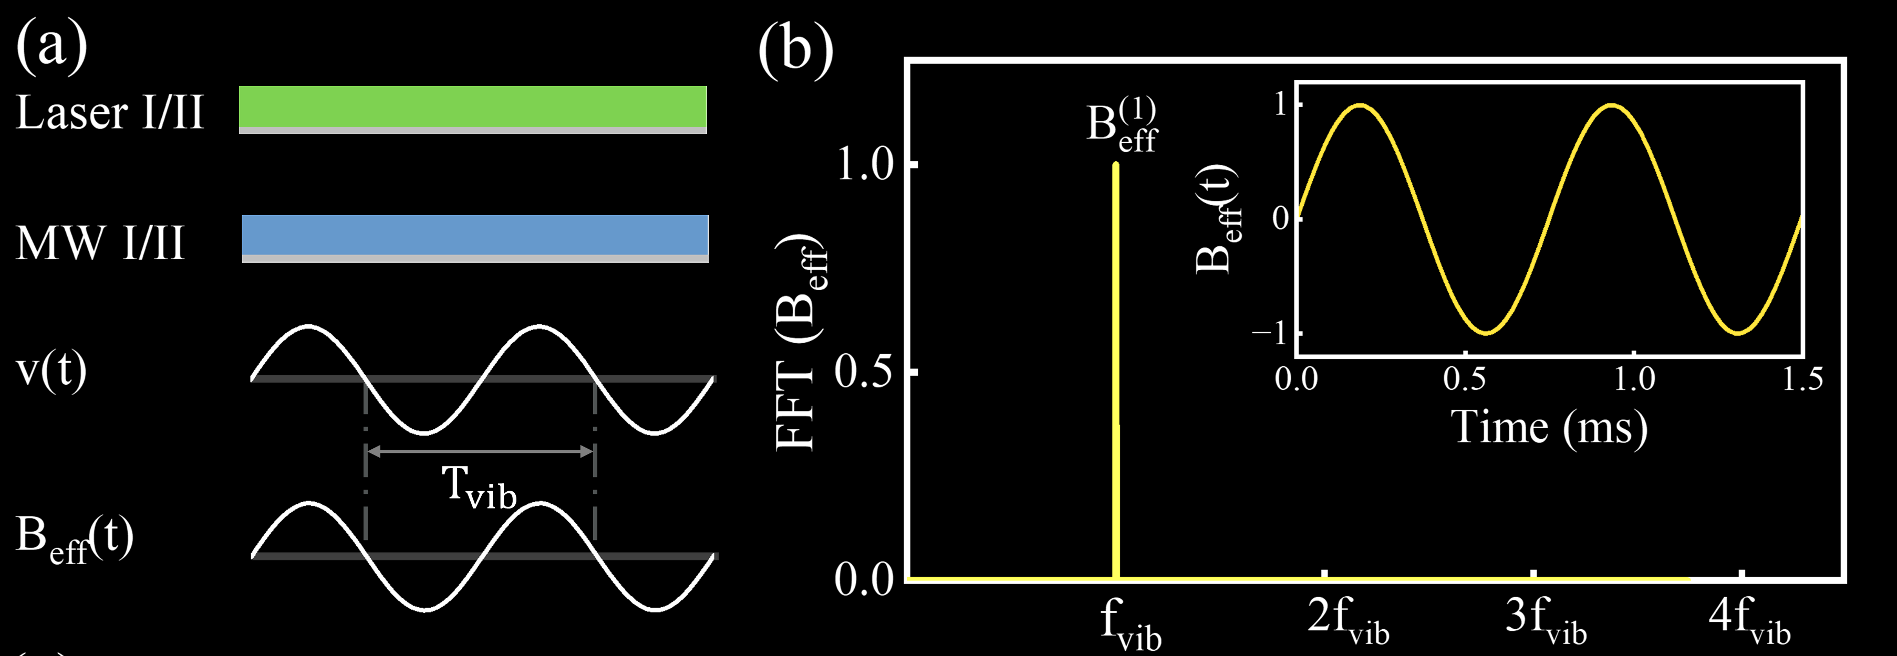

Experimental searching for
The Velocity-dependent interaction
The spin source was modulated by a piezoelectric bender to vibrate with a frequency $f_{vib}$= 1.337 kHz.
exotic velocity-dependent signal in-phase channel
other displacement-dependent signals quadrature channel

Slide 29
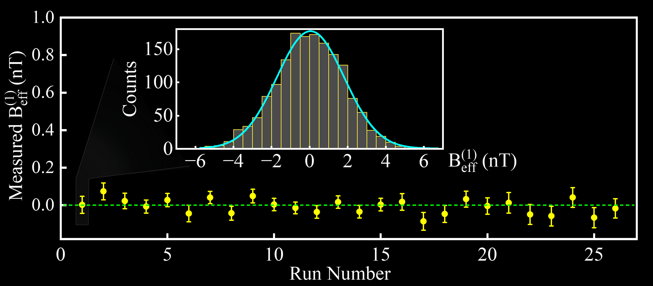
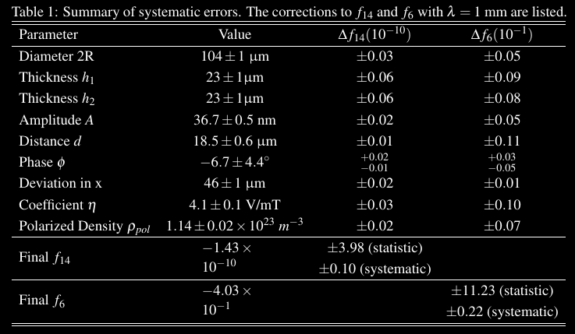

Statistical errors and systematic errors
With 26-hour data, the first order amplitude of effective magnetic field $B_{eff}^{(1)}=\left(−2.8±7.8\right)$pT with the reduced chi-square $χ^{2}=0.82$.
For λ=1 mm, $f_{14}=\left(−1.43±{3.98}_{stat}±{0.10}_{sys}\right)×{10}^{−10}$.
The statistical errors can be further reduced by improving the stability of our system and realizing longer measurement.
The systematic errors mainly come from the uncertainties of geometric parameters of the spin source.

Slide 30
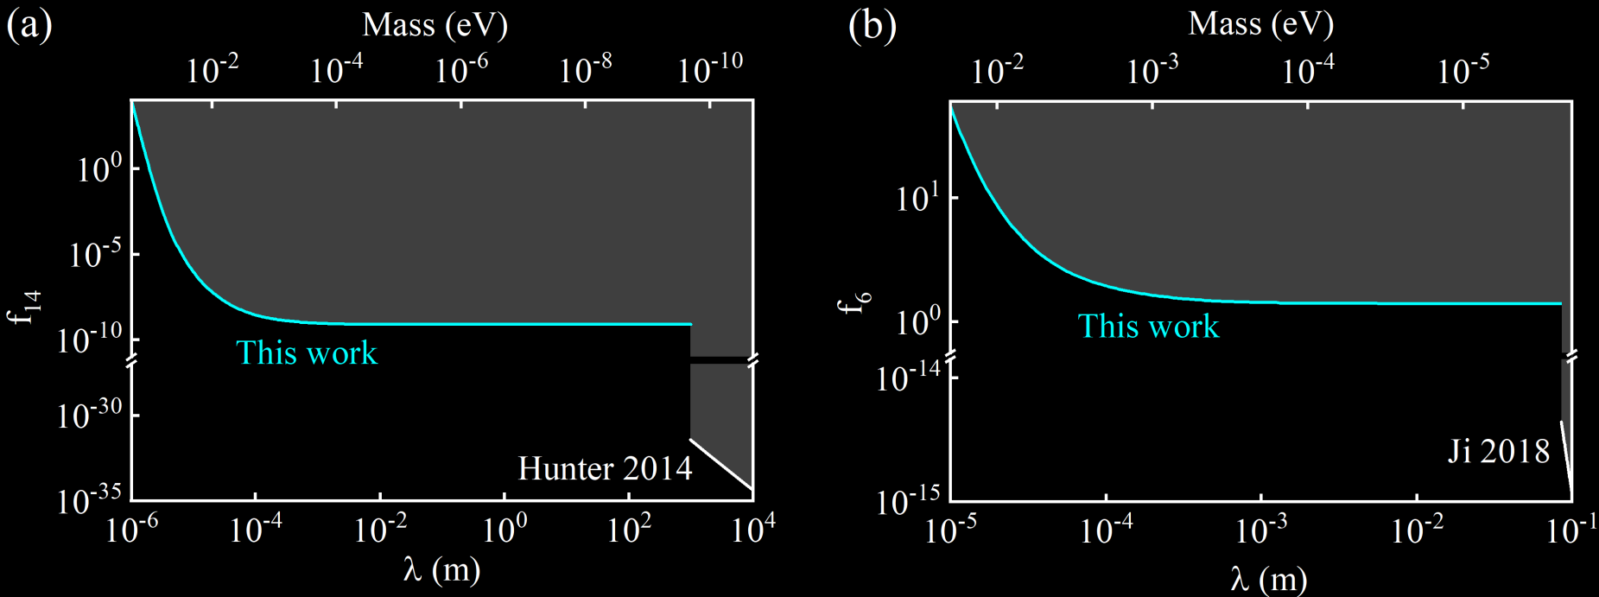
New constraints on ${\text{V}}_{14}$and${\text{V}}_{6}$
V₁₄: new constraints for the force range $λ<1$km
V₆: new constraints for the force range $λ<1$cm
Manuscript preparing

Slide 31
SUMMARY
NV center is a powerful platform for investigating exotic spin dependent interactions.
In the future, other types of spin source can be incorporated to investigate new physics with NV center in diamond.

Slide 32






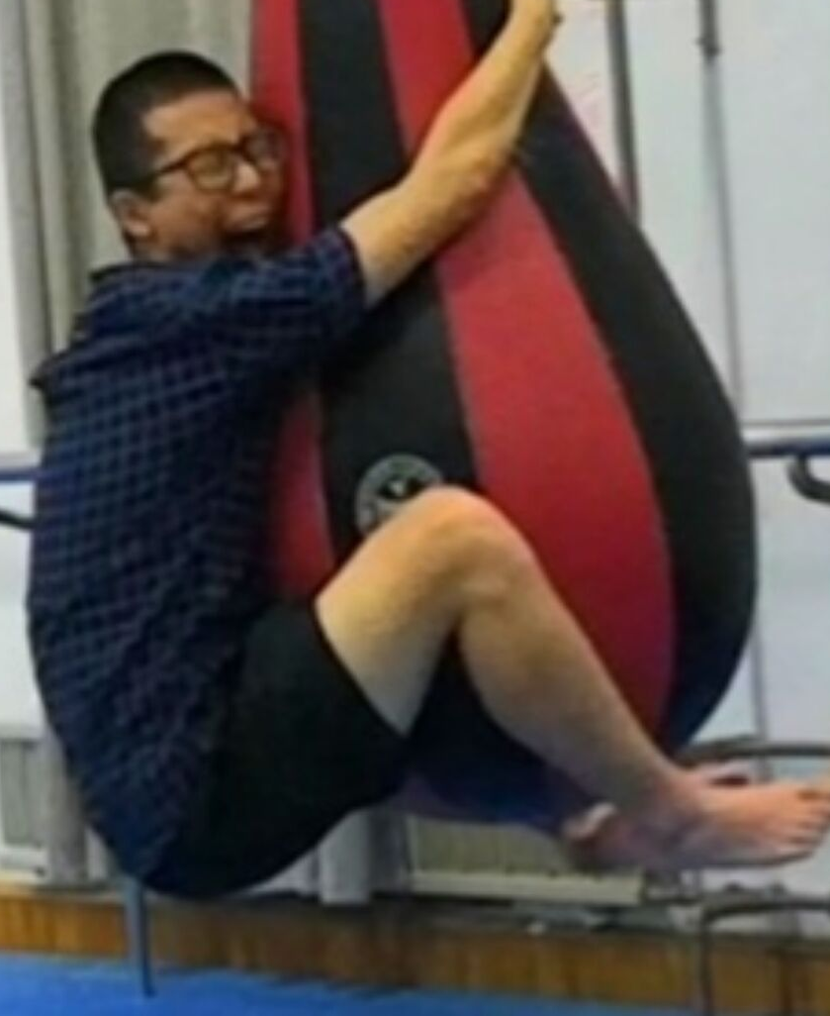
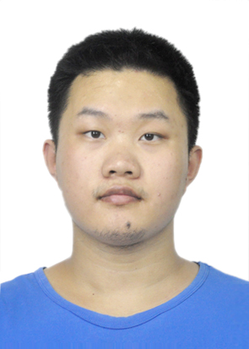

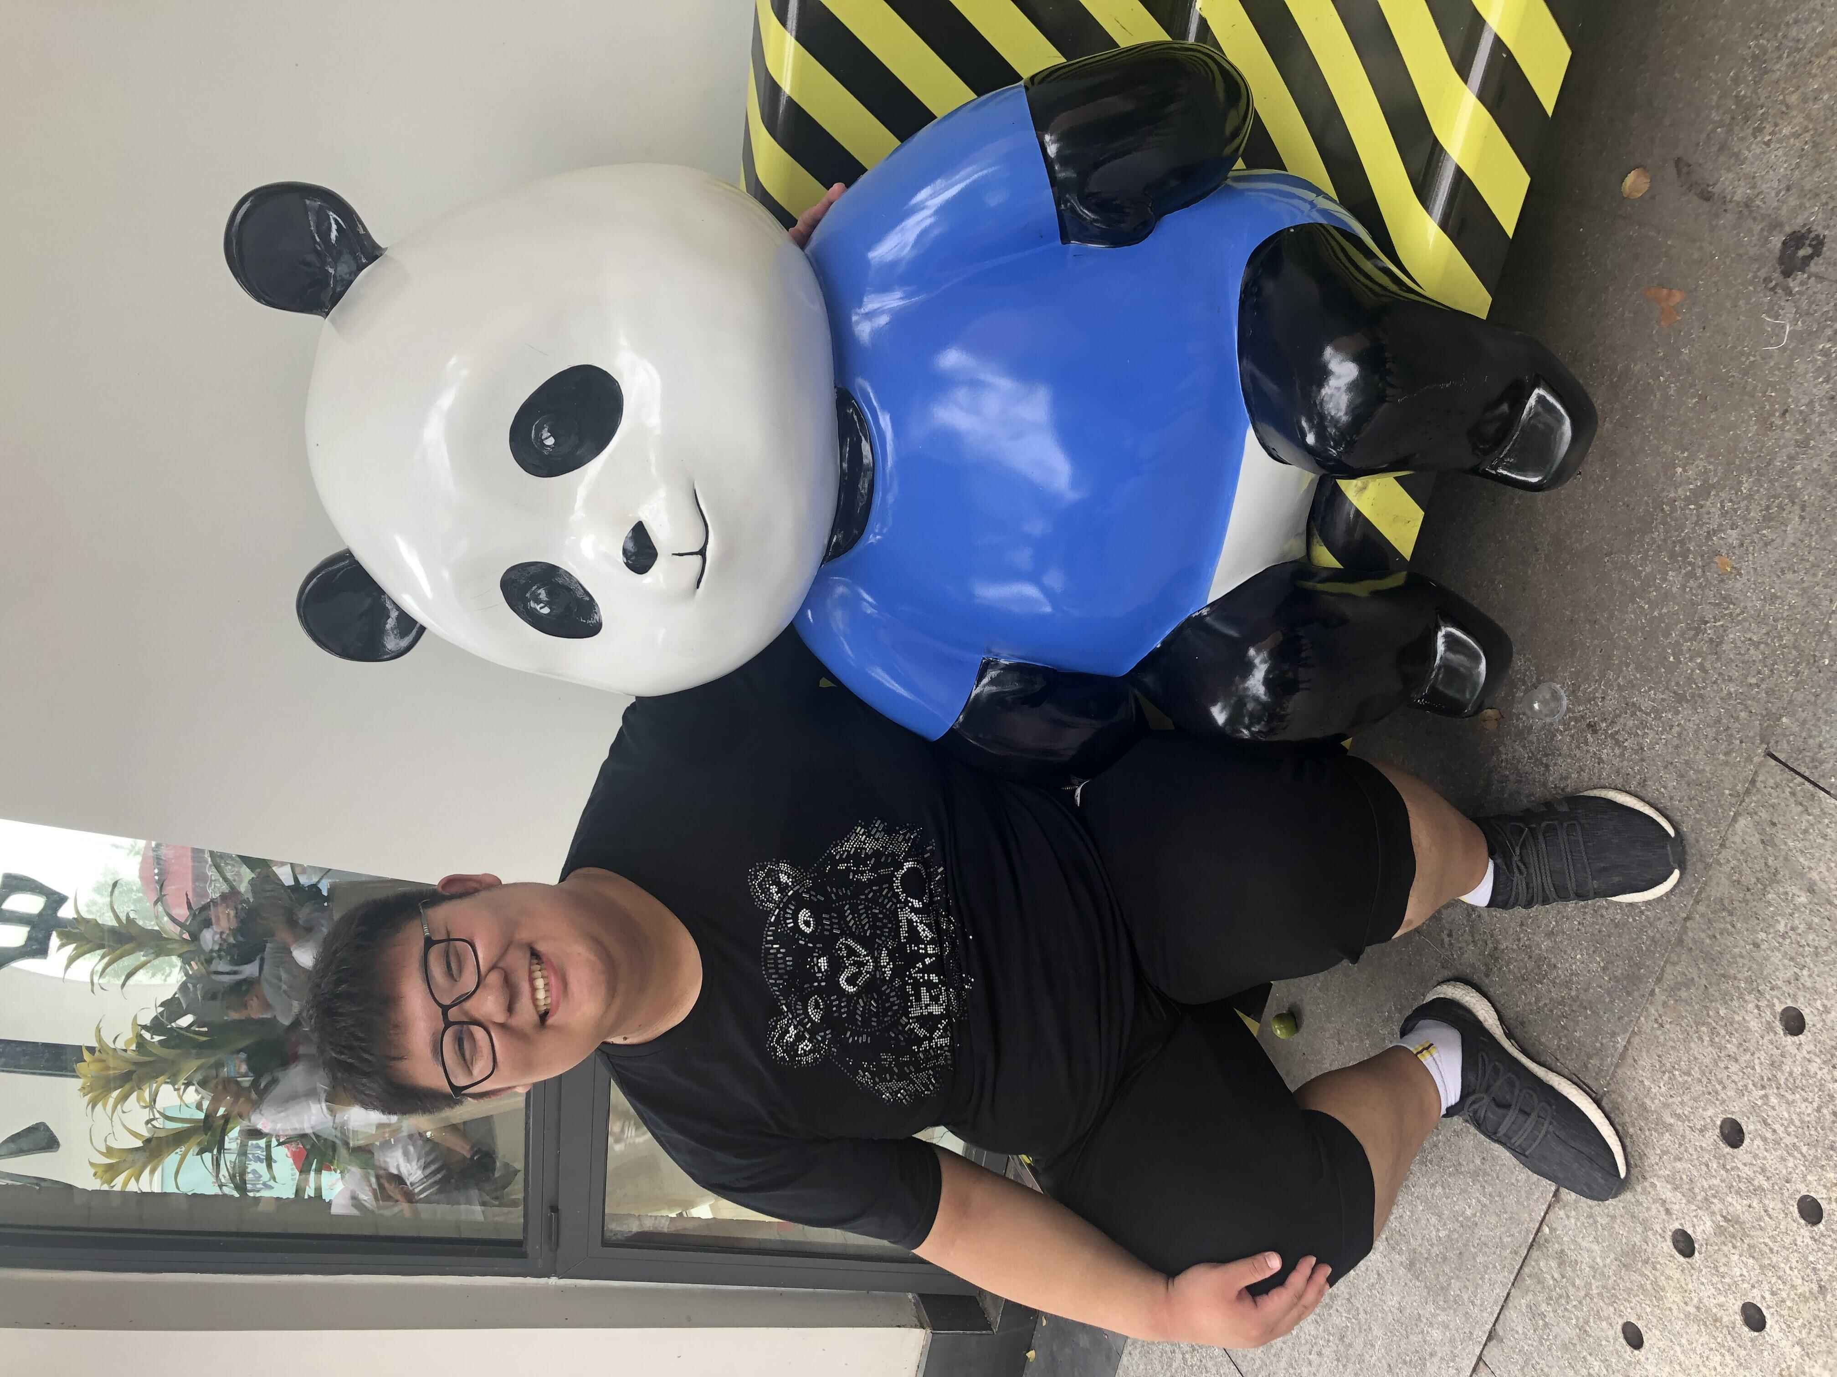
ACNOWLEDGEMENTS
Jiangfeng Du
Yi-Fu Cai
Ya Wang
Man Jiao
Runqi Kang
Hang Liang
Diguang Wu
Yue Huang

