Slide 1
A Stationary Mössbauer Scheme for Gravitational Wave detection
高宇 (Yu Gao)
高能物理研究所(IHEP)
A conceptual experiment presented
in 2310.06607. In collaboration with
张华桥、徐伟
MEPA2023
合肥, 2023/10/20

Slide 2
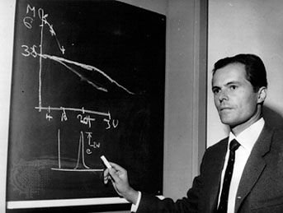

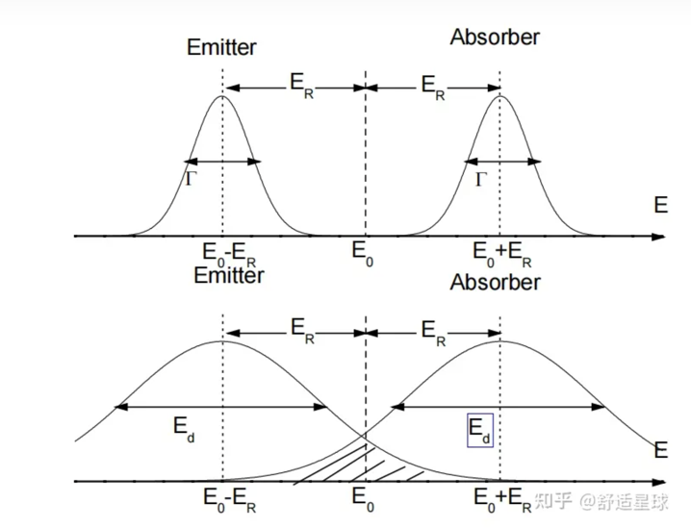
Mössbauer effect
1961
Recoil-less emission and resonant
absorption of nuclear transition photons.
W/O phonon excitations, the recoil is extremely small (against the entire lattice + other shifts)
Resonance is sensitive to a tiny photon energy variation.
Frequency peaks with recoil-less (natural) width
Γ are separated by suppressed shifts (collective
recoils, Doppler shifts, energy level differences)
E_{R}. The separation 2*E_{R} is compensated for by
a manually introduced shift to achieve resonance.
E_{γ} Sensitivity:
⁵⁷Fe
⁶⁵Zn
¹⁰⁹Ag
~ 10⁻¹³
~ 10⁻¹⁵
~ 10⁻²²
(mostly used)
+ many others.

Slide 3
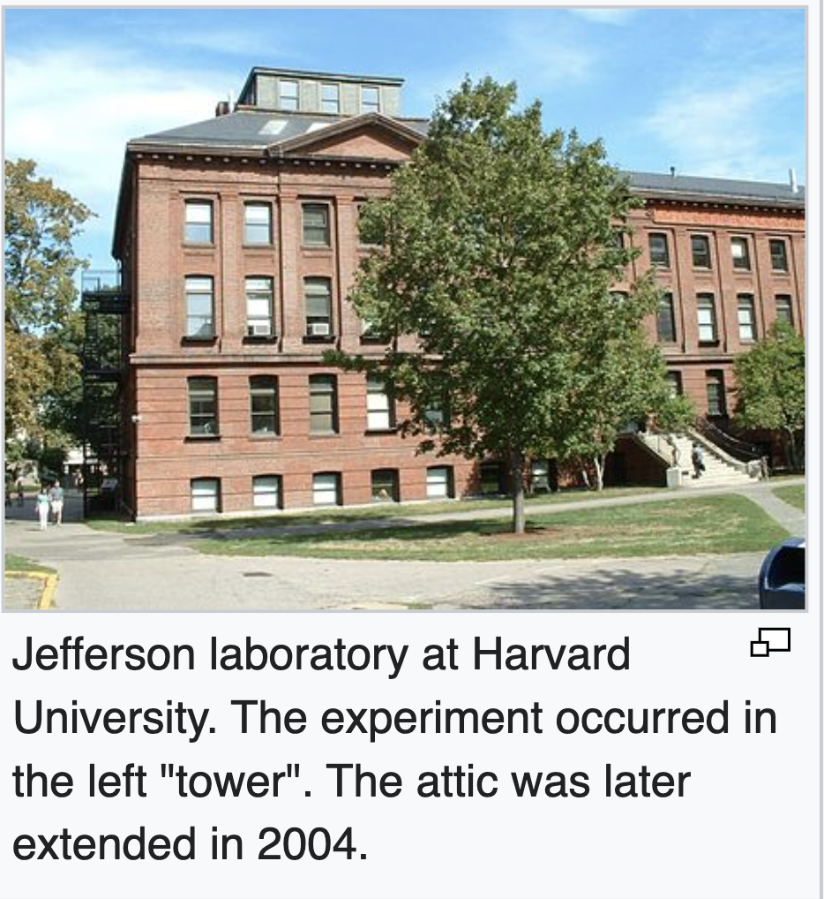
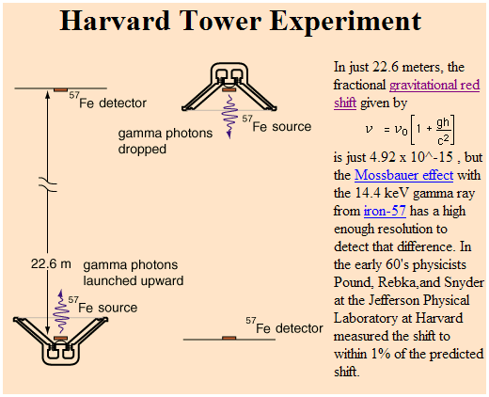

An early role in relativity test
Mossbauer effect can sense the gravitational redshift.
Also see: frequency shift due to acceleration
H.J. Hay, J. P. Schiffer, T. E. Cranshaw, and P. A. Egelstaff,
(Atomic Energy Research Establishment,1960)
Pound, Rebka & Snyder (1960-1965)
Observation of a height-induced
$2ghc^{−2}\sim 4.905×{10}^{−15}$ frequency shift

Slide 4
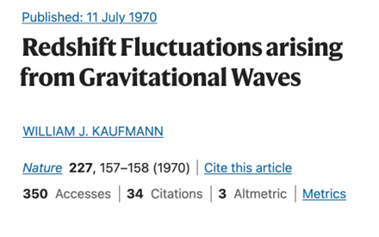
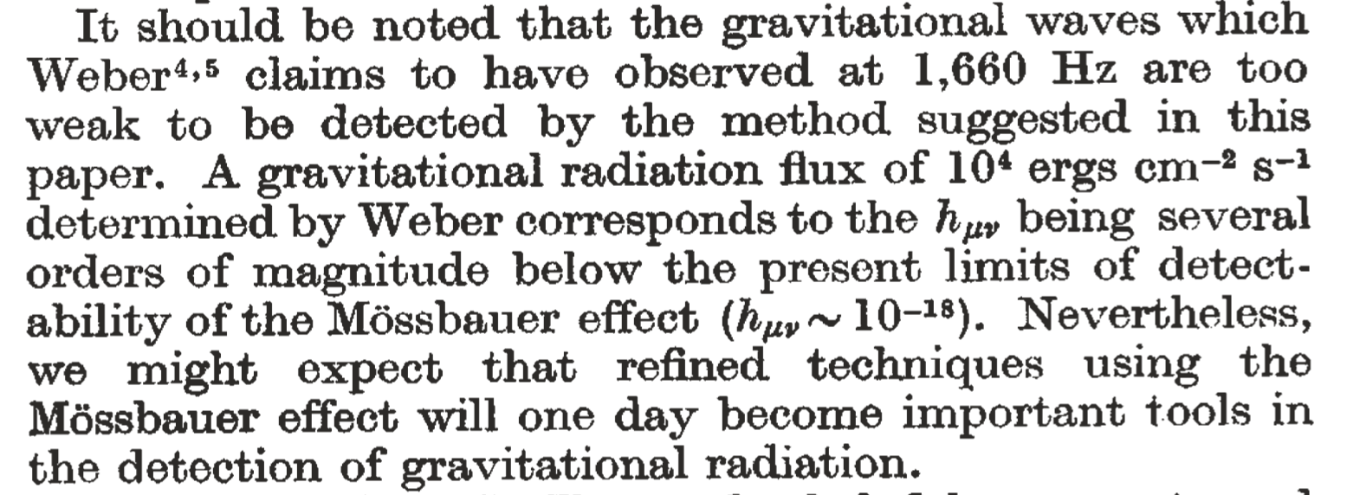
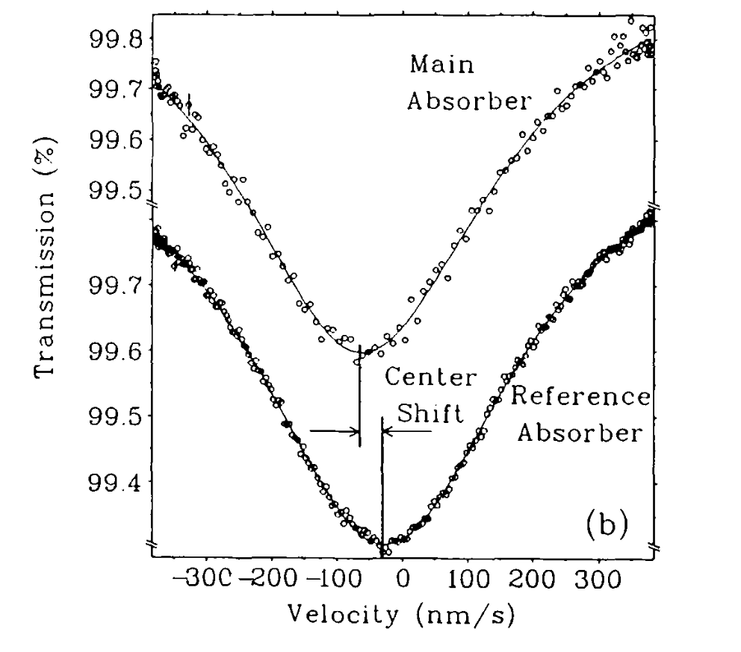
Mössbauer for GW?
Many have thought about it, no doubt…
Photon frequency varies when it propagates
in an un-even space-time background.
Mössbauer gave way to clock-based experi-
ments in later tests of gravity.
Issues with line-shifts.
See K. Hentschel,
Annals of Science 53,
269–295 (1996)
A cryogenic ⁶⁵Zn measure-
ment of the local g-value
(Potzel et.al. 1992)
Differential measurement
of the resonance with a
sinusoidal oscillator
* resonance is achieved
* g-value is off, possibilly
due to various line-shifts.
Can improve with
a stationary scheme
“such solid-state effects might be difficult … …
there might exist two exceptions. The first are null redshift experiments,
in particular measurements with stationary source and absorber”.

Slide 5
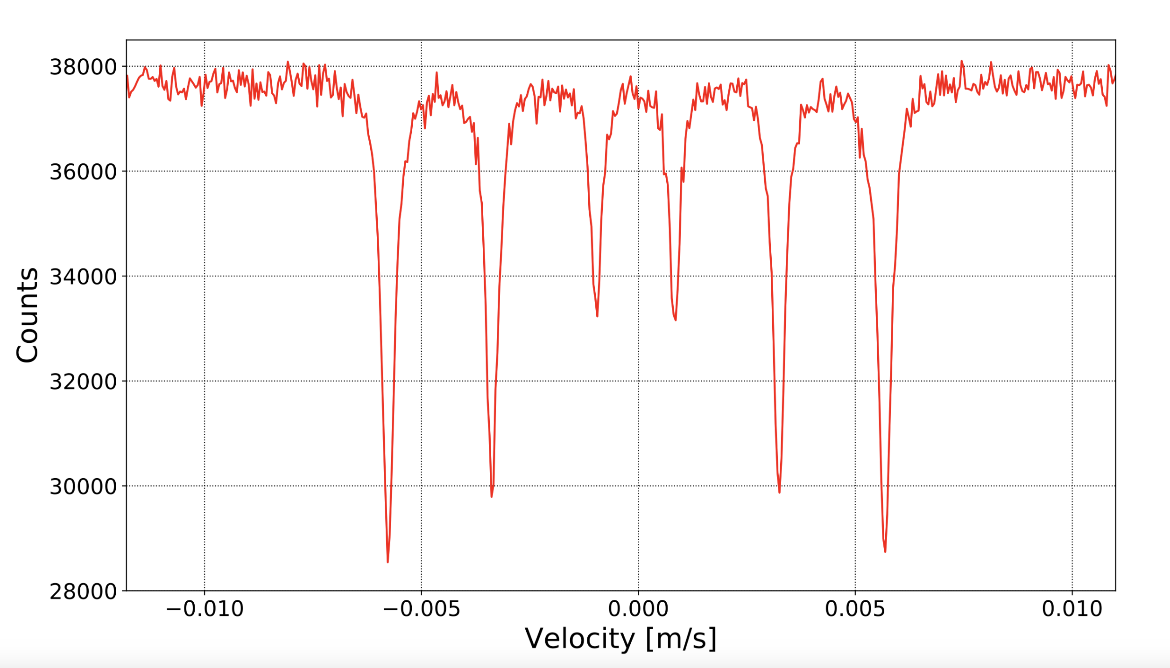

A stationary measurement?
Improve on vibration-induced uncertainties. √
Replace Doppler shift with gravitational shift. √
GW: time-variance of resonance’s height-shift instead of absolute height $→$ avoid uncontrolled energy level uncertainties.
Photon
counters
¼ cut view
Z
Energy loss E_{R} is compensated by a slight height difference between absorber and source:
can be calibrated in advance.
--- the absolute height of resonance (Z₀) is affected by
large systematics: 2nd Doppler,
chemical composition, etc.
--- but its time-dependent shift under GW is not affected.
h
horizontal→
distance (d)
Resonance peak(s)
0
x
Radioactive source
(intensity R_{S})
-h
absorption layer

Slide 6
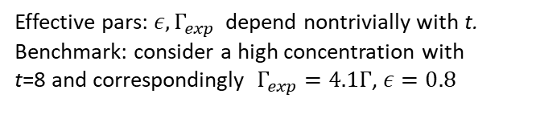



Stationary detectors’ resonance
The recoil-free absorption peak spectrum. $f_{S}$:
Natural width $Γ\sim$ ${lifetime}^{−1}$
The photon count spectrum
(behind an absorption layer)
Intrinsic transition energy
Arrival energy (with shift)
Expansion in the
thin layer limit
($t→0$)
Height-induced
energy shift replaces
the Doppler shift
Effective pars: $ε,Γ_{exp}$ depend nontrivially with t.
Benchmark: consider a high concentration with
t=8 and correspondingly $Γ_{exp}=4.1Γ$, $ε=0.8$

Slide 7
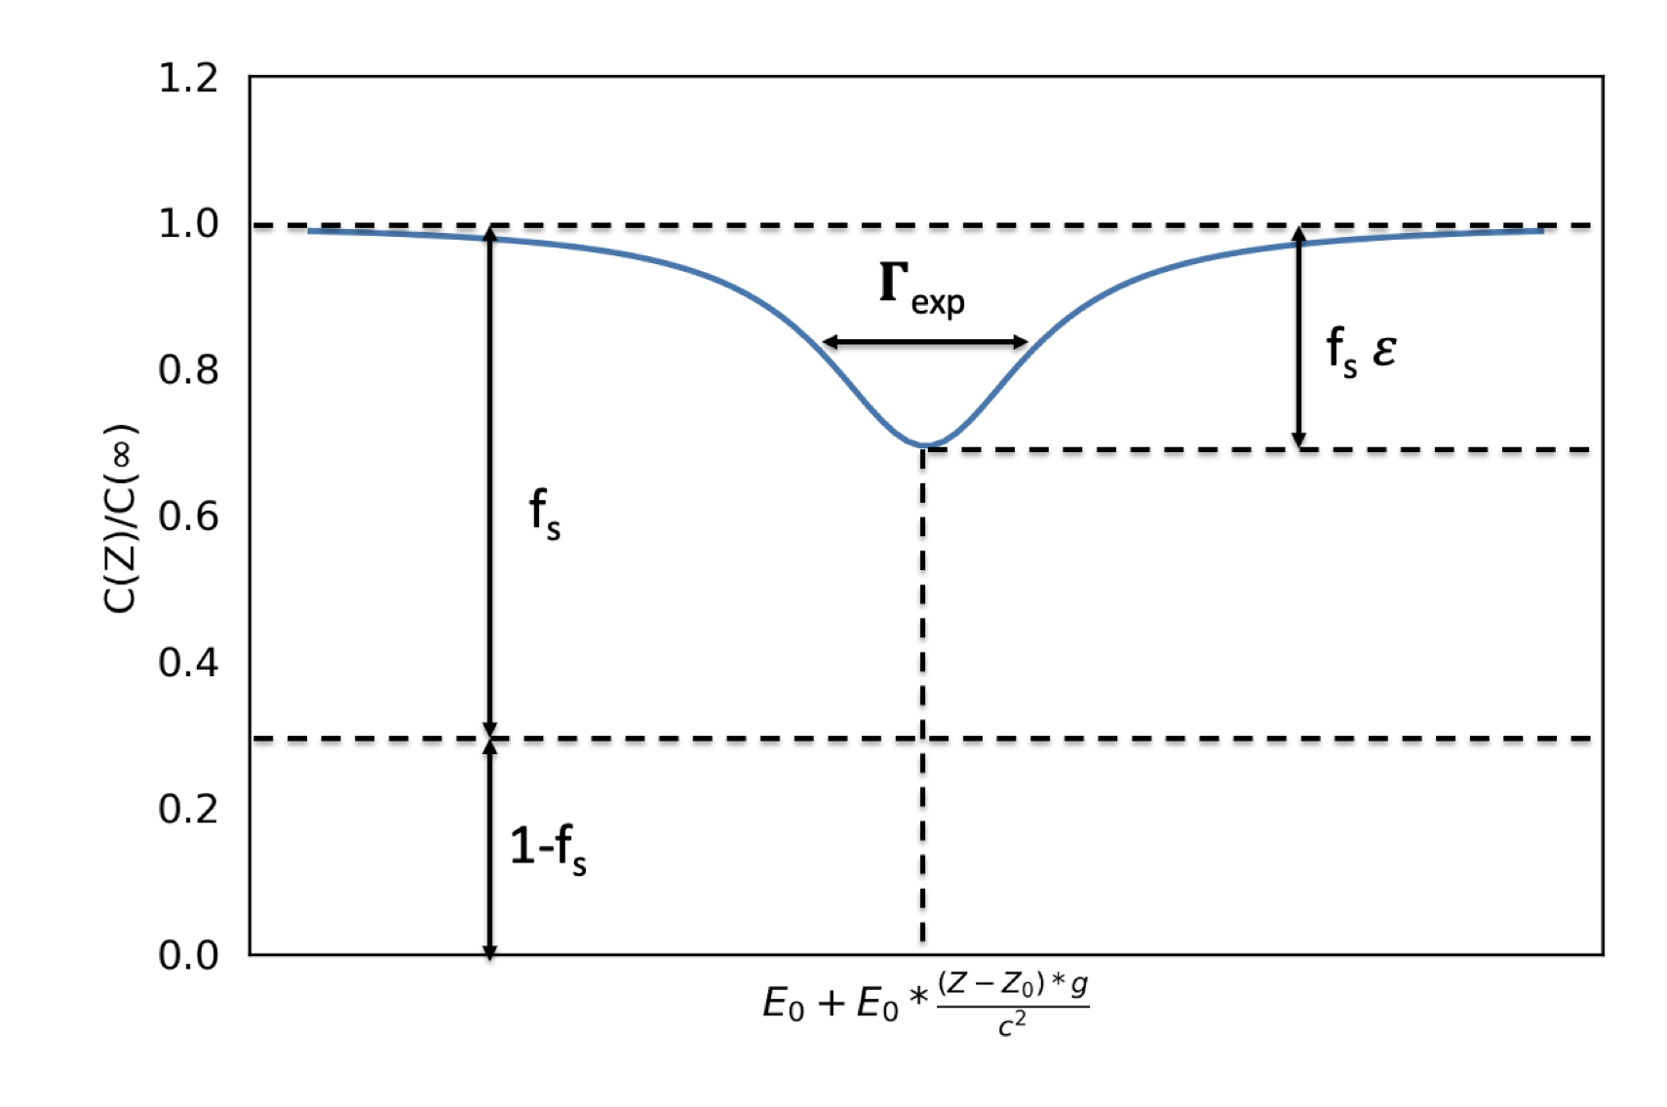
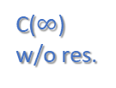
The resonance line-shape (in terms of absorber height Z)
C($∞$)
w/o res.
Flux reduction due to
res. absorption
Recoil-free
photons
( parameters
exaggerated
for illustration )
w recoil
with extra shift/perturbation:

Slide 8
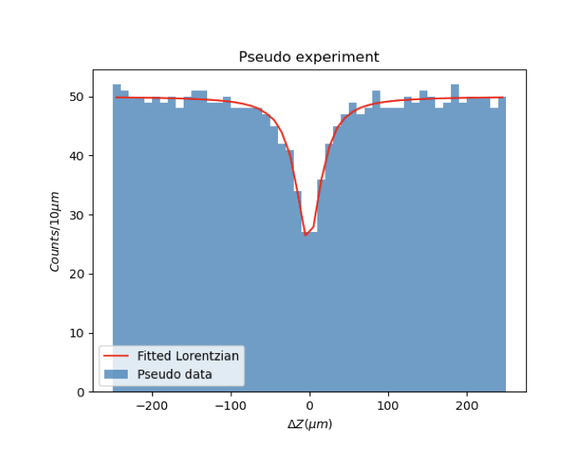

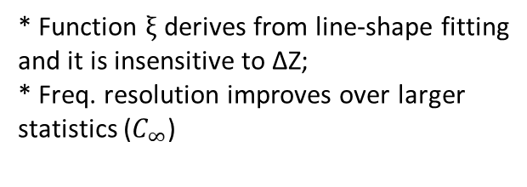

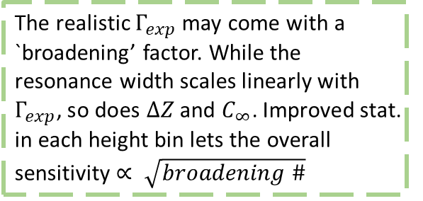
Choose height binwidth that matches $Γ_{exp}$ :
Silver alloy/compound with higher T_{deBye} helps improve f_{S}
e.g. AgB₂ has a higher T_{deBye} and f_{S} =0.2 (@ 4K)
Spatially resolved: $δf/f∝\sqrt{Γ_{exp}}$
Spatial resolution of peak relates to freq. shift:
The realistic $Γ_{exp}$ may come with a `broadening’ factor. While the resonance width scales linearly with $Γ_{exp}$, so does $∆Z$ and $C_{∞}$. Improved stat. in each height bin lets the overall sensitivity $∝ \sqrt{broadening \#}$
* Function $ξ$ derives from line-shape fitting
and it is insensitive to ΔZ;
* Freq. resolution improves over larger
statistics ($C_{∞}$)

Slide 9
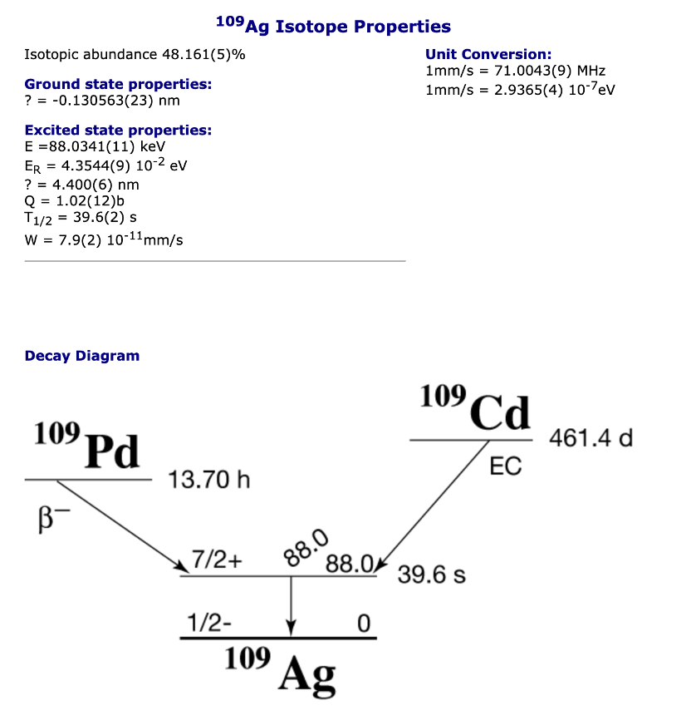
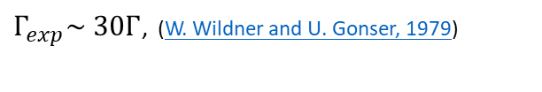
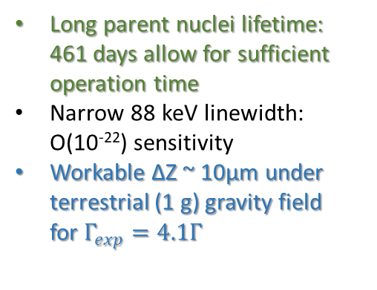
Isotope of choice: ¹⁰⁹Ag
Long parent nuclei lifetime:
461 days allow for sufficient operation time
Narrow 88 keV linewidth:
O(10⁻²²) sensitivity
Workable ΔZ ~ 10μm under terrestrial (1 g) gravity field
for $Γ_{exp}=4.1Γ$
R&D with high-z detectors
The quest of the ¹⁰⁹Ag resonance:
$Γ_{exp}\sim 30Γ$, (W. Wildner and U. Gonser, 1979)
Improved resonance resolution, w
broadening factors down to 16 (US)
R. D. Taylor and G. R. Hoy, SPIE 875, 126 (1988).
S.RezaieSerej, G. R. Hoy, and R. D. Taylor, Laser Phys. 5, 240 (1995).
Russian group: improvements with Grav. Effects
V. G. Alpatov, et.al. Laser Physics 17, 1067–1072 (2007).
Yu. D. Bayukov, et.al. JETP Letters 90, 499–503 (2009).
Mössbauer database (DICP, CAS)

Slide 10
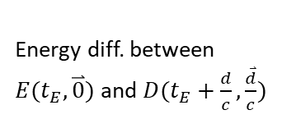
The GW signal: frequency shift
Consider a plain-wave strain perturbation
$$h\left(x,t\right)=h_{0} e^{i(ωt−k∙x)}$$
$$ds^{2}=c^{2}dt^{2}−\left[1+h\right]dx^{2}−\left[1−h\right]dy^{2}−dz^{2}$$
A particle’s 4-momentum response to GW strain
after one-way propagation:
Estabrook and Wahlquist, Gen. Relat.
Gravit. 6, 439–447 (1975);
Hellings, Phys. Rev. D 23, 832–843 (1981).
(figure from Hellings paper)
Energy diff. between
$E(t_{E},\overset{⃑}{0})$ and $D(t_{E}+\frac{d}{c},\frac{\overset{⃑}{d}}{c})$

Slide 11
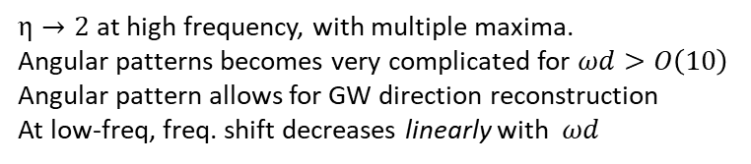
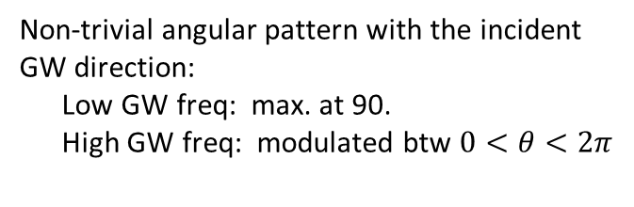

When the baseline distance approaches
to the GW’s wavelength scale, a particle
starts to see the strain difference.
Non-trivial angular pattern with the incident
GW direction:
Low GW freq: max. at 90.
High GW freq: modulated btw $0<θ<2π$
“blind directions”
Multiple directions can compensate for
others’ insensitive directions.
* Requires a perpen-
dicular h component.
* Extra complication w
baseline at high freq.
* Vanishes when (anti)
parallel to GW direction
Spin-2
$$ϕ_{pol}=0$$
Maximal shift with GW frequency:
$η→2$ at high frequency, with multiple maxima.
Angular patterns becomes very complicated for $ωd>O\left(10\right)$
Angular pattern allows for GW direction reconstruction
At low-freq, freq. shift decreases linearly with $ωd$
(optimal angle)

Slide 12
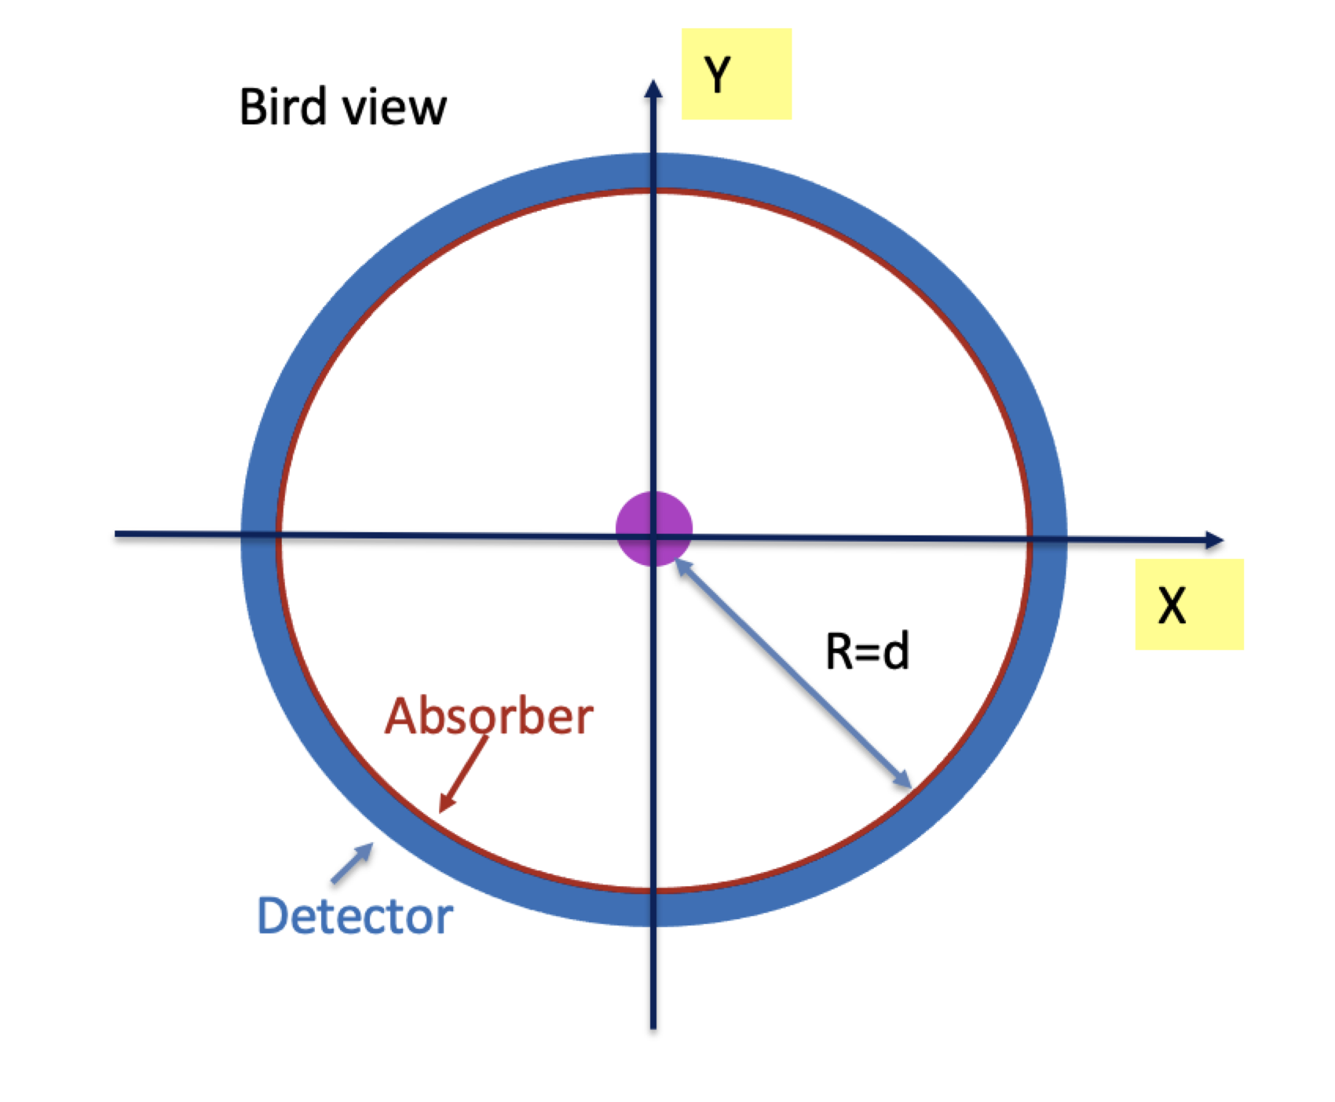
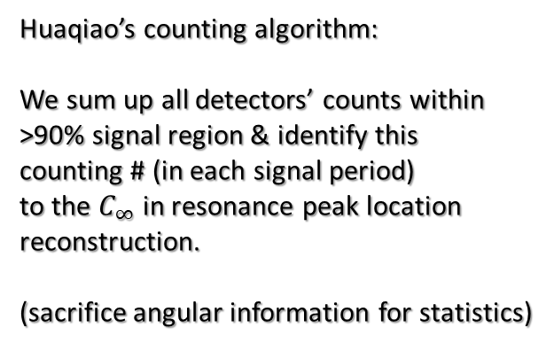
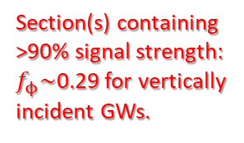
A circular layout
A ring of detectors in the horizontal plane covers
when GW comes at angle θ.
Guarantee (at least) two perpendicular directions
relative to any GW incident θ angle.
Huaqiao’s counting algorithm:
We sum up all detectors’ counts within
>90% signal region & identify this
counting # (in each signal period)
to the $C_{∞}$ in resonance peak location
reconstruction.
(sacrifice angular information for statistics)
f_{t}~0.3 for the time fraction of
>90% signal in each period.
Total angular fraction:
Section(s) containing
>90% signal strength:
$f_{ϕ}\sim$0.29 for vertically
incident GWs.
Circle stays horizontal:
for height compensation
of Mossbauer E_{R}.

Slide 13
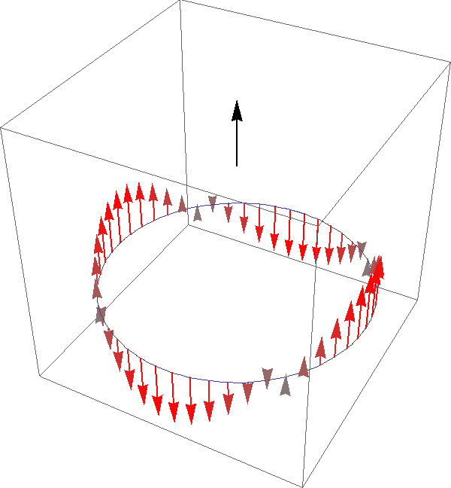
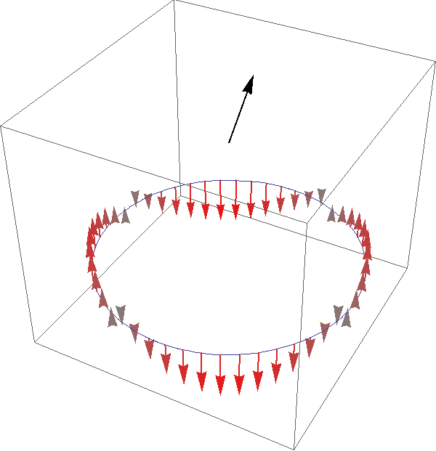


$${\overset{⃑}{k}}_{GW}⫽\hat{z}$$
$$θ=45°, ϕ_{pol}=30°$$

Slide 14
An estimate on the required source intensity:
(R_{S} for an isotropic source)
Benchmarks:
A: table-top experiment.
B: 10-meter radius in low-g
Beware: pars on the 2nd line
do not scale independently.
Source intensity scales
linearly with baseline length
and inversely with the local
gravitational acceleration.
Need to balance between
resonance shift length, detector
size, and practical sources.
Non-isotropic source / focusing
would immensely enhance efficiency.
Coherently repeated signals can
boost statistics: N₉₀ -> N₉₀*Q

Slide 15
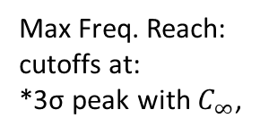
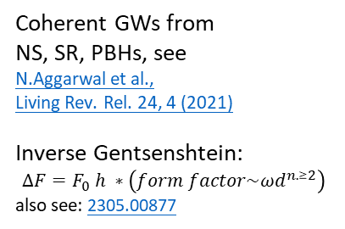

2310.06607
A, A’ & B:
single period
A^{C}:
10⁶ periods
10¹¹ Bq.,1m
10¹³ Bq., 5m
Max Freq. Reach:
cutoffs at:
*3σ peak with $C_{∞}$,
10¹¹ Bq. 1m
* $2πfd<O(10)$
10¹⁴ Bq., 10m
Coherent GWs from
NS, SR, PBHs, see
N.Aggarwal et al.,
Living Rev. Rel. 24, 4 (2021)
Inverse Gentsenshtein:
$$∆F=F_{0} h ∗\left(form factor\sim {ωd}^{n.≥2}\right)$$
also see: 2305.00877

Slide 16
Take-home message
2310.06607
A conceptual layout for a stationary Mössbauer measurement for GWs:
*Measure the spatial peak shift instead of peak width.
*A relatively small-scale setup (meter – 10 meter).
*¹⁰⁹Ag gives 10⁻²² sensitivity, has long lifetime.
*Encouraging forecast for f_{GW} > kHz, a multiband search alternative.
*Overall Sensitivity scales as sqrt of the effective Mössbauer width.
*Significant improvement in low-g, or any other way to enhance detectors’
angular coverage, e.g. beam focusing, Laue lens, etc.

