Slide 1
Theory overview on X17 (SM)
Xilin Zhang (张锡霖)
FRIB-TA fellow (visiting assistant professor)
zhangx@frib.msu.edu
20 Oct. 2023

Slide 2


Facility for Rare Isotope Beams (FRIB)
FRIB is a $730 million scientific user facility funded by the Department of Energy Office of Science (DOE-SC), Michigan State University, and the State of Michigan. It is the world’s premier center for rare isotope research, supporting the Office of Nuclear Physics mission in DOE-SC.
FRIB construction started in 2008 and completed ahead of schedule and on budget. The ribbon cutting was held in May 2022, and the first experiments began thereafter.
Rare isotopes are atomic nuclei composed of unusual combinations of protons and neutrons and do not naturally exist on Earth. They are produced in violent astrophysical events, and FRIB can now make them.
FRIB enables scientists to discover the properties of rare isotopes and the physics of atomic nuclei, understand the formation of elements in the Universe, test the fundamental interactions and symmetries of nature, and provide societal benefits in medicine, energy, industry, security, environment, and other applications.
2

Slide 3

Discovery Potential at FRIB
The science of FRIB:
Discover the properties of rare isotopes and the physics of atomic nuclei. Push the science frontiers and discover new phenomena.
Provide rare isotopes for societal benefits in medicine, energy, industry, security, environment, and other applications
Model astrophysical processes, interpret astronomical data, and understand the formation of elements in the Universe
Use isotopes that provide enhanced sensitivity to test the fundamental interactions and symmetries of nature
FRIB addresses important questions related to fundamental science and applications of atomic nuclei
3

Slide 4

Myself
I got my bachelor degree at USTC in 2004
Research interests (mostly in nuclear theory):
  Nuclear few-body and many-body systems
  Effective field theories
  Applications of Bayesian statistics
  Machine learning and model reduction methods
  Nuclear physics connected to the BSM physics search

Slide 5
Outline
Brief introduction of the Atomki anomalies
What are the nuclear theory predictions based on Standard Model (SM)?
A nuclear theory input for Beyond-SM (BSM) studies (is X17 a protophobic vector boson?)
Summary

Slide 6
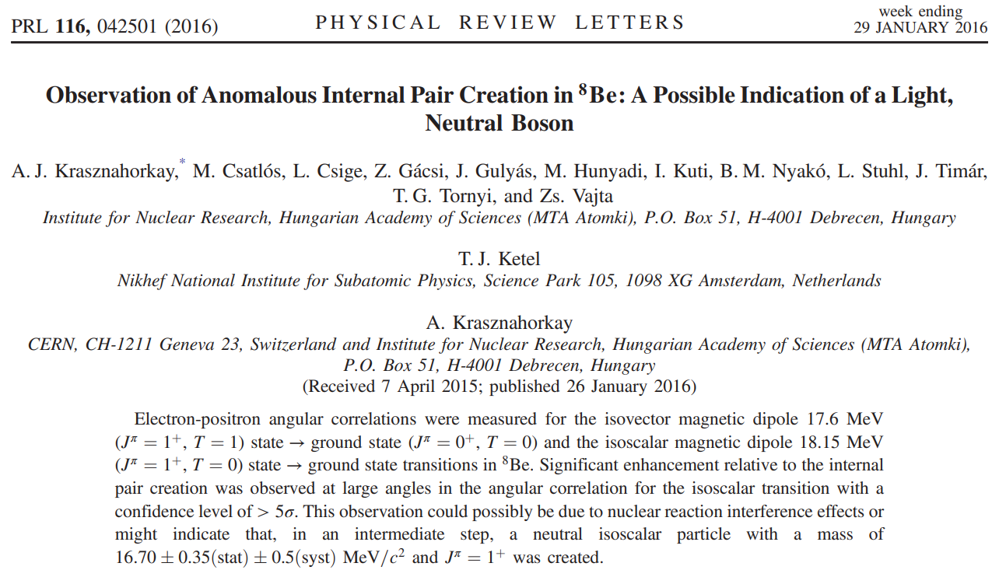
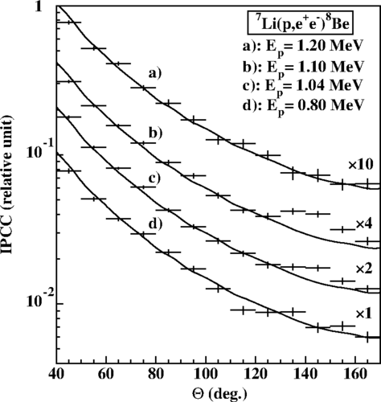

Atomki anomalies
$θ_{+ −}$ in my notation
$p+{}_{}^{7}{Li→{}_{}^{8}{Be_{gs}+e^{+}+e^{−}}}$ (PRL 116, 042501, 2015)
$p+{}_{}^{3}{H→{}_{}^{4}{He+e^{+}+e^{−}}}$ (arXiv:1910.10459 and PRC 104, 044003, 2021)
$p+{}_{}^{11}{B→{}_{}^{12}{C+e^{+}+e^{−}}}$ (PRC 106, L061601, 2022)

Slide 7



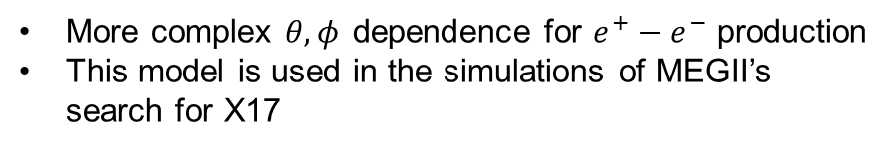
Can nuclear physics explain?
The models used in experimental analysis: M. E. Rose [PR 76, 678 (1949)] without inferences
Details about our model are in X.Z. and G. A. Miller, Phys.Lett.B 773 (2017) 159-165 [1703.04588]
It is about EM multipole (E1, M1, and/or E2) interferences and potential multipole form factor
The model was tuned to existing photon data (showing anisotropy)
M1
E1
$γ^{∗}$
$γ^{∗}$
More complex $θ,φ_{ }$dependence for $e^{+}−e^{−}$ production
This model is used in the simulations of MEGII’s search for X17

Slide 8
Can nuclear physics explain?
Interference and anisotropy do NOT explain the anomaly; EM transition form factor can, but it is unphysical (requiring a large distance scale)
Other nuclear theory studies for the Be8 system don’t find SM explanations based on one-boson approximation.
However, it is possible that the higher order correction due to two-photon exchanges might be relevant. Note the anomalous signal is very small as compared to SM background.
“A Standard Model Explanation for the ATOMKI Anomaly,” A. Aleksejevs et al., arXiv: 2102.01127
Nuclear theory conclusion is uncertain
Anisotropy?
M1 form factor?

Slide 9
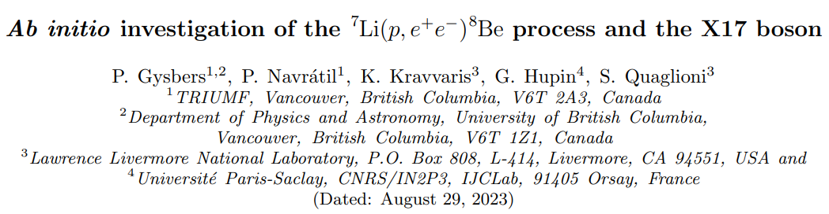
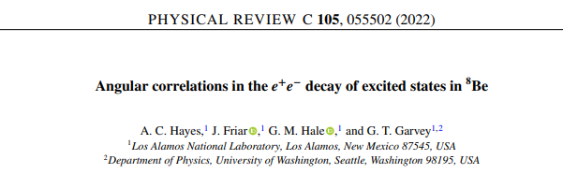
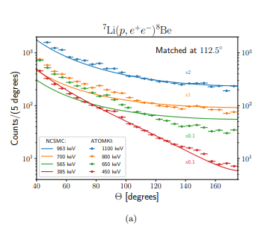
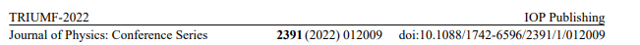
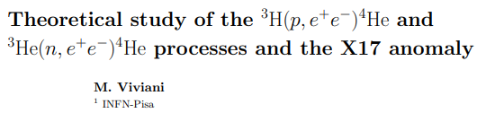
Other nuclear theory studies
Gysbers et al, 2023 [arXiv: 2308.13751]
No nuclear theory explanation based on one-photon approximation

Slide 10
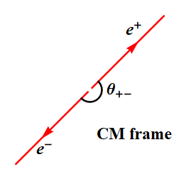
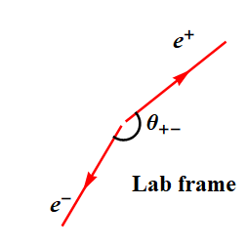
Can a protophobic vector boson explain?
Details are in XZ and G. A. Miller, Phys.Lett.B 813 (2021) 136061 [2008.11288]
This was an interesting development, which can be found in the review report: Shedding light on X17: community report, Eur.Phys.J.C 83 (2023) 3, 230.
  J.L. Feng et.al., (2016, 2017): protophobic X (17 MeV) in the Be-8 transition
  J.L. Feng et.al., (2020): consistent explanation in both Be-8 and He-4 transitions
  Nontrivial part: the required X properties, including protophobia, couplings and masses, are consistent with existing constraints
  Our study: such vector boson would be seen in all the energies measured in the initial Atomki measurement (2015), conflicting their measurements.
Boost
Krasznahorkay et al., 2016, the original Atomki PRL report

Slide 11
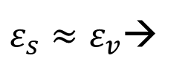
Can a protophobic vector boson explain?
The X production amplitude is directly proportional to photon production
Including differences in kinematics and polarization vectors → dominance of the energy-smooth nonresonant (Bremsstrahlung) component
Other multipoles only increase the nonresonant component
This is confirmed in other nuclear microscopic calculations for the Be8 system (Gysbers et al, 2023 )
This proportionality is confirmed for the He4 system in a separate study (Viviani et al, 2022)
R. D. Lawson, Theory of the nuclear shell model (Oxford University Press,1980) :
$ε_{s}≈ε_{v}$→

Slide 12
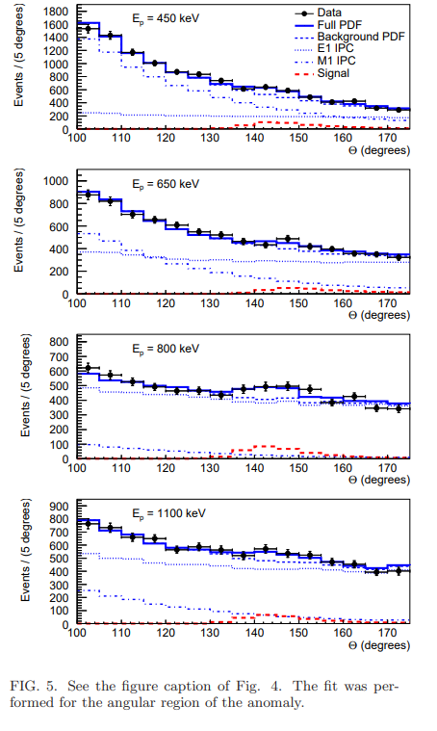
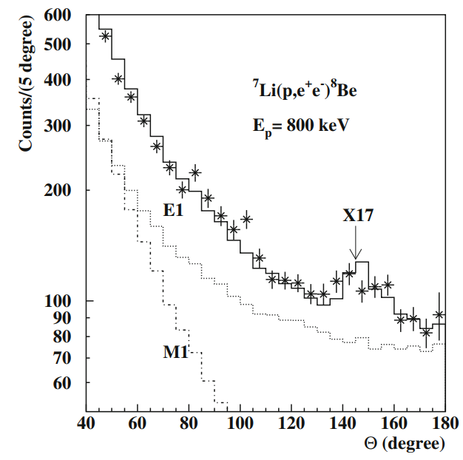

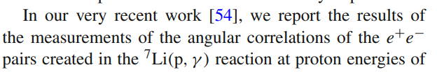
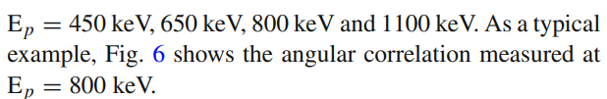
Can a protophobic vector boson explain?
Story wasn’t finished there…
In the 2021 workshop “Shedding light on X17” held at Centro Ricerche Enrico Fermi (and online), it was presented and later detailed in the summary report (Eur.Phys.J.C 83 (2023) 3, 230), and then in arXiv:2205.07744 in 2022:
So, the protophobic vector boson explanation is viable?
arXiv:2205.07744

Slide 13
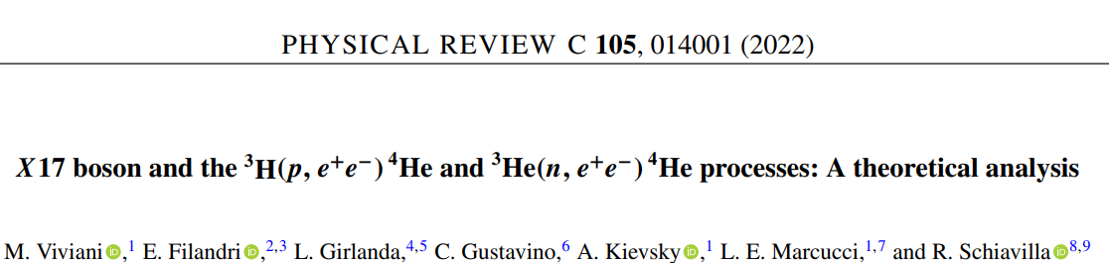
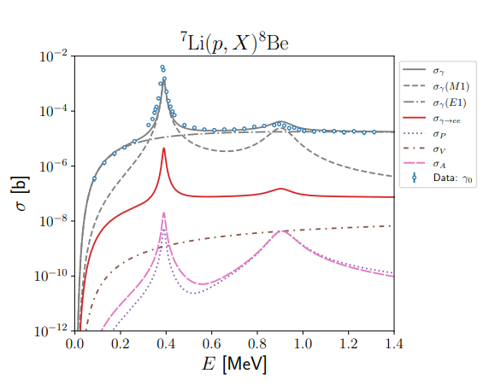
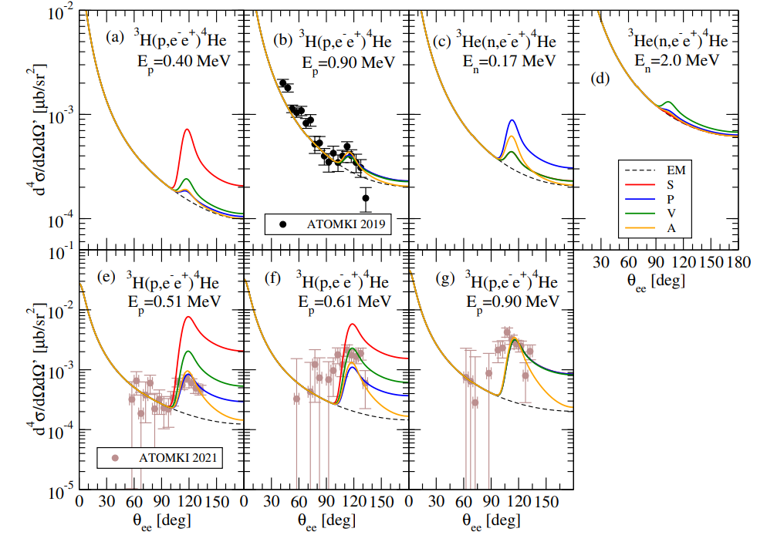
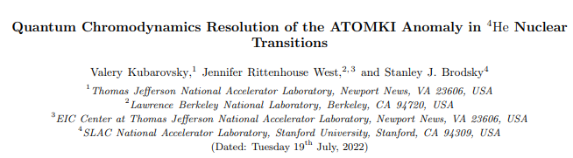
Other nuclear theory studies
Viviani et al, 2022
Novel hadronic physics ideas:
Gysbers et al, 2023 [arXiv: 2308.13751]
arXiv:2206.14441
Invoke EM transition form factor based on novel quark wave function in nuclear state
From M. Viviani, Journal of Physics: Conference Series 2391 (2022) 012009

Slide 14
Summary
Nuclear theory based on one-photon approximation can’t explain the Atomki anomalies
Nuclear theory predictions for the pair productions are valuable for experimental simulations. These processes have nontrivial multipoles interferences & anisotropies.
Other potentially viable nuclear theory explanations: two-photon exchange diagrams, and novel hadronic structure in nuclear states
Nuclear theory is needed to study BSM proposals: such as the debate on X17’s protophobic vector nature, based on nuclear isospin symmetry
More experimental approves/disapproves are needed

