Slide 1

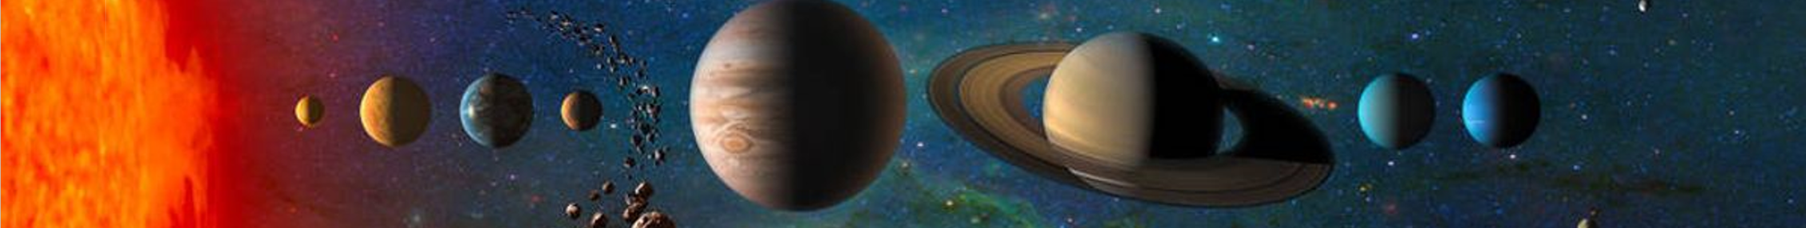
SCEP：
Magnetic Monopole search experiment using magnetometer and plastic scintillator
Qing Lin
on behalf of SCEP group
Deep Space Exploration Lab (DSEL)
& University of Science and Technology of China
2023.10.20 @ MEPA2023, Hefei

Slide 2


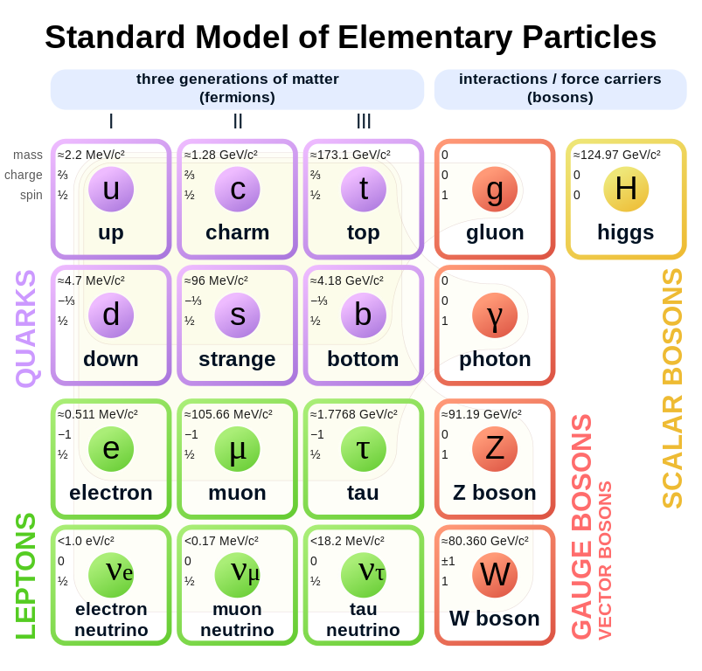
Searches for new physics
Topic | Crucial measurement | Significance
Higgs boson | M =125 GeV | Confirm spontaneous symmetry breaking in gauge theory
Gravitational waves (Graviton) | Existence | Support general relativity
Glueball, exotic hadron | Existence | QCD
Dark matter | Existence | Missing mass in the universe
Antimatter | Existence | Baryon number asymmetry
Neutrino oscillation and mass | M < 1 eV | Structure of GUTs. Eventual fate of the universe
Proton decay | t > 1.67x10³⁴ years | Evidence for validity of GUTs
Magnetic monopole | Existence, mass, electric charge | Electric and magnetic charge symmetry predicted by Dirac. Structure of gauge field configuration
Fractionally charged particle | Existence | Would confuse all current prejudice
Super-symmetric particles | Existence, M > 1 TeV | Hope of understanding gravity
Extra dimension | Existence, Heavy W/Z like particle, graviton, microscopic black hole | Hierarchy problem
CANNOT
Explain
2

Slide 3
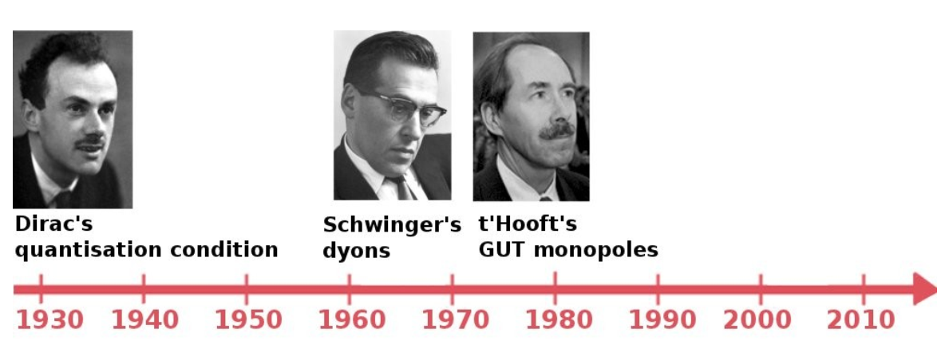
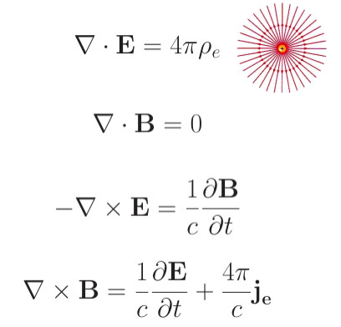
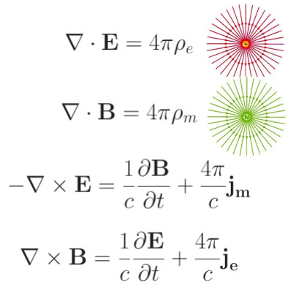
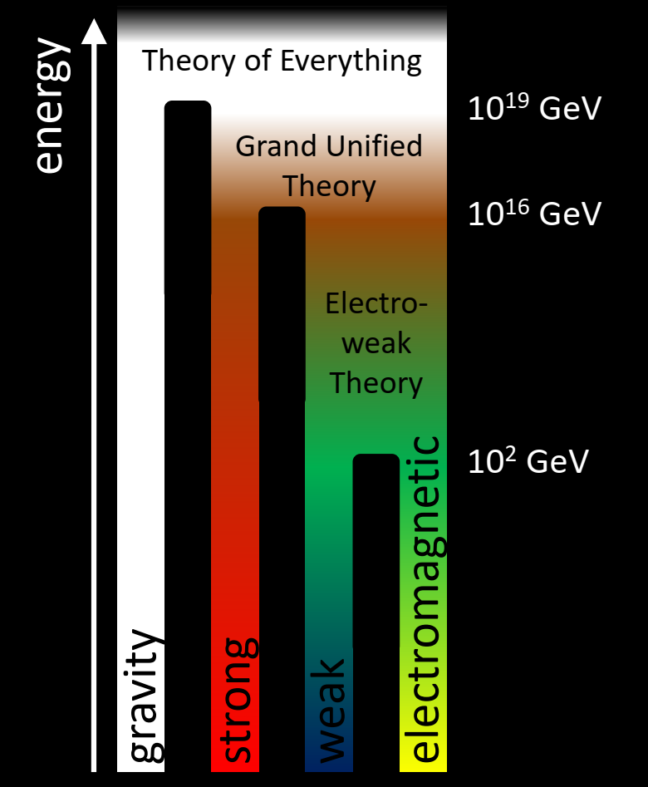
About Magnetic Monopole
Asymmetry between electricity and magnetism in Maxwell equation
GUT considers strong and EW unified at higher energy;
GUT CAN explain the quantization of electric charge naturally;
GUT also predicts the production of MM when strong and EW splitted;
Standard Maxwell Equation
Modified Maxwell Equation with magnetic charge
3

Slide 4
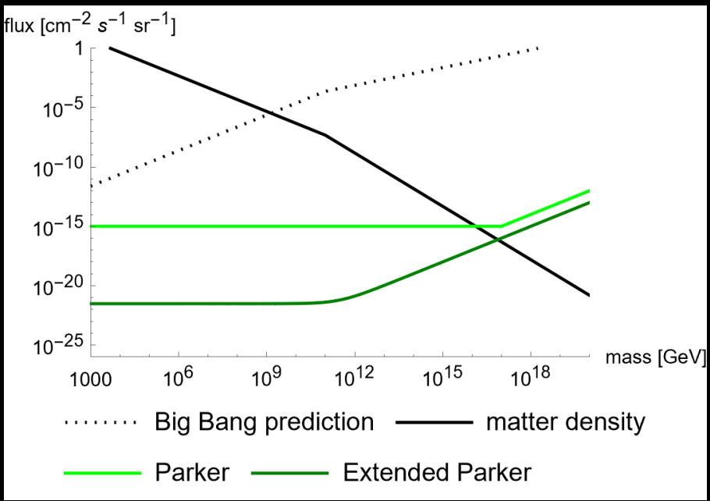
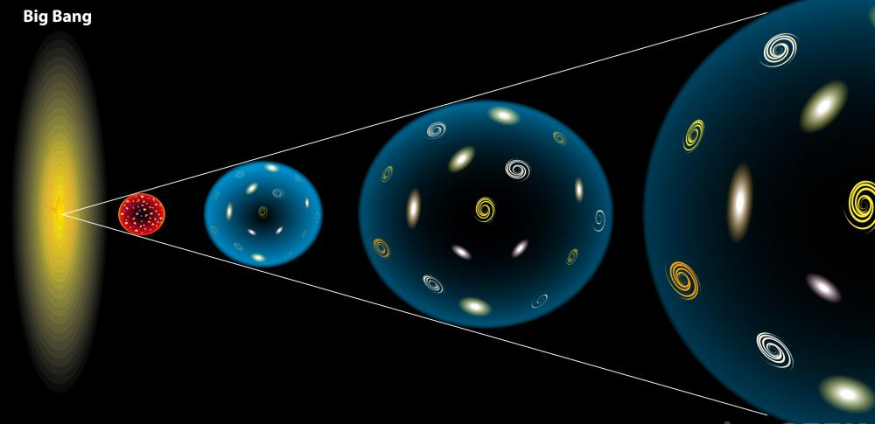
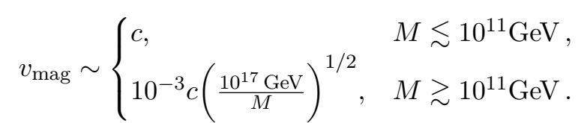
MM and its evolution
MMs were produced right after the big bang, and diluted by the inflation. These GUT MMs have mass in order of ten to the several tens of GeV.
Lighter MMs can also be produced by other less intense cosmic processes.
Parker: Excessive MMs could annihilate the magnetic field in space.
Density: Excessive MMs could conflict the gravitational observation.
4

Slide 5
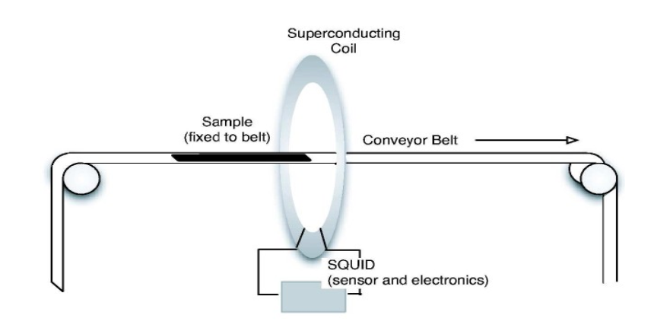
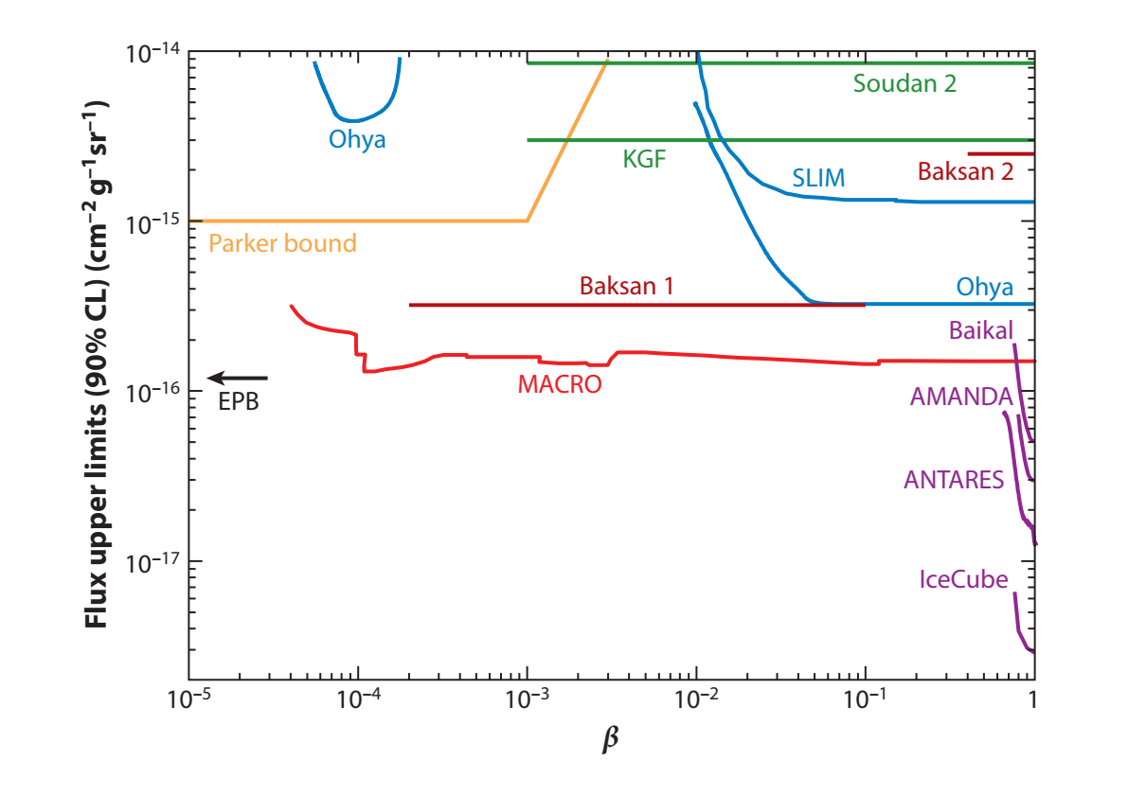
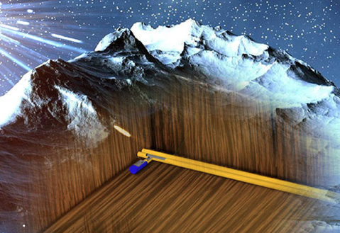
Status of the searches
Samples from Moon and Meteorites
Underground Experiment
Superconductors
No evidence of existence yet
MACRO、IceCube
Energy Deposition
Induction
Pros：Large volume, high sens.
Cons：Need low-background,
Non-unique signal feature.
Pros：Smoking-gun signal;
Cons：Need superconducting temp;
Small volume
Collider experiments
5

Slide 6
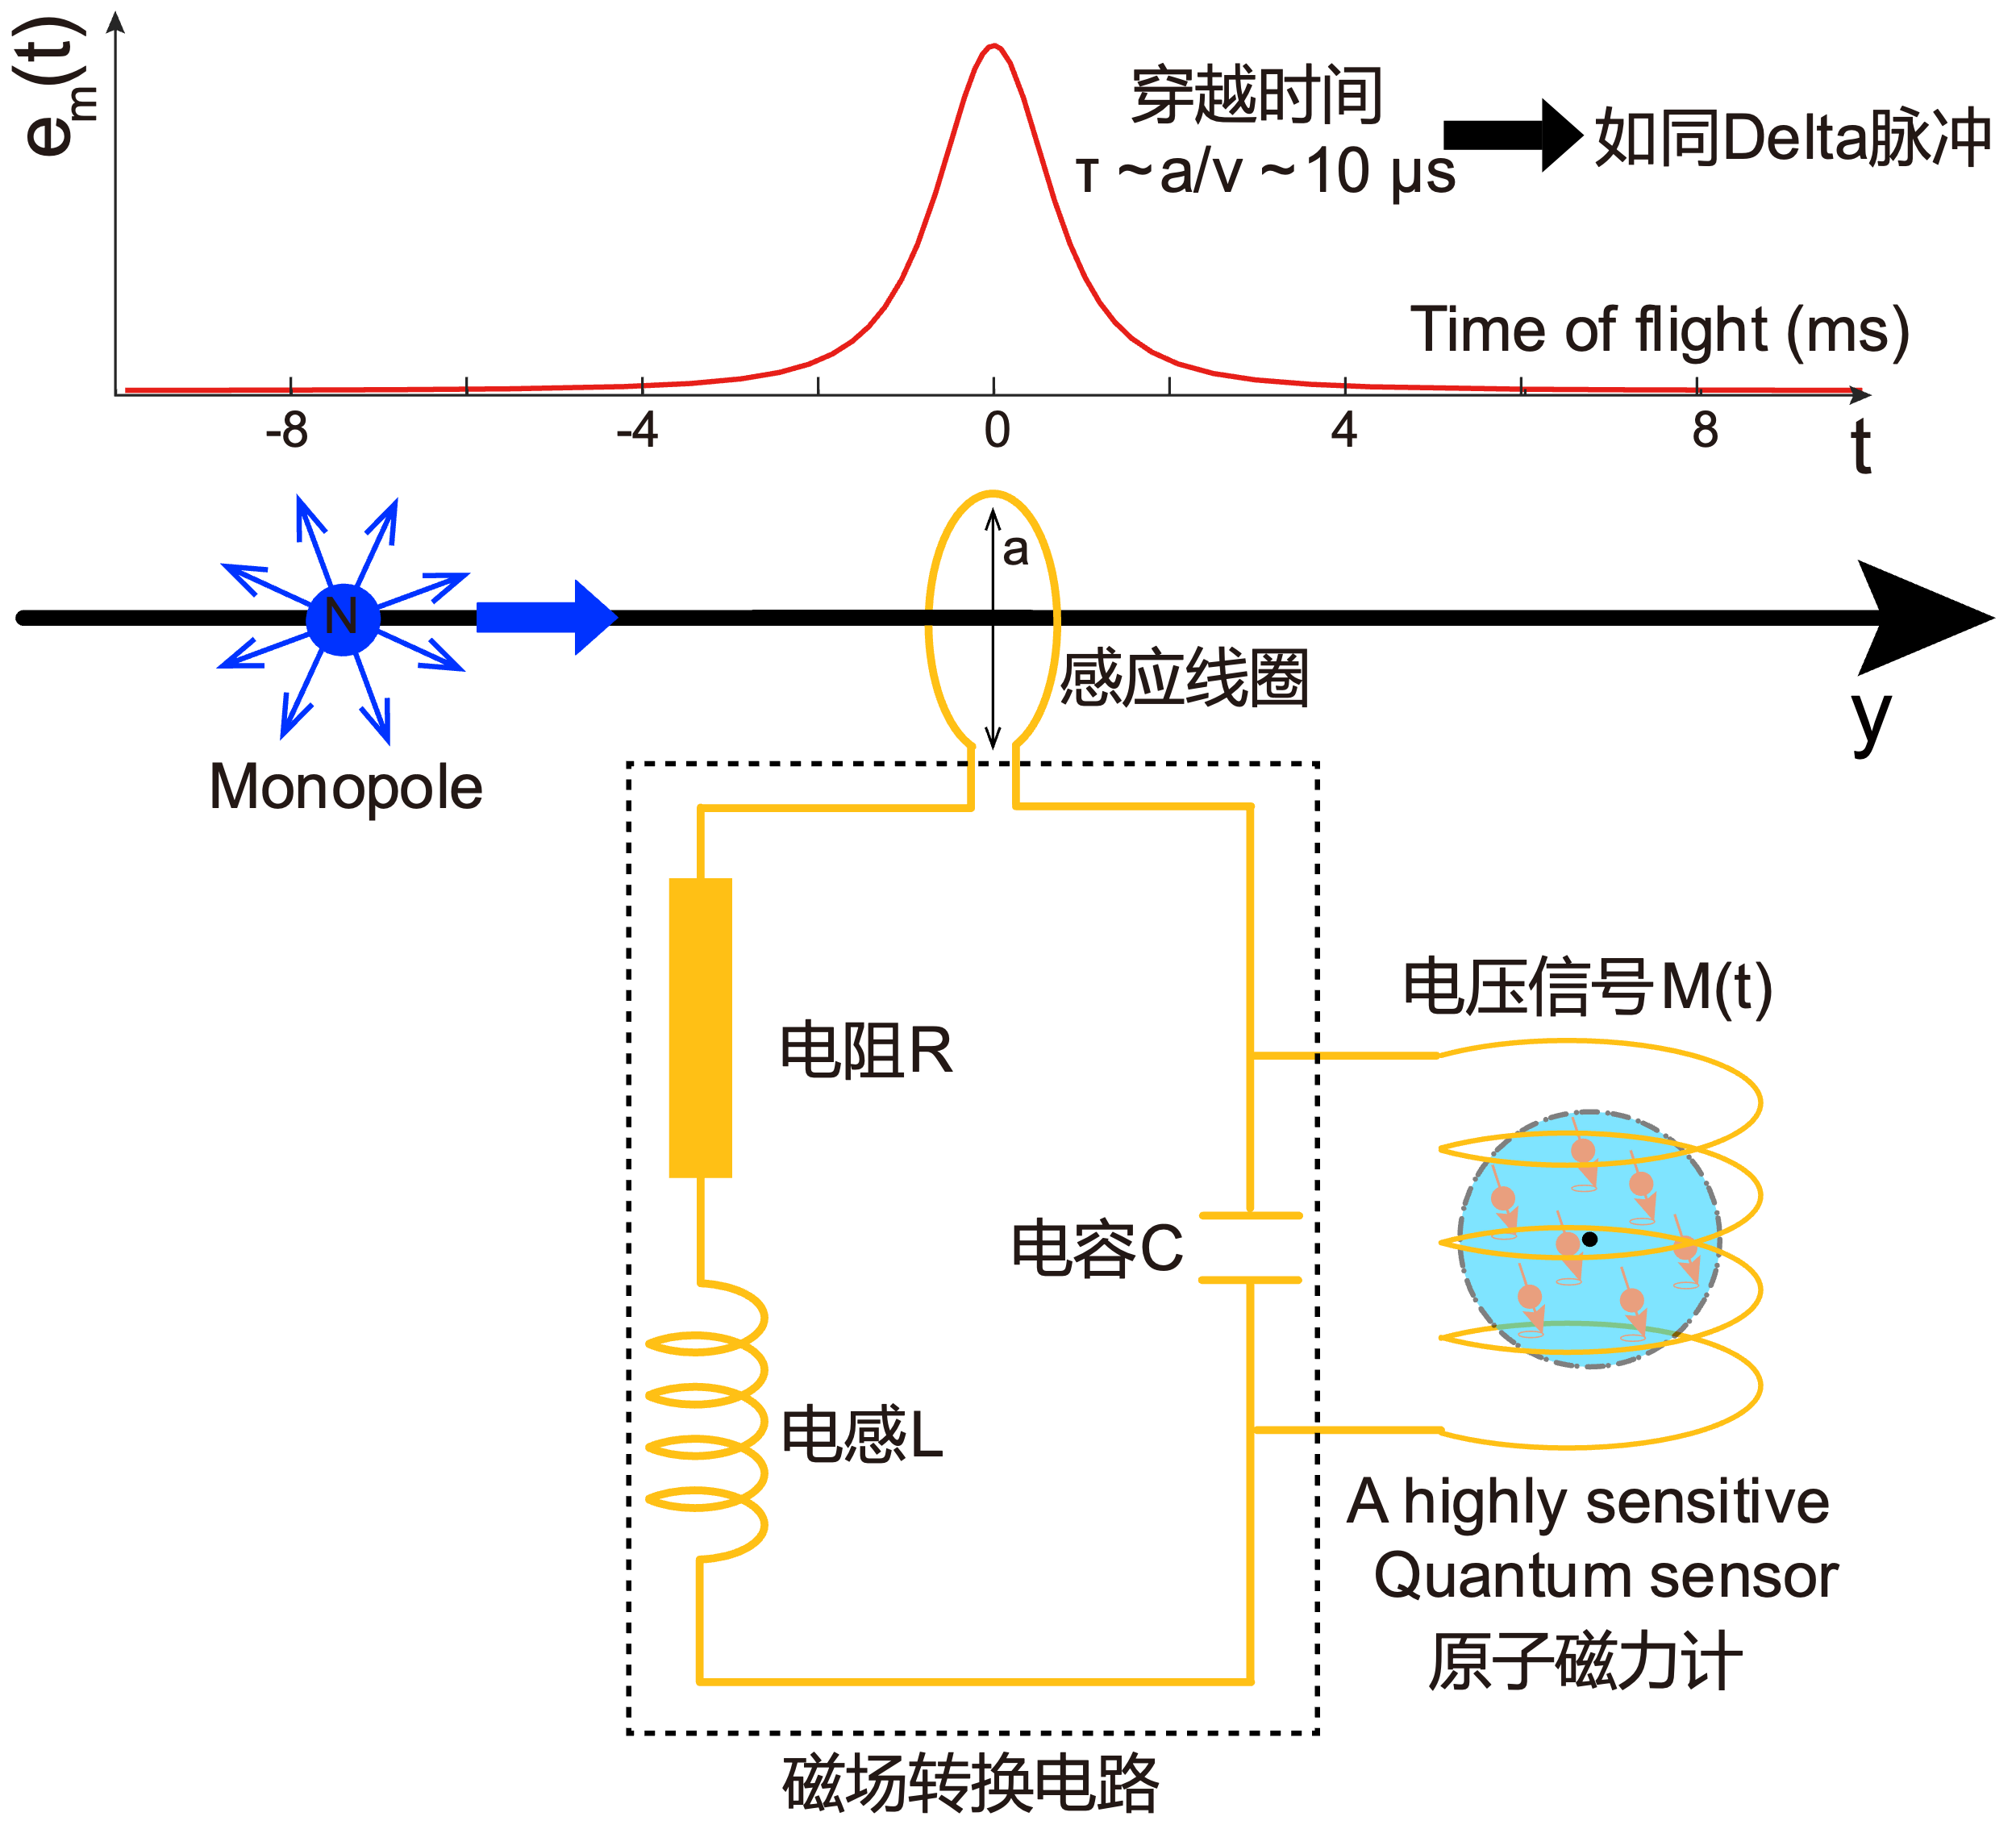
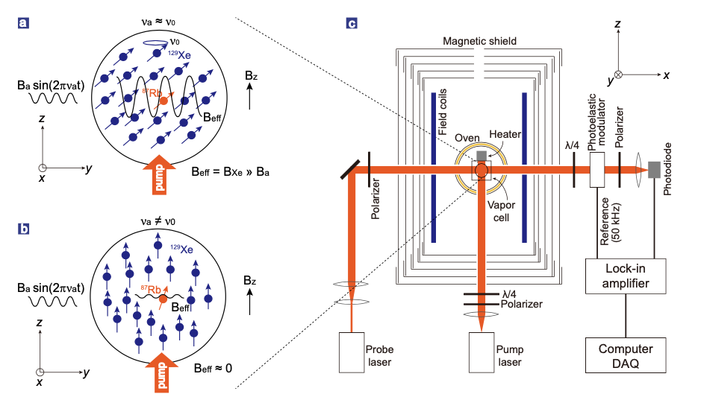
Detection Principle
New method：Coincidence between Quantum sensors and Particle detectors
Time scale
Delta pulse
Induction coil
Voltage
MM passing induction coil, producing induction voltage, which creates a magnetic pulse in middle of a Helmhotz coil;
Magnetometer is able to detect very small magnetic field change;
6

Slide 7
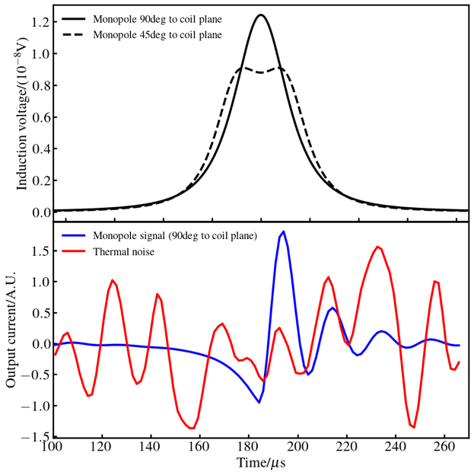
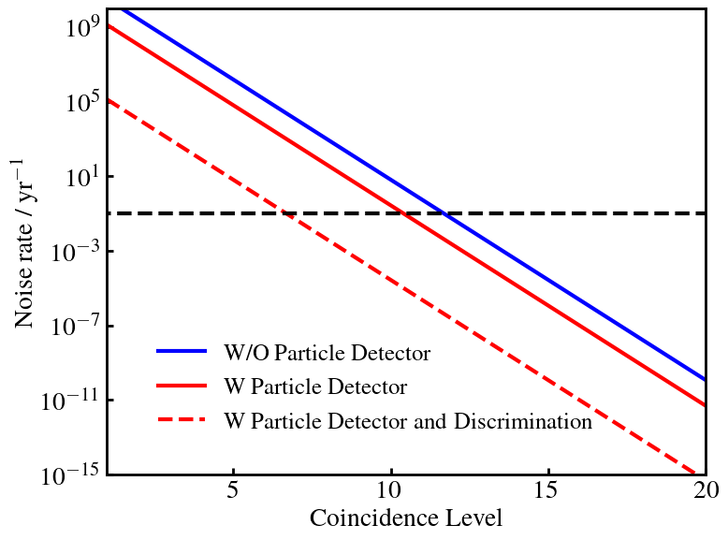
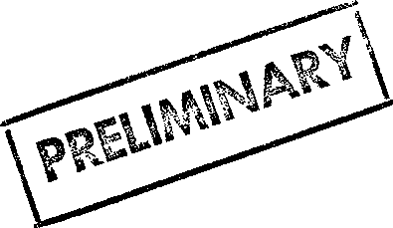
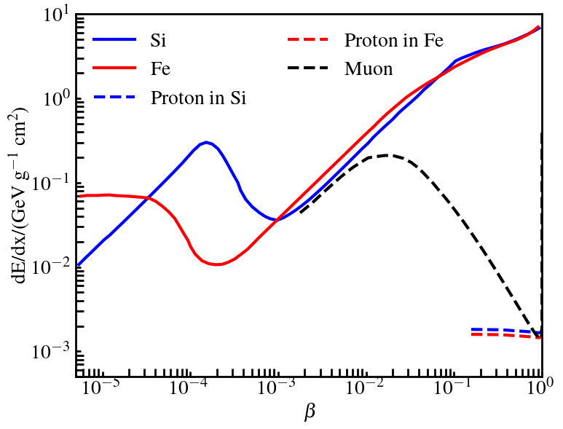
Array of detectors
Standard particles
(charged or with magnetic moment)
MM
Waveforms before/after
circuit shaping
Noise rate vs coincidence requirement
Thermal pileup
Thermal pileup dominates
SNR～ 0.2 (room temp)
Charged particle induces 1e-14V（1e-5c），Magnetic moment (electron) induces 1e-17V;
Single module SNR low, requiring larger coils’ coincidence;
Coincidence btw induction and energy deposition reduces thermal pileup;
The rejection of bkg depends on the reconstruction quality;
dE/dx
7

Slide 8
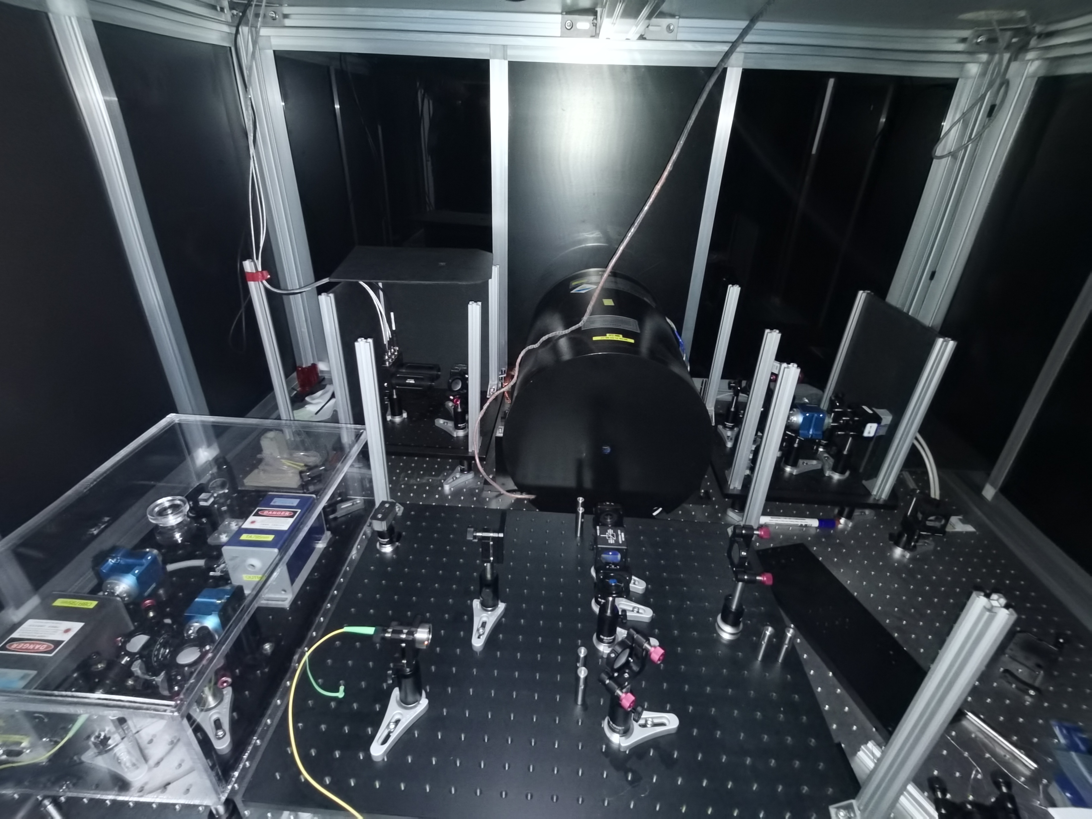
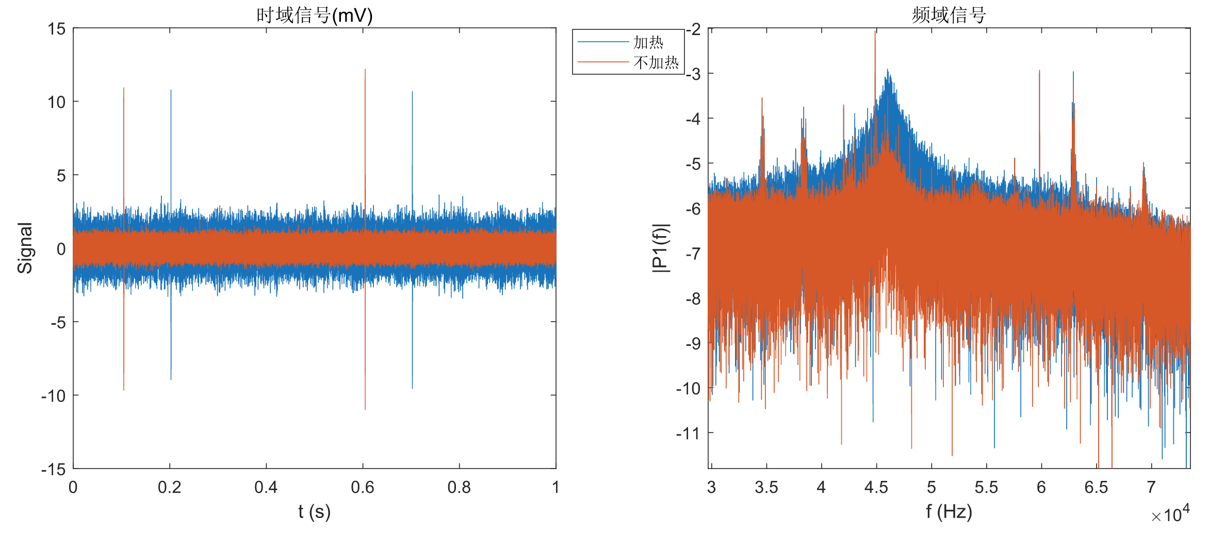
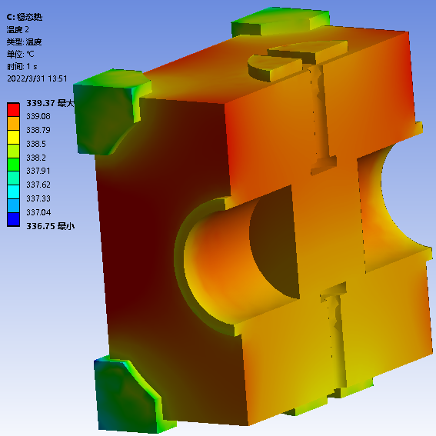
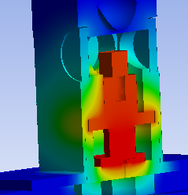
Sensitivity optimization of Magnetometer
Magnetic Shielding
Time domain
Frequency domain
New design：340deg
Old design: 140deg
Laser system
Observed high noise rate of magnetometer:
Power of laser not enough;
Non-uniform heating of gas chamber, causing the number density low；
We have updated the laser system and heater design.
Gas chamber of magnetometer
8

Slide 9
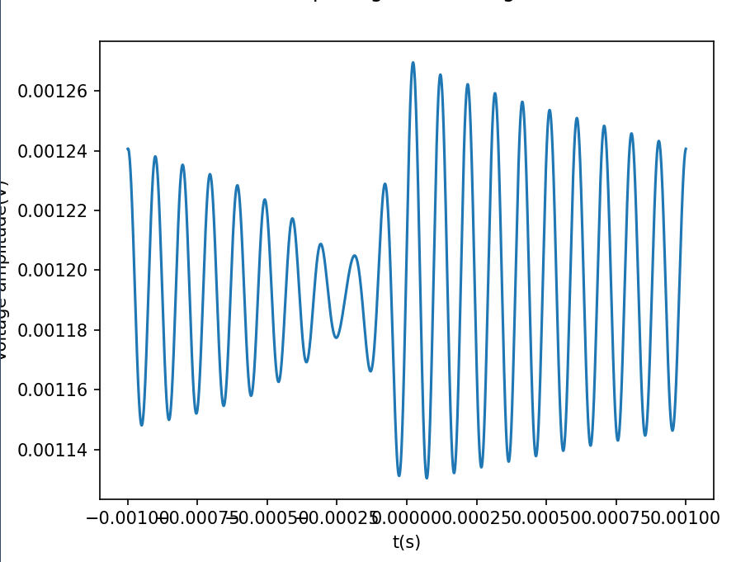
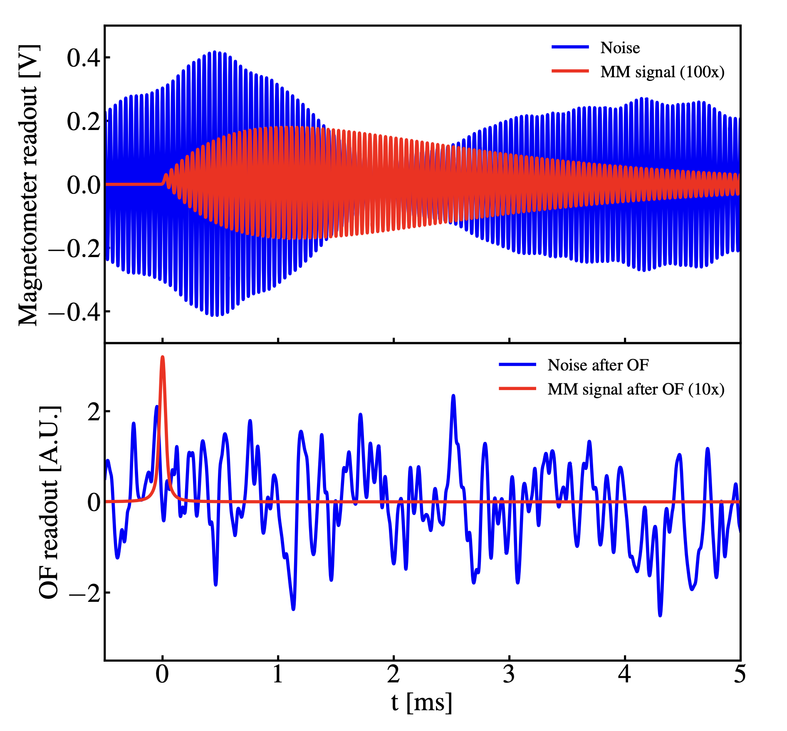
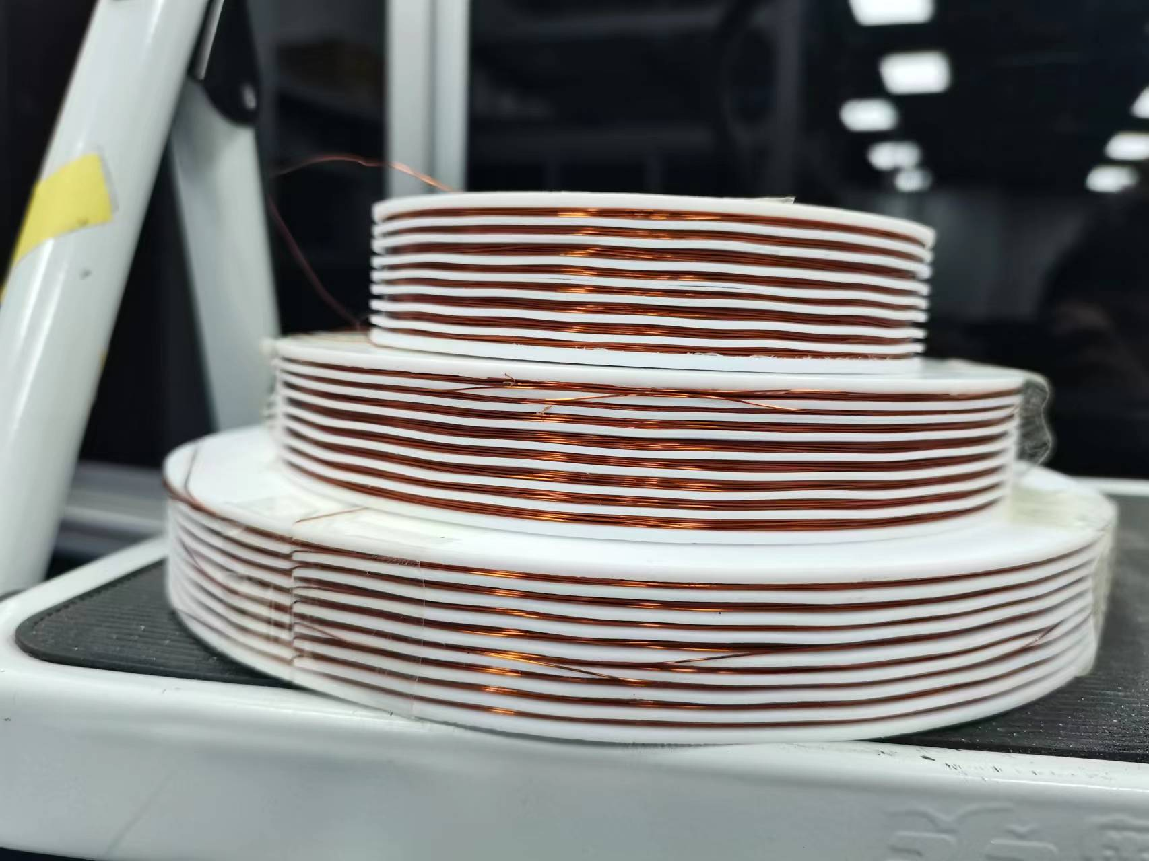
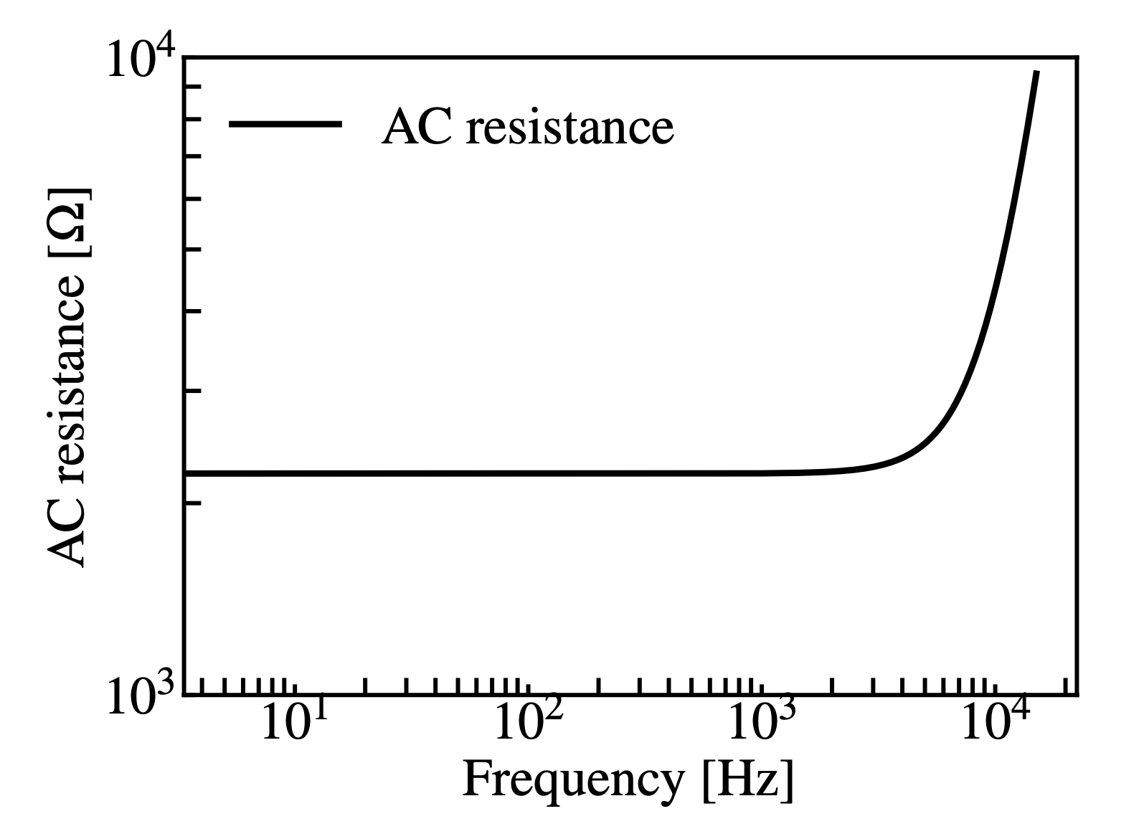
Signal Simulation and Shaping circuit optimization
Induction Voltage
Circuit shaping
Readout by Magnetometer
Optimal filter
Key parameters affecting SNR：
Resistors, capacitors, and inductors in circuit；
AC resistance of the induction coil (dependence on coil winding not well modeled)
We need measurement of AC resistance of each coil.
A test under room temp
9

Slide 10
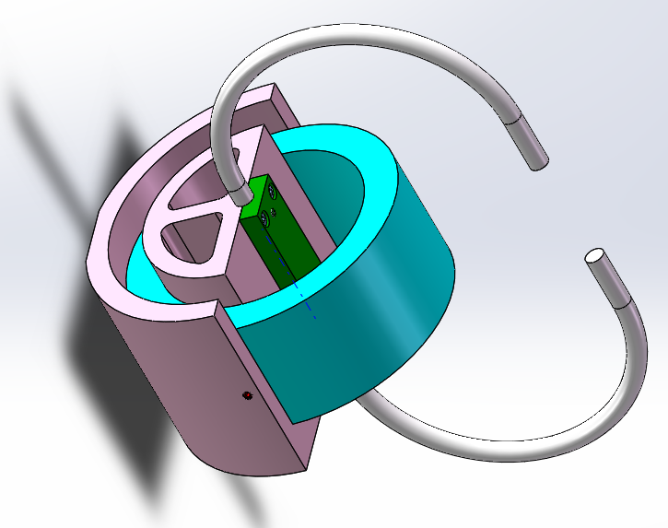
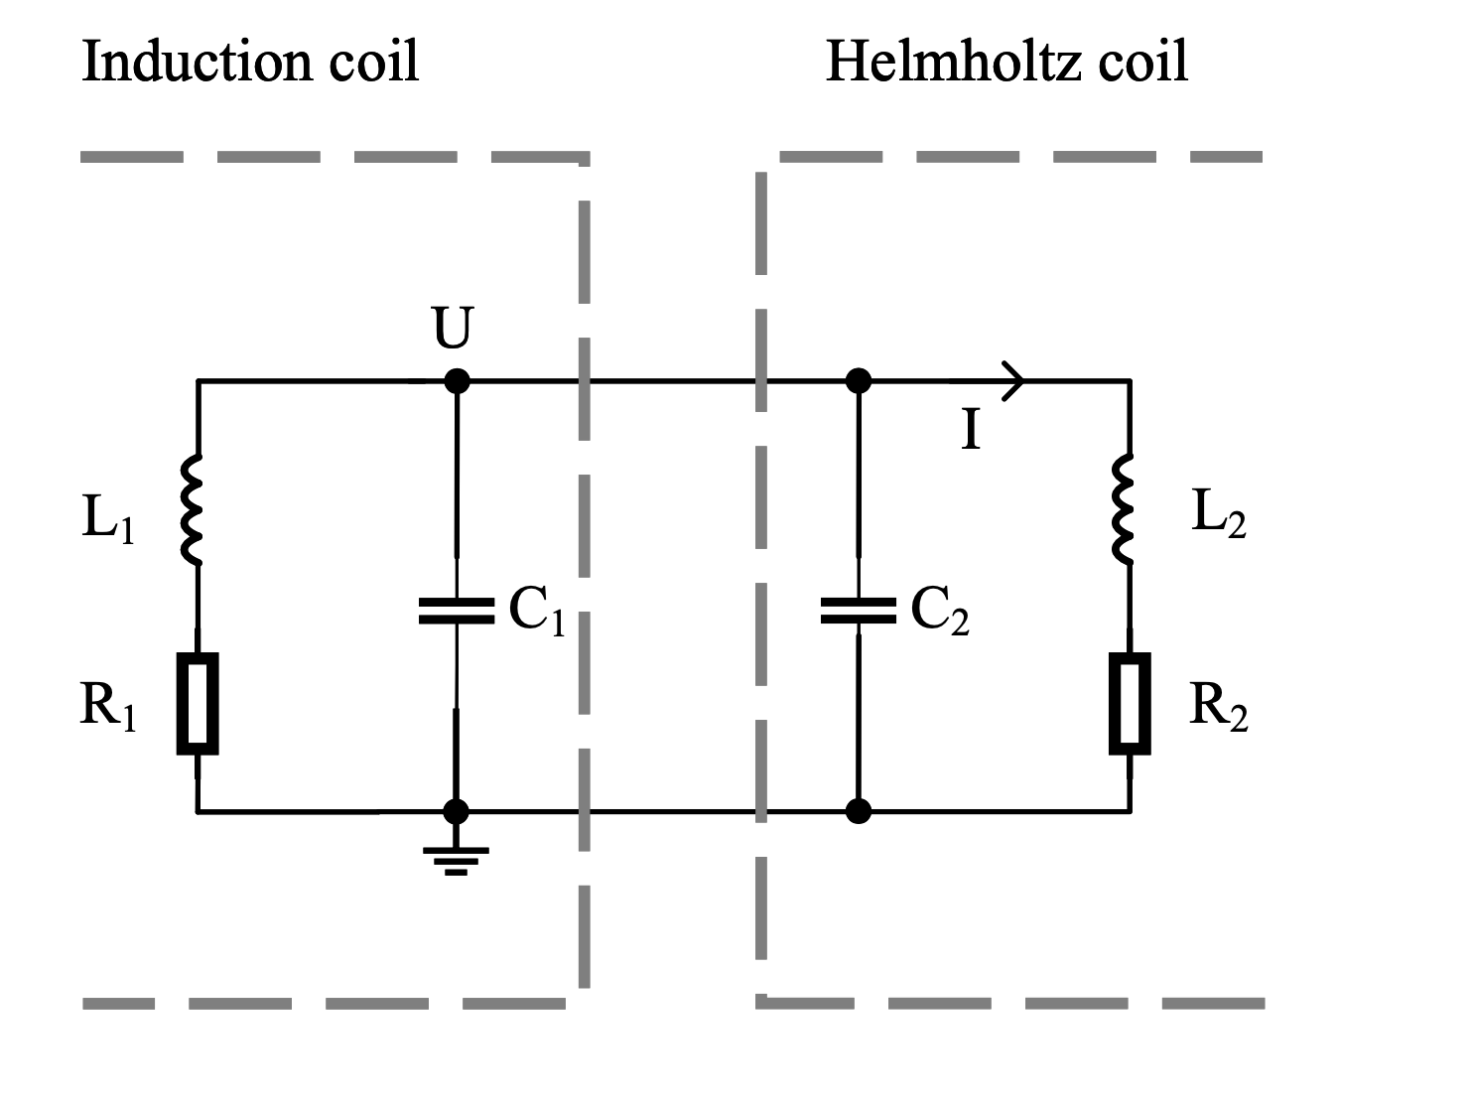
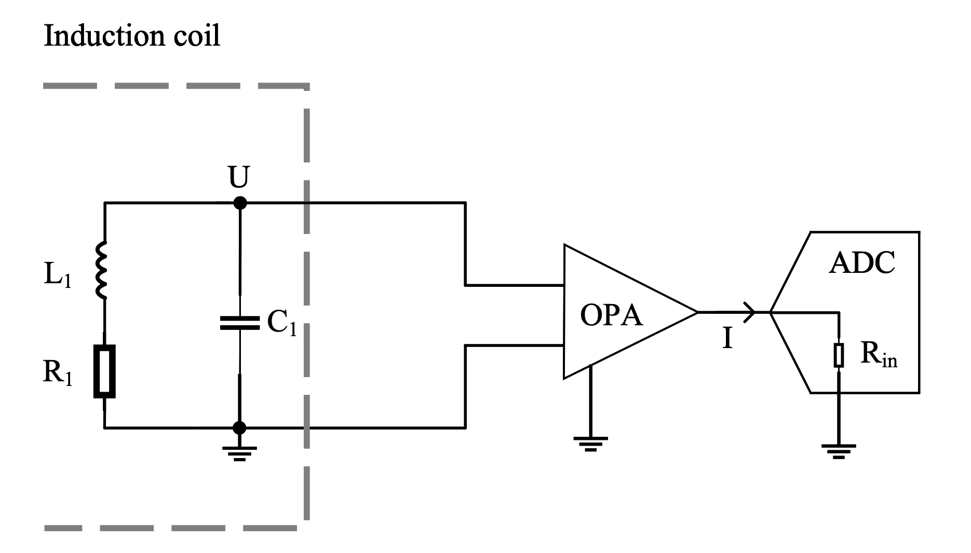
Validation of Signal Simulation
Two induction signal detection plans
Thin&long coil：
Simulate a pulse by MM transpassing.
Plan 1:
for fast MMs
Plan 2:
for slow MMs
Induction coil：
Capture the MM signal
Direct readout of induction signal using ADC. Sampling rate high, but with high noise.
Induction coil connect to Helmholtz coil, which converts current into magnetic pulse to be detected by magnetometer.
10

Slide 11
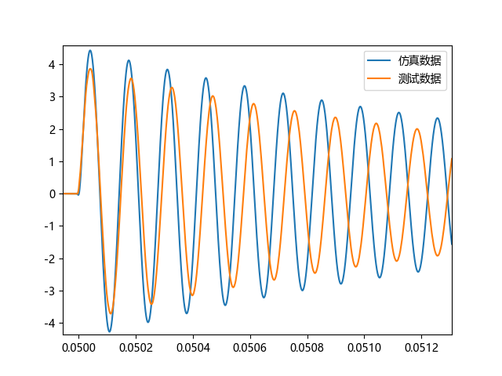
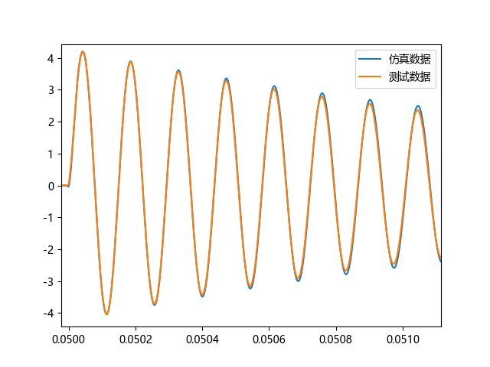
Preliminary test results: Signal
Plan 1 with large pulsed Delta input
Amplify x1.086; Correction with distributed capacitor;
Sim
Obs
Sim
Obs
 | Sim | Observed
Period | 46kHz | 44kHz
Amp | 4.33V | 3.86V
Decay | 1.9ms | 1.7ms
Diff on period: Input capacity and distributed capacitance;
Diff on amplitude: Field leakage
Diff on decay: ADC resistance or AC resistance.
11
周期对应不上，可能是输入电容以及杂散电容的影响
幅度对应不上，可能是漏磁或绕制工艺的影响
衰减对应不上，可能是采集卡输入电阻或交流电阻的影响

Slide 12
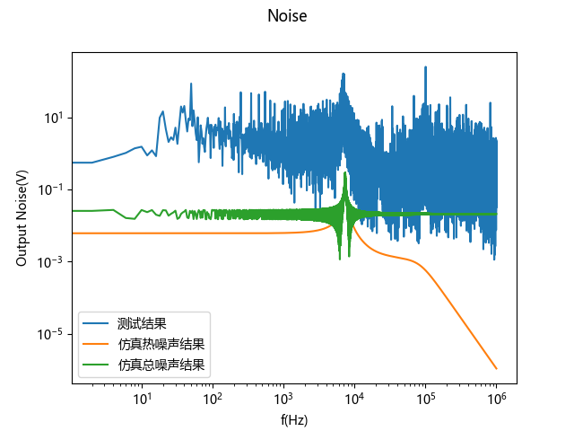
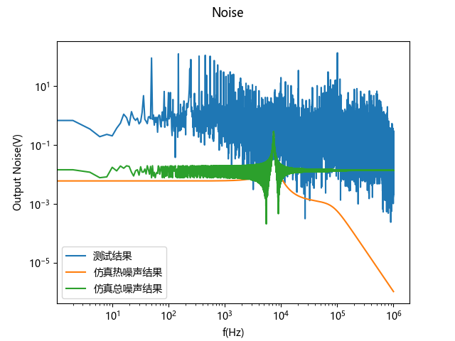
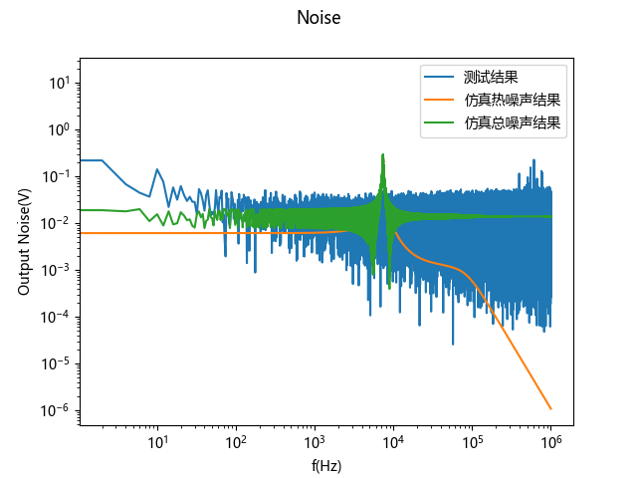
Preliminary test results: Noise
Induction coil open to air
With simple Al shielding
感应线圈铝箔屏蔽
Measured
Sim (thermal only)
Sim (with ADC noise)
Measured
Sim (thermal only)
Sim (with ADC noise)
ADC noise
Sources of noise:
EM
ADC intrinsic noise
Magnetic noise
Need shielding!
12

Slide 13
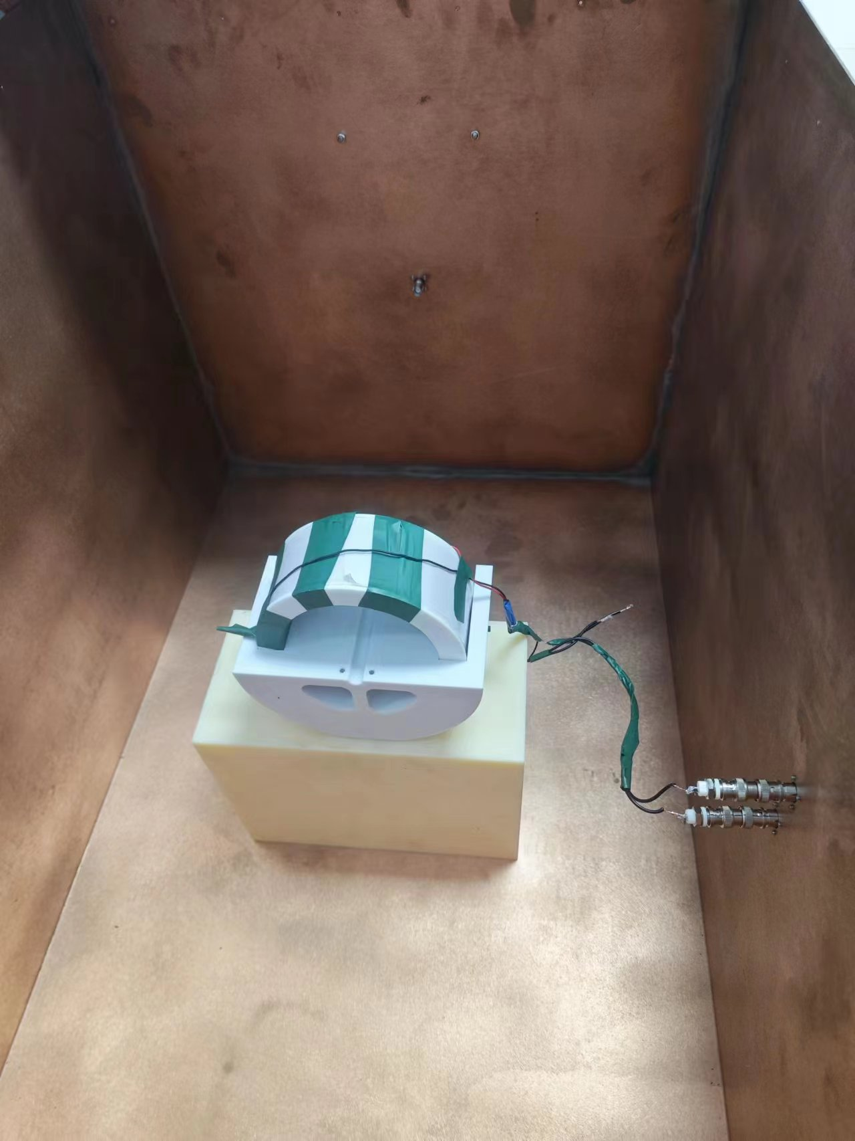
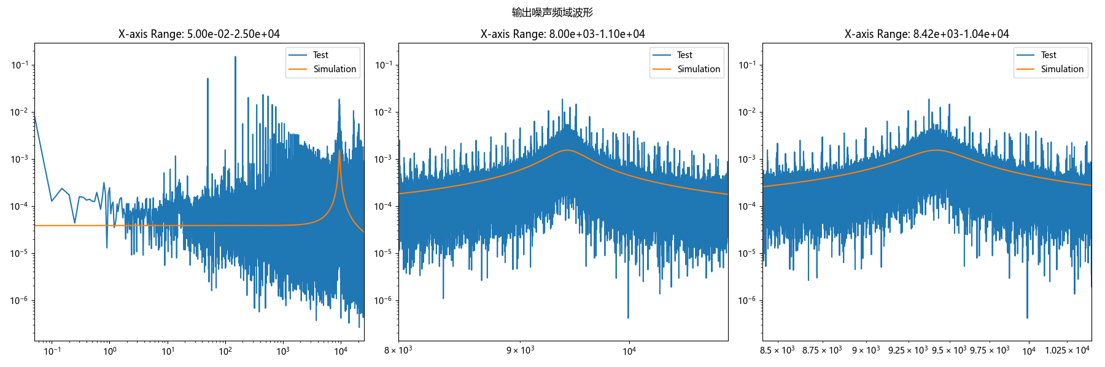
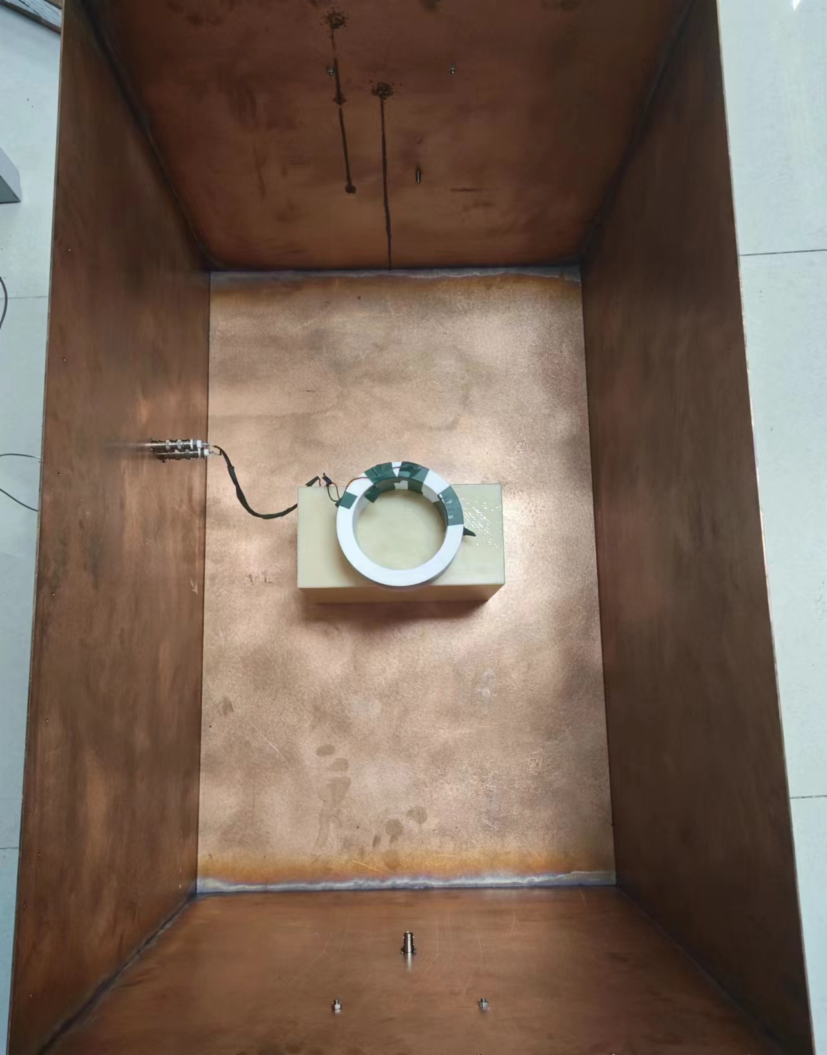
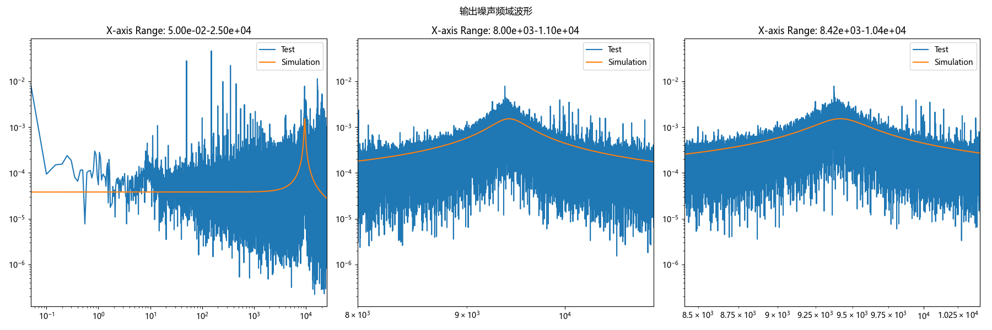
Noise
No. | Difference (%)
1 | -8.03%
2 | -8.32%
3 | -10.01%
13

Slide 14
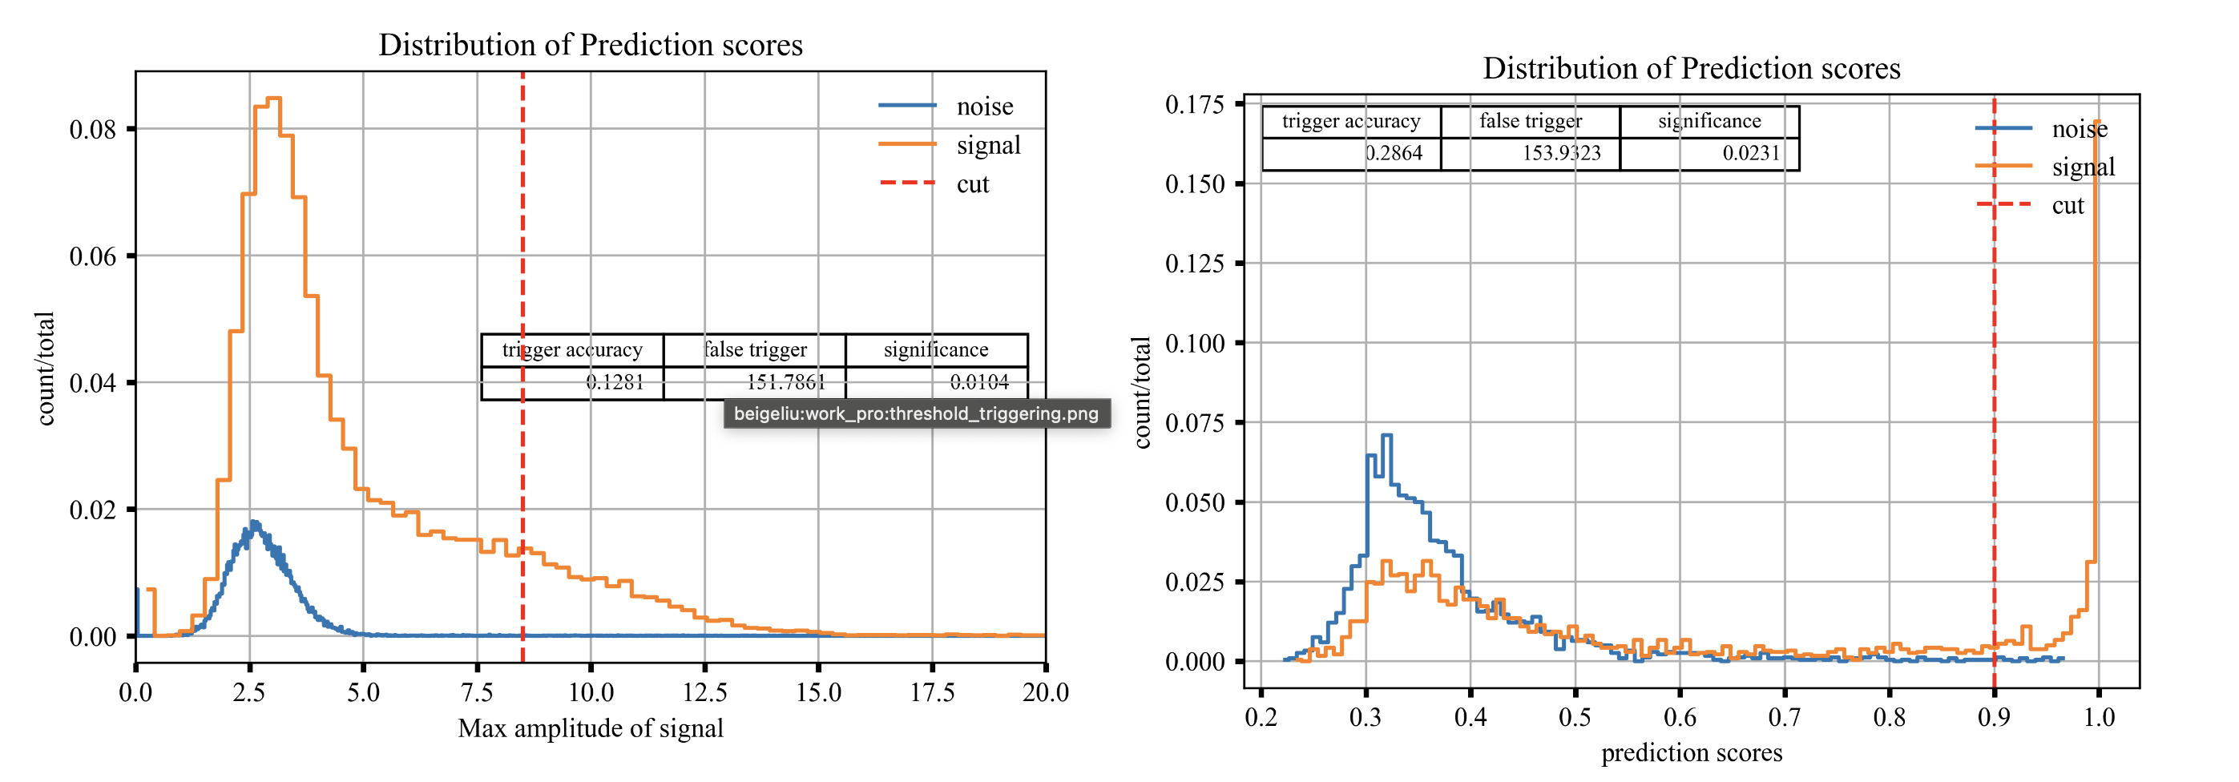
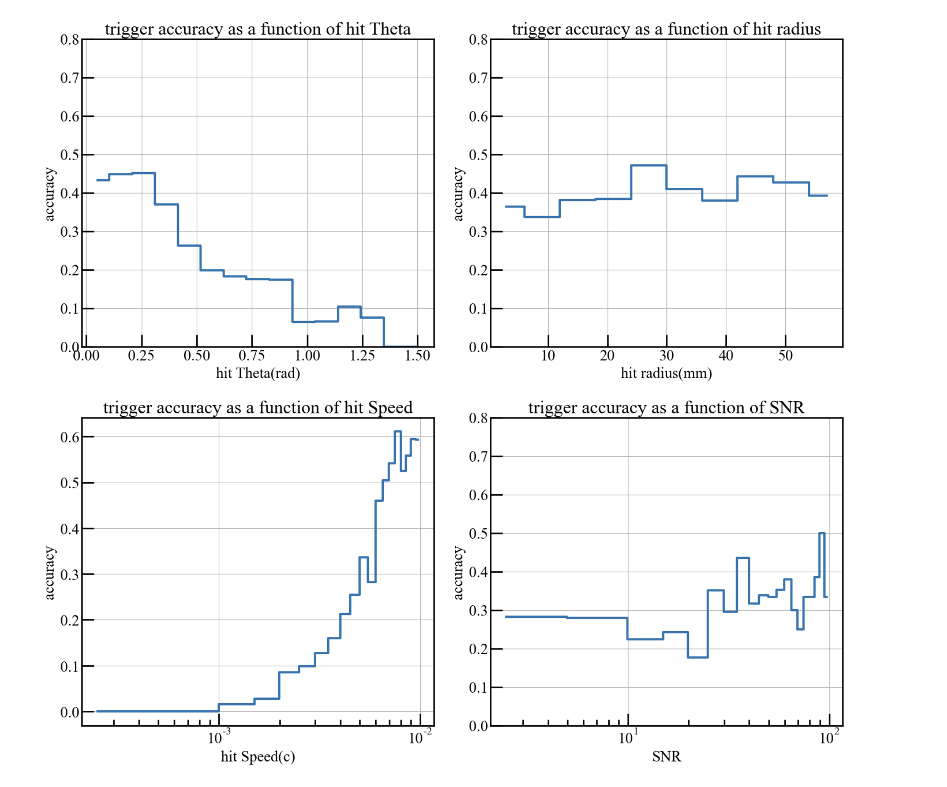
Single Module trigger
SNR~0.2
Over-threshold
MLP
Noise rate: ～150Hz
Acc: 0.14
Acc: 0.29
To do:
CNN-based DNN;
MM Track reconstruction -> pos rec. for PS;
14

Slide 15
Summary
Magnetic monopole could be produced when strong and EW forces separate, and is closely related to the long-standing charge quantization problem;
We plan to use coincidence measurement between magnetometer and plastic scintillator for MM searches;
We have carried out magnetometer optimization and signal simulation;
MM signal simulation has been validated using delta pulse from thin-long coil;
The thermal noise simulation is close to what we observed, but still some excess may be due to magnetic noises and EM.
Next step is to make the coil larger and SNR higher for single module.
16

Slide 16
Thanks for listening!
Email: qinglin@ustc.edu.cn

Slide 17
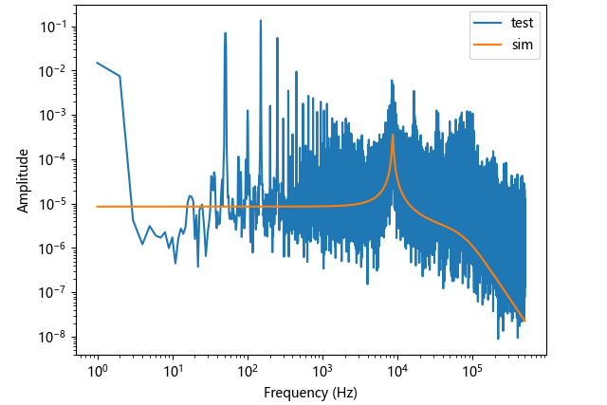
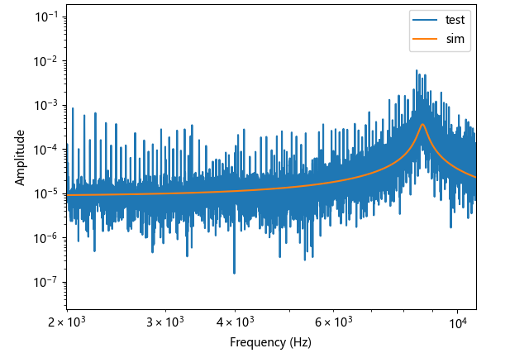
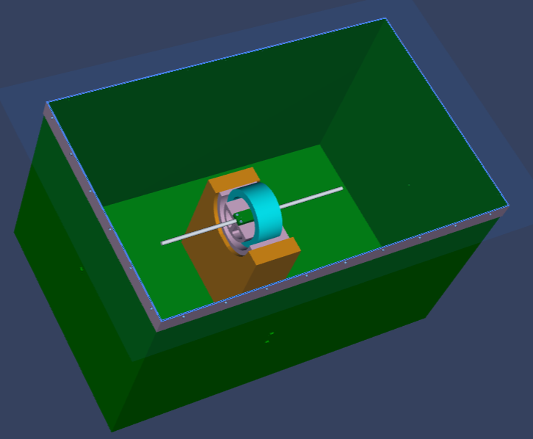
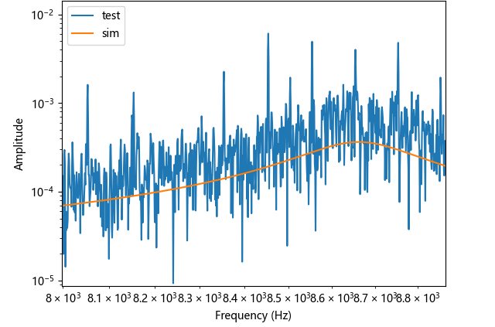
Preliminary test results: Noise (with shielding)
It seems to have some EM left from utility power;
The noise is significantly reduced, although still 2x higher than simulation.
Simple copper shielding for rejecting EM
13

Slide 18
Template

Slide 19
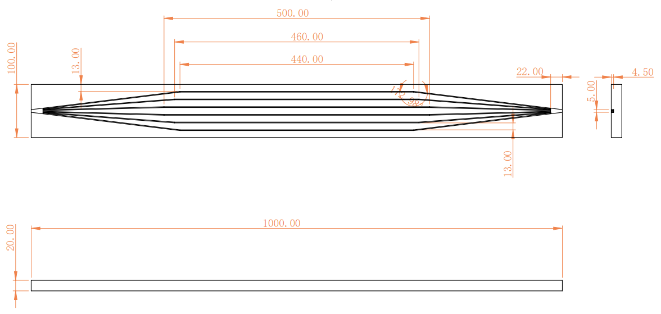
Plastic scintillator

