Slide 1

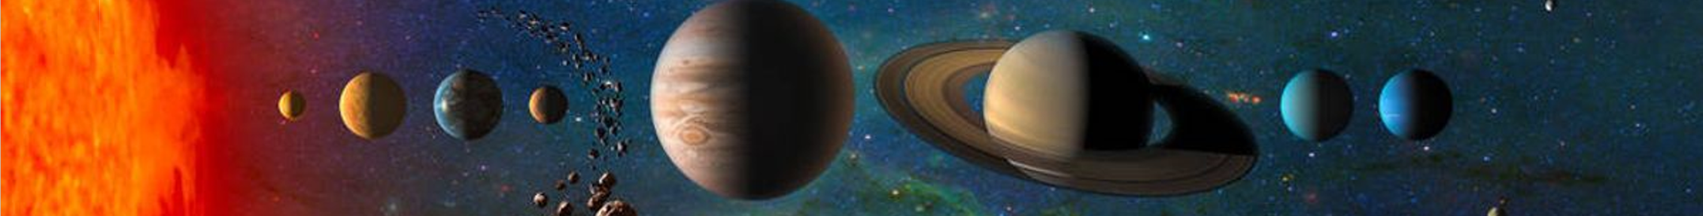

SCEP进度总体报告
林箐
on behalf of SCEP group
Deep Space Exploration Lab (DSEL)
& University of Science and Technology of China
2025.04.16 @USTC

Slide 2
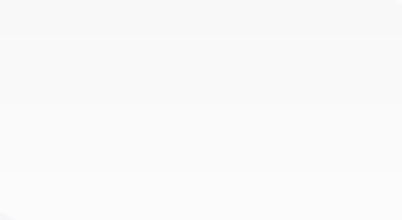
Progress Overview
Background & Monopole Sensitivity;
Magnetometer System;
Scintillation Detection System;
Optimization of Induction Detection;
Optimization of Ionization/Scintillation Detection;
Axion & Other Exotic Physics;
90%
80%
60%
70%
70%
80%
10%
30%
Monopole Sampler
40%

Slide 3
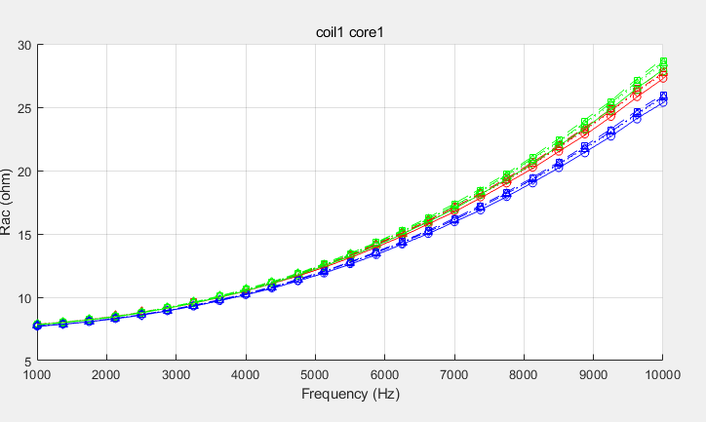
Induction Optimization
Coil1 R measurements
Test on Coil2
Key parameter: u’’
We found the measurements at different time have large variation! This is measured to be due to temperature-dependence!
We use coil#1 combined with different cores for modeling, and tested on coil#2 combined with cores. Model dependence is about ~10%-18%!

Slide 4
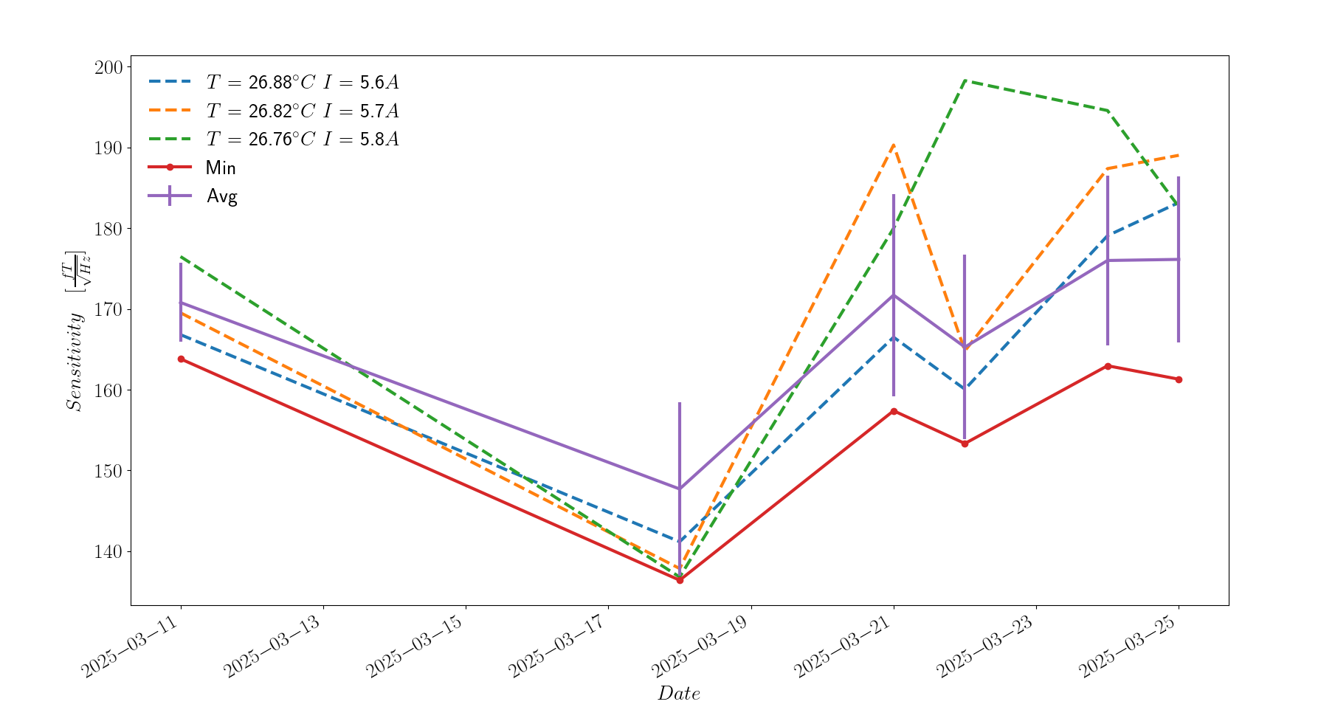
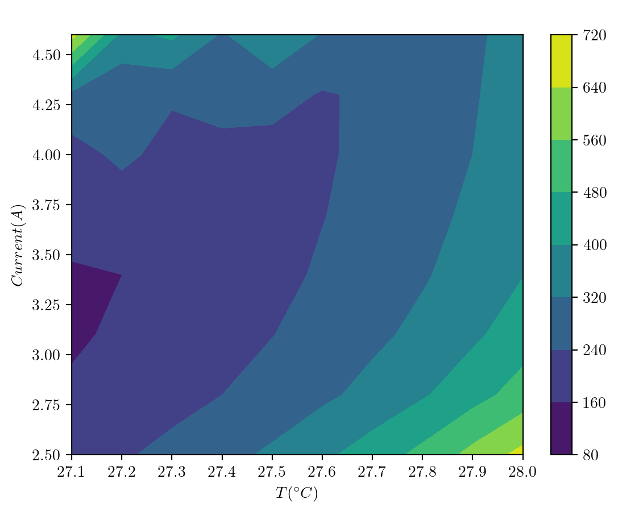
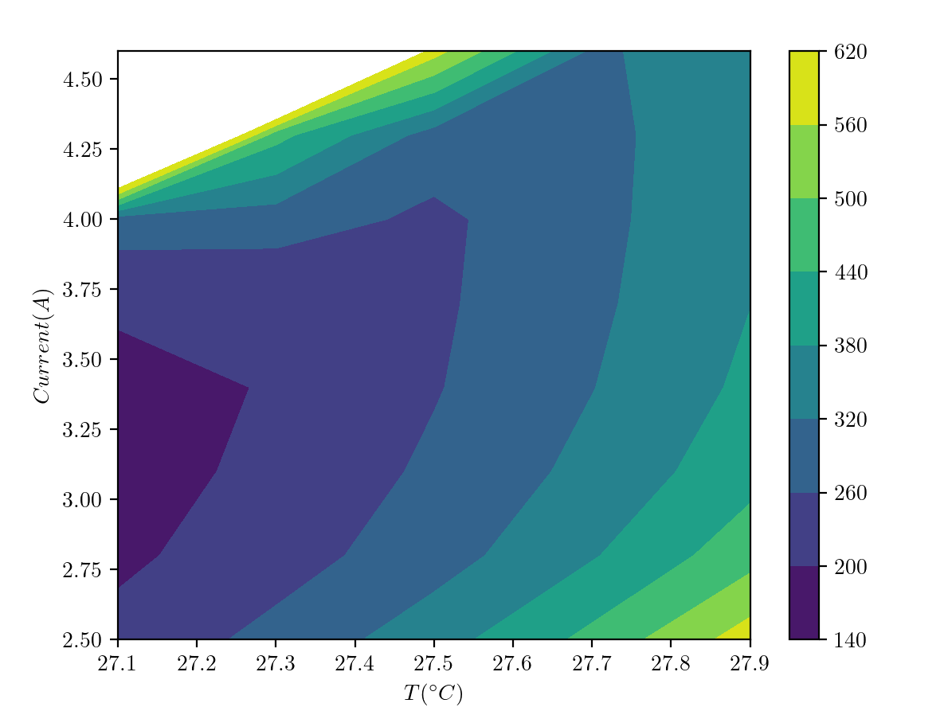
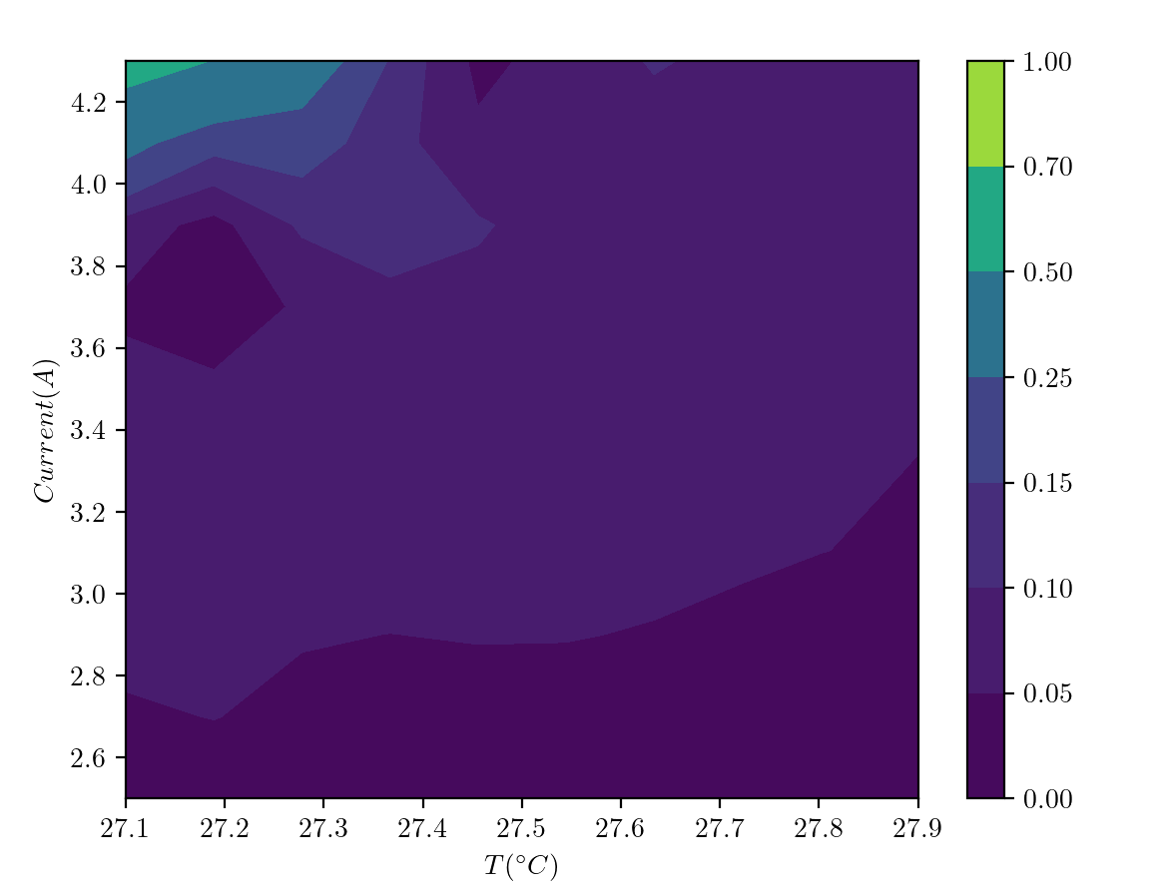
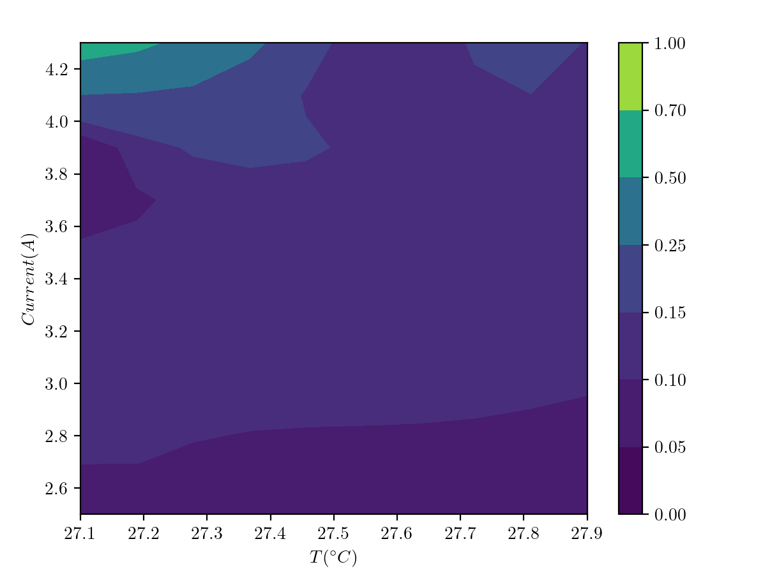
Magnetometer
02-28
03-11
02-28 vs. 03-11
03-11 vs. 03-18
Magnetometer sensitivity has not reached the expectation due to the mismatch of laser and gas chamber freq.;
Sensitivity is observed to fluctuate over time;

Slide 5
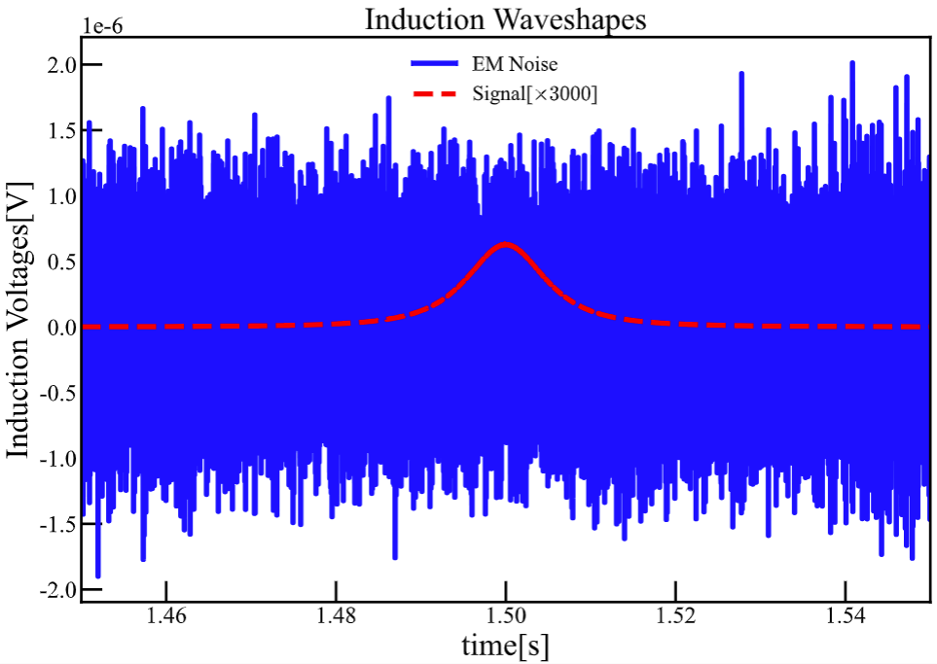
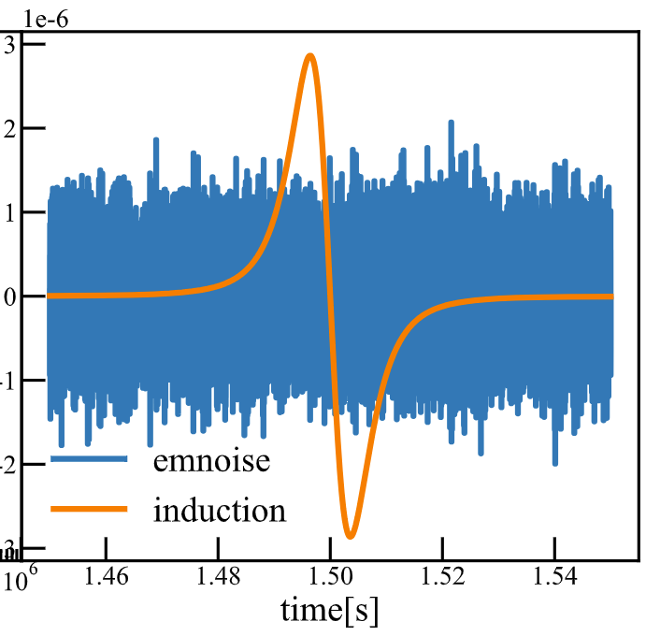
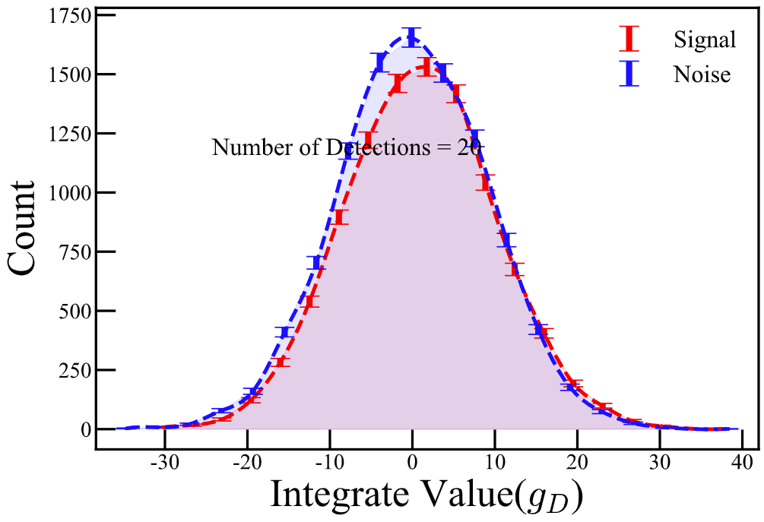
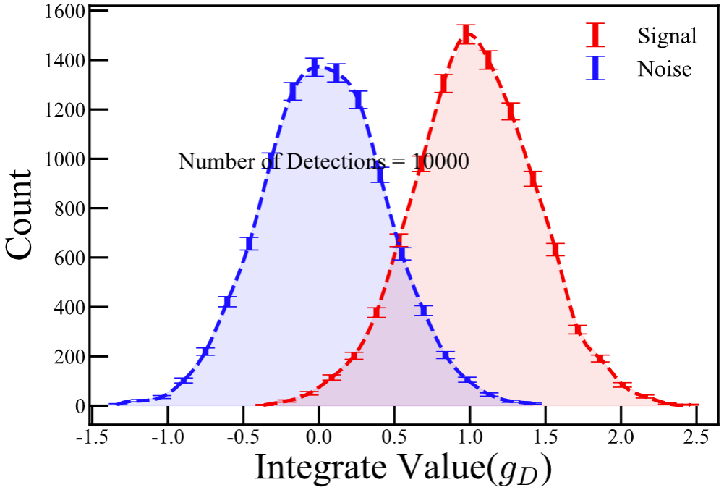
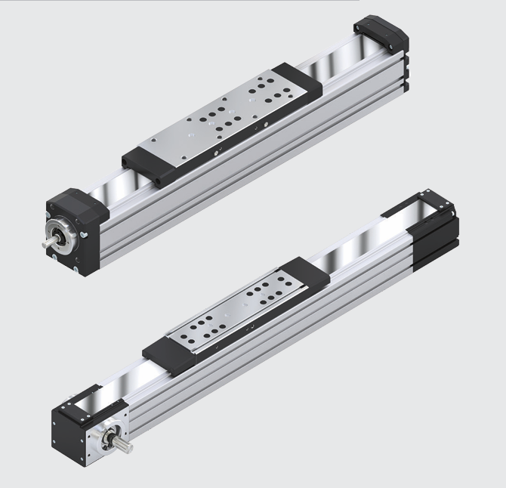
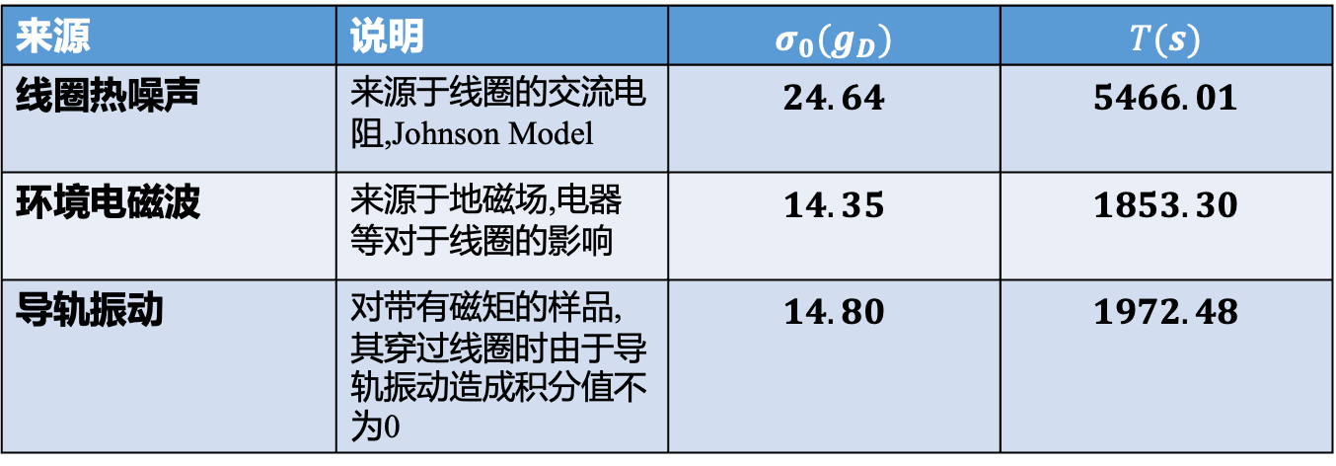
Monopole Sampler
Monopole Signal
Dipole Signal
Measure 20 times
Measure 2000 times
Sample is passed the coil multiple times!
来源 | 说明 | $$σ_{0}(g_{D})$$ | $$T(s)$$
线圈热噪声 | 来源于线圈的交流电阻,Johnson Model | $$24.64$$ | $$5466.01$$
环境电磁波 | 来源于地磁场,电器等对于线圈的影响 | $$14.35$$ | $$1853.30$$
导轨振动 | 对带有磁矩的样品,其穿过线圈时由于导轨振动造成积分值不为0 | $$14.80$$ | $$1972.48$$

Slide 6
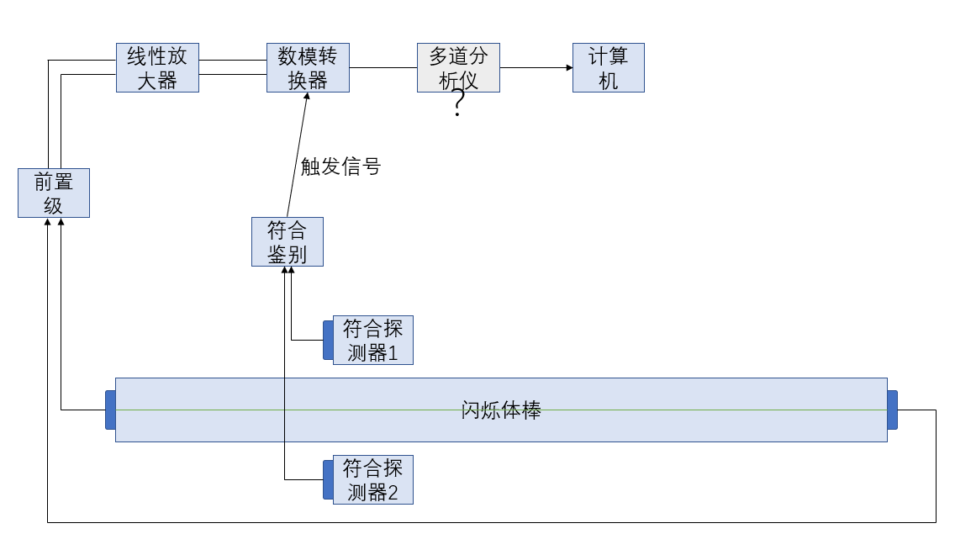
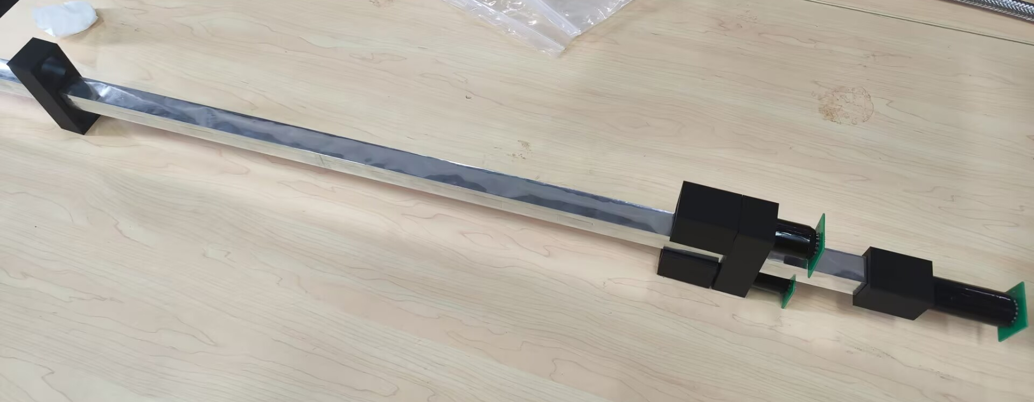
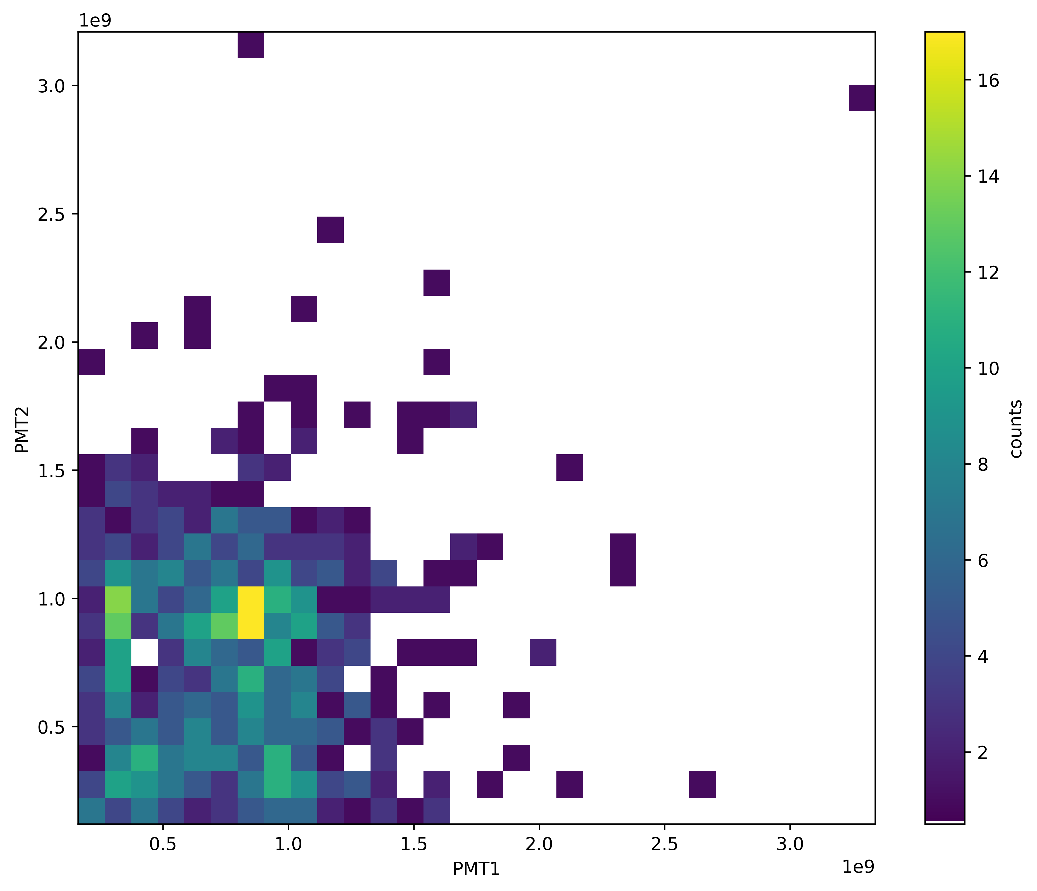
Scintillator Test
Only two tagging detectors!
Two PS options:
Pure PS + PMTs;
PS with wavelength fiber + SiPM;
Seen muon; Light yield is 1/3 of Sim;

Slide 7
Backups

