Slide 1
The Physics of the Dark Photon
张 宇
合肥工业大学 物理学院
邮箱：dayu@hfut.edu.cn
2025年3月7日 合肥 中科大

Slide 2
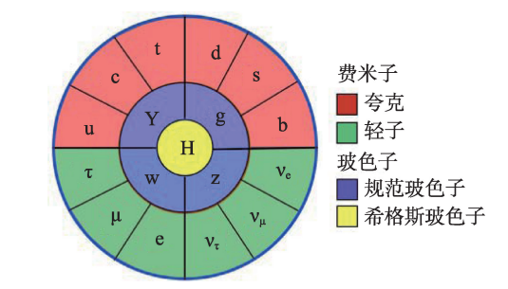
标准模型

Slide 3
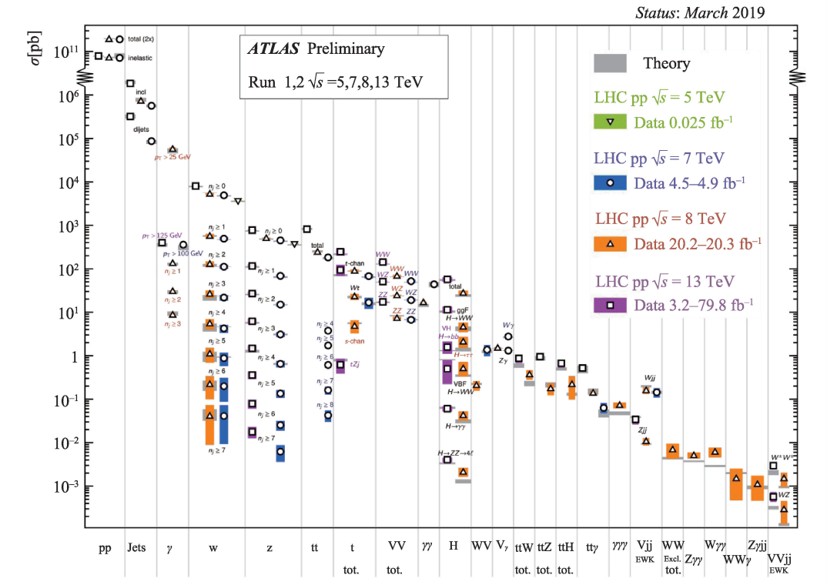
https://atlas.web.cern.ch/Atlas/GROUPS/PHYSICS/PUBNOTES/ATL-PHYS-PUB-2019-024/

Slide 4
我标准模型所向披靡

Slide 6
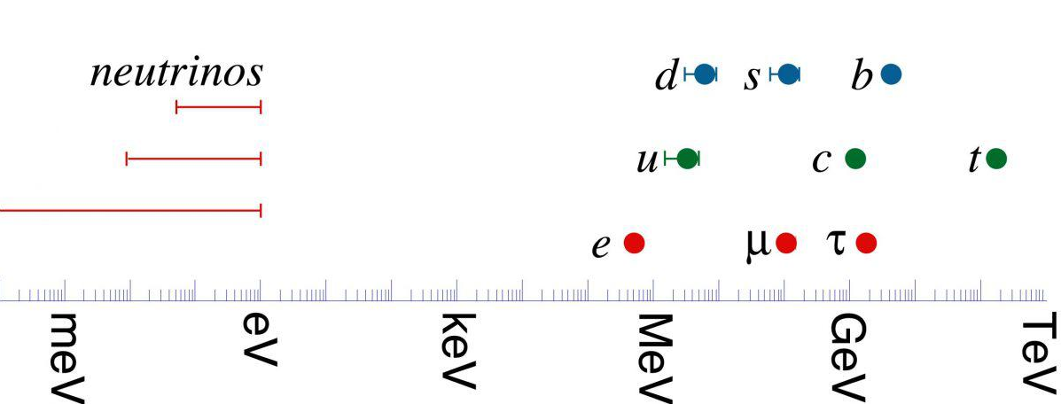
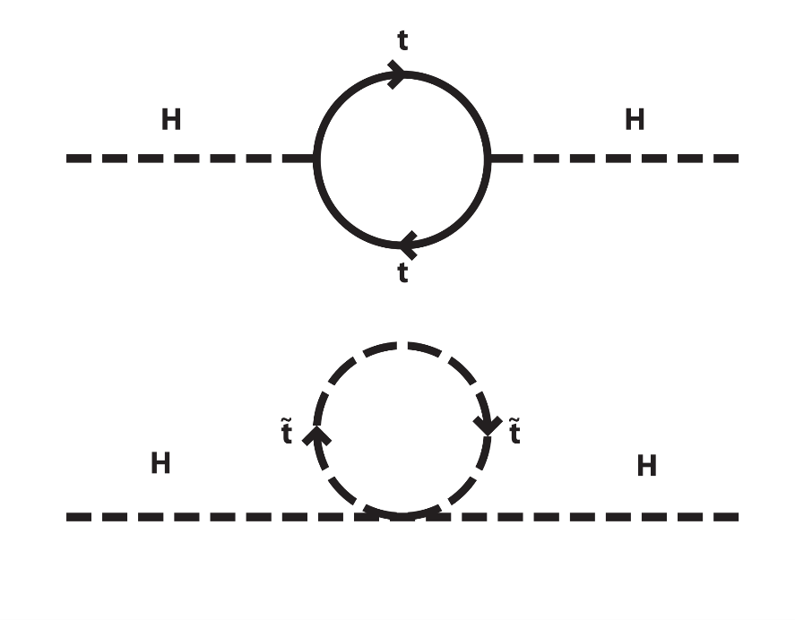
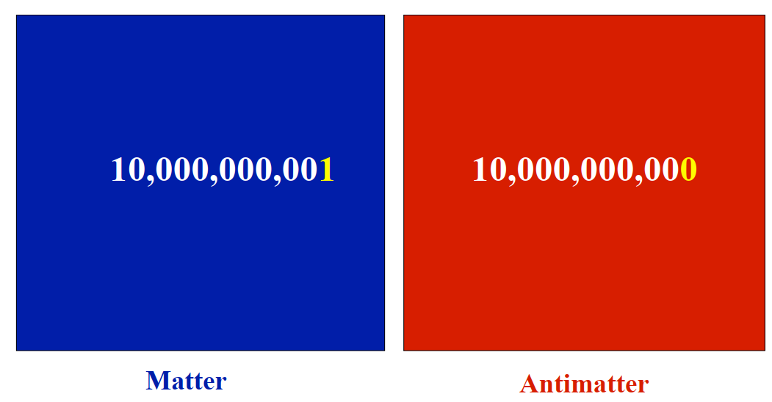
标准模型面临的问题
1. 为何标准模型中粒子质量、特别是费米子质量的差别如此之大？最重的带电粒子(顶夸克)和最轻的带电粒子(电子)间的质量差别高达 5 个量级；如果考虑到中微子，这个差别将达到15个量级。
2. 为何标准模型拥有约20个自由参数？这对于一个基础理论而言未免太多了一些。
3. 为何标准模型中只有一个标量粒子(希格斯玻色子)：它是一个基本粒子，还是一个由更基本的组分组成的粒子？如果存在更基本的组分，那么这些组分是什么？
4. 为何可见宇宙中物质的量远远多于反物质？
5. 中微子的质量。标准模型预言中微子质量为零，和目前的实验观测矛盾。
6. 暗物质和暗能量：按照目前的观测，宇宙学判断宇宙中68%的物质以暗能量形式存在，27%以暗物质形式存在，而标准模型粒子只占宇宙中所有物质的5%。
Notes:
粒子物理学界普遍认为，自然界必然存在超出标准模型的、更为基础的物理规律(新物理规律)；而标准模型则是这些新物理规律的低能有效理论(比如，牛顿力学就是相对论的低能有效理论)。

Slide 7
Dark sector
？

Slide 8
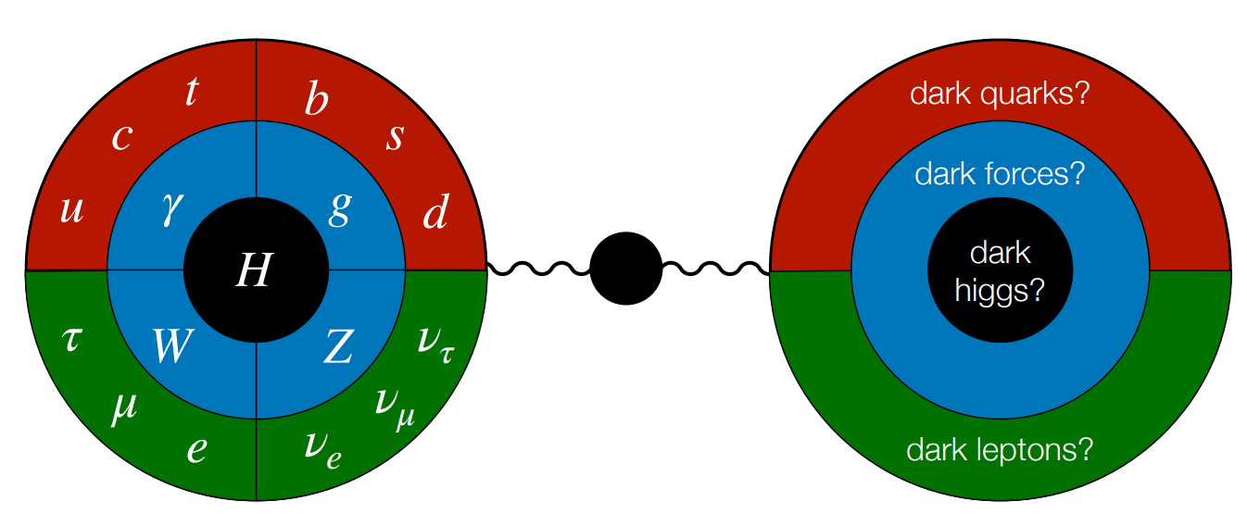
Dark sector
Standard Model
Portal
Dark Sector

Slide 9
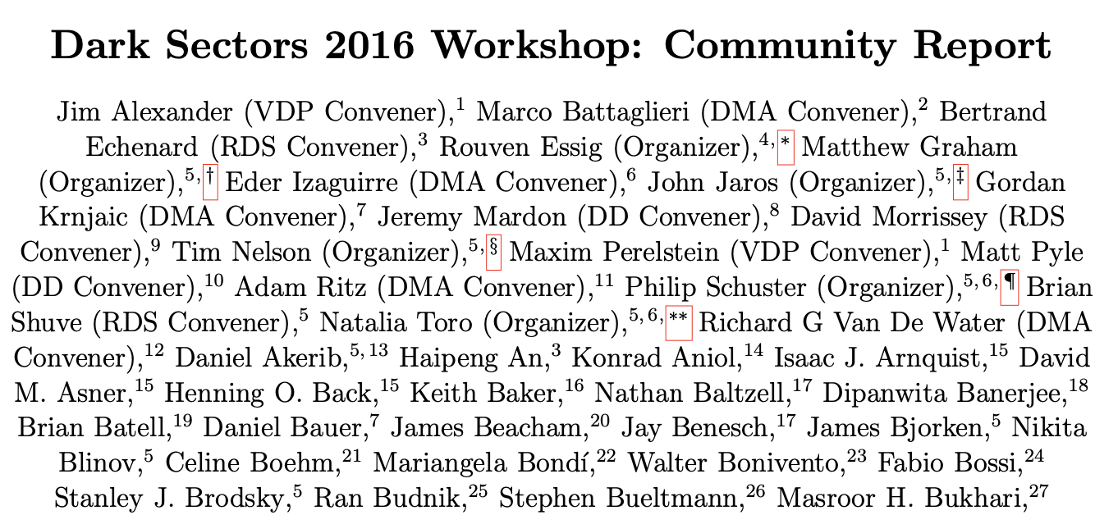
The portal formalism
$$ℒ_{total}=ℒ_{SM}+ℒ_{HS}+ℒ_{portal}$$
$$ℒ_{portal}=∑O_{SM}×O_{HS}$$
arXiv: 1608.08632

Slide 10
Dark Photon Theory

Slide 11
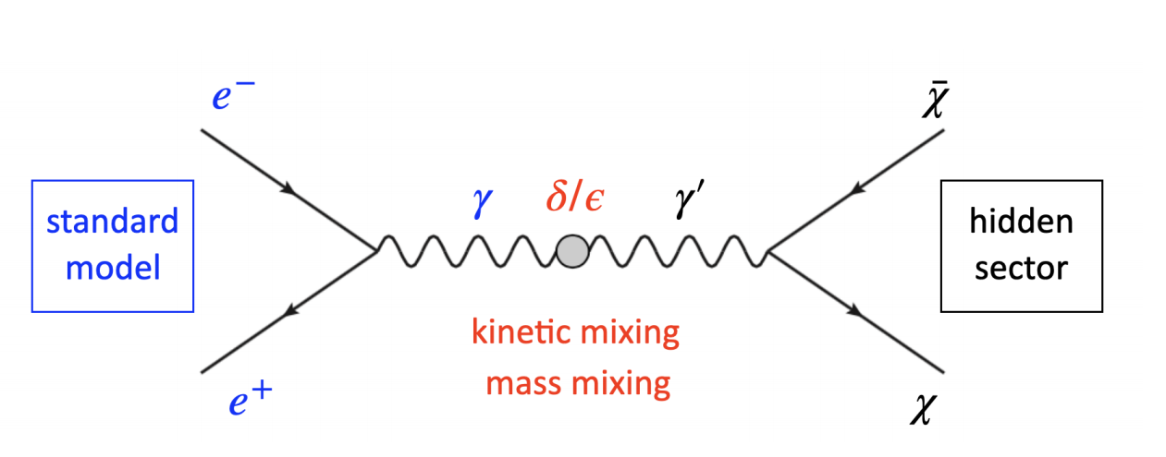
Mixing

Slide 12
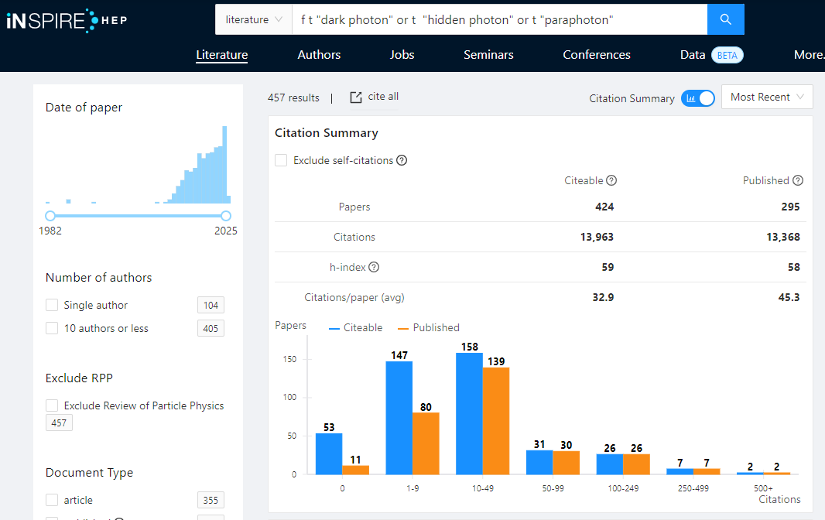
Dark photon
dark photon
hidden photon
paraphoton

Slide 13
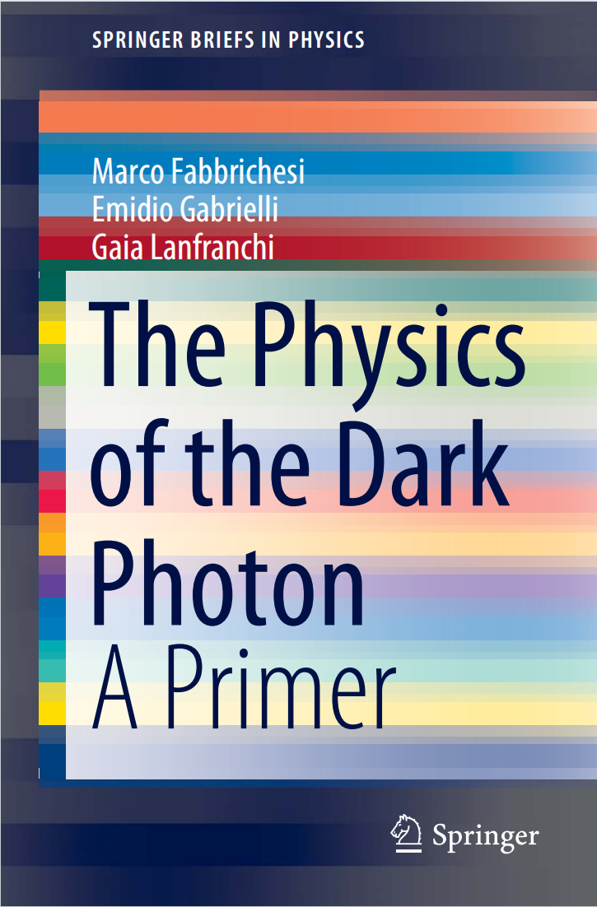
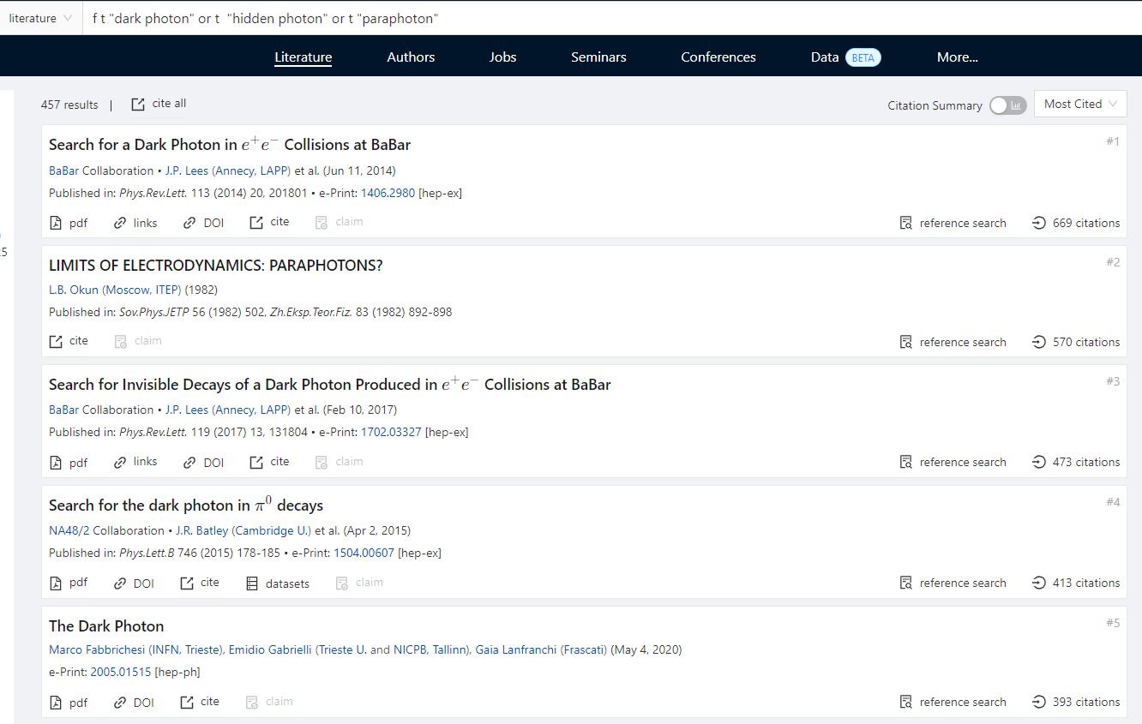

Slide 14
Kinetic Mixing
考虑2个规范玻色子$A_{1}^{μ}$和$A_{2}^{μ}$分别对应于两个$U(1)$规范群
Kinetic mixing parameter
SM current
DS current
B. Holdom, PLB 166, 196 (1986)

Slide 15
Matrix form
定义

Slide 16
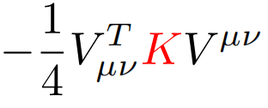
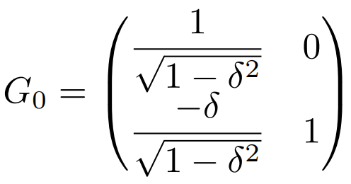
Transformation

Slide 17
Alternative Transformation

Slide 18
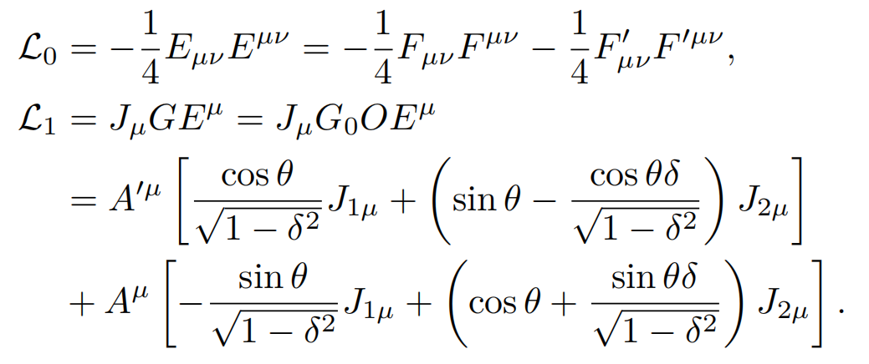
Alternative Transformation
DS current
SM current

Slide 19
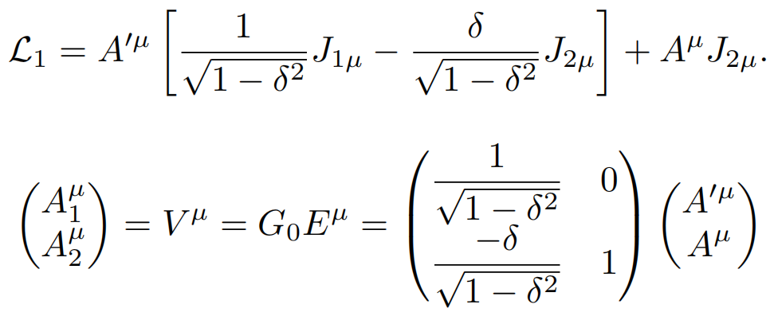
Model I
Dark photon与dark current和SM current都有相互作用；
SM photon只与SM current作用
dark photon

Slide 20
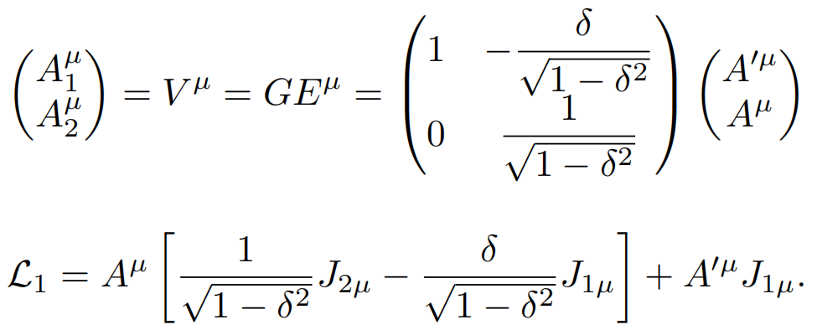
Model II
SM photon与dark current和SM current都有相互作用；
dark photon只与dark current作用
millicharge
dark photon

Slide 21
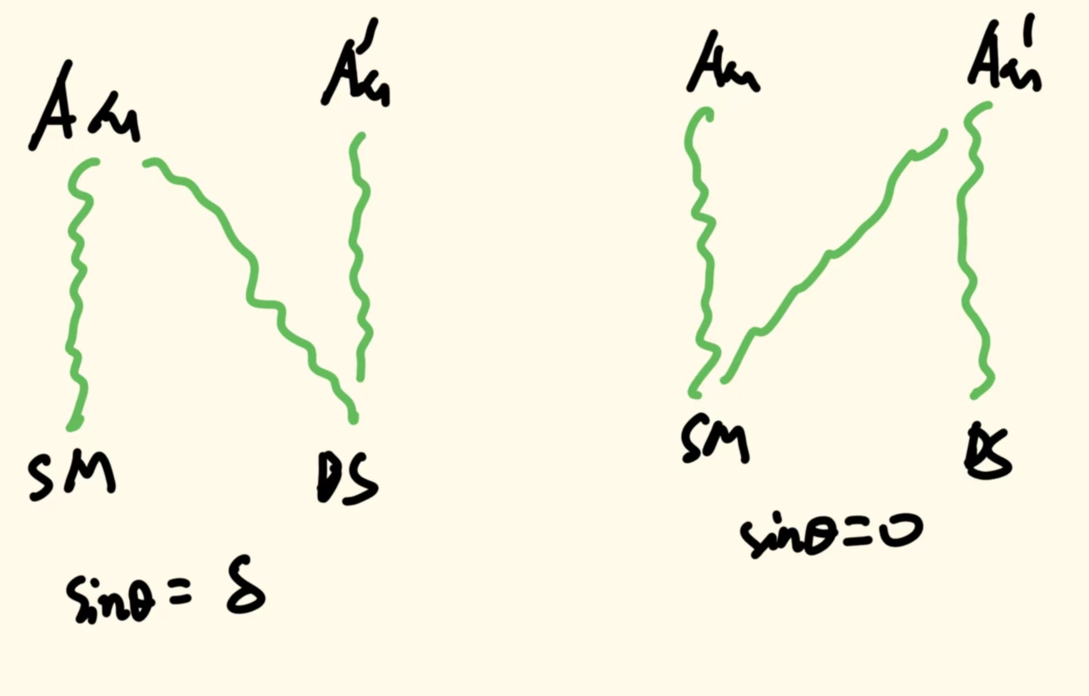
Massless dark photon
δ是kinetic mixing parameter,
θ是基矢自由转动参数

Slide 22
Model III: Massive case
Stuckelberg mass term
Mass mixing
矩阵M²的行列式为零，可以给出光子的零质量

Slide 23
Model III: Massive case
如果ε=0，没有millicharge
对于有质量的DP，kinetic mixing不能单独给出millicharge
而只有质量混合却可以给出millicharge
millicharge

Slide 24
Model I v.s. Model III
ε=0

Slide 25
Massless Dark-Photon
Massive Dark-Photon
less explored scenario
most of experimental searches focus on
massive DP scenario (tree-level couplings)

Slide 26
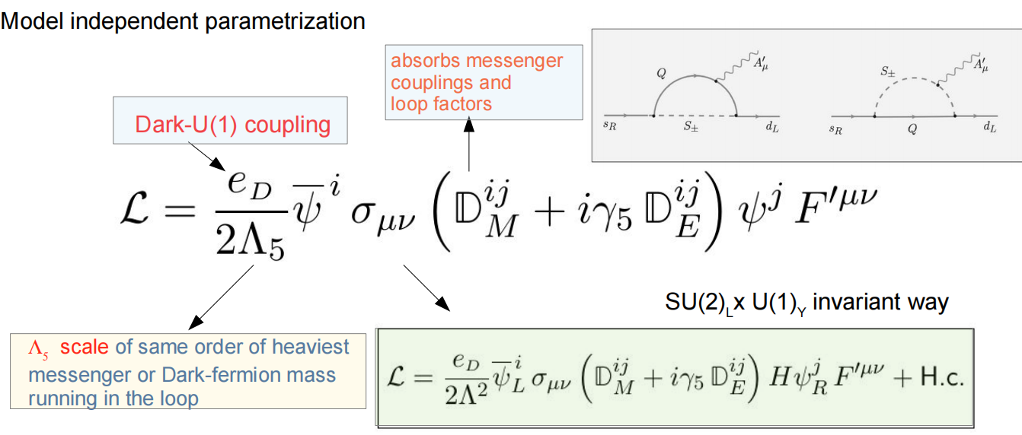
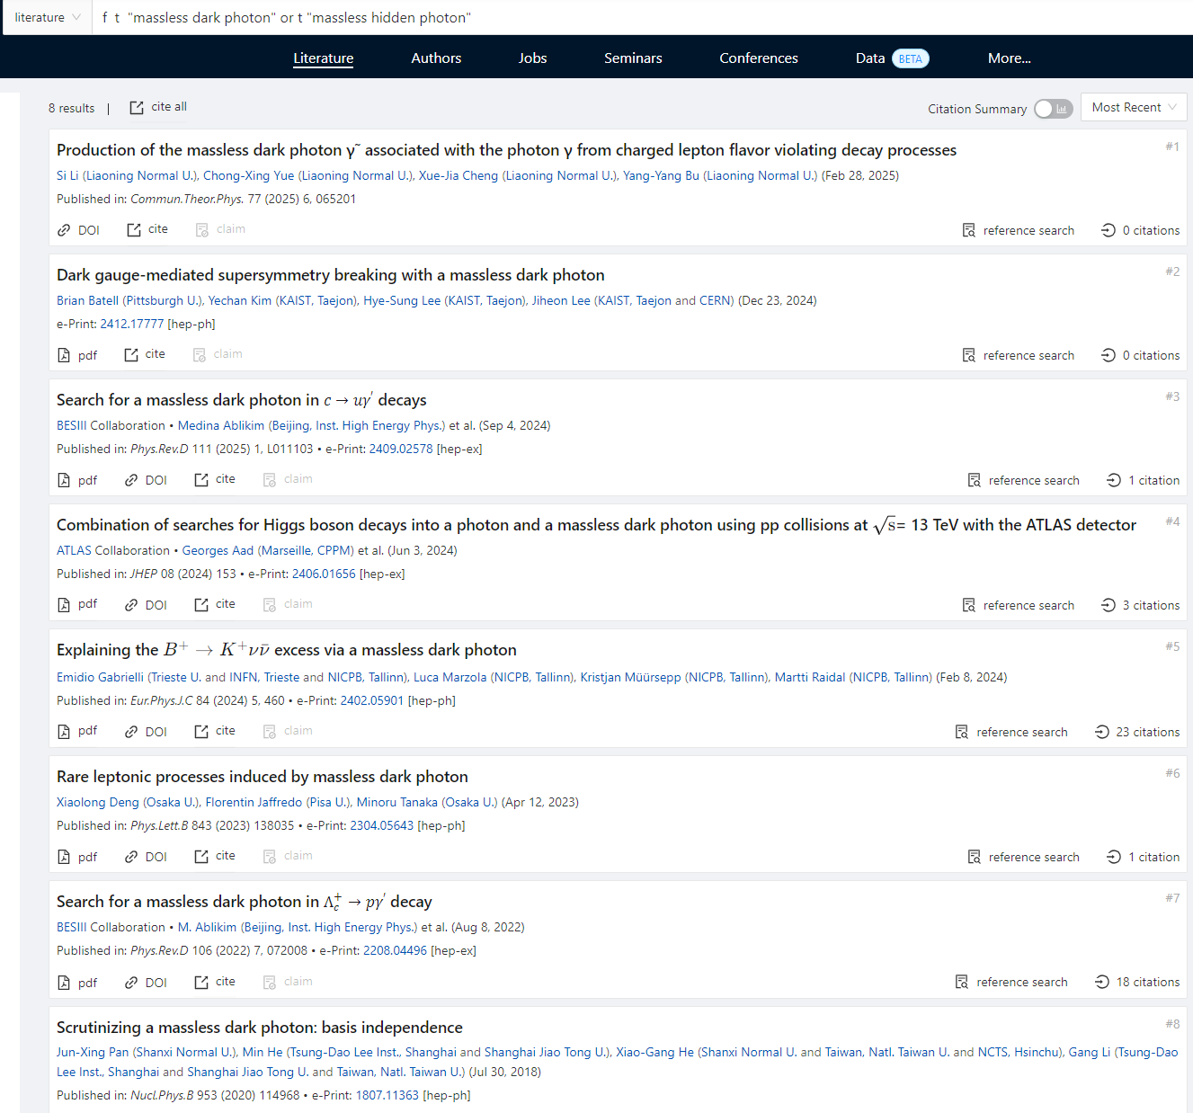
Massless DP

Slide 27
Kinetic mixing with hypercharge

Slide 28
Phenomenology of the massive DP

Slide 29
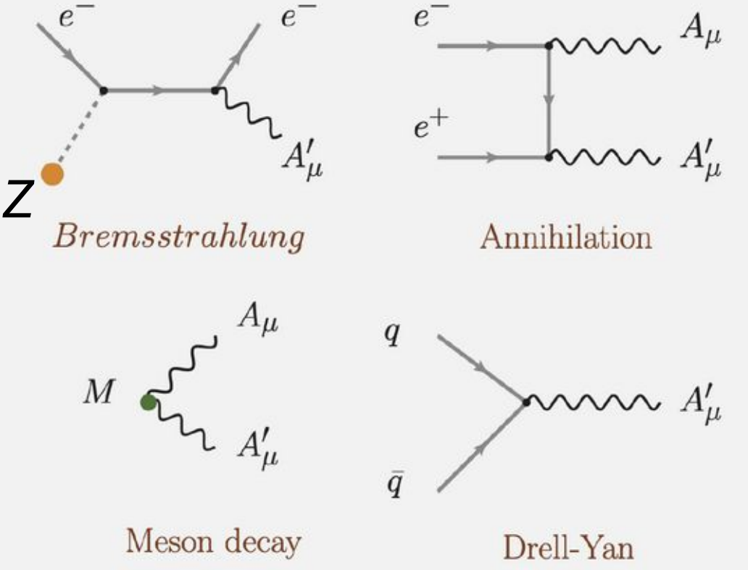
Main Production Mechanisms
Bremsstrahlung
（A1)
target nuclei
Annihilation
(BESIII)
Meson decay
(NA48/2)
Drell Yan
(LHC)
tree-level couplings

Slide 30
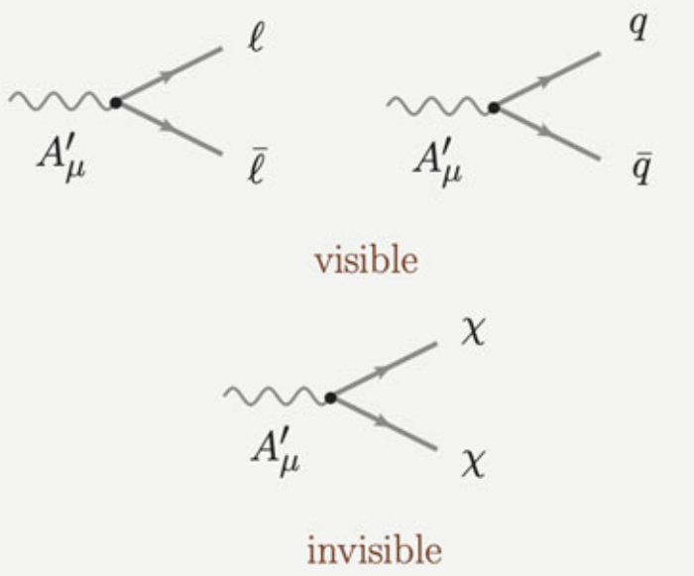
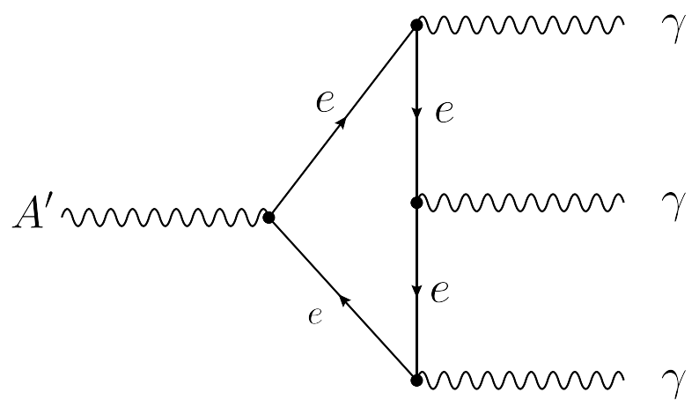
Main Decay Channels

Slide 31
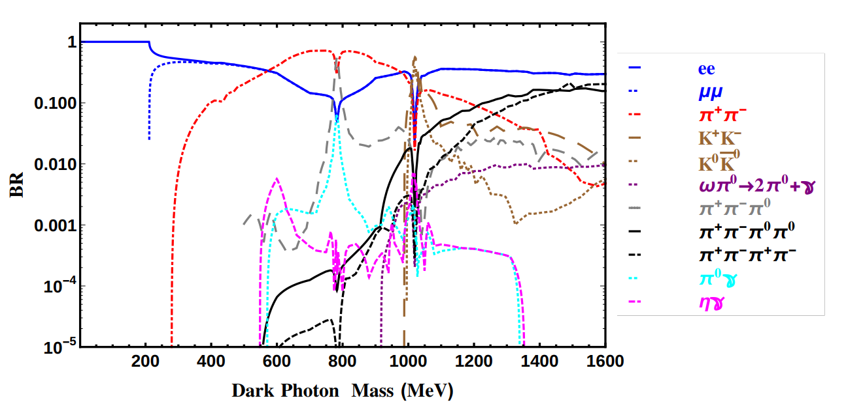
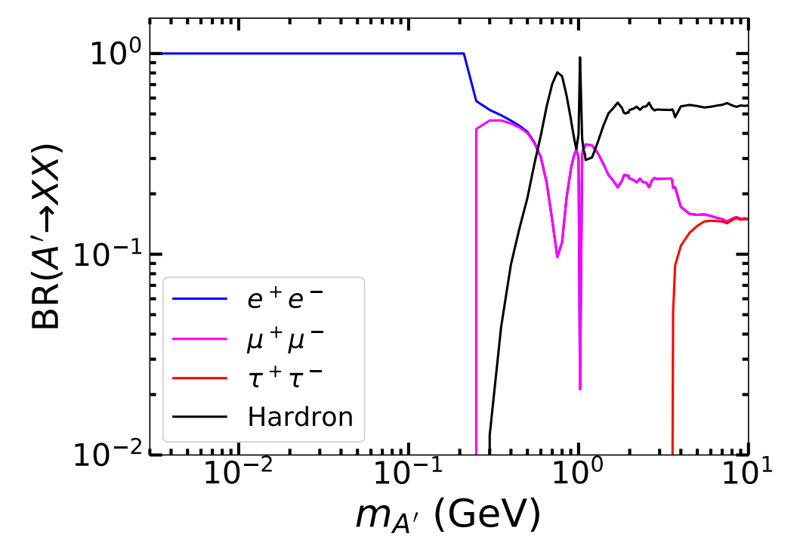
Visible decay BR
1412.1485
1912.00422

Slide 32
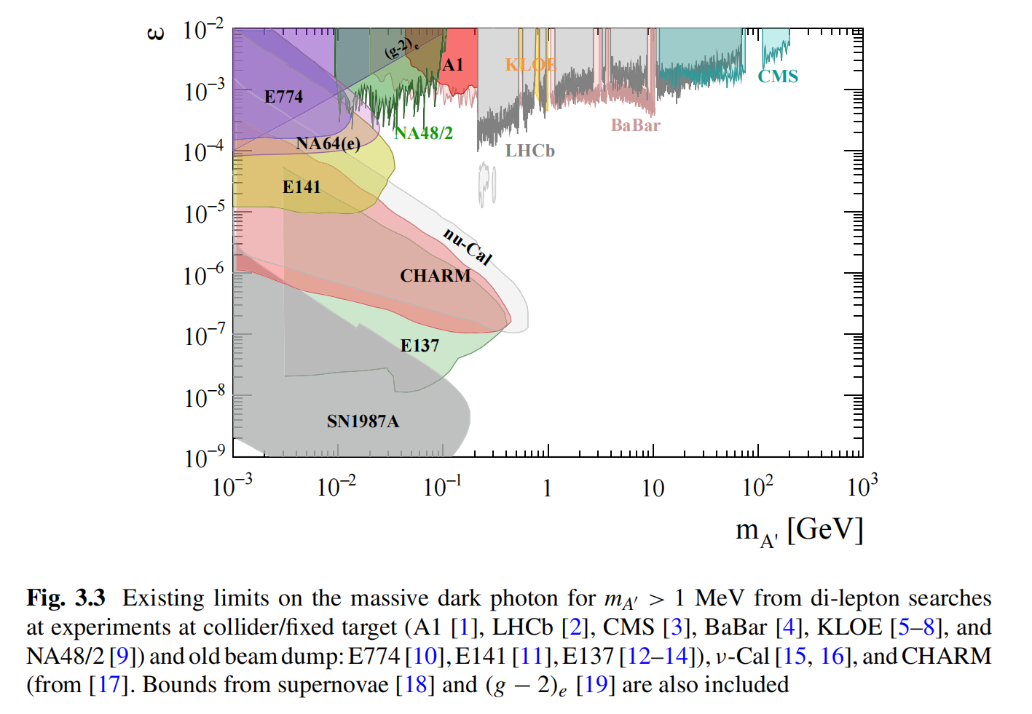
Existing limits on the massive DP(visible)
From di-lepton searches
Colliders:
Electron colliders: KLOE, BaBar, BESIII
LHC: LHCb, CMS
Fix target: A1, NA48/2
Beam dump: E774, E141, E137, ν-Cal,CHARM

Slide 33
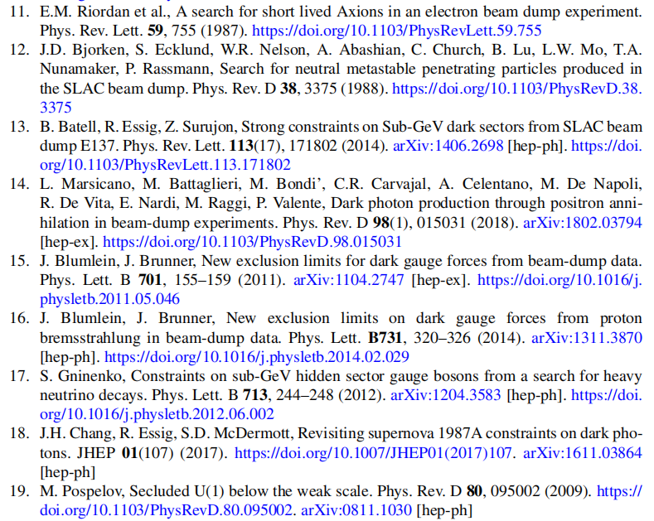
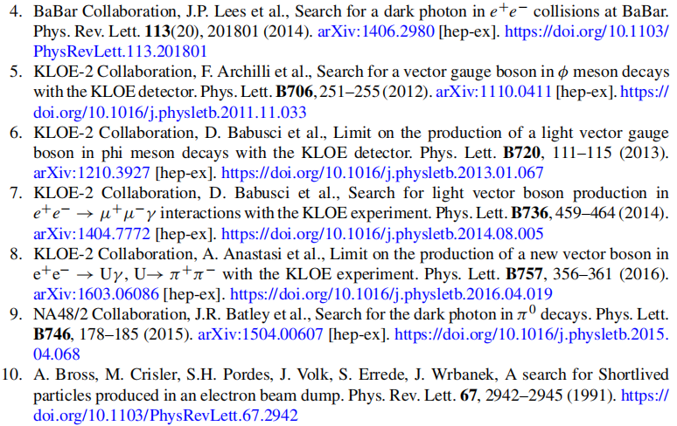

Slide 34
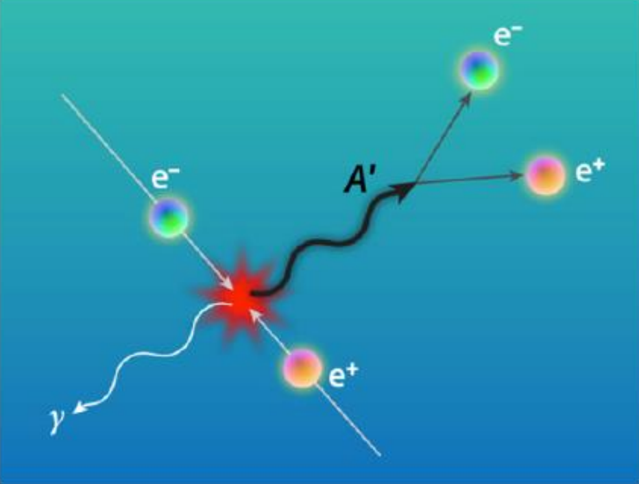
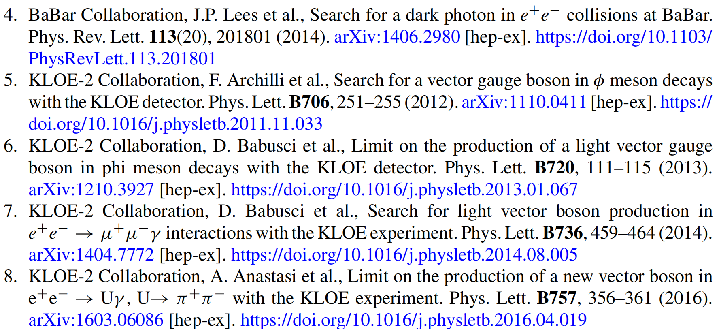
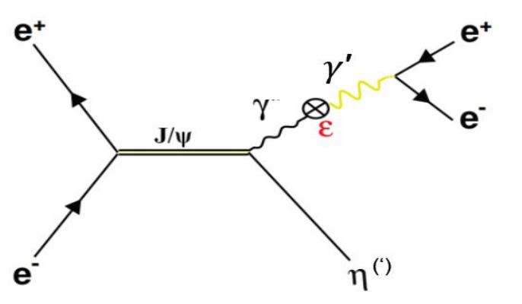
DP at electron colliders (visible)
Initial State Radiation Process

Slide 35
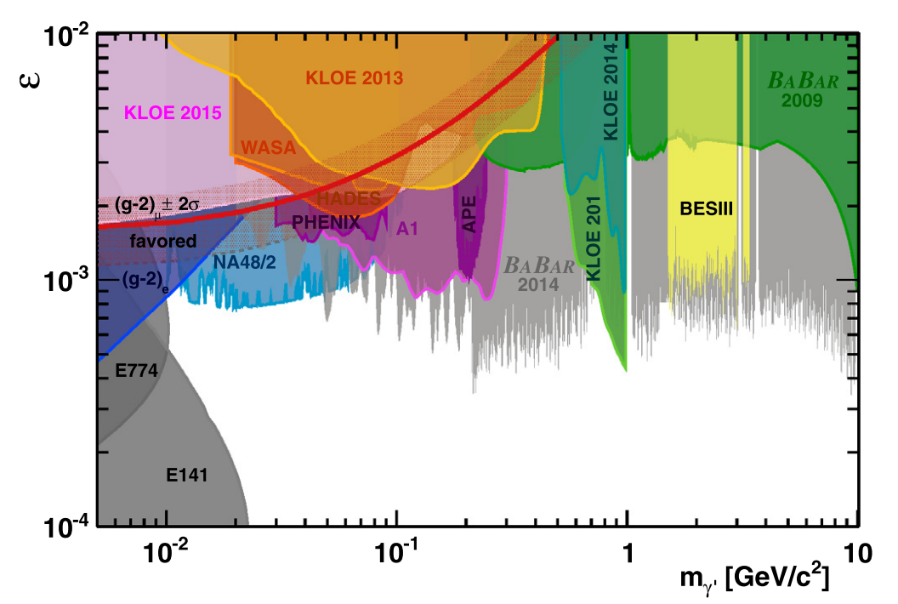
DP at electron colliders (visible)

Slide 36
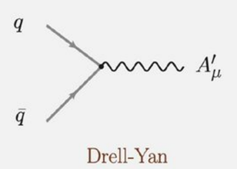
DP at LHC (visible)

Slide 37
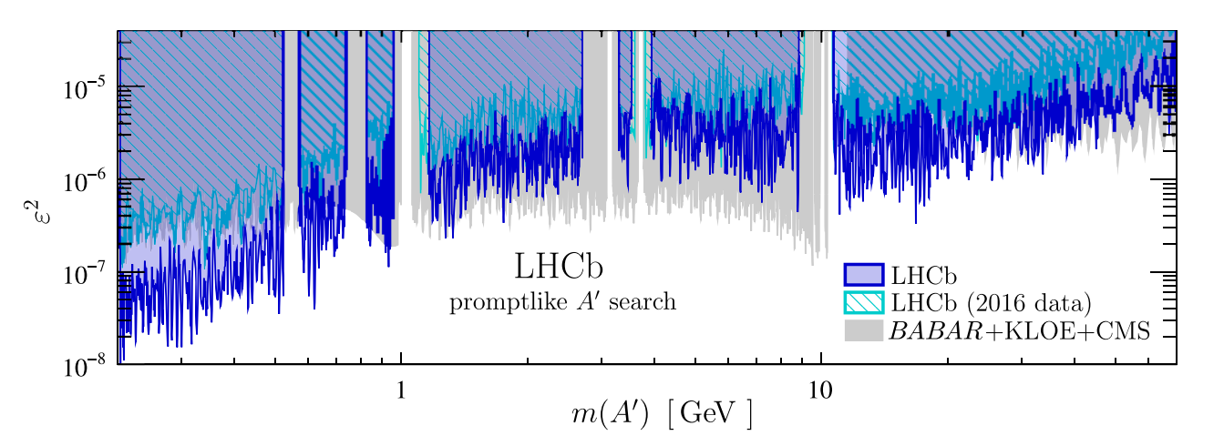
DP at LHC (visible)

Slide 38
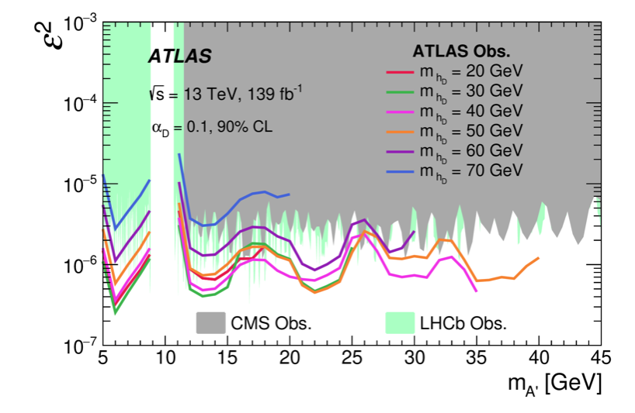
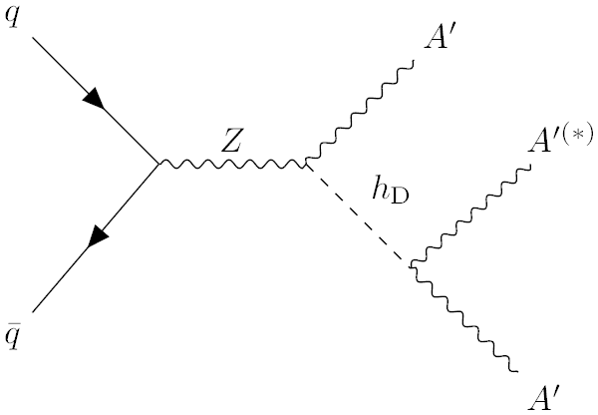
Search for Dark Photons in Rare Z Boson Decays with the ATLAS Detector,
Phys. Rev. Lett. 131, 251801,https://doi.org/10.1103/PhysRevLett.131.251801
中国科大ATLAS国际合作组

Slide 39
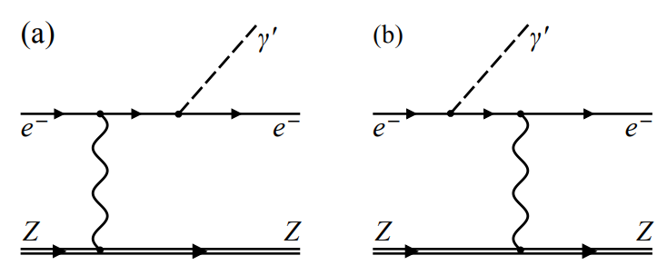
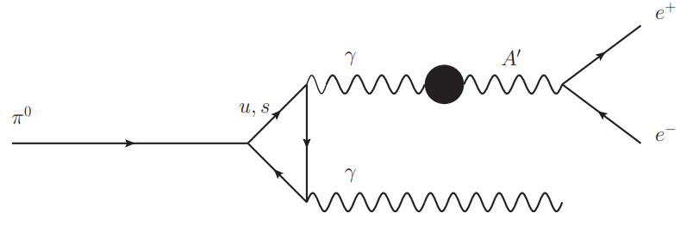
DP at Fix-Target/Beam-Dump (visible)

Slide 40
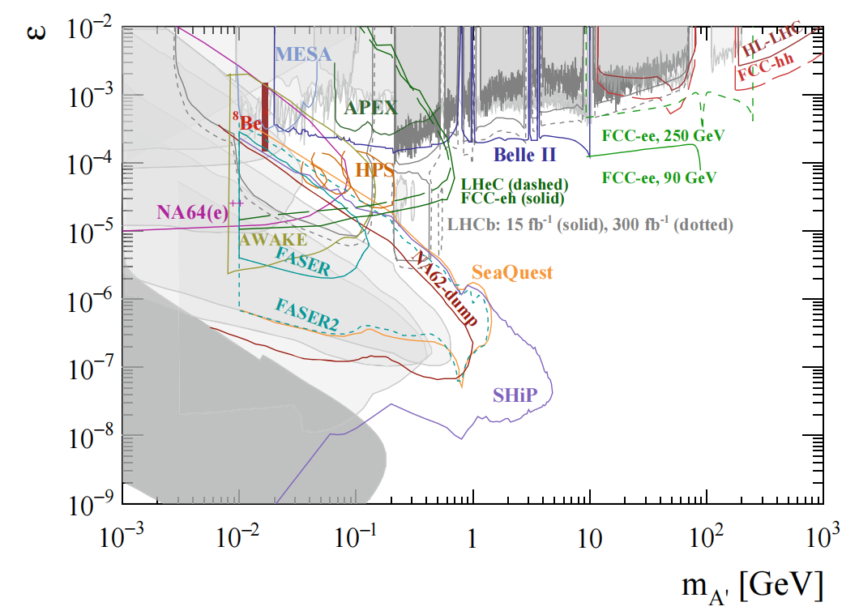
Projection on the massive DP(visible)
Belle-II [20] at SuperKEKb; LHCb upgrade [21, 22] at the LHC; NA62 in dump mode [23] and NA64(e)⁺⁺ [24] at the SPS; FASER and FASER2 [25] at the LHC; SeaQuest [26] at Fermilab; HPS [27] at JLAB; an NA64-like experiment at AWAKE [28], MESA [29, 30]. For ATLAS/CMS during the HL-LHC [31] and future FCC-ee [32], LHeC/FCC-eh [33], and FCC-hh [31]

Slide 41
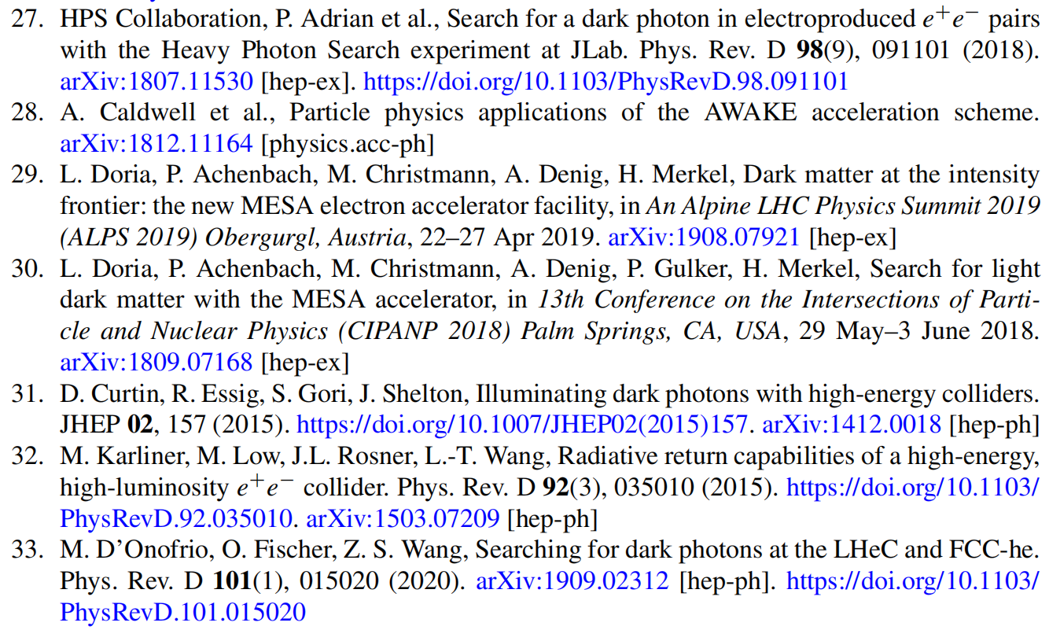
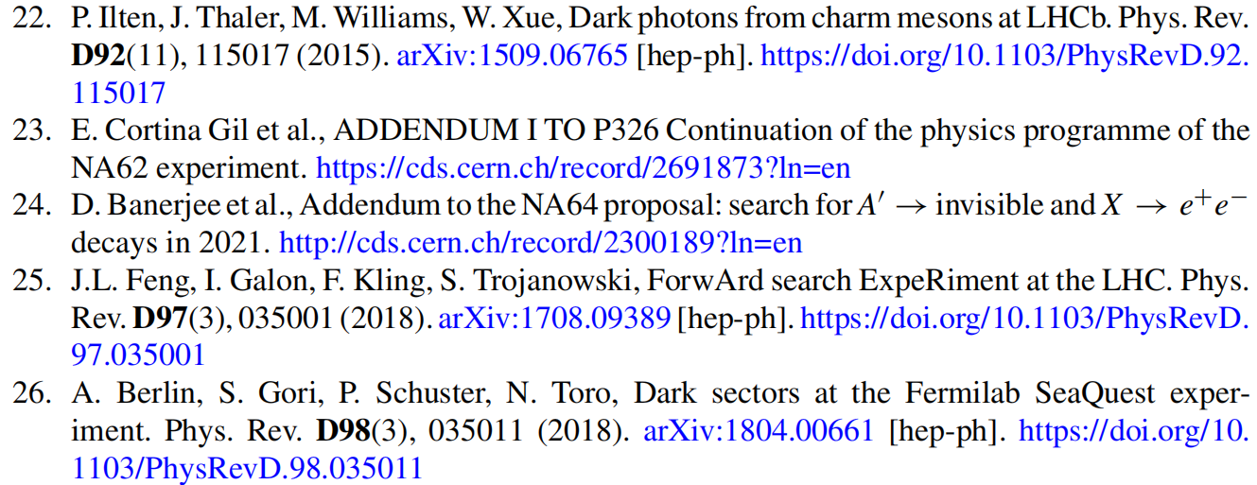

Slide 42
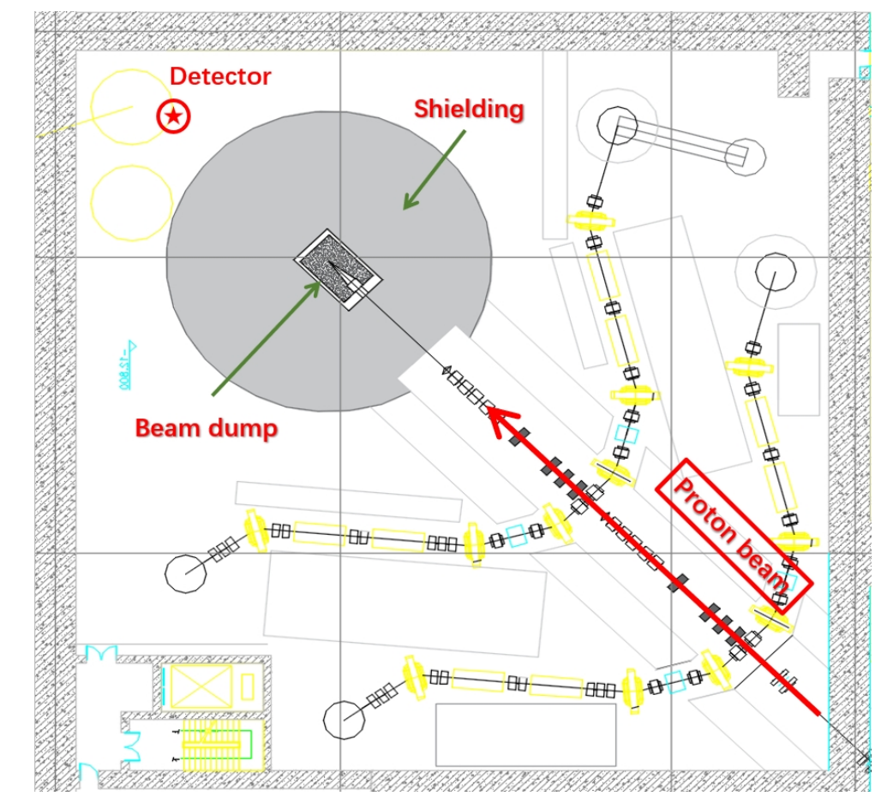
A beam-dump experiment at CiADS
The proposed location of the detector is displayed in Figure as a red circle with a star inside. The detector is to be placed 10 m behind the beam dump. If a shorterdistance is taken, we expect larger acceptance rates of the detector to the LLPs but also higher levels of background events. For the HIAF-BDE, we assume similardesigns and locations of the detector behind the dump.
Chen, Liangwen; Du, Mingxuan; Sun, Zhiyu; Wang, Zeren Simon; Xie, Fang; Xie, Ju-Jun; Yang, Lei; Yu, Pei; Zhang, Yu 2412.09132

Slide 43
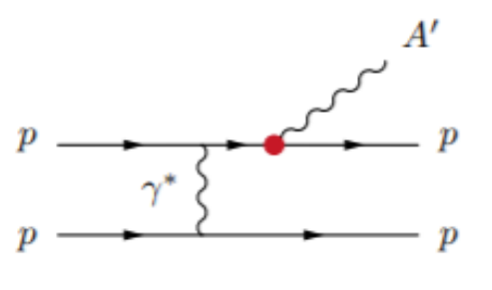
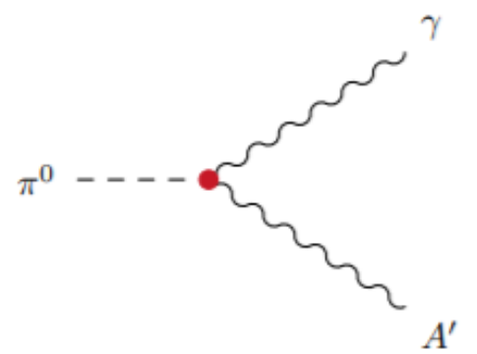
DP searches at CiADS-BD
Meson decays
Proton bremsstrahlung

Slide 44
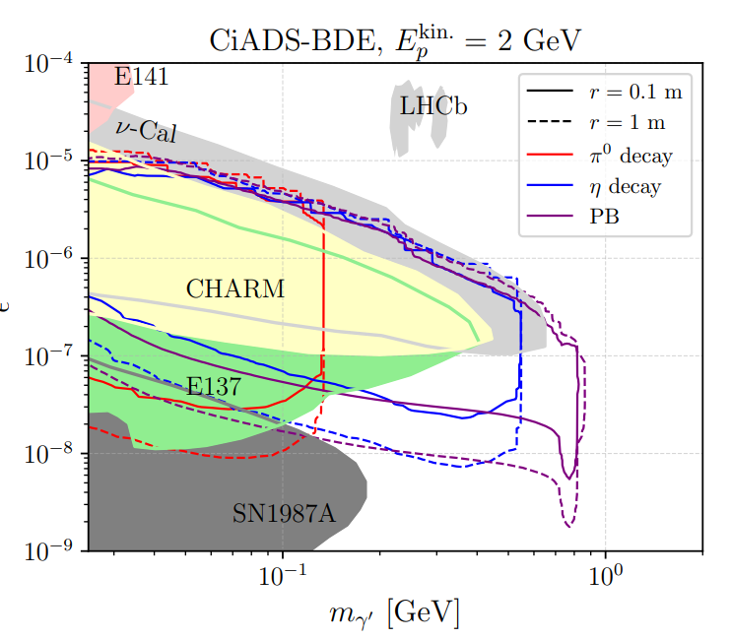
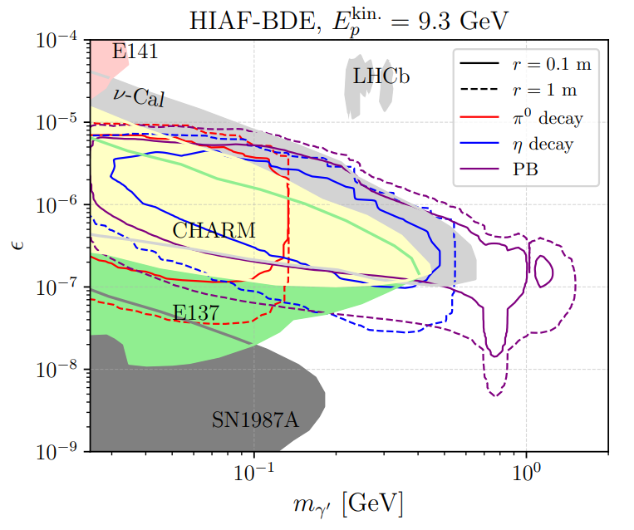

Slide 45
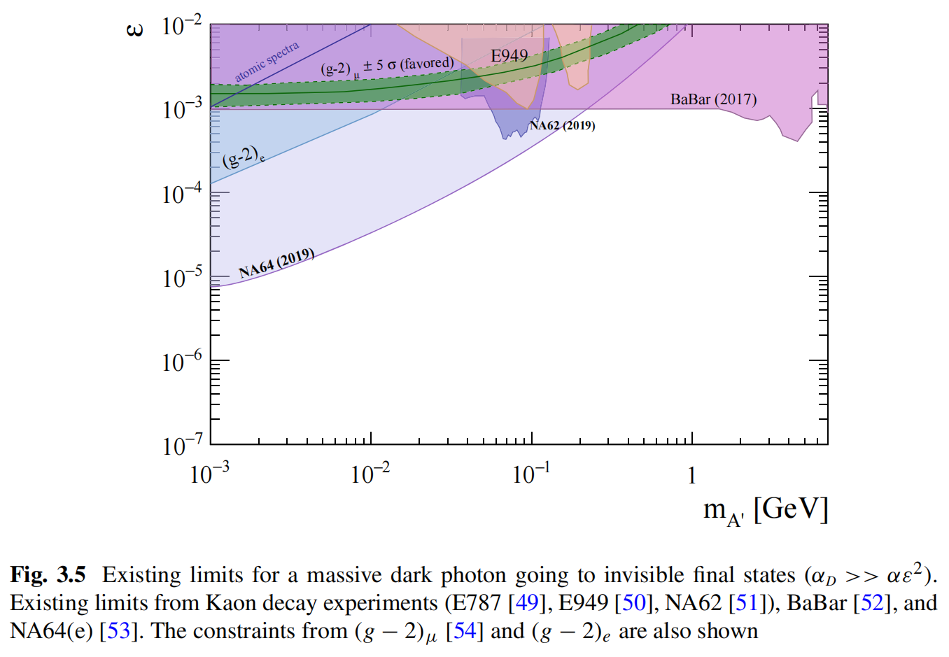
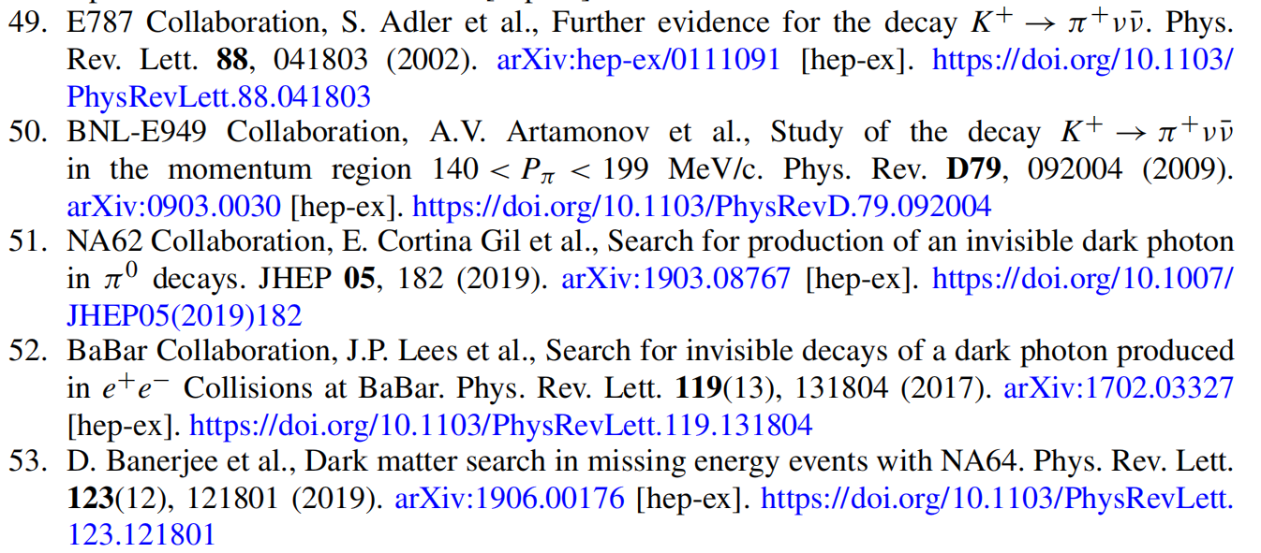
Existing limits on the massive DP (invisible)
$$Br(A^{′}→χ\overline{χ})≃100\%$$
Kaon decay experiments:
E787, E949, NA62
BaBar
NA64(e)

Slide 46
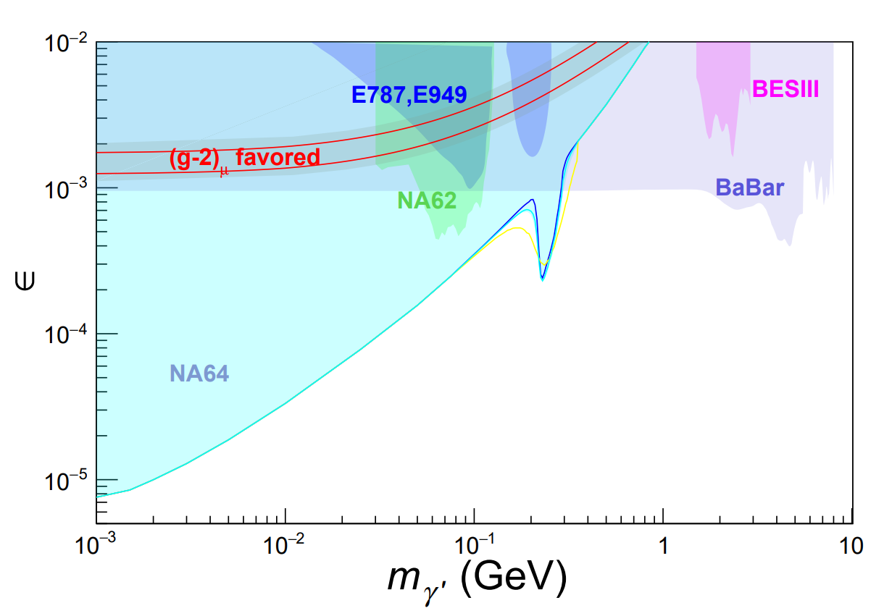
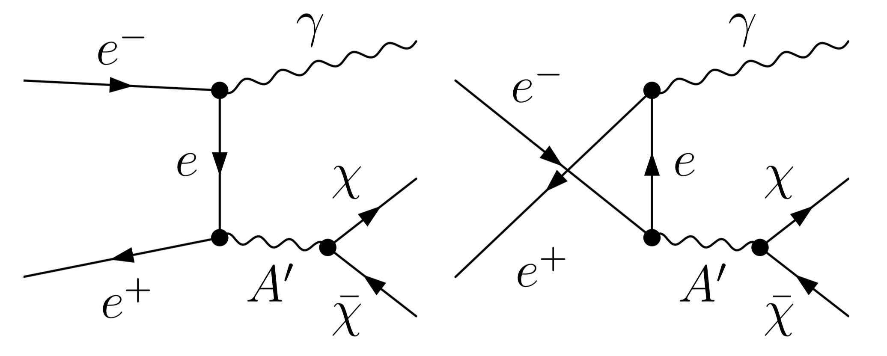
DP at electron colliders (invisible)
BESIII, 2209.13893

Slide 47
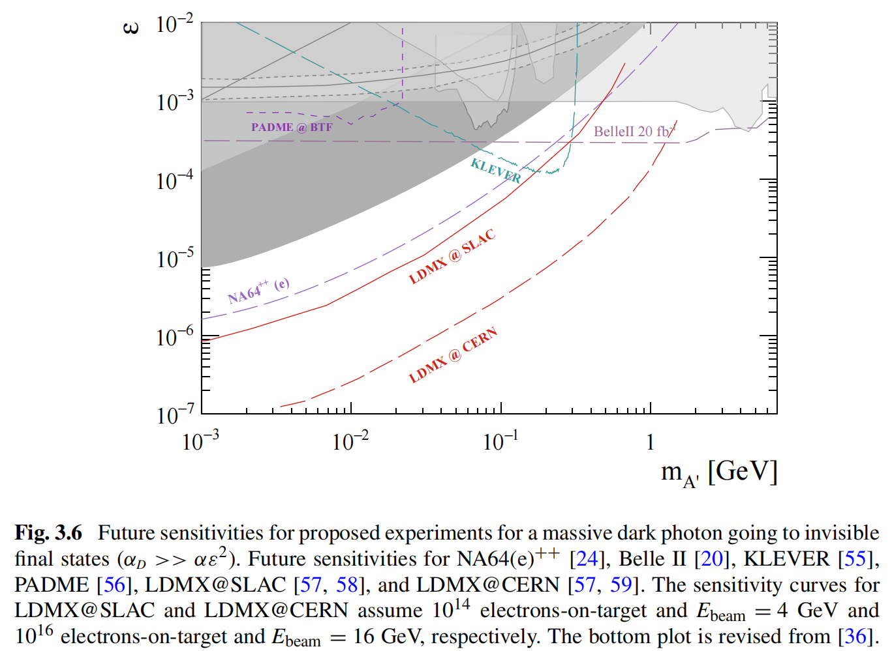
Projection on the massive DP (invisible)
NA64(e)++: at the SPS；
electrons-on-target
KLEVER: at the SPS;
Kaon experiments
PADME: positron beam on a diamond target
LDMX electrons-on-target

Slide 48
DP at electron colliders (invisible)
Y. Zhang, et al., Phys. Rev. D 100 (2019), 115016.
DarkSHINE, Sci.China Phys.Mech.Astron. 66 (2023) 1, 211062

Slide 49
Ultra-light DP (<0.1 MeV)
Atomic and nuclear experiments: detect modifications of the Coulomb force. Corrections in Rydberg atoms, Lamb shift and hyperfine splitting in atomic hydrogen
Axion-like particles and helioscopes: Experiments of light shining through a wall
Astrophysics: The non-observation of anomalous energy transport
Cosmology: The oscillation between the ordinary and the massive dark photon γ → A’ induces deviations on the black body spectrum
Dark Photon Dark Matter
A. Caputo, et. al., 2105.04565
https://cajohare.github.io/AxionLimits/docs/dp.html

Slide 50
Millicharged Particle

Slide 51
Charge quantization
Dirac’s paper on magnetic monopole & charge quantization in 1931

Slide 52
Millicharge
In general, electric charge can be of any value
$ℒ_{int}=εeA_{μ}\overline{χ}γ^{μ}χ$
$ε≪1$, $χ$ is millicharged particle
Stringent constraints on millicharge of SM particles

Slide 53
Millicharge & 21 cm anomaly
DM can cool gas
Millicharged DM cross section
easier to evade early
universe constraints
colder gas or hotter CMB than expected
Bowman et al., Nature 25792 (2018);
Barkana, Nature 25791 (2018);
Munoz, Loeb, Nature 557 (2018) no.7707, 684;
+ others

Slide 54
Current Limits
Jaeckel, Ringwald, arXiv: 1002.0329
http://arxiv.org/abs/2307.07855v2
“detect”
scintillation/ionization/scattering
missing energy

Slide 55
SLAC mQ: electron beam dump experiment
scintillation
counter
electron beam
ordinary charged
particles < 90 m
sandstone
[Prinz et al, PRL 81.1175, 1998]

Slide 56
SLAC mQ constraints on millicharge
[Prinz et al, PRL 81.1175, 1998]

Slide 57
MilliQan: scintillation detector @ LHC
The slab detector will be comprised of 40 cm×60 cm×5 cm scintillator “slabs”

Slide 58
MilliQan sensitivity
arXiv:2104.07151v1

Slide 59
Some future projections

Slide 60
Millicharge at electron colliders
Z. Liu, and YZ, Phys.Rev.D 99 (2019), 015004
YZ, Phys.Lett.B 858 (2024) 139008
J. Liang, Z. Liu, Y. Ma, and YZ, Phys.Rev.D 102 (2020), 015002
Z. Liu, Y. Xu, and YZ, JHEP 06 (2019) 009

Slide 61
Sensitivity with mono-γ
Z. Liu, Y. Xu, and YZ, JHEP 06 (2019) 009
Z. Liu, and YZ, Phys.Rev.D 99 (2019), 015004
J. Liang, Z. Liu, Y. Ma, and YZ, Phys.Rev.D 102 (2020), 015002

Slide 62
Sensitivity with mono-pi0
YZ, Phys.Lett.B 858 (2024) 139008

Slide 64
https://arxiv.org/pdf/2307.07855
https://inspirehep.net/files/db1fe23c3e54d7cc13e24e4a7ec4874e

