Slide 1
LightFCP
Rong Yi
2025/2/28

Slide 2
Selections (MC data sample: Light FCP 4 GeV~1TeV)
Pre-Selections.
  Trigger: G0, G3.
  Good track.
  Fiducial cut.
Remove oblique events.
Remove proton.
  Zeta value.
  nBarLayer13.
Angle difference between BGO track and STK track.
PSD Cuts.
  PSD charge.
  PSD path length.
  PSD two end ratio.
STK Cuts.
  First two layers are hit.
  Remove ladder’s edge cluster, and STK charge cut.

Slide 3
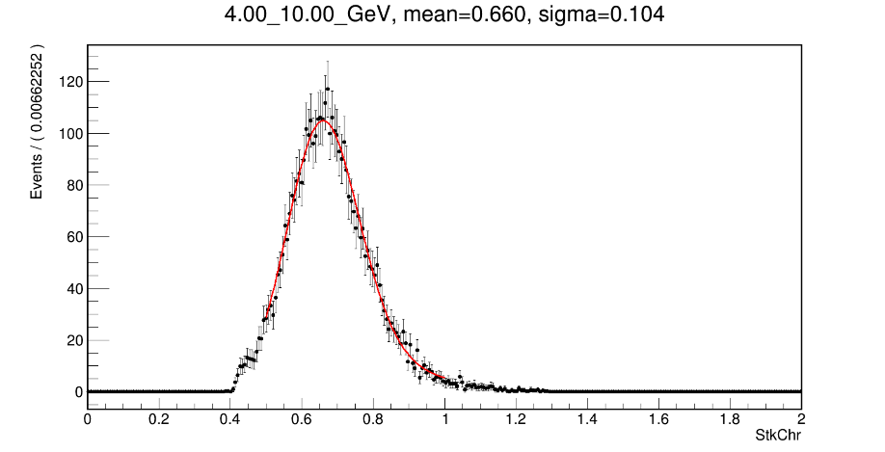
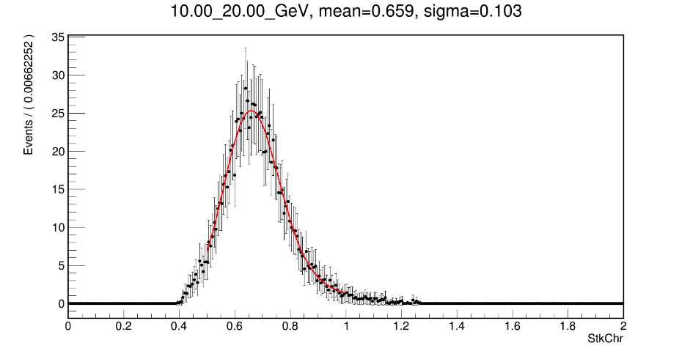
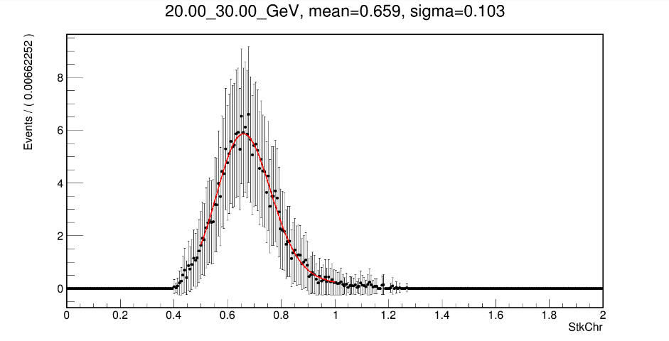
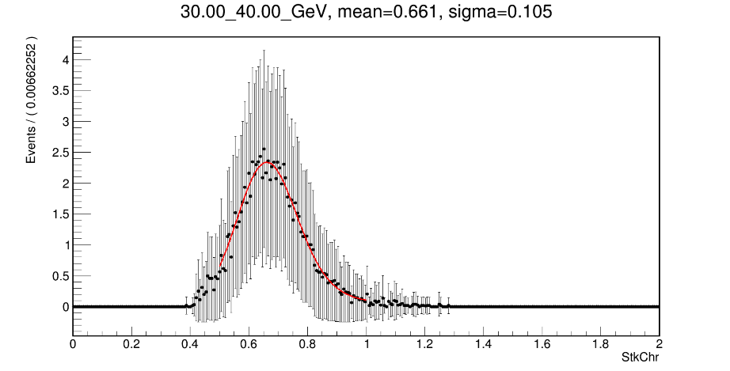
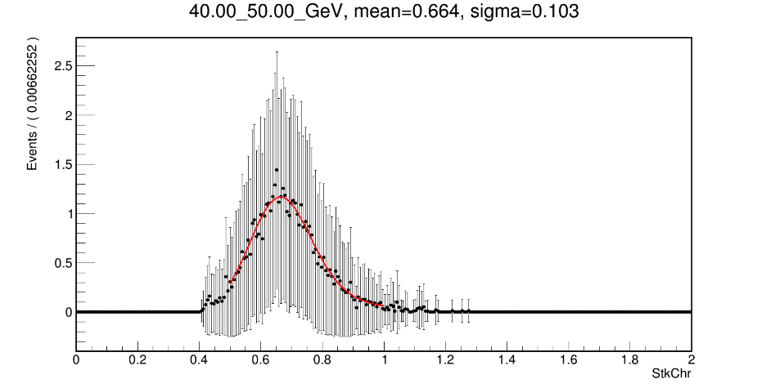
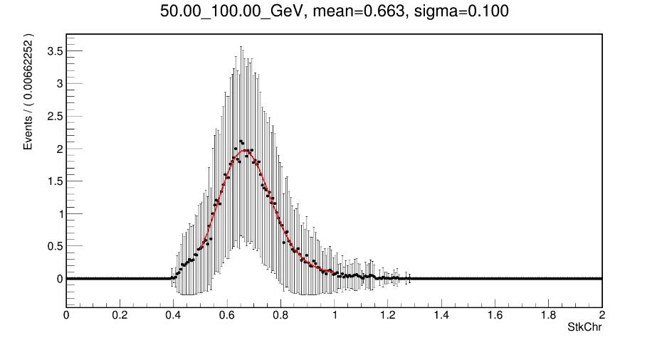
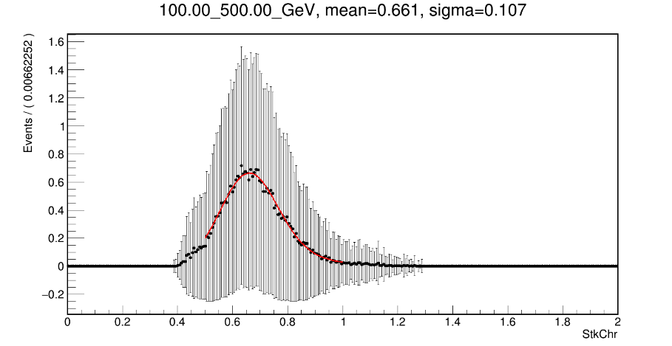
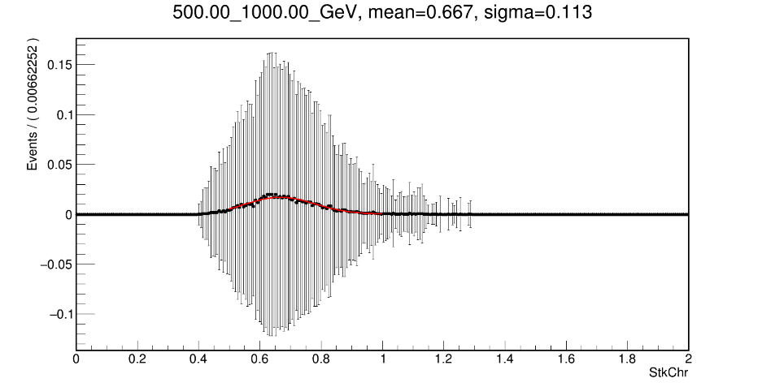
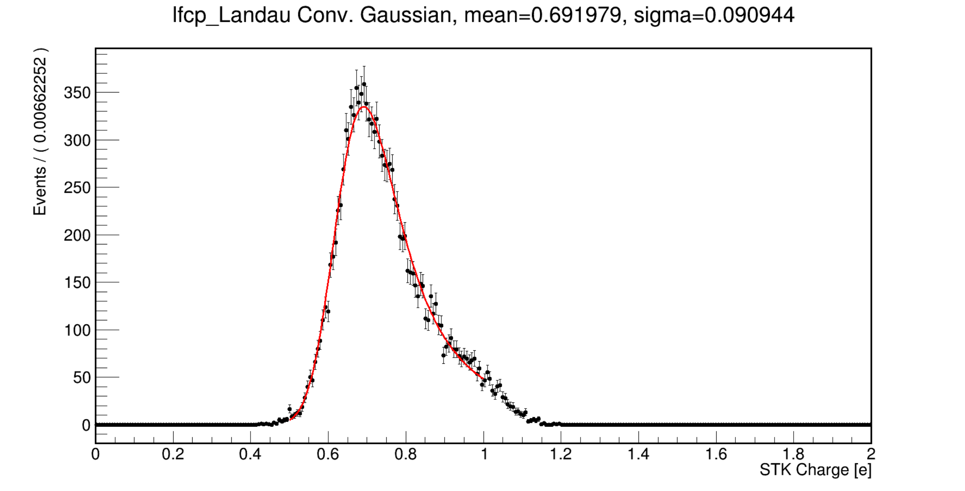
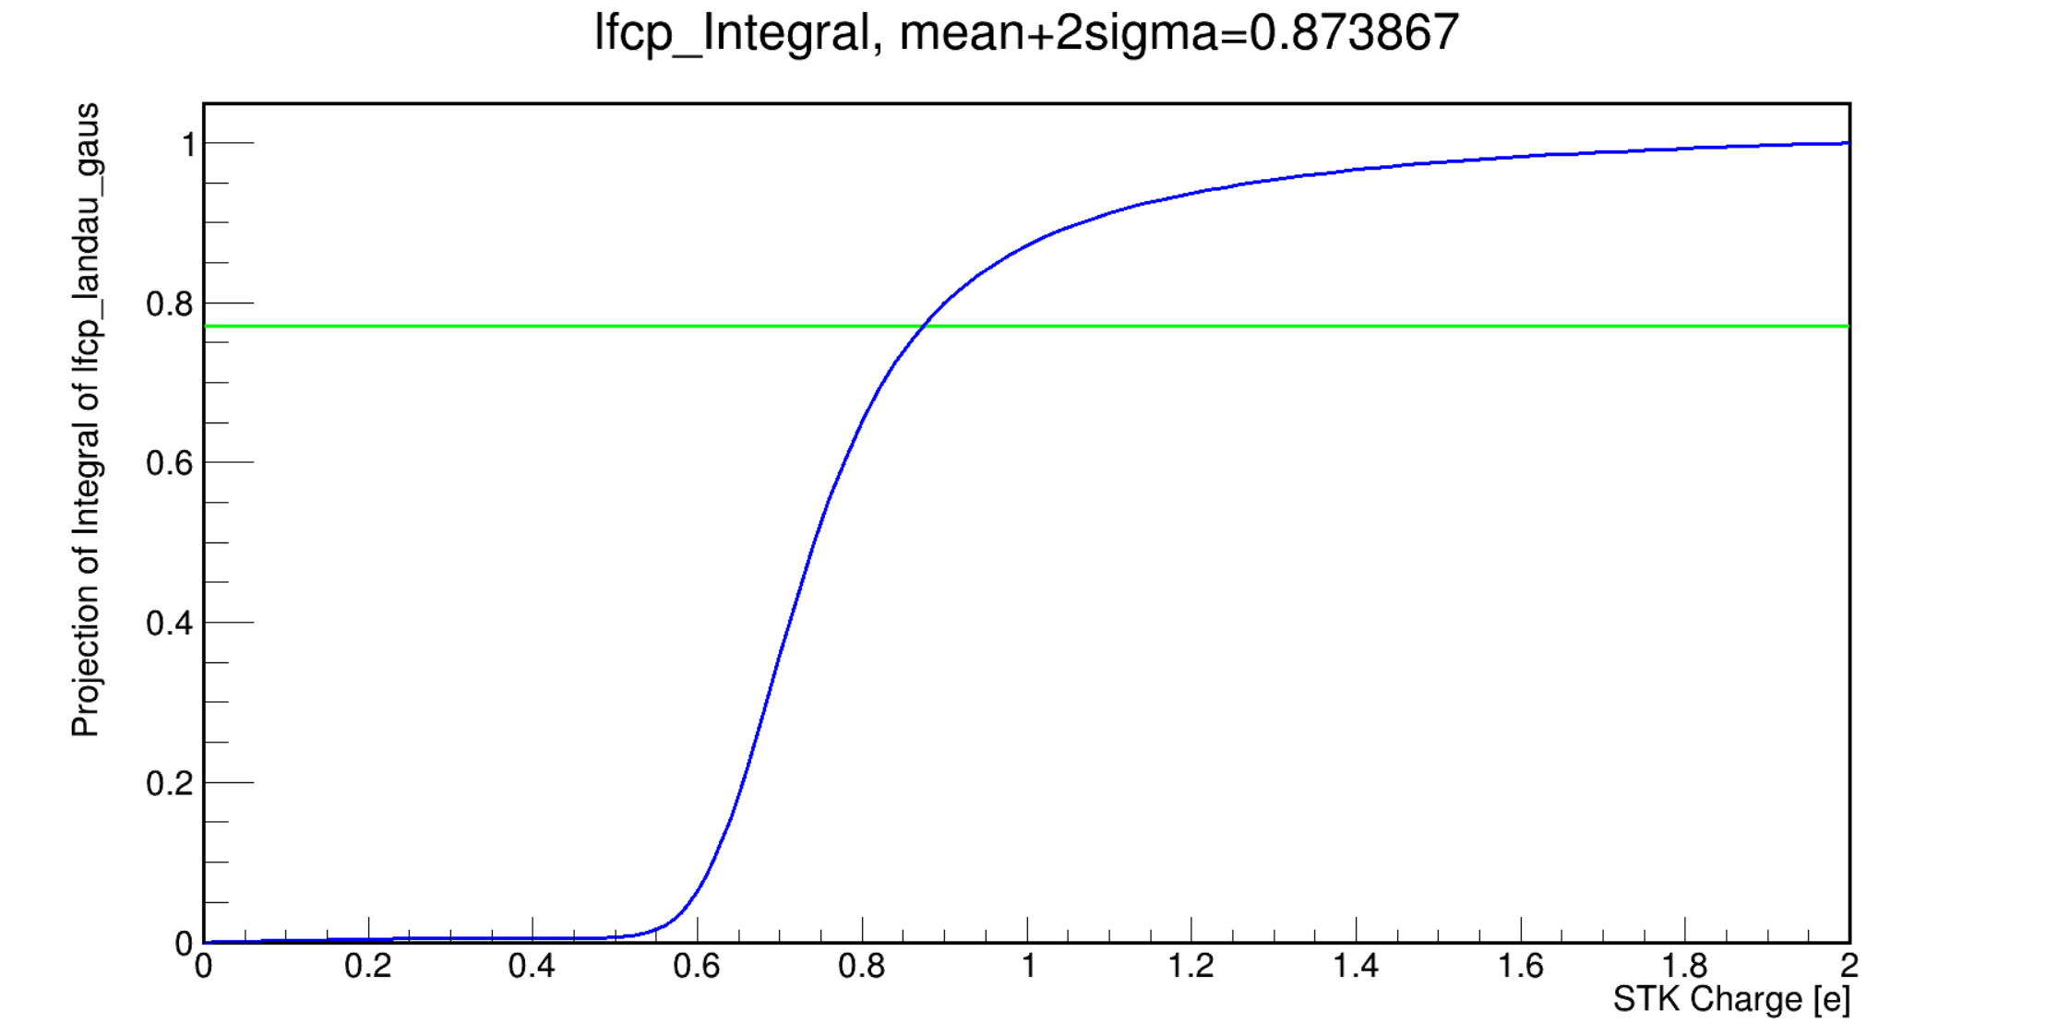
STK Charge for two layers

Slide 4
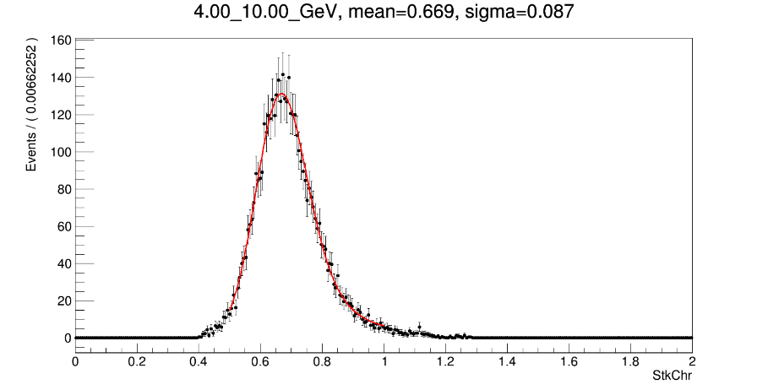
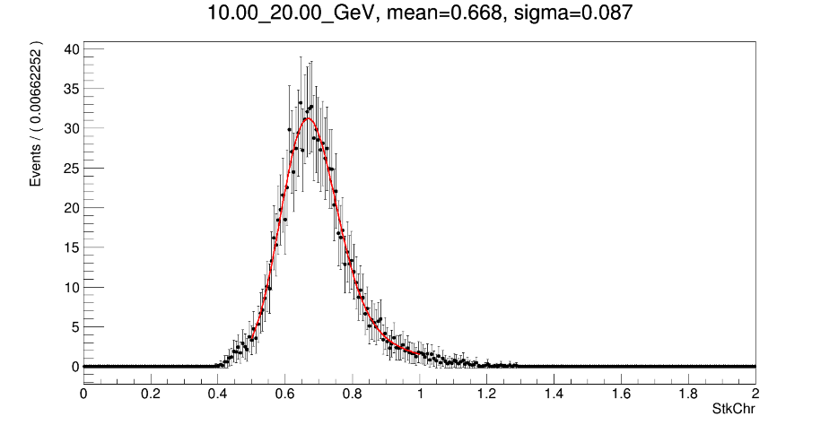
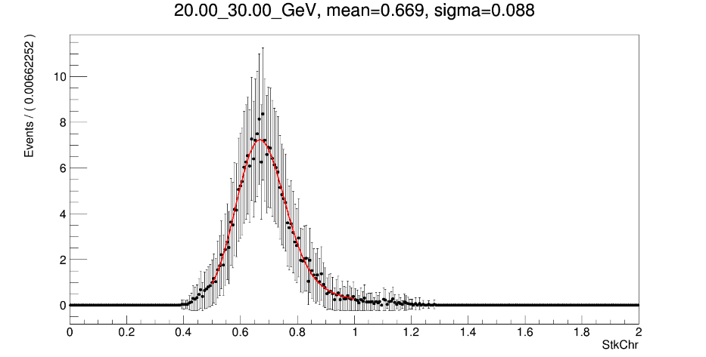
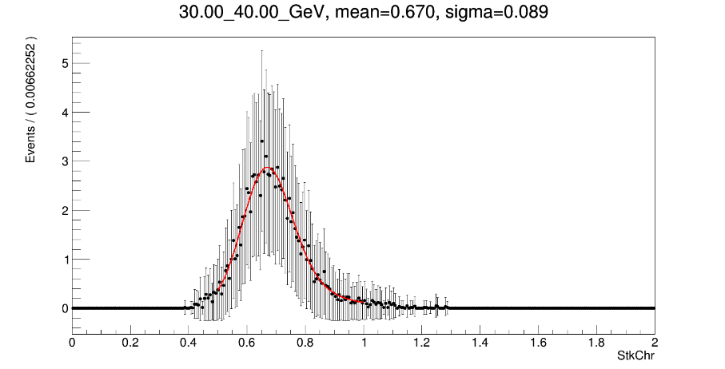
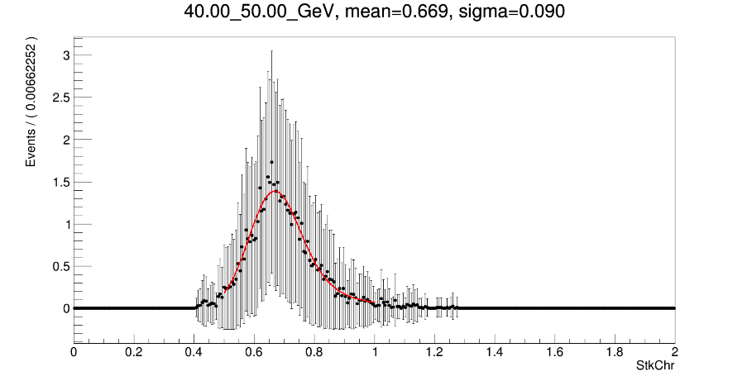

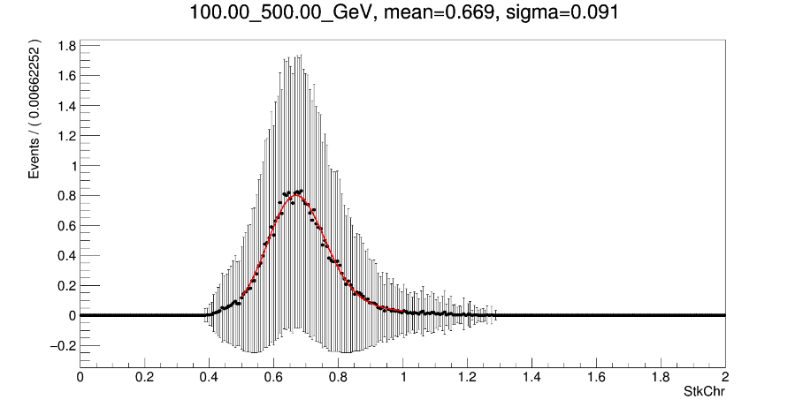
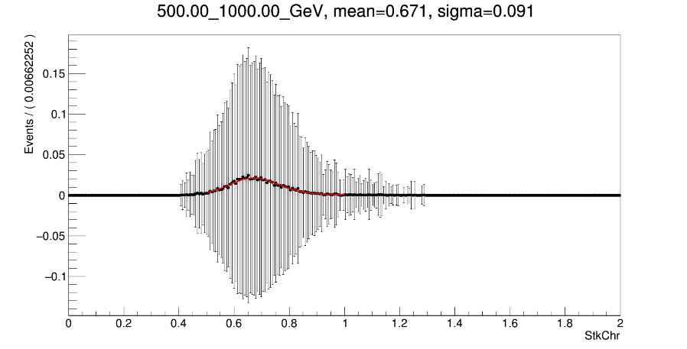
STK Charge for four layers

Slide 5
Compare
 | (Average) mean | (Average) sigma | mean+2sigma
Two layers | 0.661 | 0.105 | 0.871
Four layers | 0.670 | 0.089 | 0.848
Total layers | 0.692 | 0.091 | 0.874
The more layers involved in charge reconstruction, the higher the average charge obtained.
Sigma may have a minimum value between “four layers” and “twelve layers”.
There is no big difference in the resolution of charge obtained by particles in different energy regions.

Slide 6
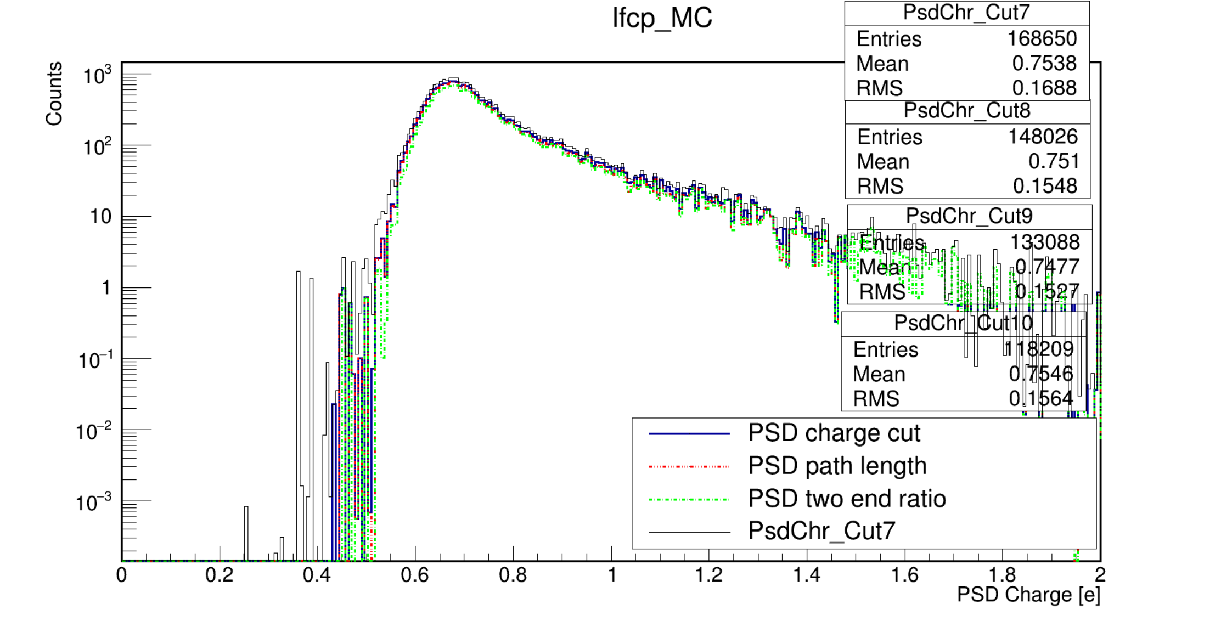
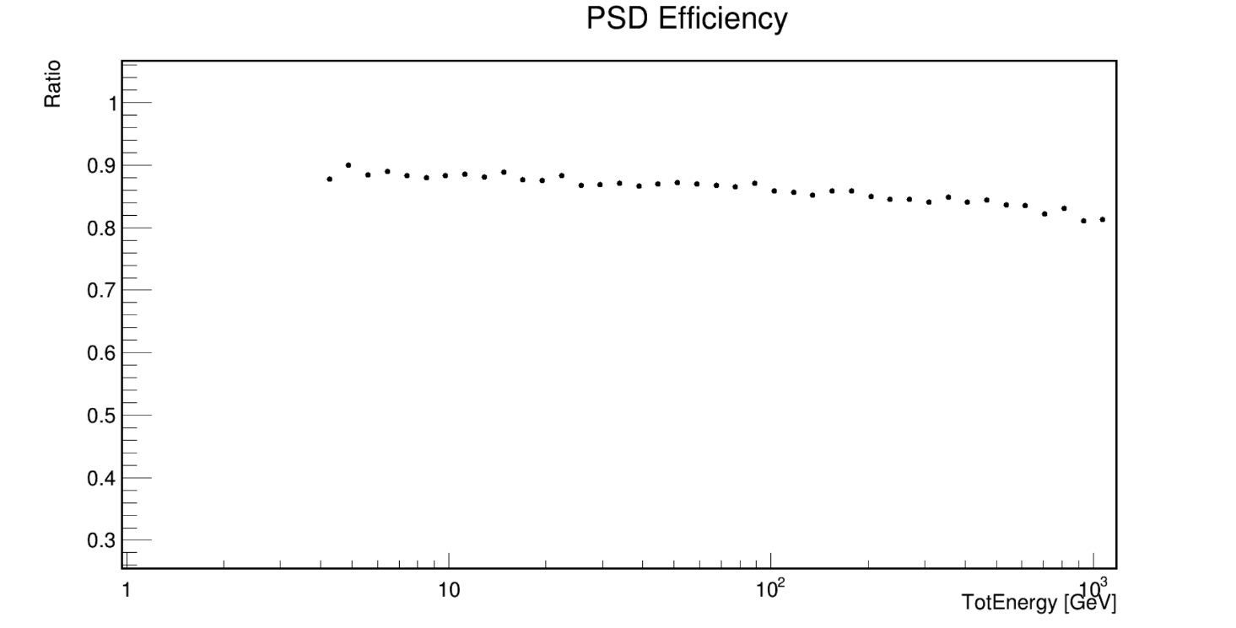
Efficiency
  PSD charge.
  PSD path length.
  PSD two end ratio

Slide 7
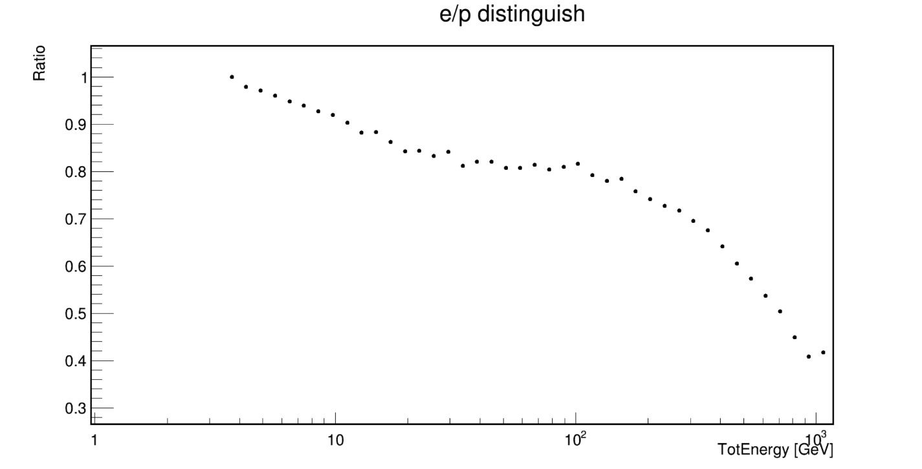
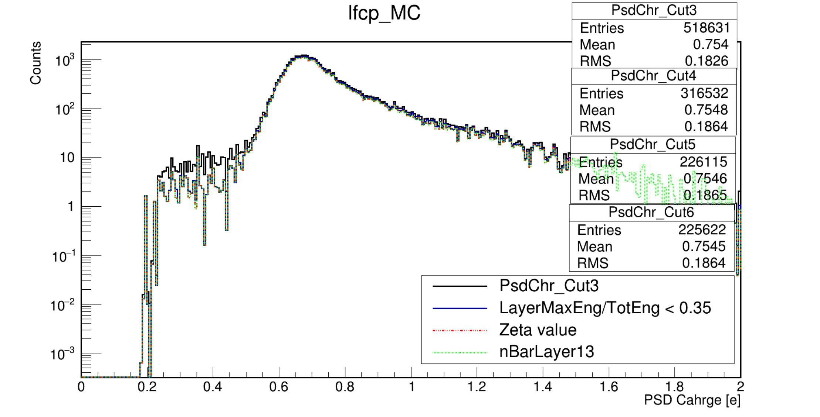
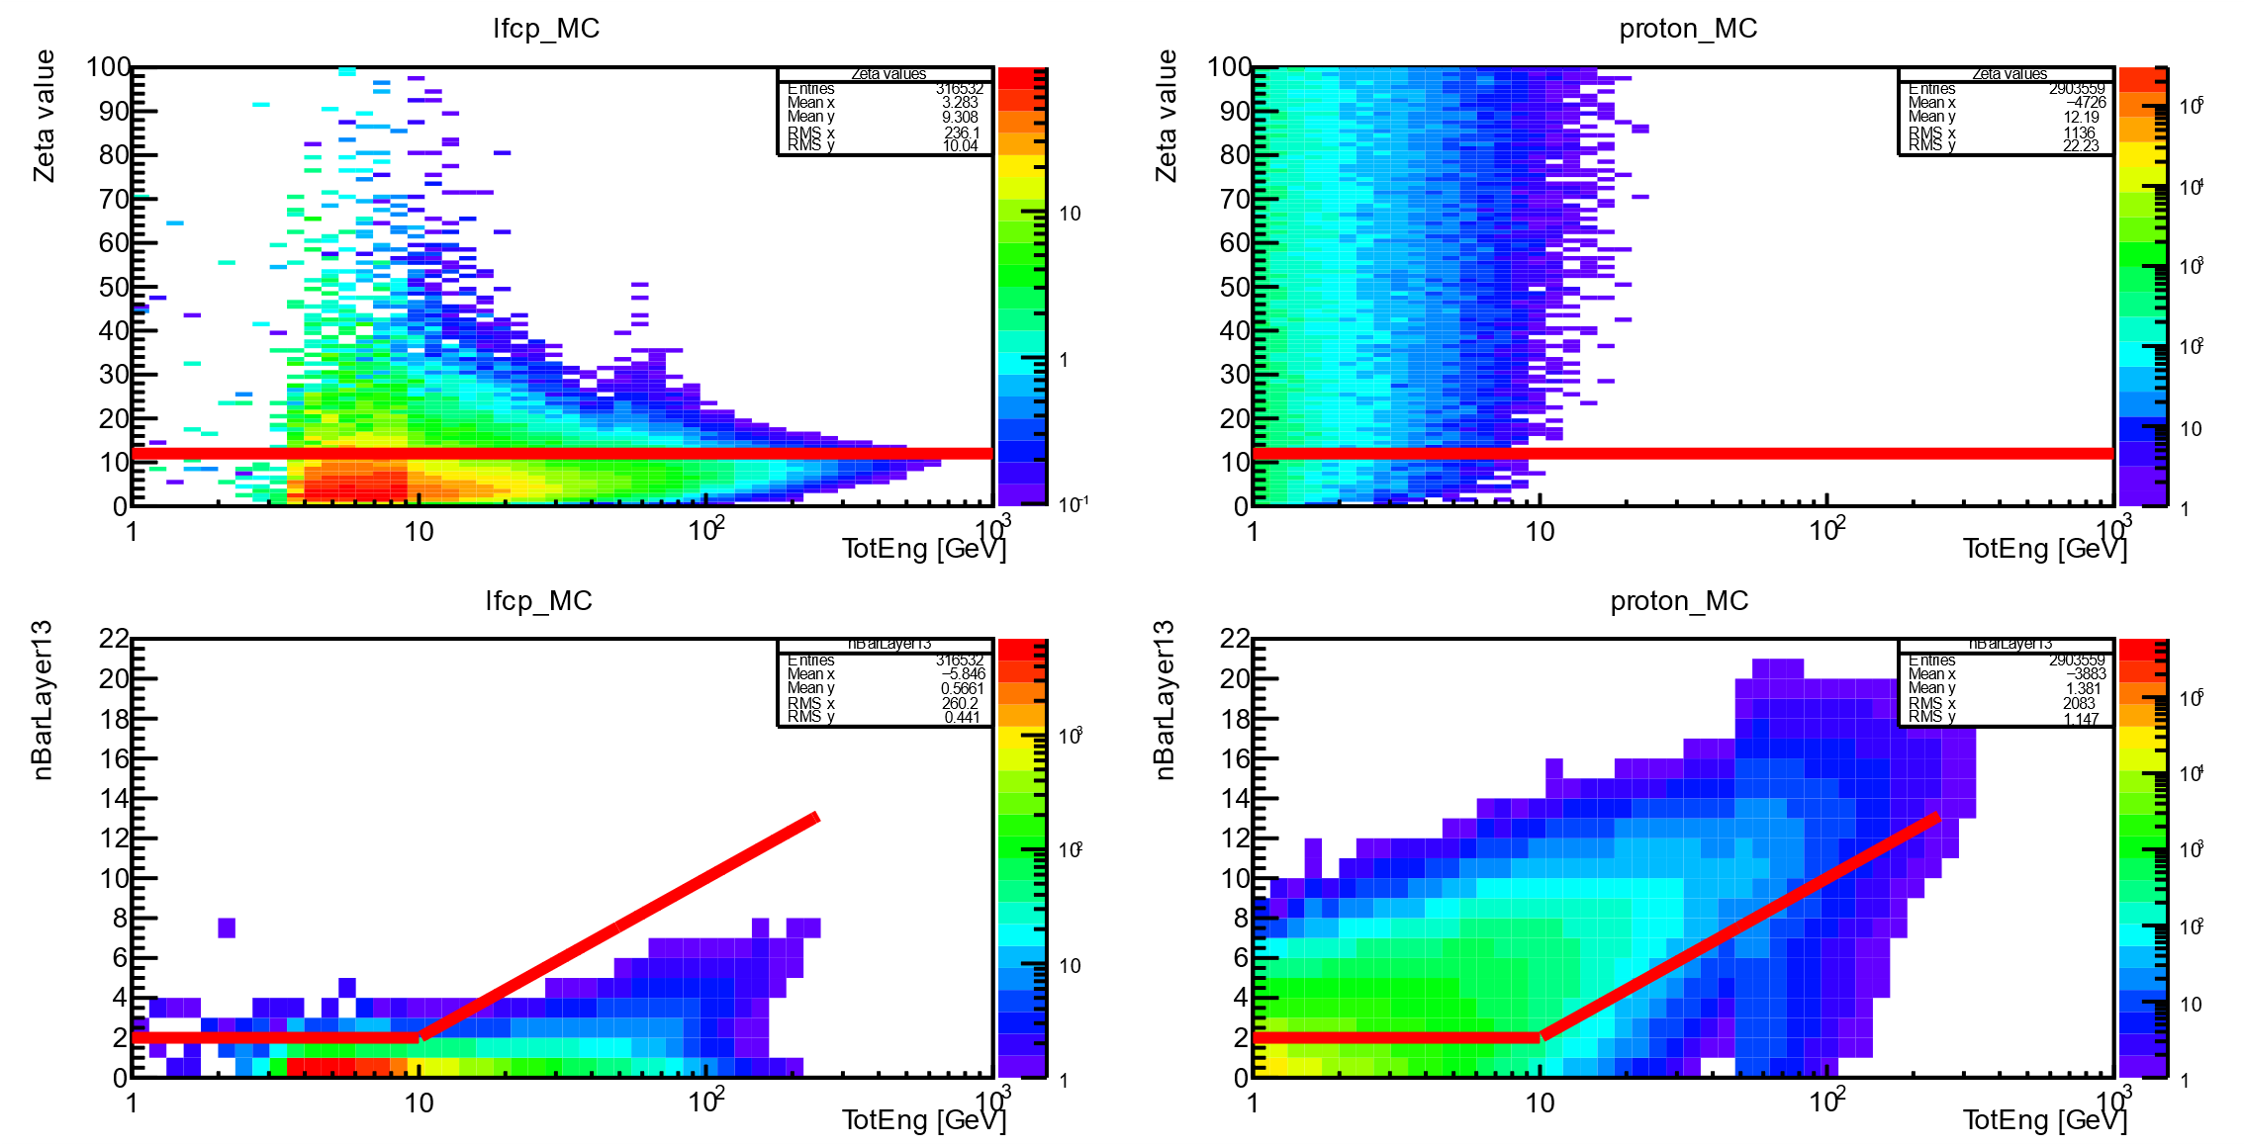
Efficiency
  Zeta value.
  nBarLayer13.
We can loosen the restriction on the value of Zeta. Instead of relying on the combination of Zeta value and nBarLayer13.

Slide 8
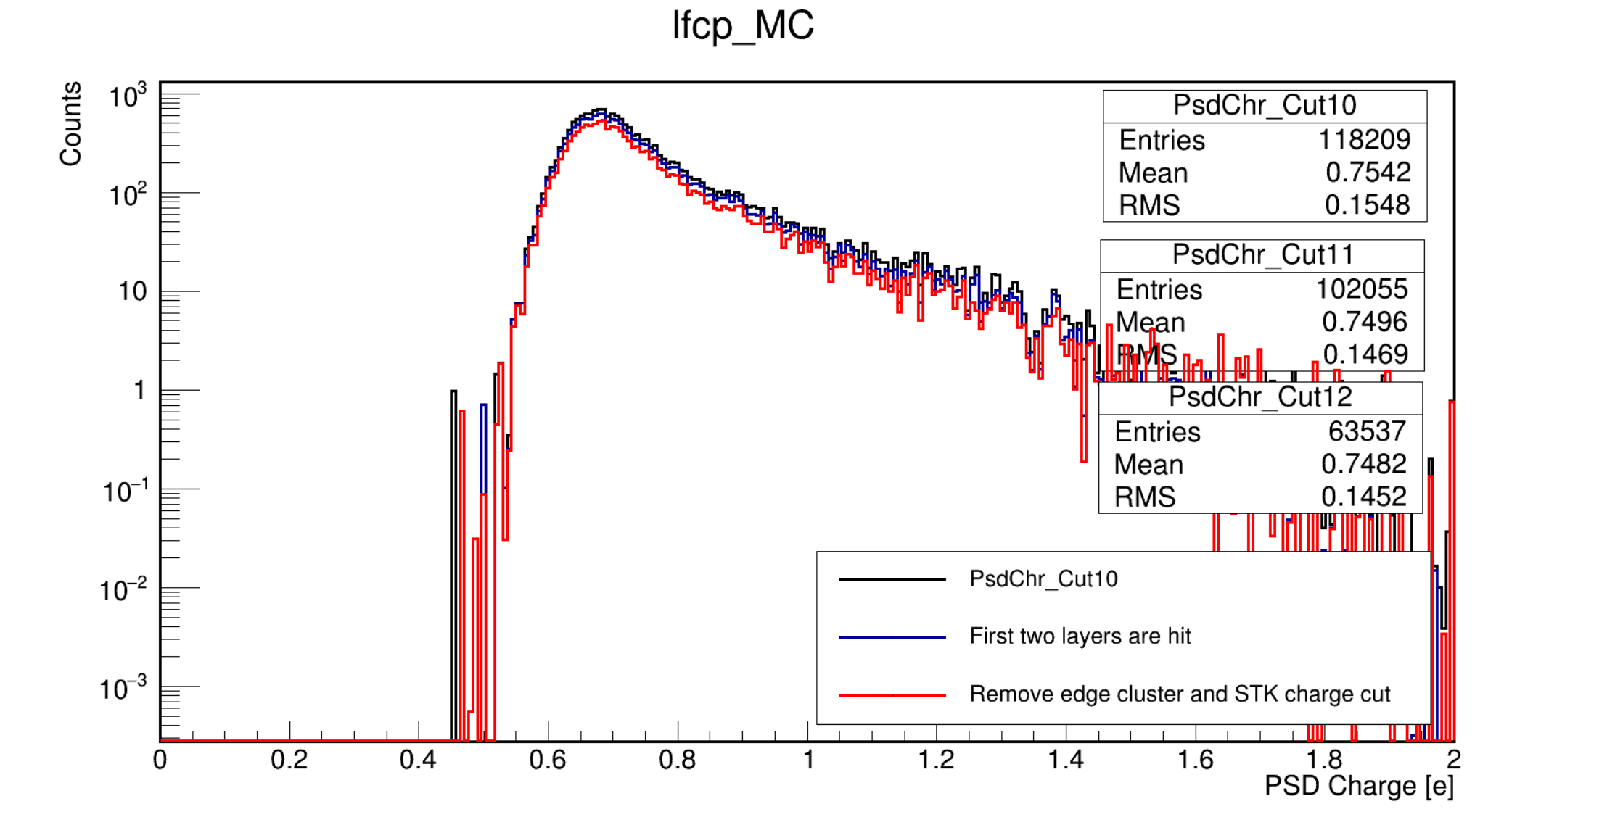
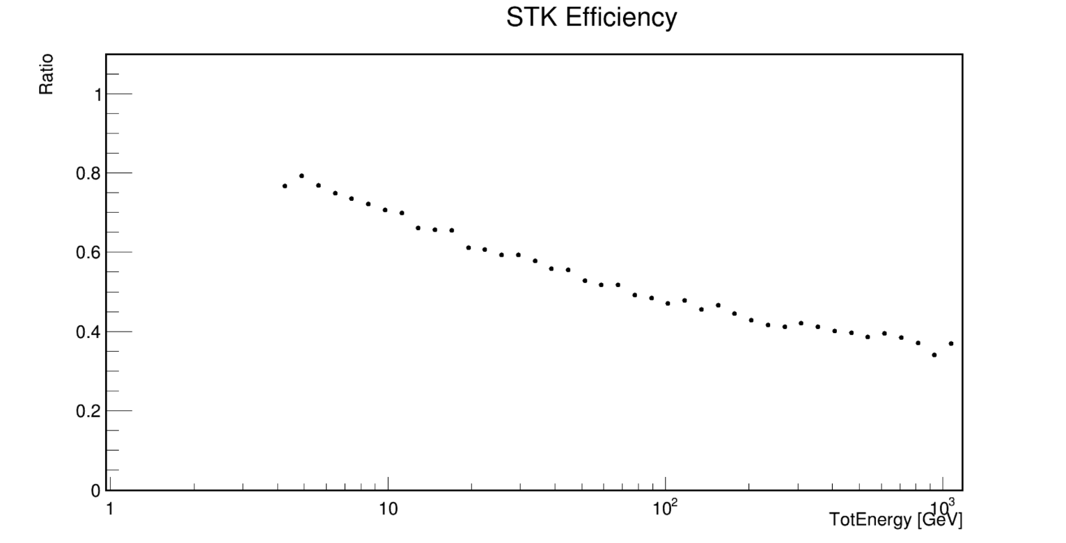
Efficiency
  First two layers are hit.
  Remove ladder’s edge cluster, and STK charge cut.

Slide 9
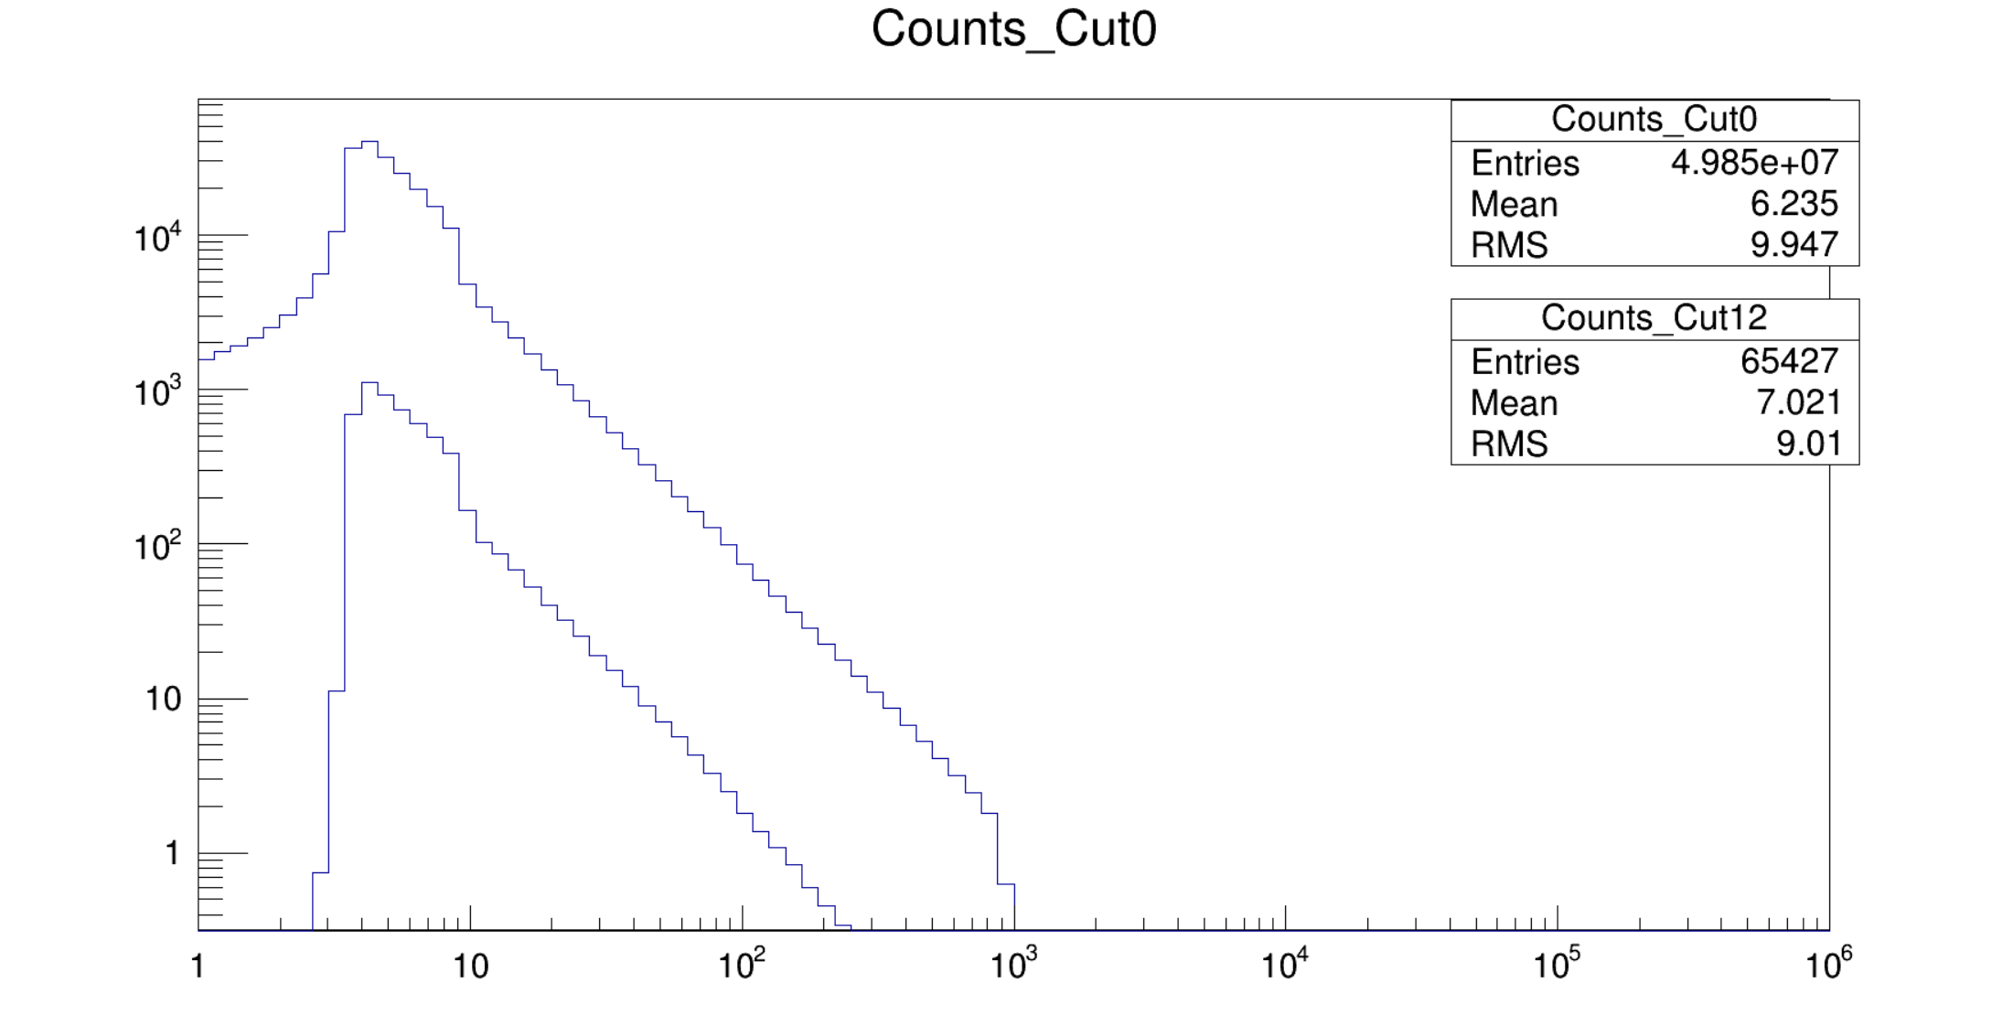

Acceptance
$$Acceptance=\frac{N_{sel}}{N_{pri}}×2π^{2}a^{2} \sim 0.0493 [m^{2}sr]$$

Slide 10
Backup

Slide 11
