Slide 1


Formation of primordial black holes from inflationary models
Yingli Zhang
Tongji University
2025. 4. 27
Based on:
X. Wang, YZ, M. Sasaki, JCAP 07 (2014) 076 [arXiv: 2404.02492]
S. Pi, YZ, Q. Huang, M. Sasaki, JCAP 05 (2018) 042 [arXiv: 1712.09896]
X. Wang, YZ, Kimura and M. Yamaguchi, SCPMA 6 (2023) 66 [arXiv: 2209.12911]
R. Kimura, T. Suyama, M. Yamaguchi and YZ, JCAP 04 (2021) 031 [arXiv: 2102.05280]
H. Wang, YZ, T. Suyama, in preparation

Slide 2
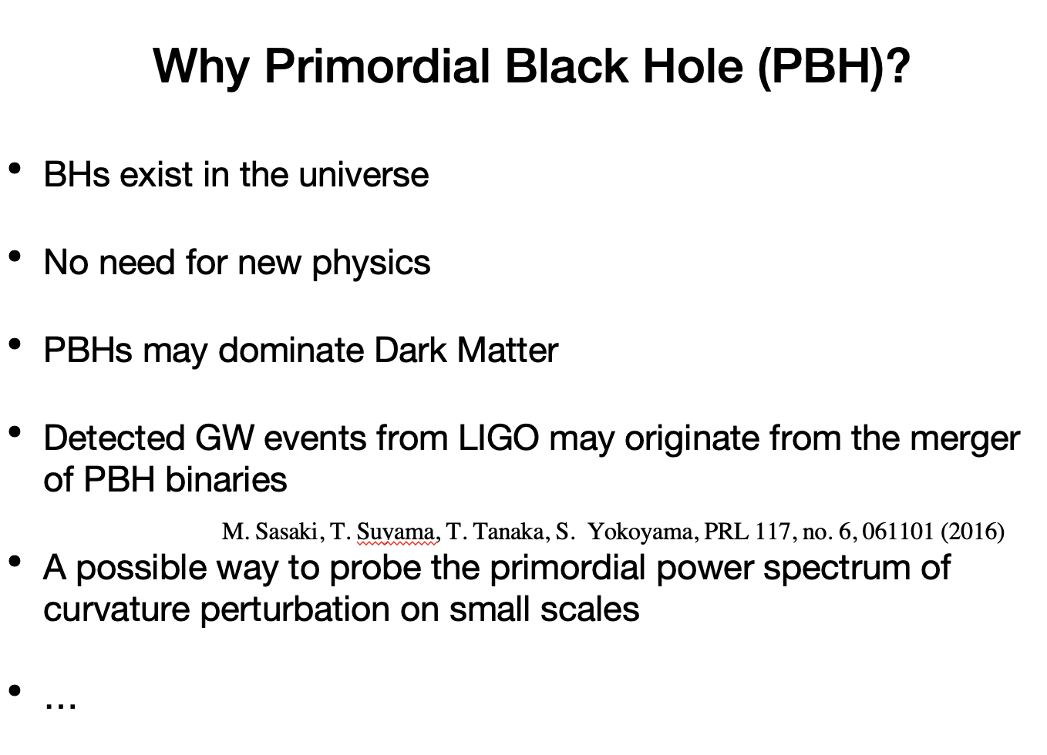

Slide 3
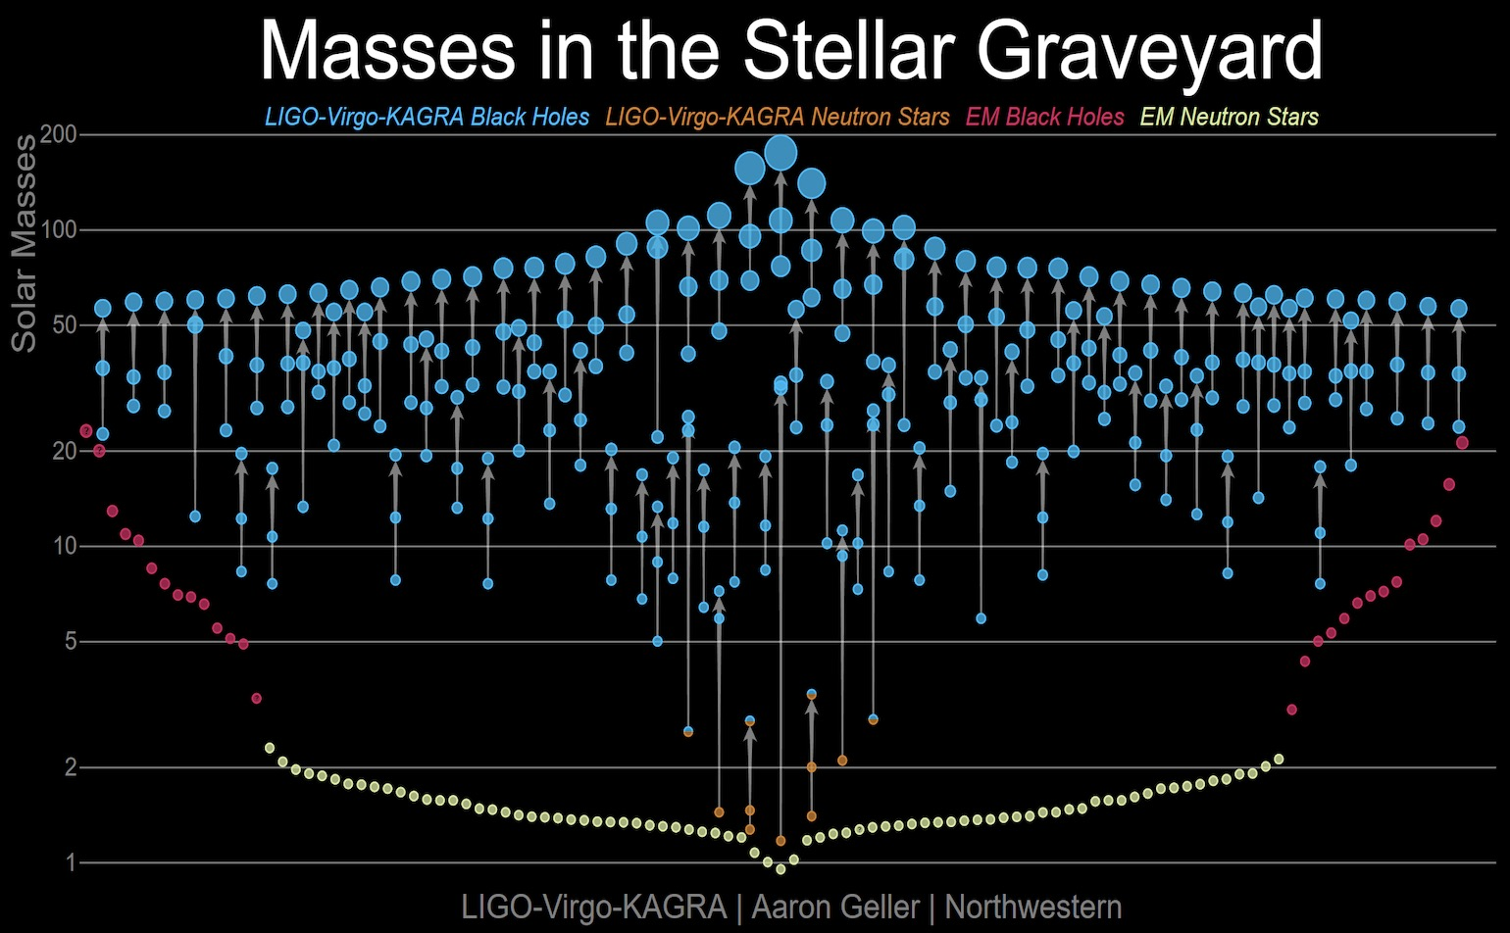
https://media.ligo.northwestern.edu

Slide 4
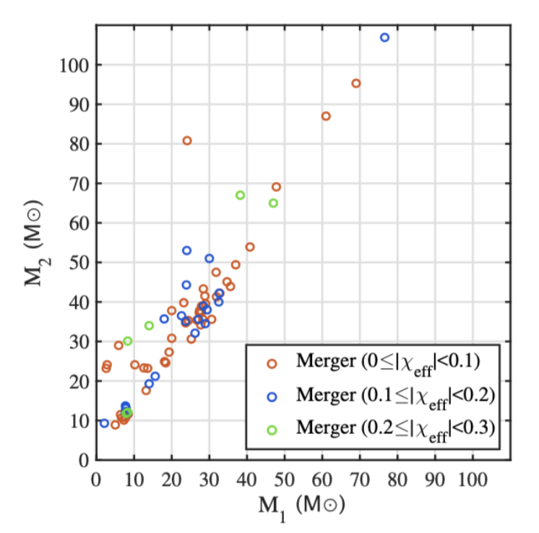


According to LIGO/Virgo O3 data
X. Wang, YZ, Kimura and M. Yamaguchi, SCPMA 6 (2023) 66
91 BBH candidates, 76 of them satisfy and

Slide 5
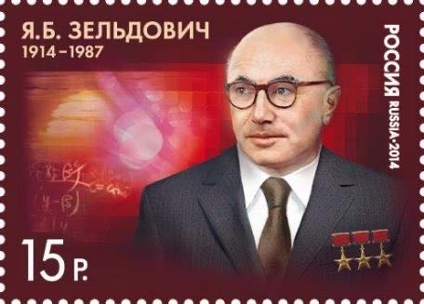
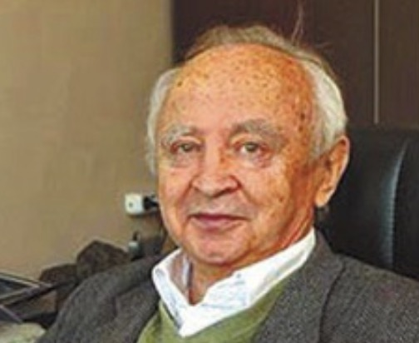
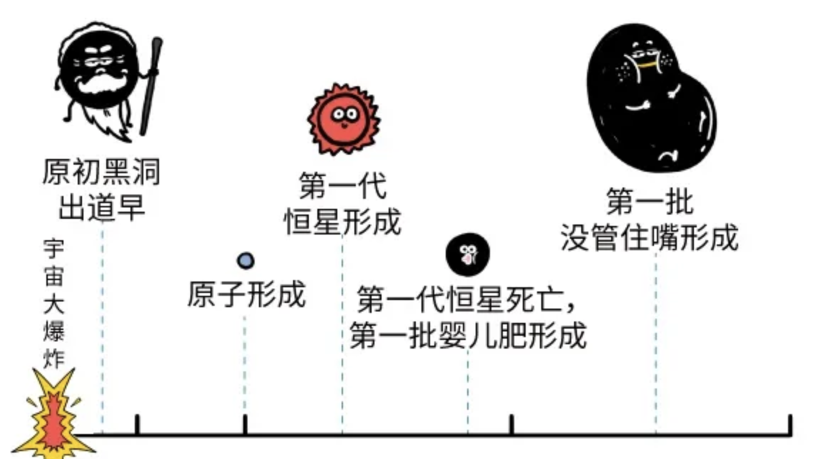



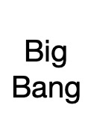


1. Merging BHs are Massive
2. Spin of BH is small
Contradiction
BHs from collapse of Stars
satisfy
Massive BHs ？
Primordial BHs
Y. B. Zel’dovich, I. D. Novikov, Soviet Astronomy 10, 602 (1967)
S. Hawking, Mon. Not. Roy. Astron. Soc. 152, 75 (1971)
380,000yr
1billion yr
13.8 billion yr
3min
Illustration from “墨子”

Slide 6
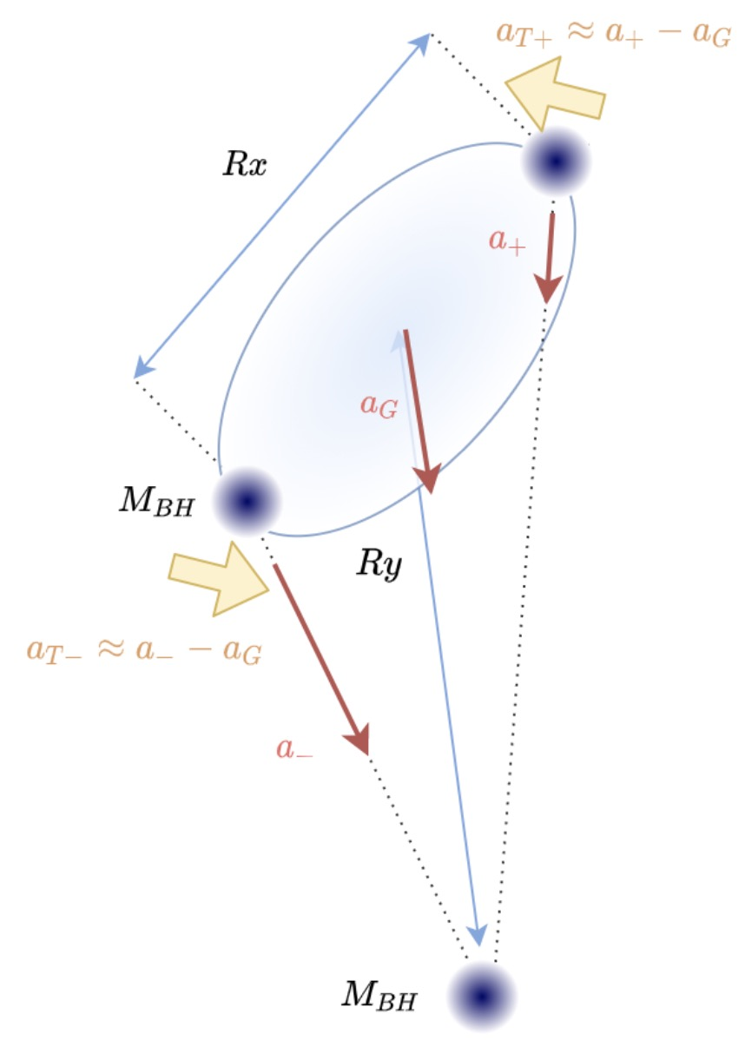
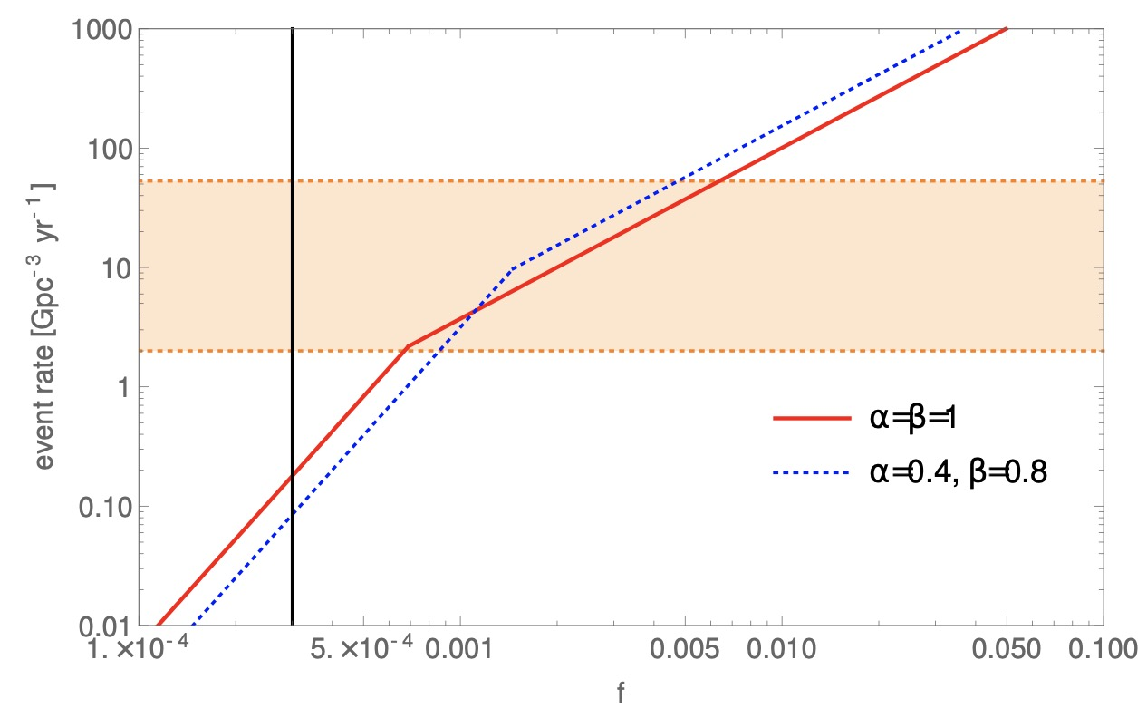

Massive PBHs for explanation of LIGO events
Sasaki, Suyama, Tanaka, Yokoyama, PRL 117 (2016) 6, 061101
Illustrated by Xinpeng

Slide 7
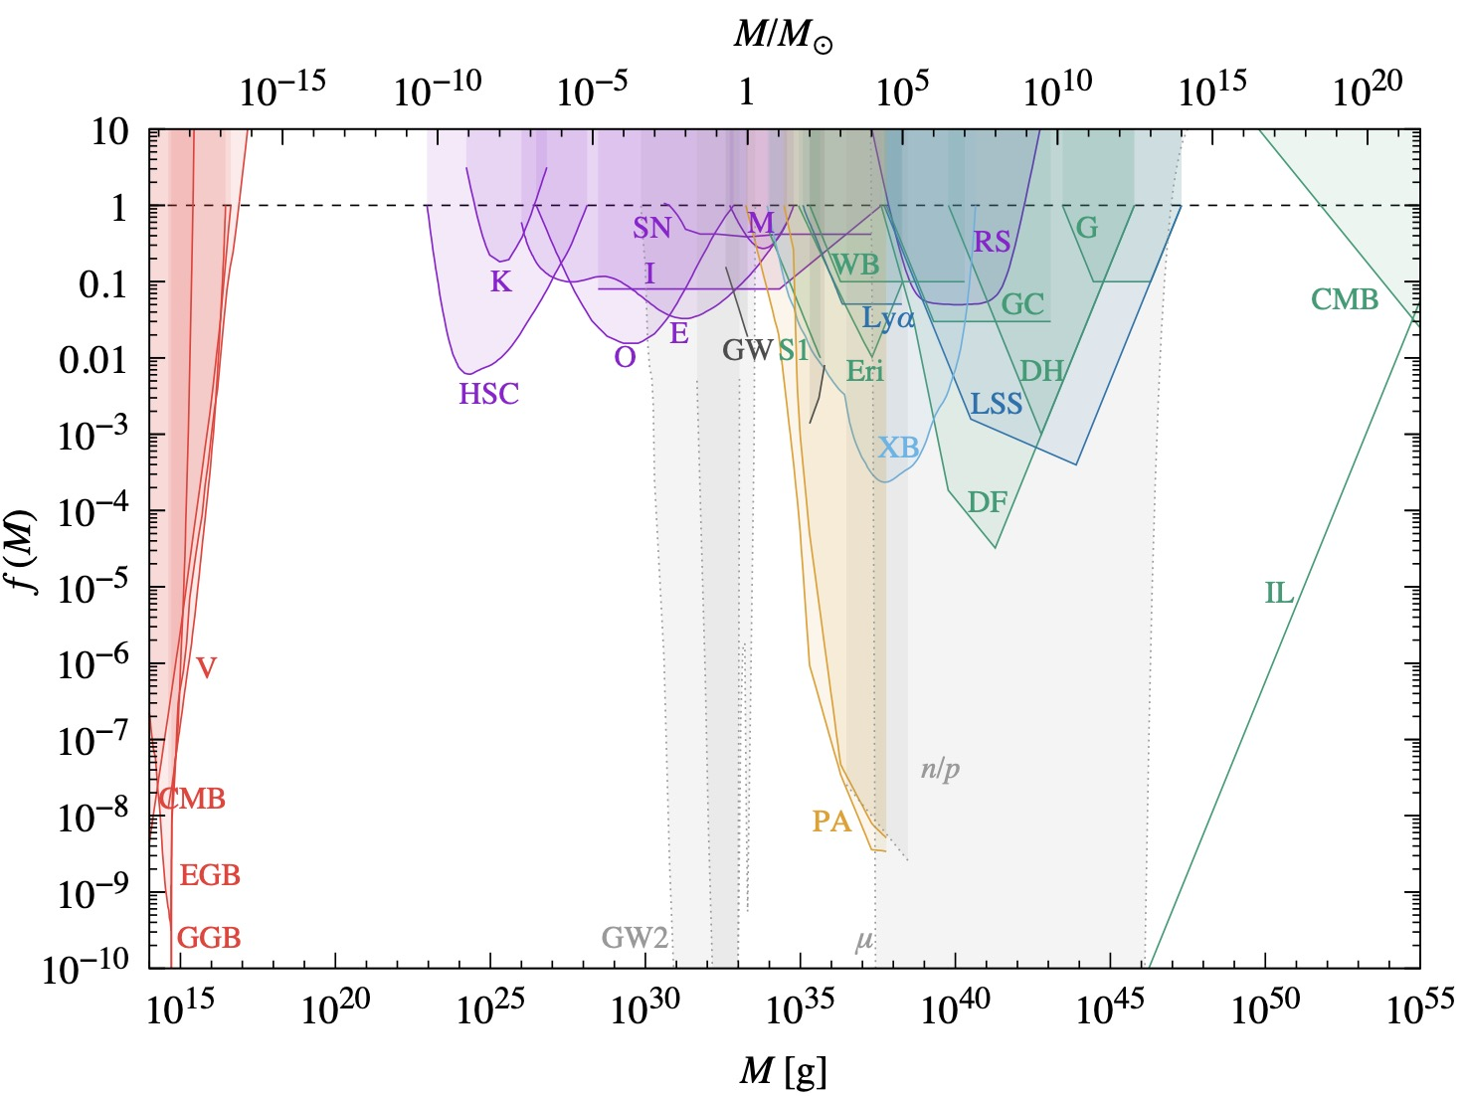
Moreover，small PBHs are candidate for DM
Carr et. al, Rept.Prog.Phys. 84 (2021) 11, 116902

Slide 8
Moreover，small PBHs are candidate for DM
No
Constraint
Schwarchild
Radius
<
Compton
wavelength
of
light
Carr et. al, Rept.Prog.Phys. 84 (2021) 11, 116902

Slide 9
Moreover，small PBHs are candidate for DM
PBHs
for
all
DM
Carr et. al, Rept.Prog.Phys. 84 (2021) 11, 116902

Slide 10

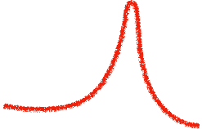
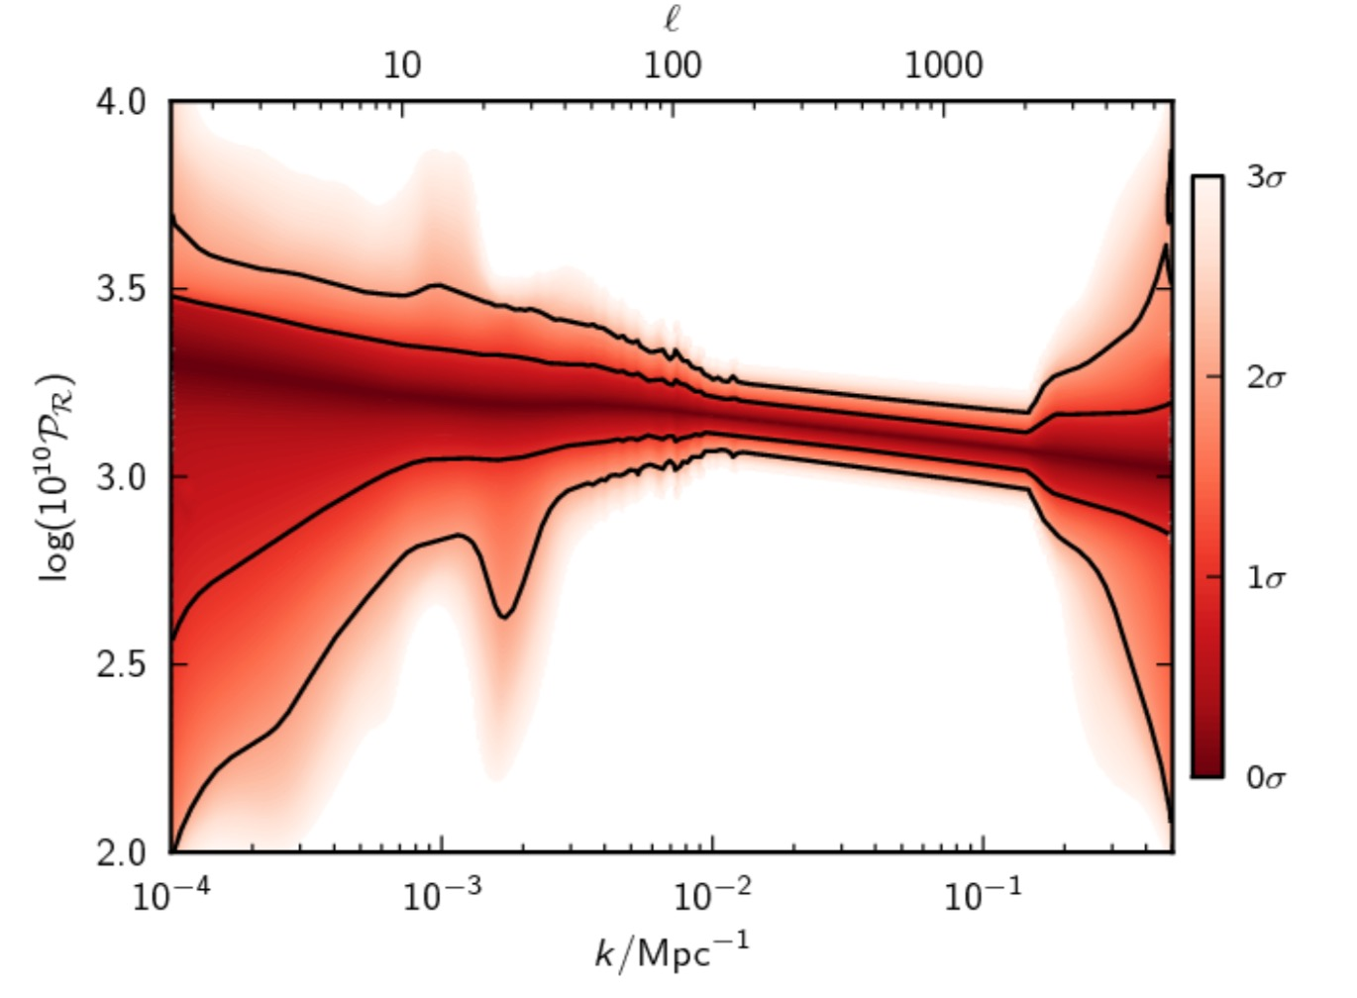
Formation of PBHs from enhancement of primordial curvature perturbations
Rad.dom.
1/Hr ~a²
a/k0
a/k*
aini
a*
aend
are-entry
aeq
a0
There is a peak on the primordial density perturbation, which leaves horizon and gets frozen at a*.
k*=Ha*

Slide 11

Formation of PBHs from enhancement of primordial curvature perturbations
Rad.dom.
1/Hr ~a²
a/k0
a/k*
aini
a*
aend
are-entry
aeq
a0
The peak scale re-enters the horizon at radiation dominated era. If it exceeded some critical value O(0.1), PBH will form. Its mass is O(MH).
k*=Ha*

Slide 12
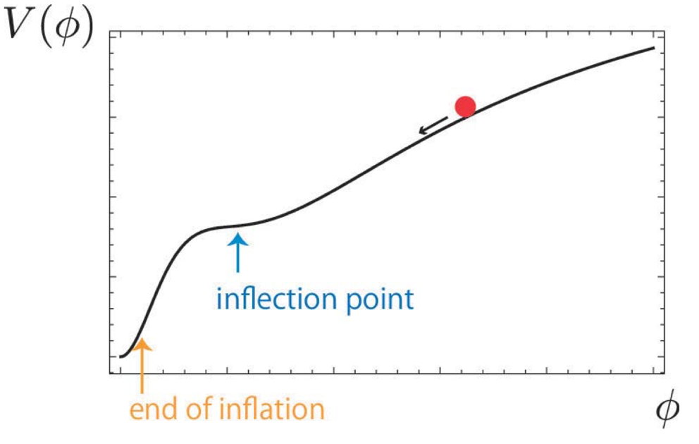
Formation of PBHs from enhancement of primordial curvature perturbations
Rad.dom.
1/Hr ~a²
a/k0
a/k*
aini
a*
aend
are-entry
aeq
a0
Fine tuning problem?
k*=Ha*

Slide 13
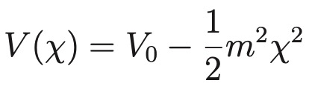
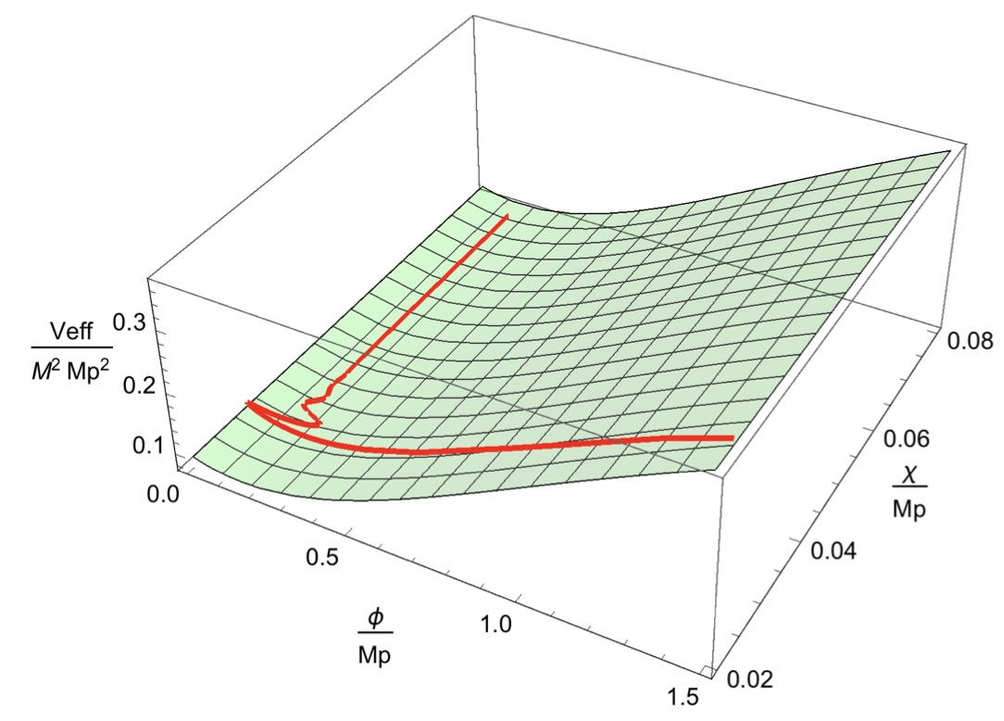
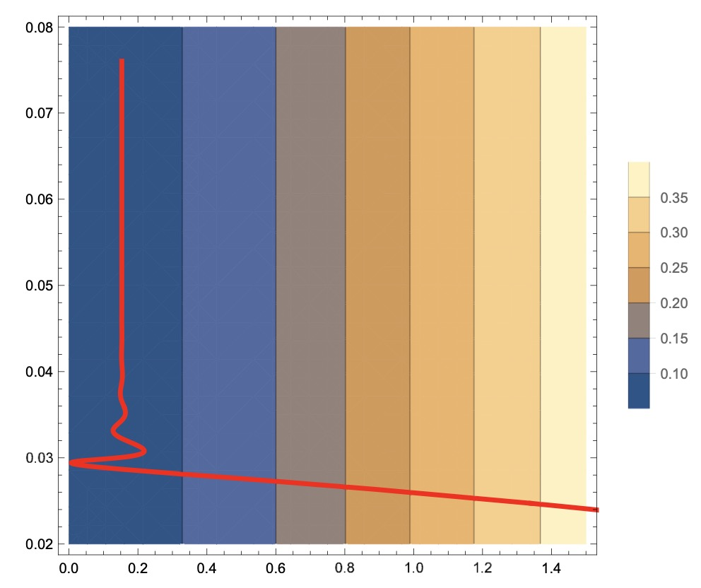
We proposed a model driven by Starobinsky model with a non-minimally coupled field
Pi, YZ, Huang, Sasaki, JCAP 05 (2018) 042 [arxiv:1712.09896]
Peak created during oscillation
scalron
Light
field

Slide 14
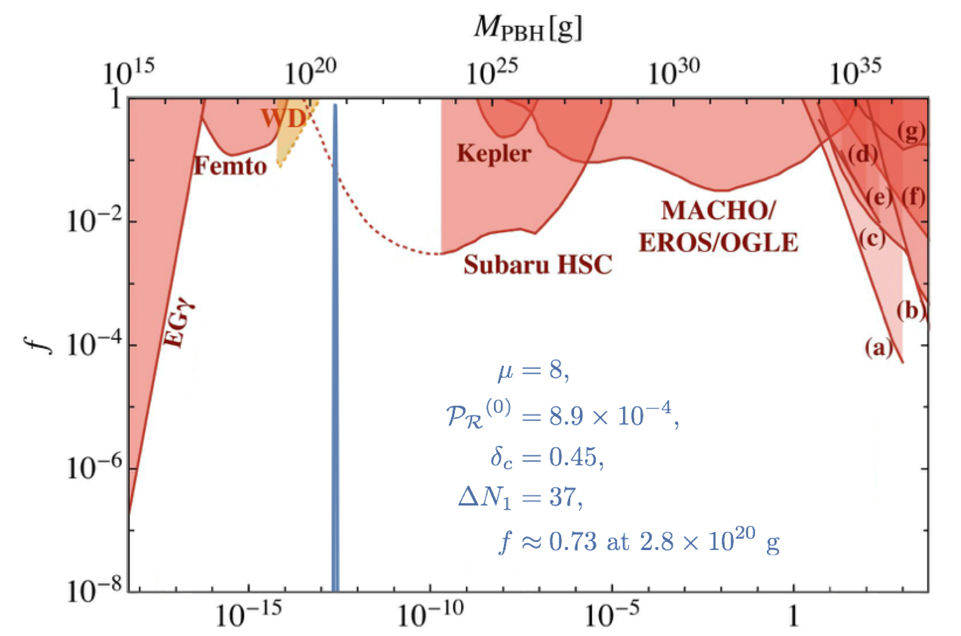
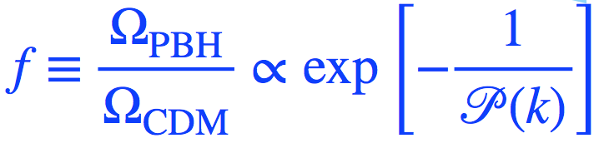
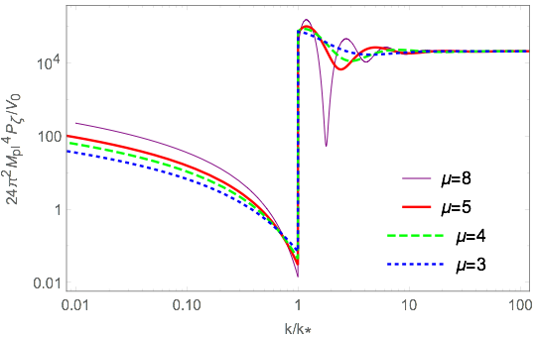
Peak
Spike
Defects: (1) No exit from inflation
(2) Incomplete interpretation
on enhancement mechanism

Slide 15
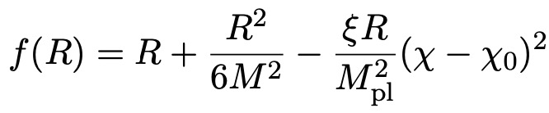

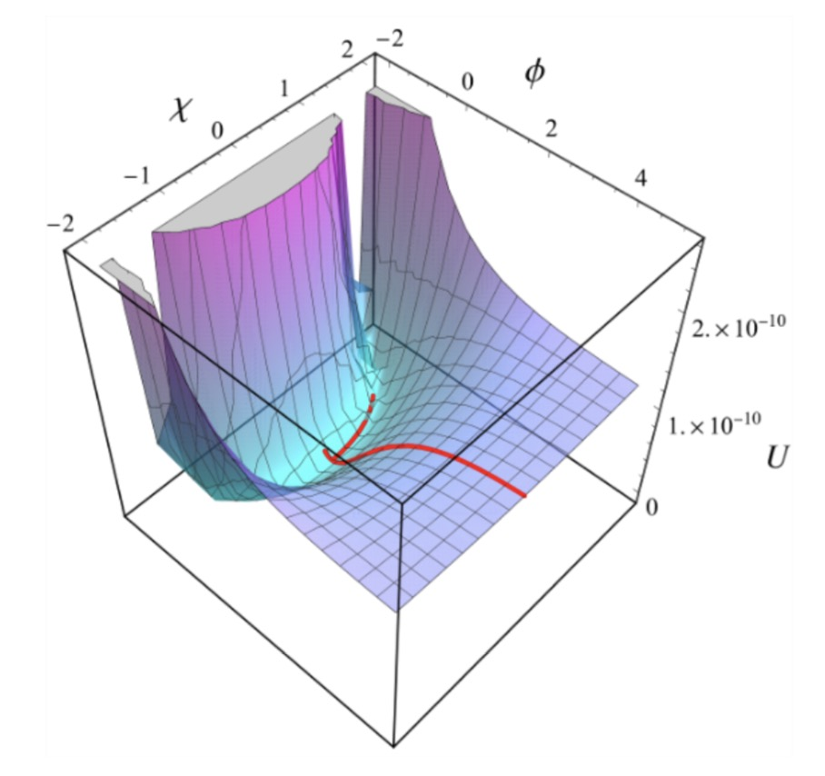
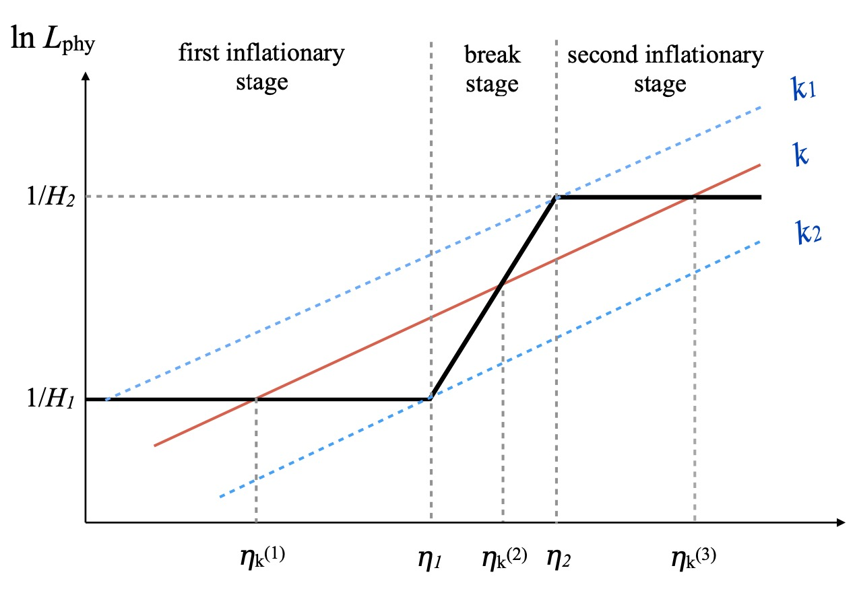
Avoid huge perturbations:
Expand the potential to 4-th order:
X. Wang, YZ, M. Sasaki, JCAP 07 (2014) 076

Slide 16
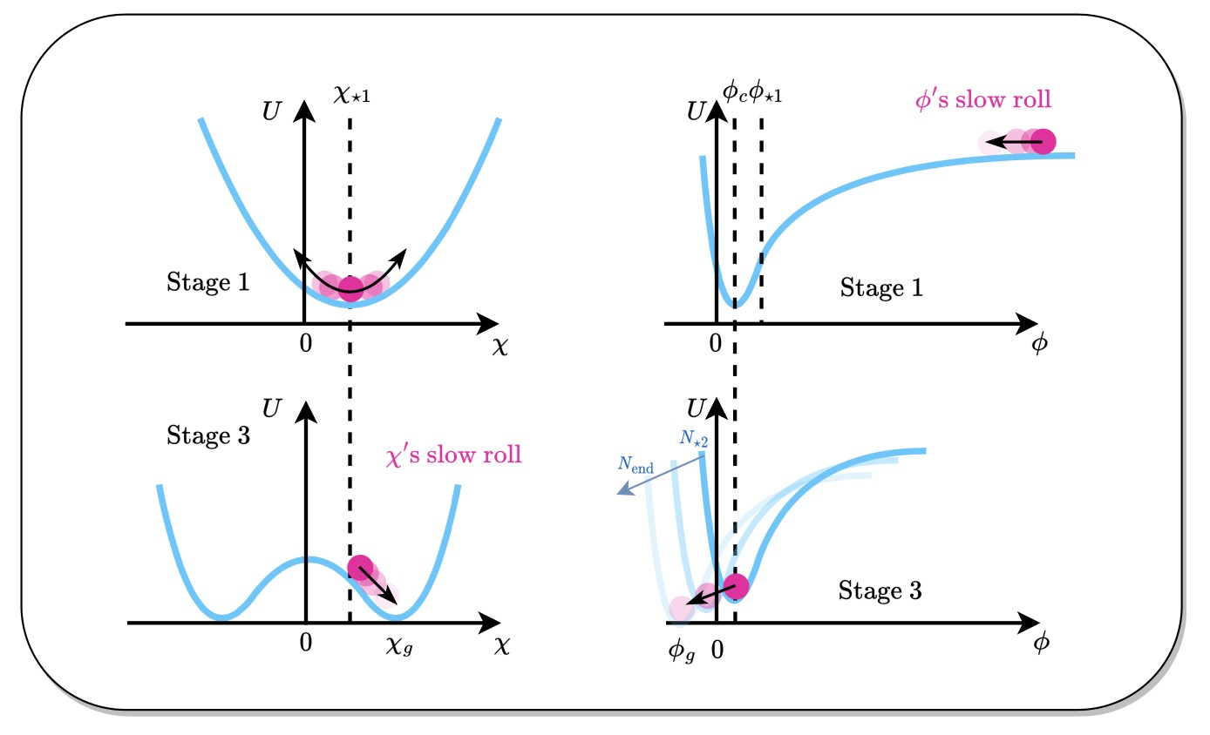
Avoid huge perturbations:
Expand the potential to 4-th order:
X. Wang, YZ, M. Sasaki, [2404.02492]

Slide 17
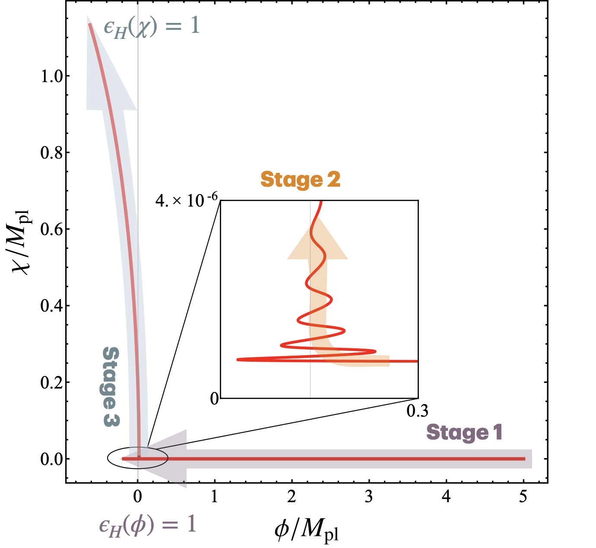
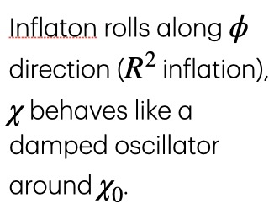
Avoid huge perturbations:
Expand the potential to 4-th order:

Slide 18
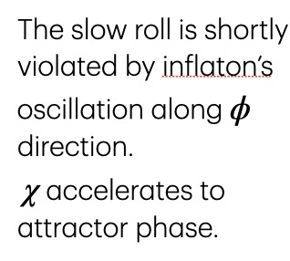
Avoid huge perturbations:
Expand the potential to 4-th order:

Slide 19
Avoid huge perturbations:
Expand the potential to 4-th order:

Slide 20
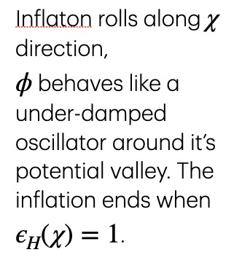
Avoid huge perturbations:
Expand the potential to 4-th order:

Slide 21
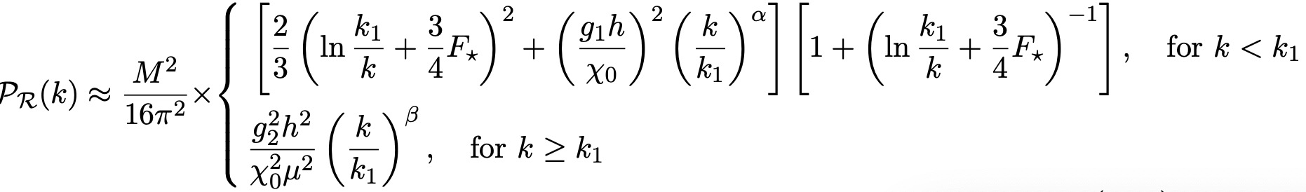
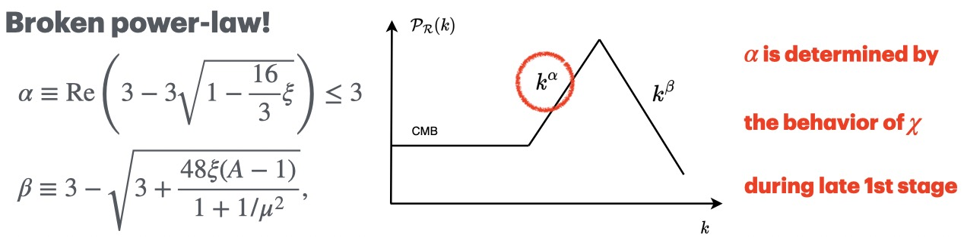
The Primordial Power Spectrum can be analytically approximated as

Slide 22
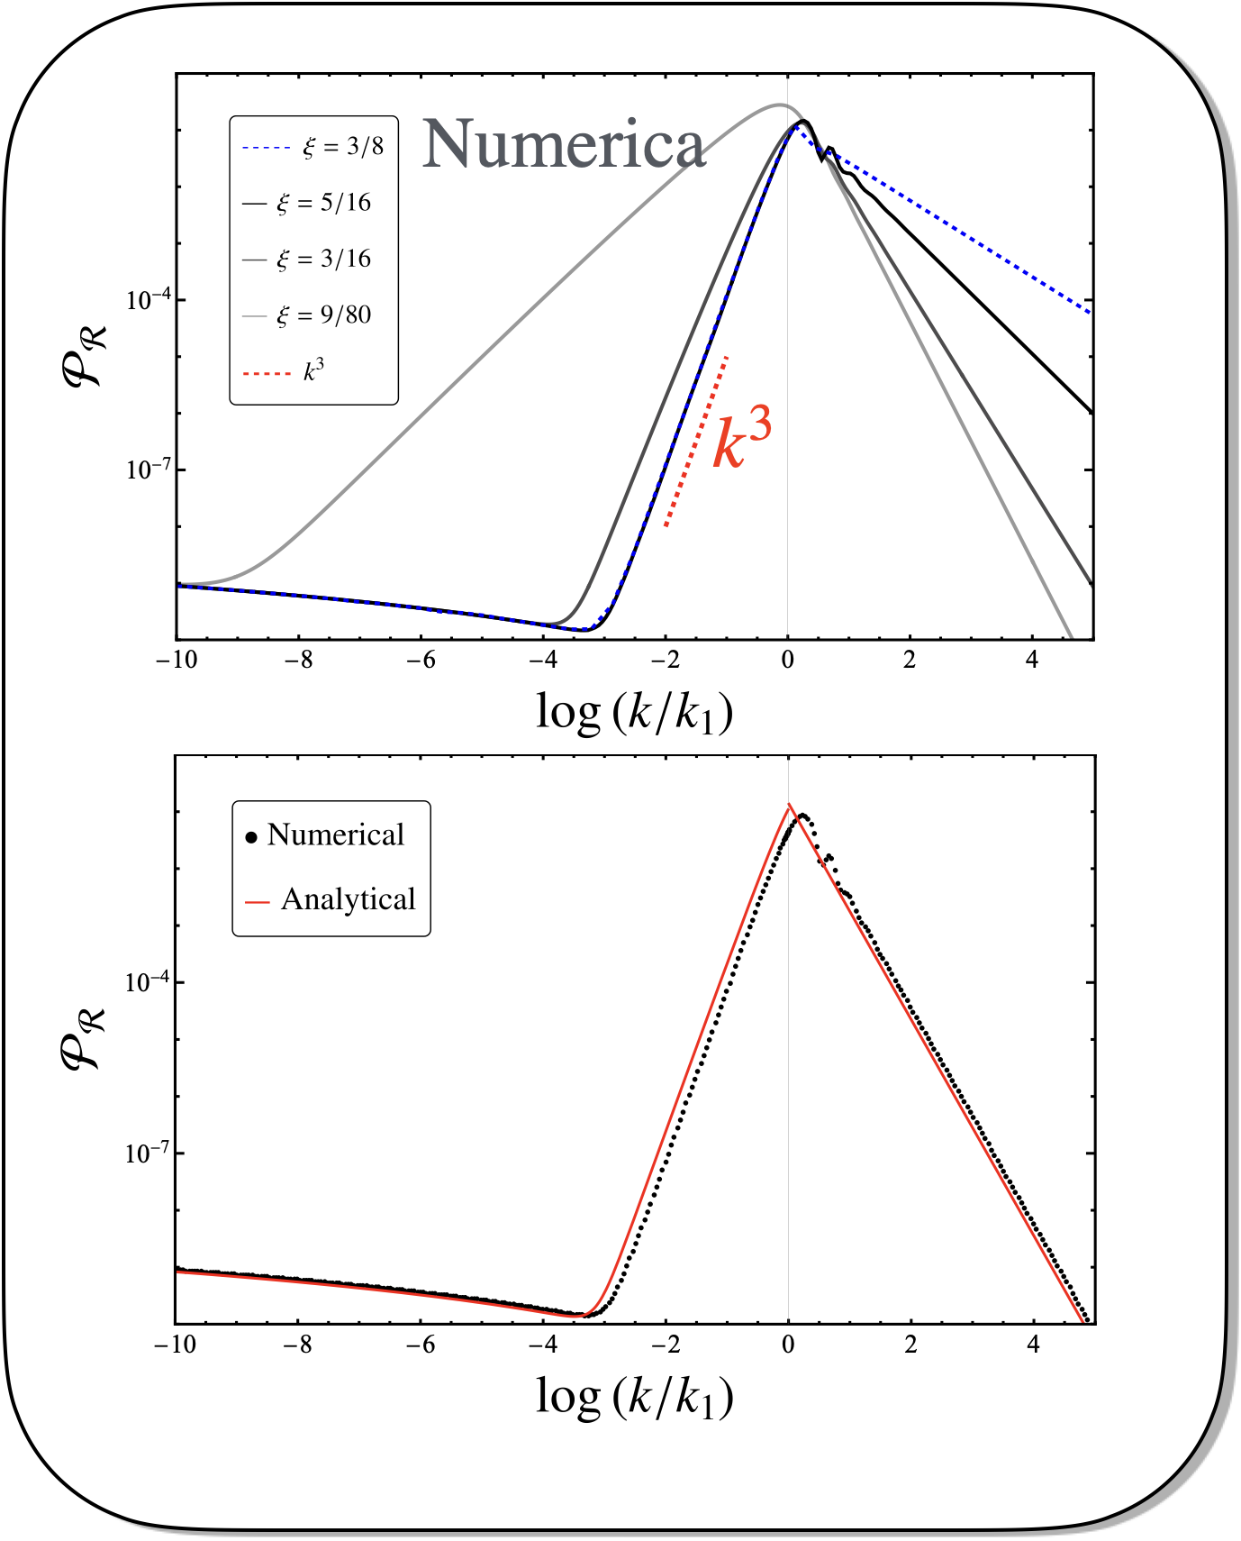
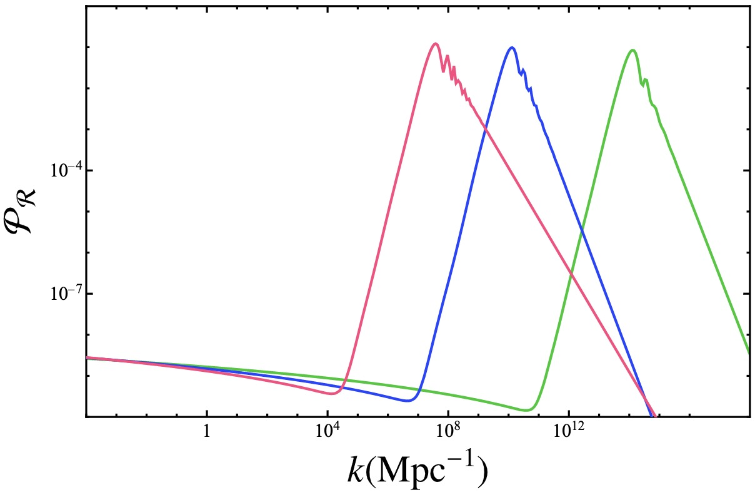
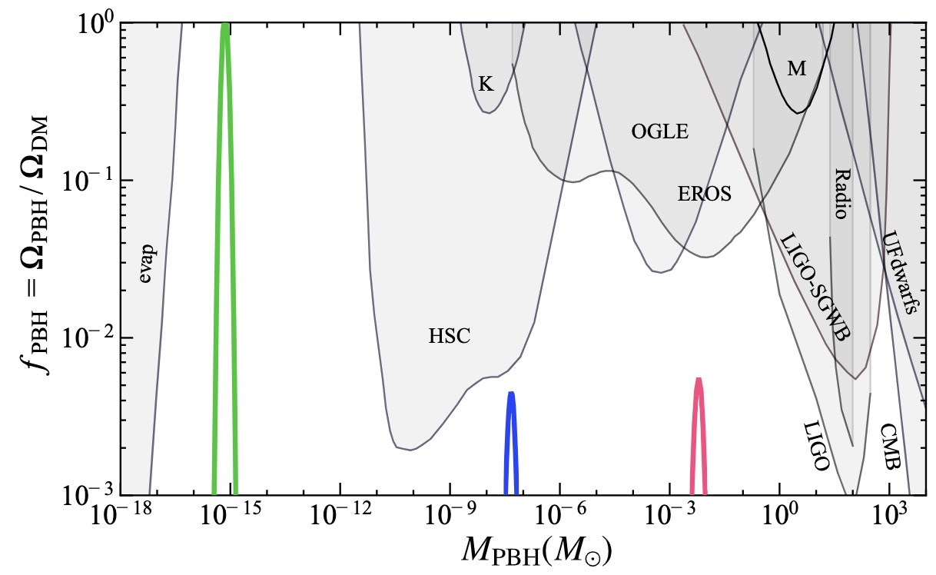

Slide 23

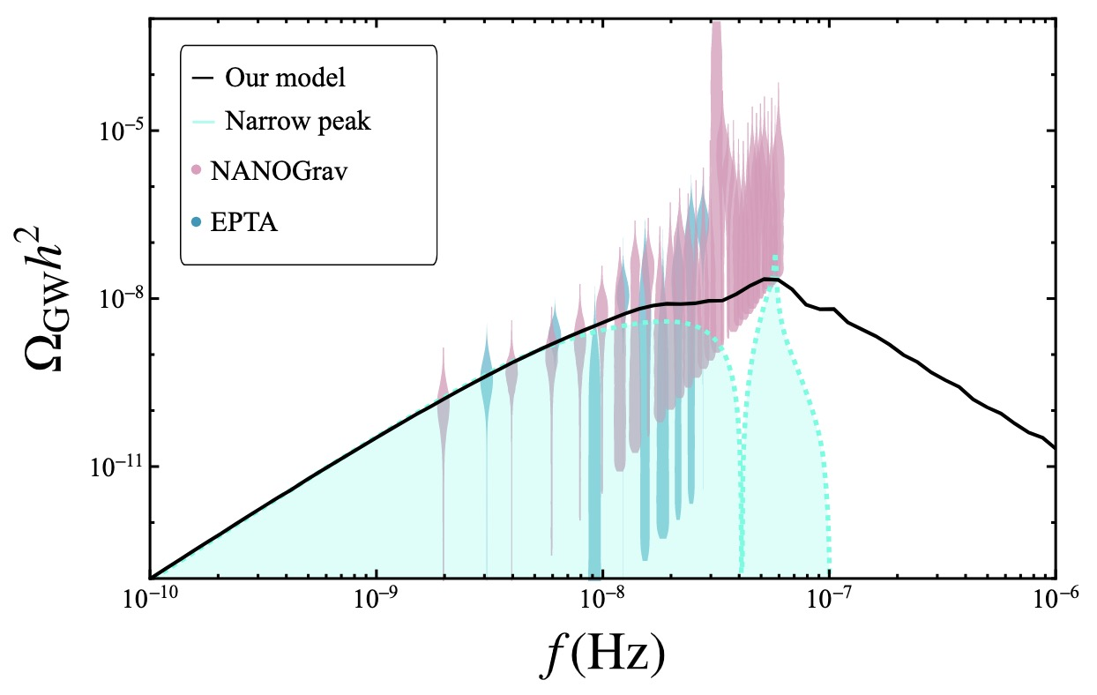
Induced Gravitational Wave (IGW)
K. Ananda,
C. Clarkson,
D. Wands, Phys.Rev.D 75 (2007) 123518
Data from: NANOGrav, 2023 (2306.16219), EPTA, 2023 [2306.16227]

Slide 24
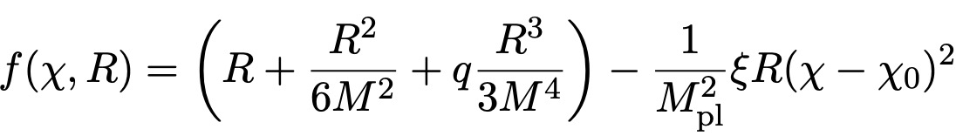
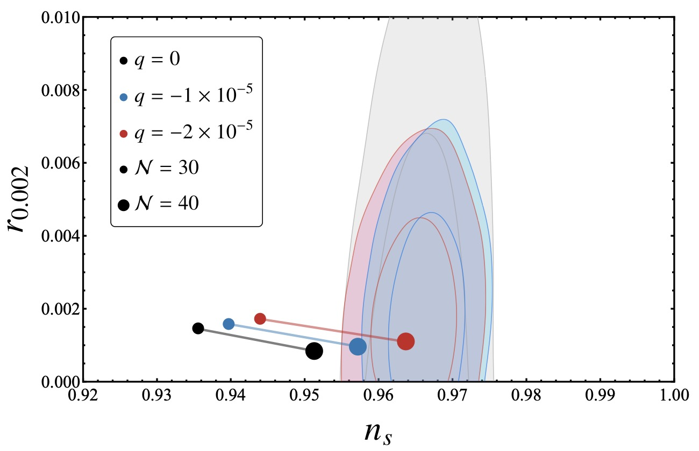
Problem: the r-ns relation is not favored

Slide 25
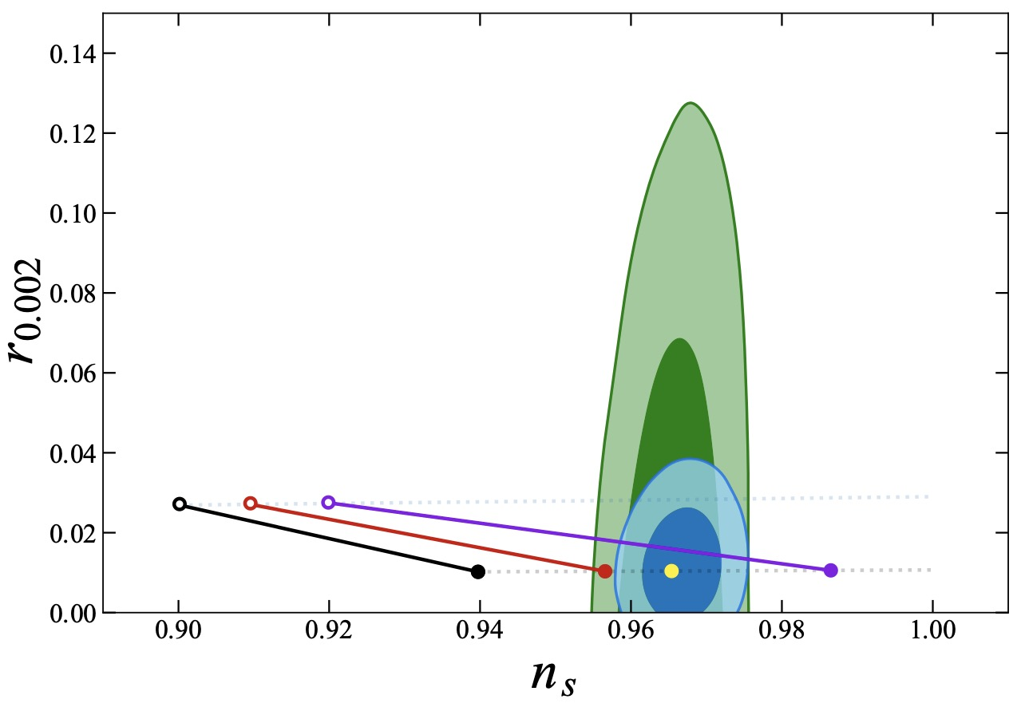


R^3 correction
In 2504.12035, with Jinsu Kim and Xinpeng Wang

Slide 26
Wait, did we forget something?

Slide 27

Wait, did we forget something?
户愚吕兄
户愚吕弟
PBH1
PBH2
PBH DM
We forgot the
Elder Brother!

Slide 28
An interesting scenario: Light PBH formation during break stage
X. Wang, YZ, M. Sasaki, in prep
M<10^8g

Slide 29
Radiation-dominated Era from Evaporation of PBHs

Slide 30

Question：Any hints on such huge amplification?
? ? ?
PBH formation:
amplification
~1Mpc
~1pc
CMB

Slide 31
Idea
PBHs from large curvature perturbations
+ LIGO data from mergers of PBH binaries
Primordial Power Spectrum of curvature perturbations?
(on small scales)

Slide 32

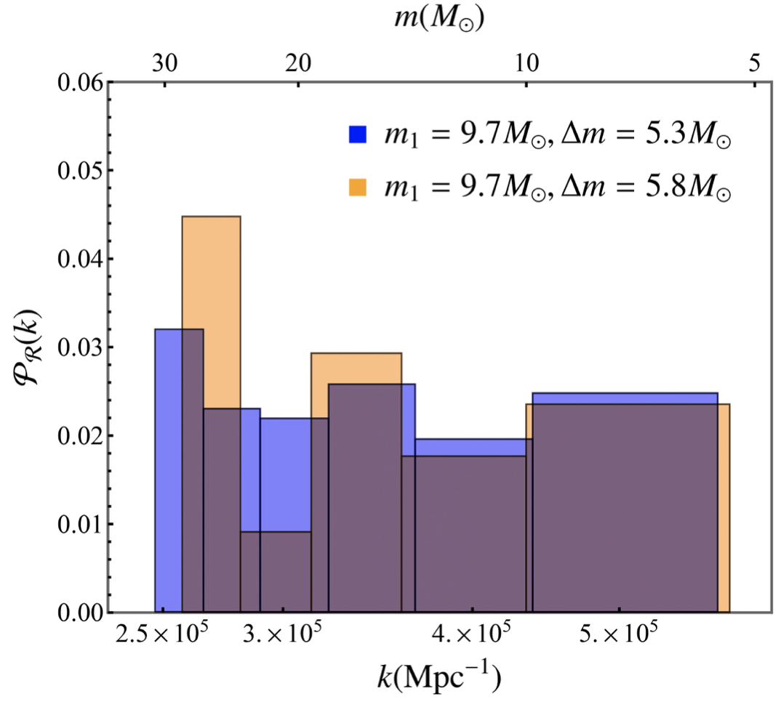
Common feature:
Amplitude of order 0.01
Consistent with PBH scenario
amplification !
~1Mpc
~1pc
CMB
R. Kimura, T. Suyama, M. Yamaguchi and YZ, JCAP 04 (2021) 031 [arXiv: 2102.05280]
X. Wang, YZ, Kimura and M. Yamaguchi, SCPMA 6 (2023) 66 [arXiv: 2209.12911]

Slide 33
Question：If no IGW observed, can we rule out PBH scenario?
Question：Is there any PBH scenario without amplification
of primordial power spectrum?

Slide 34
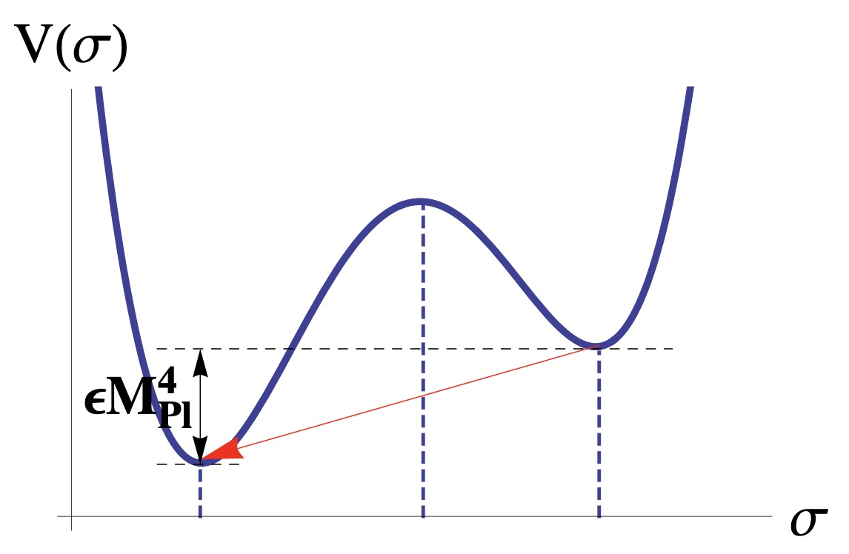
Another mechanism: The Bubble Nucleation
Bubble will be nucleated via tunneling process in early universe
False Vacuum
True Vacuum
True Vacuum
True Vacuum
During Inflation

Slide 35
Another mechanism: The Bubble Nucleation
Bubble will be nucleated via tunneling process in early universe
FV
True Vacuum
FV
True Vacuum
True Vacuum
During Inflation

Slide 36

Another mechanism: The Bubble Nucleation
Bubble will be nucleated via tunneling process in early universe
FV
PBH
True Vacuum
During Inflation

Slide 37
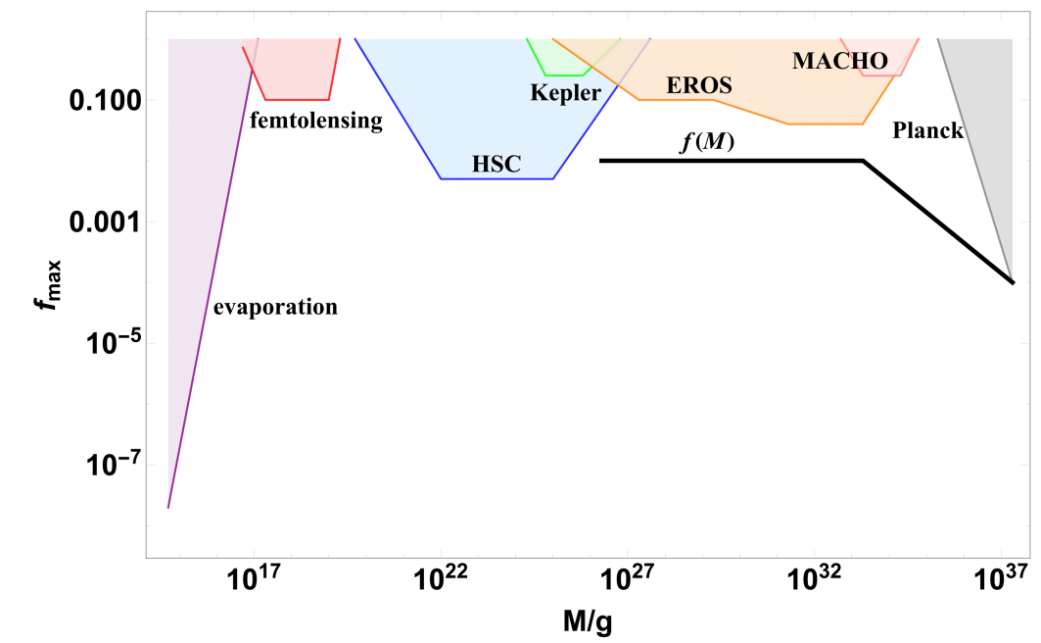
Case of a constant tunneling rate
H. Deng, A. Vilenkin, JCAP 2017(12): 044.
We need a varying tunneling rate to explain DM

Slide 38

Case of a constant tunneling rate
H. Deng, A. Vilenkin, JCAP 2017(12): 044.
Cannot
explain
DM
from
PBH
We need a varying tunneling rate to explain DM

Slide 39
The Bubble Nucleation
Bubble will be nucleated via tunneling process in early universe
False Vacuum
True Vacuum
True Vacuum
False Vacuum
True Vacuum
False Vacuum
True Vacuum
False Vacuum
During Inflation
After Inflation
Question: How to realize this scenario?

Slide 40
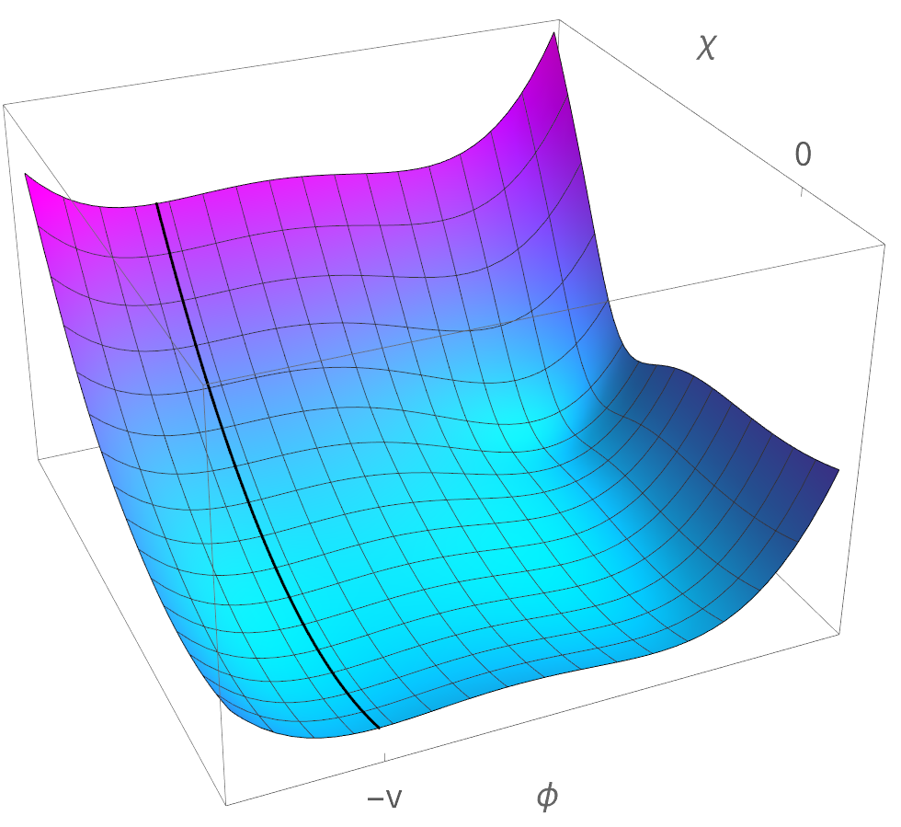
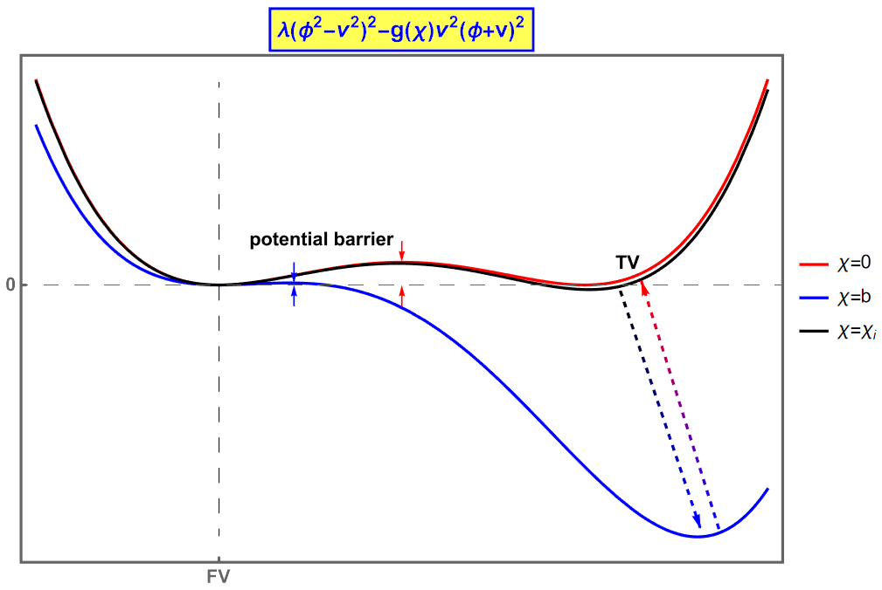
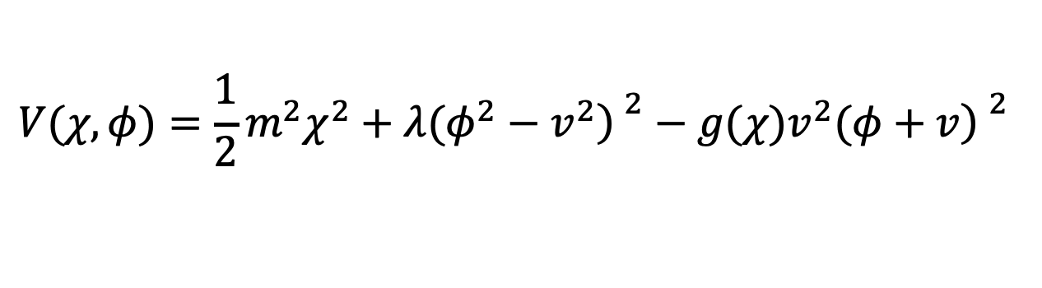
Running of local minima
$$V(χ,φ)=\frac{1}{2}m^{2}χ^{2}+λ(φ^{2}−v^{2}{\left) \right.}^{2}−g(χ)v^{2}(φ+v{\left) \right.}^{2}$$
inflaton
instanton
TV
FV
slow-roll
tunneling
H. Wang, YZ, T. Suyama, in preparation

Slide 41
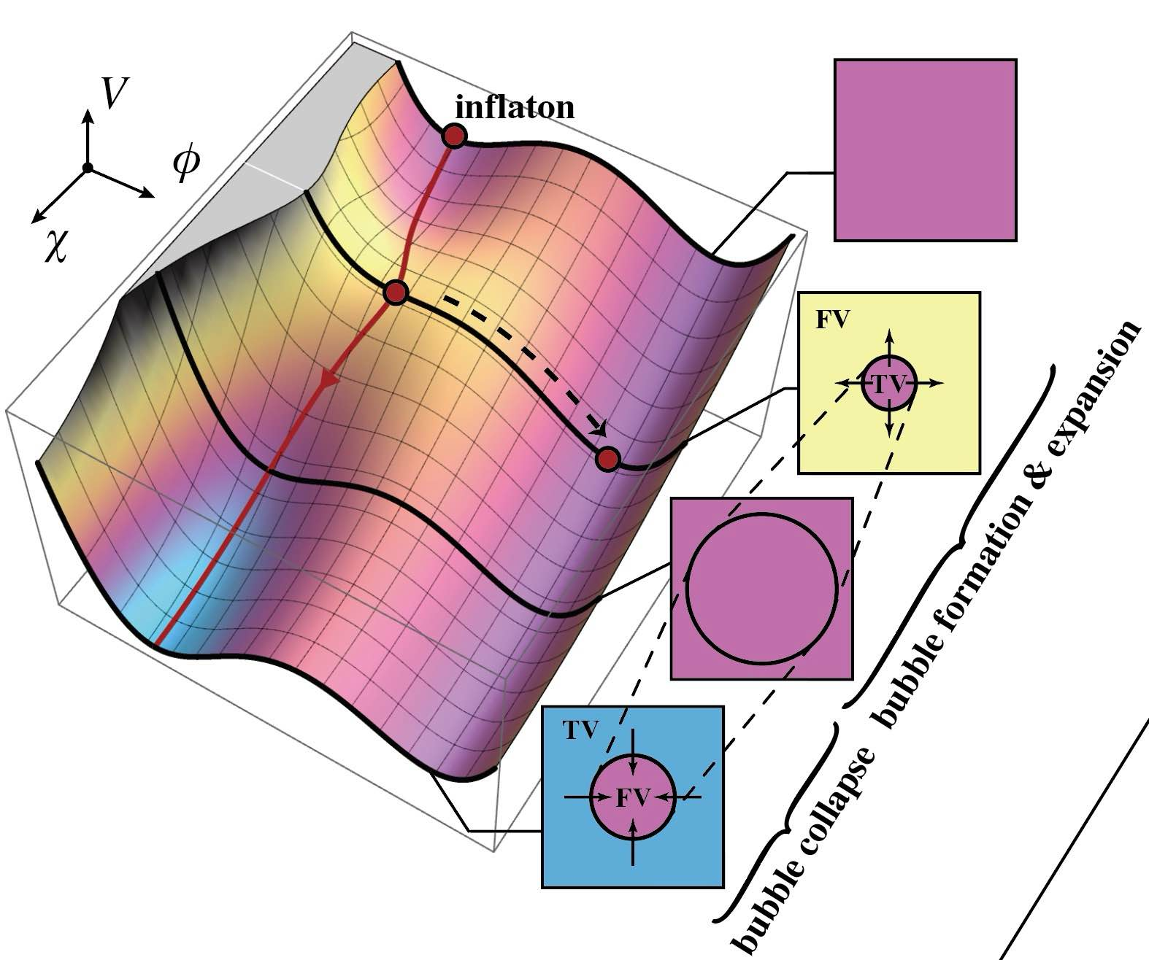

Slide 42
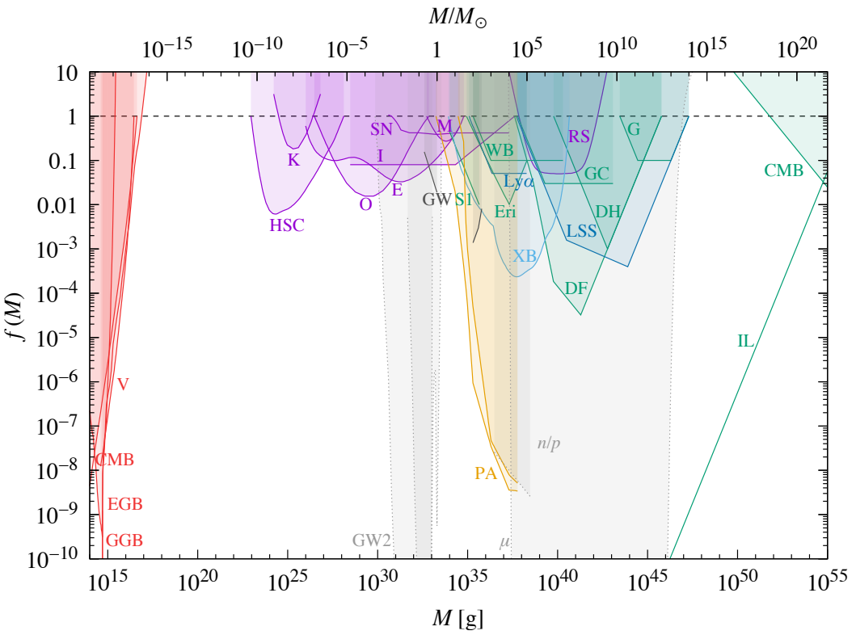

Single Field case
H. Deng, A. Vilenkin, JCAP 2017(12): 044.
Two field with nonminimally coupling

Slide 43
Summary
LVK：GW from
PBH binaries
PTA observations…
DM
YZ, M. Sasaki, S. Pi, in preparation
X. Wang, YZ, Kimura and M. Yamaguchi, SCPMA 6 (2023) 66
R. Kimura, T. Suyama, M. Yamaguchi and YZ, JCAP 04 (2021) 031
Supermassive
BHs
PBHs
Bubbles
Primordial curvature
perturbations
H. Wang, YZ, T. Suyama,
in preparation
X. Wang, YZ, M. Sasaki, JCAP 07 (2024) 076
S. Pi, YZ, Q. Huang, M. Sasaki, JCAP 05 (2018) 042

