Slide 1
Modified gravity realizations of quintom dark energy
Yu-Hang Yang
Apr 25th 2025
@ EFTGC, HIAS, Hangzhou, China
Based on 2404.19437 (Sci.Bull), 2501.18336, 2504.06784
Collaborator: Xin Ren, Qingqing Wang, Yi-Fu Cai and Emmanuel N. Saridakis
University of Science and Technology of China
Notes:
Good afternoon, ladies and gentlemen. My name is Yang Yuhang from the University of Science and Technology of China. It is my great honor to stand here and give you a talk about our recent work named “quintom cosmology and modified gravity after DESI 2024”. We used the latest DESI 2024 BAO to reconstruct the dynamical evolution of our universe. Before starting my talk, I want to give a big thanks to my collaborators, thanks their hard-working and valuable discussion, we have done a great job together.

Slide 2
Content
Part 1: Dark energy in light of latest observations
Part 2: Modified gravity realizations of quintom dark energy
Part 3: Cosmological constrain on quintom model
Part 4: Summary and conclusion
Notes:
First of all, let’s have a brief introduction of dark energy and modified gravity

Slide 3
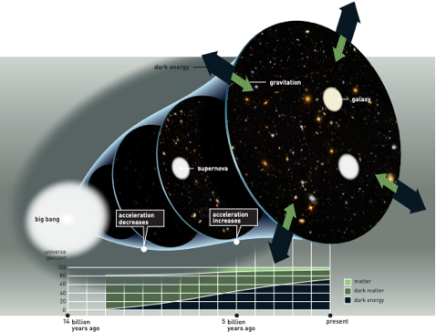
Great discovery
A story begins from 1998.
Our Universe is accelerating!
The type-Ia supernovae produces consistent peak luminosity because of the uniform mass of white dwarfs that explode via the accretion mechanism. These explosions can be used as standard candles to measure the distance to their host galaxies since the visual magnitude of the supernovae depends primarily on the distance.
Notes:
The story of dark energy begins from 1998. After Einstein came up with his theory of general relativity, he believed that our universe should be static, so he removed the cosmological constant term from his field equations. But in 1998, astronomers discovered that distant Type Ia supernovae (SN Ia) were accelerating away at an increasing pace.

Slide 4
Cosmic Pie
What can drive the late-time cosmic acceleration?
According to modern cosmology, anything can’t be explained by the conventional paradigm, it must belong to …
Dark Universe
Dark Matter
Dark Force
Observable Universe
Dark Universe
Notes:
With such a shocking observation result, it is natural to wonder how we can explain this phenomenon, or ask what can drive the late-time cosmic acceleration?
To explain the flatness of the galaxy's rotation curve, the concept of dark matter has been introduced to be responsible. Similarly, the concept of dark energy, responsible for such a phenomenon, but the underlying nature remains mysterious.
Surprisingly, cosmological measurements show that only about 5% of our universe is made up of baryonic matter which we are familiar with, while 95% of it is still unknown. We call it dark universe! And for the dark universe, dark energy accounts for the vast majority, accounting for 70% of the total matter content of our universe.
So understanding the physical meaning of dark energy is really important to our understanding of the universe we live in.

Slide 5
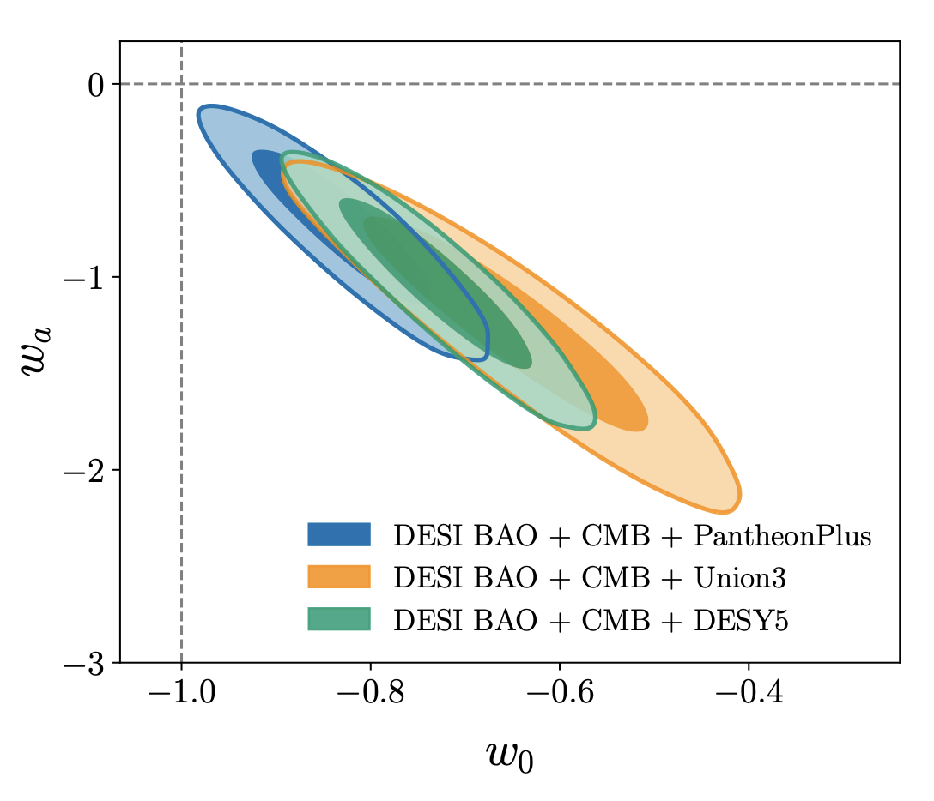
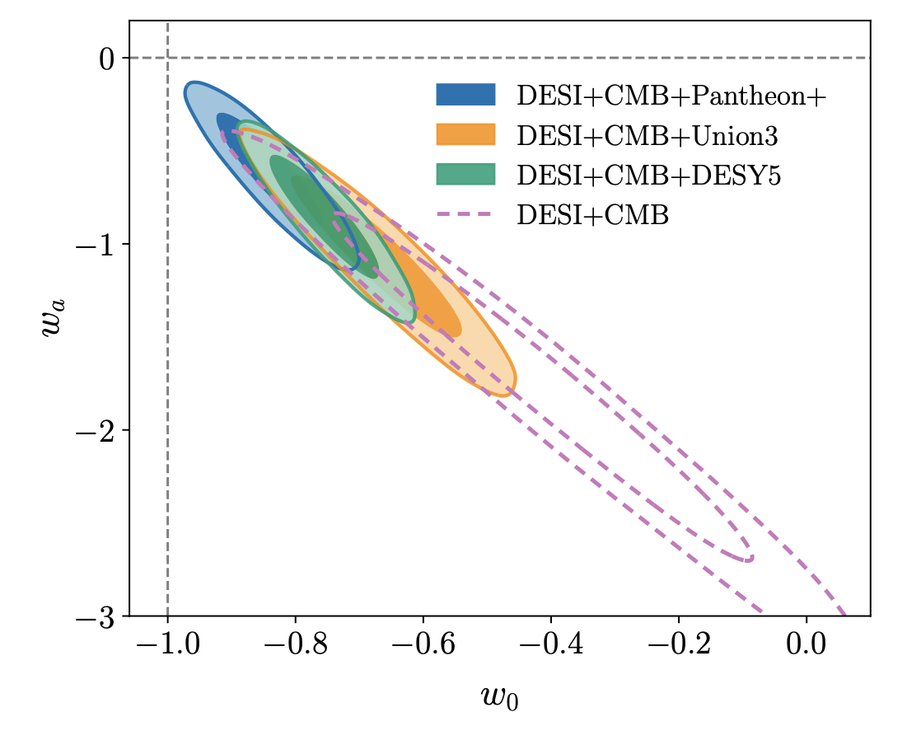
In light of latest observations
2024: 2.5-3.9σ
2025: 2.8-4.2σ
Standard ΛCDM model may not be very “standard”!
We may need dynamical dark energy?
DESI Collaboration 2404.03002, 2503.14738

Slide 6
In light of latest observations
Quintom-B
Quintom-B
2024: 2.5-3.9σ
2025: 2.8-4.2σ
Standard ΛCDM model may not be very “standard”!
We may need dynamical dark energy?
DESI Collaboration 2404.03002, 2503.14738

Slide 7
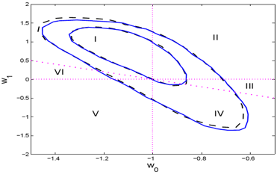
Categories of Dynamics
The dynamics of dark energy crucially rely on the equation-of-state parameter, which is defined by the ratio of pressure to energy density
A simple parametrization:
Categories:
Λ: w=-1 ΛCDM
Quintessence: -1<w<-1/3 II and III
Phantom: w<-1 V and VI
K-essence: w>-1 or w<-1
Quintom: w crosses -1 I and IV
Quintom-A
Quintom-B
Feng, Wang, Zhang, 2005; Huterer, Cooray, 2005;
Xia, et al., 2006
Notes:
In order to classify different models of dark energy, we introduce an important parameter describing the dynamics of dark energy, the equation-of-state parameter of dark energy w, defined by the ration of pressure to energy density.
We can use a simply parametrization of w called CPL parametrization which is first introduced by Chevallier, Polarski and Linder. W0 reprents the value of w at current time, while for a=0, w= w0+w1.
If the dark energy is a cosmological constant, w=-1 is a constant. Together with non-relativistic cold dark matter leads to the modern standard cosmology model LCDM.
From the parametrization, the parameter space of w0, w1 can be divided into six different regions, represents three or four different characteristic of dark energy.
It is worth noting that this is just a classification based on the phenomenology of dark energy
Through the reconstruction of the EoS parameters of dark energy, professor Zhao Gongbo found that the evolution of dark energy showed dynamic behavior, which posed a huge challenge to the cosmological constant dark energy, and the confidence of this dynamic dark energy is becoming higher and higher with the accuracy of the observation data

Slide 8
Gaussian Process
Method: Gaussian Process, a stochastic procedure to acquire a Gaussian distribution over functions from observational data.
Marina Seikel, et al, JCAP06, 036 2012
Arman Shafieloo, et al, PRD.85.123530
Key points：
The observation data we get are some data points with error bar at different redshifts independently.
To understand the law of the function we will reconstruct, we only need consider the finite dimensional distributions (FDDs) for all n∈N.
Gaussian process is a stochastic process with Gaussian FDDs.
We apply GAPP (Gaussian Processes in Python) to reconstruct H(z) and its derivatives through observational data points.

Slide 9
Gaussian Process
Detail：
The observation data $y$ together with its covariance matrix $C$
The reconstructed $f^{∗}$ with the kernel function $K\left(X,X^{∗}\right)$
﻿The hyperparameters σf the kernel function can now be optimized by maximizing the likelihood
When consider the observation or reconstruction of the derivative of the function, the procedure is similar.
Notes:
Our goal is to form a predictive distribution of y given x. That means I want something where if I plug in an x value, it will give me a distribution over y.
If we consider linear regression, that is we fit a line and then estimate the remaining noise variance which gives us a predictive distribution. The problem is this is missing an important source of uncertainty the uncertainty in the line.
How to capture this, our idea is to use Bayesian linear regression.
Prior sample, we can use bayes theorem to update our model such that it produces samples that agree with our data. Then we gat the posterior samples. Now we can apply a noise variance to each sample, then to get the final result.

Slide 10
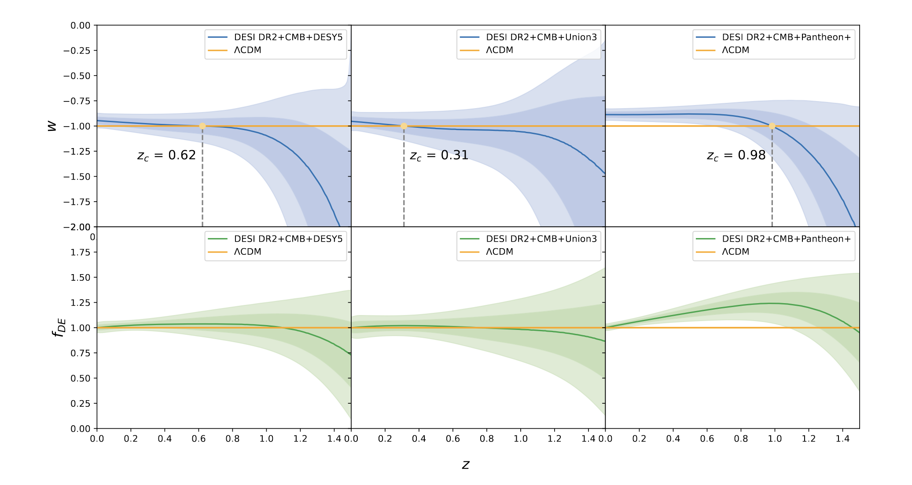
Non-parametric approach to w(z)
Concerning $w(z)$, we can see that it always crosses -1 from below, thus experiencing the quintom-B behavior.
For $f_{de}\left(z\right)$, the normalized energy density, we find that it tends to decrease with increasing redshift, remaining always positive.
Notes:
We all know that the flatness of galactic rotation curves introduced us to the concept of dark matter, but some people have tried to explain it by modifying gravity, leads to the MOdified Newtonian Dynamics,
Also in the early universe, there are also many modified gravity, the first and so far most successful inflation model is based on modified gravity – R² model by Starobinsky

Slide 11
No-Go Theorem
No-Go theorem:
For theories of dark energy in the 3+1 dimensional FRW universe described by a single perfect fluid or a single scalar field with a generic K-essence Lagrangian, which minimally couples to GR, its equation-of-state parameter cannot cross over the cosmological constant boundary/phantom divide.
Key points to the proof:
For a single perfect fluid, the sound speed square becomes divergent when w=-1 crossing occurs
For a single scalar field, there is a general dispersion relation for perturbations, which also becomes divergent when w=-1 crossing occurs
CYF, et al., Phys.Rept. 2010;
Feng, et al., 2005; Vikman, 2005;
Hu, 2005; Xia, CYF, et al., 2008
Notes:
If the fluid is barotropic, the adiabatic sound speed is determined by. From this relation we can see that the sound speed of a single perfect fluid is apparently divergent when w crosses −1, which leads to instability in DE perturbation.

Slide 12
Model Buildings
The Key: To realize the dynamics of w=-1 crossing over, one ought to break at least one condition presented in the No-Go theorem for dark energy.
Models:
Gauss-Bonnet Modified gravity – Cai, Zhang, Wang, CTP 2005
Yang-Mills model – Zhao, Zhang, CQG 2006
DGP brane-world – Zhang, Zhu, PRD 2007
Interacting DE – Wang, et al., PLB 2005; RPP 2016
Effective Lagrangian – CYF, et al., PLB 2007; CQG 2008
Horndeski DE – Matsumoto, PRD 2018
……
Modified gravity theory

Slide 13
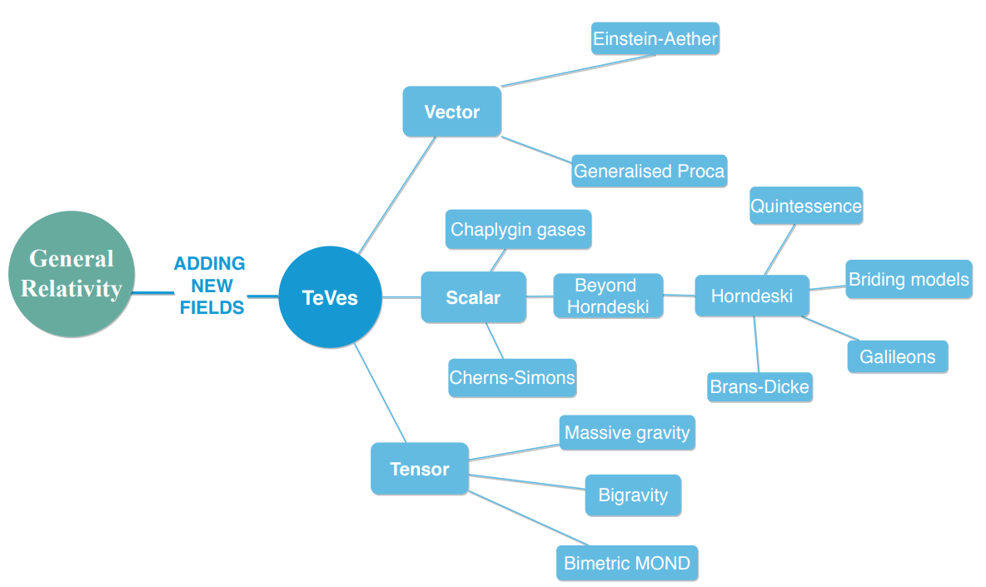
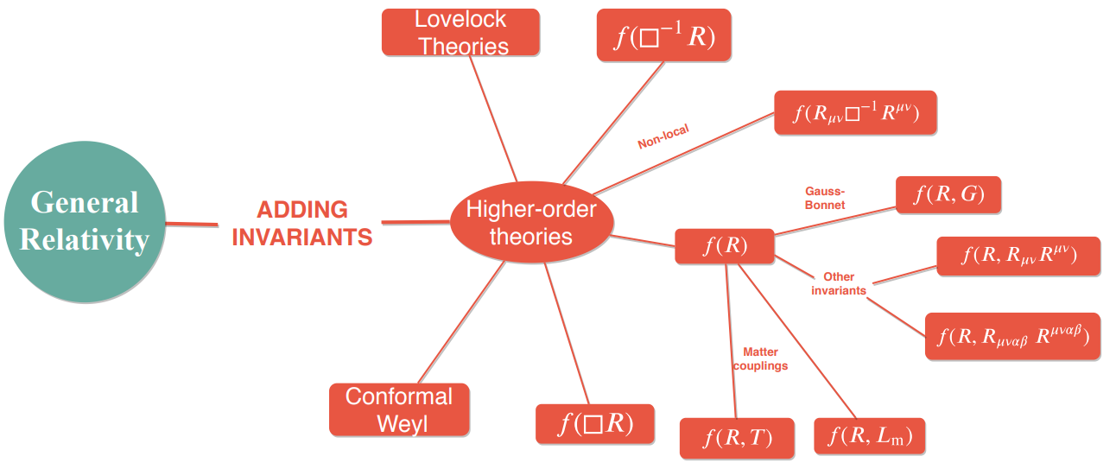
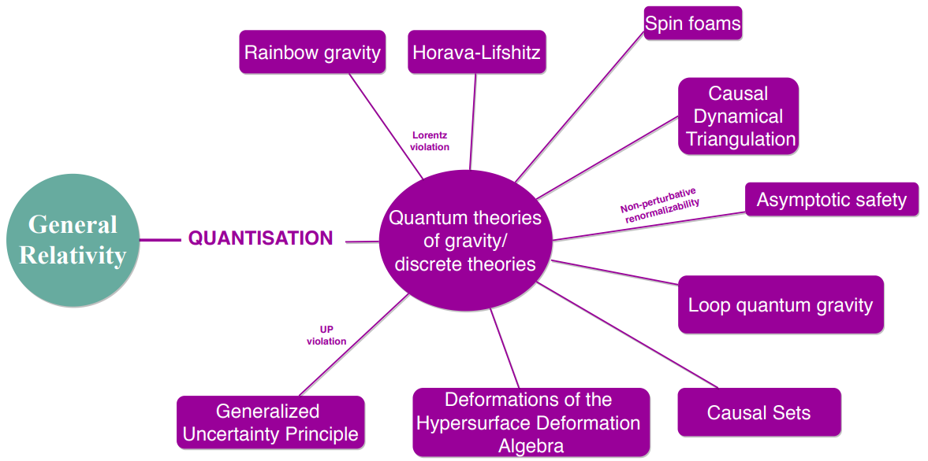
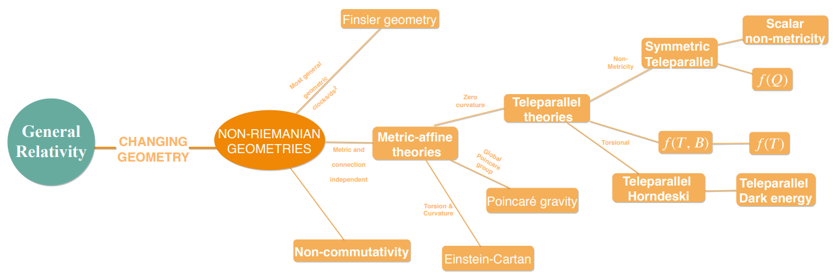
How many MGs
Emmanuel N. Saridakis et al., 2023
Metric-Affine gravity

Slide 14
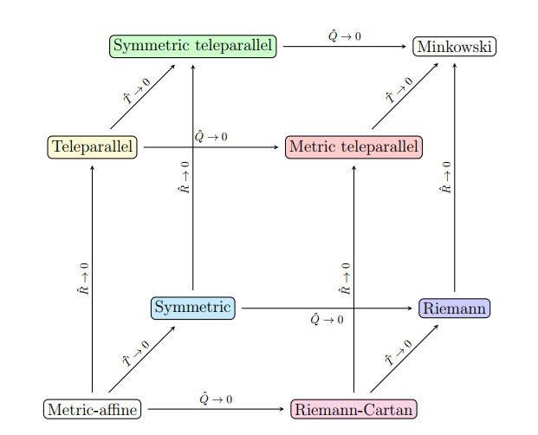
Metric-Affine gravity
f(R) gravity —— curvature
f(T) gravity —— torsion
f(Q) gravity —— non-metricity
Metric-Affine gravity
For f(Q) gravity with coincident gauge, it consists with f(T) gravity.
(All affine connections are zero!)
General action, where X represents R, T or Q
Sebastian Bahamonde et al., 2023
curvature
torsion
non-metricity
Spacetime geometries
Metric-Affine spacetime
Notes:
Curvature describes how curved spacetime is, torsion describes how twisted spacetime is, and non-metricity describes deformation of spacetime

Slide 15
EFT of dark energy
General EFT in unitary gauge
Yang et al, 2504.06784
Gubitosi et al. 1210.0201
Li et al. 1803.09818
Curvature based EFT
Torsion contribution
Non-metricity contribution
Mixing
(Coincident gauge)
Notes:
The story of dark energy begins from 1998. After Einstein came up with his theory of general relativity, he believed that our universe should be static, so he removed the cosmological constant term from his field equations. But in 1998, astronomers discovered that distant Type Ia supernovae (SN Ia) were accelerating away at an increasing pace.

Slide 16
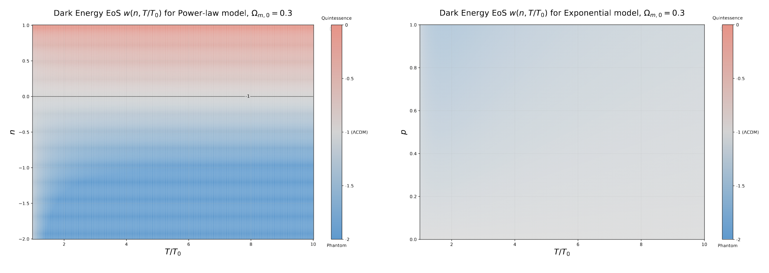
Quintom f(T) model
Power-law model
Exponential model
Quintessence
Phantom
Phantom
Quintessence or phantom like
Phantom like
No phantom crossing!

Slide 17
Quintom f(T) model
Power-law model + Exponential model ----> a quintom f(T) model
Quintessence-like
Phantom-like

Slide 18
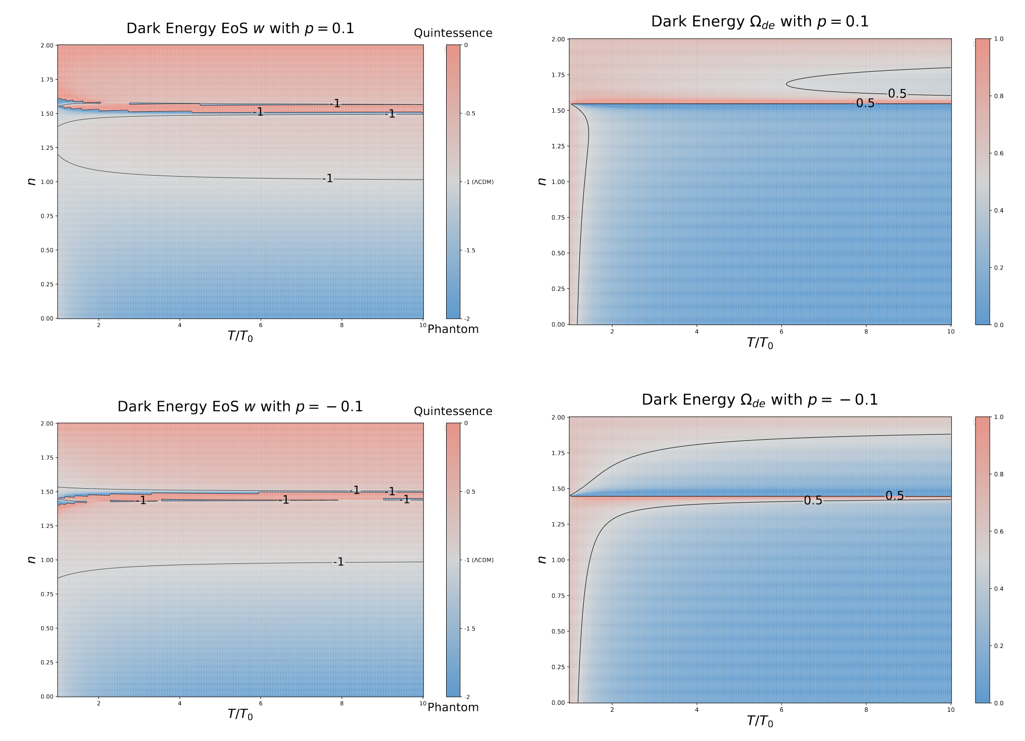
Quintom f(T) model
Power-law model + Exponential model ----> a quintom f(T) model
Quintom-A
Quintom-B

Slide 19
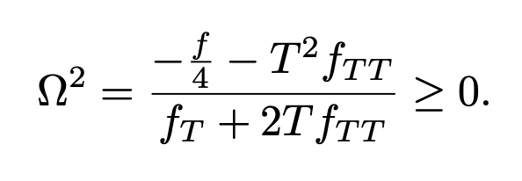
Quintom f(T) model
Power-law model + Exponential model ----> a quintom f(T) model
Quintessence-like
Phantom-like
Stability of this model requires

Slide 20
Quintom f(T) model
Power-law model + Exponential model ----> a quintom f(T) model
Quintessence-like
Phantom-like
Stability of this model requires
Stable
Stable

Slide 21
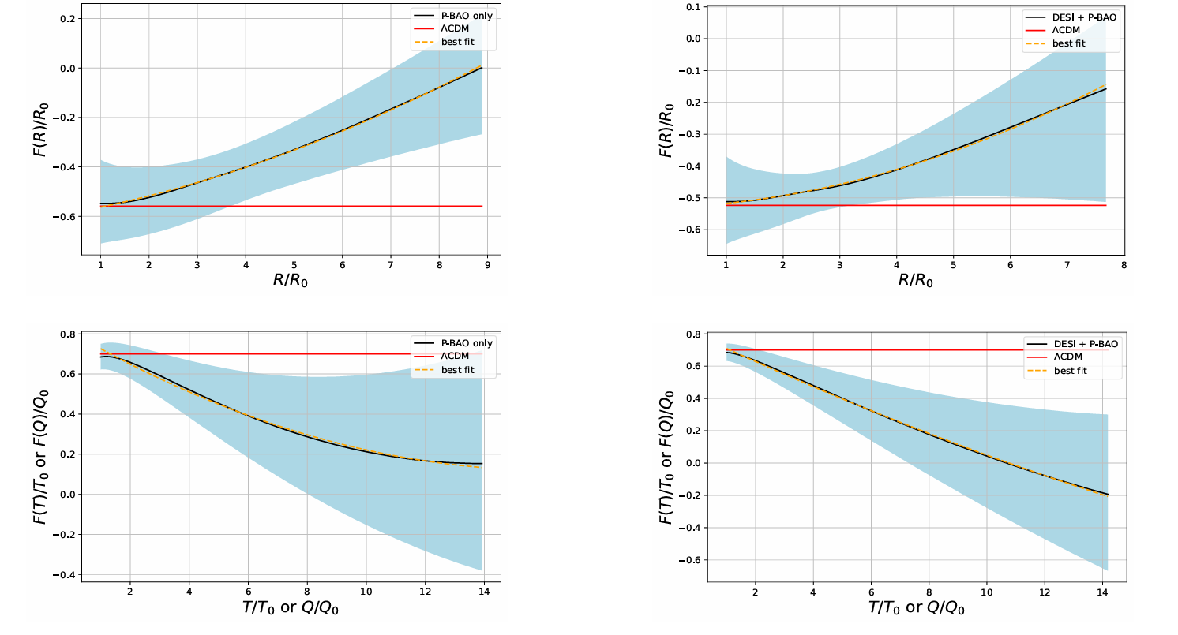
Quadratic f(T) model
The reconstructed f(X) from DESI 2024 can be effectively parametrized as
Yang, et al., 2404.19437
The reconstruction results indicate f(X) beyond the standard ΛCDM.
For all cases, the quadratic deviation from ΛCDM is mildly favored.
This model is also cable of quintom-behavior.
Notes:
Since we have reconstructed the evolution of the dark-energy EoS parameter from the data, and we have expressed it in terms of the modified gravity involved function, based on H(z) and its derivative we can straightforwardly obtain the reconstruction of these functions too in a nearly model-independent way, the only assumption we made is the spacetime geometry of the gravity. Based on the relationship between X and H(z), we can obtain f as the reconstructed function of X. The relation between f (X) and X, using the reconstructed H(z) results. We mention that we do not use the DESI only result to obtain the reconstruction, since the H(z) at low redshift does not behave very efficient. And we find the reconstruction results indicate f (X) beyond the standard ΛCDM. We know that as the universe evolves, the absolute value of R, T or Q gradually become smaller and smaller, which means that in the late universe we can always do a polynomial expansion of the gravitational theory’s action f (X) similar to Taylor’s expansion, writing them as a sum of different series. However, such a description in the late universe is only a effective description of the original action, and it is still worth considering what kind of original function it is in general.

Slide 22
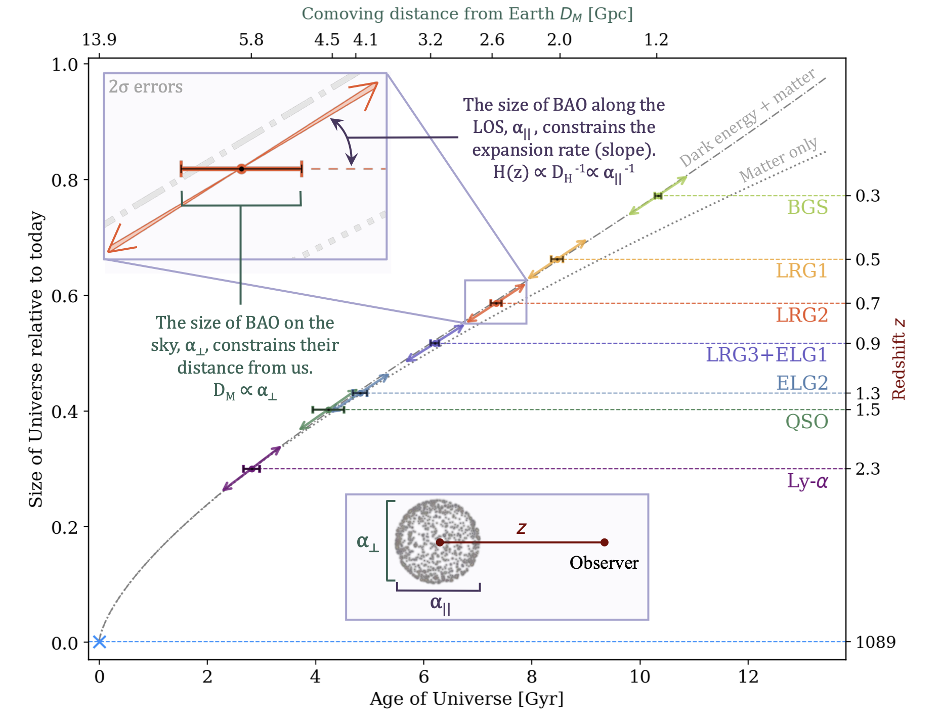
Cosmological observations
SNe
BAO
CMB
Notes:
We all know that the flatness of galactic rotation curves introduced us to the concept of dark matter, but some people have tried to explain it by modifying gravity, leads to the MOdified Newtonian Dynamics,
Also in the early universe, there are also many modified gravity, the first and so far most successful inflation model is based on modified gravity – R² model by Starobinsky

Slide 23
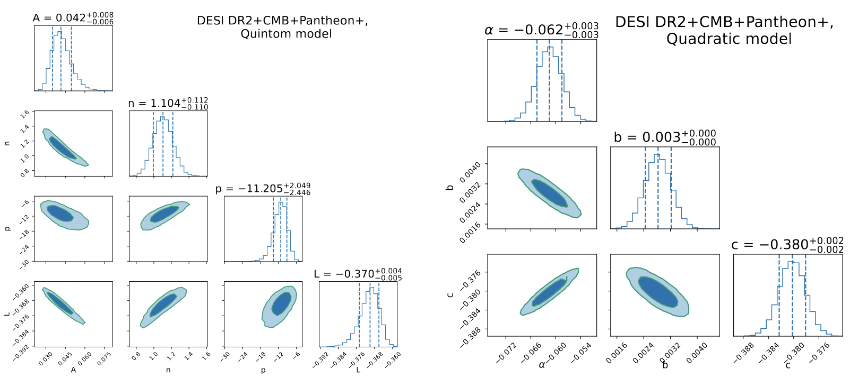
Cosmological constrain
At the background-level, BAO+CMB+SNe
The quadratic model is slightly favored by the data.
Notes:
We all know that the flatness of galactic rotation curves introduced us to the concept of dark matter, but some people have tried to explain it by modifying gravity, leads to the MOdified Newtonian Dynamics,
Also in the early universe, there are also many modified gravity, the first and so far most successful inflation model is based on modified gravity – R² model by Starobinsky

Slide 24
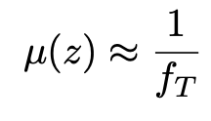
Cosmological constrain
At the perturbation-level, BAO+RSD+SNe
Gravity modifications are reflected into an effective gravitational constant or a modified gravity parameter given by $μ\left(k,a\right)=G_{eff}/G$.
In f(T) gravity, we have
Notes:
We all know that the flatness of galactic rotation curves introduced us to the concept of dark matter, but some people have tried to explain it by modifying gravity, leads to the MOdified Newtonian Dynamics,
Also in the early universe, there are also many modified gravity, the first and so far most successful inflation model is based on modified gravity – R² model by Starobinsky

Slide 25
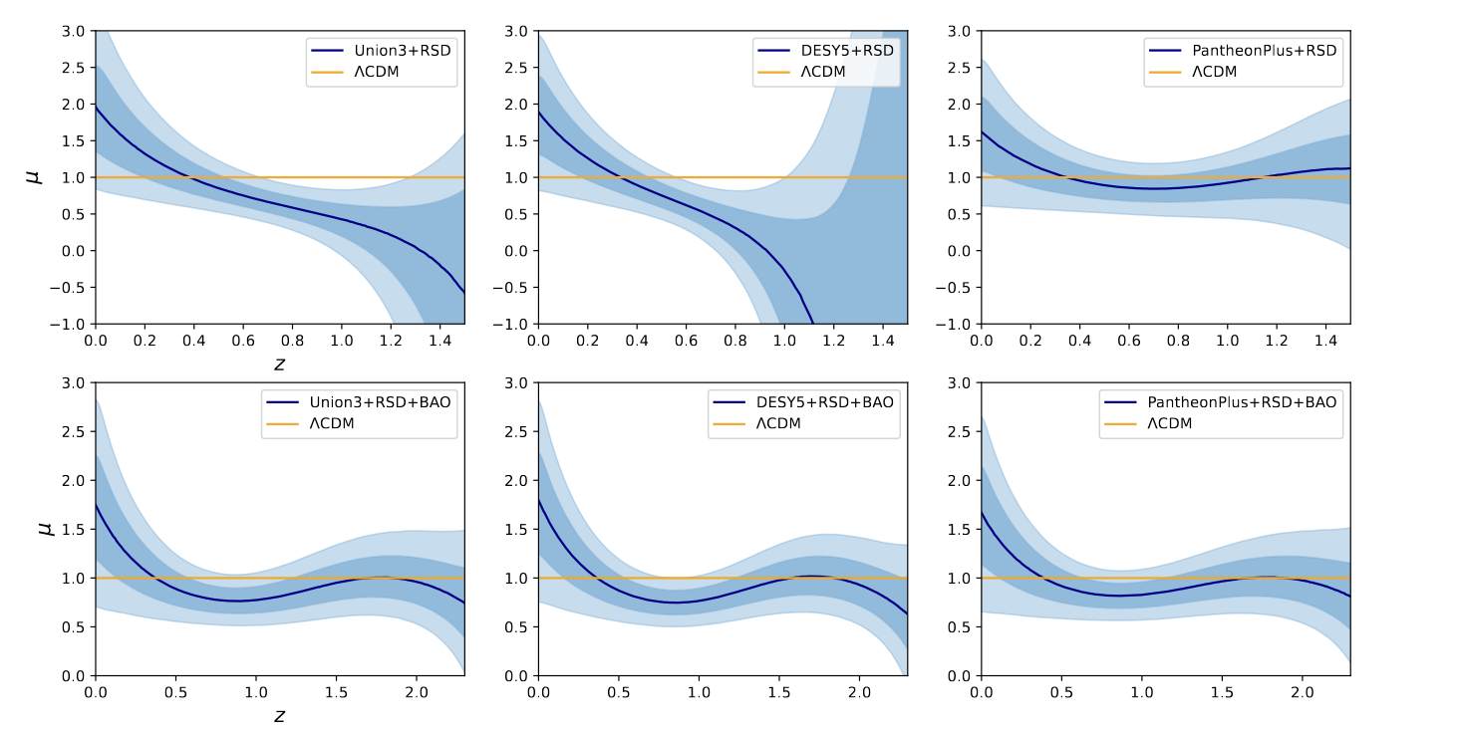
Cosmological constrain
At the perturbation-level, BAO+RSD+SNe
There is no strong evidence that GR needs to be significantly modified, but small corrections are necessarily needed.
Notes:
We all know that the flatness of galactic rotation curves introduced us to the concept of dark matter, but some people have tried to explain it by modifying gravity, leads to the MOdified Newtonian Dynamics,
Also in the early universe, there are also many modified gravity, the first and so far most successful inflation model is based on modified gravity – R² model by Starobinsky

Slide 26
To B or not to B ?
w0-wa parametrization:
Past
Now
Future
Will the confidence of the quintom-B behavior become larger and larger
in the future? Or it is wrong?
Dark Energy (Quintom-B) tension?

Slide 27
Summary
Our understanding of the dynamics of late-time cosmic acceleration remains unclear.
DESI 2025 data interpretation:
w(z) exhibits a quintom-B behavior, crossing -1 from phantom region to quintessence region.
Modified gravity theory such as metric-affine gravity can explain such a behavior.
Outlook: on. Also more theoretical mechanisms hold promise for being tested. Accumulated high-precision data are expected to explore the nature of late-time cosmic acceleration.
DESI may shed light on the dynamical nature, more are coming.

Slide 28
https://cospa.ustc.edu.cn/
Thanks

