Slide 1
Matrix moment approach to positivity bounds and UV reconstruction from IR
Shi-Lin Wan & Shuang-Yong Zhou
Effective Field Theories, Gravity and Cosmology
April 25th, HIAS(UCAS)
Based on arXiv 2411.11964

Slide 2
Outline
Introduction
The moment approach to positivity bounds
Single scalar: sufficient conditions
Multi-DoFs: Matrix moment problem
Mixed-variate formulation: numerical efficiency
Inverse problem: reconstruct UV from IR coefficients

Slide 3
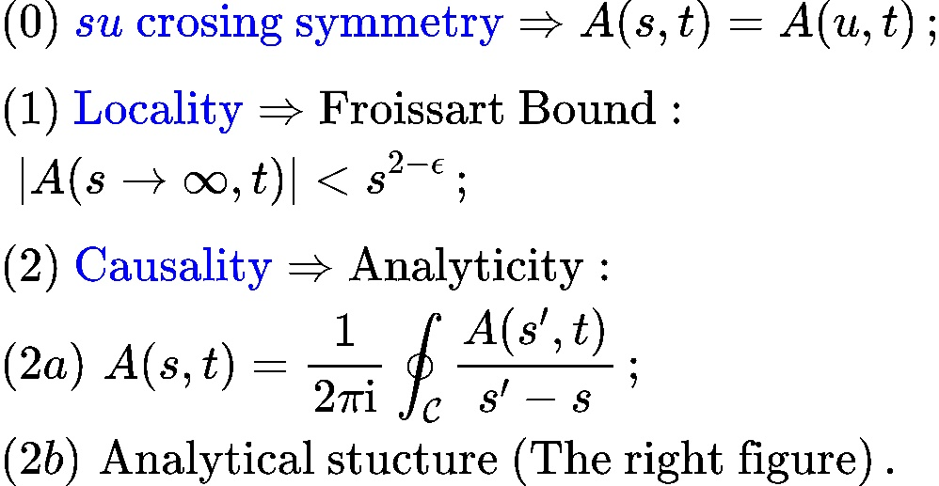
Dispersion Relation
Introduction

Slide 4
Forward Bounds
Introduction

Slide 5
Non-Forward Bounds
Introduction

Slide 6
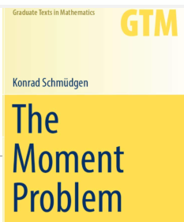
Basic Conceptions
The moment problem

Slide 7
EFT-Hedron for t=0
The moment problem

Slide 8
t≠0: Bi-variate Formulations
The moment problem

Slide 9
What’s next
The moment problem
Bi-moment formulation is numerically slow
How to formulate the physical problem as a moment problem for multi-DoFs?
Multiple fields
Fields with spin
Noticeable differences between the moment method and numerical results
Necessary and sufficient condition
Truncation and flat extension
How to infer the UV spectrum from IR with the moments?

Slide 10
Mixed-variate Formulation: Multi-Scalar
The moment problem

Slide 11
Fields with Spin: Semi-algebriac Function
The moment problem

Slide 12
Fields with Spin: More Variables
The moment problem

Slide 13
Necessary Condition
The moment problem

Slide 14
Sufficient Condition
The moment problem

Slide 15
Truncation, Flat Extension
The moment problem

Slide 16
Corrections to previous scalar bounds
The moment problem

Slide 17
Multi-DoFs Results
The moment problem

Slide 18
L-moment Results
The moment problem

Slide 19
Atomic Measures
Inverse problem

Slide 20
Curto-Fialkow algorithm
Inverse problem

Slide 21
Example: Veneziano amplitude
Inverse problem

Slide 22
Non-Forward: Unique coefficients
Inverse problem

Slide 23
EFT Coeff’s to Moments: Spectral method
Inverse problem

Slide 24
Example: Virasoro amplitude
Inverse problem

Slide 25
UV spectrum
Inverse problem

Slide 26
Uniqueness criterion
Inverse problem

Slide 27
Summary
Moment problem as alternative approach to get positivity bounds — connection with math literature
Generalized the moment formulation to include multiple fields and spin
Faster numerical efficiency with mixed-variate method
Inverse problem: extract UV spectrum from EFT data

