Slide 1
DAMPE squib? Signiﬁcance of the 1.4 TeV DAMPE excess
刘传国 SA22170034
Physics Letters B 780 (2018) 181–184

Slide 2
The Dark Matter Particle Explorer (DAMPE) experiment recently published the energy spectrum of electrons and positions from about 10 GeV to about 4 TeV .
The spectrum, by eye, contained two interesting features: a break at about 1 TeV and a monochromatic excess at about 1.4 TeV.
dark matter (DM) was invoked to explain the excess. DM with a mass of about 1.4 TeV could annihilate into electrons in a subhalo within about a kpc resulting in a narrow spike in the spectrum.

Slide 3


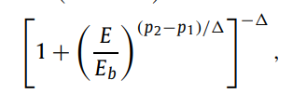


we ﬁt the spectrum by three toy models
A single power-law (PL)
A smoothly-broken power-law (SBPL)
A half-normal distribution upon a smoothly-broken power-law (signal)

Slide 4
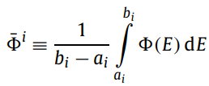



DAMPE measured the average ﬂux in 38 energy bins. We may
predict the average ﬂux in the i-th bin by
where the bin spans energies ai to bi .<E_{i}> is deﬁned by
The SBPL and PL ﬂuxes are, however, approximately linear on scales similar to the bin width such that it approximately holds,

Slide 5

The signal model contains a peak that may be narrower than the bin width and we must explicitly calculate it,i.e.,
This subtlety means that previous calculations of the required amplitude of a DM signal are underestimates by a factor of approximately the bin width divided by the signal width, ∆E/σ ≈ 5 – 20

Slide 6


We performed two hypothesis tests: an SBPL versus a single PL under the hypothesis of a single PL, and an SBPL versus a signal under the hypothesis of an SBPL. We performed the former to validate our methodology against a result published by DAMPE.
We used chi-squared test-statistics
The chi-squared itself was
We minimised the chi-squared with a CMA-ES evolutionary algorithm
implemented in stochopy.

Slide 7

we generated 1000 pseudo-datasets from the best-ﬁt single PL and best-ﬁt SBPL models and reminimised the test-statistic for each dataset and model.we estimated the p-value
by the fraction of pseudo-experiments in which the test-statistic
exceeded that observed.

Slide 8
For the hypothesis test of the PL versus SBPL, we found no differences in chi-squared between the PL and SBPL models .
This resulted in a p-value associated with the PL model of at most 0.002, which is equivalent to at least 2.9σ . DAMPE applied Wilks’theorem to estimate the signiﬁcance, ﬁnding 6.6σ .
We found about 7σ with a similar procedure.

Slide 9
For the hypothesis test of the SBPL versus signal model, only 11 of our 1000 pseudo-experiments under the SBPL hypothesis had differences in chi-squared.resulting in a global signiﬁcance of about 2.2σ –2.4σ .
This includes a two-dimensional look-elsewhere effect in the mass and width of the excess and corresponds to a p-value of about 1%. The local signiﬁcance was about 3.6σ , assuming a 1/2χ² distribution for the test-statistic.
To validate our methodology, we checked that our Monte Carlo reproduced a 1/2χ² distribution from a model with a ﬁxed mass and width

Slide 10
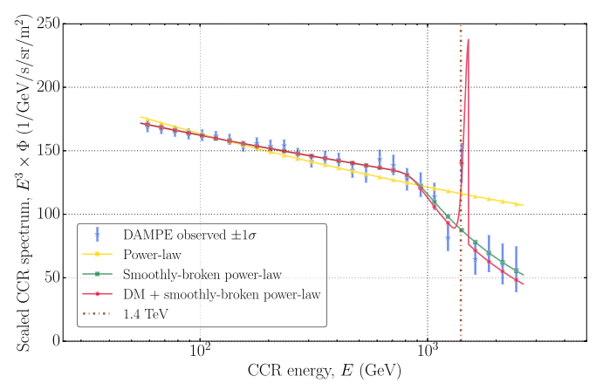
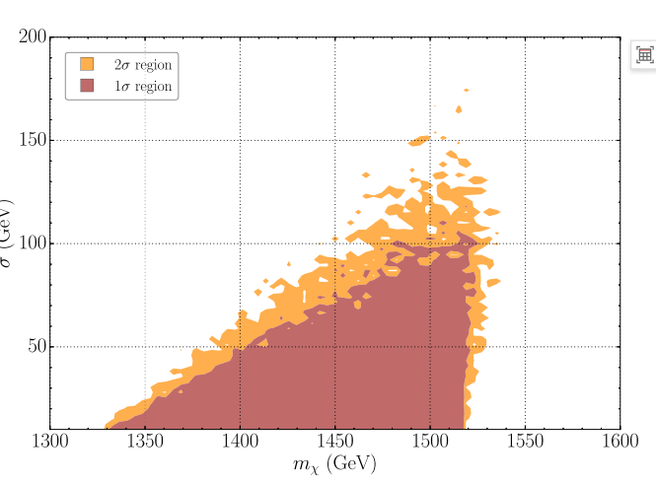
The DM signal must have a mass of about 1300 GeV to 1500 GeV, a width of less than about 100 GeV, and an amplitude of about 10−5/s/sr/m2. This amplitude corresponds to a peak ﬂux of about
10−7/GeV/s/sr/m2 for a signal width of σ = 10 GeV

Slide 11


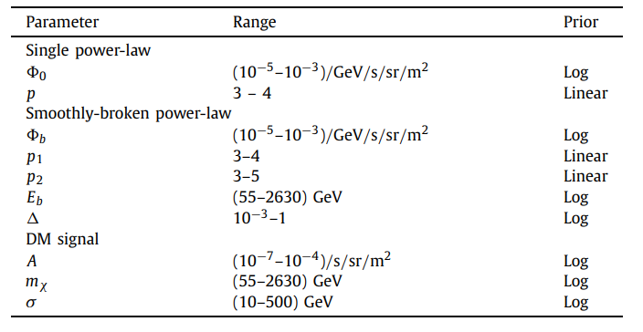
We considered Bayes factors between the three competing models of the spectrum.
The Bayes factor
where x represents a model’s parameters, p(D | M, x) =1/2 χ² is our likelihood function and p(x | M) are our priors for the model’s parameters.

Slide 12
the SBPL model was favoured against the single PL model by about 10¹⁰
the signal model was favoured versus an SBPL by a Bayes factor of about 2. We anticipate that changes in priors for could not substantially modify the Bayes factor.
the Bayes factor increased to 4 with linear rather than logarithmic priors for the mass, amplitude and width of the DM signal.
The maximum Bayes factor achievable with any priors is about 500.

Slide 13
For the SBPL versus the PL, we found a Bayes factor of about 10¹⁰ and a p-value of about 10⁻¹².
For the signal versus the SBPL, we found a Bayes factor of about 2 and a global p-value of about 1%.

