Slide 1
Measurements of ${}_{Λ}^{3}H$ and ${}_{Λ}^{4}H$ Lifetimes and Yields in Au+Au Collisions in the High Baryon Density Region
Yulou Yan
June 29,2023

Slide 2
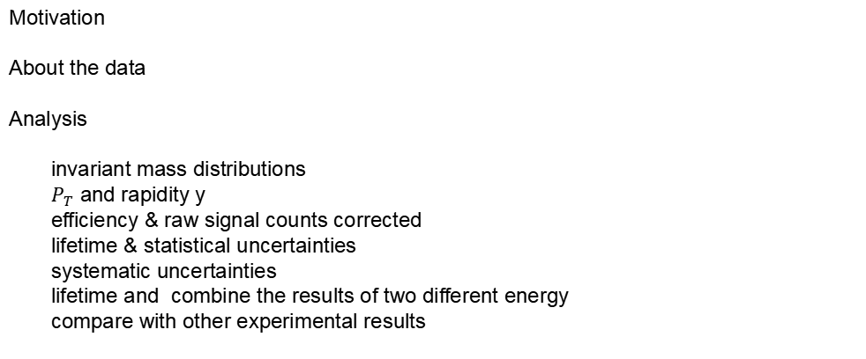
Outline
Motivation
About the data
Analysis
invariant mass distributions
$P_{T}$ and rapidity y
efficiency & raw signal counts corrected
lifetime & statistical uncertainties
systematic uncertainties
lifetime and combine the results of two different energy
compare with other experimental results
●
●
●
●
●
●
●
Summary

Slide 3

Motivation
✭
Hypernuclei are excellent experimental probes to study the hyperon-nucleon (Y –N) interaction
✭
Y –N interaction
●
an important ingredient in equation-of-state (EoS) of astrophysical objects such as neutron stars
●
an important ingredient in the description of the hadronic phase of a heavy-ion collision
✭
Lifetime, branching ratios, and binding energy measurements provide key information to understand the YN potential
●
${}_{Λ}^{3}H$ Binding energy~0.4 MeV，Theory predicts lifetime close to the free lambda lifetime
●
${}_{Λ}^{3}H$ lifetimes with large uncertainties ranging from ∼ 50% to ∼ 100% $τ_{Λ}$ in STAR , ALICE and HypHI
an enhancement in the hypernuclei yield is generally expected due to the higher baryon density
${}_{Λ}^{3}H$ and ${}_{Λ}^{4}H$
simple hyperon-nucleon bound states

Slide 4
About the data
✭
2018 fixed-target $\sqrt{S_{NN}}$ = 3.0 (7.2) GeV：2.8×${10}^{8}$(1.5×${10}^{8}$) qualified events
✭
The minimum bias (MB) trigger condition is provided by the Beam-Beam Counters (BBC) [33] and the
Time of Flight (TOF) detector
✭
top 0–50% most central events
✭
Particle identification is achieved by the measured ionization energy loss in the TPC
✭
reconstructed ${}_{Λ}^{A}H$ → π− + ${}_{2}^{A}{He}$ where A = 3, 4 using KFParticle package

Slide 5
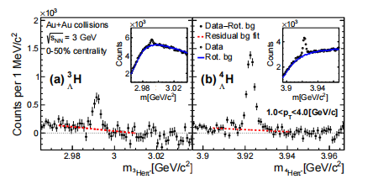
Analysis—invariant mass distributions
pT region (1.0–4.0) GeV/c
background:
①all π− tracks in a single event are rotated with a fixed angle multiple times and then normalized in the side-band region (bule line) uncorrelated background
②
perform a linear fit using the side-band region to remove any residual background(red line) correlated background

Slide 6
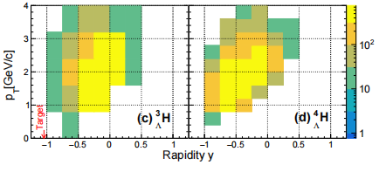
Analysis—$P_{T}$ and rapidity y
subtracted background

Slide 7
Analysis—efficiency & raw signal counts corrected
the TPC acceptance, tracking, and particle identification efficiency
using an embedding technique:
the TPC response to Monte Carlo (MC) hypernuclei and their decay daughters is simulated in the STAR detector
described in GEANT3
Simulated signals are embedded into the real data and processed through the same reconstruction algorithm as in real data
●
●

Slide 8
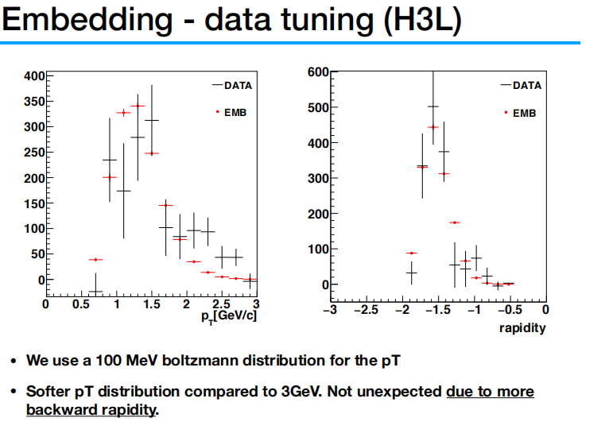
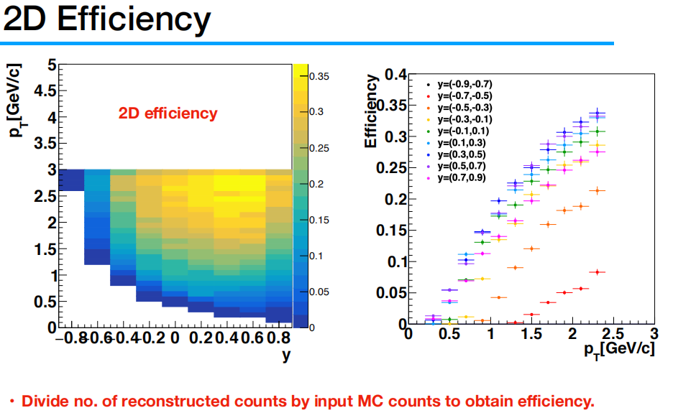
Analysis—efficiency
$$Λ$$
both graphs are not in this article
calculated using embedding, depends on the pT and rapidity spectra of the input simulation
• use a Boltzmann distribution for the input pT
• tune the pT spectra/rapidity of the simulation to match the data
• Efficiency is obtained by dividing the pseudodata(模拟数据) by the input

Slide 9
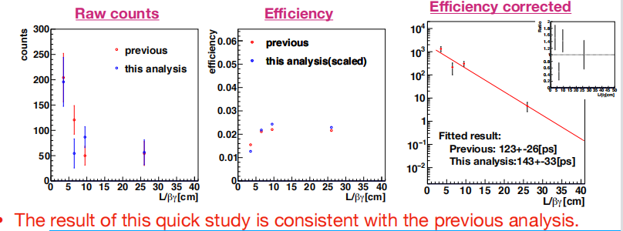
Analysis— raw signal counts corrected
graph is not in this article
Run10 data as a example
Efficiency corrections as a function of lifetime

Slide 10
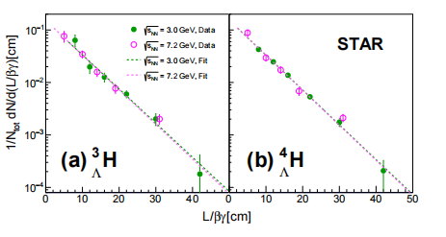
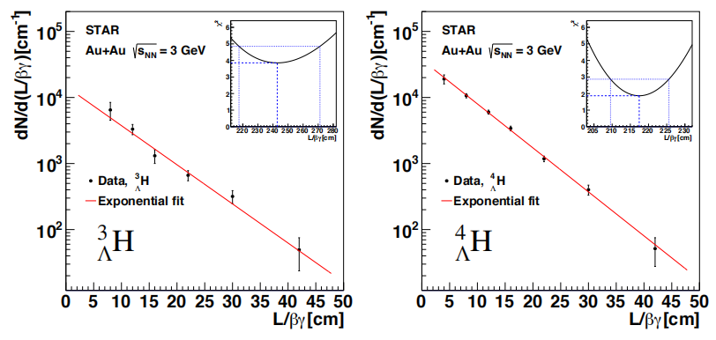




Analysis— lifetime & statistical uncertainties
graph is not in this article
$$N=N_{tot}e^{−L/βγcτ}$$
$\frac{1}{N_{tot}}(\frac{dN}{d(L/βγ)})=\frac{1}{cτ}(e^{−L/βγcτ})$ fit
$χ^{2}$+1 → $σ$
Residual distribution of the fit scaled by the statistical uncertainties.
$$log(\frac{1}{N_{tot}}(\frac{dN}{d(L/βγ)}))=−\frac{1}{cτ}\frac{L}{βγ}+C1$$

Slide 11
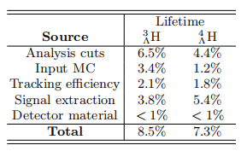
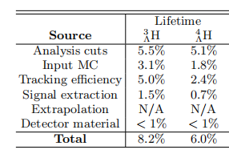

Analysis— systematic uncertainties
✭
imperfect description of topological variables in the simulations
estimated by varying the topological cuts
✭
imperfect knowledge of the true kinematic distribution of the hypernuclei
estimated by varying the input MC pT spectra
✭
the TPC tracking efficiency
estimated by varying the nhits requirement
$$σ_{total}^{2}=σ_{1}^{2}+σ_{2}^{2}+σ_{3}^{2}+σ_{4}^{2}+σ_{5}^{2}+...$$
✭
7.2Gev
3.0Gev
the signal extraction technique
estimated by varying the signal counting window
back up：slides15,16,17

Slide 12
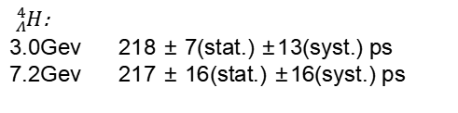



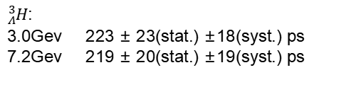
Analysis—lifetime and combine the results of two different energy
${}_{Λ}^{3}H$:
3.0Gev 223 ± 23(stat.) ±18(syst.) ps
7.2Gev 219 ± 20(stat.) ±19(syst.) ps
final${}_{Λ}^{3}H$: 221 ± 15(stat.) ± 19(syst.) ps
${}_{Λ}^{4}H$:
3.0Gev 218 ± 7(stat.) ±13(syst.) ps
7.2Gev 217 ± 16(stat.) ±16(syst.) ps
final${}_{Λ}^{4}H$: 218 ± 6(stat.) ± 13(syst.) ps
$$\overline{τ}=\frac{\sum_{i}{ω_{i}τ_{i}}}{\sum_{i}{ω_{i}}}$$
$$σ_{\overline{τ},stat}=\frac{1}{\sum_{i}{ω_{i}}}$$
$$σ_{\overline{τ},syst}=\frac{\sum_{i}{ω_{i}σ_{i,syst}}}{\sum_{i}{ω_{i}}}$$
where $τ_{i}$ is the lifetime measured at energy i, $σ_{i,stat}$ and $σ_{i,syst}$ are the statistical and systematic uncertainties of the individual measurements, and $ω_{i}$ = 1/$σ_{i,stat}^{2}$

Slide 13
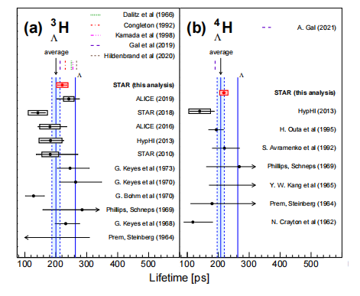
Analysis—compare with other experimental results
average lifetimes of ${}_{Λ}^{3}H$: 200 ± 13 ps
average lifetimes of ${}_{Λ}^{4}H$: 208 ± 12 ps
Horizontal lines represent statistical uncertainties, while boxes represent systematic uncertainties.
All data from ALICE, STAR and HypHI lie within 1.5σ of the global averages.
These precise data clearly indicate that the ${}_{Λ}^{3}H$ and ${}_{Λ}^{4}H$ lifetimes are considerably lower than $τ_{Λ}$.
lifetimes of ${}_{Λ}^{3}H$ , lifetimes of ${}_{Λ}^{4}H$ corresponding to (76±5)% and (79±5)% of $τ_{Λ}$.

Slide 14
Summary
✭
precise measurements of ${}_{Λ}^{3}H$ and ${}_{Λ}^{4}H$ lifetimes have been obtained using the data samples of
Au+Au collisions at $\sqrt{S_{NN}}$ = 3.0 and 7.2 GeV
●
${}_{Λ}^{3}H$: 221 ± 15(stat.) ± 19(syst.) ps
●
${}_{Λ}^{4}H$: 218 ± 6(stat.) ± 13(syst.) ps
✭
The averaged ${}_{Λ}^{3}H$ and ${}_{Λ}^{4}H$ lifetimes combining all existing measurements are both smaller than $τ_{Λ}$ by ∼ 20%.
✭
The precise ${}_{Λ}^{3}H$ lifetime reported here resolves the tension between STAR and ALICE.

Slide 15
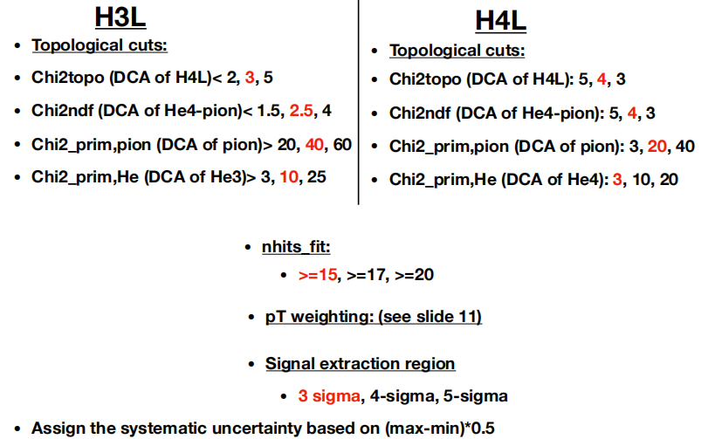
back up- systematic uncertainties

Slide 16
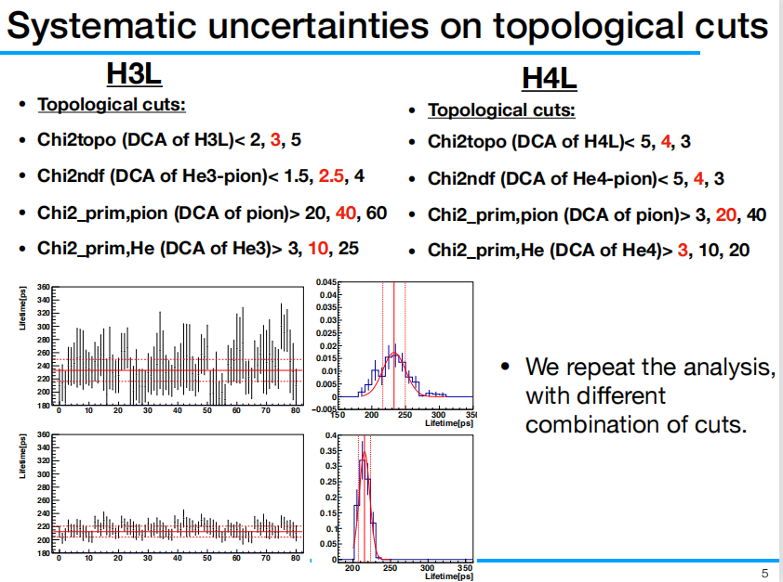
back up- systematic uncertainties for topological cuts
systematic uncertainties for the nhits requirement is the same

Slide 17
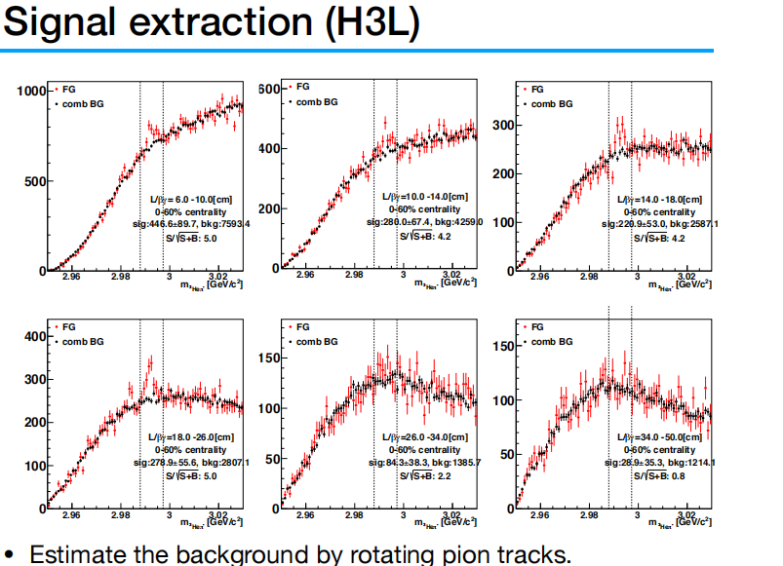

back up- systematic uncertainties for the signal extraction
change the signal counting window

Slide 18
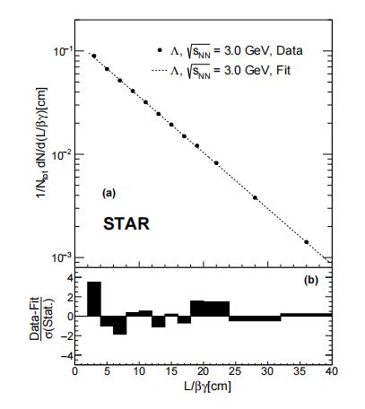
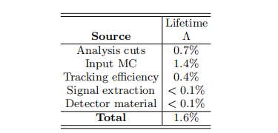
back up-lifetimes of ${}_{Λ}^{3}H$ & systematic uncertainties at 3Gev
theoretical calculations : ${}_{Λ}^{3}H$ lifetime (81±2)% of $τ_{Λ}$
${}_{Λ}^{4}H$ lifetime (74±4)%$τ({}_{Λ}^{4}{He)}$ here (83±6)%$τ({}_{Λ}^{4}{He)}$ using previous$τ({}_{Λ}^{4}{He)}$

