Slide 1
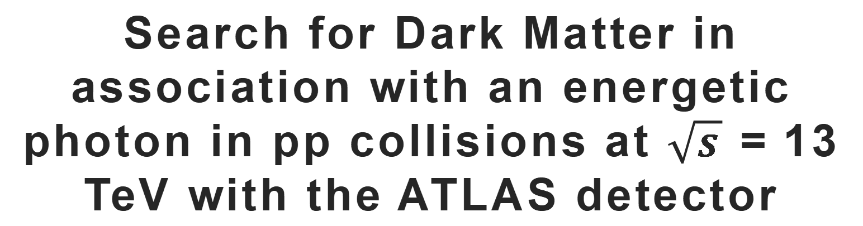
Search for Dark Matter in association with an energetic photon in pp collisions at $\sqrt{s}$ = 13 TeV with the ATLAS detector
Author: F.Piazza, on behalf of the ATLAS collaboration
Speaker: Tianao Wang (SA22004047)
Link: https://cds.cern.ch/record/2857866?ln=zh_CN
Notes:
大家好，我的报告题目是：在ATLAS探测器上质心能量为13TeV的质子对撞中寻找和高能光子关联的暗物质。下方是原文的链接。

Slide 2
Introduction
Dark Matter (DM) accounts for about 27% of the universe’s mass.
Non-gravitational interactions with ordinary matter have never been confirmed.
Its nature and properties are still largely unknown.
There are too many possible DM models and candidates in a wide range of mass.
Notes:
根据天文学观测的结果，宇宙总质量的27%都是暗物质。作为一种参与引力相互作用的不可见物质，已有明确的证据证明了它的存在。但是暗物质与普通物质的非引力相互作用一直没有被证实，人们对它的基本性质和特征也所知甚少，这导致了过多的暗物质模型以及在很大质量范围内的众多候选粒子。因此，寻找暗物质是一项重要的课题。

Slide 3
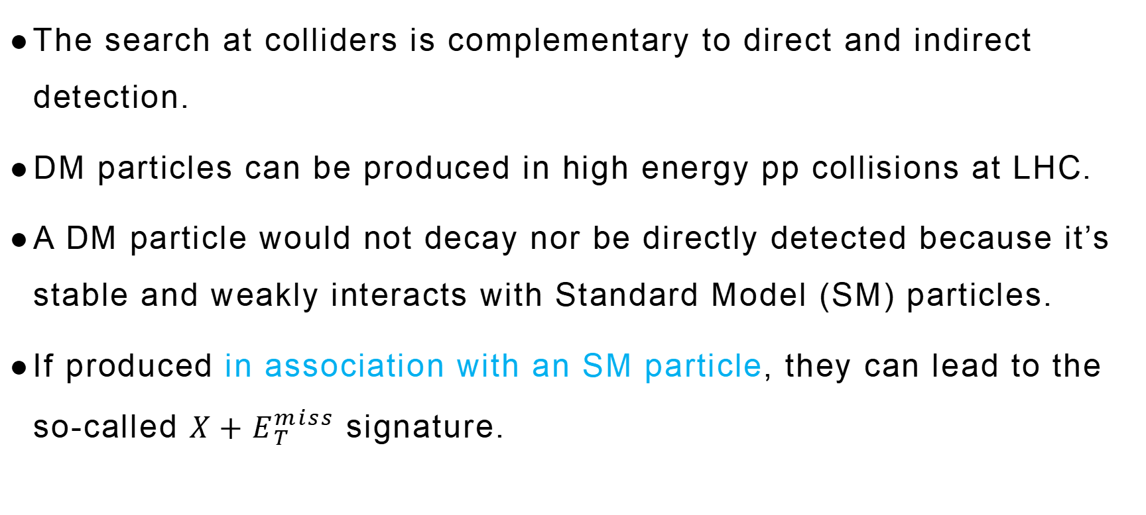
Introduction
The search at colliders is complementary to direct and indirect detection.
DM particles can be produced in high energy pp collisions at LHC.
A DM particle would not decay nor be directly detected because it’s stable and weakly interacts with Standard Model (SM) particles.
If produced in association with an SM particle, they can lead to the so-called $X+E_{T}^{miss}$ signature.
Notes:
在对撞机上寻找暗物质是直接和间接探测之外的一种补充方法。如果暗物质与普通物质间存在相互作用，那么原则上暗物质粒子就可以在LHC上的高能质子对撞中产生。由于暗物质粒子是与标准模型粒子弱作用的稳定粒子，LHC上产生的暗物质粒子不会衰变也不能被直接探测。如果它和一个标准模型粒子关联产生，那么在末态就可以观察到所谓的$X+E_{T}^{miss}$特征，也就是在横向上缺失了本应与一个可观测标准模型粒子相消的动量。

Slide 4
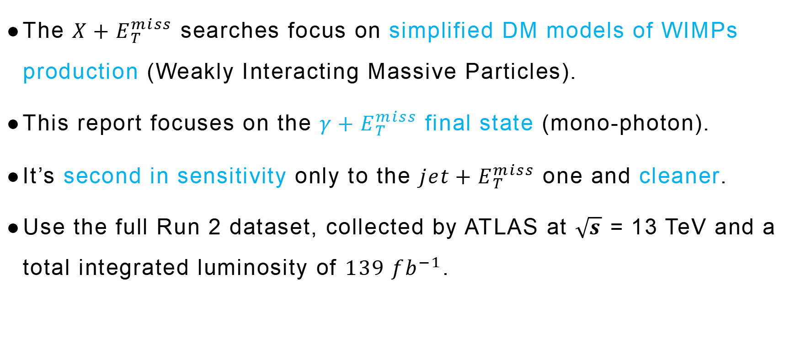
Introduction
The $X+E_{T}^{miss}$ searches focus on simplified DM models of WIMPs production (Weakly Interacting Massive Particles).
This report focuses on the $γ+E_{T}^{miss}$ final state (mono-photon).
It’s second in sensitivity only to the $jet+E_{T}^{miss}$ one and cleaner.
Use the full Run 2 dataset, collected by ATLAS at $\sqrt{s}$ = 13 TeV and a total integrated luminosity of $139 {fb}^{−1}$.
Notes:
对 $X+E_{T}^{miss}$ 的寻找关注在大质量弱作用粒子产生的简化暗物质模型上，而本研究则集中于单光子的$γ+E_{T}^{miss}$ 末态。相较于其他末态，它的优势在于有着第二高的灵敏度，仅次于 $jet+E_{T}^{miss}$ 末态，且更干净。本研究使用了ATLAS Run 2 的全部数据集，它们是在13TeV的质心能量和$139 {fb}^{−1}$的总积分亮度下得到的。

Slide 5
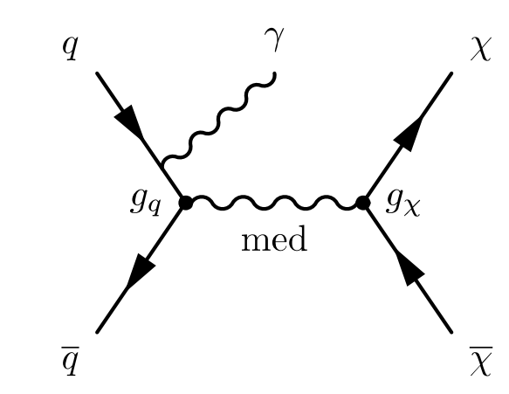

Signal models
Simplified DM models
Free parameters:
• DM and mediator masses: $m_{x}$ and $m_{med}$
• Couplings of the mediator to the quarks, leptons and DM particles: $g_{q}$, $g_{l}$ and $g_{x}$
• Mediator width:
Figure 1: Feynman diagram of the simplifief DM model for WIMPs production.
Notes:
简化暗物质模型预言了一种标准模型之外的狄拉克费米子作为WIMP的候选，它在s-channel通过矢量或者轴矢量媒介子产生，与一个来自初态辐射的光子关联。它的费曼图如图所示。此模型只依赖于少数的几个自由参数，分别是暗物质粒子和媒介子的质量；媒介子和夸克，轻子，暗物质粒子的耦合常数；以及媒介子的宽度。其中媒介子的宽度在给定质量和耦合常数后被固定到极小值上。

Slide 6
Data and MC simulations
Select good quality data: Stable beams conditions, good operational status of detectors.
MC tools:
  Sherpa MC generator for the SM background processes
  Geant4 for the full simulation of the particles interaction with the ATLAS detector
  MadGraph5_aMC@NLO generator for the signal
  Pythia8 for the parton shower simulation, hadronization and underlying events modelling
MC samples include the simulation of pile-up and are reweighted in order to reproduce the pile-up conditions observed in data.
Notes:
数据的选择有两点要求，分别是稳定的束流情况和良好的探测器运行状态。蒙卡方面，使用了以下四种工具对多种物理过程进行了模拟。背景和信号的蒙卡样本中都包含了对事例堆积的模拟，并且通过调整相对权重再现了观测数据中的堆积情况。

Slide 7
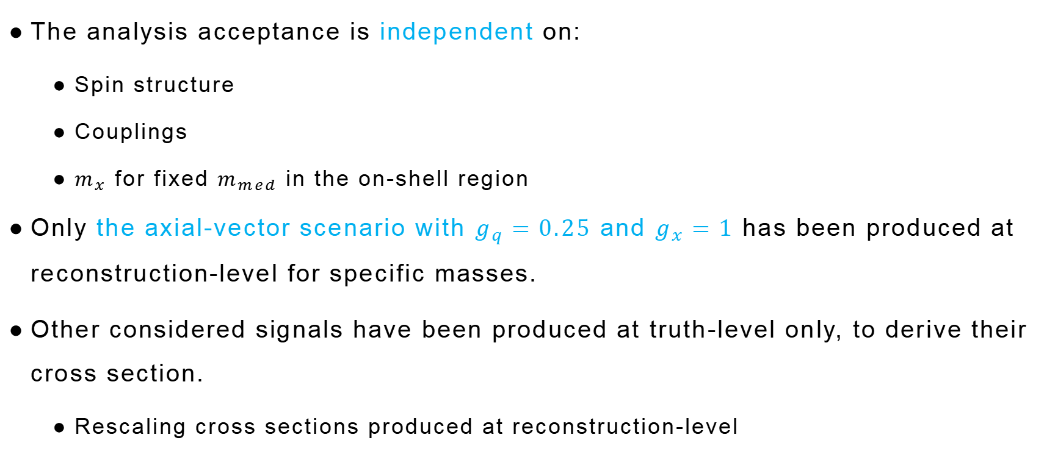
Data and MC simulations
The analysis acceptance is independent on:
  Spin structure
  Couplings
  $m_{x}$ for fixed $m_{med}$ in the on-shell region
Only the axial-vector scenario with $g_{q}=0.25$ and $g_{x}=1$ has been produced at reconstruction-level for specific masses.
Other considered signals have been produced at truth-level only, to derive their cross section.
  Rescaling cross sections produced at reconstruction-level
Notes:
对于简化暗物质模型，分析中的接收率不依赖于自旋结构，耦合常数以及当$m_{med}$固定在on-shell区时的$m_{x}$。因此，只对特定质量的轴矢量媒介子情况进行了reconstruction-level的模拟，其中$g_{q}取0.25$ ，$g_{x}取1$。其他信号都只做truth-level的模拟，以得到他们的截面。方法是对reconstruction-level下得到的截面做放缩。

Slide 8
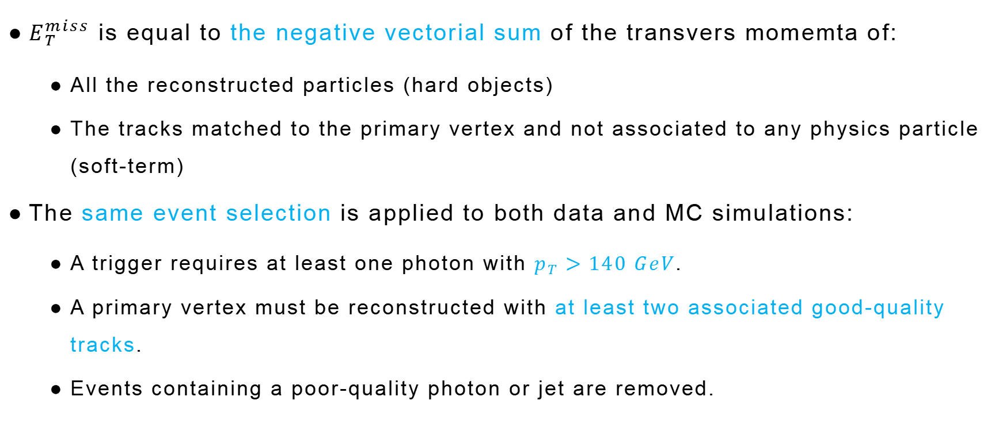
Analysis strategy
$E_{T}^{miss}$ is equal to the negative vectorial sum of the transvers momemta of:
  All the reconstructed particles (hard objects)
  The tracks matched to the primary vertex and not associated to any physics particle (soft-term)
The same event selection is applied to both data and MC simulations:
  A trigger requires at least one photon with $p_{T}>140 GeV$.
  A primary vertex must be reconstructed with at least two associated good-quality tracks.
  Events containing a poor-quality photon or jet are removed.
Notes:
此分析中的关键判别量是$E_{T}^{miss}$，它定义为以下两部分的横向动量的负矢量和，包括所有重建出的粒子，这部分称为hard objects，以及匹配到初始顶点但不与任何物理粒子相关的径迹，这部分称为soft term。对数据和蒙卡模拟都要进行相同的事例筛选，包括要求至少有一个横动量大于140GeV的光子才能触发，一个初始顶点必须关联至少两个好的径迹，以及剔除含有不好的γ或jet的事件。

Slide 9
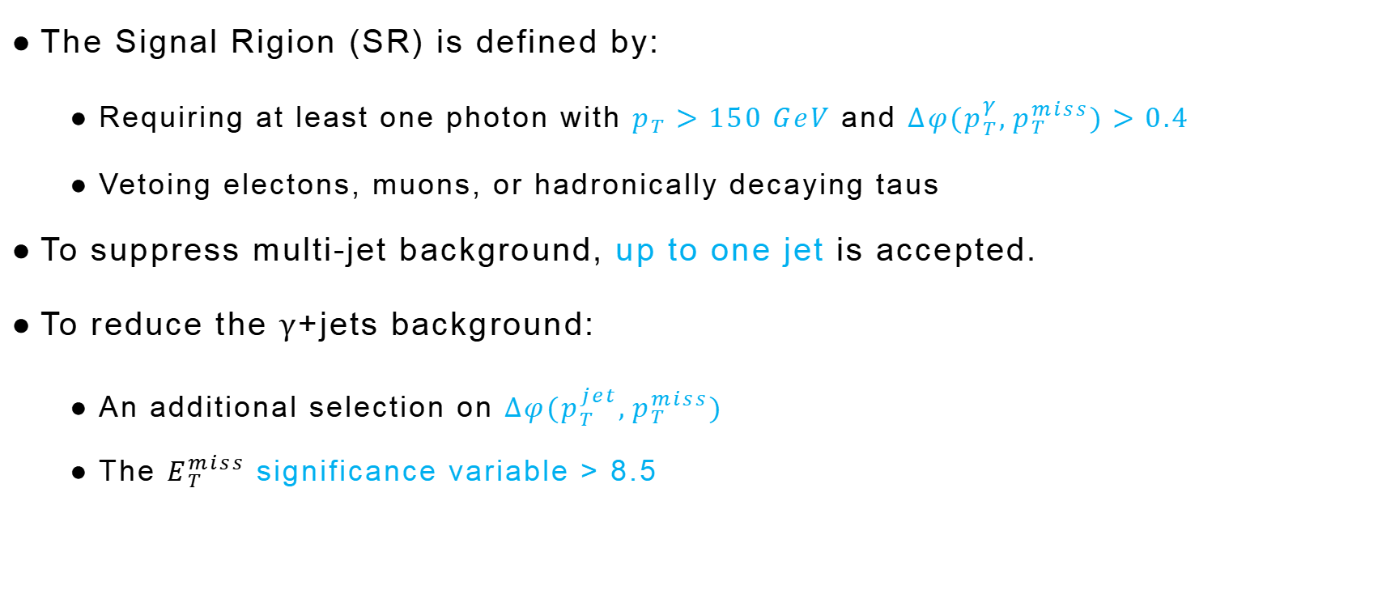
Analysis strategy: Event selection
The Signal Rigion (SR) is defined by:
  Requiring at least one photon with $p_{T}>150 GeV$ and $∆φ(p_{T}^{γ},p_{T}^{miss})>0.4$
  Vetoing electons, muons, or hadronically decaying taus
To suppress multi-jet background, up to one jet is accepted.
To reduce the γ+jets background:
  An additional selection on $∆φ(p_{T}^{jet},p_{T}^{miss})$
  The $E_{T}^{miss}$ significance variable > 8.5
Notes:
下面具体来讲事例的选择。Signal Rigion定义为：要求至少有一个光子的横动量大于150GeV，且与缺失的横动量间的$∆φ$大于0.4，同时还要禁止电子，缪子以及强子化衰变的τ，以此排除W/Z和γ或jet关联产生的事件。为了压制multi-jet本底，可接受的事例中最多包含一个jet。为了减少γ+jets的本底，还要额外对jet的横动量与缺失横动量间的$∆φ$进行筛选，同时要求$E_{T}^{miss}$的显著性参数大于8.5。

Slide 10

Analysis strategy: Signal Rigions
In order to enhance the analysis sensitivity, 7 SRs are defined:
  4 inclusive SRs with increasing $E_{T}^{miss}$ thresholds
  3 exclusive SRs corresponding to different $E_{T}^{miss}$ bins
Table 1: Defination of the analysis Signal Rigions.
Notes:
为了提高此分析的灵敏度，定义了七个signal rigion，包括四个阈值递增的inclusive signal region和三个对应不同bin的exclusive signal region。下表列出了七个signal region的范围和简称。

Slide 11
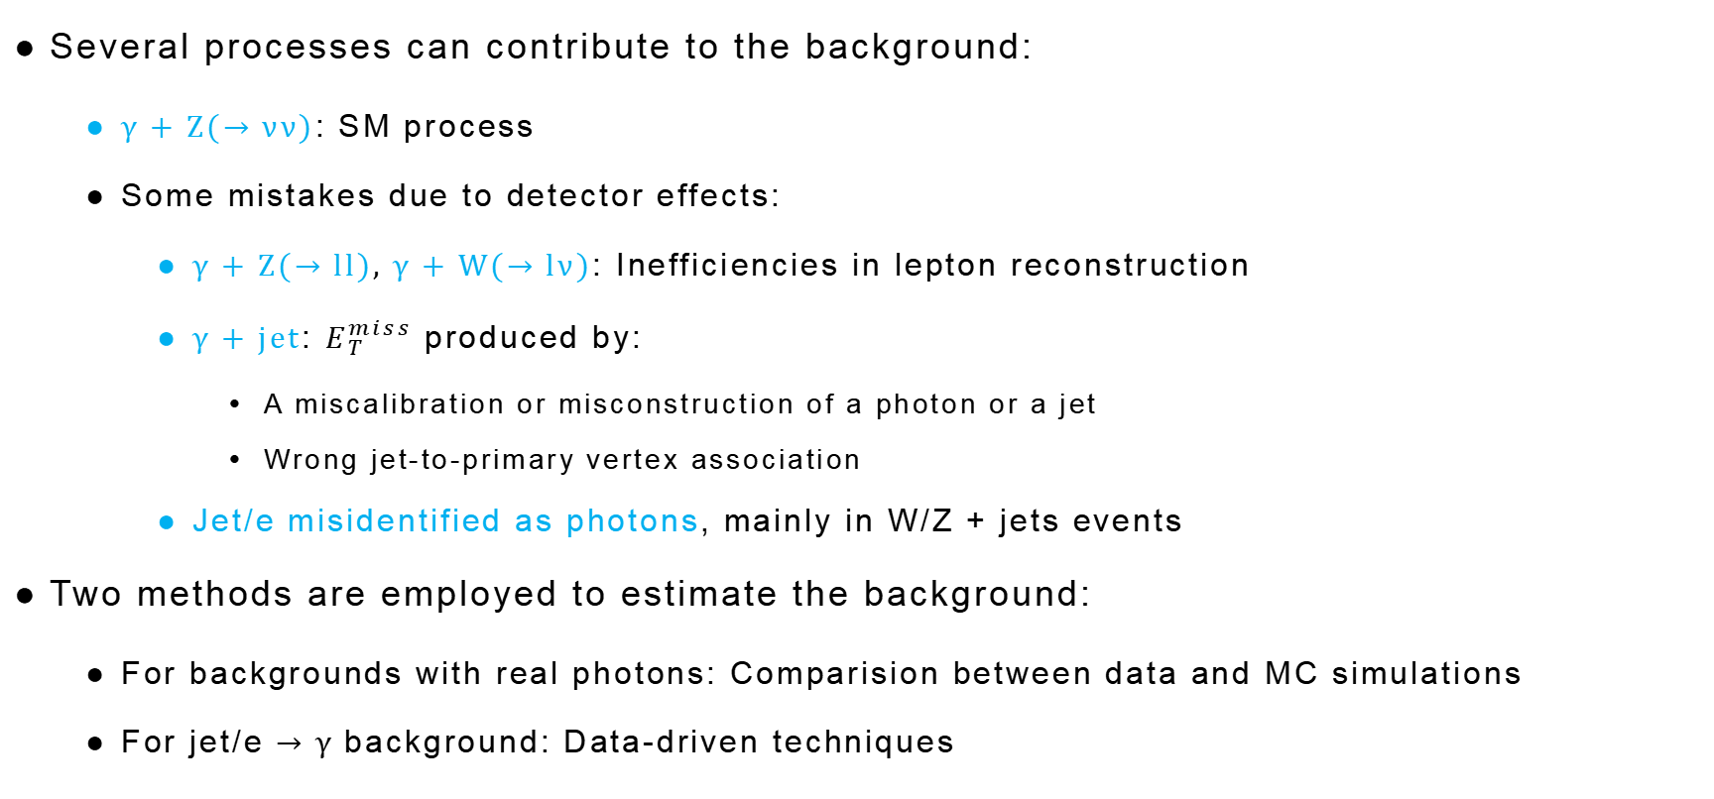
Analysis strategy: Background estimation
Several processes can contribute to the background:
  γ + Z(→ νν): SM process
  Some mistakes due to detector effects:
    γ + Z(→ ll), γ + W(→ lν): Inefficiencies in lepton reconstruction
    γ + jet: $E_{T}^{miss}$ produced by:
      A miscalibration or misconstruction of a photon or a jet
      Wrong jet-to-primary vertex association
    Jet/e misidentified as photons, mainly in W/Z + jets events
Two methods are employed to estimate the background:
  For backgrounds with real photons: Comparision between data and MC simulations
  For jet/e → γ background: Data-driven techniques
Notes:
下面来讲本底估计。多个过程都对本底有贡献，其中占主导地位的是γ + Z(→ νν)末态，这是一个标准模型过程，因此无法祛除。另外就是一些源于探测器效率的本底：轻子重建的失效会将这两种γ+lepton或ν的末态误判为目标事件；γ + jet的末态也可能被误判，其中的$E_{T}^{miss}$来自γ 或jet的错误标定或错误重建，又或者是jet和初始顶点的关联错误；jet或电子也可能被误判为光子，这主要发生在W/Z+jets的事件中。为了估计本底，使用了以下两种方法：对于带有真光子的本底，通过比较数据和蒙卡模拟的方法来估计；对于jet或电子误判为光子的本底，使用data-driven的技术。

Slide 12
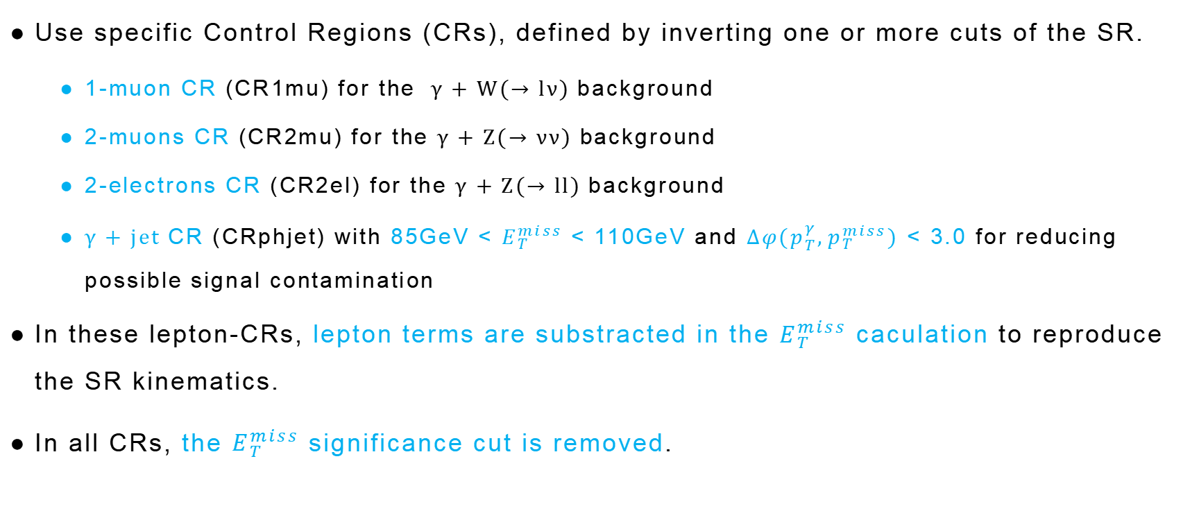
Analysis strategy: Real-photon backgrounds
Use specific Control Regions (CRs), defined by inverting one or more cuts of the SR.
  1-muon CR (CR1mu) for the γ + W(→ lν) background
  2-muons CR (CR2mu) for the γ + Z(→ νν) background
  2-electrons CR (CR2el) for the γ + Z(→ ll) background
  γ + jet CR (CRphjet) with 85GeV < $E_{T}^{miss}$ < 110GeV and $∆φ(p_{T}^{γ},p_{T}^{miss})$ < 3.0 for reducing possible signal contamination
In these lepton-CRs, lepton terms are substracted in the $E_{T}^{miss}$ caculation to reproduce the SR kinematics.
In all CRs, the $E_{T}^{miss}$ significance cut is removed.
Notes:
为了估计真光子的本底，要定义一些特定的control region：1-muon CR要求事例中有且只有一个缪子；2-muons CR要求事例中有两个缪子，且禁止其他轻子；2-electrons CR要求事例中有两个电子，且禁止其他轻子；γ + jet CR是为了减少可能的信号污染，要求85GeV < $E_{T}^{miss}$ < 110GeV，且光子横动量与缺失横动量间的$∆φ$小于3.0。为了在这些轻子control region中重建signal region中的动力学，这些轻子都被视为不可见粒子，在计算$E_{T}^{miss}$时减去对应的项。另外，在所有control region中，$E_{T}^{miss}$显著度的截断都被去掉了。

Slide 13
Analysis strategy: Jet/e → γ background
The jet → γ background is estimated through a two side-band method (ABCD):
  Analysis region (A) requires photons to:
    Satisfy identification criteria based on shower shape varibles
    Be isolated from nearby signals in the calorimeter
  Background-regions (B,C,D) are obtained by reverting one or both of these requirements
The e → γ background is estimated by scaling the event yield in the probe-electron CRs.
  These CRs are defined by replacing the photon by an electron in the analysis region.
  The scaling is performed by the probability for such a misreconstruction.
  The probability is derived from a data sample of Z → ee events.
Notes:
为了估计jet误判为光子的本底，要使用一种所谓的双边带方法，简称ABCD：其中analysis region A 要求光子满足基于簇射形状变量的识别标准，同时还要远离量能器中邻近的信号；Background-regions (B,C,D)通过解除上述限制中的一个或全部来得到。为了估计电子误判为光子的本底，要对所谓probe-electron CRs中的事例产额进行放缩。这些CR是通过把analysis region中的光子替换为电子来定义的，放缩要基于电子被误重建为光子的概率，这个概率可以从Z到ee的数据样本中得到。

Slide 14
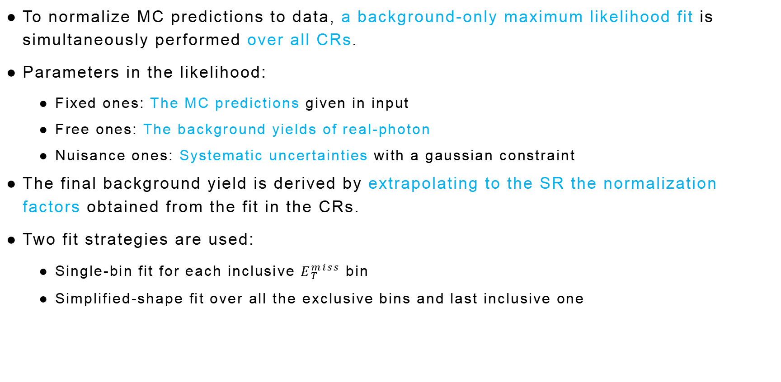
Analysis strategy: Background-only fit
To normalize MC predictions to data, a background-only maximum likelihood fit is simultaneously performed over all CRs.
Parameters in the likelihood:
  Fixed ones: The MC predictions given in input
  Free ones: The background yields of real-photon
  Nuisance ones: Systematic uncertainties with a gaussian constraint
The final background yield is derived by extrapolating to the SR the normalization factors obtained from the fit in the CRs.
Two fit strategies are used:
  Single-bin fit for each inclusive $E_{T}^{miss}$ bin
  Simplified-shape fit over all the exclusive bins and last inclusive one
Notes:
下面来讲Background-only fit，为了把蒙卡预期normalize到数据上，要对所有CR同时做background-only的极大似然拟合。作为输入的蒙卡预期是固定参数；真光子本底产额是自由参数，允许通过相关的归一化因子浮动；系统误差是冗余参数，带有一个高斯约束。最终的本底产额通过把从CR中拟合得到的归一化因子外推到SR中得到。拟合中使用了两种策略：对每个 inclusive${ E}_{T}^{miss}$ bin，使用所谓的Single-bin fit；而所谓的Simplified-shape fit是对所有 exclusive bin以及最后的inclusive bin来做，它提供了一种利用$E_{T}^{miss}$形状信息的方法，因此加强了对信号和本底的分辨，从而提高了分析的灵敏度。

Slide 15
Results
Systematic uncertainties include both experimental and theoretical contributions:
  Experimental ones are related to:
    Energy and momentum scales and resolution
    Identification, reconstruction and isolation efficiencies
    Soft-term scale and resolution
    Intergrated luminosity measurement and pile-up reweighting
    Jet/e → γ background estimates
  Theoretical ones from MC simulations are related to:
    QCD factorisation and renormalization scales
    Strong coupling constants value
    Choice of parton distribution functions
Notes:
接下来就是此分析得到的结果。首先来看系统误差，它包含实验误差和理论误差两部分。实验误差来自于能动量标度和分辨率；识别、重建和分离效率；soft-term的标度和分辨率；积分亮度的测量和堆积权重调整；以及jet或电子误判为光子的本底估计。理论误差来源于蒙卡模拟，包括QCD的因式分解和重整化标度；强耦合常数的取值；部分子分布函数的选择。

Slide 16
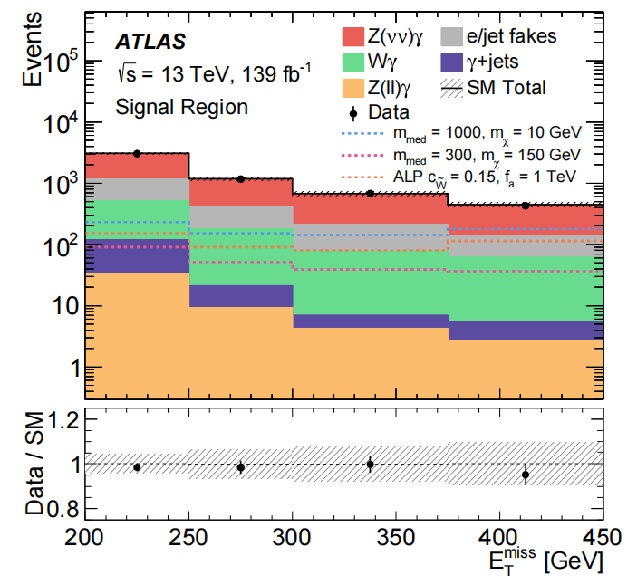

Results
After the background-only fit, the background in the first inclusive SR is composed by:
  63% of γ + Z(→ νν)
  21% of jet/e → γ
  13% of γ + W(→ lν)
  2% of γ + jets
  <1% of γ + Z(→ ll)
Figure 2: $E_{T}^{miss}$ distribution for data and SM expectations after simplified-shape fit.
Notes:
在做完background-only fit之后，第一个inclusive SR中的本底由以下几部分组成。右图展示了simplified-shape fit后数据和标准模型预期的$E_{T}^{miss}$的分布情况。下面的是每个bin中数据和本底估计的比值， error bar表示数据的统计误差，虚线带表示本底的系统和统计误差。

Slide 17
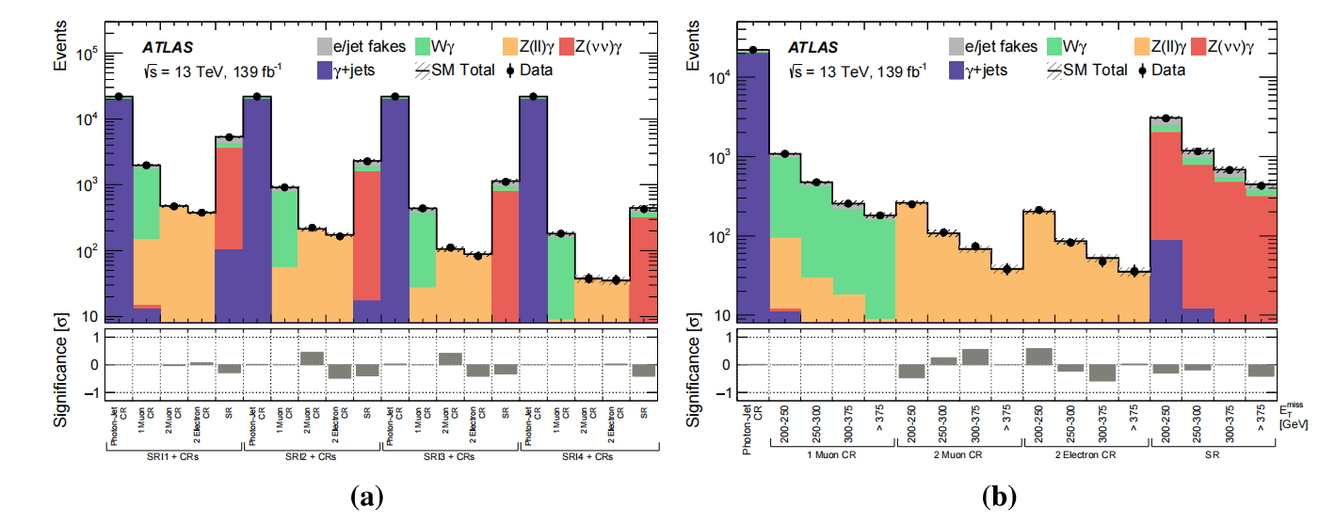
Results
There is a good agreement in all regions between data and background expectations.
No significant Beyond Standard Model (BSM) events are observed.
Figure 3: Data event yields and SM predictions from the background-only single-bin fit (a) and simplified-shape fit (b).
Notes:
下面两幅图分别总结了single-bin fit 和simplified-shape fit在所有SR和CR中的结果。底下的是数据与本底间差异的显著性，可以看出在所有region中数据和本底都有很好的一致性，没有观测到显著的超标准模型事件。

Slide 18
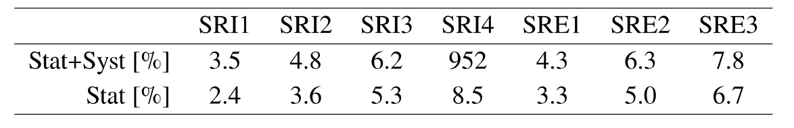
Results
The analysis is generally dominated by statistical uncertainties.
The relative impact of each source of systematic uncertainties on the background yields:
  Jet → γ: 1.4% ~ 4.1%
  Electron → γ: 2% ~ 2.3%
  Jet energy scale and resolution: 1.6% ~ 2.7%
  Other experimental systematics: <1.5%
  Theoretical uncertainties: <0.5%
Table 2: Statistical and systematic uncertainties in each SR.
Notes:
这个表格总结了拟合得到的系统和统计误差，可以看到此分析大体上受统计误差主导。比较每种系统误差来源在本底产额上的相关影响，可知占主导地位的是jet和电子误判为光子的本底，以及jet能量标度和分辨率的影响。其他实验误差的影响低于1.5%，理论误差的影响不超过0.5%。

Slide 19
Interpretation of the results
Results are interpreted in terms of:
  Exclusion upper limits on the simplified DM models
  Model-independent limits on the visible cross section of BSM processes
The likelihood fits are based on the profile-likelihood-ratio test statistics and confidence levels (CLs) prescriptions.
For the model-dependent limit, a simplified-shape fit is performed on fast simulated signal samples in both SRs and associated CRs.
  Signal yields as a fixed parameter
  Signal strength as freely floating normalization factor
    Excluded if the upper limit <1 at 95% CL
Notes:
最后是对结果的解释。分析的结果被解释为简化暗物质模型的排除上限，以及超标准模型过程可观测截面的不依赖模型的上限。所做的似然拟合基于剖面似然比检验统计量和置信度要求。为得到模型依赖的上限，对SR和关联的CR中的快速模拟信号样本做simplified-shape fit。其中信号产额作为固定参数，信号强度作为自由浮动的归一化因子。如果一个信号的强度的95%置信上界小于1，它就会被排除。

Slide 20
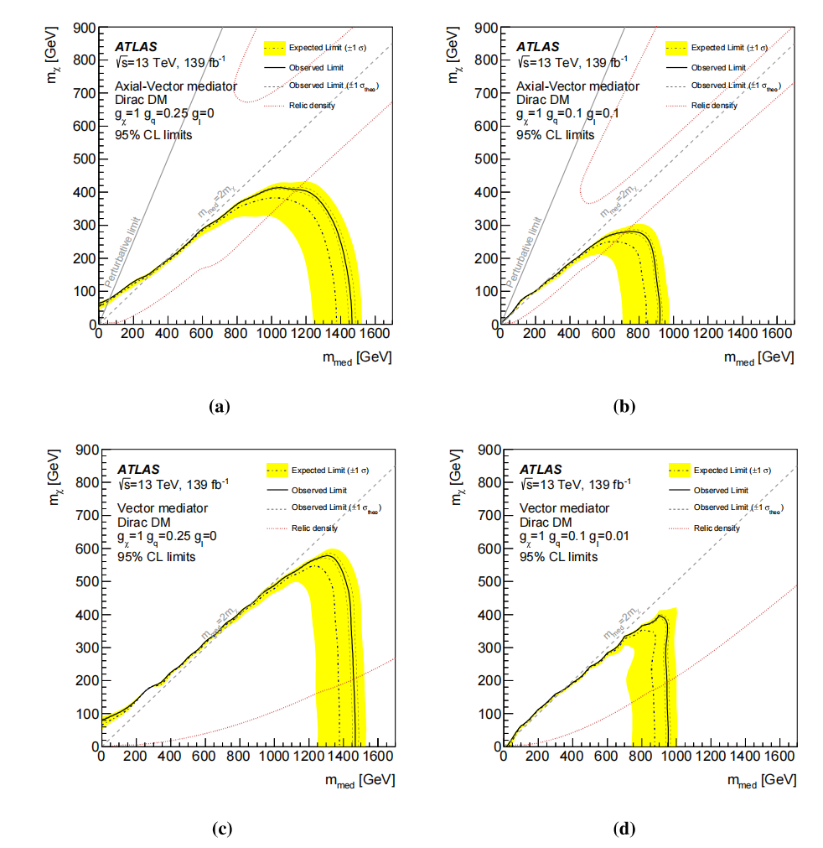
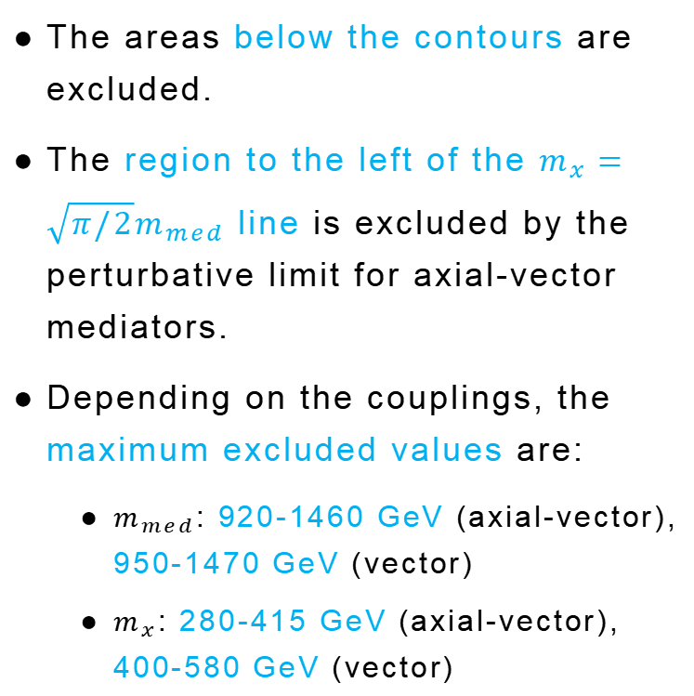
Interpretation of the results: Model-dependent limits
The areas below the contours are excluded.
The region to the left of the $m_{x}=\sqrt{π/2}m_{med}$ line is excluded by the perturbative limit for axial-vector mediators.
Depending on the couplings, the maximum excluded values are:
  $m_{med}$: 920-1460 GeV (axial-vector), 950-1470 GeV (vector)
  $m_{x}$: 280-415 GeV (axial-vector), 400-580 GeV (vector)
Figure 4: The observed and expected 95% CL exclusion contours in the
$m_{x}−m_{med}$ plane for a simplified DM model.
Notes:
右边展示的是简化暗物质模型在$m_{x}−m_{med}$平面上的95%置信度排除曲线，四幅图是在不同的夸克和轻子耦合常数下对轴矢量和矢量媒介子情形做的。曲线下方的区域都被排除，轴矢量情形下，在 $m_{x}=\sqrt{π/2}m_{med}$直线左侧的区域也被排除。依据所取的耦合常数的不同，最大排除阈值分别为：轴矢量情况下$m_{med}$是920-1460 GeV，$m_{x}$是280-415 GeV；矢量情况下$m_{med}$是950-1470 GeV，$m_{x}$是400-580 GeV。

Slide 21
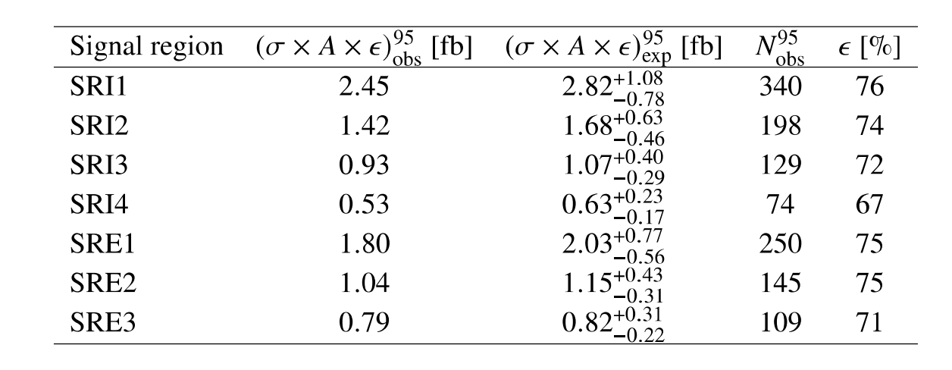

Interpretation of the results: Model-independent limits
A profile-likelihood-ratio test is performed, based on single-bin fits in each inclusive and exclusive $E_{T}^{miss}$ bin, including both SRs and CRS.
The upper limits on the visible cross section of new physics are expressed as $σ×A×ε$.
  $σ$: The production cross section
  A: The fiducial acceptance
  $ε$: The fiducial efficiency
Table 3: Upper limits at 95% CL on the visible cross section (observed and expected) and on the number of events (observed) and fiducial efficiencies.
Notes:
为了解释本分析中没有考虑的信号模型，还给出了新物理可观测截面的不依赖模型的上限。基于在每个inclusive和exclusive $E_{T}^{miss}$ bin中的single-bin fit，做了一个包含SR和CR的剖面似然比检验。信号事例数的上限可以被重放缩成数据集的积分亮度，从而给出新物理可观测截面的上限，表示为$σ×A×ε$。其中$σ$是产生截面；A是所谓的基准接收率，它定义为一个particle-level的基准区域的接收率，这个区域使用和SR相同的选择标准，但不考虑探测器效率；$ε$是所谓的基准效率，它可以用particle-level和reconstruction-level的比值来估计。下表展示了在每个$E_{T}^{miss}$ bin中预期和观测到的可观测截面以及观测到的事例数的95%置信上界。

Slide 22
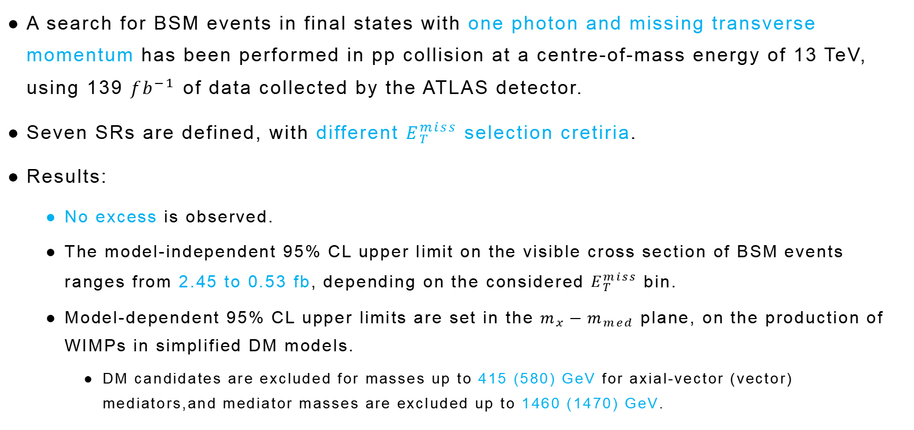
Conclusions
A search for BSM events in final states with one photon and missing transverse momentum has been performed in pp collision at a centre-of-mass energy of 13 TeV, using 139 ${fb}^{−1}$ of data collected by the ATLAS detector.
Seven SRs are defined, with different $E_{T}^{miss}$ selection cretiria.
Results:
  No excess is observed.
  The model-independent 95% CL upper limit on the visible cross section of BSM events ranges from 2.45 to 0.53 fb, depending on the considered $E_{T}^{miss}$ bin.
  Model-dependent 95% CL upper limits are set in the $m_{x}−m_{med}$ plane, on the production of WIMPs in simplified DM models.
    DM candidates are excluded for masses up to 415 (580) GeV for axial-vector (vector) mediators,and mediator masses are excluded up to 1460 (1470) GeV.
Notes:
总的来说，本研究使用ATLAS上质心能量为13TeV、积分亮度为139${fb}^{−1}$的质子对撞数据，寻找末态包含单光子和横向动量缺失的超标准模型事件。使用不同的$E_{T}^{miss}$选择标准，建立了7个SR。得到的结果是：没有超标准模型事件被观测到。超标准模型事件可观测截面的不依赖于模型的95%置信上界在2.45到0.53fb之间，取决于考虑的$E_{T}^{miss}$ bin。此外，依赖于WIMP产生的简化暗物质模型的95%置信上界也在$m_{x}$-$m_{med}$平面上得到。轴矢量情况下暗物质粒子和媒介子的质量下限分别为415和1460GeV;矢量情况下暗物质粒子和媒介子的质量下限分别为580和1470GeV。以上就是我报告的全部内容，感谢大家的聆听。

