Slide 1

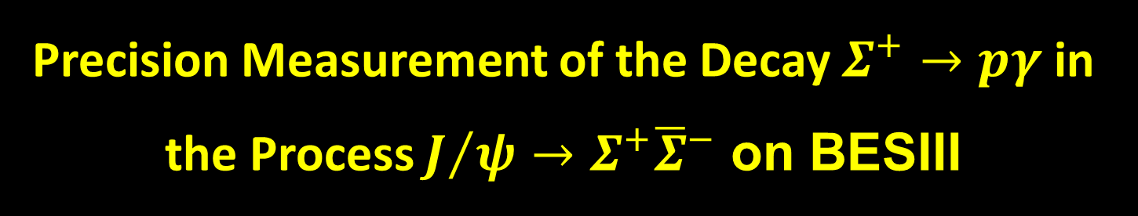
Precision Measurement of the Decay $Σ^{+}→pγ$ in the Process $J/ψ→Σ^{+}{\overline{Σ}}^{−}$ on BESIII
Teng Ma
Reference:
Phys. Rev. Lett. 130, 211901

Slide 2
Outline
Introduction
Data Samples and MC Simulations
Single Tag (ST) Analysis
Double Tag (DT) Analysis
Decay Parameter measurement
Systematic Uncertainties

Slide 3
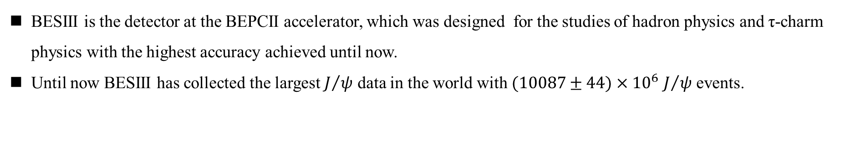
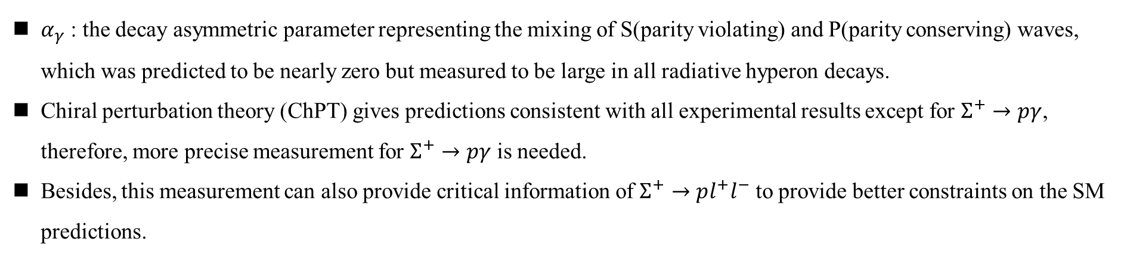
Introduction
Motivation
$α_{γ}$ : the decay asymmetric parameter representing the mixing of S(parity violating) and P(parity conserving) waves, which was predicted to be nearly zero but measured to be large in all radiative hyperon decays.
Chiral perturbation theory (ChPT) gives predictions consistent with all experimental results except for $Σ^{+}→pγ$, therefore, more precise measurement for $Σ^{+}→pγ$ is needed.
Besides, this measurement can also provide critical information of $Σ^{+}→pl^{+}l^{−}$ to provide better constraints on the SM predictions.
BESIII
BESIII is the detector at the BEPCII accelerator, which was designed for the studies of hadron physics and τ-charm physics with the highest accuracy achieved until now.
Until now BESIII has collected the largest $J/ψ$ data in the world with $(10087±44)×{10}^{6}$ $J/ψ$ events.

Slide 4
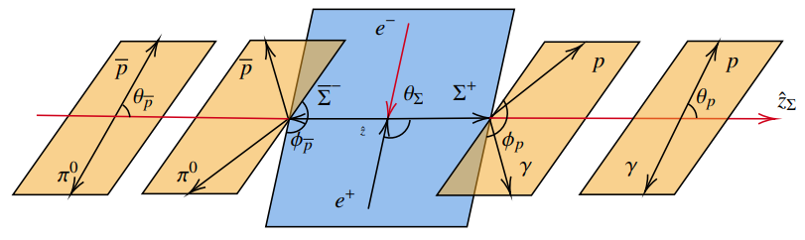
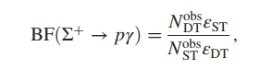
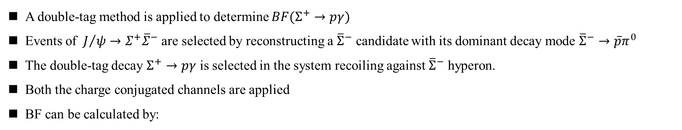


Analysis Strategy
Single Tag $→$
$←$ Double Tag
A double-tag method is applied to determine $BF(Σ^{+}→pγ)$
Events of ${ J}/ψ→Σ^{+}{\overline{Σ}}^{−}$ are selected by reconstructing a ${\overline{Σ}}^{−}$ candidate with its dominant decay mode ${\overline{Σ}}^{−}→\overline{p}π^{0}$
The double-tag decay $Σ^{+}→pγ$ is selected in the system recoiling against ${\overline{Σ}}^{−}$ hyperon.
Both the charge conjugated channels are applied
BF can be calculated by:

Slide 5
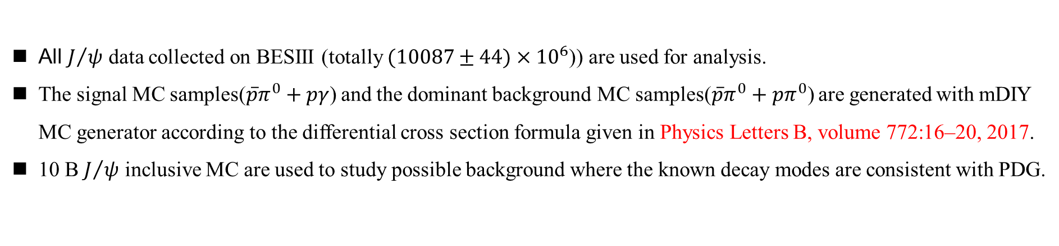
Data samples
All $J/ψ$ data collected on BESIII (totally $(10087±44)×{10}^{6}$)) are used for analysis.
The signal MC samples($\overline{p}π^{0}+pγ$) and the dominant background MC samples($\overline{p}π^{0}+pπ^{0}$) are generated with mDIY MC generator according to the differential cross section formula given in Physics Letters B, volume 772:16–20, 2017.
10 B $J/ψ$ inclusive MC are used to study possible background where the known decay modes are consistent with PDG.

Slide 6
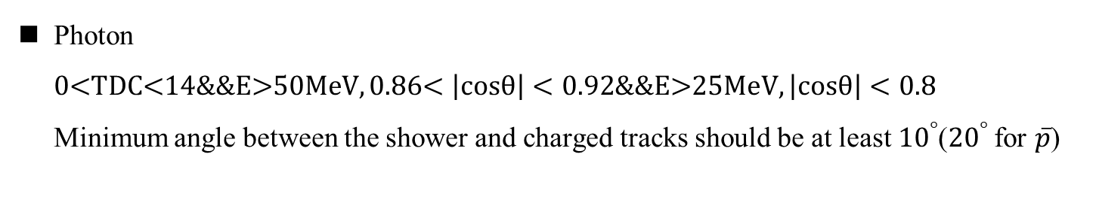

Single Tag Analysis
Event selection
Charged Tracks
$\left|cosθ\right|<0.93$
$\left|V_{r}\right|<2cm$ $\left|V_{z}\right|<10cm$
$N_{good}≤2$
PID (dE/dx && TOF)
Prob(p) > Prob(K/π) && $P_{p}>0.5GeV/c$
$N_{p}≥1$
$π^{0}$ reconstruction
$116<M_{γγ}<148MeV/c^{2}$
$N_{γ}≥2$
The $π^{0}$ candidate with the minimum$|M_{γγ}−M_{π^{0}}|$ is preserved.
Photon
0<TDC<14&&E>50MeV, 0.86< $\left|cosθ\right|<0.92$&&E>25MeV, $\left|cosθ\right|<0.8$
Minimum angle between the shower and charged tracks should be at least ${10}^{°}$(${20}^{°}$ for $\overline{p}$)

Slide 7
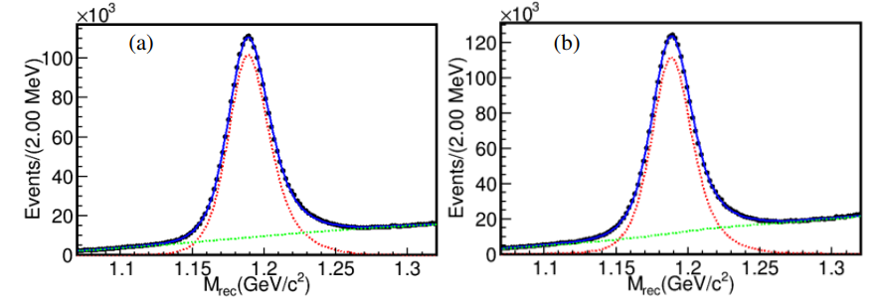
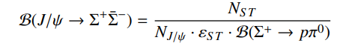
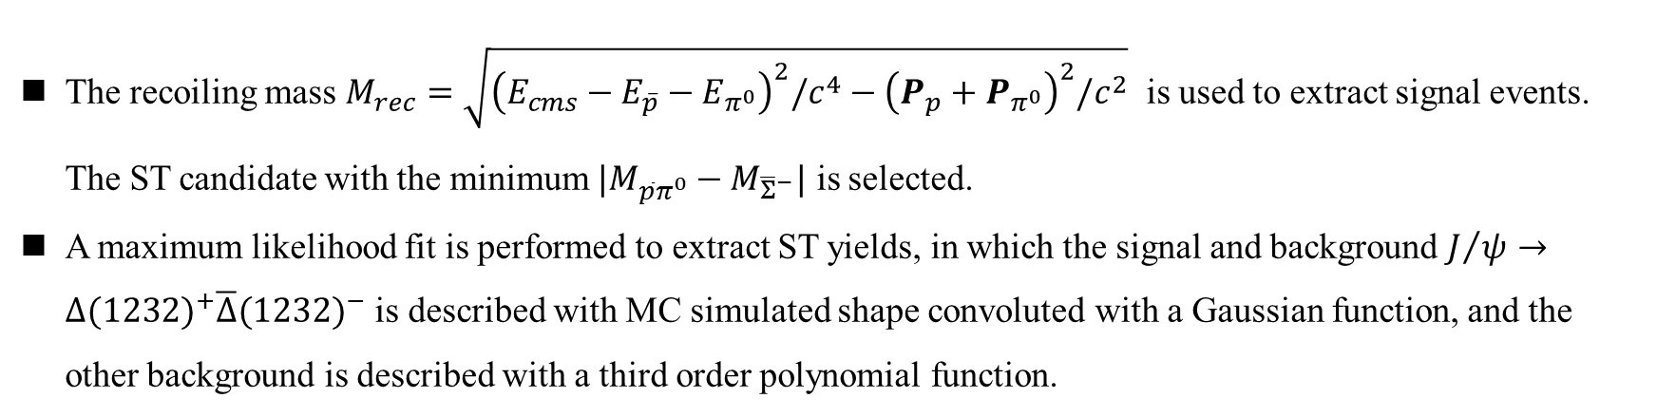
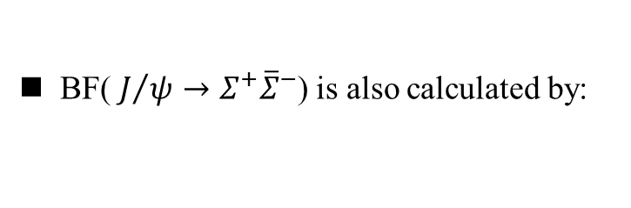
Single Tag Analysis
ST Candidate
The recoiling mass $M_{rec}=\sqrt{{\left(E_{cms}−E_{\overline{p}}−E_{π^{0}}\right)}^{2}/c^{4}−{\left(P_{p}+P_{π^{0}}\right)}^{2}/c^{2}}$ is used to extract signal events. The ST candidate with the minimum $|M_{\overline{p}π^{0}}−M_{{\overline{Σ}}^{−}}|$ is selected.
A maximum likelihood fit is performed to extract ST yields, in which the signal and background $J/ψ→Δ{(1232)}^{+}\overline{Δ}{(1232)}^{−}$ is described with MC simulated shape convoluted with a Gaussian function, and the other background is described with a third order polynomial function.
BF(${ J}/ψ→Σ^{+}{\overline{Σ}}^{−}$) is also calculated by:
which is consistent very well with PDG.
(a) $M_{pπ^{0}}$ and (b) $M_{\overline{p}π^{0}}$ within $Σ^{+}{/\overline{Σ}}^{−}$ signal region

Slide 8
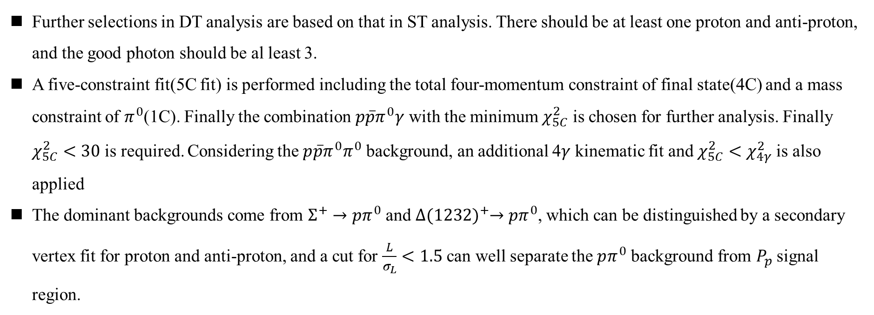
Double Tag Analysis
Event selection
Further selections in DT analysis are based on that in ST analysis. There should be at least one proton and anti-proton, and the good photon should be al least 3.
A five-constraint fit(5C fit) is performed including the total four-momentum constraint of final state(4C) and a mass constraint of $π^{0}$(1C). Finally the combination $p\overline{p}π^{0}γ$ with the minimum $χ_{5C}^{2}$ is chosen for further analysis. Finally $χ_{5C}^{2}<30$ is required. Considering the $p\overline{p}π^{0}π^{0}$ background, an additional 4$γ$ kinematic fit and$χ_{5C}^{2}<χ_{4γ}^{2}$ is also applied
The dominant backgrounds come from $Σ^{+}→pπ^{0}$ and $Δ{(1232)}^{+}→pπ^{0}$, which can be distinguished by a secondary vertex fit for proton and anti-proton, and a cut for $\frac{L}{σ_{L}}<1.5$ can well separate the $pπ^{0}$ background from $P_{p}$ signal region.

Slide 9
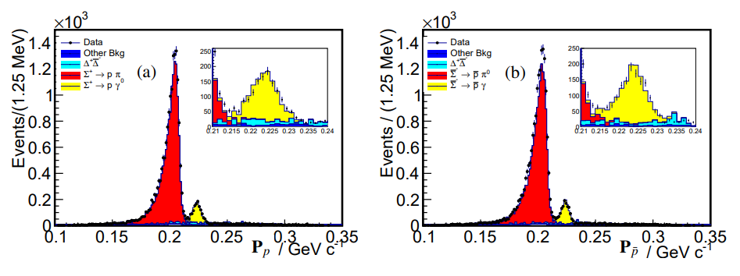
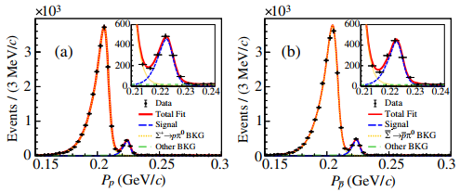
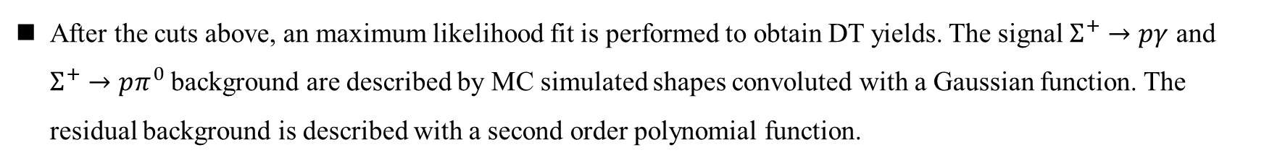
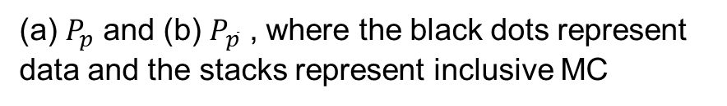
Double Tag Analysis
(a) $P_{p}$ and (b) $P_{\overline{p}}$ , where the black dots represent data and the stacks represent inclusive MC
After the cuts above, an maximum likelihood fit is performed to obtain DT yields. The signal $Σ^{+}→pγ$ and $Σ^{+}→pπ^{0}$ background are described by MC simulated shapes convoluted with a Gaussian function. The residual background is described with a second order polynomial function.

Slide 10
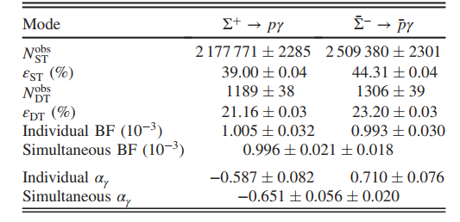
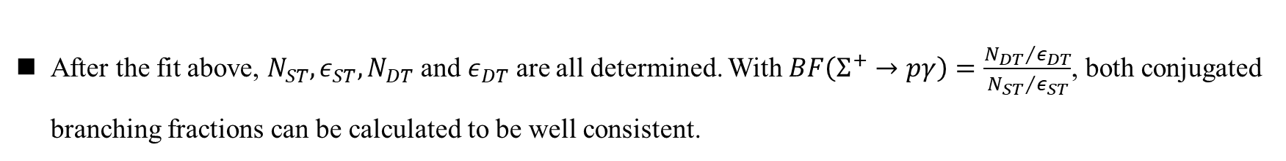
Double Tag Analysis
After the fit above, $N_{ST}, ε_{ST},N_{DT}$ and $ε_{DT}$ are all determined. With $BF\left(Σ^{+}→pγ\right)=\frac{{N_{DT}}/{ε_{DT}}}{{N_{ST}}/{ε_{ST}}}$, both conjugated branching fractions can be calculated to be well consistent.

Slide 11
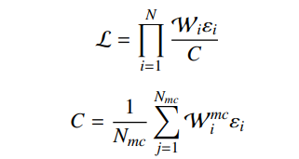
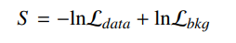
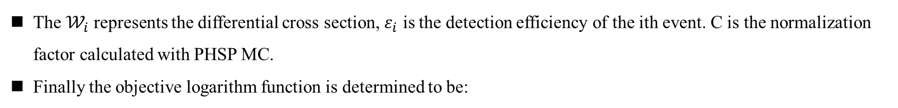
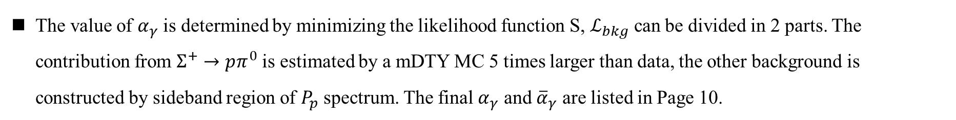
Decay parameter measurement
The joint likelihood function is defined by:
The $𝒲_{i}$ represents the differential cross section, $ε_{i}$ is the detection efficiency of the ith event. C is the normalization factor calculated with PHSP MC.
Finally the objective logarithm function is determined to be:
The value of $α_{γ}$ is determined by minimizing the likelihood function S, $ℒ_{bkg}$ can be divided in 2 parts. The contribution from $Σ^{+}→pπ^{0}$ is estimated by a mDTY MC 5 times larger than data, the other background is constructed by sideband region of $P_{p}$ spectrum. The final $α_{γ}$ and ${\overline{α}}_{γ}$ are listed in Page 10.

Slide 12
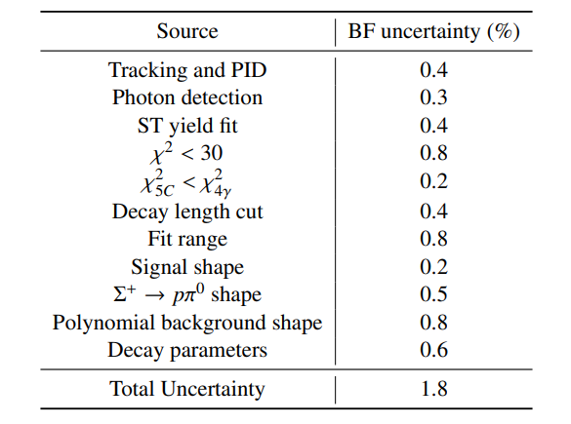
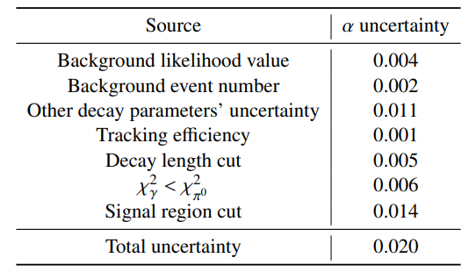
Systematic Uncertainties
The systematic uncertainties for branching fraction measurement and $α_{γ}$ measurement are listed below:
Summary of the systematic uncertainties in the BF
Summary of the systematic uncertainties in $α_{γ}$ measurement

Slide 13
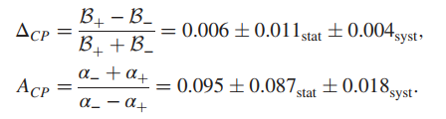
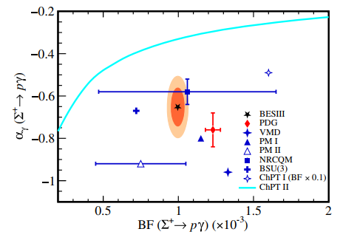
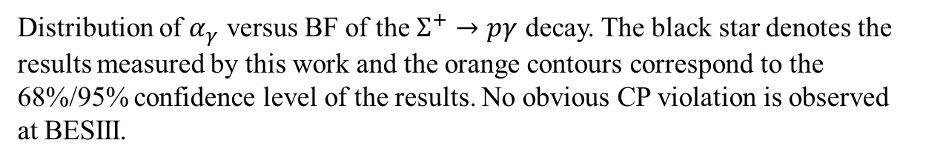
CP Asymmetry
Based on the results above, the CP asymmetry is calculated below with systematic uncertainties:
The “+” denotes $Σ^{+}→pγ$ and “-” denotes ${\overline{Σ}}^{−}→\overline{p}γ$
Distribution of $α_{γ}$ versus BF of the $Σ^{+}→pγ$ decay. The black star denotes the results measured by this work and the orange contours correspond to the 68%/95% confidence level of the results. No obvious CP violation is observed at BESIII.

Slide 14
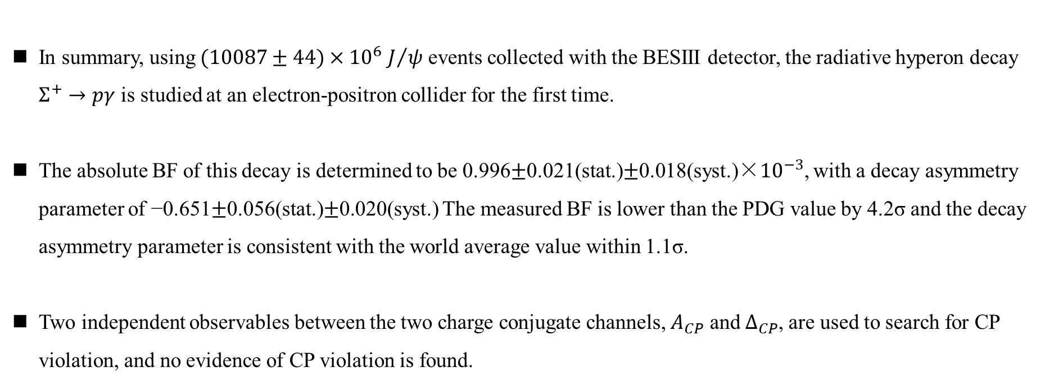
Summary
In summary, using $(10087±44)×{10}^{6}$ $J/ψ$ events collected with the BESIII detector, the radiative hyperon decay $Σ^{+}→pγ$ is studied at an electron-positron collider for the first time.
The absolute BF of this decay is determined to be 0.996$±$0.021(stat.)$±$0.018(syst.)×${10}^{−3}$, with a decay asymmetry parameter of −0.651$±$0.056(stat.)$±$0.020(syst.) The measured BF is lower than the PDG value by 4.2σ and the decay asymmetry parameter is consistent with the world average value within 1.1σ.
Two independent observables between the two charge conjugate channels, $A_{CP}$ and $Δ_{CP}$, are used to search for CP violation, and no evidence of CP violation is found.

