Slide 1
Study of CEPC ECAL Calibration
Xiang Li, Zhen Wang, Jiaxuan Wang
2025.4.1
Notes:
Thank you for joining me today. This presentation focuses on the energy calibration data processing of the CEPC ECAL. I will explain the challenges we faced with muon-based MIP calibration and how we transitioned to using electrons for a more accurate and reliable calibration.

Slide 2
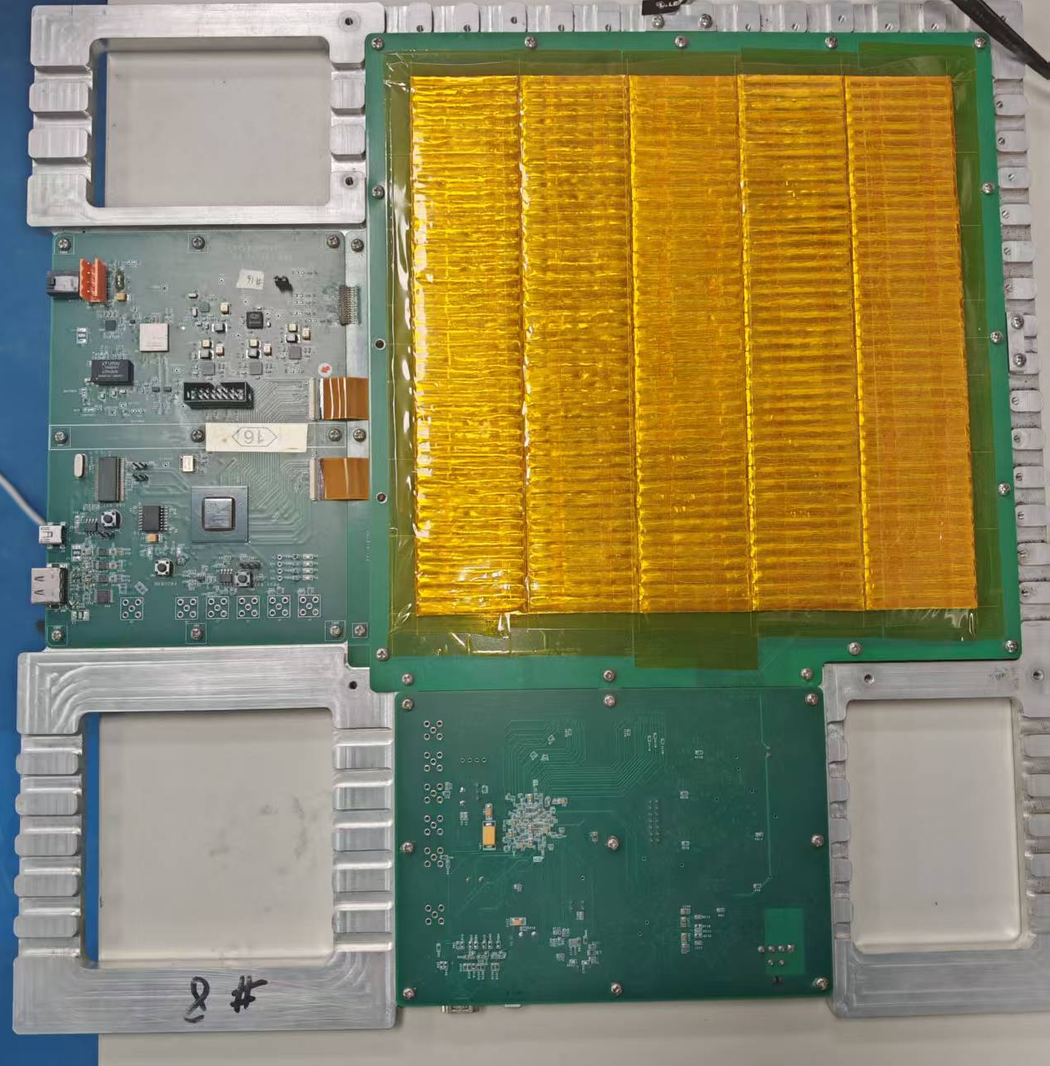
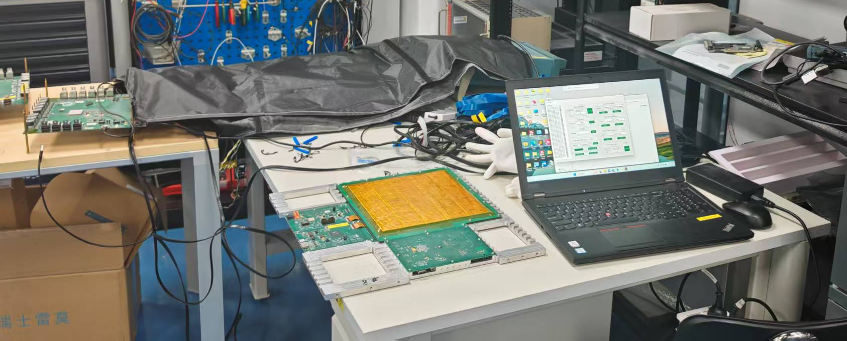
Cosmic Ray Calibration:
15mm SiPM
Testing has begun
a single-layer structure
Notes:
Initially, we attempted to use muons for MIP calibration。but they are not optimal for achieving the desired accuracy. To address this, electrons are used as a substitute.
First, we examine the energy and ADC distribution of central cells to understand their response. Based on this analysis, we determine scale factors to rescale individual channels, ensuring uniformity and accuracy across the system.
This approach allows us to improve calibration precision and achieve more reliable results moving forward.

Slide 3
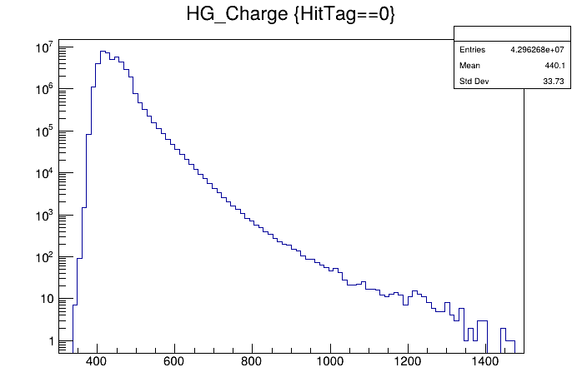
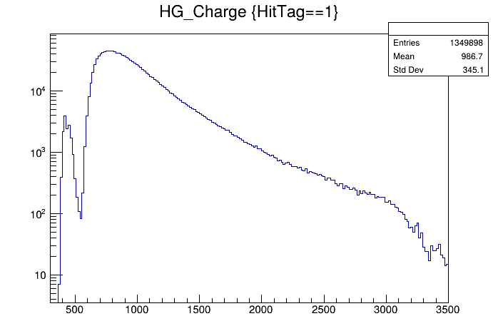
Cosmic Ray Calibration Data:
The statistics are relatively low.
Test duration 2.5d
Notes:
Initially, we attempted to use muons for MIP calibration。but they are not optimal for achieving the desired accuracy. To address this, electrons are used as a substitute.
First, we examine the energy and ADC distribution of central cells to understand their response. Based on this analysis, we determine scale factors to rescale individual channels, ensuring uniformity and accuracy across the system.
This approach allows us to improve calibration precision and achieve more reliable results moving forward.

Slide 4
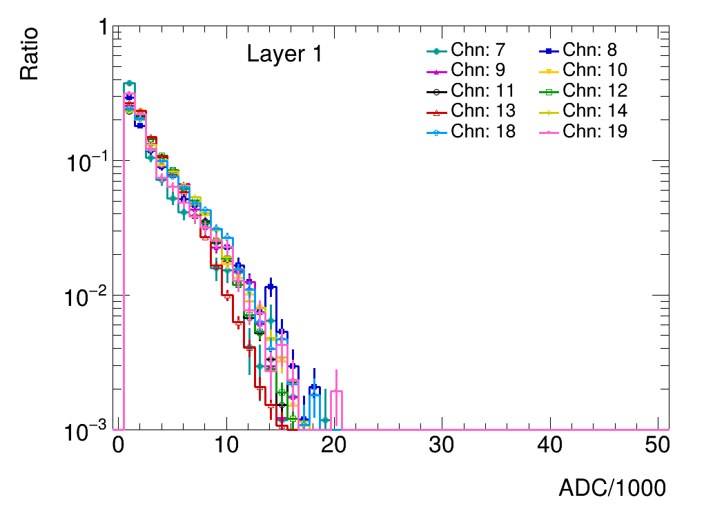
Motifition
A larger size Sipm, the larger ADC
initial stage of the shower
the ionization energy loss like MIP
First 4 layers
15mm SiPM
40Gev electron beam
Layer 00 01 02 energy deposition is small
Notes:
Initially, we attempted to use muons for MIP calibration。but they are not optimal for achieving the desired accuracy. To address this, electrons are used as a substitute.
First, we examine the energy and ADC distribution of central cells to understand their response. Based on this analysis, we determine scale factors to rescale individual channels, ensuring uniformity and accuracy across the system.
This approach allows us to improve calibration precision and achieve more reliable results moving forward.

Slide 5
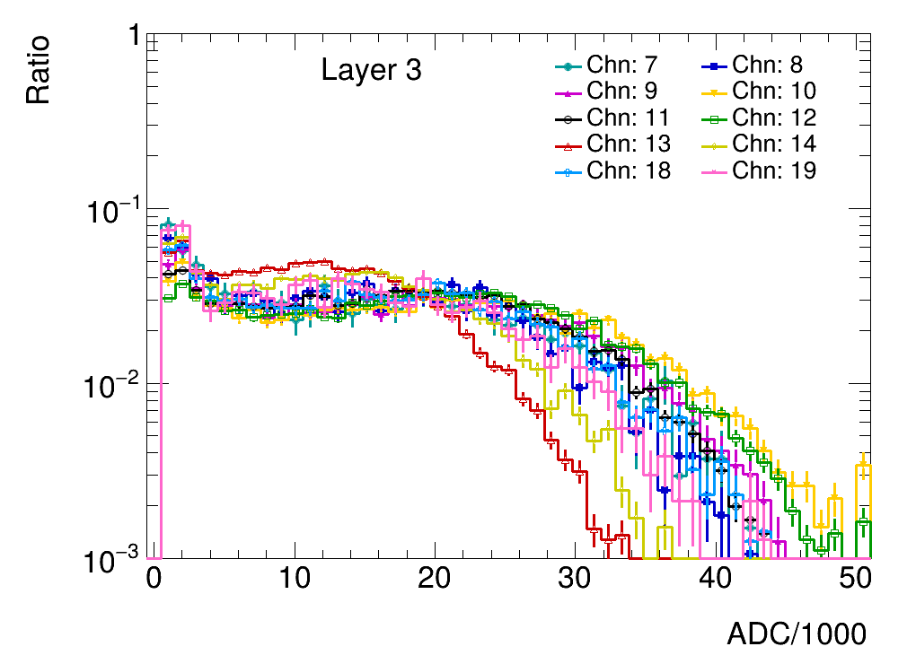
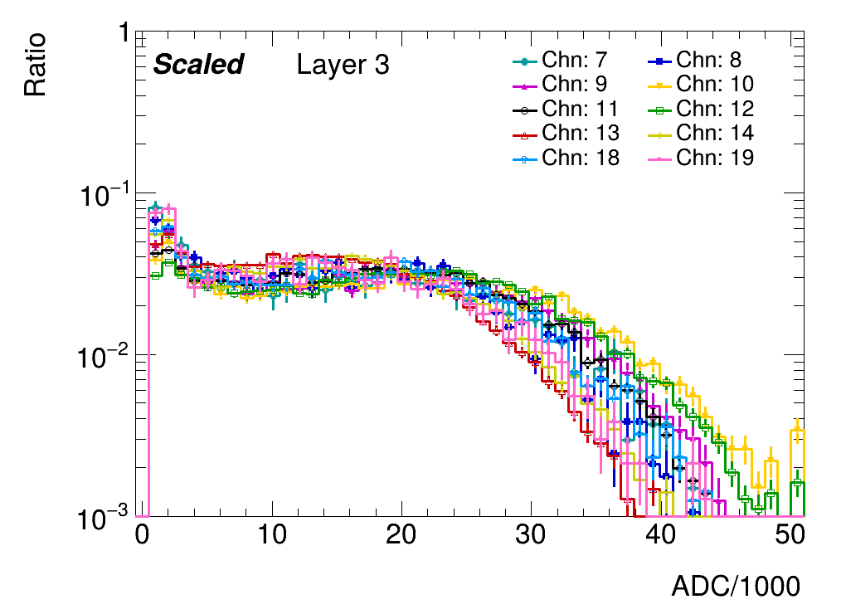
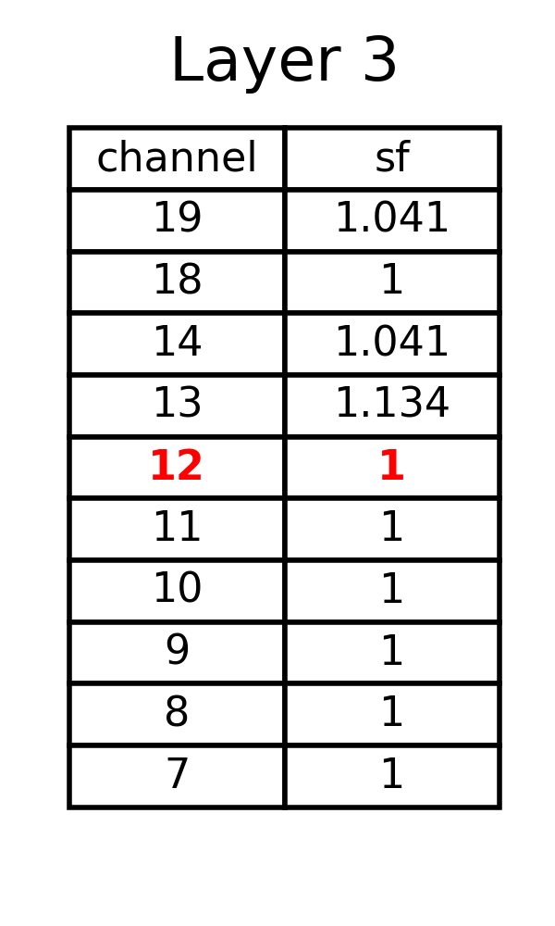
scale vs unscale
layer3 threshold 0.5
Notes:
Initially, we attempted to use muons for MIP calibration。but they are not optimal for achieving the desired accuracy. To address this, electrons are used as a substitute.
First, we examine the energy and ADC distribution of central cells to understand their response. Based on this analysis, we determine scale factors to rescale individual channels, ensuring uniformity and accuracy across the system.
This approach allows us to improve calibration precision and achieve more reliable results moving forward.

Slide 6
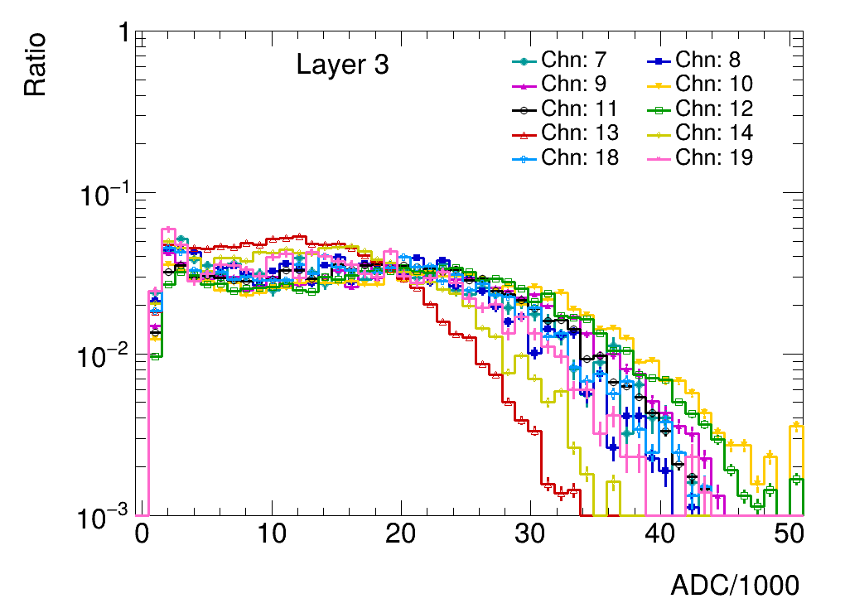
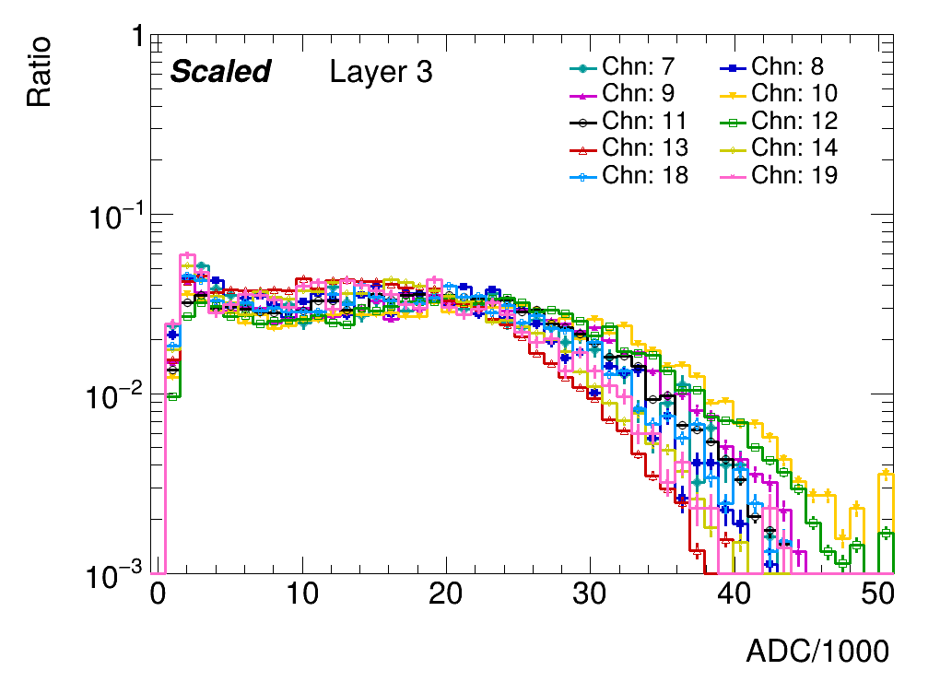
scale vs unscale
layer3 threshold 2.5
Notes:
Initially, we attempted to use muons for MIP calibration。but they are not optimal for achieving the desired accuracy. To address this, electrons are used as a substitute.
First, we examine the energy and ADC distribution of central cells to understand their response. Based on this analysis, we determine scale factors to rescale individual channels, ensuring uniformity and accuracy across the system.
This approach allows us to improve calibration precision and achieve more reliable results moving forward.

Slide 7
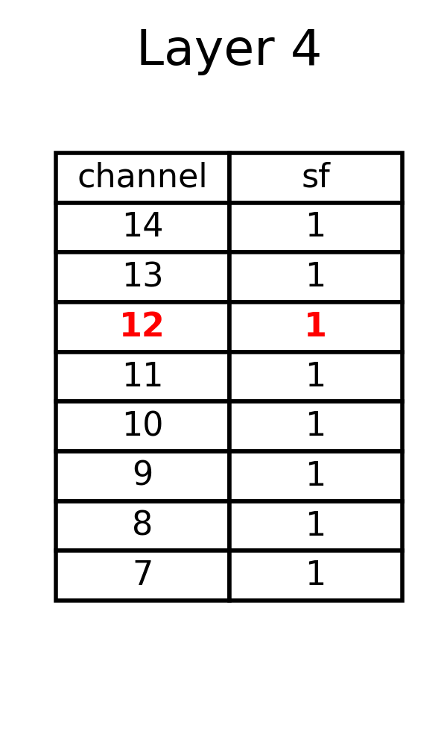
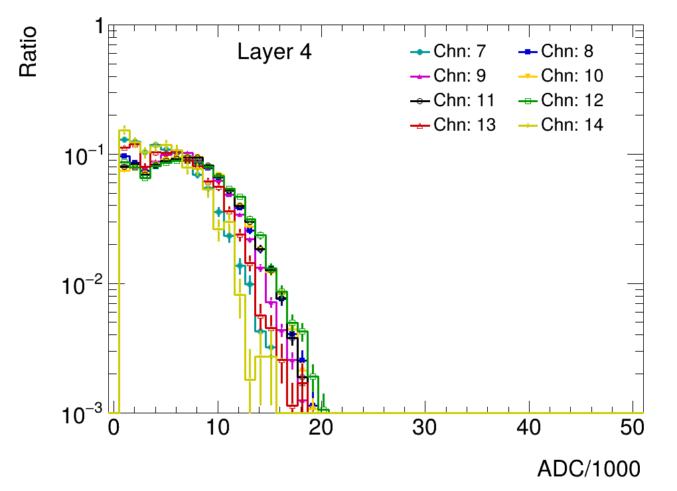
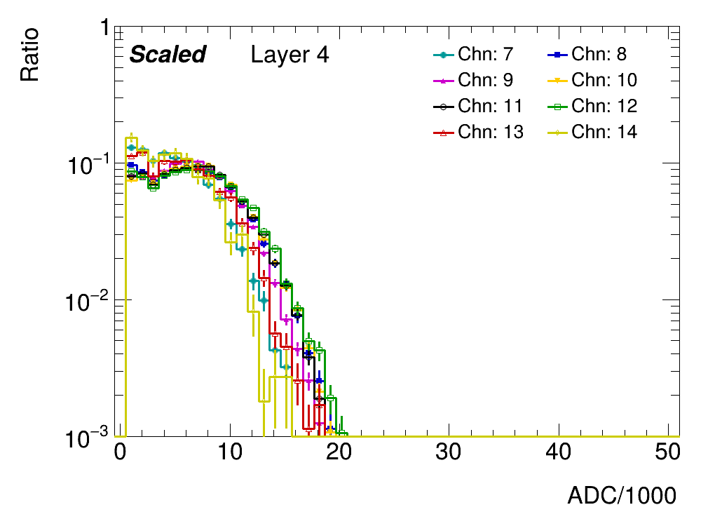
scale vs unscale
layer8 threshold 0.5
Notes:
Initially, we attempted to use muons for MIP calibration。but they are not optimal for achieving the desired accuracy. To address this, electrons are used as a substitute.
First, we examine the energy and ADC distribution of central cells to understand their response. Based on this analysis, we determine scale factors to rescale individual channels, ensuring uniformity and accuracy across the system.
This approach allows us to improve calibration precision and achieve more reliable results moving forward.

Slide 8
MIP:
layer3 chip2 channel6-23 15mm Sipm
Notes:
Initially, we attempted to use muons for MIP calibration。but they are not optimal for achieving the desired accuracy. To address this, electrons are used as a substitute.
First, we examine the energy and ADC distribution of central cells to understand their response. Based on this analysis, we determine scale factors to rescale individual channels, ensuring uniformity and accuracy across the system.
This approach allows us to improve calibration precision and achieve more reliable results moving forward.

Slide 9
MIP:
layer4 chip2 channel6-23 10mm Sipm
Notes:
Initially, we attempted to use muons for MIP calibration。but they are not optimal for achieving the desired accuracy. To address this, electrons are used as a substitute.
First, we examine the energy and ADC distribution of central cells to understand their response. Based on this analysis, we determine scale factors to rescale individual channels, ensuring uniformity and accuracy across the system.
This approach allows us to improve calibration precision and achieve more reliable results moving forward.

Slide 10
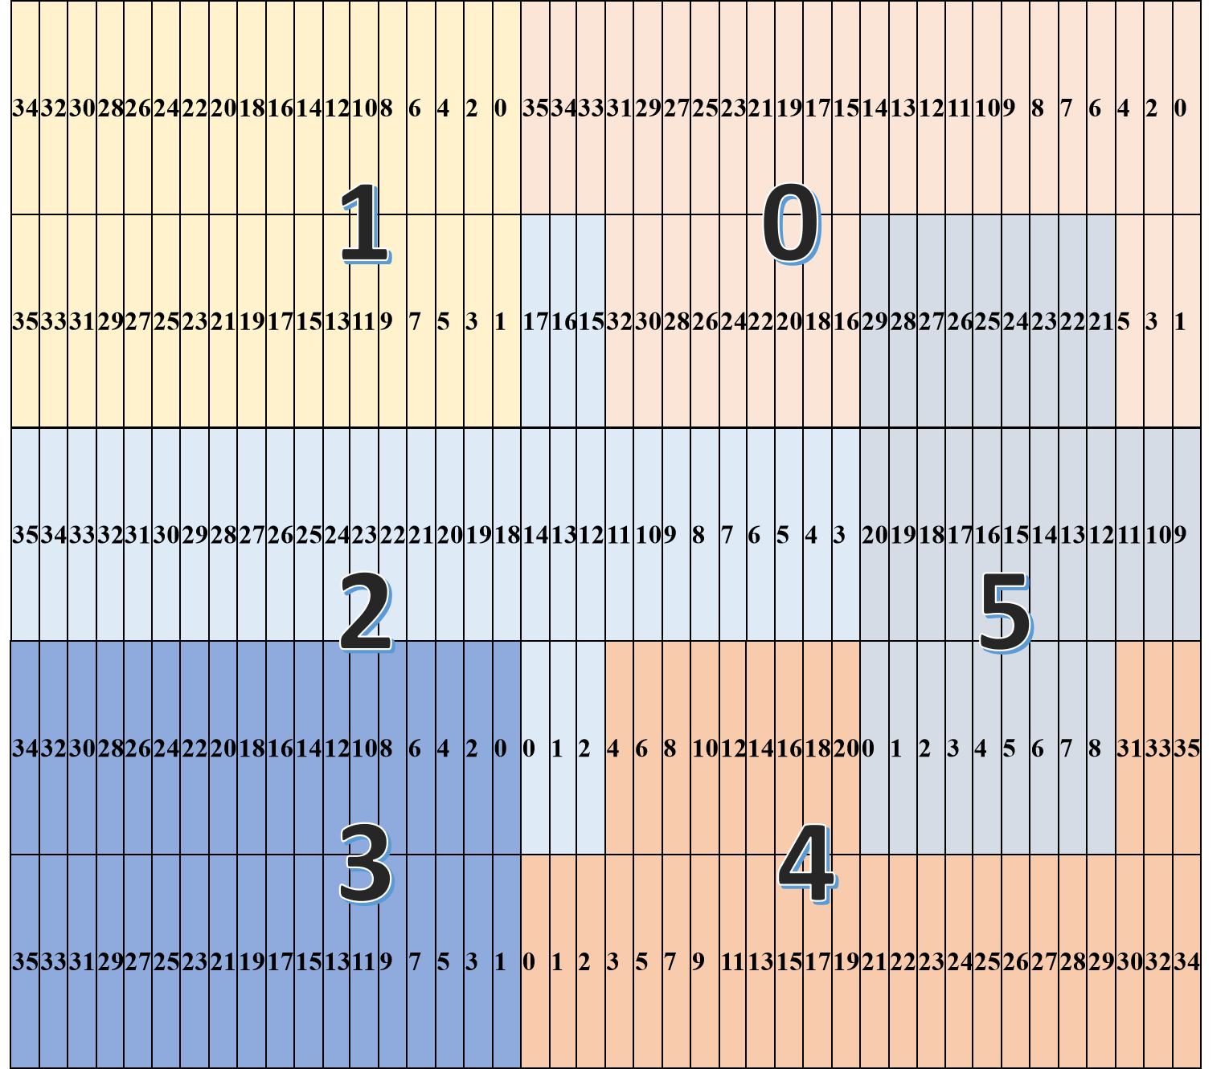
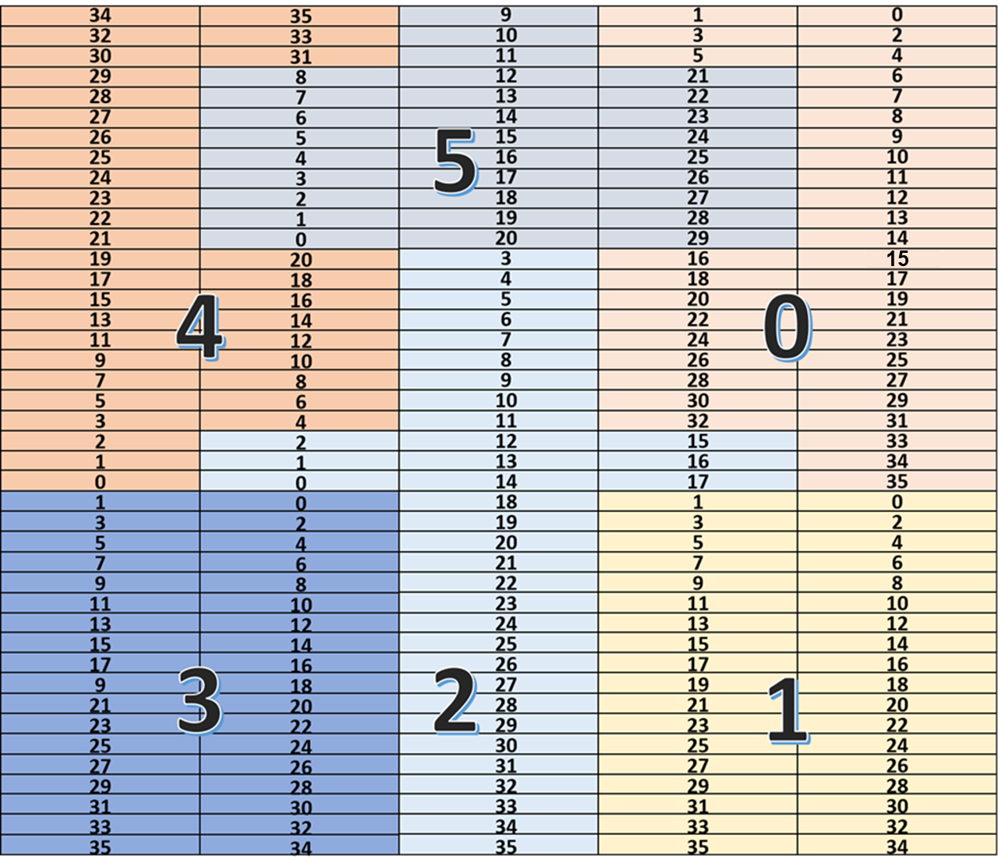
back up: the position of channels

Slide 11
MIP:
layer1 chip2 layer6-23
Notes:
Initially, we attempted to use muons for MIP calibration。but they are not optimal for achieving the desired accuracy. To address this, electrons are used as a substitute.
First, we examine the energy and ADC distribution of central cells to understand their response. Based on this analysis, we determine scale factors to rescale individual channels, ensuring uniformity and accuracy across the system.
This approach allows us to improve calibration precision and achieve more reliable results moving forward.

Slide 12
MIP:
layer2 chip2 layer6-23
Notes:
Initially, we attempted to use muons for MIP calibration。but they are not optimal for achieving the desired accuracy. To address this, electrons are used as a substitute.
First, we examine the energy and ADC distribution of central cells to understand their response. Based on this analysis, we determine scale factors to rescale individual channels, ensuring uniformity and accuracy across the system.
This approach allows us to improve calibration precision and achieve more reliable results moving forward.

Slide 13
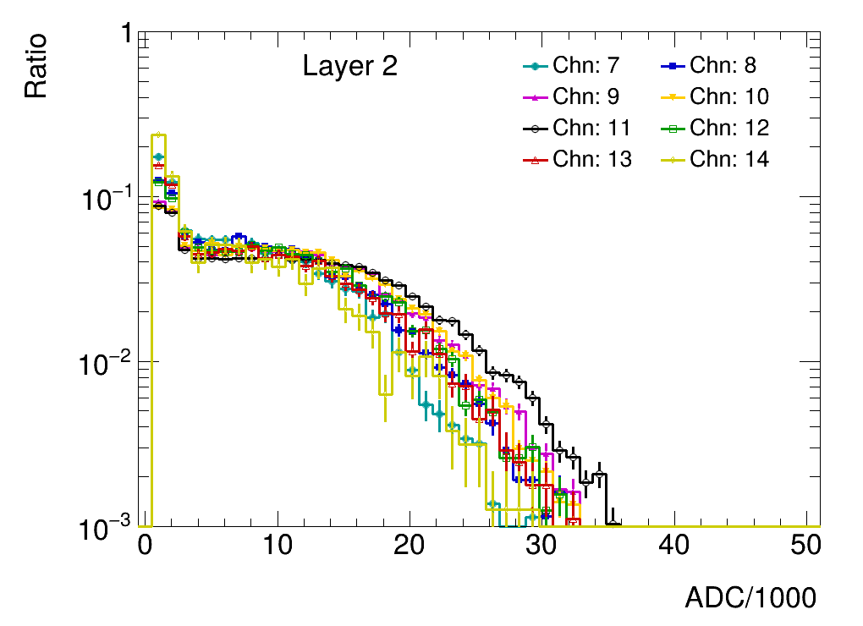
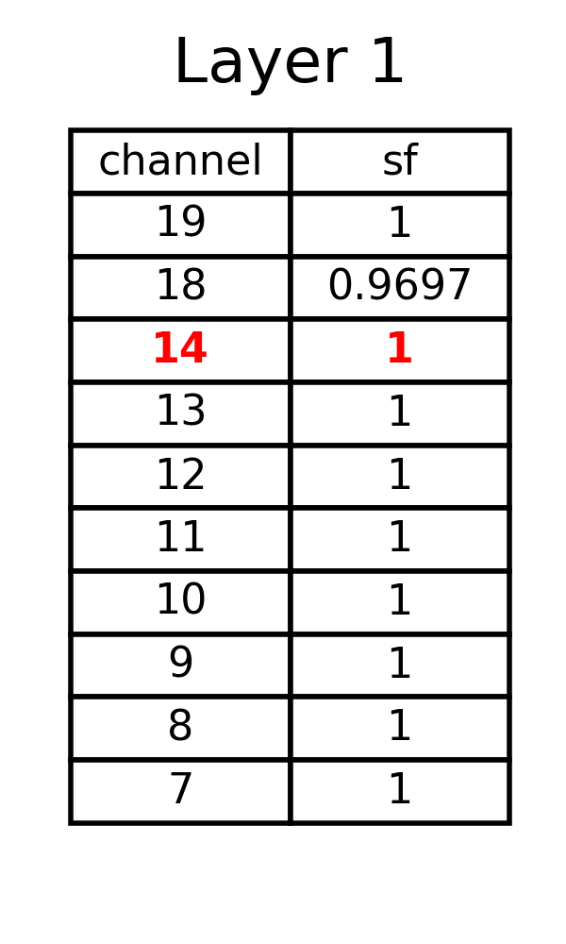
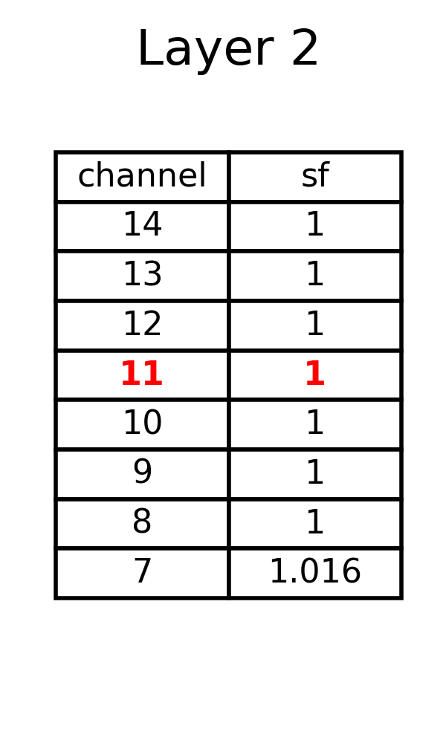
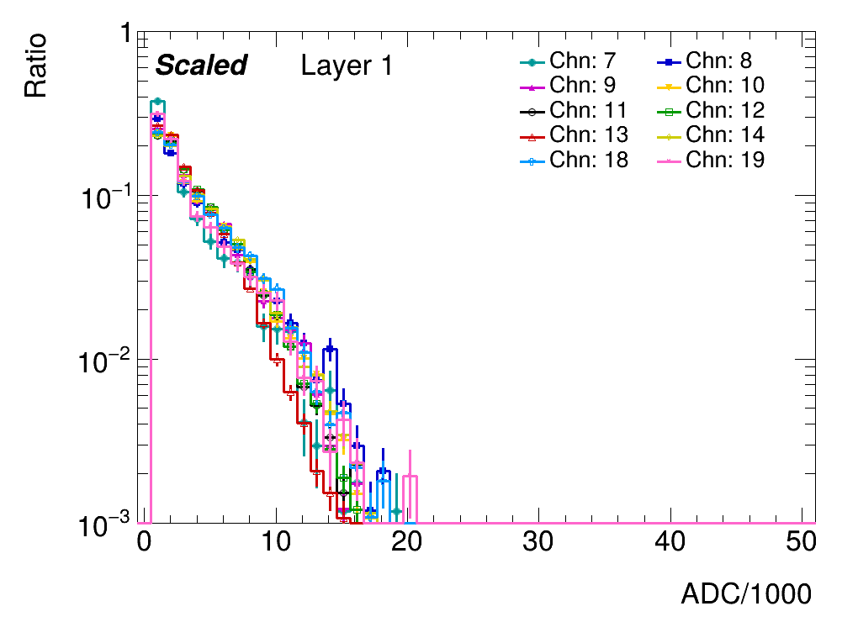
scale vs unscale
layer1 threshold0.5
layer2 threshold0.5
Notes:
Initially, we attempted to use muons for MIP calibration。but they are not optimal for achieving the desired accuracy. To address this, electrons are used as a substitute.
First, we examine the energy and ADC distribution of central cells to understand their response. Based on this analysis, we determine scale factors to rescale individual channels, ensuring uniformity and accuracy across the system.
This approach allows us to improve calibration precision and achieve more reliable results moving forward.

