Slide 1
digitization tuning
Hongbin Diao
State key laboratory of particle detection and electronics
University of Science and Technology of China

Slide 2
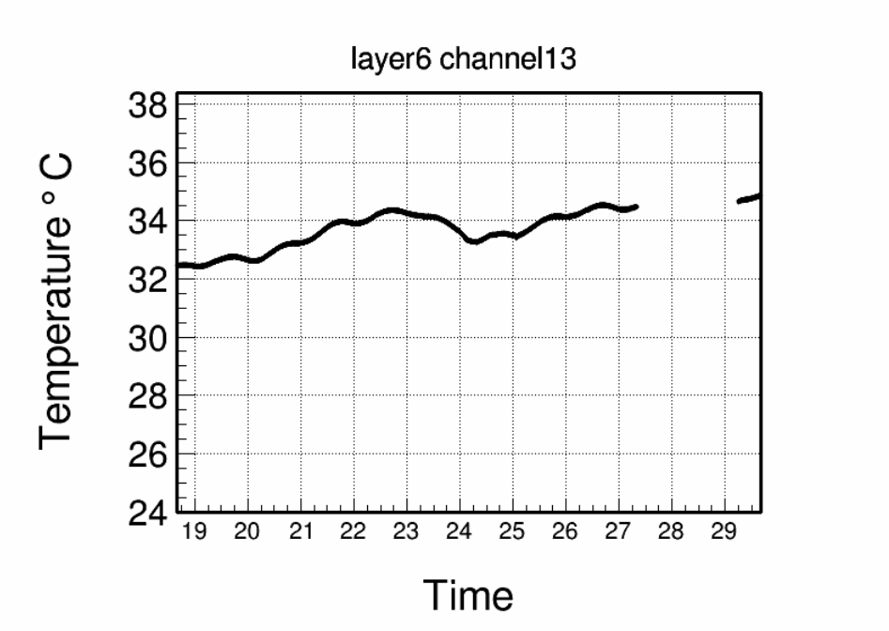
temperature
MPV difference between muon and muon events in electron beam
e-
muon
May
MPV differnece [%]

Slide 3
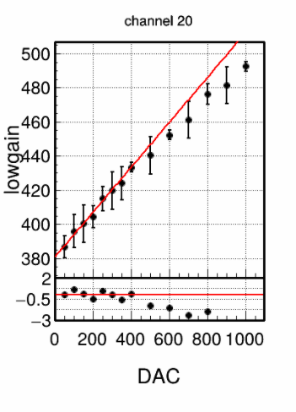
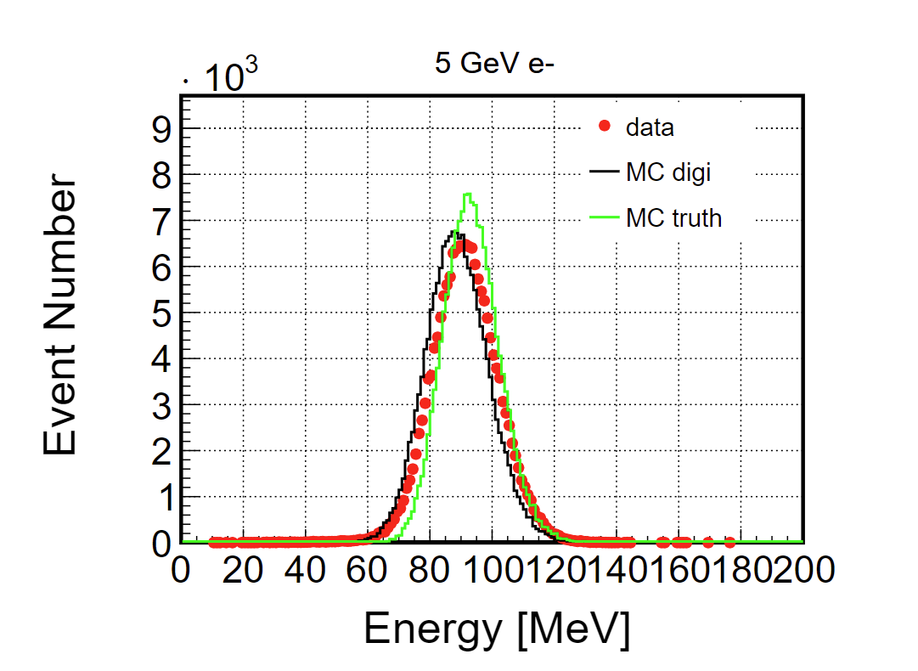
electron calibration
did in 2022 March

Slide 4
backup

Slide 5
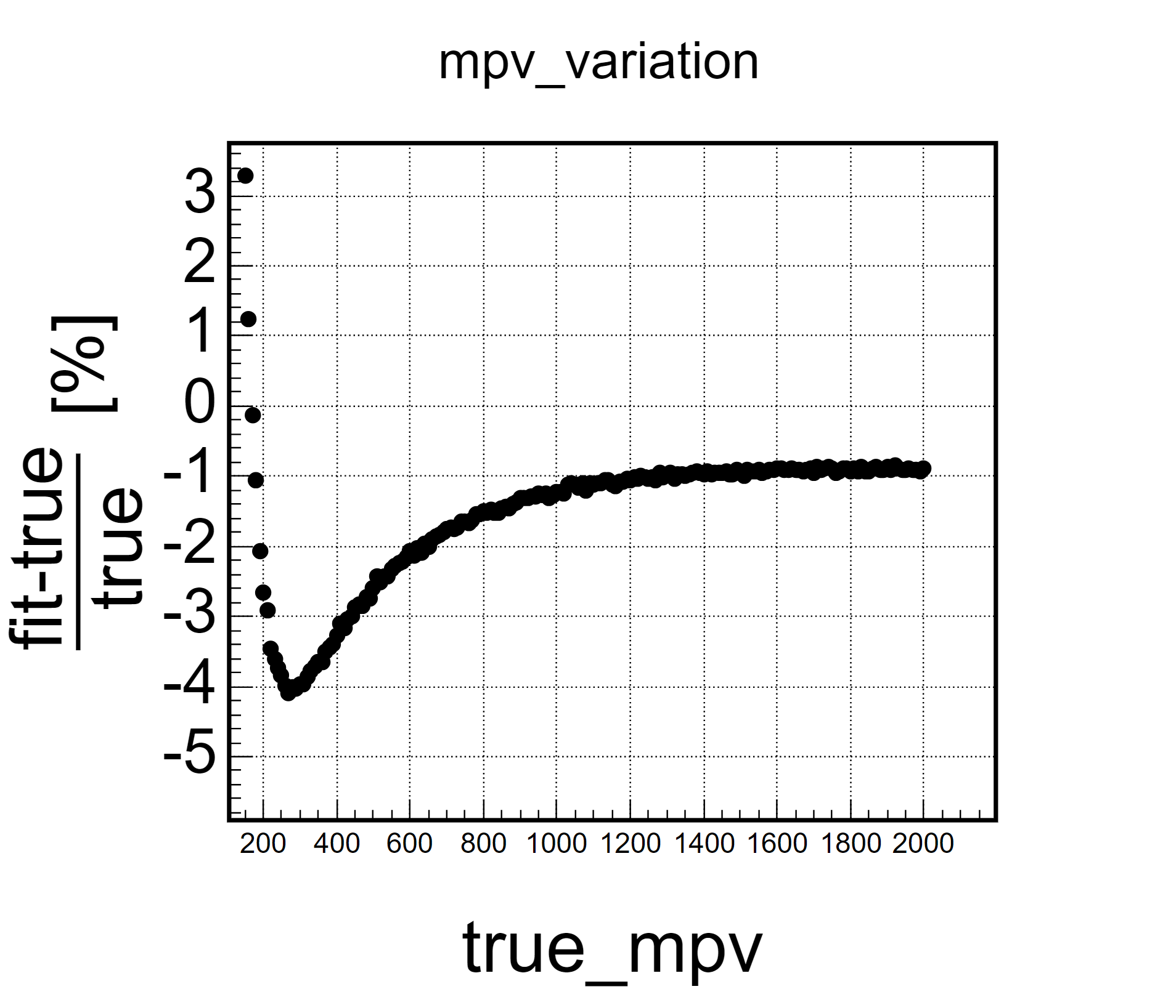
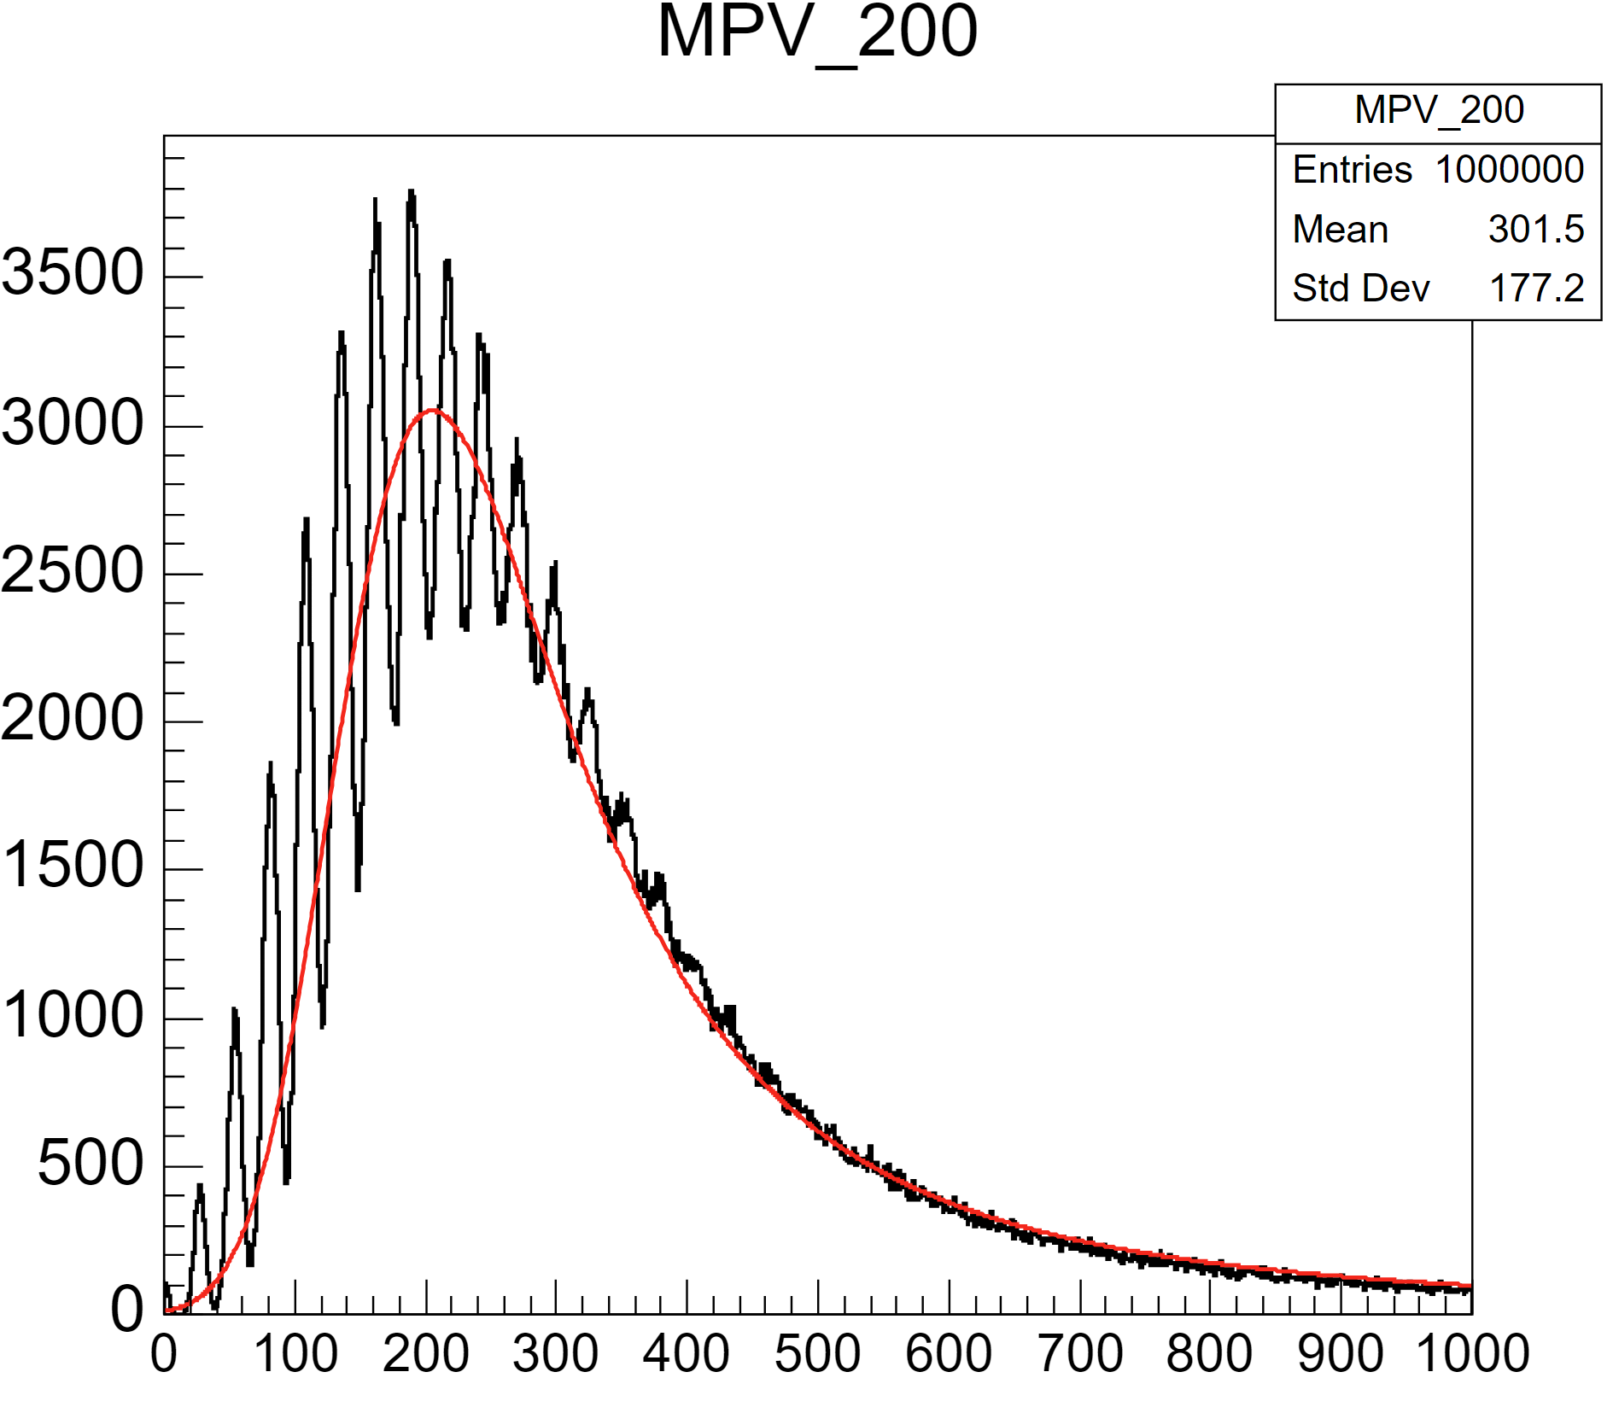
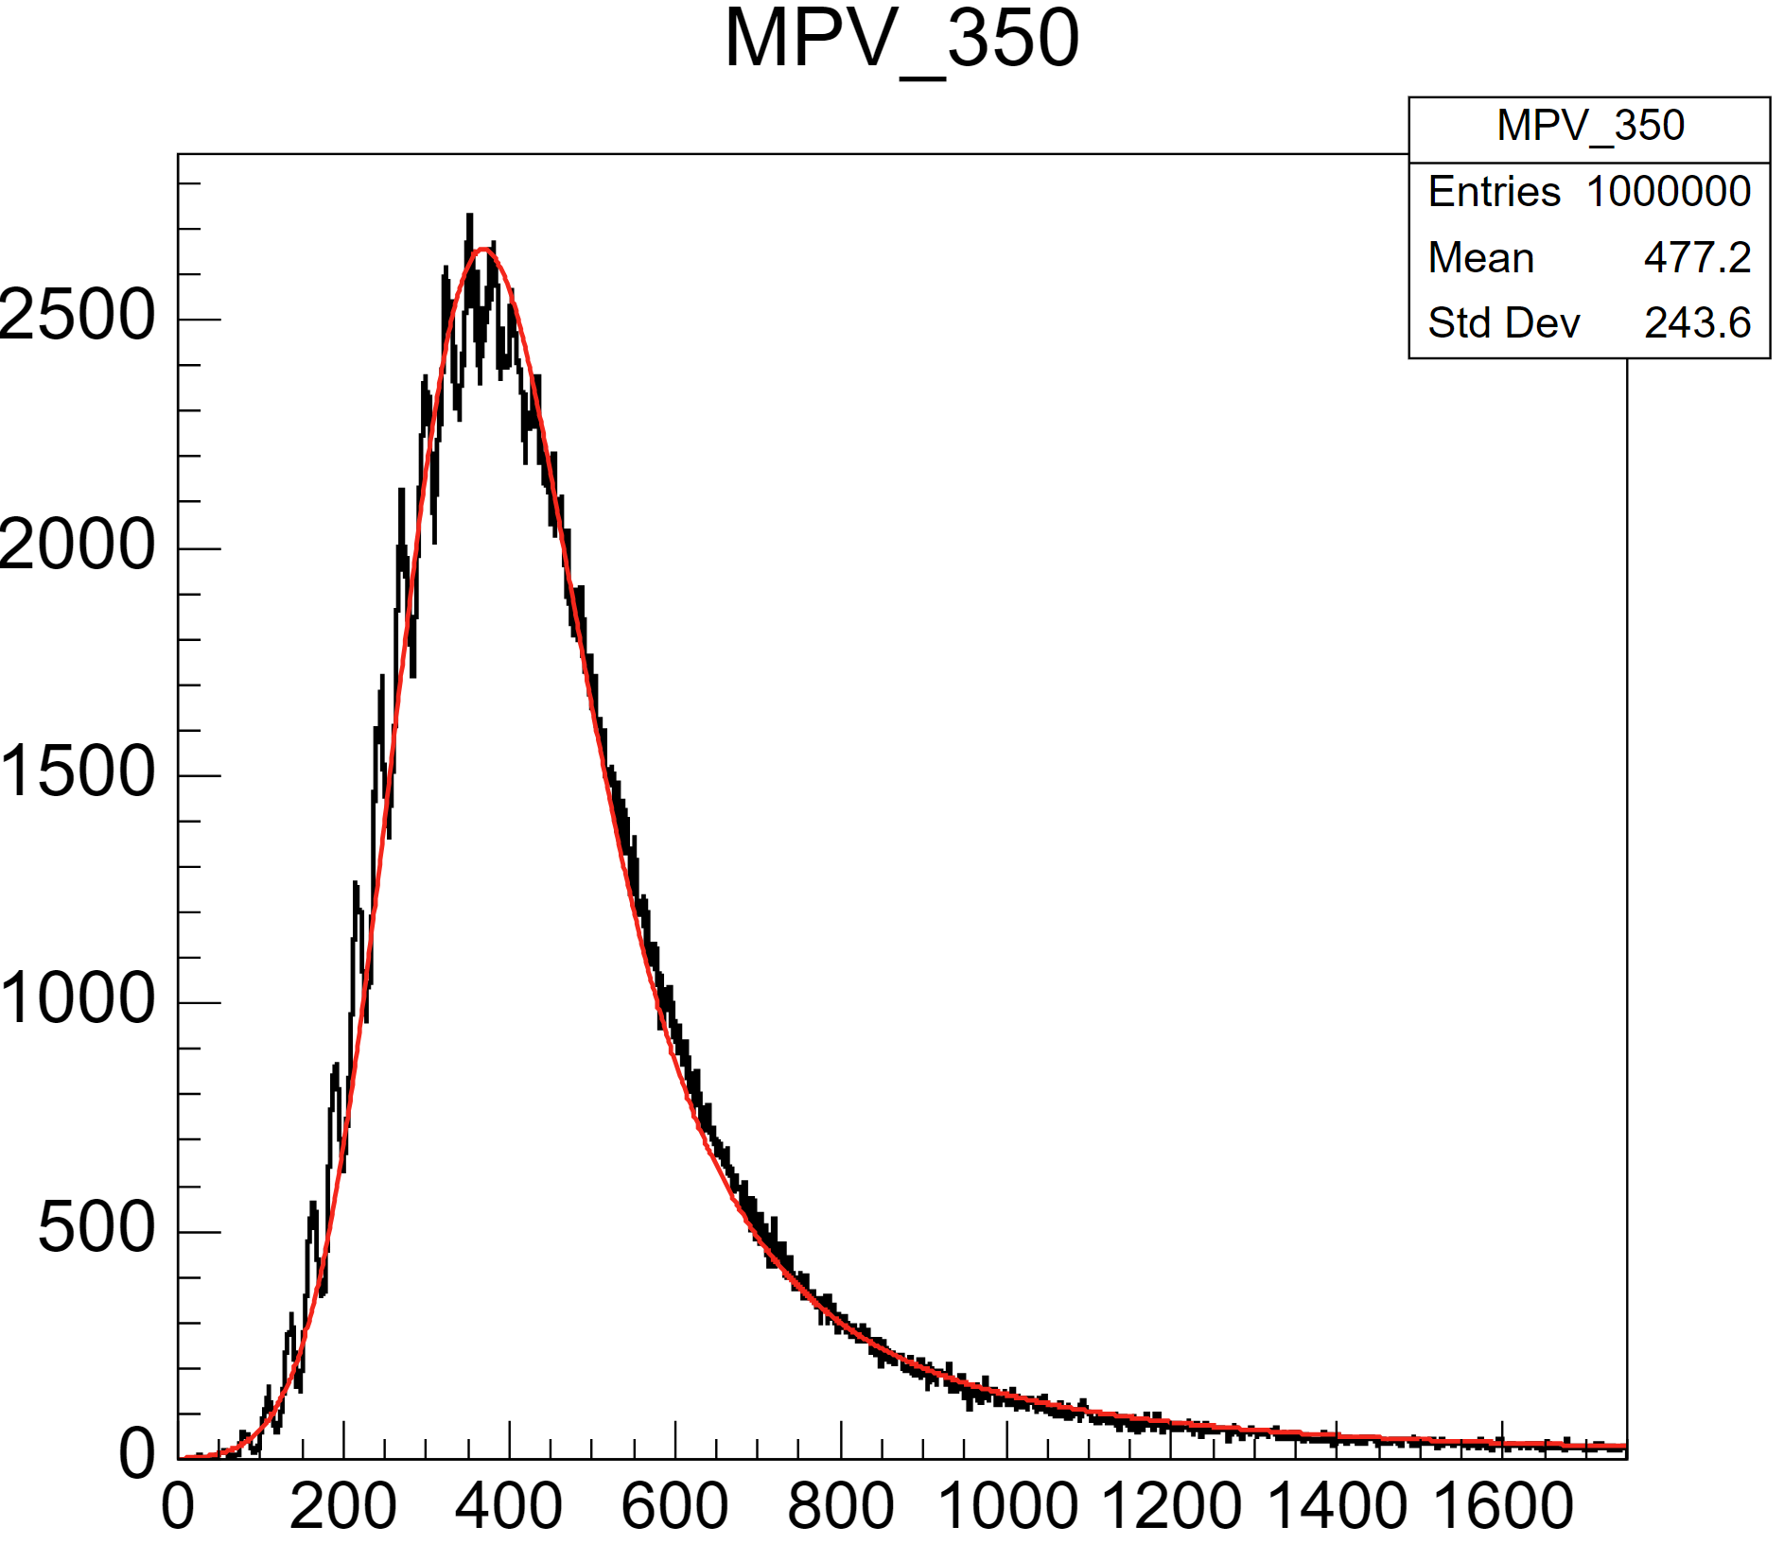
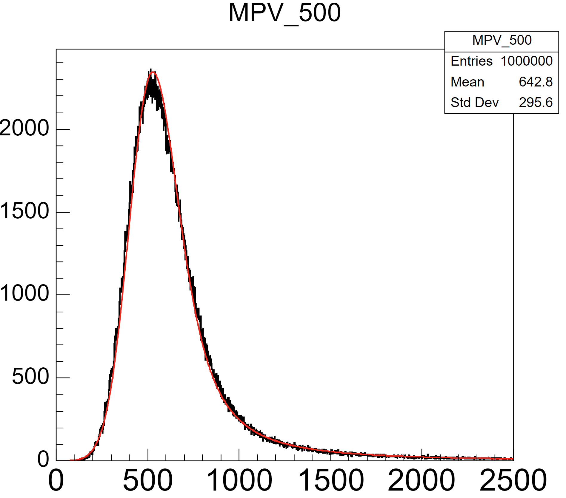
MIP calibration
a Toy MC has been done
fit left limit (threshold) problem is small
poisson distribution problem also exists

